Slide 1
ILC Status and Plans
Benno List
CLIC Mini WS
11.12.23

Slide 2
The ILC IDT organization – initiated at the ICFA meeting at SLAC February 2020
2020-21: The IDT – created by ICFA and hosted by KEK – was set up to move ILC towards construction. The worldwide structure of the WGs: https://linearcollider.org/team/
A set of key activities were identified in a Preparation Phase Programme.
2022-23: A subset of the technical activities of the full ILC preparation phase programme have been identified as critical (next slide). These are being addresses by a ~4 year programme called ITN – the ILC Technology Network. Moving forward with this work is being supported by the MEXT (ministry) providing crucial increased funding.
As of today: With funding from 1.4.2023 ITN is now starting. An agreement KEK and CERN and several European lab activities have been/are being set up. In the US the P5 process is ongoing, the hope is that ITN planning and interests can turn into important ITN involvements in due time.
S. Stapnes IFCA Seminar

Slide 3
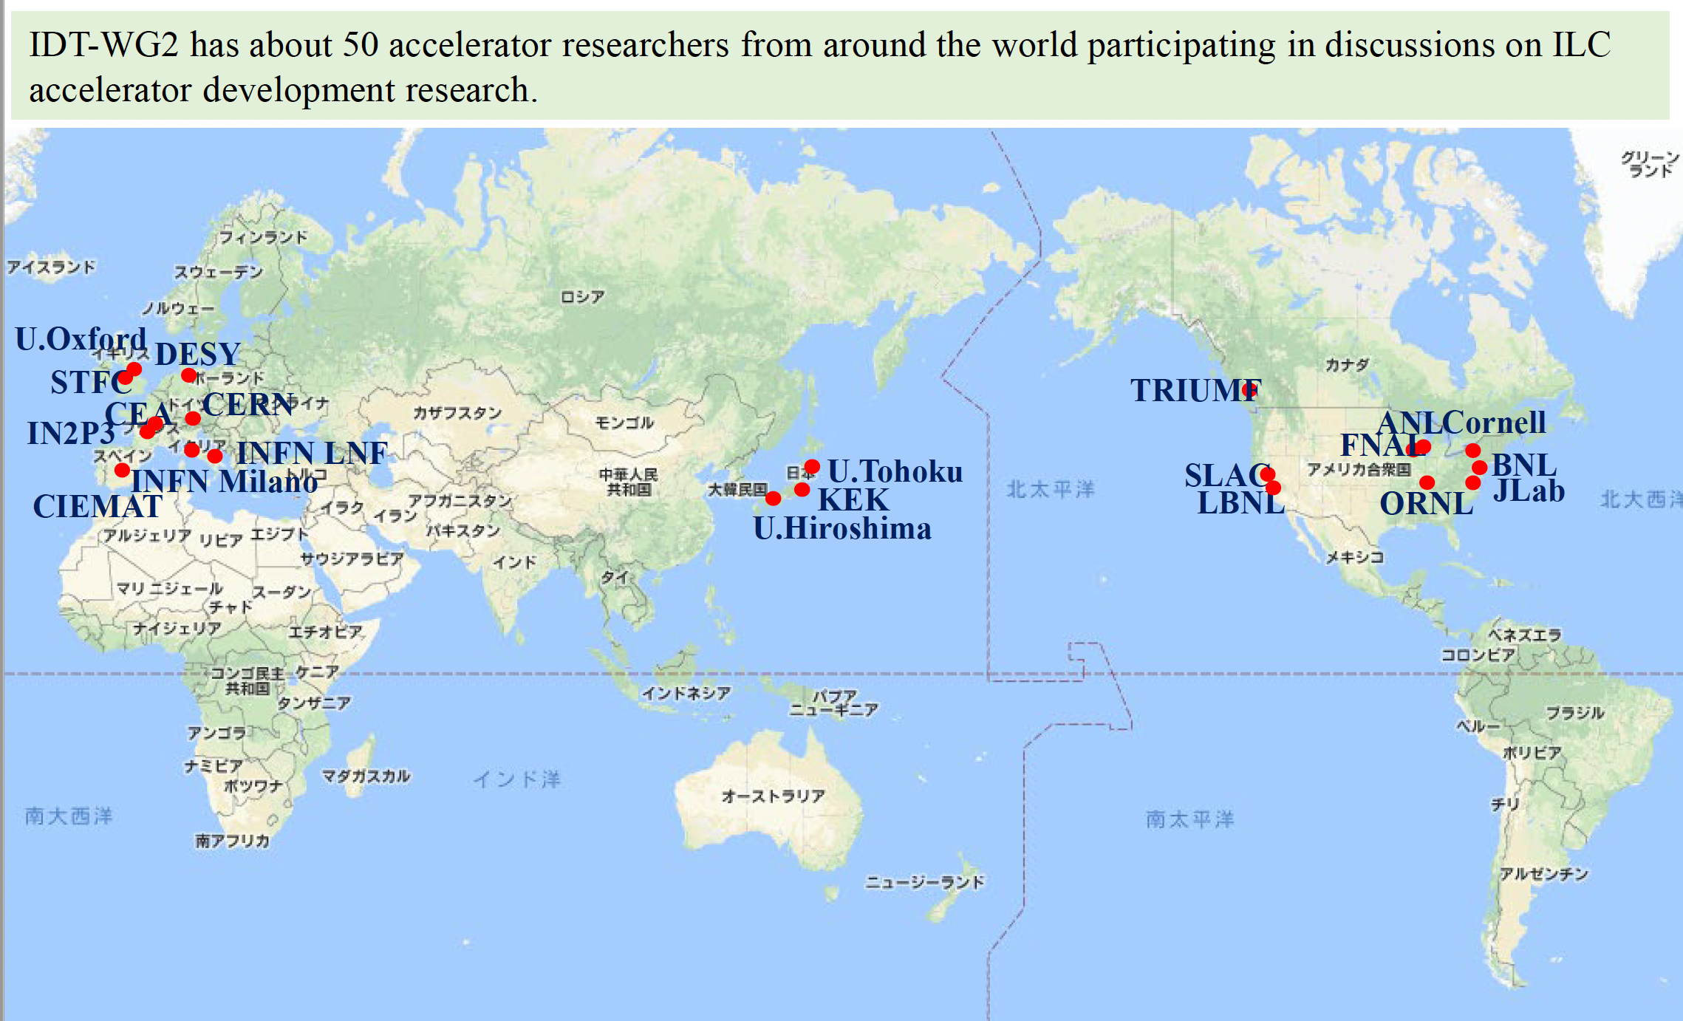
IDT WG2 around the World
S. Michizono, LCWS 20223

Slide 4
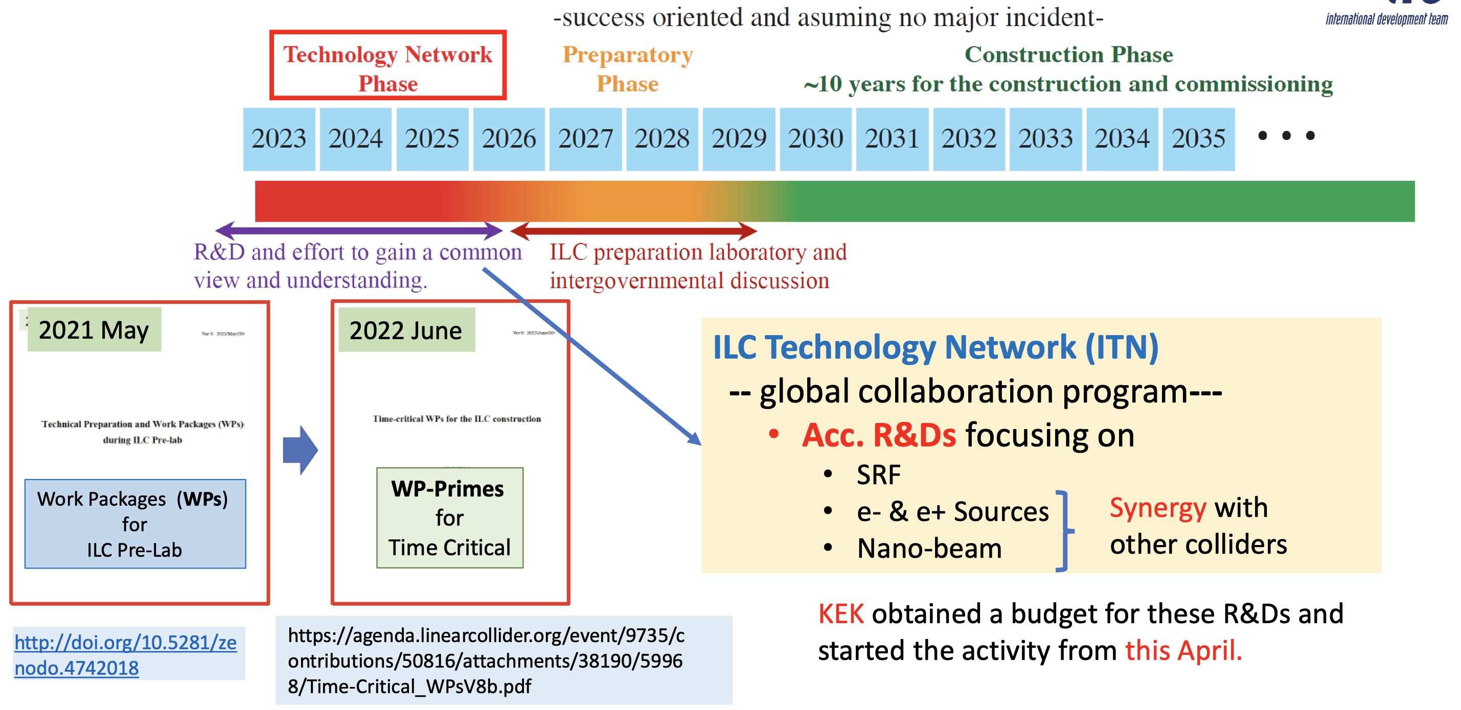
ILC Timeline
S. Michizono, LCWS 20223

Slide 5
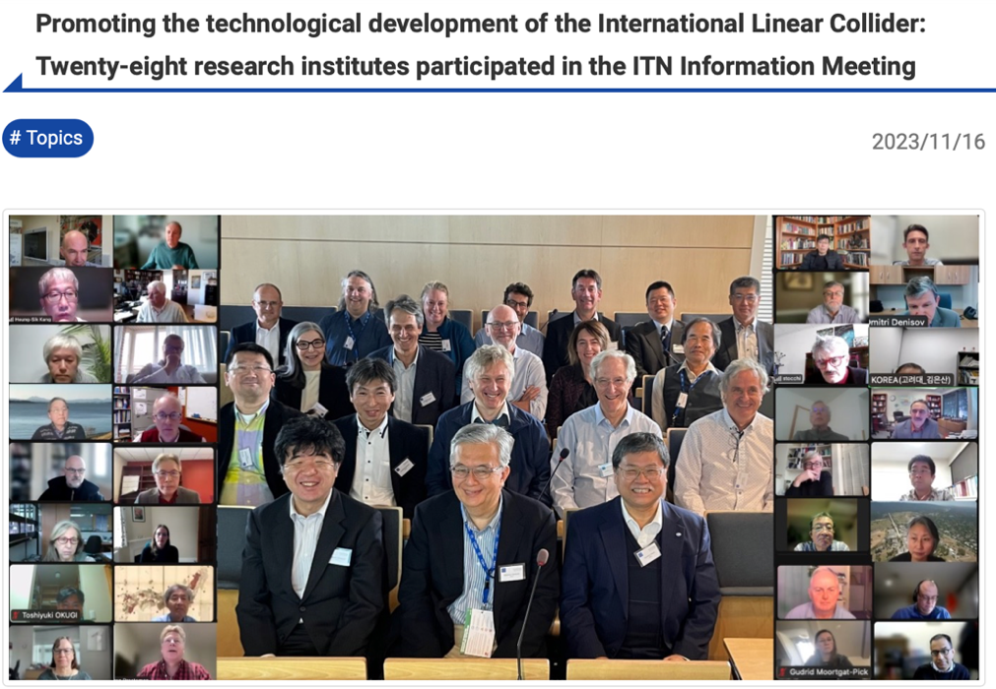
The ITN
WPP | 1 | Cavity production
WPP | 2 | CM design
WPP | 3 | Crab cavity
WPP | 4 | E- source
WPP | 6 | Undulator target
WPP | 7 | Undulator focusing
WPP | 8 | E-driven target
WPP | 9 | E-driven focusing
WPP | 10 | E-driven capture
WPP | 11 | Target replacement
WPP | 12 | DR System design
WPP | 14 | DR Injection/extraction
WPP | 15 | Final focus
WPP | 16 | Final doublet
WPP | 17 | Main dump
Building the ITN activities:
Planning in the IDT WG2 – significant interests and expertise already represented
Information meeting at CERN 16-17.10 jointly organized by KEK and the IDT
Interest matrix for the ITN work-packages, being consolidated
The next step: Further technical discussion to define deliverables, followed by agreement who among the laboratories will deliver what
S. Stapnes IFCA Seminar

Slide 6
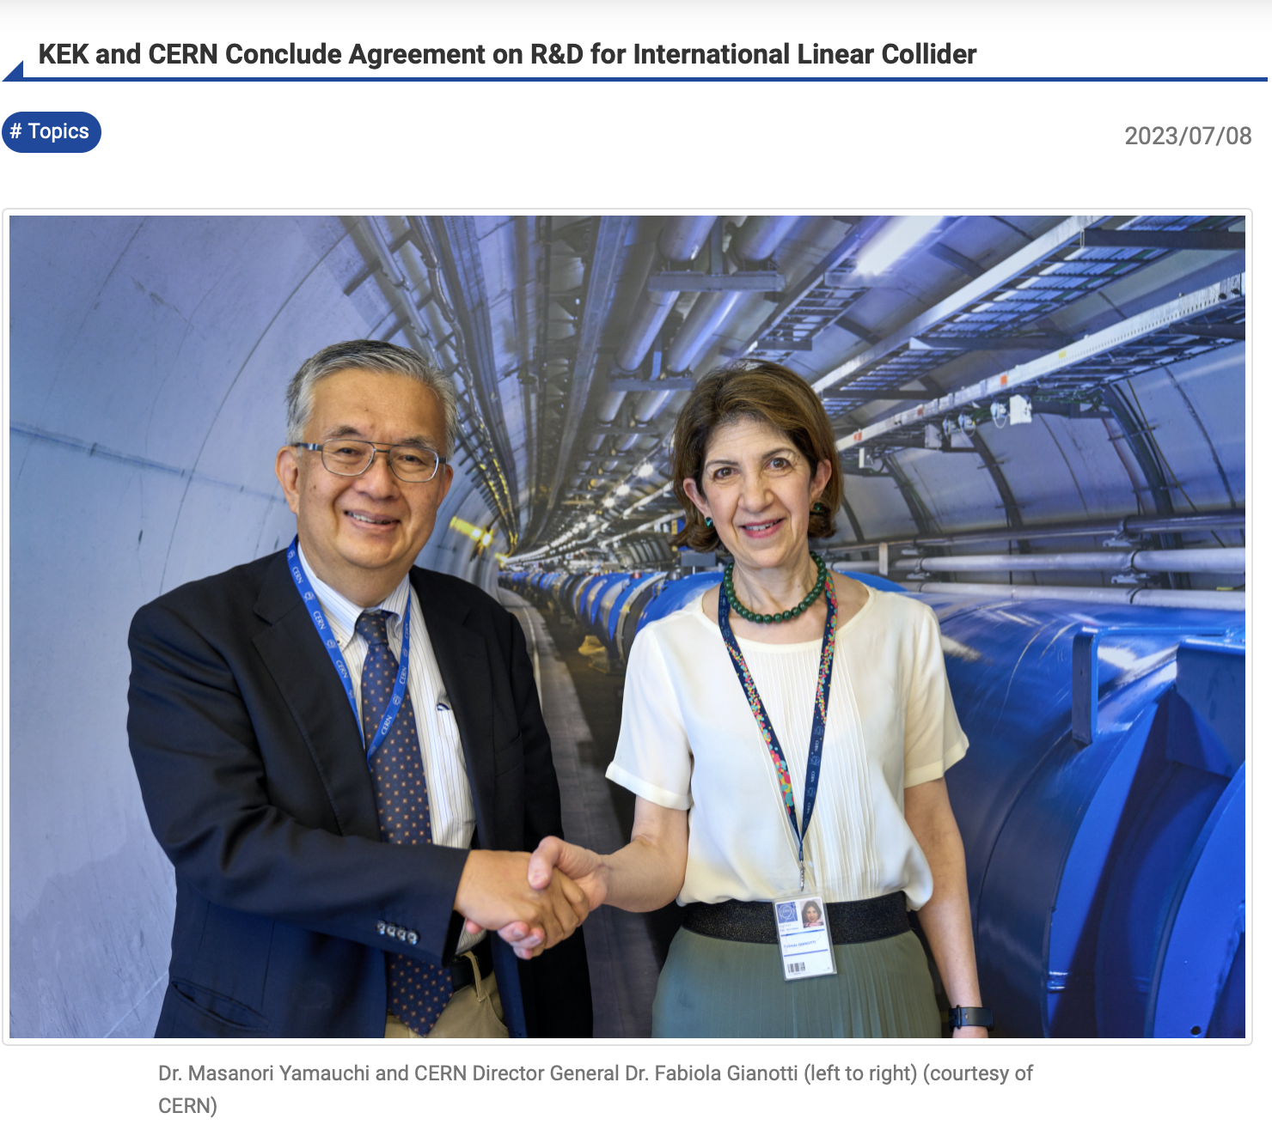
ITN Agreement between KEK and CERN
On July 7th, 2023, KEK and European Organization for Nuclear Research (CERN) concluded an agreement on “Support for the European International Linear Collider (ILC) Technology Network,” concerning a new framework of research and development for the ILC: the ILC Technology Network (ITN).
This Agreement was signed by KEK Director General Dr. Masanori Yamauchi and CERN Director General Dr. Fabiola Gianotti while DG Yamauchi was visiting CERN. It is stated in this agreement that CERN will cooperate for ITN specific studies and at the same time will act as a coordinating and facilitating hub for ITN-specific technology developments and studies in Europe.
ITN is a framework to promote high priority tasks of the ILC accelerator development. It is based on bilateral arrangements, for instance a memorandum of understanding (MoU), an addendum to an existing agreement, or new agreement, between KEK and laboratories. This conclusion became the first agreement under this framework. KEK would like to conclude similar arrangements with other research institutes and expand this ITN framework.
https://www.kek.jp/en/topics-en/202307081205/

Slide 7
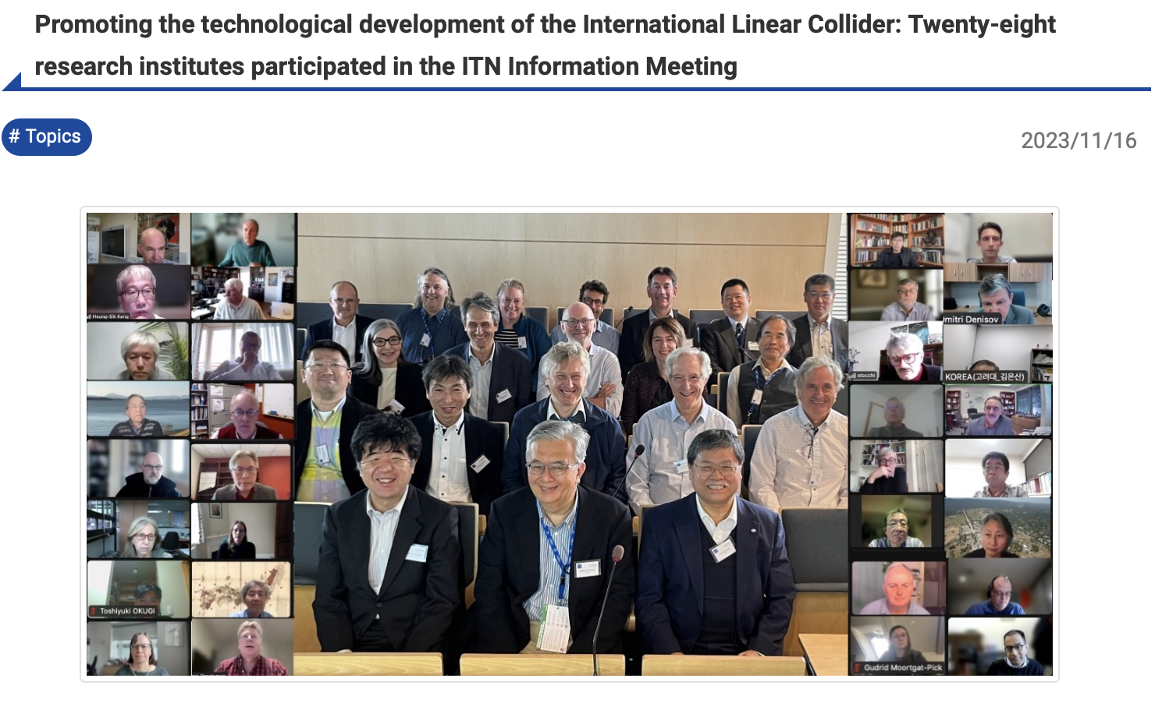
ITN Kickoff at CERN
The “ILC Technology Network (ITN) Information Meeting” was held at the European Organization for Nuclear Research (CERN) in Geneva on October 16 and 17, hosted jointly by KEK and the ILC International Development Team (IDT). Sixty-eight participants from 28 research institutes over ten countries participated in the meeting either in person or remotely.
The ITN is a framework for international collaboration to promote high-priority tasks of accelerator development (called “work packages”) for the International Linear Collider (ILC), jointly established by KEK and the IDT. ITN membership is defined through bilateral arrangements between KEK and laboratories. In July of this year, CERN became a member by exchanging an agreement with KEK, which states that CERN will serve as a hub for European research institutions participating in the ITN.
This meeting was held to present the opportunities provided by the ITN and to collect interests of the potential members to achieve its goal. CERN was chosen as the venue to facilitate participation by the European research institutes, which are major players in ITN activities at this moment.
https://www.kek.jp/en/topics-en/202311161700/

Slide 8
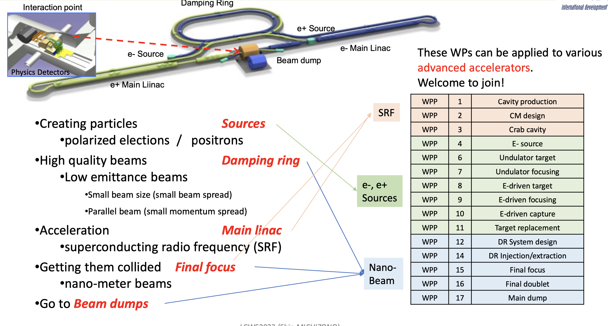
The updated Priority Work Packages (WP’)
S. Michizono, LCWS 20223

Slide 9
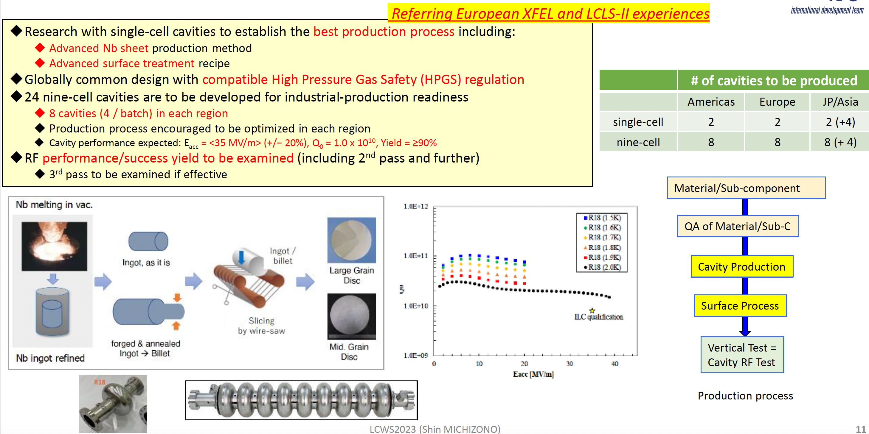
WP’1: Cavity Production
S. Michizono, LCWS 20223

Slide 10
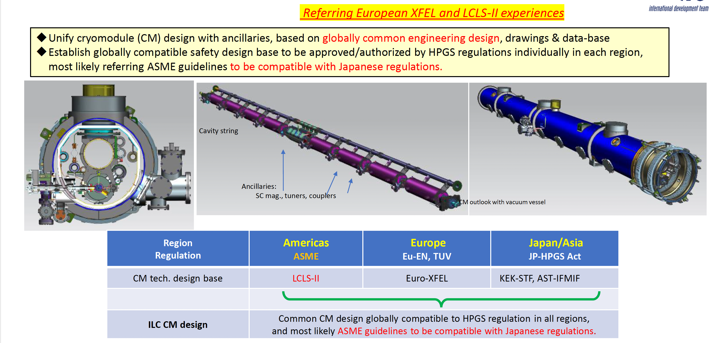
WP’2: Cryomodule Design
S. Michizono, LCWS 20223

Slide 11
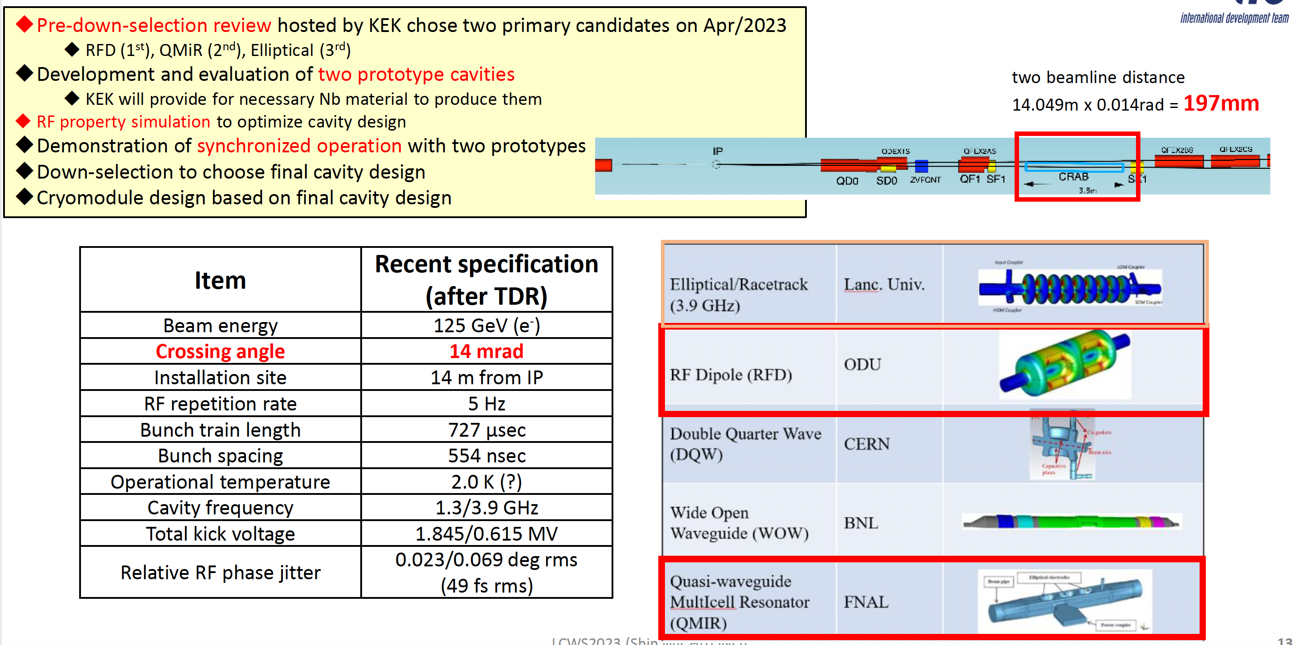
WP’3: Crab Cavities
S. Michizono, LCWS 20223

Slide 12
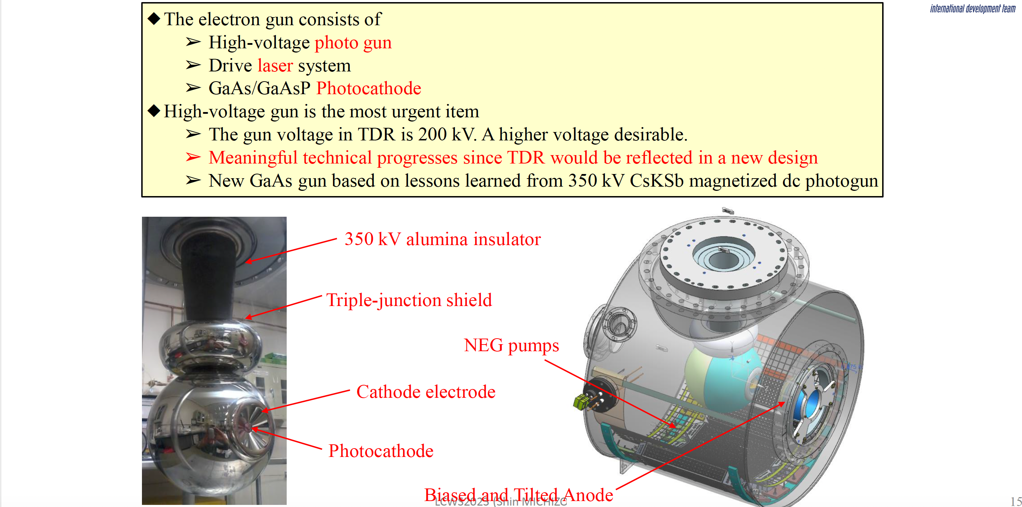
WP’4: Electron Gun
S. Michizono, LCWS 20223

Slide 13
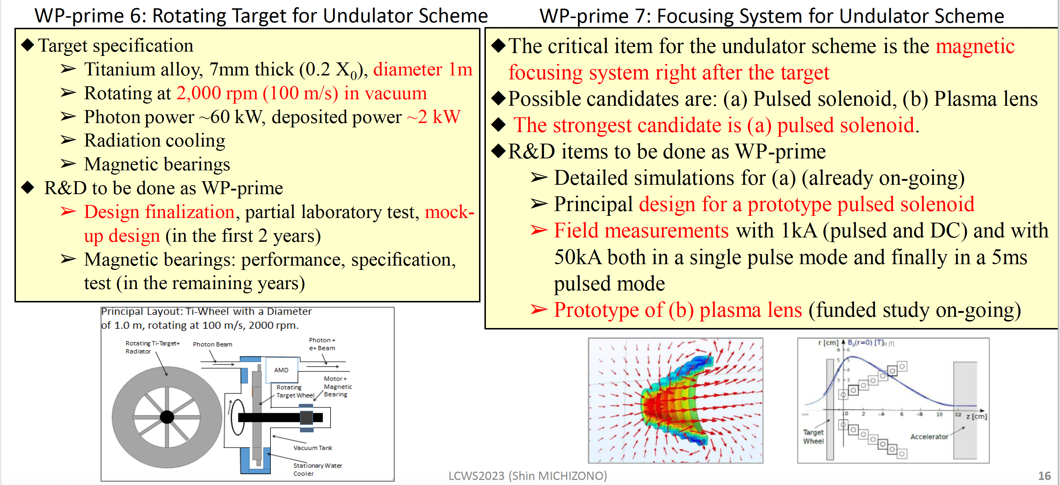
WP’ 6-7: Undulator Driven Positron Source
S. Michizono, LCWS 20223

Slide 14
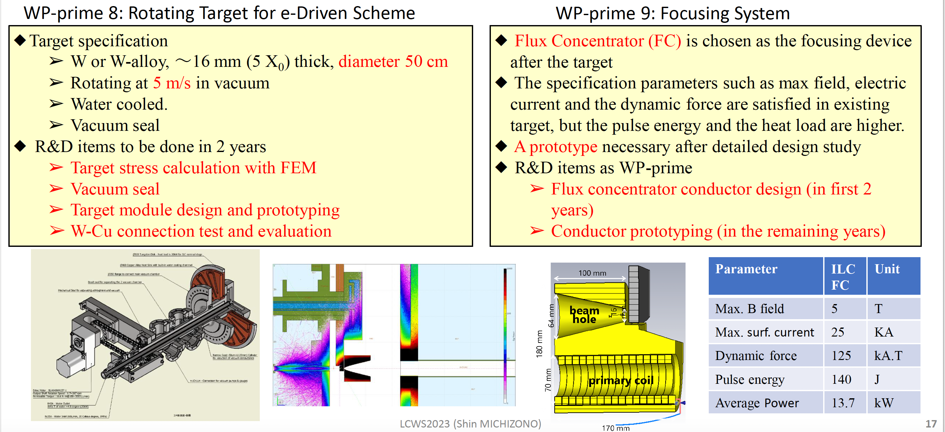
WP’ 8-11: Electron Driven Positron Source
S. Michizono, LCWS 20223

Slide 15
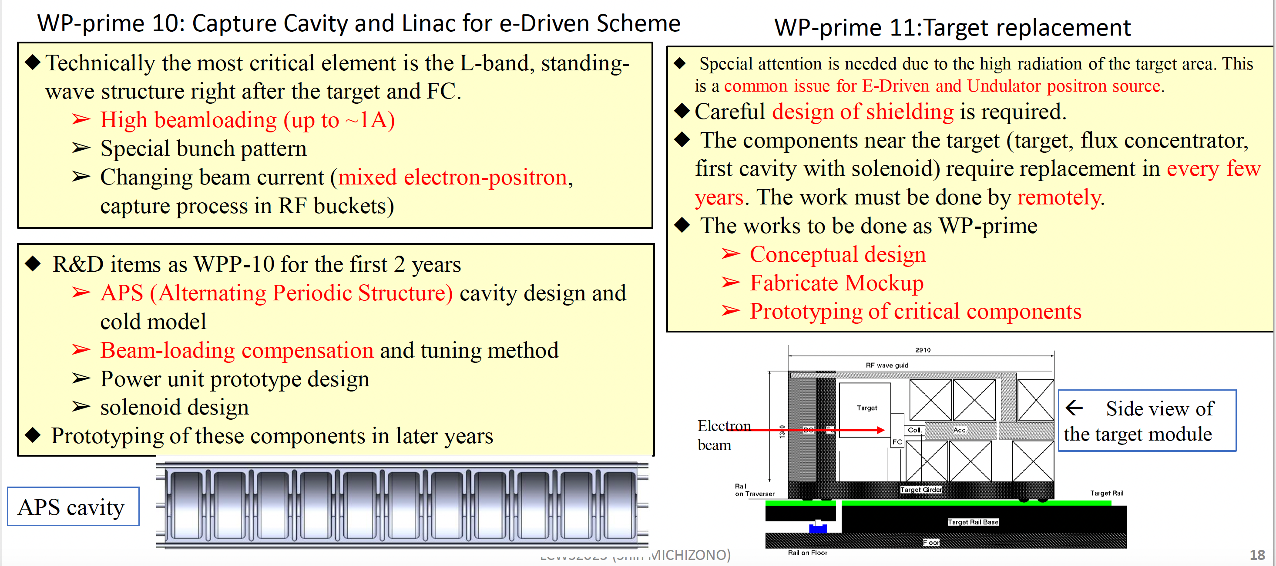
WP’ 8-11: Electron Driven Positron Source (cont’d)
Common for both sources
S. Michizono, LCWS 20223

Slide 16
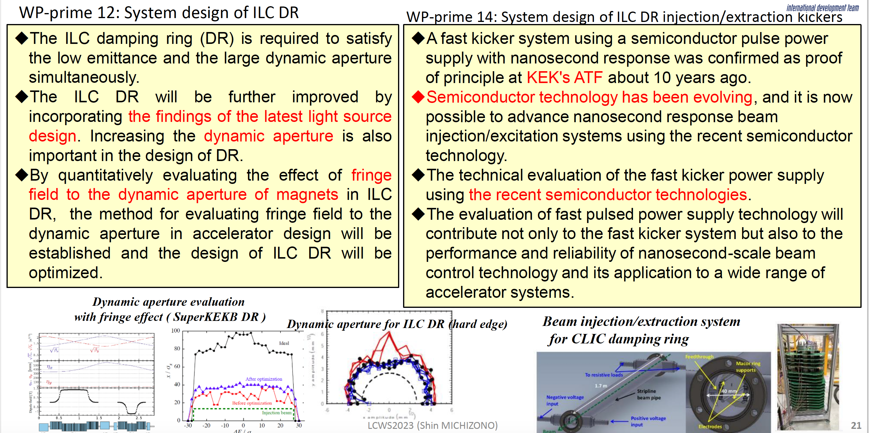
WP’ 12/14: Damping Ring
S. Michizono, LCWS 20223

Slide 17
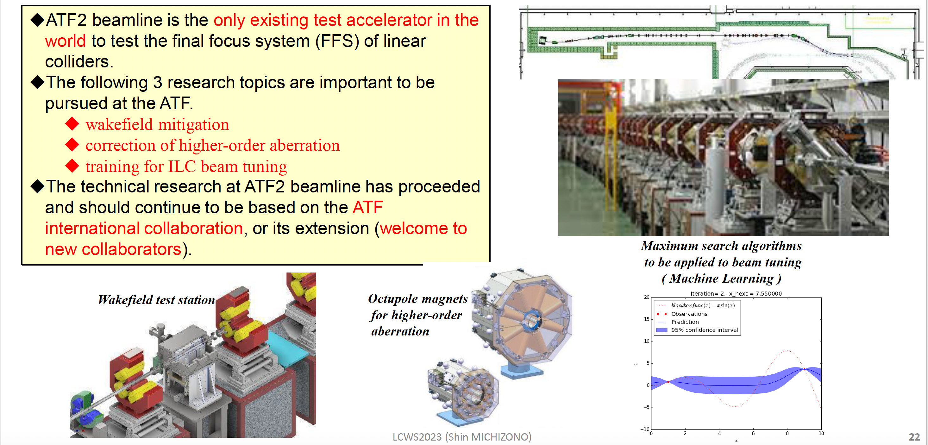
WP’ 15: Final Focus System
ATF Collaboration
S. Michizono, LCWS 20223

Slide 18
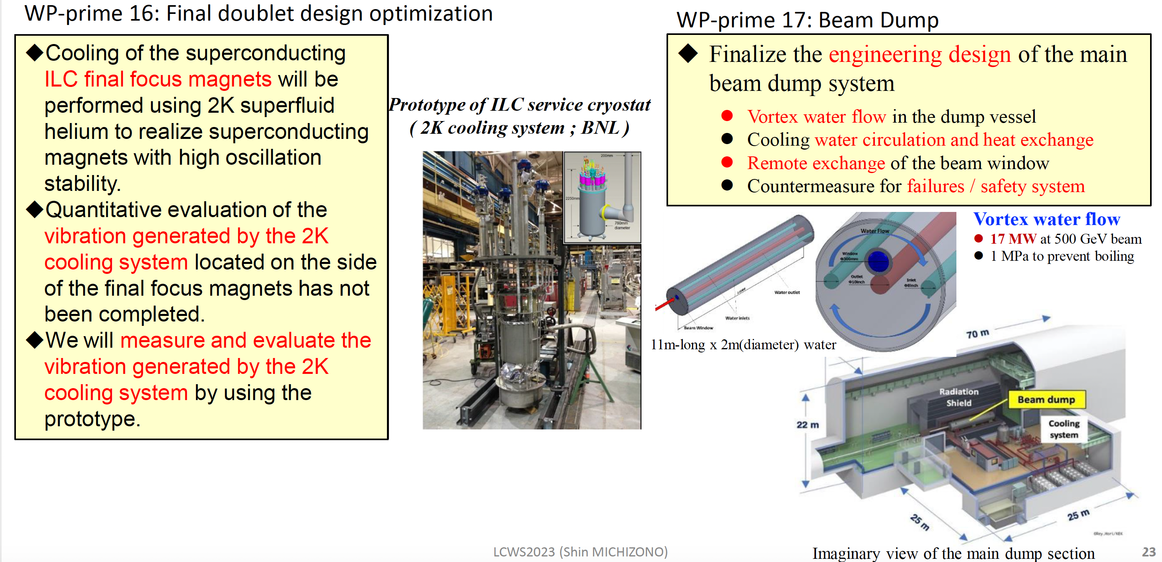
WP’ 16-17: Final Doublet, Main Dumps
S. Michizono, LCWS 20223

Slide 19
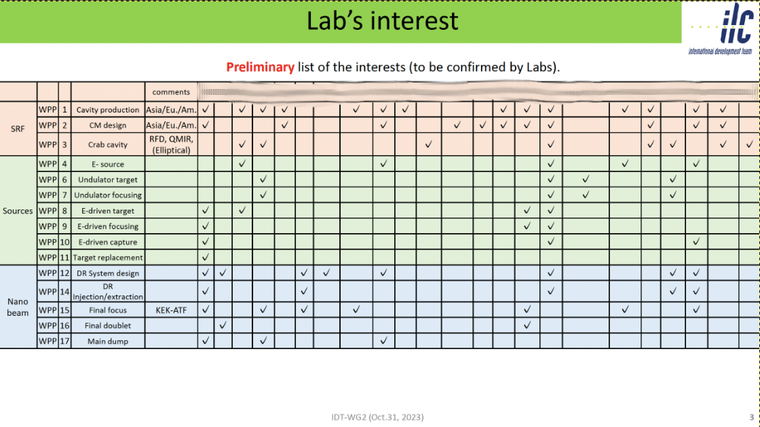
Linking IDT and ITN
IDT Subgroups (SRF, Sources, BDS/DR/Dumps) contact & invite representatives from interested/participating labs
-> IDT subgroups initiate formation of ITN work packages

Slide 20
The European ITN activities – 2023
Personnel with interest and skills in European labs/Univ., local infrastructure.
Material funds as estimated (major/core part from KEK), in some cases complemented by local funding.
Agreement signed 7.7.2023
EAJADE, MC exchange project supporting Higgs factory personnel exchange to Japan and the US.
Started 1.3.2023
CERN LC, project office (within existing LC resources at CERN).
LC budget line in MTP until end 2028
European ITN studies are distributed on five main activity areas:
A1 with three SC RF related tasks
SRF: Cavities and Cryo Module (INFN, CEA, DESY, IJCLAB?)
Crab-cavities (STFC, CERN?)
Main Linac elements: ML quads and cold BPMs (CIEMAT, IFIC)
A2 Sources
Pulsed magnet (Uni.H, DESY, CERN)
Wheel/target (the same and UK groups)
A3 Damping Ring including kickers
Low Emittance Ring lab(s) (UK?)
A4 ATF activities for final focus and nanobeams
On-going/restarted (Oxford, DESY, IJCLAB, CEA, CERN, IFIC)
MDI here ?
A5 Implementation including Project Office
Dump, CE, Cryo – earlier efforts at CERN, possible follow up being considered
Sustainability, Life Cycle Assessment (CERN, DESY, CEA, UK groups?)
EAJADE started (EU funding) SHOW groups?
S. Stapnes ILC Europe Meeting 4.10.23
EAJADE: Information at LINK

Slide 21
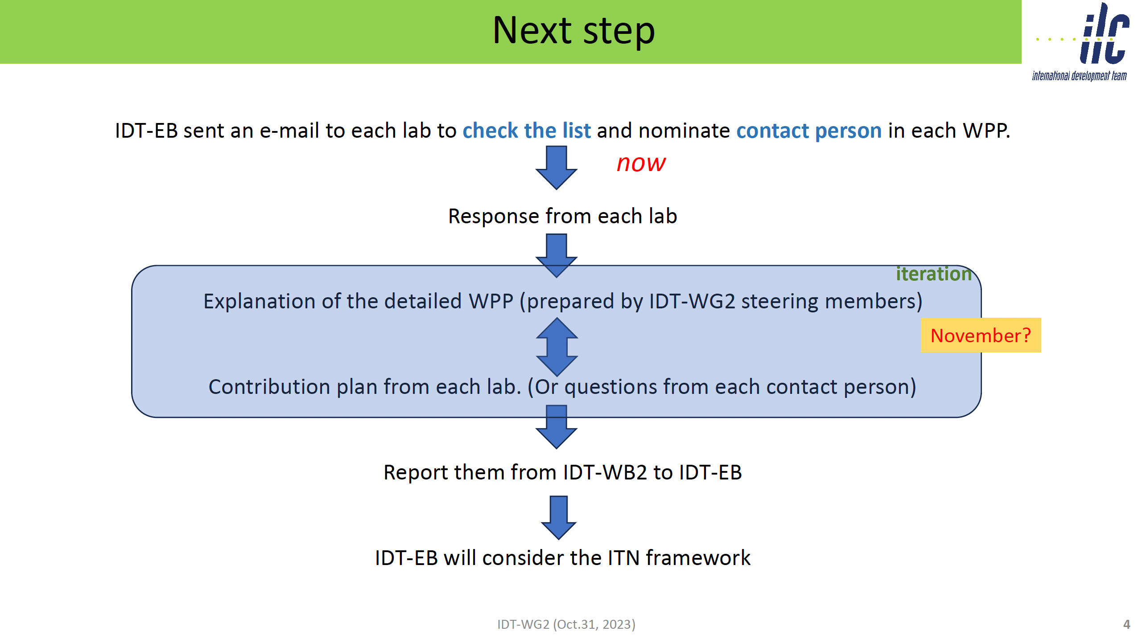
Happening now

Slide 22
Summary
ILC accelerator R&D effort is now conducted by the International Technology Network ITN
ITN is based on bi-lateral agreements between laboratories
KEK provides funding for ITN activities
CERN serves as Hub laboratory for Europe
ITN is now in the process of being constituted, with a specific work plan and commitments by contributing laboratories

Slide 23
Thank You

Slide 24
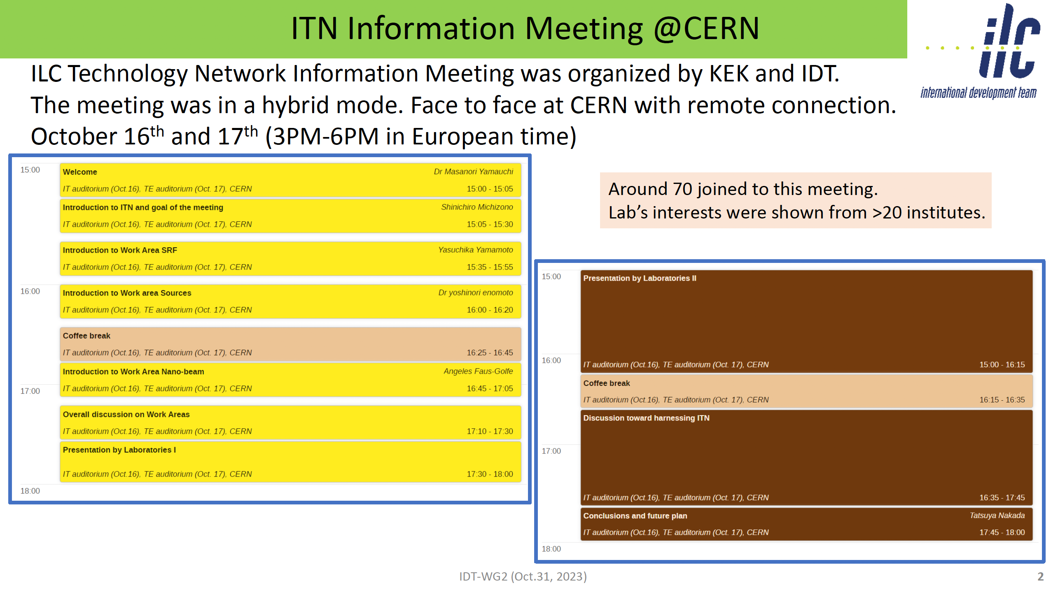
S. Michizono
IDT WG2 Meeting 31.10.23
https://agenda.linearcollider.org/event/10200/contributions/53479/

Slide 25
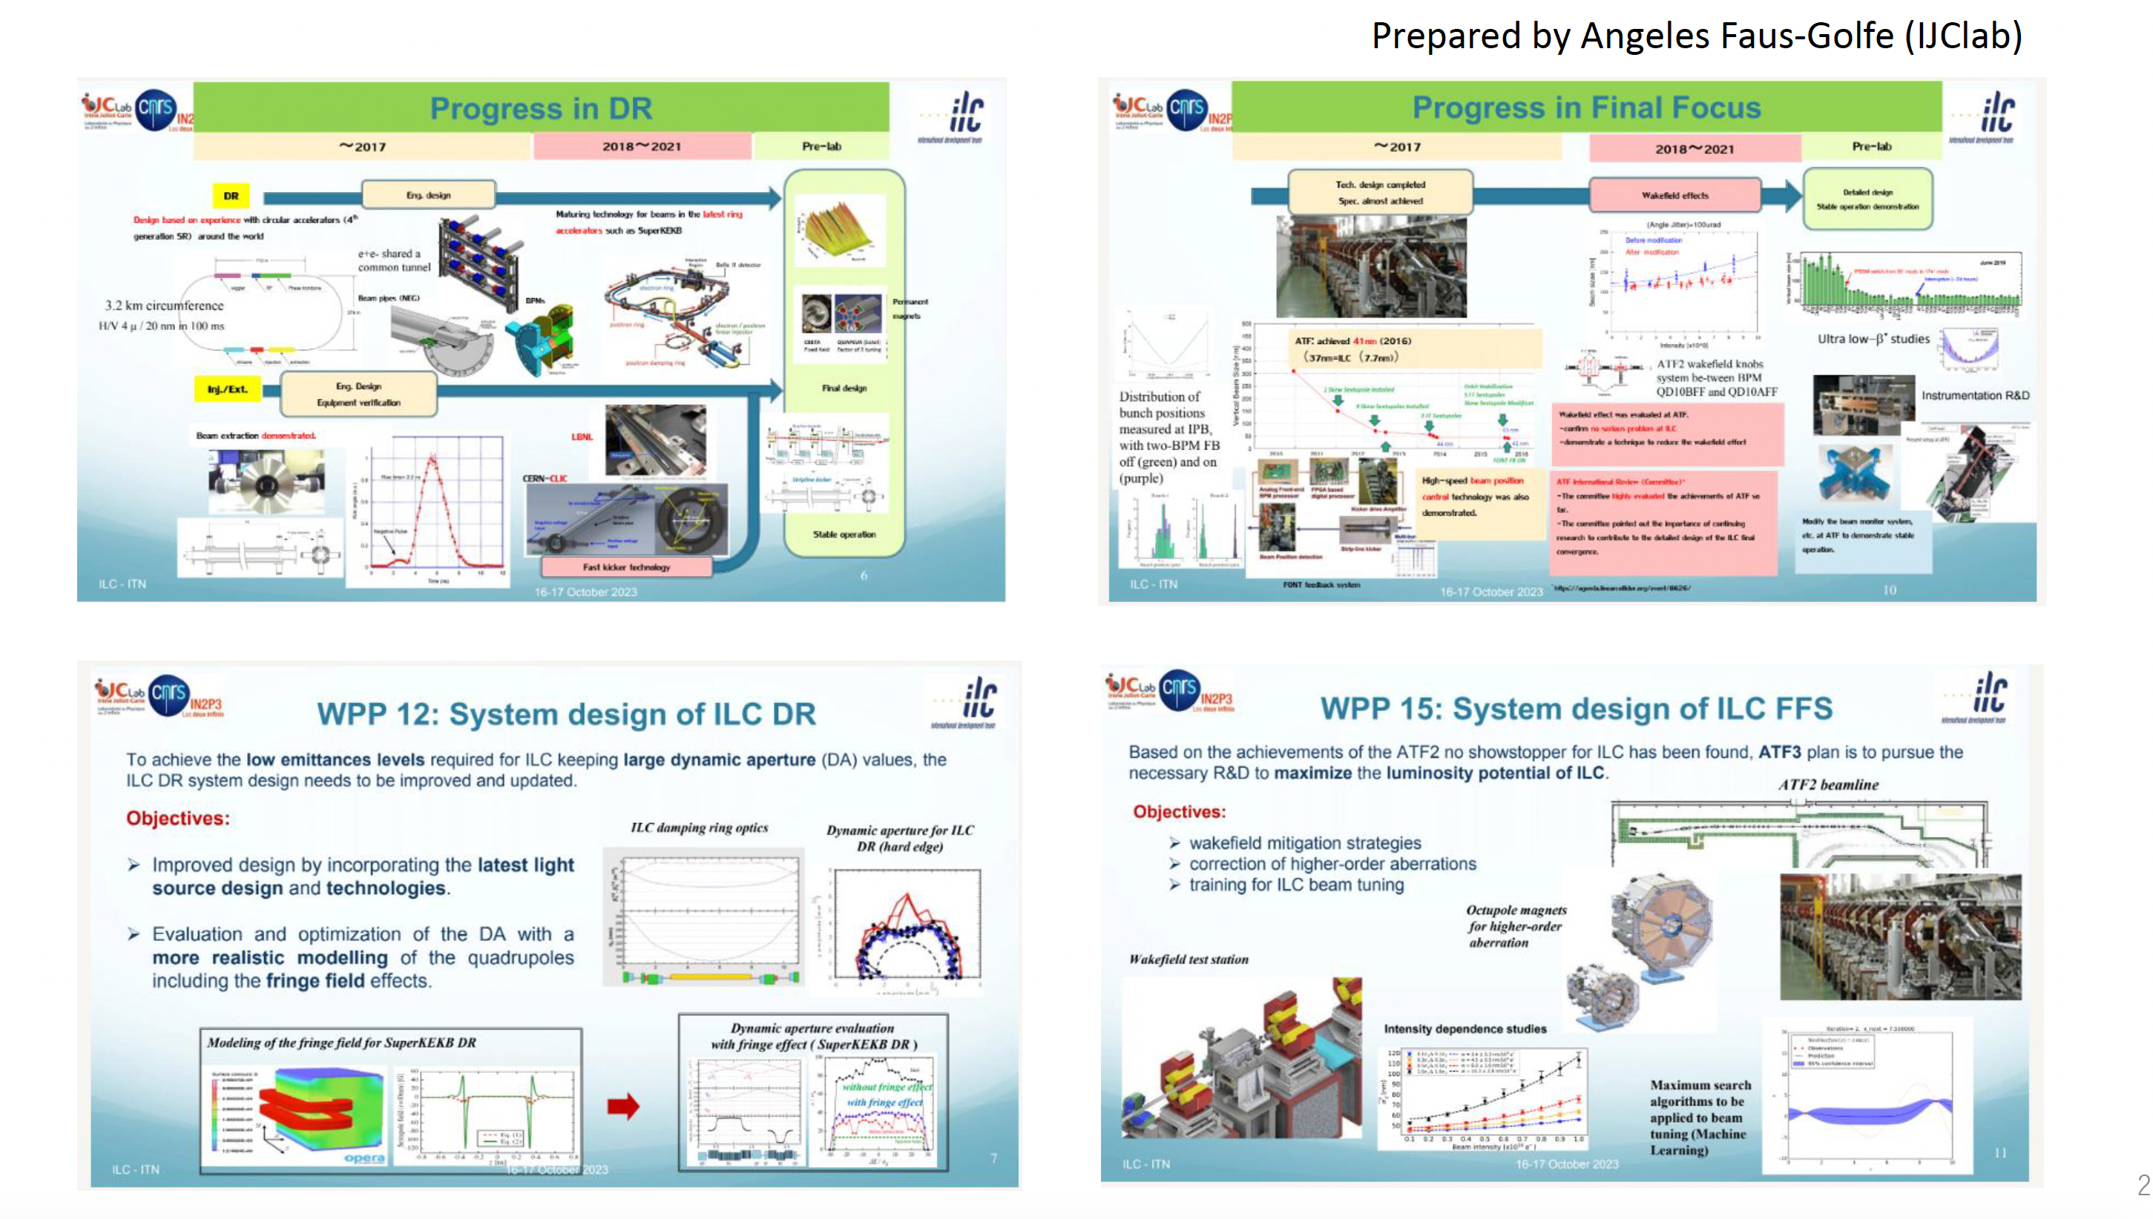
T. Okugi
IDT WG2 Meeting 31.10.23
https://agenda.linearcollider.org/event/10200/contributions/53483/

