Slide 1




THE FCC-ee INJECTOR COMPLEX: AN OVERVIEW
Alexej Grudiev on behalf of the CHART/FCCee Injector design collaboration
Slides (most of) are kindly provided by Paolo Craievich

Slide 2
Acknowledgements
2
PSI | R. Zennaro, M. Schaer, N. Vallis, B. Auchmann, I. Besana, S. Bettoni, H. Braun, M. Duda, R. Fortunati, H. Garcia-Rodrigues, D. Hauenstein, E. Hohmann, R. Ischebeck, P. Juranic, J. Kosse, F. Marcellini, U. Michlmayr, S. Muller, G. L. Orlandi, M. Pedrozzi, J.-Y. Raguin, S. Reiche, M. Seidel, R. Rotundo, S. Sanfilippo, M. Zykova all the technical groups involved in the P3 experiment
IJCLab | I. Chaikovska, F. Alharthi, V. Mytrochenko, R. Chehab
CERN | A. Grudiev, A. Latina, S. Doebert, Z. Vostrel, Y. Zhao, B. Humann, A. Lechner, A. Kurtulus, R. Mena Andrade, J.L. Grenard, A. Marcone, M. Calviani, W. Bartmann, Y. Duthell, H. Bartosik, K. Oide, F. Zimmermann, M. Benedikt
INFN-LNF | C. Milardi, A. De Santis, O. Etisken, S. Spampinati
SLAC | T. Rauberheimen
KEK: | Y. Enomoto, K. Furukawa
and L. Bandiera, M. Soldani, A. Sytov (INFN/Ferrara), A. Bacci, M. Rossetti Conti (INFN/Milano)
This work was done under the auspices of CHART (Swiss Accelerator Research and Technology) Collaboration, https://chart.ch - CHART Scientific Report 2022: https://chart.ch/reports/

Slide 3
Content
3
Where we are in FCCee
Injector parameters (for the choice of key technology)
  Pre-requisite for linacs technology: conventional normal conducting technology based on the SwissFEL facility (at the Paul Scherrer Institut)
  FCC CDR0 as a starting point
Baseline layout: linacs, positron source and damping ring
Some remarks
Summary

Slide 4
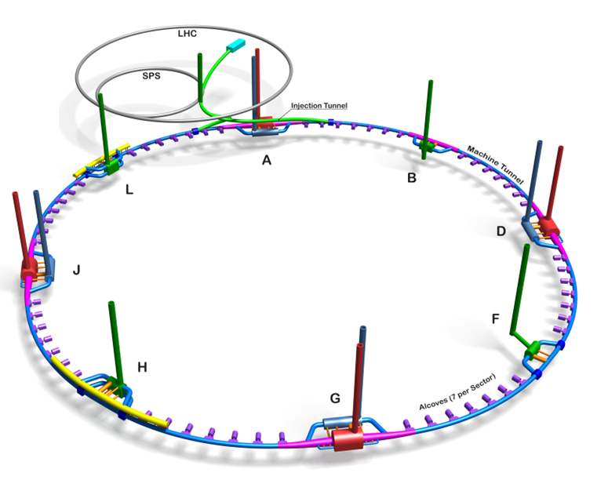
Where we are in FCCee
4
Injector complex, total length ~1.1 km
SPS to be used as a Pre-booster
Electron-Positron collider
~90.7 km

Slide 5
Injector parameters (Z-mode)
5
K. Oide, FCC week 2023 talk
 | SPS | HE Linac | Unit
Injection energy | 6 | 20 | GeV
Bunch charge both species | 4.0* | 4.0* | nC
Repetition rate | 200 | 200 | Hz
Number of bunches | 2 | 2
Bunch spacing | 25 | 25 | ns
Norm. emittance (x, y) (rms) | 10,10 | 10,10 | mm mrad
Bunch length (rms) | ~1 | ~1 | mm
Energy spread (rms) | 0.3 | ~0.1 | %
*Maximum charge to be injected into the collider rings 4 nC (bunch pop. 2.5x10¹⁰ particles)
Target bunch length and energy spread at the linac end, TL from HE linac to booster will include an energy compression (and bunch decompression)
The bunch-by-bunch intensity will arbitrarily vary from 0 to 100%, depending on the intensity balance between the collider rings
Bunch-by-bunch intensity fluctuation: 5% (Z mode), 3% (WW, ZH, tt)

Slide 6
Injection time – HE linac option
6
Booster ring, 11200 bunches, Injection time 28 s, Ramp up 0.32 s, Flat-top 1.9 s, Ramp down 0.32 s
5600 rf pulses x 2 bunches (28 s)
Booster ring
Cycle time 30.54 s
5600 rf pulses x 2 bunches (28 s)
Linac up to 20 GeV
≥ 2.54 s
1 injection
Collider parameters from the mid-term review:
- Bunch charge 34.24 nC, bunch pop. 2.14E11
Δ = 5%, 1.712 nC (charge for top up) → is there margin on this 5%?
Lifetime (τ₂): 1240 s (~21 min)
τ_{top-up} = Δτ₂ = 62 sec (Δ = τ_{top-up}/τ₂)
Injection time for one specie: 30.54 s, top-up time for both species 61 sec
5 ms
Collider rings, 11200 bunches
Filling from scratch 305.4 s for each species (3.5 nC/bunch)
Total filling time from scratch 2x305.4 s = 610.8 s (~10 min)
25 ns
Collider rings, top up (Z mode) – 200 Hz
Collider filling time 30.54 s for each species
In top up, the injector will run continuously, and the reliability becomes an important aspect for the Injector design.

Slide 7
Schematic layout of Injector complex – work breakdown structure
7
WP1. Electron source and linacs (A. Grudiev, CERN)
WP3. Positron source and capture system
(I. Chiakovska, IJCLab)
WP4. Damping ring and return transfer line
(C. Milardi LNF INFN)

Slide 8
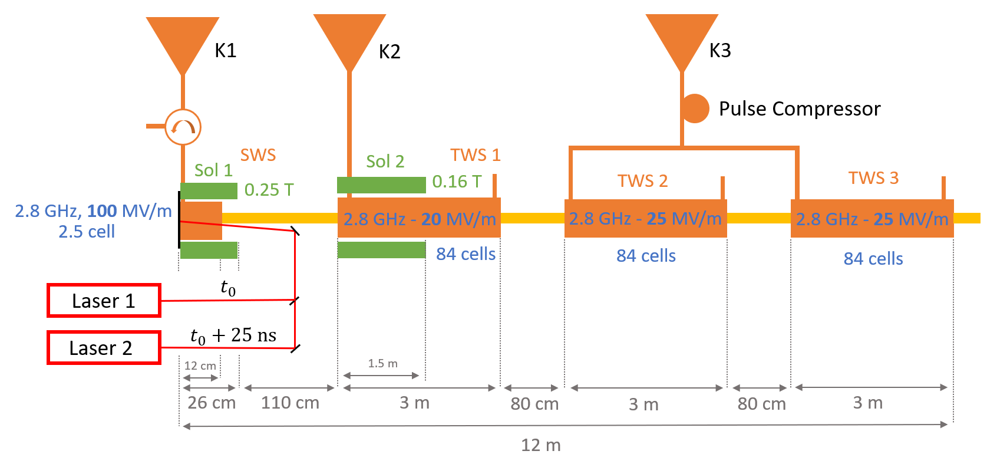
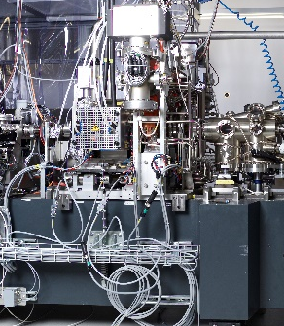
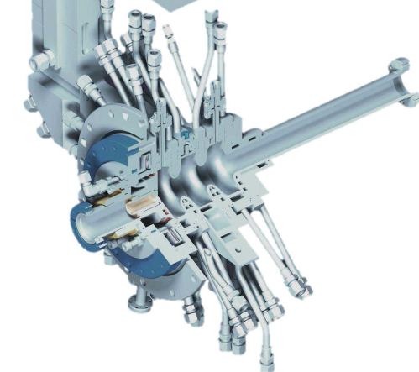
Electron source
8
SwissFEL RF gun
Provide electrons for positron production and injection into CR, it is based on the SwissFEL gun
Two laser systems, each for one bunch (as in SwissFEL)
Top up injection scheme: Robust solution to preserve the emittance for different bunch charge
Bunch-by-bunch intensity fluctuation: 5% (Z mode), 3% (WW, ZH, tt)
Courtesy of Zdenek Vostrel and Steffen Doebert

Slide 9
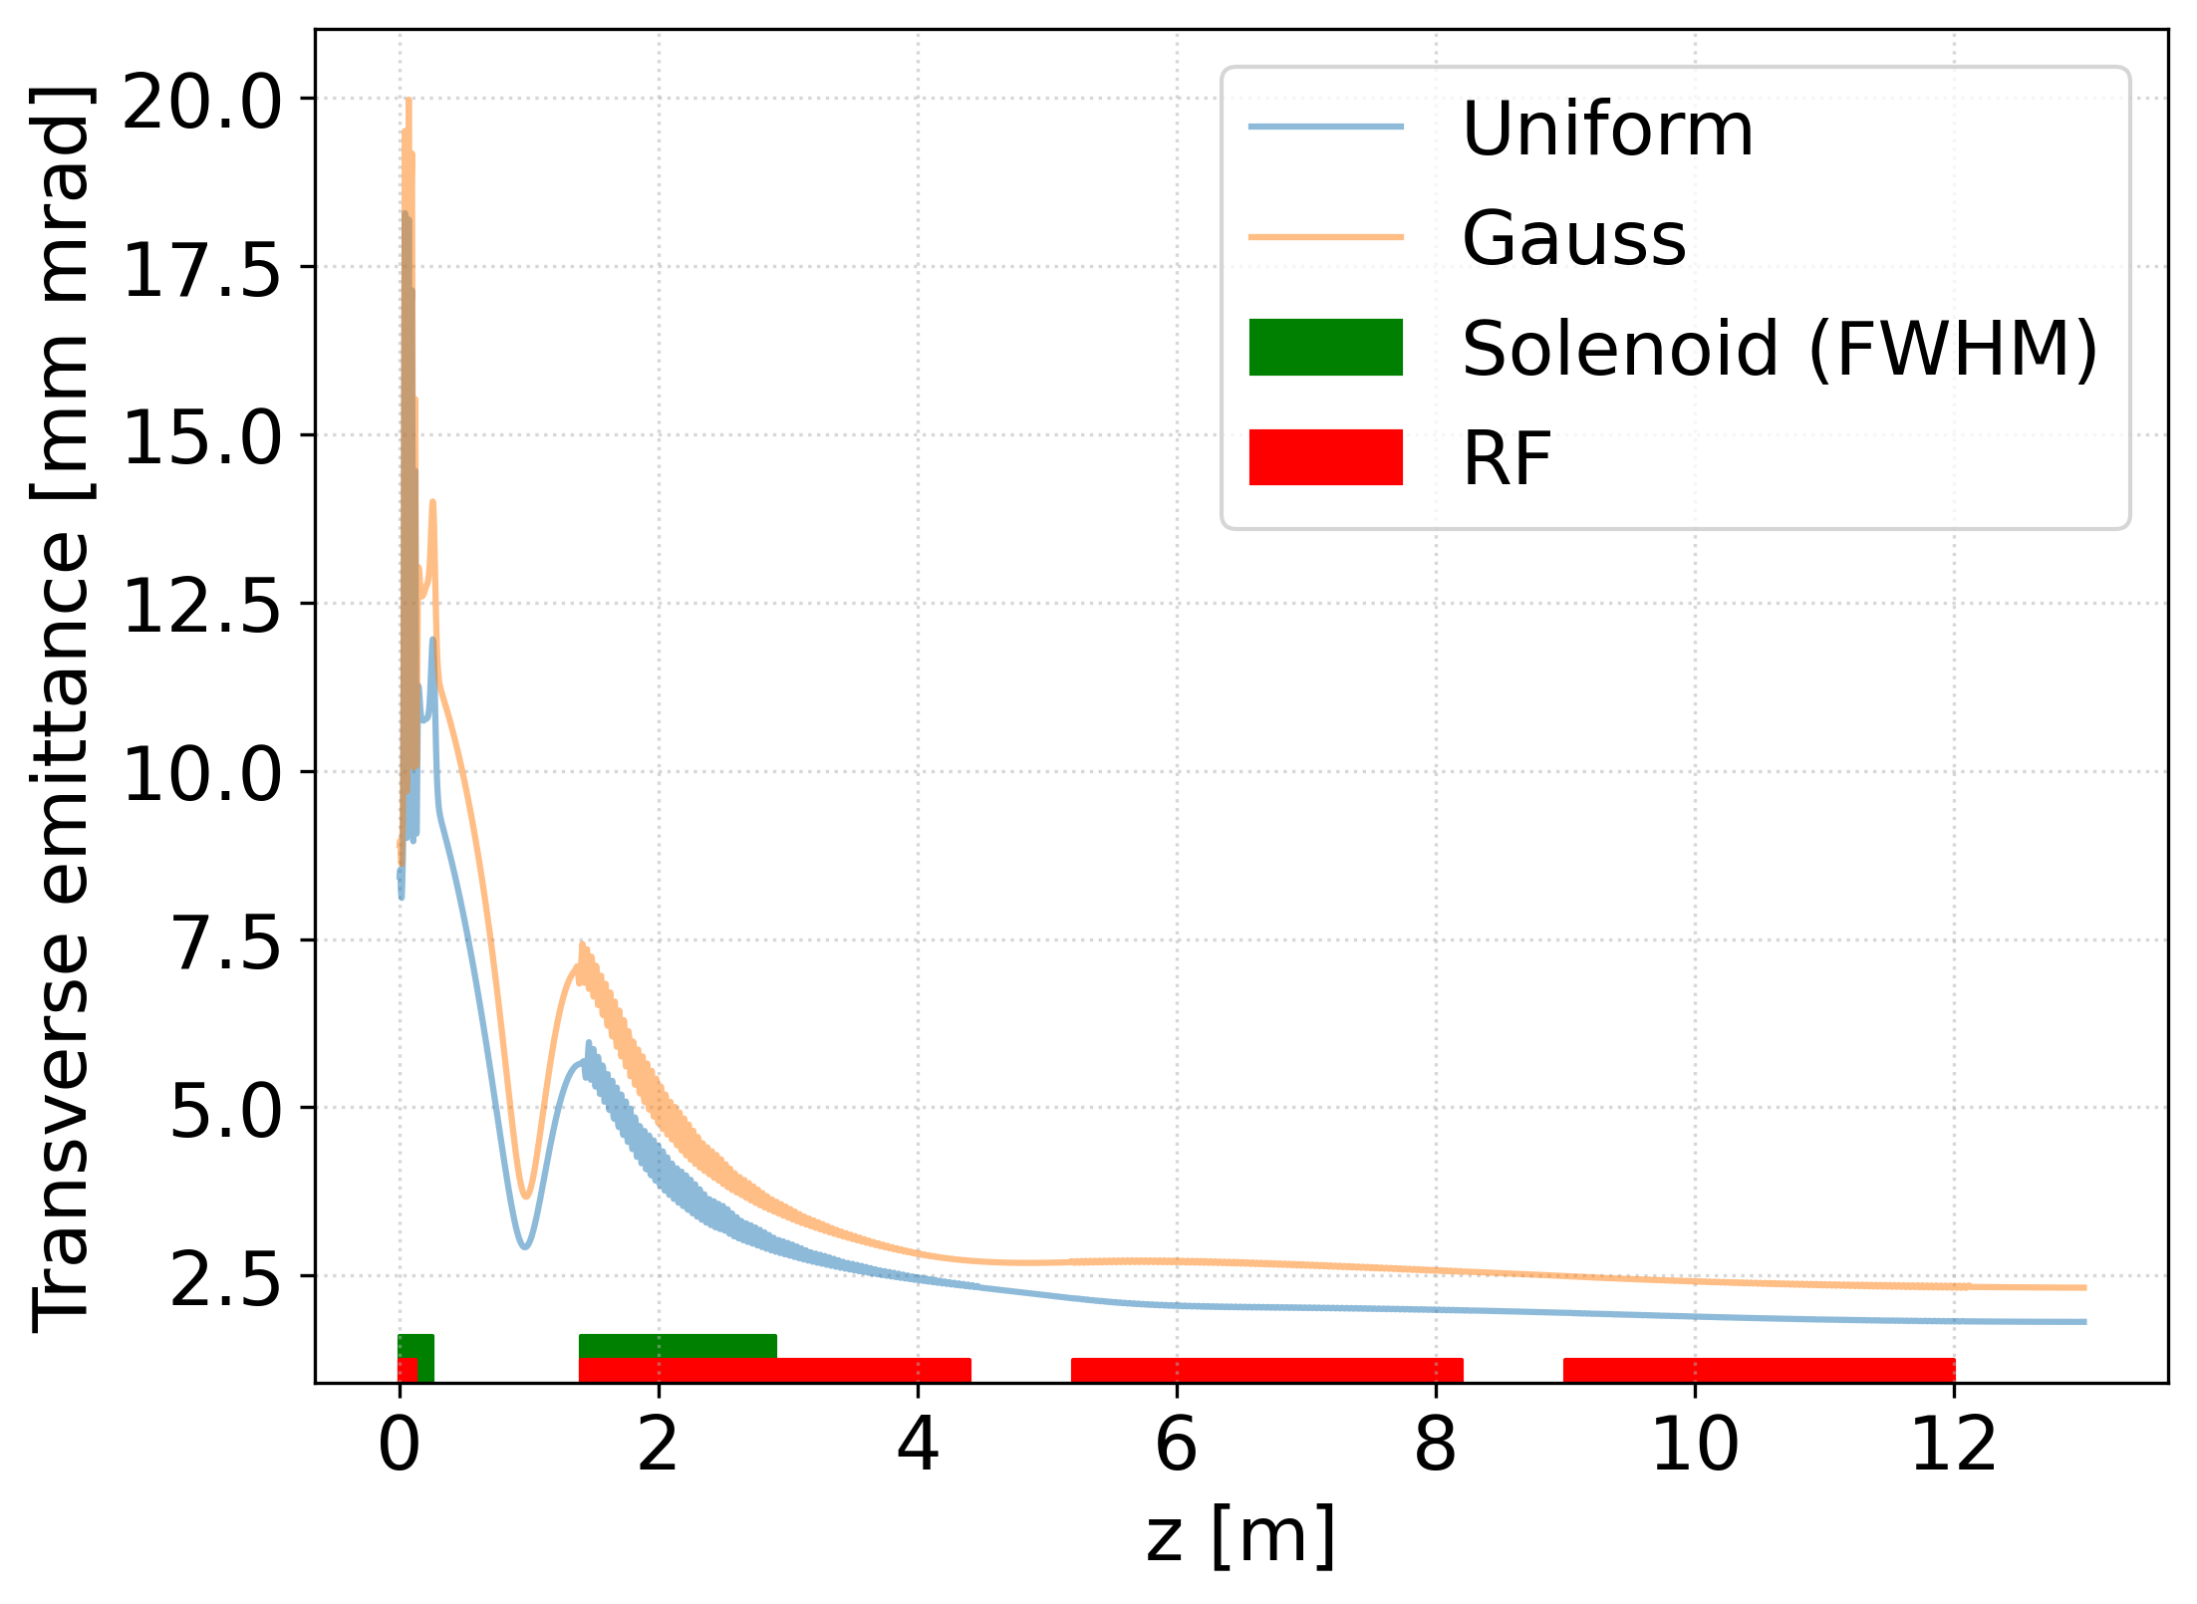
Electron source
Key properties listed in the table, reached
Bunch parameter | Simulation | Target
Transverse emittance | 3.14 mm mrad (rms) | < 4 mm mrad
Bunch length | 0.96 mm (rms) | ~ 1 mm (or shorter)
Energy | ~ 190 MeV | ~ 200 MeV
Energy spread | 390 keV (0.2 %) | < 0.5 %
Peak charge | 5 nC | 5 nC
Emittance evolution for 5 nC charge
Courtesy of Zdenek Vostrel and Steffen Doebert

Slide 10
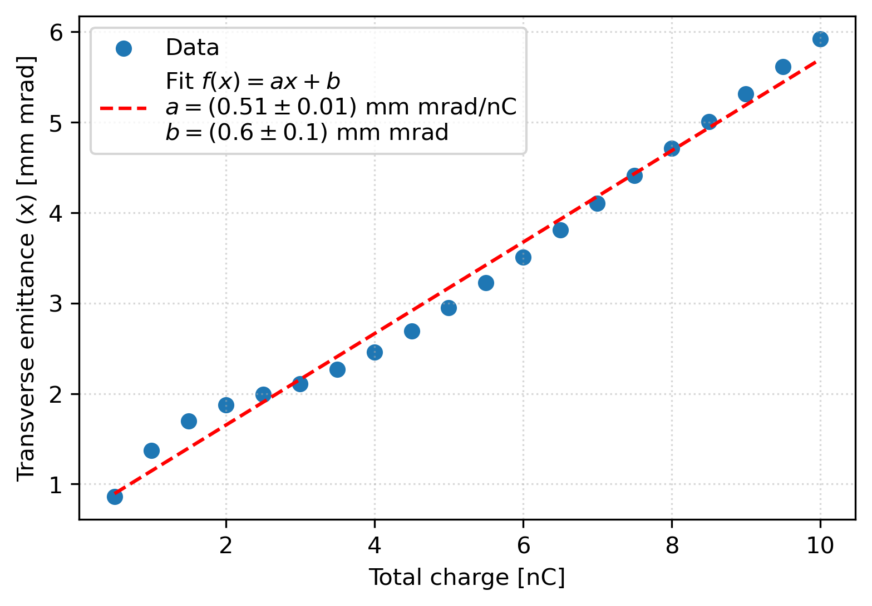
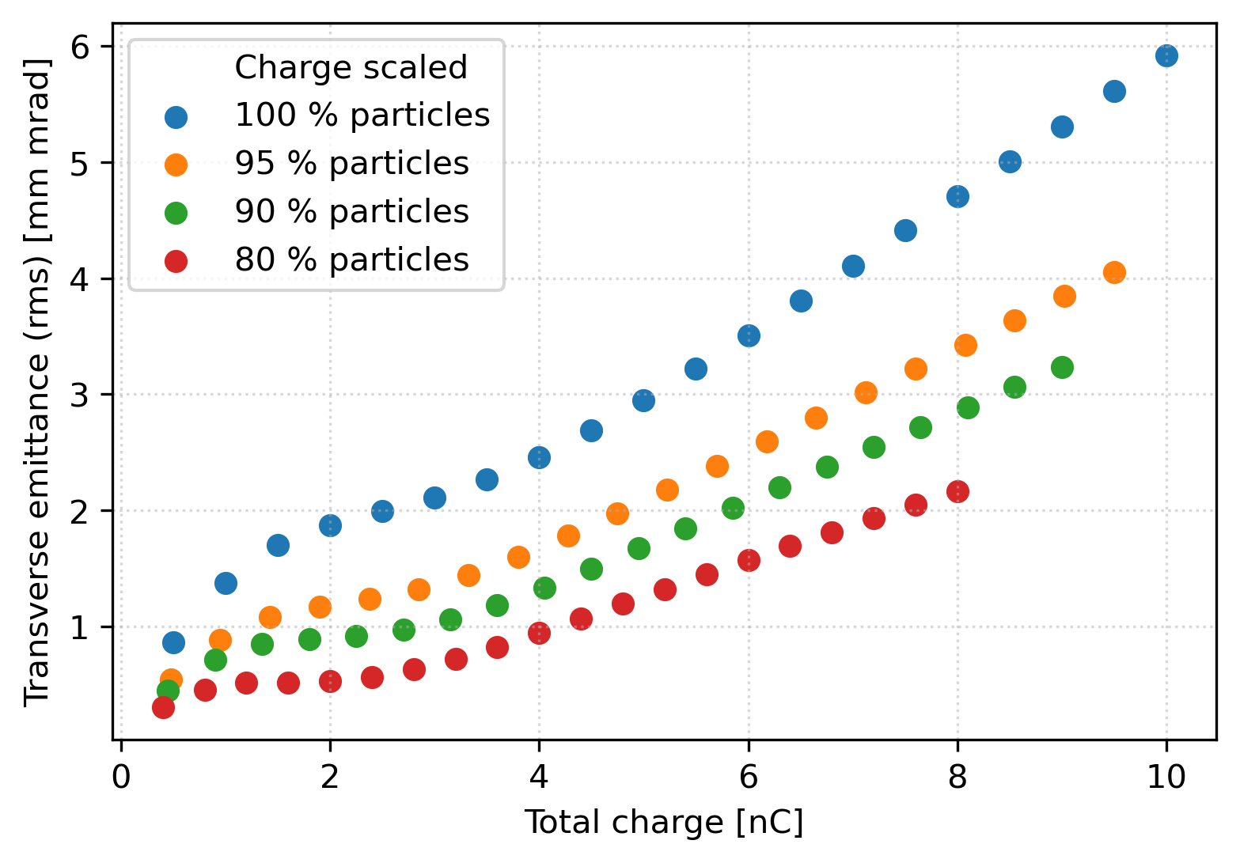
Electron source
Robust solution to preserve the emittance for different bunch charge
Emittance for different charges (nominal design charge is 5 nC)
Large contribution from 5% particles
Cutting particles based on energy or transverse position
Courtesy of Zdenek Vostrel and Steffen Doebert

Slide 11
e-, common, e+ and HE-linacs: design steps
Beam dynamics design (start-to-end simulations) provides specification for accelerating structure design: aperture, RF frequency, structure length, gradient, etc.
RF design of accelerating structures (S-, C-band, 2.0 GHz)
RF module layout and parameters are put together based on the above input and the parameters of the RF power sources
Klystron abbrev. | Linac | Freq. | Peak power specification | Rep. Rate | RF pulse length | Duty factor | Average power | Required numbers
 |  | [MHz] | [MW] | [Hz] | [μs] | [1e-3] | [kW]
Kly_p | p-linac + Ecomp | 2004 | 80 | 200 | 5 | 1 | 80 | 16 + 1
Kly_e | e-linac + e-source HE-linac S-band | 2806 | 80 | 200 | 3 | 0.6 | 48 | 10 + 1 82
Kly_c | c-linac | 2806 | 50 | 400 | 3 | 1.2 | 60 | 35
Kly_HE_C | HE-linac C-band | 5611 | 50 | 200 | 3 | 0.6 | 30 | 86
A. Grudiev, J.-Y. Raguin, S. Bettoni, M. Schär et al.

Slide 12
Positron, Electron, Common, HE linacs
12
RF module summary table for all linacs
Peak gradient → Average power: up to 7.5 kW/m, power density on outer wall radius up to 104 kW/m²
Inc. WG loss and 90% margin
Same for quads, corrs. and BPMs
A. Grudiev, A. Kurtulus et al.

Slide 13
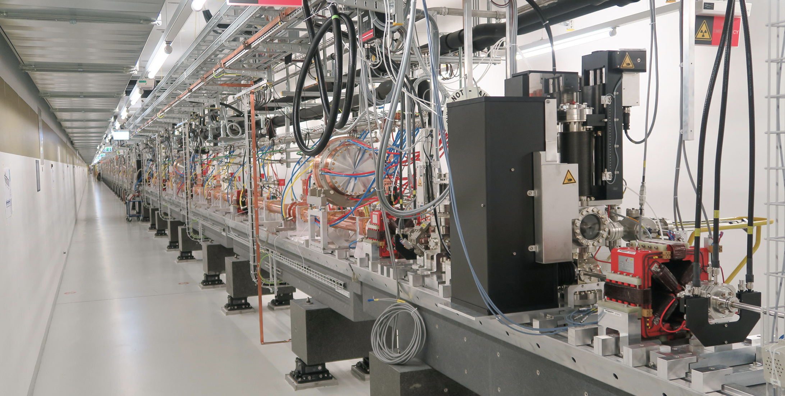
Electron-, Common, Positron and HE-linacs
13
RF technology: tuning-free from PSI
Each RF module: one klystron/modulator, rf WG network, 2 rf structures (3-m long), LLRF, cooling system, 2 BPMs, 2 quads and 2 correctors. Total length: 7.5 m
Common linac at 400 Hz during positron production
SwissFEL linac

Slide 14
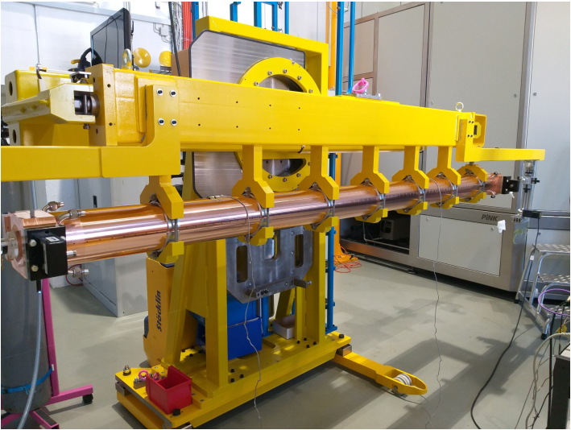
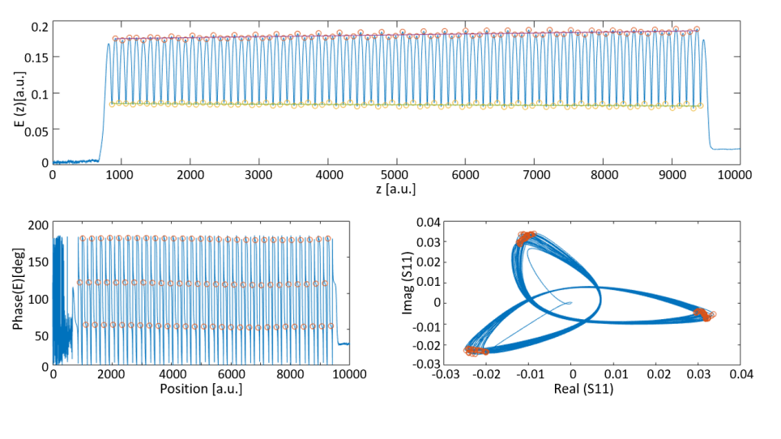
High gradient & Breakdown rate
Tuning-free technology: PSI has developed a production line of high technological content for high-quality, high gradient C-band accelerating structures for the SwissFEL project (~120 structures) https://doi.org/10.1038/s41566-020-00712-8
  Gradient and BDR at 100 Hz: max 55 MV/m, BDR=1E-07, operation at 30 MV/m
Collaboration CERN-PSI on first-tuning-free X-band Accelerating Structures: CLIC X-band prototypes (max gradient ~120 MV/m at 100 Hz) https://doi.org/10.1109/TNS.2022.3230567
Collaboration Elettra-PSI: free tuning free S-band Accelerating Structures https://doi.org/10.1016/j.nima.2023.168543
  Gradient and BDR at 100 Hz: max 40 MV/m, BDR=1E-07, operation at 30 MV/m
  Max gradient was limited by the RF source
As a conclusion: present gradients (30 MV/m at 200 Hz, 21.5 MV/m at 400 MV/) are well supported by experiences, thermo-mechanical analysis to be performed with higher dissipated power density
3m-long S-band structure brazed in one piece

Slide 15
Electron, Common, HE linacs – RF power density
15
200 Hz
400 Hz
200 Hz
Linac | Freq. | Peak gradient | Average power <Pin> | Structure length | Average power <Pin>/L*3/4 | Outer wall radius | Power density on outer wall radius
 | [GHz] | [MV/m] | [kW/structure] | [m] | [kW/m] | [mm] | [kW/m^2]
p-linac | 2.0 | 20 | 31 | 3 | 7.5 | 60 | 125
e-linac HE-linac S-band | 2.8 | 29.5 | 18 | 3 | 4.5 | ~40 | 112.5
c-linac | 2.8 | 23.4 | 22.5 | 3 | 5.6 | ~40 | 141
HE-linac C-band | 5.6 | 28.8 | 11 | 3 | 2.8 | ~20 | 140
SwissFEL C-band | 5.7 | 30 | 5 | 2 | 1.9 | ~20 | 95

Slide 16
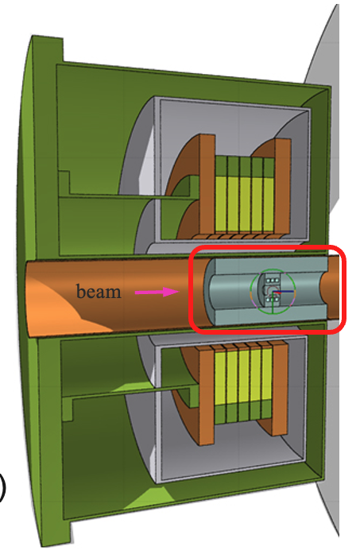
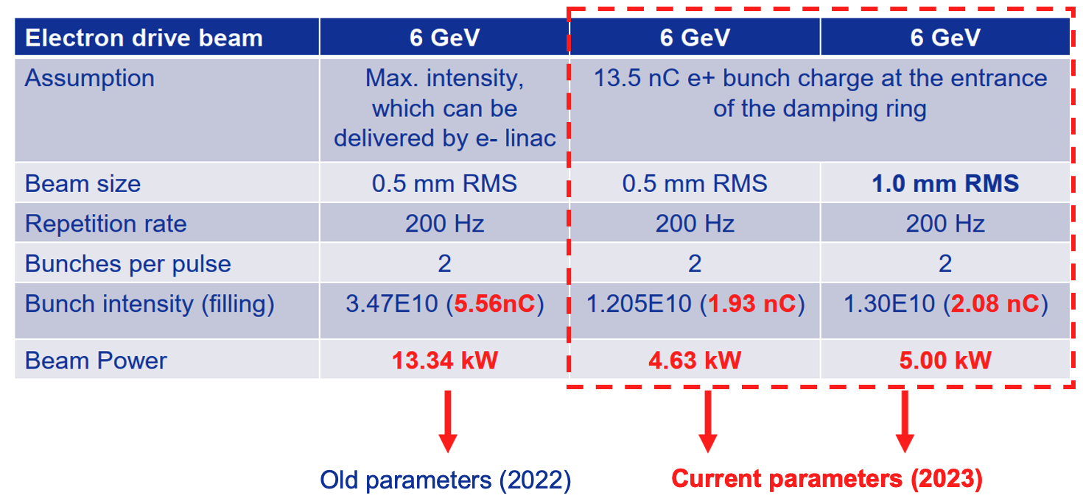
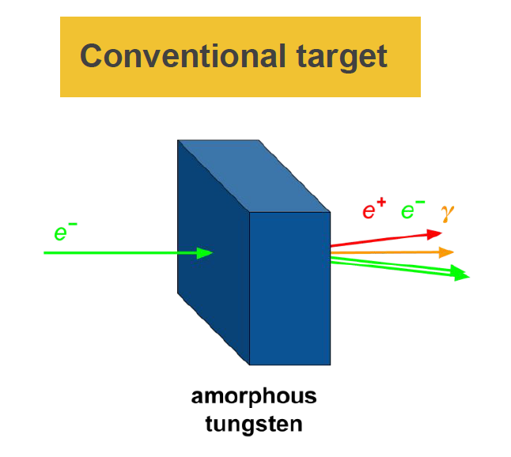
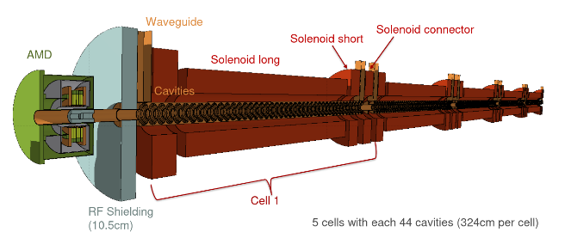
Positron source and capture linac
Accepted e⁺ yield is a function of primary beam characteristics + target + matching device + capture linac + beam transport + DR acceptance
Primary (drive) beam parmeters
Conventional target
Matching device (MD)
Capture linac and solenoid focusing
I. Chaikovska et al.

Slide 17
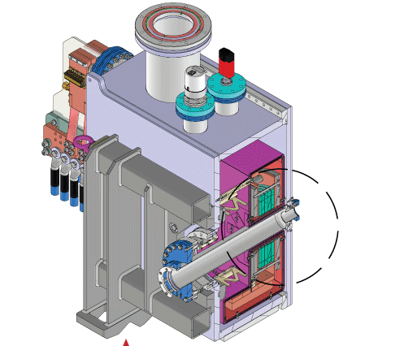
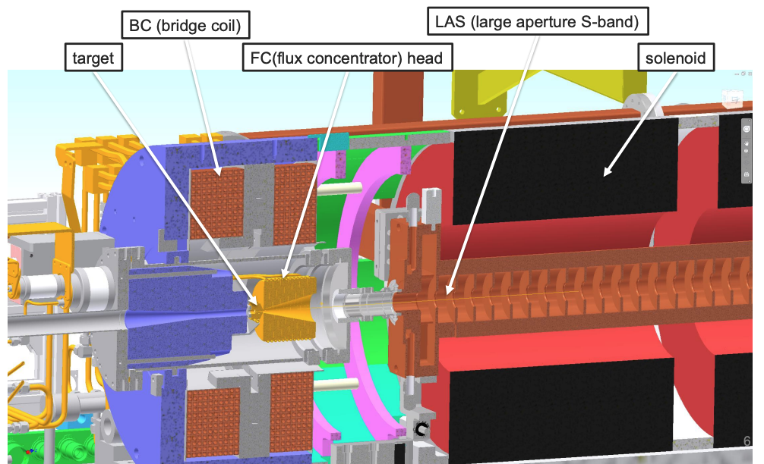
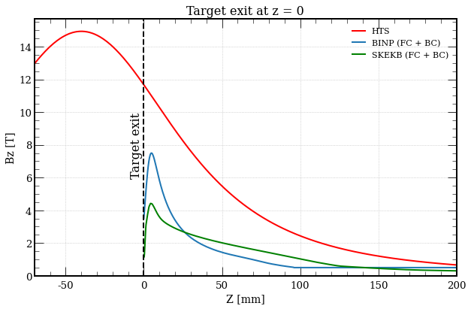
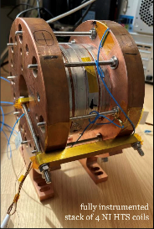
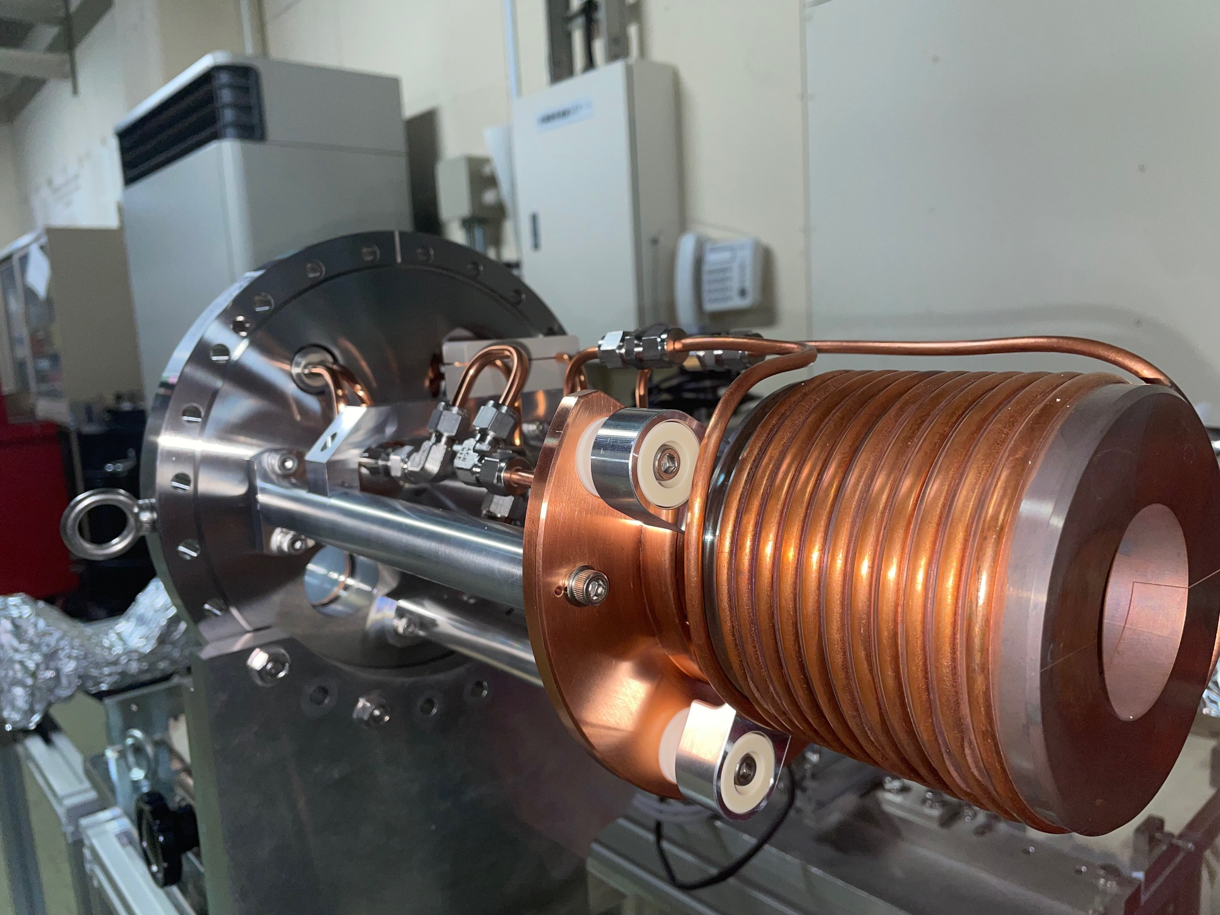
Positron source: matching device
17
Magnetic field profiles
SC solenoid (PSI)
Flux concentrator (FC) - SuperKEKB source
18.2 T @15K@2kA reached
FC: lower peak field and aperture, fixed target position, challenging power source working at 200 Hz, robust and reliable solution…
HTS solenoid: higher peak field and aperture, flexibility on the field profile and target position, DC operation, innovative solution in application for e⁺ capture…

Slide 18
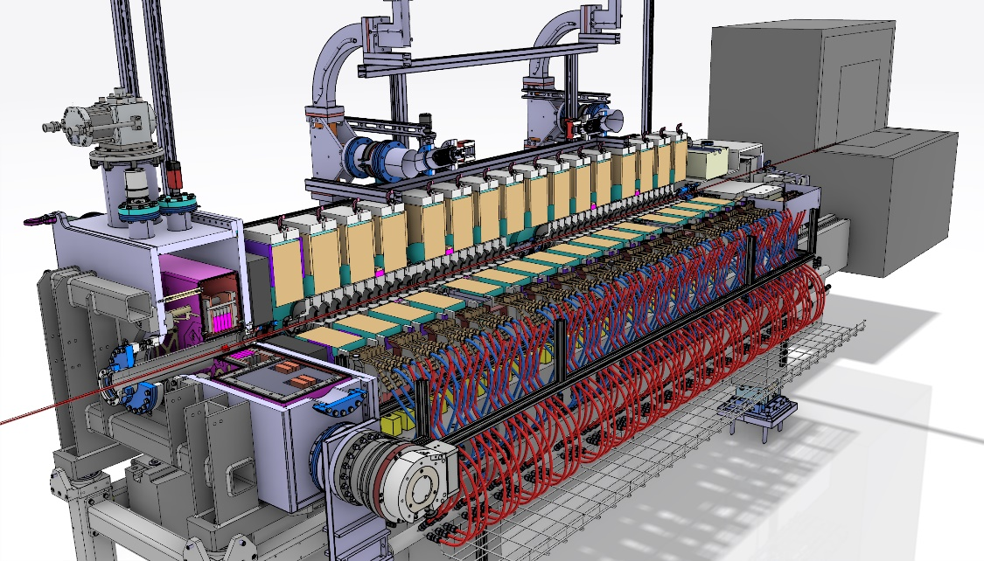
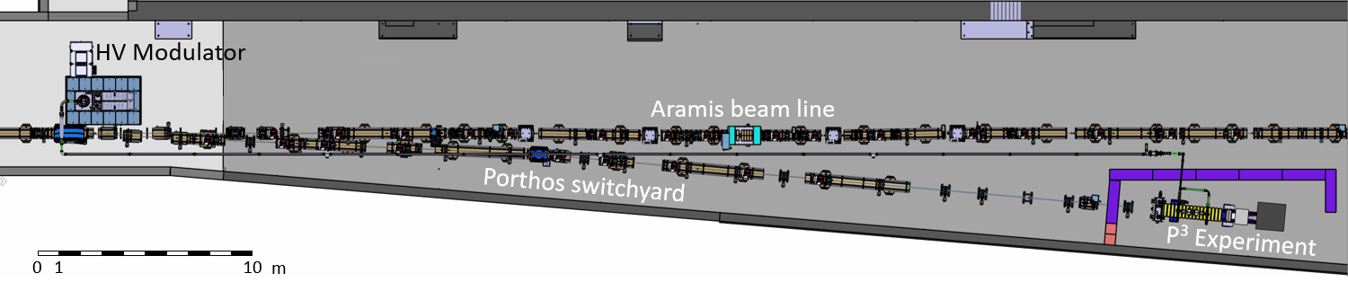
PSI Positron Production (p-cubed) experiment
Design phase well advanced, several components are ordered
Installation on the Porthos extraction line ongoing
Ongoing collaboration with CERN STI for the target
Experiments in 2025/2026
N. Vallis et al., Proof-of-principle e + source for future colliders, accepted PR AB.

Slide 19

Positron source: capture linac
Baseline structure: large-aperture (Φ = 60 mm) TW L-band @ 2 GHz, 9π/10, 3-m long, 20 MV/m. 5 RF structures are used to accelerate the e⁺ beam up to ~200 MeV where there is the electron/positron separation
Baseline solenoid configuration: 0.5 T NC solenoid, magnetic field uniformity, solenoid focusing first 50 m, quadrupole focusing downstream

Slide 20
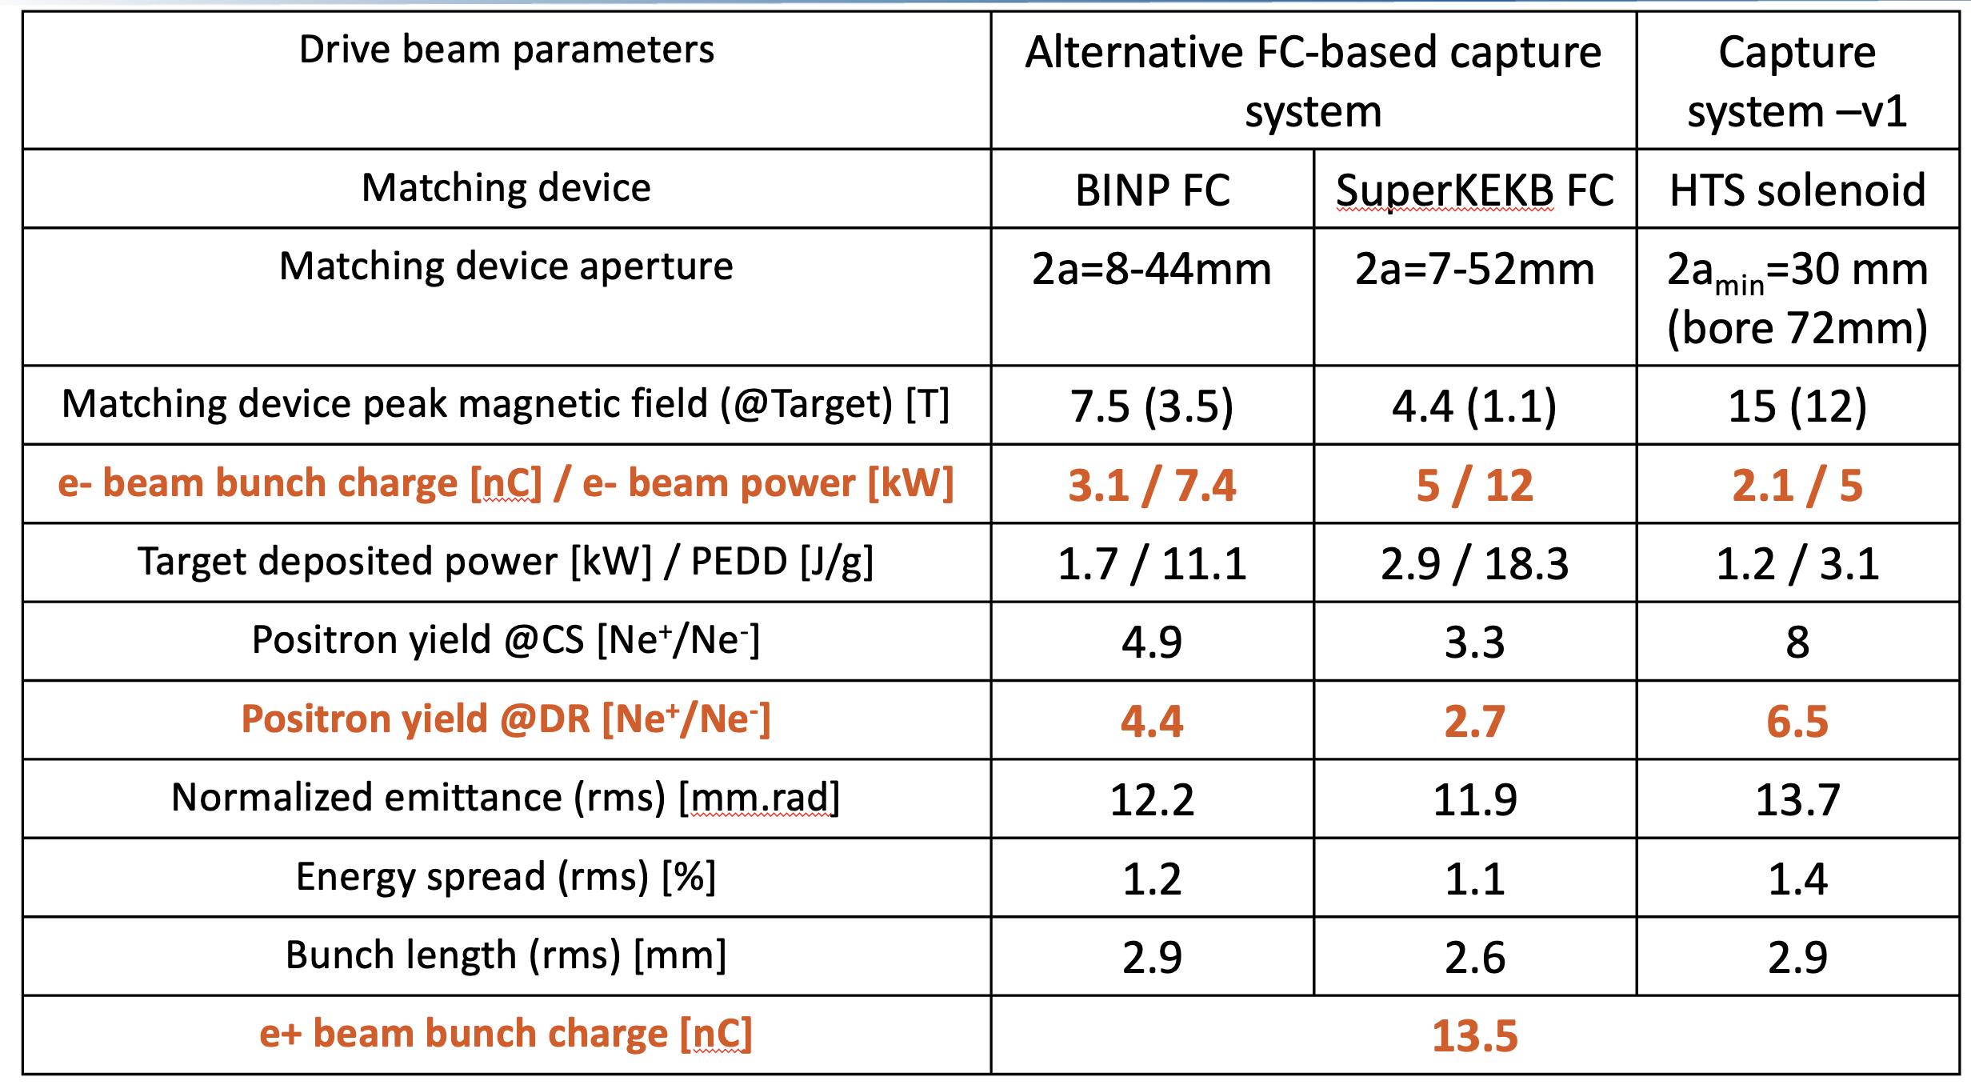
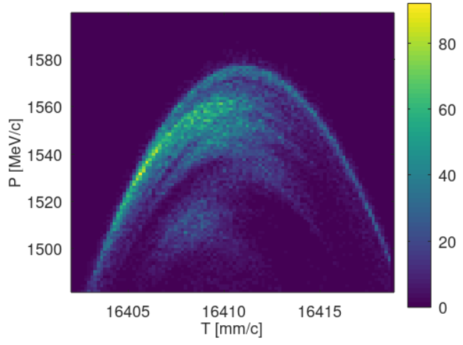
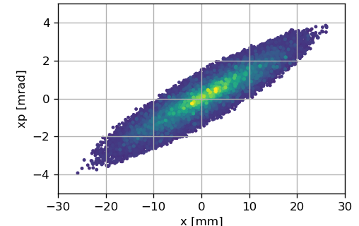
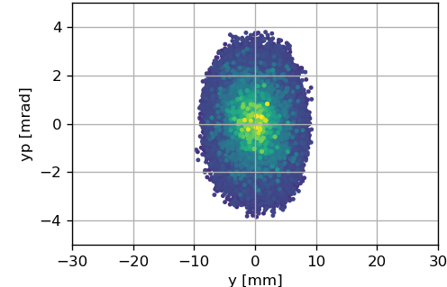
Positron source and capture linac
Safety margin for the acceptance in the DR and transport in the linac (13.5 nC)
Drive beam parameters have been also updated based on this safety margin
The studies on the positron source based on the SC solenoid are well advanced
@ 1.54 GeV (DR entrance)
Long. phase space
Horizontal phase space
Vertical Phase space
I. Chaikovska et al.

Slide 21
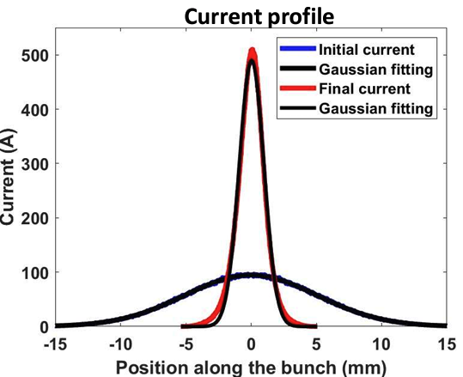
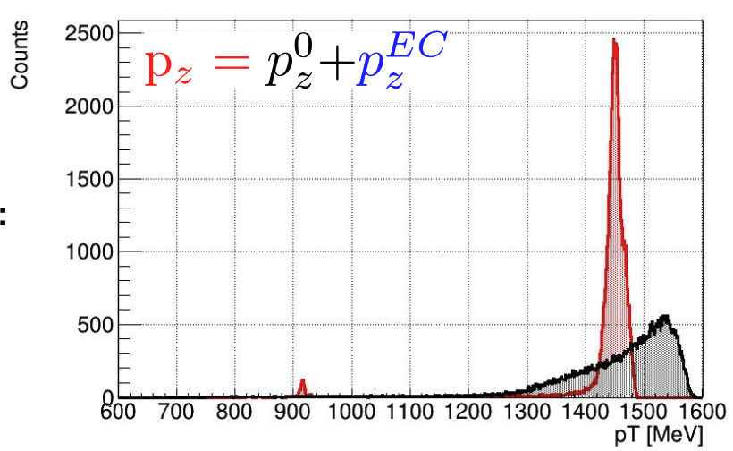
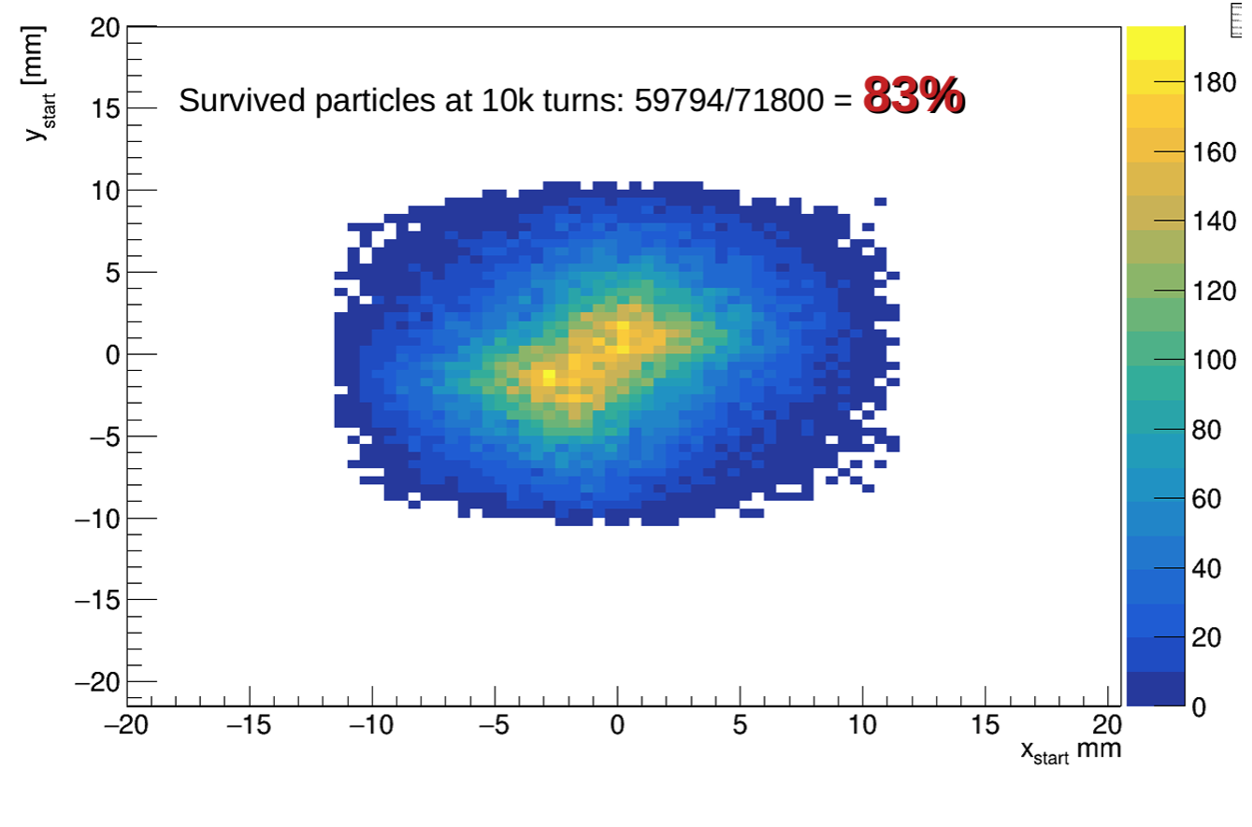
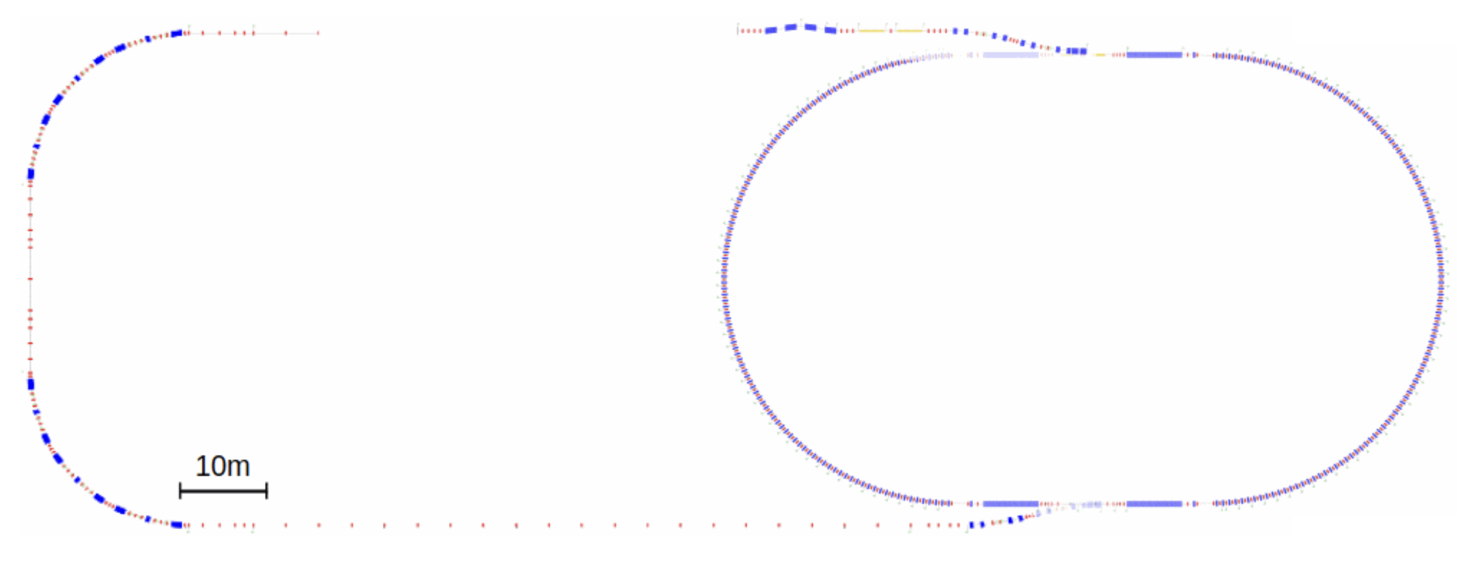
Damping Ring and Return Transfer Lines
21
Bunch profile to c-linac
After BC
Analytical Energy Compressor
Before BC
Damping ring acceptance
LPS from positron linac
Energy Compressor
R₅₆ = 0.40 m
One S-band RF module to chirp the beam. Accelerating voltage 54 MV (70.5 MV available)
Two S-band RF modules to remove part of the chirp. Accelerating voltage 110 MV (140MV available)
Injection dogleg
Damping Ring 1.54 GeV – C=242 m
Bunch Compressor
Extraction dogleg
C. Milardi, A. De Santis, S. Spampinati, O. Etisken

Slide 22
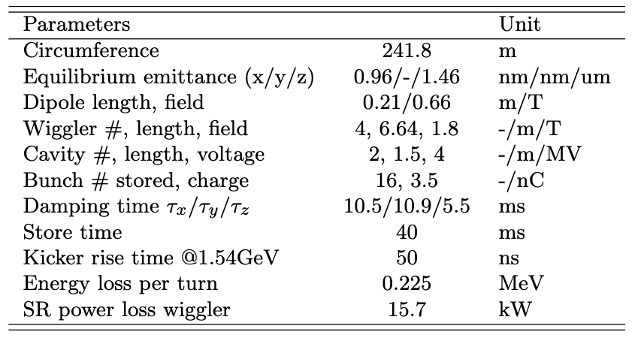
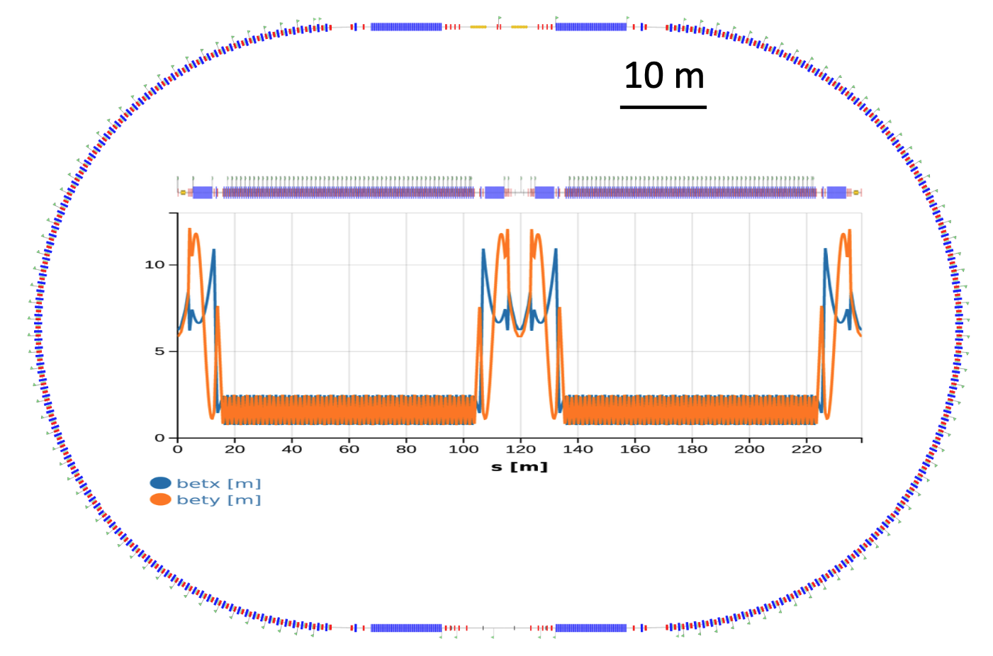
Damping Ring and Return Transfer Lines
22
400 MHz, RF cavity
106 x 53 m
Layout in CDR0 for cost estimate: DR and TLs design has been complete
DR acceptance larger than 83% can be achieved with the help of the ECS installed between the p-linac and the DR injection line
A BCS has been included in the return line from DR to c-linac (max compression factor 5)
Alternative DR designs are being considered
  Different types of cells and magnets are being evaluated to reduce the number of elements
  Preliminary study for a DR at higher energy is on-going

Slide 23
Summary
23
A baseline for the pre-injector layout was ready for the mid-term review (week 42)
  Cost estimates for the hardware, technical infrastructures and civil engineering are available for the project
Pre-Injector can fulfill the (partially new) requirements for the collider rings
  but there is still room for some optimizations
P³ project is underway, and will be a first step towards the FCCee positron source
Several presentations with more details were given at FCC week 2023

Slide 24
Credits
24
PSI | R. Zennaro, M. Schaer, N. Vallis, B. Auchmann, I. Besana, S. Bettoni, H. Braun, M. Duda, R. Fortunati, H. Garcia-Rodrigues, D. Hauenstein, E. Hohmann, R. Ischebeck, P. Juranic, J. Kosse, F. Marcellini, U. Michlmayr, S. Muller, G. L. Orlandi, M. Pedrozzi, J.-Y. Raguin, S. Reiche, M. Seidel, R. Rotundo, S. Sanfilippo, M. Zykova all the technical groups involved in the P³ experiment
IJCLab | I. Chaikovska, F. Alharthi, V. Mytrochenko, R. Chehab
CERN | A. Grudiev, A. Latina, S. Doebert, Z. Vostrel, Y. Zhao, B. Humann, A. Lechner, A. Kurtulus, R. Mena Andrade, J.L. Grenard, A. Marcone, M. Calviani, W. Bartmann, Y. Duthell, H. Bartosik, K. Oide, F. Zimmermann, M. Benedikt
INFN-LNF | C. Milardi, A. De Santis, O. Etisken, S. Spampinati
SLAC | T. Rauberheimen
KEK: | Y. Enomoto, K. Furukawa
and L. Bandiera, M. Soldani, A. Sytov (INFN/Ferrara), A. Bacci, M. Rossetti Conti (INFN/Milano)
This work was done under the auspices of CHART (Swiss Accelerator Research and Technology) Collaboration, https://chart.ch - CHART Scientific Report 2022: https://chart.ch/reports/

Slide 25

Thank for your attention!!
Warm autumn colours at the PSI Campus

Slide 26
Reduction of gradient (and dissipated power)
Common linac | Baseline | Option 1*
Repetion rate (Hz) | 400 | 400
Gradient (MV/m) | 23.4 | 16.5
Length (m) | 262.5 | 360
Cost for module (MCHF/module) | 1.840 | 2.455
# module | 35 | 26
Total cost (MCHF)
Cost per meter (kCHF/m)
Plug power red. |  | -26%
HE linac | Baseline | Option 1*
Repetion rate (Hz) | 200 | 200
Gradient (MV/m) | 29.5 | 20.9
Length (m) | 615 | 885
Cost for module (MCHF/module) | 1.805 | 2.415
# module | 82 | 59
Total cost (MCHF)
Cost per meter (kCHF/m)
Plug power red. |  | -28%
*Option 1: four RF structures per klystron, total module length: 15 m

Slide 27
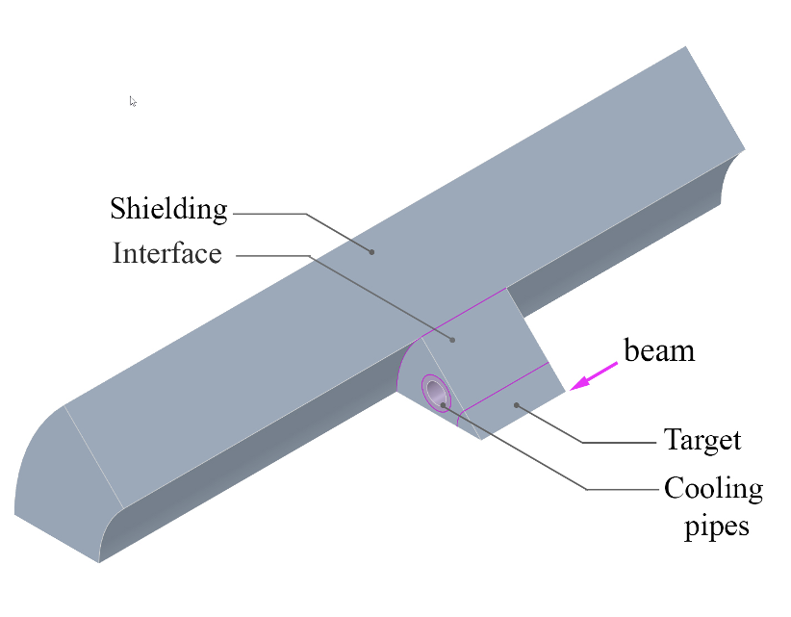
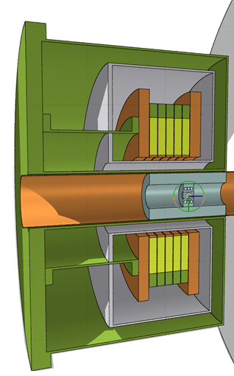
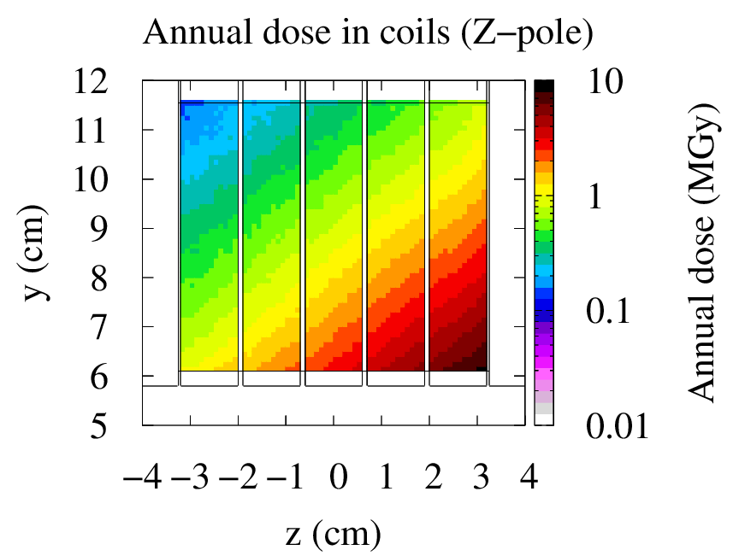
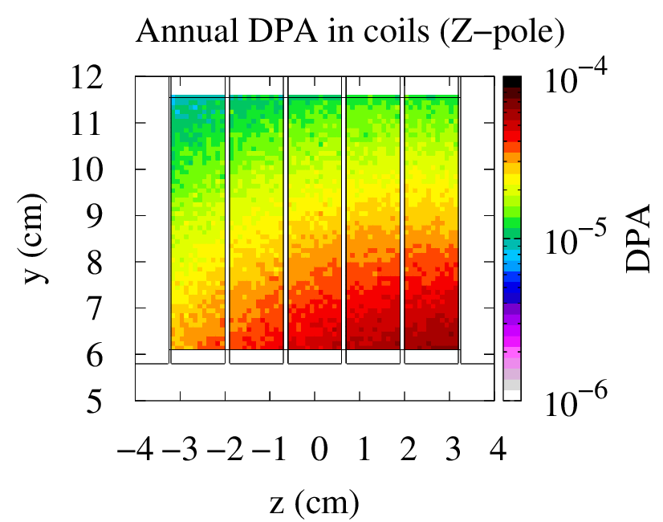
Positron source: target
R. Mena Andrade (SY-STI) et al., FCC week 2023
After several iterations, the current beam parameters provide a solid baseline for the design of the FCC-ee positron source target.
A target made of pure tungsten now is a feasible option. The thermo-mechanical studies show values of temperature and stresses inside of the safety limits of tungsten.
As a next step, a R&D test campaign is foreseen to evaluate different manufacturing options for the target and the hipping of the tubes for the cooling system.
Radiation load to HTS coils
Cumulative dose in coils
(one year at Z-pole)
DPA in coils
(one year at Z-pole)
In general, no showstopper, but shielding design to be further optimized
DPA likely acceptable (with annealing cycles)
Limits for ionizing dose to be understood (if any)
Up to 8MGy/year
Up to 8E-5 DPA/year

Slide 28
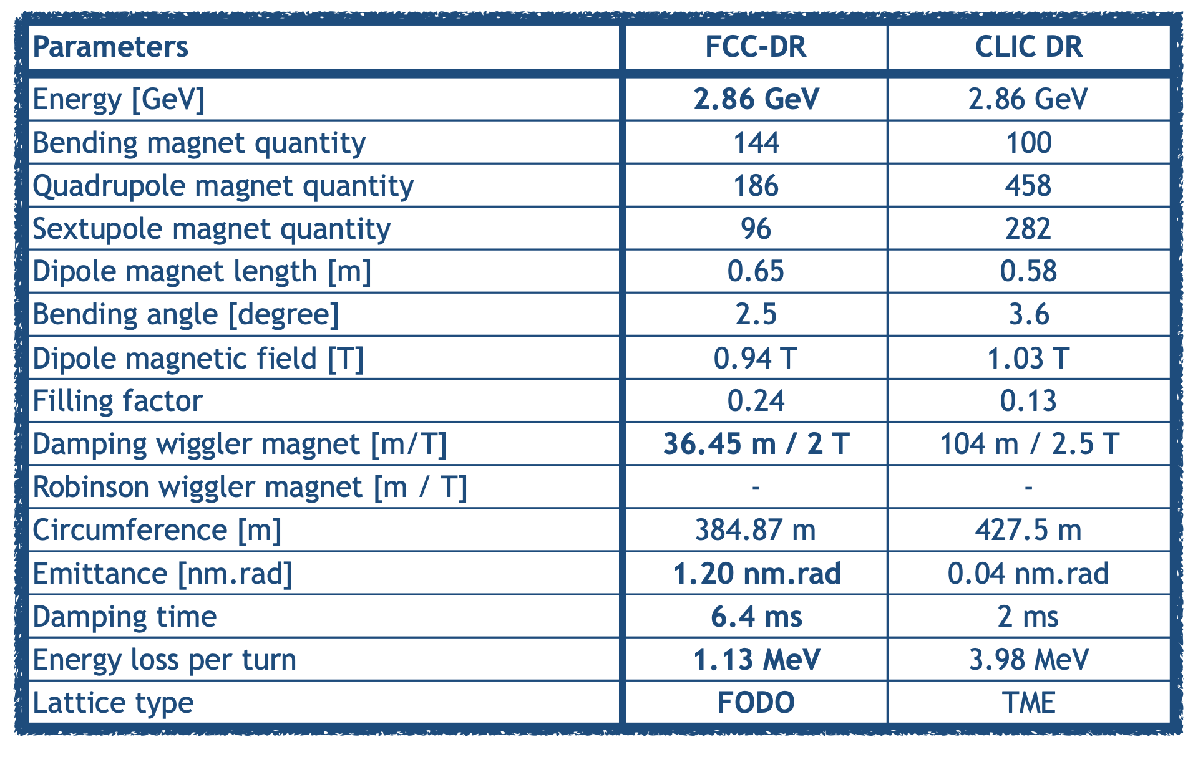
Injector layout with DR at higher energy
28
The present positron yield would allow positrons to be generated at a lower electron beam energy. Preliminary study showed no more stringent specifications for the target, compatibility with present target study.
Common linac: Rep rate 200 Hz instead of 400 Hz → less average rf power, higher accelerating gradient, shorter linac
Dedicated linac for electron and positron before the DR.
Overall, the cost of the hardware remains approximately the same, the costs of the CE and TI to be evaluated

Slide 29
Some general remarks
29
RF systems at 2.0, 2.8 and 5.6 GHz to be developed: Pulsed RF sources are moving to higher repetition rate but still not mature, 400 Hz is challenging for klystrons and HV modulators → collaboration with suppliers for development of prototypes
RF structures: peak gradient vs dissipated power and breakdown rate (prototypes), high power density to be dissipated → thermo-mechanical analysis to be performed
Damping ring acceptance must be confirmed with collective effects, IBS, etc…
Positron source: AMD based on SC solenoid, demonstrator will provide several information, AMD based on FC to be verified the operation at 200 Hz in term of ohmic losses on the FC and high-power requirement for the pulsed PS
Electron source: stability and top-up scheme to be verified up to 5 nC

Slide 30
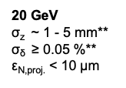
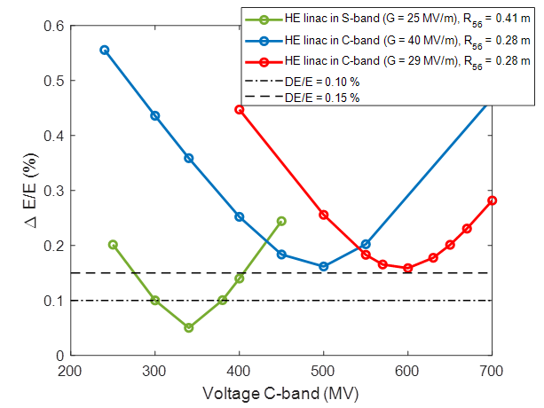
Energy compressor at linac end
BR
Trasfer line with bunch decompression/EC
R₅₆
Short linac
With this option, the specifications for the linac end and for injection into the BR can be partially decoupled
More flexibility for the linac but more complex transfer line
Independent tuning of the bunch length (operating rf phase, R₅₆, zero-crossing) and energy spread (RF voltage)

Slide 31
SPS vs HE linac performances
31
HE linac delivers beam with 4x small energy spread and 16x smaller transverse emittance. The Booster injection will be difficult and will need additional time at max energy to damp.
Collective effects in the SPS have not been evaluated for the FCC-ee bunch train (5 nC!)
HE linac allows for higher injection energy into the booster (e.g., 20 GeV versus 16 GeV from SPS) and injection into the booster would be much more flexible (low magnetic field at booster injection and impedance effects)
  further energy increases through linac extensions could be possible, should an even higher injection energy turn out to be desirable AND would be fully independent of any hadron beam operation, and it could serve for many additional applications.
  the construction and commissioning could proceed in parallel to any SPS or LHC hadron beam operation, while the reconstruction and use of the SPS could not begin before the end of the HL-LHC programme
SPS as a pre-booster during Z running would be used most of the time for lepton operation. HE linac would not impact hadron beam operation. SPS option would have major repercussions for any hadron beam programme in the SPS, and also implications for any use of the SPS as a future hadron beam injector to the LHC or FCC-hh

