Slide 1
380 GeV CLIC power consumption estimate
Alexej Grudiev (CERN)
11/12/2023

Slide 2
Outline
Reminder
  2016 Power consumption estimate for the 1st stage optimization
  2018 Power consumption estimate for the Project Implementation Plan (PIP)
Update for 100 Hz operation for high luminosity studies in 2019
Update for the new DR design, 2021
Update for the new DB klystron parameters, 2022
Summary
N.B. In the following slides power consumption estimate always refer to the CLIC 380 GeV Drive beam baseline option

Slide 3
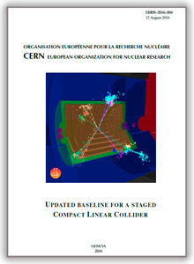
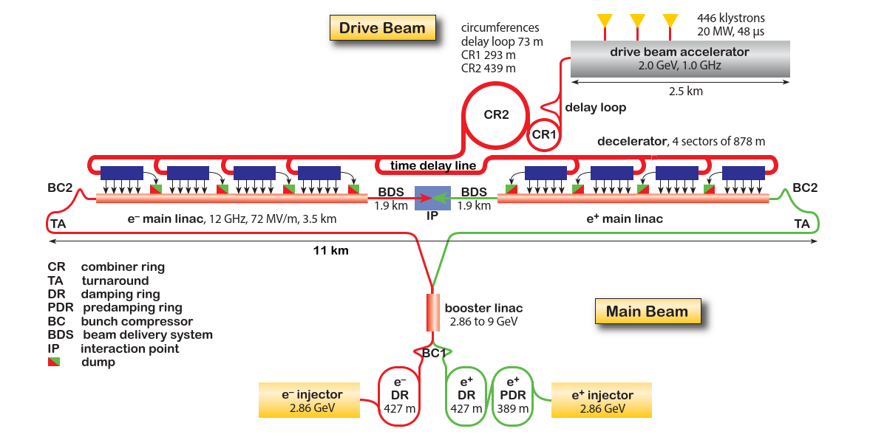
380 GeV CLIC layout and power consumption
Updated baseline for a Staged Compact Linear Collider, CERN-2016-004, 2016
Total power consumption of 380 GeV CLIC was estimated to be 252 MW
It was estimated using parameterized model [*] derived from the CDR power estimates at 3, 1.5 and 0.5 TeV stages and used for 1st stage optimization
* B. Jeanneret, CLIC Total Electrical power: a parametrization, CERN-ACC-Note-2013-0020, 2013

Slide 4

Power consumption estimate for Project Implementation Plan (PIP) in 2018
Motivations:
Parameterized model used in 2016 required verification at 380 GeV
Several changes in the design parameters had been made:
  Development of high efficiency klystrons
  (Pre-)Damping rings bunch-to-bunch spacing reduced from 1 ns to 0.5 ns
  Drive beam energy is reduced from 2.4 to 2.0 GeV
  Different design of the BDS at 380 GeV
Alternative klystron-based option of the first stage at 380 GeV needed power consumption estimate as well.
Assumptions
Project breakdown structure (PBS) of the costing tool has been used in order to insure the consistency of the power and the cost estimate
Expected Operating (not the specification) values have been consistently used for the RF and magnet systems

Slide 5
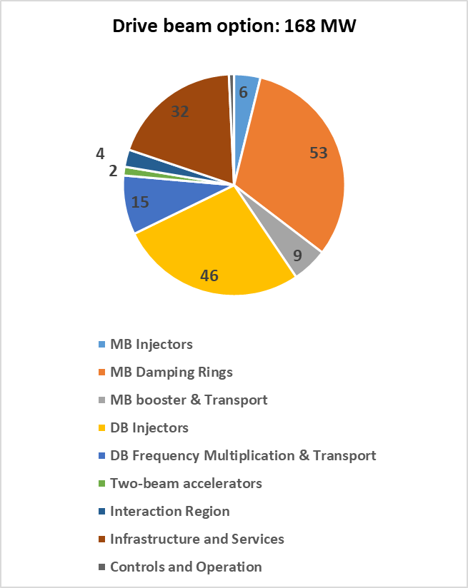
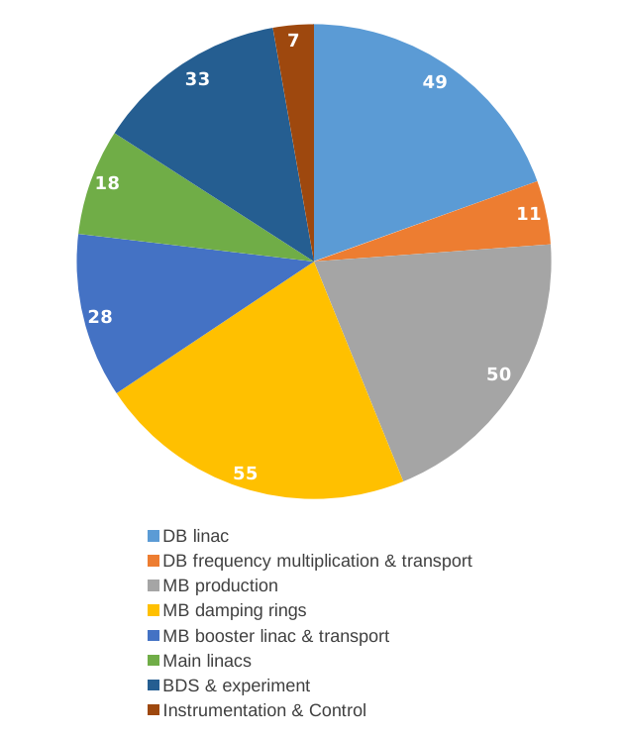
Comparison: 2016 vs 2018
252 MW
Significantly lower power consumption in the areas of MB injector, booster and transport as well as in the BDS has been found

Slide 6
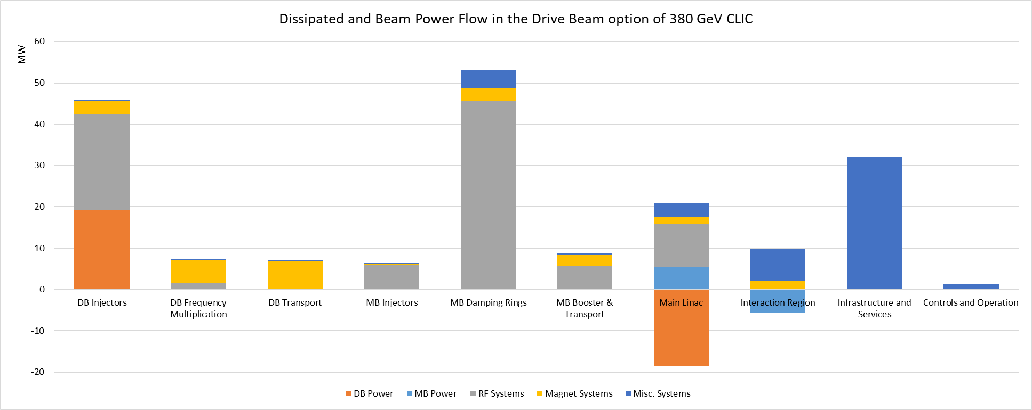
Distribution of dissipated and beam powers

Slide 7
Power increase for operation mode at 100 Hz
To estimate increase in power consumption when go from 50 to 100 Hz
Pulsed RF and beam power is calculated: 55 MW
Addition EL and CV power is calculated: 13 MW
Total power increase: 68 MW
Total power consumption: 168+68= 236 MW
This estimate was used in CLIC – Note – 1143: HIGH-LUMINOSITY CLIC STUDIES

Slide 8
CLIC DRs
A lot of power dissipated in DR RF systems: 46 MW

Slide 9
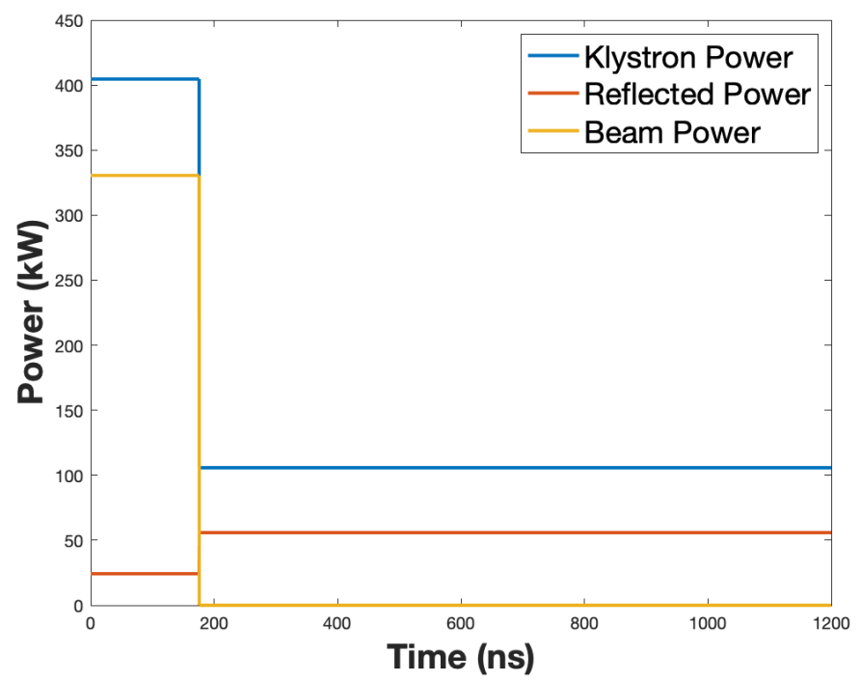
CLIC DR summary of PIP baseline
Cavity type | ARES
RF frequency [GHz] | 2
Cavity R/Q [Ω] | 7.5
Number of cavities | 32
Cavity Q0 | 55000
BL compensation method | feedforward
Beam phase variation [º] | ~1
Peak input power [kW/cavity] | 405
Total peak input power [kW] | 12960
Klystron power lost
Strong transient beam loading effects cause:
Very high peak power
Larger klystron bandwidth
Strong peak power modulations on each turn
Inefficient due to most of average power lost
(NIMA V985, 164659, 2021)

Slide 10

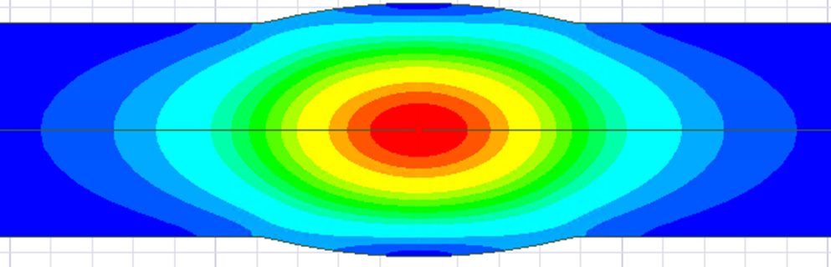
Novel cavity: Barrel Cell Cavity (BCC) geometry for ultra low R/Q
Rarc
Rcav
a
Beam axis
E-field
Large aperture => low R/Q
Long cell: ~λ => low transit time factor
Low field on the cavity wall
More details in: CLIC-note-1173,
or in rf development meeting (22 September 2021)

Slide 11
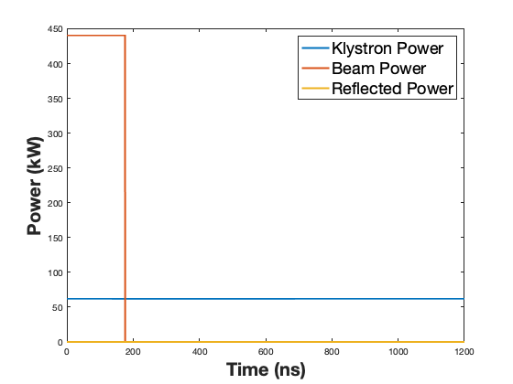
DR Comparison: PIP baseline vs BCC
PIP baseline
BCC design #1
Cavity type | PIP b. | BCC
Cavity R/Q [Ω] | 7.5 | 0.6
N of cavities | 32 | 24
Peak input power [kW/cavity] | 405 | 62.2
Total peak input power [MW] | 13 | 1.5
RF power match the average beam power => efficient
No klystron power modulation => no large bandwidth
Peak power requirements are SIGNIFICANTLY reduced => cost, size

Slide 12
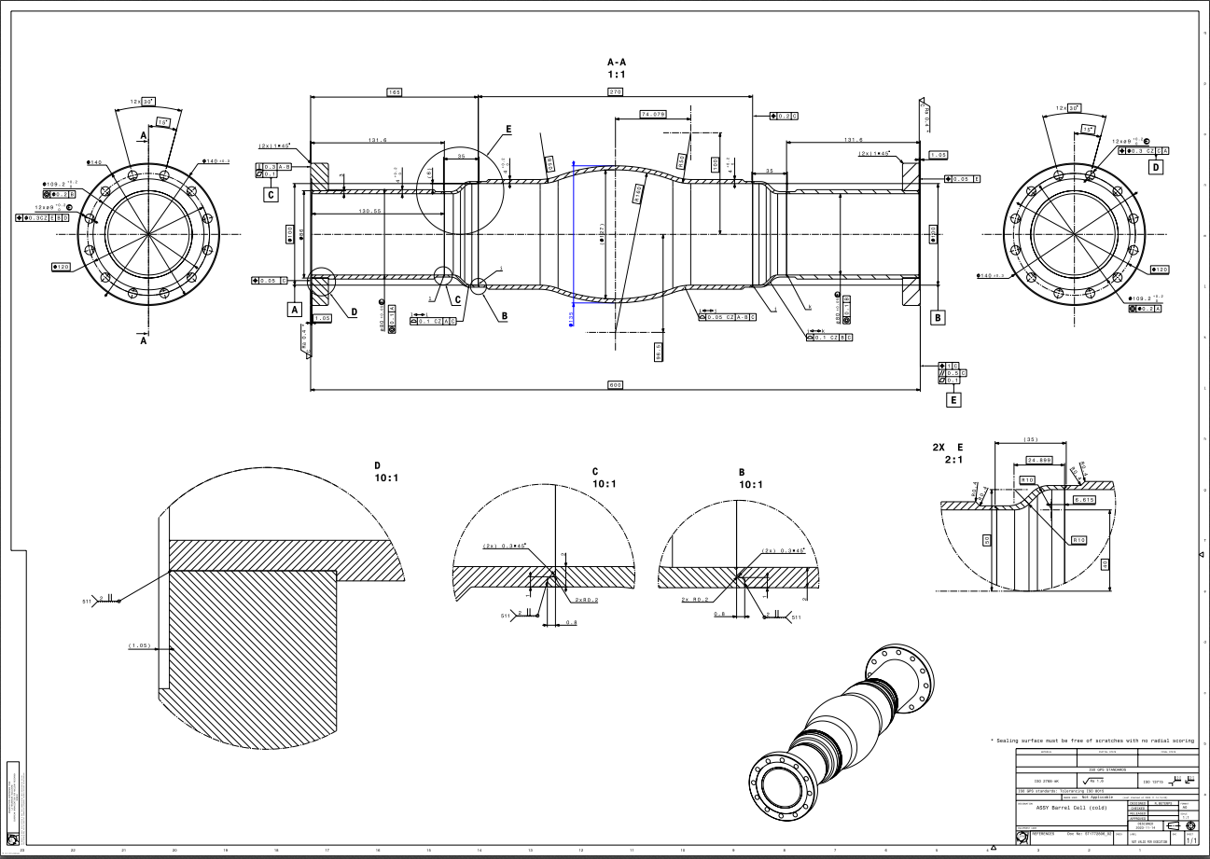
BCC prototype planned to be built at CERN and tested at FNAL 2024

Slide 13
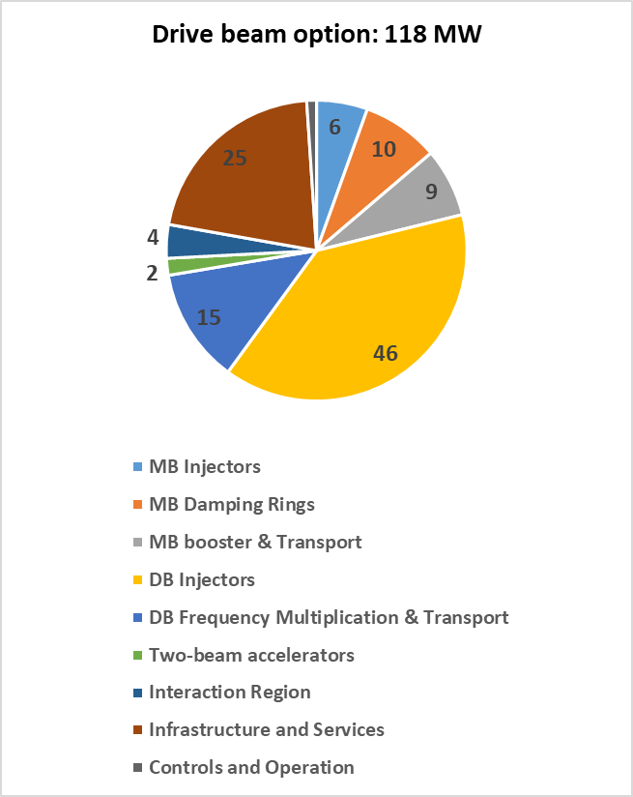
Comparison DR: PIP baseline vs BCC design
- 50 MW
- 43 MW
- 7 MW

Slide 14
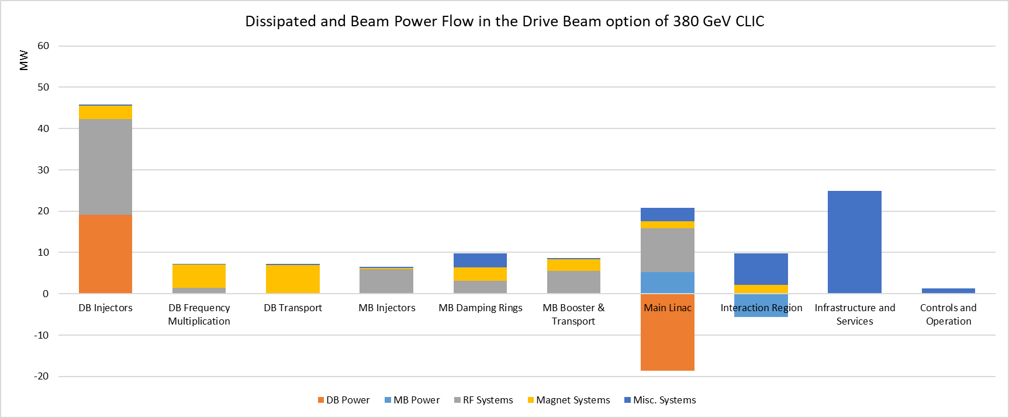
CLIC DRs: power reduction due to BCC design
Total power reduction due to new DR design: 50 MW

Slide 15
Drive beam injector complex
Largest power consumption is in DB injector:
23 MW is dissipated in RF system -> ☹
19 MW goes to the drive beam -> ☺

Slide 16
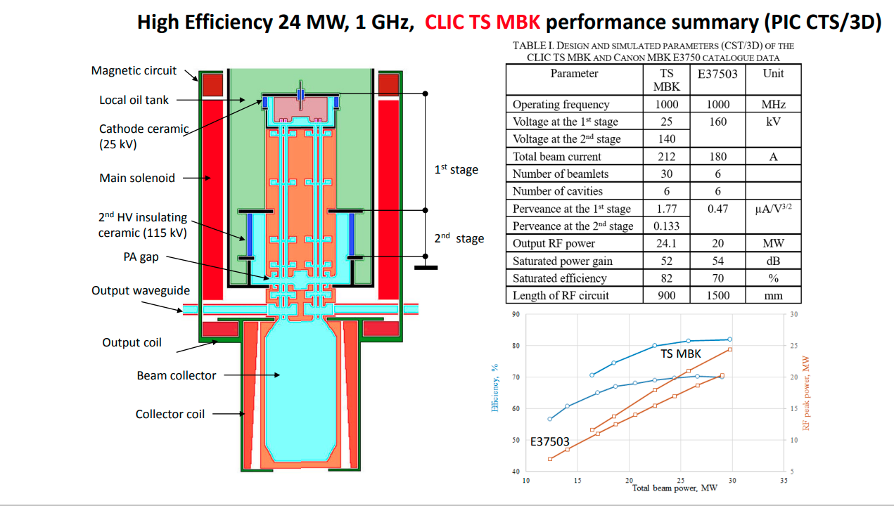
New ideas for CLIC 1GHz klystron for DB linac
Novel design Two-Stage (TS)
Multi-Beam Klystron (MBK)
2nd stage is not pulsed:
More efficient modulator
It has more power per klystron compared to PIP baseline: 20 MW -> 24 MW
Significant cost impact
It has higher Efficiency compared to PIP baseline: 70 % -> 82 %
Significant impact on power consumption
CLIC project meeting 15 June 2021 Igor Syratchev (cern.ch)
TS MBK concept will be test at 400 MHz for FCC-ee tube

Slide 17
Step 1: Scaling AS from 20 to 24 MW
Nominal AS input power for FBL is lower than klystron power due to margins:
WG losses: 5%
Power margin for bunching (off crest operation): 3%
Power margin for operation and availability: 5%
All together ~10% less power available for FBL acceleration
RF acc. structure (AS) parameters for CLIC 380 | PIP 20 MW MBK | New 24MW TS-MBK
Beam current | 4.2 | 4.2
active length | 2.3 | 2.5
Peak input power for Full Beam Loading (FBL) | 18 | 21.5
Unloaded acc. Voltage | 7.92 | 9.45
Loaded acc. voltage | 4.08 | 4.875
Loaded acc gradient | 1.77 | 1.94
RF-to-beam Efficiency | 95 | 95
Linac parameters
Number of AS in DBL1 | 62 | 52
Number of AS in DBL2 | 398 | 333
Total number of AS (klystron, modulators) | 460 | 385
Total number of quads | 204 | 172
More power per klystron, modulator, AS unit => less AS, less quads (TBC by BD)

Slide 18
Step 2: Applying higher efficiency 70 -> 82%
70% -> 82% is straightforward to do
However, it should be noted that there are several other efficiencies at similar level:
WG losses: 5% -> Efficiency : 95%
Modulator CW efficiency: 94%
Modulator Pulse efficiency: 86%
AS RF-to-beam efficiency: 95%
So, there is a limit to which point it make sense to push the klystron efficiency. Maybe we are approaching this limit !
See next slide

Slide 19
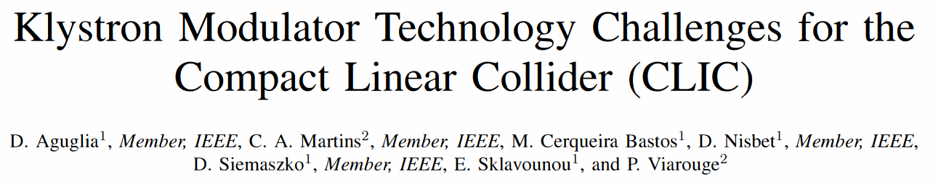
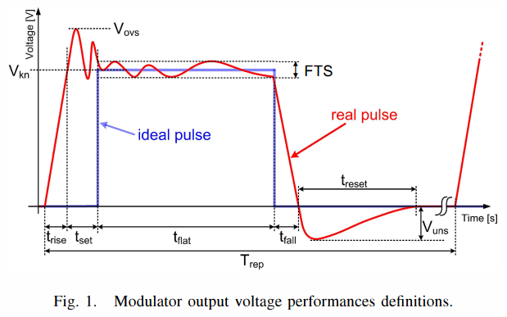
Step 3: Modulator pulse efficiency increase
Modulator pulse efficiency: Eff_{pulse} = t_{flat}/(t_{flat}+t_{set}+t_{rise})
Aguglia (2011) optimized for 3TeV case. 95% achieved (t_{flat}=140us, t_{set}=5us, t_{rise}=3us)
For 380 GeV, set and rise time are significant fraction of the pulse (48 us): Eff_{pulse}= 86% only
Igor said: TS MBK allow significant reduction of set time to practically zero: Eff_{pulse} = 94%

Slide 20
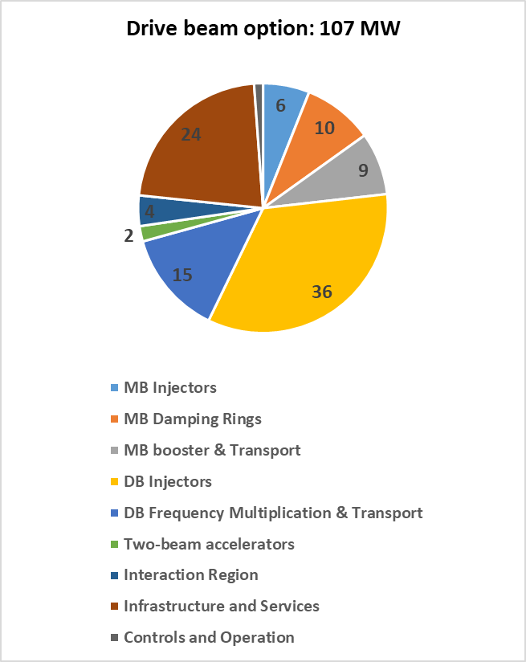
Comparison: 20MW MBK vs 24MW TS-MBK
- 11 MW
- 10 MW
- 1 MW

Slide 21
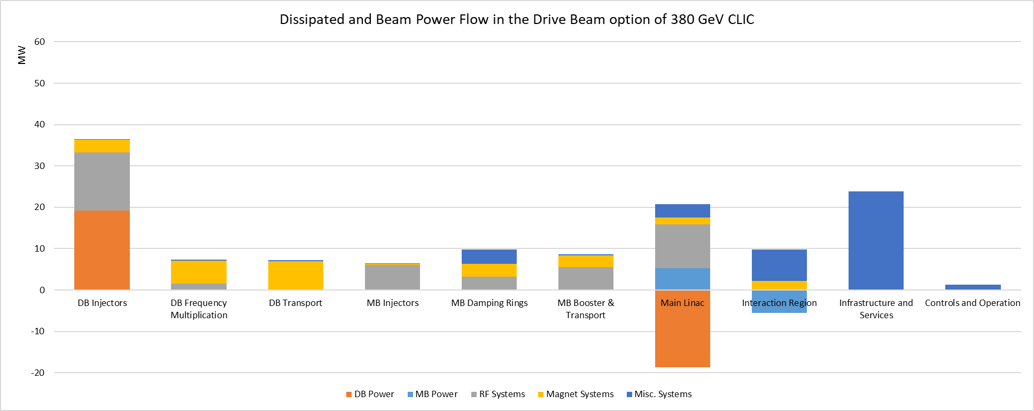
Power reduction due to TS MBK
Total power reduction due to TS MBK: 11 MW

Slide 22
Comparison of wall plug to beam efficiencies
 | PIP baseline | New BCC DR | New TS MBK
DB klystron efficiency [%] | 70 | 70 | 82
DB modulator pulse efficiency [%] | 86 | 86 | 94
DB complex Wall plug to DB efficiency [%] | 31.8 | 31.8 | 37.6
DR wall plug to MB efficiency [%] | 7.9 | 56.7 | 56.7
CLIC Wall plug to MB efficiency [%] | 3.3 | 4.8 | 5.2

Slide 23
Summary
CLIC 380 GeV power estimate has been updated to include several possible changes
Increase in repetition rate from 50 to 100 Hz result in increase in power consumption by 68 MW from 168 to 236 MW
New design of the DRs demonstrates significant reduction of the power consumption by 50 MW from 168 to 118 MW
Using new Two Stage MBK results in 11 MW reduction in CLIC power consumption from 118 to 107 MW

Slide 24
Backup slides

Slide 25
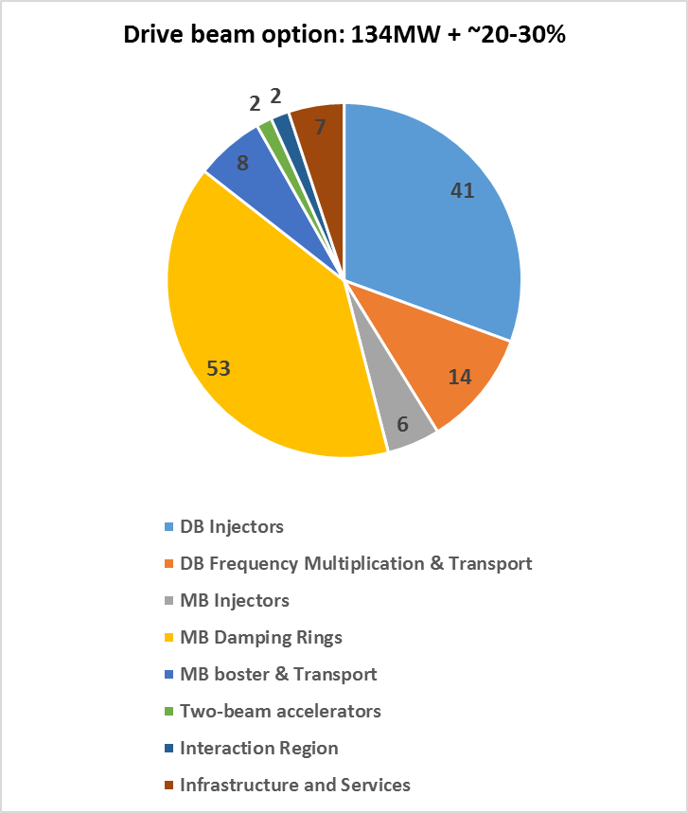
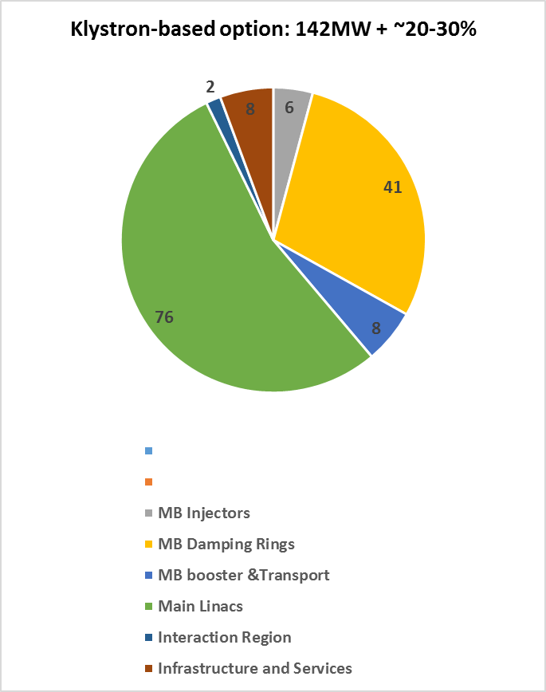
Comparison of Drive beam and Klystron options
Preliminary
2018

Slide 26
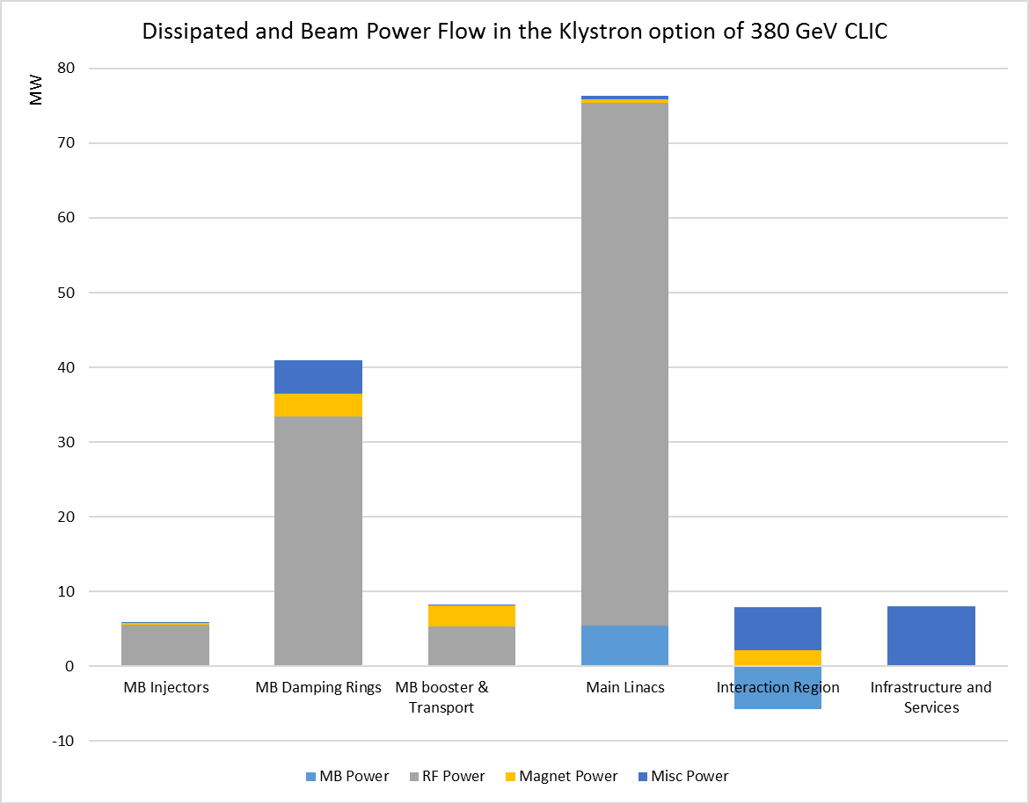
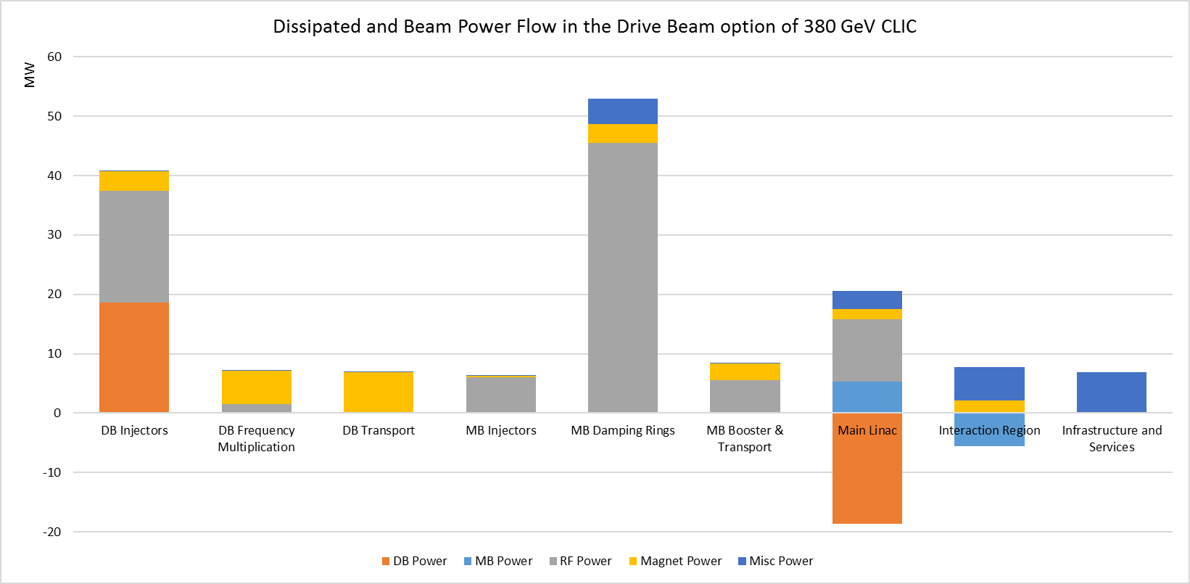
Comparing power flows:
Drive beam and
Klystron options
Overall plug to main beam efficiency: 4.1%
Overall plug to main beam efficiency: 4.2%
Preliminary
2018

Slide 27
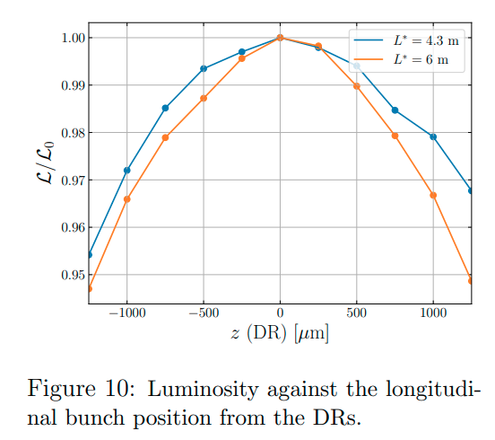
380 GeV CLIC DR parameters (PRAB22, 091601)
Parameter of DR |  | value | unit
Energy | E | 2.86 | GeV
Circumference | C | 373.7 | m
Revolution frequency | f₀ | 802 | kHz
RF frequency | f_{RF} | 2 | GHz
Harmonic number | h | 2493
Energy loss per turn | eV_{A} | 5.8 | MeV
RF voltage | V_{C} | 6.5 | MV
RF stable phase | φ | -26.8 | º
Bunch population | N_{e} | 5.7 | 1e9
Number of bunches per train | N_{b} | 352
Number of trains | N_{t} | 1
Peak beam current | I_{b} | 1.8 | A
1%
±400μm
Strict specifications on the bunch spacing variation: δφ_{b} < ±1º at 2 GHz (±400μm) for Luminosity loss < 1% (CLIC-Note-1138)
This is difficult to maintain due to strong transient beam loading effects caused by large difference between peak and average beam power values of 10.4 MW and 1.5 MW, respectively

Slide 28
Design philosophy for Ultra low R/Q RF cavity
Increase cavity aperture to reduce loss factor => reduce R/Q per cavity
Increase cavity length to reduce transit time factor => reduce R/Q per cavity
Optimize cavity wall shape to minimize H-field to reach largest stored energy per cavity under the H-field limit of 80 kA/m (100 mT, private communication, W. Venturini, 2021) => reduce number of cavities
R/Q per cavity x N of cavities must be below Total R/Q: 14.3 Ω
More details in: CLIC-note-1173, or in rf development meeting (22 September 2021)

Slide 29
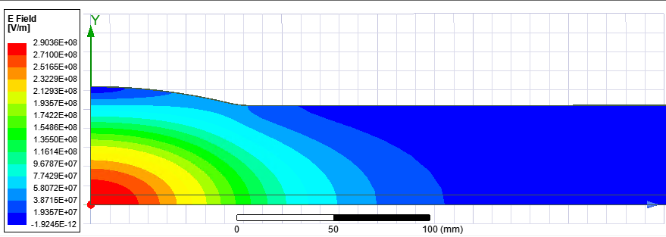
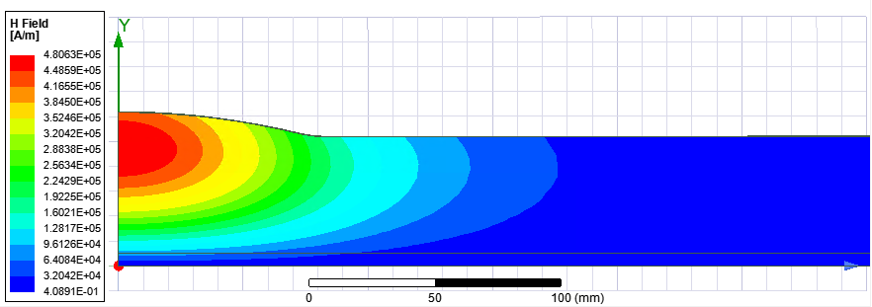
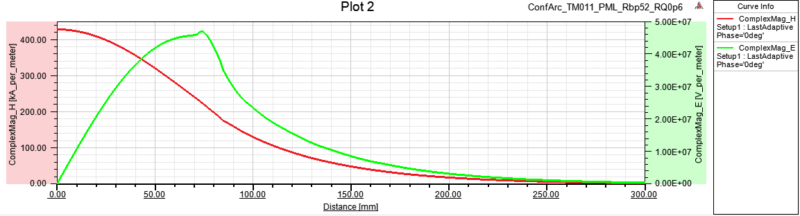
Design of the cavity for total R/Q=14.3Ω
TM011
a [mm] | 52
f [GHz] | 2
a/λ | 0.347
Lc [mm] (0.01Hmax) | ~520
Rarc [mm] | 307
Rcav [mm] | 61.95
R/Q [Ω] | 0.6
Emax/Vacc [1/m] | 31.6
Hmax/Vacc [mA/Vm] | 291
E- and H-fields for 144J
To get this design parameters,
two conditions must be met:
R/Q per cavity is 14.3Ω/Ncav
AND
Vmax per cavity is 6.5MV/Ncav
Hmax limit: 80kA/m
Vmax = 0.275 MV
Umax = 5.0 J
Emax = 8.7 MV/m
Ncav = 24

Slide 30
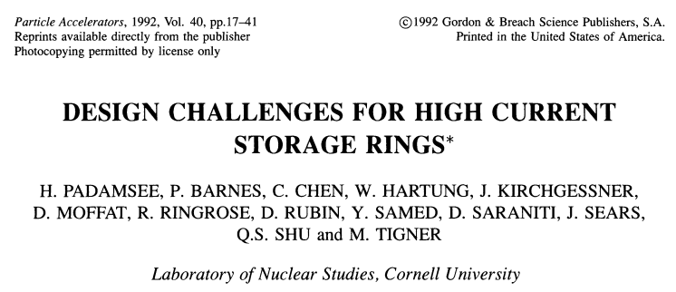
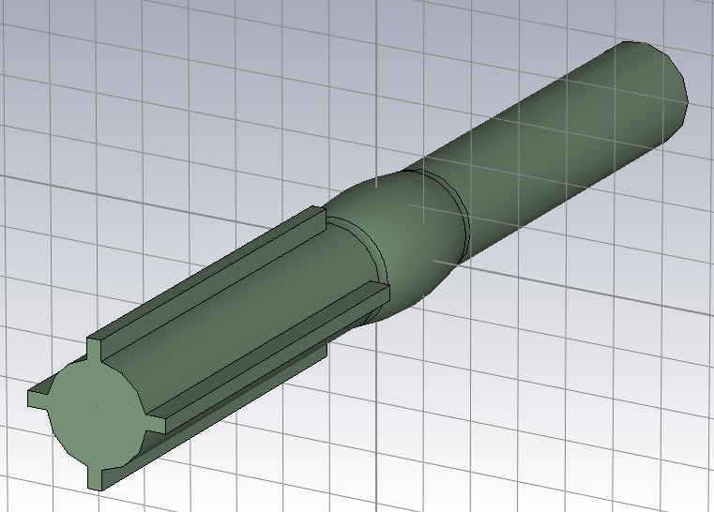
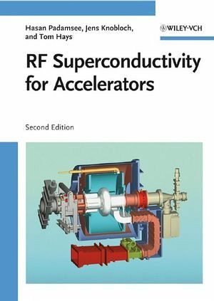
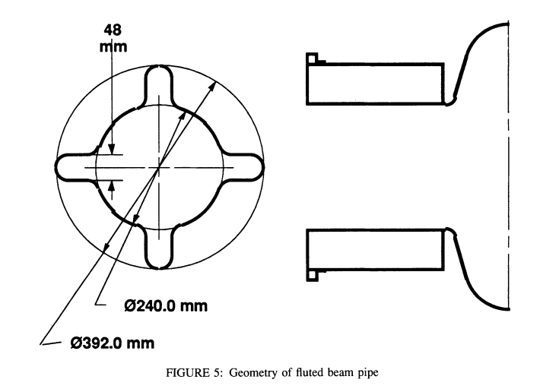
All LOM and HOMs damped
The magic flute helps to damp dipole LOM
One of the BCC beam pipes is ‘fluted’ using 4 longitudinal grooves to reduce TE11 WG mode cutoff from 1.69 GHz to lower value and let TE111 mode at f=1.59 GHz escape.

Slide 31
Summary table.More details : CLIC-note-1173, or in rf development meeting
Case | 1 | 2 | 3 | 4
Cavity R/Q [Ω] | 0.6 |  | 2.04
a [mm] | 52 |  | 50
Lc [mm] (0.01Hmax) | 520 |  | 500
Rarc [mm] | 307 |  | 160
Rcav [mm] | 61.95 |  | 63.55
Total R/Q [Ω] | 14.3 | 7.15 | 28.6 | 14.3
Bunch phase variation [º] @2GHz | 1 | 0.5 | 2 | 1
Ncav | 24 | 12 | 14 | 7
Cavity input power Pin [kW] | 60 | 120 | 103 | 206
Bmax [mT] | 100 | 200 | 100 | 200
Hmax [kA/m] | 80 | 160 | 80 | 160
Emax [MV/m] | 8.7 | 17.4 | 11.7 | 23.4
Cavity voltage Vc [MV] | 0.275 | 0.55 | 0.47 | 0.94
Cavity stored energy Uc [J] | 5.0 | 20.0 | 4.3 | 17.1

Slide 32
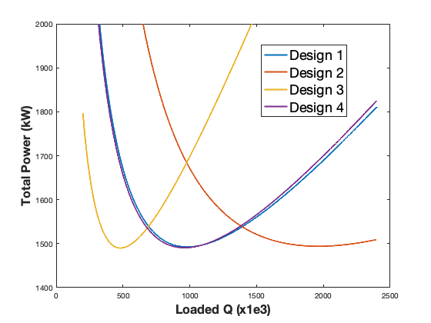
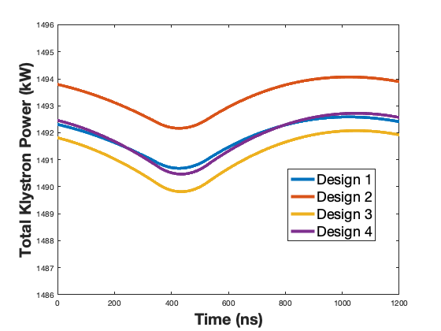
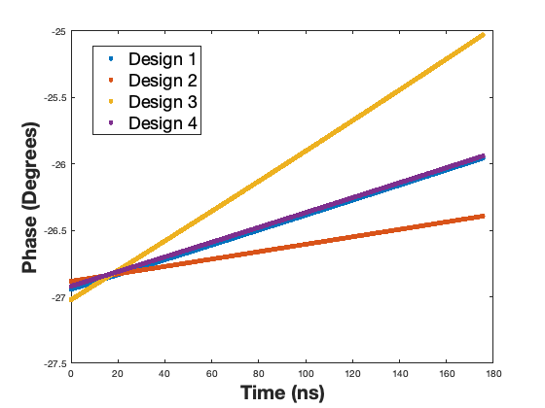
LLRF simulation results
Design | Δf (Hz) | Q_{L} | Peak power per klystron (kW) | Total peak power (MW) | φ_{b} | Δφ
1 | -514 | 983e3 | 62.2 | 1.49 | -26.8° | 0.99°
2 | -257 | 1962e3 | 125 | 1.49 | -26.8° | 0.49°
3 | -1020 | 496e3 | 107 | 1.49 | -26.8° | 1.99°
4 | -510 | 990e3 | 213 | 1.49 | -26.8° | 0.98°
T. Mastoridis
Due to the very high cavity filling time, the closed-loop response of the RF/LLRF system is slow.
In addition, there is a 350 ns delay in the RF loop. Very small klystron power modulation

