Slide 1
A Compact Inverse-Compton Scattering Source
Based on X-band Technology and
Cavity-Enhanced High-Average-Power Ultrafast Lasers
Andrea Latina, V. Muşat, R. Corsini, L.A. Dyks, E. Granados, A. Grudiev, S. Stapnes, P. Wang,
W. Wuensch (CERN, Geneva, Switzerland), E. Cormier, G. Santarelli (LP2N, Talence, France)
CLIC mini week, December 2023, CERN

Slide 2
Contents
  X-ray sources
  - Storage-ring and Linac based
  - Inverse-Compton Scattering Sources
  Key technologies
  - X-band high-gradient acceleration
  - Fabry-Pérot resonator in burst mode
  Proposed setup
  - Parameters
  - Beam dynamics
  Estimated performance

Slide 3
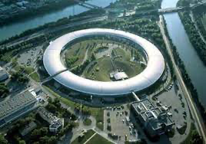
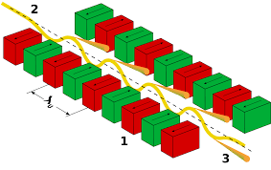
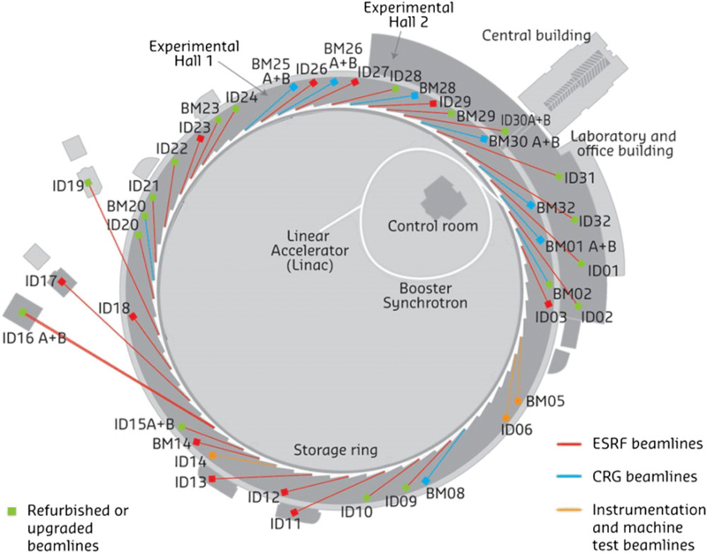
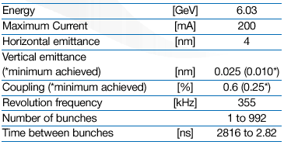
Storage-ring-based X-ray sources
Storage rings X-ray sources offer high fluxes and large energy ranges, e.g. ESRF, Grenoble
Typical X-ray energies are from 5 to 60 keV.
Research with X-ray radiation focuses on fields as diverse as protein crystallography, earth science, palaeontology, materials science, chemistry and physics.
Undulator
Circumference length 844 m

Slide 4

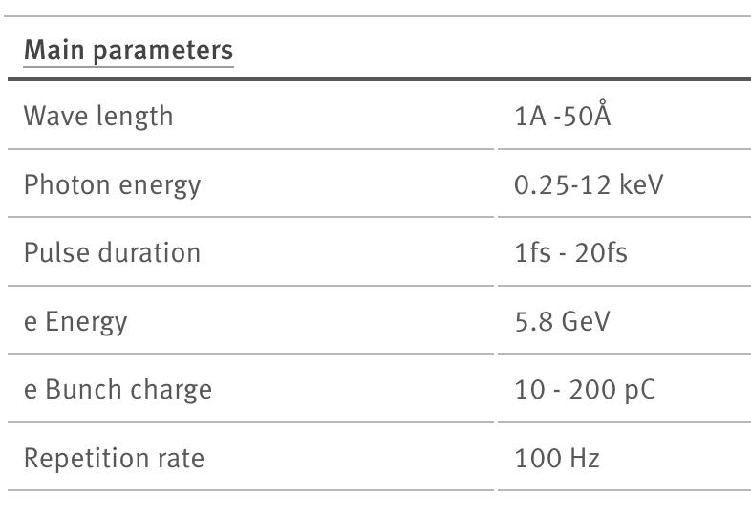
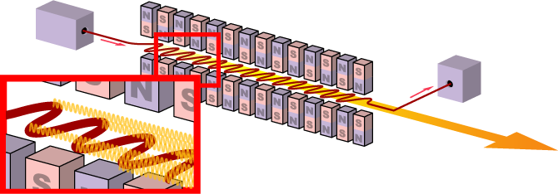
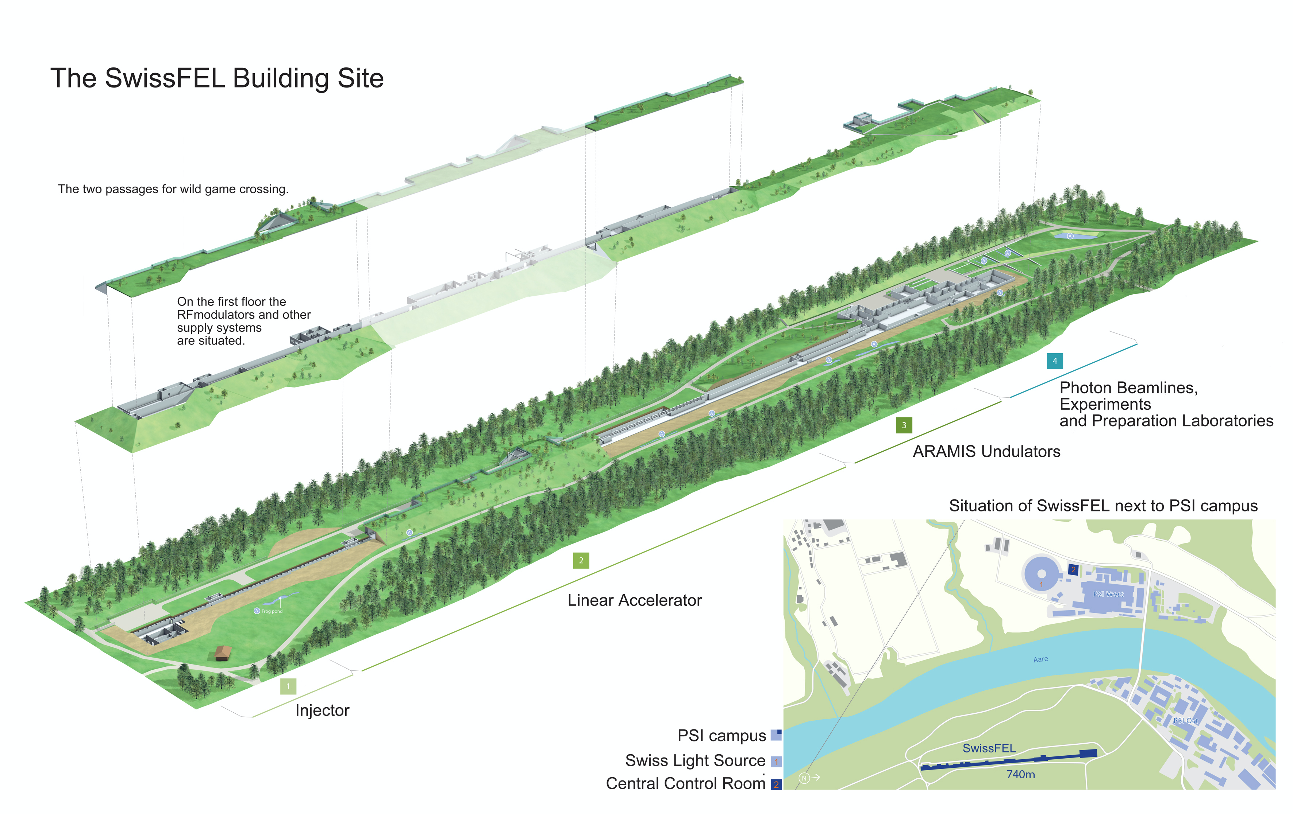
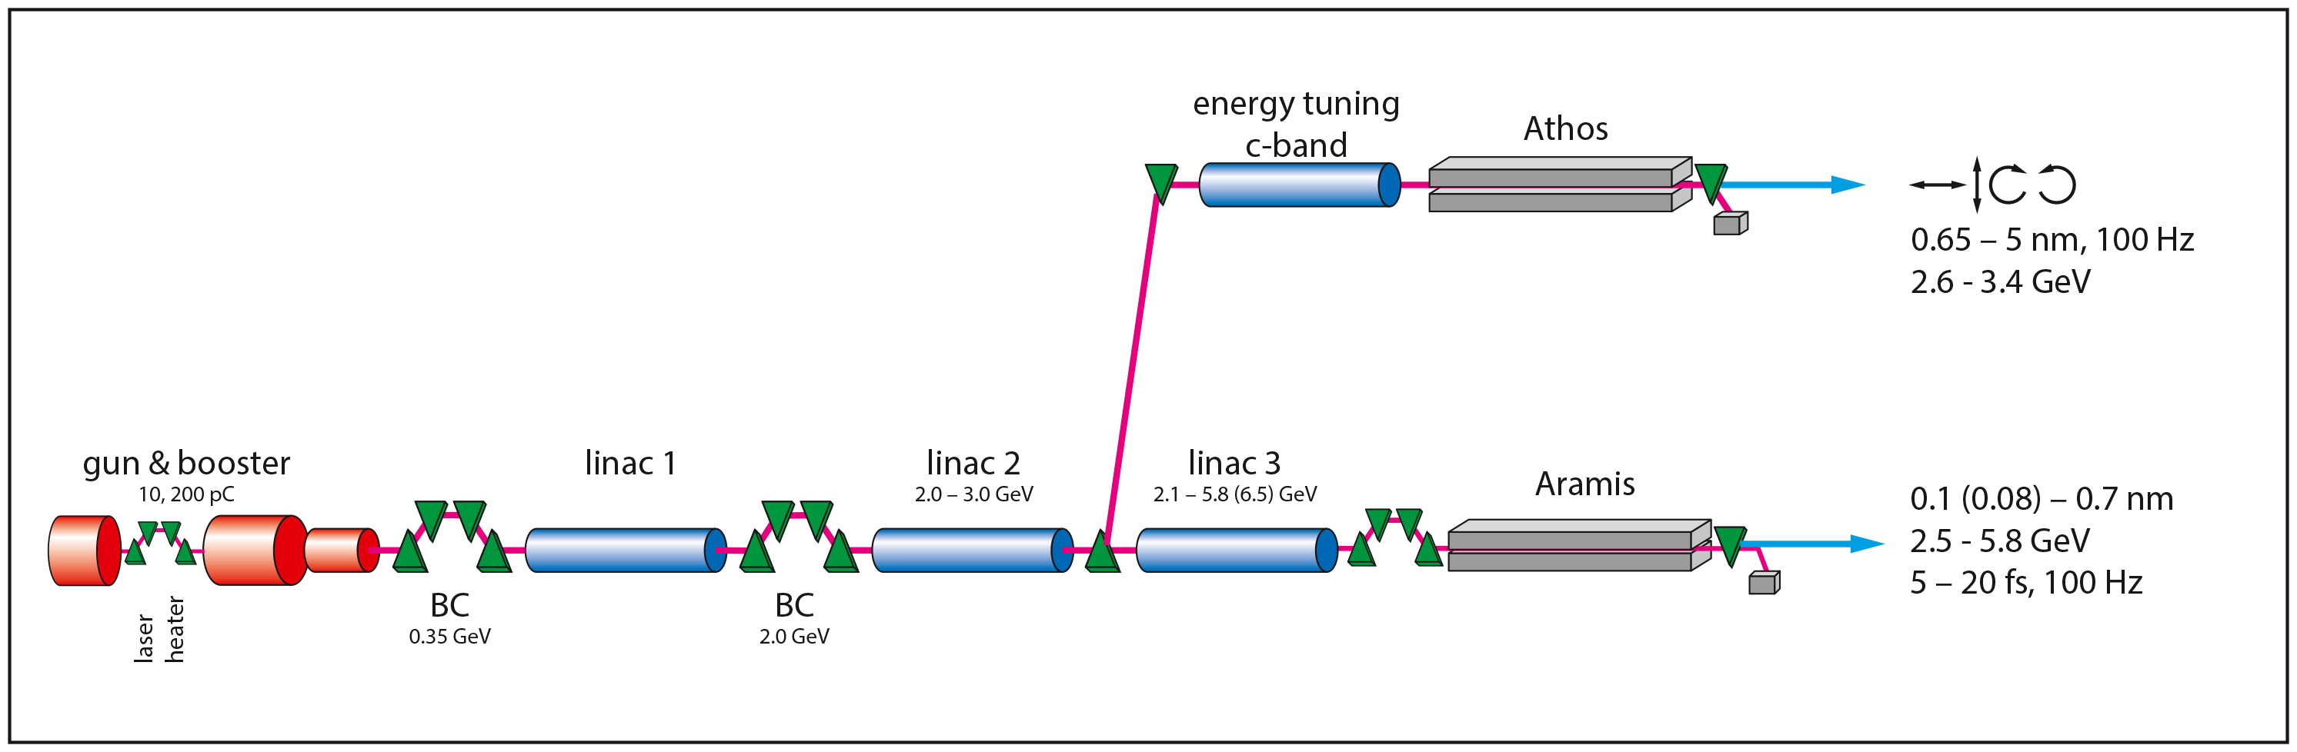
Linac-based X-ray sources: FEL
Free-Electron Lasers: e.g., SwissFEL
FELs feature extremely high brilliance.
Total length of the facility 740 m

Slide 5
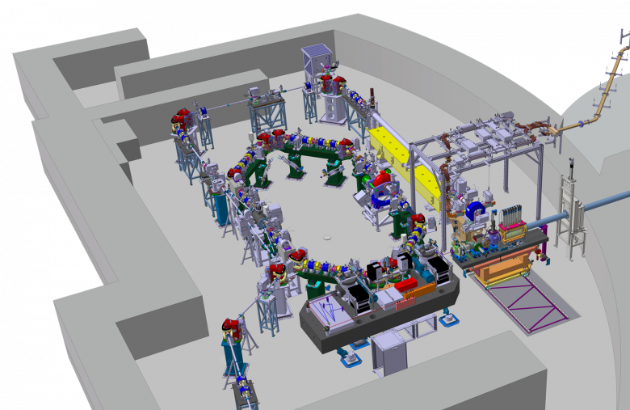
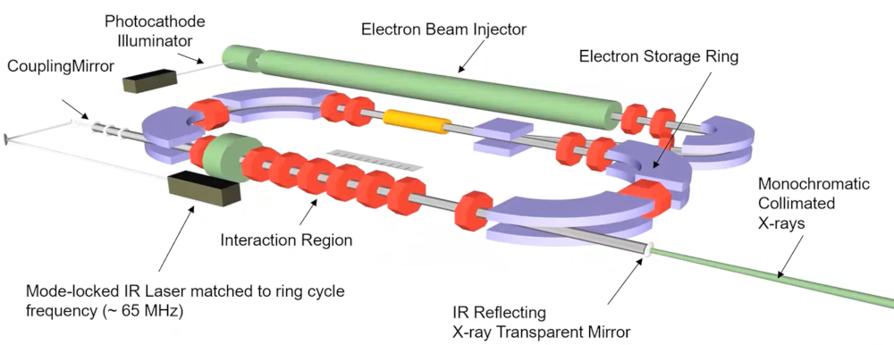
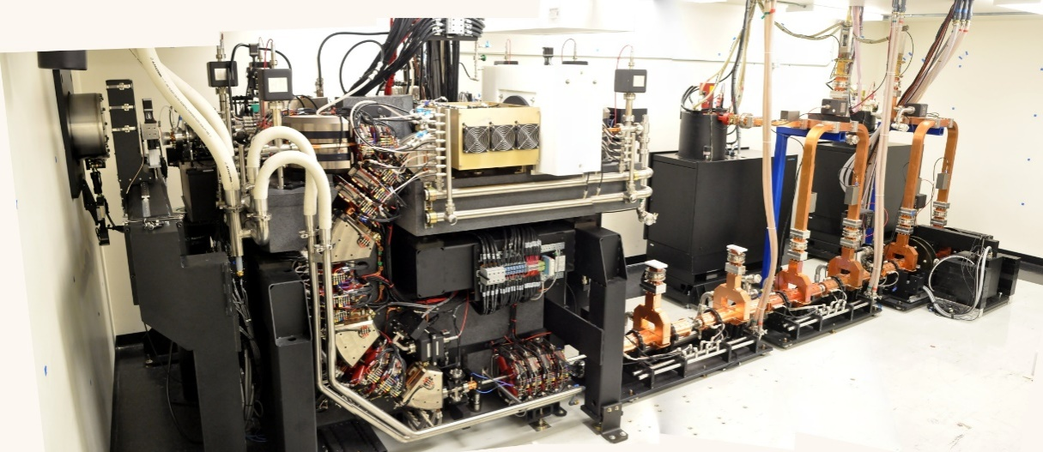
Storage-ring-based ICS sources
ThomX
ICS = Inverse Compton Scattering (or Compton backscattering)
Lyncean Compact Light Source
Key subsystems:
- Short linac
- Compact storage ring
- Fabry-Pérot enhancement cavity in continuous-wave operation
X-ray energy:
- 15 – 35 keV (Munich CLS, ~35 MeV e⁻ beam)
- 45 – 90 keV (ThomX, 50 MeV e⁻ beam)
More compact than Synchrotrons and FELs, but still quite complex to operate
Munich CLS

Slide 6
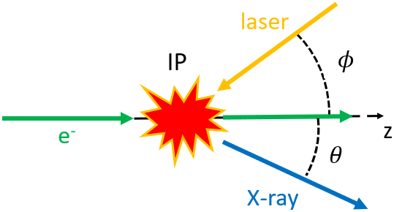
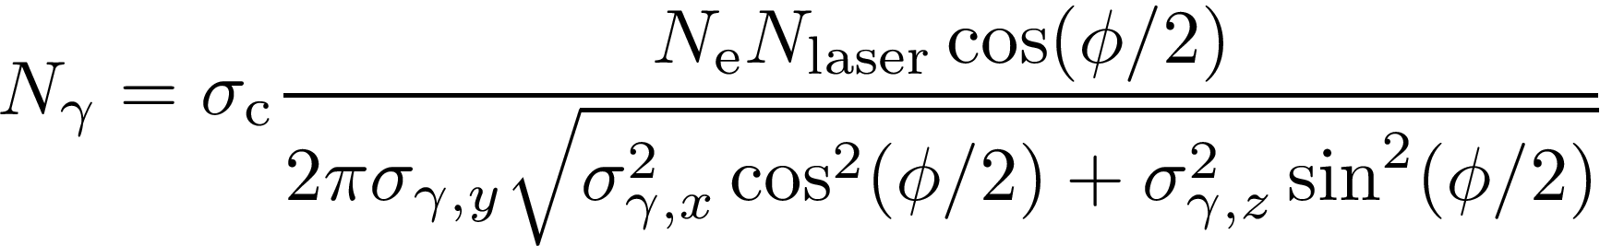
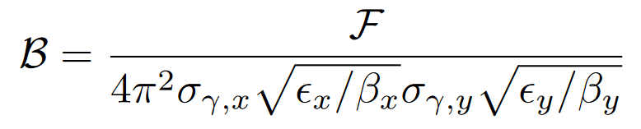
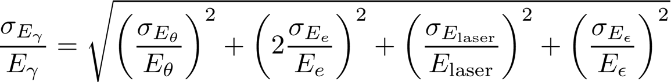
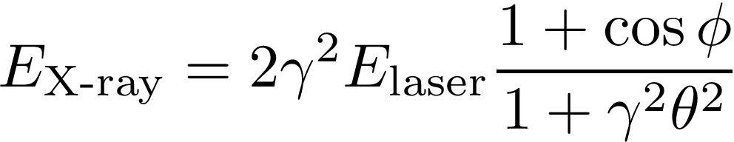
Inverse Compton scattering
= The conversion of a low energy photon from an EM field to a high-energy photon (X-ray or gamma ray) during the interaction (scattering) with a charged particle.
Total flux
Average brilliance
Photon bandwidth
Photon energy
[ Slide by V. Musat ]

Slide 7
Linac-based ICS sources: extreme compactness
ICS = Inverse Compton Scattering (or Compton backscattering)
HPCI–ICS
HPCI: High-brilliance, compact X-ray sources
  Photoinjector -> high-brilliance
  X-band acceleration -> compactness, high flux, and high energy
  Fabry-Pérot -> high-flux
  Potential to generate soft X-rays up to gammas (~MeV)
Significantly more compact than FELs and Synchrotrons.

Slide 8

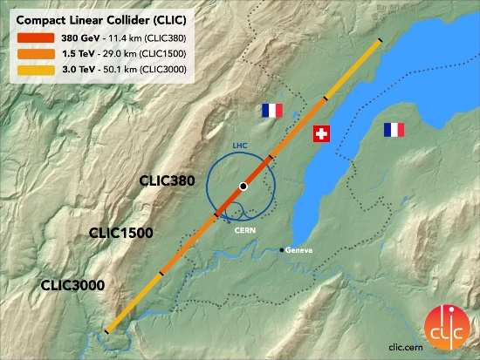
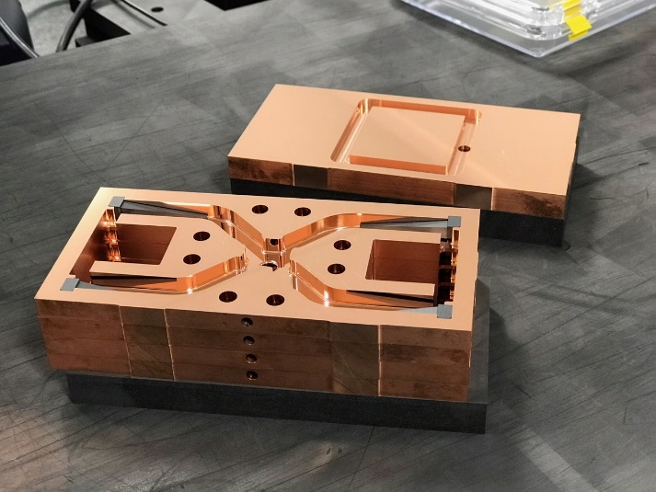
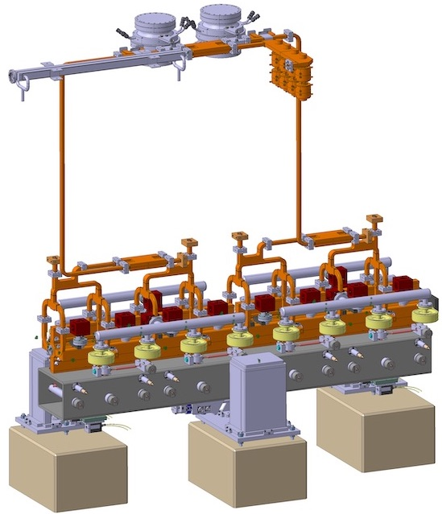
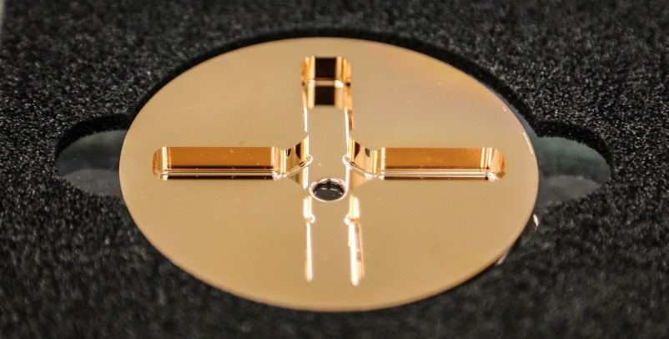
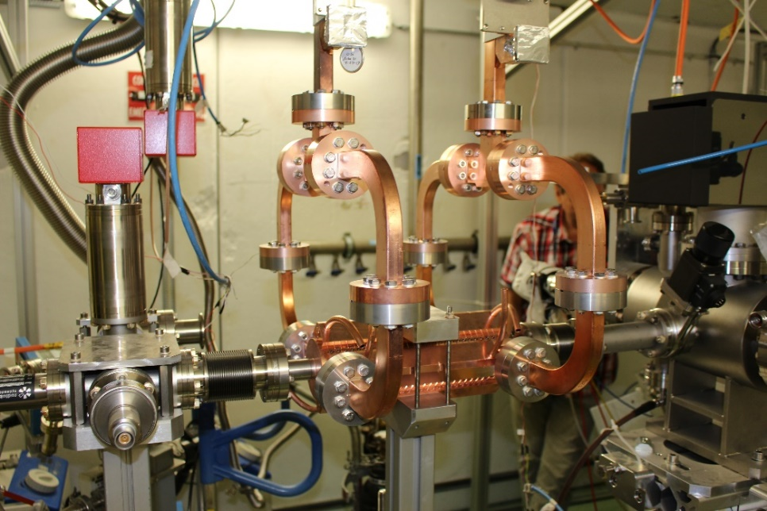
Enabling technology: X-band acceleration
CLIC design study
Very high-accelerating gradient to make compact facility - 100 MV/m accelerating gradient - 12 GHz - normal conducting
Efficiency a design goal from the beginning
1m long accelerator structure is sufficient for generating up to ~100 keV monochromatic X-ray beams

Slide 9
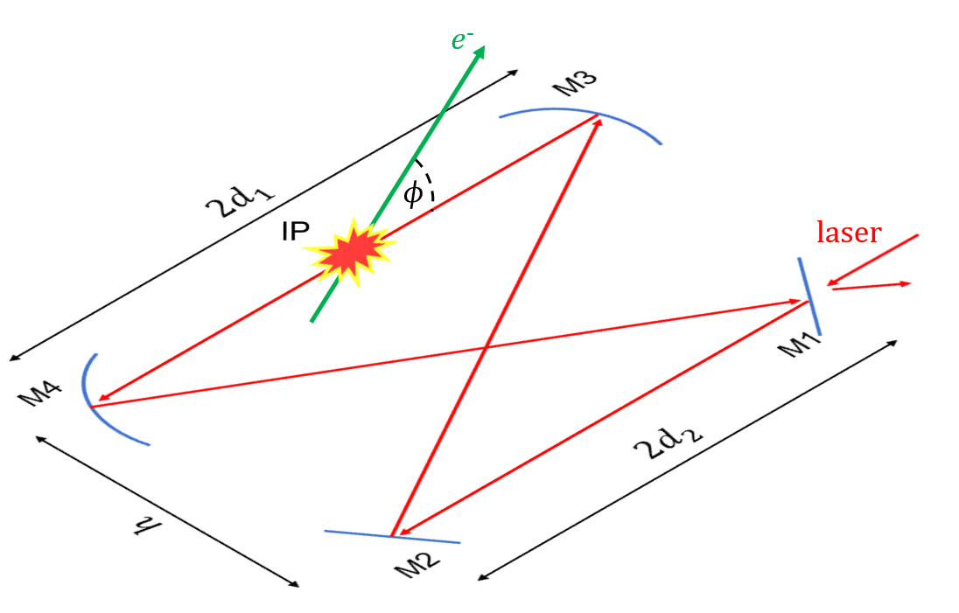
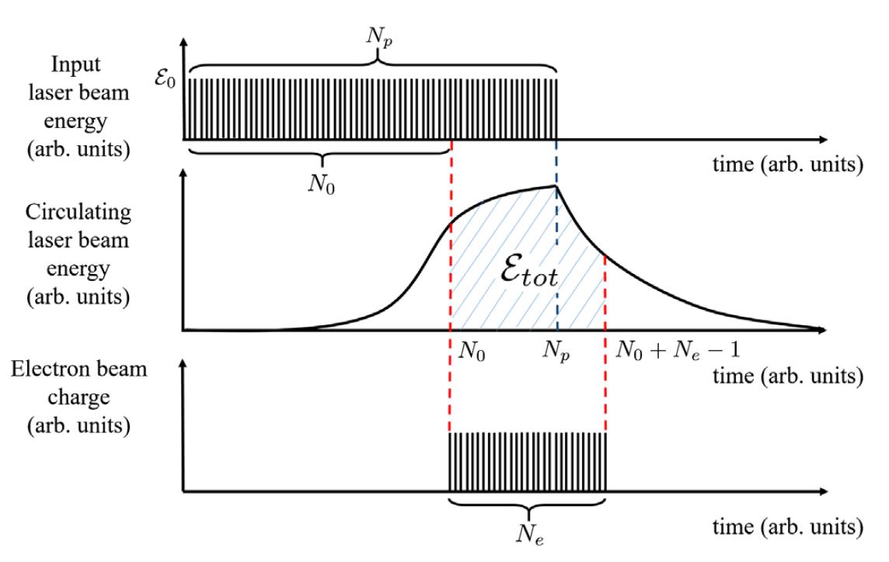
Enabling technology: burst-mode Fabry-Pérot
The burst mode operation of a Fabry-Perot cavity:
  Has a temporal pattern of the laser pulses like the incoming electron train.
  The effective gain is 2 to 3 orders of magnitude larger than the continuous wave mode.
  Due to the lower intracavity average power, thermal effects on the cavity mirrors are minimised
See V. Mușat, FLS2023, TU1C1
FPC | Value | Unit
Micropulse energy | 10 | μJ
Effective gain | 264 | -
Macropulse energy | 22.9 | mJ
ε_{tot} | 6 | J

Slide 10
Key parameters of the HPCI–ICS source
Electron beam | Value | Unit
Energy | 240 | MeV
Single-bunch charge | 100 | pC
Repetition rate | 100 | Hz
Nb. of bunches per train | 1000
Bunch length | < 300 | μm/c
Bunch spacing | 1/3 | ns
Norm. transverse emittance | < 3 | mm.mrad
Final bunch energy spread | 0.3 | %
ICS Laser beam | Value | Unit
Wavelength | 515 | nm
Pulse energy | 10 | μJ
Pulse length | 1.2 | ps
Crossing angle | 2 | deg

Slide 11
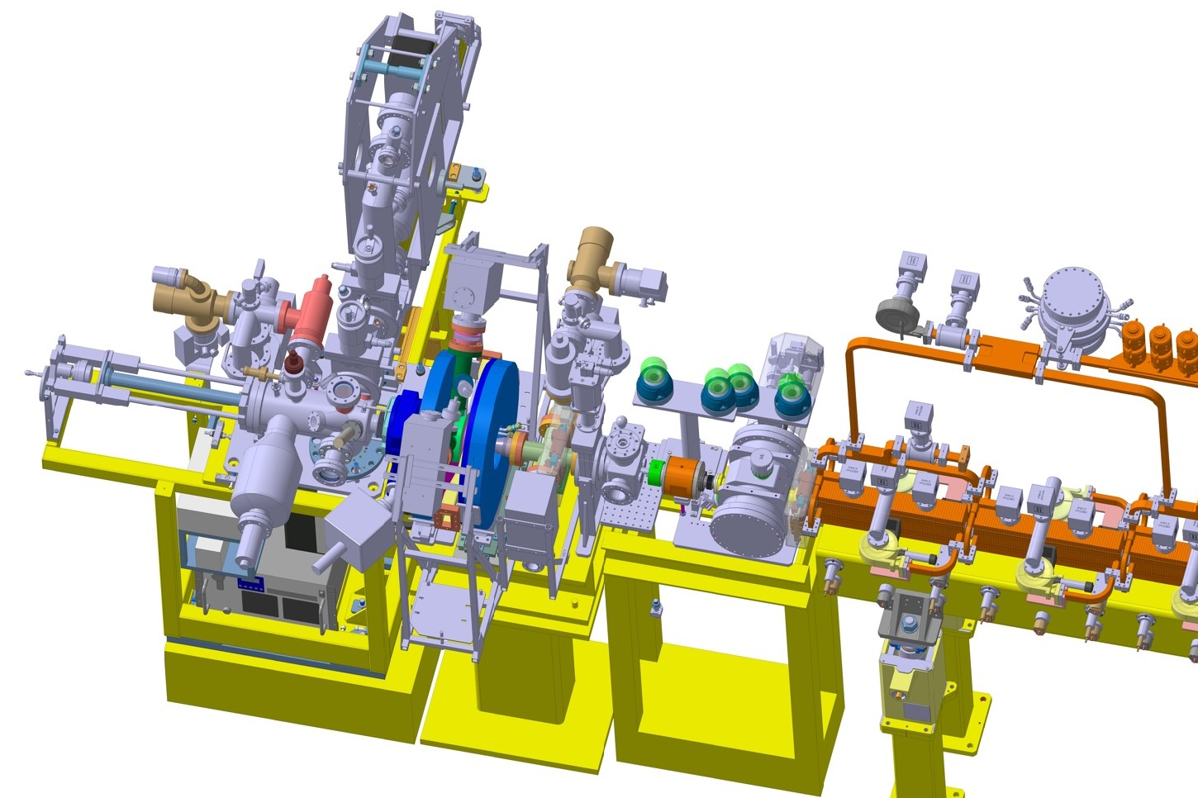
Photoinjector
Photoinjector | Value | Unit
Gradient at cathode | 90 | MV/m
Frequency | 3 | GHz
Cathode | Cs₂Te
Laser | UV
Bunch charge | 100 | pC
Energy | 6.5 | MeV
Norm. transverse emittance | < 4 | mm.mrad
Total length | 1.3 | m
1000 bunches
S-band gun. Similar to the photoinjector of the CLEAR facility at CERN
1/3 ns
t
100 Hz

Slide 12
Linac
X-band linac | Value | Unit
Frequency | 12 | GHz
Phase advance | 2π/3 | rad
Average loaded gradient | 35 | MV/m
Average iris aperture radius | 3.8 | mm
Structure length | 0.5 | nm
HOM damping | yes | -
Energy gain per module | ~80 | MeV
1 Klystron + 1 Pulse compressor can feed up to 8 structures.
It’s a wakefield-dominated linac.
X-band => small iris apertures => strong wakefields

Slide 13
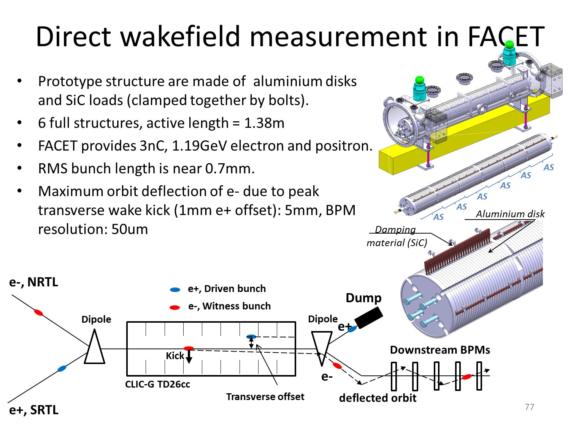
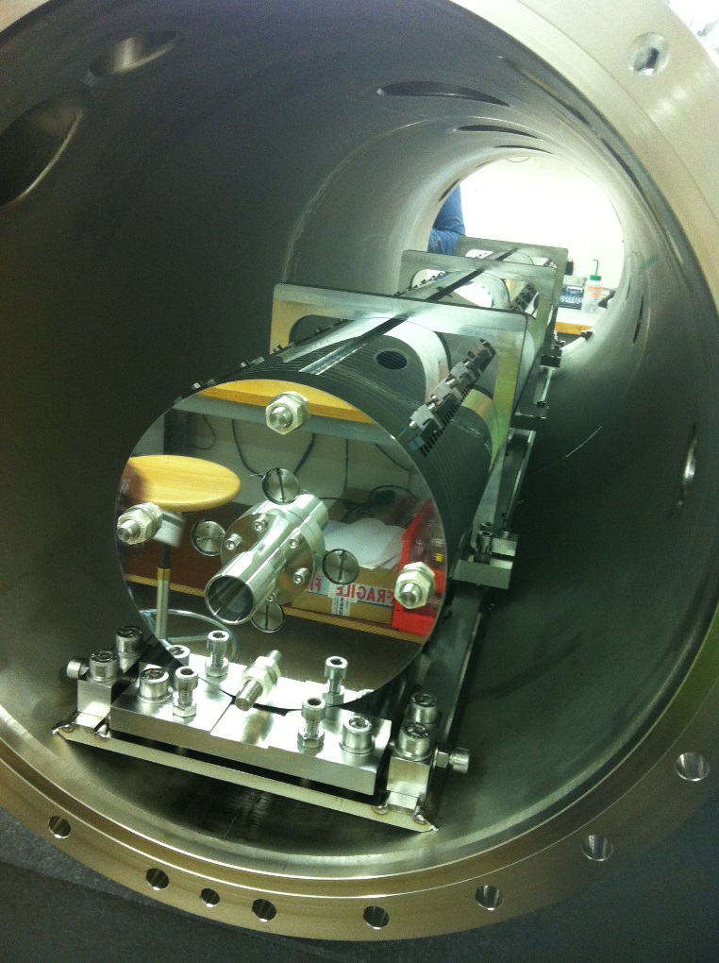
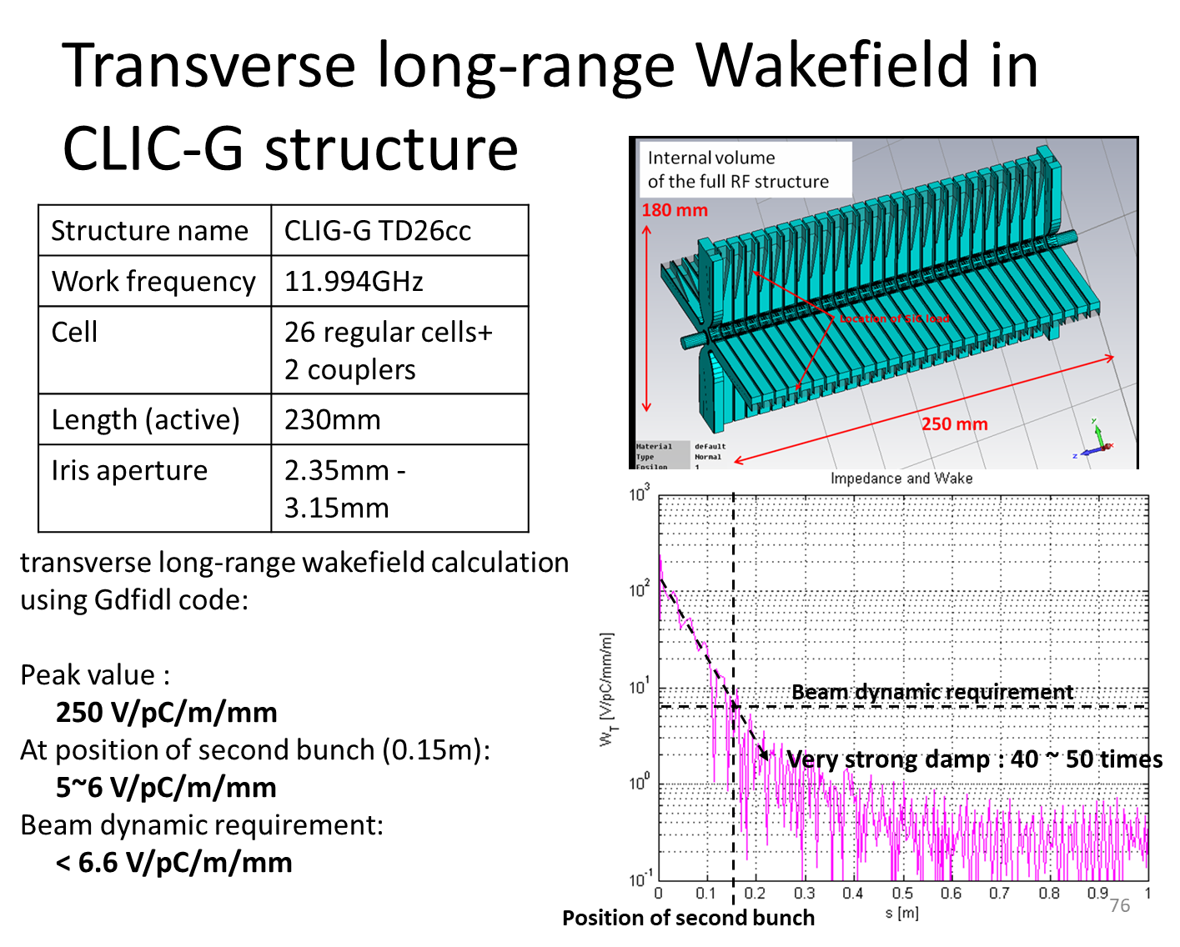
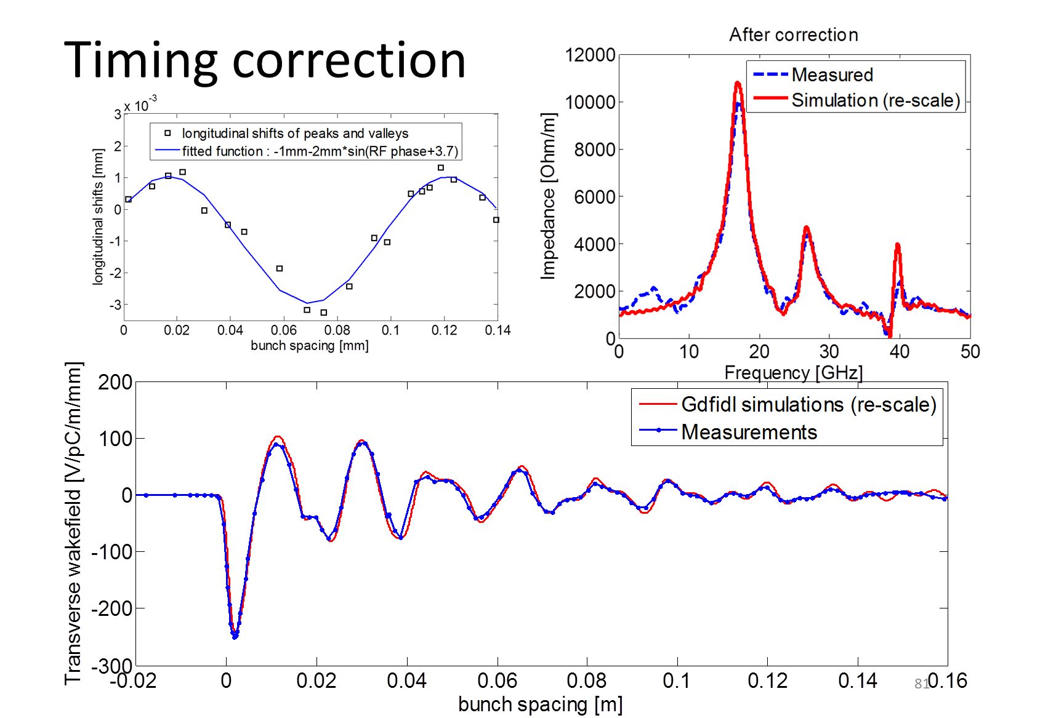
CLIC high current beam stability
High-current beam requires Higher-Order-Mode suppression for beam stability, just like CLIC
https://doi.org/10.1103/PhysRevAccelBeams.19.011001

Slide 14
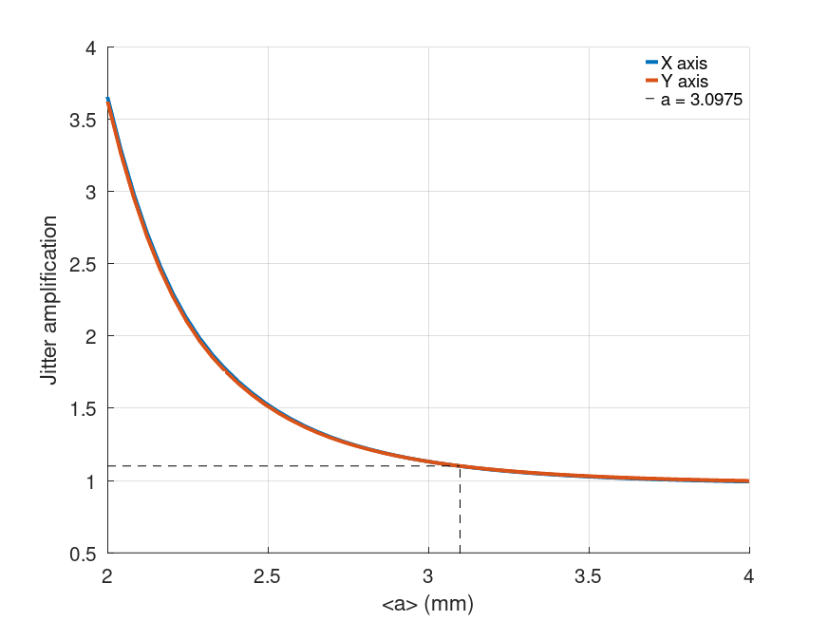
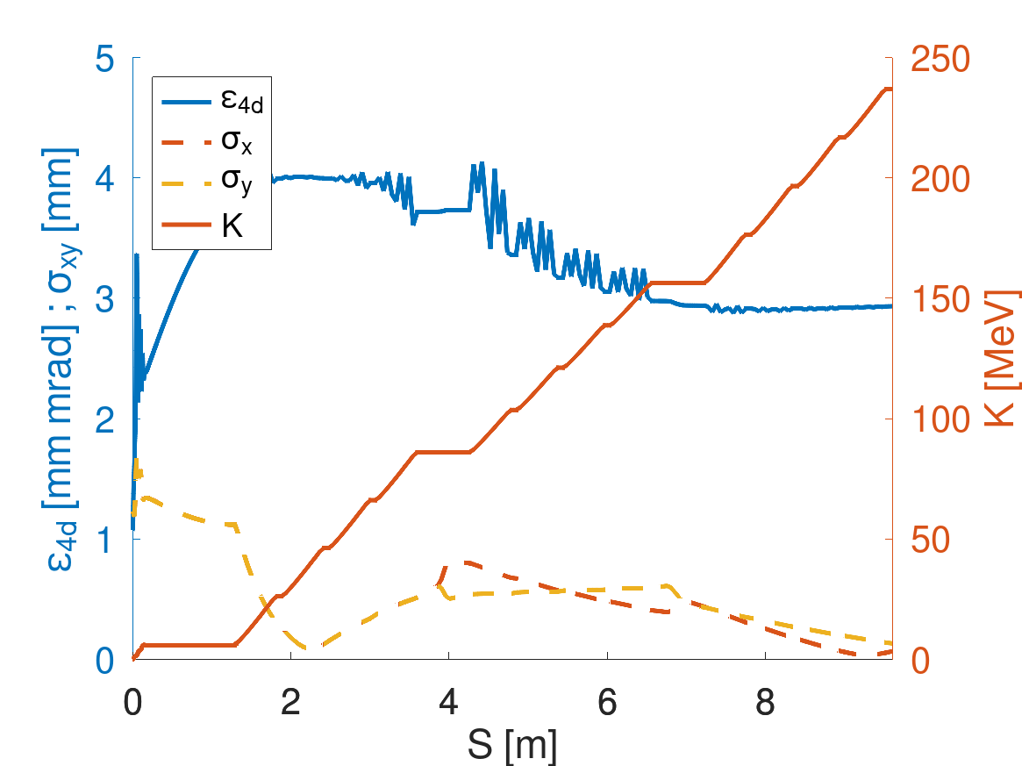
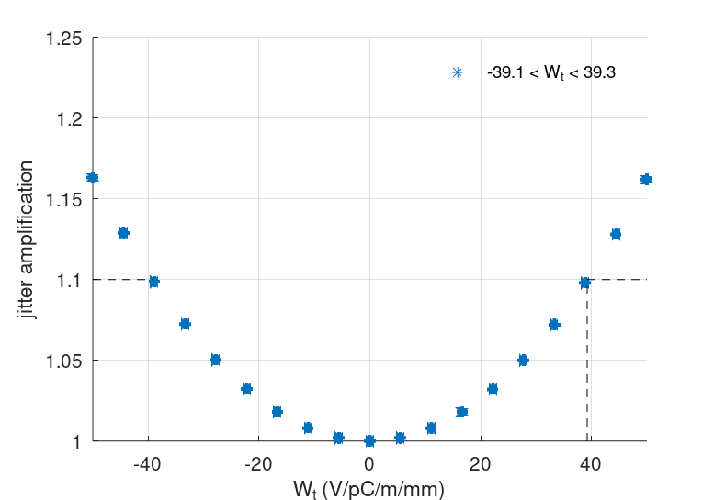
Electron beam dynamics
RF-Track simulation
Single-bunch jitter amplification
Multi-bunch jitter amplification

Slide 15
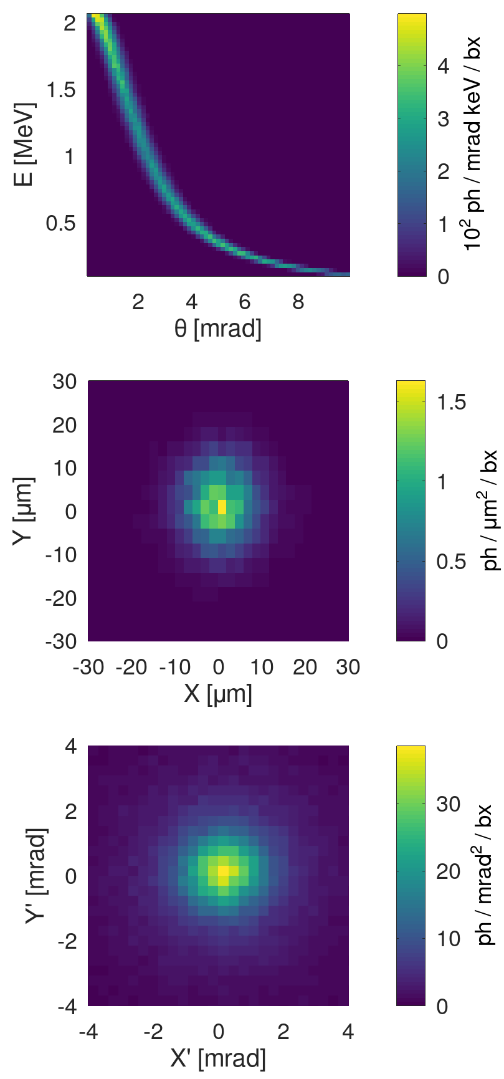
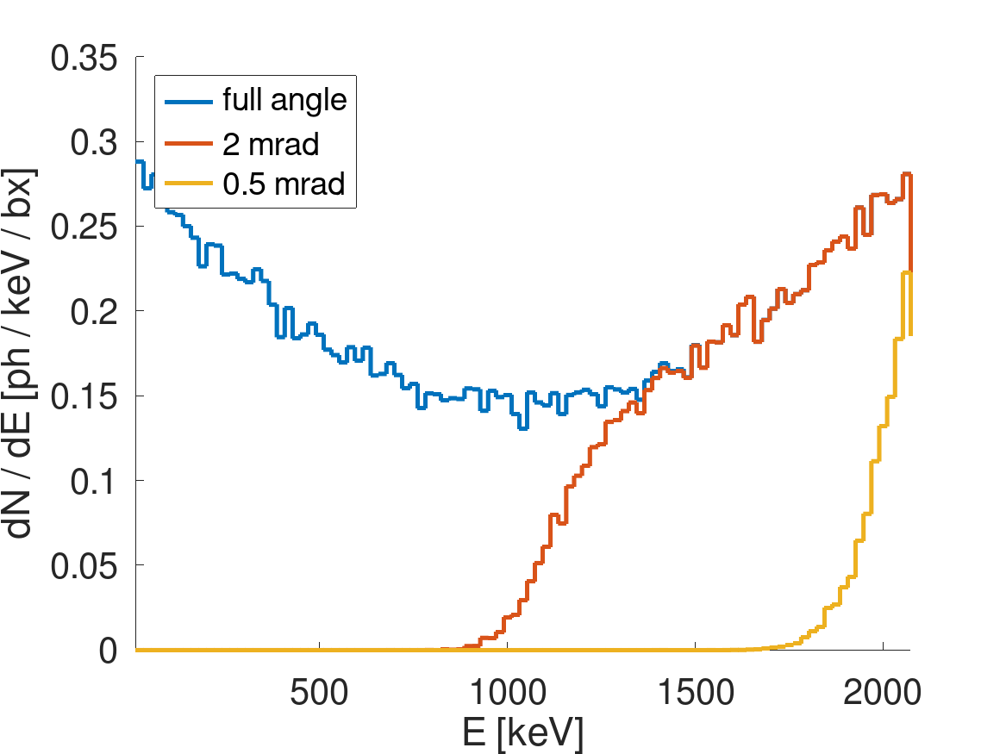
Photon performance
RF-Track simulation
0.5 mrad = 2% BW
bx = bunch crossing

Slide 16
Photon performance
Outcoming photons | Value | Unit
Compton edge | 2.1 | MeV
Total flux | 2.2 x 10¹³ | ph/s
Bandwidth (0.5 mrad) | 2.0 | %
Flux (0.5 mrad) | 1.6 x 10¹² | ph/s
Average Brilliance | 4.4 x 10¹³ | ^{(*)}
Peak Brilliance | 3.9 x 10²³ | ^{(*)}
^{(*)} ph / (s mm² mrad² 0.1% BW)

Slide 17
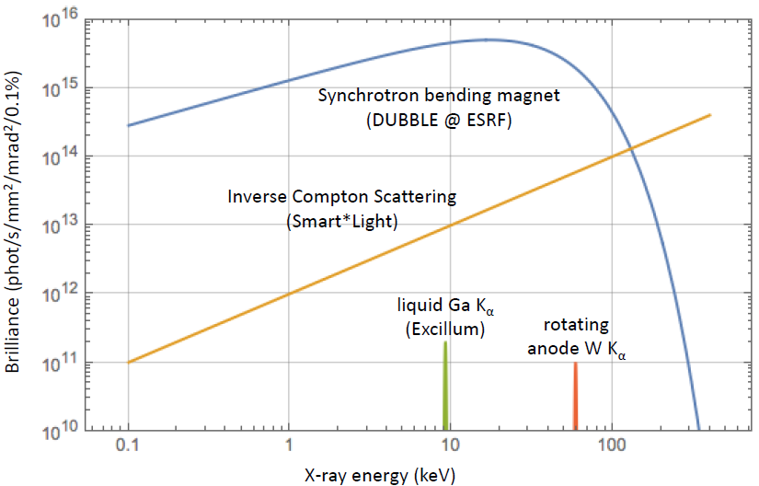
Landscape of light sources
HPCI-ICS
HPCI-ICS
Courtesy Smart*Light
Enters the ballpark of facilities like ELI-NP Gamma beam System: a source of “up to 20 MeV Gamma Rays based on Compton back-scattering, i.e. collision of an intense high power laser beam and a high brightness electron beam with maximum kinetic energy of about 720 MeV”.
CompactLight CDR, https://doi.org/10.5281/zenodo.6375645

Slide 18
Conclusions
We presented an advanced conceptual design of a compact ICS source:
S-band photoinjector
High-gradient multi-bunch X-band acceleration
Fabry-Pérot cavity operating in burst mode
Realistic start-to-end simulations were performed, showing that the HPCI-ICS source has the potential to produce 2 MeV gamma rays with a total flux of 2.2 x 10¹³ ph/s in less than 15 meters in length. It's one of the most compact, high energy and high flux sources in the landscape of existing and planned ICS sources.
MeV energy range gamma rays can have applications in various fields: material science, medicine, nuclear physics research, homeland security by nuclear resonance fluorescence inspection, and non-destructive testing of industrial materials.

