Slide 1

Progress on the Eupraxia@SPARC_LAB Project: with special focus on X-band
11-13/12/2023 CLIC Mini Week - CERN
F. Cardelli, INFN-LNF
on behalf of the TeX technical team and the EuPRAXIA@SPARC_LAB team
LNF Nov. 21, 2023

Slide 2
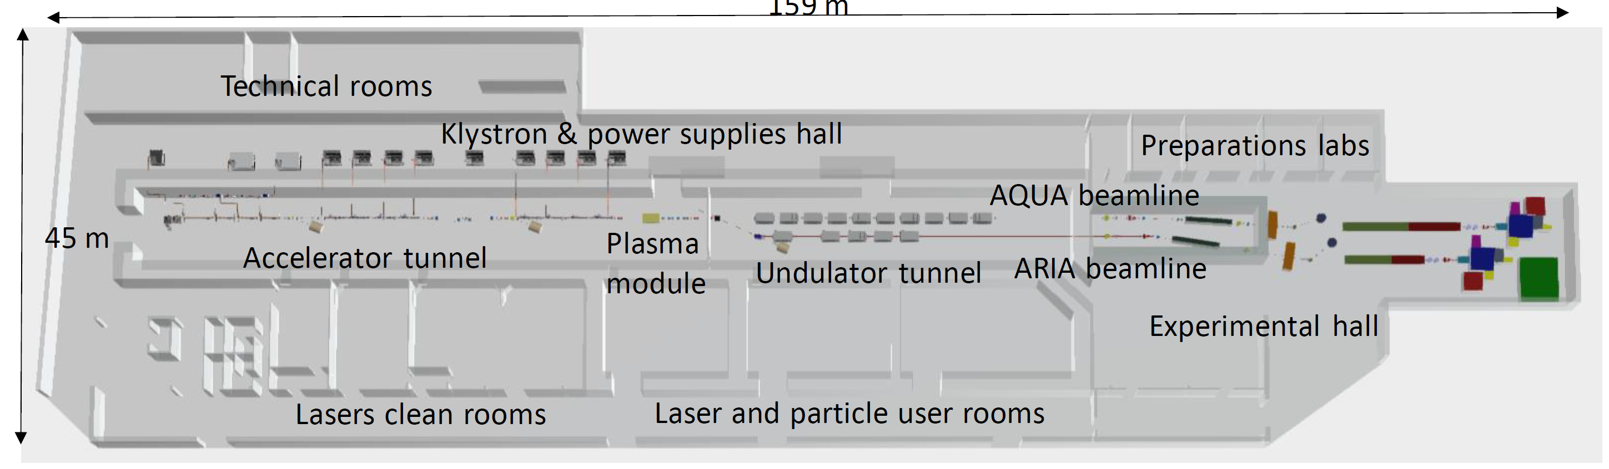
EuPRAXIA@SPARC_LAB Project
The project is one of the pillars of the European Project EUPRAXIA (http://www.eupraxia-project.eu/) – European Plasma Research Accelerator with excellence in Applications
EuPRAXIA has been included in the ESFRI 2021 Roadmap
The project EuPRAXIA@SPARC_LAB is the pillar of the EuPRAXIA project based on beam driven plasma wakefield acceleration (PWFA). It aims at constructing a FEL radiation source (two FEL lines λ_{FEL}=4 nm and 50-180nm) combining by:
  1GeV RF X-band Linac with an high brightness injector
  Plasma module for PWFA.
The project is currently in the preparatory phase of the Technical Design Report.
A new building, now under executive design phase, will host the new Facility at LNF, the construction should start by the end of 2024.
160 m

Slide 3
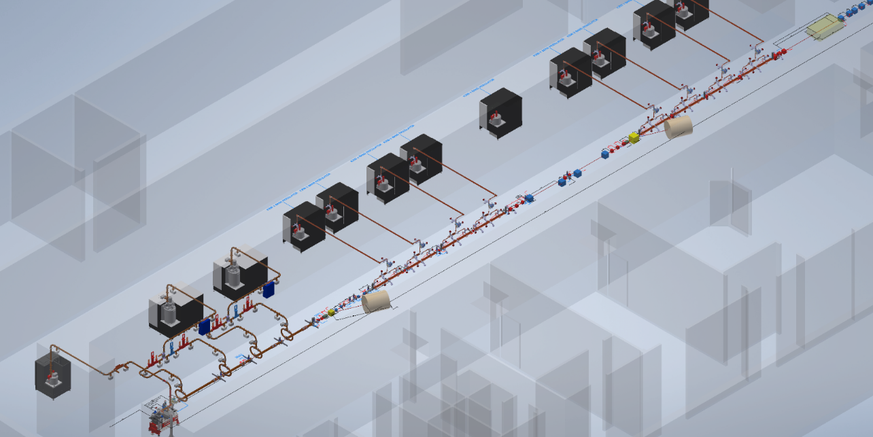

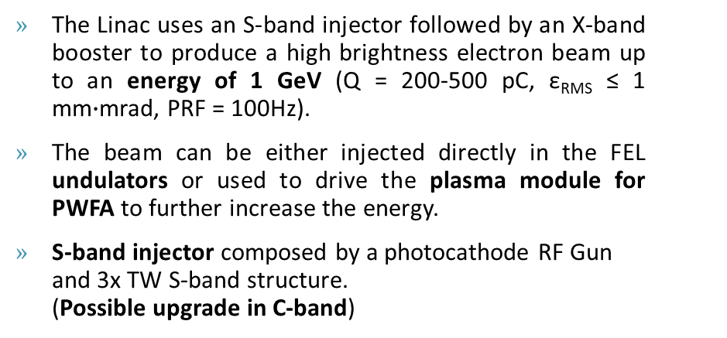
Overview of the LINAC
The Linac uses an S-band injector followed by an X-band booster to produce a high brightness electron beam up to an energy of 1 GeV (Q = 200-500 pC, ε_{RMS} ≤ 1 mm$∙$mrad, PRF = 100Hz).
The beam can be either injected directly in the FEL undulators or used to drive the plasma module for PWFA to further increase the energy.
S-band injector composed by a photocathode RF Gun and 3x TW S-band structure. (Possible upgrade in C-band)
X-band power stations
Plasma module
X-band booster: 16x, 0.9m, TW accelerating structures that has to work at 60MV/m
X-band Booster
Magnetic chicane
S-band
power stations
X-band modules
S-band Injector
S-band RF gun
Courtesy of E. Di Pasquale

Slide 4
X-band RF Module Layout
PARAMETER | Value
Frequency [GHz] | 11.9942
Average acc. gradient [MV/m] | 60
Structures per module | 2
Peak input power per structure [MW] | 70
Input power averaged over the pulse [MW] | 51
Filling time [ns] | 130
Required Kly power per module [MW] | 22.5
Kly RF pulse length [µs] | 1.5
Repetition Rate [Hz] | 100
Mode converter
(INFN-SLAC design)
BOC pulse compressor
(PSI design or INFN brazing free)
Power Source: Solid State Pulsed Modulator + 25 MW Klystron
Spiral RF LOADS
(CERN Design)
25 MW
1.5 us
100 Hz
circular waveguide
Pumping units
140-70 MW
6 m
130 ns
100 Hz
Hybrid
(CERN design)
Transport line: Low loss Circular waveguide
X band structures
(INFN design)
70-35 MW
130 ns
100 Hz
Pumping units (CERN design)
NEXTORR Pumps
(SAES)
DC
(CERN design)
Accelerating module
2.3 m

Slide 5
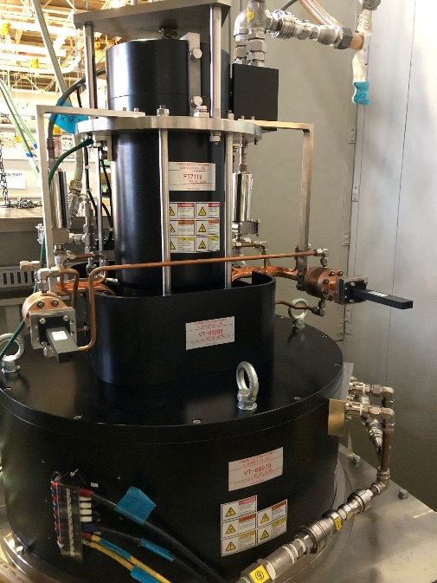
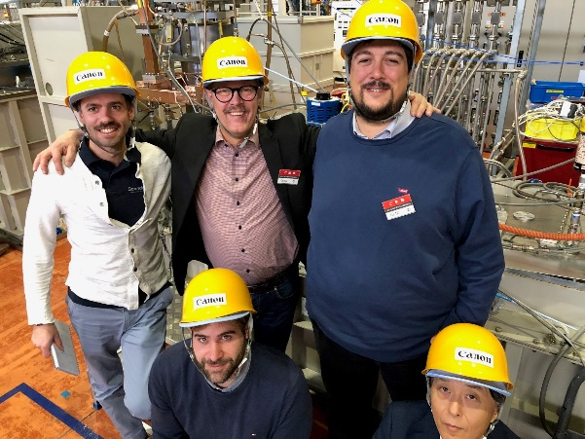
X-band RF Power Sources
Currently, the test stand is based on CPI VKX8311A Klystron on loan from CERN already commissioned and in operation
Two other X-band klystrons will be tested at TEX:
CANON E37119
  Low modulator peak power requirement
  Very high repetition rate (Interesting for a future upgrade of the machine)
  8x power sources for the linac booster
  Status:
    FAT of the klystron done @CANON 11/2023, 25 MW, 10 Hz, t=1.5us
    FAT do be done with modulator @SCANDINOVA spring 2024
CPI High efficiency VKX8311HE (collaboration CERN/INFN/CPI).
  High efficiency
  Increased klystron lifetime
  4x power sources for the linac booster
  Status:
  Realization phase (expected delivery February 2025)
Parameter | Unit | Canon E37119 | CPI VKX8311HE | CPI VKX8311
Frequency | MHz | 11994 | 11994
Vk beam voltage | kV | 318 | 415 | 430
Ik cathode current | A | 197 | 201 | 330
Peak RF output Power | MW | 25 | 50 | 50
Average RF output power | kW | 15 | 7,5 | 7,5
Modulator Average power | kW | 75,2 | 25 | 43
RF pulse length | μs | 1,5 | 1,5
Repetition Rate | Hz | 400 | 100 | 100
Gain | dB | 47 | 50 | 47
Efficiency | % | 40 | 55 | 38
Perveance | μp | 1.16 | 0.75 | 1.15
CANON E37119

Slide 6
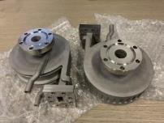
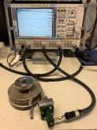
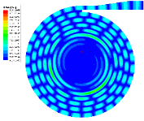
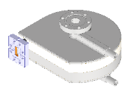
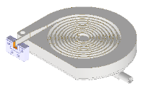
X-band RF components
Many of the X-band components needed for the EuPRAXIA module are based on CERN design and have been manufactured, purchased and installed in the TEX layout: directional couplers, pumping units, splitter, loads [6]
X-band BOC pulse compressor
Mode converter
3D printed Ti spiral load
Spiral loads
We procured 6 spiral loads 3D printed. Two has been installed and conditioned up to 35 MW with 200 ns pulse length at 50 Hz.
Circular waveguide WC50 and T-pumping units for circular waveguide
# | Company | S11@f0 [dB]
001 | 3t am | -31
002 | 3t am | -30
003 | ISC | -37,7
004 | ISC | -36,4
005 | ISC | -42
006 | ISC | -43,9
3dB Hybrid
Machined spiral load
Splitter
EM and mechanical design: done
Manufacturing : ongoing
Accelerating structures
Directional couplers
WR90 Pumping units
NEXTORR Pumps
WR90 straights and elbows
[6] N. Catalan-Lasheras, et al., 9th Int. Particle Accelerator Conf. (IPAC18), Vancouver, BC, Canada, May 2018, paper WEPMF074.

Slide 7
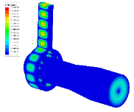
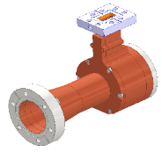
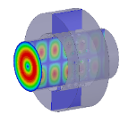
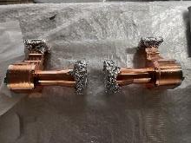
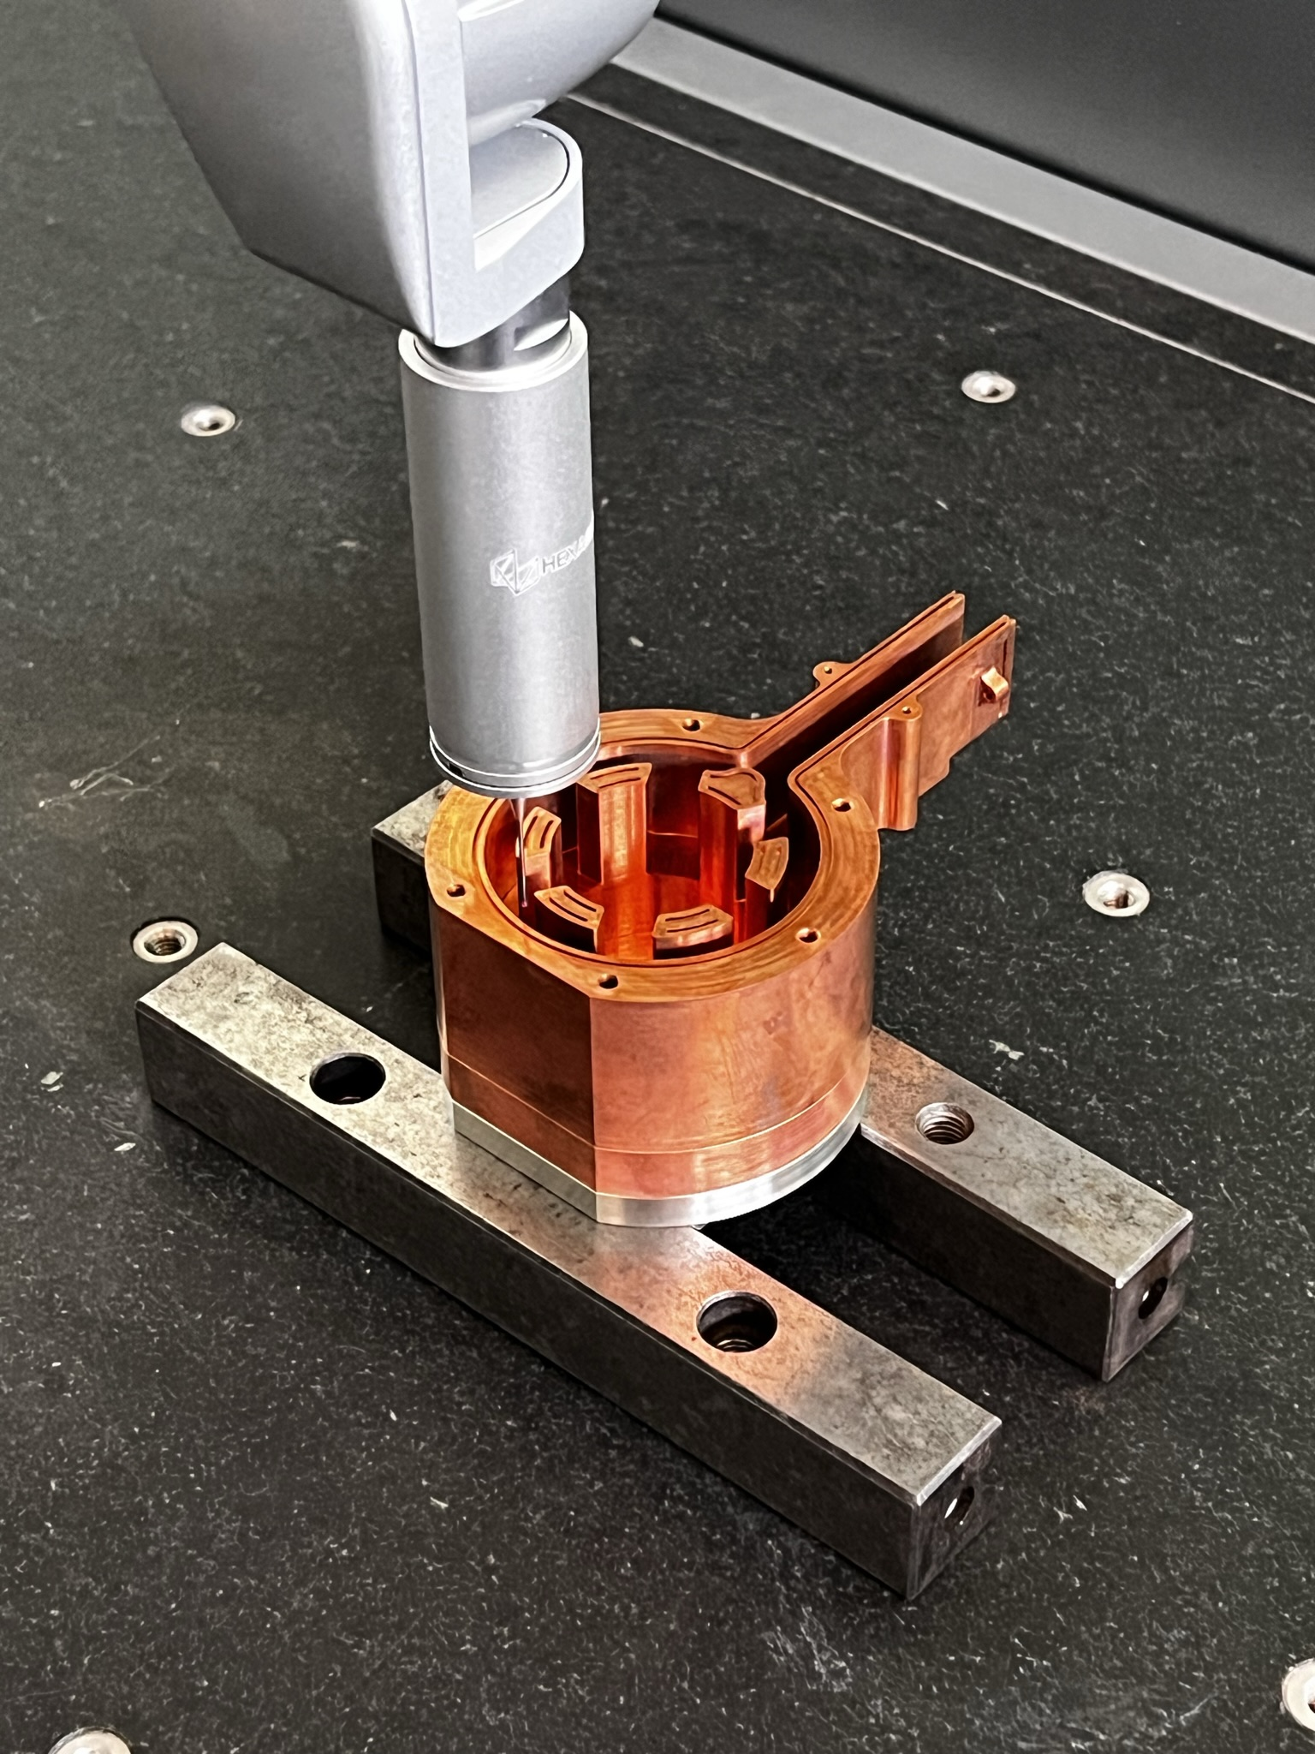
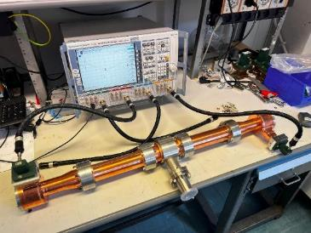
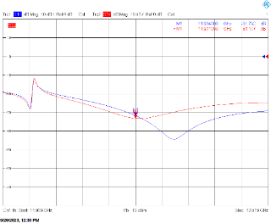
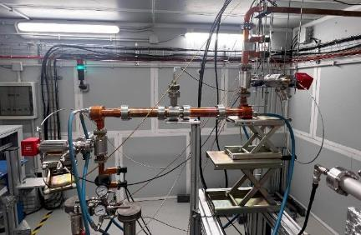
Mode Converter
Modified version of the “wrap around” mode converter from TE₁₀□ to TE₀₁○ developed at SLAC [7] and pumping port for circular waveguide
EM and mechanical design: done
Machining by a private company (TSC): done
Brazing at INFN-LNF: done
Low Power RF test: done
High Power test: Ongoing
[7] S. Tantawi, et all. (2000). Reviews of Modern Physics – doi: 10.1103/PhysRevSTAB.3.082001

Slide 8

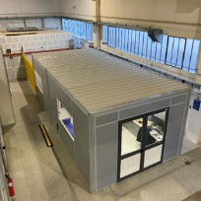
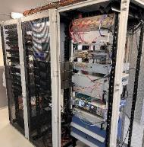
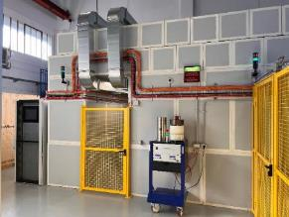
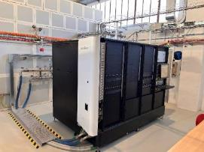
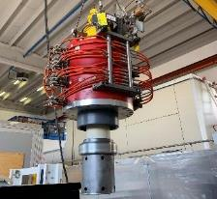
TEX Facility Now
Modulator
BOC
(spring 2024)
Accelerating structure
The TEst-stand for X-band (TEX) is conceived for R&D and test on high gradient X-band accelerating structures, RF components, LLRF systems, Beam Diagnostics, Vacuum system and Control System
It has been co-funded by Lazio region in the framework of the LATINO project (Laboratory in Advanced Technologies for INnOvation). The setup has been done in collaboration with CERN and it will be also used to test CLIC structures
The civil engineering works in the building has been concluded in August 2021
The installation and commissioning of the Modulator and klystron has been completed in February 2022 [3]. At the same time LLRF system [4], EPICS control system have been commissioned
The complete waveguide network has been procured and installed
SSD
PARAMETER | MEAS. VALUE
Cathode peak voltage | 427 kV
Peak RF output power | 50 MW
Pulse length | 250 ns (1.5 us)
Repetition Rate | 50 Hz
RF output amplitude stability | < 0.09 %
RF output phase stability | 20.9 fs
LLRF
Klystron
DC
DC
DC
DC
Control Room
LLRF system
Concrete Bunker
RF Source
VKX8311A Klystron
[3] F. Cardelli et al., 13th Int. Particle Accelerator Conf. IPAC22, Bangkok, Thailand, Jun. 2022, paper TUPOPT061
[4] L. Piersanti et al., 13th Int. Particle Accelerator Conf. IPAC22, Bangkok, Thailand, June 2022, paper TUPOST015

Slide 9
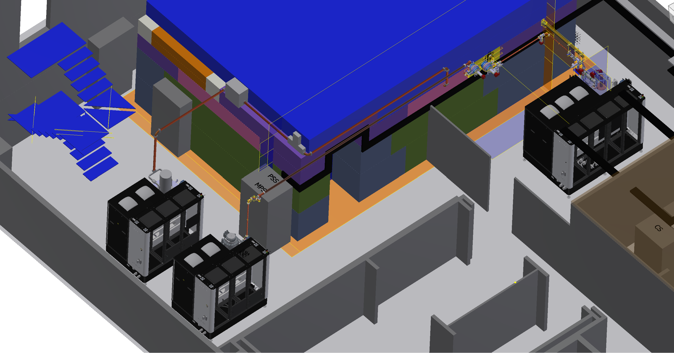
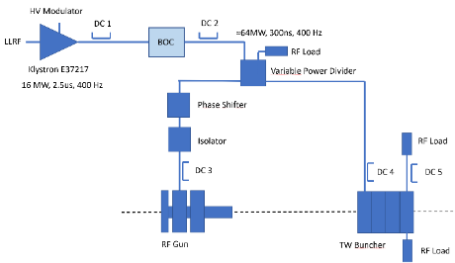
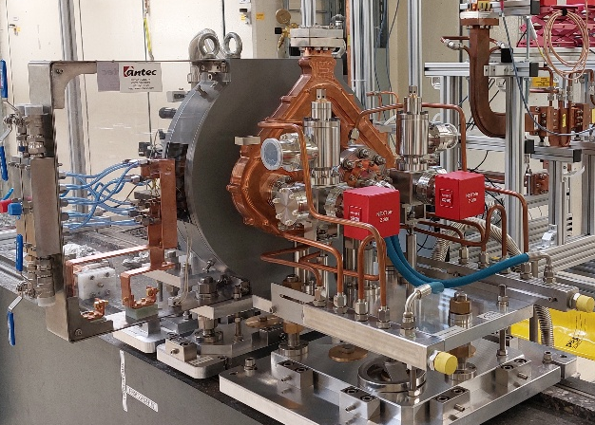
TEX Upgrade
An X-band BOC pulse compressor will be integrated in actual layout in order to increase the available power (ordered to PSI)
A new X-band power source based on Scandinova k300 modulator with Canon E37119 klystron
A C-band power source Scandinova k300 modulator with Canon E37217 klystron with a BOC pulse compressor already purchased (FAT of the klystron performed at Canon in November 2023, expected FAT of the complete source in Spring 2024)
New C-band Source
Parameter | Unit | Canon E37217
Frequency | MHz | 5712
Vk beam voltage | kV | 280
Ik cathode current | A | 240
Peak drive power | W | 500
Peak RF output Power | MW | 20
Average RF output power | kW | 21
Modulator Average power | kW | 75,2
RF pulse length | us | 2.5
Repetition Rate | Hz | 400
Gain | dB | 50
Efficiency | % | 40
New X-band Source
High gradient C-band Gun (now @PSI)

Slide 10
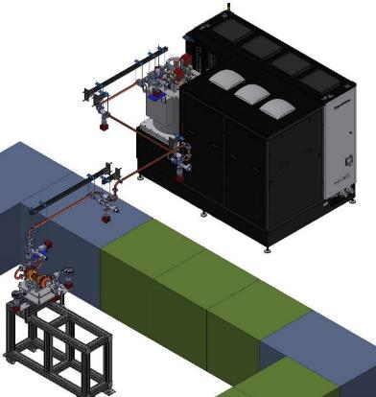
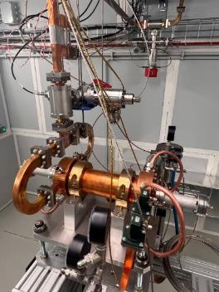
Conditioning of T24 structure
In April 2023 we installed, inside the bunker, a CERN accelerating section of the T24 CLIC type realized by PSI. The RF test started in May and lasts nearly 40 days reaching 38 MW power at the structure input with 150 ns pulse length at 50 Hz.
This test has been preparatory to the conditioning of the first EuPRAXIA accelerating structure prototype, which will take place by November 2023.
The test has been performed with an automatic conditioning routine.
Directional coupler
Conditioning story
Accelerating structure
Pumping units
Faraday Cup

Slide 11

Mode Converter high power test
Modified version of the “wrap around” mode converter from TE₁₀□ to TE₀₁○ developed at SLAC [7] and pumping port for circular waveguide
EM and mechanical design: done
Machining by a private company (TSC): done
Brazing at INFN-LNF: done
Low Power RF test: done
High Power test: Ongoing
Power loss in the circular waveguide ≤ 100 kW
Power reached on the single Spiral load:
  P_{peak} = 10 MW, t_{pulse} = 1μs, PRF = 50 Hz
[7] S. Tantawi, et all. (2000). Reviews of Modern Physics – doi: 10.1103/PhysRevSTAB.3.082001

Slide 12
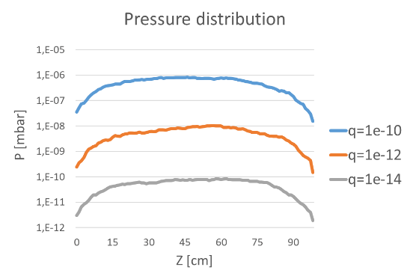
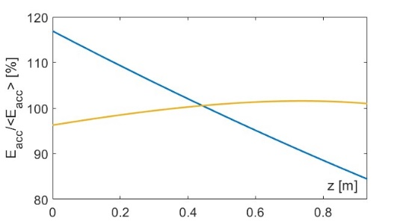
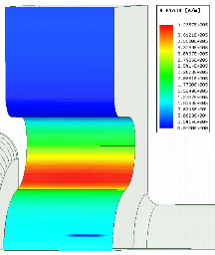
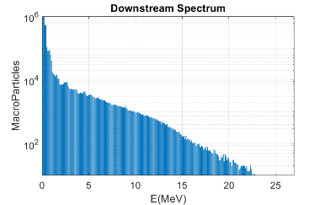
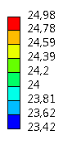
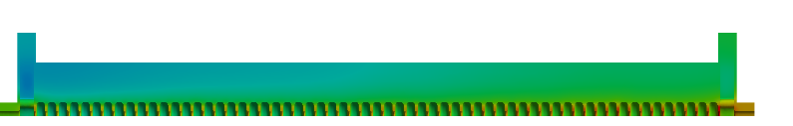
X-band Accelerating structures design
The EM design of the structure is completed: 0.9 m long structures with 3.5 mm average iris radius design to work with an average acceleration gradient of 60 MV/m. The single cell and RF structure optimization has been completed developing a semi-analytical code to consider also the power gain from the BOC pulse compressor [10]: done
Thermo-mechanical simulations to demonstrate the correct sizing of the cooling system (at 100 Hz and 400 Hz): done
Dark current simulations (CST Particle in cell) have been performed to evaluate the background radiation together with vacuum calculation to verify the pression distribution along the structure: done
The final mechanical design of the final X-band structure has been under constant review, related to the result of the pre-prototyping activity: brazing test, cell to cell alignment, etc: done
PARAMETER | Value
 | Quasi-Constant Gradient | Constant Impedance
Frequency [GHz] | 11.9942
Average acc. gradient [MV/m] | 60
Structures per module | 2
Iris radius a [mm] | 3.85 - 3.15 | 3.5
Tapering angle [deg] | 0.04 | 0
Struct. length L_{s} act. Length [m] | 0.94
No. of cells | 112
Shunt impedance R [MΩ/m] | 93-107 | 100
Effective shunt Imp. R_{sh_eff} [MΩ/m] | 350 | 347
Peak input power per structure [MW] | 70
Input power averaged over the pulse [MW] | 51
Average dissipated power [kW] | 1
P_{out}/P_{in} [%] | 25
Filling time [ns] | 130
Peak Modified Poynting Vector [W/μm²] | 3.6 | 4.3
Peak surface electric field [MV/m] | 160 | 190
Required Kly power per module [MW] | 22.5
Kly RF pulse length [µs] | 1.5
Repetition Rate [Hz] | 100 (400)
[10] M. Diomede et al. NIM A 909 (2018) 243–246

Slide 13
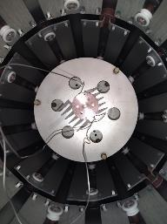
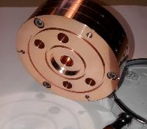
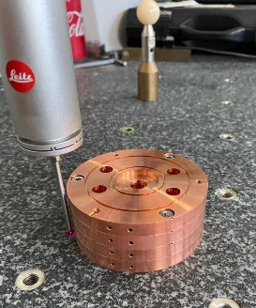
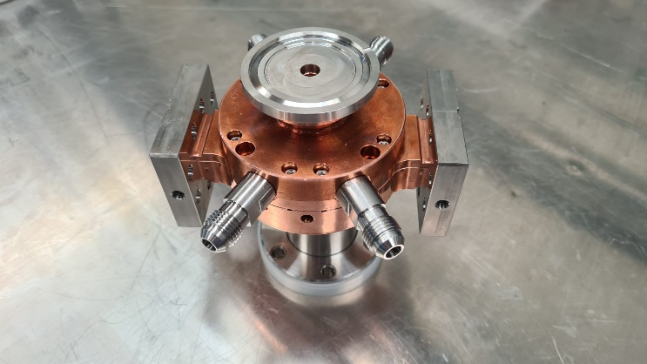
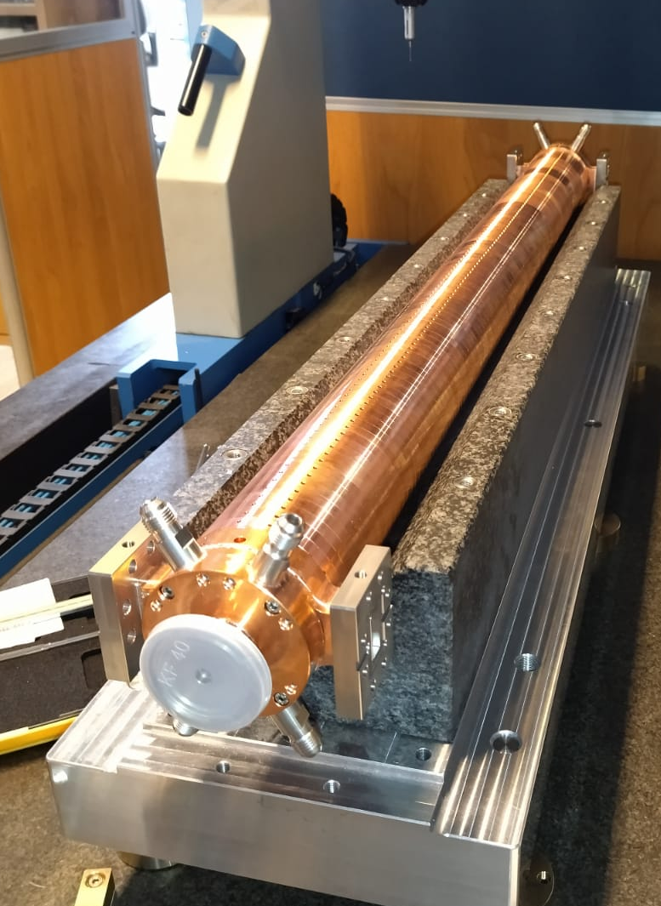
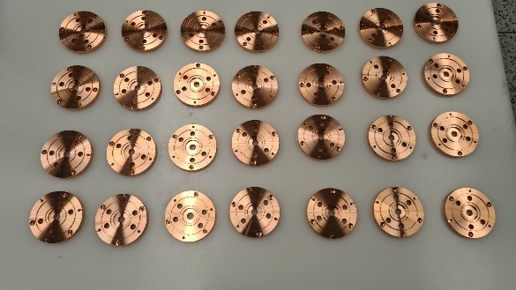
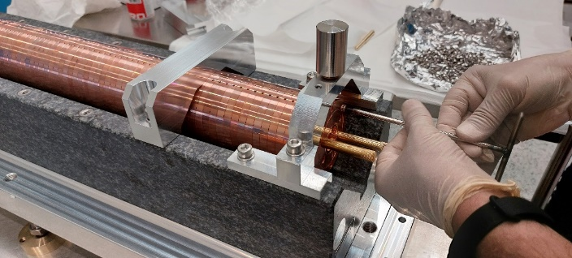
Structure Prototyping Activity
Four main steps of prototyping:
Pre-prototypes on 3-cells and simplified couplers to test and optimize the brazing procedure, cells assembly, alignment etc: done
Full scale mechanical prototype: 0.9 m prototype to test the overall brazing process of the full structure and the cell-to-cell alignment before and after brazing: done
20 (+2) cells RF prototype for high power test w/o tuning, constant impedance: realized (to be tested at high power)
Final full scale EuPRAXIA@SPARC_LAB structure prototype 0.9 m constant impedance: to do

Slide 14
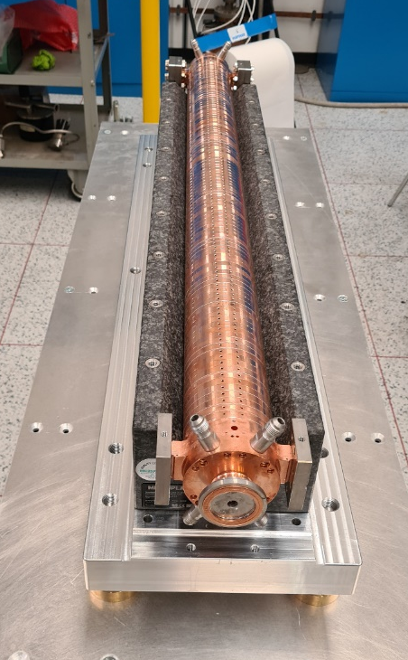
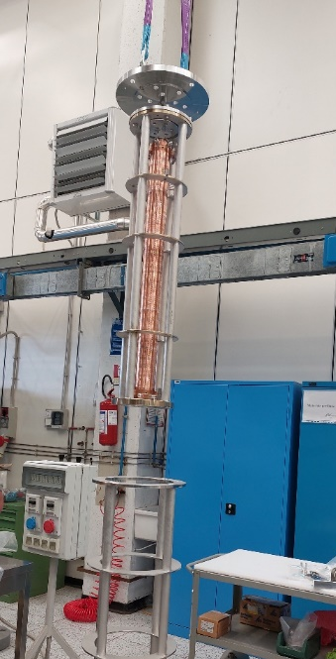
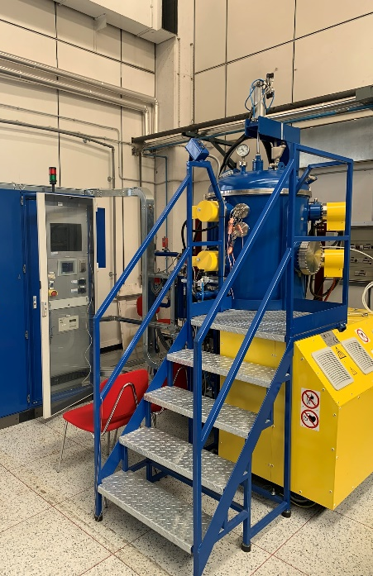
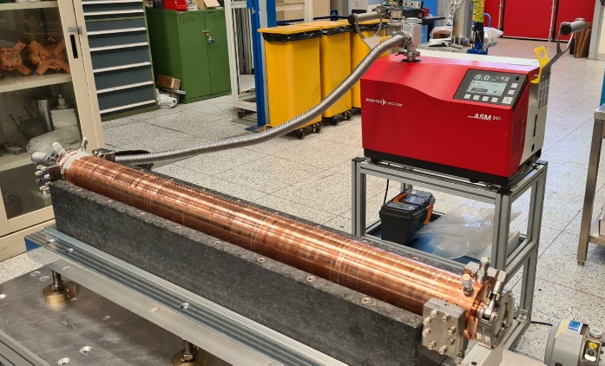
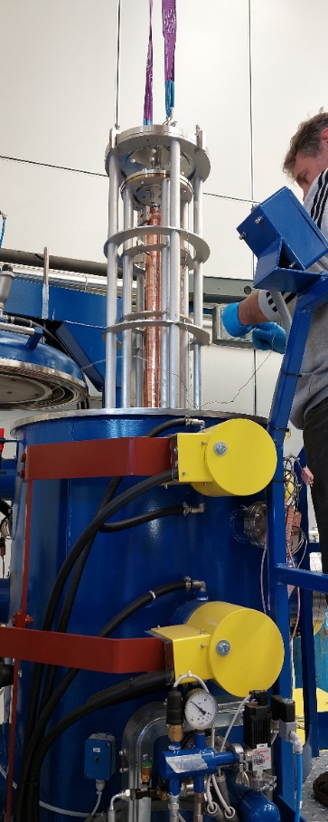
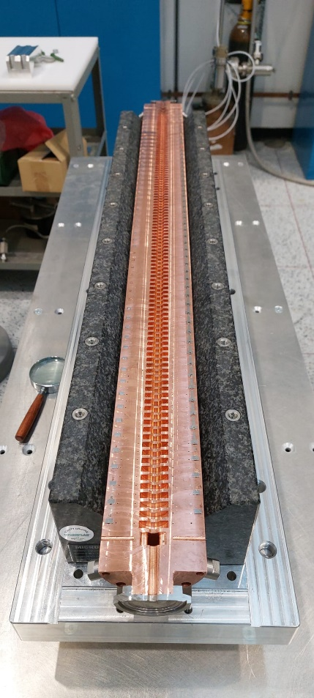
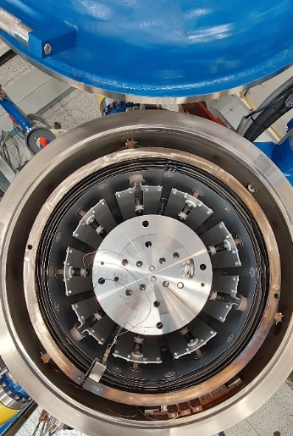
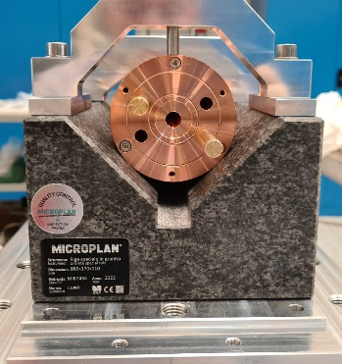
Full-Scale Mechanical Prototype Brazing
Full scale mechanical prototype brazing
To maintain the alignment and cell to cell straightness during and after the brazing process, each cell is fixed to the next one by means of screws and mounted on a very precise granite support. This ease also the cells assembly
Results on the brazed structure
Vacuum test OK (except one coupler for a miss-positioning of the brazing alloy)
Straightness ±15 μm obtained after brazing (±30 μm required by BD)
Another full-scale mechanical prototype has been realized and brazed in order to further optimize the brazing procedure.

Slide 15
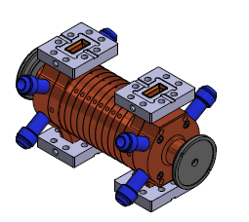




First RF Prototype
X-band, 20 (+2) cells, CI, travelling wave structure prototype
Before brazing
After brazing
The structure has been realized without tuners on the cells, there are 2 tuners on each coupler.
We perform the low power measurement before cells brazing, after the brazing and then we perform the tuning of the couplers.
During the measurements and the tuning procedures the structure has been continuosly fluxed with nitrogen.
2

Slide 16

BeadPull measurements
The bead drop measurement has been performed before and after the tuning of the couplers
Phase advance per cell
Cumulative Phase advance
All the cells sems to be smaller (2-3 um on the diameter) to compensate to obtain the best response from the cells we will need to increase the working temperature → T_{cav} = 30 – 35 °C
Average Phase Advance = 120,3 °

Slide 17

Conclusions and future activities
  EuPRAXIA@SPARC_LAB is the next INFN-LNF facility. It is the beam driven pillar of the EuPRAXIA project, included in the ESFRI 2021 Roadmap
  TEX (Frascati Test stand for X-band): has been completely commissioned and used to test some components
    A new X-band RF source based on the 25 MW, 400Hz E37119 klystron has been tested at CANON and will be commissioned at TEX starting in Spring 2024. Also a C-band source will be installed at TEX in the same period.
    A high efficiency klystron 50 MW VKX8311HE developed by CPI/CERN should be commissioned at the beginning of 2025.
  Many X-band RF components of the EuPRAXIA RF module have been purchased and tested at nominal power other will be tested soon:
    A brazing free BOC design is ongoing, a standard BOC is in procurement from PSI.
    The test of the mode converters and circular waveguide components is ongoing.
  X-band structures: An intensive prototyping activity is ongoing exploiting the new vacuum furnace at LNF.
    The full-scale mechanical prototype brazing test gives optimum results in term of straightness and vacuum tightness (another prototype has been realized).
    The 20 cells CI RF prototype has been realized and tested at low power
      Low power RF measurements showed that the cells are all the same but smaller by approx ±2 μm
      The 20 cells structure high power test will start in January.
    A full-scale 0.9m RF prototype is in production.
THANK YOU!
Aknowledgements:
INFN-LNF: D. Alesini, S. Bini, B. Buonomo, S. Cantarella, R. Clementi, L. Faillace, M. Ferrario, A. Gallo, L. Giuliano, C. Di Giulio, E. Di Pasquale, G. Di Raddo, R. Di Raddo G. Latini, A. Liedl, V. Lollo, L. Piersanti, S. Pioli, R. Ricci, B. Serenellini, M. Zottola on behalf of the TEX and EuPRAXIA technical team, INFN-LNF Accelerator Division and Technical Division
CERN: W. Wuensh, N. Catalan-Lasheras, A. Grudiev, G. McMonagle on behalf of the CLIC and XBOX group
SLAC: V. A. Dolgashev

