Slide 1
The PolariX TDS system at SwissFEL
Thomas Geoffrey Lucas on behalf of the PolariX team :: Paul Scherrer Institute
CLIC Mini Week 2023

Slide 2
Contents
PolariX
Low Power Measurements and Supporting X-band Components
RF System and High Power Conditioning
First Beam Operation
Calibration, resolution and bunch length
Conclusion

Slide 3
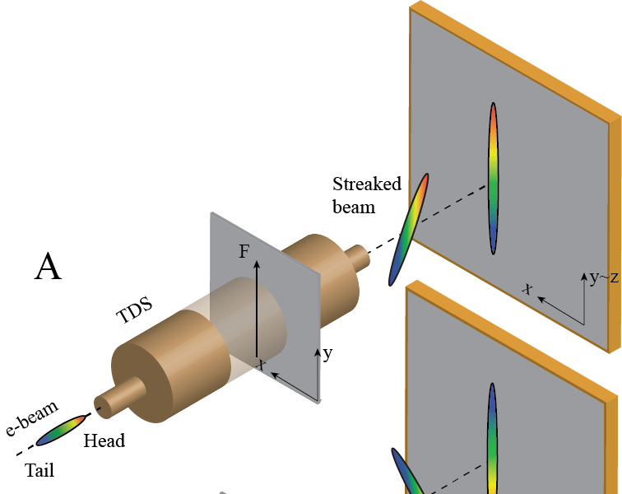
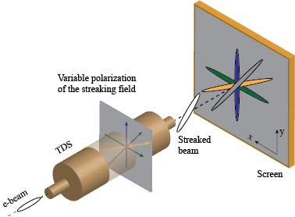
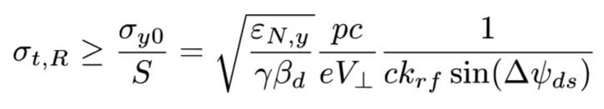
Transverse Deflecting Structures – What’s next?
TDS are RF-based devices used for the manipulation and/or the diagnostics of charged particle beams to retrieve longitudinal/temporal proprieties
Conventional TDS: streaking in a fixed polarization (i. e. vertical or horizontal)
POLARIzable X-band Transverse Deflection Structure – POLARIX TDS
The longitudinal distribution of the e-bunch is mapped into the transverse one thanks to the time dependent transversely deflecting field

Slide 4
DESY-CERN-PSI Collaboration
The PolariX TDS has been developed in the framework of a collaboration among CERN, DESY and PSI.
As a result, 7 TDS have been produced:
  1 TDS in FLASHForward
  2x TDSs installed in FLASH II
  2x TDS installed in SINBAD-ARES (DESY)
  2x TDSs installed in Athos, the Soft X-rays beamline in SwissFEL

Slide 5
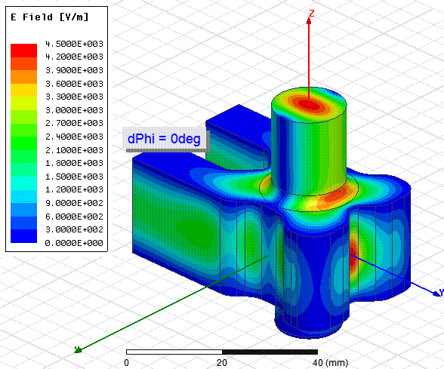
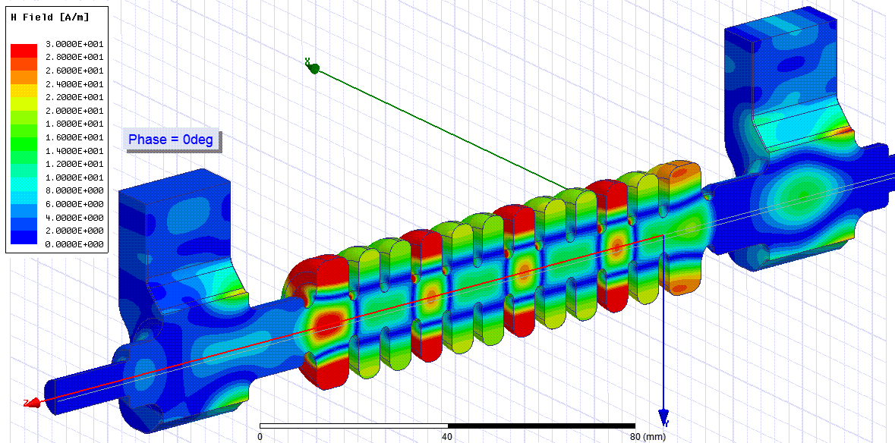
Novel Concept with Variable Polarization – X band
Key Component
E- Rotator: E-plane TE11 rotating mode launcher
Key Technology:
PSI high-precision tuning-free assembly procedure
Polarization of deflecting field in the structure depends on the relative phase difference at the two TDS input ports.
References:
Grudiev, CLIC-Note-1067, 2016
P. Craievich et al., Phys. Rev. Accel. Beams, 2020
B. Marchetti et al., Sci. Rep., 2021

Slide 6
TDS RF measurements
On axis bead pulling, phase difference between input ports 0°
Cell to cell phase advance, phase difference between input ports 0°
Insertion and return loss measured for different polarizations
Average cell to cell phase advance measured at different polarization.
Peak to peak phase adv. 0.03°.→ very good cell rotational symmetry.

Slide 7
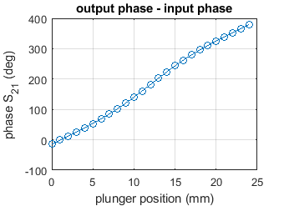
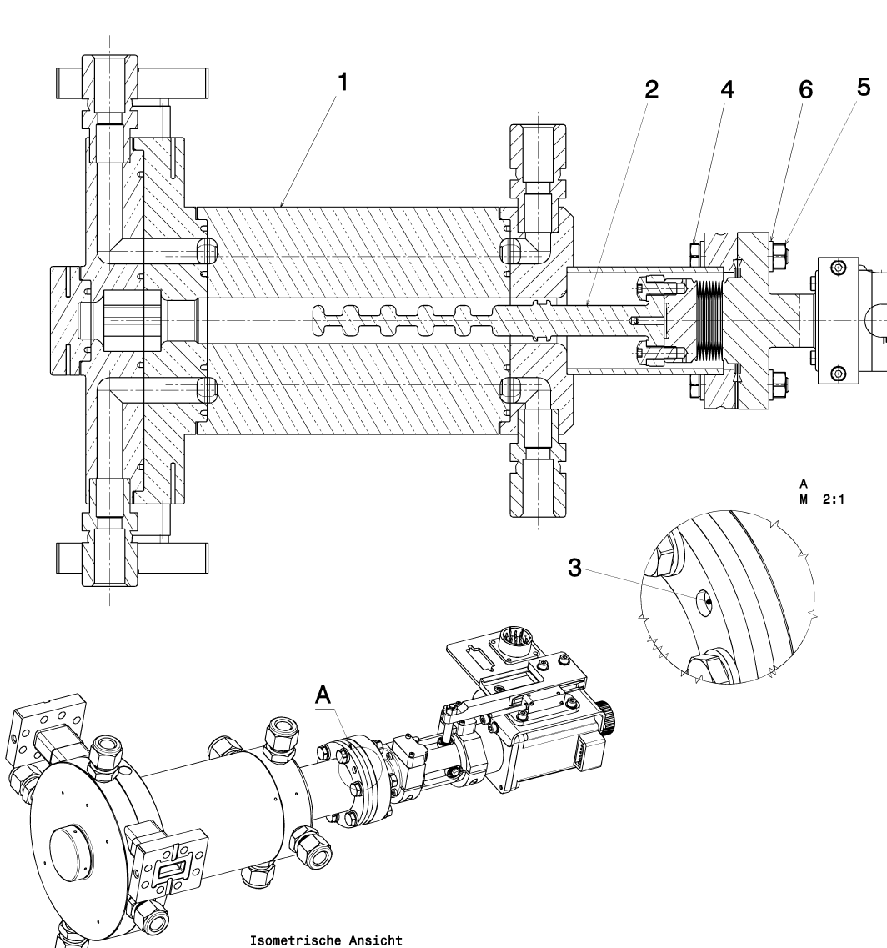
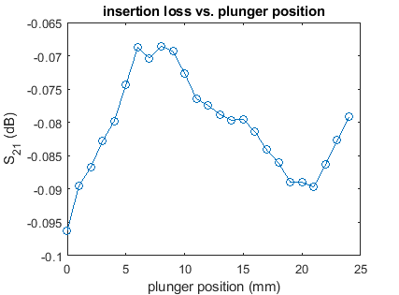
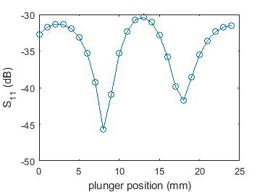
X-band phase shifter measurements

Slide 8
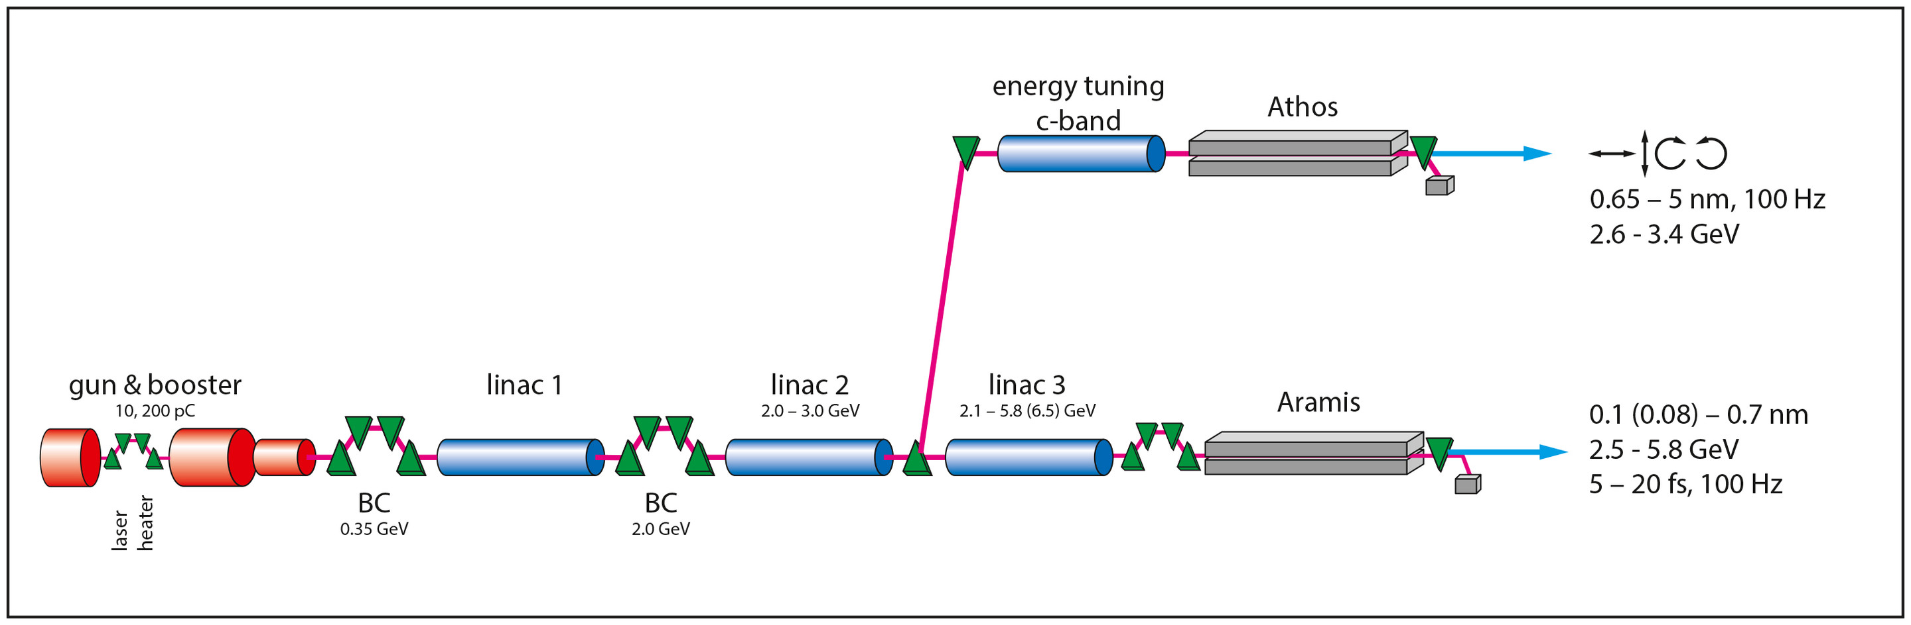
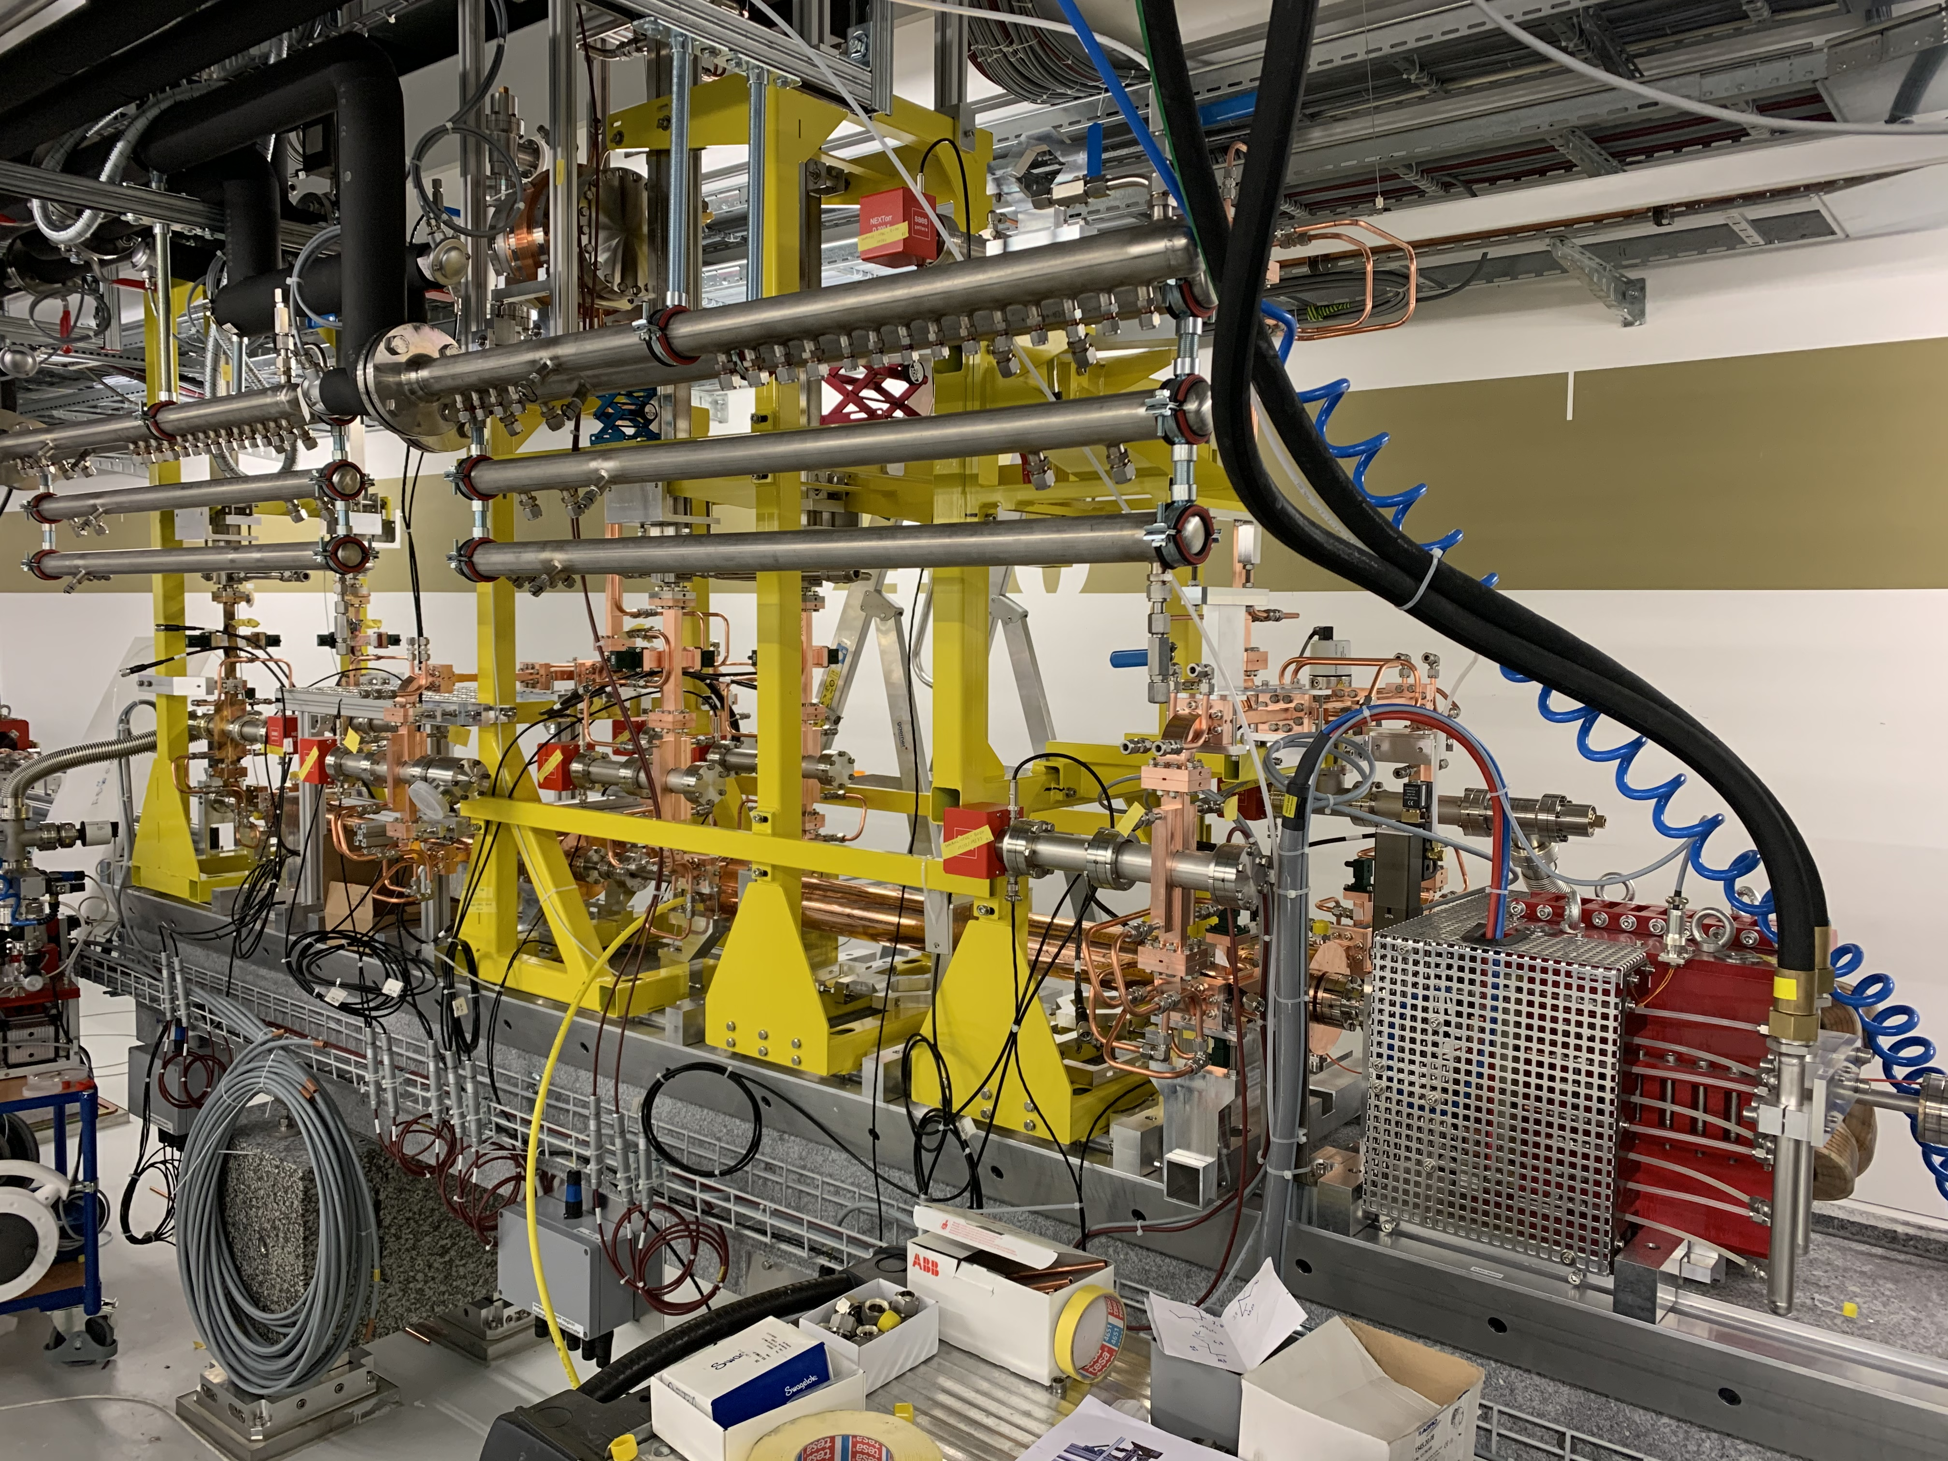
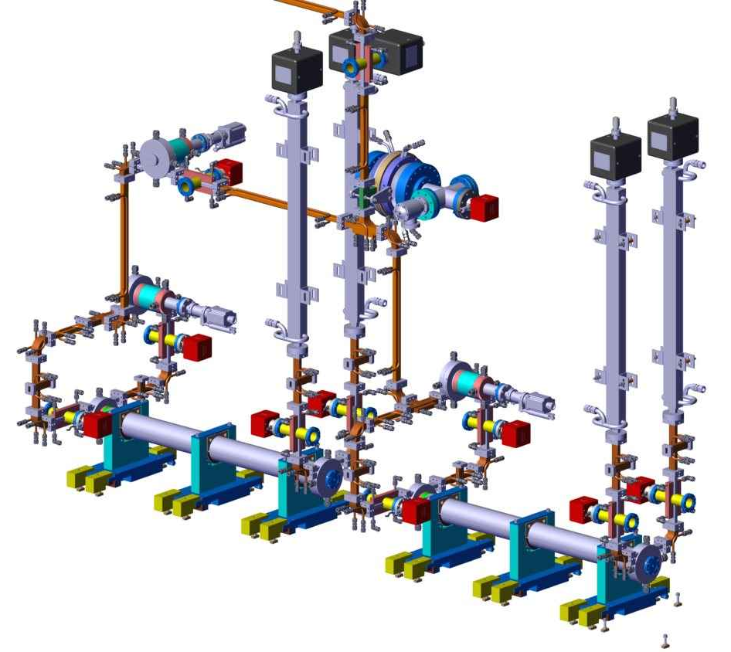
PolariX in ATHOS
PolariX TDS placed downstream the ATHOS undulators
PSI HV modulator: develop and built in-house (400 kV, 3 us)
  based on the Linac 1 and 2 design (Ampegon)
  Investment for future renewal of the injector modulators (S-band and X-band)
Klystron: CPI VKK-8311 50 MW X-band.
Waveguide RF components including the XBOC, phase shifters and directional couplers designed and built at PSI.
Two TDSs (120 cells version) built at PSI.

Slide 9
Conditioning and breakdown analysis
Results of the first systematic conditioning performed in July ’23.
Target klystron output power: 34MW

Slide 10
Conditioning and breakdown analysis

Slide 11
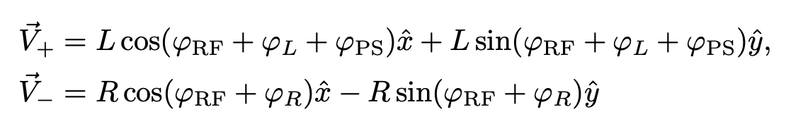
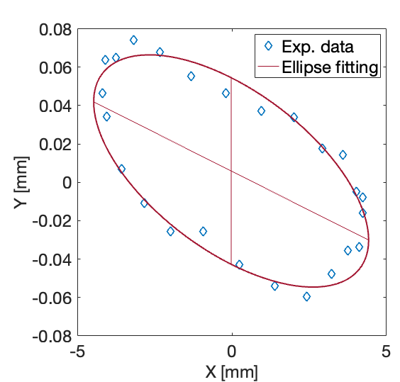
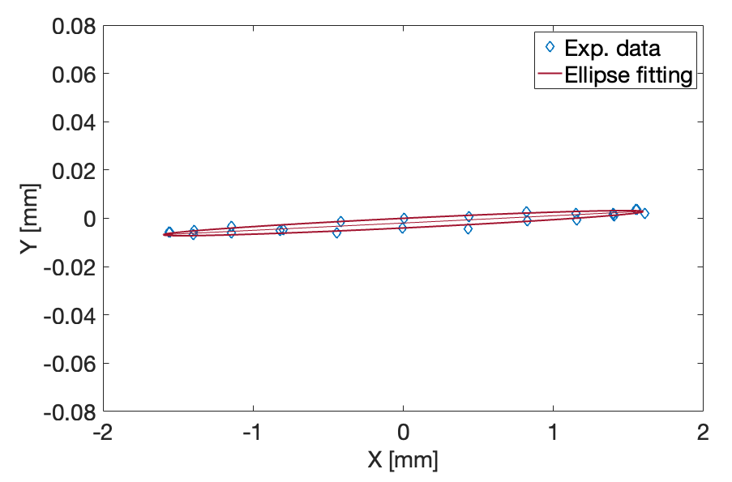
RF setup and commissioning with beam
Deflecting field is the sum of two rotating modes, one clockwise and the other counter clockwise
Wrong setting of the PSs and/or the amplitudes are unbalanced then the superposition of the two rotating modes results in an elliptically polarized mode, whose effect is to provide a kick in the plane orthogonal to the streaking plane (we will call this effect a residual kick).
F. Marcellini et al.

Slide 12
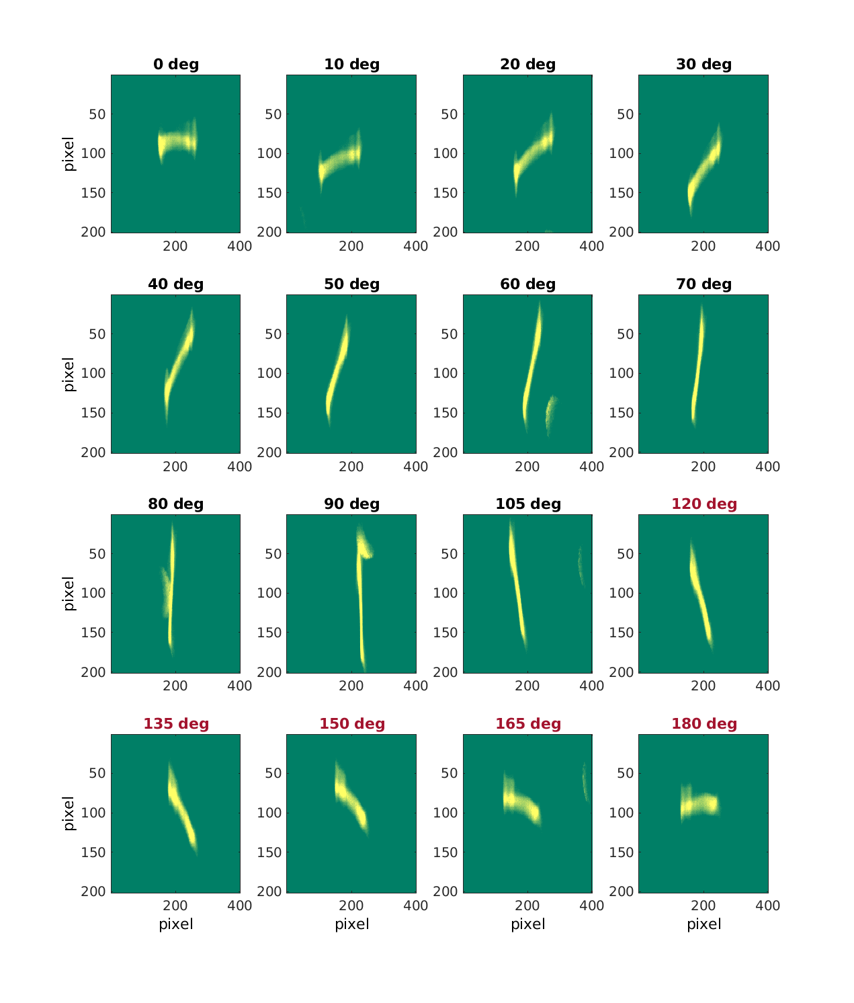
Variable polarization – first measurements
Bunch centroid on a BPM after TDSs as a function of the global RF phase. Polarisation variation of 5 deg.
Right plots: Images on screen before dipole as a function of polarization angle. Dark polarization angles: 85 MW, red polarization angles: 72.8 MV.

Slide 13
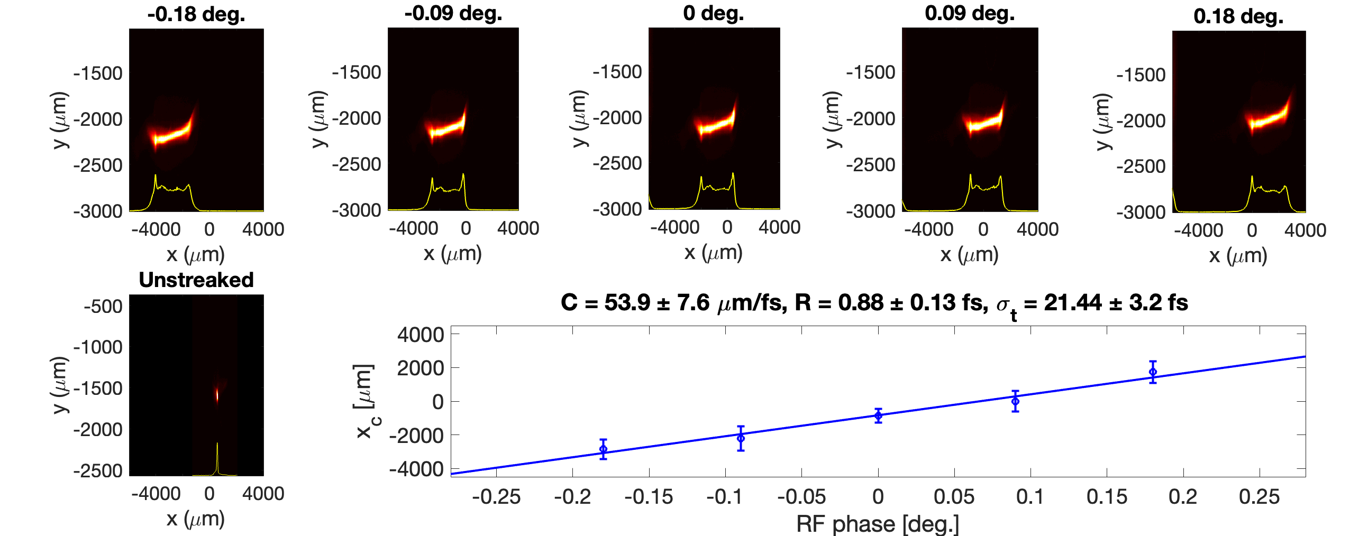
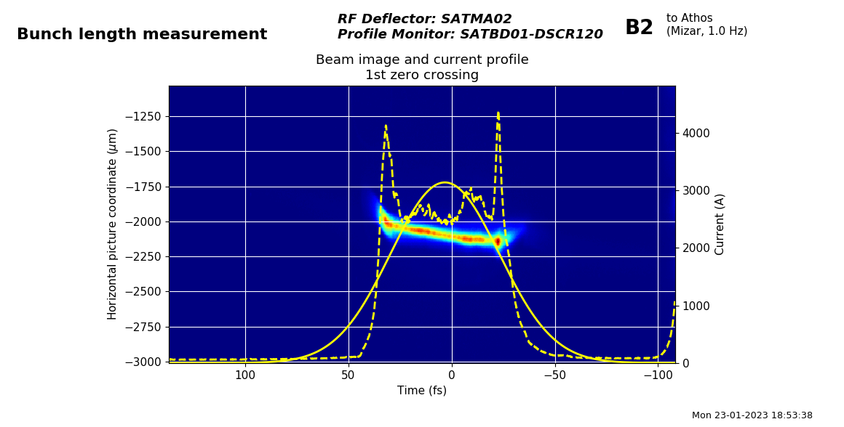
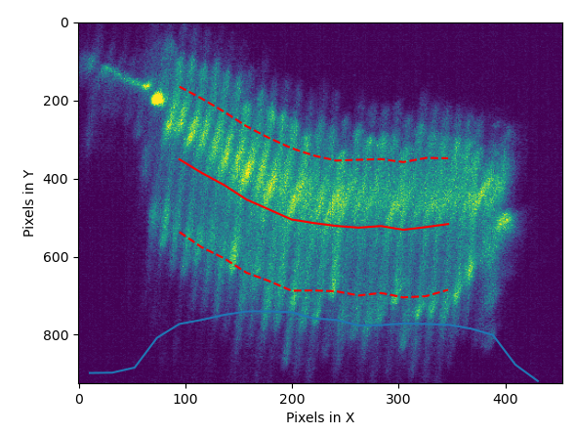
Calibration, resolution and bunch length
The absolute calibration factor C between the transverse coordinate on a screen and the time coordinates within the electron bunch is obtained by measuring the dependence of the transverse position of the centroid of the streaked beam on the RF phase
Time coordinates are obtained by dividing the transverse coordinates on the screen by the calibration
Bunch length is simply obtained as the streaked beam size divided by the calibration factor C
Resolution R= s₀/C < 1fs
σ₀ = 47.7 ± 0.6 μm
Deflecting voltage 85 MV, s₀ = 47.7 ± 0.6 μm
ESASE: the periodicity of the modulation is 800 nm, corresponding to 2.66 fs. It shows that we have a resolution well be 1 fs
Courtesy of S. Reiche’s
Courtesy of Paolo Craievich

Slide 14
Conclusions
Seven PolariX transverse deflecting structures have been realised as part of collaboration between PSI, DESY and CERN.
Fabricated through PSI brazed structure technology, the low power measurements illustrate that these are extremely well-tuned structure.
Two TDSs have been installed in the Athos line of SwissFEL and conditioned to high power across all polarisation. The conditioning found evidence of a reduction in conditioning time when changing polarisation between angles where peak fields overlap.
Measurements found a residual kick on the beam resulted in an ellipsoidal behaviour for streaking.
After calibration, the first measurements of the bunch length found a value of 21.44 ± 3.2 fs with a measurement resolution of 0.88 ± 0.13 fs.

Slide 15
Wir schaffen Wissen – heute für morgen
Thank you to everyone that has contributed.
We thank all the technical groups at PSI involved in the installation and commissioning of the PolariX TDS system
To prepare my slides, I have especially used material from: E. Prat, F. Marcellini, S. Reiche
Thanks also go to our colleagues at CERN and DESY involved in this collaboration for the useful discussions.
Thank you for your attention!

Slide 16
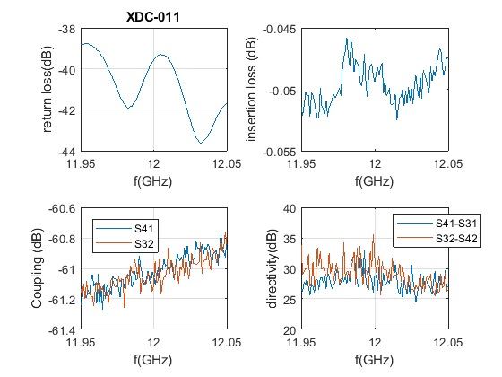
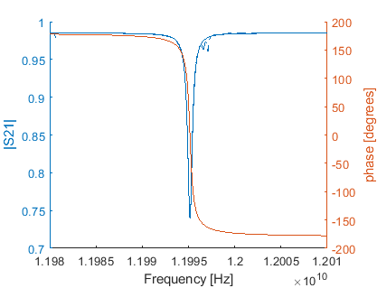
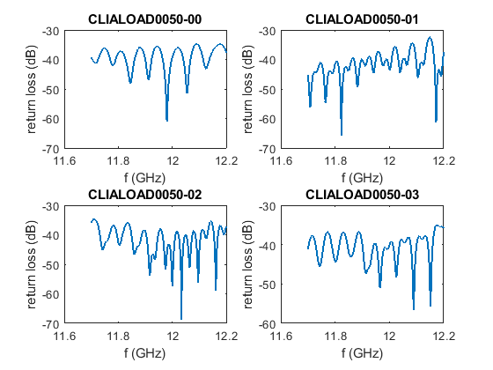
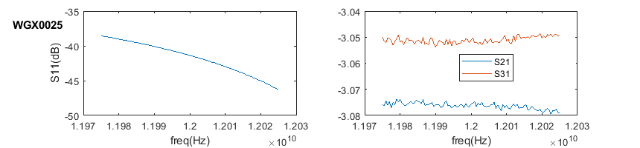
Other X-band components
BOC
Directional
couplers
3-dB splitters
Loads

