Slide 1
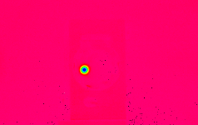
AWAKE e- linac including CTF2 injector status
Awake electron injectors
CTF2 prototype status
Conclusion and outlook
CLIC Mini Week, Dec 11-13, CERN
Steffen Doebert

Slide 2
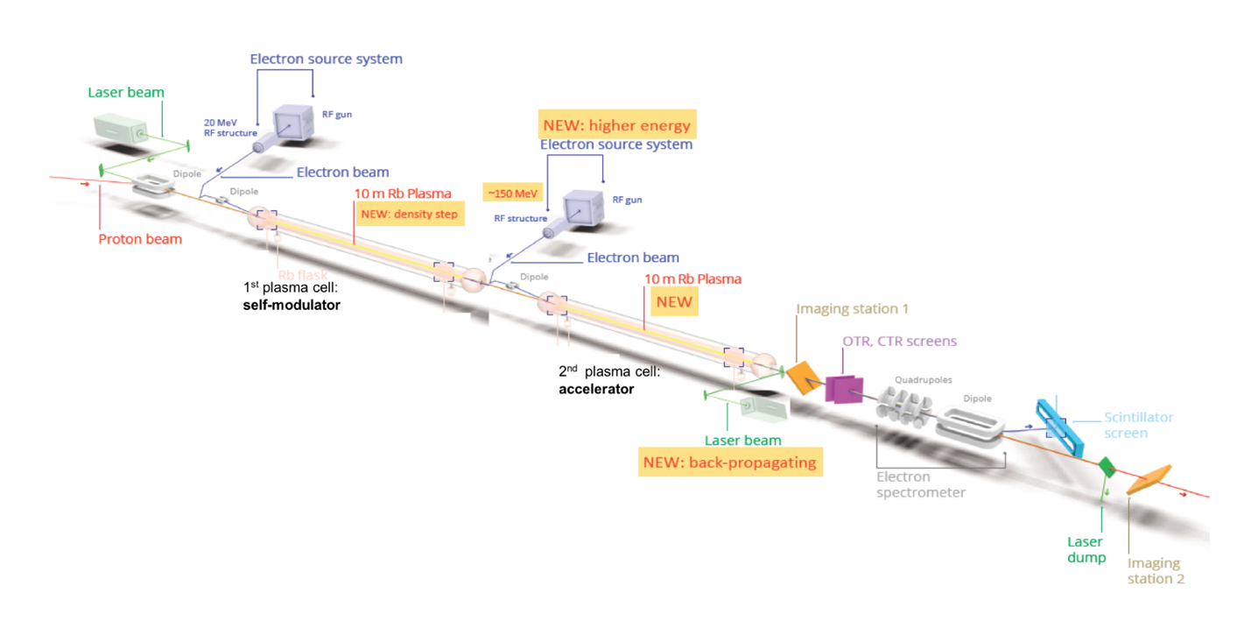
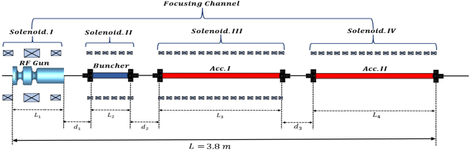
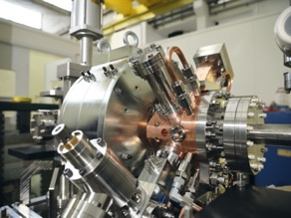
AWAKE Run 2
Demonstrate possibility to use AWAKE scheme for high energy physics applications in mid-term future!
Start 2021! Staged program for ~ 10 years
  Need to work in blow-out regime and do beam-loading
  New electron beam based on x-band:
  150 MeV, 200 fs, 100 pC, σ = 5.75 µm
Goals:
Accelerate an electron beam to high energy (gradient of 0.5-1GV/m)
Preserve electron beam quality as well as possible (emittance preservation at 10 mm mrad level)
Demonstrate scalable plasma source technology (e.g. helicon prototype)

Slide 3
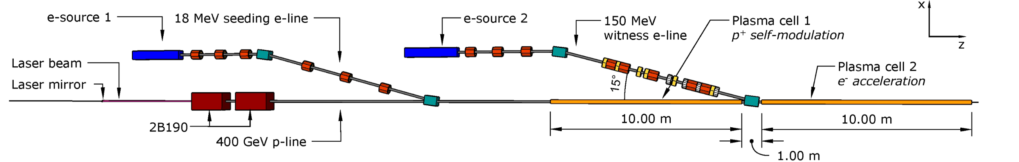
Parameters for both injectors
Working documents held by Rebecca (Injector 2, EDMS 2378918) and John (Injector 1, EDMS 2417022,2588263)
 | Beam Energy | Energy Spread | Energy stability | RMS Bunch Length | Bunch Charge | Emittance | Beam size plasma focus
Injector 1 | $$18.5 MeV$$ | $0.5 \%$ | 1 x 10⁻² | $$≈2−3 ps$$ | $$100 −600 pC$$ | 2 - 5$μm$ | $$\sim 190 µm$$
Injector 2 | $$150 MeV$$ | $0.2 \%$ | 1 x 10⁻³ ? | $$≈200−300 fs$$ | $$100 pC$$ | 2 $μm$ | $$5.75 µm$$
Energy as high as affordable ?
Energy spread as low as possible !
Energy stability as good as possible !
Emittance reasonably low, no need for ultra-low

Slide 4

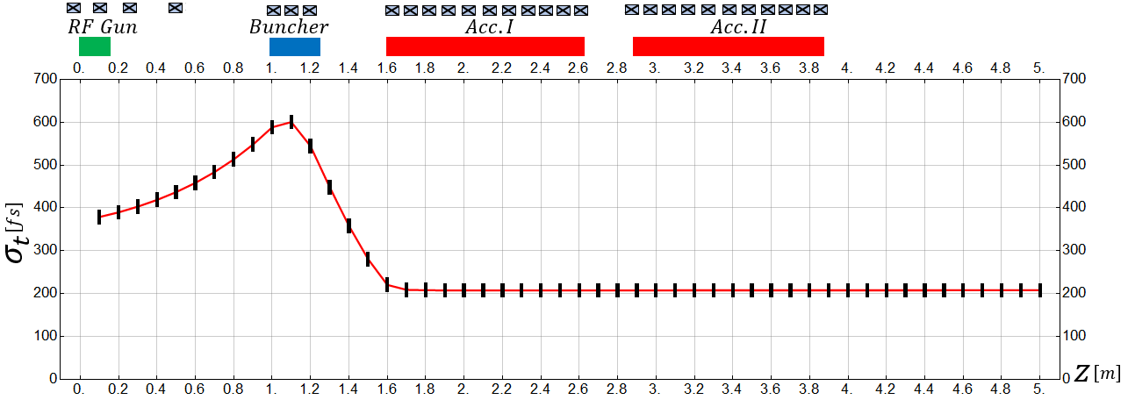
Reference design
Well advanced concept and beam dynamics design
Laser parameters
$$λ\left[nm\right]$$ | $$w\left[ev\right]$$ | $$r\left[mm\right]$$ | $$t\left[ps\right]$$ | $$q\left[nc\right]$$
262 | $$4.31$$ | 1.0 | $$1.0−5.0$$ | 0.1-1.0
RF parameters
Parameter | RF Gun | Buncher | Acc. I | Acc. II
Frequency | $$3.0$$ | $$12.0$$ | $$12.0$$ | $$12.0$$
Gradient | $$120MV/m$$ | $$35MV/m$$ | $$80MV/m$$ | $$80MV/m$$
N. Cell | $$1.5$$ | $$30$$ | $$120$$ | $$120$$
$$E_{k}\left[MeV\right]$$ | $$σ_{r}\left[mm\right]$$ | $$σ_{t}\left[fs\right]$$ | $$ε_{x}\left[μm\right]$$ | $$σ_{E}\left[\%\right]$$ | $$I_{av}\left[A\right]$$
$$165$$ | 0.14 | $$207$$ | 0.44 | $0.0$9 | $$168$$
Mohsen Dayyani Kelisani

Slide 5
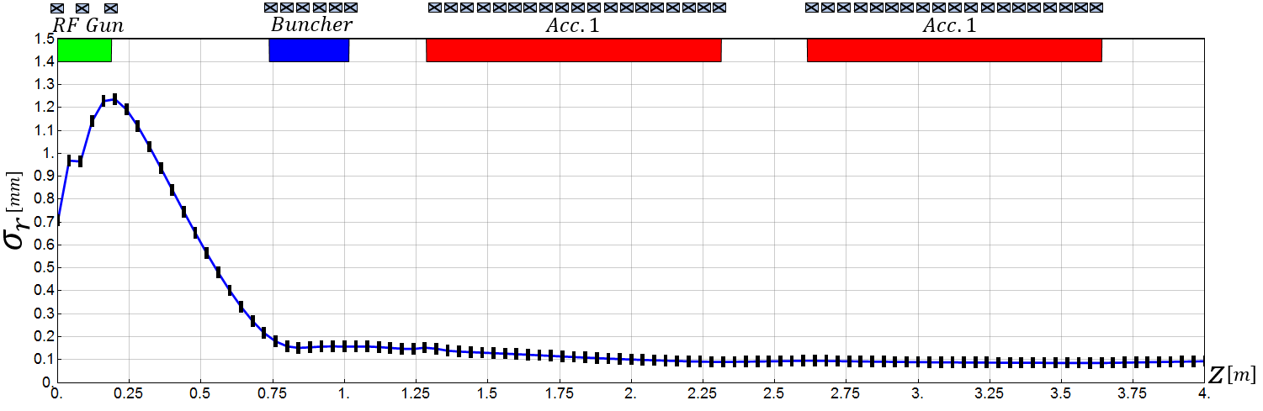
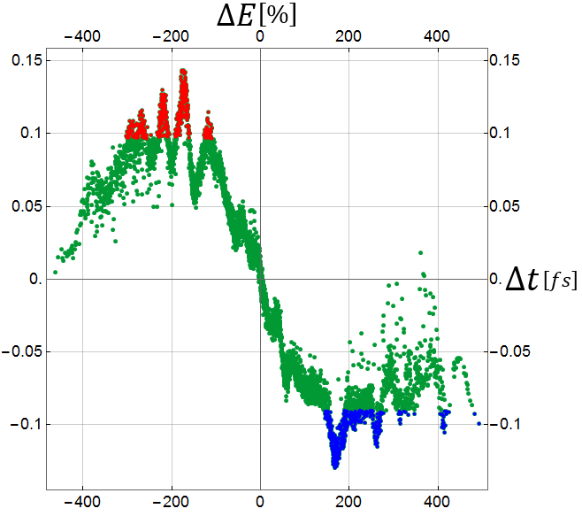
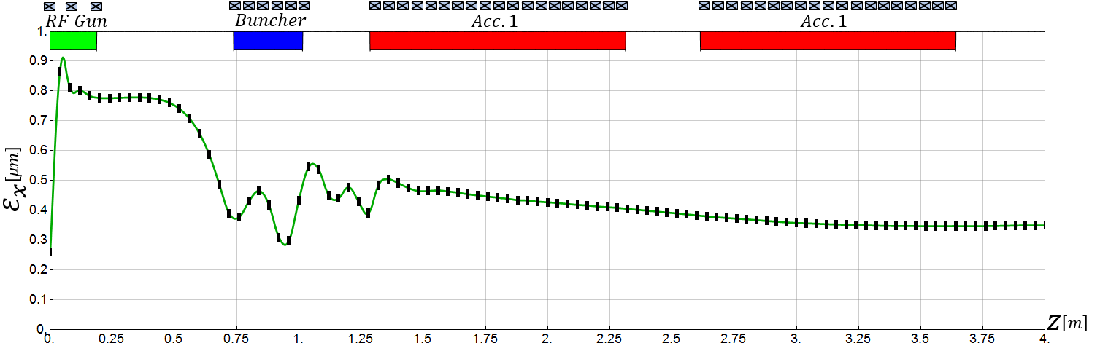
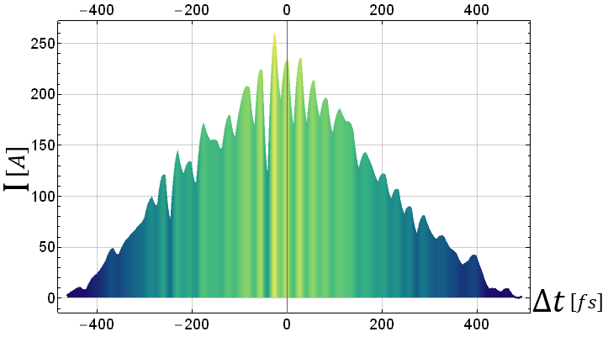
Reference design
Mohsen Dayyani Kelisani

Slide 6
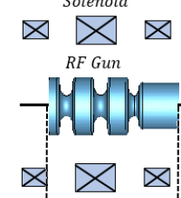

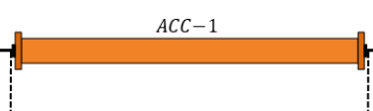
Awake schematic RF layout
Mini klystron
7-10 MW, S-band
Mini klystron
5-10 MW, x-band
25 / 50 MW klystron, x-band
PC, 15 -20 MW
PC, 160 -200 MW
A, ϕ
Possibly long waveguides 30 m
Round or double height WG needed
Or 2 klystrons
Solenoid
Solenoid
3 structures at 55 MV/m
X
X
X
X
X
X
X
X
X
X
X
X
X
X
Total Energy 100- 160 MeV, 10 Hz rep. rate, single bunch
Will try to use CLIC developed x-band components as much as possible

Slide 7
Studied alternative scenarios
Beam dynamics:
3 identical structures, one 50 MW klystron → Save small klystron, waveguide run and buncher structure
RF power variants:
One 25 MW klystron for acceleration, small 8 MW klystron for bunching → less expensive klystron and modulator
Only one 25 MW klystron for everything → less expensive klystron, save second waveguide run and small klystron
Integration scenarios:
Keep Run 1 modulator (PPT) for LINAC 1, instead of two K100 modulators → no new hardware needed
Use K400 modulator instead of PPT → better performance and stability
Replace K400 x-band with 2x K200 x-band → essentially staged scenario to upgrade energy later

Slide 8
SOLUTION 1
Keep PPT modulator from Run1 for Linac 1
CURRENT
KLYSTRON
K100
K200
K400
TRANSPORT VOLUME

Slide 9
SOLUTION 2-B
0.8m
0.9m
1m
0.9m
0.9m

Slide 10
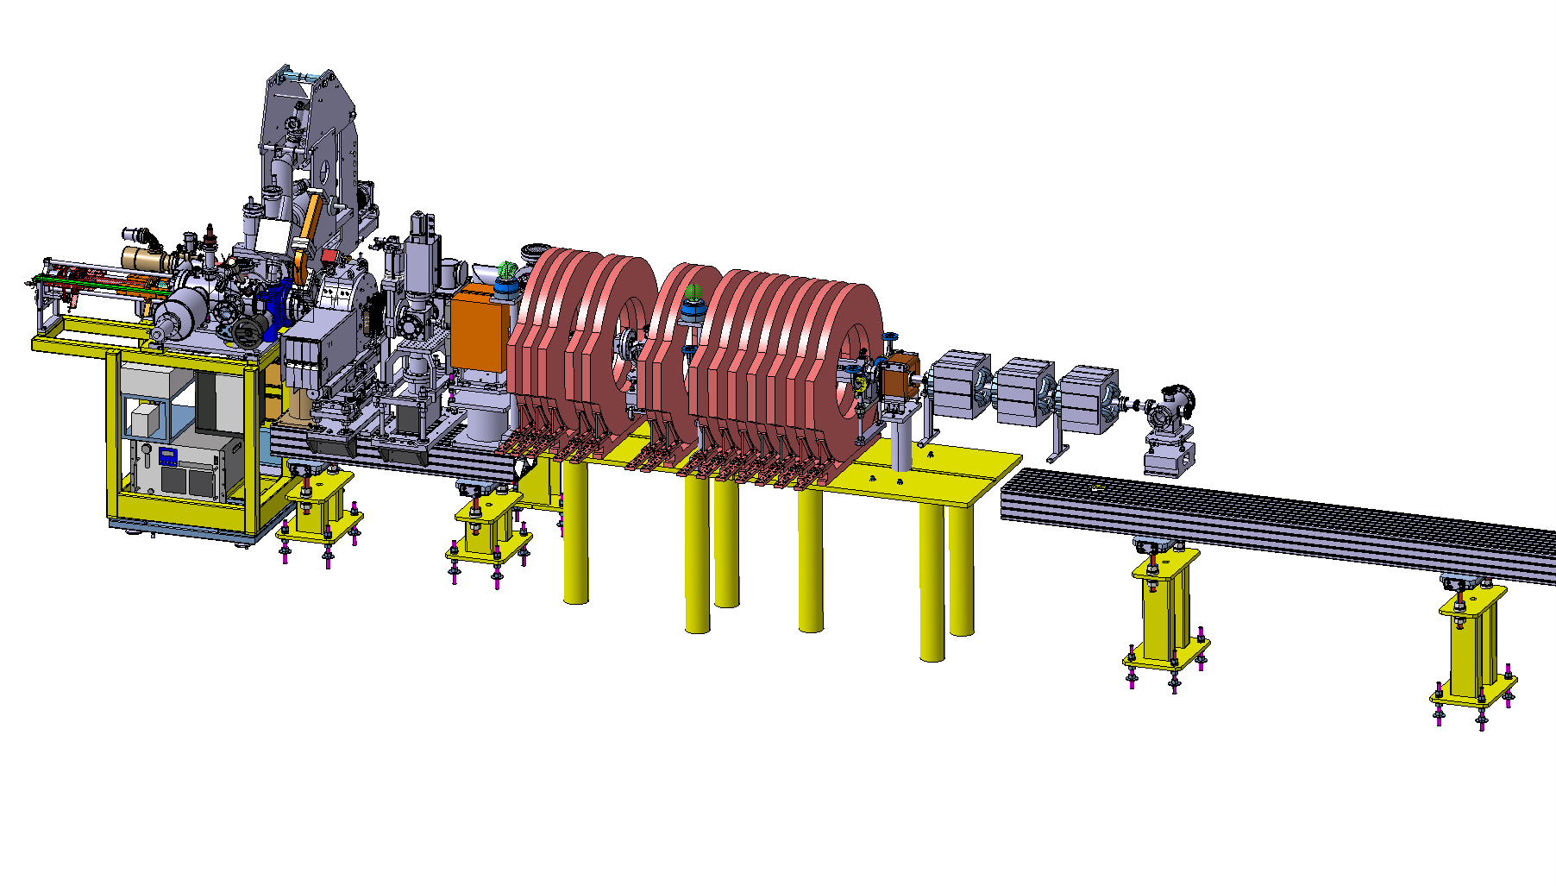
Injector prototype in CTF2
for CLEAR and AWAKE
ARTI (AWAKE Run2 Test Injector)
Reduced scale prototype, 60 MeV, T24 as buncher and PSI-linearizing structure for acceleration.
Goal: demonstrate the velocity bunching and emittance preservation with x-band
Prototyping of key hardware

Slide 11
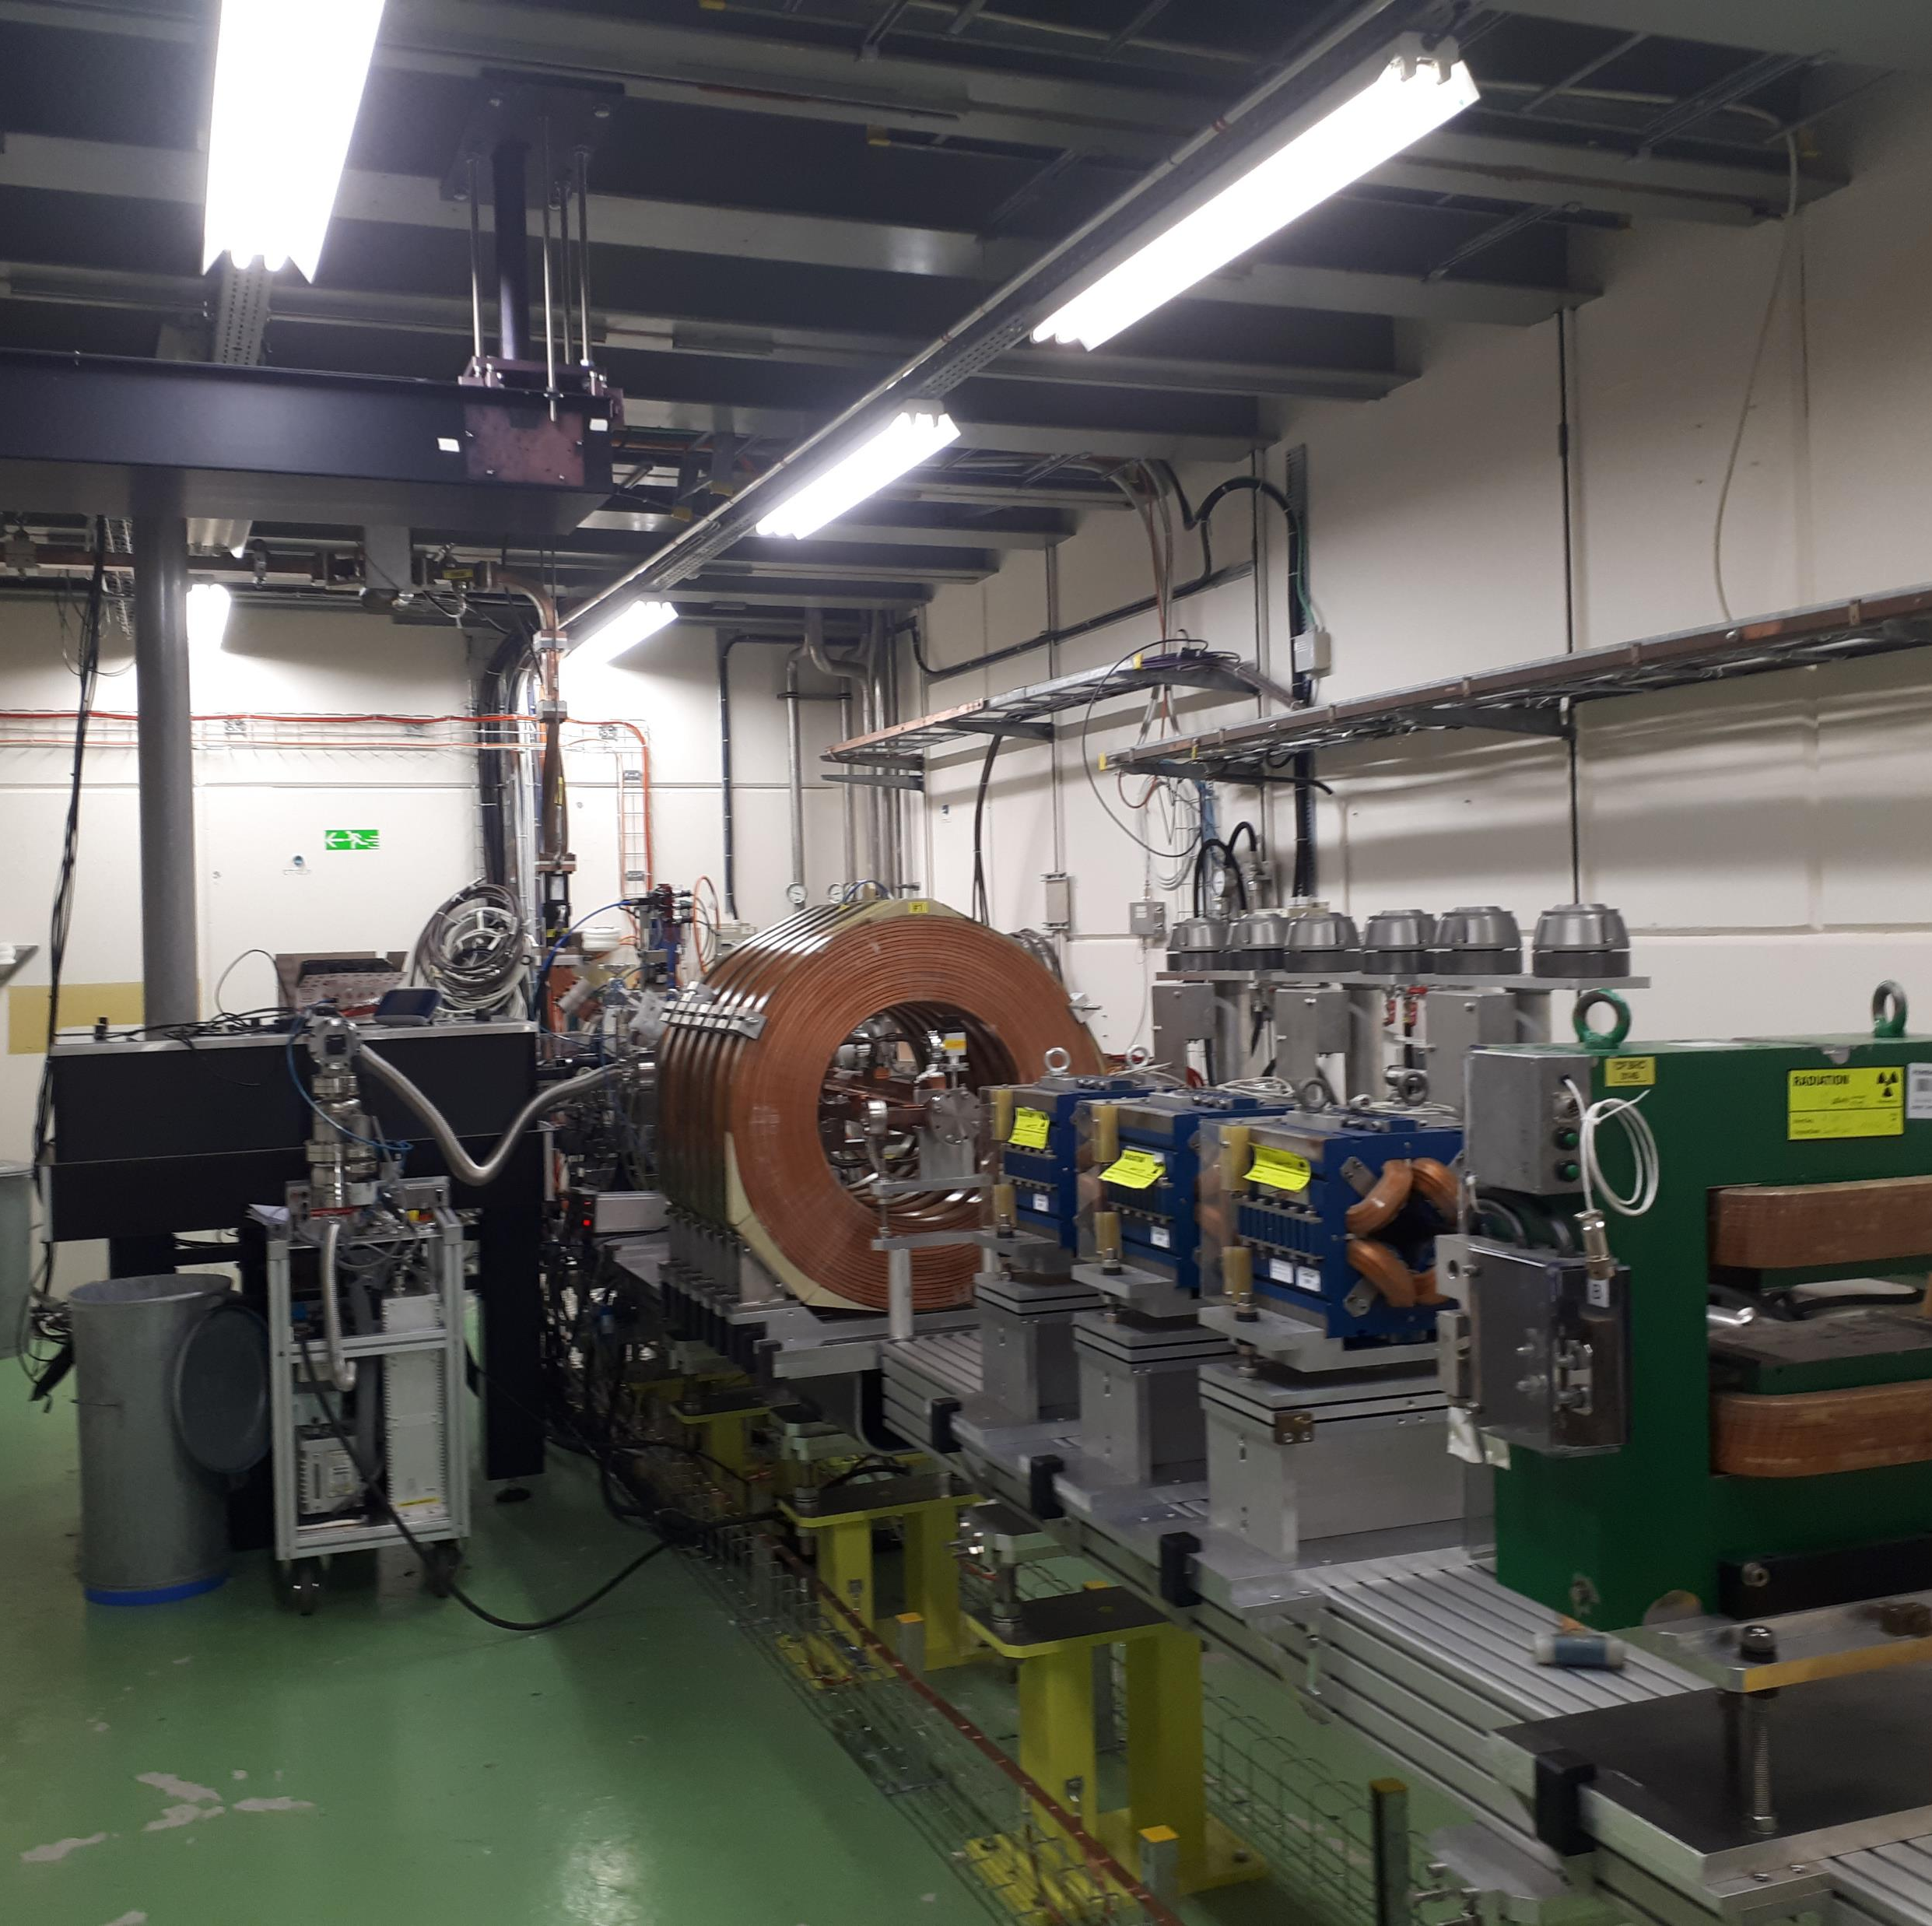
ARTI status
RF-gun and diagnostics operational
(under commission)
Magnets for second phase installed
Vacuum system will be next
(this shutdown)
Missing the x-band waveguide system
and the klystron (still at CPI for repair)
First ‘user’ experiment planned next spring: Vlad’s CBS experiment

Slide 12
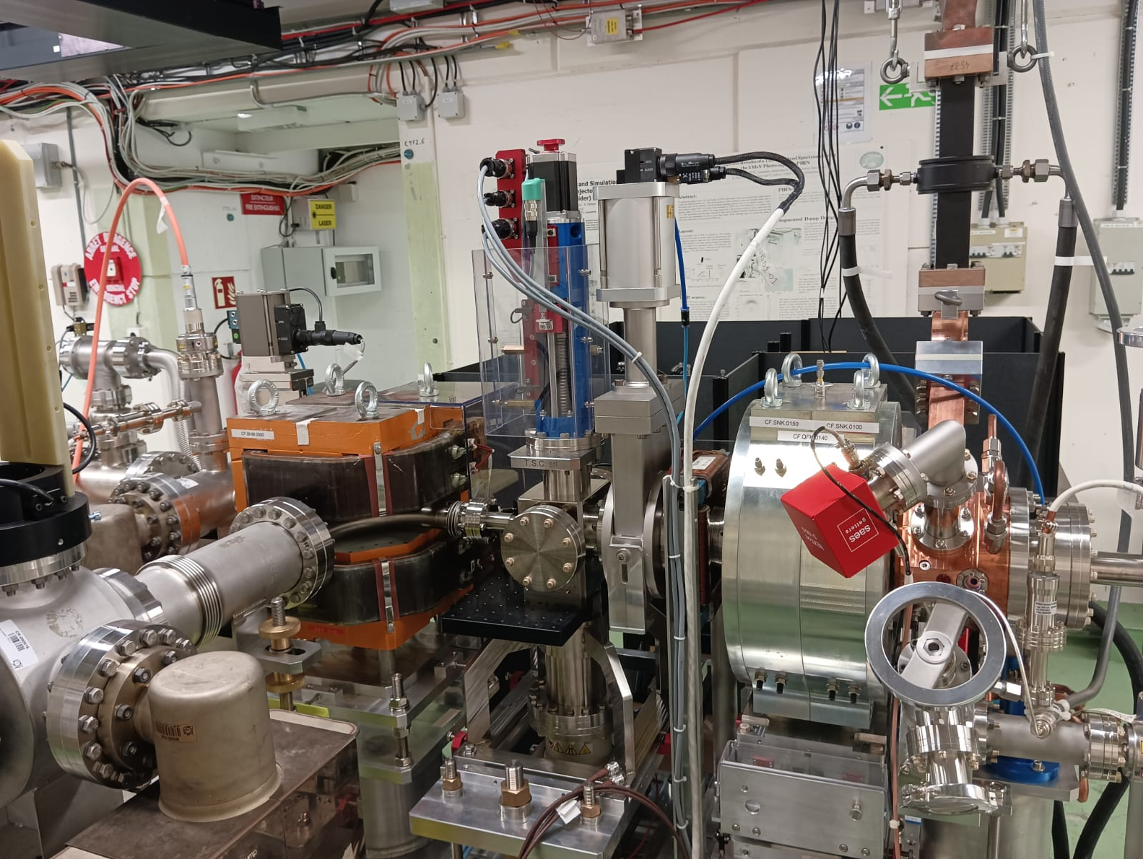
F-Cup
ARTI in CTF2
Screen BTV1
RF-GUN
RF-gun conditioned to 120 MV/m on the cathode
200 ns
400 ns
600 ns
800 ns
1 us
Spectrometer
Notes:
.

Slide 13
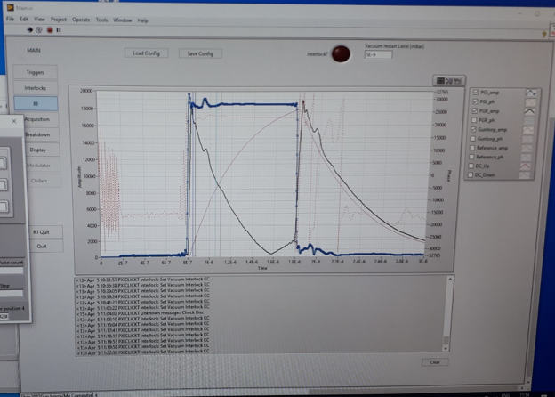
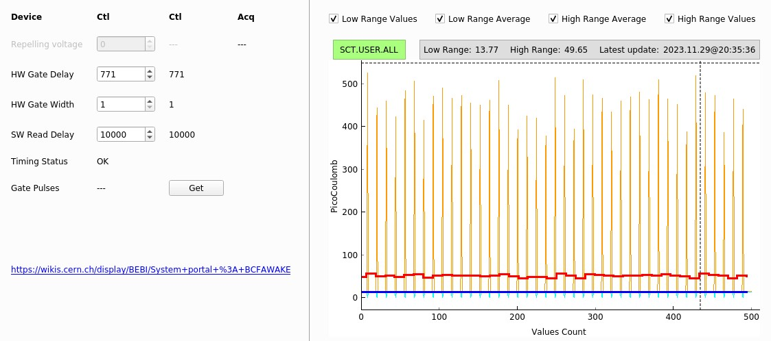
First results with beam
Beam charge:
Faraday Cup: up to 440 pC
Copper Qe: 9 x 10⁻⁴
Very promising for Copper cathodes
No dark current basically not measurable for time being:
< 5 pC (preliminary)
RF set-up:
Input Power: 13 MW
Gradient: 114 MV/m
Warning: calibrations still floating

Slide 14
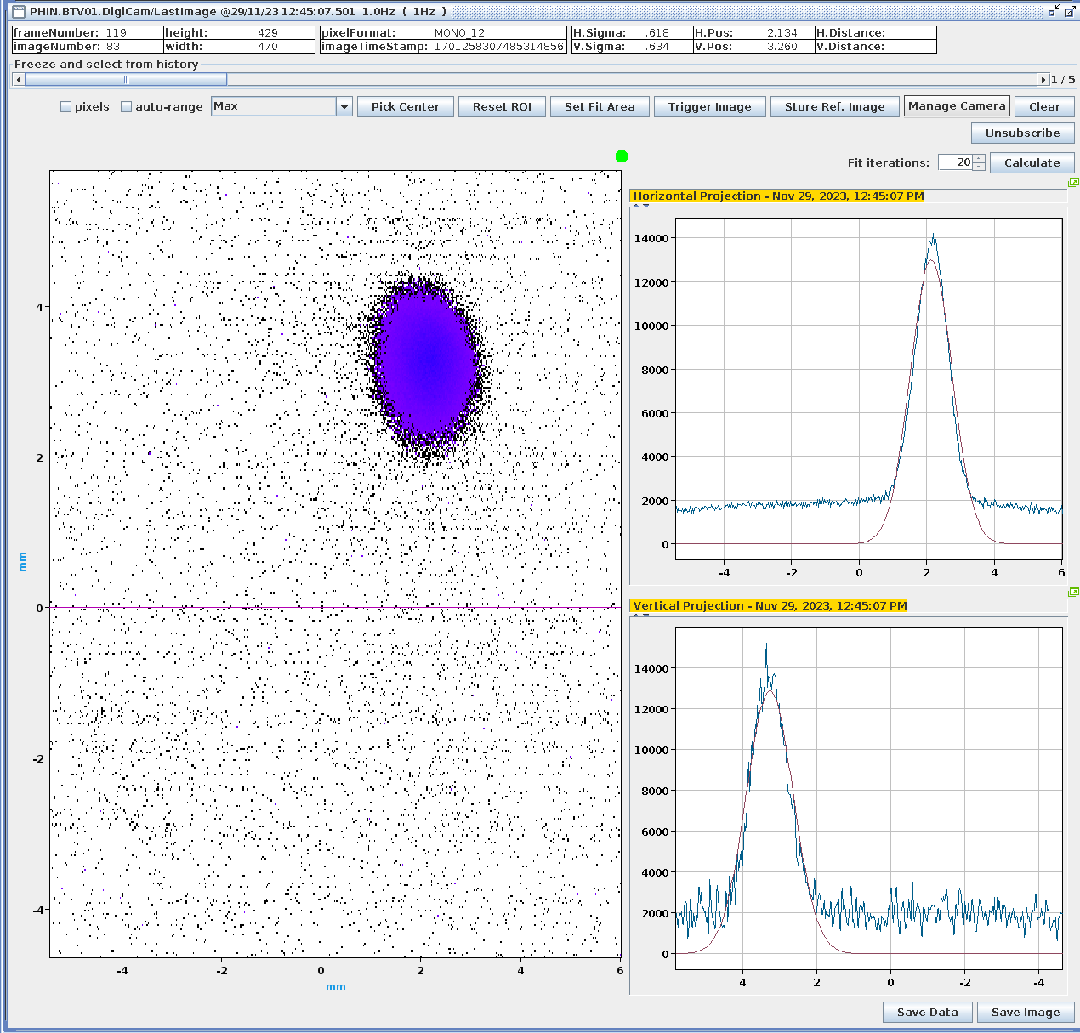
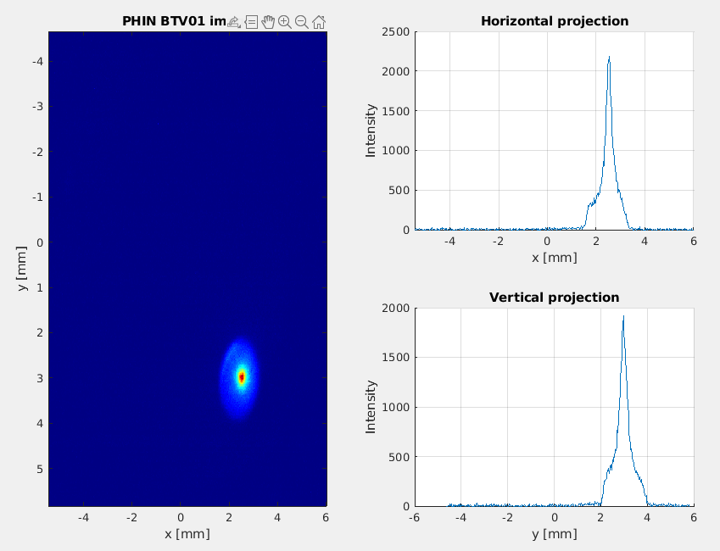
Beam profile characterisation
Screenshot of unfocused beam
Screenshot of focused beam
The beam appears to have a halo surrounding a sharp peak -> RMS from beam projection overestimated beam size
Vlad Muscat

Slide 15
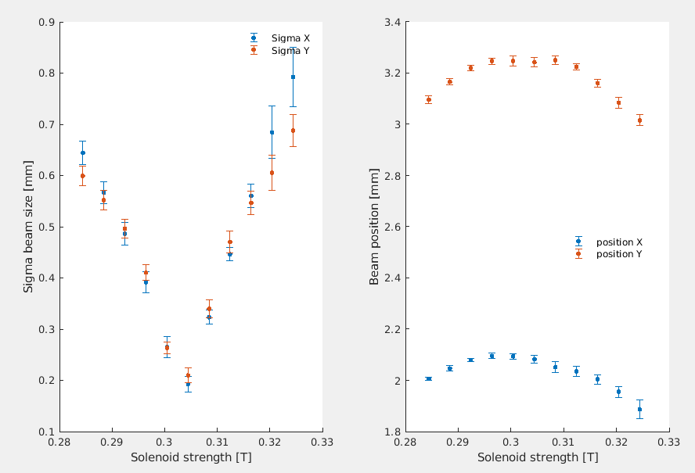
Solenoid scan at 400 pC
200 um RMS spot reached!
Results closer to expectations I had from simulations (130 um RMS).
We currently try understand the results with simulations.
Work in progress
Vlad Muscat

Slide 16
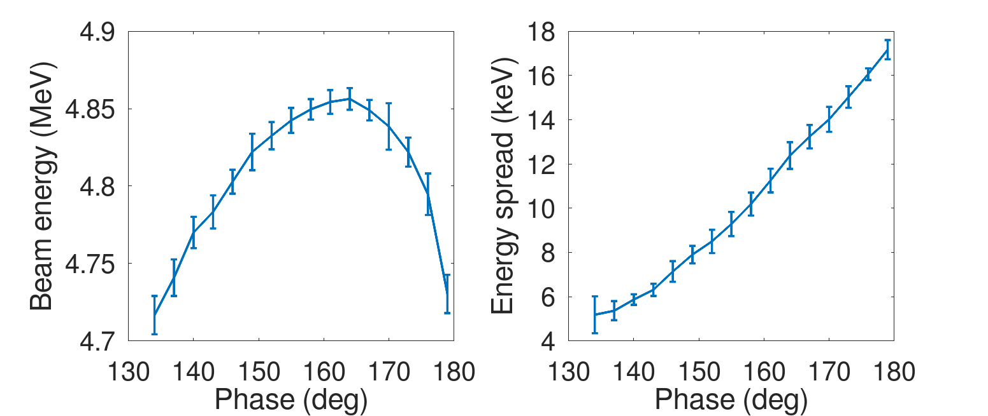
Phase scans
The on-crest phase was shifted by 20 deg. On-crest now at 163 deg.
Warning: calibrations still floating
Vlad Muscat

Slide 17
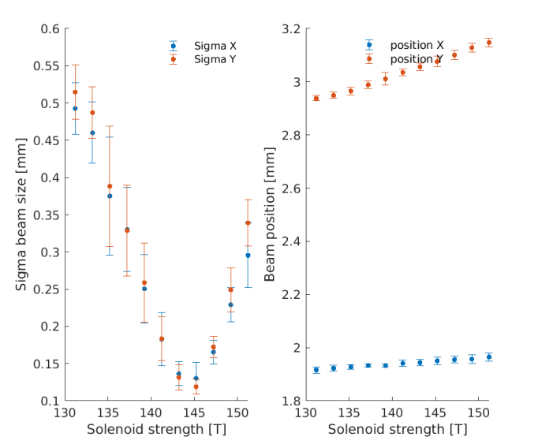
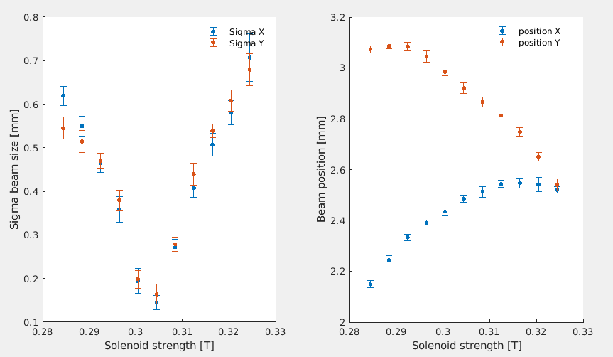
More solenoid scans
Laser pulse length = 112.7 fs RMS
Laser pulse length = 327 fs RMS
Vlad Muscat

Slide 18
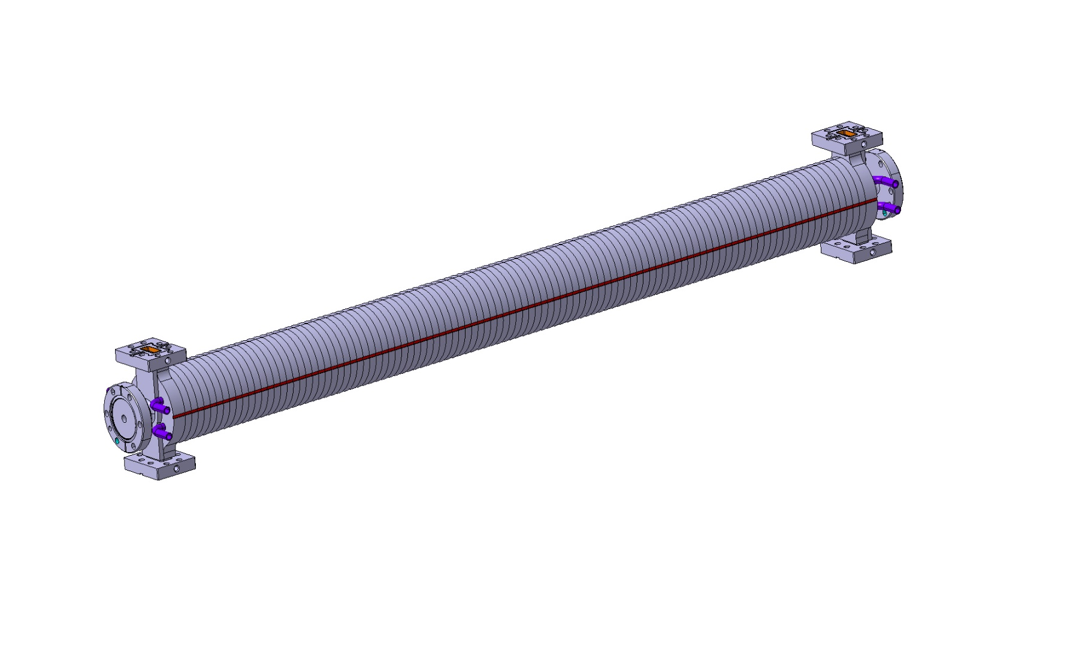
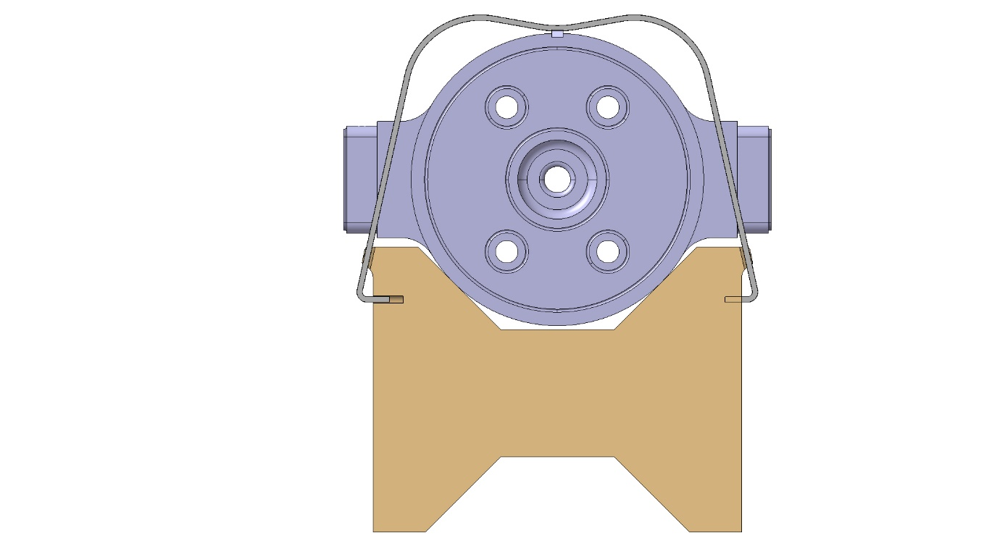
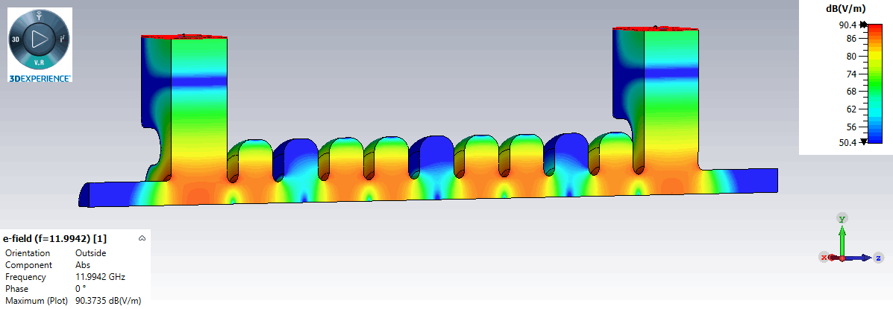
X-band structure developments
Travelling wave Constant Impedance
Shunt Impedance [MΩ/m] | 100
Group Velocity vg/c [%] | 2.4
Q-Factor | 7061
Attenuation [1/m] | 0.7
Length [m] | 0.9
Mechanical design
made at CERN
CLIC style tolerances
Vacuum brazing design
Structure to be inserted in a solenoid of 150 mm diameter bore radius
Designed by INFN Frascati, D. Alesini, M. Diomede,
for CompactLight and EuPraxia

Slide 19
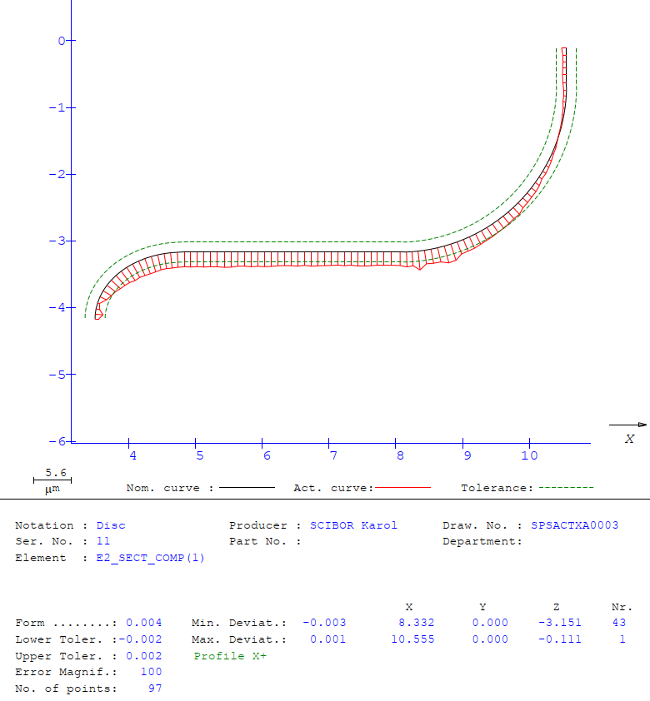
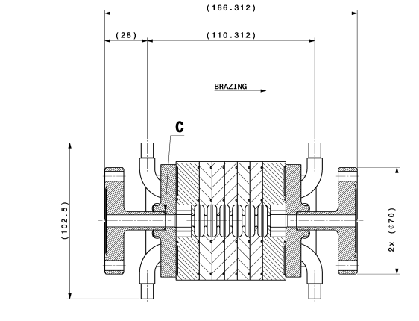
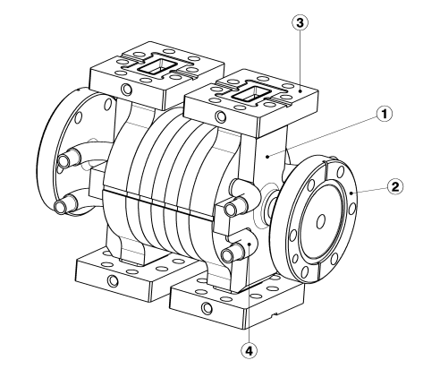
First short prototype under construction
C. Capelli, N. Chritin
Verify mechanical design, brazing assembly and tolerances needed
Maybe low power RF measurements but no high-power test planned

Slide 20
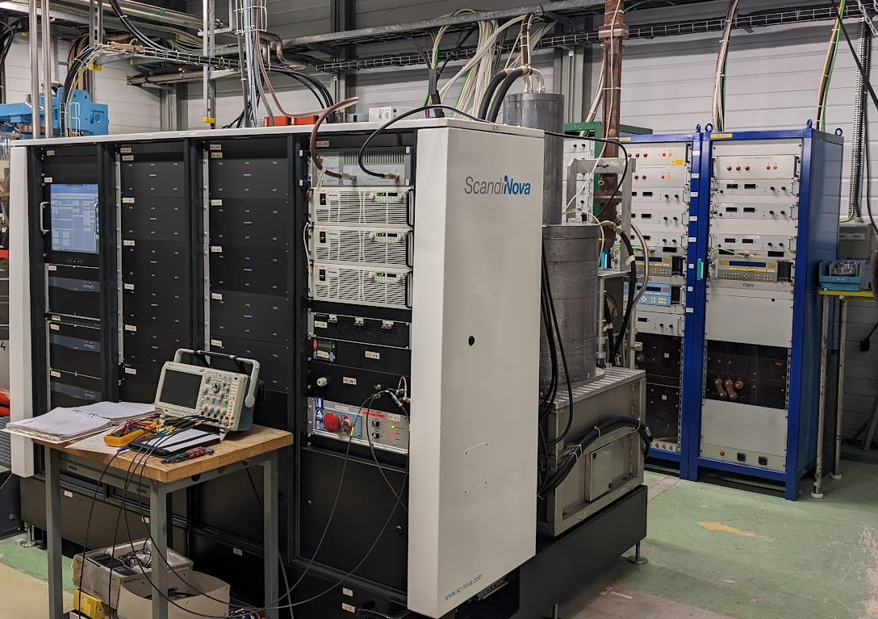
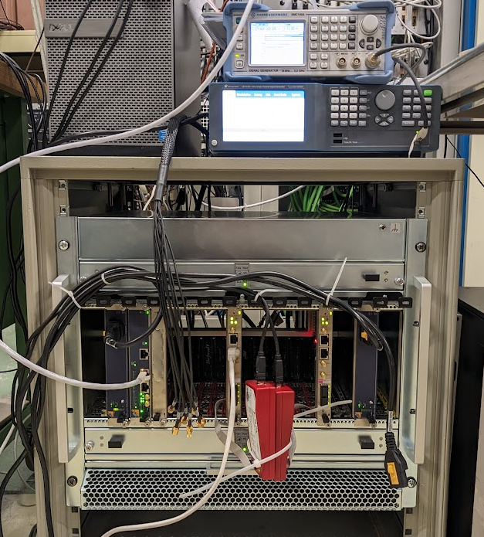
μ−TCA development for LLRF with Uppsala
System shipped to CERN from Uppsala, installed in the form CLIC test facility.
RF signal acquisition, generation and feedback/forward loops tested.
Use of DESY BSP and python GUI.
External trigger injection through RJ45 connector on SIS8300KU AMC, distributed to mLVDS lines.
  Currently under test/development (still some bugs to iron out)
Work progressing well on a DESYRDL to CERN/Cheby convertor script.
Modulator and S-band 40MW klystron (above)
MicroTCA crate and LO, CLK generators (right)

Slide 21
Conclusion and outlook
Further optimisation of the existing baseline injector for Run 2c with respect to performance, cost and integration
Very good start of the beam commissioning. No major problems spotted so far
Of course, fine tuning is needed and systematic measurements.
Clearly much more work to do !
Will alternate commissioning periods with installations periods to complete the injector
Interesting times ahead, a first visible piece of hardware for Run 2c and a first ‘user’ experiment on CBS at low energy. See Vlad’s presentation
Thanks to Jordan Arnesano for his contributions to AWAKE
Welcome to Anton Eager to take over in December

Slide 22
Additional material

Slide 23
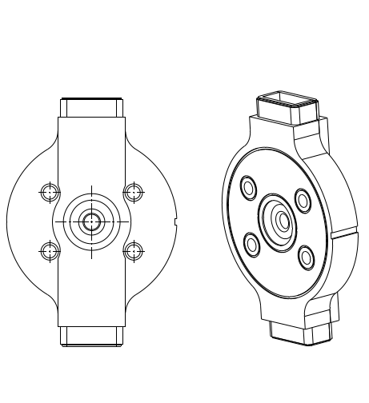
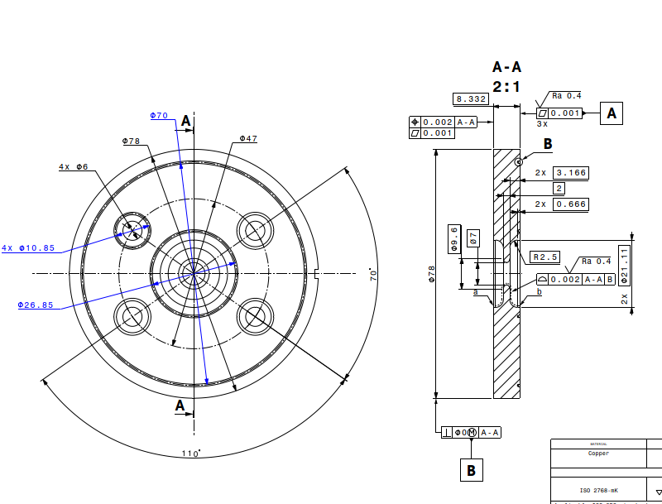

X-band accelerating structure
Mechanical design
Structure to be inserted in a solenoid of
150 mm diameter bore radius
CLIC style tolerances
Vacuum brazing design
RF-Design made by D. Alesini, M. Diomede, INFN Frascati

Slide 24
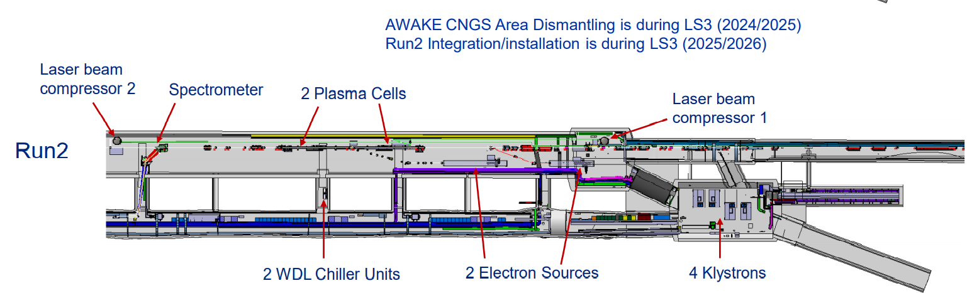
Other requirements
A certain flexibility in the beam parameters which can be delivered keeping good energy spread and emittance
Energy: +- 10%, Charge +400% ?, Bunch length: 100%, beam size : see transport
Constraint space for hardware
Excellent timing stability and synchronisation with laser and self modulation device
30 fs stability

Slide 25
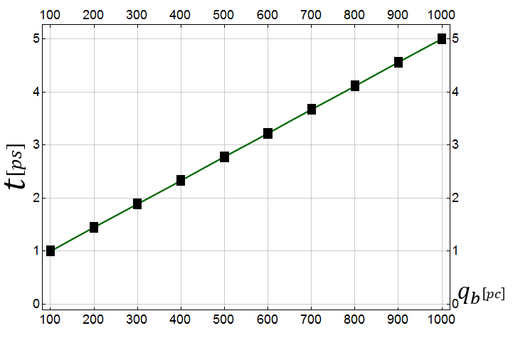
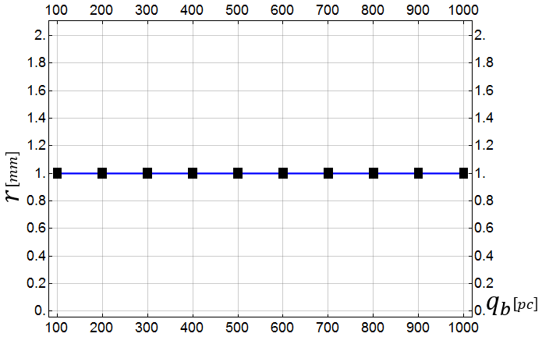
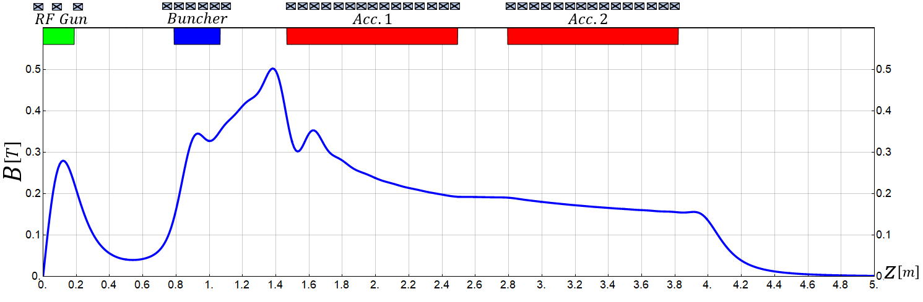
3. High Current Operation
Flexibility to produce higher charge
(for lower plasma density or experimental reasons)
3.1 100pC-1000pC
Changing only laser pulse length and adapting magnetic field slightly
Laser Pulse Duration
Laser Spot Size
Mohsen Dayyani Kelisani

Slide 26
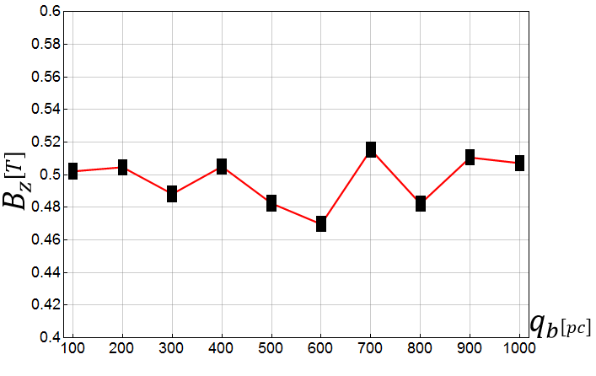
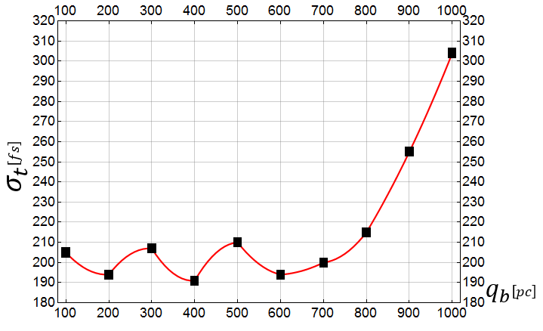
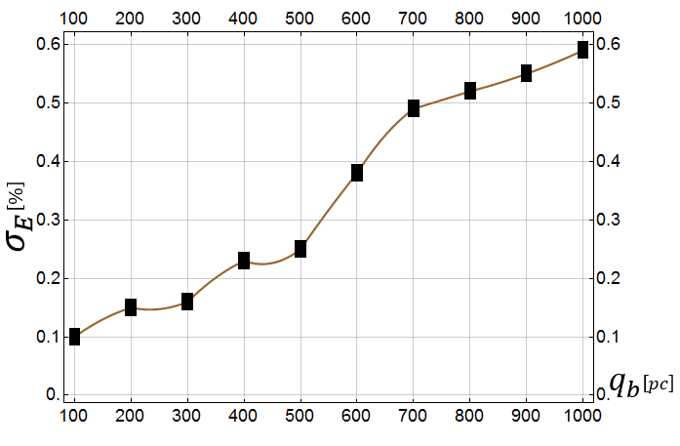
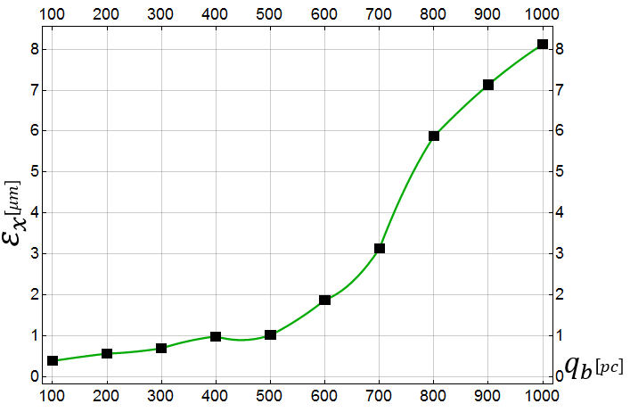
3. High Current Operation
Flexibility to produce higher charge
0.1 to 1 nC per bunch
3.1 100pC-1000pC
Max_$B_{z}$
Bunch Length
Energy Spread
Bunch Emittance
Mohsen Dayyani Kelisani

Slide 27
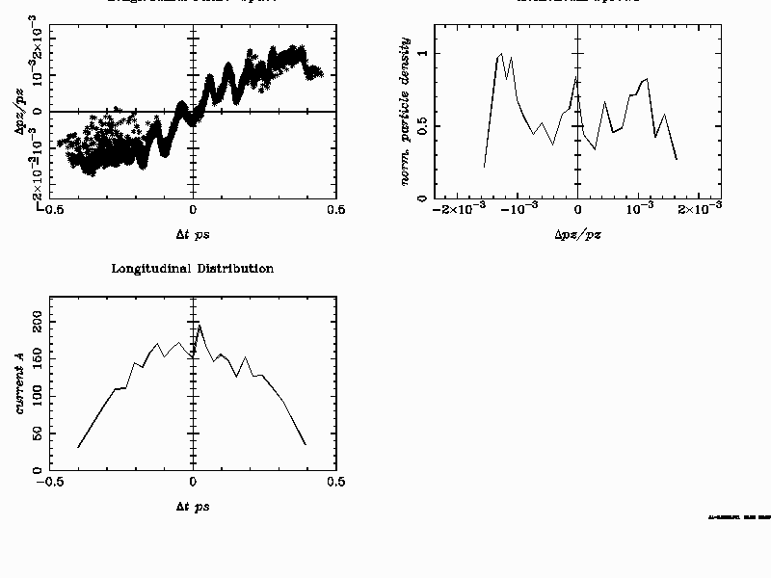
Tentative RUN 2 injector parameter for 150 MeV
Only scaled down accelerating gradient, identical initial distributions,
no new optimization
Energy: 151.8 MeV
Energy Spread: 144.5 keV rms =9.5 10⁻⁴
Emittance: x/y: 0.7 mm mrad
Bunch length: 60 um rms
Bunch Charge: 100 pC

Slide 28
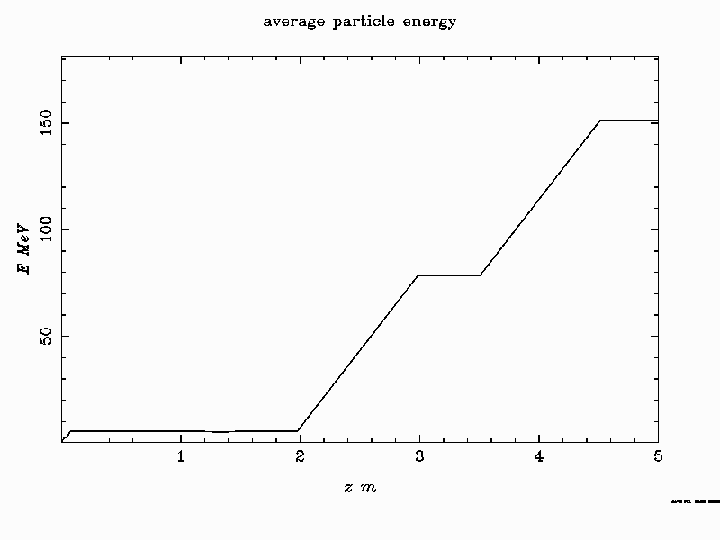
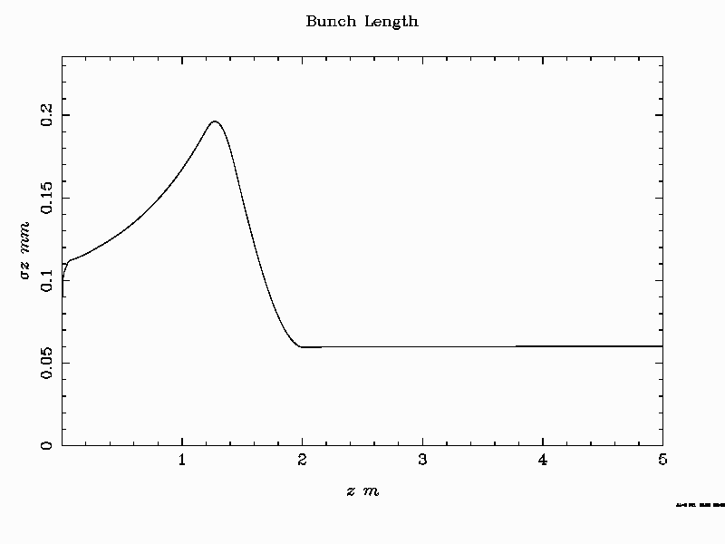
Tentative RUN 2 injector parameter for 150 MeV

Slide 29
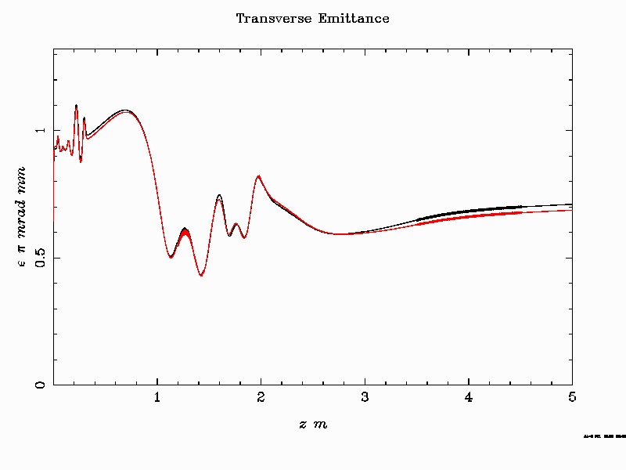
Tentative RUN 2 injector parameter for 150 MeV

Slide 30
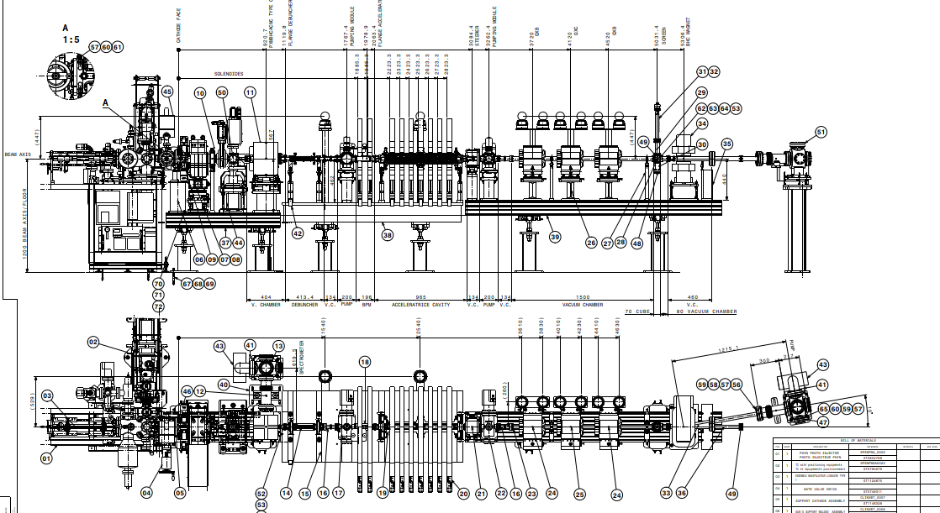

Slide 31
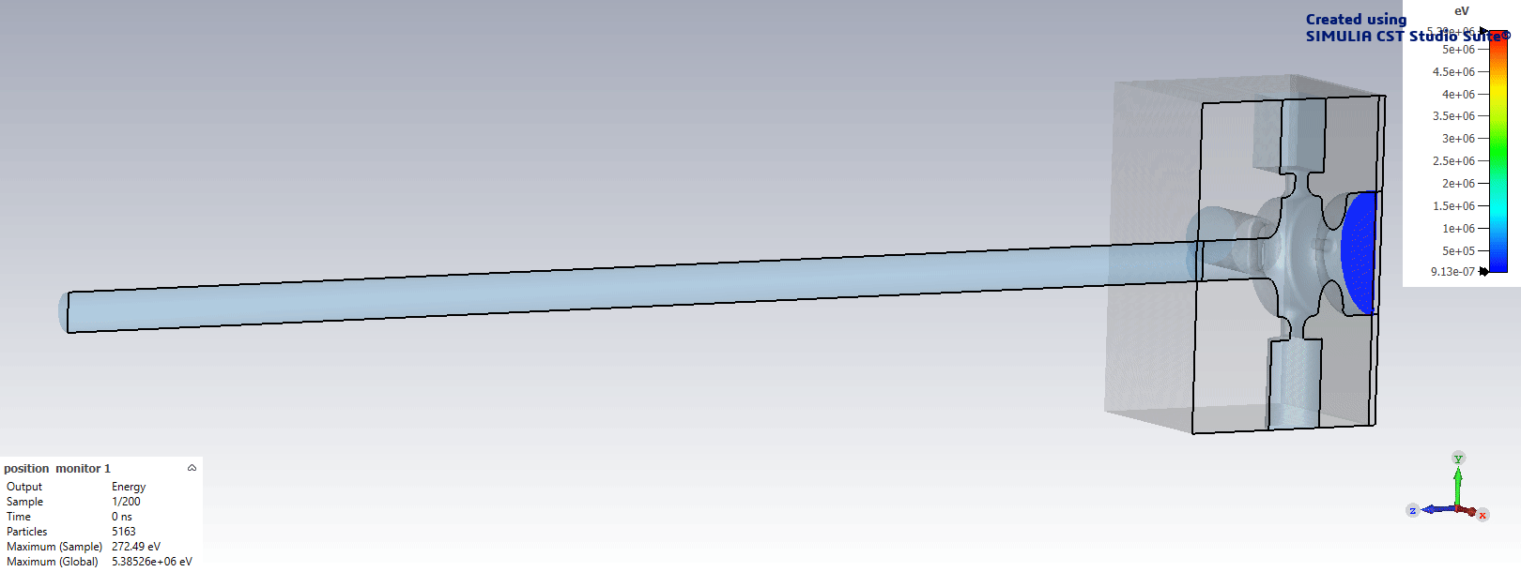
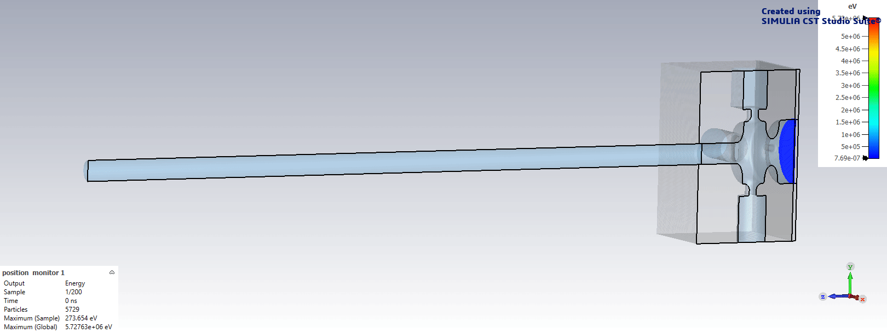
PIC Dark Current Simulations
No Solenoid
Solenoid: Antisymmetric mode
Pablo Martinez-Reviriego, IFIC
Notes:
.

Slide 32
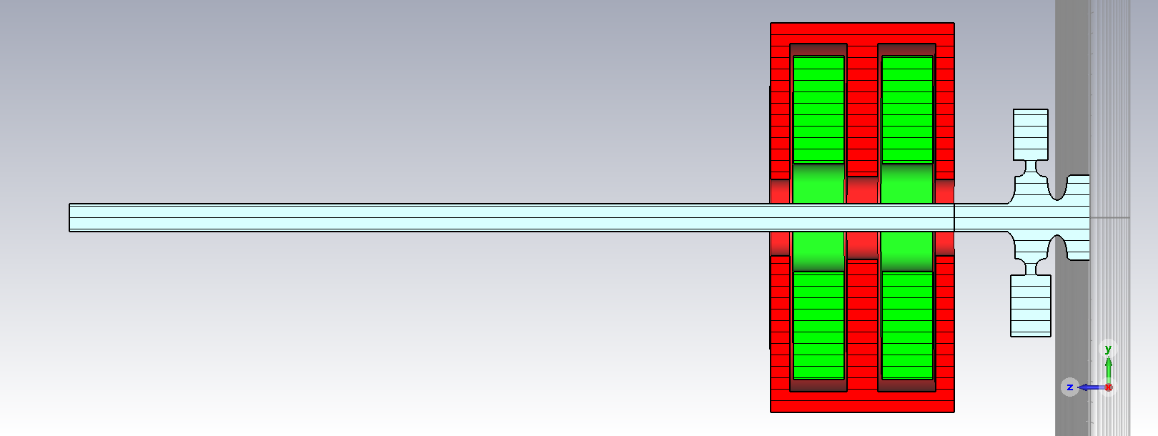
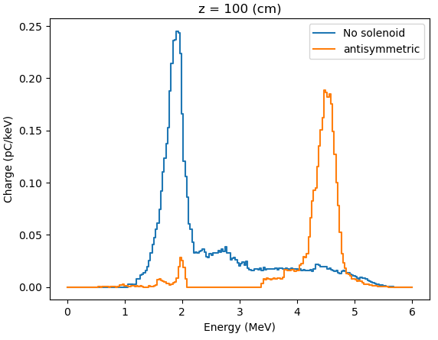





Dark Current Simulations
$z=13$cm
$z=100$cm
$z=50$cm
Pablo Martinez-Reviriego, IFIC
FC
Notes:
.

