Slide 1
The LDG RF Activities
Giovanni Bisoffi, INFN
CLIC Mini Week, CERN
December 12,2023

Slide 2

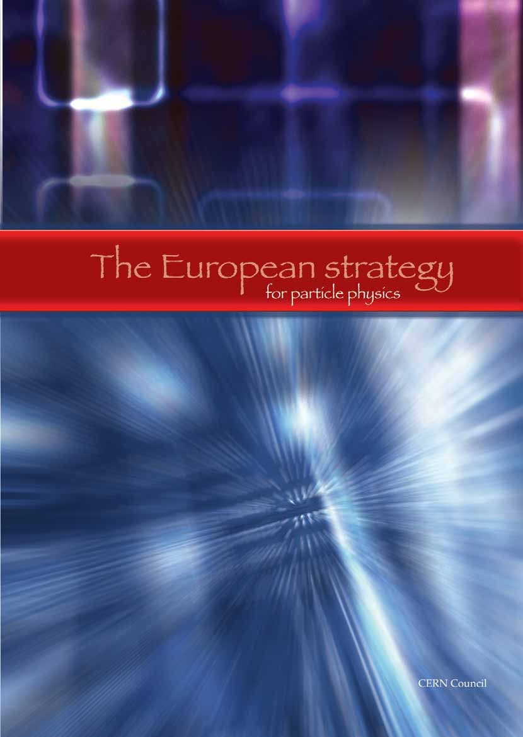

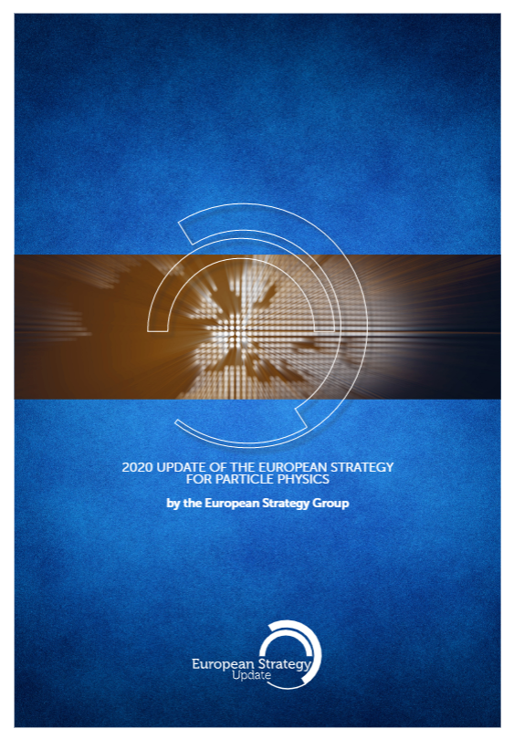
European Particle Physics Strategy and its updates
“(…) cornerstone of Europe’s decision-making process for the long-term future of the field. Mandated by the CERN Council, it is formed through a broad consultation of the grass-roots particle physics community (…) and it is developed in close coordination with similar processes in the US and Japan (…)”
European Strategy Group
Chairperson
1/CERN Member State,
1/lab of the major European Laboratory Directors’ Group, LDG
CERN Director-General,
SPC Chairperson,
ECFA Chairperson.
Invitees:
President of the CERN Council,
1/Associate Member States,
1/Observer State,
1/European Commission, JINR
Chairs of ApPEC, FALC, ESFRI, and NuPECC
Members of Physics Prep Group
Strategy 14 July 2006
Update 30 May 2013
Update 19 June 2020

Slide 3
European Laboratory Directors Group (LDG)
Lab representatives from NIKHEF, INFN, STFC, CIEMAT, CERN, DESY, RAL, CNRS, PSI
Standing observers: ECFA Chair, SPC Chair, CERN Directorate
Dialogue among Lab Directors and CERN
Input to the ESPP, liaise with EU Commission and national funding agencies, institutes and universities
Maximise national benefits of investment in fundamental research and in CERN
Look at activities outside CERN’s Member States, and of other groups in PP and related fields
Draw up and maintain a prioritised accelerator R&D roadmap towards future large-scale facilities for PP
Coordinate the accelerator R&D activities on the roadmap, until the next SU

Slide 4
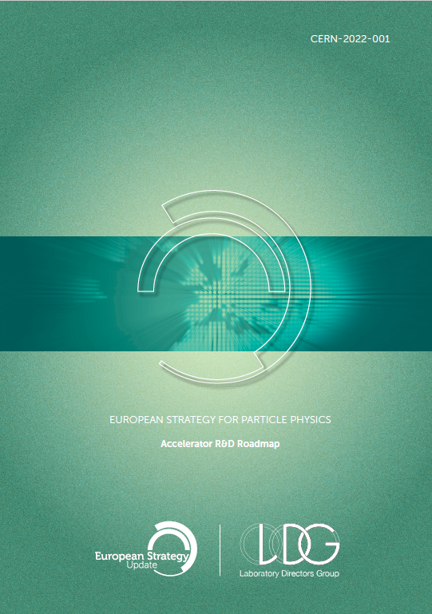
Approved R&D strategy and its implementation
https://doi.org/10.23731/CYRM-2022-001
Accelerator R&D Roadmap presented to SPC in March 2022 and adopted by the Council
Each technology area deeply surveyed
Key R&D objectives, deliverables (at 5 and 10 years)
Resource estimates, needed facilities
Emphasis on: e+e- programme and sustainability
After that: expert coordination panels, working with LDG (“extended LDG”) and accelerator R&D community to begin implementation of roadmap recommendations
Lab representatives from NIKHEF, INFN, STFC, CIEMAT, CERN, DESY, RAL, CNRS, CEA, PSI - Standing observers: ECFA Chair, SPC Chair, CERN Directorate
Extended LDG members: on HF-Magnets , Muon C, ERL, Laser Plasma Acc , RF

Slide 5
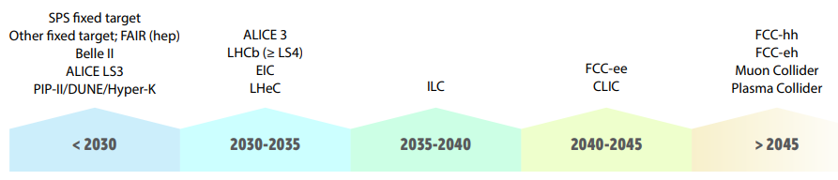
LDG and the and Acc R&D Coordination panels
(~ feasible start dates)
The 5 R&D Themes
High-field magnets
High-gradient plasma and laser accelerators
Bright muon beams and muon collider
Energy Recovery Linacs
High-gradient RF structures and systems
Scope
R&D needs
Teams
Time horizon

Slide 6

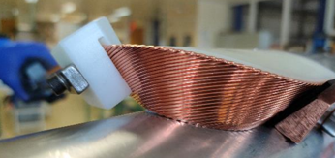
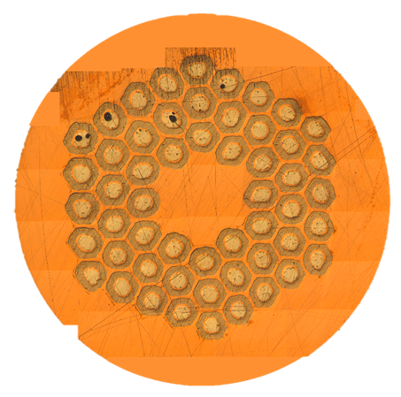
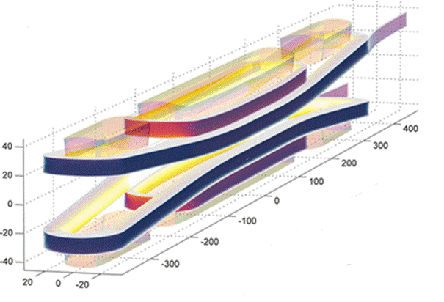
1. High Field Magnets
HFM Key for new colliders, beyond the LHC
Goals (on conductor and magnets):
16 T Nb3Sn technology (large-scale, industry-optimised) for FCC-hh, demonstration before 2026
20 T at 10÷20K with HTS (proof-of-principle, tapes and cables with industry)
Decades needed, broad expertise and coordination, infrastructures, industry: CARE, EUCARD, EUCARD2, ARIES, now I-FAST, CERN-High Field Magnet and US-MDP
Cross-cutting activities: materials, powering and protection, infrastructures and instruments, quench detection and protection
New infrastructures needed!
12 T prototypes expected in INFN-Ge and CERN by 2025; CEA: a 16 T prototype plan
Focus on stress/strain sensitivity and degradation of Nb₃Sn: mech. strength, higher J_{C}, stress-adapted magnet design
Hybrid LTS/HTS magnets: ReBCO tapes or Bi-2212 cables (still a long way to go for 16 T)
Panel chairs: P. Vedrine, M. Lamont
Notes:
Nb3Sn: production scale through robust design, industrial manufacturing processes and cost reduction, taking as a reference the HL-LHC magnets, i.e. 12 T
Rare earth Barium Copper Oxide
INFRASTRUCTURES: The cross-cutting technology activities will be a key seed for innovation. The scope includes materials
and composites development using advanced analytics and diagnostics, new engineering solutions
for the thermal management of high-field magnets, and the development of modelling tools within a
unified engineering design framework. We propose to explore alternative methods of detection and protection
against quench (especially important for HTS) including new measurement methods and diagnostics.
Finally, dedicated manufacturing and test infrastructure required for the HFM R&D programme,
including instrumentation upgrades, needs to be developed, built and operated through close coordination
between the participating laboratories.
Hybrid LTS/HTS SC - In transient conditions, rather lower minimum propagation currents have also been observed due to the long magnetic diffusion time constant in the pure aluminum compared with the steady-state recovery currents [3], [4]. To solve these problems, a new kind of LTS/HTS superconductor is proposed where HTS is used as a stabilizer in place of low resistive metals, such as pure aluminum. By this modification, the steady-state cold-end recovery currents can be improved as the HTS has very low resistance as compared with pure aluminum.

Slide 7
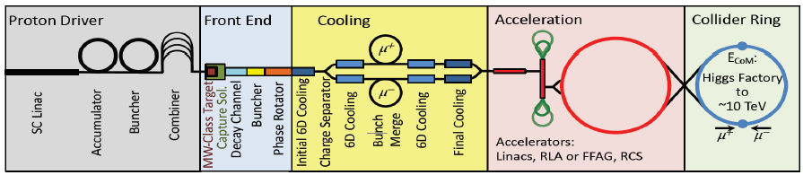
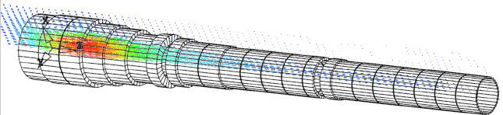
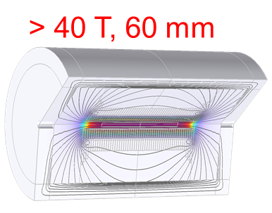
2. Muon Collider
5 GeV p → π → μ,
cooled and
accelerated
at 3/10 TeV
3/10 TeV μ acceleration via RLA/FFAG and RCS (with 14 T
Magnets)
For long-term sustainability of collider physics: strong suppression of synchrotron radiation (μ vs. e) power consumption at 10 TeV lower than CLIC at 3 TeV; L/P_{beam} increasing with collision energy
Needed: a fully integrated design (on target, detector, cooling and accelerator chain)
Needed from RF technology: e.g. HG room-T cavity in high-field SC solenoid, 20 T solenoids (HFM), ERL linac
MuCol Collaboration: 32 partners Institutions in Europe, plus USA (waiting for P5), China, India: 7-15 M€ thus far
After 2026, CDR R&D with a μ-cooling demonstrator
After the target: 200 mm bore 15÷20 T solenoid
(synergy with fusion)
Cooling channel demonstrator is key:
HG room-T cavity in
high-field SC solenoid
Panel chairs: S. Stapnes, D. Schulte
Notes:
3 → 10 TeV with added accelerator ring and with a new collider ring

Slide 8
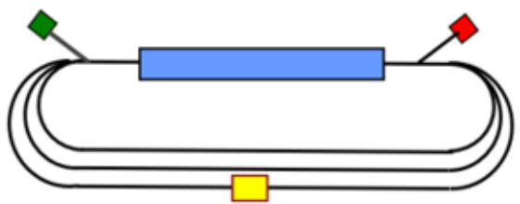
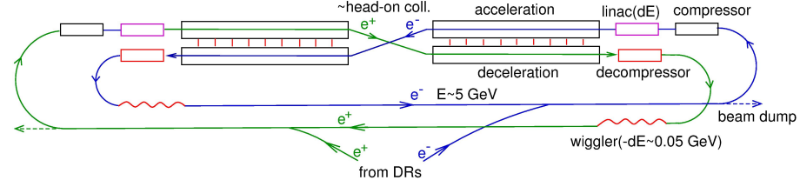
3. Colliders based on Energy Recovery Linacs
LHC/FCC-based
electron-hadron
Collider
Multipass accel/decel (energy efficient)
«Linac» beam quality, «ring» high I_{ave}
ERL-based colliders: LHeC, FCC-eh, CERC, ERLC
Current facilities: S-DALINAC (Darmstadt), MESA (Mainz), CBETA (Cornell, US), cERL (KEK), Recuperator facility (BINP)
New ERLs: Berlin-PRO, PERLE, CEBAF5, ERL-ecool at EIC
Collaboration: iSAS project approved (July 10, 2023): 1000 person*months, 12.6 M€, 4 years
Needed from SRF technology: Q~10¹¹ at higher T (4K); HOM extraction at high-T; FE-FRT to control transient beam loading and microphonics; dual-axis cavities; ...
Circular ER Collider
Energy Recovery Linear Collider
Panel chairs: J. D’Hondt, M. Klein
Notes:
electron-hadron versions of LHC and FCC (LHeC and FCC-eh)
Luminosity increase for physics applications by one or more orders of magnitude at a power consumption comparable comparable to classic lower luminosity solutions
Using Energy Recovery Linacs (ERL) located in the same-size 100 km tunnel would allow a large reduction of the beam energy losses, and therefore a reduction of the power consumption, while providing higher luminosity. Recovers beam energy loss (by recovering the energy); higher L, higher energy (final stage of acceleration without going around and more efficient in accelerating/losing energy); recycles particles, not only energy

Slide 9
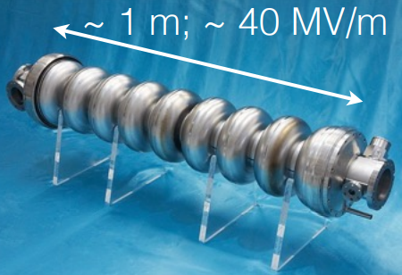
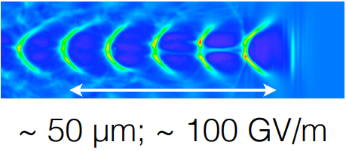
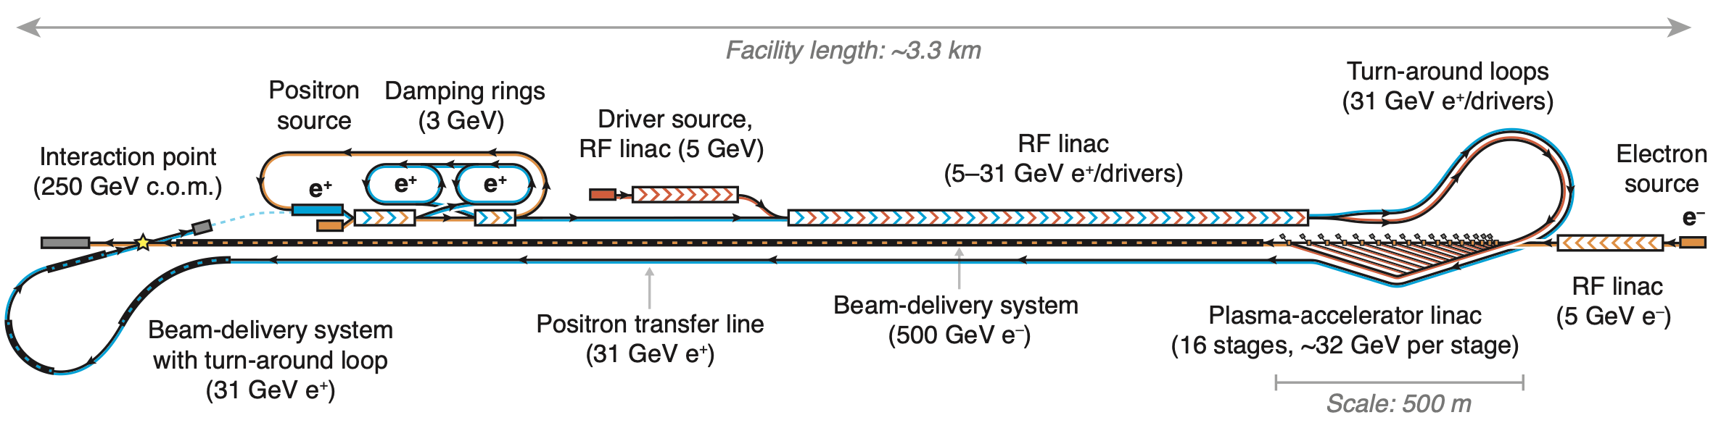
4. High-gradient plasma and laser accelerators
Electron bunch or laser (v~c) induce wave-like separations of electrons from ions (~ at rest)
Experimental studies on key R&D: e+ bunch acceleration, sufficient bunch charge, nm-scale emittance, staging of multiple structures, spin-polarisation preservation, high rep-rate and power handling, high rep-rate lasers, energy efficiency.
Pre-CDR and Collider Feasibility Report (2025), CDR in 2026-2030 with demo of technical parameters.
A collider option beyond 2050 (after FCC-hh)
Driving discipline is photon/material science: ELI and EuPRAXIA distributed facilities.
R&D strategies at CERN (AWAKE), CLARA, CNRS, DESY, Helmoltz’s, INFN, RAL, and abroad.
HEP-related programmes: EU (EuroNNAc), the US (DOE) and world-wide (ALEGRO).
HALHF
HALHF, with both RF and PBA: e- 500GeV electrons onto e+ 31GeV positrons
Panel chairs: W. Leemans, R. Patahill
Notes:
Hybrid Asymmetric Linear Higgs Factory (HALHF)

Slide 10
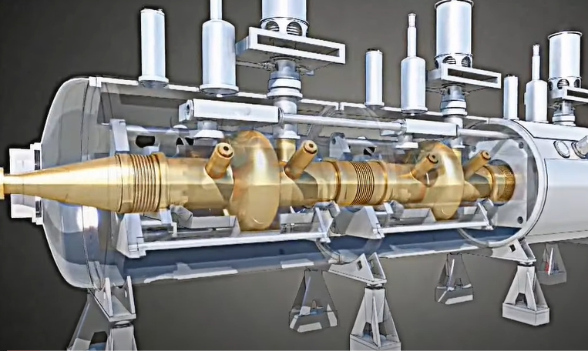


RF = increase beam energy efficiently and reliably
GOAL
Per year: 10 M€, 90 FTE (nominal, ~30% higher than actual - ref. Accelerator R&D strategy)
Notes:
Including: 3 M€ and 18 FTE in 5 years for MC test stand (obsolete)

Slide 11
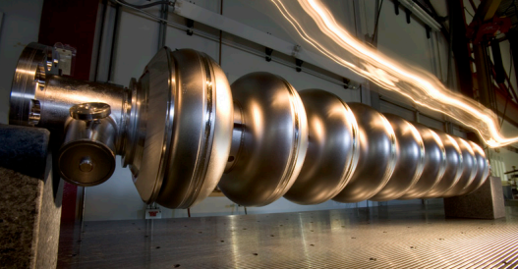
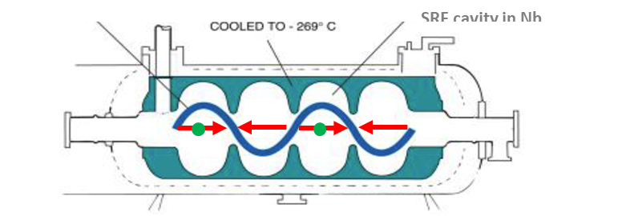
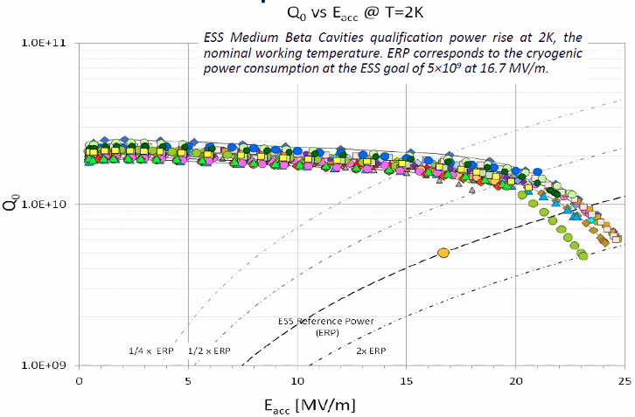
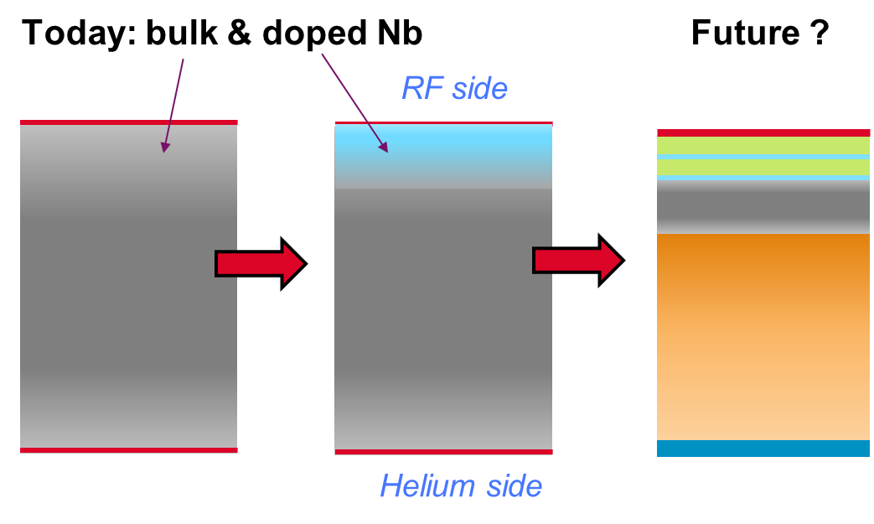

SRF Cavities: reduce operational cost (Q₀ ↑) and capital cost (E_{acc} ↑)
Cavity types – mostly elliptical: 1.3 GHz (3.9 GHz), 802 MHz (401 MHz), 704 MHz (352 MHz), 650 MHz (325 MHz).
(mature)
Niobium (T_{c}=9.2K, T_{cryo}= 2K is mandatory)
E_{acc} > 40 MV/m, Q₀ > 10¹⁰
Theoretical limits close? ≤ 57 MV/m s.h. ….
Thin films (higher-T_{C} materials)
E_{acc} x 2 higher than Nb (≤100 MV/m); Q₀>10¹⁰ at T_{cryo}=4.2K (66% saving in P_{ele,cryo}) – 40% cryo-plant cost saving (cryocoolers?))
P_{diss, ref}
$Q_{0}=\frac{2πf_{0}U}{P_{diss}}$ vs. E_{acc}
NEEDS:
Higher E_{acc}
ILC – higher E_{acc} ⇒ smaller linac (= lower capital cost)
MC – quick acceleration (vs μ-lifetime)
FCC – fewer cavities ⇒ smaller RF installation
Higher Q₀
FCC, ERL, ILC – lower RF losses, cryogenic power minimised.
Others: Reproducibility, cost, industrial manufacturing
(R&D goal)
Notes:
cryogenic power reduced by factor > 2 with high measured Q₀
Grassellino: we discover that the addition during the mild bake of a step at 75deg for few hours, before the 120deg, increases systematically the quench fields up to unprecedented values of 49 MV/m.

Slide 12
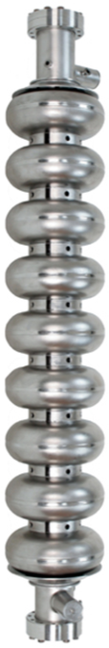
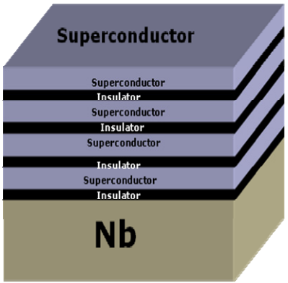
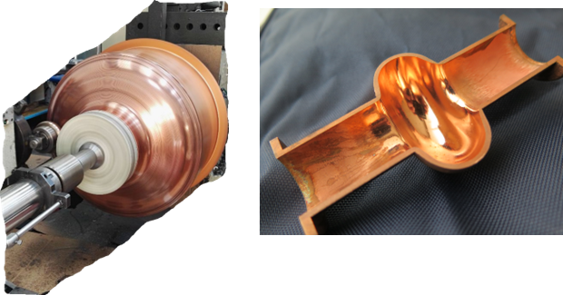
WG2 – Thin film Cavities
C. Antoine (CEA) and O. Malyshev (STFC)
WG1 –Bulk Nb Cavities
M. Baylac (IJCLab), C. Madec (CEA) and L. Monaco (INFN)
  Goals: high Q₀ @ 4.2K; much higher E_{acc}.
  A15 materials: Nb₃Sn-on-Nb (USA). Nb₃Sn-on-Cu (IFAST EU project, on going)
  SIS (multi-layer): higher performance, less defect-sensitive (sample→cavity, CEA).
  Cu cavity base production R&D: spinning (CERN, INFN), 3D-printing; Cu-surface preparation.
Nb₃Sn/Nb
1.`Further increase Q and E_{acc}: surface polishing, treatment (N doping), low/mid/2-step baking, H degas).
2. Improve reproducibility of high-E_{acc} fields: robots in clean room, in-situ plasma processing.
3. Reduce the cost: Fine → Medium Grain
4. Risk of losing manufacturing capability?
Maintain SRF technology skills in both labs & industry.
Invest in industrial processes (FCC – ~1000 cavities, ILC - 8000 cavities).
CERN (CH), CEA and IJCLab (F), DESY, HZB, Hamburg-Uni (D), INFN (LASA, LNF, LNL), STFC (UK)
CEA-Saclay, CERN, HZB, HZDR, INFN, STFC, USI, Hamburg U. (DESY), (I.FAST-WP) JLAB, KeK and FNAL
Notes:
medium grain : grain size < 1 mm; large grain : grain size >> 1 cm (: material 35% cheaper, full cavity 5% cheaper)
Few Nb suppliers (1 in China, perhaps 2 in Japan/USA).
Few cavity suppliers (2 in Europe, 2-3 in China, 1 in Japan)
Reduce contamination during assembly (E_{acc} , field emission-FE)
**************************************************************************
$P_{plug}∝{\text{h}}_{T}$ $∝\frac{T_{cryo}}{300K−T_{cryo}}$ → higher T_{C} material allows T_{cryo} = 4.2K instead of 2K, which reduces P_{plug} by a factor 3.
SIS: . If the superconducting film is deposited with a thickness d < lambda, the Meissner state can be retained at a magnetic field much higher than the bulk Hc1. The strong increase of Hc1 in films allows utilization of RF fields higher than the critical field Hc of Nb but lower than those at which the flux penetration at grain boundaries may create a problem.
A superconductor with little or no magnetic field within it is said to be in the Meissner state. The Meissner state breaks down when the applied magnetic field…

Slide 13
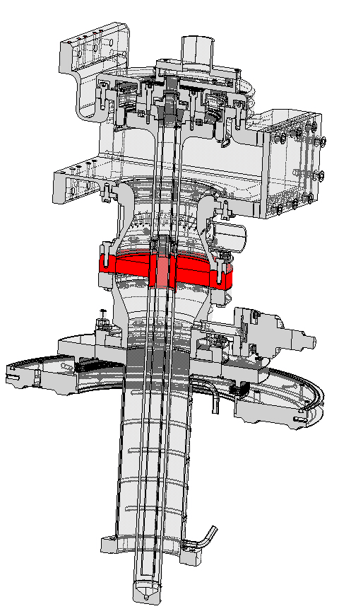
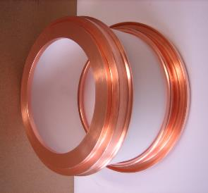
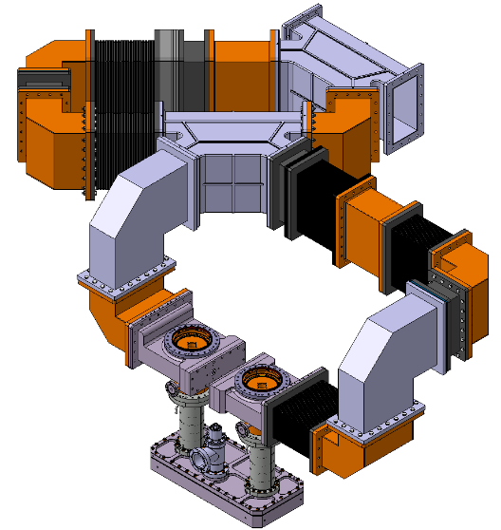
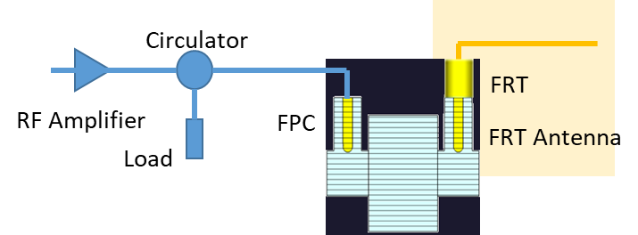
WG3: Fundamental Power Couplers (FPC) and HOM
F. Gerigk (CERN), A, Neumann (HZB) and E. Montesinos (CERN)
1. Ceramic window! No leak allowed vs. cavity and entire machine, low losses at operating f and T, but brazed, low T-gradient
2. CERN SPS resonant ring
3. Fast Reactive Tuners (potential game changer for tuning, transient beam loading, microphonics)
Transmitting hundreds of kW (W’s in the cold mass) reliably through thin ceramic windows (diameter ~ 5÷ 50 cm) into SRF cavities.
FCCee (Z→W,H → ttb modes): 112→864 couplers, CW, 400-800 MHz, P = 165 - 900 kW
MC (SC driver, NC RF, SC RCS): 250, 7000, 4500 couplers, dc 0.05% → 4%, 325-1300 MHz, P = 100 - 4000 kW
(for ILC and CLIC: FP specs achieved)
FABRICATION CAPABILITIES, TEST STAND
CERN: for future colliders, long-term expertise; couplers for Soleil, ESRF, PERLE, … - CEA: couplers on request for XFEL, ESS DESY: 1.3 GHz CW couplers RI company
EIC (USA): couplers with challenging specs, developments will benefit next colliders.
HOMs couplers (see iSAS proposal): R&D on 800, 1300 MHz multicell; ~ kW RF power out of the cold mass
Notes:
A resonant ring is a closed loop of a waveguide system that can amplify power, and it is widely used for the breakdown test of the RF components under high power
FerroElectric Fast Reactive Tuners (FE-FRTs) are a novel type of tuner that may be able to achieve near perfect compensation of microphonics in the near future. This would eliminate the need to design over-coupled fundamental power couplers and thus significantly reduce RF power, particularly for low beam current applications.

Slide 14
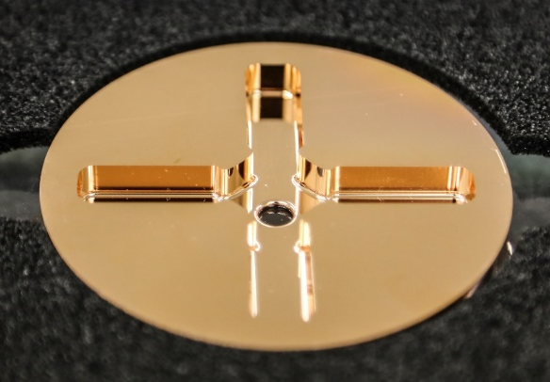
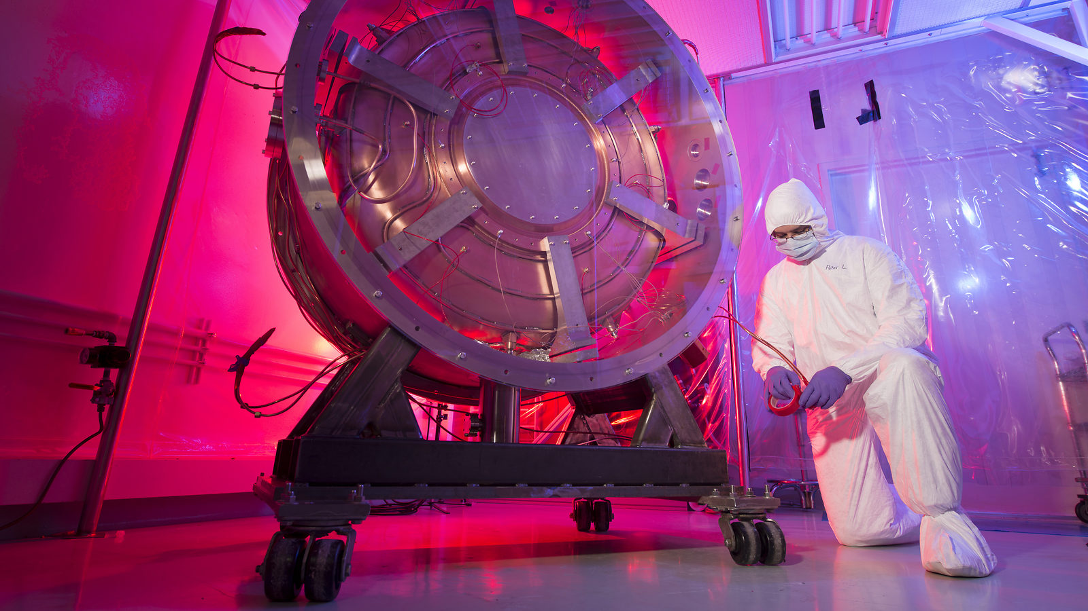
WG4: HG Normal-Conducting RF
W. Wuensch (CERN) and D. Alesini (INFN)
CLIC
HG (70 to 100 MV/m), X-Band with very low breakdown rate, key for cost (linac length) and efficiency (BD).
Good alignment mitigates HG/BD interplay (wakefields).
Muon Collider
Muon capture: HG with high external magnetic field.
FCC-ee 20 GeV NC injector; FCC-hh E-separators (S and C-Band).
Synergic with applications outside HEP (60 - 70 MV/m)
Achieved: Gradient; understanding of fundamentals physics; industry on NC RF components/systems; synergies (XFEL, Eupraxia, ICS, medical, plasma accelerator, RFQ, …)
Generated: dielectric structures, short pulse acceleration and HT superconductors.
Required: systems engineering, integration, mechanics R&D, design, μm-level alignment.
Fundamentals of breakdown: on materials, plasma, surface physics, …
Operational test infrastructures: CERN (n.3, 50 MW, 12 GHz), Trieste (45 MW, 3 GHz), Valencia (7.5 MW, 3 GHz), Frascati (50 MW, 12 GHz), Uppsala (cryo pulsed DC sys)
X-band linearizers and deflectors: PSI, DESY, STFC
Linac design, operation: INFN (Roma and LNF), CERN, PSI, Eindhoven, Elettra, Medical VHEE, FLASH
Notes:
Funding for CLIC from 4 to 2 nowadays

Slide 15
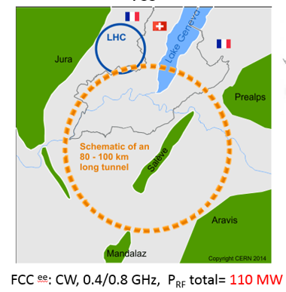
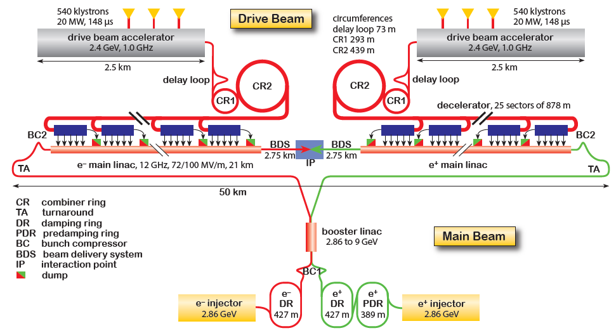
WG5: High Efficiency Amplifiers
I. Syratchev (CERN), G. Burt (Lancaster U) and M. Jensen (ESS)
High efficiency RF power sources for future large-scale particle accelerators (LHC and FCC_{ee} first)
In collaboration with industry to secure to ensure decades of industry support.
FCCee
105 MW
from 380 klystrons
and 600 SSPAs
Only large projects can afford R&D costs and risks,
which benefit many applications; for small labs
energy savings are not worth R&D investment.
Klystrons (CERN, Lancaster, ESS, CEA): R&D expensive, today done solely with industry (3 qualified vendors!). 50-100% cost increase in last ~5 yrs. SSPA (CERN, Uppsala, CEA Saclay, INFN-Legnaro, NCBJ (Swierk), CIEMAT): industry on transistor (and η) R&D; labs contribute with combination/matching techniques
3.0 TeV CLIC^{e+e-} ; pulsed, 1.0 GHz, P_{RF, total} = 180 MW
Notes:
The cavity combiner is a symmetrical device, which means that it can be used to combine the power of several inputs into one common output, but also to divide the power of a common input into several outputs. Therefore, it is possible to perform the validation indistinctly working as a combiner or as a divider.

Slide 16
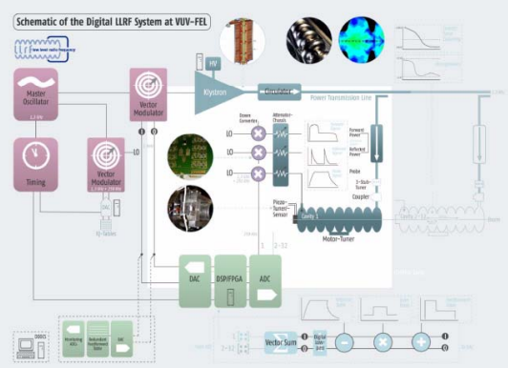
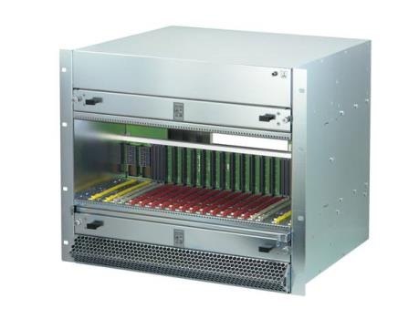
WG6: RF Control – LLRF, ML and AI
G. Zheqiao (PSI) and W. Cichalewski (DMCS)
Comprehensive, intelligent, highly automated, and standardised LLRF system
is essential for the success of the RF systems of future colliders.
Accelerator sections with different beam patterns and f_{RF} high-level AI automation/optimisation.
ILC/FCC/MC SC RF cavities → RF control vs. vibrations and heavy BL
Lower energy consumption → RF/operation control
Long construction and operation cycles → optimal architecture and framework suited for long-term standardised HW/SW
RF stability figures achieved! (FEL specs ~ 0.01 % amplitude and 0.01° phase; ILC: 0.07 % and 0.24°); real-time stabilization with AI automation/optimization alogorithms (telecom industry providing high-res fast ADCs and high-performance DSPs.
Availability, reliability and operability (FCC, ILC, MC, …) with many RF stations & cavities (ILC, > 560 RF stations and 14500 cavities), ML algorithms will decrease operation/maintenance costs.
Standardise LLRF system design and gain long-term industry support to labs (HW/SW platforms like VME, ATCA to MicroTCA, System-on-Chip): it will facilitate in-kind for large scale projects

Slide 17
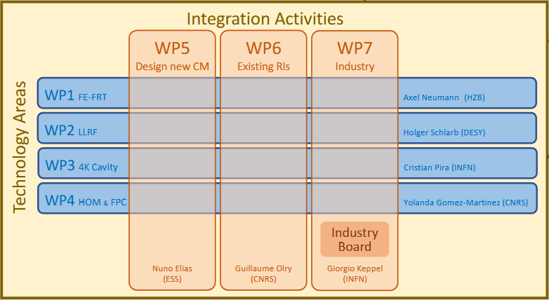
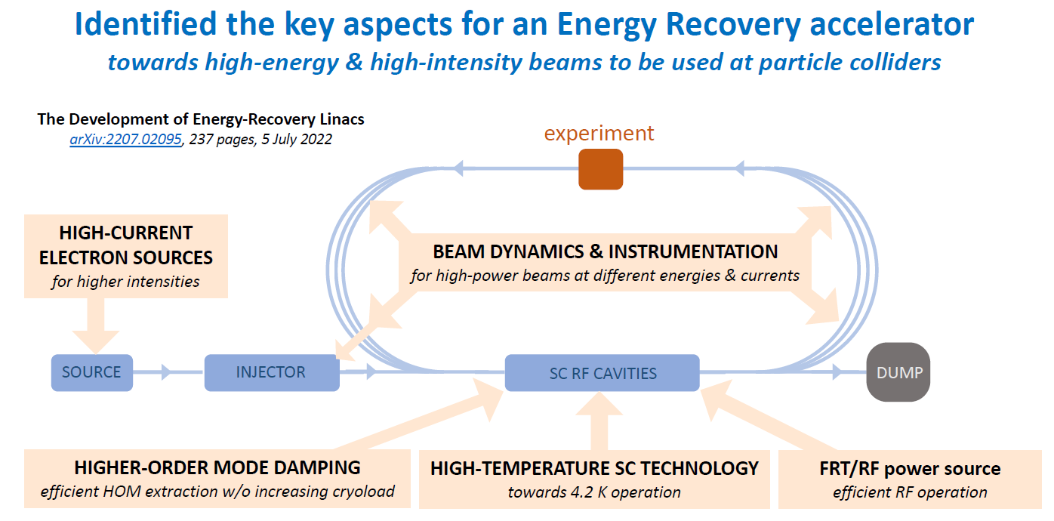
RF-to-ERL Panel link
M. Baylac (CNRS)
ERL/RF Panel collaboration: iSAS project 1000 person*months, 12.6 M€, 4 years
(Approved July 10, 2023, Start March 1, 2024):
CNRS, CERN, ESS, DESY, VUB, CEA,
HZB, INFN
RF items
(WG2-Thin films, WG3-Couplers, WG5-Power Sources, WG6-LLRF, ML and AI)

Slide 18
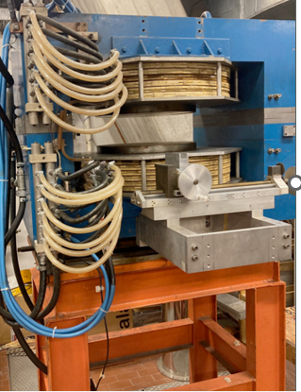
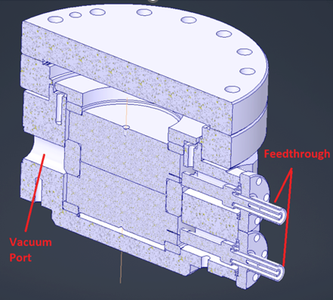
RF-to-MC link: high E_{a} in high B
G. Burt (STFC)
(WG4-NC High Grad, WG5-Power Sources)
Study of RF breakdown (BD) under strong magnetic fields for muon ionisation cooling
So far (FNAL): 50 MV/m at 3 T
Four test stands being considered:
UHF test facility (CEA)
Higher frequencies - 3 GHz, 12 GHz (INFN, CERN and Cockcroft): smaller, quicker, act as guideline
DC field breakdown test stands (CERN, Cockroft, Uppsala): cheaper, compact, short gap
New compact klystrons (with WG5)
MC/RF Panel coordination → survey sent to each institute involved, responses awaited on capabilities and physics targeted by each facility; joint meeting to follow
Notes:
50 MV/m at 3 T , using Be elements inside the cavity (to limit plastic deformation/pulsed heating).
cheaper, compact, short gasp (altering the physics in strong B-fields?)
LASA setup: due blocchi di Cu spaziati da un gap di 0.1 mm, Delta-V 10 kV pulsato
INFN – 3 GHz in 7 T SC magnet

Slide 19
Outlook - Progress of the LDG RF Panel
Nov22 – Mar23: watch future collider needs and RF goals
From Apr23:
Outreach (Community Forum-July 2023; special session at HG2023), priorities revised
Apr23 – Oct23:
Who is doing what/progress on the Roadmap milestones: survey of national teams
Continue coordination with ERL and MC panels
Jan-Jun 24:
Coordinate teams vs priorities, explore funding routes: national and EU
Zoom meeting with RF coordinators in Snowmass-P5 (February 2024)
Promote RF developments/needs towards HEP-physicists and funding agencies
Idea, a superWP on RF in I.FAST2 ← EU funds, national matching funds, more cohesion in the RF community at large
Jul-Dec 24, … : report on progress in the field and impact of above actions
+
=
Notes:
MC: this infrastructure (Graeme is comparing the test stands, as an exercise with proponents), plus related cavity design and RF Power Source items

Slide 20
Spare slides

Slide 21
Outlook - lobbying for more funds
How to address the funding agencies after the survey?
Highlight priority areas; identify best lab candidates to address them
Elaborate a overall investment proposal
Coordinate within the extended-LDG on the overall fund requests to the funding agencies
«IFAST-2»
Initial contacts to develop a super-workpackage clustering several R&D activities in RF (now in I.FAST: thin films, HE power sources, C-guns, AM).
Additional funds for RF by EU
National FAs to add matching funds.
It encourages RF coordination across Europe → one community
Notes:
"to support development of new concepts, new ideas and to prove their feasibility"

Slide 22
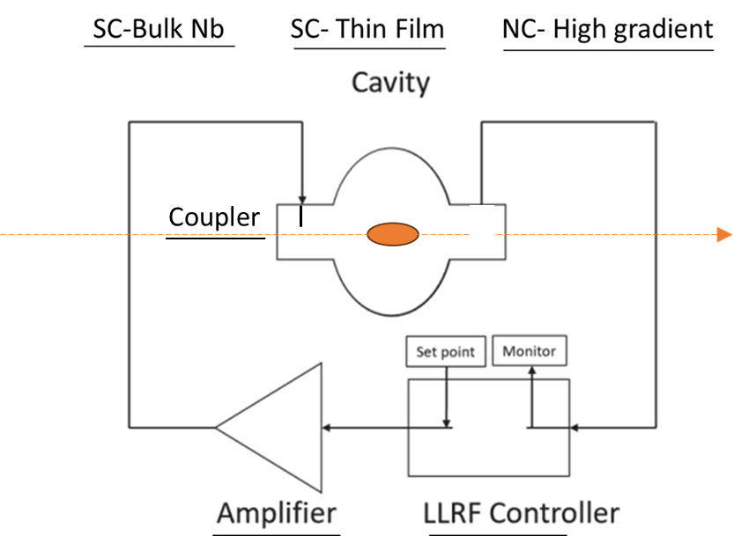
Outlook
Done:
Future collider RF needs well focused
European contributing teams identified, along with available infrastructures; Progress/challenges in RF theme areas followed up
Next:
The Nov-2023 progress report to the CERN council, as basis for periodic updates
Correlate needs - candidate labs to fulfill them → coordinate (at LDG level) towards national funding agencies
Elaborate on a super-RF-WP in the “I.FAST2” proposal

Slide 23
European Particle Physics Strategy and its updates
“(…) cornerstone of Europe’s decision-making process for the long-term future of the field. Mandated by the CERN Council, it is formed through a broad consultation of the grass-roots particle physics community (…) and it is developed in close coordination with similar processes in the US and Japan (…)”
European Strategy Group (ESG)
Chairperson
1/CERN Member State,
1/lab of the major European Laboratory Directors’ Group, LDG
CERN Director-General,
SPC Chairperson,
ECFA Chairperson.
Invitees:
President of the CERN Council,
1/Associate Member States,
1/Observer State,
1/European Commission, JINR
Chairs of ApPEC, FALC, ESFRI, and NuPECC
Members of Physics Prep Group
Strategy 14 July 2006
Update 30 May 2013
Update 19 June 2020

Slide 24
European Laboratory Directors Group (LDG)
Remit by CERN Council:
Dialogue among Lab Directors and CERN
Input to the ESPP, liaise with EU Commission and national funding agencies, institutes and universities
Maximise national benefits of investment in fundamental research and in CERN
Look at activities outside CERN’s Member States, and of other groups in PP and related fields
Draw up and maintain a prioritised accelerator R&D roadmap towards future large-scale facilities for PP
Coordinate the accelerator R&D activities on the roadmap, until the next SU
Standing observers
‣ K. Jakobs (ECFA Chair)
‣ M. Lamont (CERN Directorate)
‣ J. Mnich (CERN Directorate)
‣ H. Montgomery (SPC Chair)
‣ S. Bentvelsen (NIKHEF)
‣ F. Bossi (LNF)
‣ J. Clarke (DL)
‣ N. Colino (CIEMAT)
‣ F. Gianotti (CERN)
‣ B. Heinemann (DESY)
‣ D. Newbold (RAL)
‣ E. Previtali (LNGS)
‣ F. Sabatie (IRFU)
‣ M. Seidel (PSI)
‣ A. Stocchi (IJCLab)
Secretary
‣ E. Tsesmelis (CERN)
Extended LDG members
‣ G. Bisoffi (for RF) + P. Macintosh
‣ W. Leemans (for LPA) + R. Patahill
‣ S. Stapnes (for Muons) + D. Schulte
‣ J. D’Hondt (for ERL) + M. Klein
‣ P. Vedrine (for HFM) + M. Lamont

Slide 25
European Strategy Update and Accel R&D
What R&D? which priorities?
How long might it take? How much will it cost?
Which science with demonstrators, or intermediate-scale facilities?
Which new infrastructures?
Key questions during the 2020 Strategy Update on R&D for future collider options:
Large-scale accelerator R&D plan to inform and support future decision-making in the field
Superconducting RF: bulk niobium cavities, surface preparation, thin films
NC structures: fundamental limitations, surface preparation, manufacturing techniques
High power RF sources, accelerating structures ancillaries (couplers, tuners…), LLRF and AI
Authors of RF R&D strategy:
S. Bousson (IJCLab), Hans Weise (DESY). G. Burt (Lancaster University); G. Devanz (CEA); A. Gallo (INFN LNF); F. Gerigk (CERN); A. Grudiev (CERN); D. Longuevergne (IJCLab); T. Proslier (CEA); R. Ruber (Uppsala University), plus added experts
HF magnets
HG RF structures and systems
HG plasma and laser accelerators
Muon colliders,
Energy Recovery Linacs

Slide 26
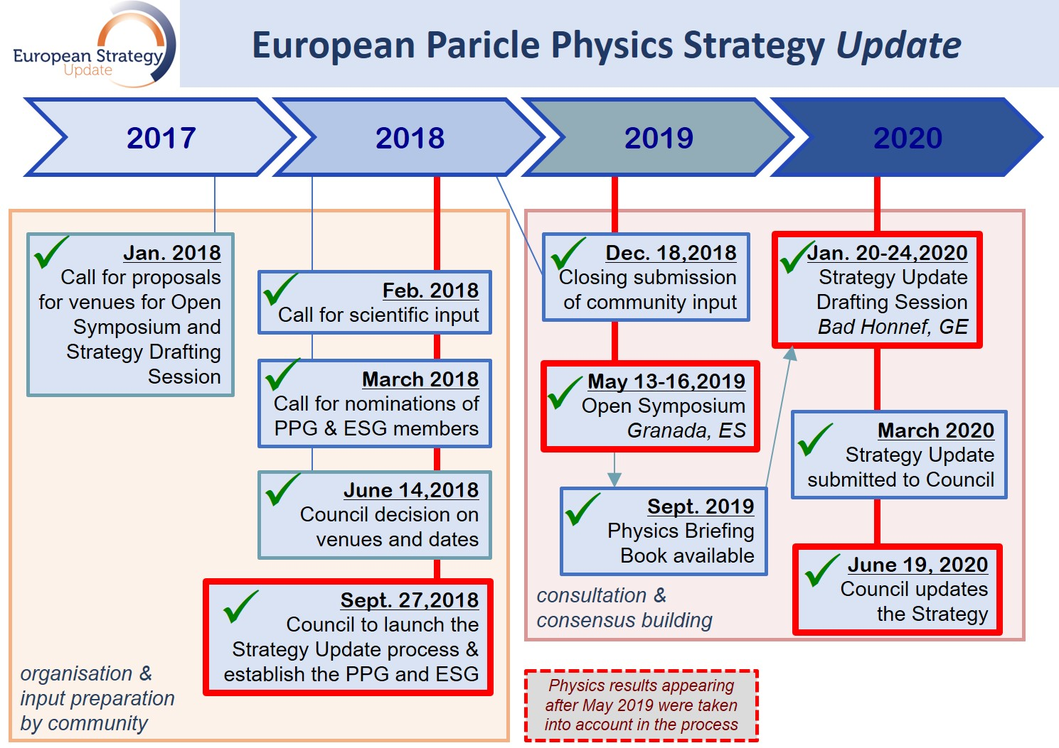
Strategy update process timeline
→ 2020÷2027
CERN Council: decision making body, coordinating particle physics in Europe (23 Member States)
End of 2024,
start of the next exercise !
Notes:
ECFA - EUROPEAN COMMITTEE FOR FUTURE ACCELERATORS (https://ecfa.web.cern.ch/ecfa-terms-reference). It is a broader representation of physicists, involved at high level in CERN activities

Slide 27
Example: INFN-Projects for ESPP Accelerator R&D
Damping Ring and Transfer Lines for FCC-ee Injector
FCC-ee IR and MDI full-scale experimental validation
Muon Collider R&D activities
High-Q/high-G SRF R&D
SRF R&D for FCC-ee
HFM Italy
GANDALF (GaN-baseD AmpLiFier)
^{(*)} Allocated funds (for 3 years, 2023-2026): 4929 k€
- 2125 k€ (of which RF: 1730 k€)
- Temporary personnel 552k€ p (of which RF: 288 k€)
- 2252 k€ staff
Approved ^{(*)}
On-hold

Slide 28
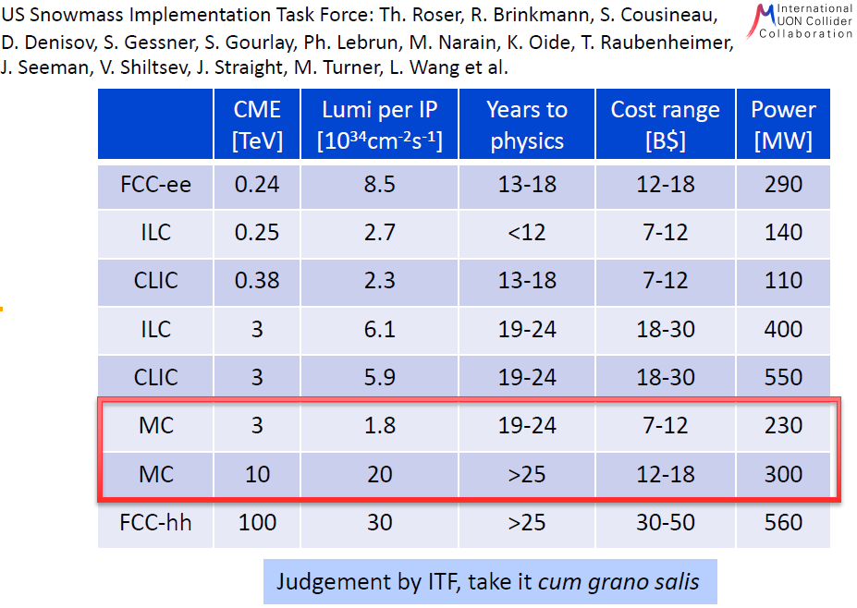
Notes:
LEP and FCCee: With two independent 100-kmcircumference rings for e+ and e− , a total synchrotron power fixed to 100 MW, and two interaction points (IPs), a yearly integrated luminosity more than five orders of magnitude larger than that of LEP can be achieved at the Z pole, as shown in Fig. 2

Slide 29
ERL RF topics

Slide 30
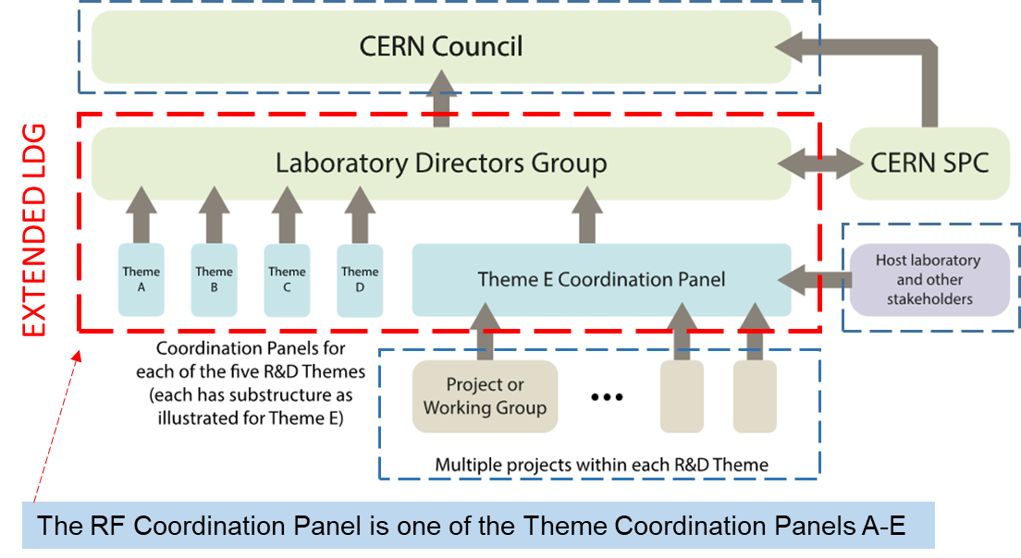
Extended LDG role

