Slide 1



ICS experimental studies in CTF2
CLIC Mini Week
Vlad Musat, Andrea Latina, Eduardo Granados, Steffen Döbert

Slide 2
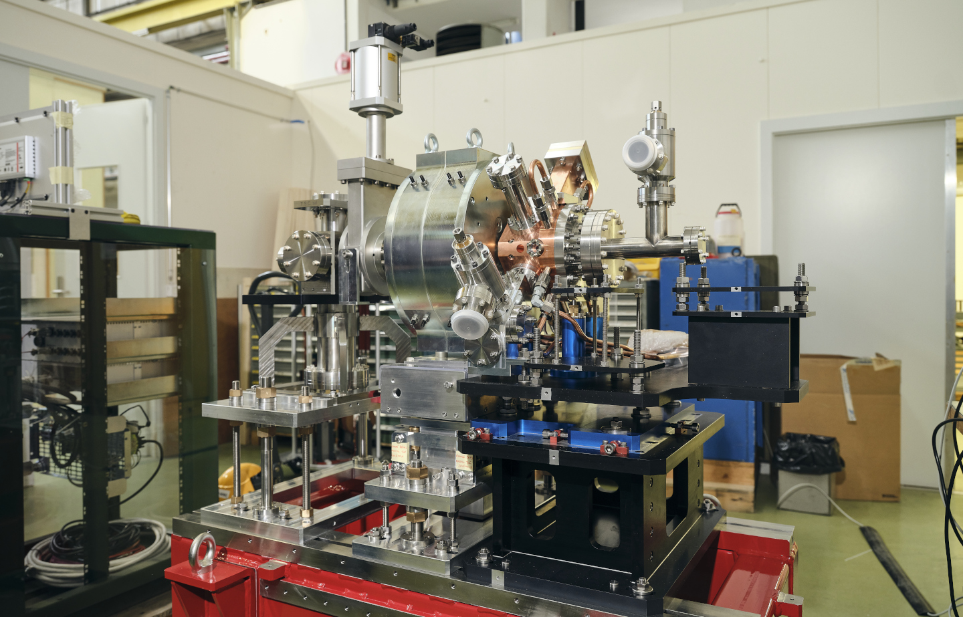
Contents
Introduction
RF-Track simulations of the CTF2 gun
Experimental development
2

Slide 3
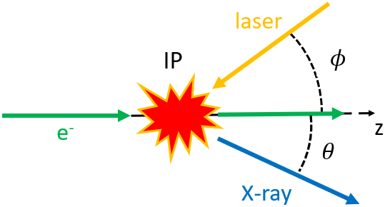
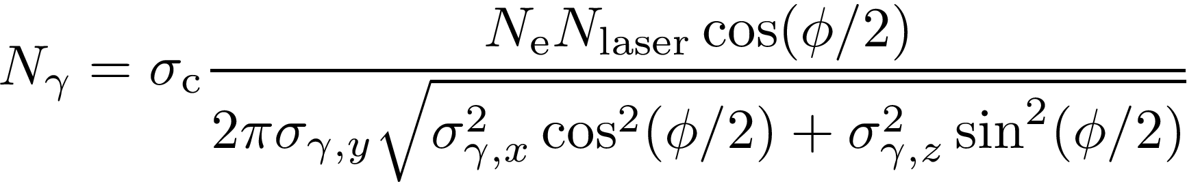
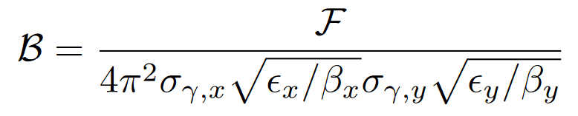
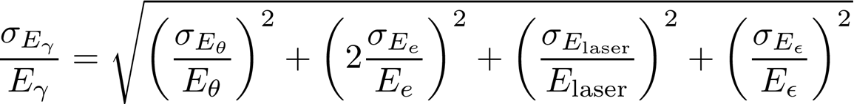
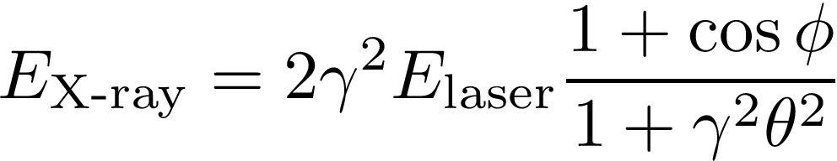
Compton backscattering
= The scattering of a low energy photon from an EM field to a high-energy photon (X-ray or gamma ray) during the interaction with a charged particle.
Total flux
Average brilliance
Photon bandwidth
Photon energy
3

Slide 4
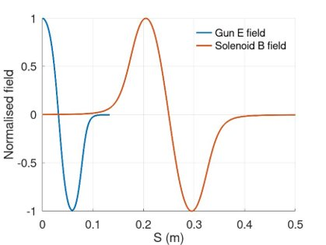
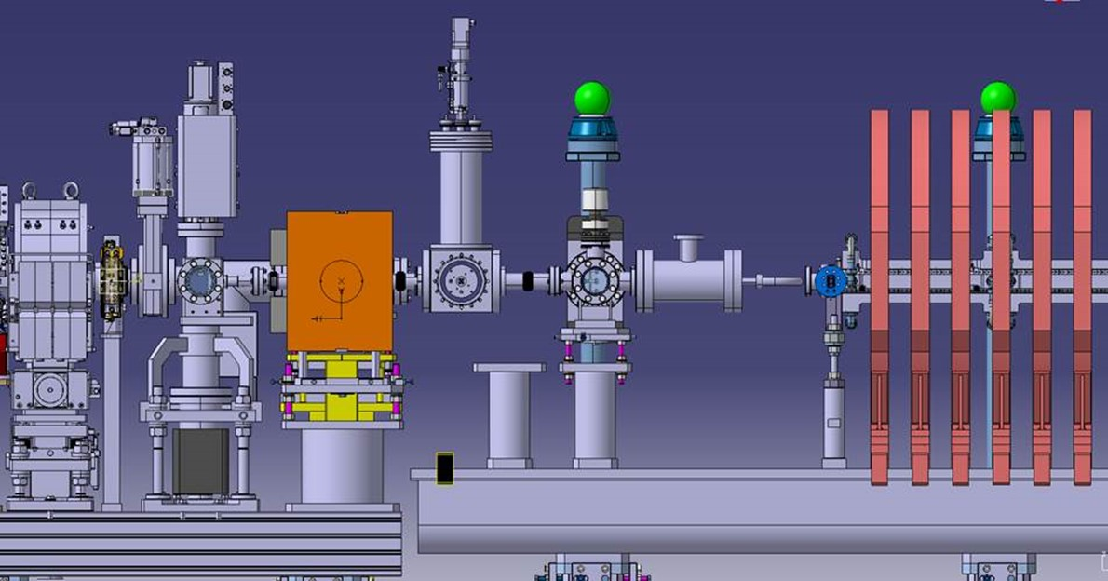
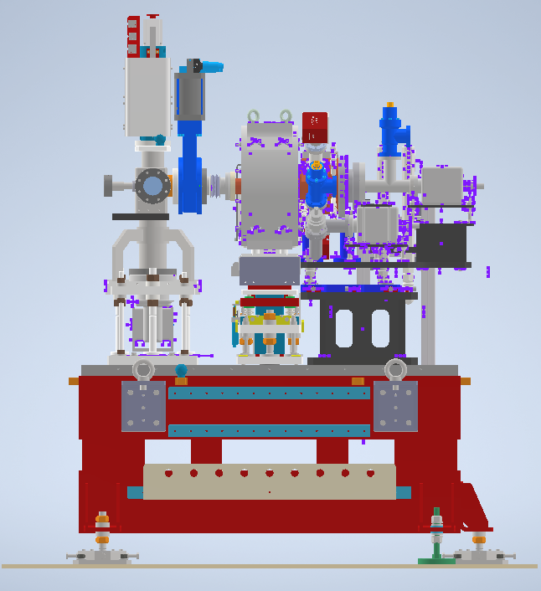
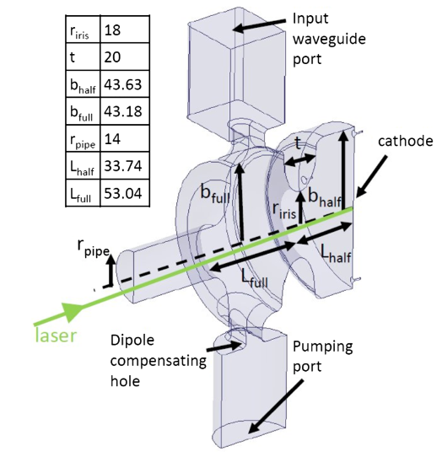
The CTF2 gun
0.57 m
0.3 m
Spectrometer + Faraday cup
CLINXBT_0001
S-band standing wave 1.5 cell RF-gun intended for the new AWAKE injector.
Prototype constructed by INFN-Frascati and commissioned at CTF2.
Fabricated with brazing free technology [1].
[1] D. Alesini, et al., PRAB, vol. 21, n. 11, November 2018

Slide 5
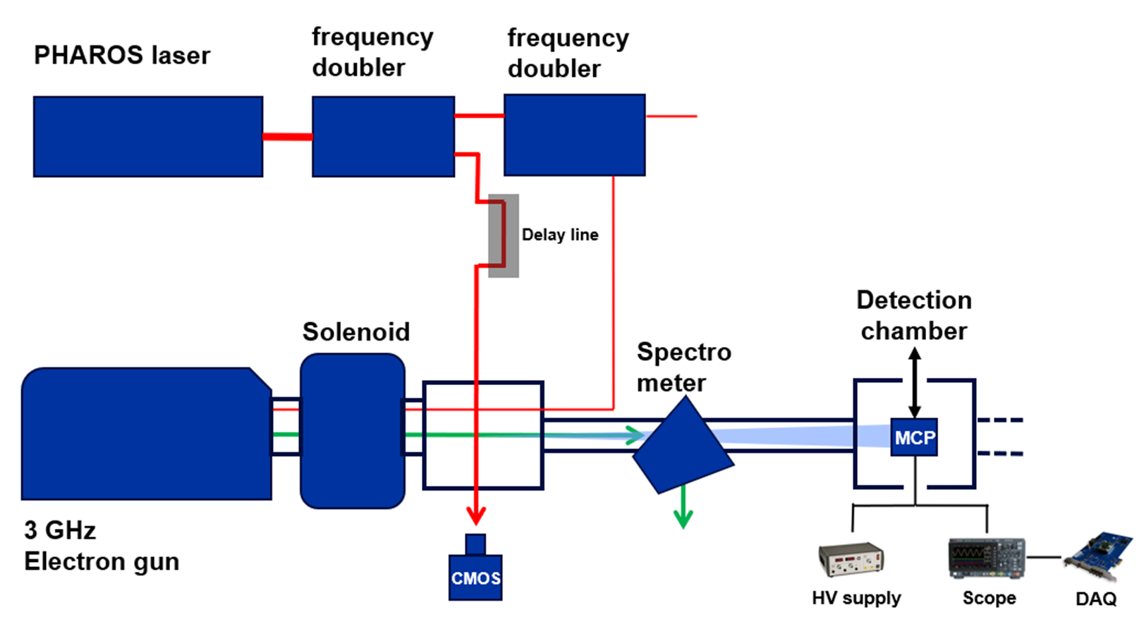
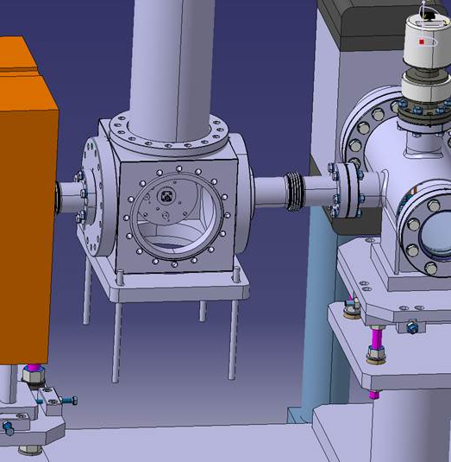
Experimental set-up
2.1 mJ, 1030 nm, 112 fs
Laser beam
Electron beam
X-ray beam
6 MeV, 400 pC
5

Slide 6
Gun simulations

Slide 7
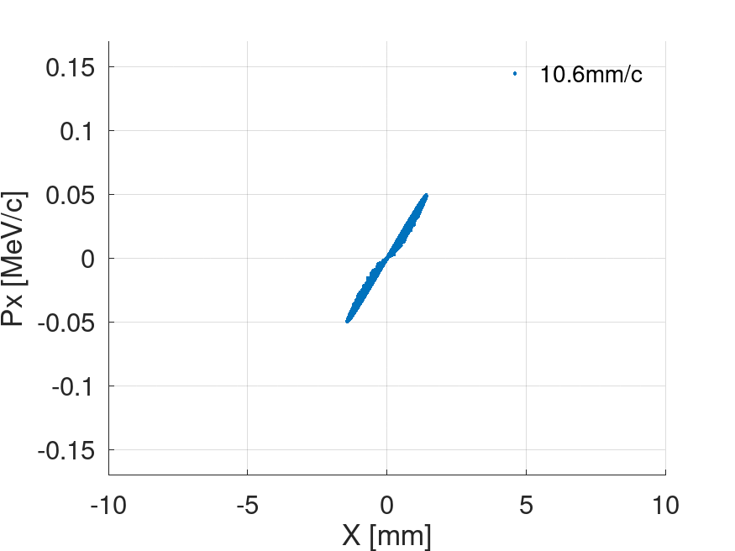
Simulations of CTF2 injector
Evolution of the phase space from cathode to screen
A model of the CTF2 gun was implemented in RFT. The model comprised the cathode, gun, and solenoid.
Optimisation goals:
  Maximise flux
  Minimise background
0 – 20 mm/c
30 – 200 mm/c
Cathode | Gun | Solenoid
Bunch charge (laser intensity) | RF phase | B field
Laser spot size (Gaussian) | RF gradient
7

Slide 8
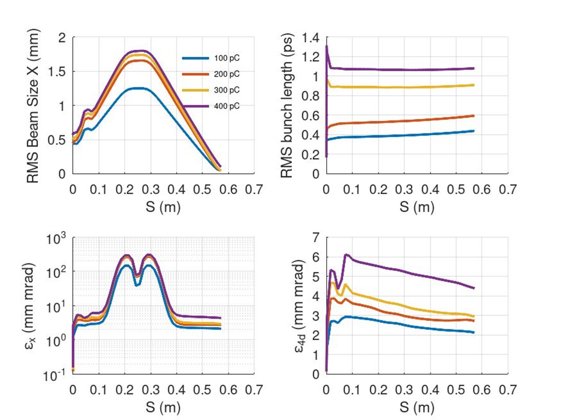
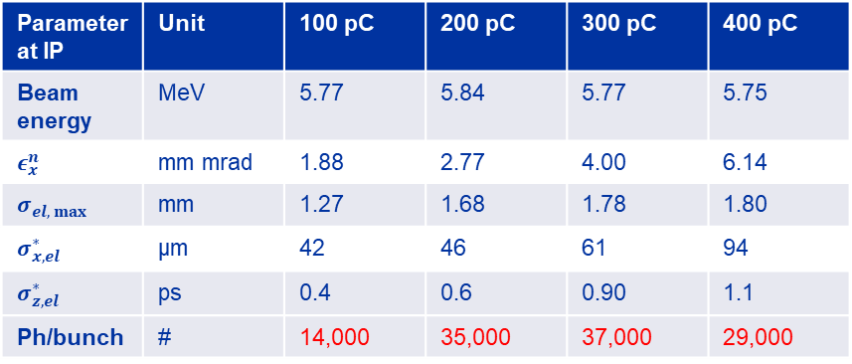

Results: Flux optimisation (cathode $→$ screen)
Gun
Solenoids
Gun
Solenoids
Setup | Unit | 100 pC | 200 pC | 300 pC | 400 pC
Gun phase (RFT) | Deg | 100.5 | 108.5 | 99.0 | 94.0
Gun gradient | MV/m | 120 | 120 | 120 | 120
Max B field | T | 0.350 | 0.355 | 0.350 | 0.336
Laser RMS size | mm | 0.438 | 0.482 | 0.502 | 0.567
Parameter at IP | Unit | 100 pC | 200 pC | 300 pC | 400 pC
Beam energy | MeV | 5.77 | 5.84 | 5.77 | 5.75
$ε_{x}^{n}$ | mm mrad | 1.88 | 2.77 | 4.00 | 6.14
$σ_{el, max}$ | mm | 1.27 | 1.68 | 1.78 | 1.80
$σ_{x,el}^{∗}$ | µm | 42 | 46 | 61 | 94
$σ_{z,el}^{∗}$ | ps | 0.4 | 0.6 | 0.90 | 1.1
Ph/bunch | # | 14,000 | 35,000 | 37,000 | 29,000
On-crest phase in RFT: 120°
Distance from cathode to IP = 0.57 m
8

Slide 9
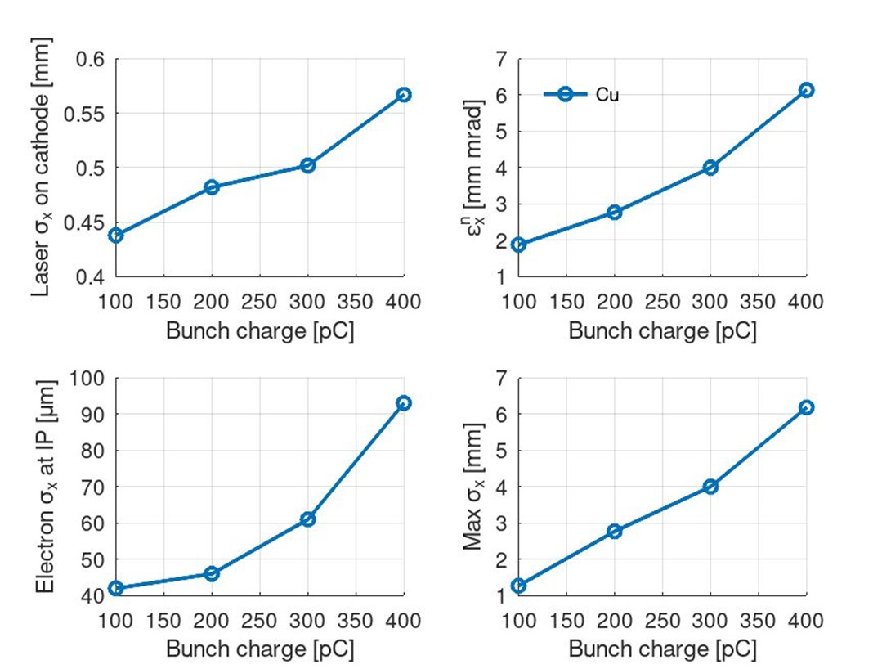
Results: Flux optimisation (cathode $→$ screen)
Setup | Unit | 100 pC | 200 pC | 300 pC | 400 pC
Gun phase (RFT) | Deg | 100.5 | 108.5 | 99.0 | 94.0
Gun gradient | MV/m | 120 | 120 | 120 | 120
Max B field | T | 0.350 | 0.355 | 0.350 | 0.336
Laser RMS size | mm | 0.438 | 0.482 | 0.502 | 0.567
Parameter at IP | Unit | 100 pC | 200 pC | 300 pC | 400 pC
Beam energy | MeV | 5.77 | 5.84 | 5.77 | 5.75
$ε_{x}^{n}$ | mm mrad | 1.88 | 2.77 | 4.00 | 6.14
$σ_{el, max}$ | mm | 1.27 | 1.68 | 1.78 | 1.80
$σ_{x,el}^{∗}$ | µm | 42 | 46 | 61 | 94
$σ_{z,el}^{∗}$ | ps | 0.4 | 0.6 | 0.90 | 1.1
Ph/bunch | # | 14,000 | 35,000 | 37,000 | 29,000
On-crest phase in RFT: 120°
Distance from cathode to IP = 0.57 m
9

Slide 10
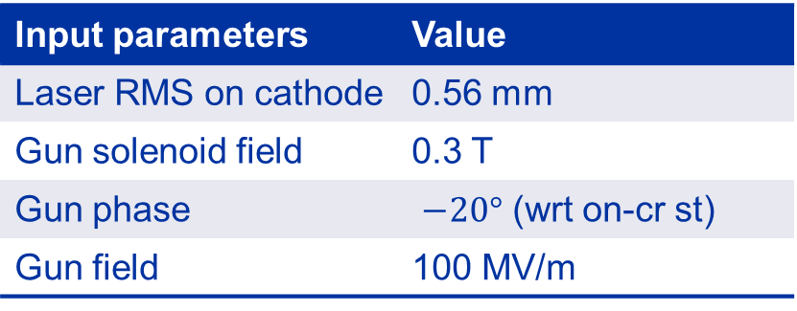
Optimal beam parameters
Electron beam parameter | Value
Beam energy | 5 MeV
Bunch charge | 400 pC
RMS beam size at IP | 94 µm
RMS bunch length | 1 ps
Repetition rate | 10 Hz
Laser beam IP parameter | Value
Wavelength | 1030 nm
Laser pulse energy | 0.9 mJ
RMS pulse length | 112 fs
M2 | 1.3
Laser waist at IP | 15 µm
Input parameters | Value
Laser RMS on cathode | 0.56 mm
Gun solenoid field | 0.3 T
Gun phase | $−20°$ (wrt on-cr st)
Gun field | 100 MV/m
18mrad
13.5 mm
0.75 m
Collection angle of photon detector

Slide 11
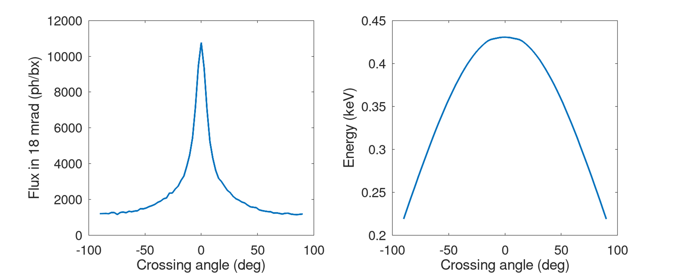
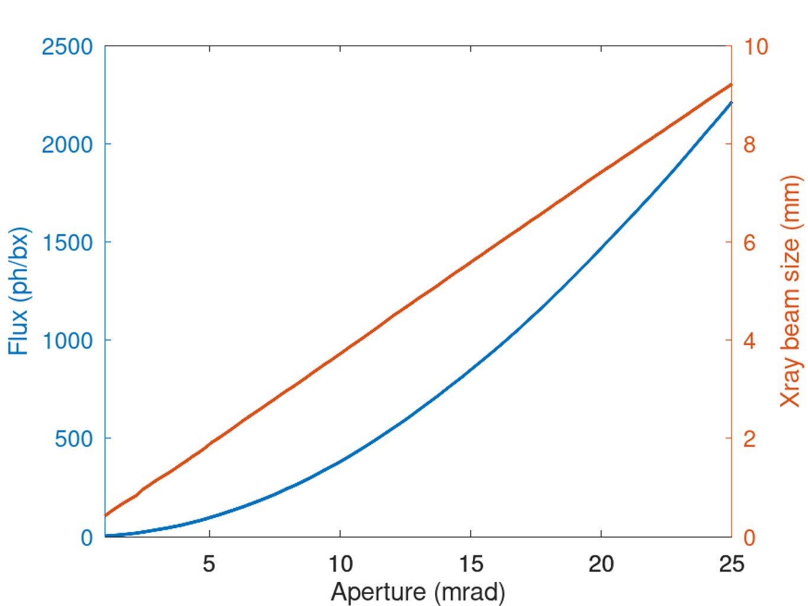
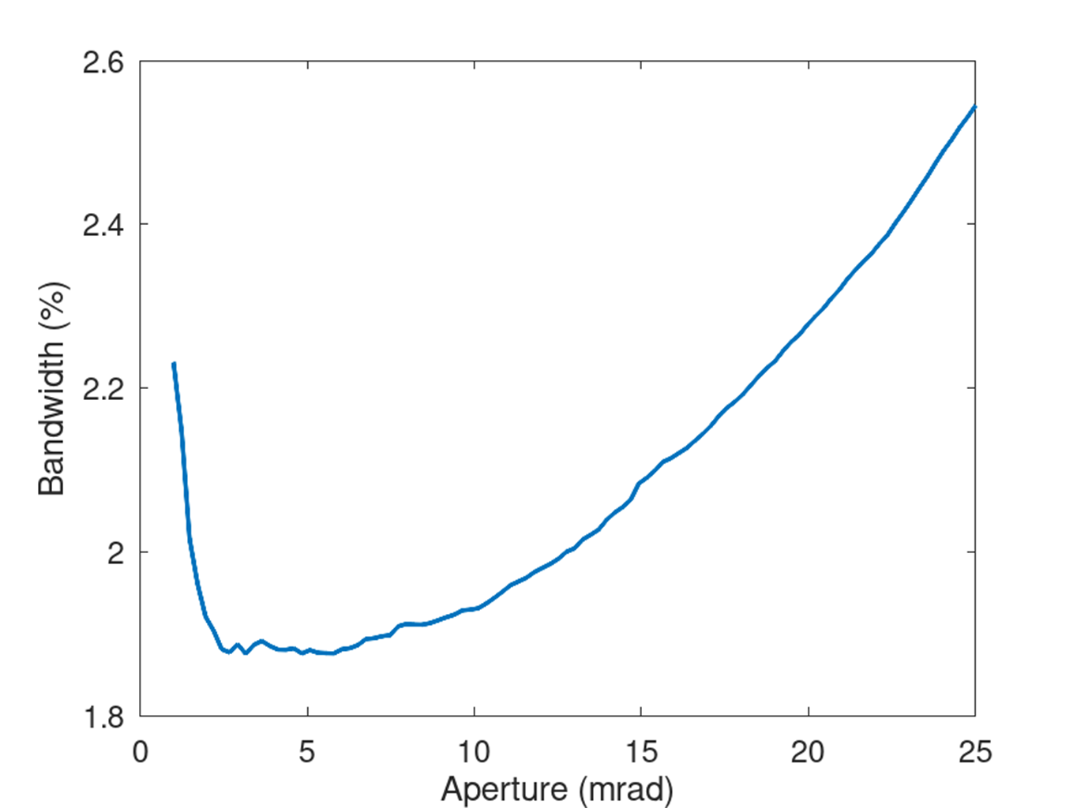
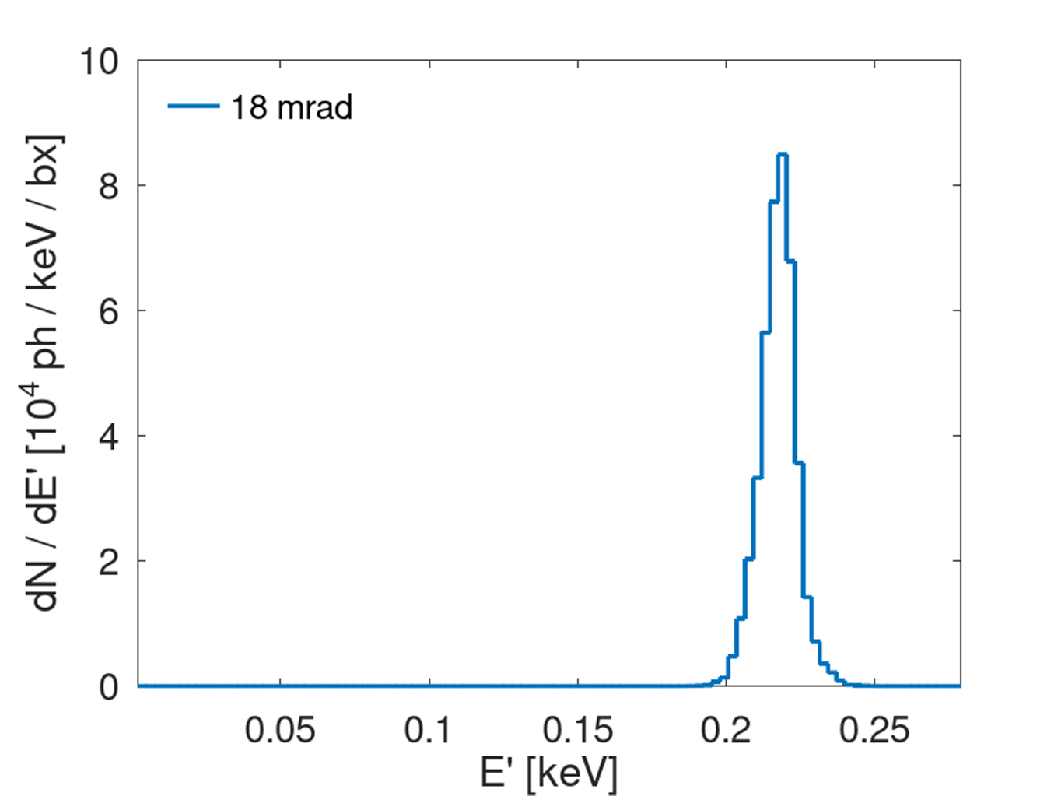
Simulated X-ray parameters
X-ray beam parameter | Value
Photon energy | 220 eV
Wavelength | 5.6 nm
Crossing angle | 90
RMS beam size on detector | 6.7 mm
RMS pulse length | 0.23 ps
Nb photons per pulse (total) | 29,000
Nb photons per pulse (18 mrad) | 1,200
Bandwidth | 2.2%
11

Slide 12
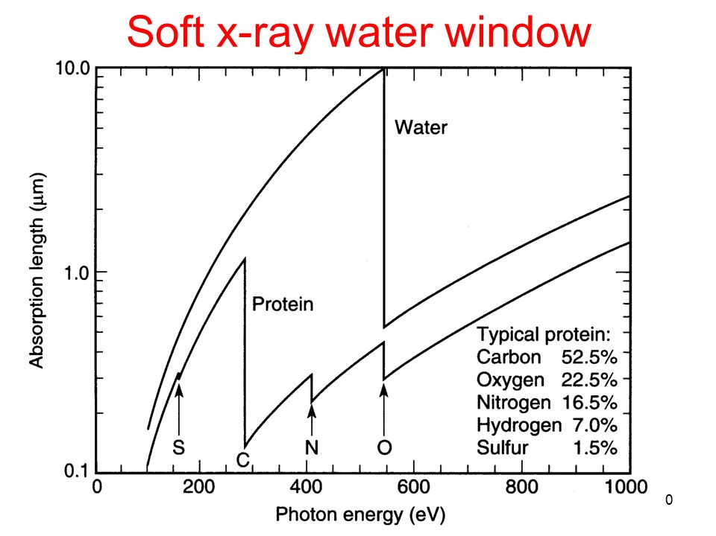
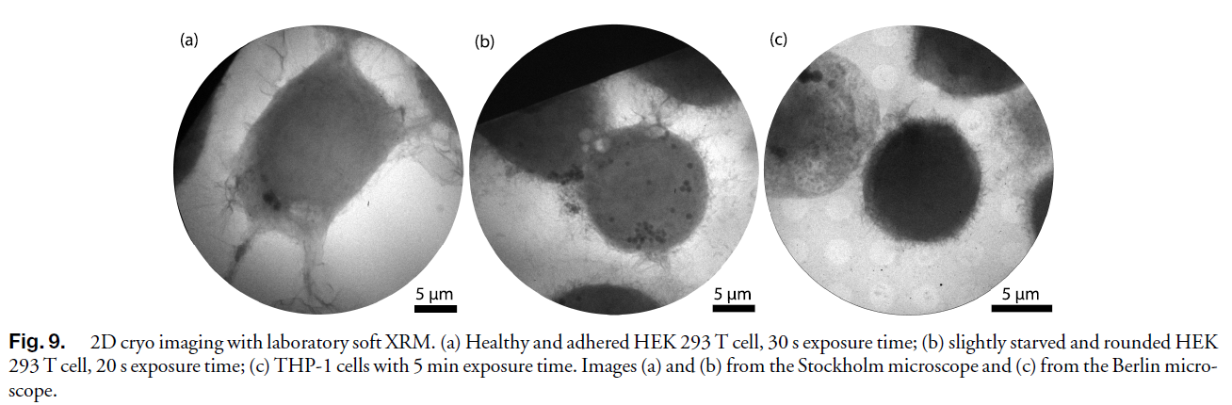

Water Window X-ray source
Water window is a region in the electromagnetic spectrum where water is invisible.
The region spans the K-edge of Carbon (282 eV) to Oxygen (533 eV).
Only microscopy allowing for 10 nm range 3D imaging of cellular samples in their near-native state $→$ quantitative characterisation of (sub)cellular organisation in single cells and cell-cell interaction [1].
Most water window microscopes have been implemented as part of synchrotrons.
[1] V. Weinhardt, J.-H. Chen, A. Ekman, G. McDermott, M. A. Le Gros, and
C. Larabell, “Imaging cell morphology and physiology using x-rays,”
Biochem. Soc. Trans. 47, 489–508 (2019).
https://doi.org/10.1364/OPTICA.393014

Slide 13
Experimental set-up

Slide 14
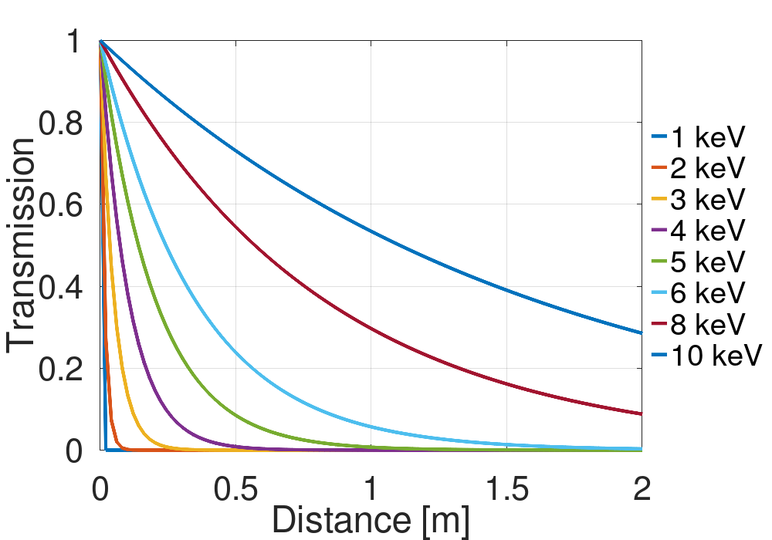
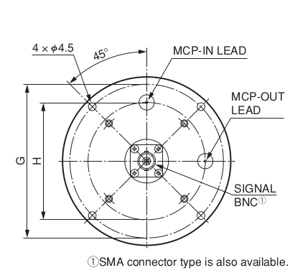
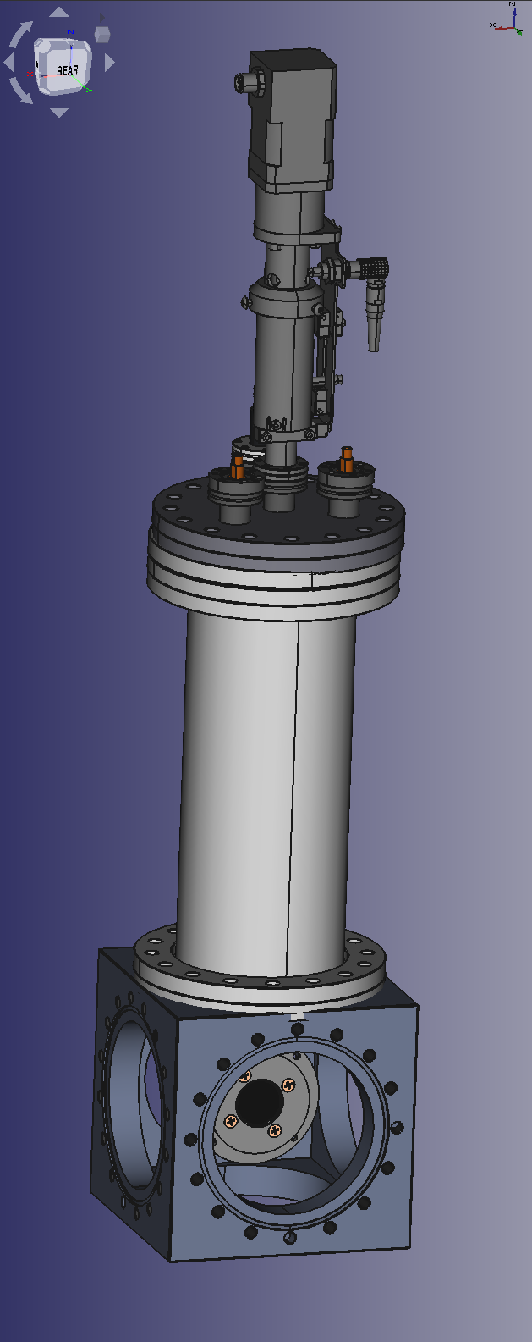
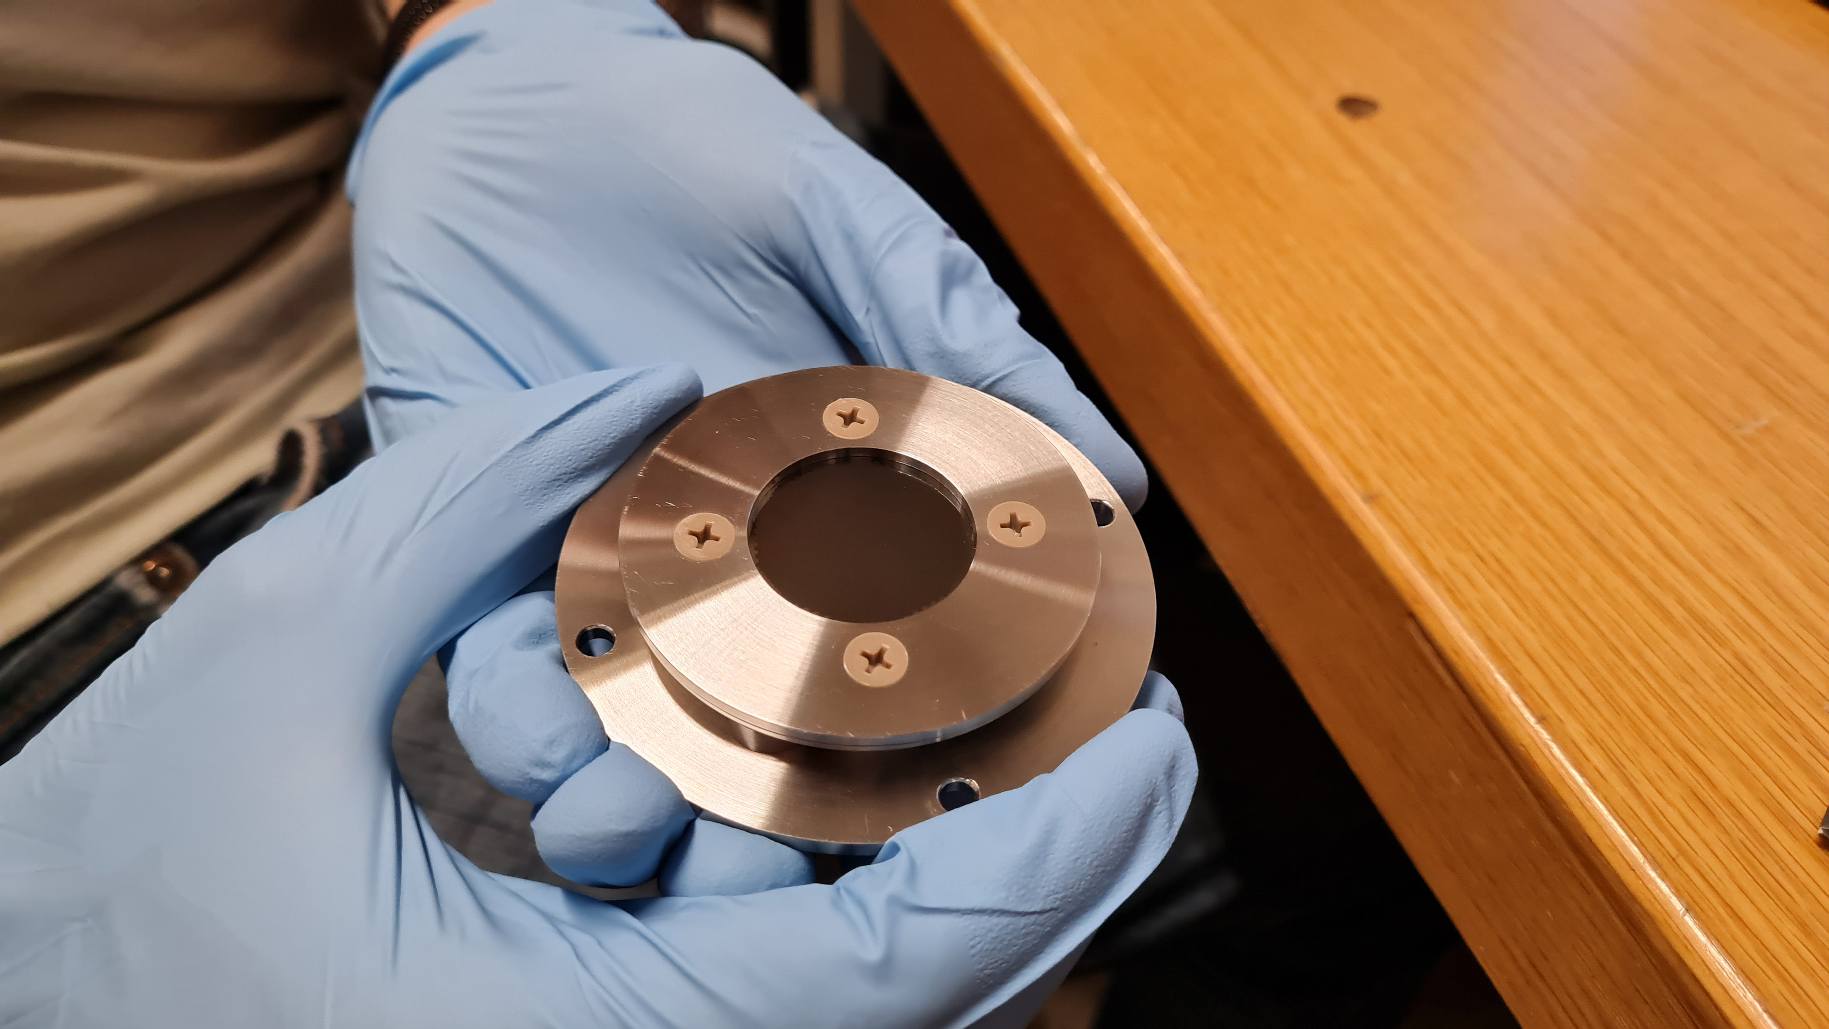
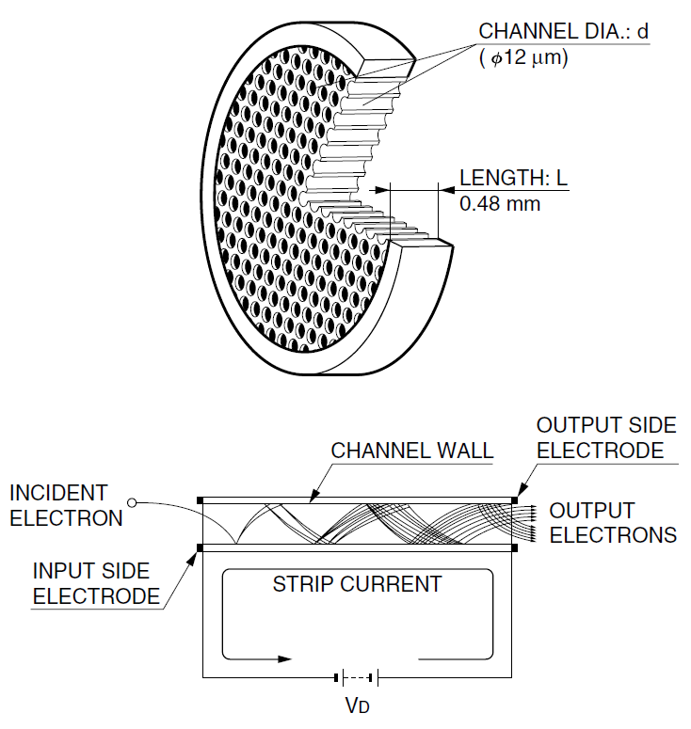
The detector set-up
(air)
High absorption of soft X-rays in air prevents us from placing the photon detector in-air
Dimensions: 81 by 36 mm
Provides 10⁶ gain with a 27 mm effective diameter
Operated in vacuum (< 1e-4 Pa)
Capable of time-of-flight measurements (900 ps FWHM pulse width)

Slide 15
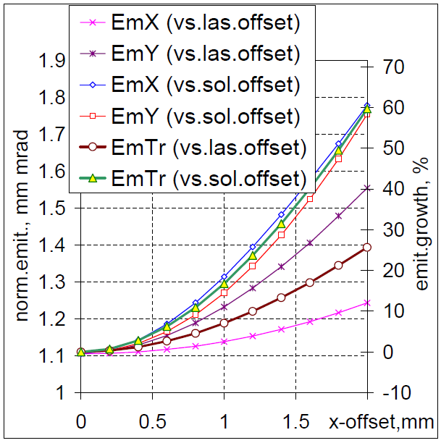
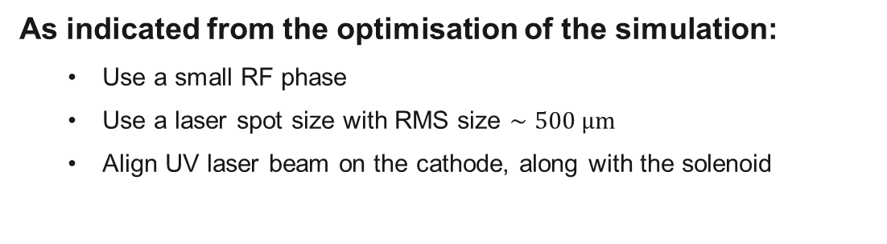
Configuring the CTF2 gun for the ICS experiment
To maximise the scattered photon flux we need:
  High bunch charge (> 200 pC)
  High laser pulse energy (1 mJ from frequency doubler)
  Small laser pulse length (100 fs RMS)
  High beam energy to reduce angular spread of ICS photons (> 5 MeV)
  Small spot size (< 150 µm RMS)
Total flux
As indicated from the optimisation of the simulation:
  Use a small RF phase
  Use a laser spot size with RMS size $∼500 μm$
  Align UV laser beam on the cathode, along with the solenoid
“Beam based procedures for RF guns”, PAC2005
15

Slide 16
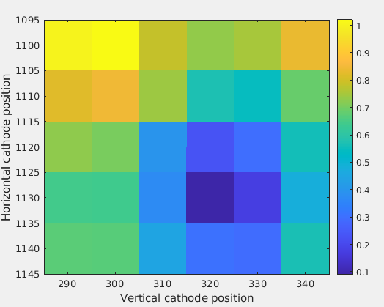

Alignment of laser spot on cathode with solenoid
Method: scan the laser position on the cathode, and for each point, made a solenoid scan and determined the beam drift $→$ select laser coordinates with smallest drift.
Stable beam region accuracy set by drift distance of the laser spot within 160 $μm$.
Stable point
Electron beam position drift
y
d₂
Total drift = d₁ + d₂
0.27 T
d₁
0.28 T
0.29 T
x

Slide 17
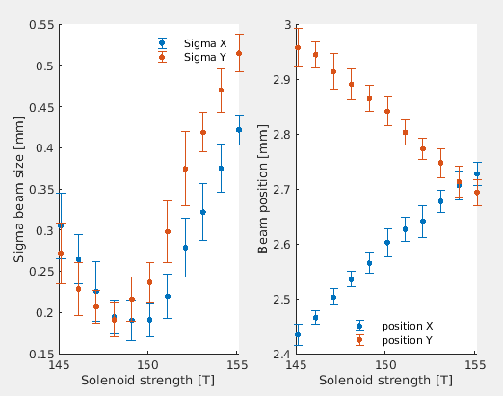
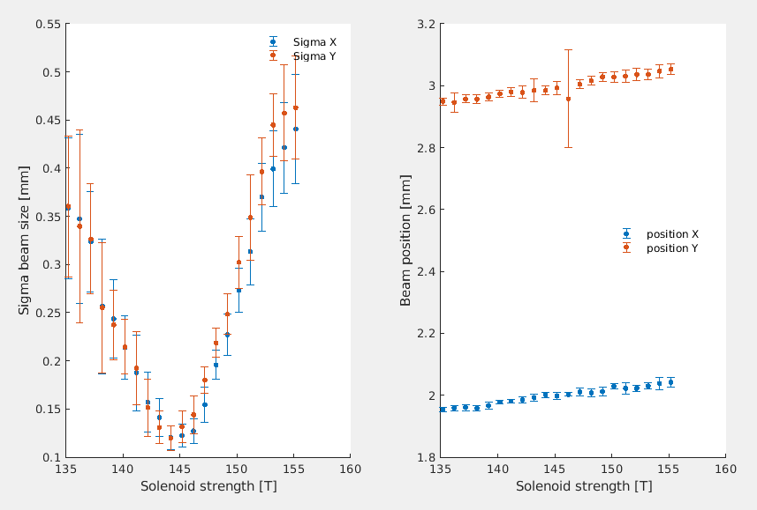
Alignment of laser spot on cathode with solenoid
Stable beam for a large range of solenoid strengths was obtained.
Solenoid current [A]
Solenoid current [A]
Solenoid current [A]
Solenoid current [A]

Slide 18
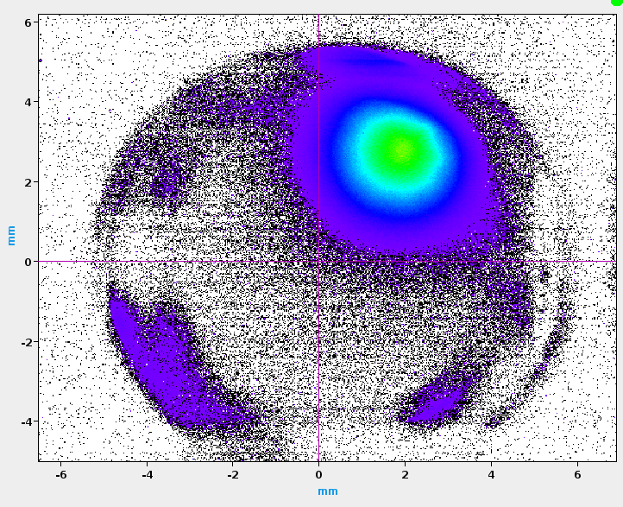
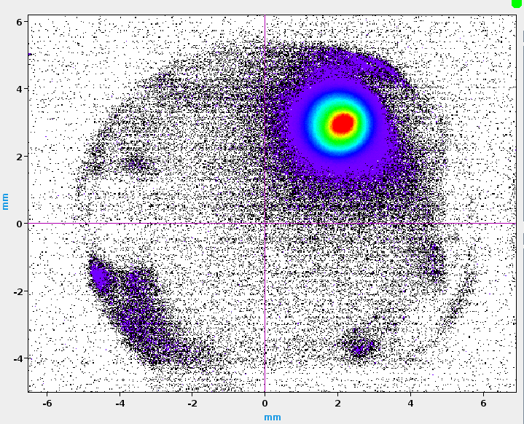
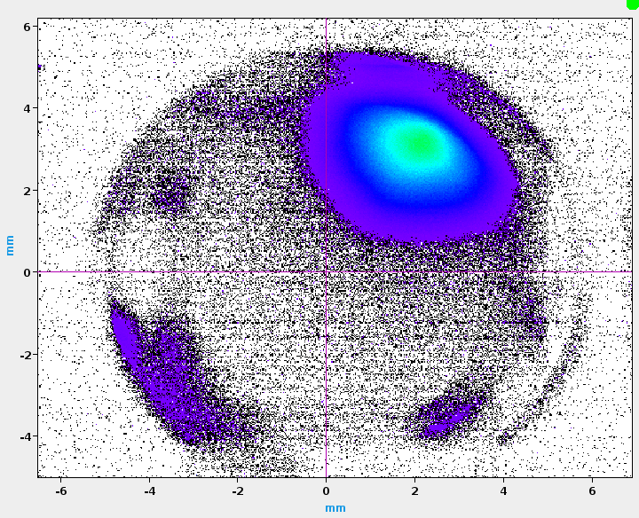
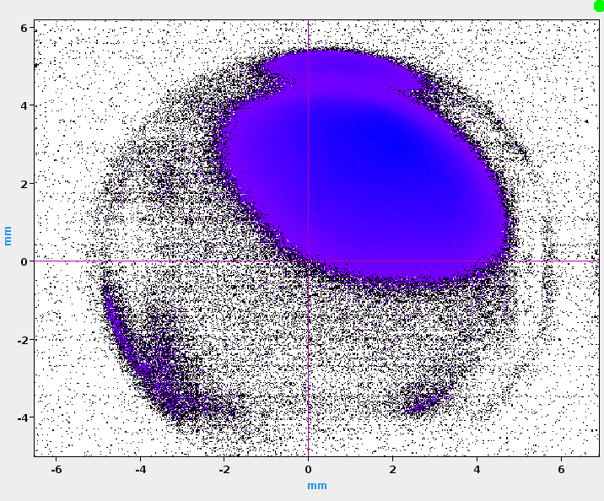
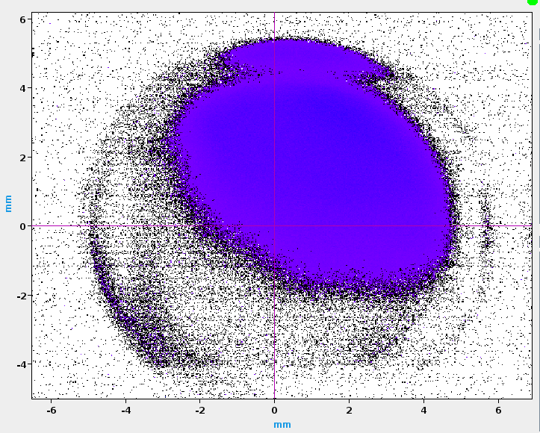
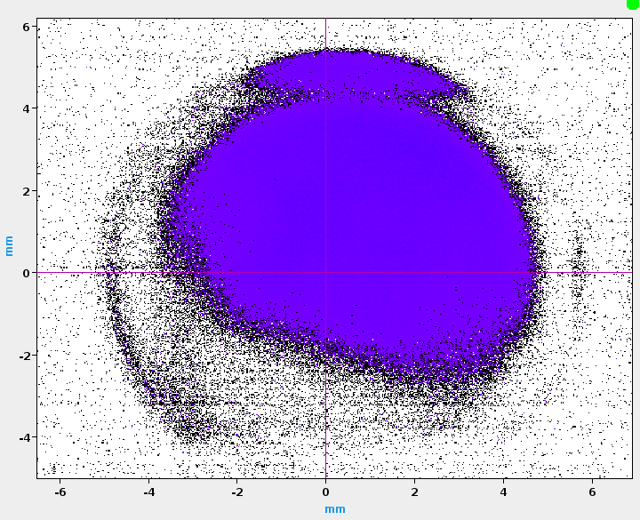
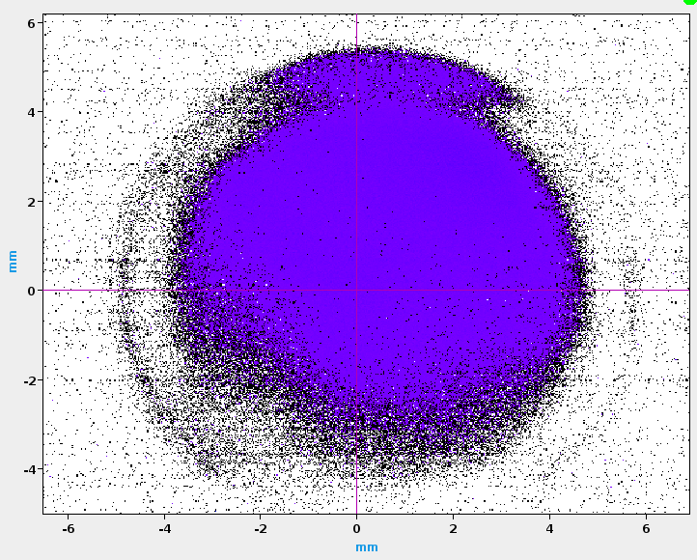
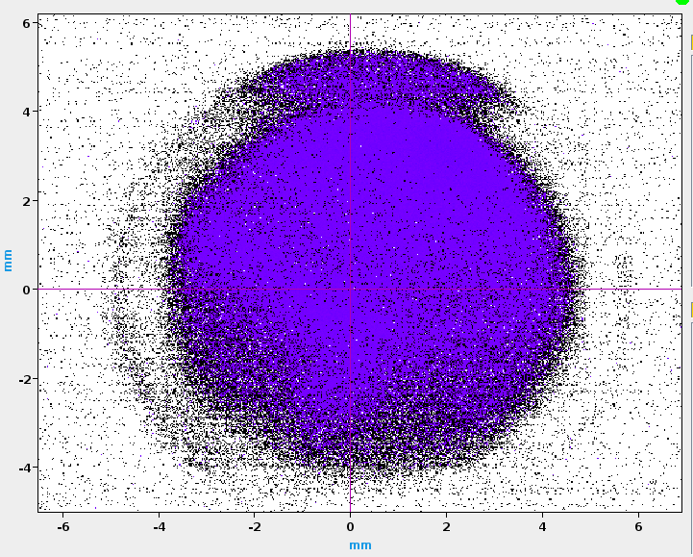
Stable beam point found
0.351 T
0.329 T
0.307 T
0.285 T
0.263 T
0.241 T
0.219 T
0.197 T

Slide 19
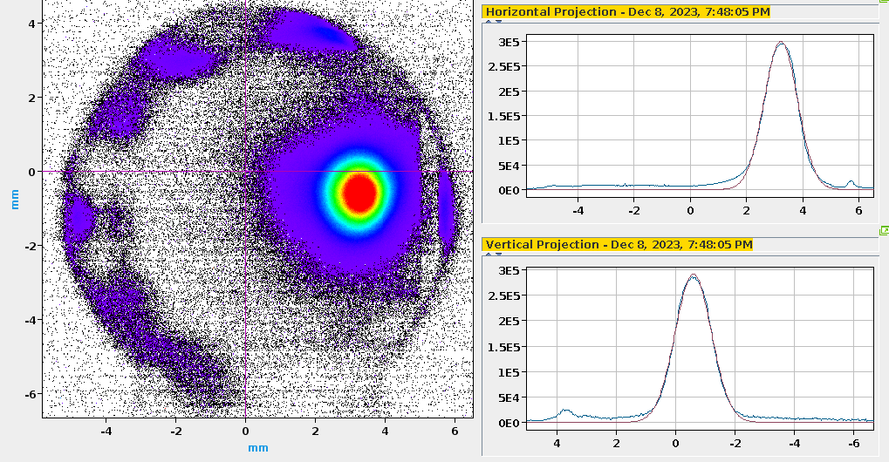
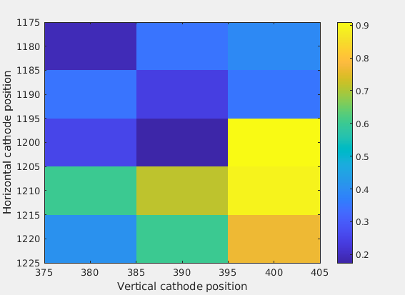
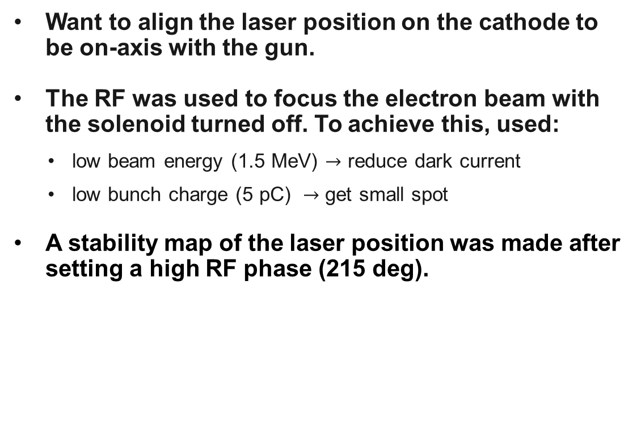
Centering the laser on cathode
Want to align the laser position on the cathode to be on-axis with the gun.
The RF was used to focus the electron beam with the solenoid turned off. To achieve this, used:
  low beam energy (1.5 MeV) $→$ reduce dark current
  low bunch charge (5 pC) $→$ get small spot
A stability map of the laser position was made after setting a high RF phase (215 deg).

Slide 20
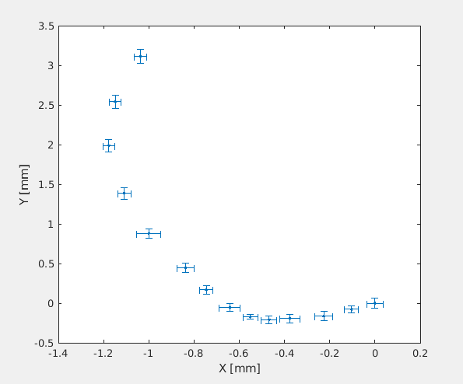
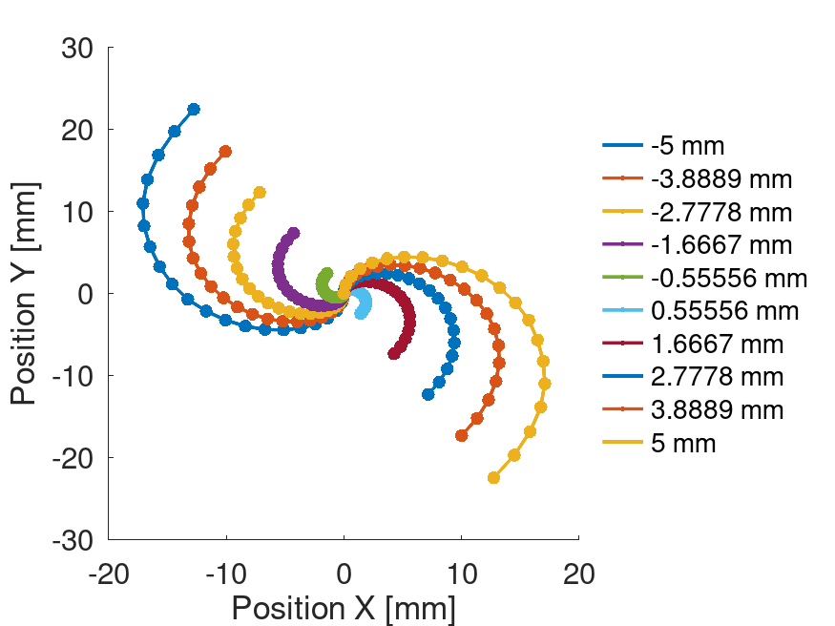
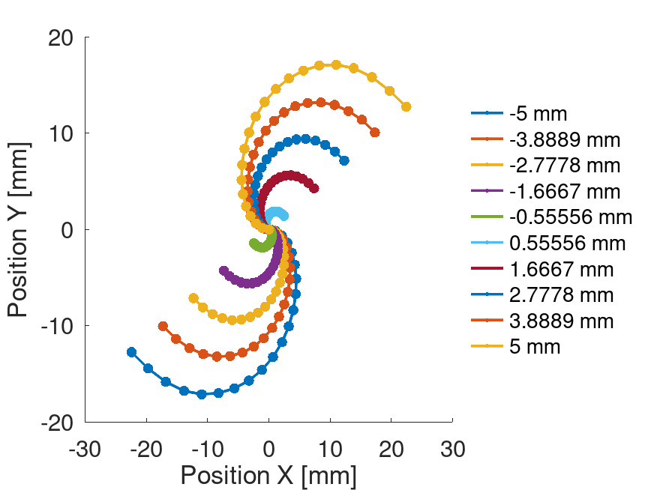
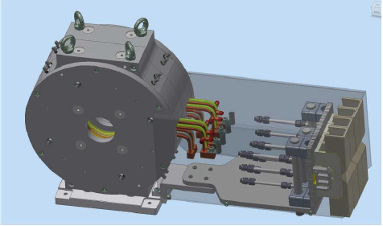

Centering the gun solenoid
To further reduce the emittance from the gun, the position of the electron beam can be tracked through a solenoid scan
$→$ solenoid position and angle offset can be inferred by fitting the beam trajectory to simulations. Preliminary results predict a transverse misalignment less than 1 mm.
Solenoid X offset
Solenoid Y offset

Slide 21

Small spot working point
Used a small RF phase and a laser RMS spot of 200 µm.
An electron RMS spot of 100 µm was obtained for a bunch charge of 200 pC.
At 400 pC, a 200 µm RMS spot was obtained.
Note the presence of an electron beam halo, inducing a non-Gaussian beam profile.
Is this profile optimal for generating a high photon flux?

Slide 22

Optimum beam profile for high photon flux
Simulations indicate that non-Gaussian beam distributions with a sharp peak and space charge-induced halo achieve the highest flux.

Slide 23
Conclusions
The CTF2 gun serves as an ideal test bench for an ICS proof of concept experiment.
The obtainable X-ray parameters are compatible with water window microscopy.
Working points have been defined to allow the generation of high flux photons.
Installation and experiment to be completed during the first half of next year.
End goal: experiment with a CLIC X-band structure-accelerated beam and Fabry-Perot cavity.
Thanks to CTF2 team: Steffen Döbert, Edu Granados, Miguel Calderon.

Slide 25






Impact of RF phase on electron spot size at IP
100 pC
200 pC
Simulation
Measurement
Q = 200 pC
300 pC
400 pC
Negligible change in electron spot = 190 um
25

Slide 26




Tolerance study (Cathode)
Determine the impact of offsets in injector parameters on the total flux from CBS.
Tolerance study done for 200 pC with Copper cathode.
Bunch charge
Laser pulse length
Cathode
Laser spot
size
Laser spot
position

Slide 27



Tolerance study (RF Gun)
The RF gradient controls the beam energy at the injector exit.
Difference with respect to nominal energy leads to poor focusing $→$ flux is most sensitive to the gun gradient.
RF Gun
Gradient
Phase

Slide 28




Tolerance study
(Gun Solenoid)
Due to the strong focusing involved, the CBS photon flux is sensitive to offsets of the gun solenoid.
Solenoid
B-field
amplitude
Offset
Transverse & Angular

Slide 29





Tolerance study (IP region)
2 deg
crossing angle
Electron beam phase space at the IP

