Slide 1



Beam Loading Studies
in Positron Source Capture Linac of
Compact Linear Collider (CLIC)
Nafiseh Mesbah (Nafiseh.mesbah@cern.ch)
Institute for Research in Fundamental Sciences (IPM), School of Particles and Accelerators, Tehran, Iran.
European Organization for Nuclear Research (CERN), Geneva, Switzerland.
CLIC mini week
December 2023
Notes:
Positron sources are the key elements for the future and current lepton collider projects such as ILC, CLIC, SuperKEKB, FCC-ee, Muon Collider

Slide 2
Table of content
Introduction
Beam Loading effect
RF-Track and Beam Loading
Simulation and Results
Summery

Slide 3
Introduction
Beam Loading effect
RF-Track and Beam Loading
Simulation and Results
Summery
Introduction
Beam Loading effect
RF-Track and Beam Loading
Simulation and Results
Summery

Slide 4
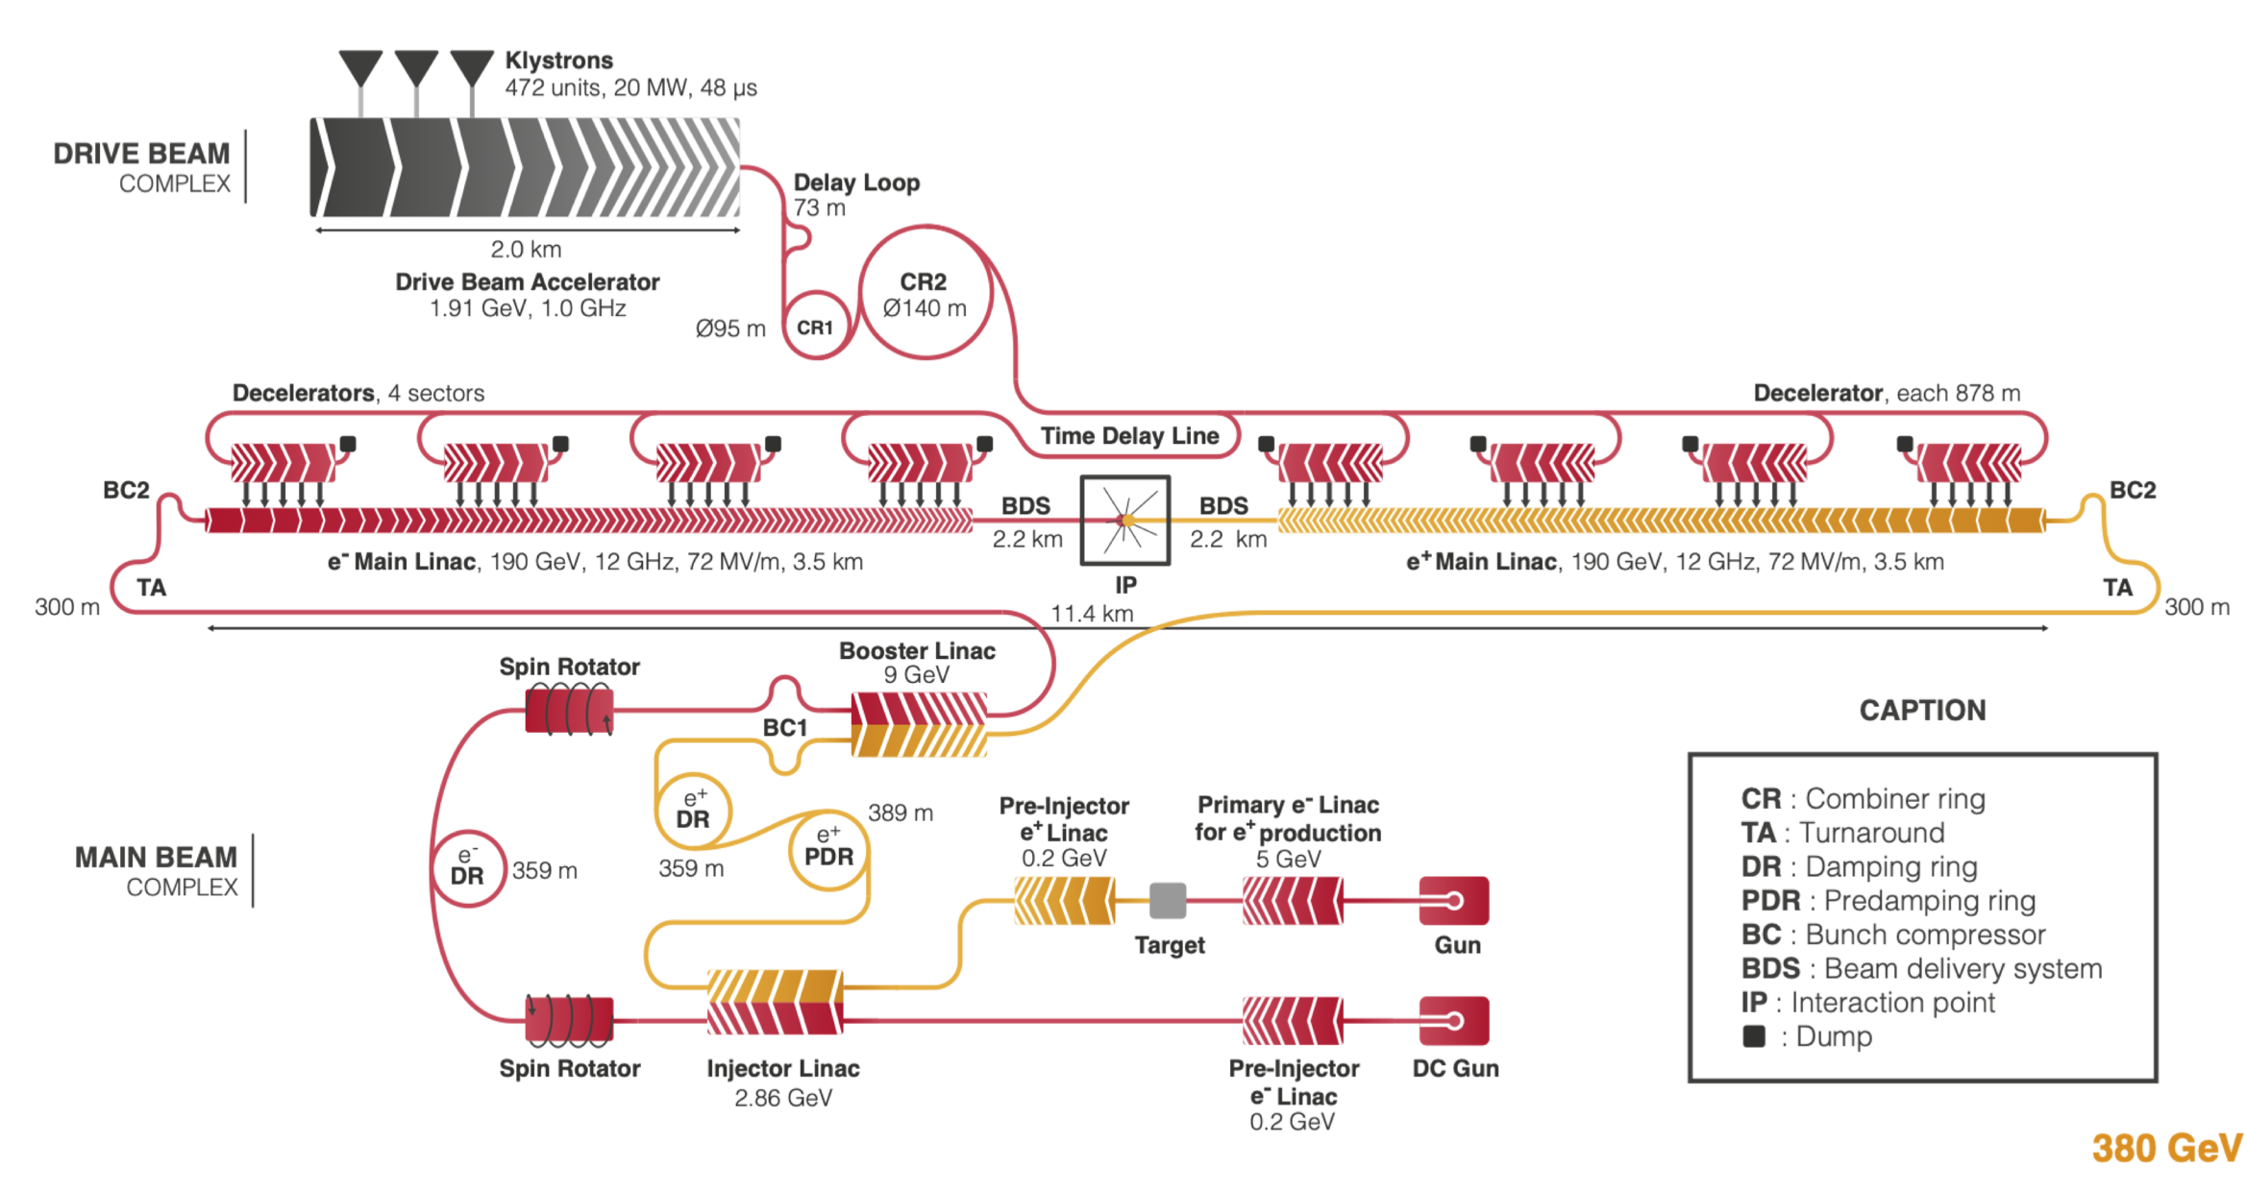
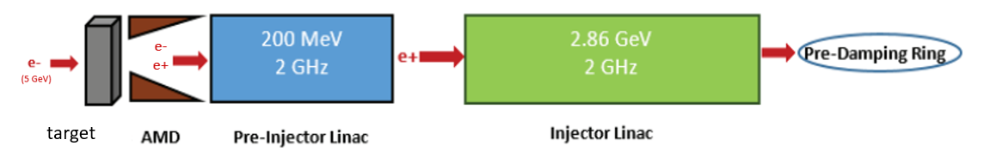
Introduction
CLIC Positron Source
Notes:
In this stage, positrons will be accelerated and prepared for entering the pre-damping ring for emittance reduction.
four possible projects: the International Linear Collider (ILC) in Japan, the Compact Linear Collider (CLIC) or the Future Circular Collider (FCC-ee) at CERN and the Circular Electron Positron Collider (CEPC) in China.
precision study of the Higgs boson and the exploration of the high-energy frontier .These are two complementary ways to address the open questions in particle physics.
lepton colliders should provide high precision measurements.
multi-TeV 𝜇 +𝜇 − Muon Collider, which can serve for both precision measurements and discovery physics.

Slide 5
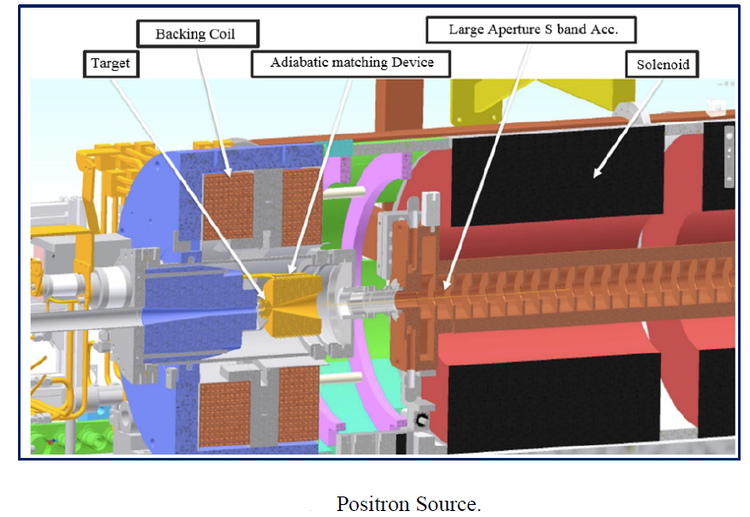
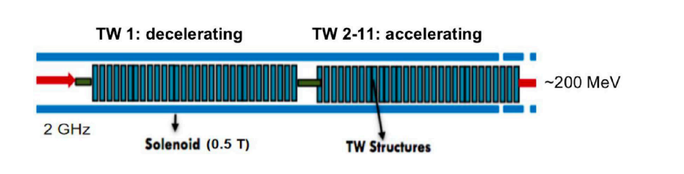
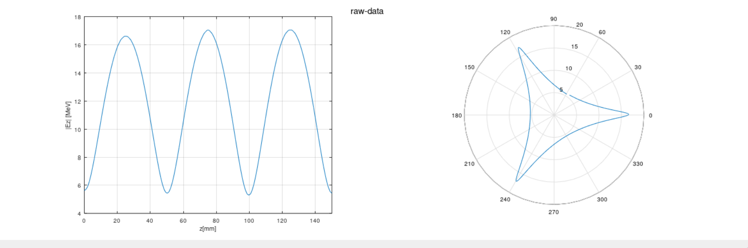
Introduction - CLIC Positron Source - Capture Linac
2 GHz room temperature, 2𝜋/3 phase advance per cell, traveling-wave accelerating structure
Structure: 1.5 m long, 2 cm aperture (radius), 20 cm distance, with NC selonoid 0.5 T
Number of structures: 11 => 1 for deceleration 10 for acceleration
The captured positrons at the end of the CL reach 200 𝑀eV energy.
Positron source of the SuperKEKB
Optimisation of the CLIC positron source, Yongke Zhao, CLIC beam dynamics meeting,2021
Notes:
My work is on blue part

Slide 6
Introduction
Beam Loading effect
RF-Track and Beam Loading
Simulation and Results
Summery
Introduction
Beam Loading effect
RF-Track and Beam Loading
Simulation and Results
Summery

Slide 7
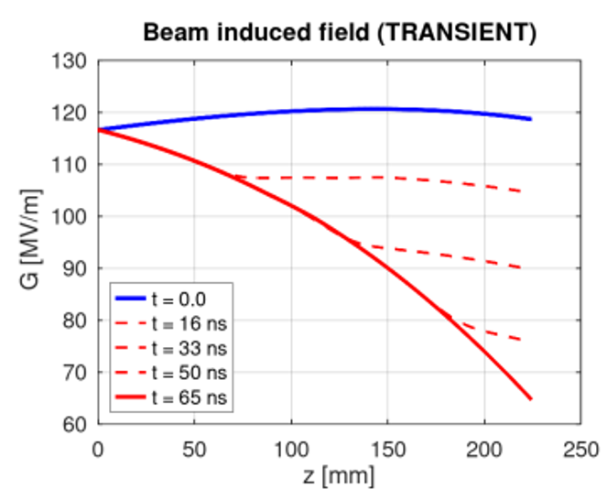
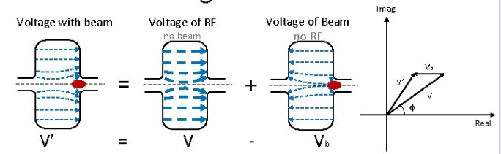

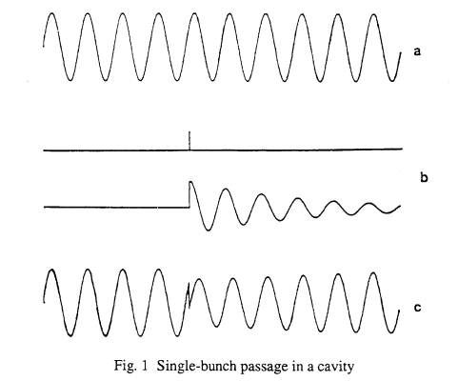
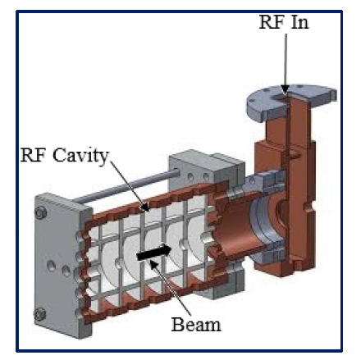
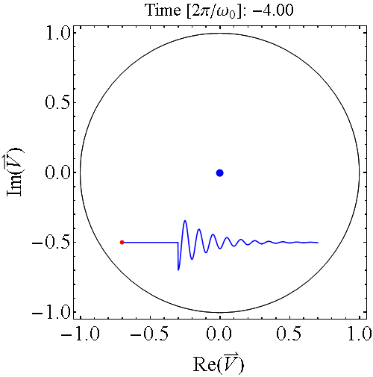
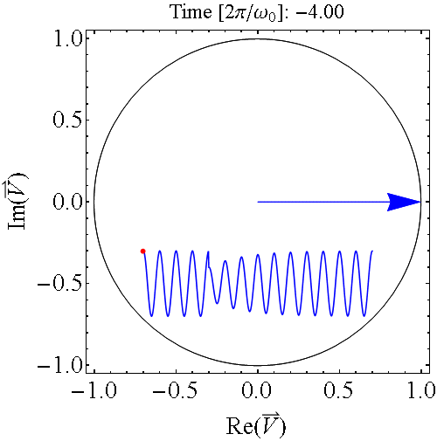

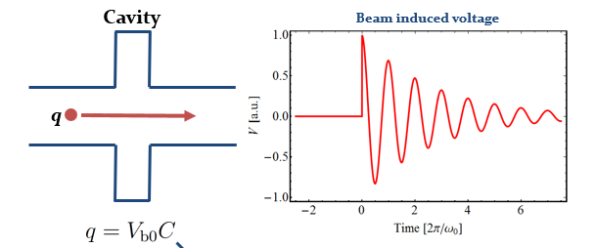
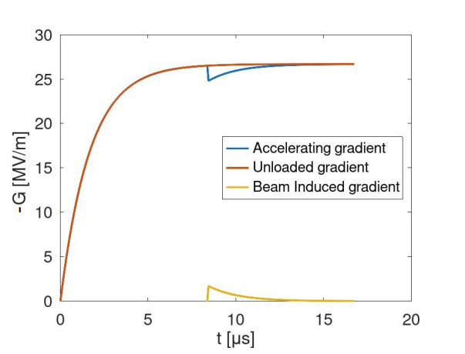
Cavity Beam Interactions and Beam Loading Effect
A particle crossing a cavity would be affected by the excited fields in the cavity.
care must be taken that there are two sources for exited fields.
The induced excitation can reduce cavity voltage and hence the Gradient of the structure.
  lasts for a long time – Long range effect
  Accumulated from bunch-to-bunch
A. Grudiev, A.Lunin,. Phys. Rev. Special topics 14, 052001 (2011)
external generator
beam loading effect
Reduction of available accelerating gradient
Cavity without external generator
Cavity driven by external source
H. Damerau,CAS, 9 November 2022
Notes:
In fact, inside a cavity the beam is not only a medium which can exchange energy with the electromagnetic fields, but also it can behave exactly like an internal generator. As the beam current increases the interaction between the beam and cavity becomes more important to some extent that sometime induced fields by the beam becomes considerable.
The effects of the beam on the cavity field are referred to beam loading effect which physically arises from all of interactions between cavity fields and passing current through the cavity

Slide 8
Introduction
Beam Loading effect
RF-Track and Beam Loading
Simulation and Results
Summery
Introduction
Beam Loading effect
RF-Track and Beam Loading
Simulation and Results
Summery

Slide 9
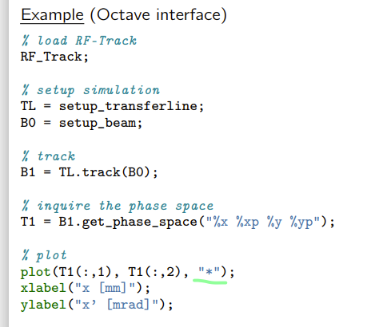
About RF_Track
a novel tracking code developed by Andrea Latina
transport beams of particles
  solving fully relativistic equations of motion
  using parallel algorithms
  written in optimized and parallel C++
  user interfaces scripting languages
    Octave
    Python
RF-Track has been tested successfully in several cases:
  TULIP, ELENA ring, the CLIC positron injector, and the AWAKE injector Linac.
https://zenodo.org/record/4580369
https://abpcomputing.web.cern.ch/codes/codes_pages/RF-Track/

Slide 10
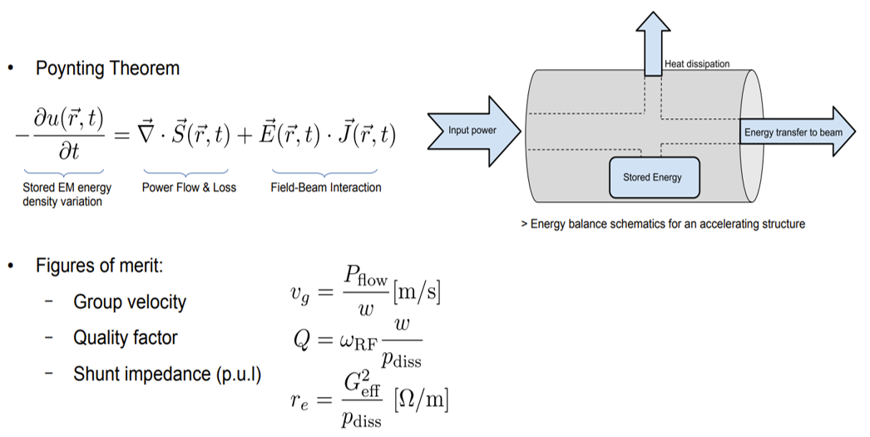
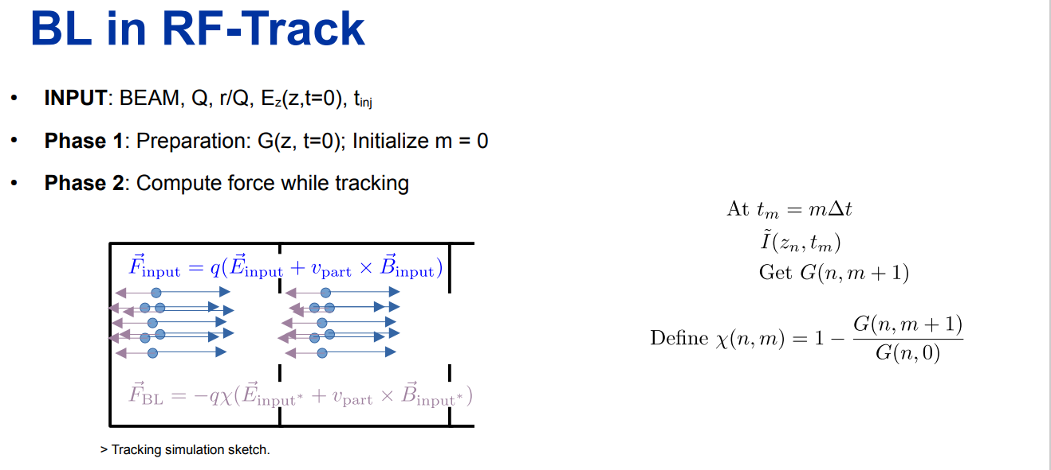
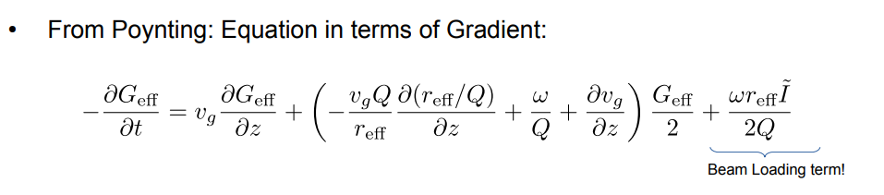
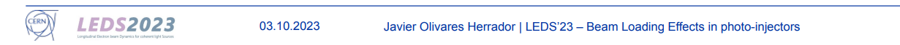
Beam Loading in RF_Track
Gradient reduction due to beam-cavity interaction can be understood with the Power-Diffusive model
Self consistent module: additional decelerating kick attached to Drift spaces, TW and SW structure, field maps
Compute force while tracking
power-diffusive model
More in : J.Olivares Herrador, A. Latina, et. al. Beam Loading Simulation for Relativistic and Ultrarelativistic Beams in the Tracking Code RF-Track. Linac 2022 Edited

Slide 11
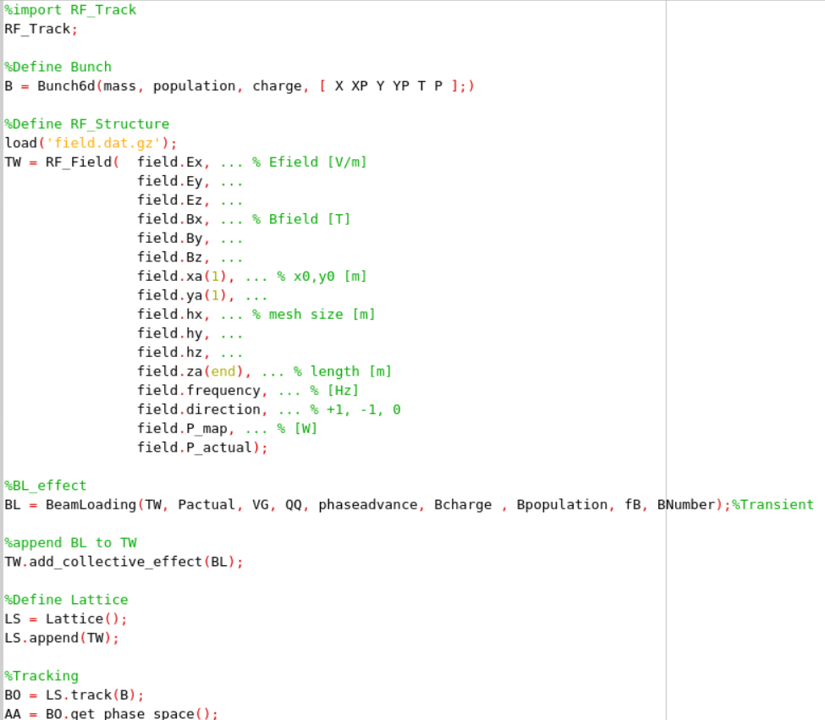
Beam Loading in RF_Track -Example (Octave)
Parameter | Value
Structure frequency | 2 GHz
Q- factor | 18346
Input power | 59.54 MW
Average group velocity | 0.0145 c
Filling time | 333 ns
Number of bunch per train | 312
Bunch spacing | 0.5 ns
Population per bunch | 7.5e9
Train length | 156 ns
Notes:
7.5e9=1.2 nC *312=374.4 nC
e- = 4e9 0.64 nC 1.3 A *312
Tf= L/vg = 333.33 ns
1. Inputs
2. PDE solving: Finite difference method Get G(z,t)
3. Tracking

Slide 12
Introduction
Beam Loading effect
RF-Track and Beam Loading
Simulation and Results
Summery
Introduction
Beam Loading effect
RF-Track and Beam Loading
Simulation and Results
Summery

Slide 13
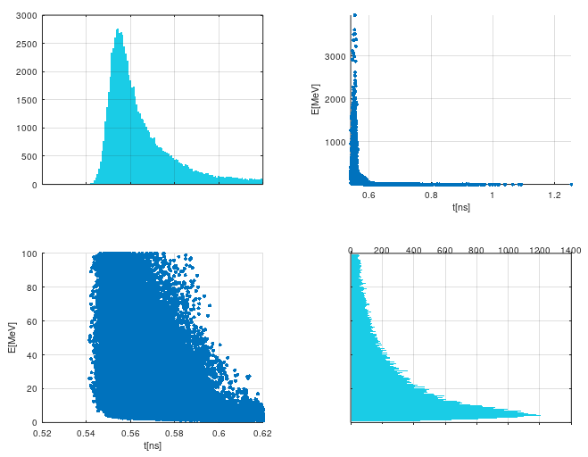
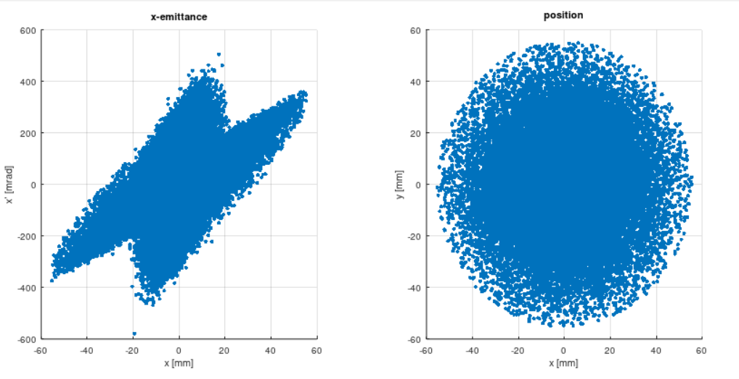
Challenges
Capture Linac includes both e- e+ with large energy-spread, large-bunch-length, large-emittance
Structure suffers from both e- and e+ Beam Loading
Goal: Preserve as many e+ as possible and prepare them for entry into the pre-damping ring for emittance reduction
Notes:
0.04 ns ~ 30 degree

Slide 14
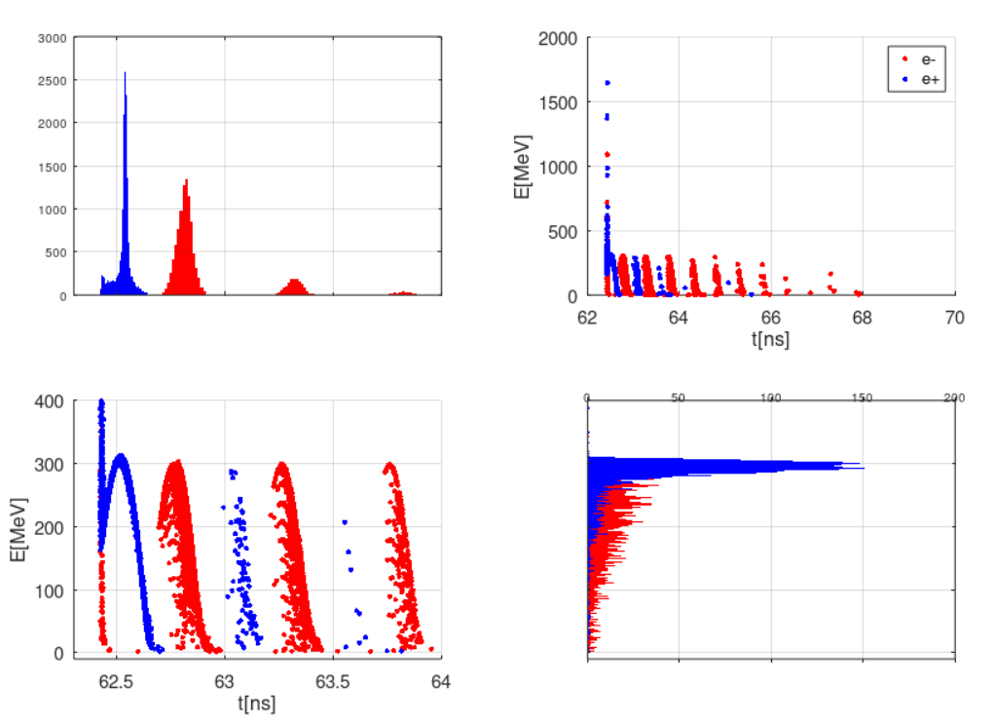
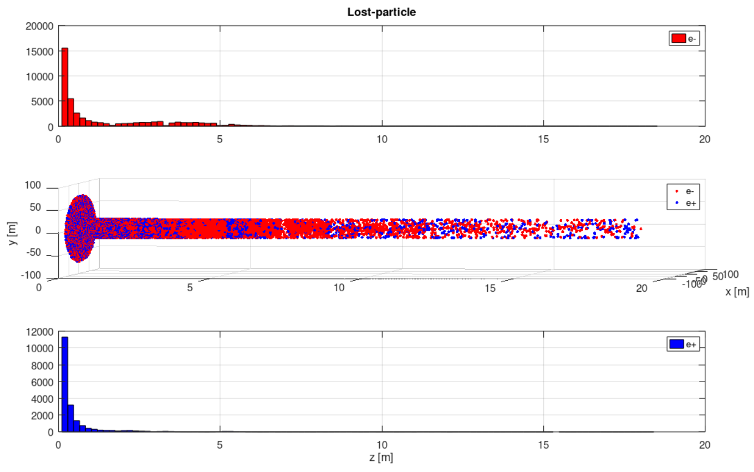

e- e+ outputs
Most of the positrons are lost at the beginning of the pipe => Cooling needs to be addressed.
Electrons have a phase shift of $π$ degree apart with respect to positrons, moving to the accelerating phase and gaining energy.
27327
11114
Notes:
We could see the eng and loss in the following slides.

Slide 15
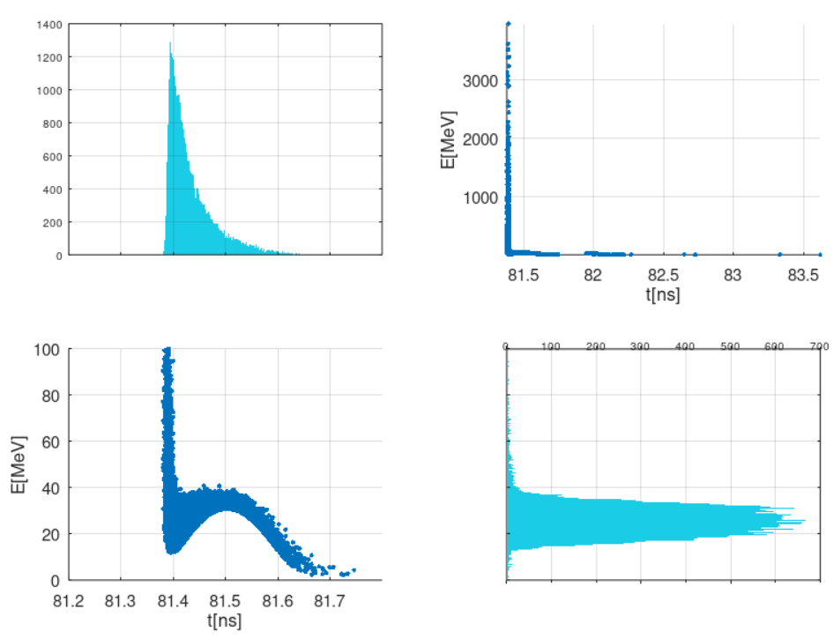
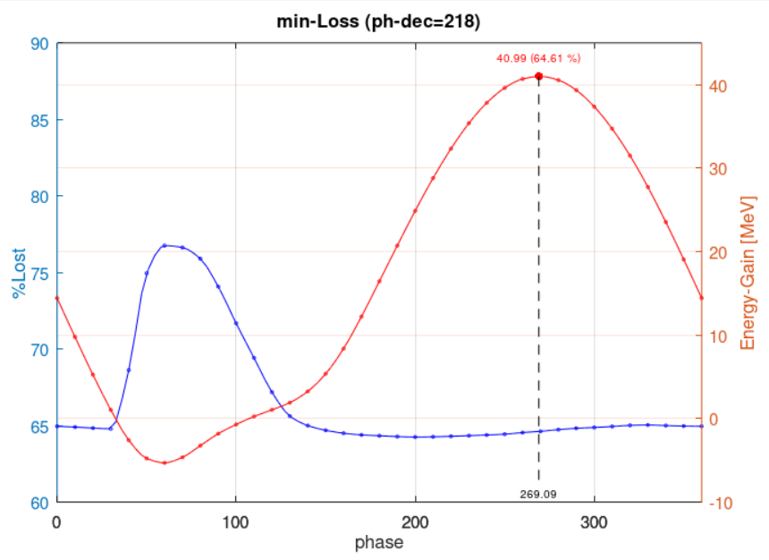
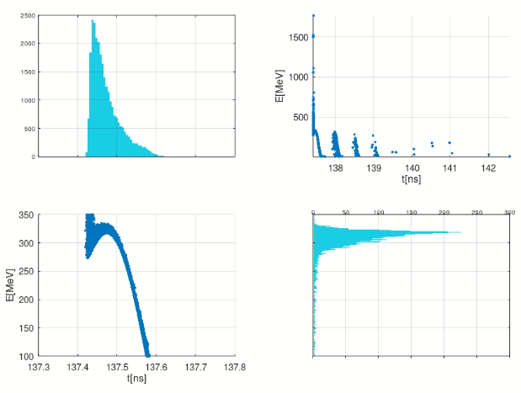
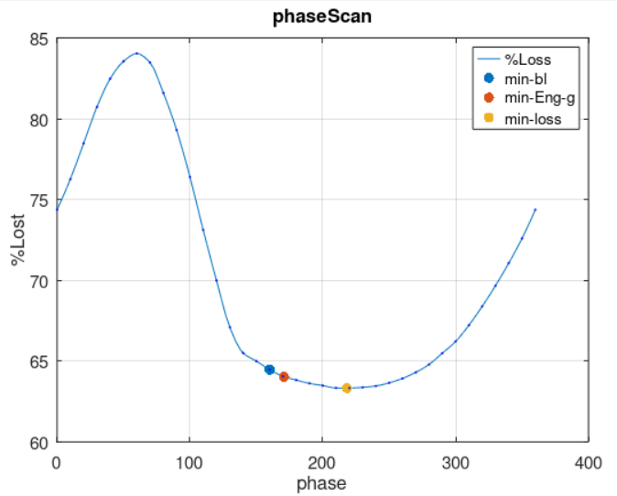
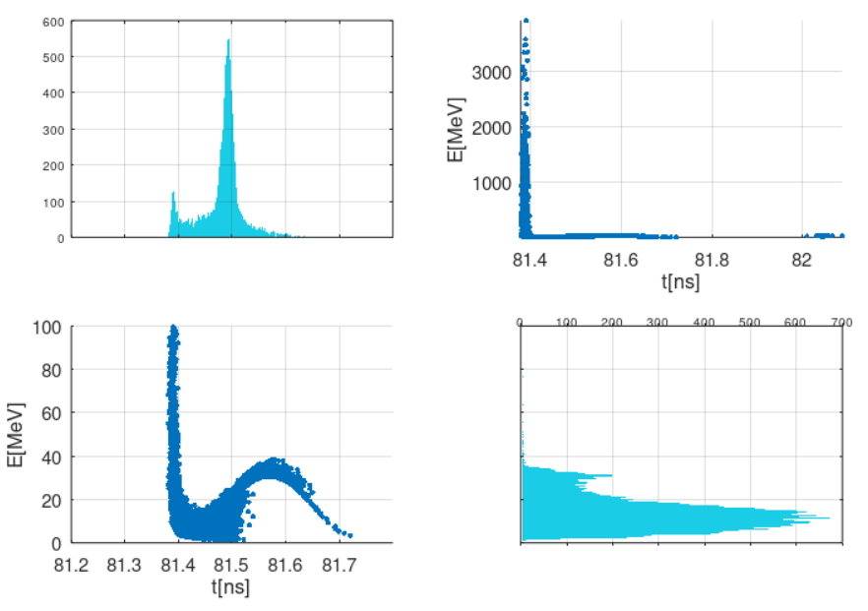
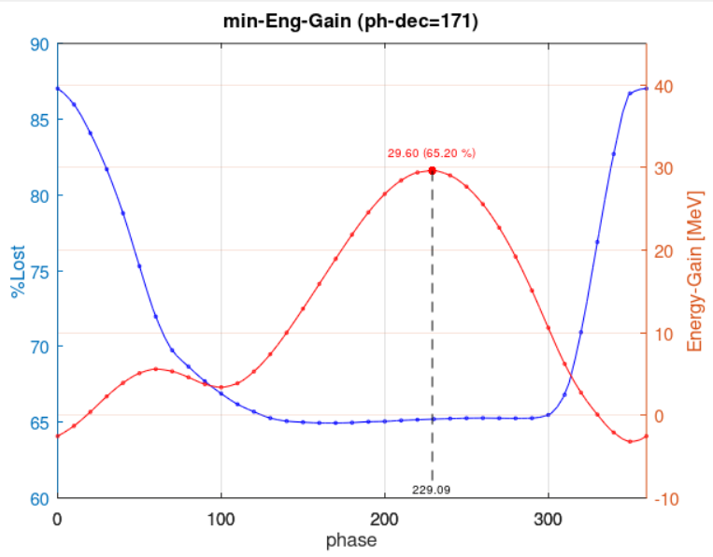
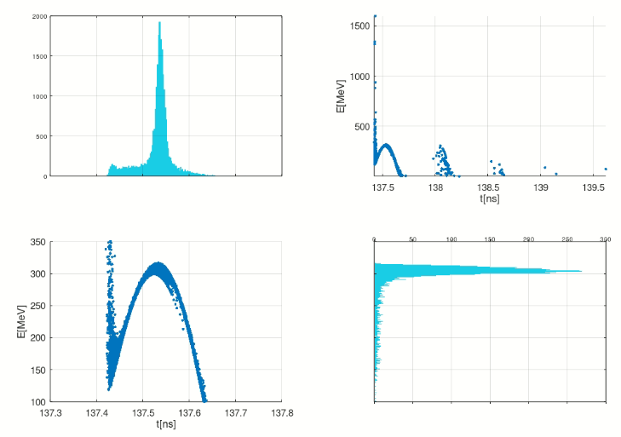
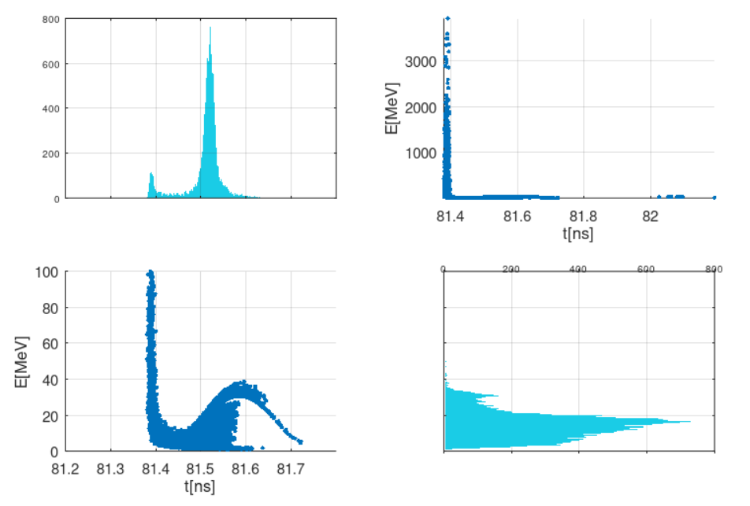
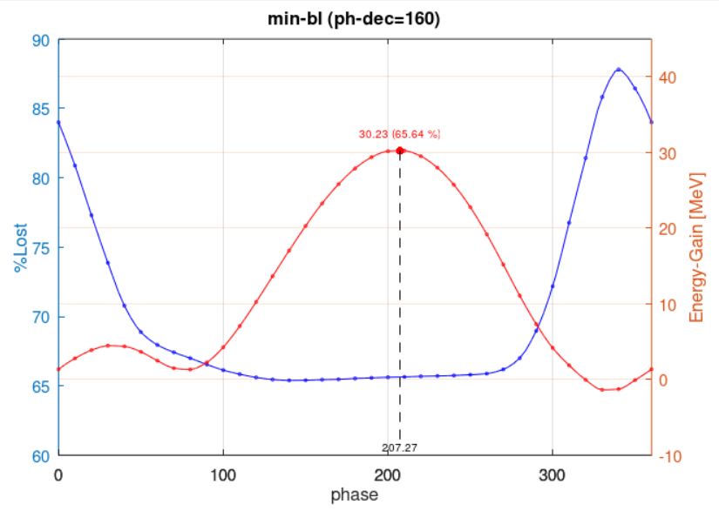
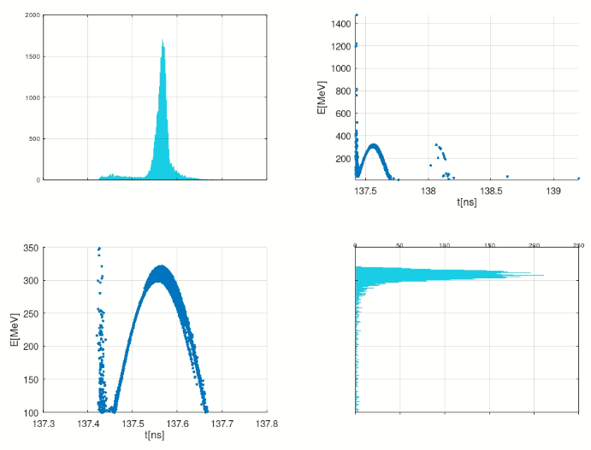
Phase Scan
The structure can be optimized through different criteria.
Min_loss
Min_Eng_gain
Min_bunch_length
Notes:
Due to large emit and eng spread and bl it’s not clear which criteria one can use.
We have a broad phase choice in which the loss for 1st structure(sominant loss) is min.

Slide 16
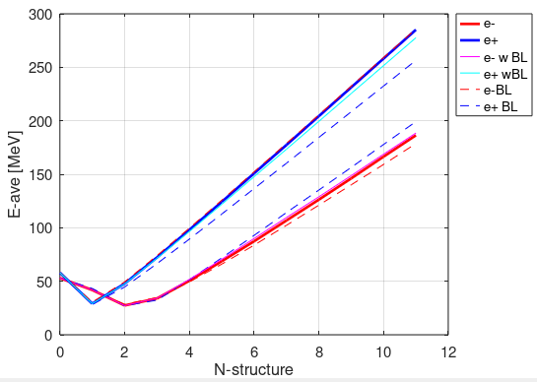
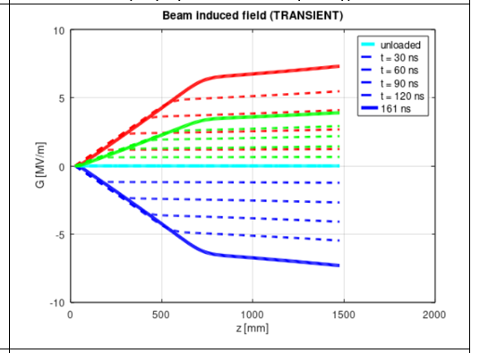
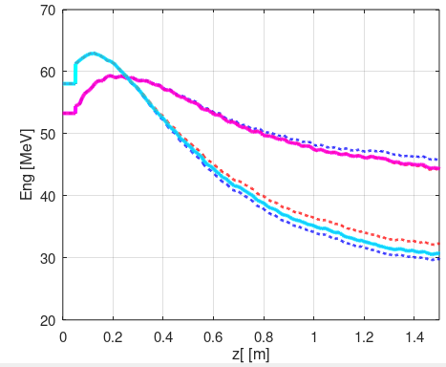
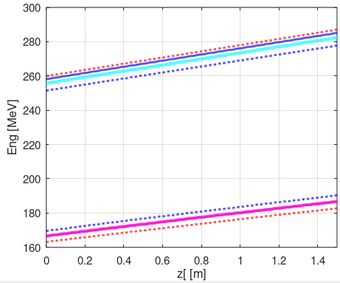
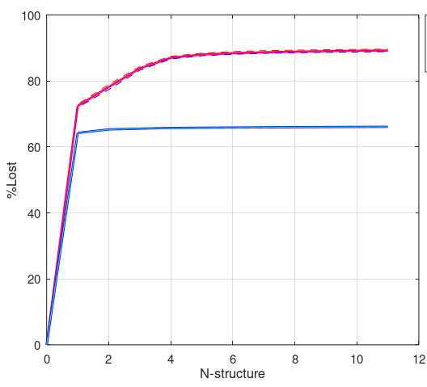
Beam Loading results
Gradient reduction for middle bunch n=150
First structure
Last structure

Slide 17
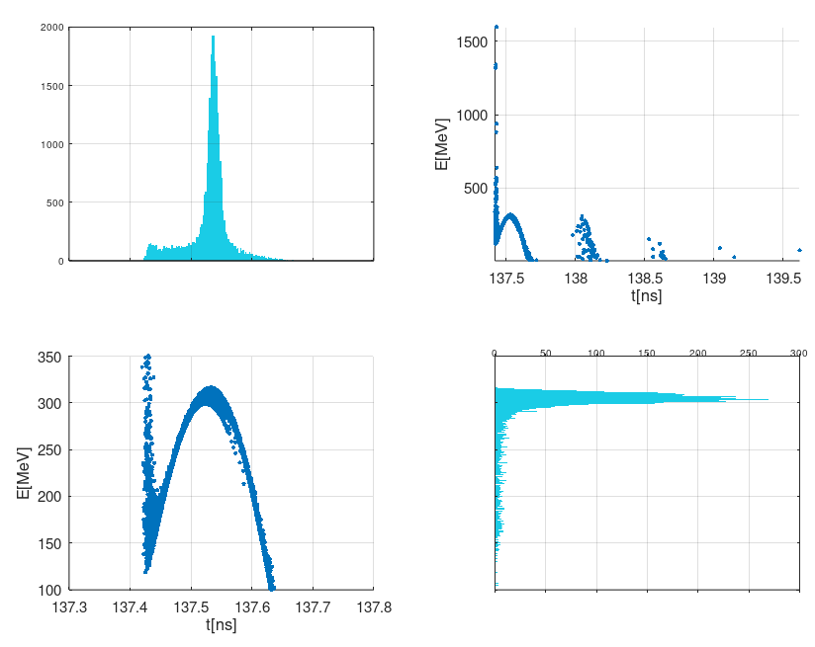
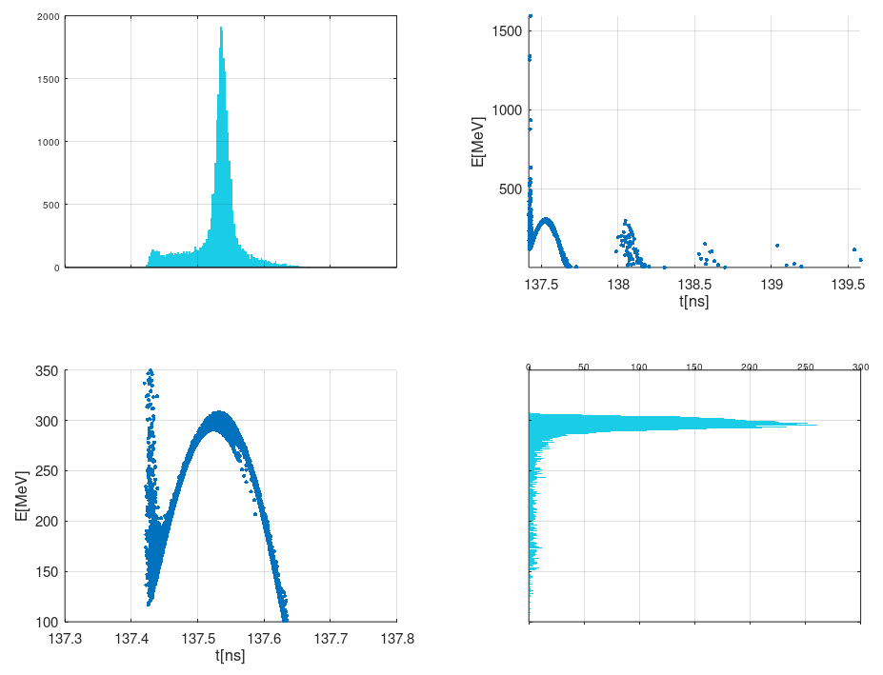
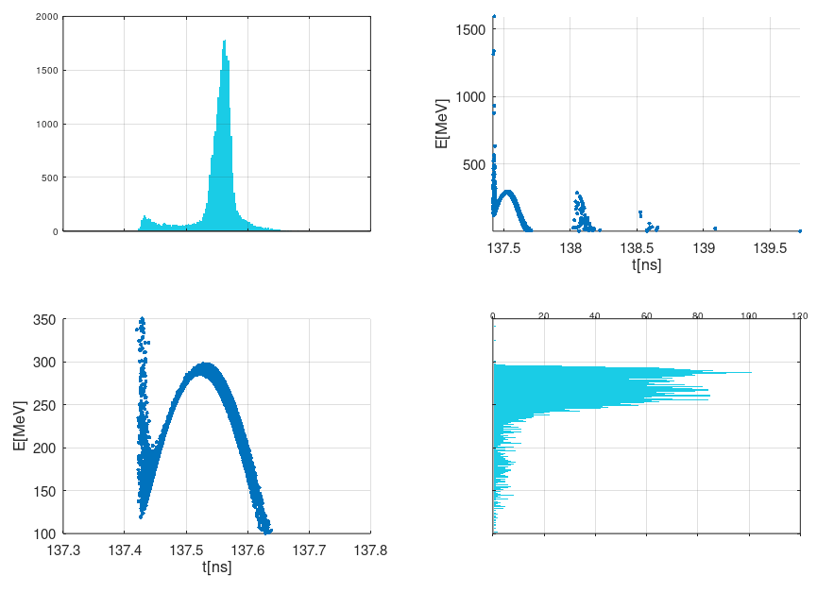
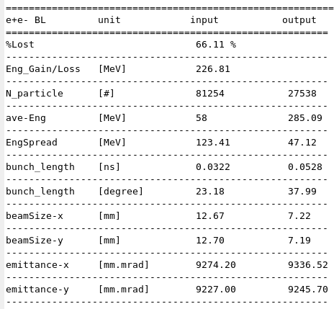
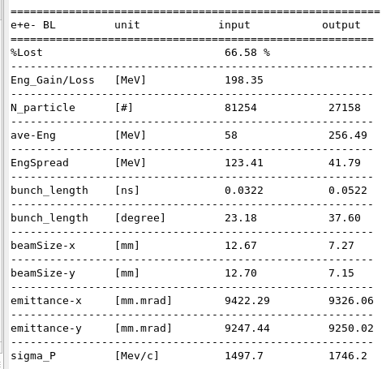
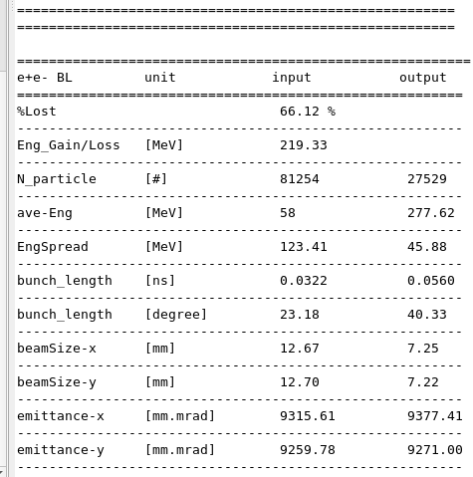
Beam Loading results
Positron phase space with e+ BL with both e+ e- BL w/o BL
w/o BL
w/ e+ BL
w/ e+ e- BL

Slide 18
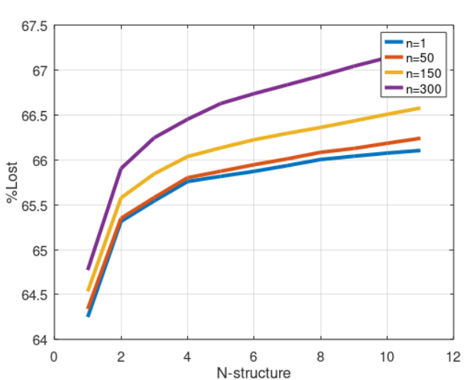
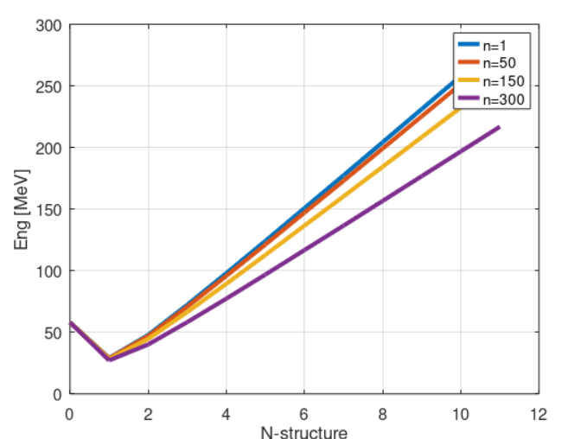
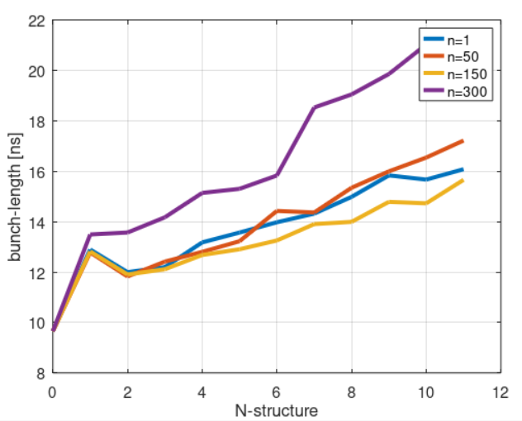
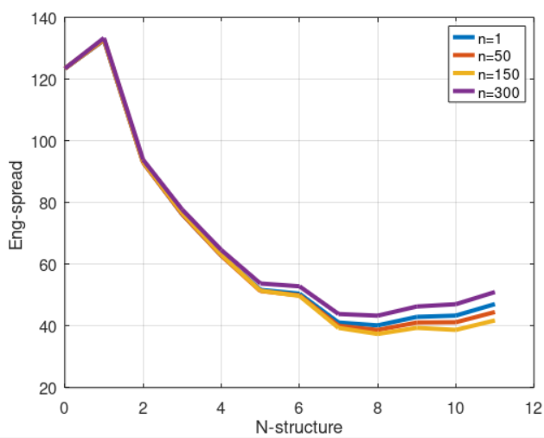
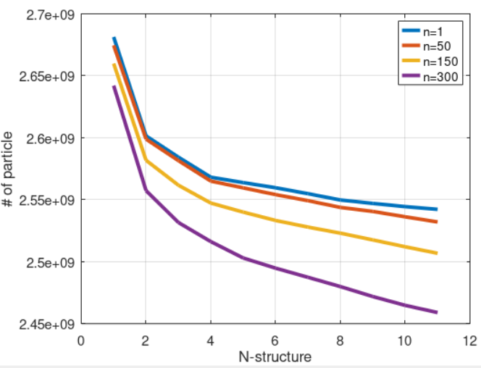


Beam Loading results
$τ_{f}> τ_{train}⇒$transient Beam Loading affects particles.
bunch-to-bunch variation
e+ with e+ Beam Loading
Need more consideration

Slide 19




Beam Loading effect in optimized phase
Beam loading effect on an optimized structure with a focus on achieving maximum yield in the DR entrance.
w/o BL
w/ e+ e- BL

Slide 20
Summery
Tracking of electron and positrons in capture Linac of positron source of the CLIC has been performed using RF_Track.
Beam Loading with respect to presence of both electron and positron has been studied with the aid of Beam Loading simulation module in RF_Track.
The effect of BL in an optimized structure (based on maximum yield in DR entrance) has been studied.
studies are still ongoing….
OUTLOOK:
  Further optimization for finding appropriate phase and gradient in the presence of Beam Loading
  Further optimization to investigate and compensate bunch to bunch variation

Slide 21
Acknowledgements
I would like to express my gratitude to Steffen Doebert and Mohsen Dayyani for giving me this opportunity to work on this project.
I am very grateful to Javier Olivares, Yongke Zhao, Andrea Latina for great discussion and help.

Slide 22
Thanks for your attention

Slide 23
BackUp

Slide 24



Introduction - CLIC Positron Source
an electron beam is generated by a high current thermionic electron gun with 5𝐴 current is accelerated up to 5 𝐺eV in a 2 𝐺Hz driver Linac and at the end is collided to a hybrid target.
positrons emerge from the target with a large momentum spread.
C. Bayar, “Design and Optimization of the CLIC Positron Source from the Target to Damping Ring”,
CERNTHESIS-2011-44, (2018).

Slide 25


inputs

Slide 26




A. Grudiev, A.Lunin, V. Yakovlev. Analytical solutions for transient and stead state beam loading in arbitrary travelling wave accelerating structures. Phys. Rev. Special topics 14, 052001 (2011)

Slide 27

Phase Scan
The structure can be optimized through different criteria.

