Slide 1
Missing energy analysis of vacuum breakdowns in a high-power X-band system
Mareike Wendelmuth

Slide 2
Scope of the thesis
Outline
Motivation
Investigate the missing energy during a breakdown
Estimation of energy distribution during normal operation and during breakdowns
Breakdowns are still not fully understood
Conditioning is interrupted after a breakdown
In a real accelerator, not as many measurements are possible. This information can help for later operation

Slide 3
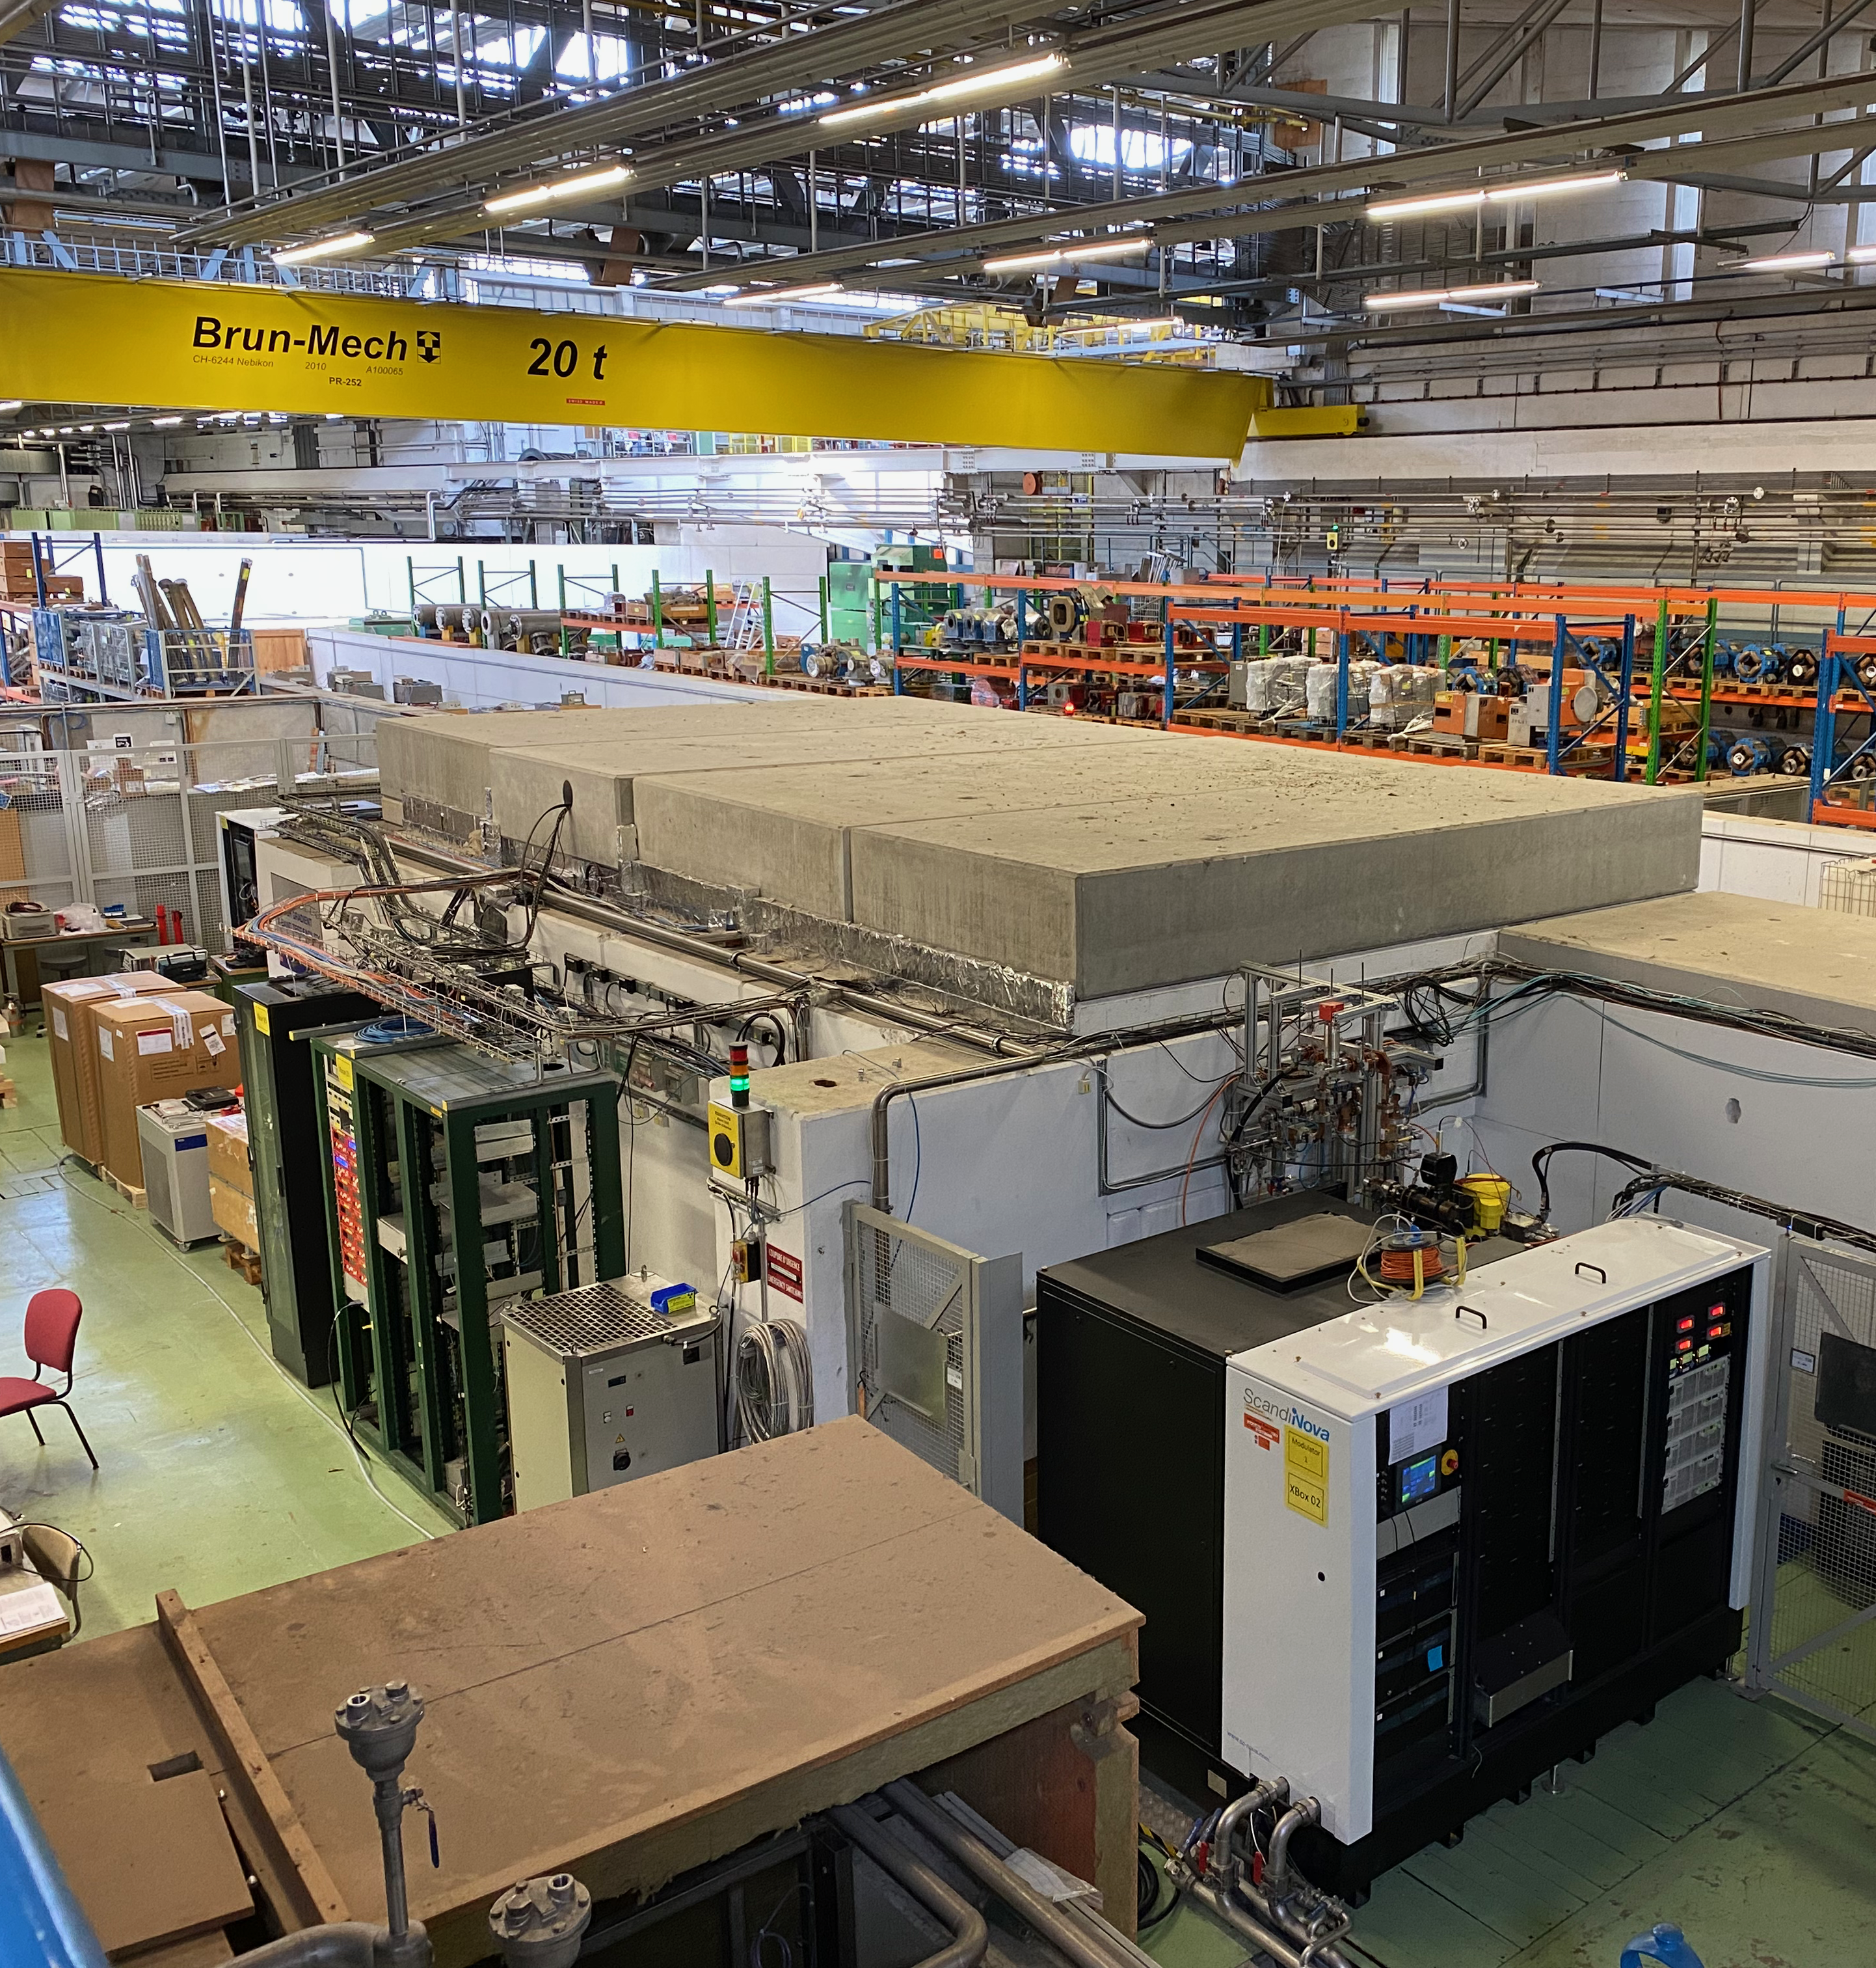
X-Band Facility
Part of the CLIC research program
Two test benches:
  X-Box 2: One 50 MW Klystron
  X-Box 3: Two 8 MW Klystrons
Testing and conditioning of CLIC X-Band (11.994 GHz) structures
Repetition rate of up to 50 Hz at X-Box 2
and 200 Hz at X-Box 3

Slide 4
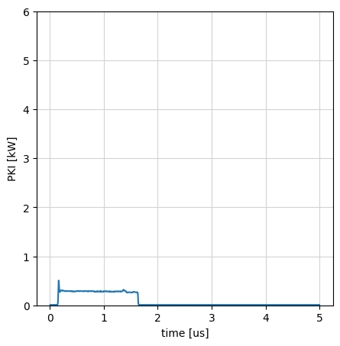
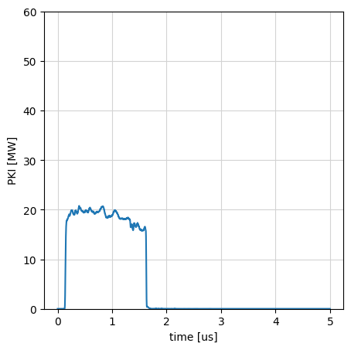
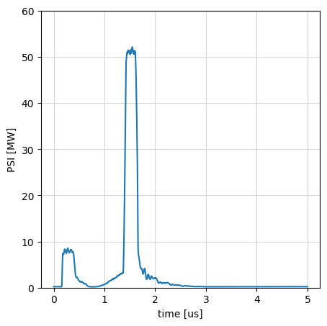
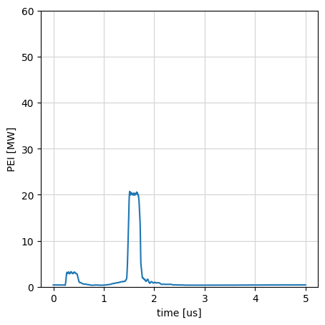
X-Box2
Modulator
KLY_in
PKI
REF
INC
TRA
Klystron
Pulse Compressor
Accelerating Structure
RF Load
300 W
1.5 us
20 MW
1.5 us
50 MW
250 ns
20 MW
250 ns

Slide 5
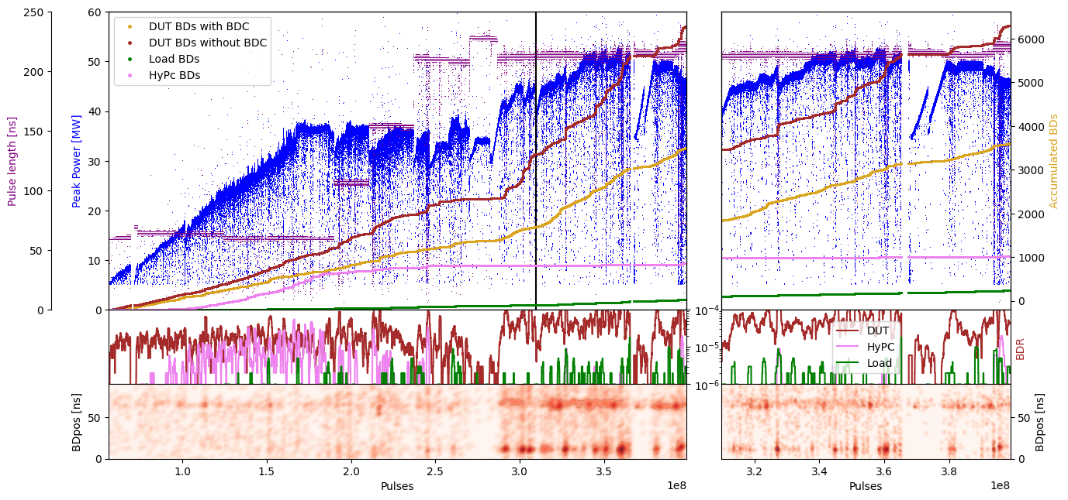
Conditioning process of one structure

Slide 6
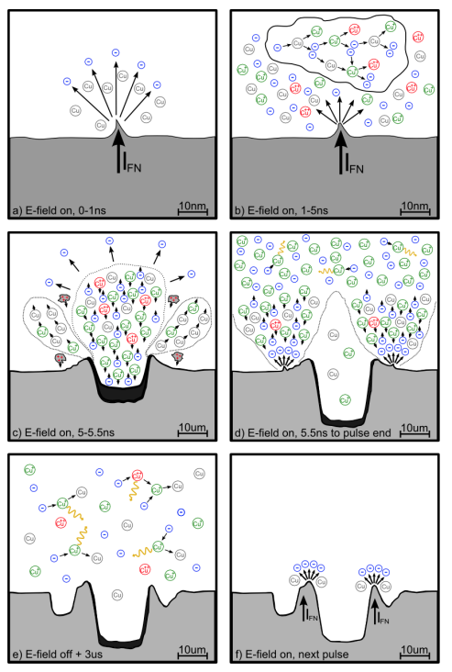
Breakdown definition
Breakdowns are caused by emission of electrons, due to the large electric fields
RF power reflected by occurring electric arc
Damage on copper surface usually visible and cause to new breakdowns
Breakdowns are part of the conditioning process
Picture taken from: J. W. Kovermann, “Comparative Studies of High-Gradient RF and DC Break-
downs,” Ph.D. dissertation, RWTH Aachen University, 2010

Slide 7






Energy Distribution
$$∫INC=$$
$$∫TRA+$$
$$∫REF+$$
$$Energy\left(DC_{up}+DC_{Down}\right)+$$
$$Loss_{Heating}$$
DC Up
DC Down
INC
TRA
REF

Slide 8








Energy Distribution Breakdown
$$∫INC=$$
$$∫TRA+$$
$$∫REF+$$
$$Energy\left(DC_{up}+DC_{Down}\right)+$$
$$Loss_{Heating}$$
$$+$$
$$Energy\left(BDC\right)+$$
$$Missing Energy$$
DC Up
DC Down
+ BDC Up
+ BDC Down
INC
TRA
DC – Dark Current
BDC – Breakdown Current
REF

Slide 9
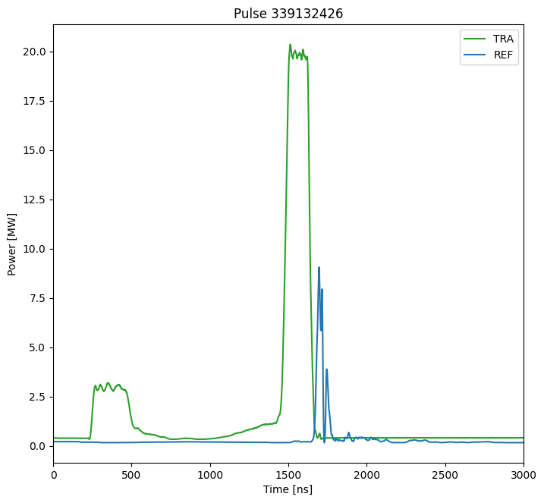
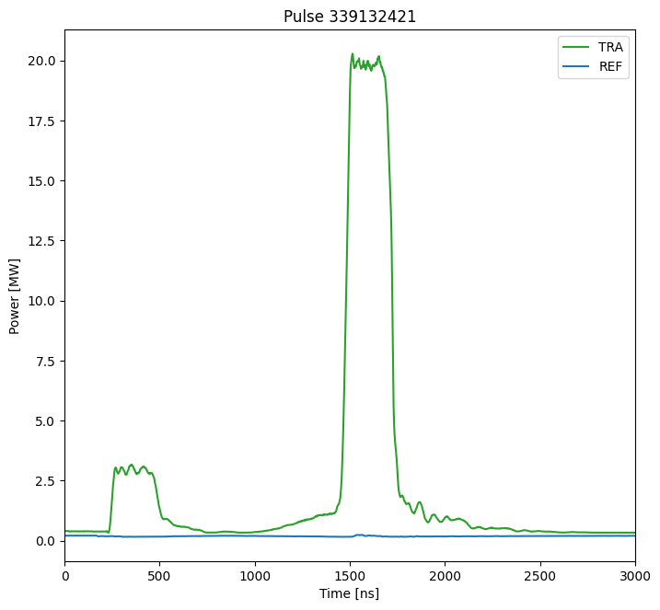
Pulses
Normal Pulse
Breakdown Pulse

Slide 10


Structures – Breakdown Position
DC
DC
REF
TRA
INC
TRA
50%
REF
$$REF_{t}$$
$$TRA_{t}$$

Slide 11
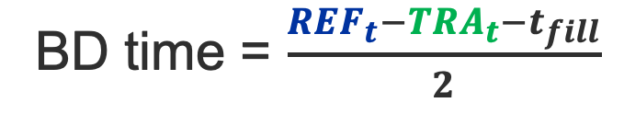
Structures – Breakdown Position
DC
DC
REF
TRA
INC
TRA
50%
REF
t_fill
$$REF_{t}$$
BD time = $\frac{REF_{t}−TRA_{t}−t_{fill}}{2}$
$$TRA_{t}$$

Slide 12
Breakdown types
Flags are risen during operation
Classification done later in Post-processing:
  HyPc BD: Breakdowns in the Hybrid part of the system
  Load BD: Breakdown in the load after the structure
  BD with BDC: Breakdown with detected Breakdown Current (BDC), larger than usual Dark Current (DC)
  BD without BDC: Breakdown without Breakdown Current detection
Modulator
REF
INC
TRA
Klystron
Pulse Compressor
Accelerating Structure
RF Load

Slide 13
Breakdown types
Flags are risen during operation
Classification done later in Post-processing:
  HyPc BD: Breakdowns in the Hybrid part of the system
  Load BD: Breakdown in the load after the structure
  BD with BDC: Breakdown with detected Breakdown Current (BDC), larger than usual Dark Current (DC)
  BD without BDC: Breakdown without Breakdown Current detection
Modulator
REF
INC
TRA
Klystron
Pulse Compressor
Accelerating Structure
RF Load

Slide 14
Breakdown types
Flags are risen during operation
Classification done later in Post-processing:
  HyPc BD: Breakdowns in the Hybrid part of the system
  Load BD: Breakdown in the load after the structure
  BD with BDC: Breakdown with detected Breakdown Current (BDC), larger than usual Dark Current (DC)
  BD without BDC: Breakdown without Breakdown Current detection
Modulator
REF
INC
TRA
Klystron
Pulse Compressor
Accelerating Structure
RF Load

Slide 15
Breakdown types
Flags are risen during operation
Classification done later in Post-processing:
  HyPc BD: Breakdowns in the Hybrid part of the system
  Load BD: Breakdown in the load after the structure
  BD with BDC: Breakdown with detected Breakdown Current (BDC), larger than usual Dark Current (DC)
  BD without BDC: Breakdown without Breakdown Current detection
Modulator
REF
INC
TRA
Klystron
Pulse Compressor
Accelerating Structure
RF Load

Slide 16
Breakdown types
Flags are risen during operation
Classification done later in Post-processing:
  HyPc BD: Breakdowns in the Hybrid part of the system
  Load BD: Breakdown in the load after the structure
  BD with BDC: Breakdown with detected Breakdown Current (BDC), larger than usual Dark Current (DC)
  BD without BDC: Breakdown without Breakdown Current detection
Modulator
REF
INC
TRA
Klystron
Pulse Compressor
Accelerating Structure
RF Load

Slide 17
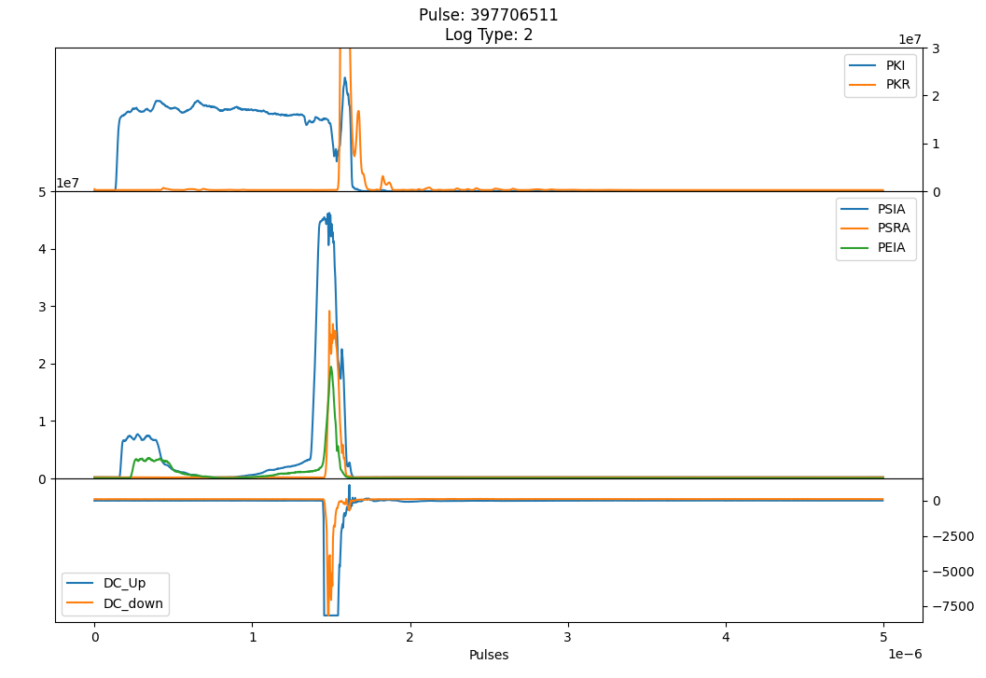
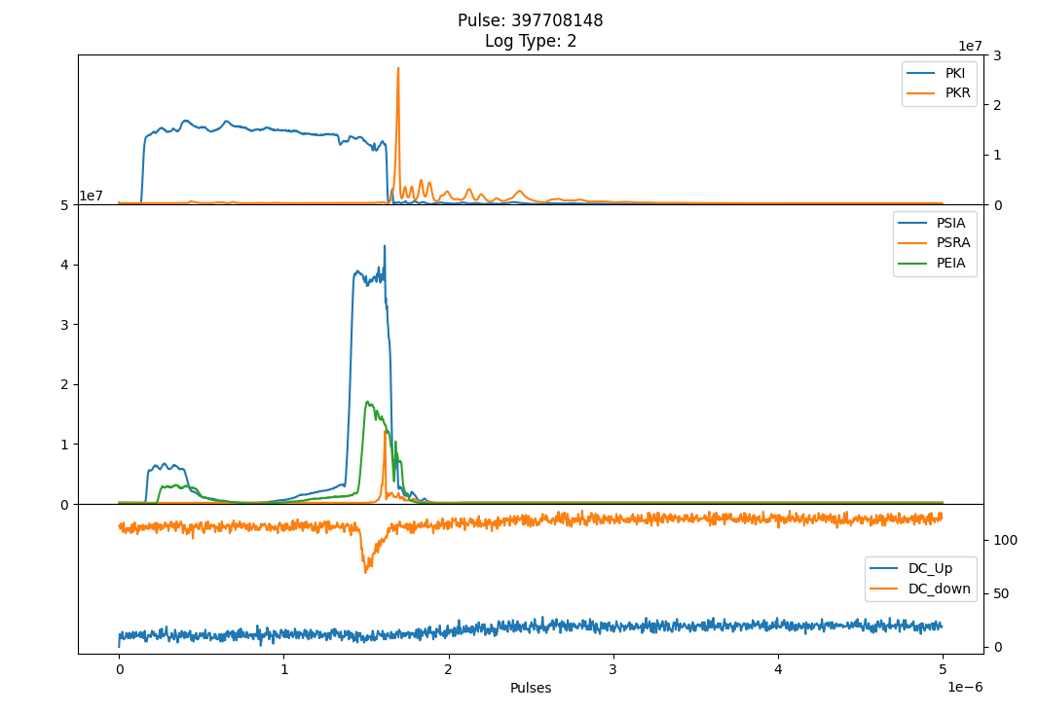
Breakdown Types
BD with Breakdown Current (BDC)
BD without Breakdown Current (BDC)

Slide 18
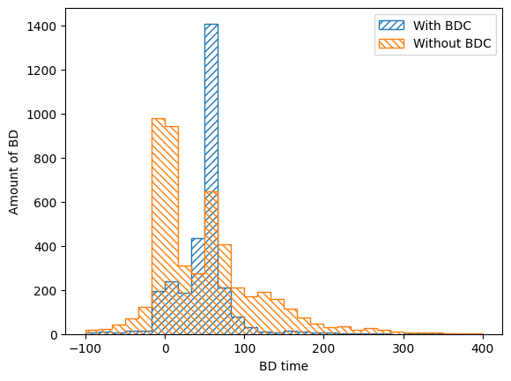
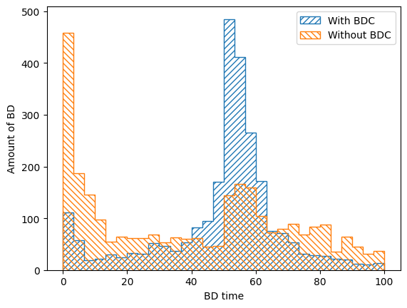
Position distribution of BD (XBox2)
-> BD with Breakdown Current (BDC) occur later in the structure than without BDC

Slide 19





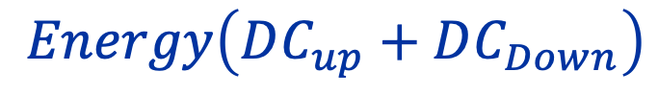






Missing Energy
$$∫INC$$
$$=$$
$$∫TRA$$
$$+$$
$$∫REF$$
$$+$$
$$Energy\left(DC_{up}+DC_{Down}\right)$$
$$+$$
$$Loss_{Heating}$$
$$+$$
$$Energy\left(BDC\right)$$
$$+$$
$$Missing Energy$$

Slide 20








Missing Energy
$$Missing Energy$$
$$=$$
Measures
$$∫INC$$
$$−$$
$$∫TRA$$
$$−$$
$$∫REF$$
$$−$$
$$Energy\left(DC_{up}+DC_{Down}\right)$$
$$−$$
$$Loss_{Heating}$$
$$−$$
$$Energy\left(BDC\right)$$
Measures
Measures + Simulation
Measures + Simulation

Slide 21
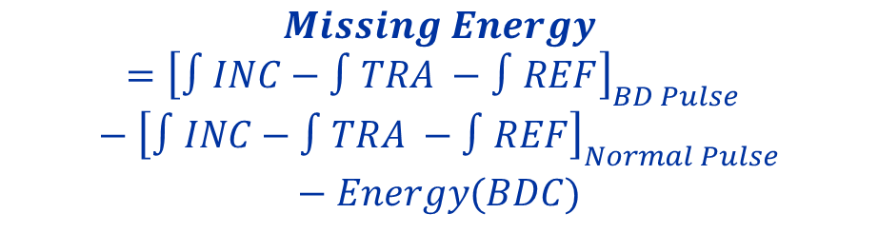
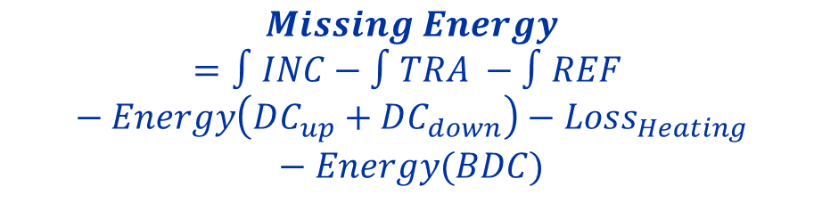
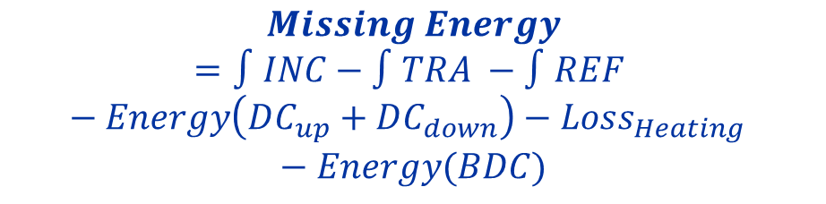
Missing Energy
Simplified Analysis
Precise Analysis
$$Missing Energy=∫INC−∫TRA −∫REF −Energy\left(DC_{up}+DC_{down}\right)−Loss_{Heating} −Energy(BDC)$$
$$Missing Energy=∫INC−∫TRA −∫REF −Energy\left(DC_{up}+DC_{down}\right)−Loss_{Heating}−Energy(BDC)$$
Measures
$${\left[Energy\left(DC\right)+Loss_{Heating}\right]}_{BD Pulse}≈{\left[∫INC−∫TRA −∫REF\right]}_{Normal Pulse}$$
Measures +
Simulation
Measures +
Simulation
$$Missing Energy={\left[∫INC−∫TRA −∫REF\right]}_{BD Pulse} −{\left[∫INC−∫TRA −∫REF\right]}_{Normal Pulse}−Energy(BDC)$$
Measures
Estimation

Slide 22
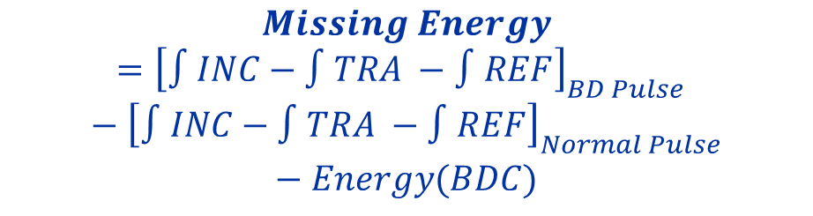
Simplified Analysis
$$Missing Energy={\left[∫INC−∫TRA −∫REF\right]}_{BD Pulse} −{\left[∫INC−∫TRA −∫REF\right]}_{Normal Pulse}−Energy(BDC)$$
Measures
Estimation
BD with Breakdown Current (BDC)
BD without Breakdown Current (BDC)

Slide 23
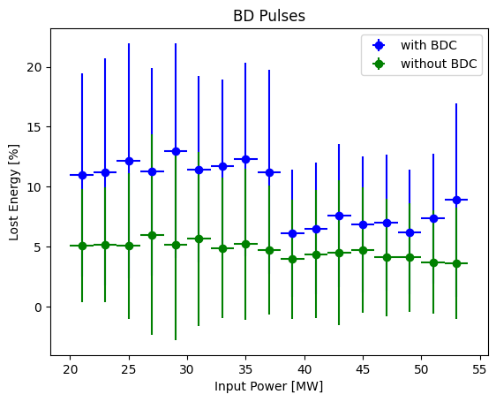
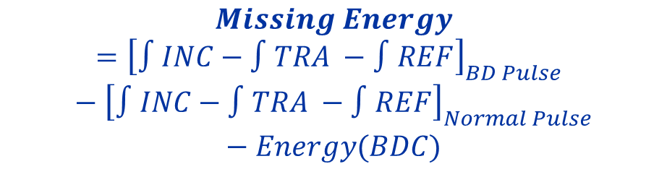
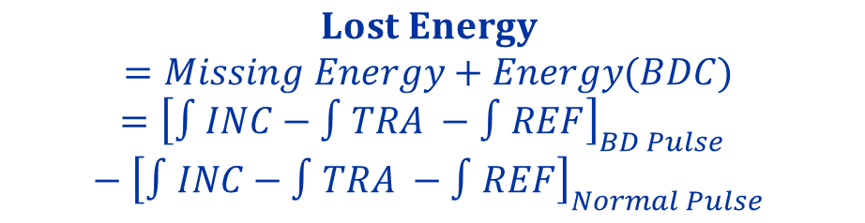
Simplified Analysis
$$Missing Energy={\left[∫INC−∫TRA −∫REF\right]}_{BD Pulse} −{\left[∫INC−∫TRA −∫REF\right]}_{Normal Pulse}−Energy(BDC)$$
Measures
Estimation
$$Lost Energy$$
$$=Missing Energy+Energy(BDC)={\left[∫INC−∫TRA −∫REF\right]}_{BD Pulse} −{\left[∫INC−∫TRA −∫REF\right]}_{Normal Pulse}$$
Measures

Slide 24
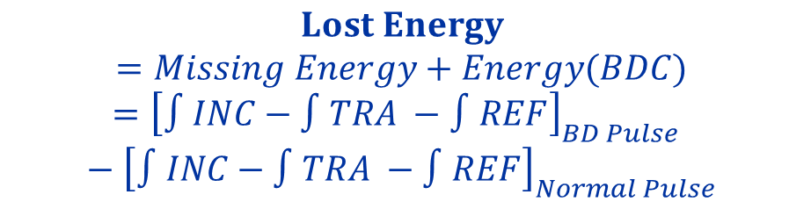
Simplified Analysis
$$Lost Energy$$
$$=Missing Energy+Energy(BDC)={\left[∫INC−∫TRA −∫REF\right]}_{BD Pulse} −{\left[∫INC−∫TRA −∫REF\right]}_{Normal Pulse}$$
With Breakdown Current (BDC), about 8-10% of the energy is lost
  Lost in BDC
  Lost in additional heating of the breakdown location
Without BDC, about 5% of the energy is lost
Thesis: 5% of the energy is lost within the structure during a breakdown, not seen in BDC

Slide 25
Missing Energy
Simplified Analysis
Precise Analysis
$$Missing Energy=∫INC−∫TRA −∫REF −Energy\left(DC_{up}+DC_{down}\right)−Loss_{Heating} −Energy(BDC)$$
$$Missing Energy=∫INC−∫TRA −∫REF −Energy\left(DC_{up}+DC_{down}\right)−Loss_{Heating}−Energy(BDC)$$
Measures
$${\left[Energy\left(DC\right)+Loss_{Heating}\right]}_{BD Pulse}≈{\left[∫INC−∫TRA −∫REF\right]}_{Normal Pulse}$$
Measures +
Simulation
Measures +
Simulation
$$Missing Energy={\left[∫INC−∫TRA −∫REF\right]}_{BD Pulse} −{\left[∫INC−∫TRA −∫REF\right]}_{Normal Pulse}−Energy(BDC)$$
Measures
Estimation

Slide 26
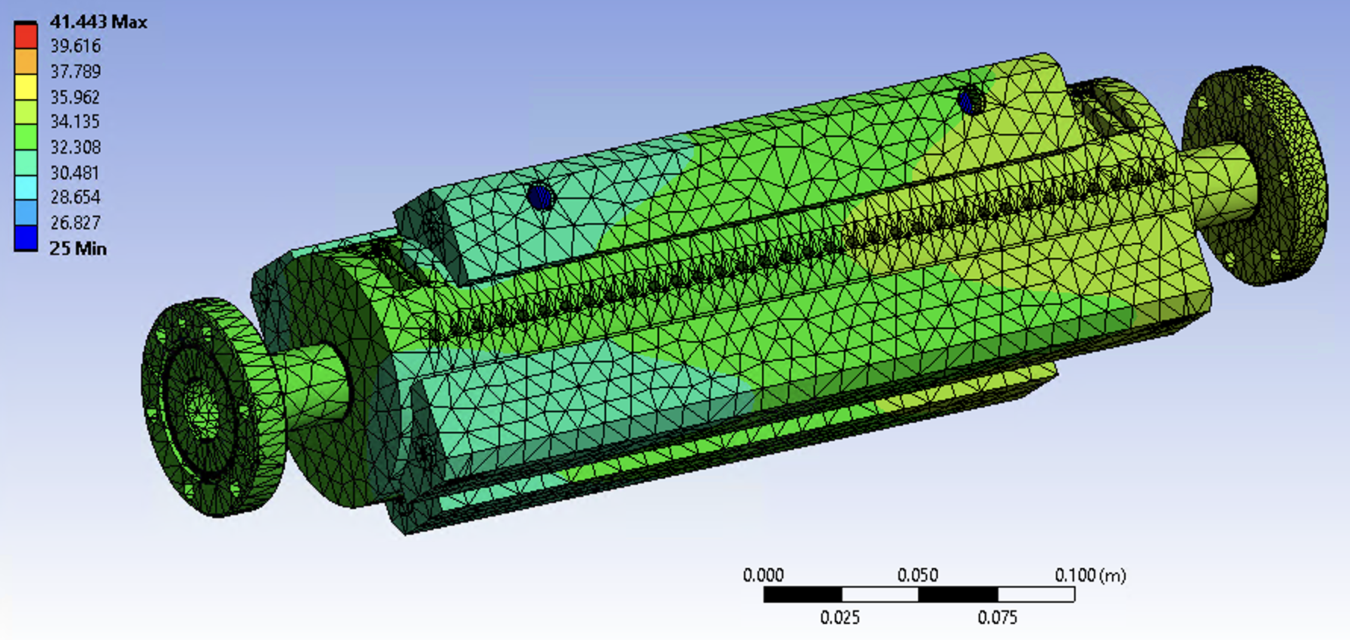
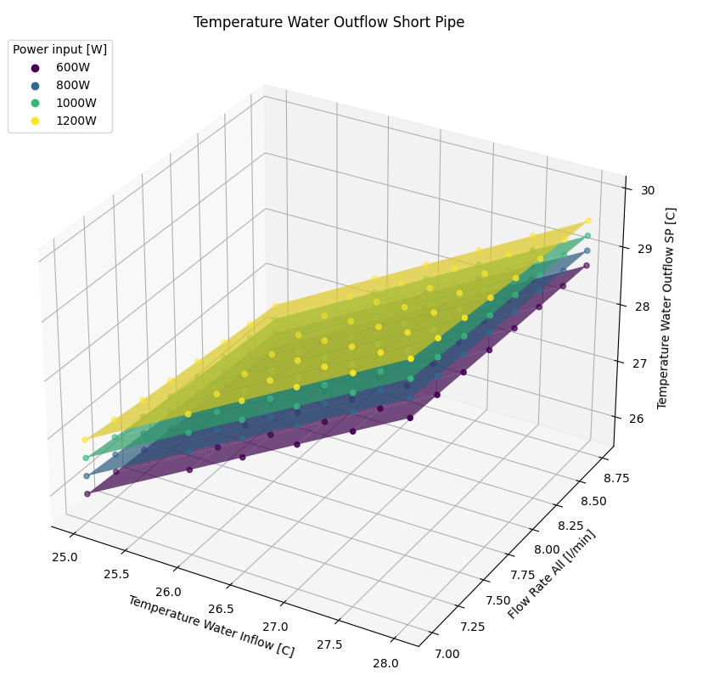
ANSYS Heat analysis
$$Missing Energy=∫INC−∫TRA −∫REF −Energy\left(DC_{up}+DC_{down}\right)−Loss_{Heating}−Energy(BDC)$$
Measures +
Simulation
Heat simulation of structure:
  Linear behavior of temperature change of Structure Surface and Water
Implementation of water temperature measurements:
  Calibration at no input power
  Uncertainty of 0.3C at sensors
  Verification of Simulation to be done

Slide 27
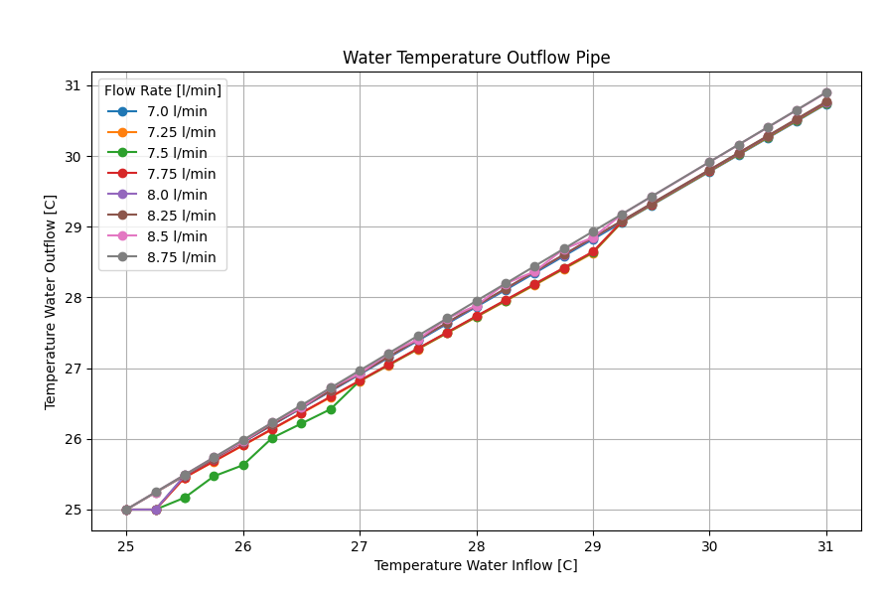
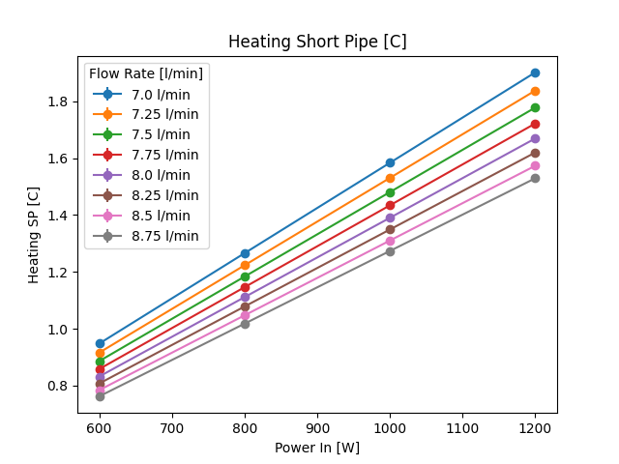

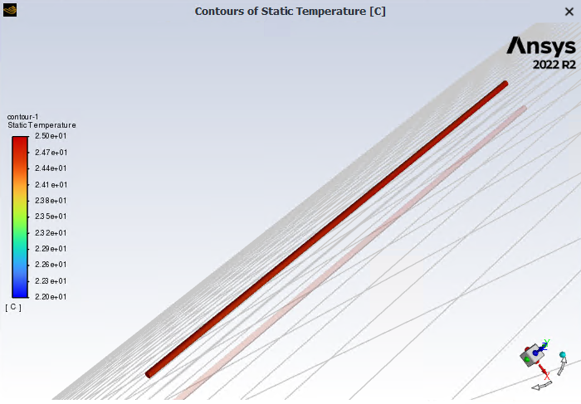
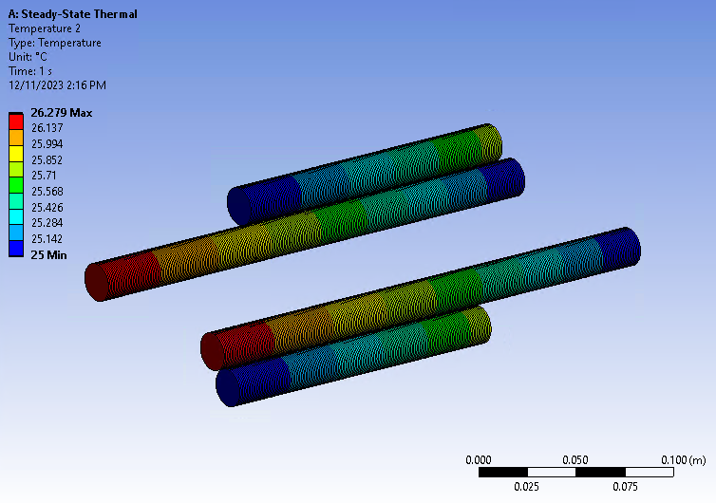
ANSYS Heat analysis
$$Missing Energy=∫INC−∫TRA −∫REF −Energy\left(DC_{up}+DC_{down}\right)−Loss_{Heating}−Energy(BDC)$$
Measures +
Simulation

Slide 28
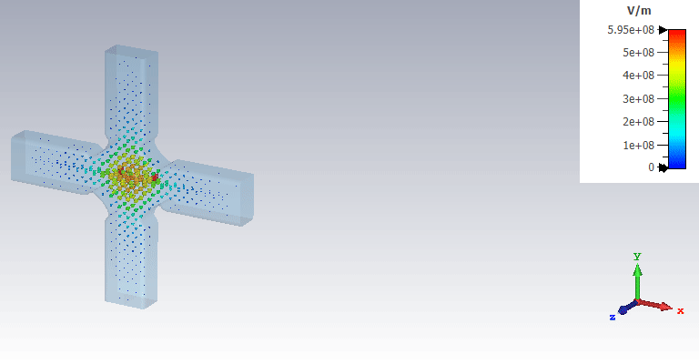
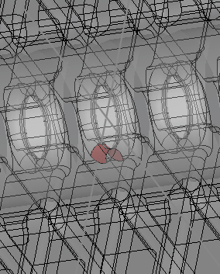
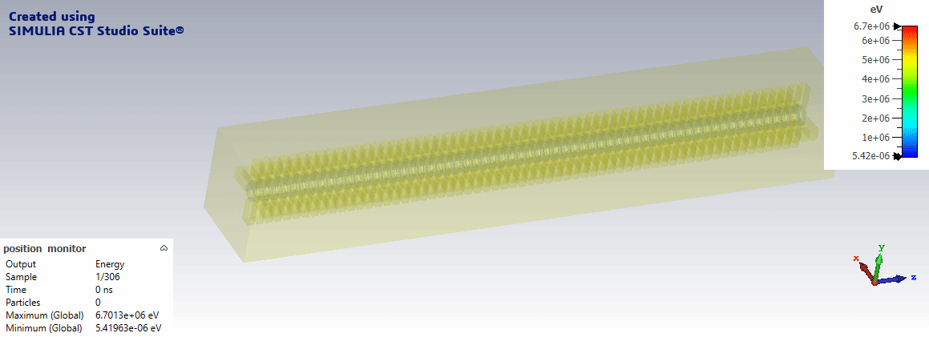
CST Analysis
$$Missing Energy=∫INC−∫TRA −∫REF −Energy\left(DC_{up}+DC_{down}\right)−Loss_{Heating}−Energy(BDC)$$
Measures +
Simulation
Simulation of Dark Current:
  Eigenmode simulation of one cell, repetition 61 times for PIC simulation
PIC:
  Emission at 1/8th of one iris
  Measurement at each iris
  Repetition for different gradients

Slide 29
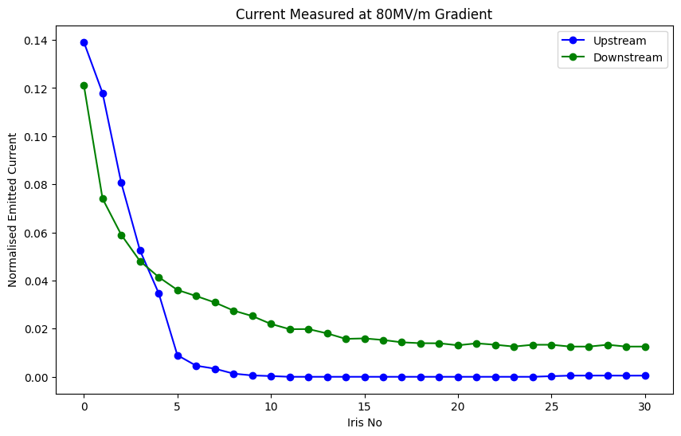
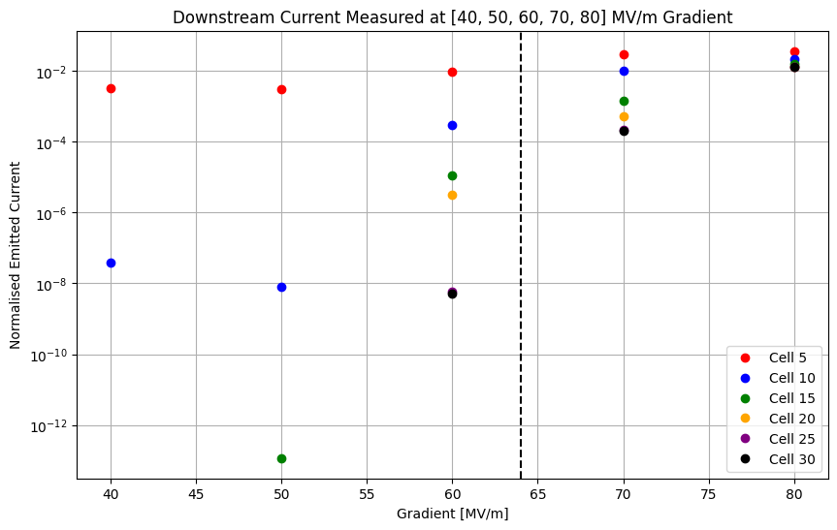
CST Analysis
$$Missing Energy=∫INC−∫TRA −∫REF −Energy\left(DC_{up}+DC_{down}\right)−Loss_{Heating}−Energy(BDC)$$
Measures +
Simulation
About 2.6% of emitted current reaches downstream faraday cup
About 1.4% of emitted current reaches upstream faraday cup
Notes:
Capture gradient

Slide 30
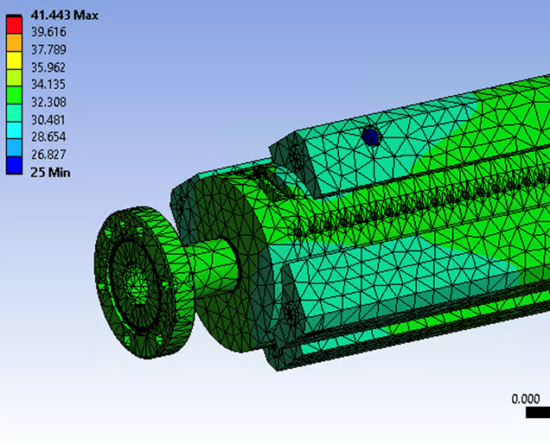
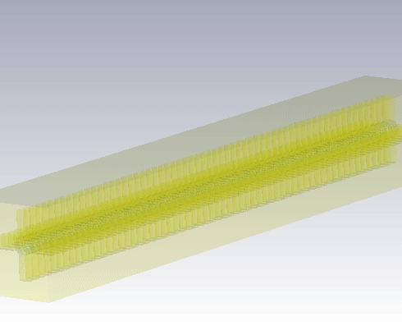
Summary
$$Missing Energy=∫INC−∫TRA −∫REF −Energy\left(DC_{up}+DC_{down}\right)−Loss_{Heating}−Energy(BDC)$$
Data Analysis
Heat Analysis
Dark Current Analysis

Slide 31
Thank you for your attention
Thanks to the complete X-Box team

Slide 32
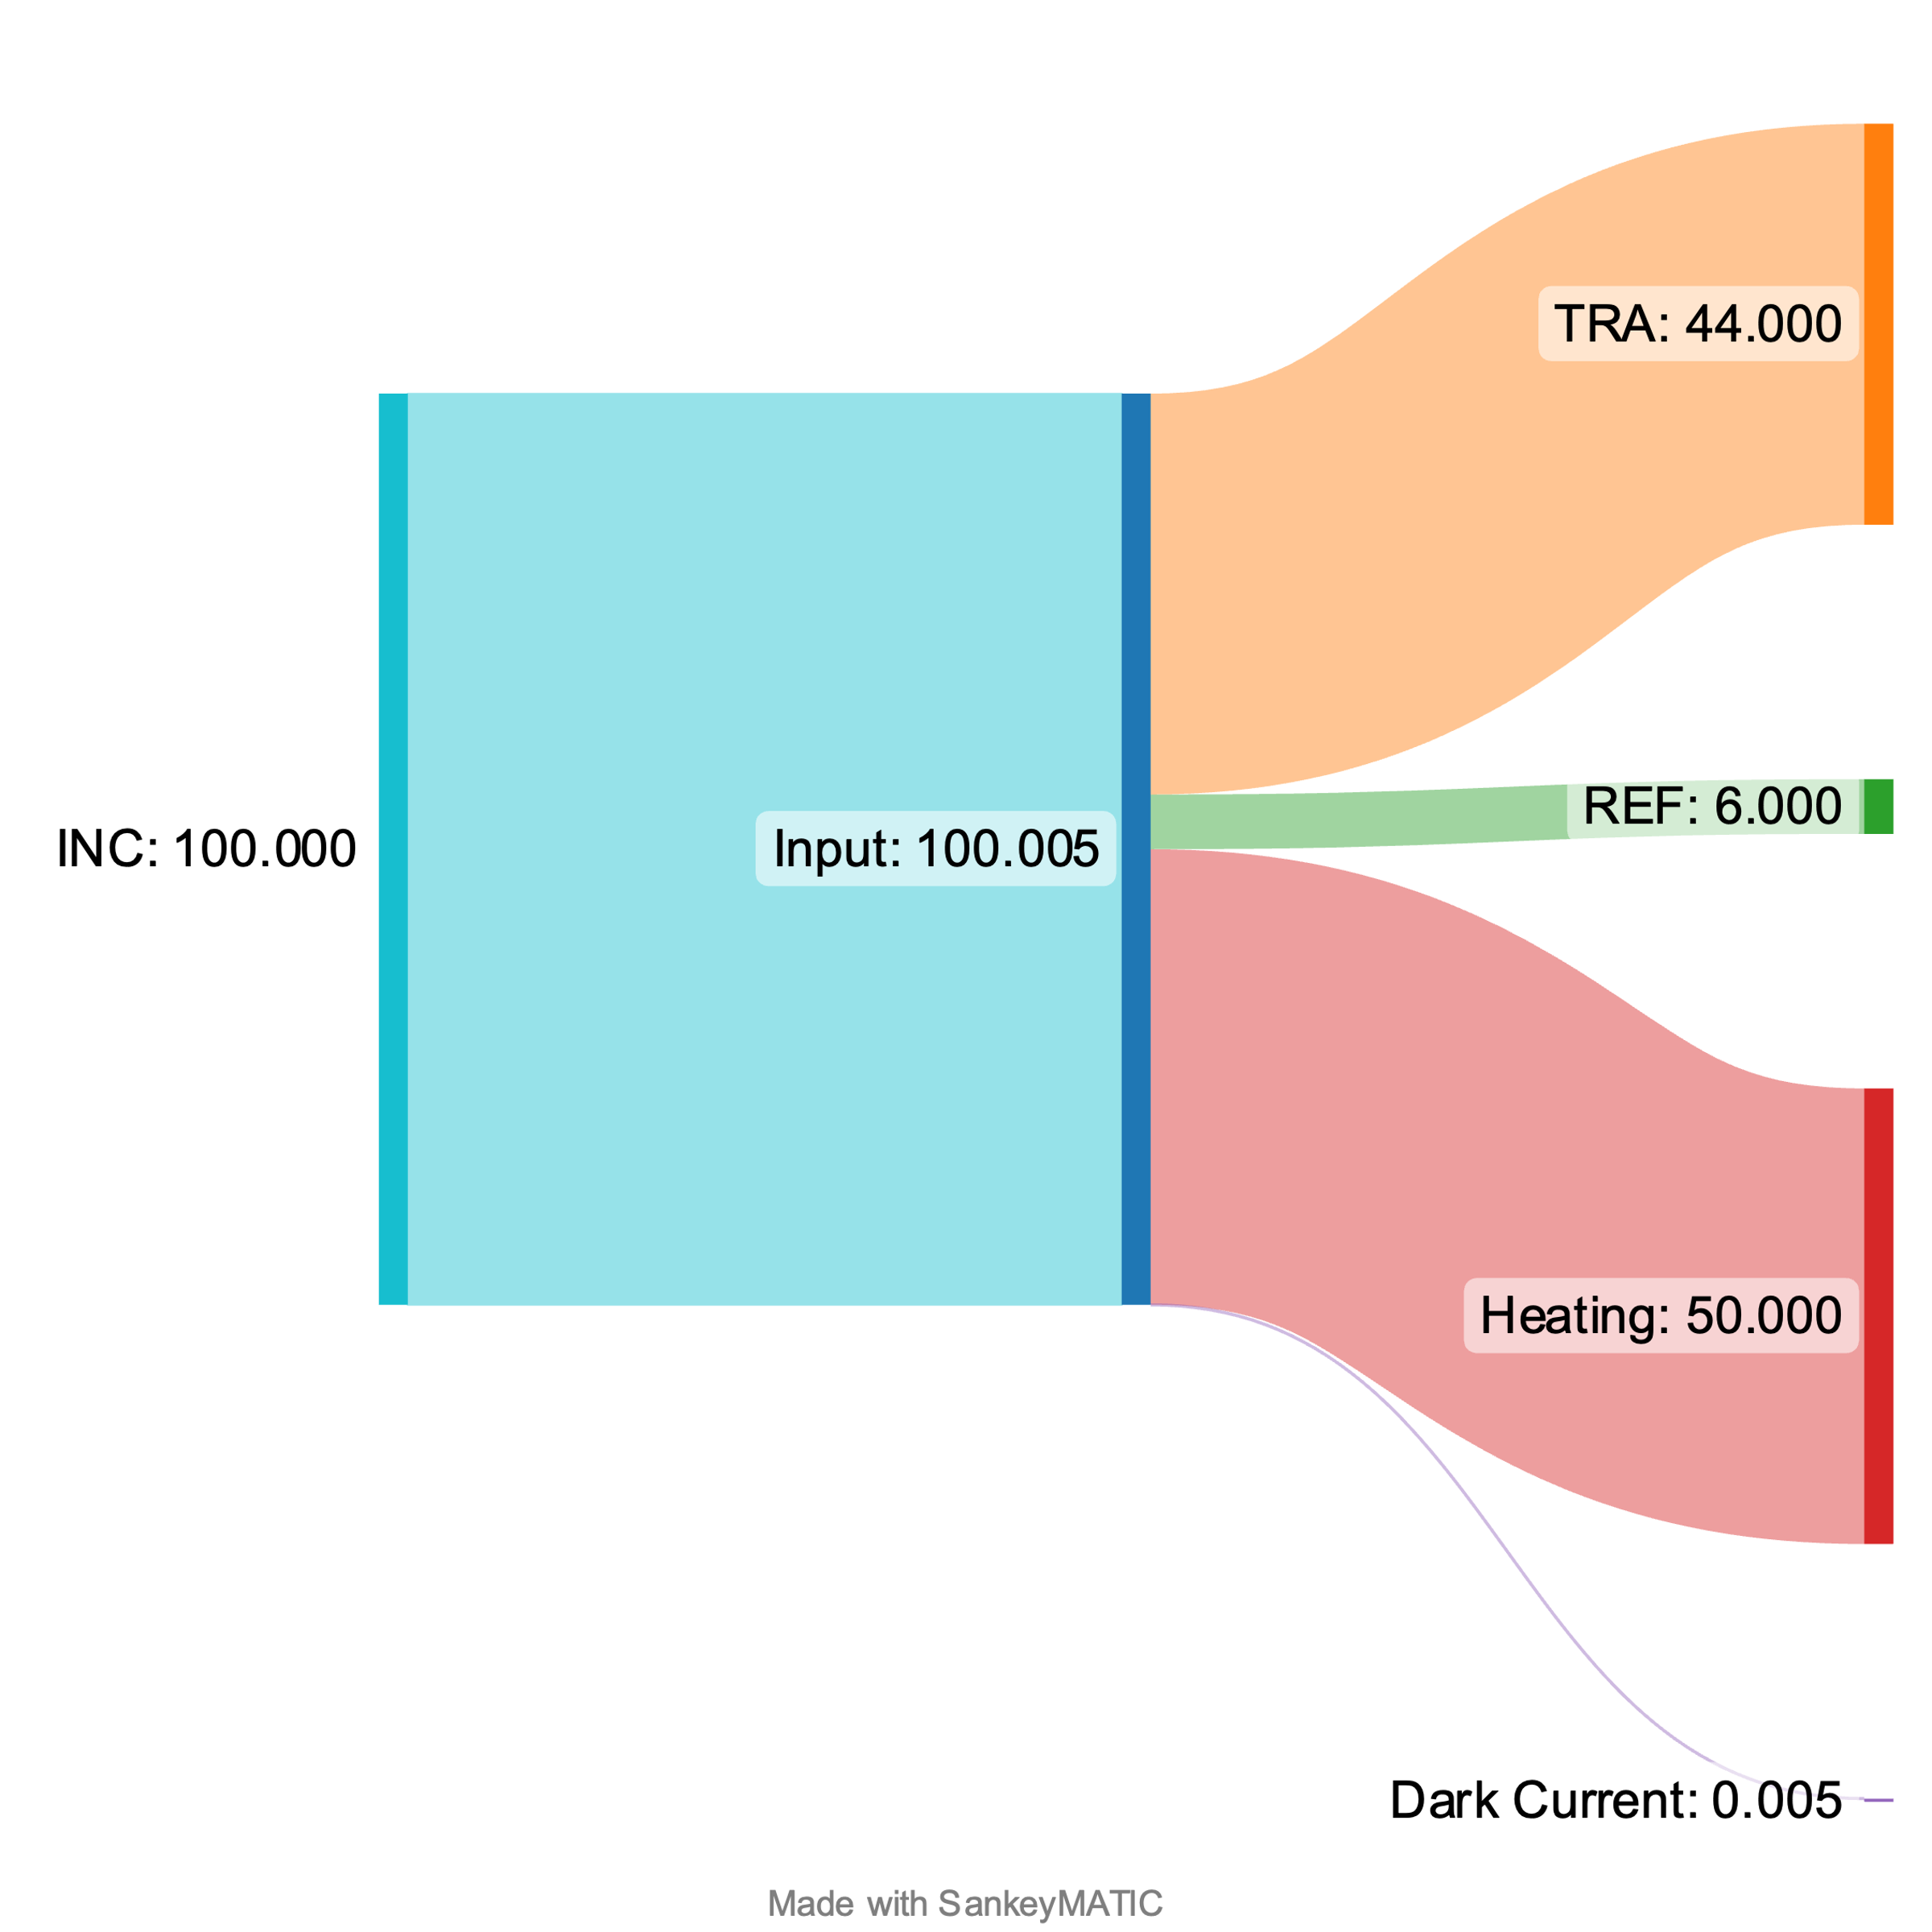
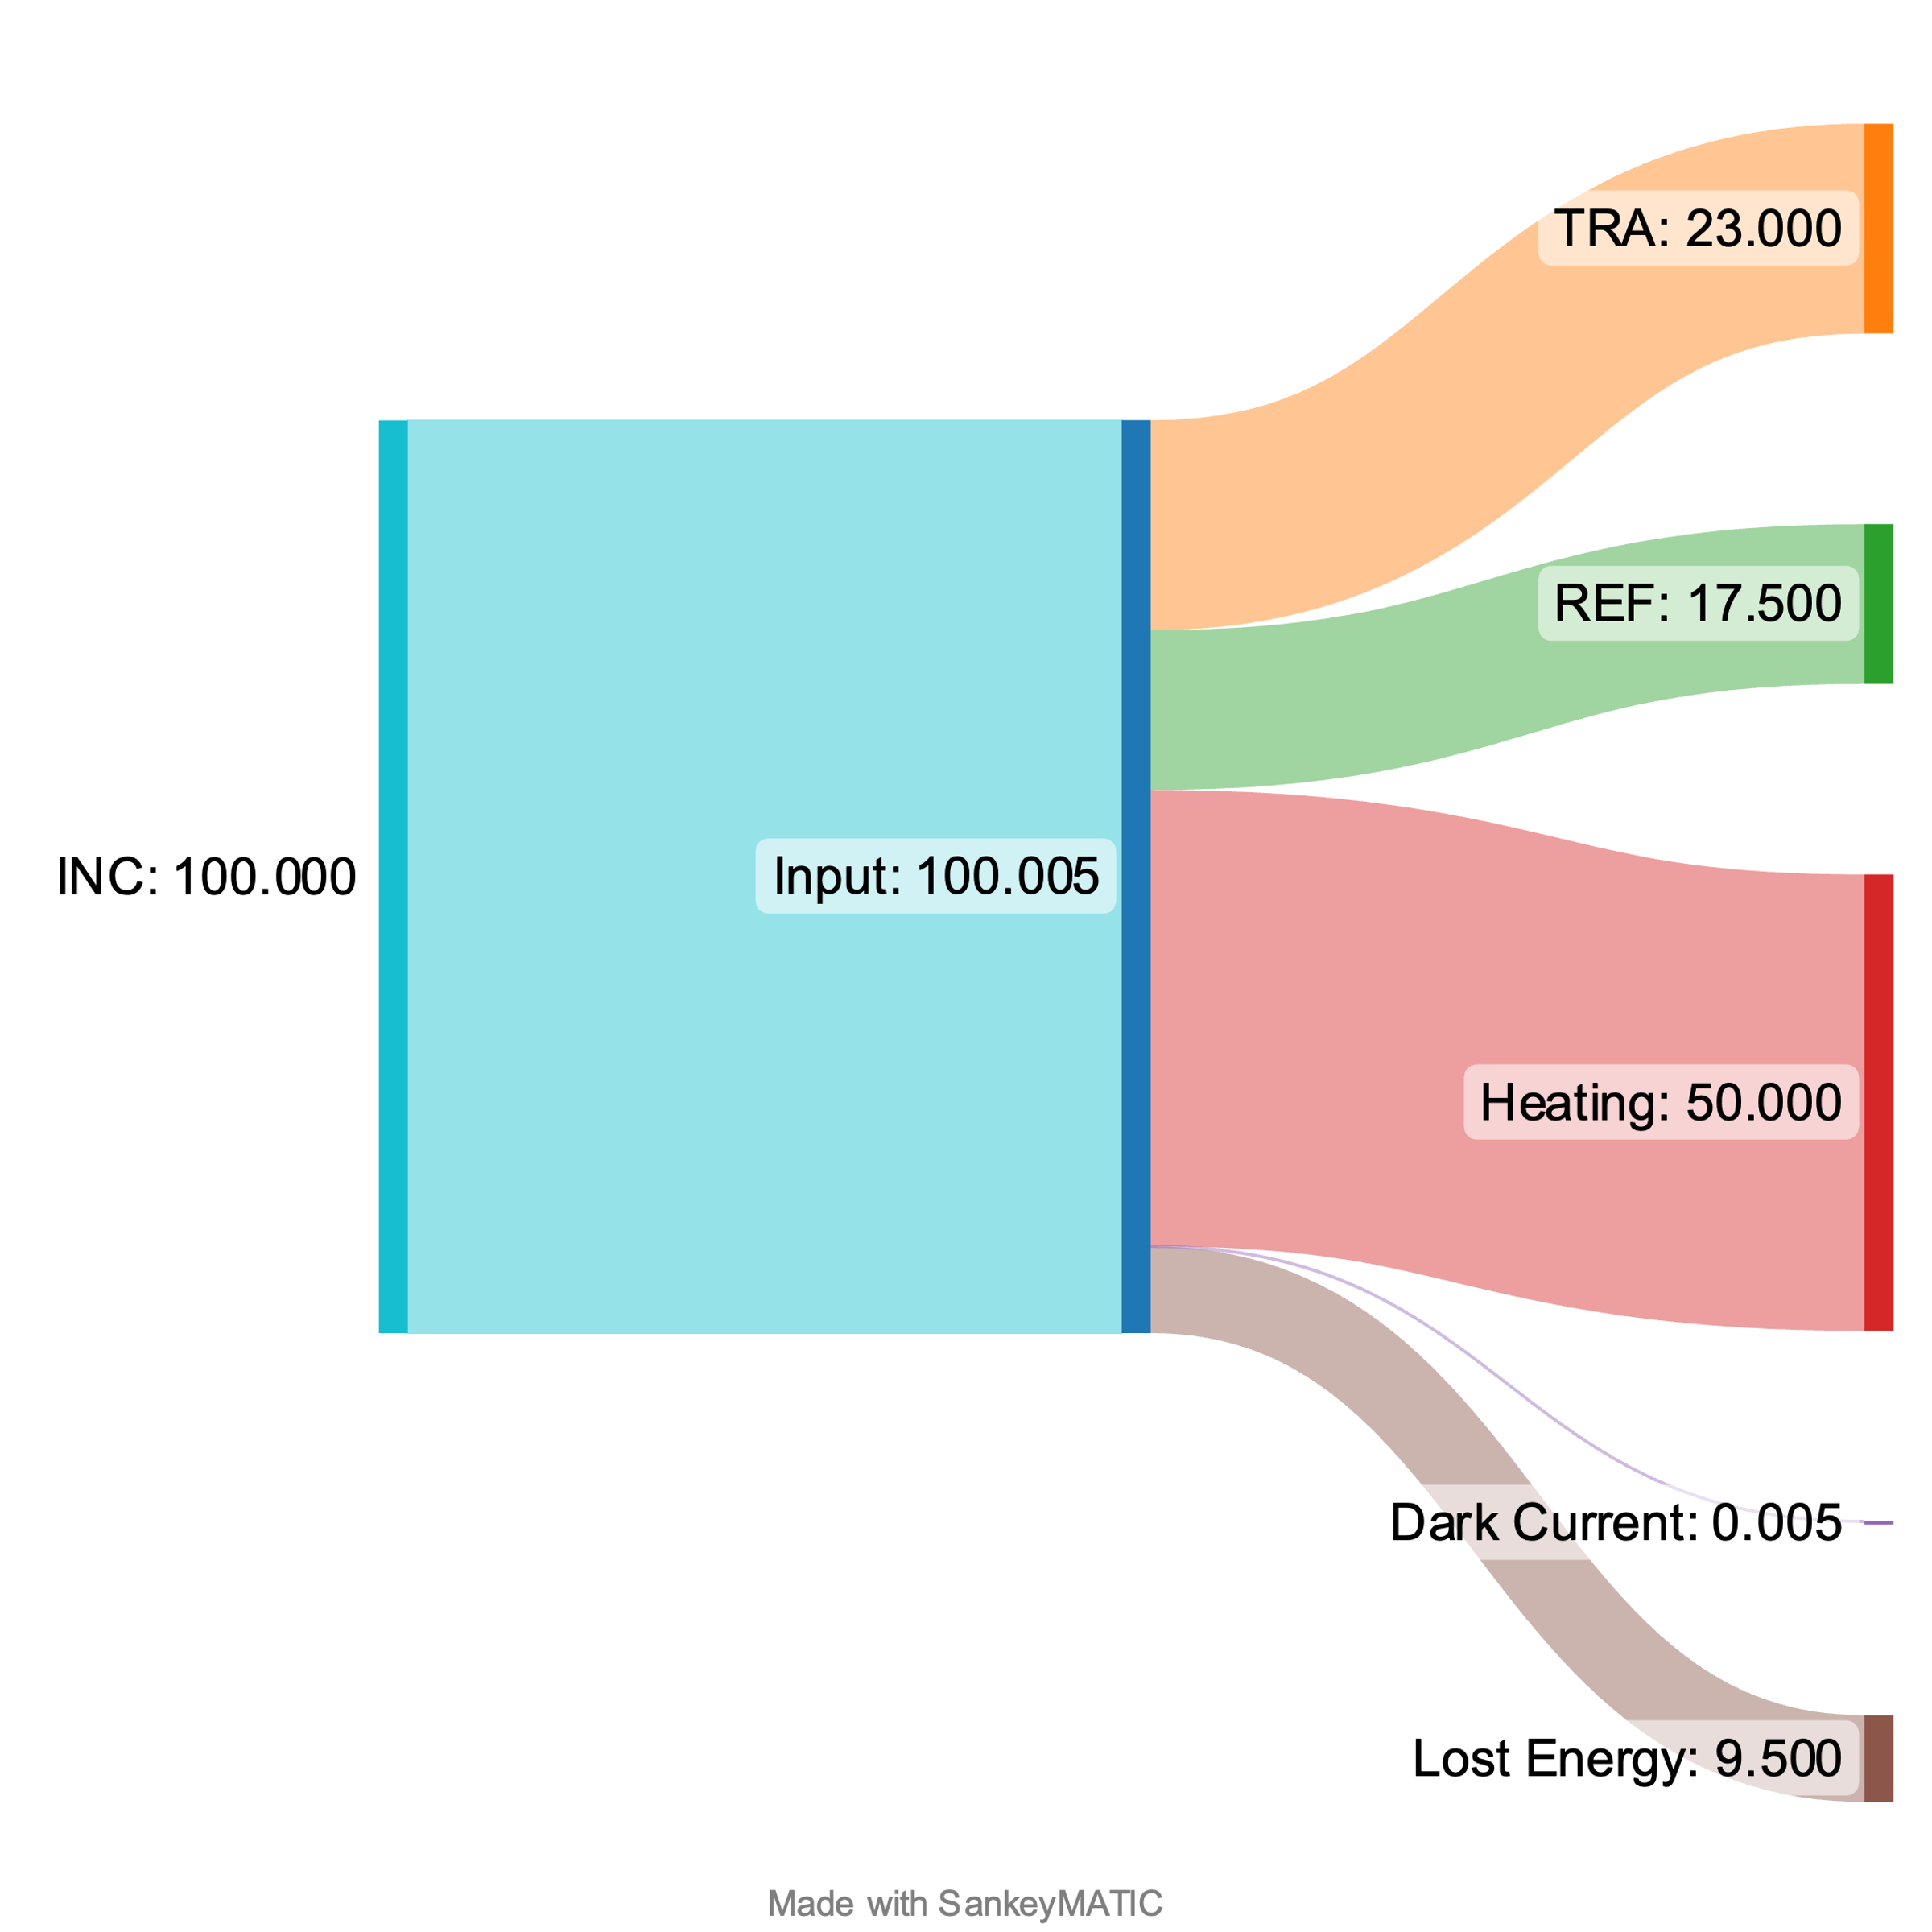
Energy Distribution
Normal Pulse
BD Pulse

Slide 33
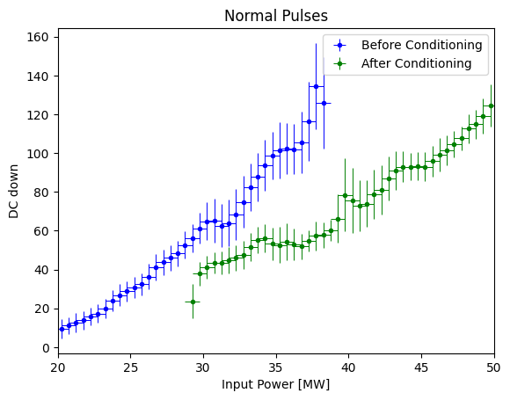
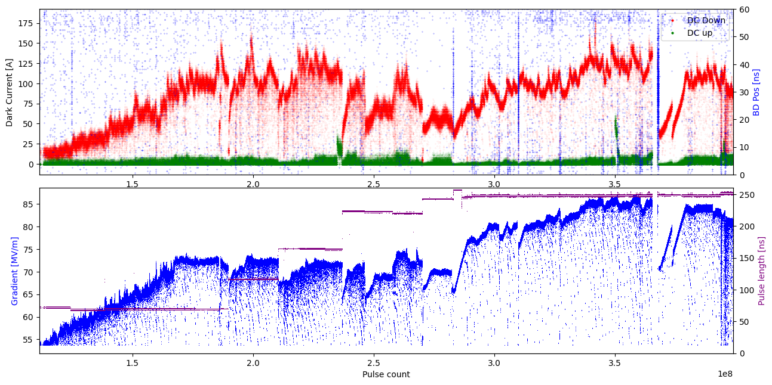
Distribution of DC
Before
Conditioning
After
Conditioning

Slide 34
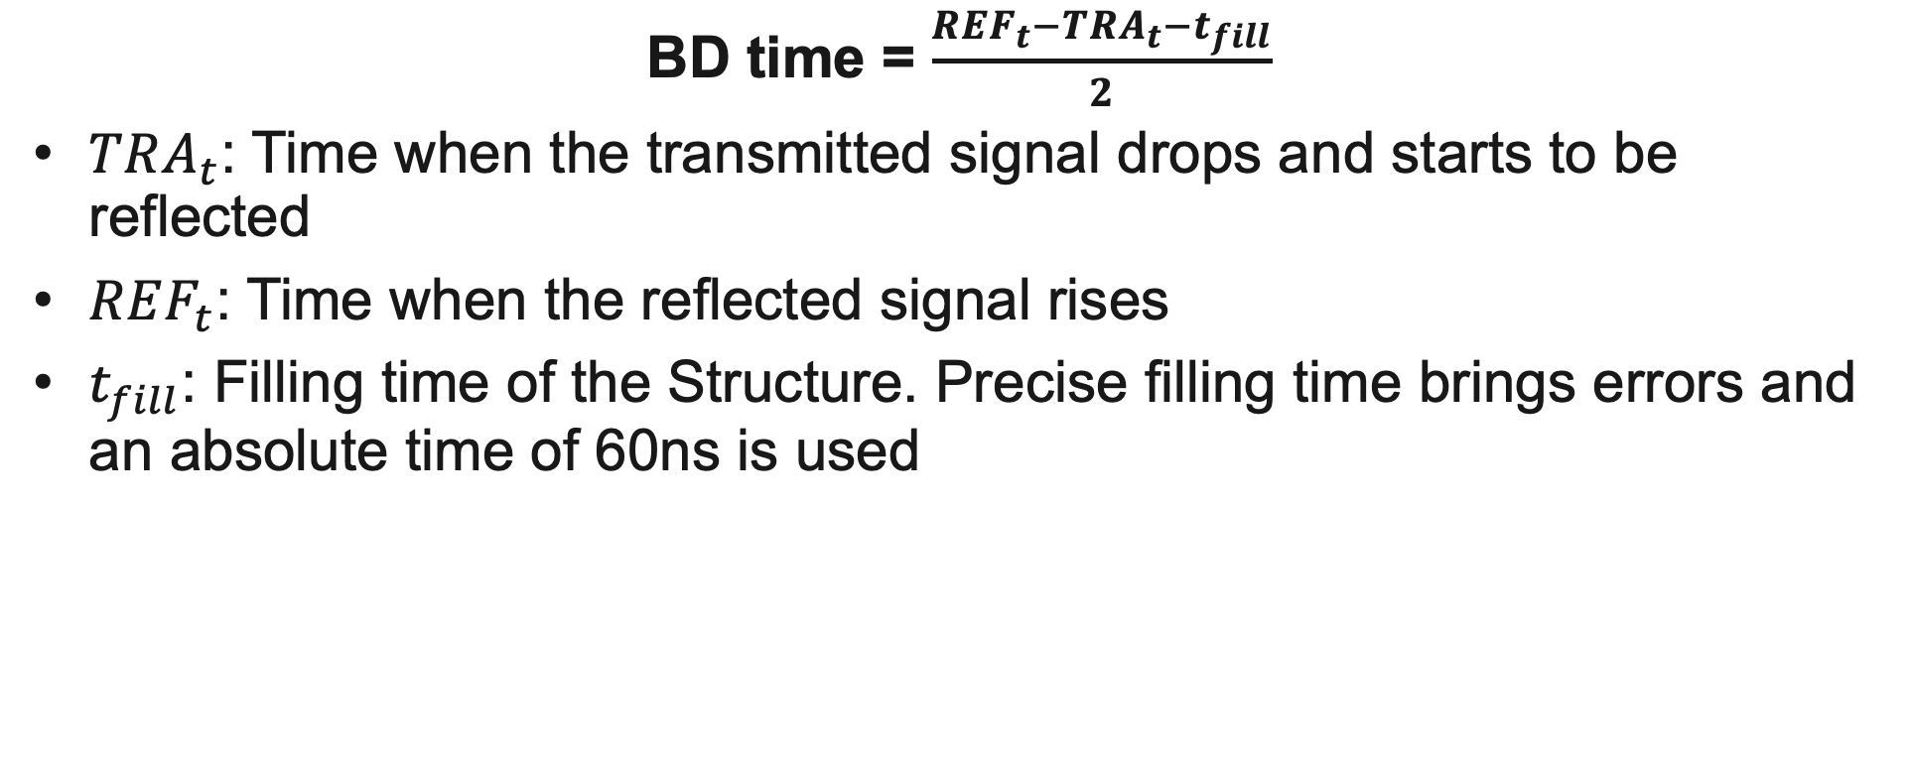
BD time
BD time = $\frac{REF_{t}−TRA_{t}−t_{fill}}{2}$
$TRA_{t}$: Time when the transmitted signal drops and starts to be reflected
$REF_{t}$: Time when the reflected signal rises
$t_{fill}$: Filling time of the Structure. Precise filling time brings errors and an absolute time of 60ns is used

Slide 35
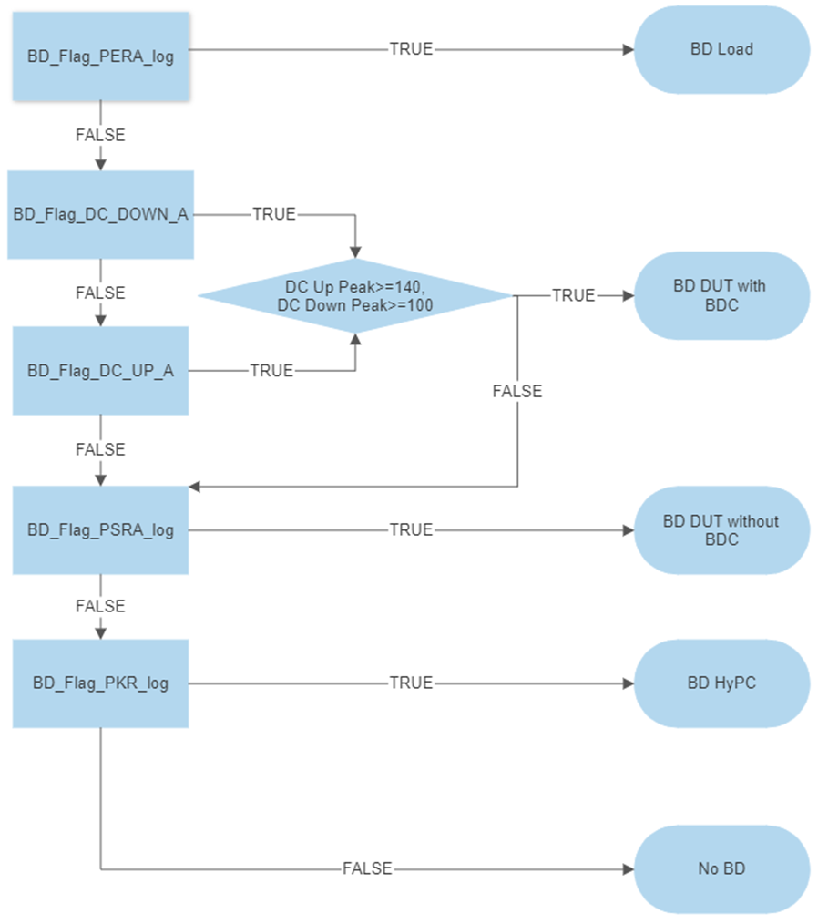
BD type definition X-Box 2
Flags are risen during operation
Division done later in Post-processing:
  HyPc BD: Breakdowns in the Hybrid part of the system
  Load BD: Breakdown in the load after the structure
  BD with BDC: Breakdown with detected Breakdown Current (BDC), larger than usual Dark Current (DC)
  BD without BDC: Breakdown without Breakdown Current detection

