Slide 1
C3 Status and Plans
Ankur Dhar, Emilio Nanni
CLIC Mini-Week
12/12/2023

Slide 2
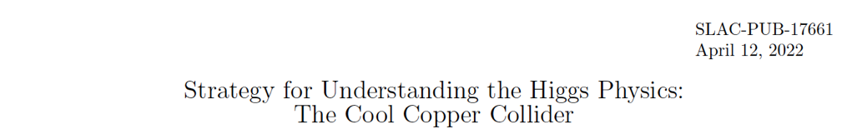
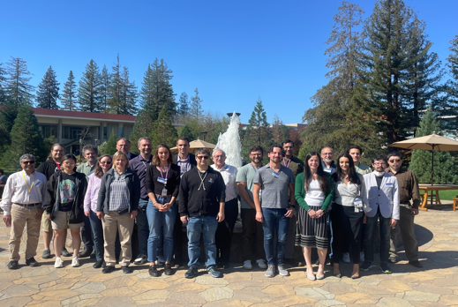
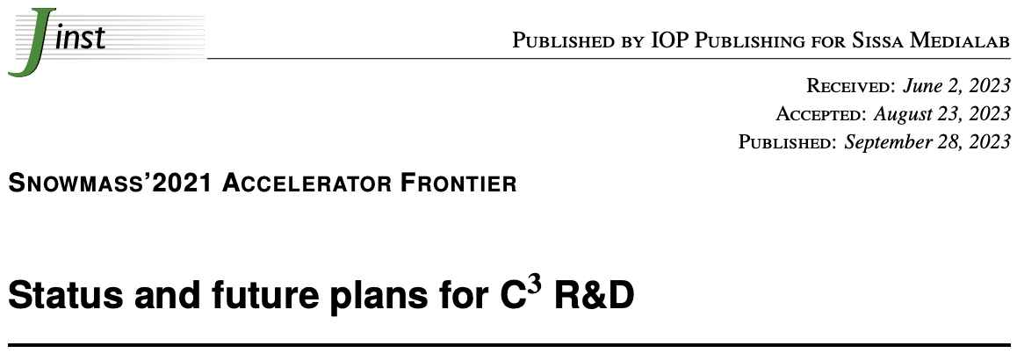
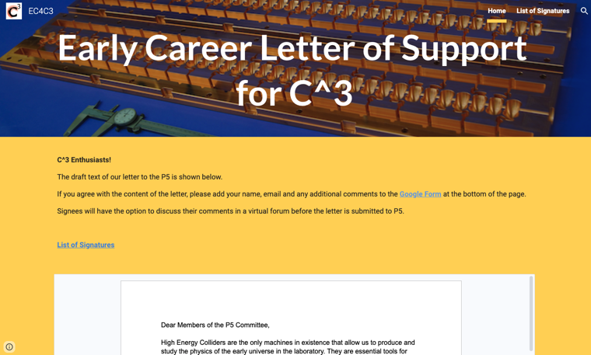
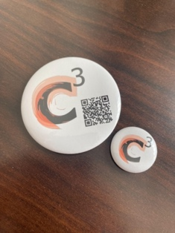
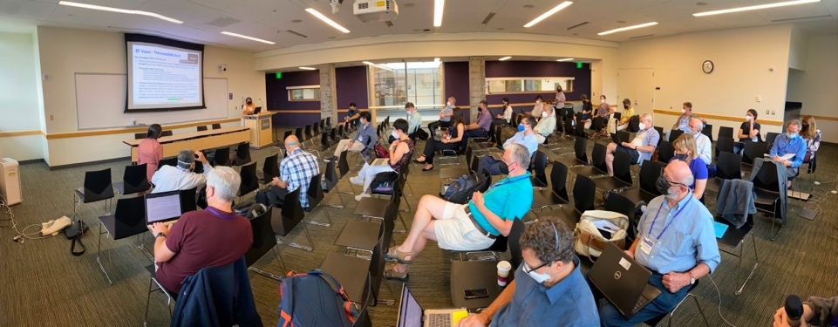
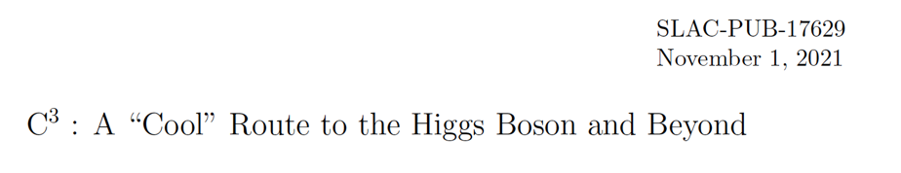
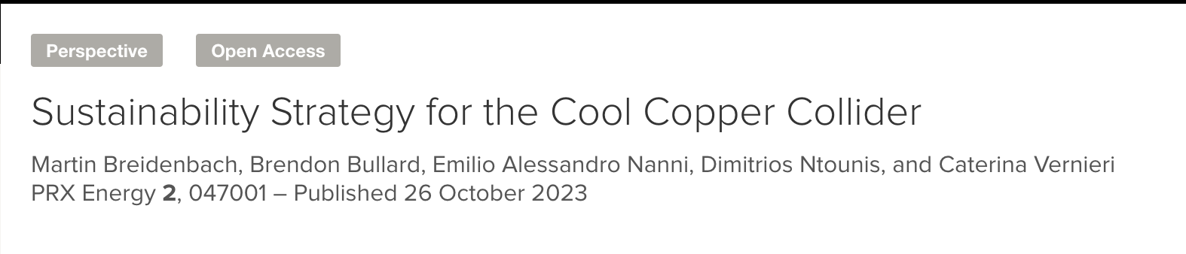
Acknowledgements
Community Events
Fermilab, SLAC, LANL & Snowmass Session in Seattle
Cornell Aug. 31st-Sept. 1st
https://indico.classe.cornell.edu/event/2283/overview
https://sites.google.com/view/ec4c3
Next Workshop In Feb. 12/13th ’24 @ SLAC
More Details Here (Follow, Endorse, Collaborate):
https://web.slac.stanford.edu/c3/
CLIC Mini Week

Slide 3
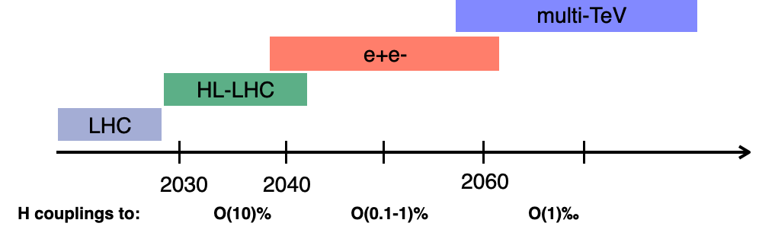
What’s Next for the Energy Frontier?
Largely mirrored in P5 Report!
Physics goals beyond HL-LHC:
1. Establish Yukawa couplings to light flavor ⟹ precision & lumi
2. Search for invisible/exotic decays and new Higgs ⟹ precision & lumi
3. Establish self-coupling ⟹ > 500 GeV e+e- operations
The Energy Frontier 2021 Snowmass Report
CLIC Mini Week

Slide 4
C³ Relevant Text and Recommendations in P5 Report (1)
Section 6.4:
  “There are exciting opportunities in the development of (i) new high average power, efficient drivers (RF, lasers, and electron beams), (ii) accelerating structures that can sustain high average power and gradient (metallic, plasma and dielectric)” …”
  “Normal conducting radio frequency (RF), superconducting RF, superconducting magnets, targets, and advanced acceleration concepts are essential to develop the next generation of accelerators for particle physics. The normal conducting RF program should incorporate innovative concepts such as cryogenic cool copper and distributed coupling.”
  Area Recommendation 8: Increase annual funding to the General Accelerator R&D program by $10M per year in 2023 dollars to ensure US leadership in key areas.
  “Technical and scientific plans should be developed for test facility projects that could be launched within the next 5–10 years. These could include the second stage cool copper test, which could develop high gradient normal conducting RF technology.”
  Area Recommendation 9: Support generic accelerator R&D with the construction of small scale test facilities. Initiate construction of larger test facilities based on project review, and informed by the collider R&D program.

Slide 5
C³ Relevant Text and Recommendations in P5 Report (2)
Section 6.5:
  “End-to-end designs are needed well before a decision can be made on a project in order to understand potential performance parameters and costs. These will guide research priorities and technology development as well as demonstrator facilities. Such early designs will also play a critical role in creating and sustaining the expertise to design such machines. Progress on these end-to-end designs should be evaluated (Recommendation 6).”
  “R&D efforts in the next five years will inform test facilities as discussed in Section 6.4 for the mid-to-late decade time period and collider design results will set the stage for initiating a demonstrator facility (Recommendation 6), that would feed into future decisions on a potential collider project.”
  Area Recommendation 10: To enable targeted R&D before specific collider projects are established in the US, an investment in collider detector R&D funding at the level of $20M per year and collider accelerator R&D at the level of $35M per year in 2023 dollars is warranted.
Section 6.9:
  “Accelerator technologies play a key role in sustainability.”
  “Accelerator structure improvements can also play an important role, including higher quality factor, and concepts like cool copper.”
  Area Recommendation 20: HEPAP, potentially in collaboration with international partners, should conduct a dedicated study aiming at developing a sustainability strategy for particle physics.

Slide 6
C³ Initial Reaction to P5 Report (Emilio’s Opinion)
P5 creates room for a future Higgs Factory!
We are in! Report highlighted value that cold copper technology can bring to HEP
We will start with targeted push under GARD with the goal of building test capabilities
Need to understand timeline for “second stage” tests (injector + one cryomodule)
  “Small” scale project ($<50M) vs. mid/large scale which require ”panel” review (Recommendation 6)
Future Collider Initiative relies on our connection multiple collider concepts – a highlight in presentation to P5 (next slide)
Eager to find areas to collaborate with CLIC (Sustainability? Collider design studies?)

Slide 7
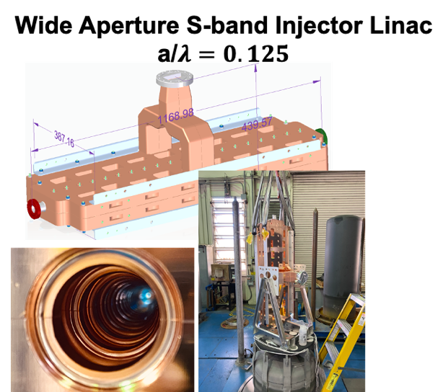
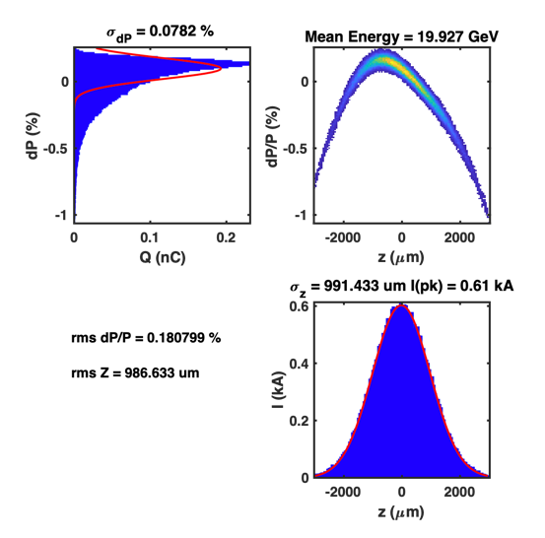
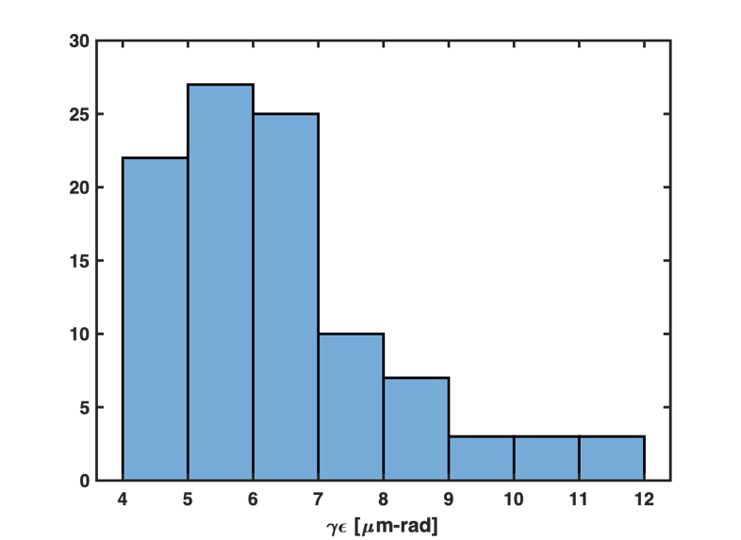
Synergies with Future Colliders
RF Accelerator Technology Essential for All Near-Term Collider Concepts
C³ Demo is positioned to contribute synergistically or directly to all near-term collider concepts
CLIC - components, damping, fabrication techniques
ILC - options for electron driven positron source based C³ technology
Muon Collider - high gradient cryogenic copper cavities in cooling channel, alternative linac for acceleration after cooling
AAC - C³ Demo utilized for staging, C³ facility multi-TeV energy upgrade reutilizing tunnel, 𝛾𝛾 colliders
FCC-ee - common electron and positron injector linac from 6 to 20 GeV
  reduce length 3.5X OR reduce rf power 3.5X
90% seeds < 8 um-rad with lattice errors
Planned test at Argonne
Tracking with Lucretia includes longitudinal and transverse wakes, chromatic effects etc
Error study is 100 seeds, 100 μm element offsets, 300 μrad element rolls (rms)
  No corrections applied
Vibrant International Community for Future Colliders is Essential
CLIC Mini Week

Slide 8
A novel route to a linear e⁺e⁻ collider

Slide 9

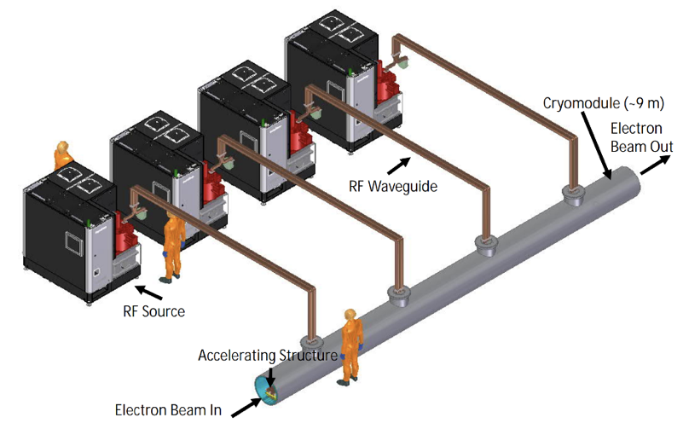
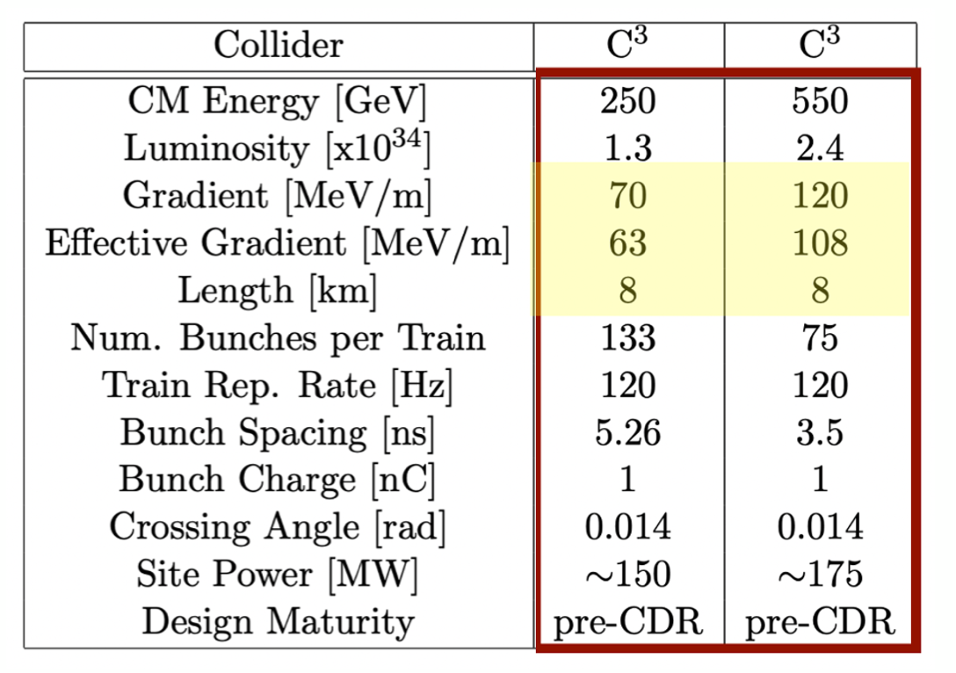
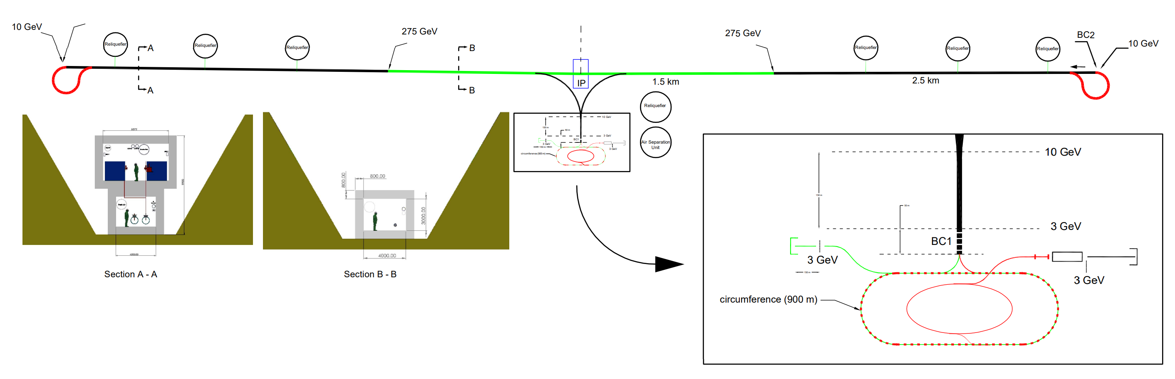
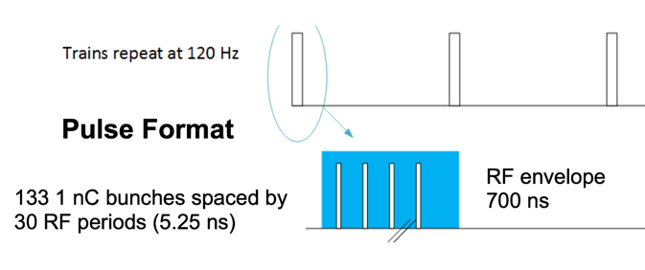
Accelerator Complex
8 km footprint for 250/550 GeV CoM ⟹ 70/120 MeV/m
Large portions of accelerator complex compatible between LC technologies
Beam delivery / IP modified from ILC (1.5 km for 550 GeV CoM), compatible w/ ILC-like detector
Damping rings and injectors to be optimized with CLIC as baseline
C³ Main Linac Cryomodule
9 m (600 MeV/ 1 GeV)
C³ Parameters
C³ - 8 km Footprint for 250/550 GeV (to scale)
Snowmass

Slide 10
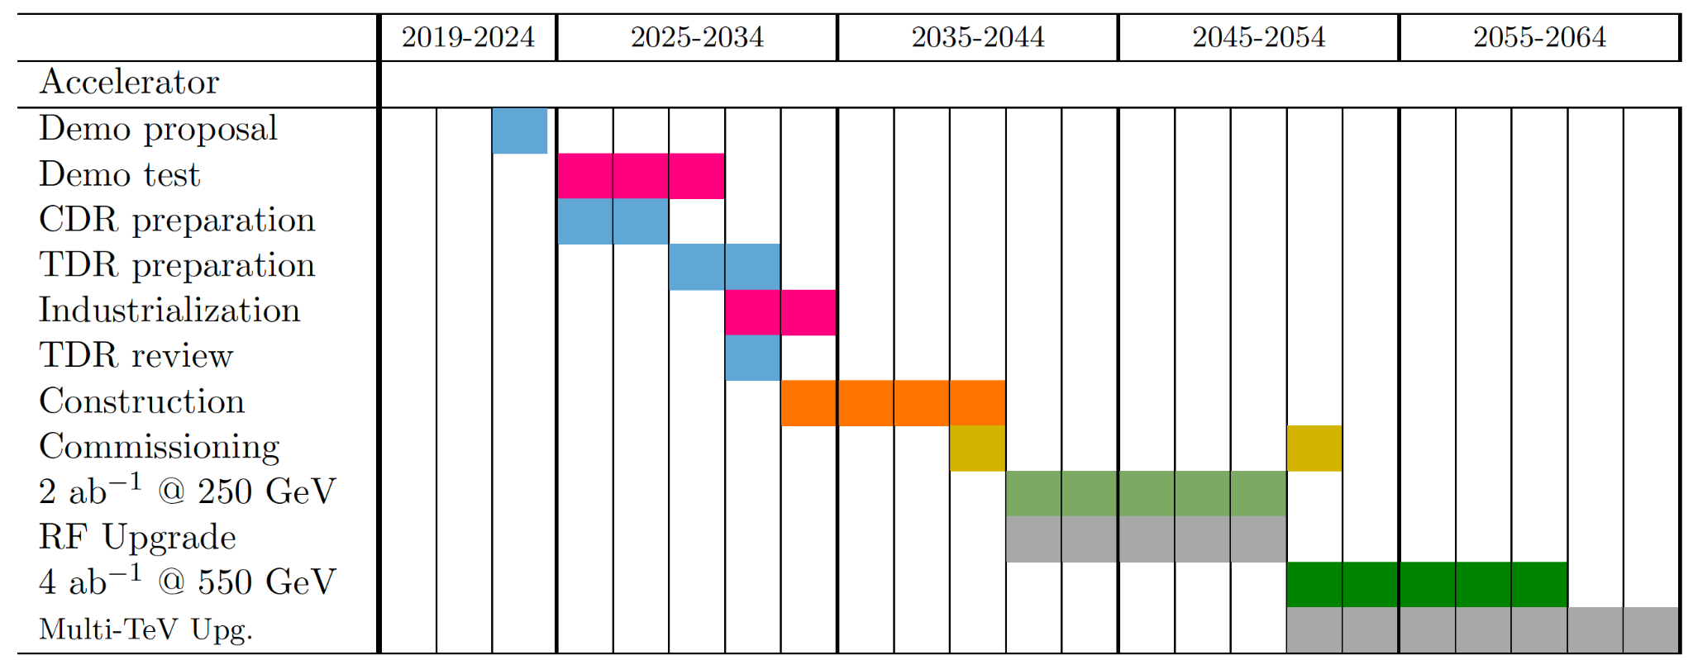
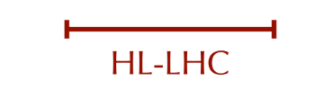
Technical Timeline for 250/550 GeV CoM
Technically limited timeline developed through the Snowmass process
Energy upgrade in parallel to operation with installation of additional RF power sources
P5 Report Dec. 23
Nex European Strategy Report??
CLIC Mini Week
Notes:
Run plan to match ILC at 250, we remain open to input -> Higher energy faster, push harder for luminosity

Slide 11
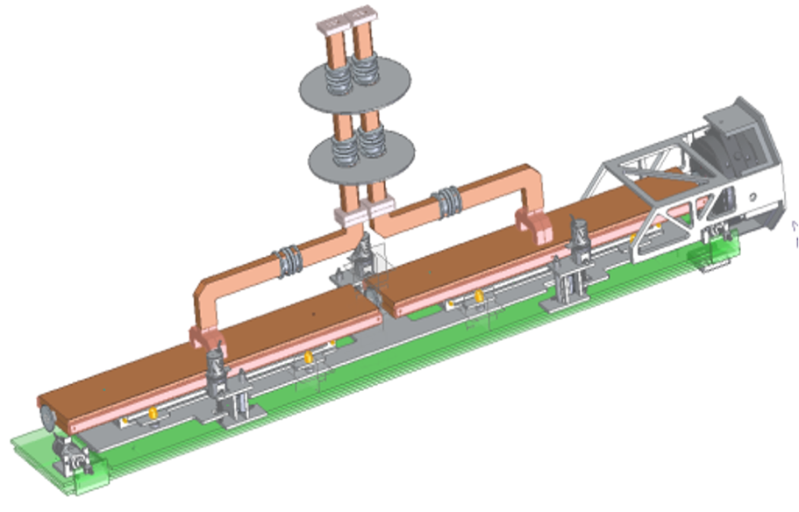
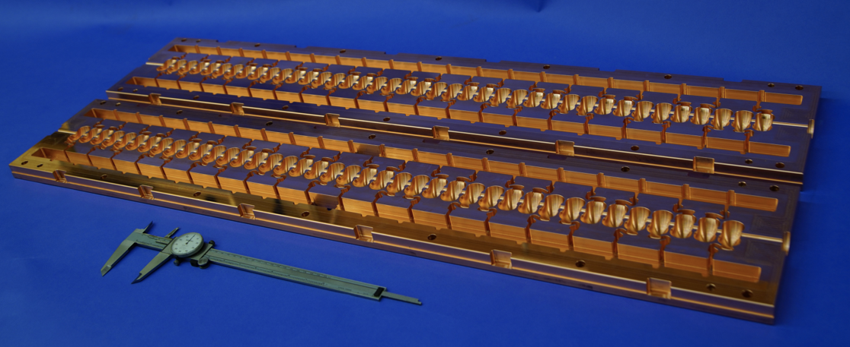
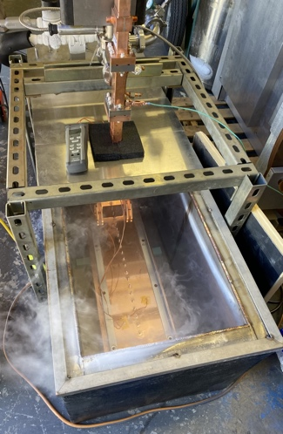
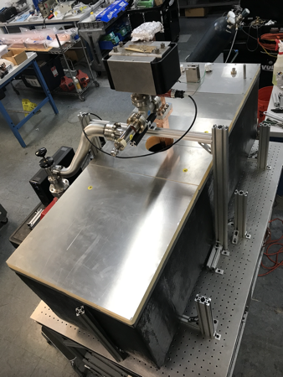
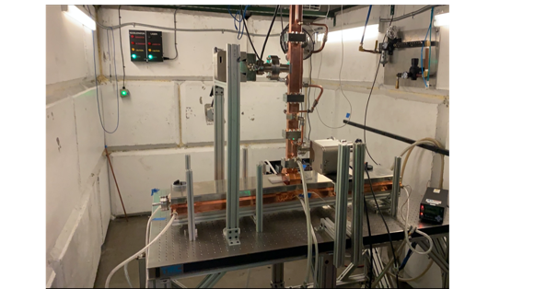
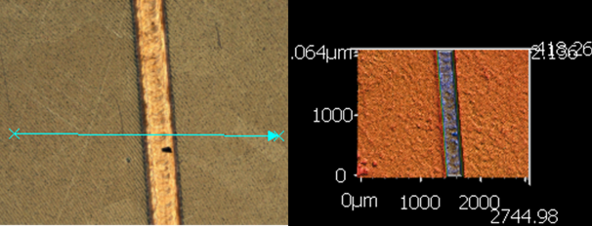

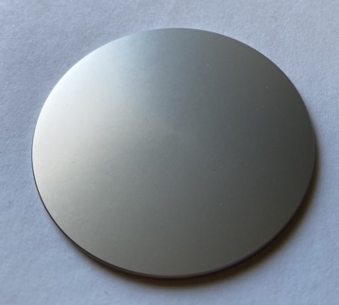
Ongoing Technological Development
Modern Manufacturing
Prototype One Meter Structure
Preliminary Alignment and Positioning
High Accelerating Gradients
Cryogenic Operation
Integrated Damping with NiChrome Coating
NiChrome sample for High Gradient Test Arrived at SLAC
NEXT: Hydrogen Furnace Fire and Ship to CERN!
CLIC Mini Week

Slide 12

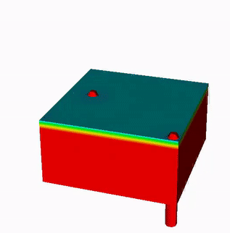
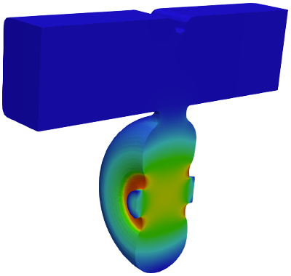
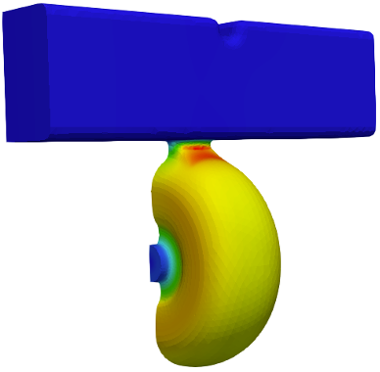
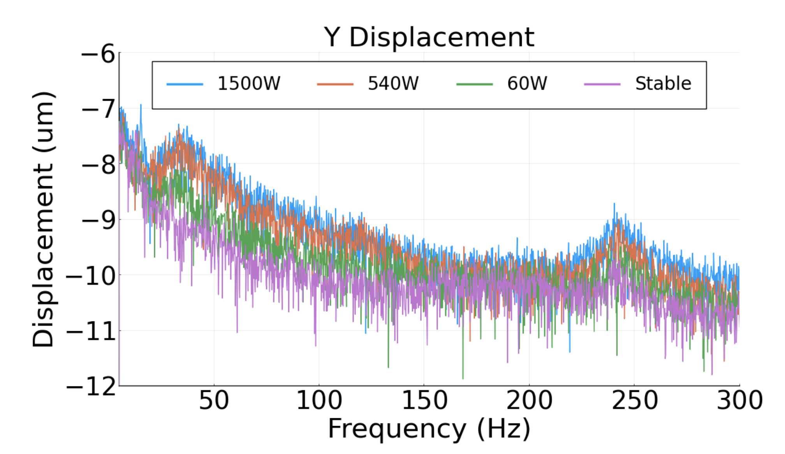
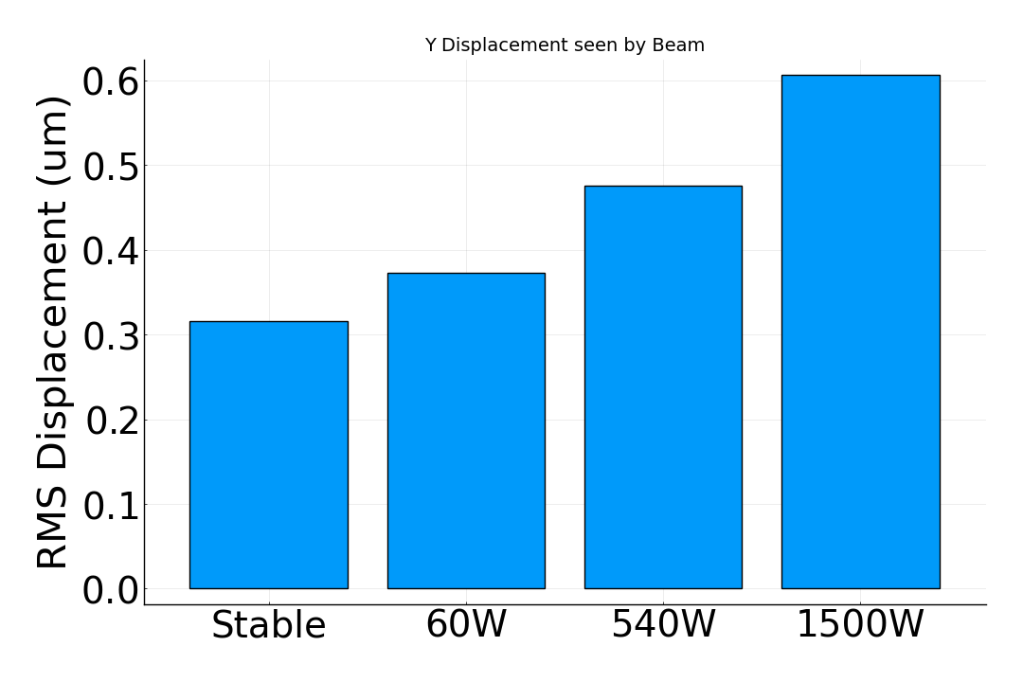


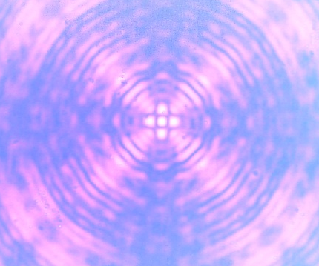
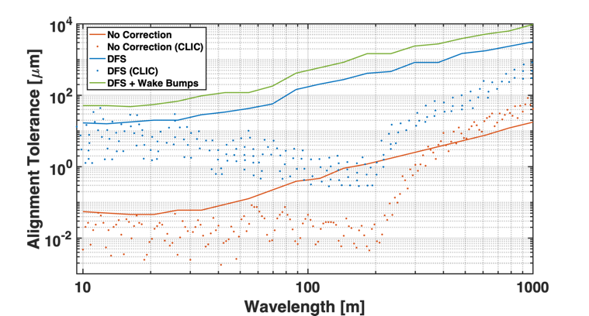
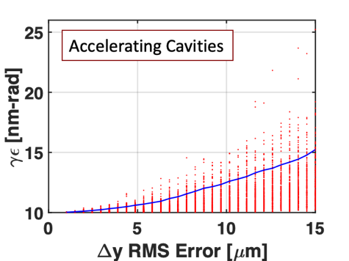
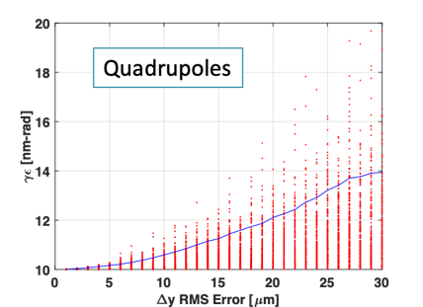
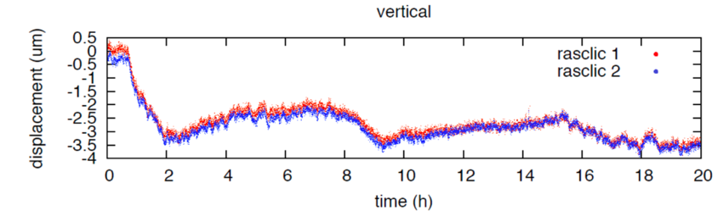
Alignment and Vibrations
Two-Phase Fluid Simulations
System level optimization essential for achieving performance
RF Structure Optimization
Vibration Measurements and Analysis
3.55 mm iris radius
2.0=E_{max}/E_{acc}
1.23=H_{coup}/H_{wall}
K. Shoele
Electric Field
Precision Short and Long Range Alignment
Magnetic Field
Z. George, V. Borzenets, A. Dhar, D. Palmer
H. Van Der Graaf
M. Shumail, Z. Li
Main Linac Beam Dynamics
Alignment Parameters | Units | Value
Raft Components | μm | 5
Short Range (~10m) | μm | 30
Long Range (>200m) | μm | 1000
Structure Vert. Vibration | μm | 9
Quad Vert. Vibration | nm | 15
BPM Resolution | μm | 0.1
BPM-Quad Alignment | μm | 2
100 nm resolution
Approved effort to test cold
White (C³), Schulte (CLIC)
https://arxiv.org/pdf/2307.07981.pdf
CLIC Mini Week

Slide 13
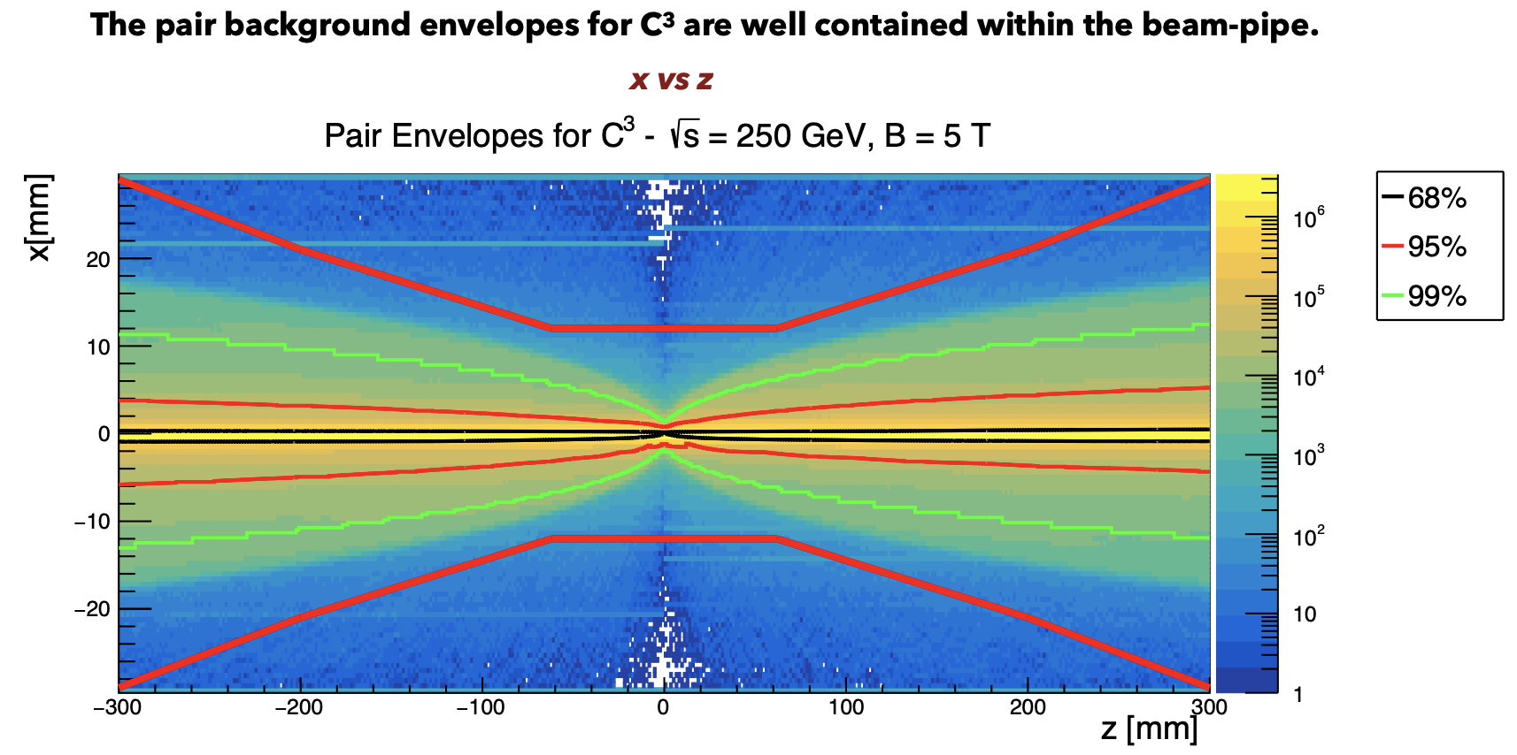
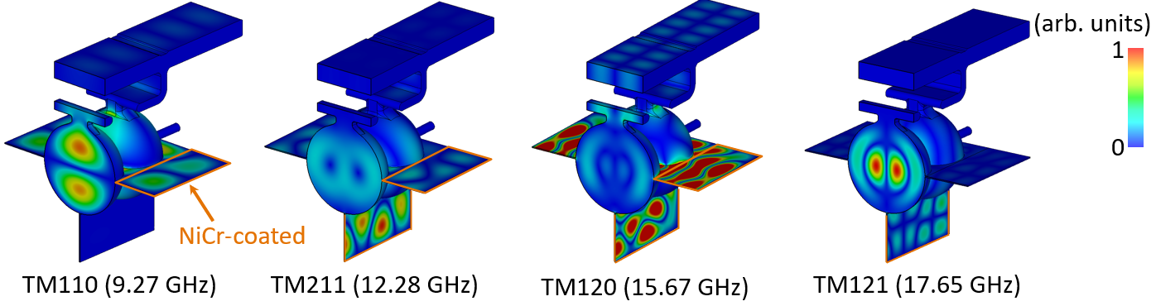
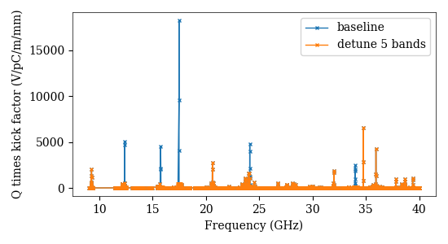
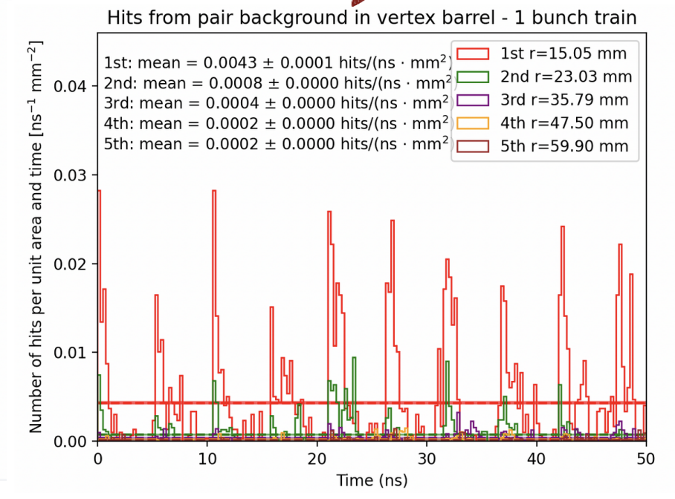
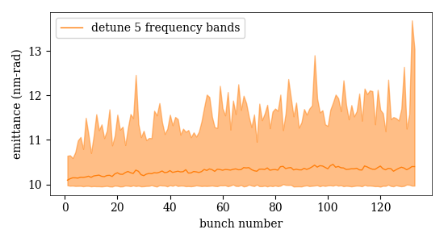
Beam Dynamics and Luminosity Studies
Compatible with ILC-like Detector
Studies ongoing towards ensuring target luminosity
Emittance Preservation with HOM Suppression
Ntounis, Gray, Vernieri
Damped / Damped-Detuned Spectrum
H. Xu et al., LANL
Wei-Hou Tan, Zenghai Li
See C3 talks at ECFA Workshop on e+e- Higgs/EW/Top Factories
https://agenda.infn.it/event/34841/
Opportunities to Collaborate: DR, Bunch Compressor, BDS, …
CLIC Mini Week

Slide 14
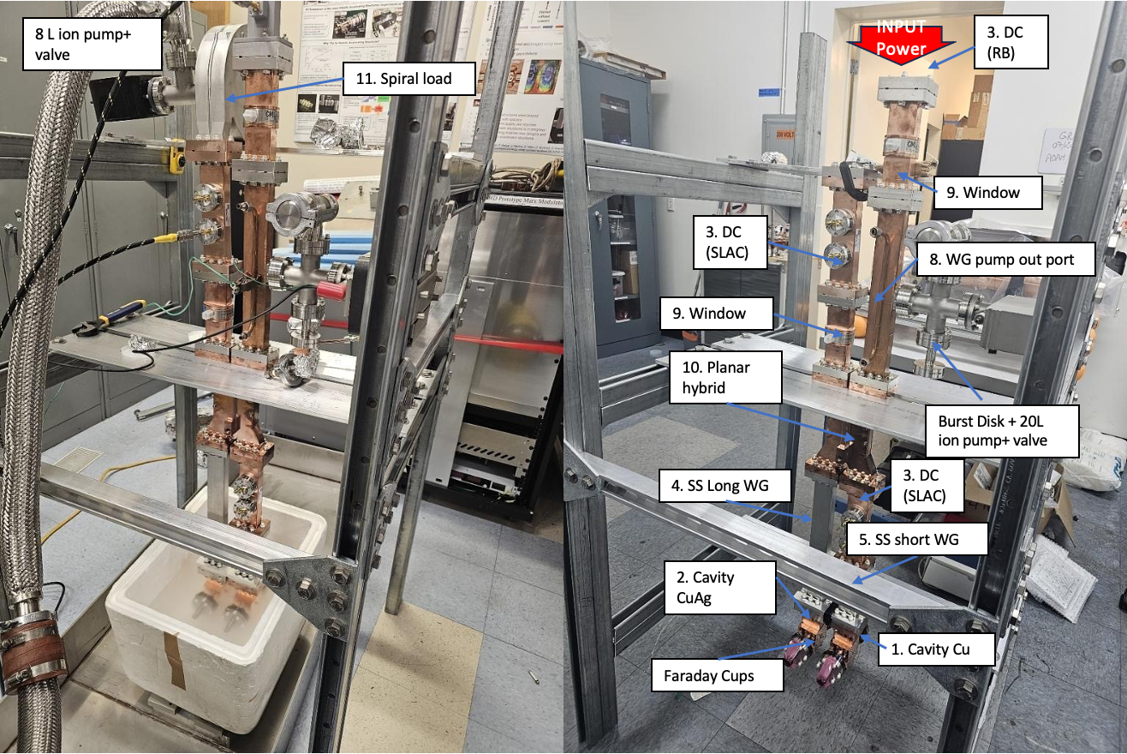
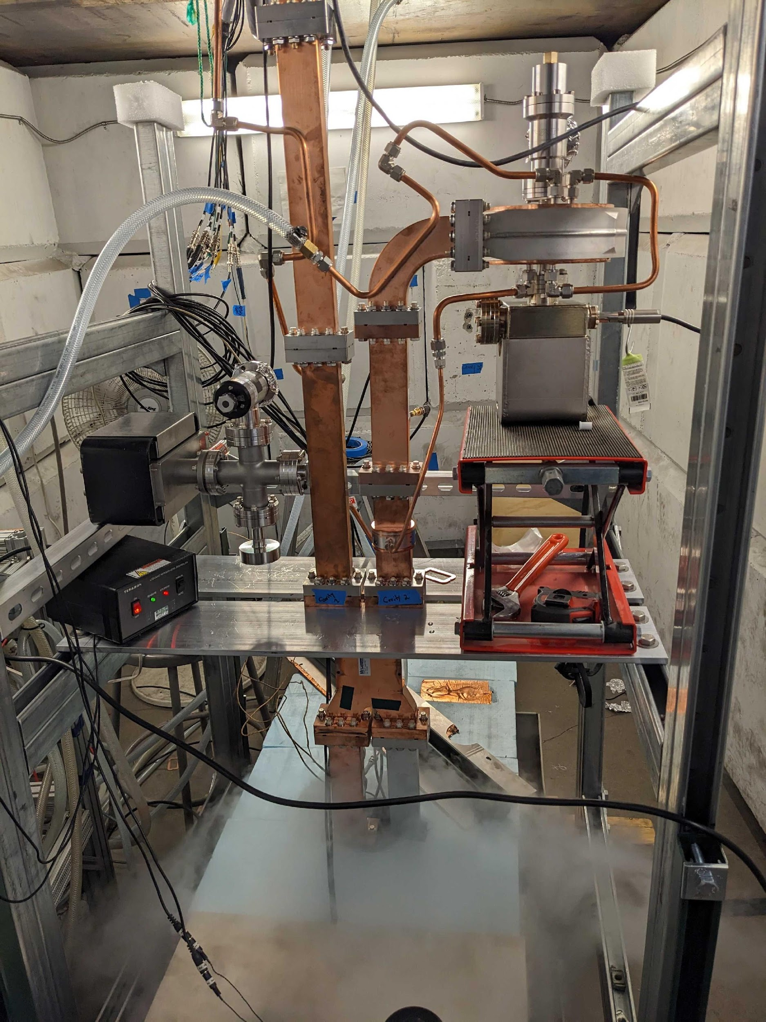
Two Cell Assembly for High Power Test
SLAC
Radiabeam

Slide 15
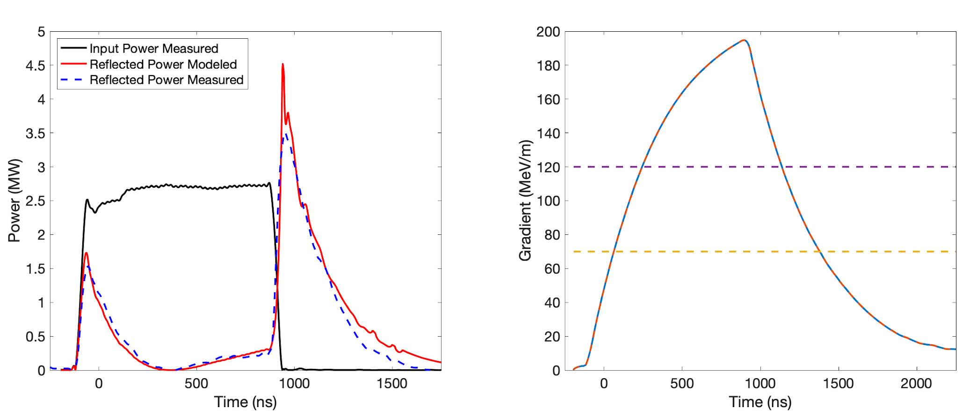
Typical (Highest Gradient) Performance
Measured and modeled response for CuAg Cavity
C³ - 550
C³ - 250

Slide 16
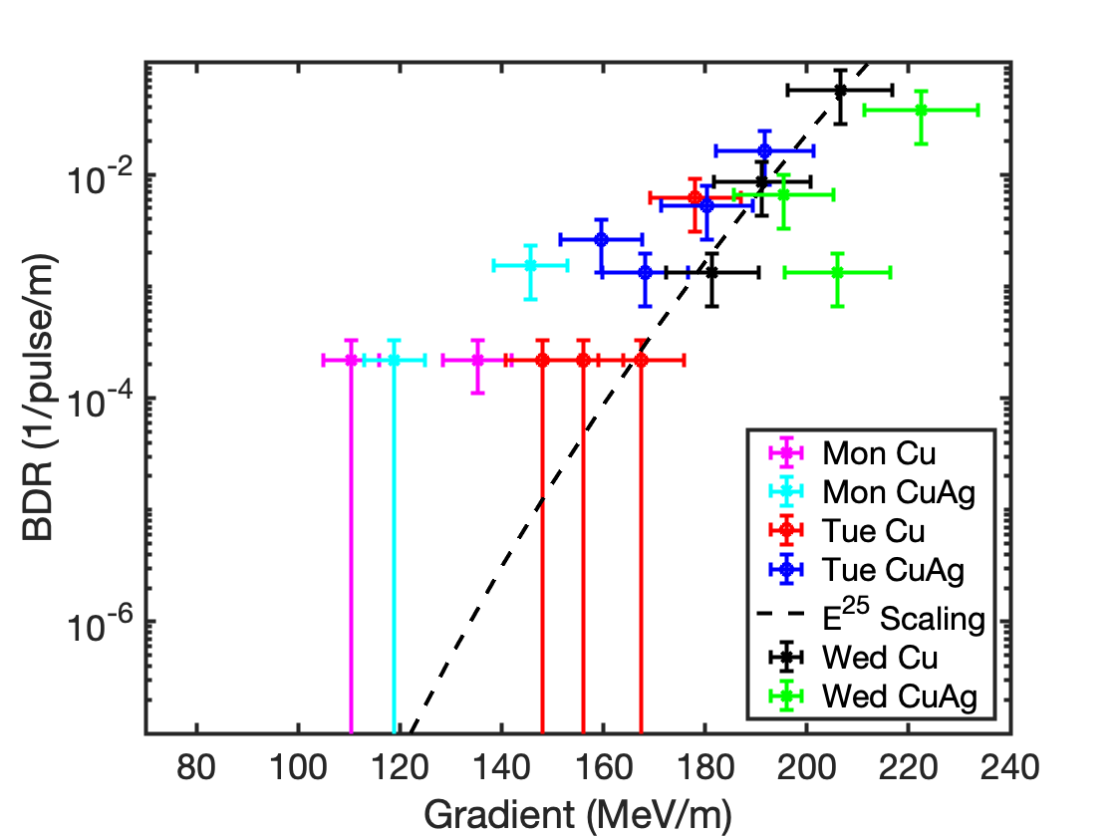
Breakdown Statistics
Challenging due to short structure length – most data points O(1 hr)
BDR of Cu and CuAg remarkably similar (very different than room temp)
Showing day to day improvement
Collected 5 more days of data – full analysis on going
Very promising for longer flat top at 120 MeV/m
Preliminary
Special Thanks: A. Diego, M. Schneider, M. Boyce and A. Dhar

Slide 17
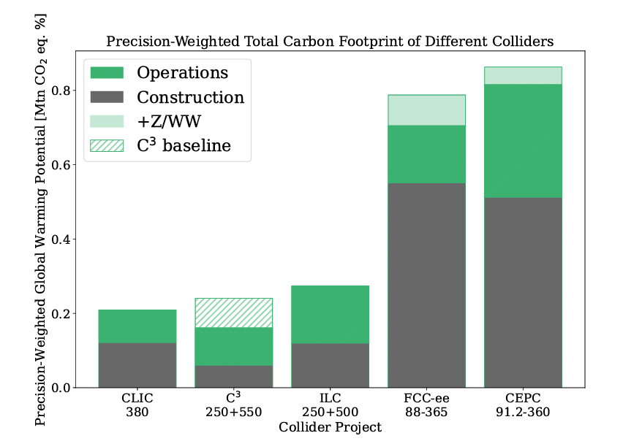
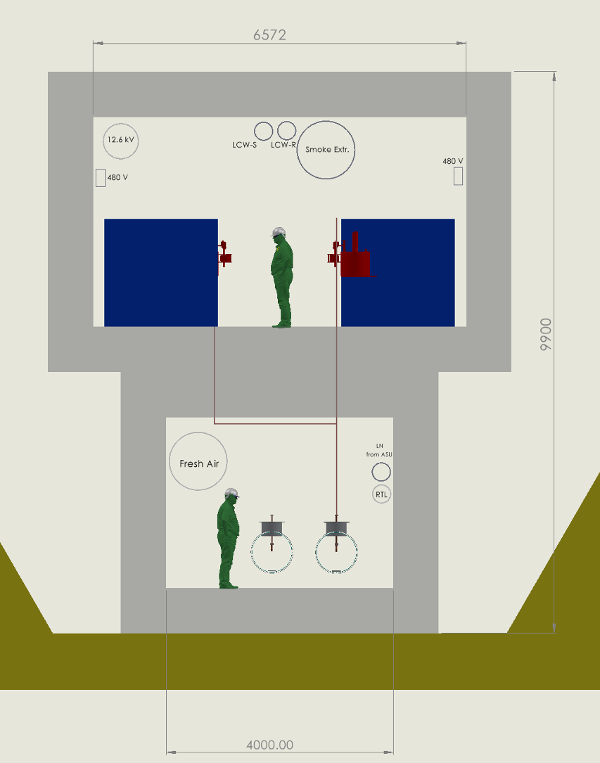
Power Consumption and Sustainability
Compact footprint <8 km for both underground and surface sites
  Underground – less constraints on energy upgrade
  Surface – lower cost and faster to first physics
Sustainability - construction + operations CO₂ emissions per % sensitivity on couplings
  Polarization and high energy to improve sensitivity
  Construction CO₂ emissions → minimize excavation and concrete
  Operations → limit power, decarbonization of the grid and dedicated renewable sources
250 GeV CoM - Luminosity - 1.3x10³⁴
Parameter | Units | Value
Reliquification Plant Cost | M$/MW | 18
Single Beam Power (125 GeV linac) | MW | 2
Total Beam Power | MW | 4
Total RF Power | MW | 18
Heat Load at Cryogenic Temperature | MW | 9
Electrical Power for RF | MW | 40
Cryoplant Electrical Power | MW | 60
Accelerator Complex Power | MW | ~50
Site Power | MW | ~150
Surface-Site Mockup
Precision-Weighted Carbon Footprint
Accepted PRX Energy, https://arxiv.org/abs/2307.04084
Notes:
Sustainability lcws talk and paper

Slide 18
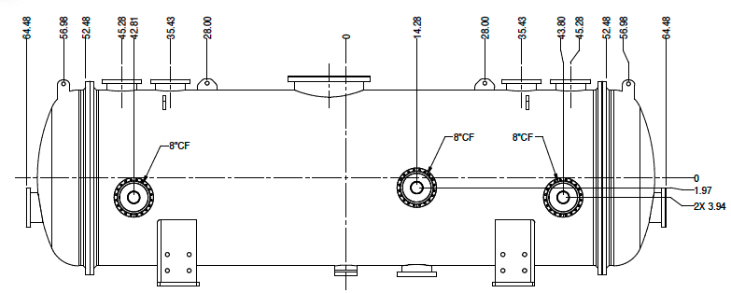
Quarter Cryomodule (QCM)
Vacuum insulation, raft length up to 2.5 m
Requisition is with procurement
All drawings, technical documents complete
Working with purchasing on RFP, aim to release prior to winter break
Notes:
Sustainability lcws talk and paper

Slide 19
Outlook

Slide 20
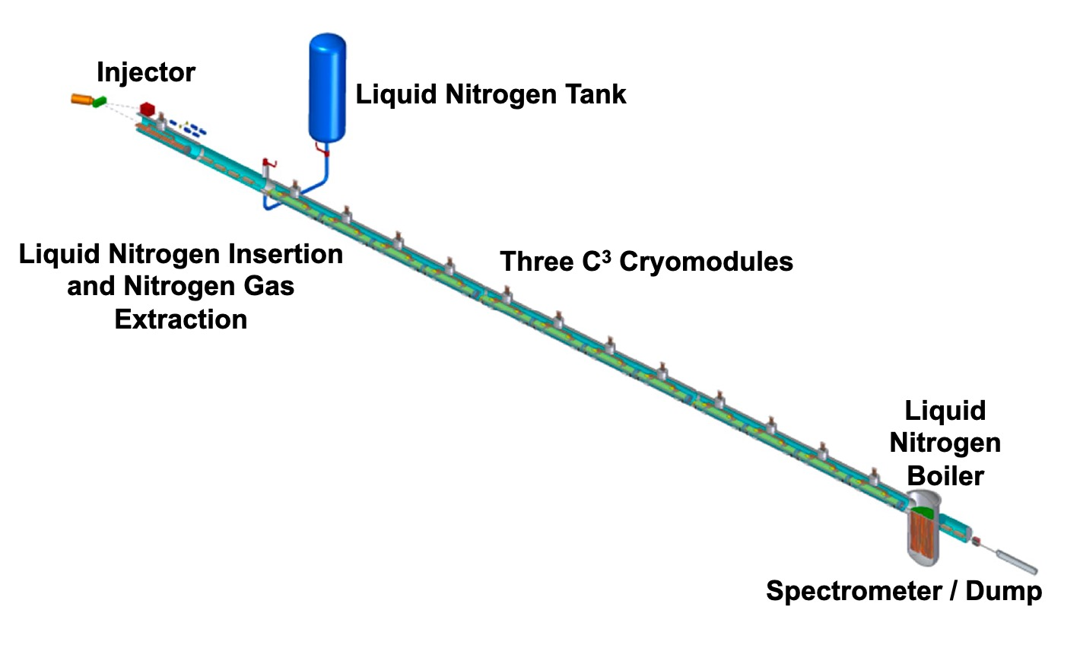
The Complete C³ Demonstrator
QCM
Stage 2:
Injector + Cryomodule
Demonstrate fully engineered cryomodule
~50 m scale facility
3 GeV energy reach
Answer technical questions needed for CDR
CLIC Mini Week

Slide 21
Conclusions
C³ provides a rapid route to precision Higgs physics with a compact 8 km footprint
  Higgs physics run by 2040
  US-hosted facility possible
C³ time structure is compatible with ILC-like detector design and optimizations ongoing
C³ upgrade to 550 GeV with only added rf sources
  Higgs self-coupling and expanded physics reach
C³ is scalable to multi-TeV
C³ Demo advances technology beyond CDR level
  5 year program, followed by completion of TDR and industrialization
  Three stages with quantitative metrics and milestones for decision points
  Direct and synergistic contributions to near-term collider concepts
More Details Here (Follow, Endorse, Collaborate):
https://web.slac.stanford.edu/c3/
CLIC Mini Week

Slide 22
Questions?

Slide 23
Additional Material

Slide 24
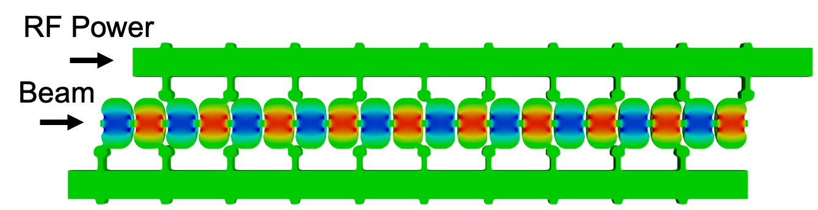
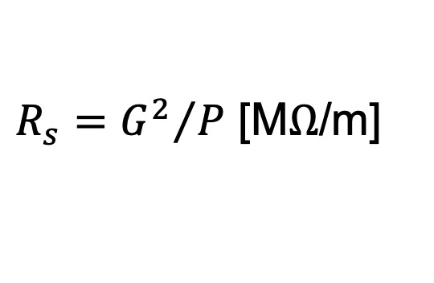
Breakthrough in the Performance of RF Accelerators
RF power coupled to each cell – no on-axis coupling
Full system design requires modern virtual prototyping
Electric field magnitude produced when RF manifold feeds alternating cells equally
Optimization of cell for efficiency (shunt impedance)
Control peak surface electric and magnetic fields
Key to high gradient operation
CLIC Mini Week
Tantawi, Sami, et al. PRAB 23.9 (2020): 092001.

Slide 25



Cryo-Copper: Enabling Efficient High-Gradient Operation
Cryogenic temperature elevates performance in gradient
Material strength is key factor
Impact of high fields for a high brightness injector may eliminate need for one damping ring
Operation at 77 K with liquid nitrogen is simple and practical
Large-scale production, large heat capacity, simple handling
Small impact on electrical efficiency
Cryogenic temperature elevates performance in gradient
Increased material strength is key factor
Increase electrical conductivity reduces pulsed heating in the material
Cahill, A. D., et al. PRAB 21.10 (2018): 102002.
CLIC Mini Week

Slide 26


C3 Cool Copper Collider
C³ Prototype One Meter Structure
C³ is based on a new rf technology
Dramatically improving efficiency and breakdown rate
Distributed power to each cavity from a common RF manifold
Operation at cryogenic temperatures (LN₂ ~80-K)
Robust operations at high gradient: 120 MeV/m
Scalable to multi-TeV operation
Cryogenic Operation at X-band
High Gradient Operation at 150 MV/m
High power Test at Radiabeam
Snowmass
Nasr, et al., PRAB 24.9 (2021): 093201.

Slide 27

Table of Parameters
CLIC Mini Week

Slide 28

Full Parameters
CLIC Mini Week

Slide 29
C³ Demonstration R&D Plan
C³ demonstration R&D needed to advance technology beyond CDR level
Minimum requirement for Demonstration R&D Plan:
Demonstrate operation of fully engineered and operational cryomodule
  Simultaneous operations of min. 3 cryomodules
Demonstrate operation during cryogenic flow equivalent to main linac at full liquid/gas flow rate
Operation with a multi-bunch photo injector - high charges bunches to induce wakes, tunable delay witness bunch to measure wakes
Demonstrate full operational gradient 120 MeV/m (and higher > 155 MeV/m) w/ single bunch
  Must understand margins for 120 - targeting power for (155 + margin) 170 MeV/m
  18X 50 MW C-band sources - off the shelf units
Fully damped-detuned accelerating structure
Work with industry to develop C-band source unit optimized for installation with main linac
This demonstration directly benefits development of compact FELs, beam dynamics, high brightness guns, etc.
The other elements needed for a linear collider - the sources, damping rings, and beam delivery system – more advanced from the ILC and CLIC – need C³ specific design
Our current baseline uses these directly; will look for further cost-optimizations for of C³
CLIC Mini Week

Slide 30


Upgrade Options
Luminosity
Energy
Beam power can be increased for additional luminosity
C³ has a relatively low current for 250 GeV CoM (0.19 A) - Could we push to match CLIC at 1.66 A? (8.5X increase?)
Pulse length and rep. rate are also options
HTS Pulse Compressor
REBCO Coatings
Scalability studied to 3 TeV
Requires rf pulse compression for reasonable site power
Higher gradient option (155 MeV/m) in consideration
Cryogenics Scale to multi-TeV
Parameter | Units | Baseline | High-Lumi
Energy CoM | GeV | 250 | 250
Gradient | MeV/m | 70 | 70
Beam Current | A | 0.2 | 1.6
Beam Power | MW | 2 | 16
Luminosity | x10³⁴ | 1.3 | 10.4
Beam Loading |  | 45% | 87%
RF Power | MW/m | 30 | 125
Site Power | MW | ~150 | ~180
Qo ~ 400k
Le Sage, CERN Collaborators
Caution: Requires serious investigation of beam dynamics - great topic for C³ Demonstration R&D
Snowmass
arXiv:1807.10195 (2018)

Slide 31





Further Cavity Optimization Possible
Single side coupling iris induces dipole and quad fields
Coupling hole symmetrization and racetrack shape incorporated to minimize dipole and quad fields
dipole, quad calculated at 50MV/m
Dipole
Quad
✅
w/o symmetrization
Dipole
Quad
V1-simple-stub
(not ideal cancellation)
V2-symm-stub
(good cancellation)
CLIC Mini Week
with symmetrization 100X reduction
Zenghai Li

Slide 32

RF Source R&D Over the Timescale of the Next P5
RF source cost is the key driver for gradient and cost
Significant savings when items procured at scale of LC
Need to focus R&D on reducing source cost to drive economic argument for high gradient
Gradient/Cost Scaling vs. RF Source Cost for Main Linac
Relative Cost
Understand the Impact on Advanced Collider Concept Enabled by the Goals Defined in the DOE GARD RF Decadal Roadmap
CLIC Mini Week
https://science.energy.gov/~/media/hep/pdf/Reports/DOE_HEP_GARD_RF_Research_Roadmap_Report.pdf

Slide 33


RF Power Requirements
70 MeV/m 250 ns Flattop (extendible to 700 ns)
~1 microsecond rf pulse, ~30 MW/m
Conservative 2.3X enhancement from cryo
No pulse compression
Ramp power to reduce reflected power
Flip phase at output to reduce thermals
RF Power
One 65 MW klystron every two meters -> Matches CLIC-k rf module power
Gradient
Thermals
CLIC Mini Week

Slide 34


Gaussian Detuning Provides Required 1st Band Dipole Suppression for Subsequent Bunch, Damping Also Needed
Dipole mode wakefields immediate concern for bunch train
4𝜎 Gaussian detuning of 80 cells for dipole mode (1st band) at 𝑓_{𝑐}=9.5 GHz, w/ ∆𝑓/𝑓_{𝑐}=5.6%
First subsequent bunch s = 1m, full train ~75 m in length
Damping needed to suppress re-coherence
CLIC Mini Week

Slide 35



Distributed Coupling Structures Provide Natural Path to Implement Detuning and Damping of Higher Order Modes
Individual cell feeds necessitate adoption of split-block assembly
Perturbation due to joint does not couple to accelerating mode
Exploring gaps in quadrature to damp higher order mode
Detuned Cavity Designs
Quadrant Structure
CLIC Mini Week

Slide 36




Implementation of Slot Damping
Kick Factor * Q
Need to extend to 40 GHz / Optimize coupling / Modes below 10⁴ V/pC/mm/m
NiCr coated damping slots in development
Kick Factor
Vacuum Space Model
Tapered Slot
Two Cell Prototype
H. Xu, NCRF W 17th May 13:30
NiCr Tested at 80K
ILC Update

Slide 37

Implementation of Slot Damping
Kick Factor * Q
Need to extend to 40 GHz / Optimize coupling / Modes below 10⁴ V/pC/mm/m
NiCr coated damping slots in development
Kick Factor
Vacuum Space Model
Damping Slot Prototype
Tapered Slot
CLIC Mini Week

Slide 38


RF Power Requirements and Cryogenics
70 MeV/m 250 ns Flattop (extendible to 700 ns)
~1 microsecond rf pulse, ~30 MW/m
2.3X enhancement from cryo
No pulse compression
Ramp power to reduce reflected power
Flip phase at output to reduce thermals
<2.5 kW/m of structure for C3-250/550
15% cooling efficiency with LN
Thermals
Gradient
RF Power
M. Breidenbach, CF W 17th May 14:15
ILC Update

Slide 39



Beam Format and Detector Design Requirements
ILC timing structure: Fraction of a percent duty cycle
Power pulsing possible, significantly reduce heat load
  Factor of 50-100 power saving for FE analog power
Tracking detectors don’t need active cooling
  Significantly reduction for the material budget
Triggerless readout is the baseline
C³ time structure is compatible with ILC-like detector overall design and ongoing optimizations
ILC timing structure
C³ timing structure
1 ms long bunch trains at 5 Hz
2820 bunches per train
308ns spacing
CLIC Mini Week

Slide 40

Why 550 GeV?
We propose 250 GeV with a relatively inexpensive upgrade to 550 GeV
An orthogonal dataset at 550 GeV to cross-check a deviation from the SM predictions observed at 250 GeV
From 500 to 550 GeV a factor 2 improvement to the top-Yukawa coupling
O(20%) precision on the Higgs self-coupling would allow to exclude/demonstrate at 5𝜎 models of electroweak baryogenesis
CLIC Mini Week

Slide 41

One note on polarization
arXiv:1708.08912
arXiv:1801.02840
There are extensive comparisons between the FCC-ee plan and the C³/ILC runs that show they are rather compatible to study the Higgs Boson
When analyzing Higgs couplings with SMEFT, 2 ab⁻¹ of polarized running is essentially equivalent to 5 ab⁻¹ of unpolarized running.
  Electron polarization is essential for this. But, there is almost no difference in the expectation with and without positron polarization.
  Positron polarization allows more cross-checks of systematic errors. We may wish to add it later.
  Positron polarization brings a large advantage in multi-TeV running, where the most important cross sections are from e-_{L}e+_{R}
CLIC Mini Week

Slide 42


Physics: Higgs Production at e⁺e⁻
ZH is dominant at 250 GeV
Above 500 GeV
Hvv dominates
ttH opens up
HH production accessible with ZHH
Delivers a rich physics program
CLIC Mini Week
The Energy Frontier 2021 Snowmass Report
Notes:
ZH -> width, couplings of the Higgs to b/c, and invisible/exotic decays (no trigger!)

Slide 43




Sustainability
Sustainability - construction + operations CO₂ emissions per % sensitivity on couplings
  Polarization and high energy to improve sensitivity
  Construction CO₂ emissions → minimize excavation and concrete
  Operations → limit power, decarbonization of the grid and
CLIC Mini Week

Slide 44




Global Contributions
C³ Technical Timeline Only Possible with the Exceptional Progress of ILC and CLIC
Benefit from injector complex and beam delivery concepts
Continue to benefit from technological improvement by ILC and CLIC
High Efficiency RF Sources (CLIC)
Electron Driven Positron Source
Nanobeams for IP (ATF)
https://www-atf.kek.jp/atf/
I. Sarchev, CERN
Courtesy of Y. Enomoto
Vibrant International Community for Future Colliders is Essential
CLIC Mini Week

