Slide 1


An Electron-Driven Neutron Source
Laurence Wroe (CERN, ATS-DO)
laurence.wroe@cern.ch
Steinar Stapnes, Walter Wuensch, Andrea Latina, Roberto Corsini, Javier Olivares Herrados
CLIC Mini-Week 2023

Slide 2
Table of Contents
Introduction to Project VULCAN
CLEAR Experiment
Accelerator Design Study
Accelerator Design Summary
Next Steps

Slide 3
Table of Contents
Introduction to Project VULCAN
CLEAR Experiment
Accelerator Design Study
Accelerator Design Summary
Next Steps

Slide 4



VULCAN
(Versatile Ultra Compact Accelerator-driven Neutron source)
Turnkey solution for generating thermal neutrons (∽ Å)
  Non-destructive, fast measurement of internal stresses of bulk metallic and ceramic structures
  Non-destructive in-situ and in-operando diagnostic of electrodes in electric batteries (measure the dendritic growth of lithium)
DAES
(Engineering solutions w/ neutron source expertise, Geneva)
DTI - Danish Technological Institute
(Neutron source instrumentation expertise, Denmark)
Xnovo Technology
(Software for instrumentation w/ x-ray crystallographic imaging expertise, Denmark)

Slide 5
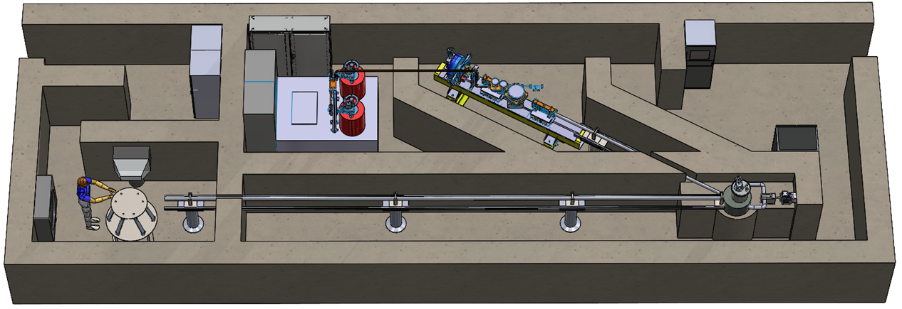
VULCAN Conceptual Layout
12 metres
Small footprint (existing lab)
Measurements in realistic times
Operated by local staff
Low maintenance
Lower power but more specialised than large neutron facilities

Slide 6

CERN Funding
2 years of funding from CERN CIPEA grant to:
  Characterise the target-moderator-reflector system for generating neutrons in CERN’s CLEAR beamline
  Develop conceptual design for compact and affordable electron linac optimized for VULCAN requirements

Slide 7
Table of Contents
Introduction to Project VULCAN
CLEAR Experiment
Accelerator Design Study
Accelerator Design Summary
Next Steps

Slide 8
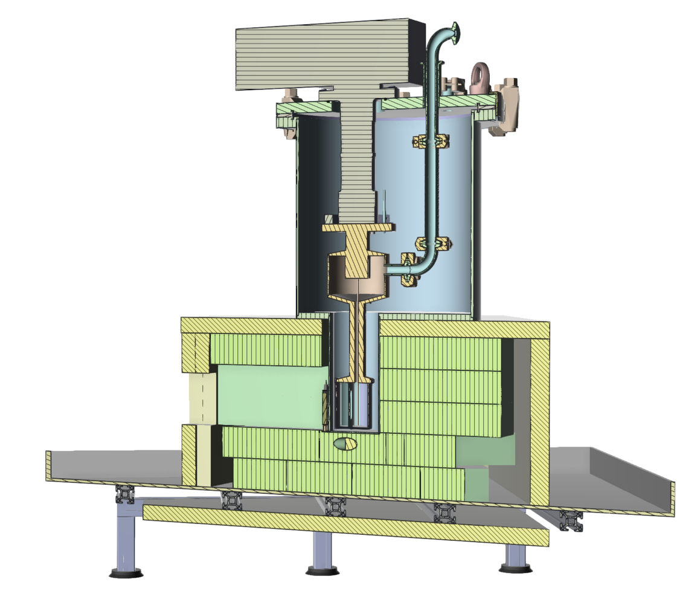
The Target-Moderator-Reflector
MeV e⁻ beam hits tungsten target, creating MeV n
CH4 inlet
MeV n moderated to meV n:
  Liquid CH4 - moderator
  Lead bricks - reflector
  Borated PE - absorber
Cryocooler
CH4 chamber
Lead bricks
Outgoing thermal n beam
  Speeds: ~ 1 km/s
  Initial pulse width: < 20 µs
  After 10 m, pulse width: ~ 5 ms
Outgoing thermal neutron beam
Borated PE
Incoming electron beam
Tungsten target

Slide 9
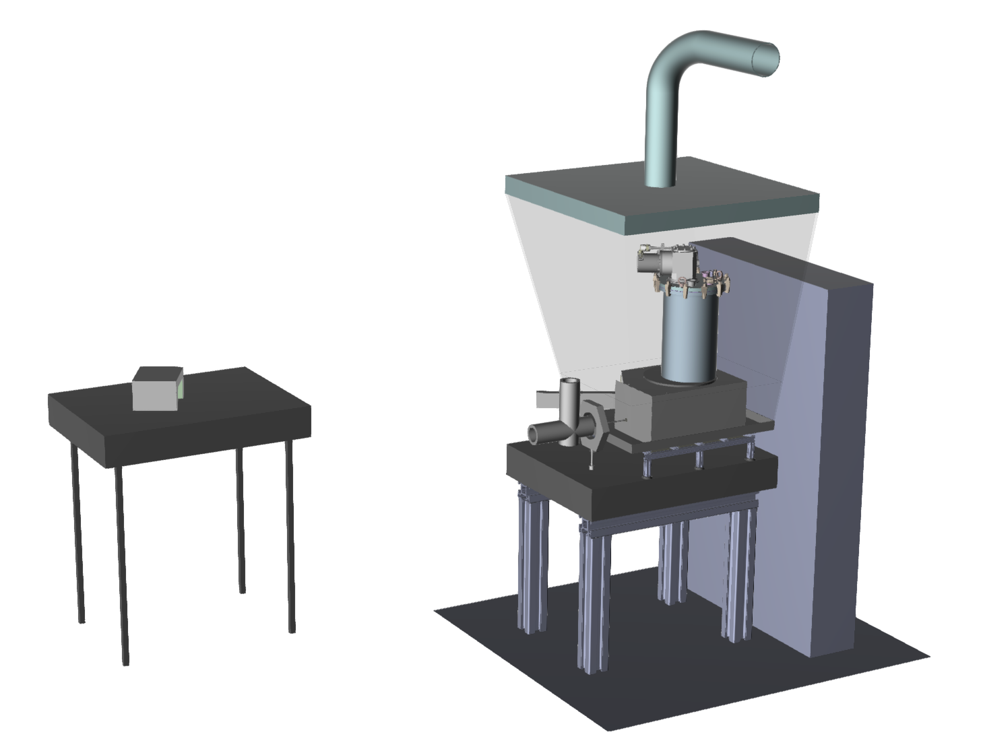
CLEAR Experiment
Measure neutron pulse flux and width at different distances
Measurements with and without Gadolinium foils
Outgoing thermal neutron beam
Incoming electron beam

Slide 10
Table of Contents
Introduction to Project VULCAN
CLEAR Experiment
Accelerator Design Study
Accelerator Design Summary
Next Steps

Slide 11
What type of accelerator?
High
Gradient
Electron
Linac
!!!
  VULCAN requirements:
    Compactness
    Affordability
    Efficiency
    Pulsed particle beam

Slide 12
Beam Specification
Parameter | Value (at target) | Unit
Energy | 35 | MeV
Energy Spread | < 5 | MeV
Beam Size | < 9 | mm
e- Train Duration | < 1 | µs
Repetition Rate | 100 | Hz
e- Train Charge (e- Beam Power) | Maximise (> 1) | nC kW
Facility Footprint | ~ 15 x 5 x 2.5 | m³
Facility Cost | 1-5 | M€

Slide 13
Optimisation - High-Level Choices
Cost, compactness and charge heavily dependent on:
  Frequency choice (S-, C- or X-band - vary)
  RF source (Single Klystron - vary power, set by market)
  Accelerating structure (Choose TW - < 1 µs, pulse compressor)
  Injector (Choose thermionic)
Assume other ancillaries (diagnostics, vacuum system, correctors, cooling + HVAC etc.) are a constant cost

Slide 14
Optimisation Process Step 1: RF
RF structure FoMs (f, R, Q, v_{g})
RF Klystron (t_{k}, P)
Pulse Compressor (f, t_{k}, t_{t}, t_{f}, Q)
Vary accelerating structure number of cells (N) and train length (t_{t})
Calculate maximum charge accelerated
Limited by either beam loading or maximum klystron power

Slide 15
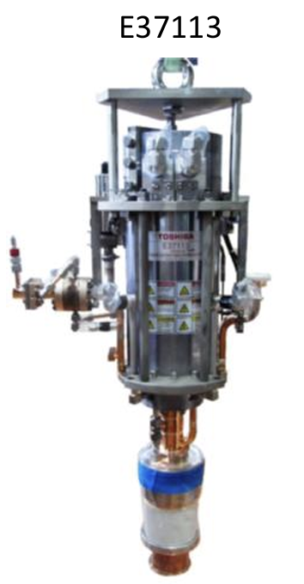
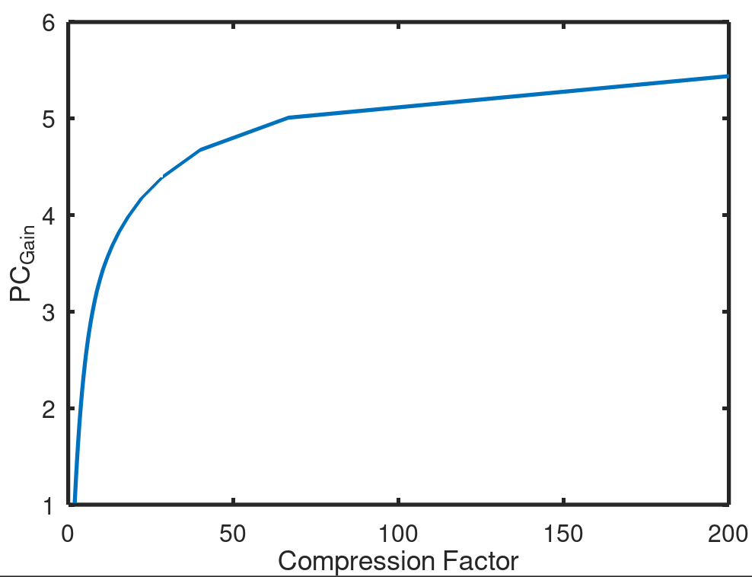
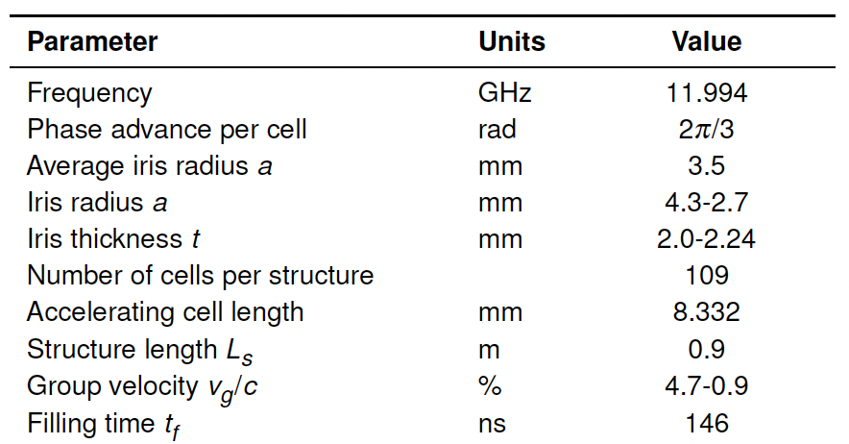
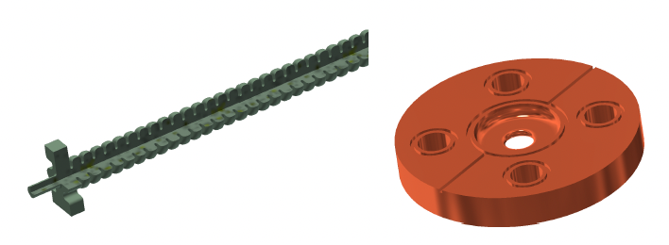
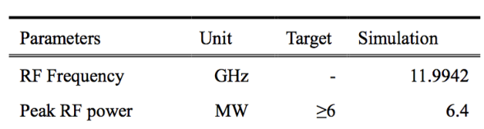
Example: XLS based structure
RF structure FoMs (f, R, Q, v_{g})
RF Klystron (t_{k}, P)
Pulse Compressor (f, t_{p}, t_{t}, t_{f}, Q)
Vary accelerating structure number of cells (N) and train length (t_{t})

Slide 16
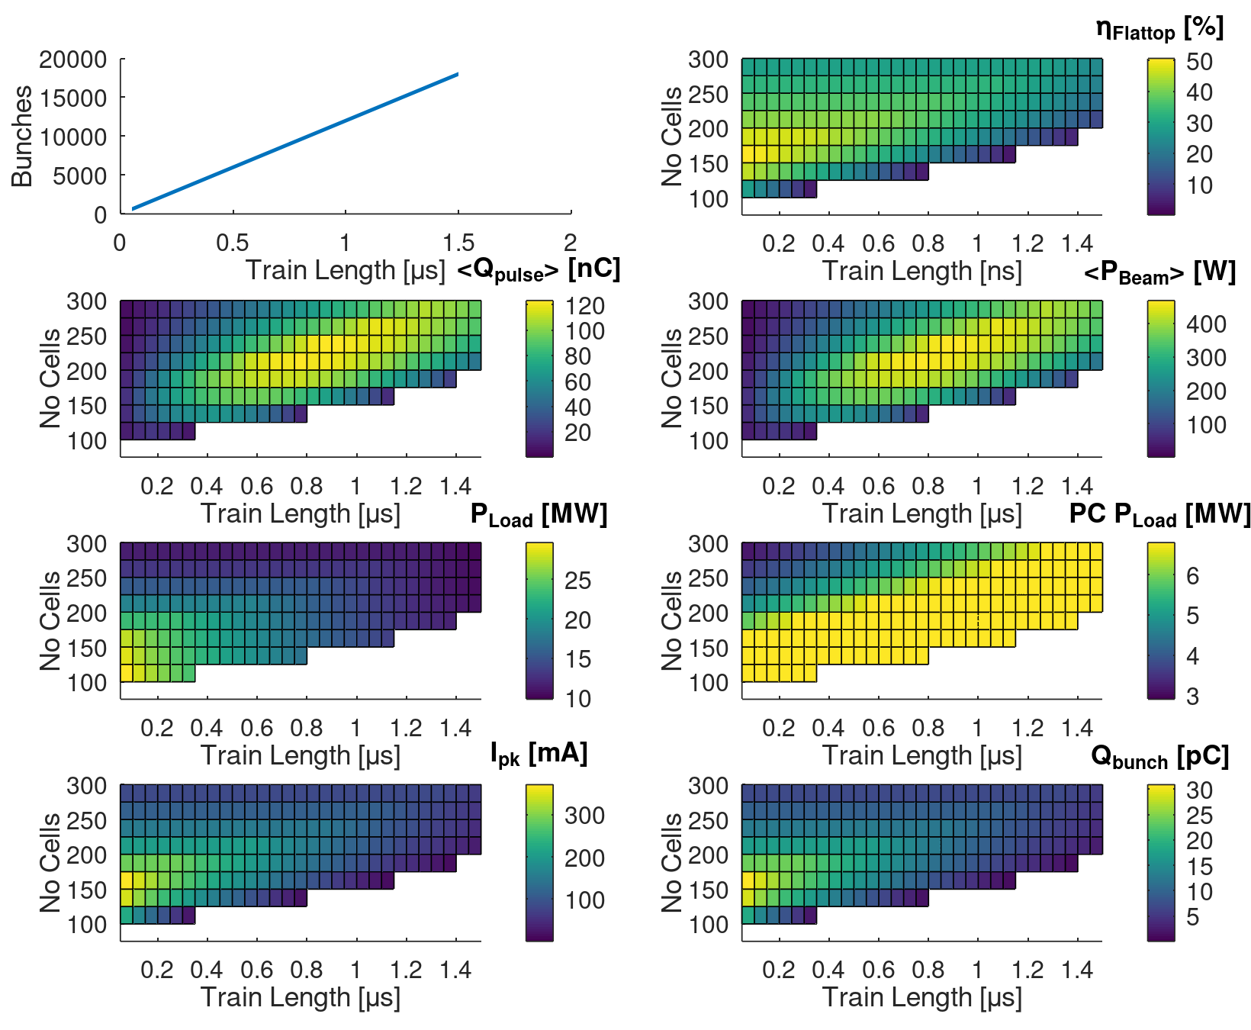
Example: XLS based structure
Calculate maximum charge accelerated
Limited by either beam loading or maximum klystron power
Beam loading
too high
Filling time and
dissipated power
too high

Slide 17
Optimisation Process Step 2: Beam Dynamics
Take optimum number of cells and train length
Incorporate bunching cells and use RF_Track to optimize them for transport and energy
Refine structure to compensate for bunching cells and iterate above
Complete start-to-end simulation from gun to target
(Include space charge, wakefield, misalignments effects)

Slide 18
Example: XLS based structure
Momentum Spread
Current
(thermionic injection)
Momentum
(T = 100 keV injection)
Cell 1
4
3
2
5
Beam Size

Slide 19
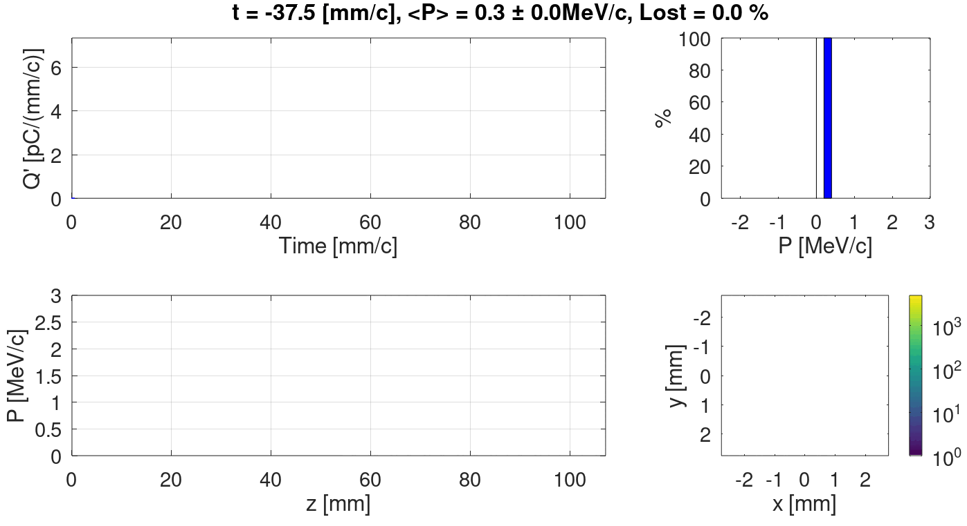
Example: XLS based structure

Slide 20
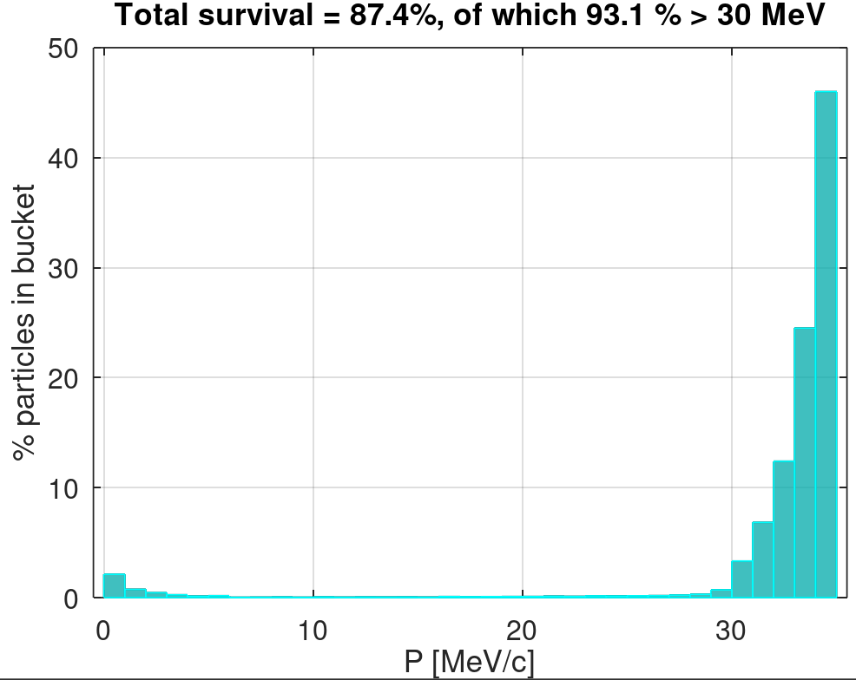
Example: XLS based structure
  DELIVERED TO TARGET
  120 nC charge in 700 ns
  (Average beam power of 400 W)
  σ_{f} ~ 1 mm
  > 90 % particles over 30 MeV

Slide 21
Table of Contents
Introduction to Project VULCAN
CLEAR Experiment
Accelerator Design Study
Accelerator Design Summary
Next Steps

Slide 22
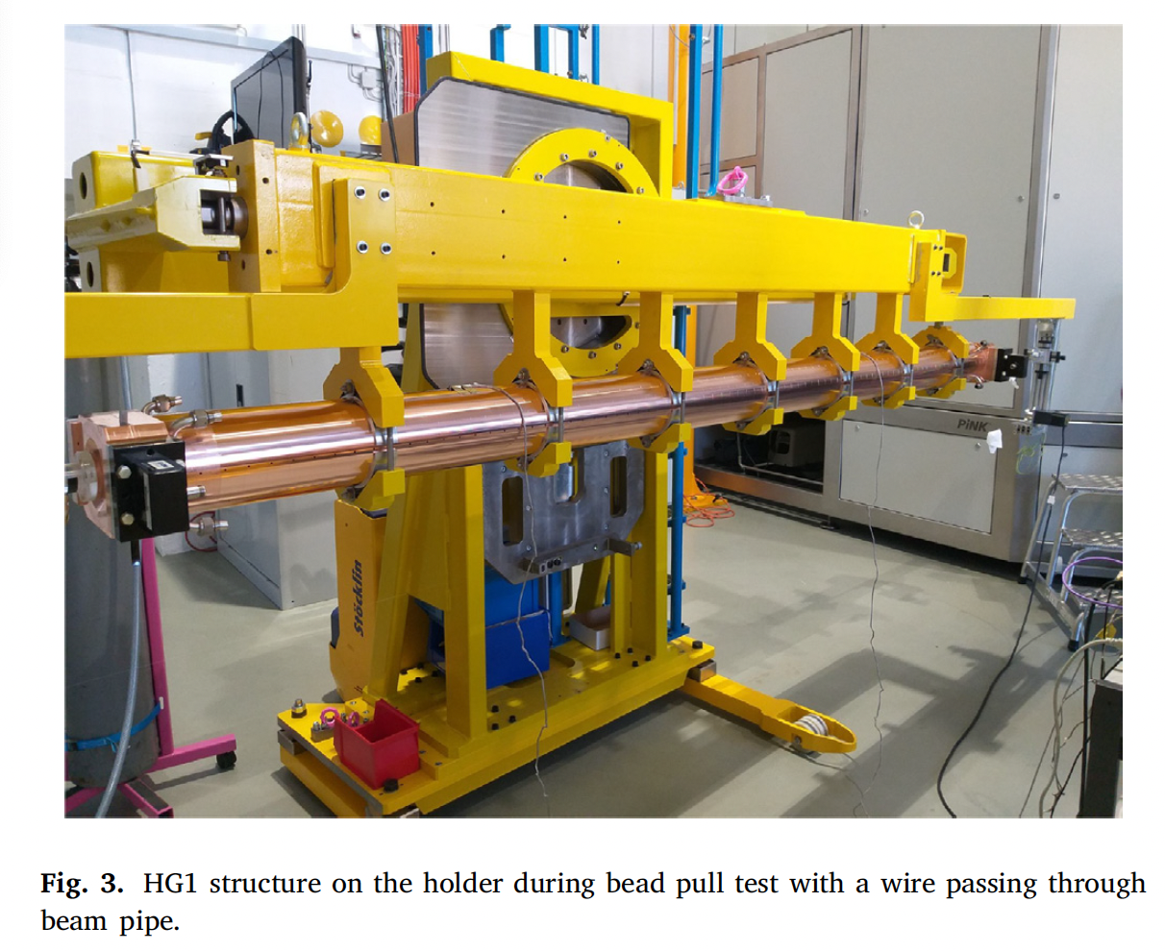
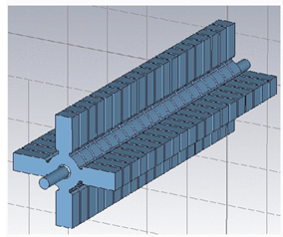
Technologies Compared
X-Band TW (XLS) | X-Band TW (XLS) | S-Band TW (FERMI HG) | S-Band TW (FERMI HG) | C-Band TW (ELI)
https://www.compactlight.eu/
https://www.compactlight.eu/
https://www.sciencedirect.com/science/article/pii/S0168900223005338
https://www.sciencedirect.com/science/article/pii/S0168900223005338
https://journals.aps.org/prab/abstract/10.1103/PhysRevAccelBeams.20.032004
Canon E37113
X-band Klystron:
5 µs pulse
8 MW power
CPI VKX-8255A
X-band Klystron:
3.5 µs pulse
25 MW power
Canon E37325
S-band Klystron:
5 µs pulse
10 MW power
…
S-band Klystron:
5 µs pulse
25 MW power
…
C-band Klystron:
4 µs pulse
8 MW power

Slide 23
 | X-Band TW (XLS) | X-Band TW (XLS) | S-Band TW (FERMI HG) | S-Band TW (FERMI HG) | C-Band TW (ELI)
RF |  |  | INJECTION
Struct Length [m] | 1.7 | 1.0 | 3.3 | 2.3 | 3.0
Klystron Power [MW] | 8 | 25 | 10 | 25 | 8
Loaded <G> [MV/m] | 23 | 37 | 11 | 18 | 12
> 30 MeV [%] | 93 | - | 83 | 80 | -
BEAM
Train Charge [nC] Beam power [W] | 120 390 | 650 2450 | 220 780 | 1100 3500 | 100 390
Train Length [ns] | 700 | 1000 | 800 | 1000 | 950
Bunch Charge [pC] | 15 | - | 140 | 360 | -
Beam Size [mm] | 0.9 | - | 2.7 | 2.8 | -
Peak Current [mA] | 220 | - | 420 | 2200 | -
COST
Cost Estimate | 1.5 M€ | 1.8 M€ | 1.4 M€ | 1.8 M€ | 1.5 M€

Slide 24
Table of Contents
Introduction to Project VULCAN
CLEAR Experiment
Accelerator Design Study
Accelerator Design Summary
Next Steps

Slide 25
Conclusions and Next Steps
Preliminary study
  Select technology to develop into CDR design with DAES
    Optimum trade-off between cost, compactness and electron beam power
  Write code into user-friendly tool
  Write up results
Developing to mini-CDR
  Develop RF structure
    CST simulations
  Develop beam dynamics
    Wakefield and offset studies
  Write into mini-CDR

Slide 26
Thanks for listening
CLIC Mini-Week 2023

Slide 27
Baseline cost estimate
Assume the below costs are constant across the different technology choices
  Gun + Cathode + HV supply = 75 k€
  RF distribution network (inc. LLRF) = 190 k€
  Mechanics and controls = 25 k€
  Vacuum equipment = 40k€
  Diagnostics = 140 k€
TOTAL BASELINE = 455 k€
(Note infrastructure, electrical installation, controls ignored here)

