Slide 1


CLEAR 2023 - Highlights and status of the second beam line
W. Farabolini on behalf of the CLEAR team:
R. Corsini – A. Aksoy – A. Malyzhenkov – P. Korysko – V. Rieker – L. Wroe
E. Granados – M. Calderon (Laser experts)
S. Doebert - S. Curt – A. Chauchet (RF experts)
J. Bateman – C. Robertson (Oxford PhD students)
K. Sjobaek (remotely from Oslo)

Slide 2

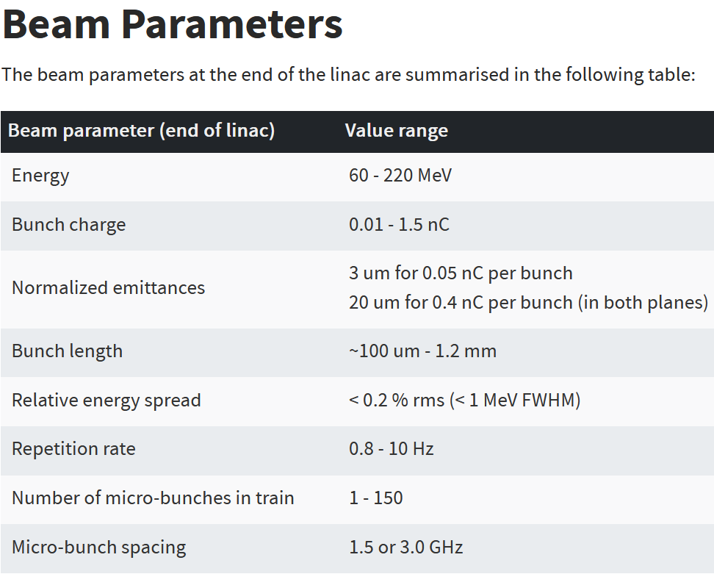
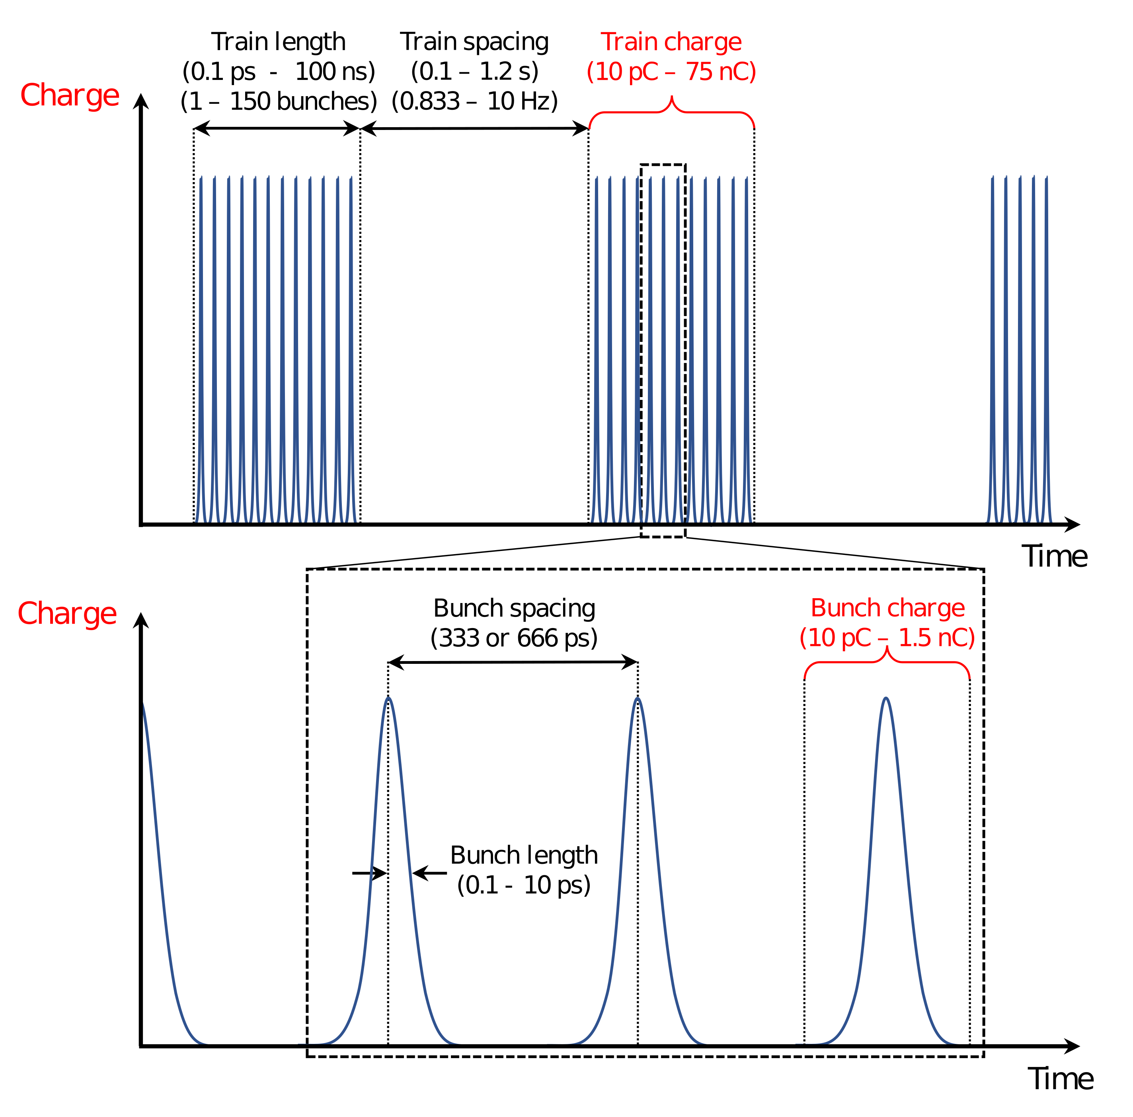
What is CLEAR ?
Scientific and strategic goals:
• Unique electron beam test facility at CERN with high availability, easy access and high-quality. Part of Euro-Labs, transnational access program
• R&D on accelerator components, beam instrumentation, high gradient RF technology.
• Irradiation facility with Very High Energy Electrons (VHEE) and Ultra-High dose rate, for technical and medical applications
• Maintaining CERN and European expertise for electron LINACs linked to future collider studies.
• Using CLEAR as a training infrastructure for the next generation of accelerator scientists and engineers.
P. Korysko - Experimental Area Upgrade at PITZ Discussion - Nov. 06, 2023
P. Korysko - CLEAR Scientific Board Meeting - Feb 1, 2023
2
2

Slide 3
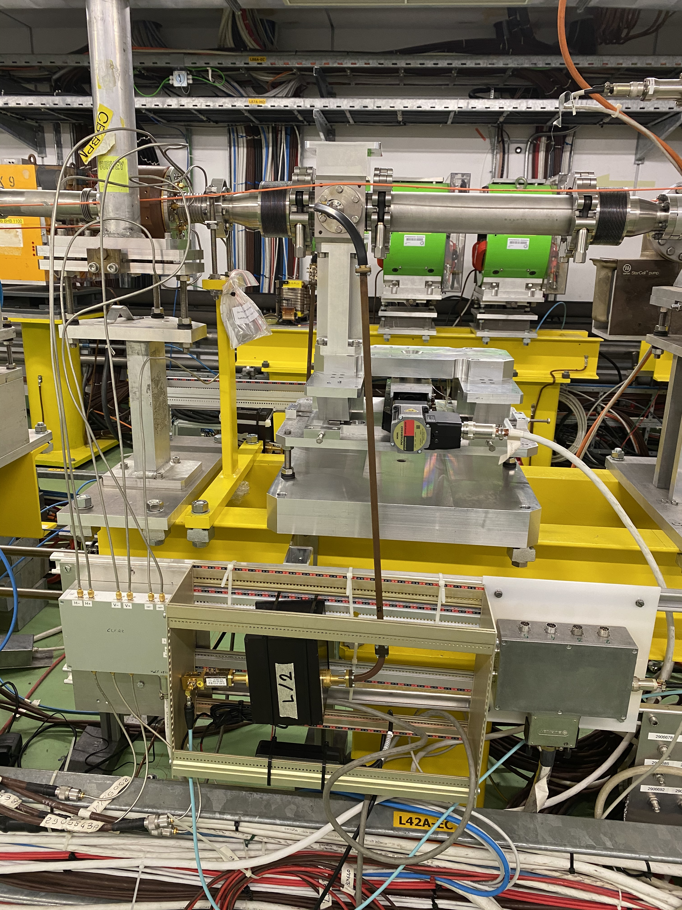

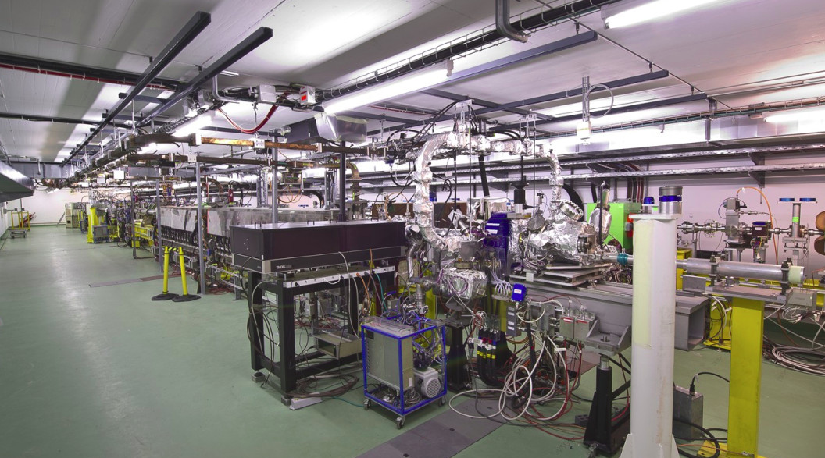
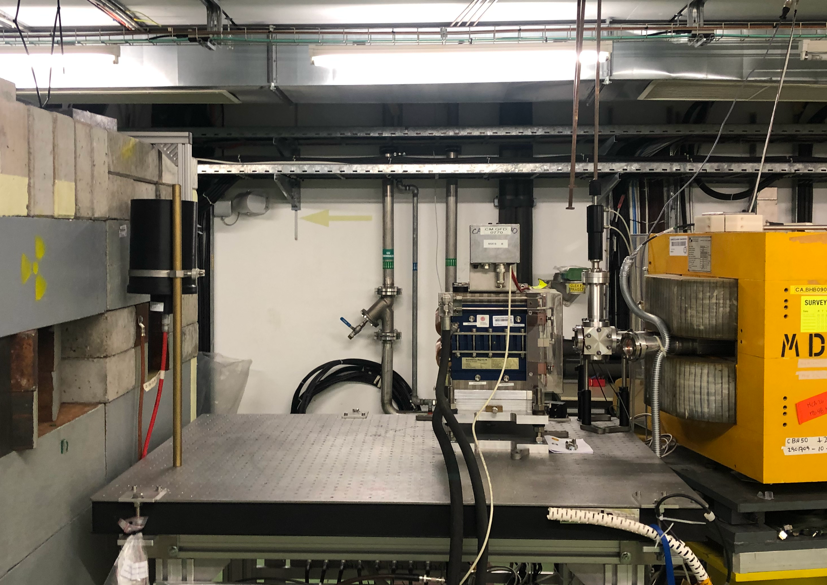
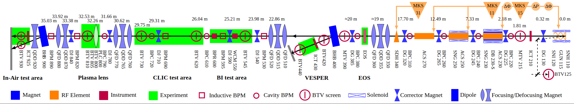
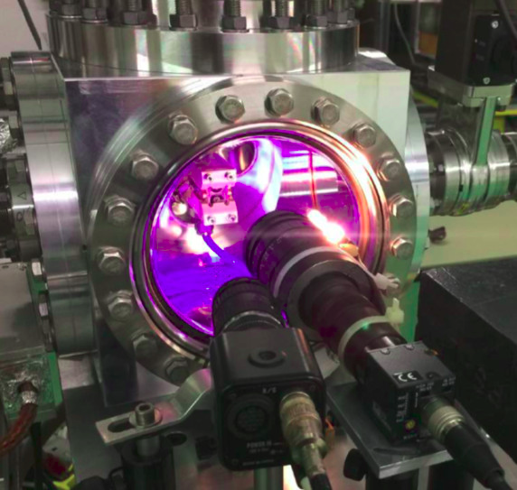
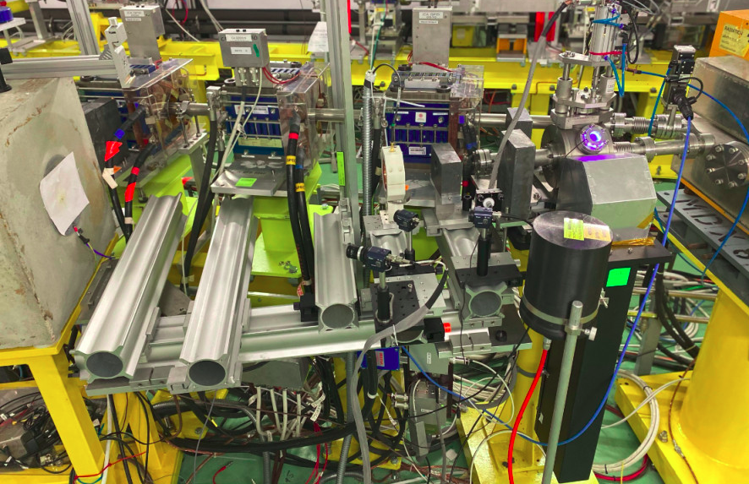


CLEAR beamline in 2023
Credit: P. Korysko
In-Air Test Stand
Diagnostics studies
Irradiation
  - Electronics
  - VHEE
BI Test Stand
CLEAR Injector
Flexible Linac
60 – 220 MeV
Beam direction
Plasma Lens
Novel plasma based focusing
Irradiation facility
- Space probes
- Electronics
- VHEE
P. Korysko - Experimental Area Upgrade at PITZ Discussion - Nov. 06, 2023
3

Slide 4
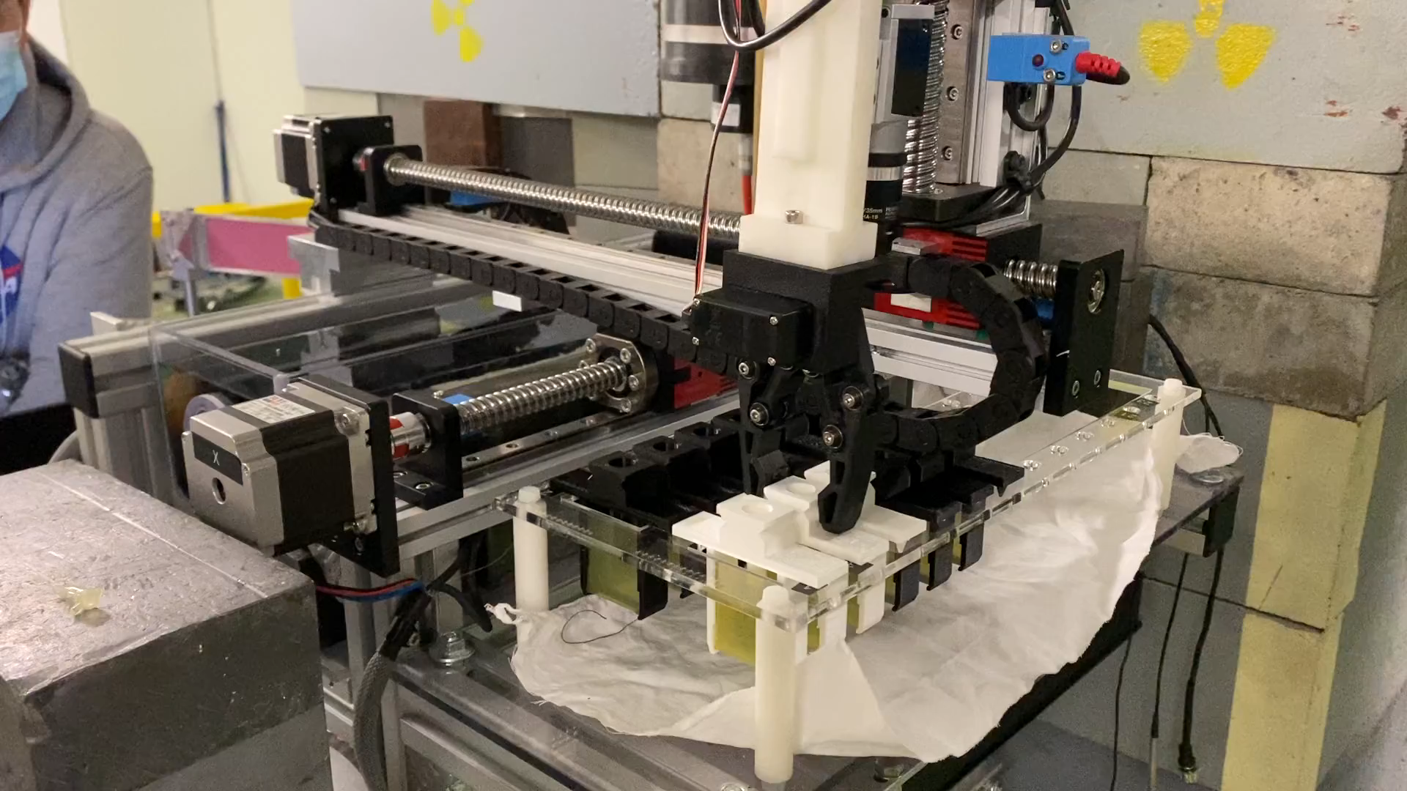
The C-Robot developed for medical samples
Recently requested by PITZ @ DESY
4

Slide 5
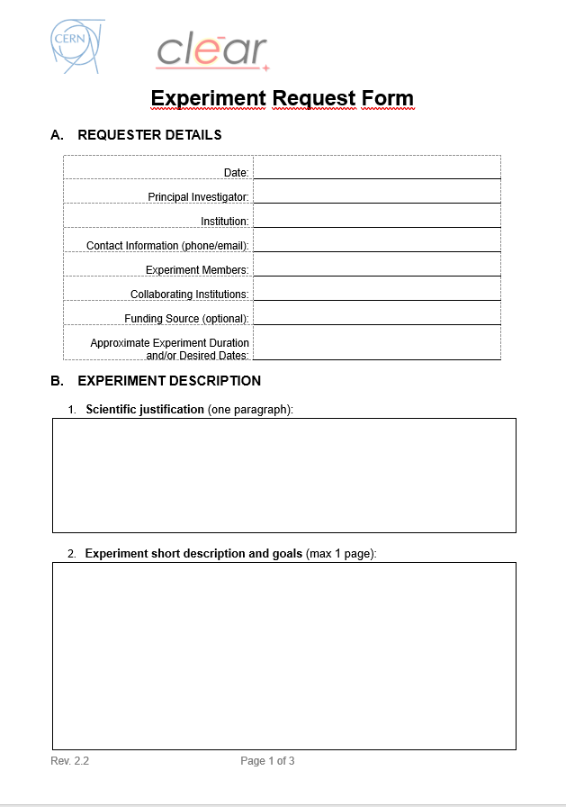
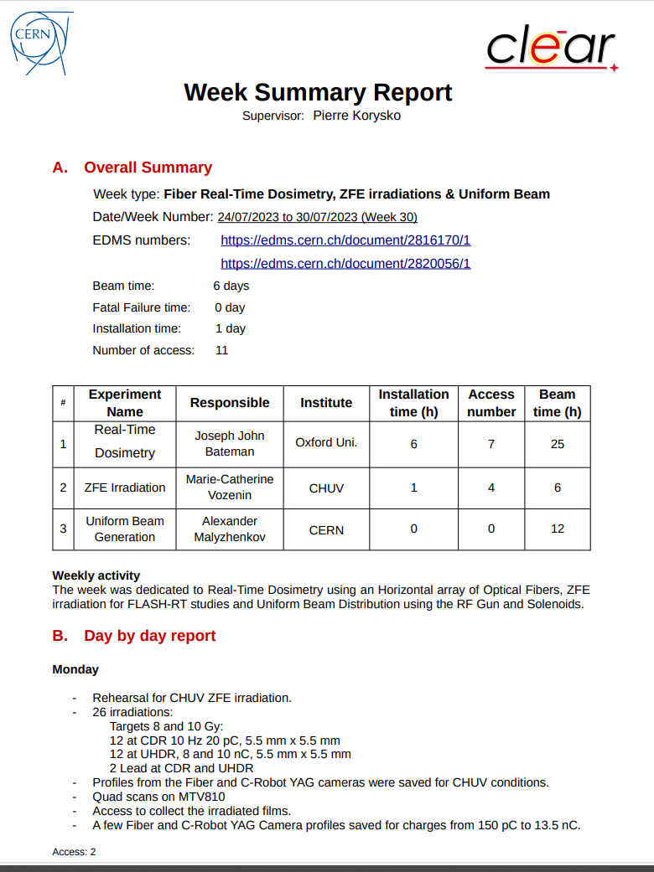
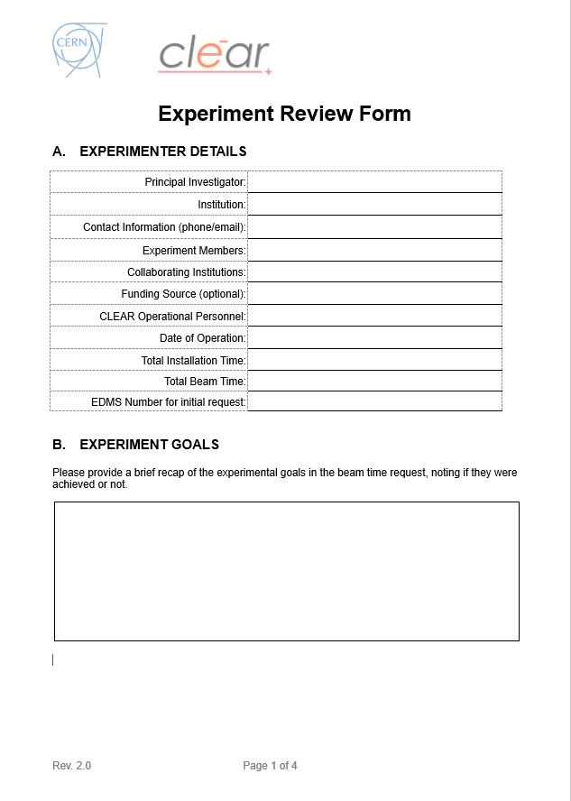
CLEAR user’s experiments workflow
Week summary report
Description of the week (-> FOM)
List of the week experiments, institutes and main contacts
- installation time
- access number
- beam time
- fatal failure time
Day by day activities
Main issues
Actions to be followed up
Experiment Review Form
Experiments goals
Beam parameters achievements
Summary of operations
- problems encountered
- improvement axis
Future work at CLEAR
Possible publications
Beam time request
- scientific justification
- description of the experiments
- beam characteristics required
- radioprotection data
- plan and logistics
- Validation by the Technical Committee
- Information to the Scientific Committee
- Validation by the RP (EDMS doc)
Dear Colleague,
The following document has changed status from "In Work" to "Engineering Check":
- 2816170 v.1 - "86-Real-Time Beam Dose Monitors" : https://edms.cern.ch/document/2816170/1
Best regards,
Roberto CORSINI
- Preparation of the set-up
- Beam delivery under the responsibility of the week supervisor

Slide 6
CLEAR summary of operations weeks
- 37 weeks of beam
- 279 hours of set-up installation
- 230 accesses with the radioprotection
- 1209 hours of beam
- 40 hours of fatal failure
- 1.9 experiments per week in average

Slide 7
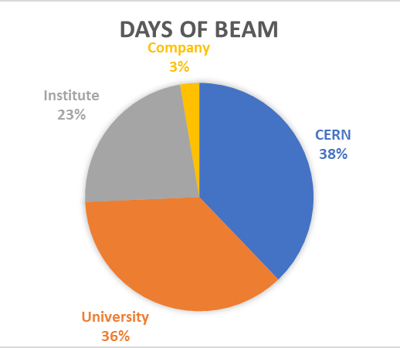
Type and origins of the experiments in 2023
CERN – ABP
CERN – BI
CERN – RP
CERN – EP
CERN – TE
CERN – SY
Manchester Univ.
Oxford Univ.
RHUL
Liverpool Univ.
Strathclyde Univ.
Queen’s Univ.
Oslo Univ.
Bern Univ.
Victoria Univ.
Kansas Univ.
PSI
CHUV
EPFL
INFN Bologna
INFN Padova
KIT
PTB
RAL – ENEA
Cockcroft Inst.
JAI
BERGOZ
DAES

Slide 8
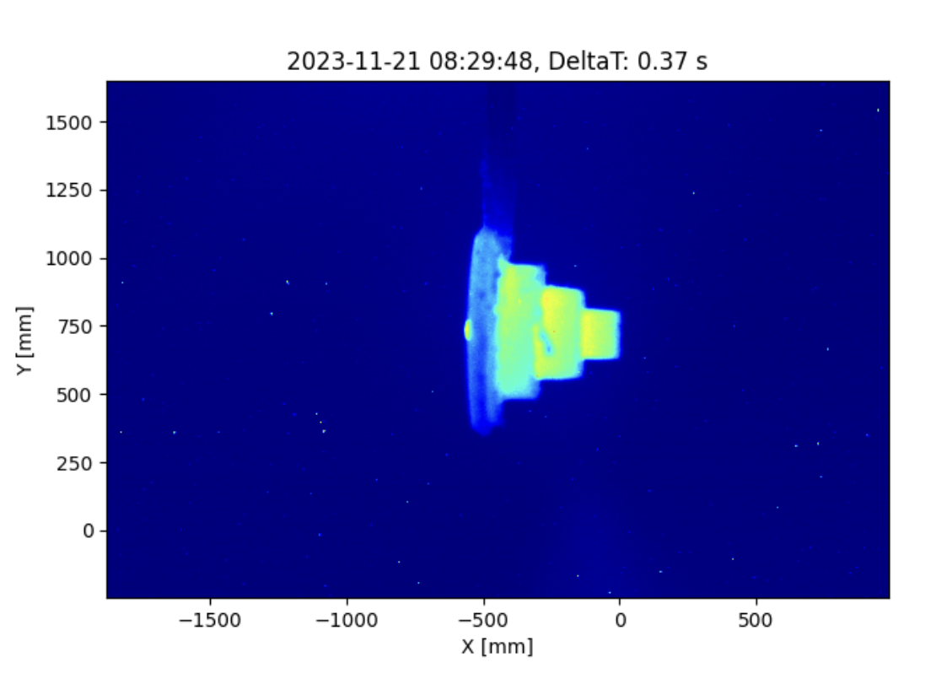
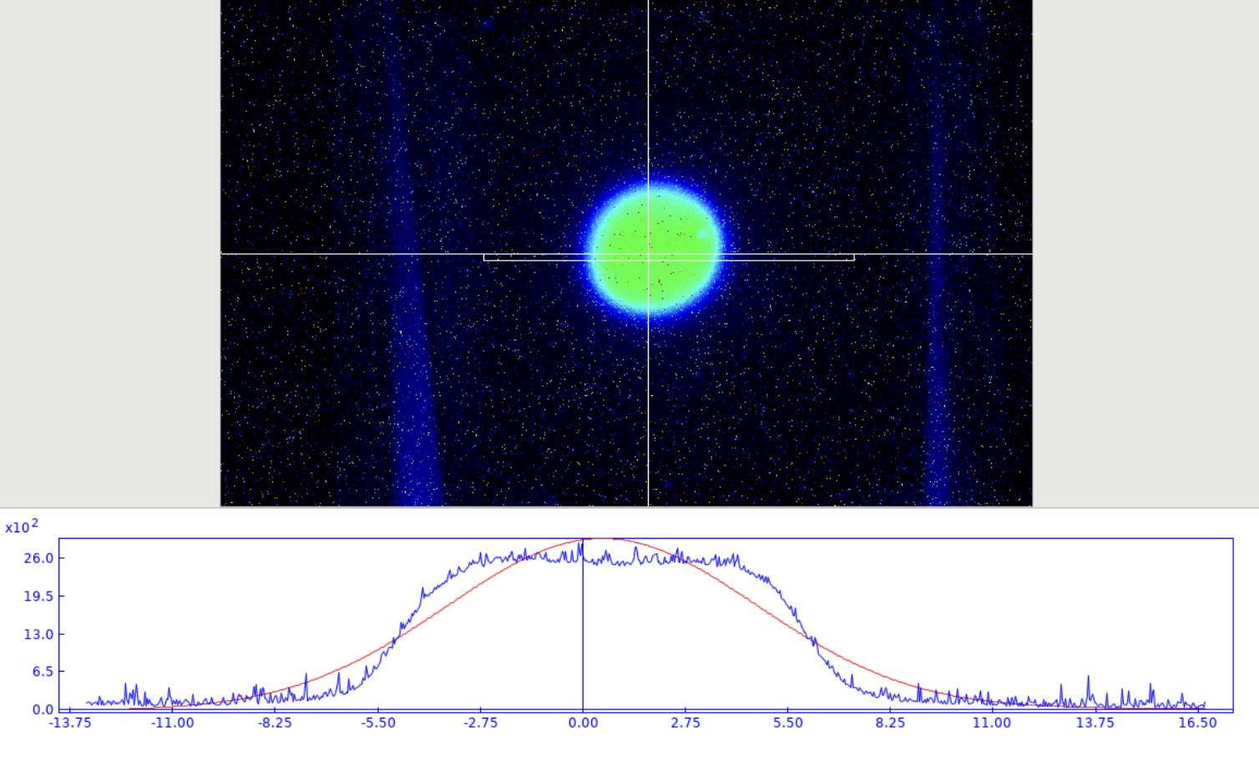
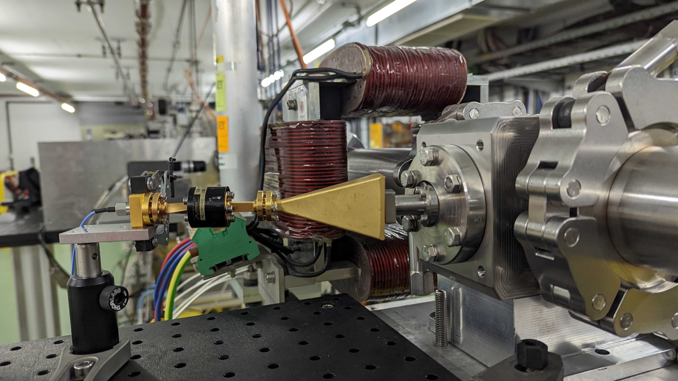
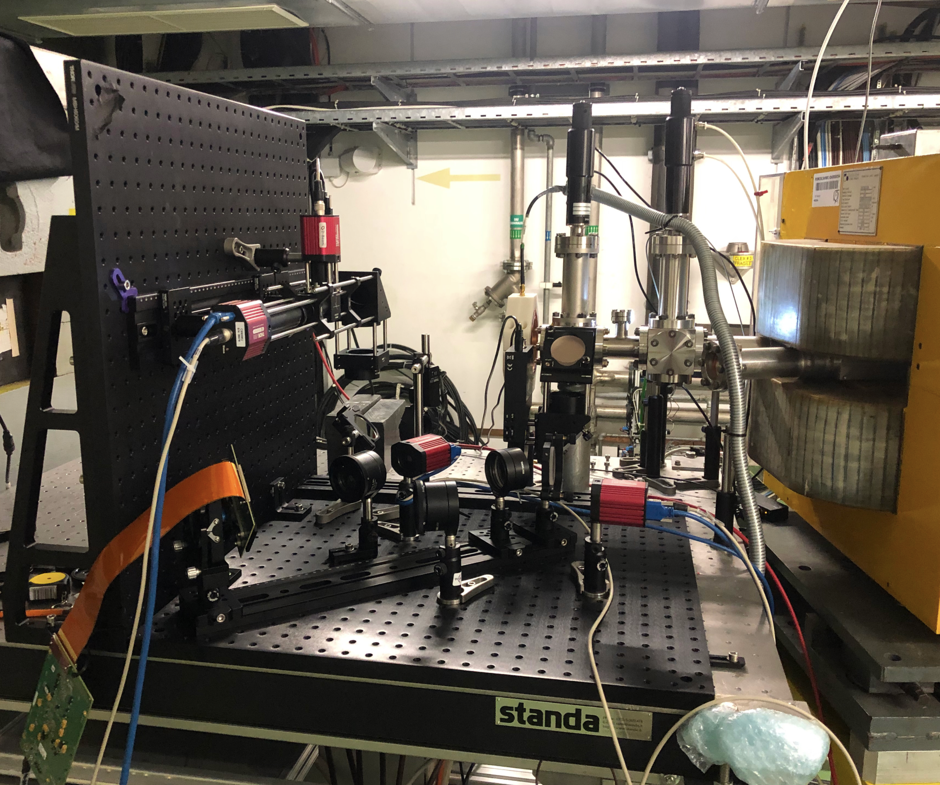
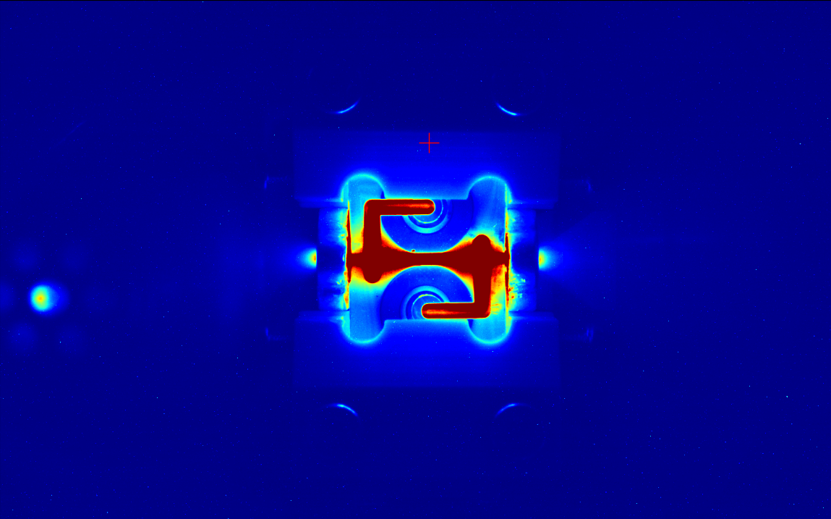
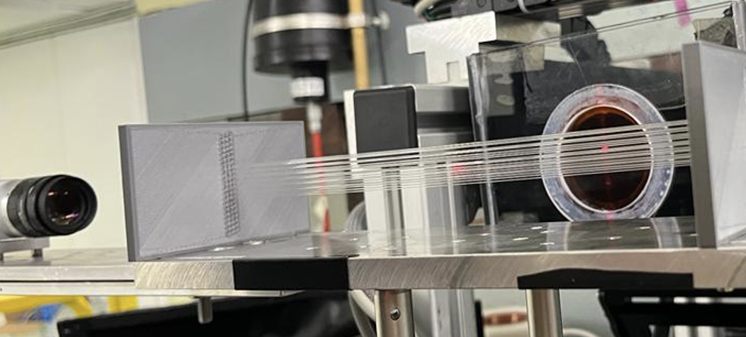
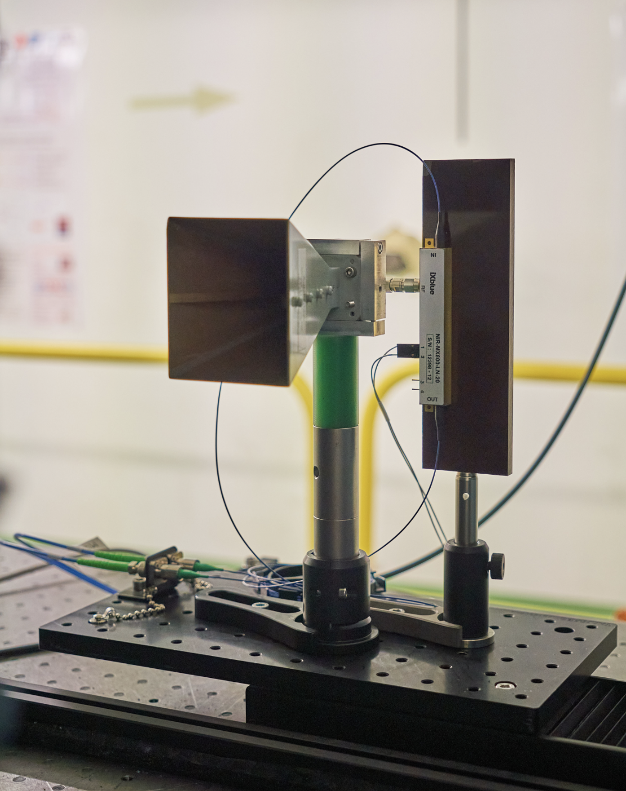
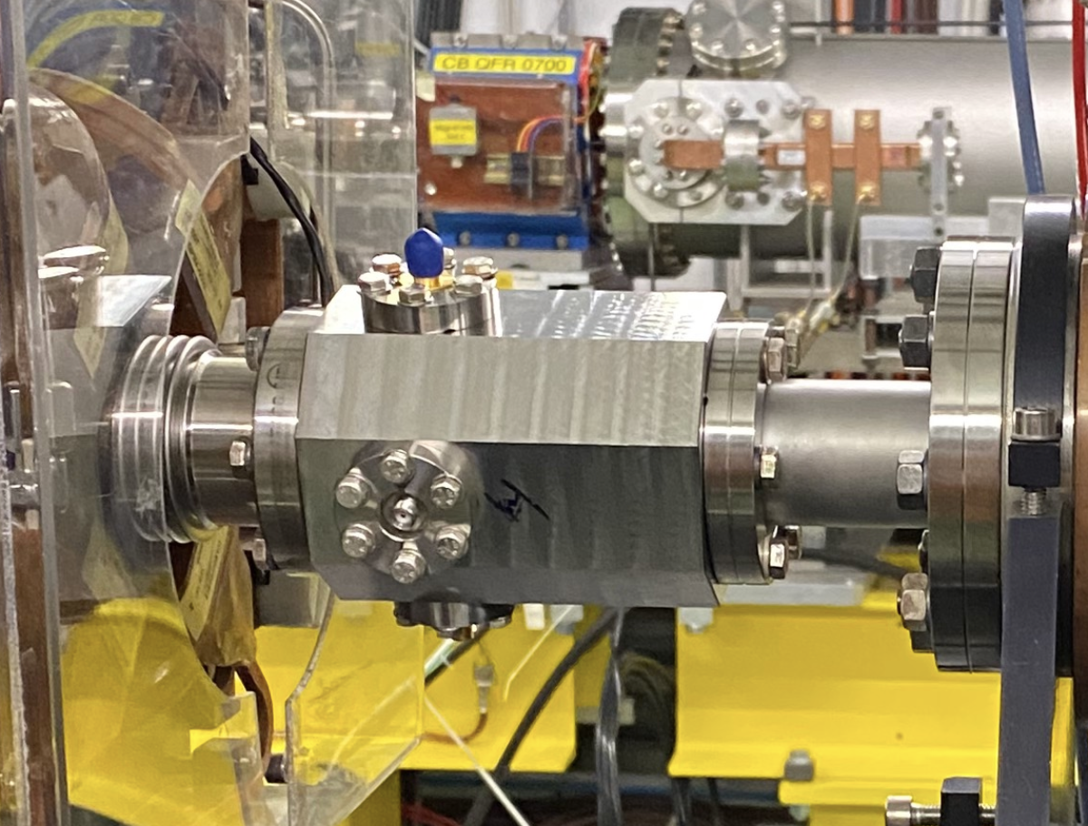
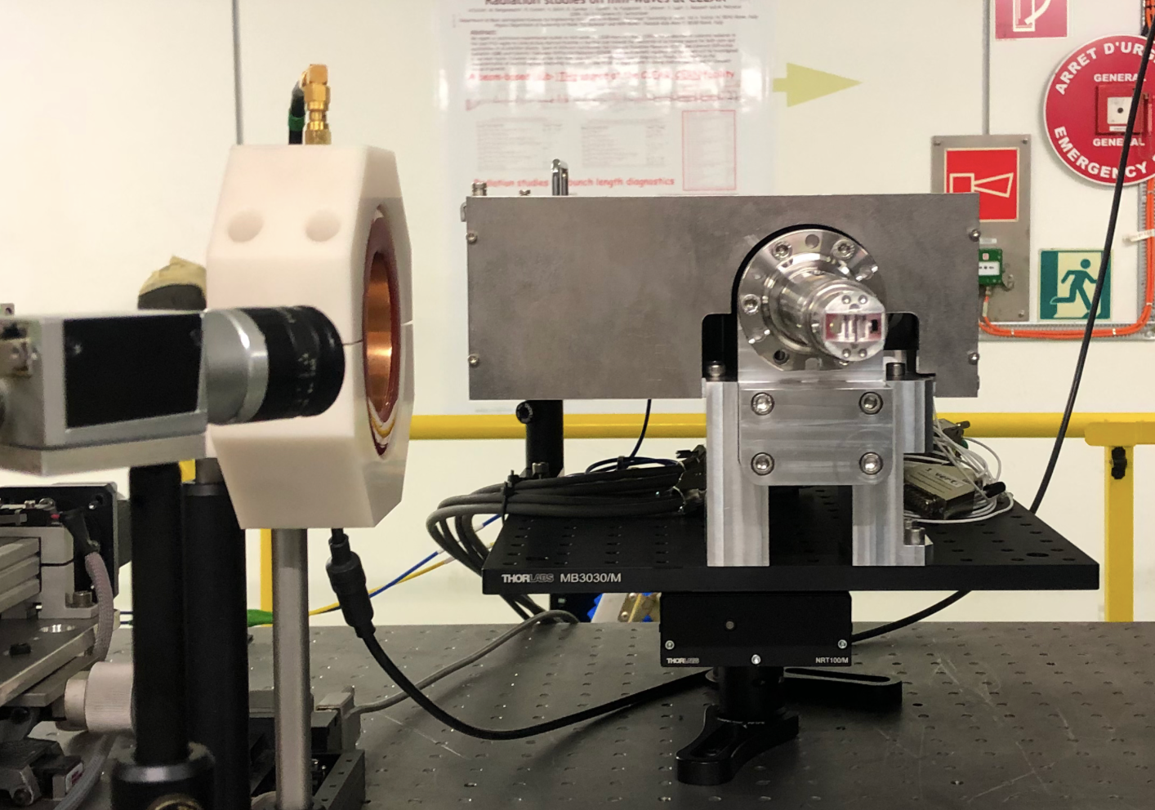
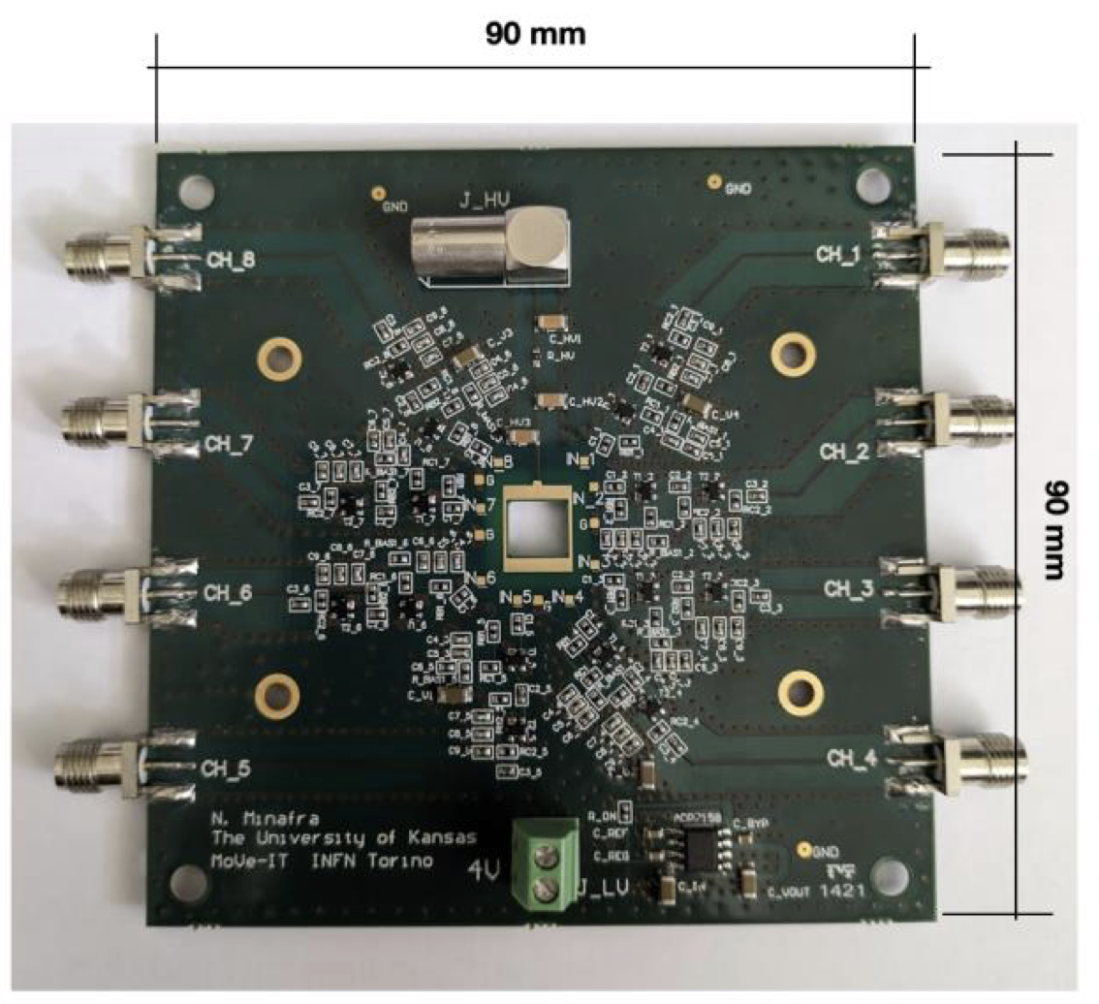
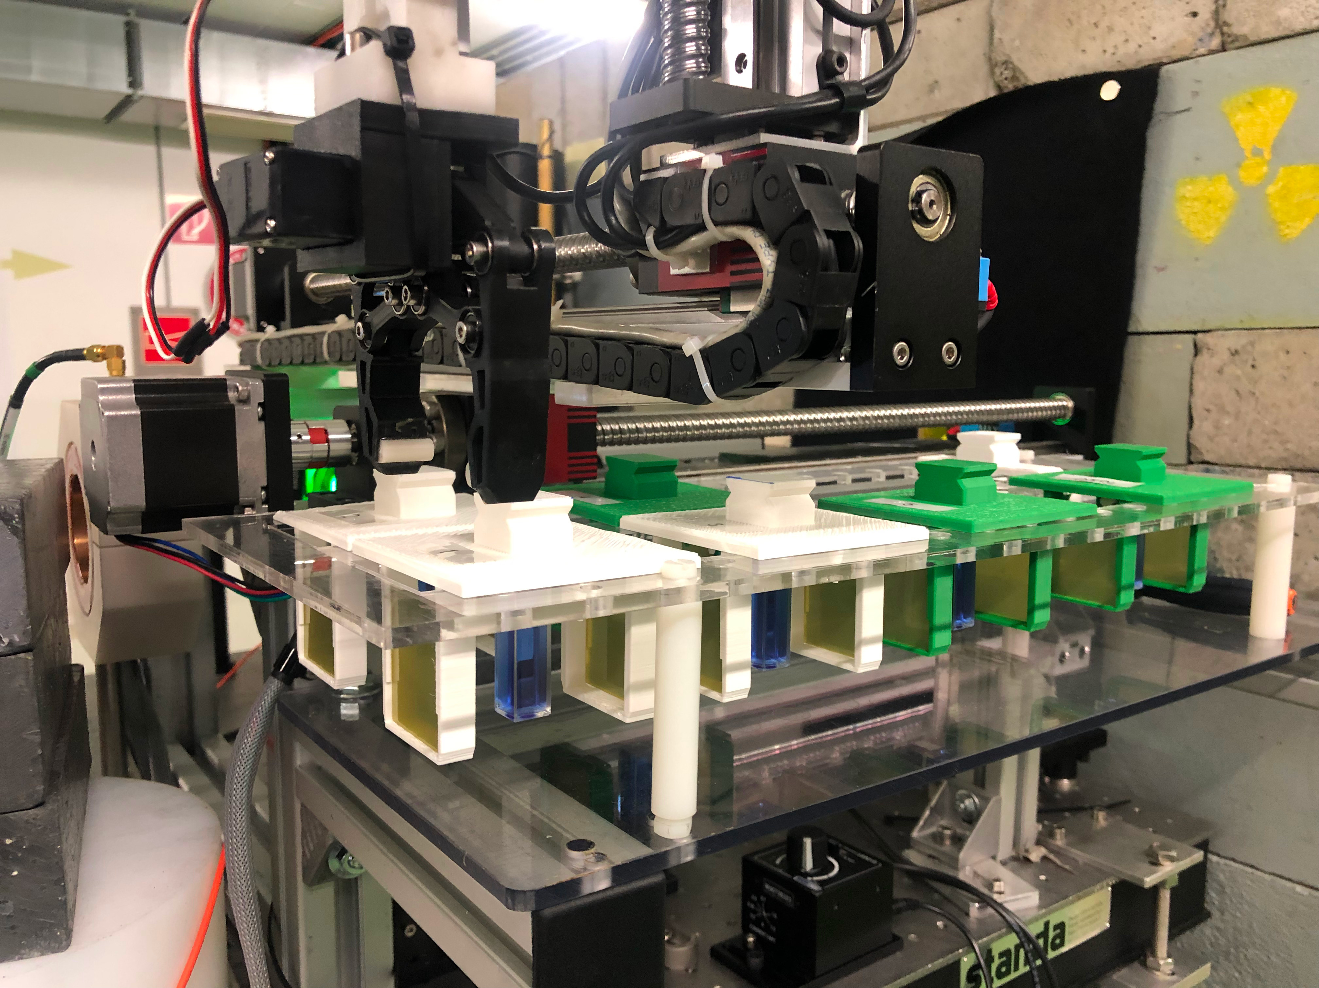
  27 Experiments
  About 18 User Groups internal/external
  More than 13 external collaborating institutes
  Beam from February 27th to December 15th
  (with 3 weeks summer stop)
  39 weeks of operation in total
Double-scattering system for uniform beam delivery
for VHEE radiotherapy (CERN/Oxford U.)
Operation
2023
A few Highlights
Credit R. Corsini
AWAKE Cherenkov Diffraction Radiation BPM
Plasma lens defocusing tests
(Oslo U./CERN/Oxford U./DESY)
Novel OTR-based emittance meas. system for AWAKE (Liverpool U.)
Fibre-optic beam profile and dose monitor for VHEE radiotherapy at ultra-high dose dates(CERN/Oxford U.)
Real-time dosimetry for VHEE radiotherapy using cuvettes (Strathclyde U.)
Coherent Cherenkov diffraction radiation dielectric buttons
(FCC-ee bunch length monitors)
Broadband Pick-up for the
PSI Positron Production Project (FCC-ee collaboration)
Bunch Profile Monitor for FCC-ee (Karlsruhe)
Beam testing of PCB + detectors using different technologies (Kansas U.)

Slide 9
Beam availability
Fatal failure time: 40 hours affecting 6 weeks (96.7 % beam availability)
  Laser: chiller cartridge, attenuator controller, amplifier water leak, (continuous run during weeks)
  Klystrons: some periods of recurrent trips
  Turbo-pump (controller inside CLEAR)
  Access control
  Power cuts
Consolidation program
  New laser oscillator bought
  Many amplifier spares from PHIN injector
  New modulator station being prepared for klystron active spares
  Turbo-pump controller being installed in the klystron gallery

Slide 10
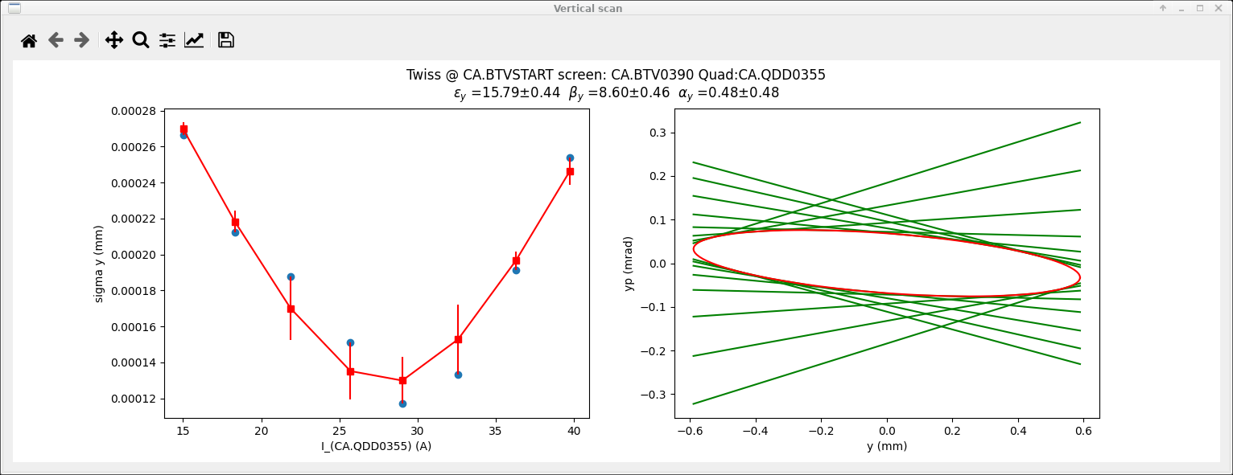
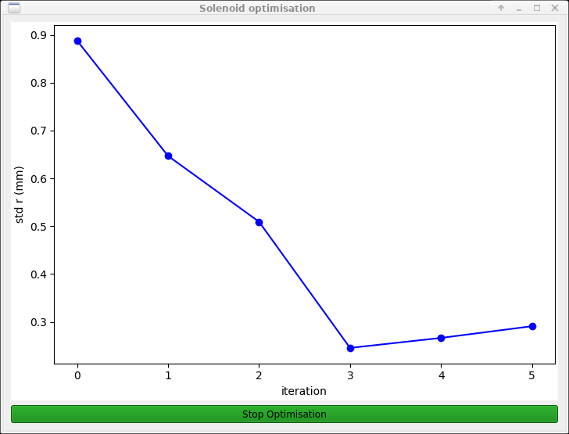
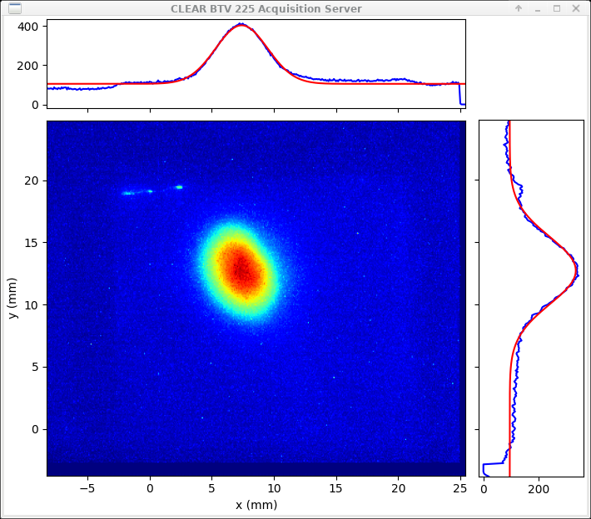
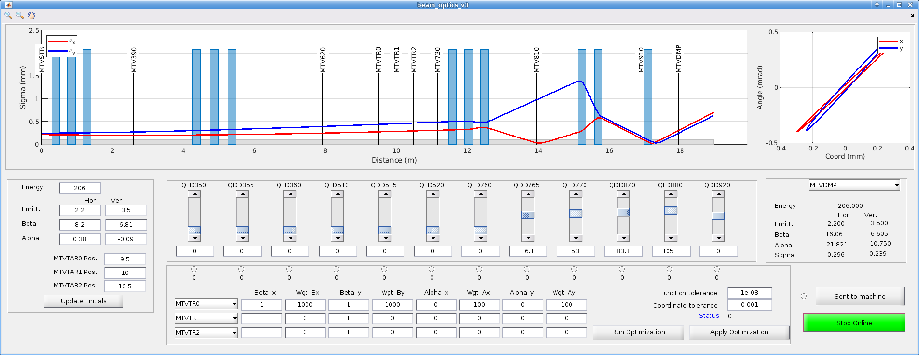
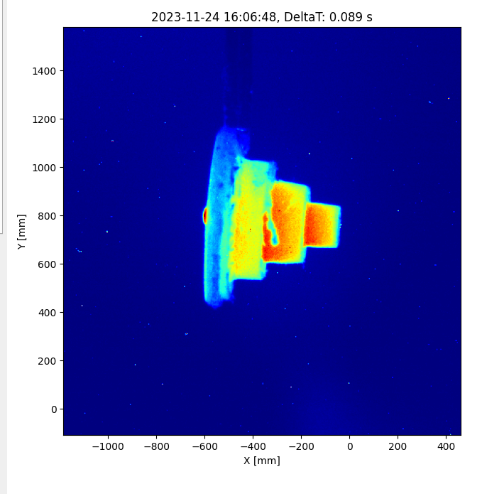
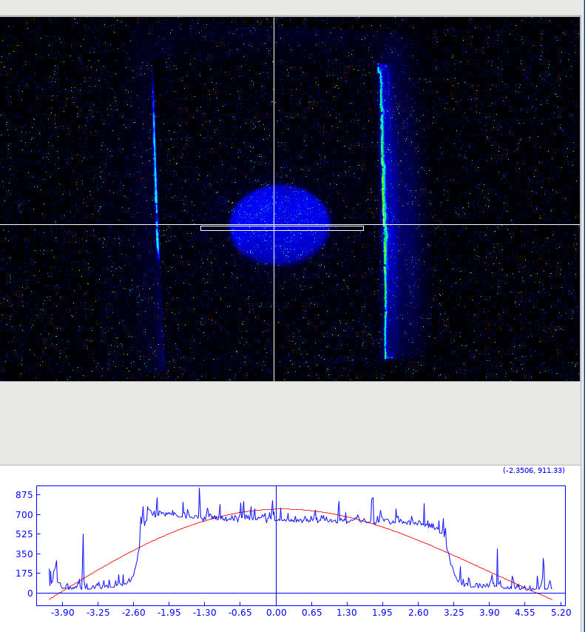
Some recent developments requested by users
Codes:
  Quad Scan
  Orbit simulation
  Dose prediction
  Multi-standard cameras control
  Beam Base Alignment
Devices:
  Double scatterers shaped for flat beam profile generation with collimator
See Avni’s talk

Slide 11
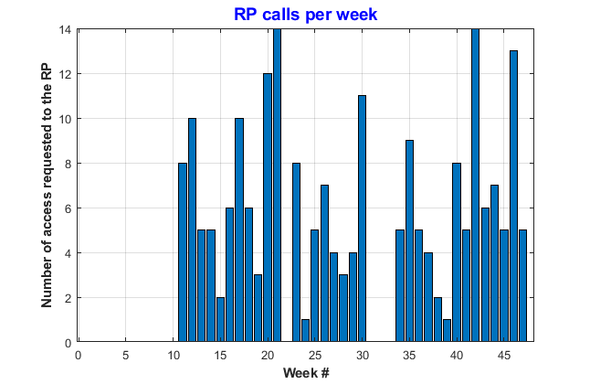
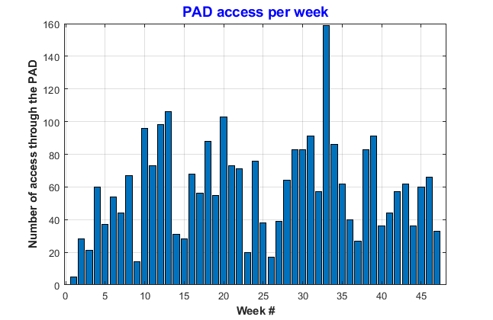
Access number
A very large number of accesses for experiment installation and user’s interventions on their set-up.
  RP calls: 213 from 01/01/23 to 30/11/23 (minimum delay 30 min, require klystron stop, limited to working hours)
  PAD accesses: 2802 D. Chapuis: « Access Point sur le complexe PS. Vous êtes en tête de liste ! »
In average:
- 9 per day
- 59 per week
- 253 per month
Summer shutdown
Winter shutdown
Mutualizing accesses with two experimental beam lines will increase the overall running time and allow more experiments per week. Complex set-up could stay installed for longer time.

Slide 12
Constraints for the second beam line
To fulfil new experiments requirement (large beam size, bunch compression, larger experimental areas)
Time: no operations interruption apart of the usual shutdowns (summer: 3 weeks, winter: 2 months)
Resources: Only the annual material budget (+ some Eurolabs founding)
No up-to-date drawings of the actual beam line (due to many user’s driven quick changes)
Limited support availability during the YETS
Solutions:
  Optimize the design (accurate beam dynamic study, large chamber size, magnetic chicane, use of sextupoles)
  Reuse of the existing equipment (taken from Drive Beam or DL/CR)
  Reuse of the installed cables whenever possible, no general de-cabling
  Tasks driven or even executed by the CLEAR team during shutdown, with the support of various groups experts.
  Flexibility in the commissioning date (Summer 24 or early 25)

Slide 13
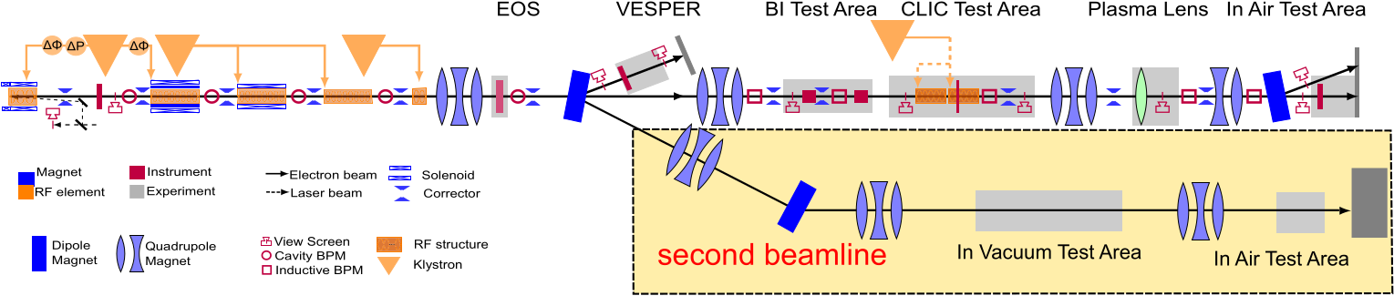
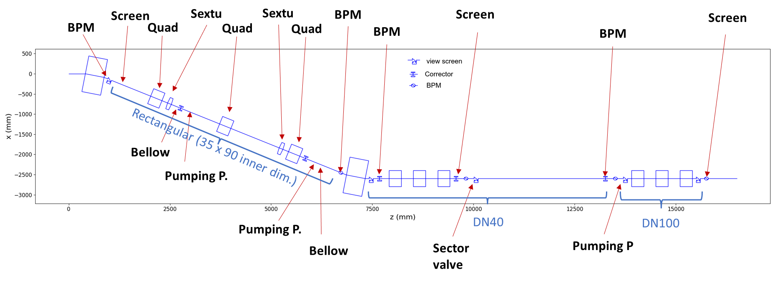
Beamline Layout
Credit: A. Aksoy
22º Dogleg

Slide 14
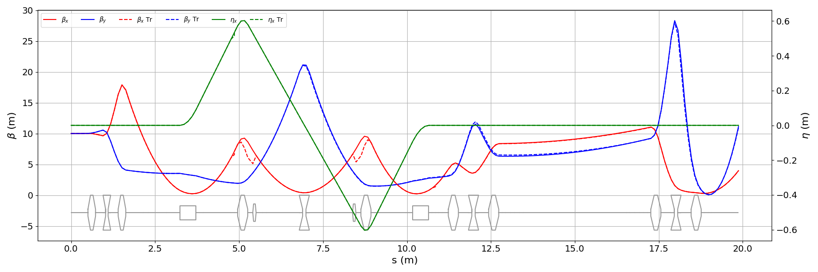
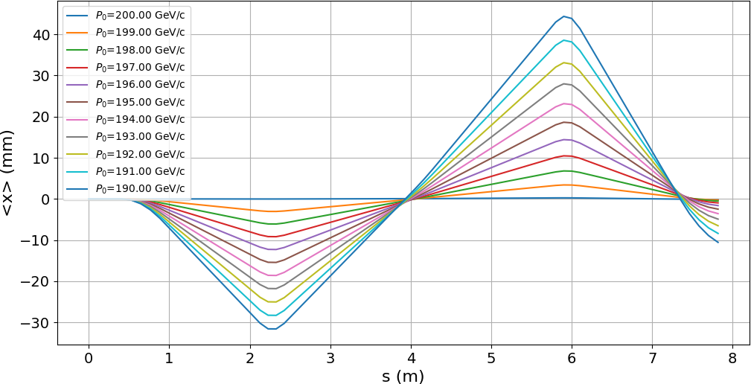
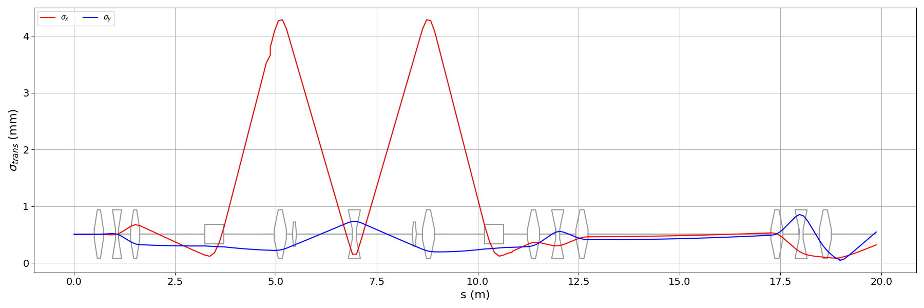
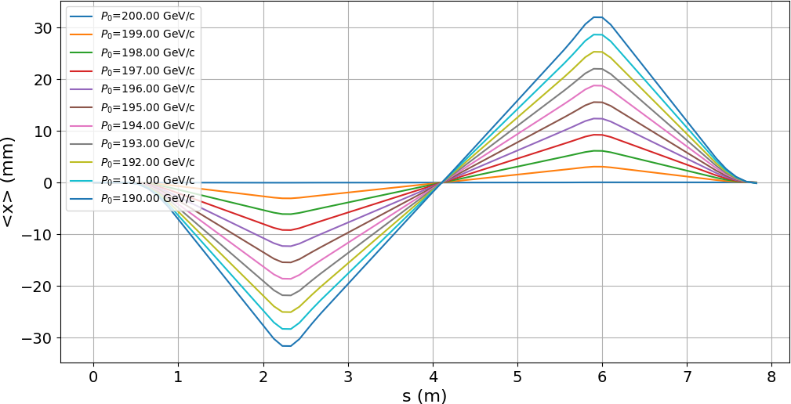
Beam dynamic studies
The dispersion is closed by side quadrupoles of a standard dogleg.
Flexible beam size adjustment with triplets on straight line
Sextupoles are adapted to close second order dispersion when energy spread is large
Credit: A. Aksoy
Twiss parameters
Beam orbit w/o sextupoles
Beam size
Beam orbit with sextupoles

Slide 15
Work Progress
Theoretical analysis performed (Luke, Alex, Avni), footprint validated
Area cleared last summer (Transport group)
Cables sorting started (by ourself, but EN-EL to provide help)
10 Quad and 3 Sextupoles taken from the CR renewed by the Magnet group TE-MSC-NCM (before YETS)
Power supplies identified in the gallery by SY/EPC
Survey work scheduled for January by BE-GM-ASG (footprint tracing)
Vacuum chambers identified and result transmitted to EN-MME-EDS
Vacuum layout being validated by TE-VSC
New RP sensors ordered by HSE-RP
Some components ordered (YAG screens, cameras, BCM, optical breadboard)
Progress meeting every Tuesday

Slide 16
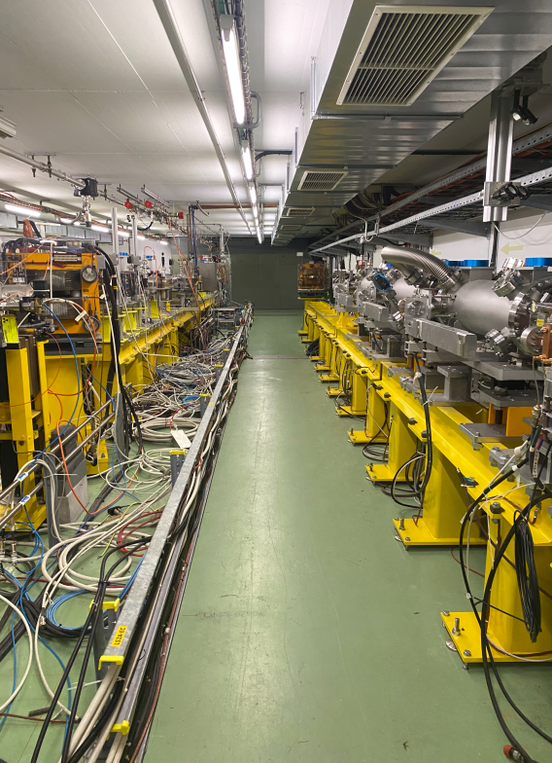
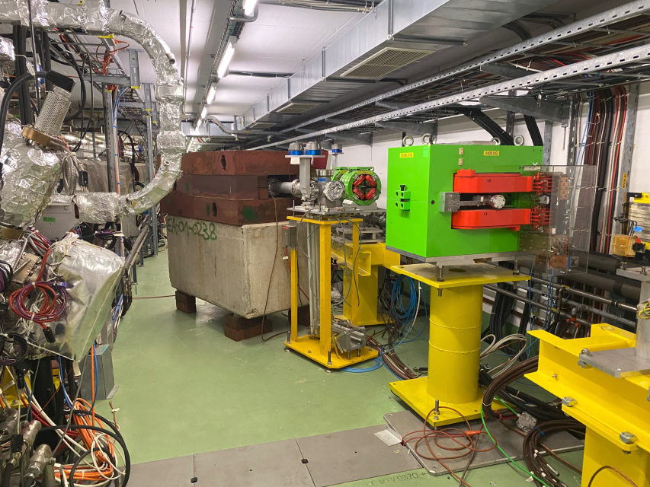
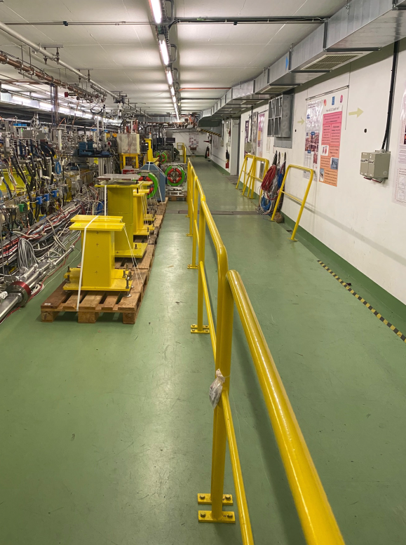
Area cleared during summer shut-down
Alley ready to host the dog-leg
Former Drive-Beam dump still to be removed
Equipment being evacuated

Slide 17
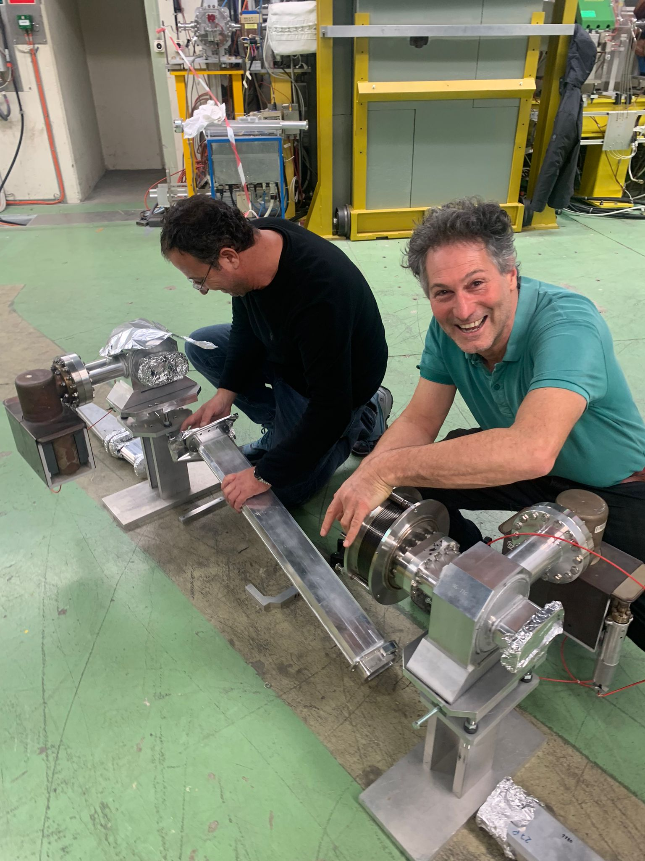
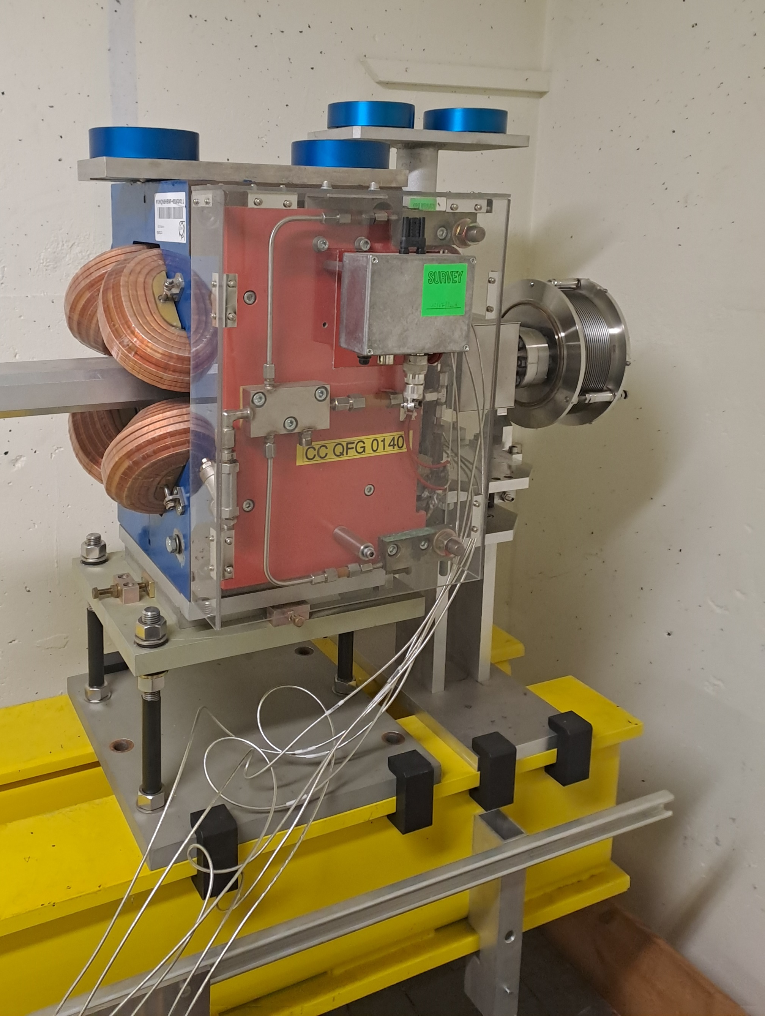
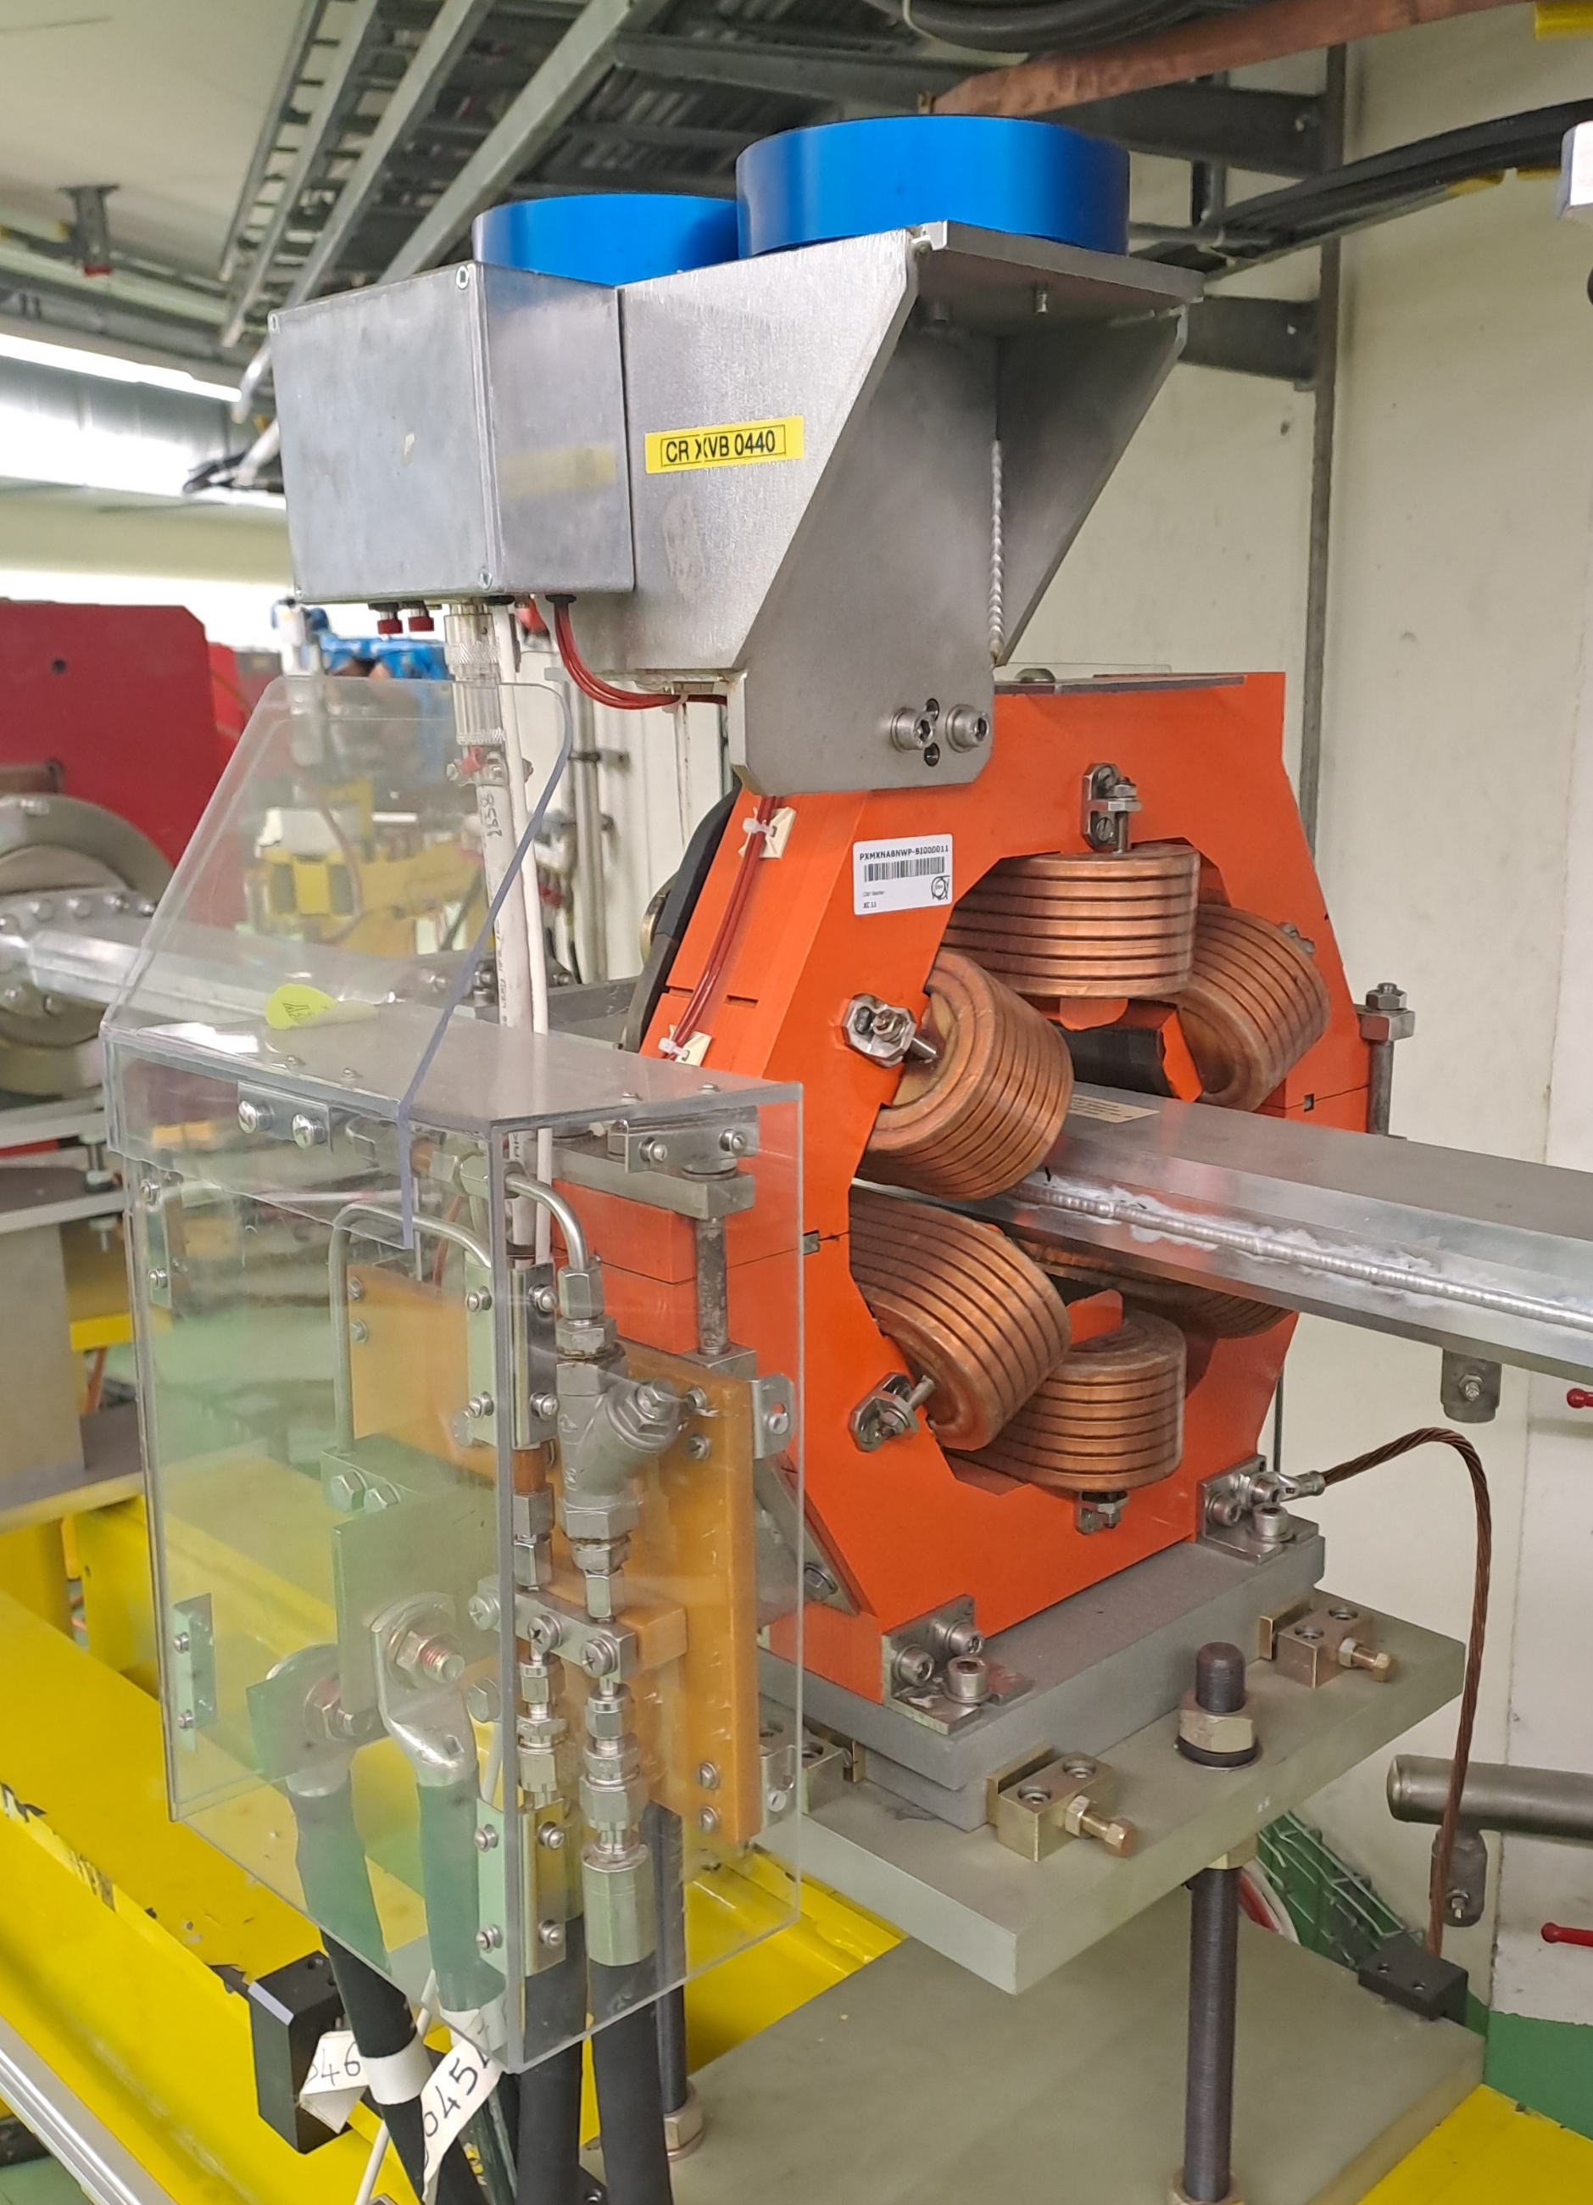
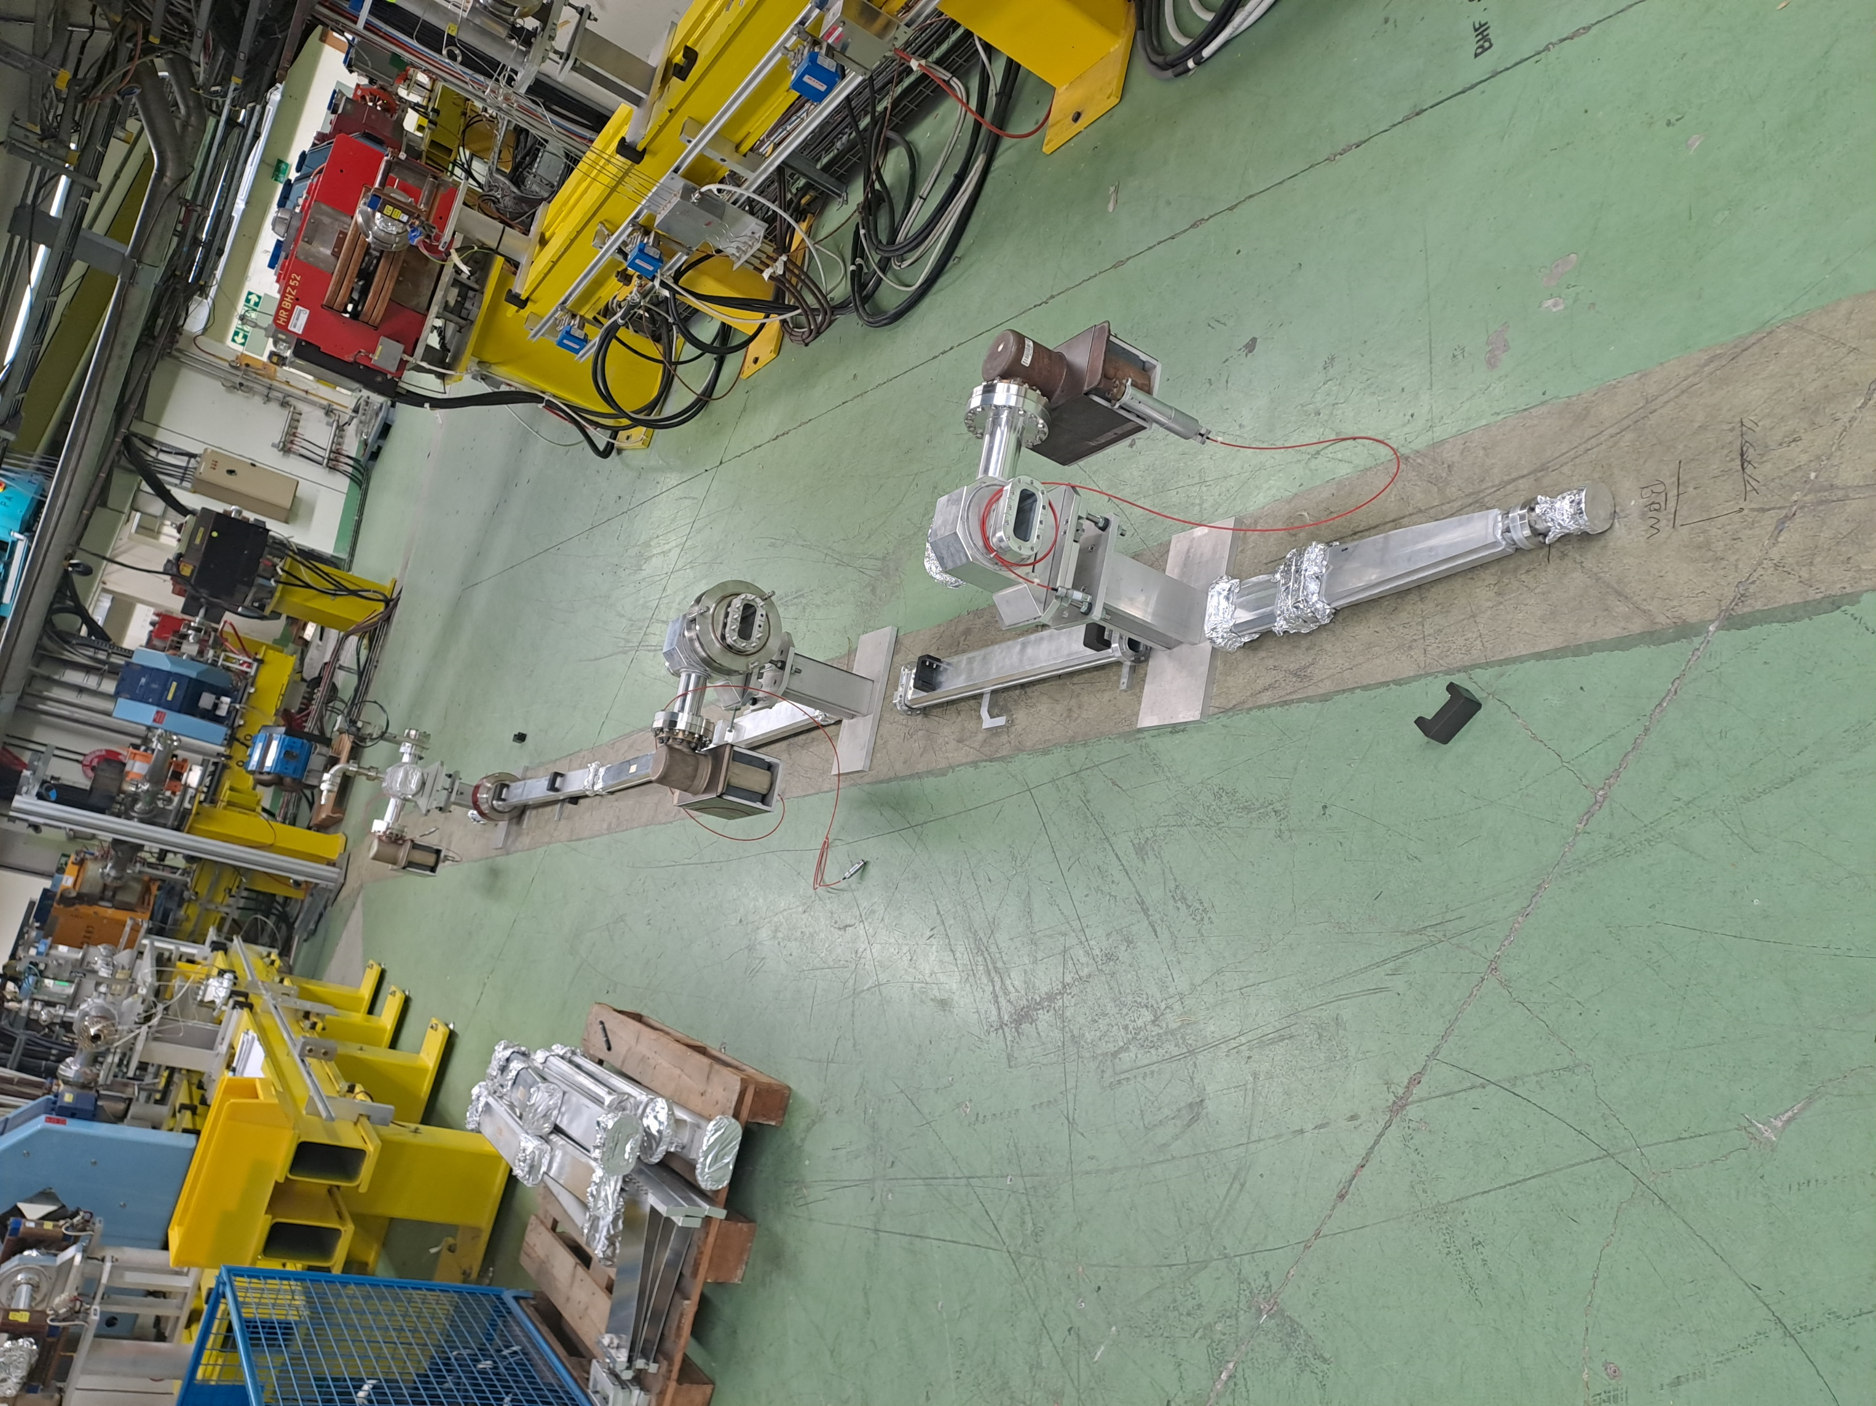
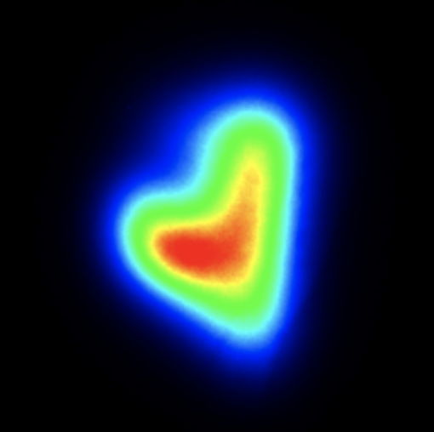
Some recent pictures
Renewed quads and sextupoles with large aperture
Blank mounting and obtained solution for the dogleg.
Stay in touch on our website:
https://clear.cern/
Thank you for your attention

