Slide 1
CLEAR Operational Improvements
CLIC Mini Week
11–13 Dec 2023 CERN
Avni Aksoy on behalf of the CLEAR team:
R. Corsini, W. Farabolini, A. Malyzhenkov, P. Korysko, V. Rieker, L. Wroe
E. Granados – M. Calderon (Laser)
S. Doebert - S. Curt – A. Chauchet (RF)

Slide 2
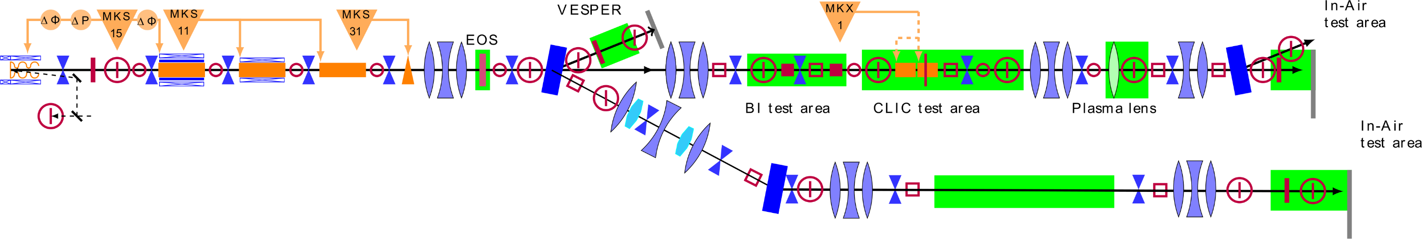
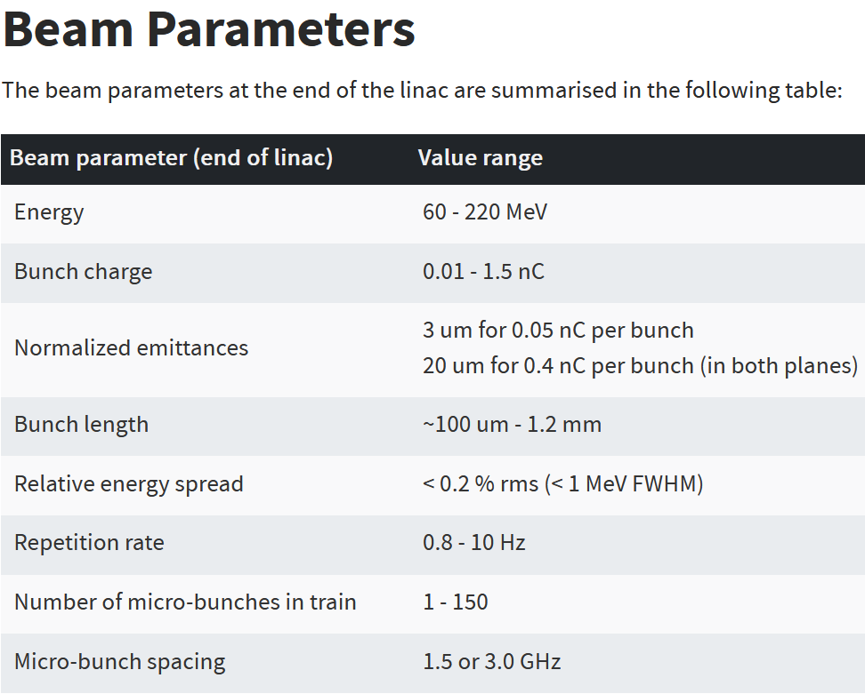
Introduction
A test facility at CERN with high availability, easy access and high-quality e- beams for wide range of users
Wide range of beam parameter
  Single bunch multi bunch wide energy change etc..
Many applications on different location of beamline
  No fixed optics, need for fast tuning of machine, fast determination of beam parameters on beamline

Slide 3
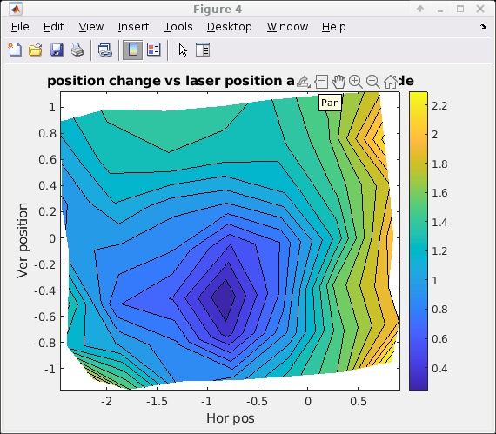
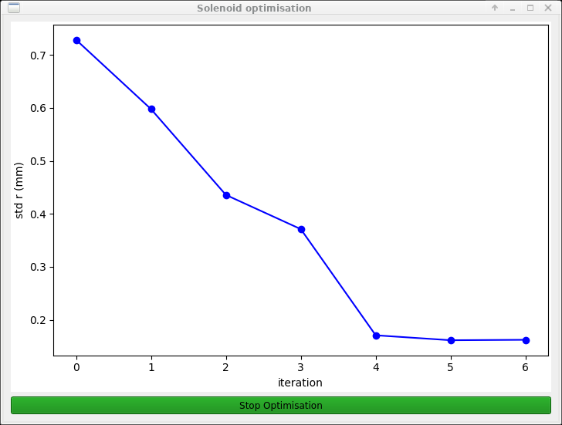
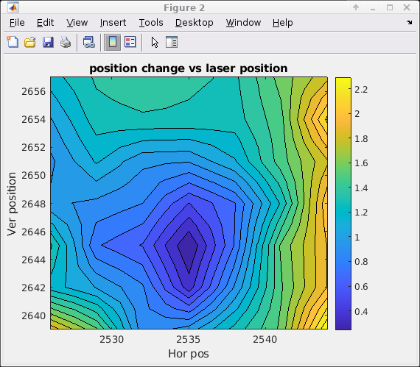
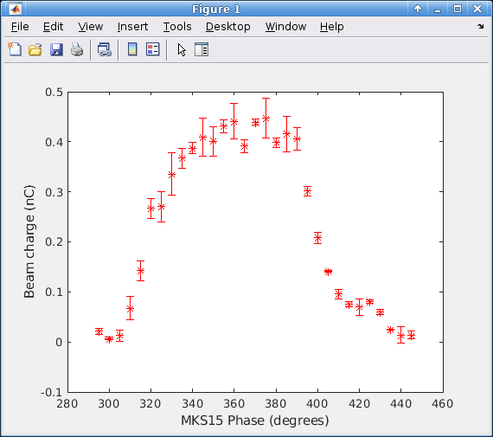
Machine startup tool
Especially after long shutdown (i.e. weekends) or temperature change we have drift in RF or change on laser position on cathode.
To start machine we have developed such a tool that finds optimum operation phase and laser position

Slide 4
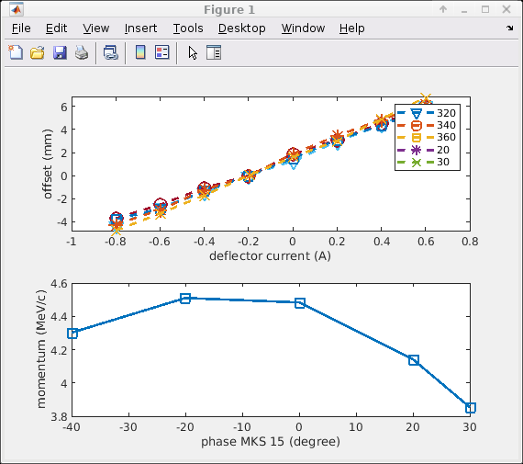
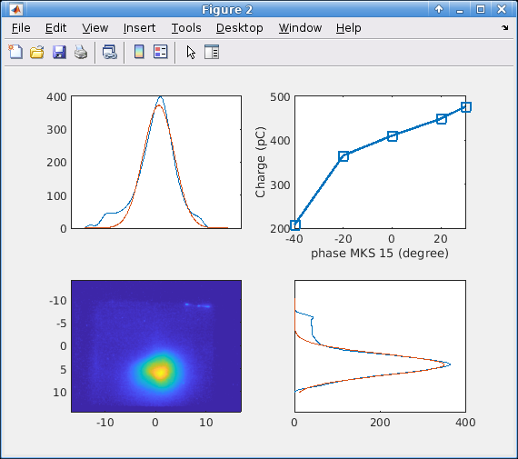
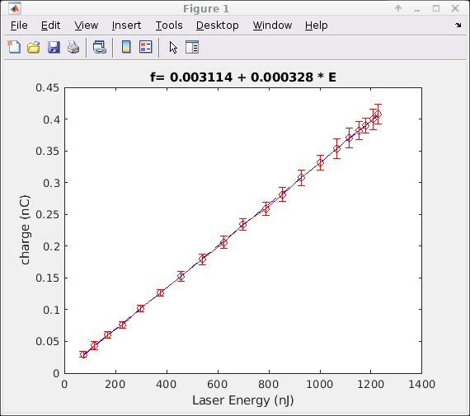
Energy and quantum efficiency measurement
To measure the quantum efficiency and gun gradient for given settings we have developed a tool which uses corrector as spectrometer and analyses all data.
The tool is almost used weekly
The stored data allows us to compare results with simulation

Slide 5
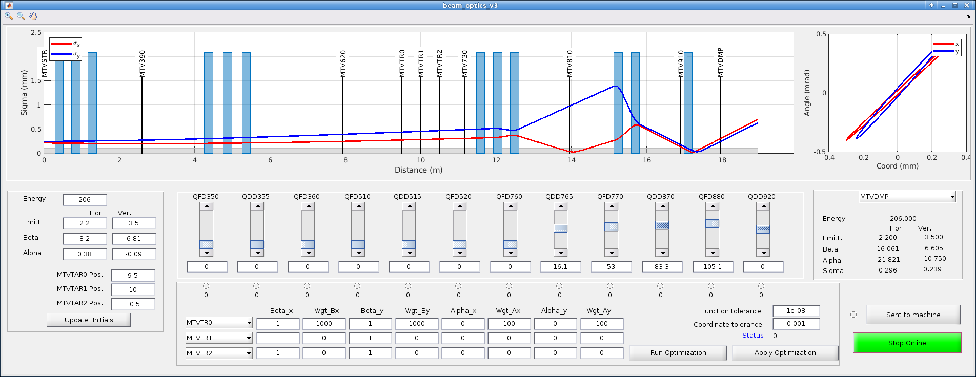
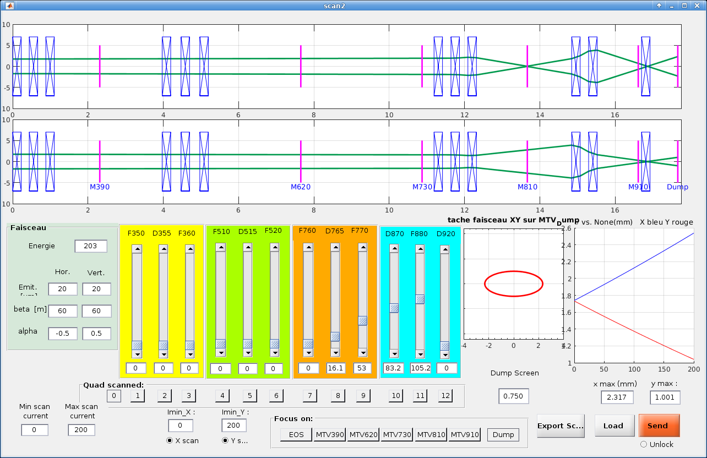
Flight simulator
Tool to predict ranges of quadrupule currents especially for quadrupole scan
Credit: W. Farabolini
We do not have a fixed optics for the machine.
Any location on beamline can be a place for an experiment.
Generic tool which beamline is created using MADX sequence file communicates with control system and optimizes beamline for given target parameters

Slide 6
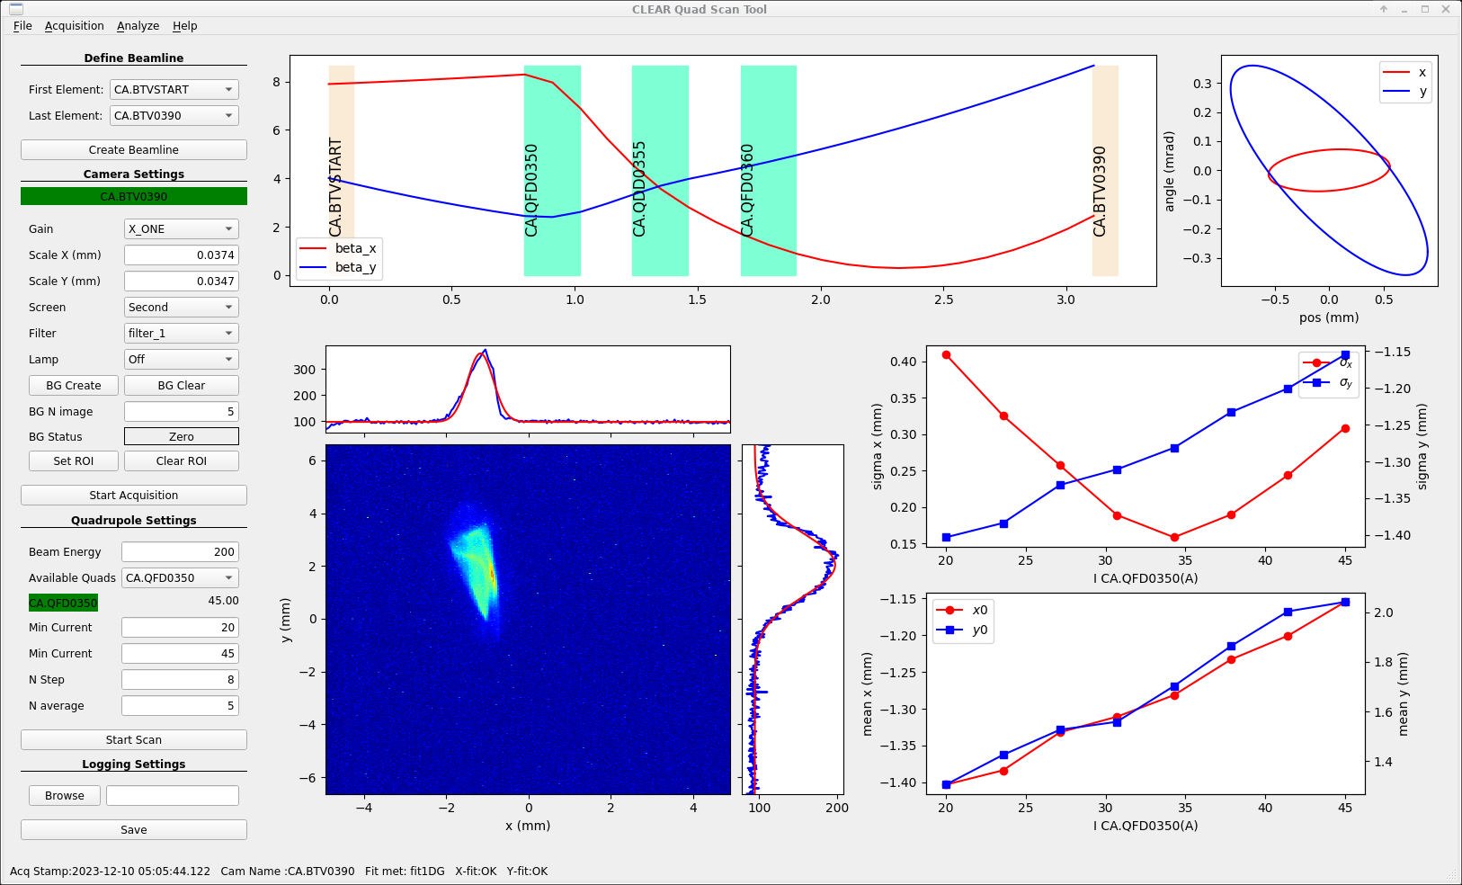
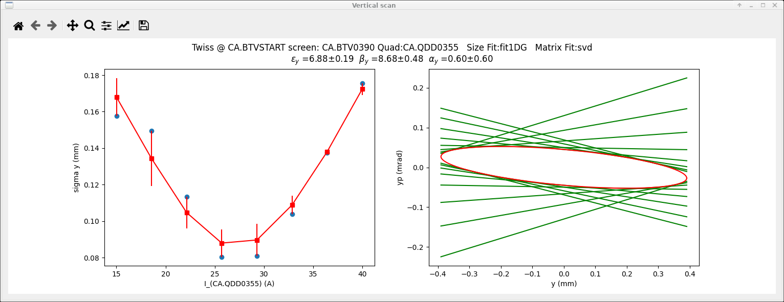
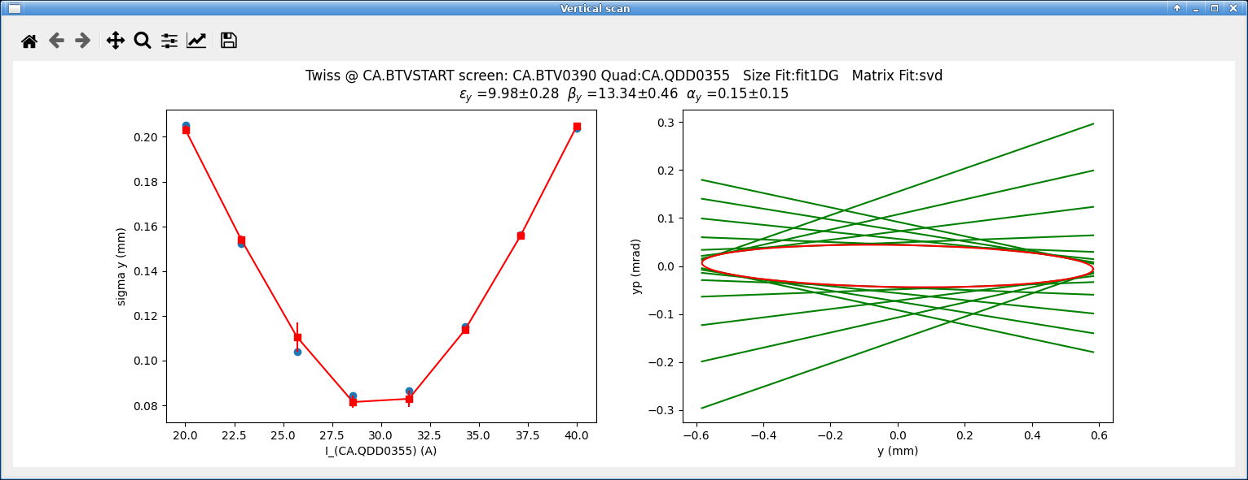
Quadrupole scan tool
Different computation methods and fittings are implemented…
  Least square, SVD, matrix inverse
  1D Gauss, 2D Gauss, Super-Gauss, 2D Weighed
We need to know Twiss parameters on any location of beamline (where the experiments are performed)
We have developed a tool on which the beamline is loaded from MADX file.
One can select the location upstream where the Twiss parameters needed to compute..

Slide 7
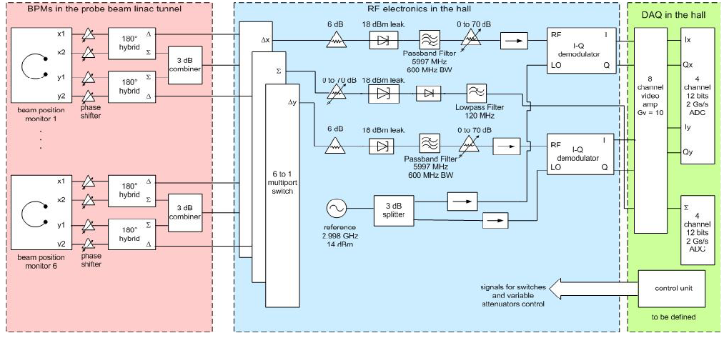
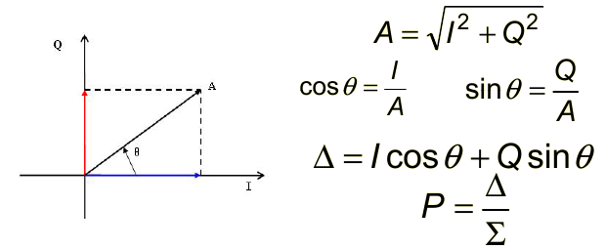
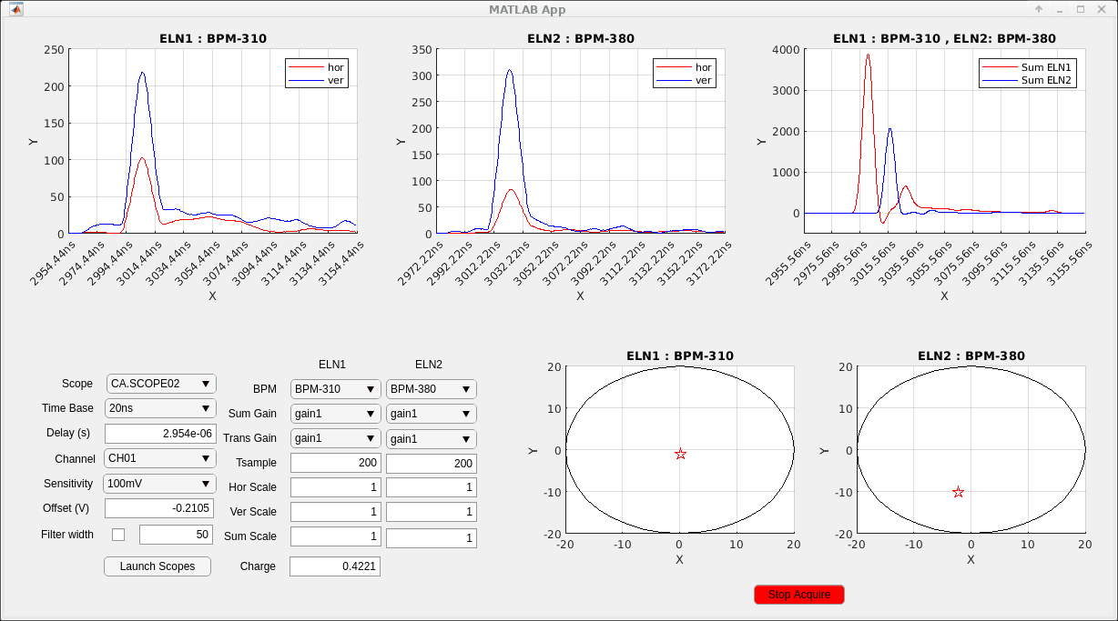
Cavity BPM calibration
We have 5 cavity BPMs (6 GHz dipole mode, 4 GHz monopole mode) installed along linac but two electronics for acquisition
The I/Q modulated signal was available but no position information
A tool has been developed to calibrate and acquire the cavity BPMs

Slide 8
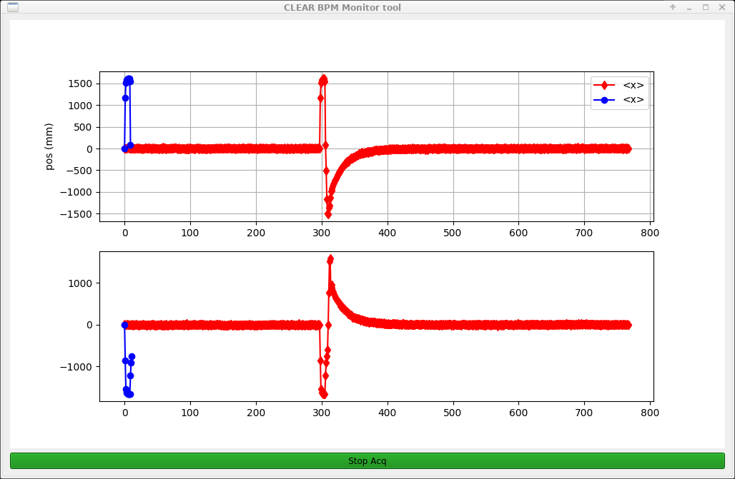
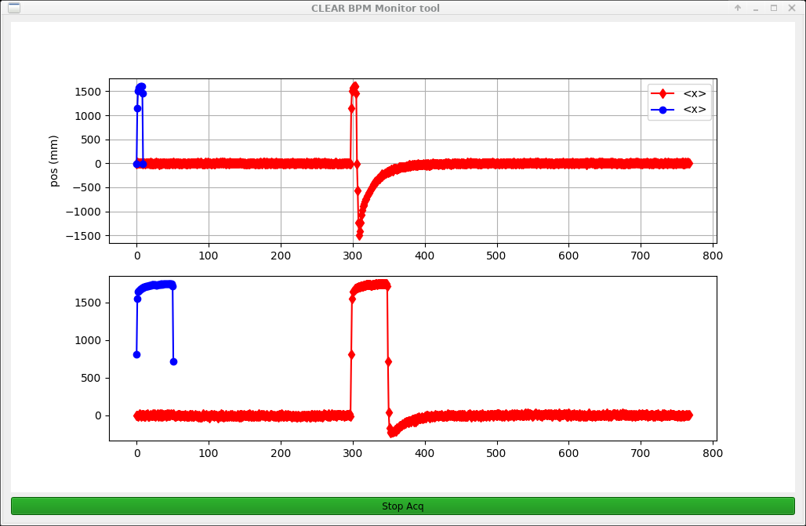
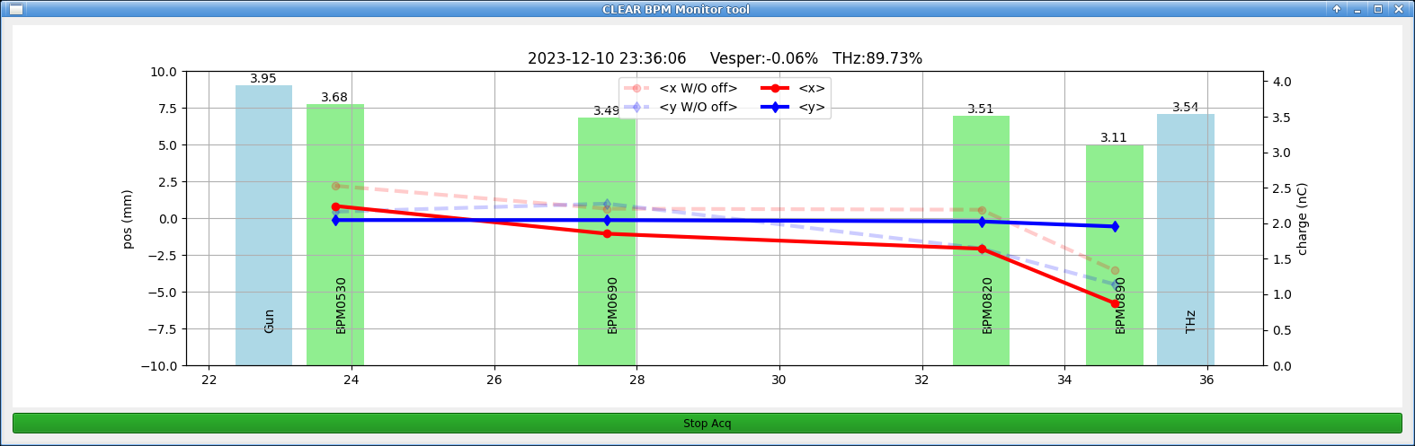
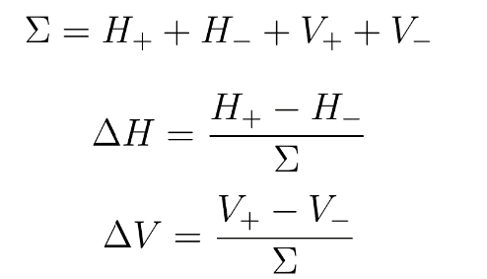
Inductive BPM Calibration
We have 5 inductive BPMs along beamline
An algorithm to “catch” correct portion of signal and do the computation
BPMs are calibrated by using last screen as well as cross calibration

Slide 9
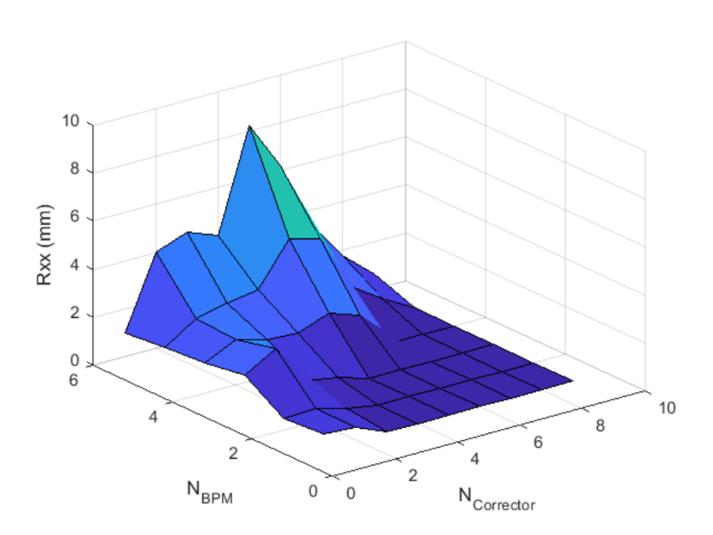
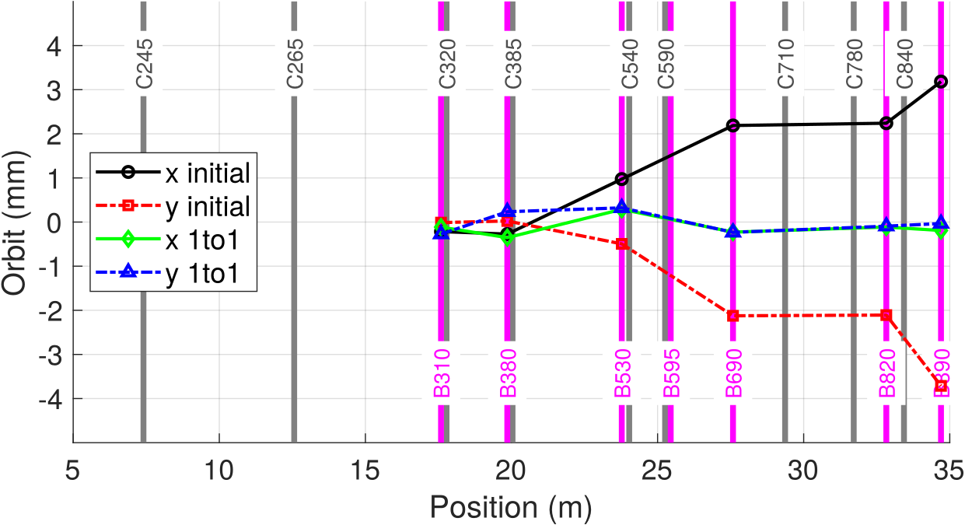




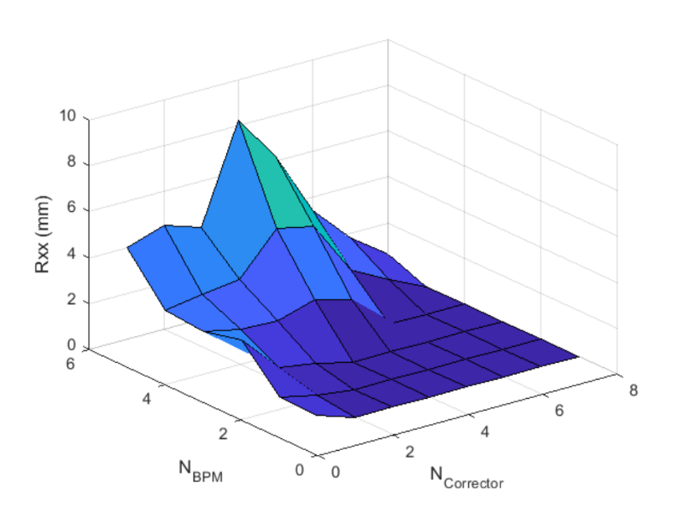
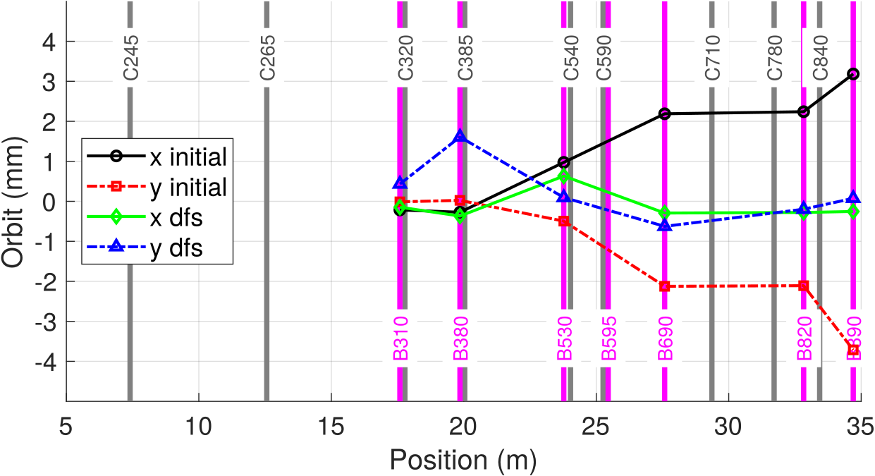
Beam Based Alignment
RLS
DFS:
Operational BPMs allowed us to do high level beam physics.
We have developed an automated response matrix generation tool.
  Random or excitation in sequence of correctors for given machine setting
  R: for nominal energy, R’ : for reduced energy
Based on chose one can create response matrix based on different algorithms (RLS, SVD) apply one-to one steering or DFS
Full process takes about 30 min
SVD

Slide 10
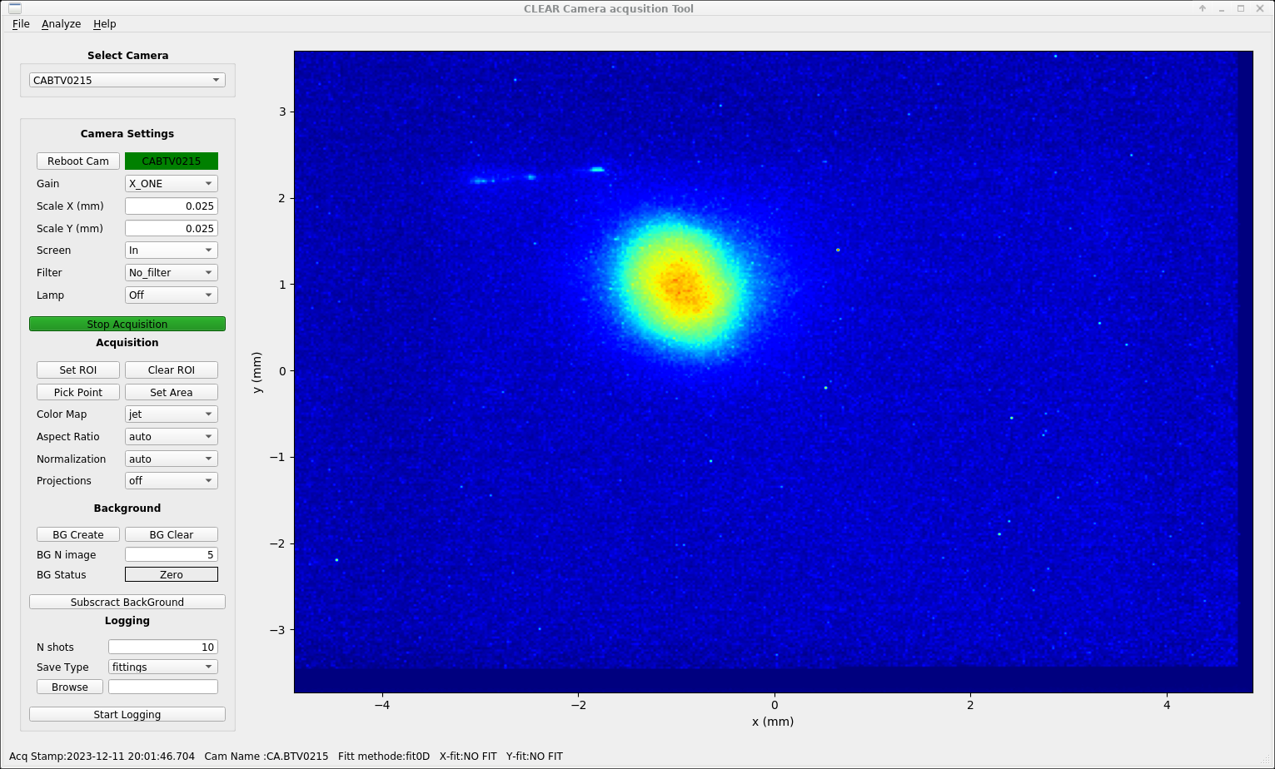
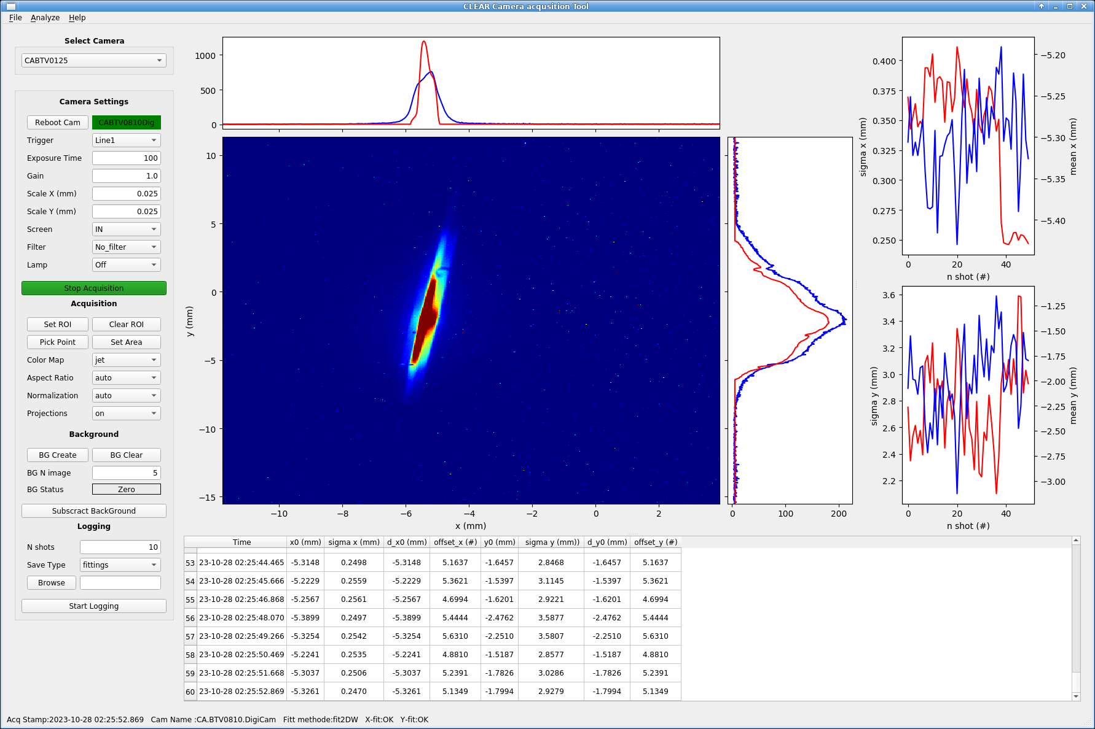
Camera acquisition
After last upgrade of camera system CLEAR has two family of cameras (we call digital/analog)
However all other hardware still relies on analog system
  Screen, filter, pusher etc..
Generic camera acquisition tool communicating both FESA clases.
Image processing algorithms such as filter, sharpening etc.. Are implemented
Background subtraction based on frame, edge frame edge is avalible
Various fittings algorithms are implemented
  1D Gauss, 2D Gauss, Super-Gauss, 2D Weighed
Some fits CPU consuming, needs improvement, i.e. fitting in linear equation system..

Slide 11
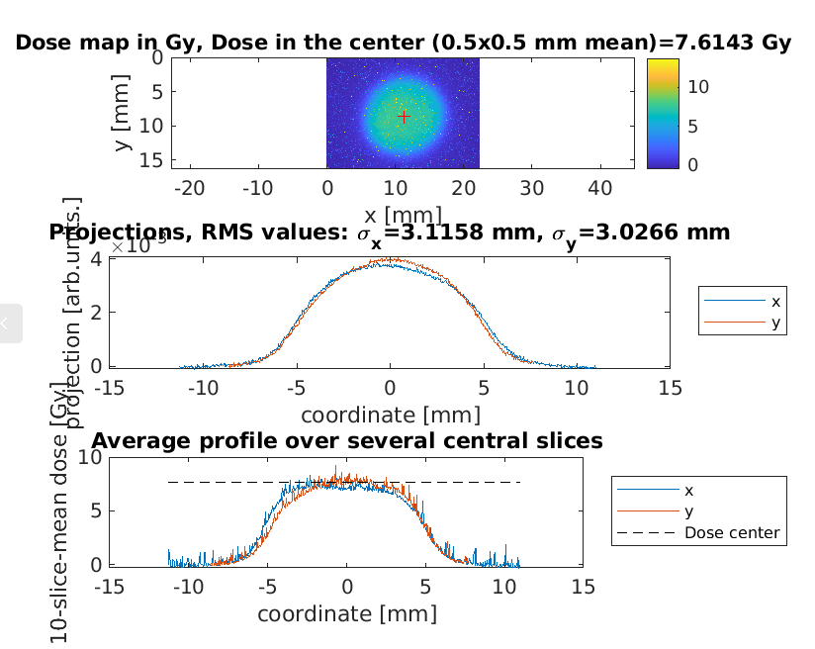
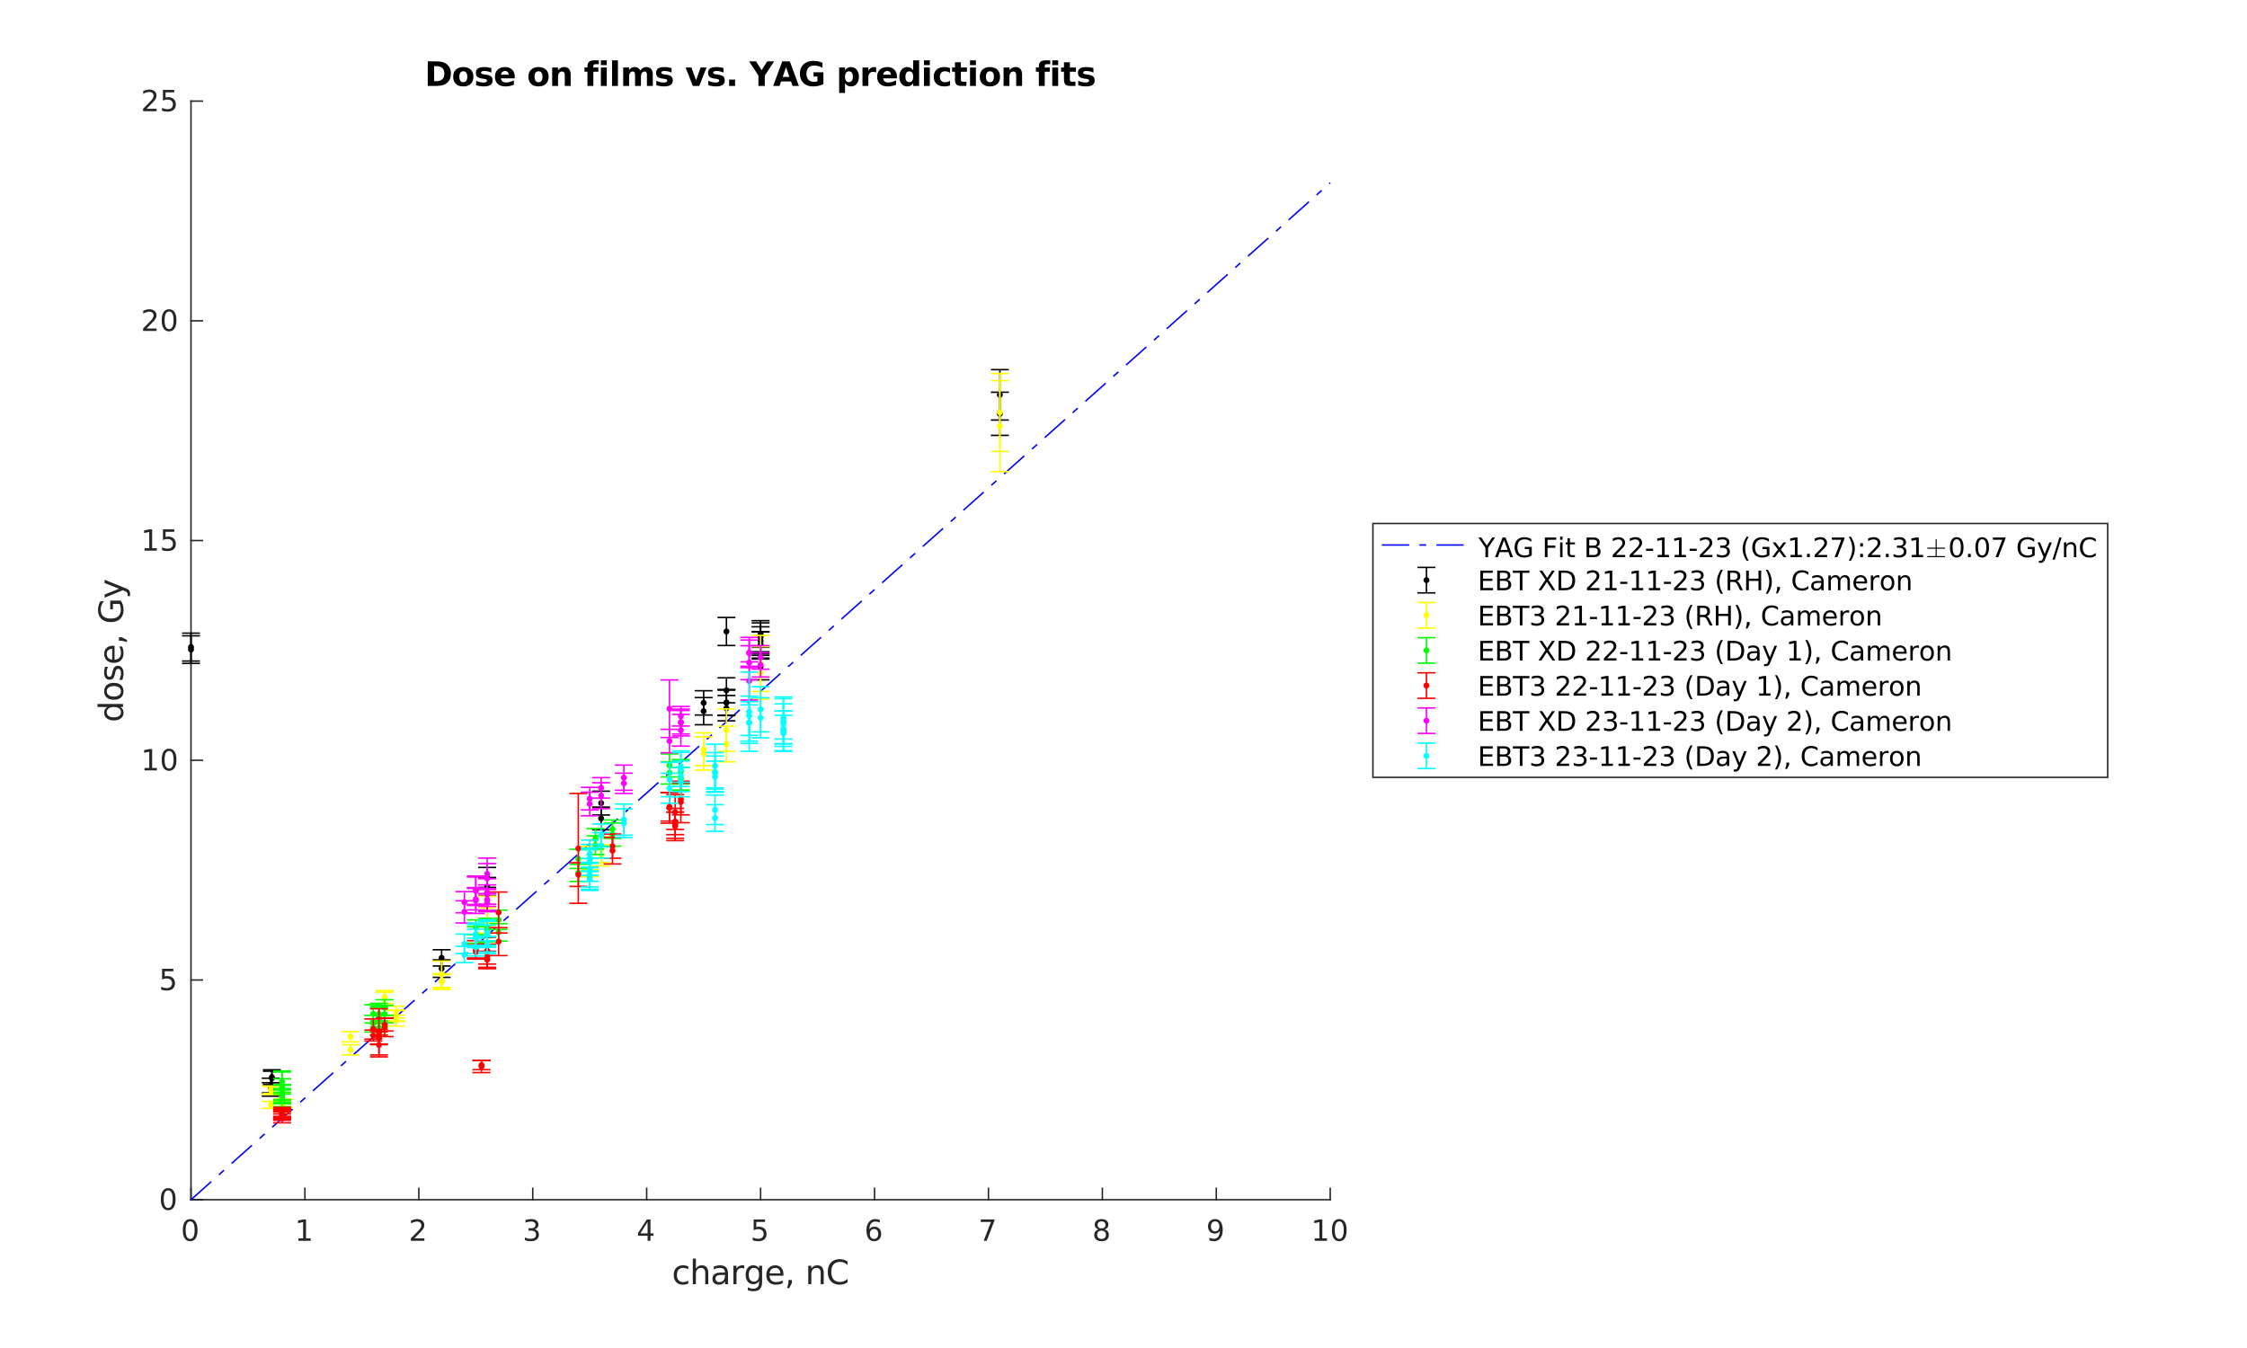
Dose prediction based on the charge density measurements
Credit A. Malyzhenkov
Measuring transverse profile and charge allows to retrieve 2D charge density of electron beams
Based on the empirical data one can translate the charge density nC/mm² to dose in Gy and compare with dose deposition films
With a thin YAG screen such approach will allow online noninvasive prediction (to be tested in 2024)
This approach is working great for beams with a uniform transverse profile since all charge can be detected
Here we use a novel double-scatterer method by C. Robertson (PhD student CLEAR/Oxford) to generate such beams

Slide 12
Conclusions
Many aspects of the machine operation were improved during 2023 despite very limited time for the Machine Development (MD)
  Some of them are not mentioned here
Machine operation for users/operators is constantly improving after MDs!
We still have a lot of opportunities for improvement in 2024,
  Starting from inteligent tracking of laser timing, aligning of the beamline elements, fully operation all BPMs and advancing operational tools…
The proper trajectory and predictable orbit would be even more critical for the commissioning and successful operation of the second beamline
  we would have to close the dispersion in wide energy and spread range!
Many of the existing operation procedures can be automatized making life of operators easier and more efficient use..
  Turns out opportunities for more experiments and additional MD

Slide 13
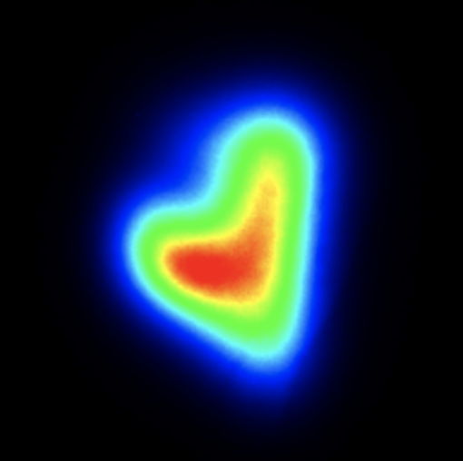
Thank you for your attention

