Slide 1
Status of the ChDR R&D at ATF2
Stefano Mazzoni, Thibaut Lefevre, Andreas Schloegelhofer, Sara Benitez CERN
Pavel Karataev, RHUL
Renjun Yang, CSNS
Alex Aryshev, KEK
13/12/2023 CLIC mini week

Slide 2
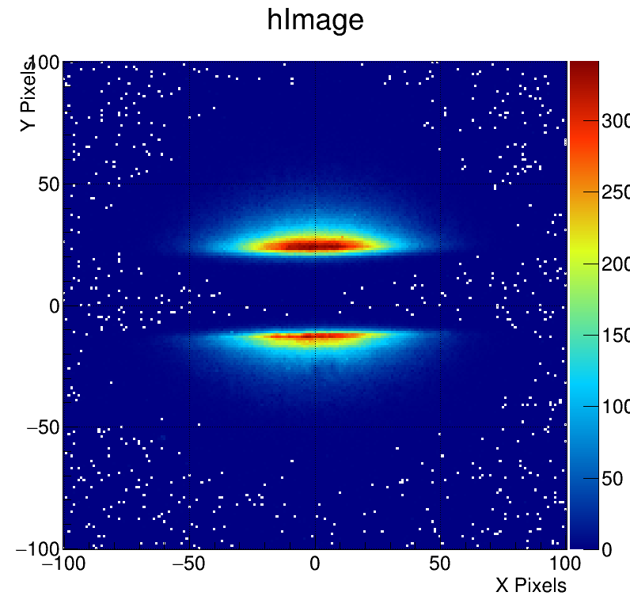
The context: Optical Diffraction radiation
Optical Diffraction Radiation (ODR) studies started in 2011 at CESR and then ATF2 since 2015
  Non invasive transverse beam size with micrometre resolution (CLIC)
  Limitations:
    low light yield
    not suitable for rings
    Synchrotron radiation background
What we need:
  higher light yield
  emission at larger angles
w
T. Aumeyr et al., PRAB 18, 042801 (2015) ; L. Bobb, PhD thesis, 2017 ; L. Bobb et al., PRAB 21, 032801 (2018) ; M. Bergamaschi et al. Phys. Rev. Applied 13, 14041 (2020)

Slide 3
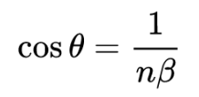
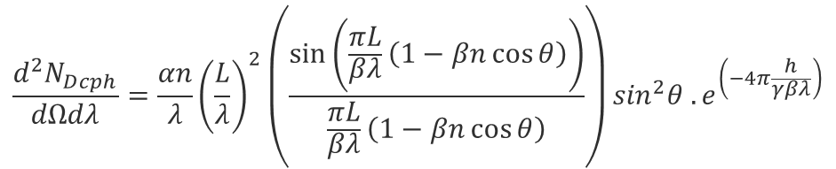

Cherenkov Diffraction Radiation (ChDR)
The electric field of ultra-relativistic charged particles passing in the vicinity of a dielectric radiator produces photons by the Cherenkov mechanism (polarization effect).
  Large emission angle: $\cos\left(θ_{Ch}\right)=\frac{1}{βn}$
  Photons emitted along the target
For cylindrical geometry:
Dielectric: ɛ,n
ChDR
θ
h - “impact parameter”
Particle: γ,β
Exponential decay
of the particle field
Cherenkov emission – spectral angular
$$\frac{d^{2}N_{Dcph}}{dΩdλ}=\frac{αn}{λ}{\left(\frac{L}{λ}\right)}^{2}\left(\frac{\sin\left(\frac{πL}{βλ}\left(1−βn\cos{θ}\right)\right)}{\frac{πL}{βλ}\left(1−βn\cos{θ}\right)}\right)\sin^{2}θ .e^{\left(−4π\frac{h}{γβλ}\right)}$$
α, fine structure constant
β, normalised beam velocity
γ, beam relativistic factor
θ, angle of observation
L, radiator length
n, index of refraction
h, impact parameter

Slide 4
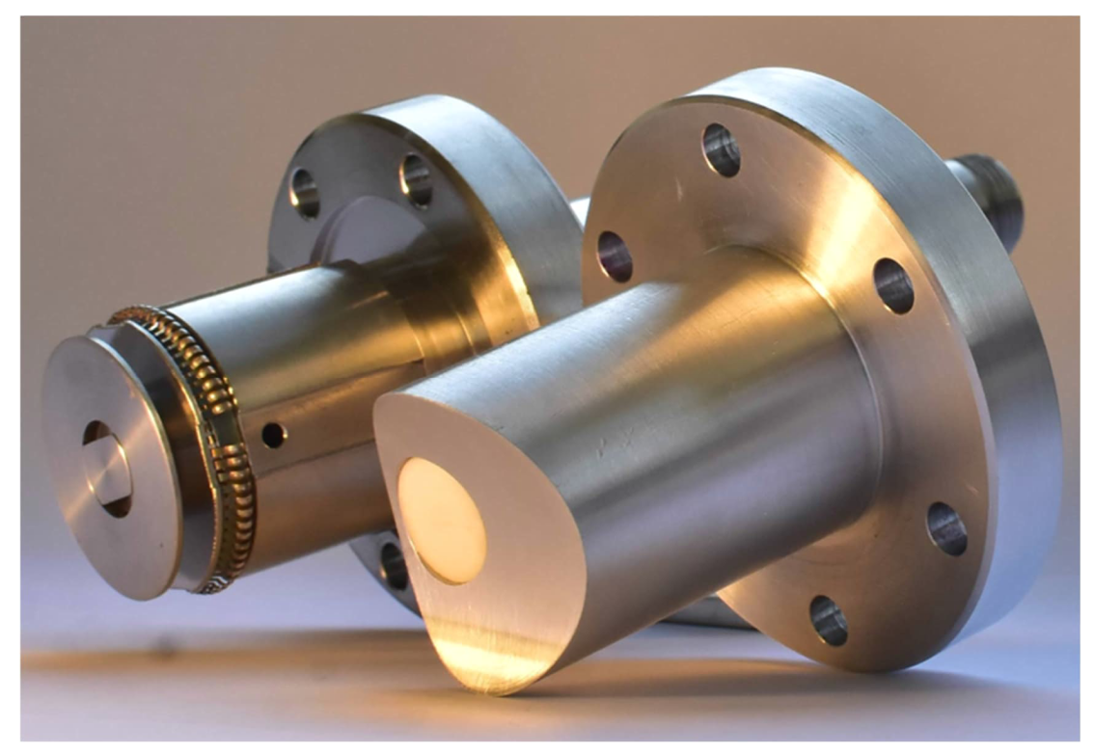
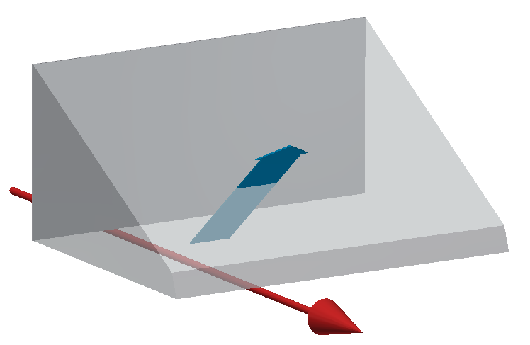
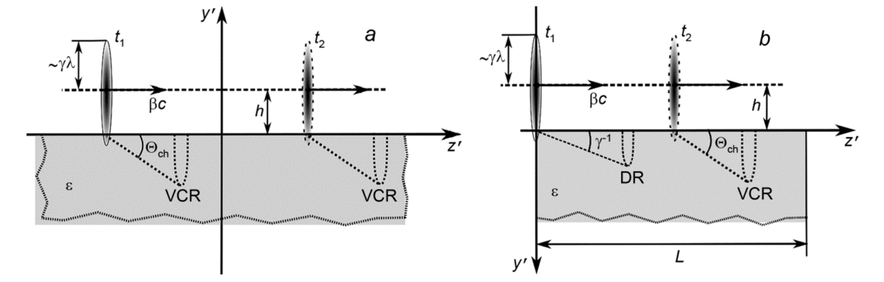
ChDR in realistic geometries
In real accelerators, dielectrics emitting ChDR will be elements embedded in beam pipe walls (a) or prisms (b)
non-cylindrical geometry
finite length
a)
b)
Diagram: A. Potylitsyn,
Russ Phys J 62, 2187–2193
1 B.M. Bolotovskii, Sov. Phys. Usp. 4 781 (1962).
2 Ulrich, Z. Physik 194, 180–192 (1966).
3. H. A. Olsen and H. Kolbenstvedt, Phys. Rev. A, vol. 21, Jun 1980.
4. Karlovets, D.V., Potylitsyn, Jetp Lett. 90, 326 (2009).

Slide 5
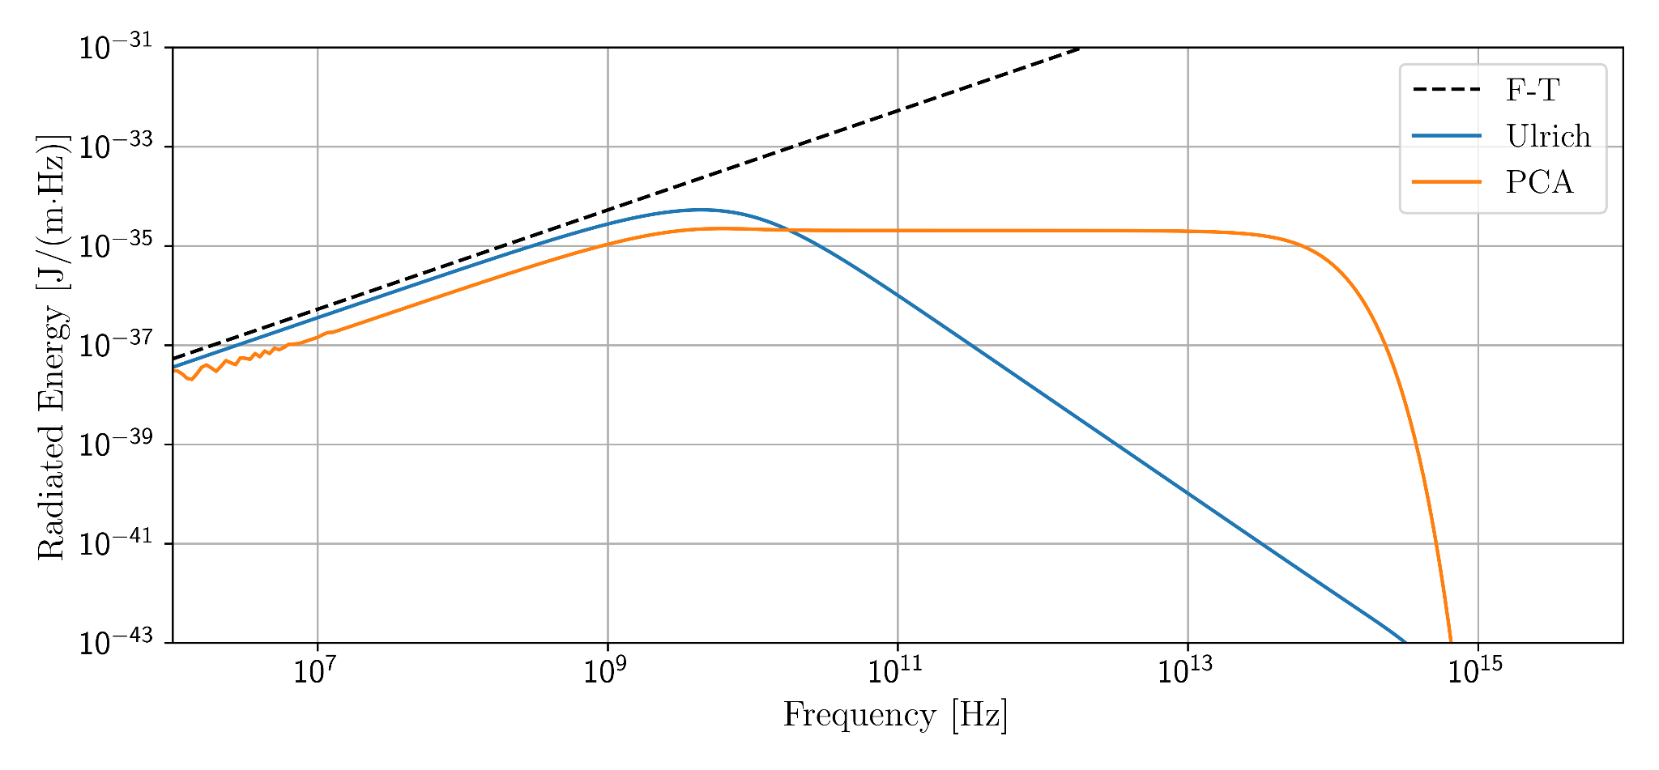


Incoherent ChDR light yield: not measured to date!
Incoherent ChDR has a potential for longitudinal diagnostics for high energy future colliders (CLIC, ILC, FCCee), but models predict large differences in photon yield
$$∝1/h$$
$$∝γ/h$$
γ ≈ 88000
h = 1 cm

Slide 6
Overview of ChDR experiments
CERN BI and collaborators established a comprehensive study on ChDR for beam instrumentation applications
Observation / characterization of coherent / incoherent ChDR:
  CESR (Cornell University): first observation of incoherent ChDR (2017)
  CLEAR (CERN): incoherent / coherent photon yield studies (2018 - present)
  ATF2 (KEK): incoherent light yield (present)
  Tomsk Microtron (Tomsk): far-IR ChDR superradiant emission (2020)
  Diamond Light Source (UK): coherent and incoherent ChDR (2018-2019)
Beam diagnostics studies
  ATF2 (KEK): transverse beam profile (2018-2019)
  CLEAR (CERN) and CLARA (Daresbury UK): bunch length via incoherent ChDR (2018-present)
  CLEAR and AWAKE (CERN): beam position via coherent radiation (2018 - present)
  Diamond Light Source (UK): incoherent BPM (2022 - present)

Slide 7
Overview of ChDR experiments
CERN BI and collaborators established a comprehensive study on ChDR for beam instrumentation applications
Observation / characterization of coherent / incoherent ChDR:
  CESR (Cornell University): first observation of incoherent ChDR (2017)
  CLEAR (CERN): incoherent / coherent photon yield studies (2018 - present)
  ATF2 (KEK): incoherent light yield (present)
  Tomsk Microtron (Tomsk): far-IR ChDR superradiant emission (2020)
  Diamond Light Source (UK): coherent and incoherent ChDR (2018-2019)
Beam diagnostics studies
  ATF2 (KEK): transverse beam profile (2018-2019)
  CLEAR (CERN) and CLARA (Daresbury UK): bunch length via incoherent ChDR (2018-present)
  CLEAR and AWAKE (CERN): beam position via coherent radiation (2018 - present)
  Diamond Light Source (UK): incoherent BPM (2022 - present)

Slide 8
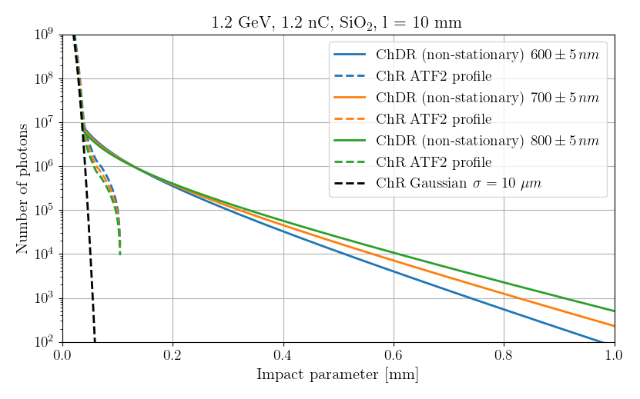
Incoherent ChDR yield at ATF2
Incoherent ChDR has a potential for longitudinal diagnostics for high energy future colliders (FCCee,…), but incoherent light yield not known precisely …challenging measurement!
  At moderate γ (GeV), impact parameter is limited
  Imperative to avoid spurious photons:
    Cherenkov from beam halo
    synchrotron radiation

Slide 9
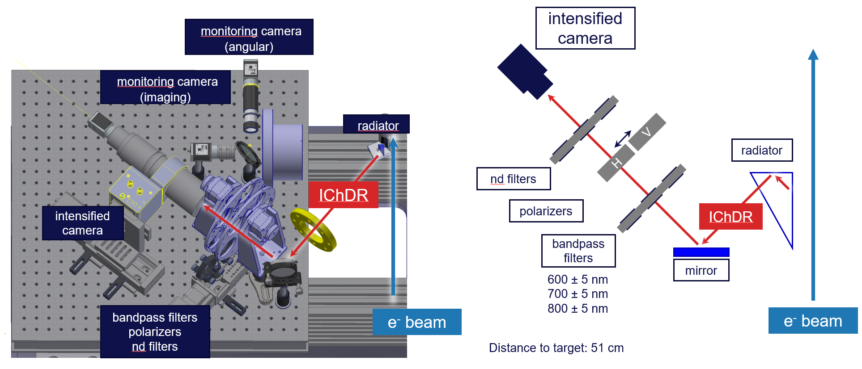
Incoherent ChDR at ATF2 - setup

Slide 10
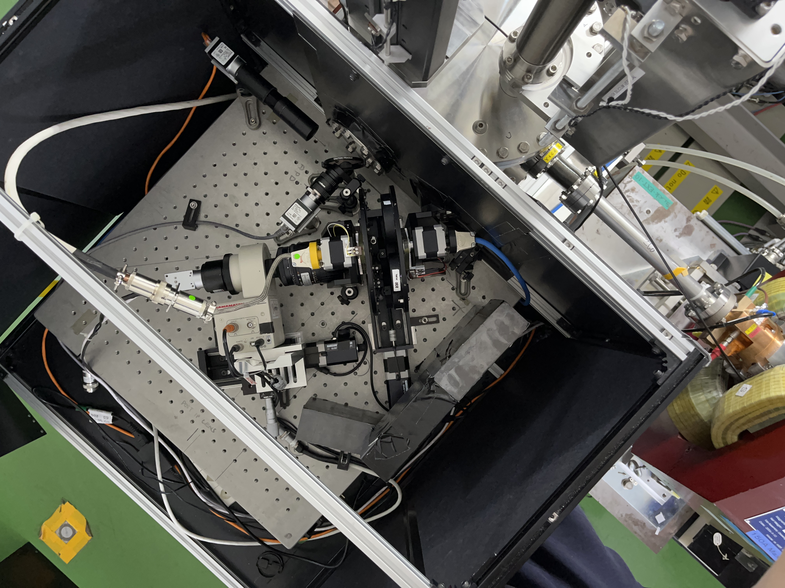
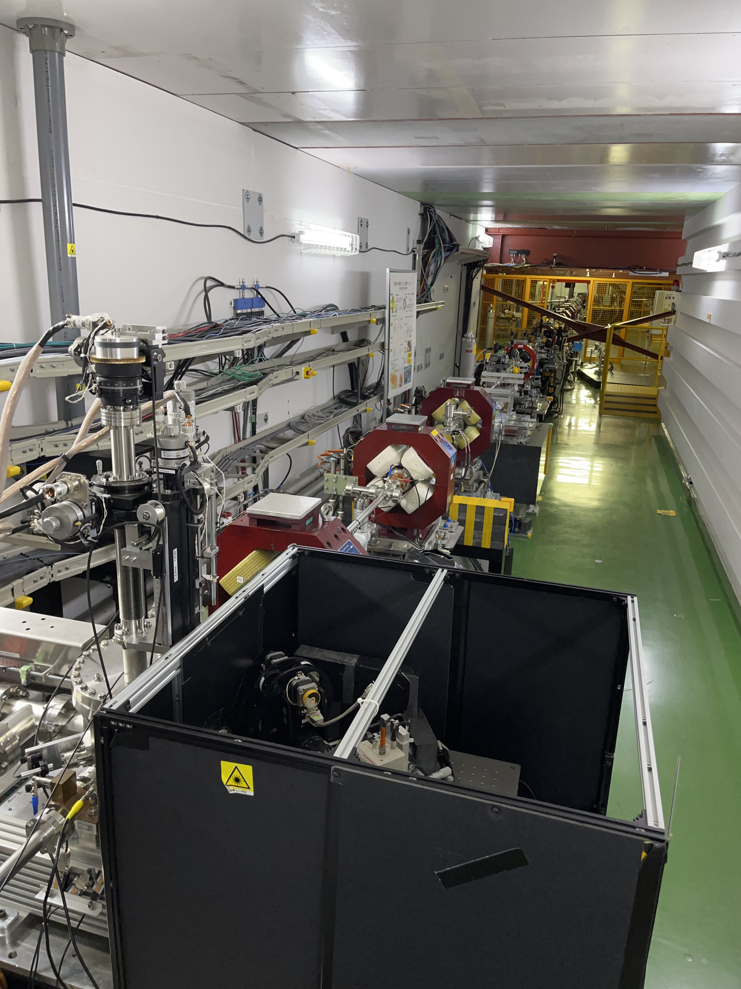
Incoherent ChDR at ATF2 - setup

Slide 11
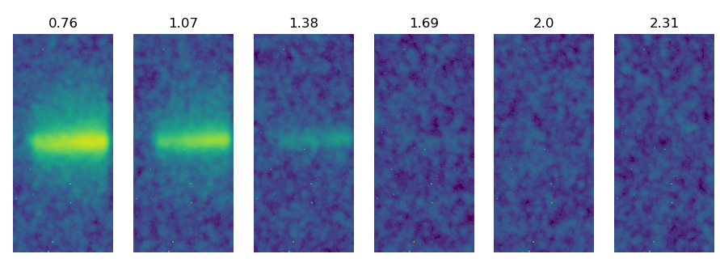
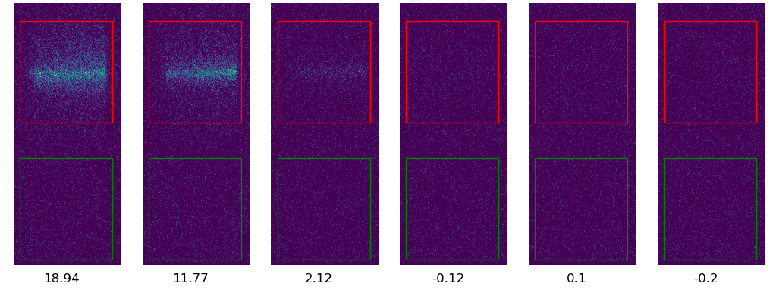
Summary of June tests
Integrated images
Impact parameter
20 different distances/bandpass filter
500 images per position
Normalized for bunch charge
Photon counting
Signal
Background
Number of Photons

Slide 12
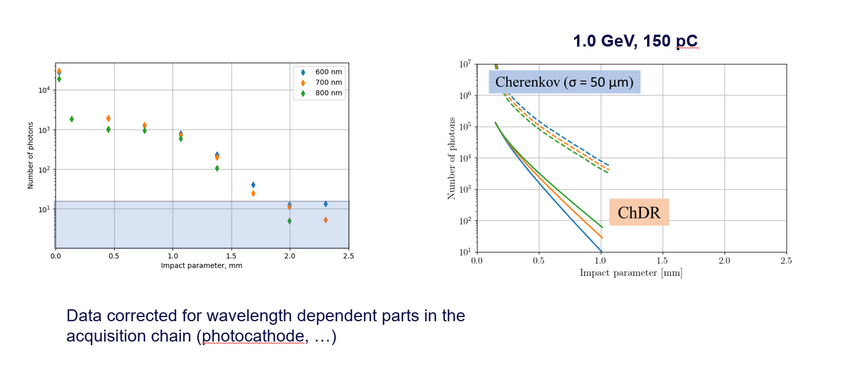
Summary of June tests
Signal dominated by Cherenkov produced by halo particles crossing the target!

Slide 13
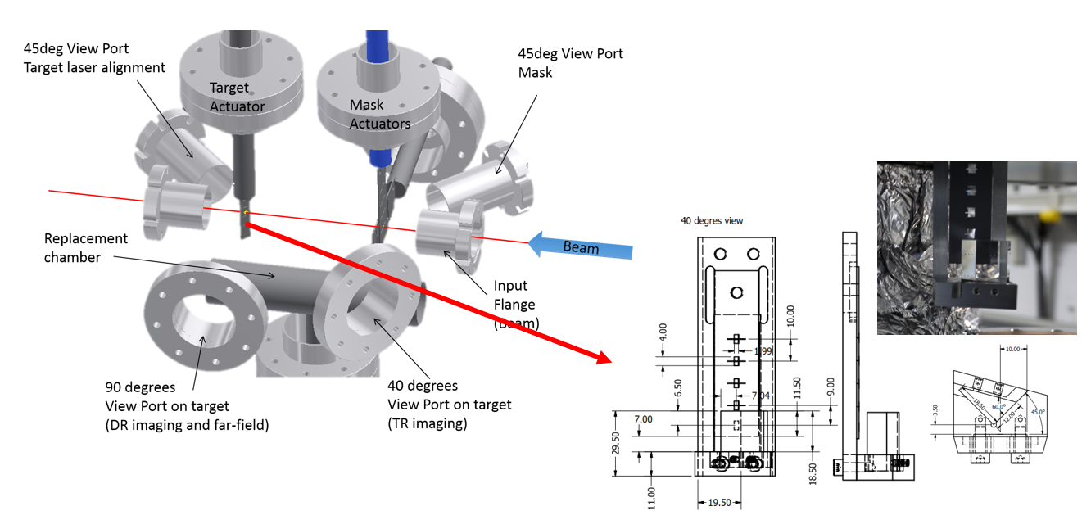
Possible upgrade of ChDR setup

Slide 14
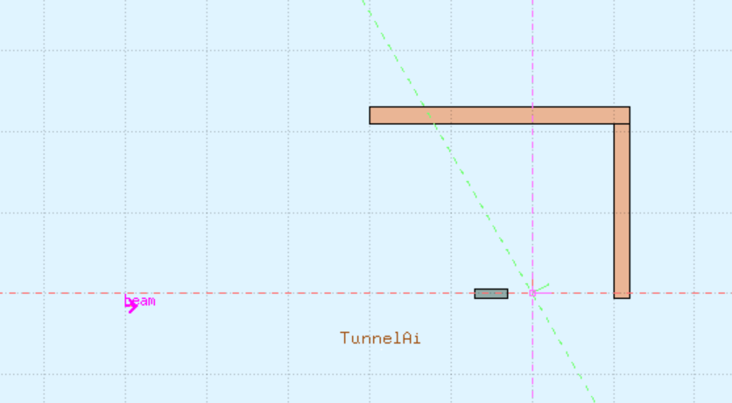
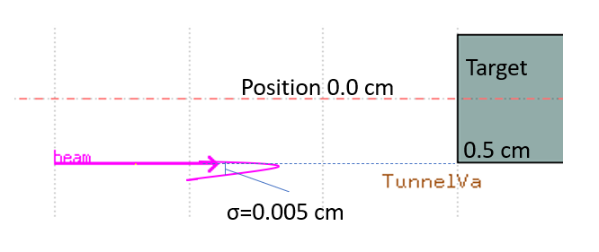
Possible upgrade of ChDR setup
FLUKA simulation: effect of 1x1x4 cm W absorber
1.2 Gev, 1,2 nC, 50 um sigma gaussian bunch
Look for charged particles with b>0.685 in a 10 mrad cone co-axial with beam direction
Expected reduction order 10⁶
^{PRELIMINARY}
Sensor
Tungsten target
1x1x4 cm
e-
Vacuum

Slide 15
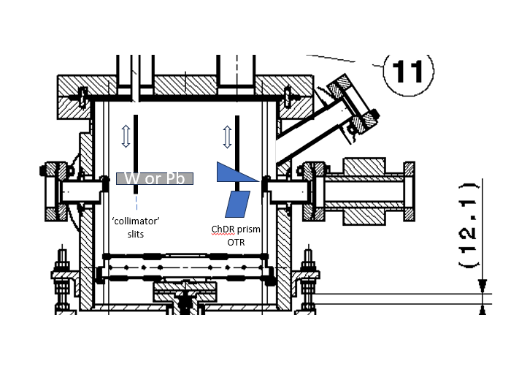
Possible upgrade of ChDR setup
preserve most of existing design: vertical actuators, support, replacement chamber
new chamber probably needed for adding 45 deg viewport
new design should better reject synchrotron radiation (vertical polarisation)

Slide 16
Summary
Incoherent ChDR can be source for beam diagnostics for future high energy colliders
Attempts at ATF2 unsuccessful so far, partially due to setup not adapted to ChDR
(Very) preliminary studies show a possible new setup design that would allow better noise rejection
New PhD student starting in 2024 to measure incoherent ChDR light yield and possibly perform longitudinal profile measurement at ATF2.
We look forward to discussing with ATF2 team for beam time availability, modification of setup, upgrade of controls etc. etc.

