Slide 1
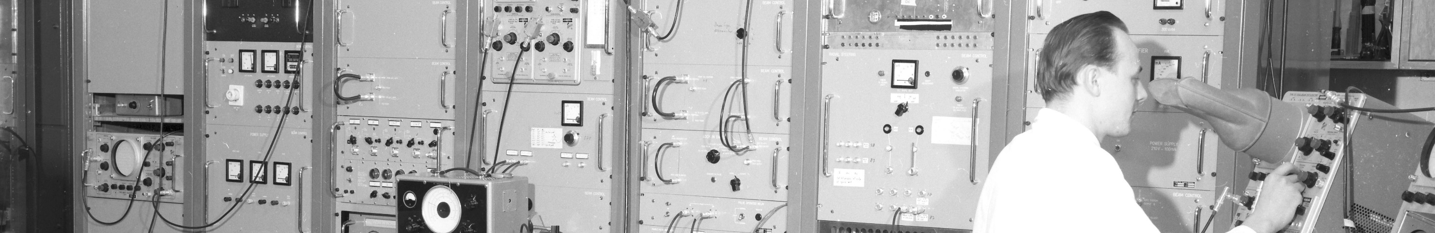
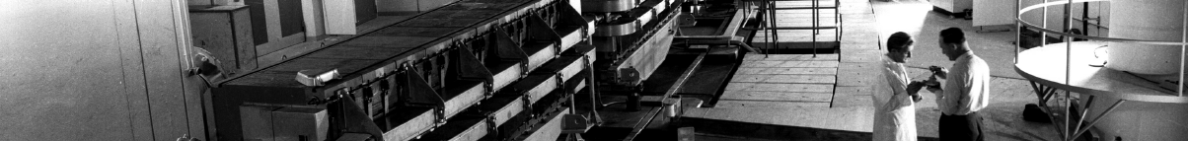
PS Report week 40/41
Many thanks
to the PS OP and coordination teams as well as all equipment experts and support teams!

Slide 2
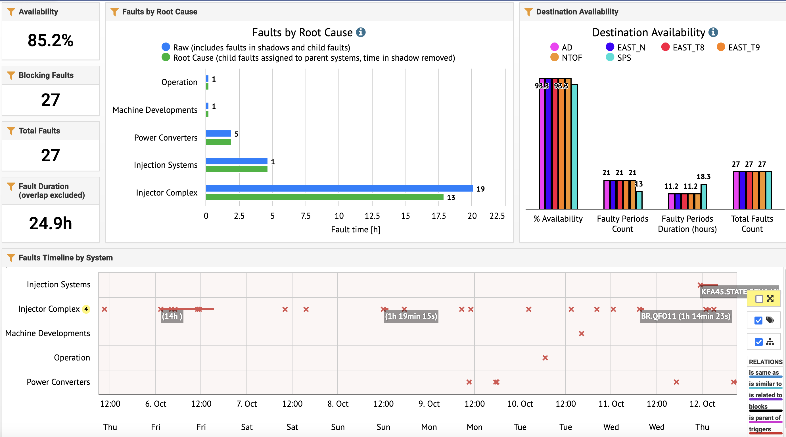
Availability W40/41 (Thu – Thu 9am)
Availability SPS 89.1%, other destinations 93.3%
PSB access
Injection kicker fault
Several injector faults (long Linac3 fault last Friday)
A few POPS trips

Slide 3
Main Issues
                Good week with few PS faults, but several injector faults (e.g. Linac3 cavity problem last Friday).
                No proton beam yesterday morning for 1h15m for regular PSB water leak inspection (in parallel to EAST and n_TOF access). Ion beams delivered in the meantime.
                POPS in degraded mode to fill up water of DCDC1 converter (known water leak) on Monday; after intervention a few POPS trips due to more stringent limits (peak power from 3.2 MW reduced to 2.5 MW); this morning the team swapped to work on DC3 (found another water leak)
                Issue with automatic asymmetry correction for EAST_T9 and EAST_N after introduction of averaging → solved Tuesday evening
                During last night, an issue with the proton injection kicker KFA45 stopped all proton beams for 4h40m; in parallel, another Linac3 cavity issue.

Slide 4
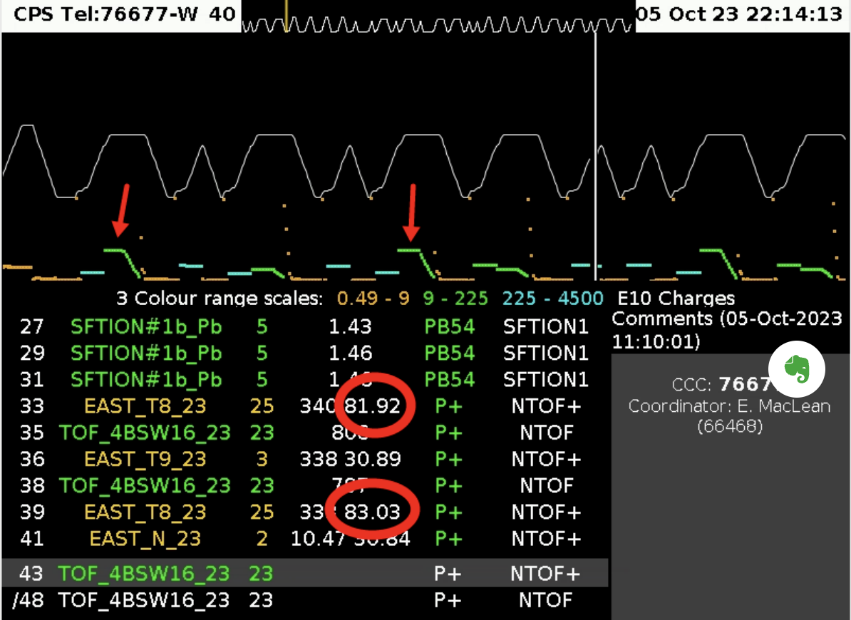
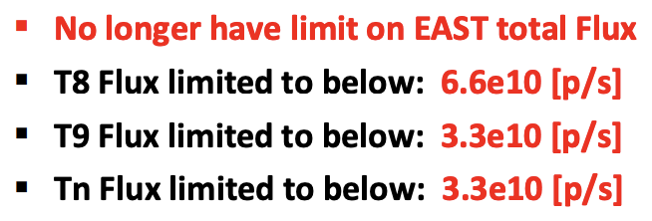
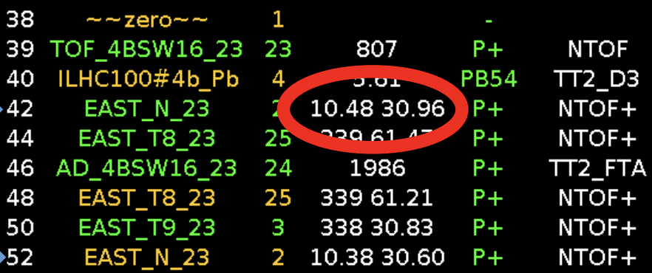
Intensity increase for EAST_T8; low-intensity n_TOF
                Increase of EAST_T8 spill intensity from 60e10 p to 80e10 p approved from Thursday morning
                Rate limits for different EAST destinations clarified by RP
                Issue last Monday with too large beam size due to wrong quadrupole settings following a mistake during an EAST MD
                Small n_TOF (10e10 p) EAST parasitic bunch is lost in the PS ring if EAST cuts the request → programmed now only on EAST_T8 cycles

Slide 5
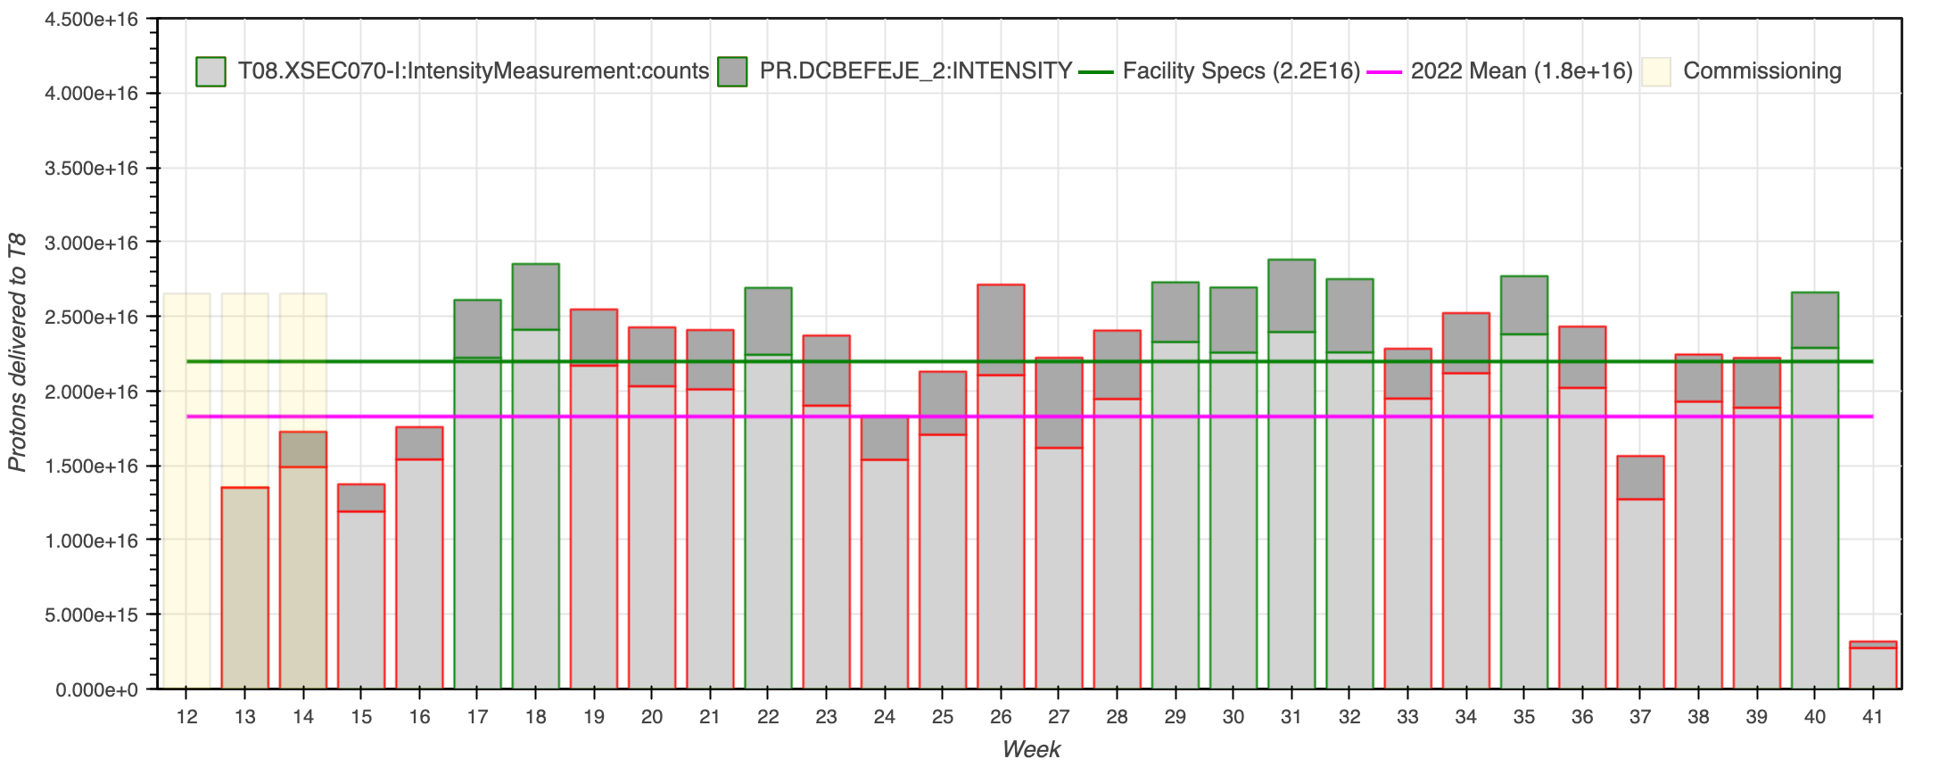
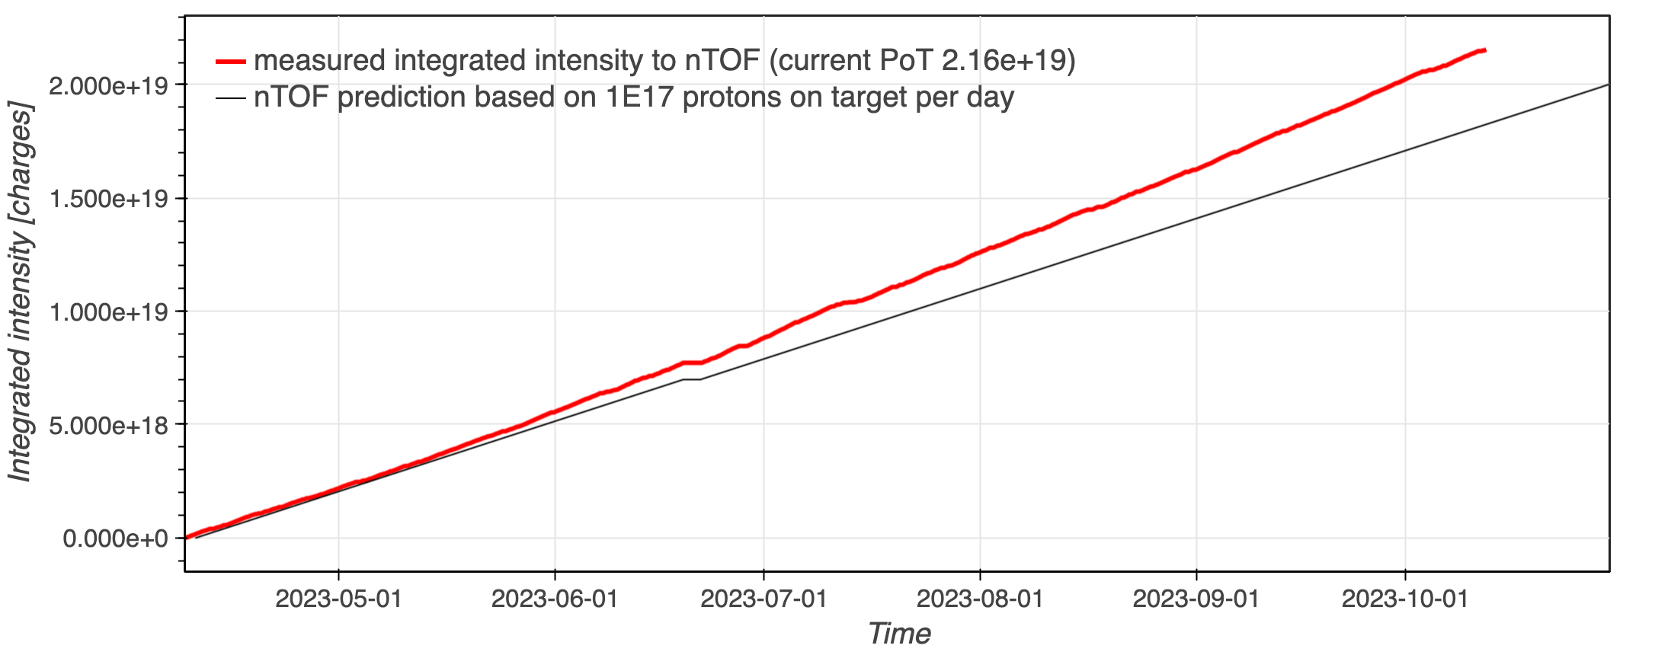
Delivered Intensity
                EAST_T8 delivered intensity
                n_TOF delivered flux

Slide 6

PS Coordinator for week 40 – Ewen MacLean
PS Coordinator for week 41 – Bettina Mikulec
PS Coordinator for week 42 – Ewen MacLean
Questions and Comments
9:00 live meeting in the CCC on Wednesday and Friday
Zoom link to follow the meeting on remote: https://cern.zoom.us/j/9372114100?pwd=L29BcmlHUENCdFBRSytXYVcrM1B4Zz09
Meeting ID : 937 211 4100
Passcode: 525463

