Slide 1
Introduction to EAM
A modular EAM training

Slide 2
Agenda for this course
Training principle: Theory – Demonstration – Practice
Quelques mot-cles
Interfaces
Search equipment
Basic data extraction

Slide 3


Systems/Asset management concepts
Functional
Position
System
Part
Item
Location
Asset

Slide 4
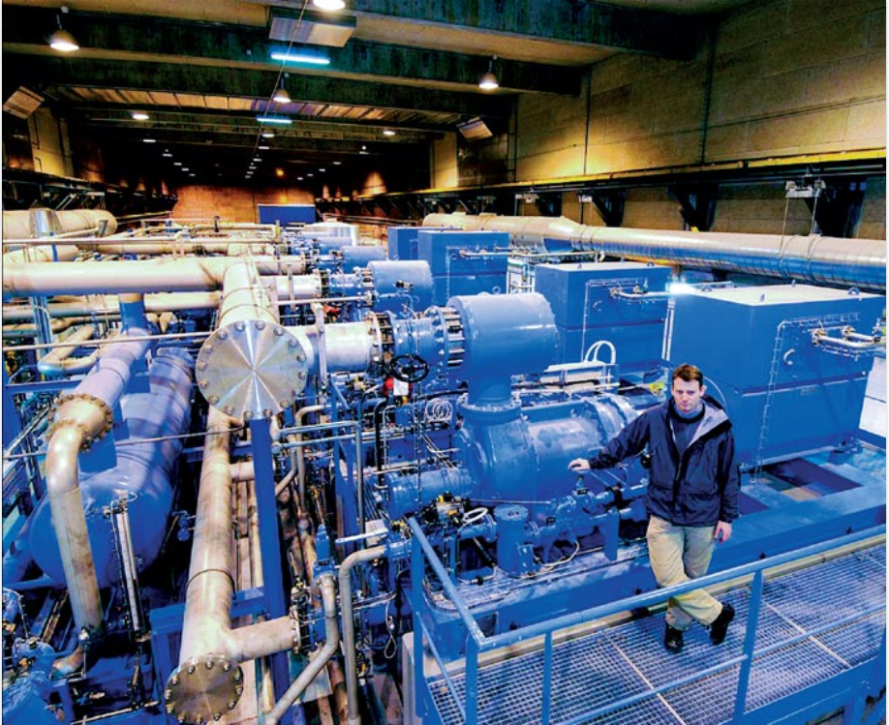
System
Major top assembly that would normally contain many sub-components (systems, positions, assets etc)
Examples of systems:
  Compressors
  Buildings
  Vehicles
  Particle accelerators
  ..

Slide 5


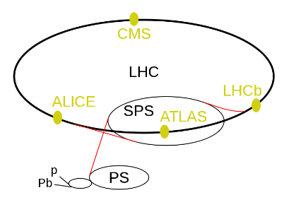

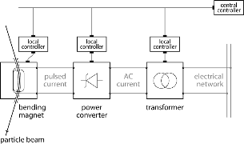
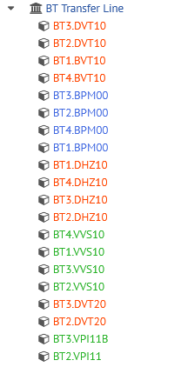

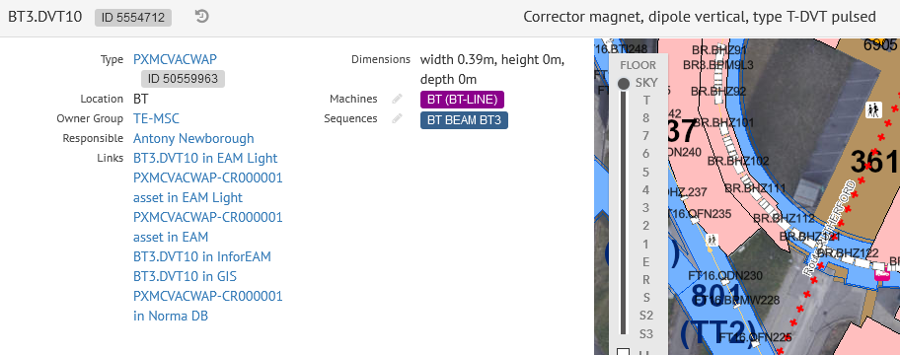
Functional positions (static need)
C4
We need a new XYZ
C5
C3
Mainly accelerator functional positions
https://layout.cern.ch
(ECR documents)
C6
C7
C1
The C system
C2
CL controls
Describe
functional
requirements!
MB
magnet
RC
converter
ET
transformer
Notes:
Functional position is a position in a process. It is not a physical position.

Slide 6
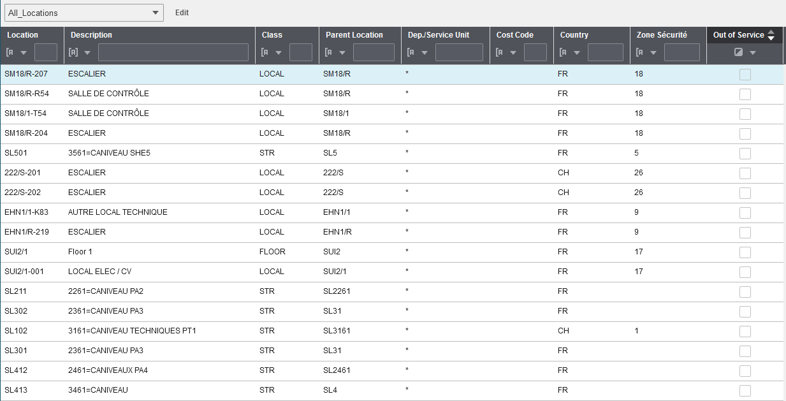

Location
Physical position of the equipment
EAM synchronised to GIS database daily
Location field in EAM Light

Slide 7

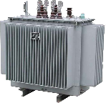
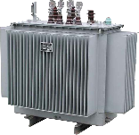
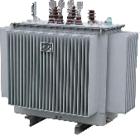
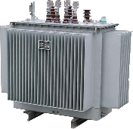
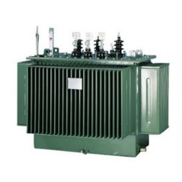
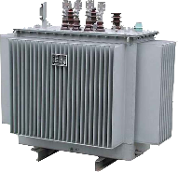

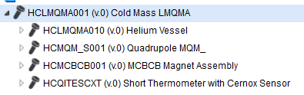
Parts (piece)
Hey, both correspond to the spec.
Describe what we got!
- Assembly that one can enter into inventory / store
- Can be assigned to a class / category (more later) and linked to an item
Example of part (big magnet assembly)

Slide 8
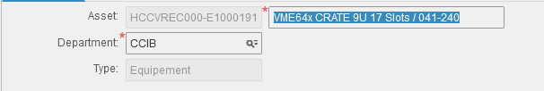


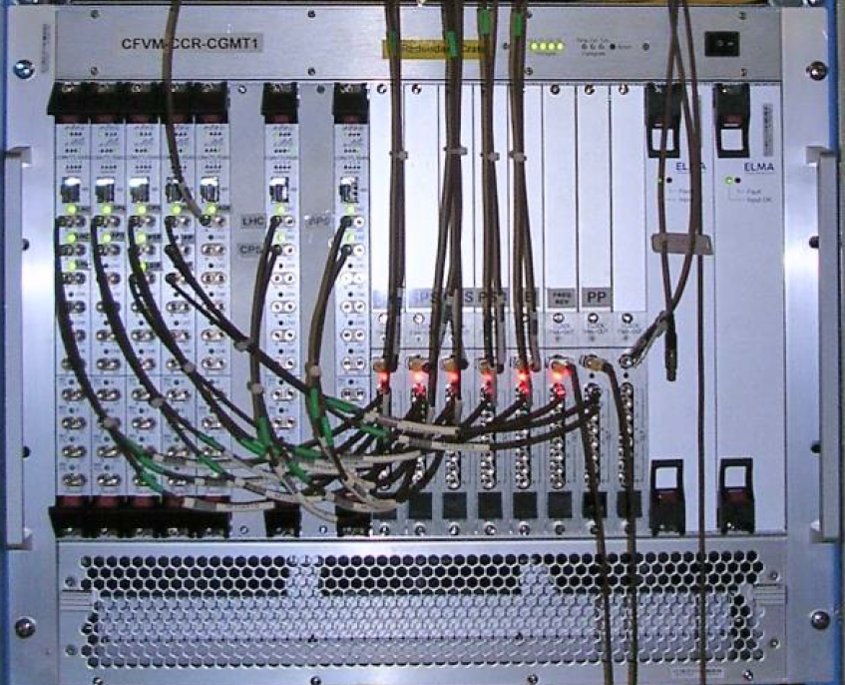
Assets
Assets are uniquely named instances of a part
Example: VME crate maintained by BE-CEM:
We need to change the oil on the pump “EC-013”
Service unit (MRC)

Slide 9
Tools and Interfaces
A modular EAM training

Slide 10
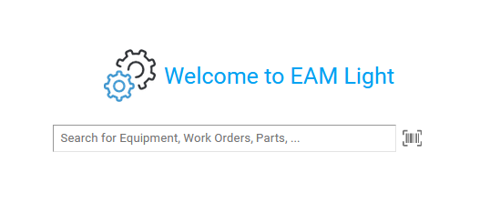
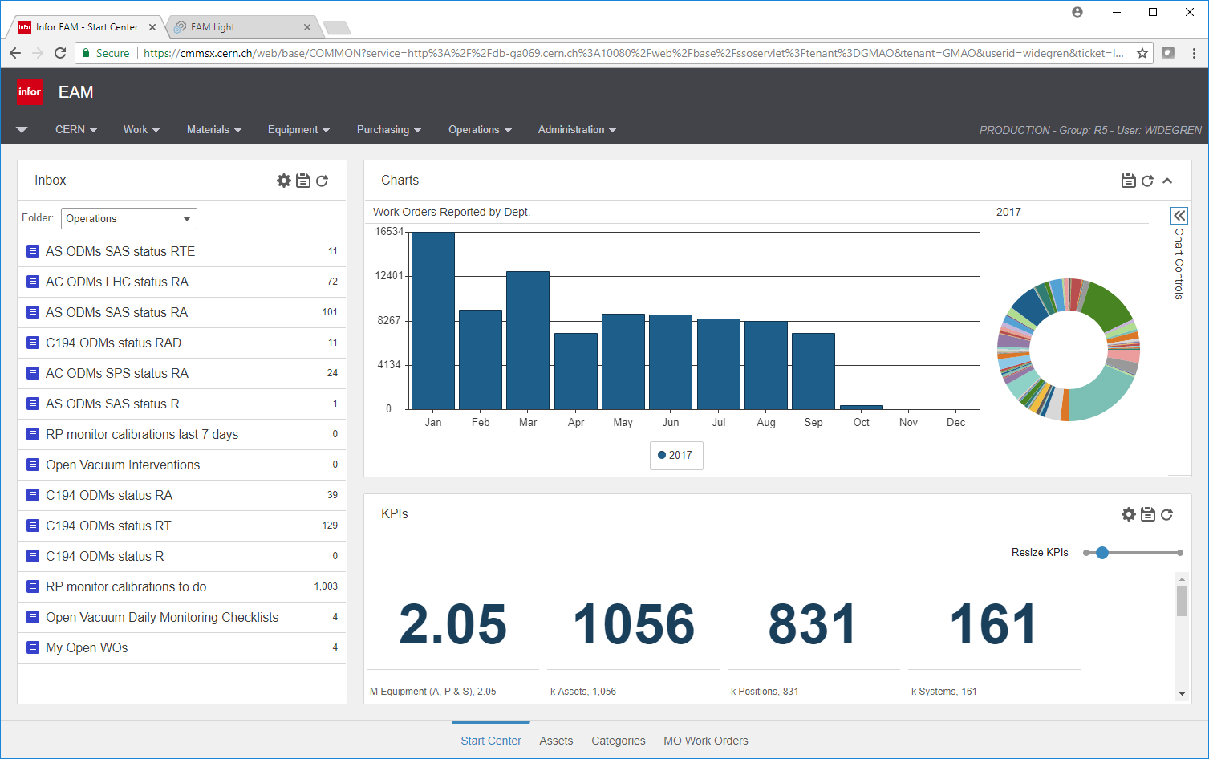
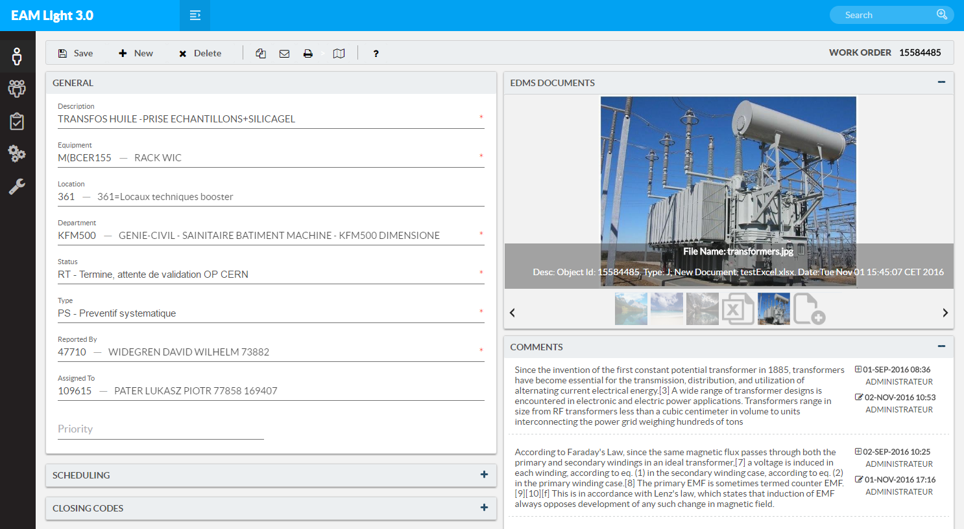

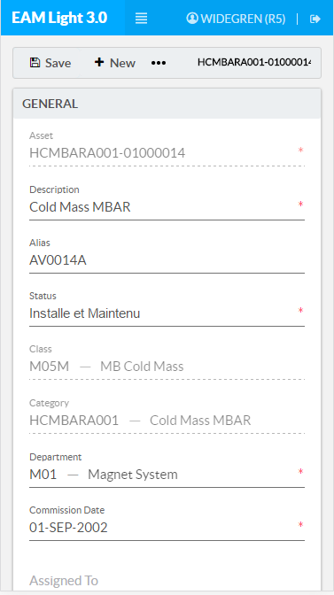

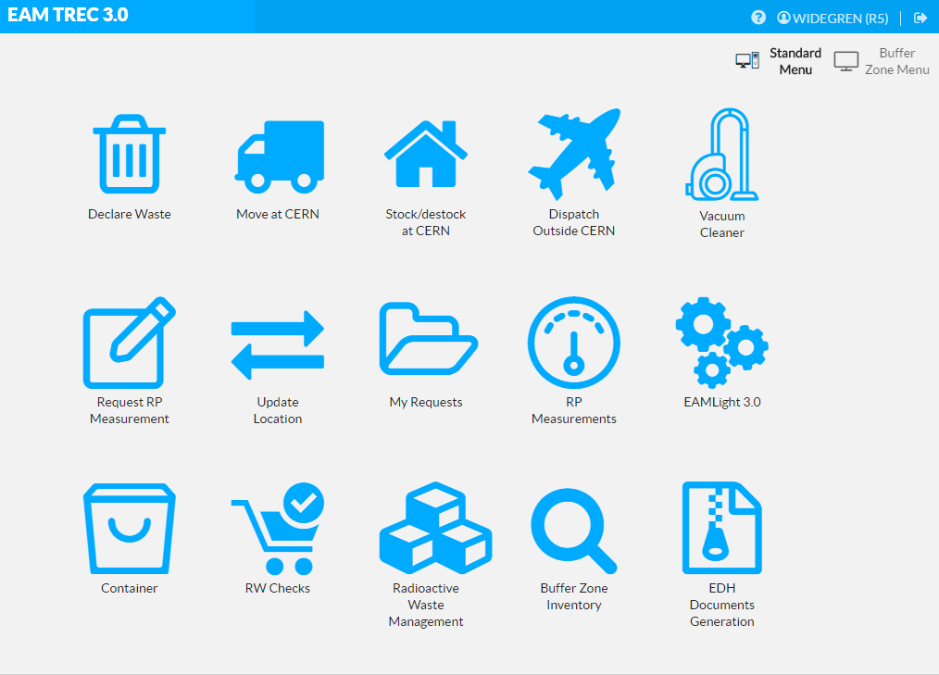
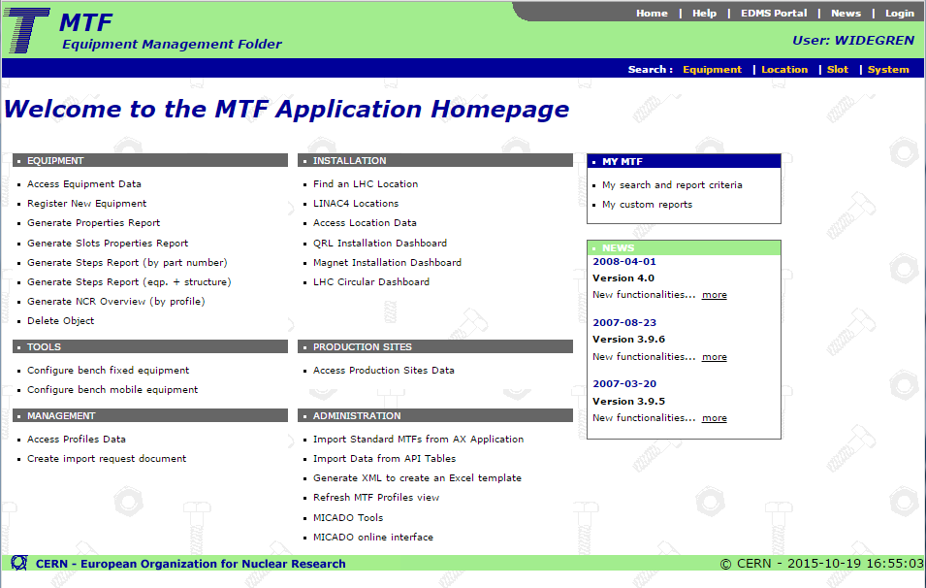


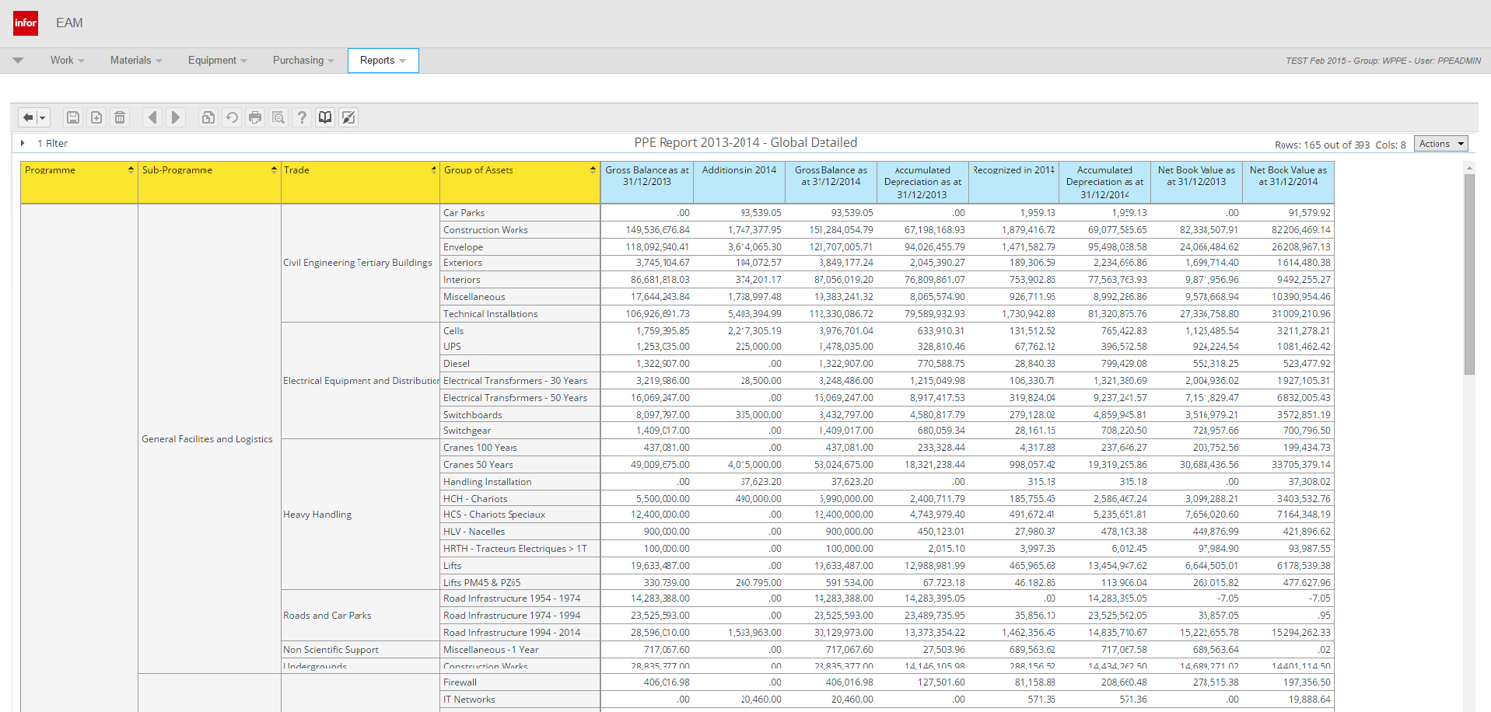


EAM system landscape at CERN
Manufacturing &
Installation
Operation &
Maintenance
Disposal & Waste
Management
EAM
Enterprise Asset Management
TREC
Radioactive Traceability
MTF
Reporting & BI
Business Intelligence / Reports
Financial Depreciation
Plant, Property & Equipment
TEST (play/test, CERN only) and PROD (work, CERN and outside)

Slide 11

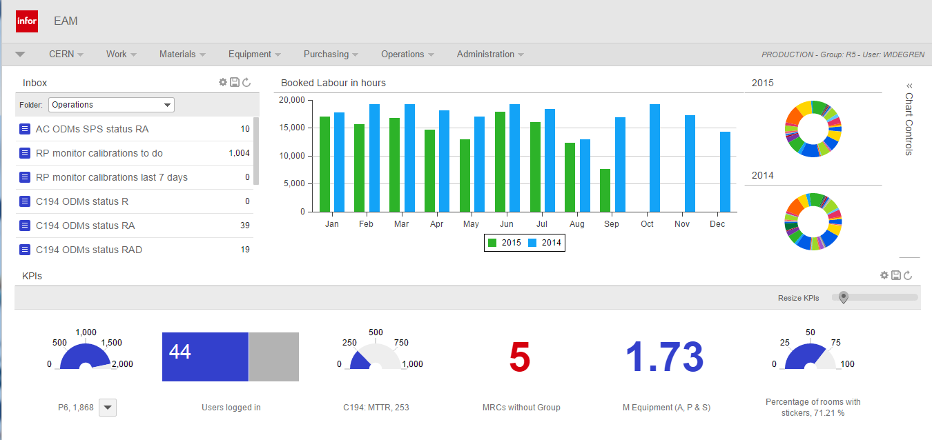
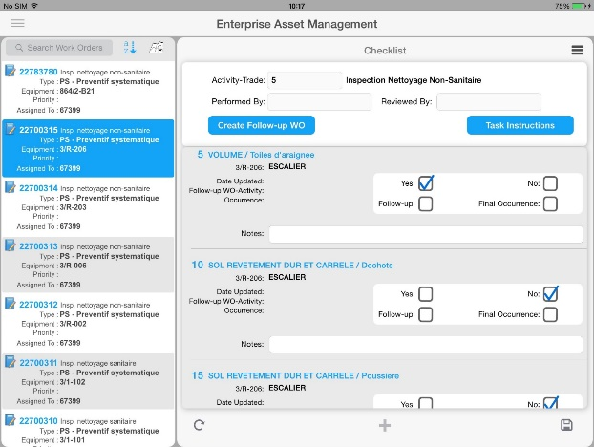
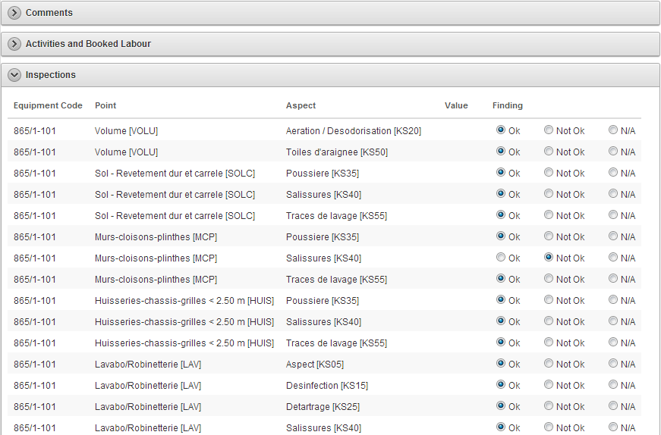
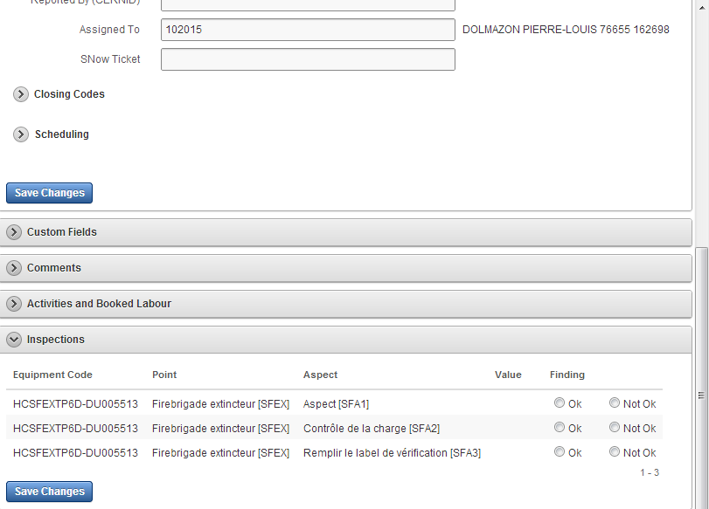
Native EAM interfaces
Not supported
EAM
Full/Expert/Extended Web Interface
Infor EAM Mobile
Offline Tablet Application

Slide 12
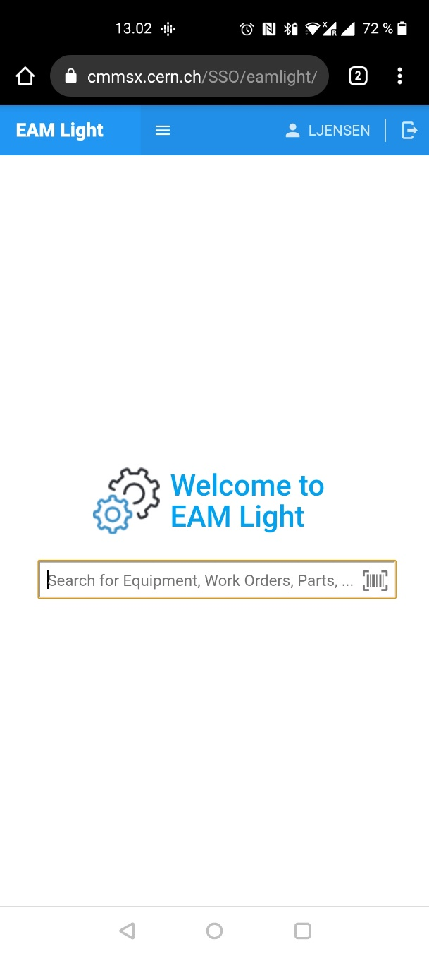
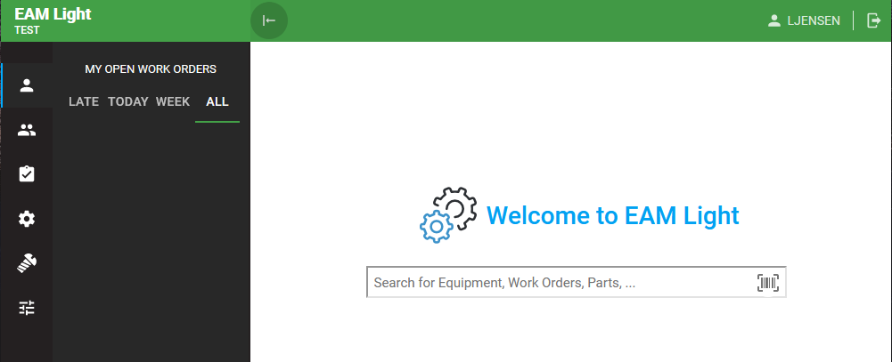
CERN EAM Light (web application) https://testeamlight.cern.ch/

Slide 13
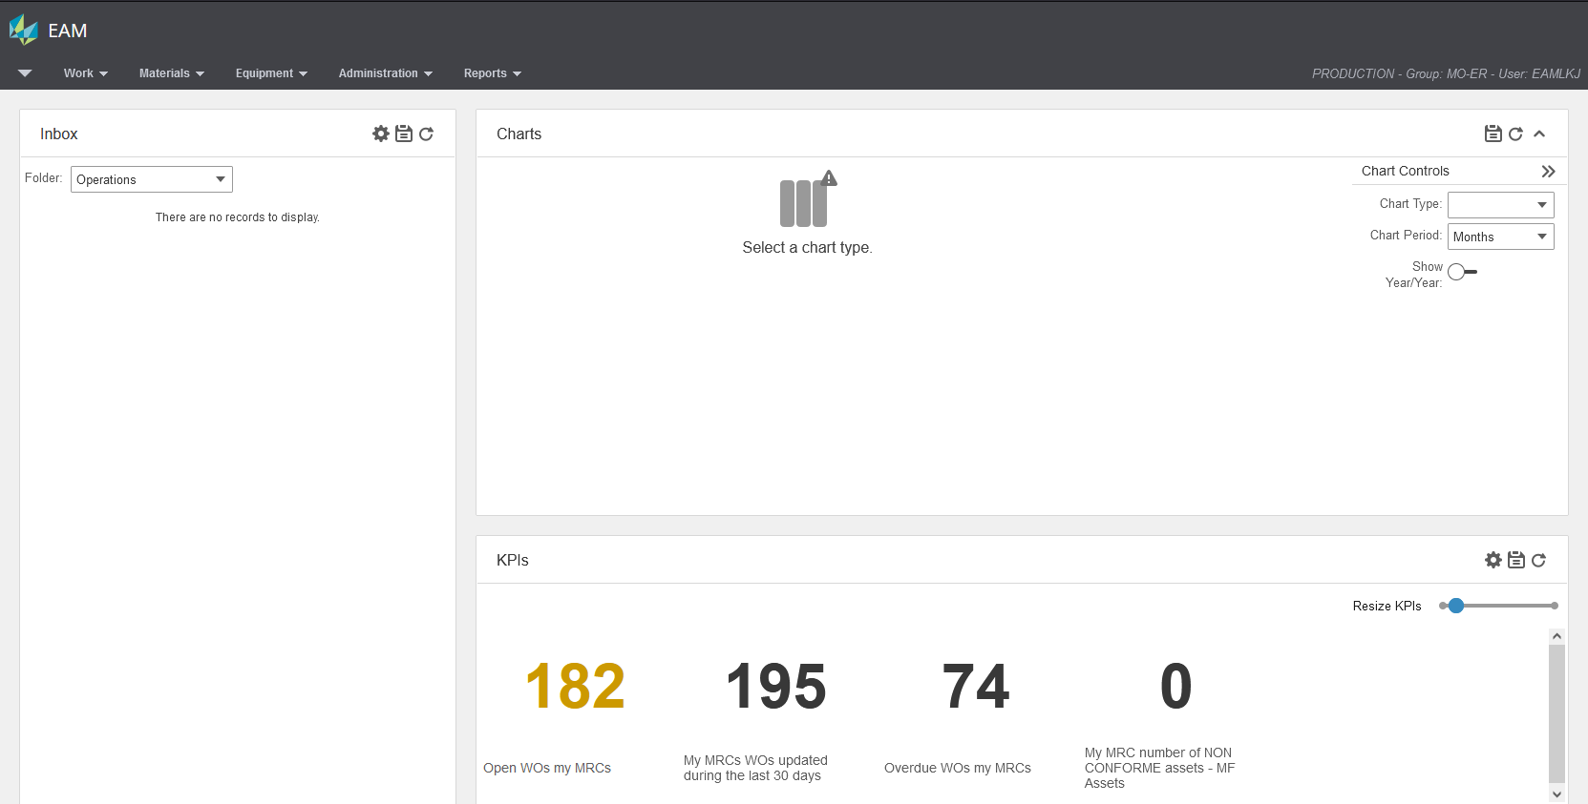
Native Interface (extended)
Access: PROD: https://eam.cern.ch
User details
Menus
Inboxes
Charts (configuration)
KPIs (configuration)

Slide 14
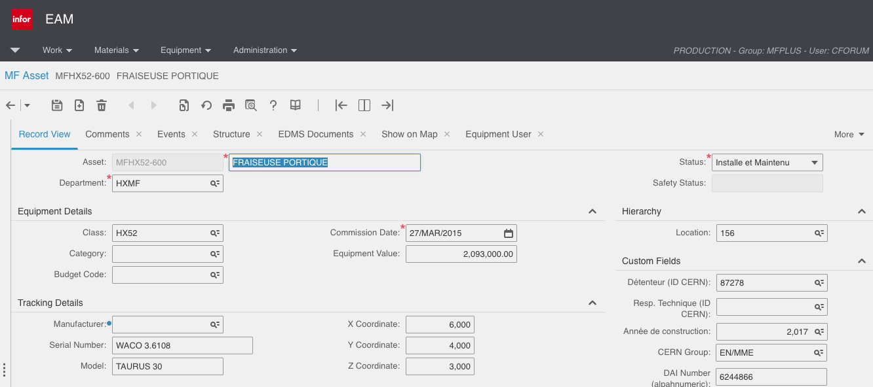
Native interface (extended)
Reset/
Refresh
New
Save
Record-/Split-/List-
View
Copy/Clone

Slide 15
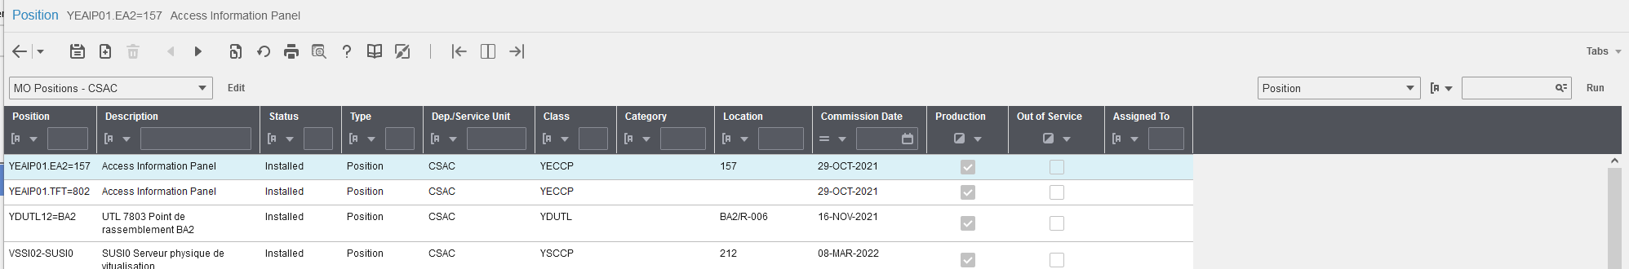
Search functions in EAM extended
Personalize
filters
Execute filter
Preconfigured
filters
Quick filter

Slide 16
Your turn: exercise #1
Aller sur EAM eam.cern.ch avec votre login / password
Verifier que vous etes tous dans le user-group “MO-ER”
Tache:
  Aller dans le menu ‘Equipment’ -> ‘A
  Trouver les positions appartenant au Dep/Service Units:
    CSAC - Software access control
    CSCV – Software cooling and ventilation
    CSEL – Software electrical distribution
  Trouver les positions en Status ‘Installed’ et ‘hors service’
  Verifier acces au ‘Data Spy’: MO Positions
  Faire son propre data-spy

Slide 17
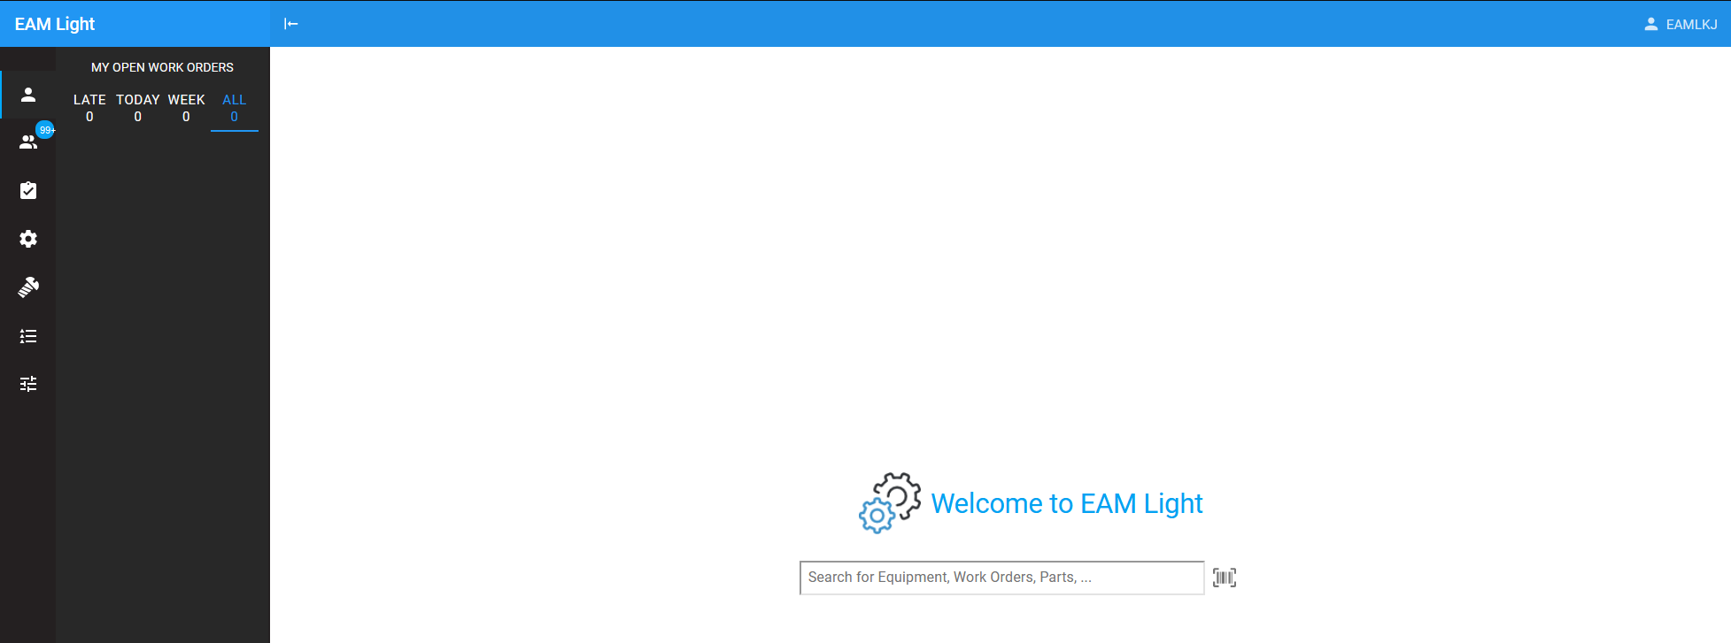
EAM-Light
Prod: https://eamlight.cern.ch
Open Work Orders assigned to me.
Open Work Orders assigned to my Department(s).
Work Order menu
Equipment menu
Materials menu
Quick Search

Slide 18

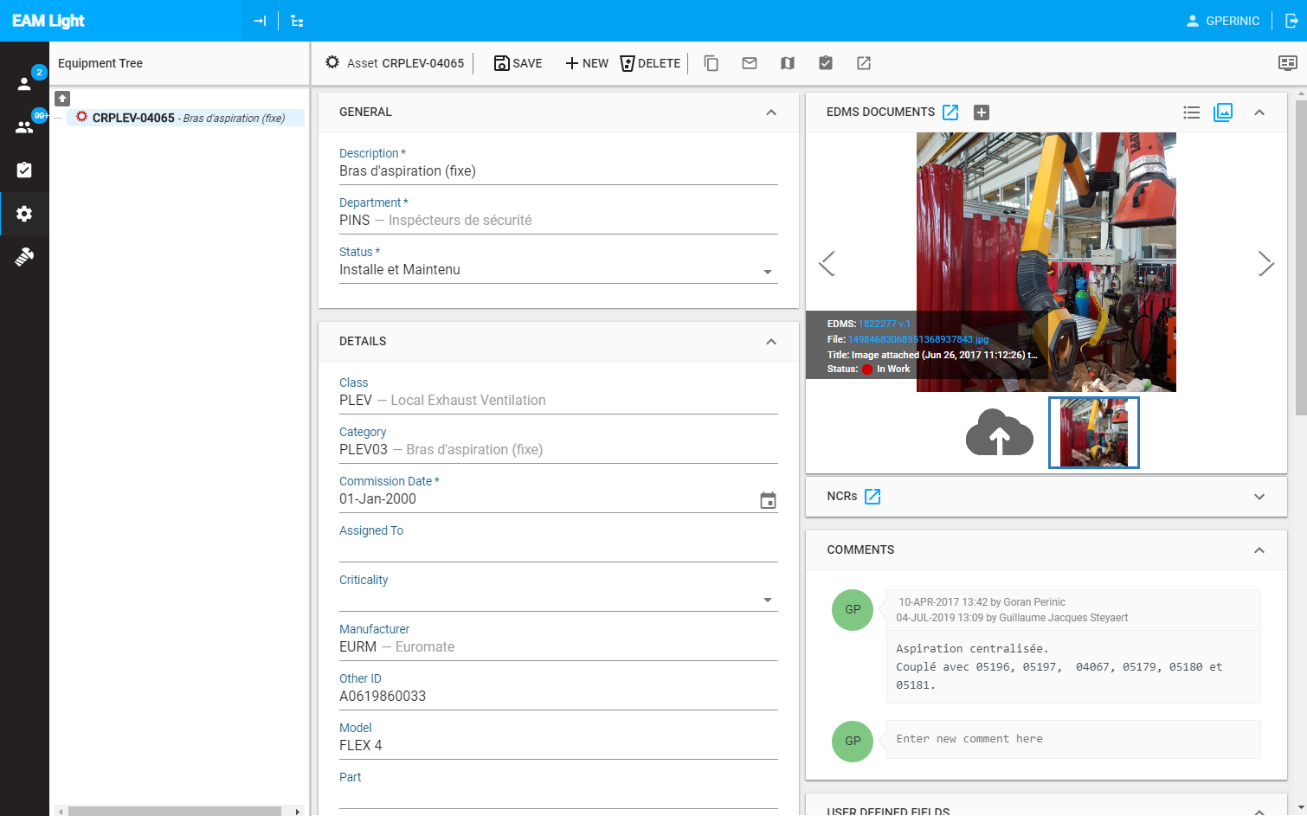
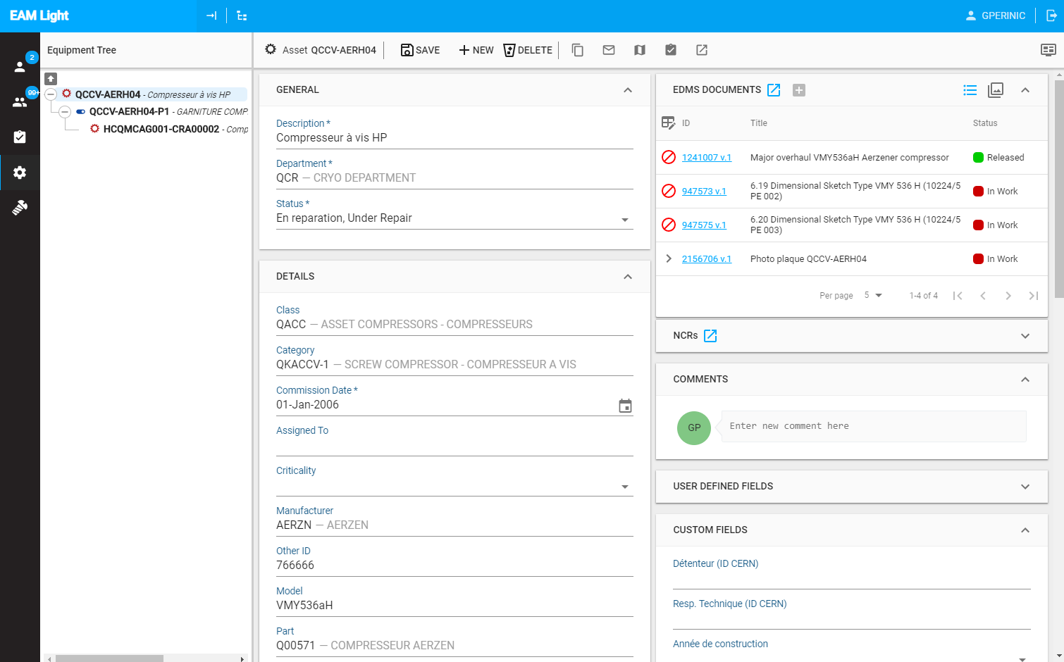
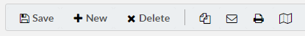
EAM-Light
Open in
EDMS
Toggle
List <->
Picture
Copy/Clone
Mail link
Show on Map
Create WO
Show in EAM

Slide 19
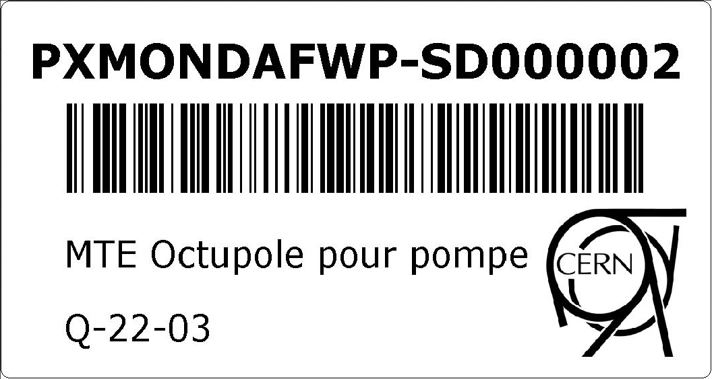
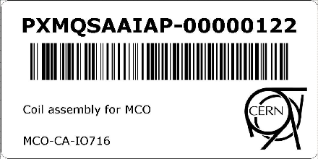



Identify the equipment - barcode printing
Identify pieces of equipment by the means of labels that contain barcodes or QR-codes.
Labels can be printed from within EAM, from the Equipment Generator and from the Kiosk application on compatible network label printers.
Printer & label recommendations and instructions: https://edms.cern.ch/document/1728014

Slide 20
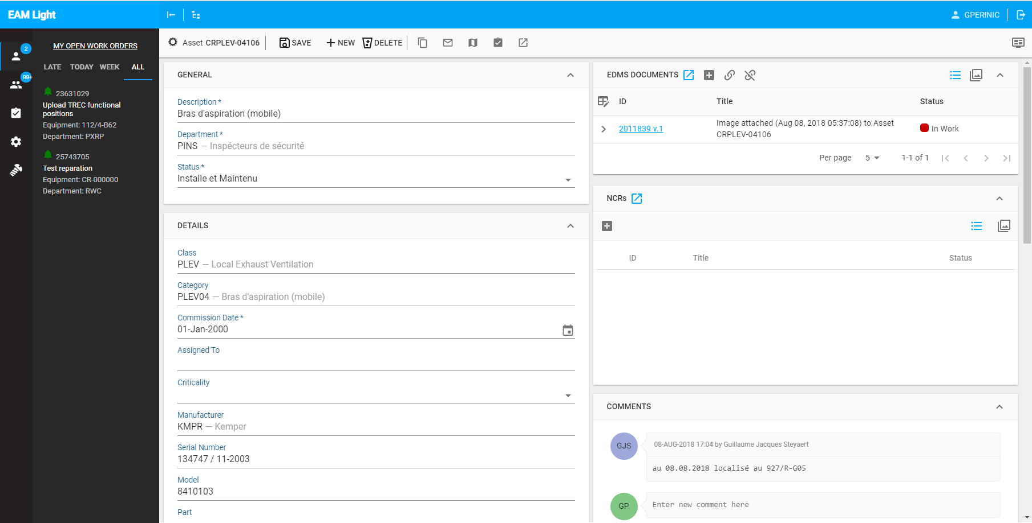
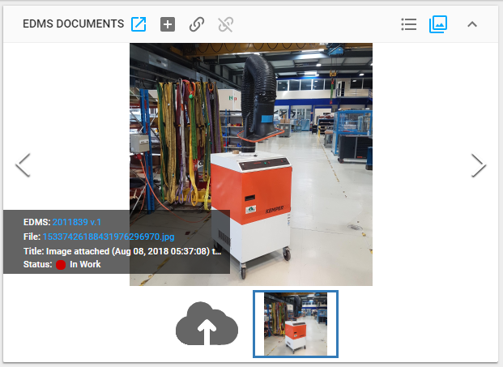
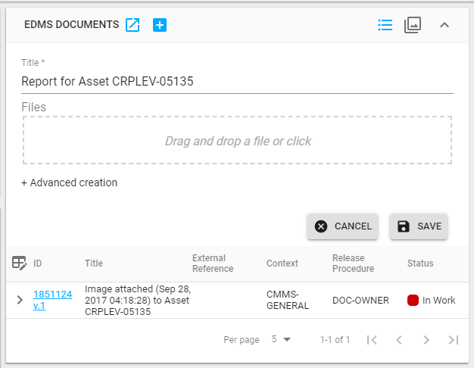
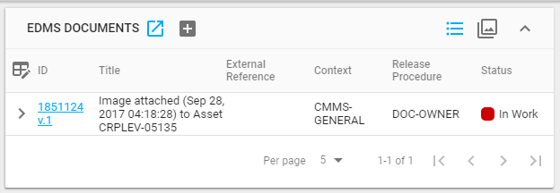
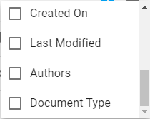
Attaching or linking documents – EAM-Light

Slide 21
Parts quick introduction
Parts in EAM are types of material used during activities (ODM)
Two part categories:
  Tracked by quantity (consumables) (UoM = pieces, m, l, % ..)
  Tracked by asset (valuable equipment)
Parts can be entered into an EAM store (magasin)
Parts can be used on assets (-> assets also into a store)

Slide 22
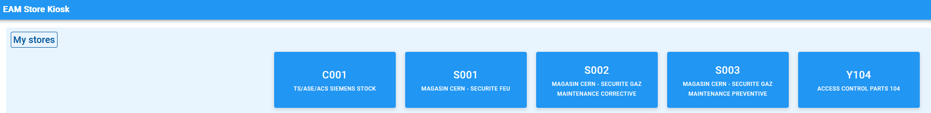
Store quick introduction
EAM stores pour tracer des parts
https://eamkiosk.cern.ch/
Membres du MO-ER ont acces a ces stores (tous en batiment 104):

Slide 23
Store exercise
Aller sur eamstore.cern.ch and select the store: ‘S002’
Check what we have using ‘Search’

Slide 24
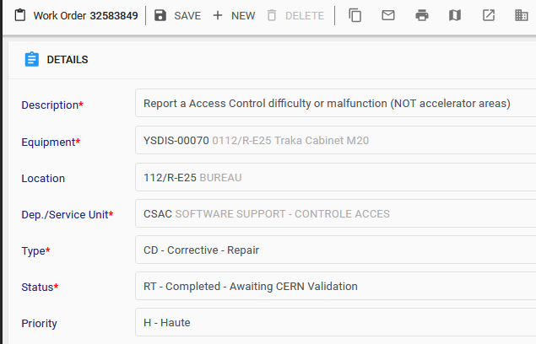
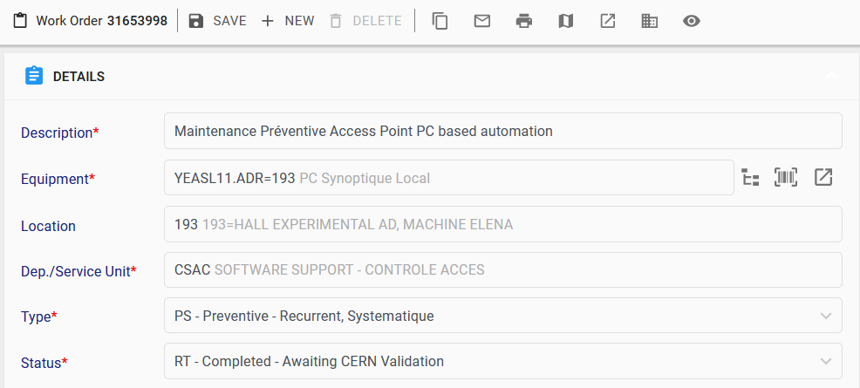
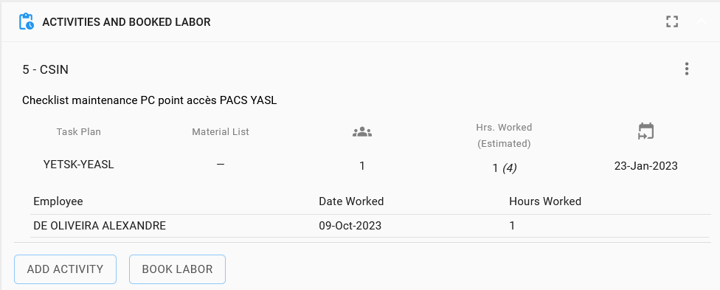
Work-orders – details et activites

Slide 25
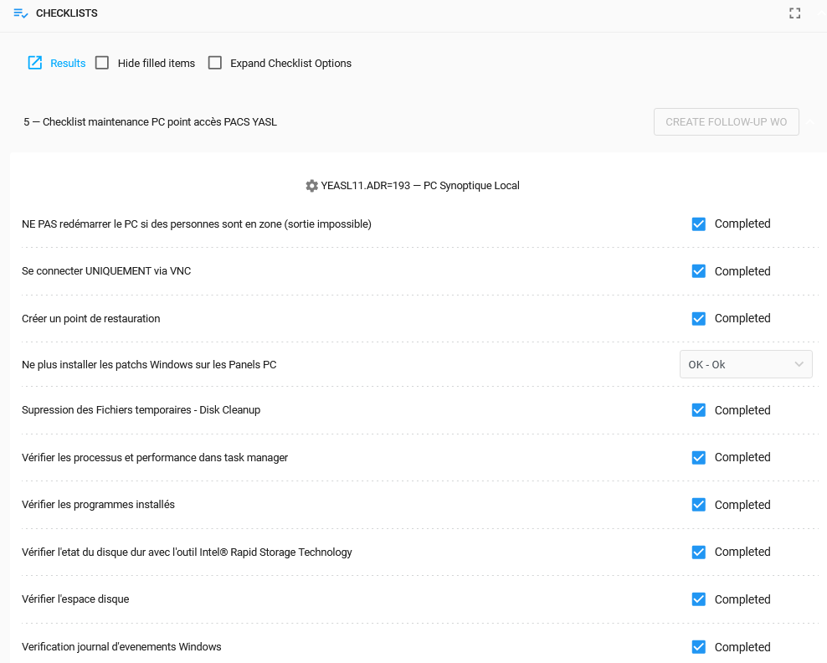
Work-order - checklist

Slide 26
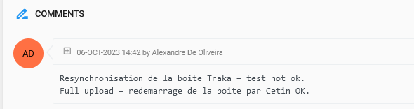
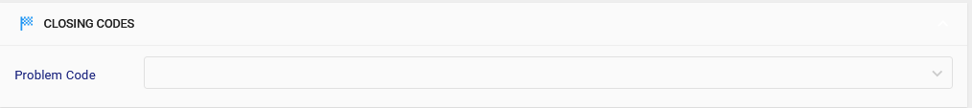
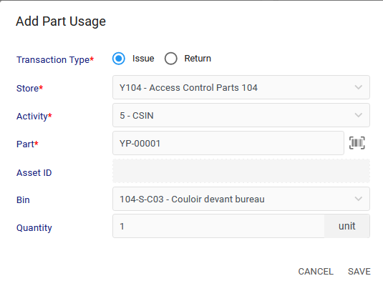

Work-order – comments/closing codes/parts

