Slide 1
Korea-CERN Cooperation Program
Expansion Plan
Oct. 27, 2023
Inkyu Park (University of Seoul)
On behalf of Korea-CERN program members

Slide 2
Korea-CERN Cooperative Program

Slide 3
Prehistoric participations
Indivisual participations
  60’s ~ 70’s … ?
  late 80’s ~ 90’s
    ALEPH (KWNU, KU)
    L3 (KAIST)
  late 90’s ~ 00’
    CMS (KU, KNU + >10 institutions)
      the biggest participation ever
    CHORUS, OPERA (GNU)

Slide 4
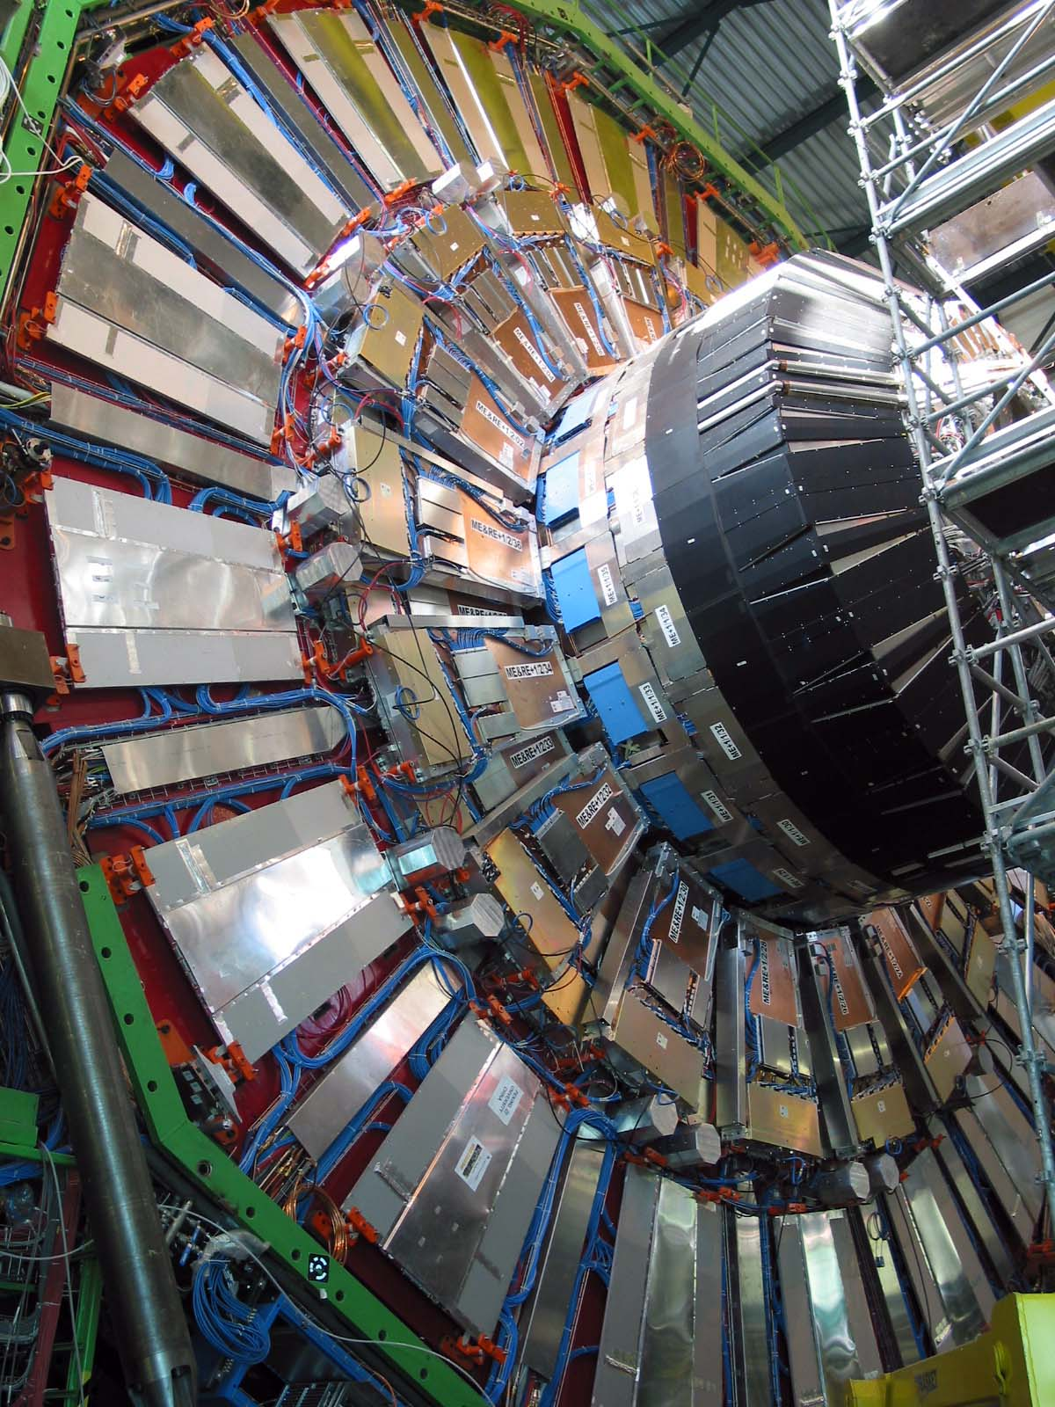
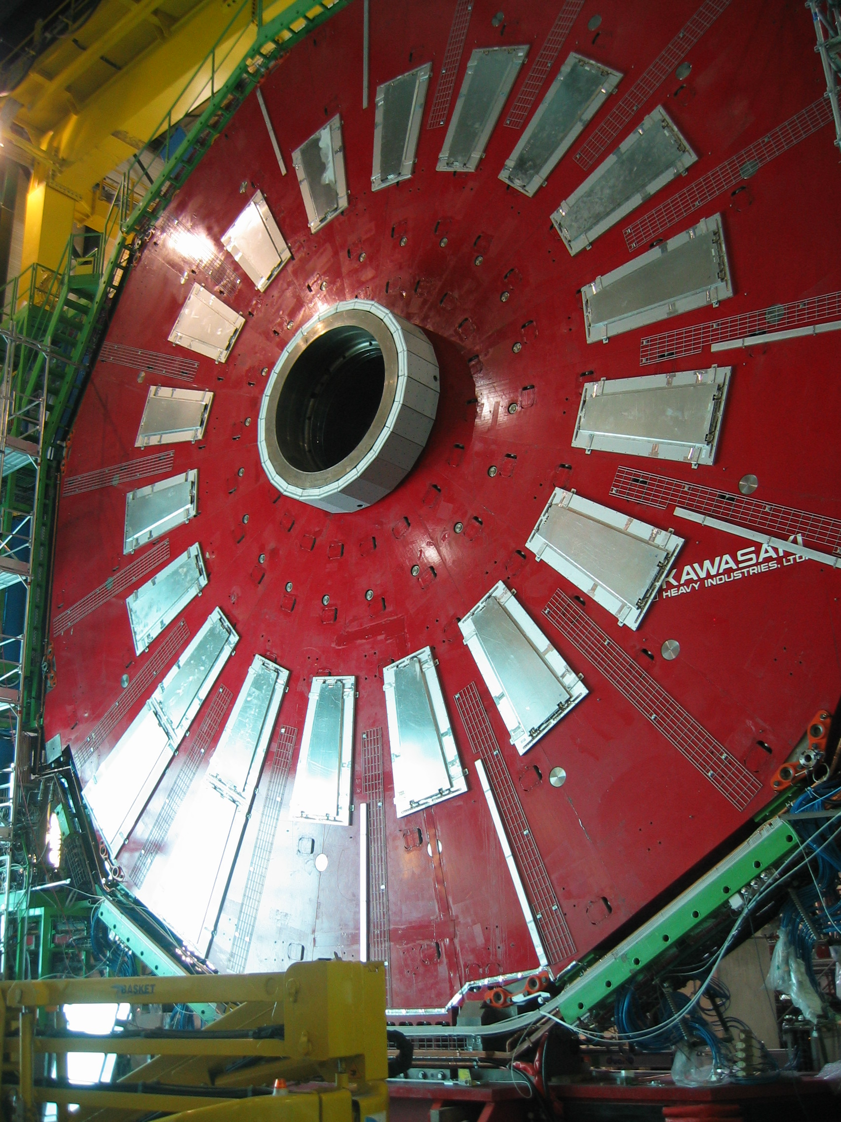
1996-2006: Participations from universities
Early voluntary individual participation in CMS - RPC construction

Slide 5
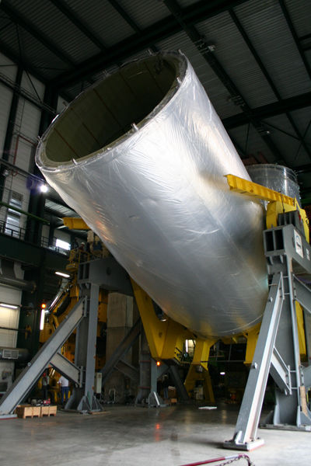
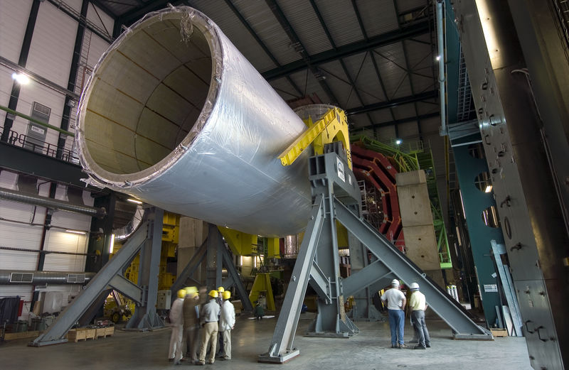
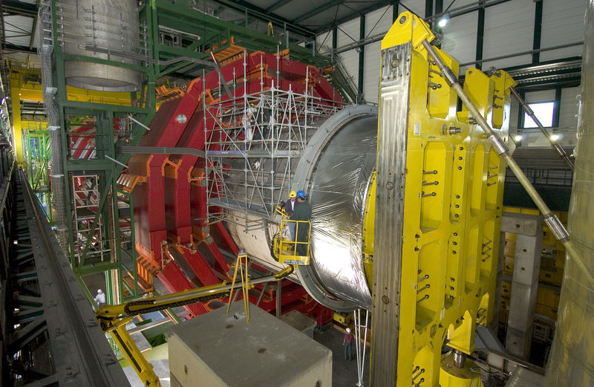
1996-2006: Industry participation
Participation of Korean companies: CMS Magnet swiveling apparatus (Dong Yang HI)

Slide 6
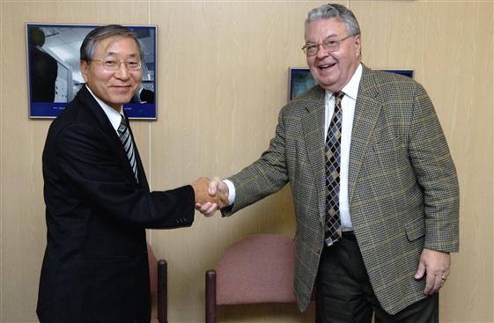
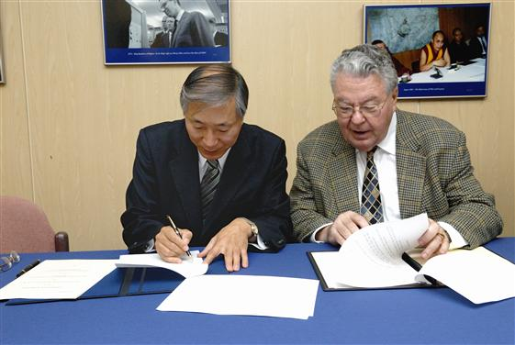
2006: The birth of CERN-Korea Program
MOU exchange for Korea-CERN Cooperative Program
Ambassador Wonhwa PARK – Director General Robert AYMAR

Slide 7
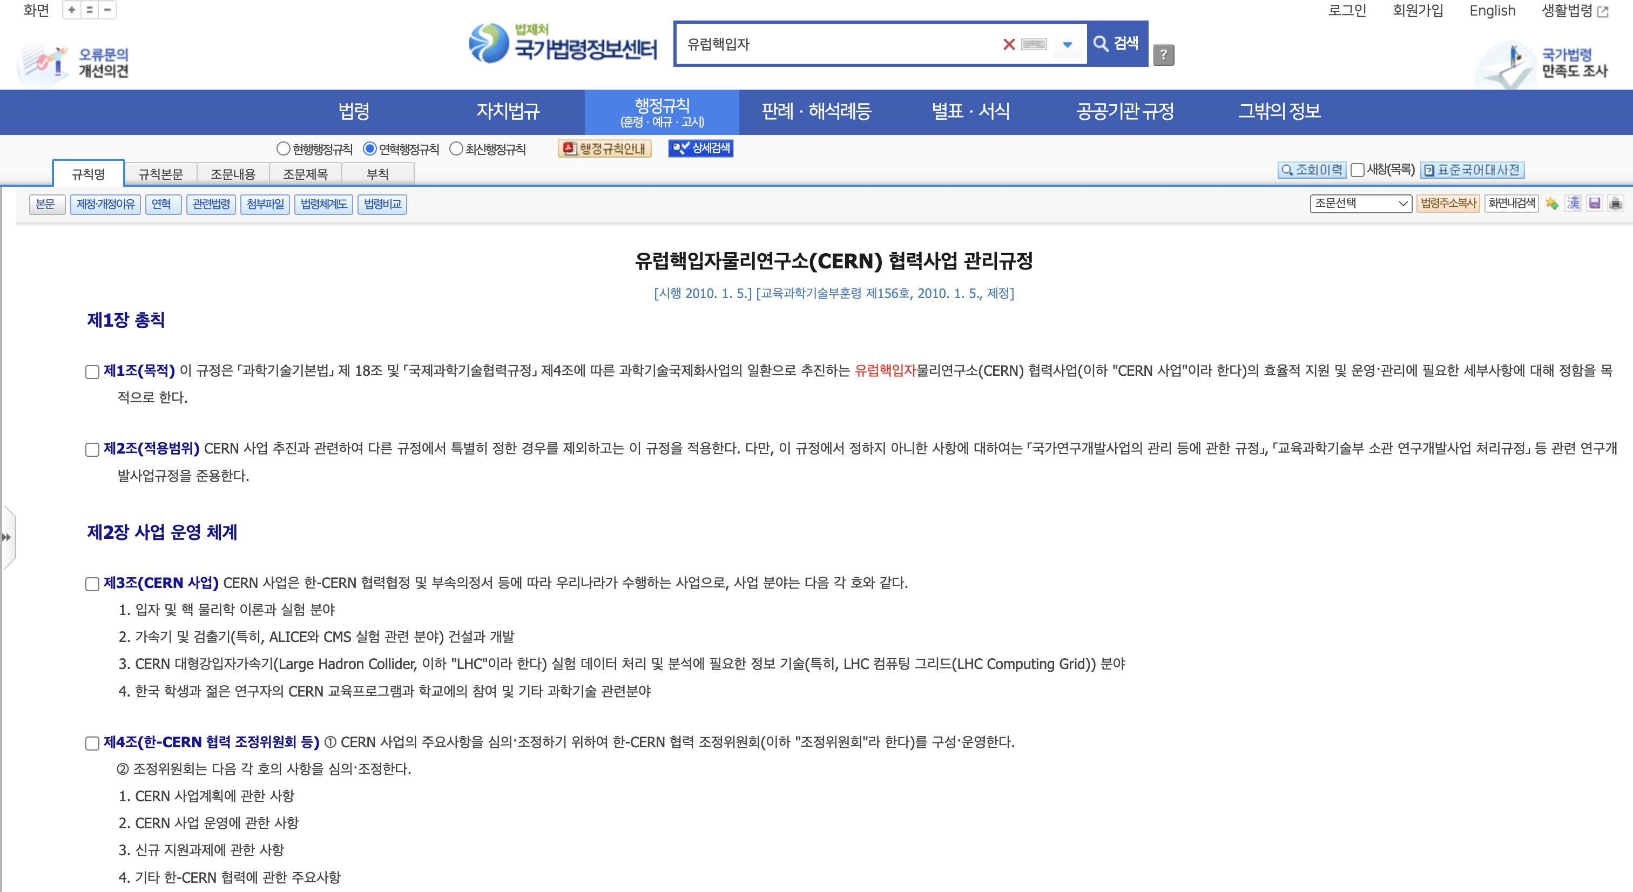
CERN cooperative program statute
National Law Information Center
CERN Cooperative Program (Instructions)
Enactment: 2010.10.5 (MEST-156)
Final Revision: 2018.6.12 (MoS&ICT)

Slide 8



Korea-CERN Program Organization Chart
CERN-Korea
Committee
(CKC)
Korea-CERN Program
Review Committee
KCMS
KoALICE
WLCG
Theory
M&O-A
10 unis.
120 pers.
~ 4 BW
8 unis.
50 pers.
~ 1.7 BW
1 inst.
>10 pers.
~ 3.3 BW
16 univ.
~21 pers.
~ 0.6 BW
MSICT
~ 50 Ph.D.s.
~ 0.5 BW

Slide 9
Expansion of Korea-CERN programs

Slide 10
Motivations
Establishment of a leading international cooperation system
  Leaping basic science and applied research through mega science
  Participation in international big science projects and fostering world-class research groups
Challenges to be solved immediately
  Need a permanent home for the programs
    Currently, we move every 3 years
  Need a common place to work together (e.g. HW R&D)
    Duplication of facilities and equipment

Slide 11
Action items & Expected outputs
Action items
  Full-scale reorganization and expansion of Korea-CERN programs, with accelerator facilities.
    Support programs that Koreans are already participating in. (ISOLDE, SND, Gbar, FCC, etc.)
  Joining CERN as an associate member
    Secure and consolidate collaborative research programs
Expected outputs (Final goal)
  Create a national High Energy Physics lab./center
    Korean version of “INFN”, “IN2P3”, “IHEP”, “KEK”

Slide 12
Associate
Membership
(CKC)
Korea-CERN Program
Review Committee
Office of Korea-CERN Program
KCMS
KoALICE
WLCG
Theory
M&O-A
SND@LHC
Gbar
ISOLDE
FCC
…
GNU
et al.
SNU &
CUP/IBS
et al.
RAON
et al.
Yonsei
et al.

Slide 13
Budget estimation
Associate membership
10 MCHF
Physics programs
(CMS, ALICE, Theory,
+ SND, Gbar, ISOLDE, FCC)
10 BKRW (currently ~3.1 BKRW)
*including M&O-A
Quantum computing
& Bigdata AI
5 BKRW (currently ~3.3 BKRW)
Quantum sensor
& Detector Lab
5 BKRW (currently ~2.2 BKRW)

Slide 14
Backup

