Slide 2
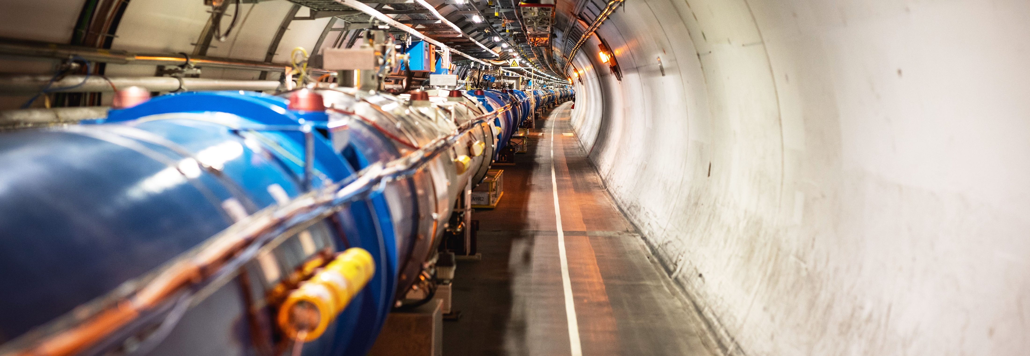
WELCOME TO CERN

Slide 3
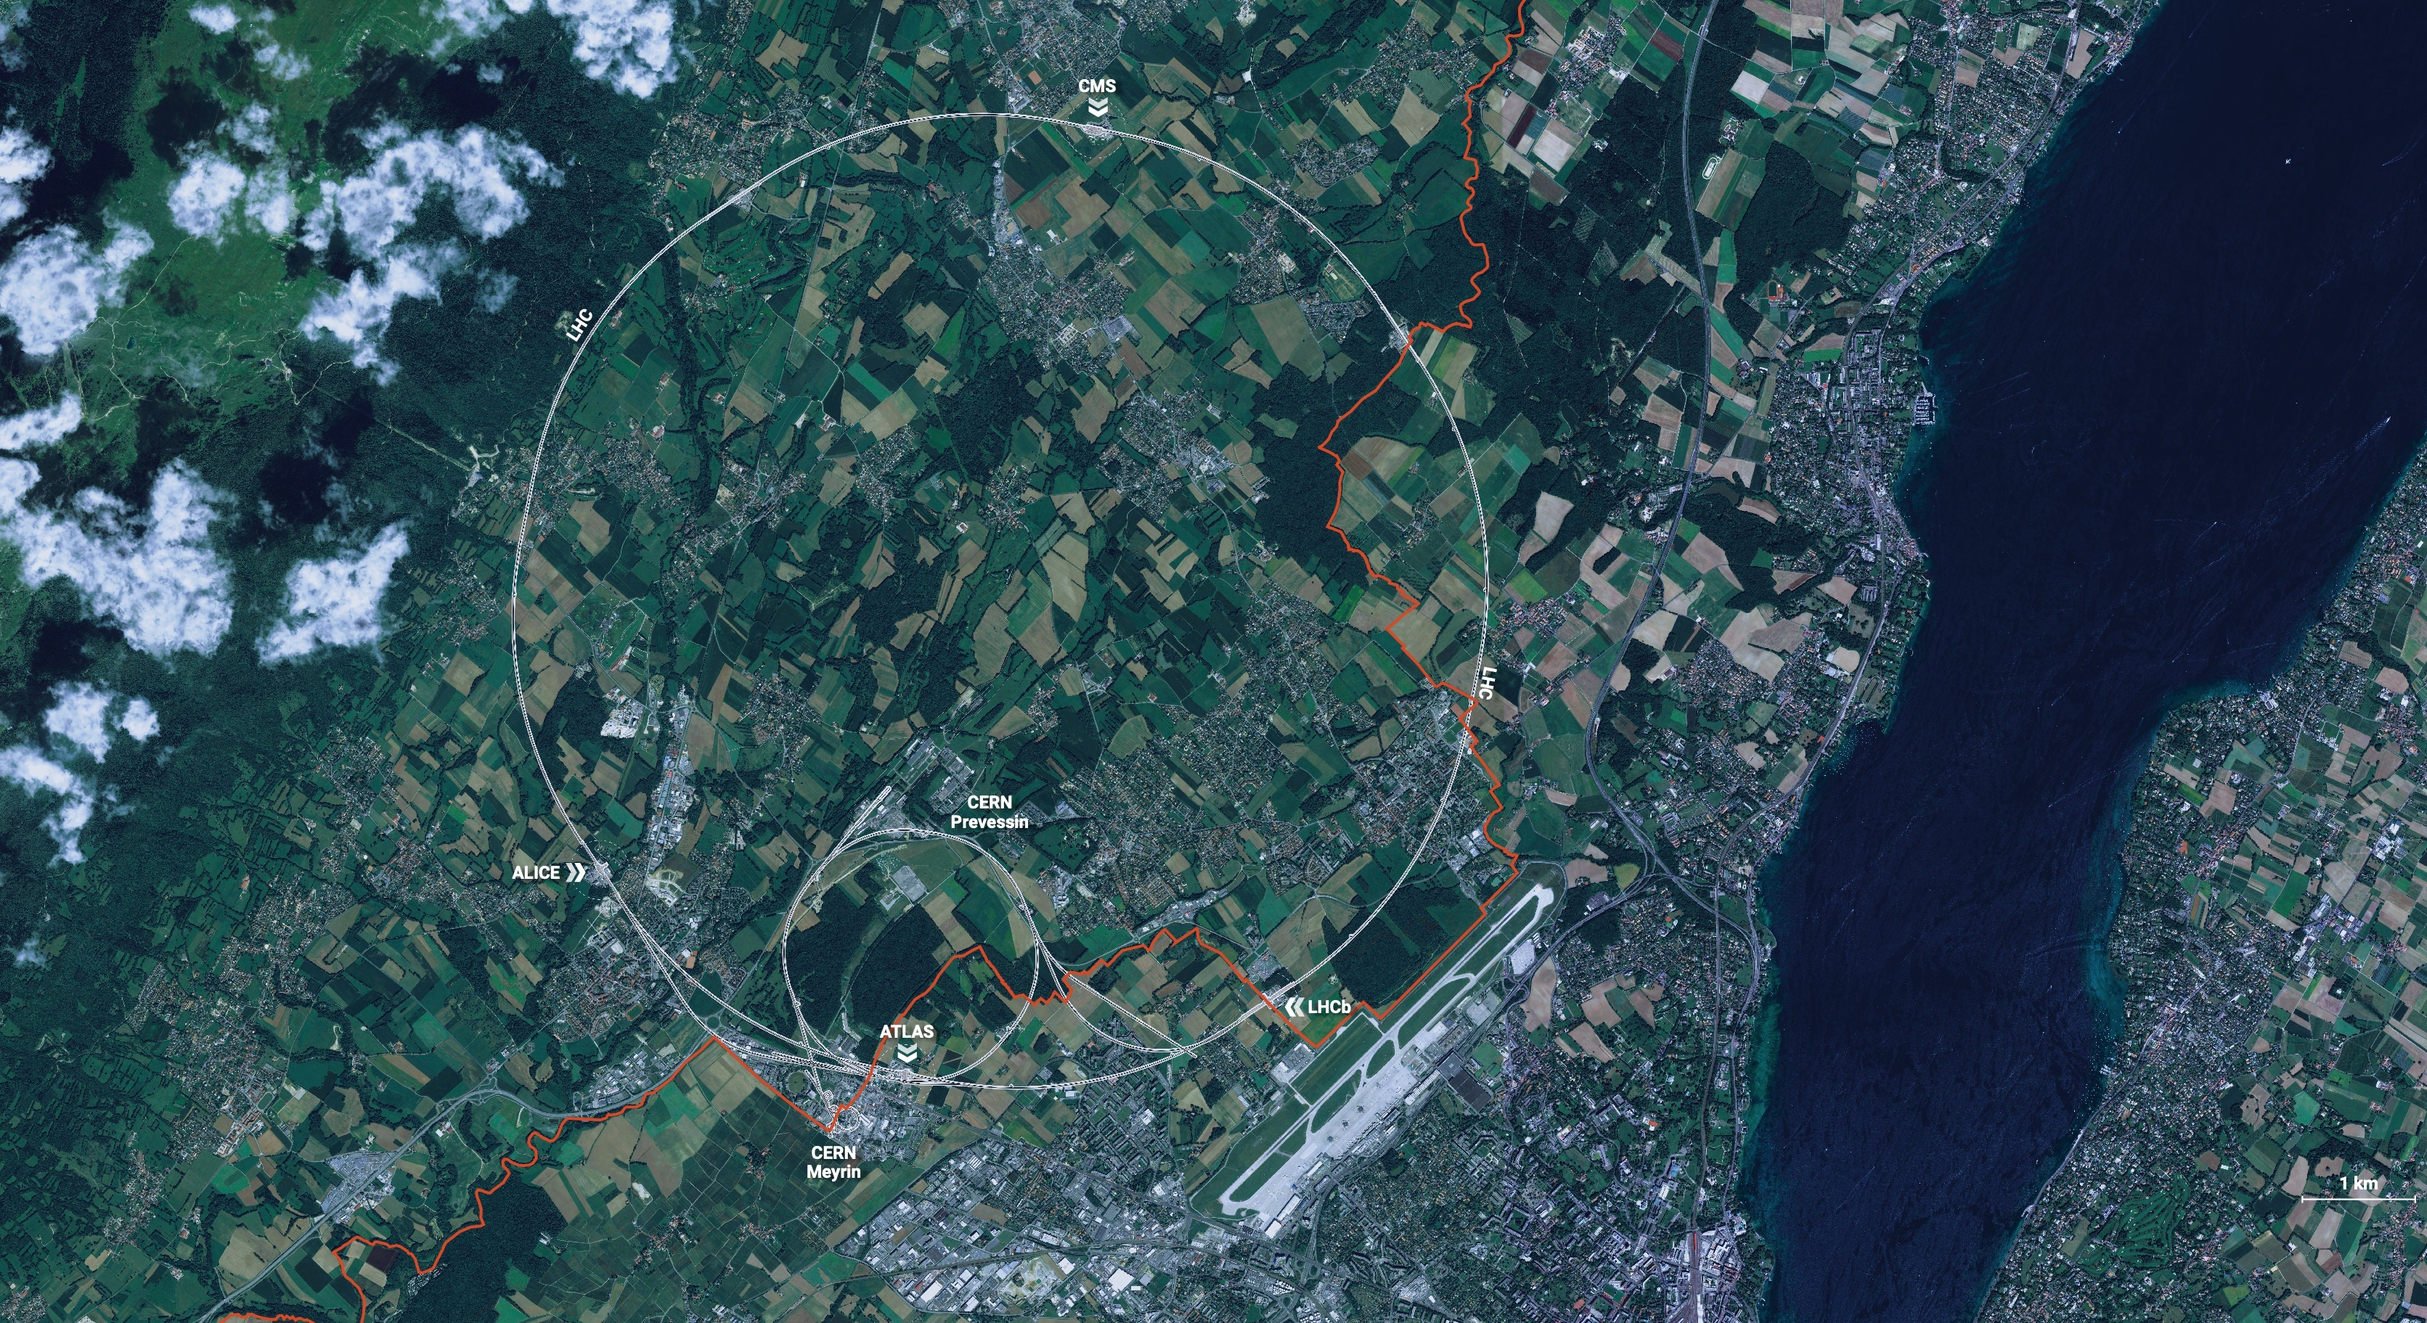
CERN is the world’s biggest laboratory
for particle physics.
Our goal is to understand the most fundamental particles and laws
of the universe.

Slide 4
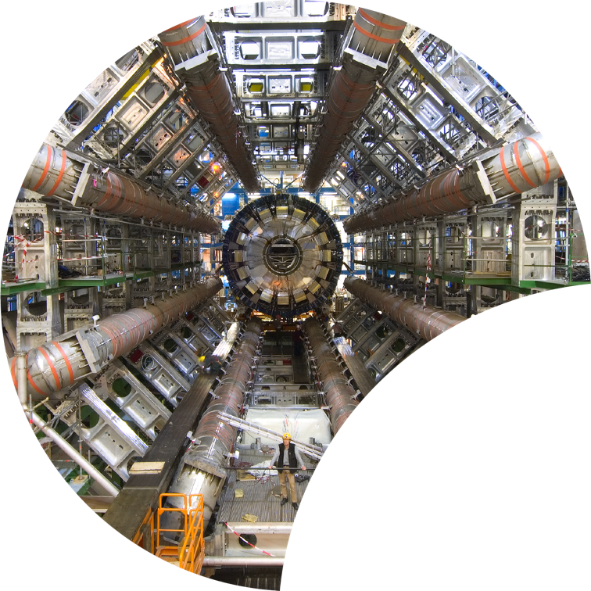
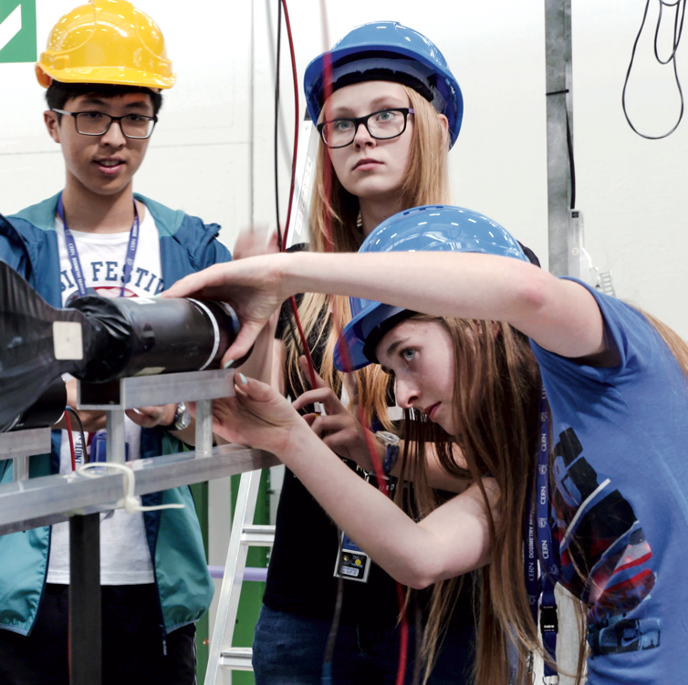
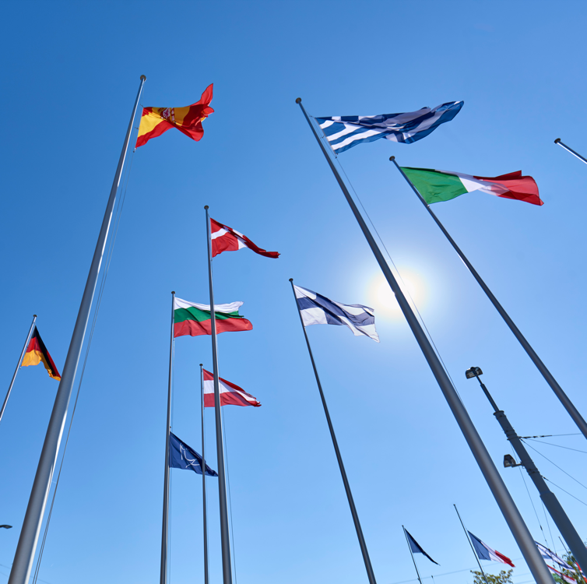
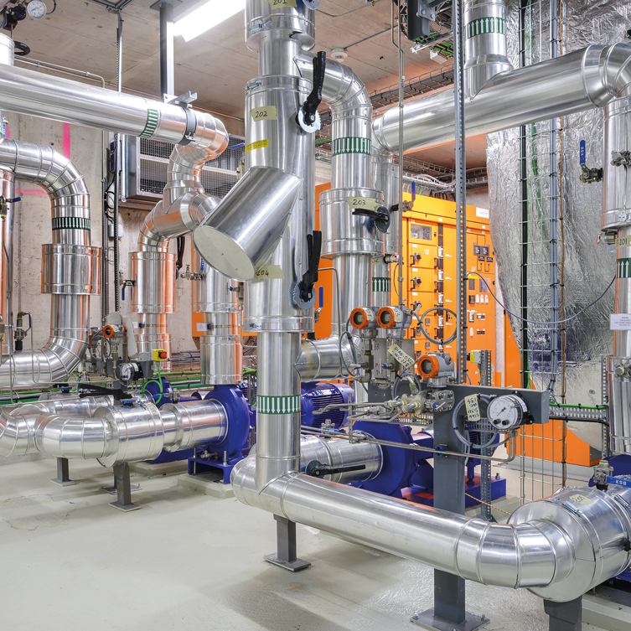

Four pillars underpin CERN’s mission
RESEARCH
EDUCATION
& TRAINING
COLLABORATION
TECHNOLOGY
& INNOVATION

Slide 5
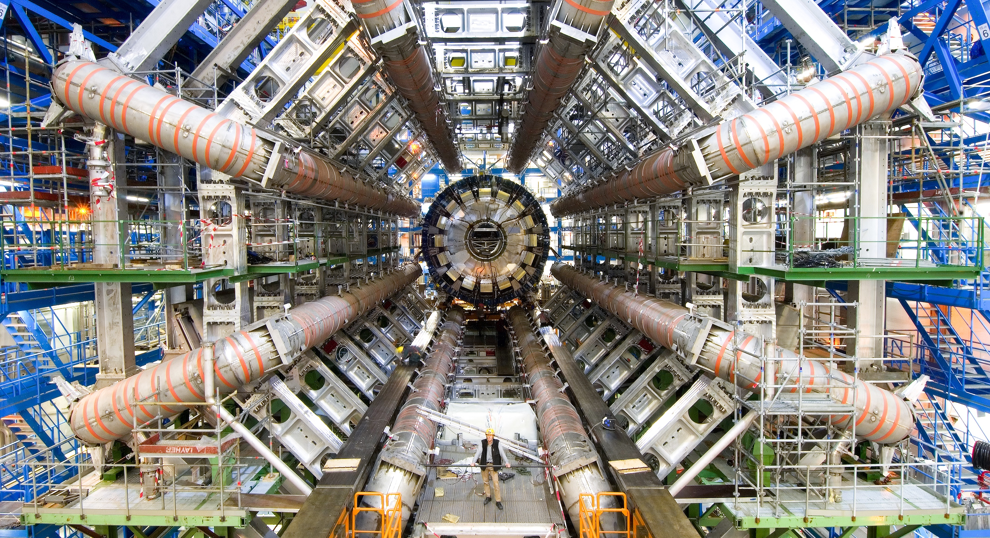
RESEARCH

Slide 6
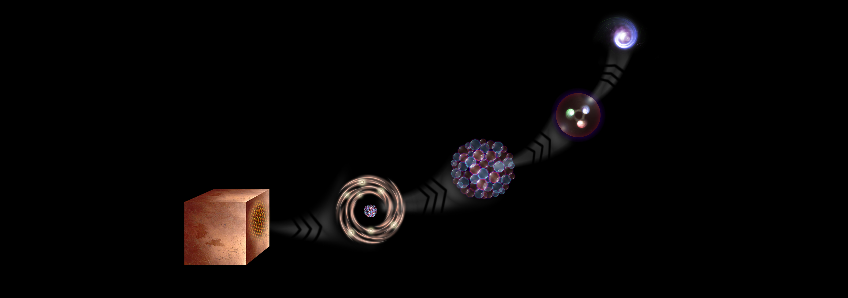
What is the universe made of?
We study the elementary building blocks of matter and the forces that control their behaviour
Quark
<10⁻¹⁸ m
Proton
~10⁻¹⁵ m
Nucleus
~10⁻¹⁴ m
Electron
Matter
0,1 m
Atom
~10⁻¹⁰ m

Slide 7
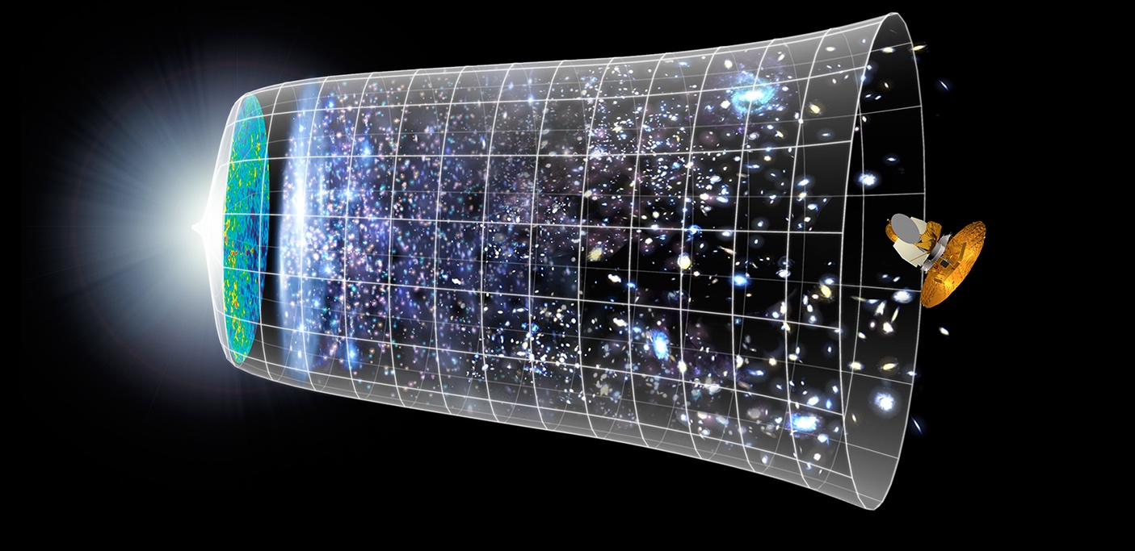

How did the universe begin?
Big Bang
We reproduce the conditions a fraction of
a second after the Big Bang, to gain insight into the structure and evolution
of the universe.
Telescopes
Accelerators
380 000 years
13.8 Billion Years
Today
10²⁸ cm

Slide 8
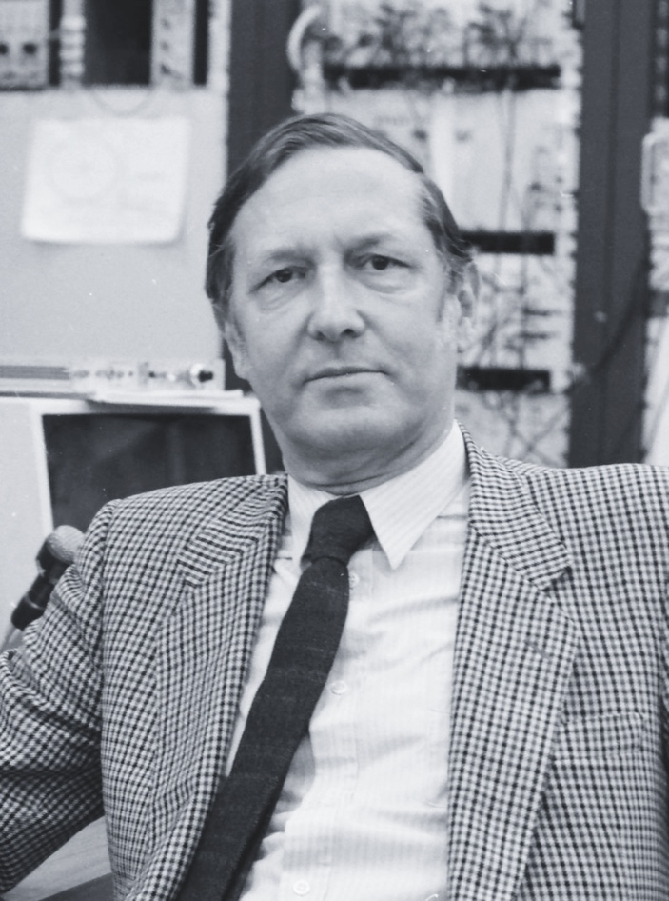
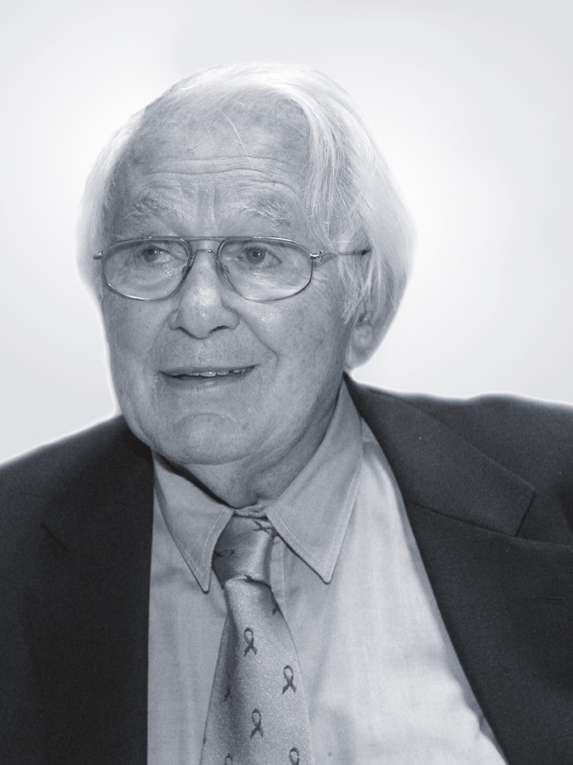
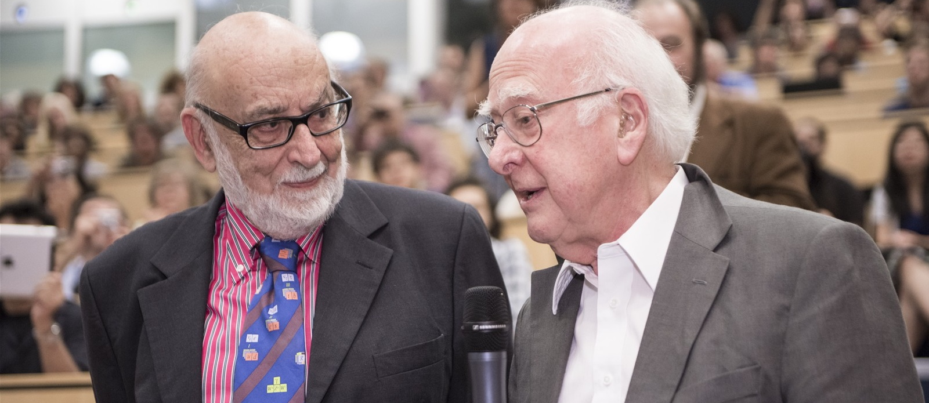
At CERN we help to answer these questions
The Higgs boson was discovered in 2012; without it fundamental particles would be massless
and atoms could not form.
Carlo Rubbia
Simon Van der Meer
Georges Charpak
Several CERN scientists have received
Nobel Prizes for key discoveries
in particle physics.
François Englert and Peter Higgs. With Robert Brout, they proposed the mechanism in 1964.

Slide 9
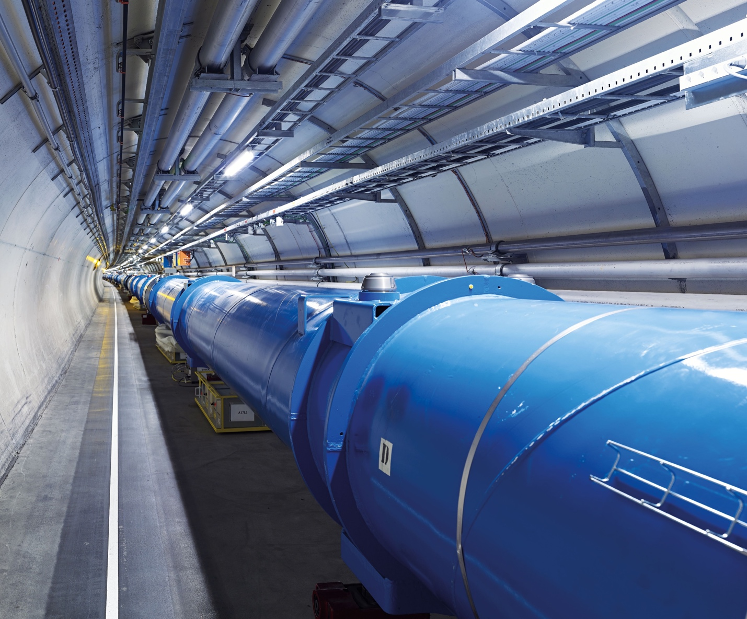
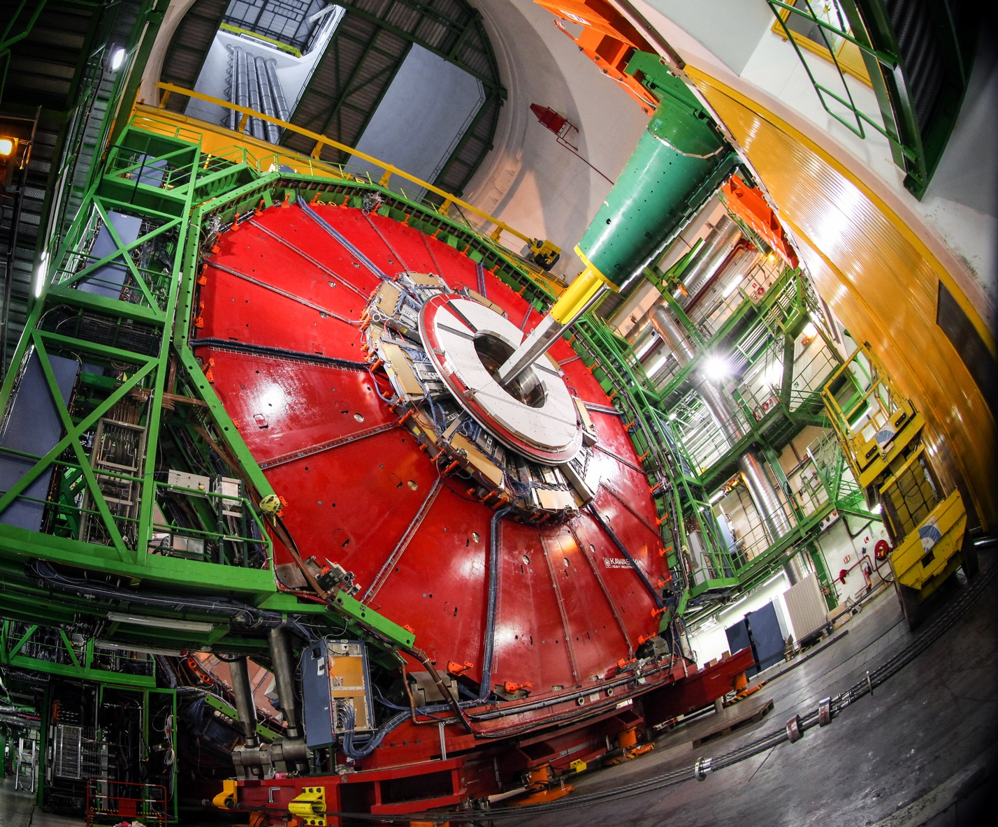
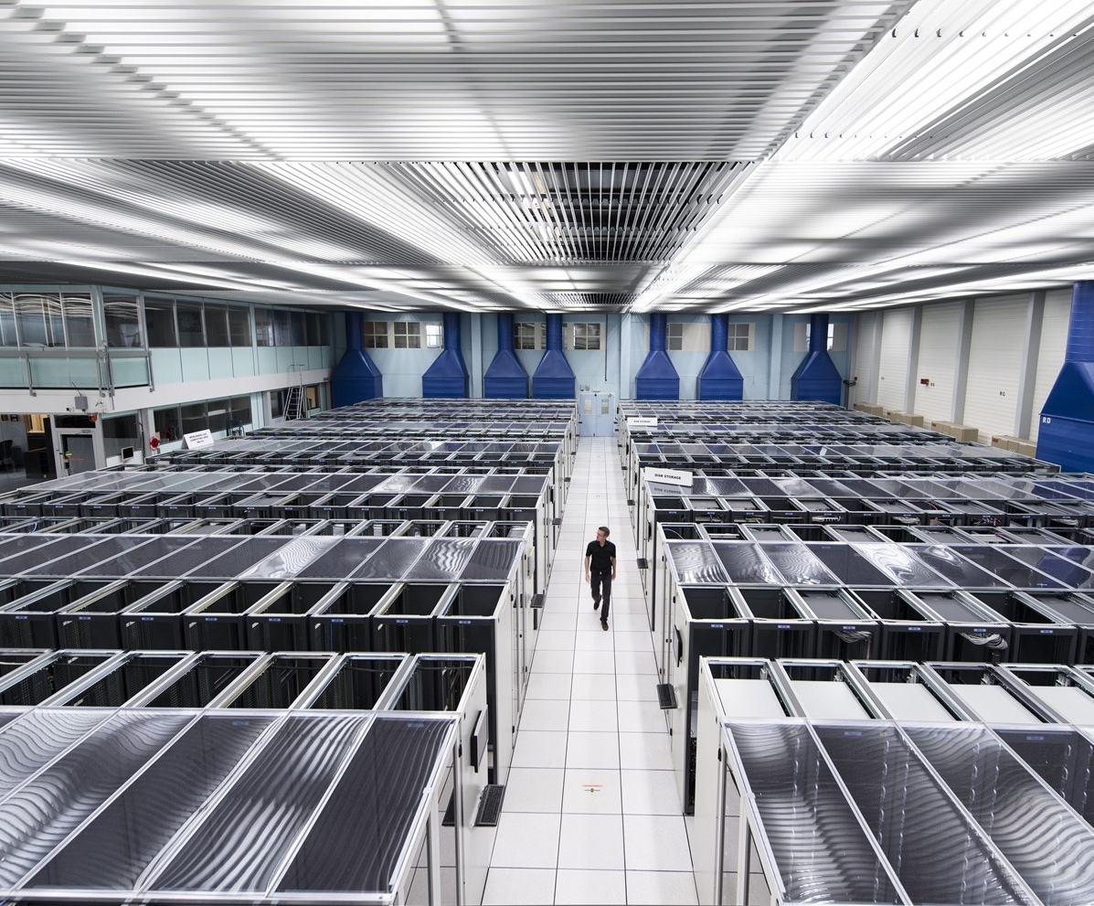
We develop technologies in three key areas
ACCELERATORS
DETECTORS
COMPUTING

Slide 10
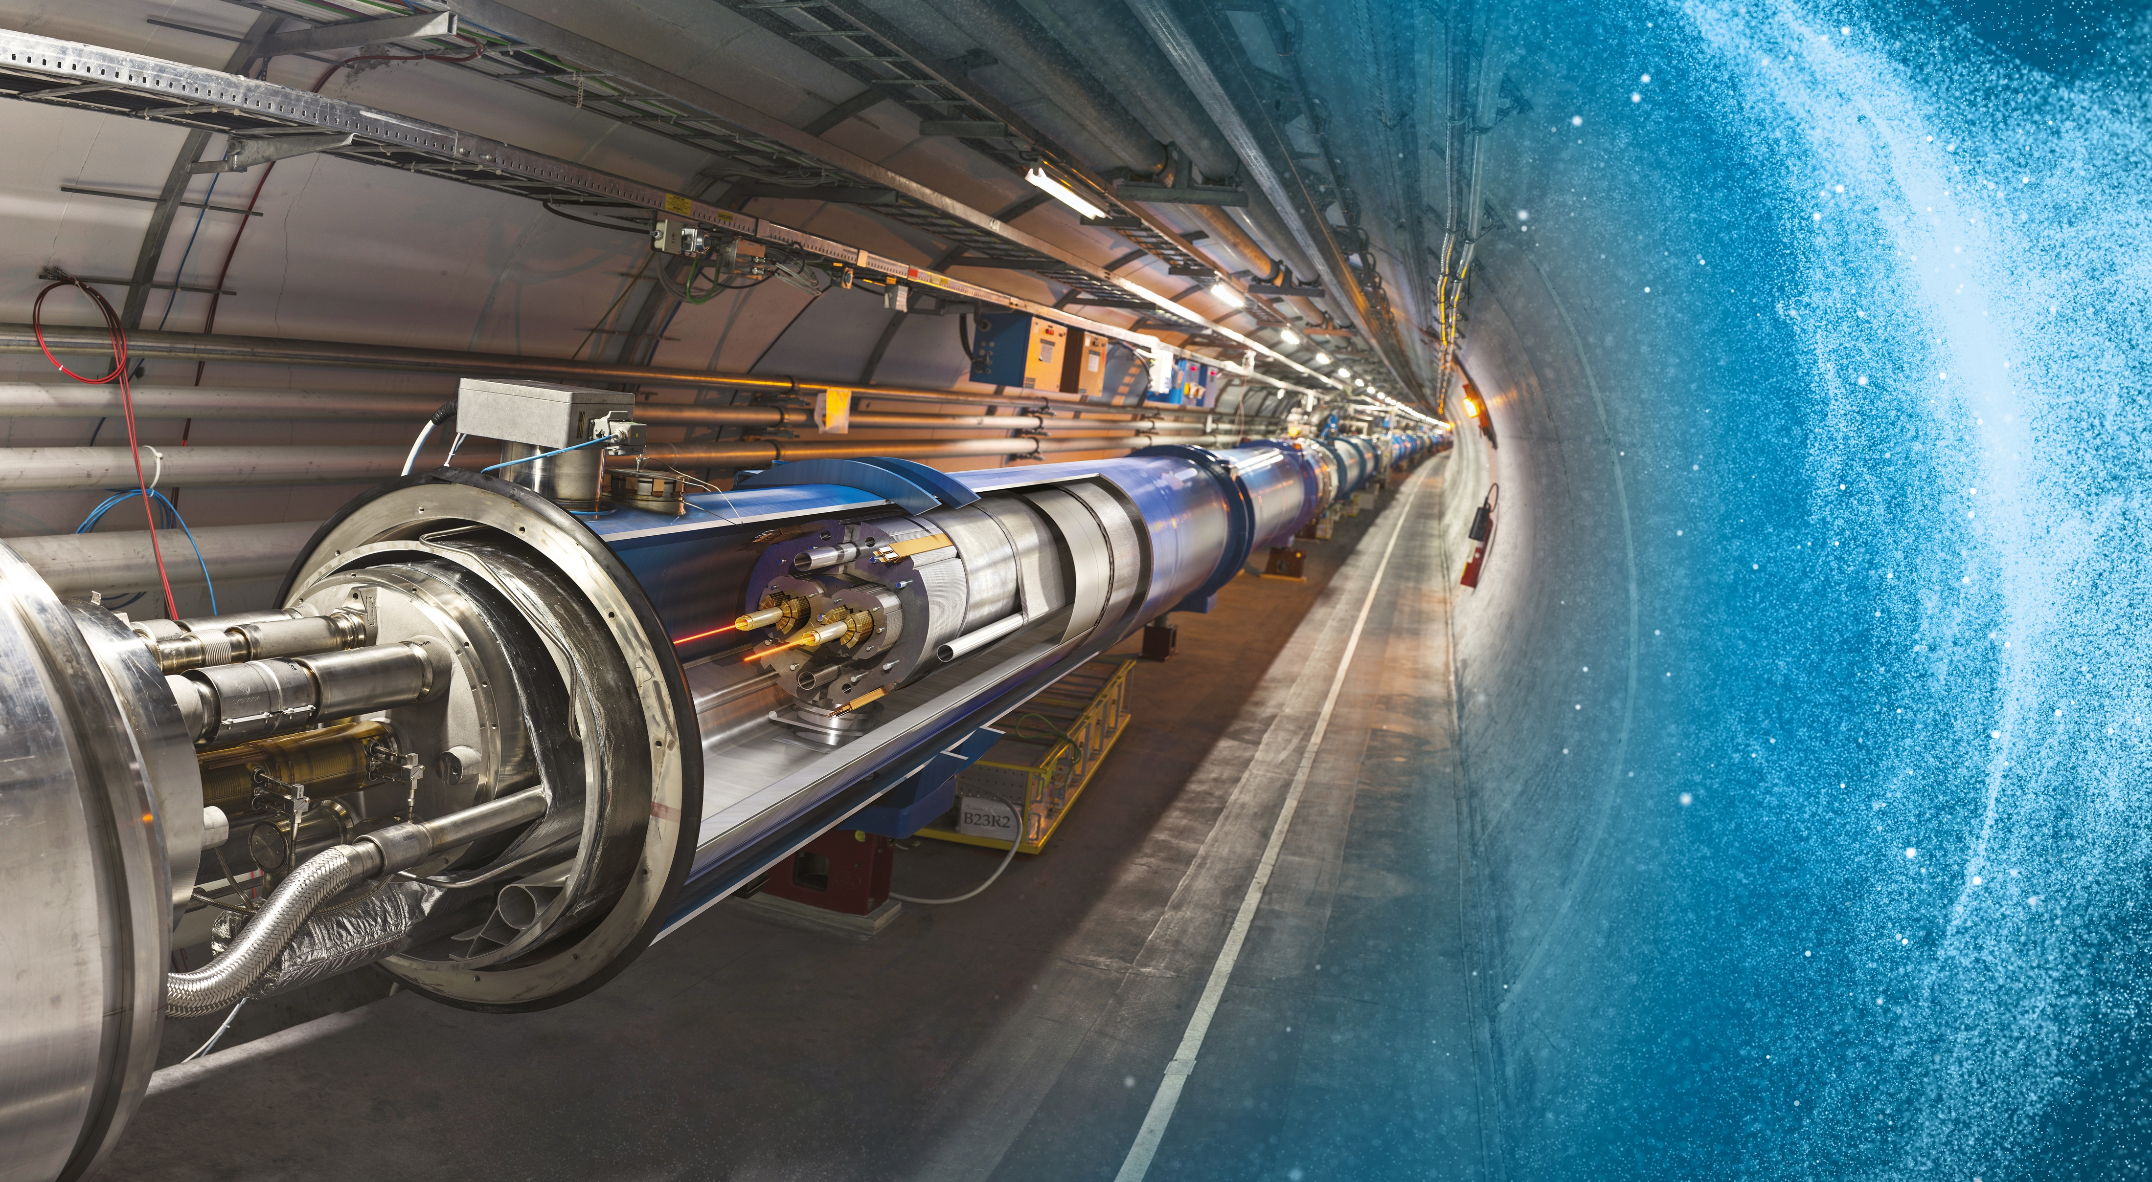
Large Hadron Collider (LHC)
27 km in circumference
About 100 m underground
Superconducting magnets steer the particles around the ring
Particles are accelerated
to close to the speed
of light

Slide 11
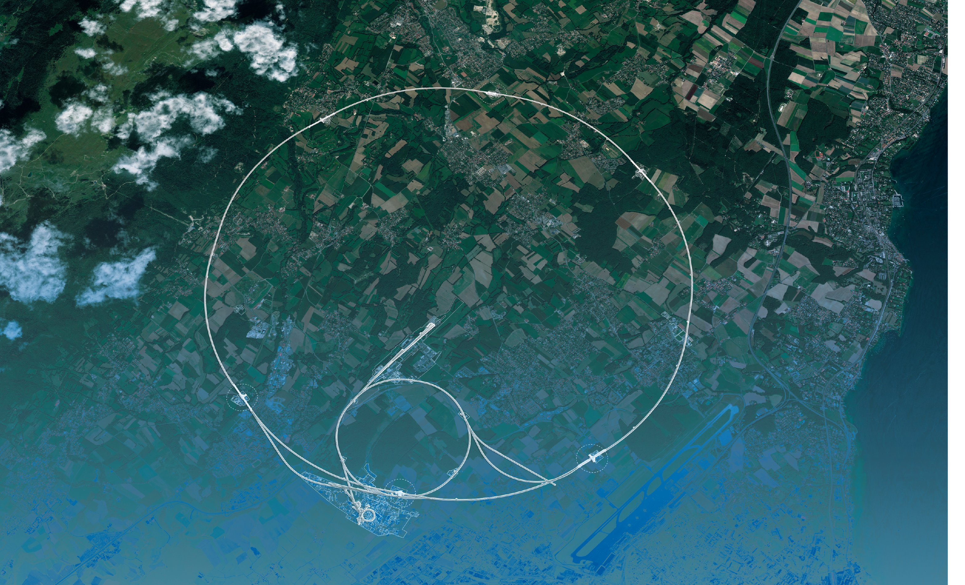
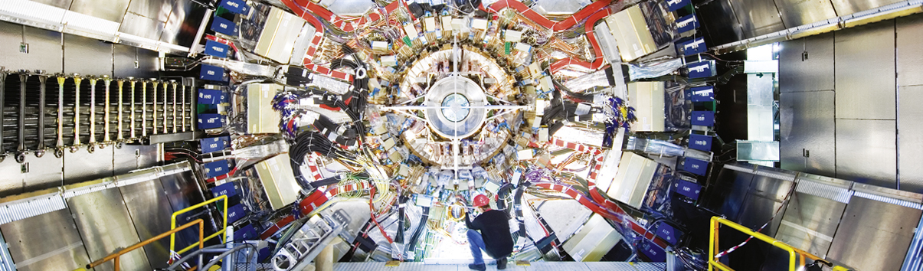
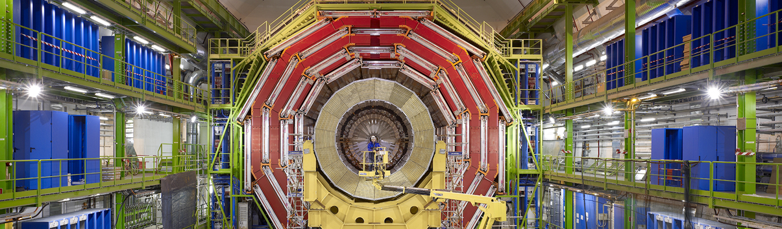
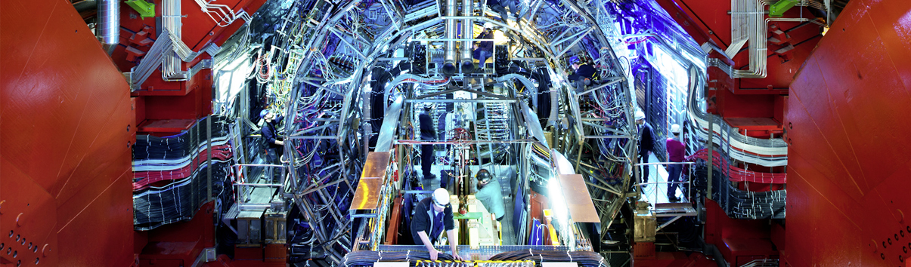
Giant detectors record the particles formed at the four collision points
ATLAS
CMS
CMS
ALICE
ALICE
ATLAS
LHCb
LHCb

Slide 12
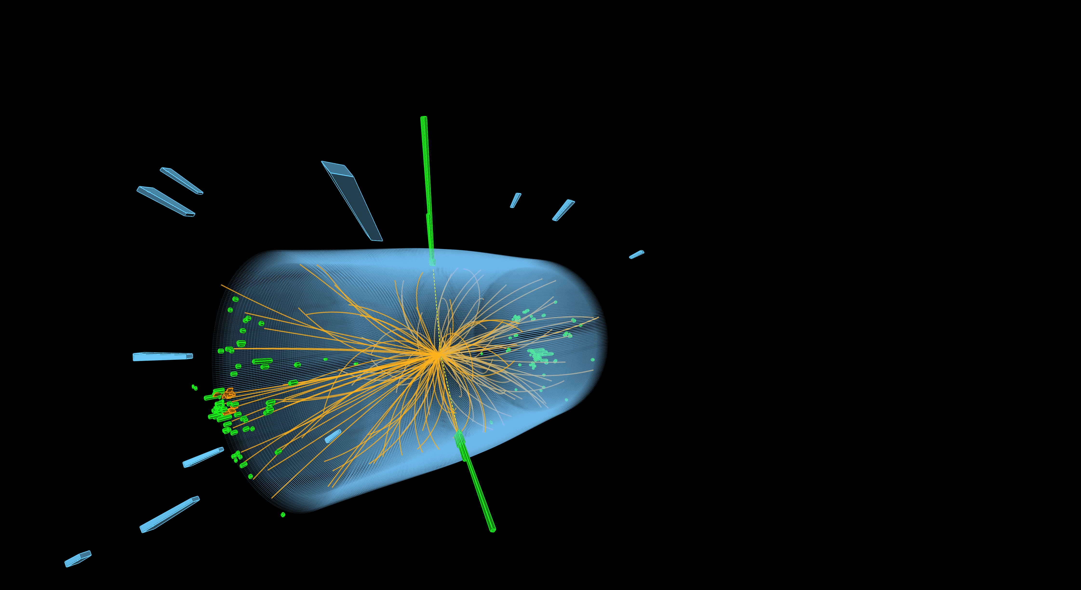
The LHC produces more than 1 billion particle collisions per second
The energy of the particles in collision is converted into new particles.

Slide 13




The LHC detectors are analogous to
3D cameras
The detectors measure the energy, direction and charge of new
particles formed.
They take 40 million pictures
a second. Only 1000 are
recorded and stored.
The LHC detectors have been built by international collaborations covering all regions of the Globe.

Slide 14
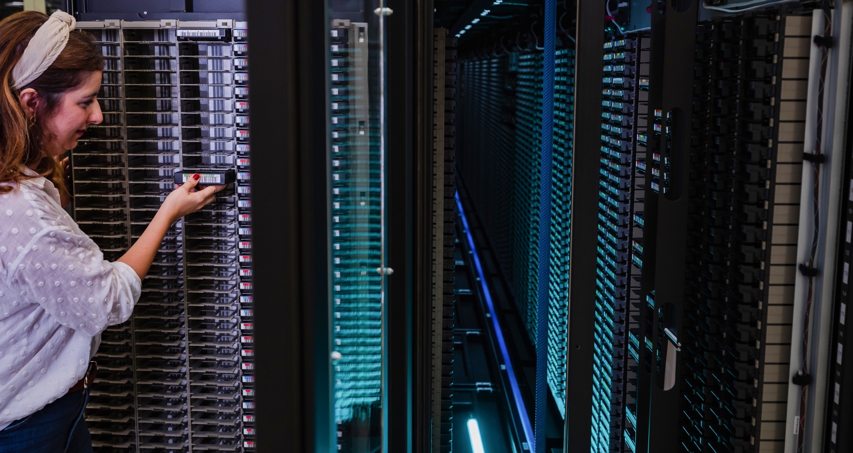
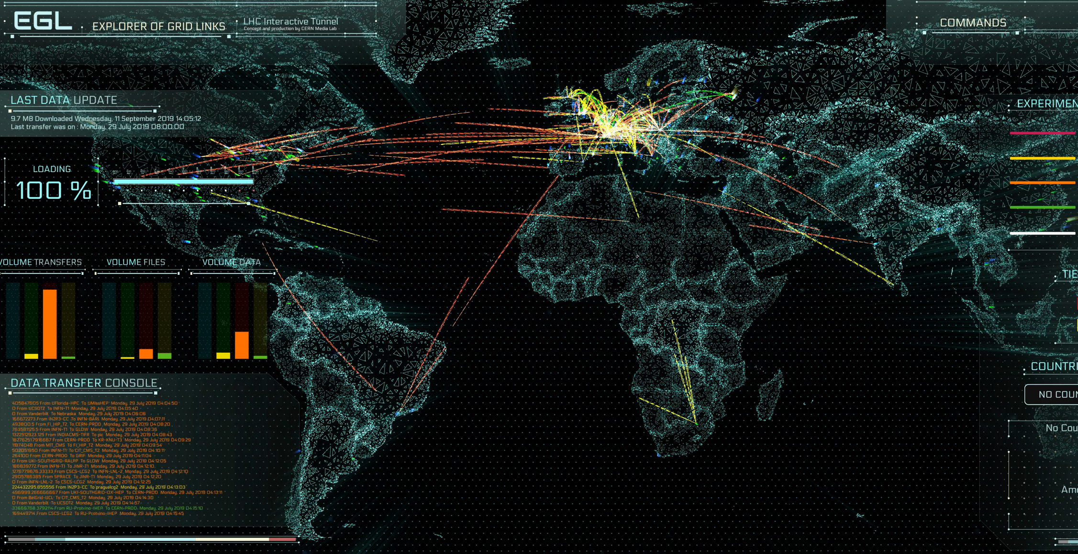
The Worldwide LHC Computing Grid (WLCG)
Used to store, distribute, process and analyse data.
1 million processing cores in about 170 data centres
and 42 countries.
More than 1000 Petabytes of CERN data stored world-wide.

Slide 15
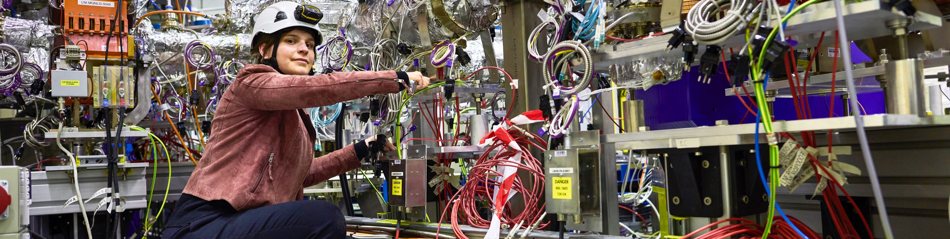
CERN has a diverse scientific programme
Nuclear Physics
(ISOLDE, n_TOF)
Antimatter Research
(Antiproton Decelerator)
Cosmic rays and cloud formation
(CLOUD)
Fixed-target experiments,
which include searches for rare phenomena
Contribution to the Long Baseline
Neutrino Facility in the USA (LBNF)

Slide 16
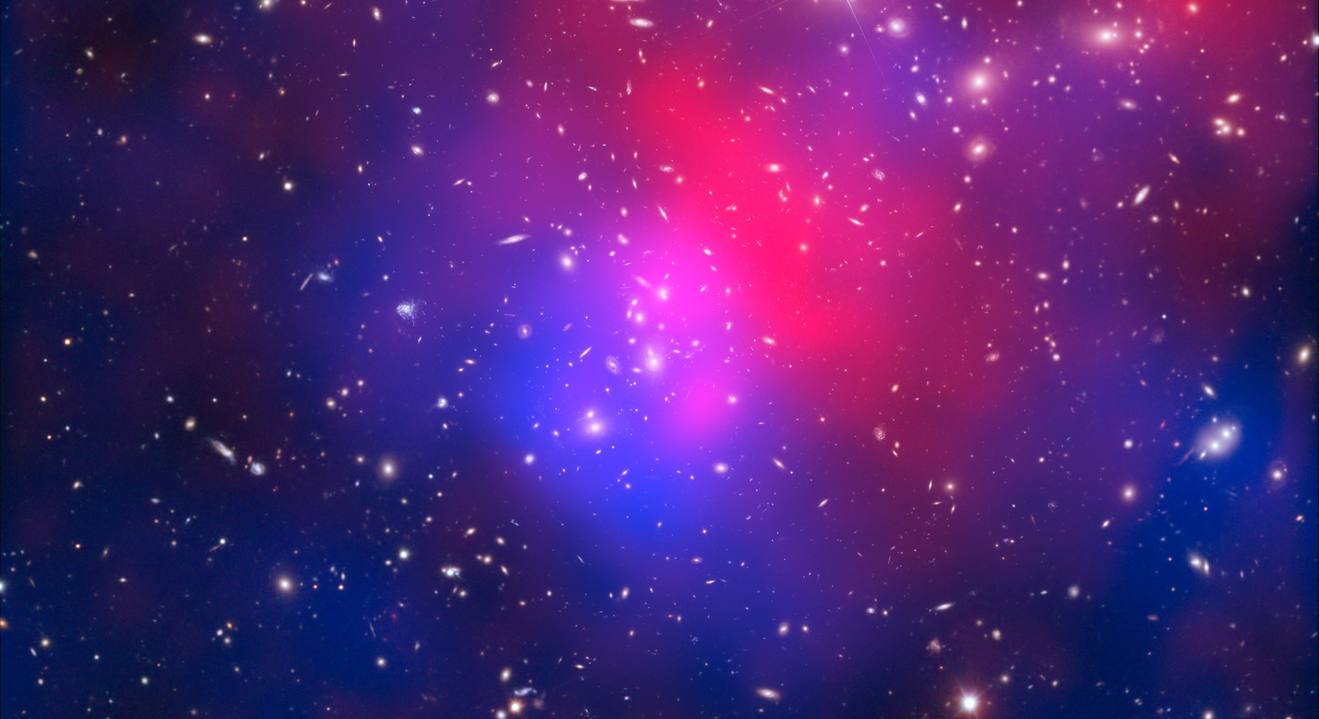
There are many unanswered questions in fundamental physics
Including
What is the unknown 95% of the mass
and energy
of the universe?
Is there only one Higgs boson, and does it behave exactly as expected?
Why is the universe made only of matter, with hardly any antimatter?
Why is gravity so weak compared to the other forces?

Slide 17
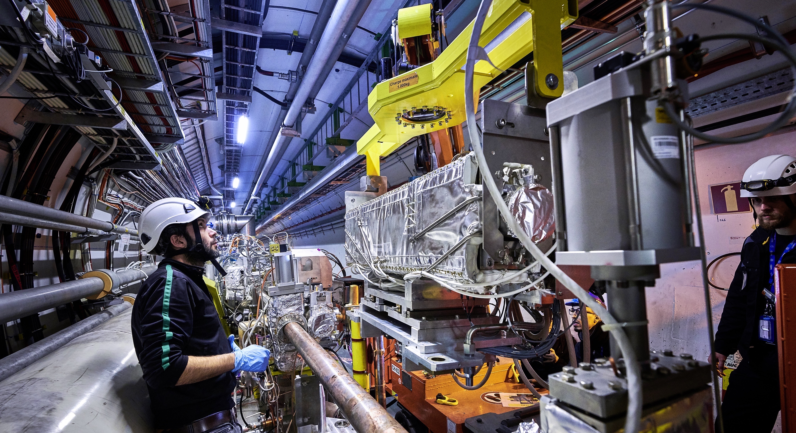
Upgrade to the
High-Luminosity LHC is under way
The HL-LHC will use new technologies to provide
10 times more collisions
than the LHC.
It will give access to rare phenomena, greater precision and discovery potential.
It will start operating in 2029, and run until approx. 2040.

Slide 18

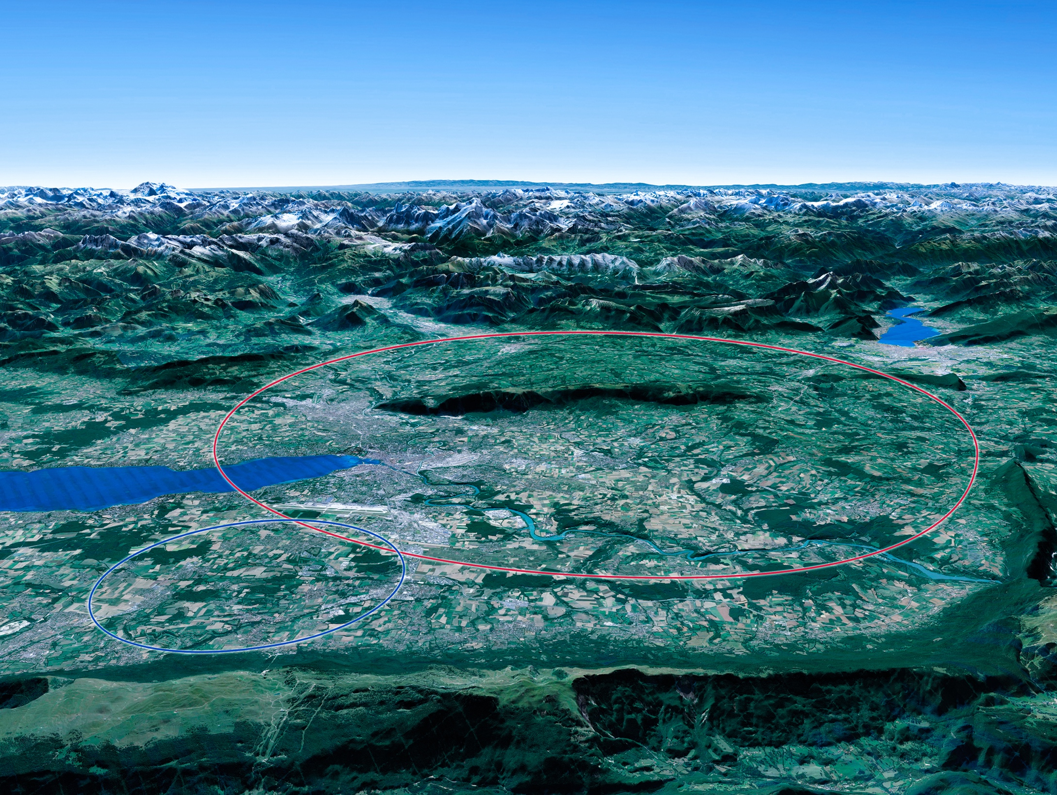

Scientific priorities for the future
Implementation of the recommendations
of the 2020 Update of the European Strategy
for Particle Physics:
• Fully exploit the HL-LHC
• Build a Higgs factory to further understand this unique particle
• Investigate the technical and financial feasibility of a future energy-frontier 100 km collider at CERN
• Ramp up relevant R&D
• Continue supporting other projects around
the world
LHC

Slide 19
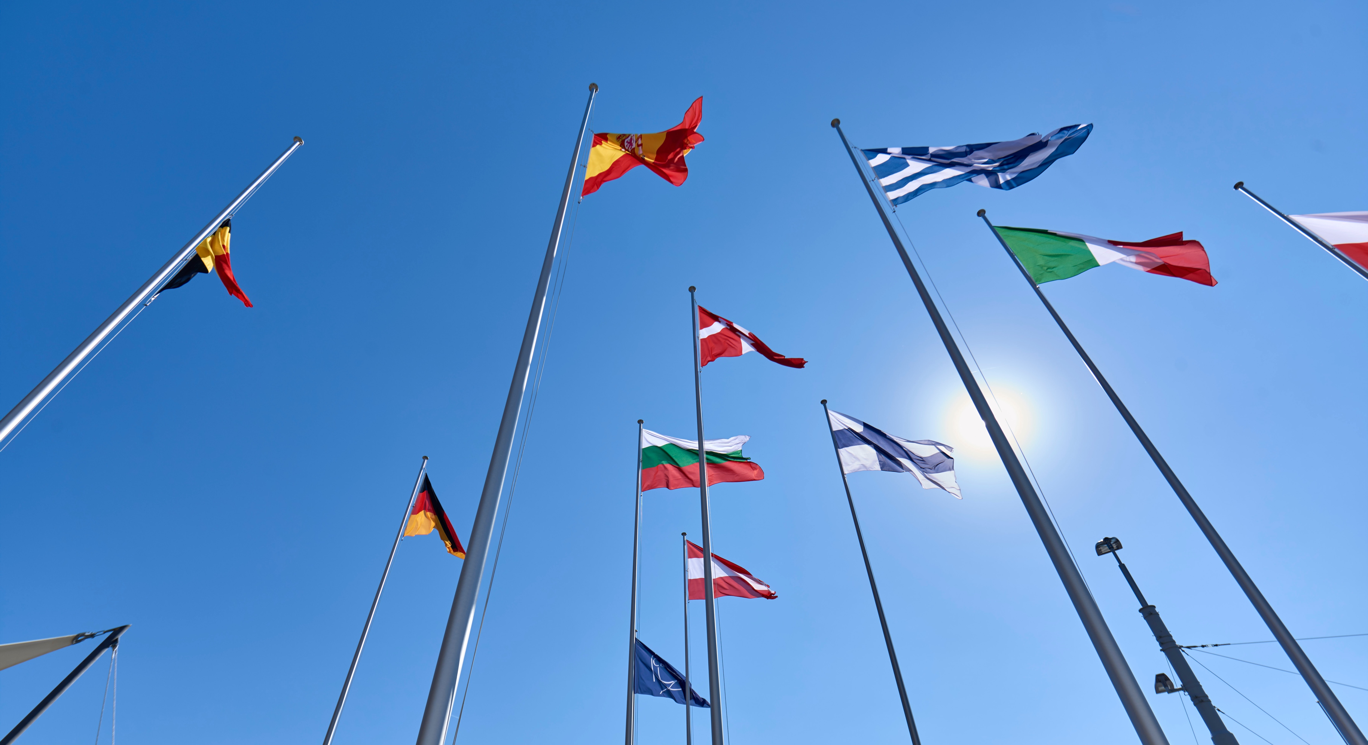
COLLABORATION

Slide 20

Science for peace
CERN was founded in 1954 with 12 European Member States
CERN’s annual budget
is 1200 MCHF (equivalent
to a medium-sized European university)
23 Member States
Austria – Belgium – Bulgaria – Czech Republic
Denmark – Finland – France – Germany – Greece Hungary – Israel – Italy – Netherlands – Norway
Poland – Portugal – Romania – Serbia – Slovakia Spain – Sweden – Switzerland – United Kingdom
As of 31 December 2022
Employees:
2658 staff, 900 fellows
Associates:
11 860 users, 1516 others
3 Associate Member States
in the pre-stage to membership
Cyprus – Estonia – Slovenia
7 Associate Member States
Croatia – India – Latvia – Lithuania – Pakistan
Türkiye – Ukraine
6 Observers
Japan – Russia (suspended) – USA
European Union – JINR (suspended) – UNESCO
Around 50 Cooperation Agreements
with non-Member States and Territories
Albania – Algeria – Argentina – Armenia – Australia – Azerbaijan – Bangladesh – Belarus – Bolivia
Bosnia and Herzegovina – Brazil – Canada – Chile – Colombia – Costa Rica – Ecuador – Egypt – Georgia – Honduras
Iceland – Iran – Jordan – Kazakhstan – Lebanon – Malta – Mexico – Mongolia – Montenegro – Morocco – Nepal
New Zealand – North Macedonia – Palestine – Paraguay – People's Republic of China – Peru – Philippines – Qatar
Republic of Korea – Saudi Arabia – Sri Lanka – South Africa – Thailand – Tunisia – United Arab Emirates – Viet Nam

Slide 21
A laboratory for people around the world
Distribution of all CERN Users by the country of their home institutes as of 31 December 2022
Geographical & cultural diversity
Users of 110 nationalities
19.4% women
Member States 7147
Austria 85 – Belgium 129 – Bulgaria 43 – Czech Republic 244 Denmark 49 – Finland 90 – France 844 – Germany 1225 Greece 119 – Hungary 73 – Israel 64 – Italy 1527
Netherlands 169 – Norway 79 – Poland 305 – Portugal 100 Romania 109 – Serbia 33 – Slovakia 70 – Spain 383
Sweden 103 – Switzerland 406 – United Kingdom 898
Associate Member States
in the pre-stage to membership 69
Cyprus 15 – Estonia 30 – Slovenia 24
Associate Member States 382
Croatia 38 – India 132 – Latvia 16 – Lithuania 14 – Pakistan 35
Türkiye 122 – Ukraine 25
Observers 2991
Japan 216 – Russia (suspended) 873 – United States of America 1902
Non-Member States and Territories 1271
Algeria 2 – Argentina 13 – Armenia 8 – Australia 21 – Azerbaijan 2 – Bahrain 4 – Belarus 18 – Brazil 122
Canada 199 – Chile 34 – Colombia 21 – Costa Rica 2 – Cuba 3 – Ecuador 4 – Egypt 20 – Georgia 32
Hong Kong 15 – Iceland 3 – Indonesia 5 – Iran 11 – Ireland 5 – Jordan 5 – Kuwait 4 – Lebanon 13 – Madagascar 1
Malaysia 4 – Malta 1 – Mexico 49 – Montenegro 4 – Morocco 19 – New Zealand 5 – Nigeria 1 – Oman 1
Palestine 1 – People’s Republic of China 333 – Peru 2 – Philippines 1 – Republic of Korea 147 – Singapore 2 South Africa 52 – Sri Lanka 10 – Taiwan 45 – Thailand 17 – Tunisia 2 – United Arab Emirates 7 – Viet Nam 1

Slide 22
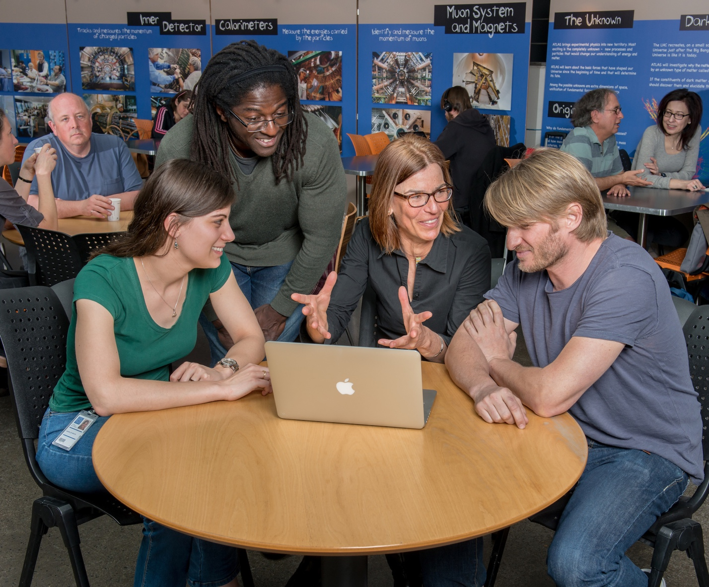
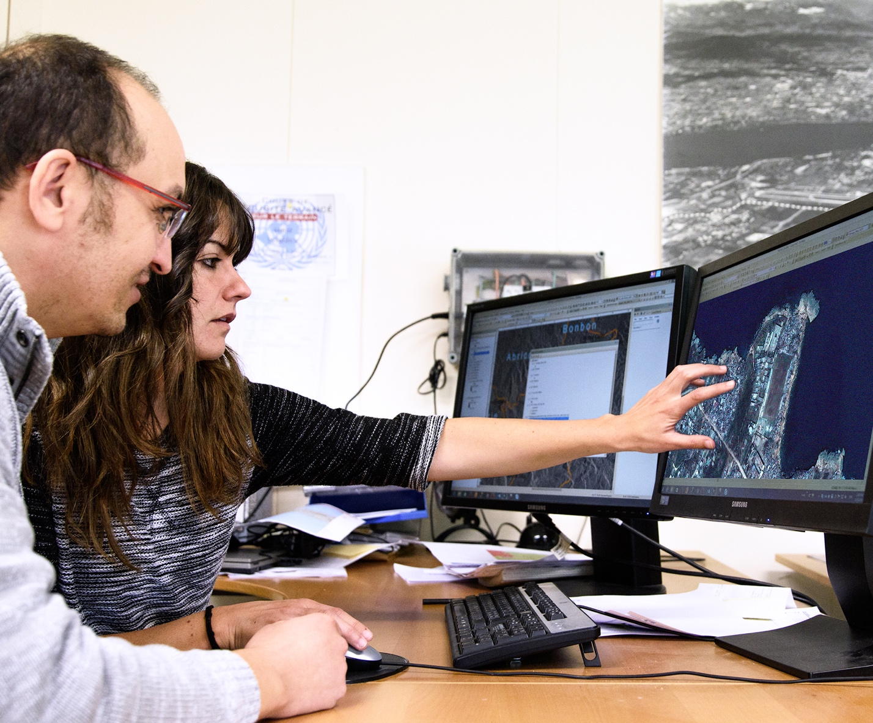
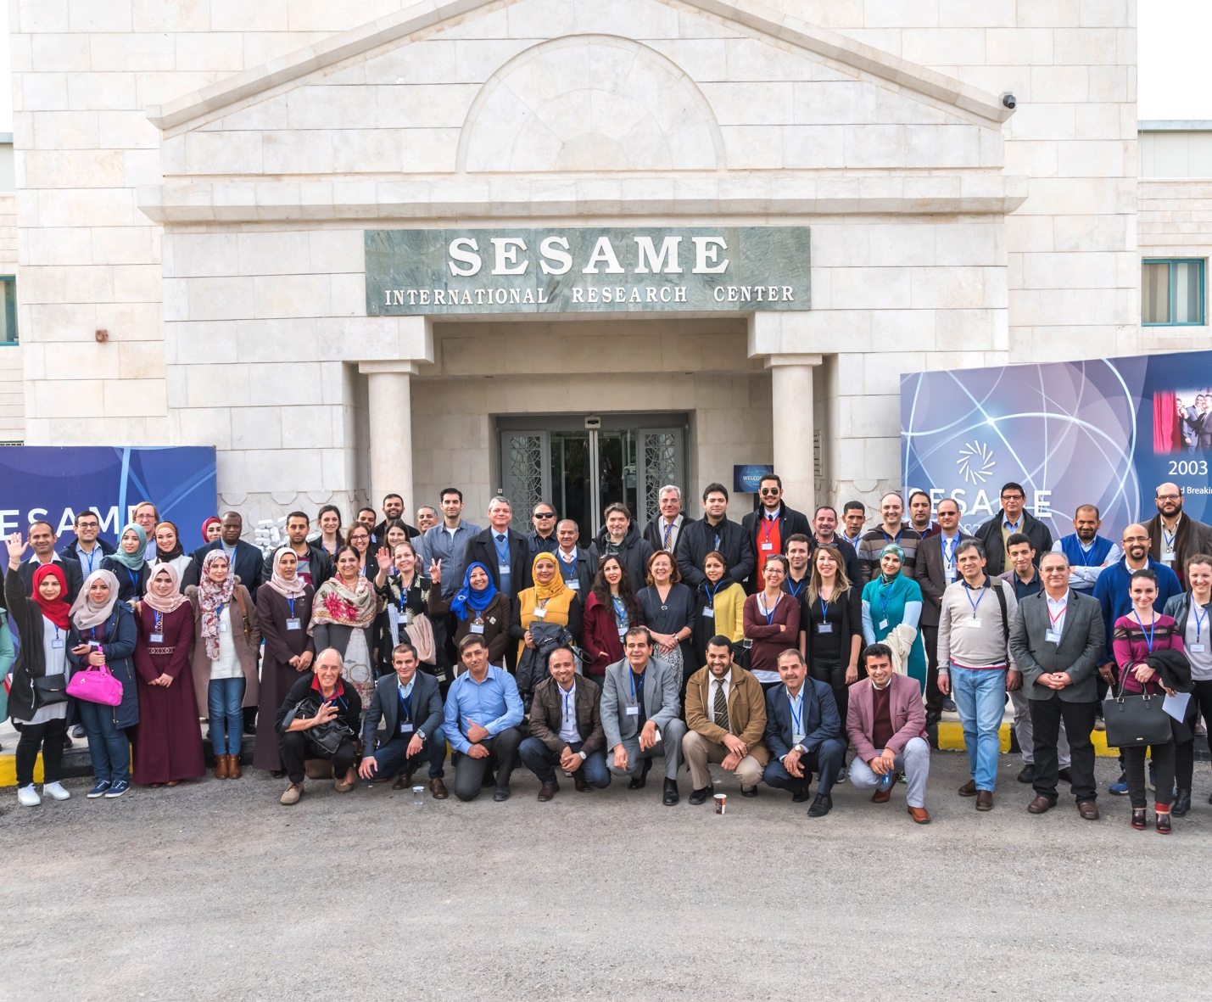
CERN is a model for open and inclusive collaboration
SESAME, a synchrotron light source
in Jordan, is modelled on CERN’s governance structure.
The LHC experiments are models of consensus building, competition and cooperation.
CERN provides the IT infrastructure for the satellite-analysis technology
used for emergency response.

Slide 23
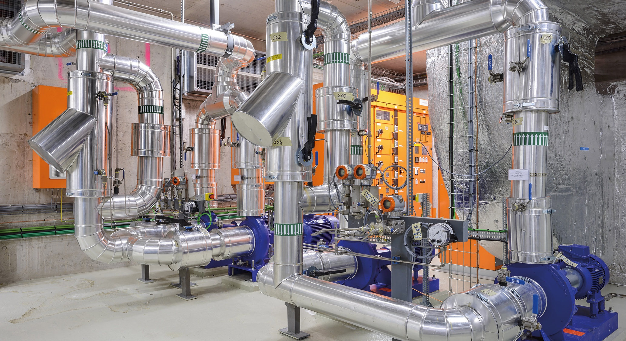
TECHNOLOGY & INNOVATION

Slide 24

CERN’s technological innovations have applications in many fields
CERN is the birthplace of the World Wide Web
And there are many more examples
Medical imaging, cancer therapy, material science, cultural heritage, aerospace, automotive, environment, health & safety, industrial processes.

Slide 25
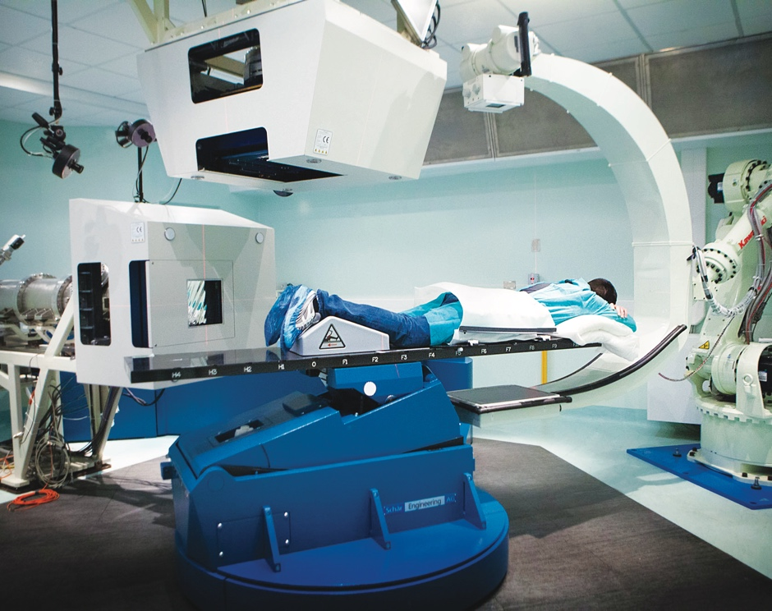
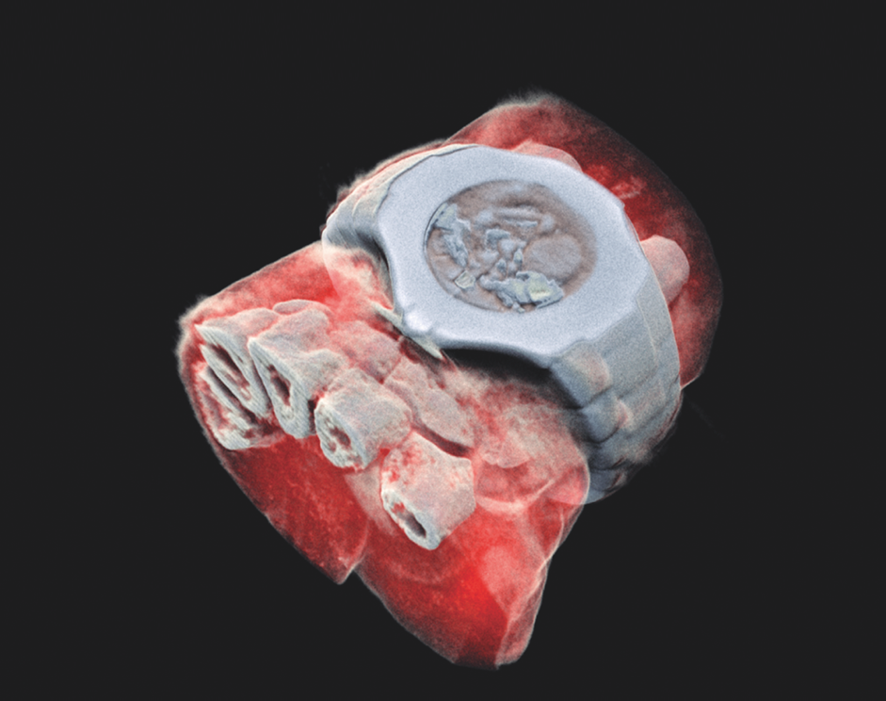
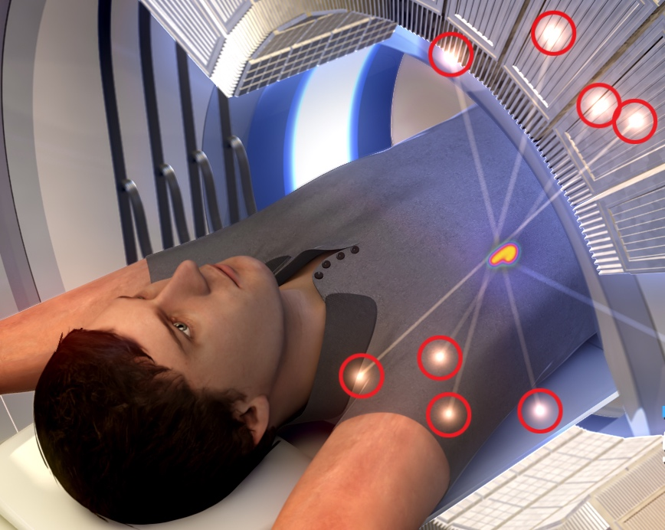
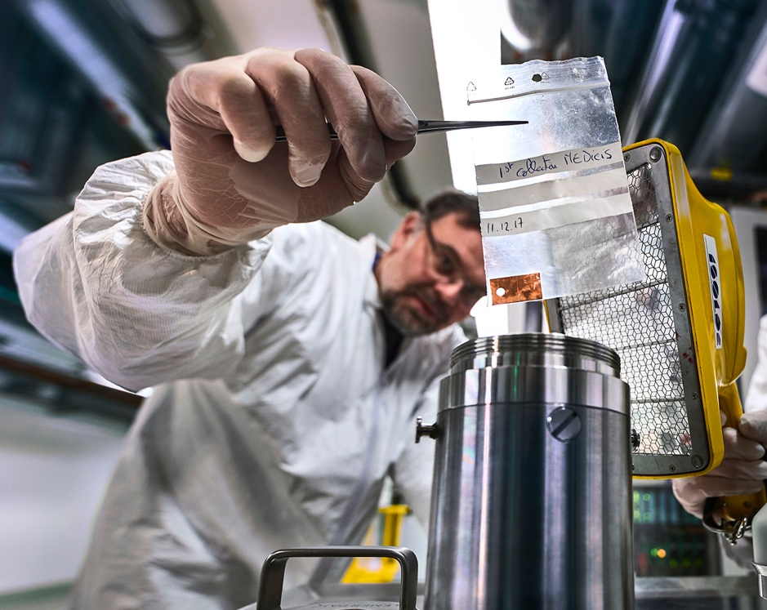
CERN’s technological innovations have important applications in medicine and healthcare
Technologies applied
at CERN are also used in PET, for medical imaging and diagnostics.
CERN produces innovative radioisotopes for nuclear medicine research.
© marsbioimaging
© CNAO
© ENVISION / ENLIGHT
Accelerator technologies are applied in cancer radiotherapy with protons, ions and electrons.
Pixel detector technologies are
used for high resolution
3D colour X-ray imaging.

Slide 26
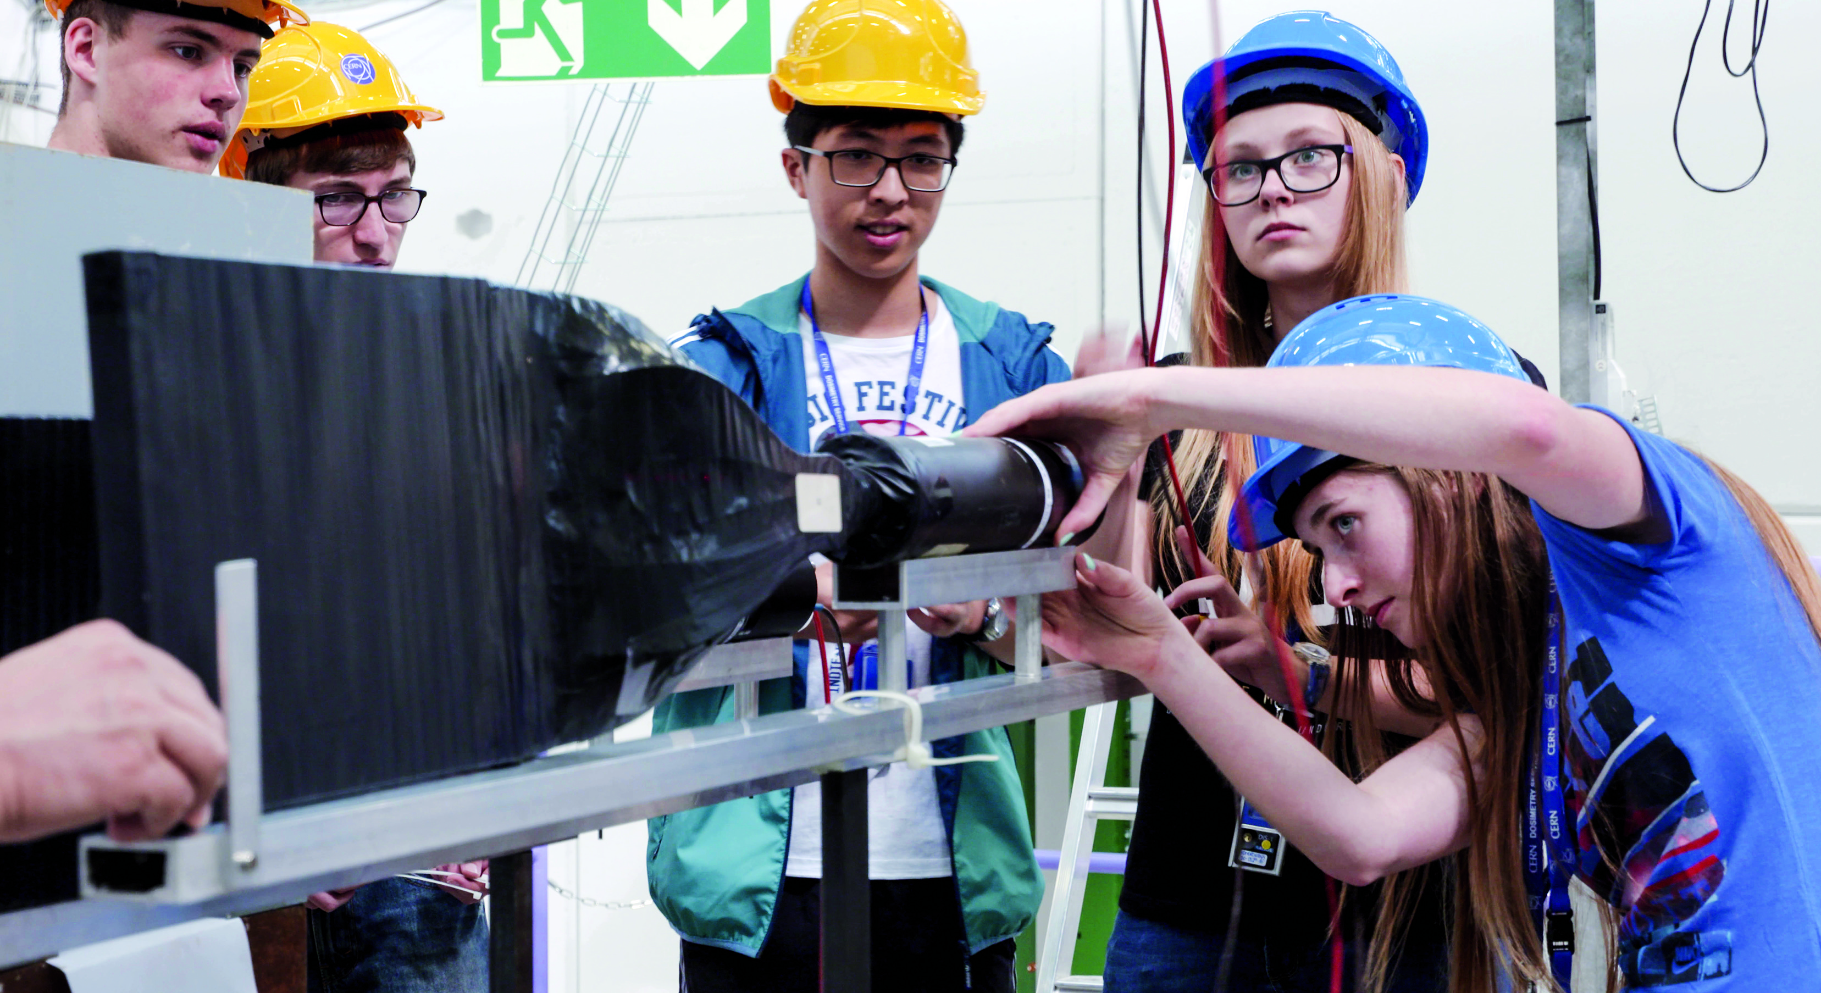
EDUCATION
& TRAINING

Slide 27
CERN opens a world of career opportunities
Number
of Persons
19%
Other fields, including
government organisations
27
45%
Industry
36%
Academia or Research
65
age
Age Distribution of Scientists working at CERN
Source: CERN Alumni survey (2014)
PhD and Technical students leaving CERN

Slide 28
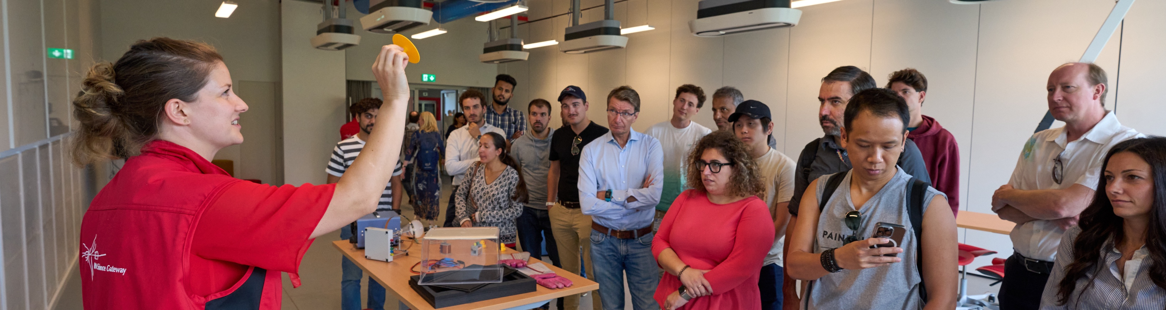
CERN’s training, education and outreach programmes
900 graduates
(including Research Fellows)
3 000 PhD students
300 Undergraduate students in
Summer programmes
>14 000 teachers participating in dedicated programmes, since 1998
Around 150 000 visitors on guided tours of CERN, from >50 countries
4.7M followers on social media, from around the globe

Slide 29
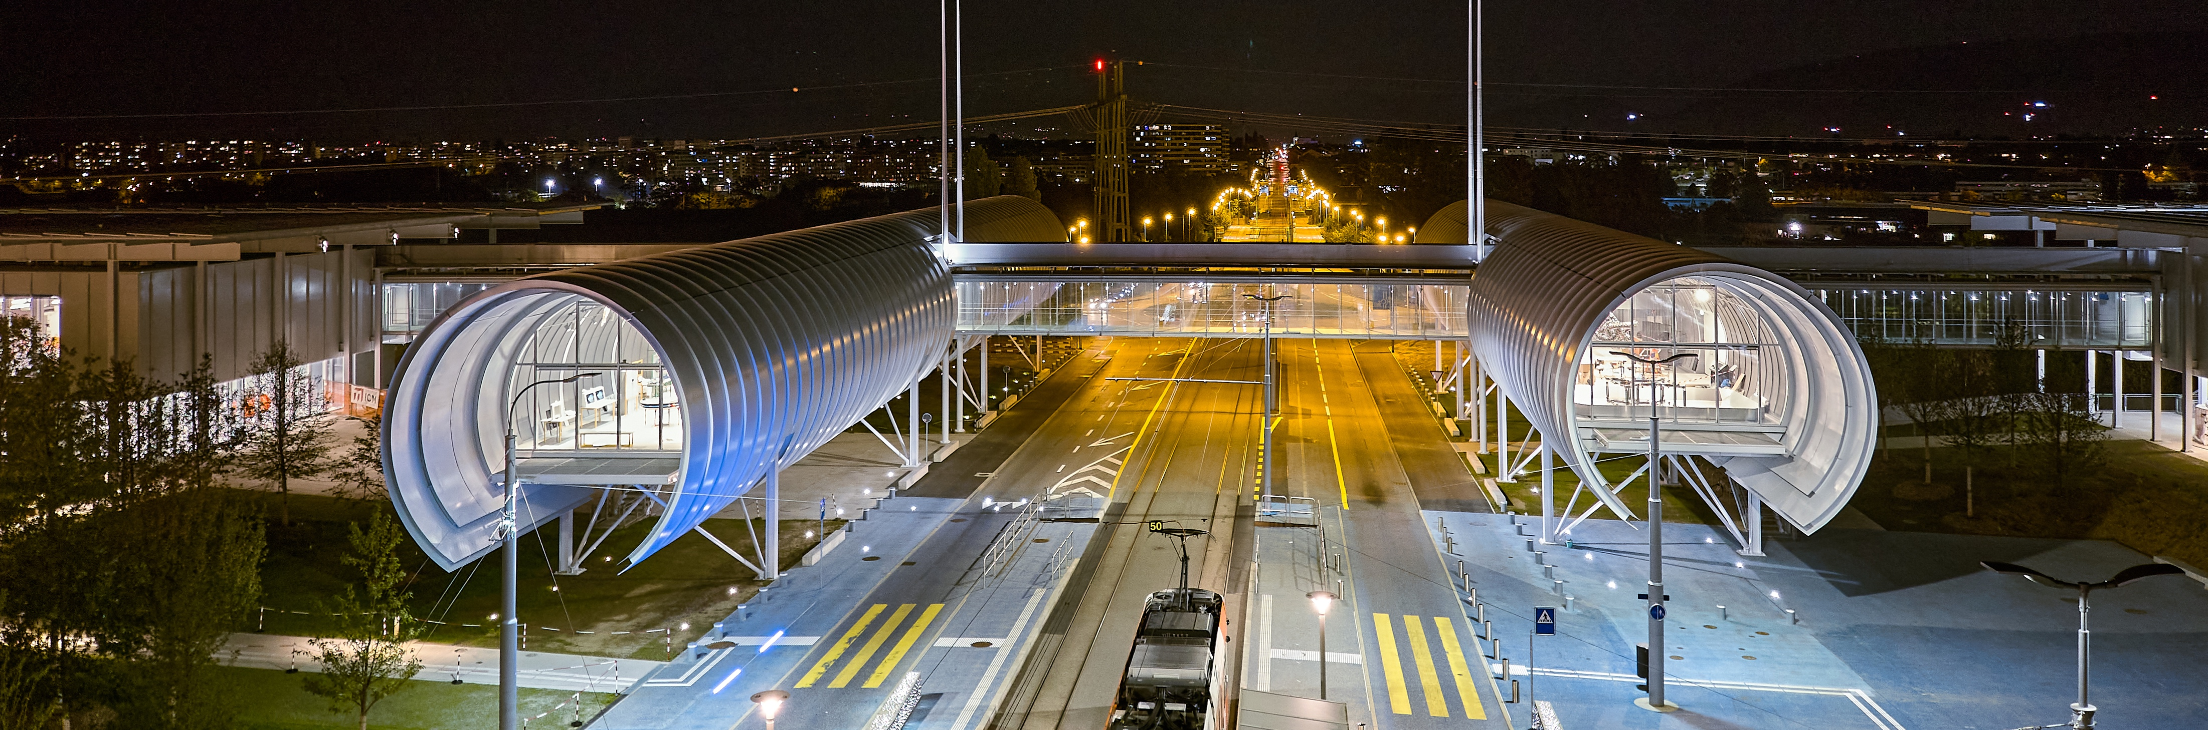
CERN Science Gateway
CERN’s new education and outreach centre for all
publics aged 5-plus.
Inaugurated
7 October 2023.
Immersive exhibitions, education labs, events
and shows.

Slide 30
There are many unanswered questions
in fundamental physics
CERN will continue to play a crucial role
in the journey of exploration

