Slide 1
Local chromatic correction Final Focus optimization
October 5th, 2023
Pantaleo Raimondi
SLAC National Accelerator Laboratory

Slide 2
Outline
Recap of Strategy to improve Final Focus DA/MA
Arc and Final Focus layout
Minimization of FF emittance growth and radiation
Deliverables objectives

Slide 3
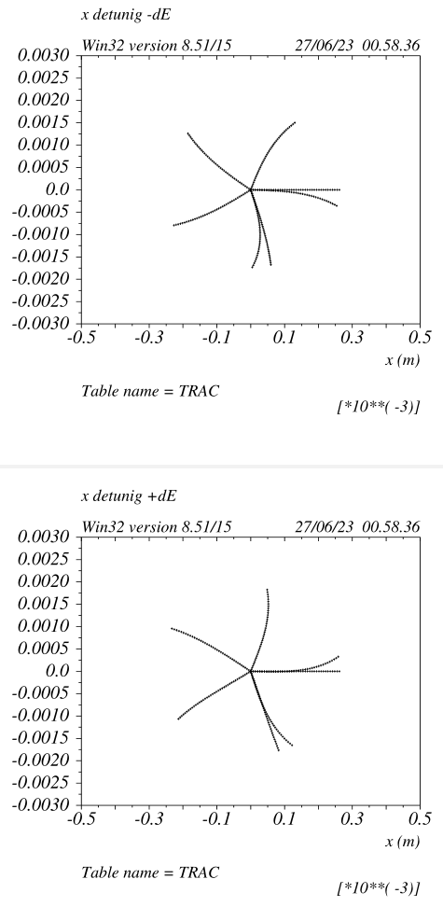
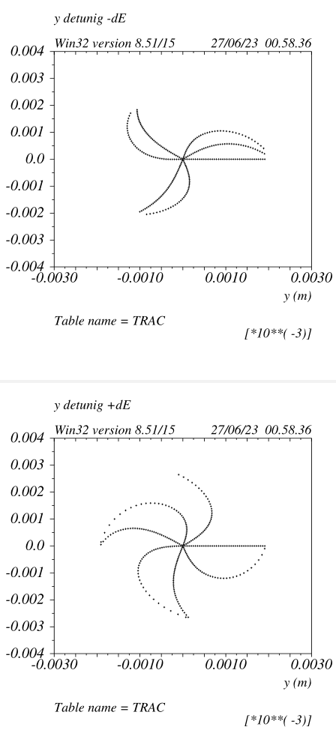
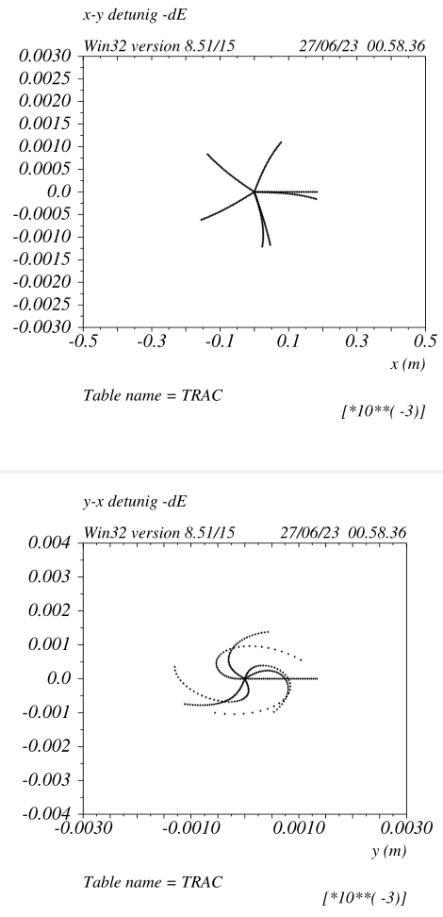
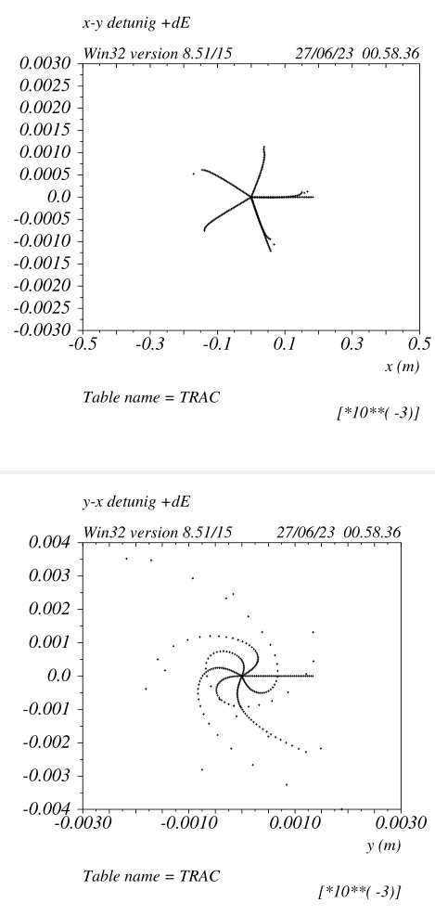
Transverse tracking with dE=+/-0.002 v_65a1
Detuning on energy is zero on a scale at least 10 times larger
Horizontal DA for small Y offset ~150um

Slide 4
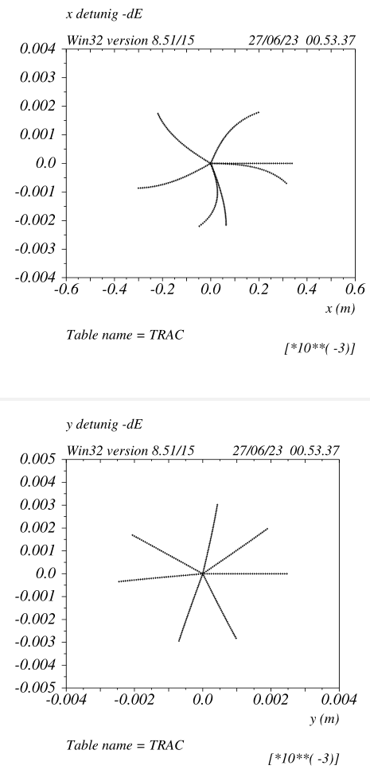
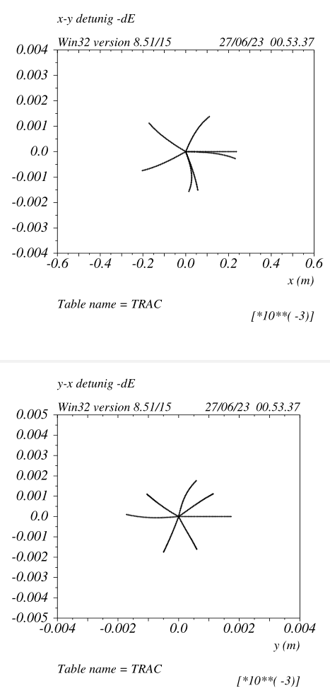
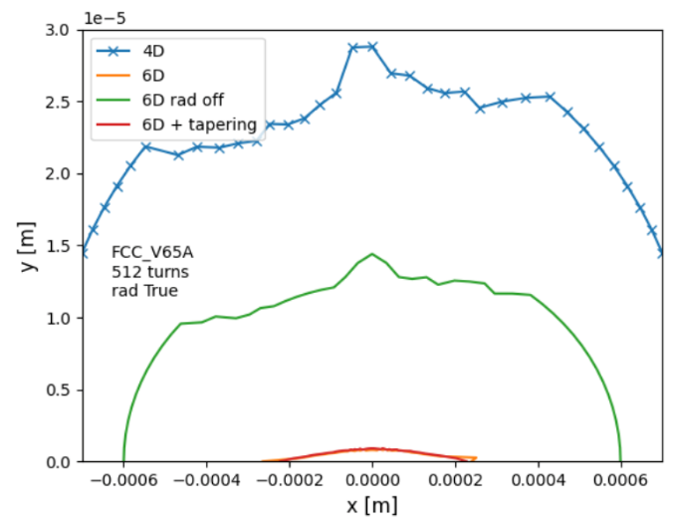
Transverse tracking with dE=+/-0.002
Tracking with just the 3 quads in the y_CCS
that provide the –I rescaled by 0.2%
The main DA limiting aberrations are
energy dependent y&xy-detuning (octupolar)
due to the breaking of the y_CCS –I condition
off energy. Reducing this aberration can enlarge
the 6D DA in principle up to green
(and possibly the green will approach the blue as well)
Energy dependent X-detuning is small, due to
the lower x-chromaticity and larger dispersion
on the sextupole.

Slide 5
Reduction of the Energy dependent Y & XY detuning
This term is proportional to the K_SD^2
1) Increase dispersion @ SDs
Different optic between the SDs might provide larger dispersion for given bend angle (see example
with 10% gain wrt v_65a1)
Find the best compromise between SR from dipoles and DA/MA
(iterate with Kevin with FF progressively stronger dipoles)
2) Reduce vertical chromaticity, make QD0 stronger and increase QD0-QF1 distance. Potential gain ~10%
in chromaticity)
- Compensate part of the vertical chromaticity in the ARCs (to be done with tracking with CRAB sextupoles)
3) Introduce decapoles in the y-CCS:
Two decapoles at –I (same sextupole locations) will generate an “octupole” for off energy particles.
The –I ensures that the decapole term is canceled. In principle this is a very effective solution,
I did some quick test, but the DA was heavily affected, possibly I did not find the sweet spot where to put them.
4) Any additional idea is more than welcome!

Slide 6
FF optimization v_66 and beyond
All points above mentioned have been implemented with steady improvement of performances.
In addition to the previous point, the ARC-FF layout optimization has been performed as well.
This has resulted in the v_66 that is currently under study by M Hofer ans S Liuzzo.
However the v_66 FF has an uncomfortably large emittance contribution at ttbar, about 0.8nm,
I am working on the minimization of such contribution (plus further optimization) and the following
slides are related to the v_67.
v_66 and v_67 have very similar performances for DA/MA, the main difference is a lower emittance growth
(presently 0.3nm)

Slide 7
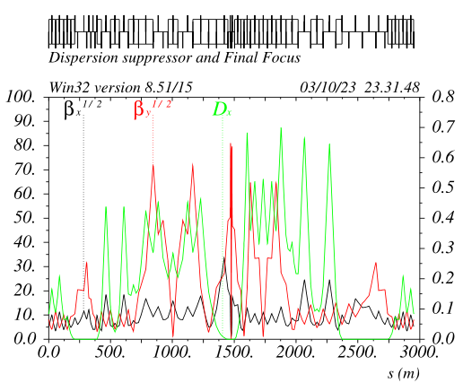
Local Chromatic Compensation FF asymmetric layout v_67 ttbar optic
The FF geometry is adjusted in order to recover entirely
the beams separation. Dipoles ARCs modification is not necessary.
Beams start to split @300m and are back @2300m
(Present separation in the ARCs is set to 40cm)
CCsX_Left section is short and has “strong bends”
CCsY_Left section is long and has “weak bend”
CCsY_Right section is short and has “strong bends”
CCsX_Right section is long and has “weak bend”
Details in next slides

Slide 8
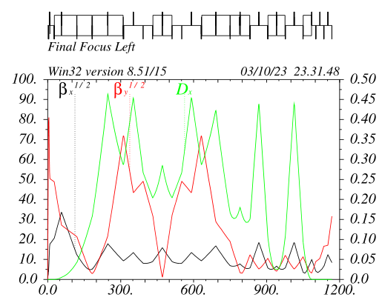
Left Final Focus v_67 ttbar optic
Last 3 dipoles EC~120KeV
CCSy optic has the largest dispersion (so far) for a given bend angle in the –I, presently Dx=0.285m@SDs
“Standard” non-linear optimization is performed as usual
Betas&Alfas at IP-phase sextupoles are optimized to reduce the DA reduction from Crab sextupoles
CCSy/x_L/R lengths and ratio between their total bend angles are optimized to have maximum dispersion on CCSy_Left and minimum overall emittance growth and radiation
CCSy sextupoles (0.6m long) are very weak Ks_madx~0.7 @ttbar, Ks~0.9 @Z. In fact ARCs sextupoles can be used in the FF as well

Slide 9
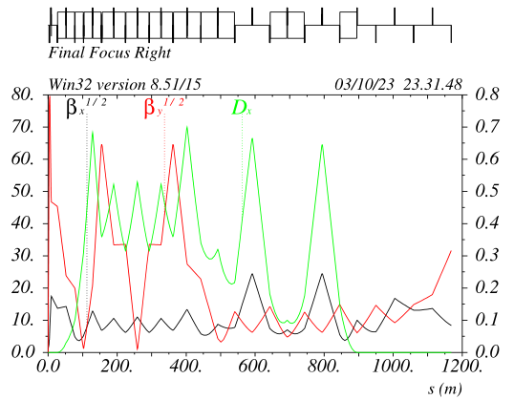
Right Final Focus v_67 ttbar optic
All dipoles in the CCSy have same field, best configuration to recover the beams separation
CCSy optic has the largest dispersion (so far) given the above requirement in the –I, presently Dx=0.355m@SDs
“Standard” non-linear optimization is performed as usual
CCsX has been shortened and pushed back, helping to recover the geometry. Incidentally this has originated a very long dispersion free straight section, ~400m when included the ARC DS part
Two drift sections about 100m long are also present in the CCsX “-I”
Alfay in the CCSx_LR is not zero to symmetrize the F_LR non linear optic

Slide 10
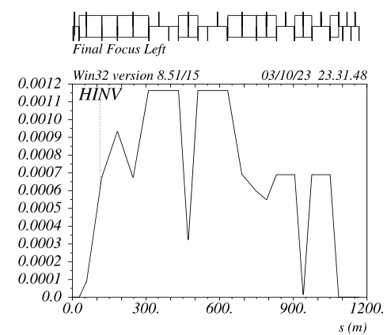
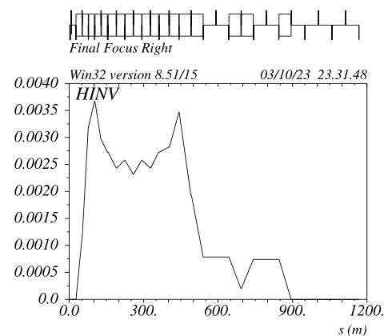
Curl_H optimization v_67 ttbar optic
CCsY Curl_H does not matter because
the dipoles are very weak
CCSX Curl_H is not optimal because the NL optimization requirement
* ARC Curl_H ~ 0.00045
CCsY Curl_H drives the emittance and is almost optimal
CCSX almost optimal as well

Slide 11
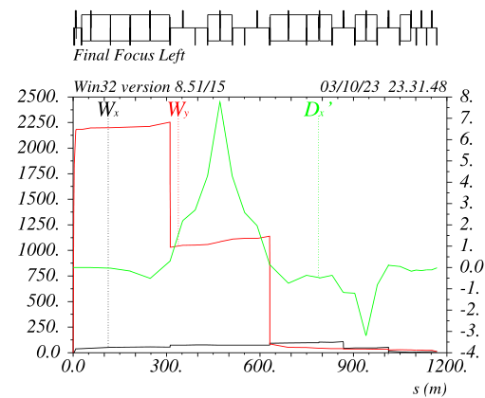
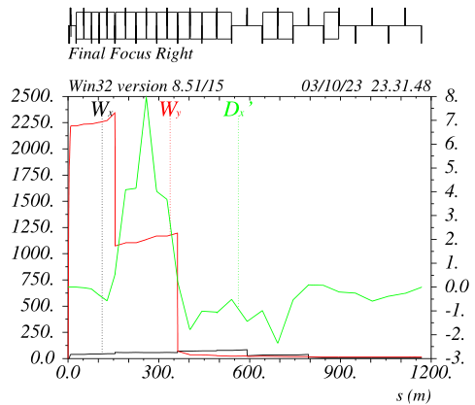
Second order dispersion optimization v_67 ttbar optic
FF_Left ddx behavior is practically perfect
Some ddx’ leakage is still present in the FF_right
Presently, NL leakage in the ARCs is just ddx, the last two ARC SF sextupoles (on each side) do compensate it.
Their modulation is about 15%@ttbar and 7%@Z. The effect on DA/MA is negligible

Slide 12
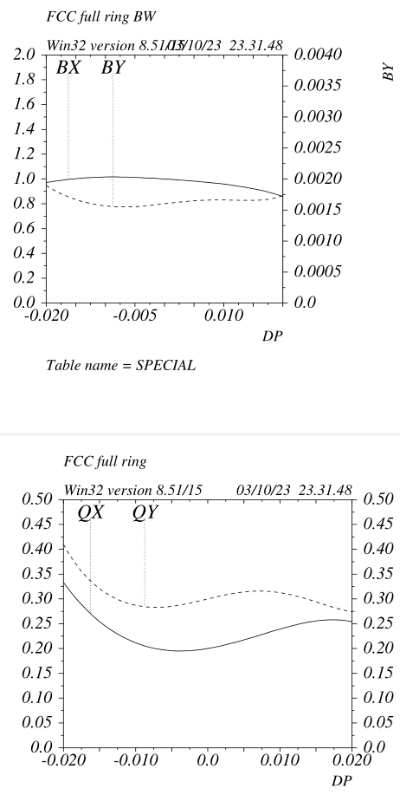
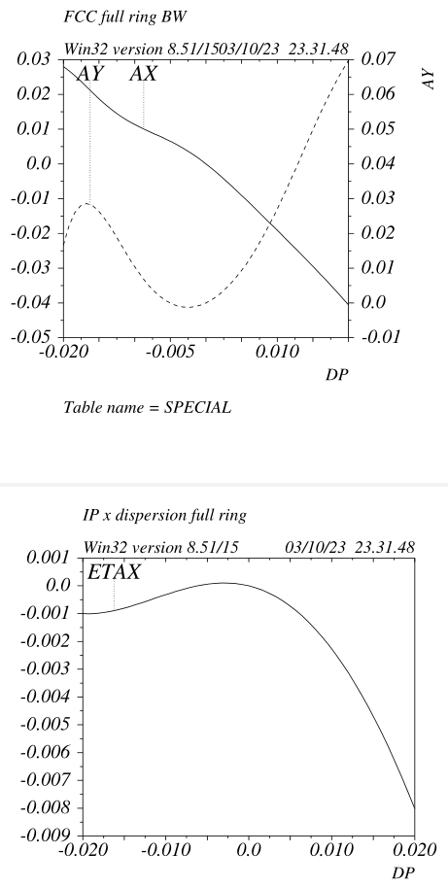
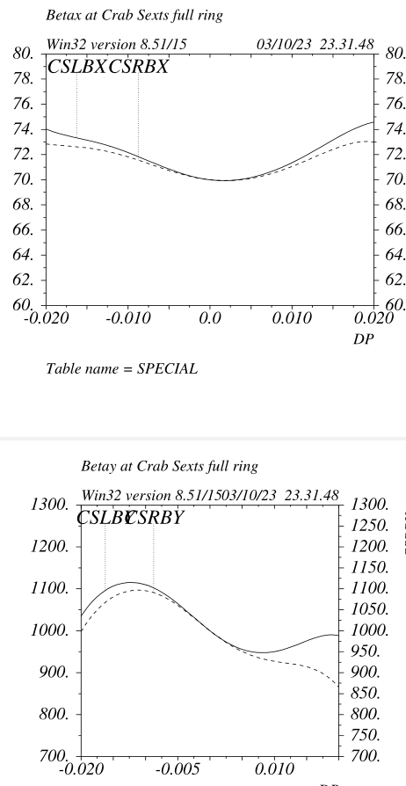
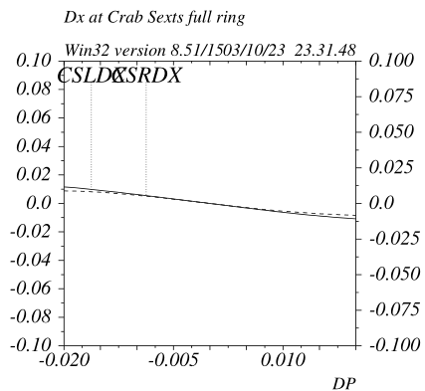
Full ring chromatic properties v_67 ttbar optic
Two very different FF do have nearly identical non linear dynamics.
Crab sextupoles dynamic betas are nearly optimal

Slide 13
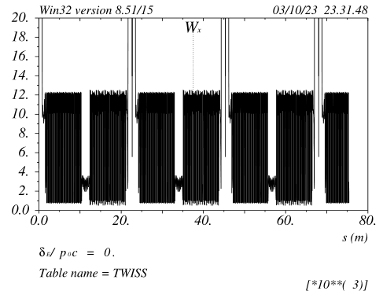
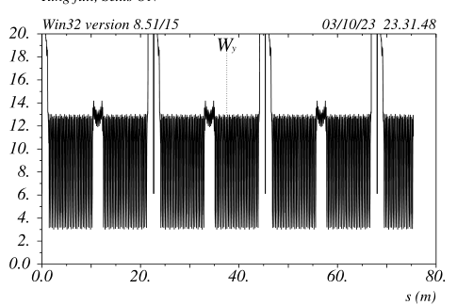
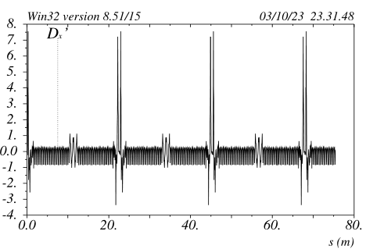
Full ring chromatic properties v_67 ttbar optic
Chromaticity in the ARCs is periodic and about 12 in both planes
This is extremely beneficial to reach and maintain top performances in a very short time
No sextupole families are needed
Because the “Full Achromat” FF property, there is no need to change the ARCs&FF sextupoles (and CS) setting when the beta-squeeze is done with the beta-matching quads (on the outer ends of the FF). This is extremely beneficial to reach top performances, it will be extremely useful to level the luminosity on the 4 IPs as well.

Slide 14
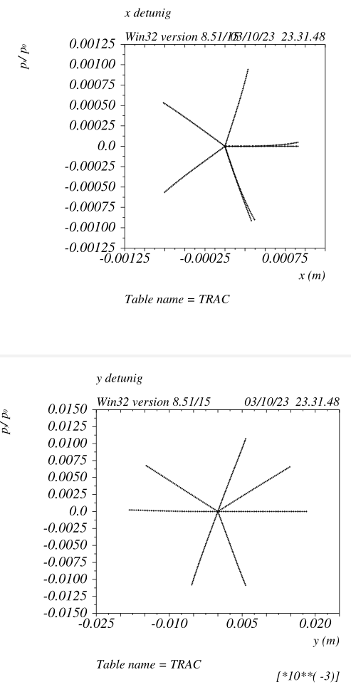
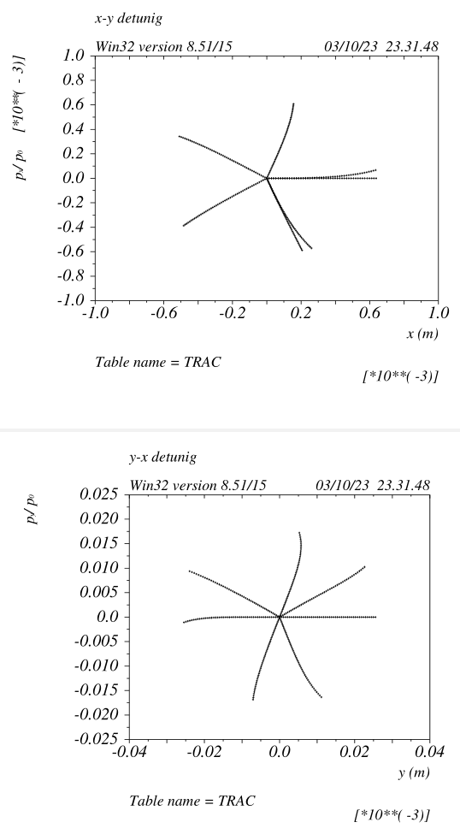
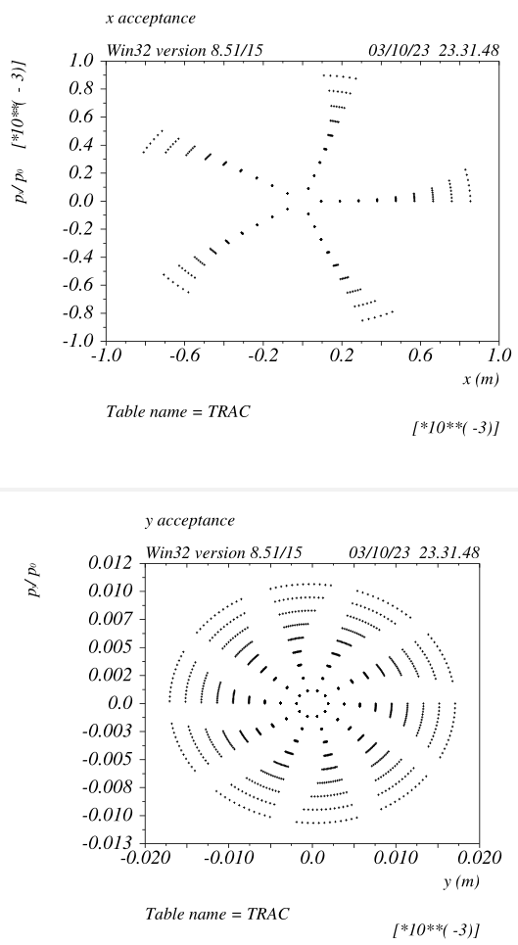
Full ring transverse DA v_67 ttbar optic
On energy dynamic is linear.
“Resonances” are virtually not existing.
Extremely favourable dynamics to minimize BeamBeam degradation

Slide 15
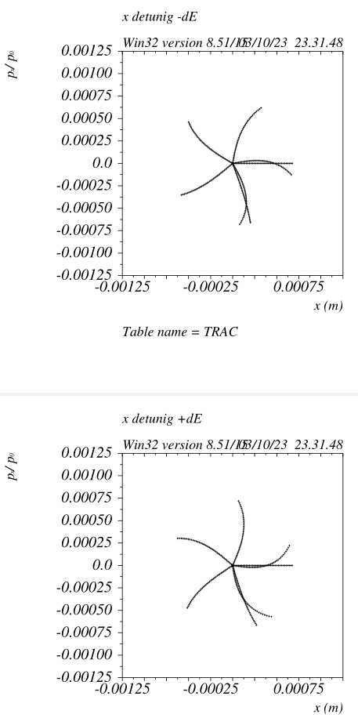
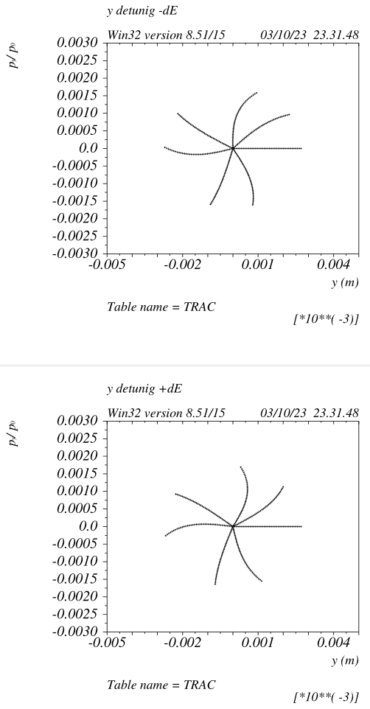
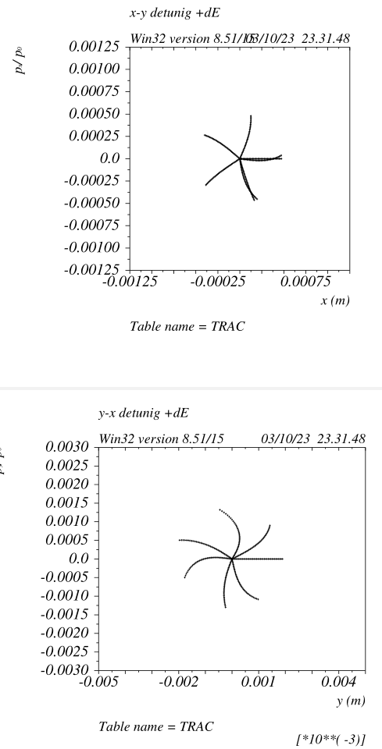
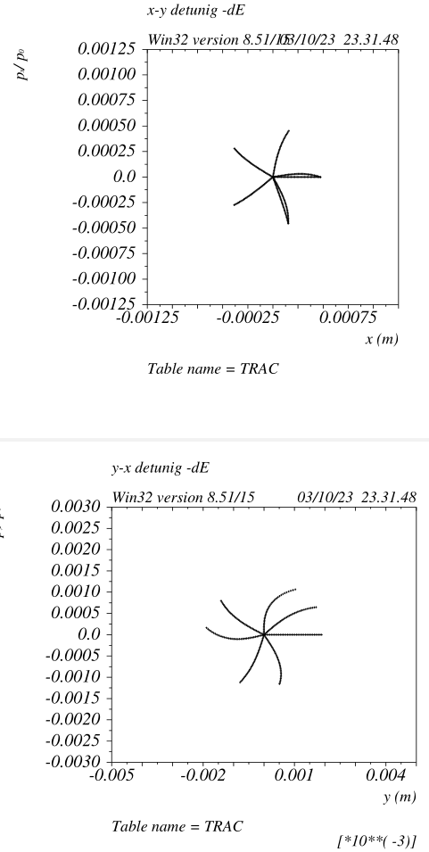
Off energy detuning (dE +/- 0.002) v_67 ttbar optic
Y and XY energy dependent detuning originated by CCsY “-I” breakage off-energy
X energy dependent detuning originated by ARCs “strong” optics

Slide 16
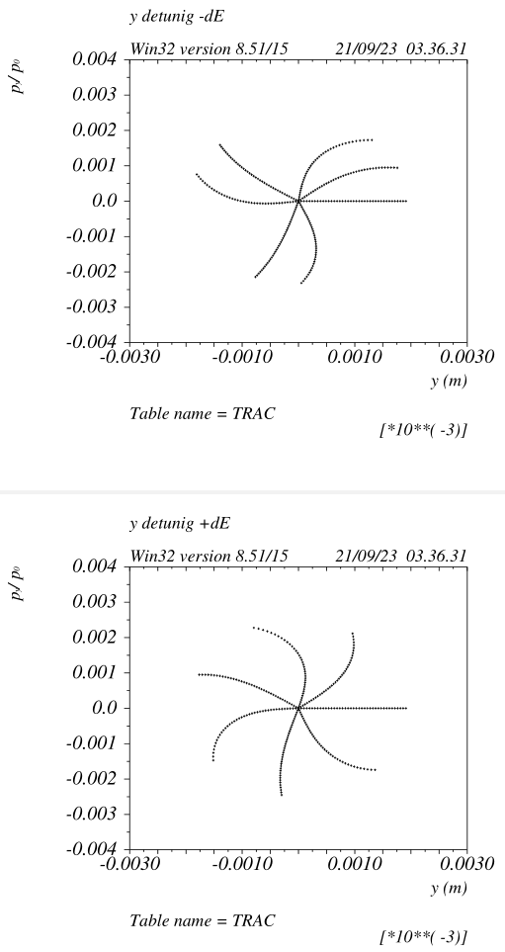
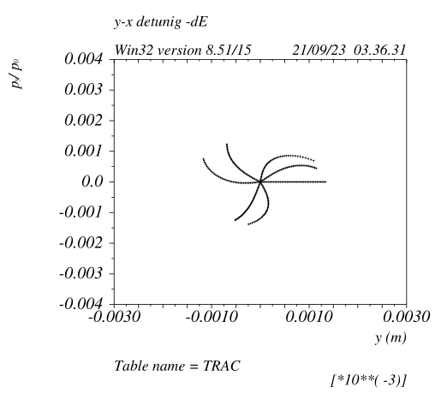
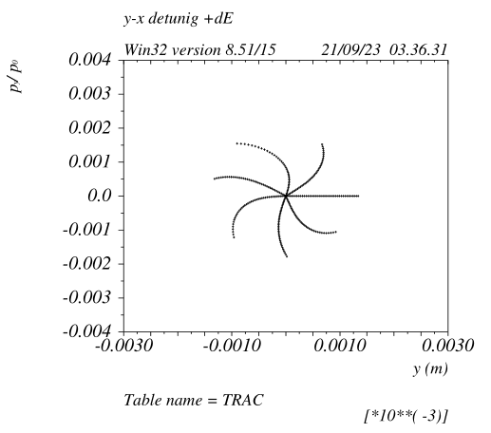
Off energy detuning (dE +/- 0.002) v_65 vs v_66 Z optic
v_65
v_66
Largely reduced detunings, still the XY energy dependent detuning is the dominant term for the off energy DA

Slide 17
IR quadrupoles asymmetric layout option
IR quads for the moment are very much symmetric
All of the above point could benefit from an asymmetric IR quadrupole layout so defined:
- QC1L should be located closer to the IP in the area where the two beamlines are separated (before the crotch chamber), it should have an higher operating gradient (~130T/m). All the other quads will stay the same.
QC1L&R will be interleaved, it will be a challenge to compensate the Quads Bfield leakage on the other beam.
It this could be achieved (M Koratzinos is looking at it), there will be many other advantages:
- QC1R/L effectively independent
- Smaller incoming beam sizes and larger stay clear.
FF Left Right sides asymmetries better match the requirements in terms of:
- Layout
- Synchrotron radiation (overall and IR)
- FF emittance contribution
- DA
- Sextupoles strengths and tolerances
- Etc

Slide 18
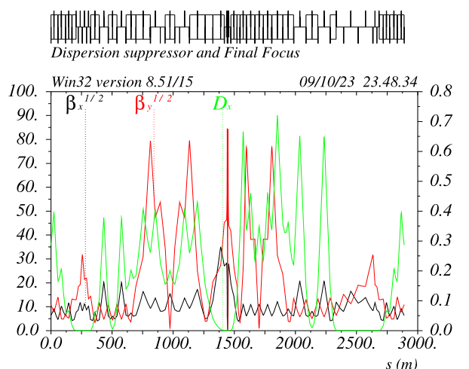
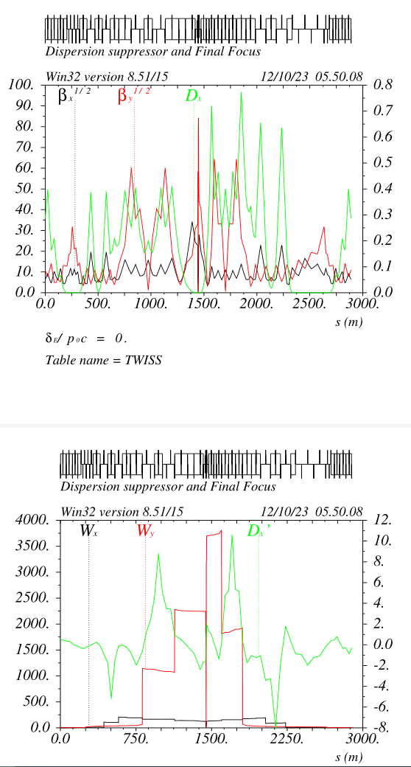
IR quadrupoles asymmetric layout option
FFL chromaticity and sextupoles are reduced by up to 40%
Sextupoles strengths and tolerances scal accordingly
Horizontal and vertical beam sizes do decrease by about 30%

Slide 19
To do list
Complete the v_67 optimization (~1 week work) ttbar optic
Match the layout to the baseline (increasing the FF length helps DA and Ex)
Build the v_67 Z optic (~1 week work)
Build the v_67_bis with low-muy-ARC optics (2 weeks)
Optimize betas @ Crab sextupoles
Compensate FD fringes with octupoles&CCs_R12/R34
Evaluate performances for v_66, in particular the FF sextupole sensitivities
Evaluate performances for v_67
Build and execute a tool for numerical optimization of sextupoles and decapoles (valid for of any version)

Slide 20
Some highlights
ARC lattice very relaxed, sextupoles very weak SF/SD~40/70cm long
ARC Sexts to quad alignment requirement ~30um
ARC Quad to quad alignment requirement > 100um and progressively larger for longer distances
Achievable vertical equilibrium emittance at least 10times lower wrt baseline parameters
Low muy ARC option has 10% fewer cells with about 40% less total integrated gradients. Twice the number of sextupoles per cell ~30cm long
Ring total number of quads lower wrt baseline
Ring total energy loss about 8.3GeV/turn @ttbar, ~2% lower for the low_muy case
FF sextupoles have integrated strengths similar to the ARC ones
FF sextupoles tolerances relaxed wrt previous versions, but still unavoidably tight due to the large chromaticity compensation.
FF tuning knobs are very standard and can be built accordingly to the SLC/NLC/LEP ones
Large orthogonality of many fundamental quantities, that can be varied separately with no need to retune other quantities:
- ARC chromaticities
- Machine tunes
- FF chromaticities
- Individual IP betas
- Individual CS pairs
- Local FF tuning knobs
- …

