Slide 1

Pick-up requirements for crab cavity system and specification
Presented by W. Hofle, CERN, SY-RF
For discussion on CC PU, Oct 18th 2023

Slide 2
Options for crab cavity PU BPTQR
Pick-ups design and construction managed by WP13
Options presented by M. Krupa at 13th HL-collaboration meeting in Vancouver in October 2023
  https://indico.cern.ch/event/1293138/contributions/5459115/attachments/2723253/4733385/230928_bptqr.pdf
Four locations: next to crab cavities at short distance from Faraday cages that house the RF electronics (WP4), ~90 m + 10 m
Location next to the crab cavities gives a high closed orbit response (cf R. de Maria et al.)
Reminder: originally, APWLs (wall current monitor) chosen as the CC phase pick-ups managed by WP4 for the phase loop
New baseline for WP4 proposed by WP13 is a pick-up ensemble for RF comprising per each IP side and beam
  set of four button pick-ups (planes: crabbing and perpendicular)
  short strip-line (matched termination on down stream port)
    crabbing plane
  baseline change: ECR 2499201
  https://edms.cern.ch/ui/file/2893433/1/HL_LHC_BPTQR_analytical_response.pdf

Slide 3
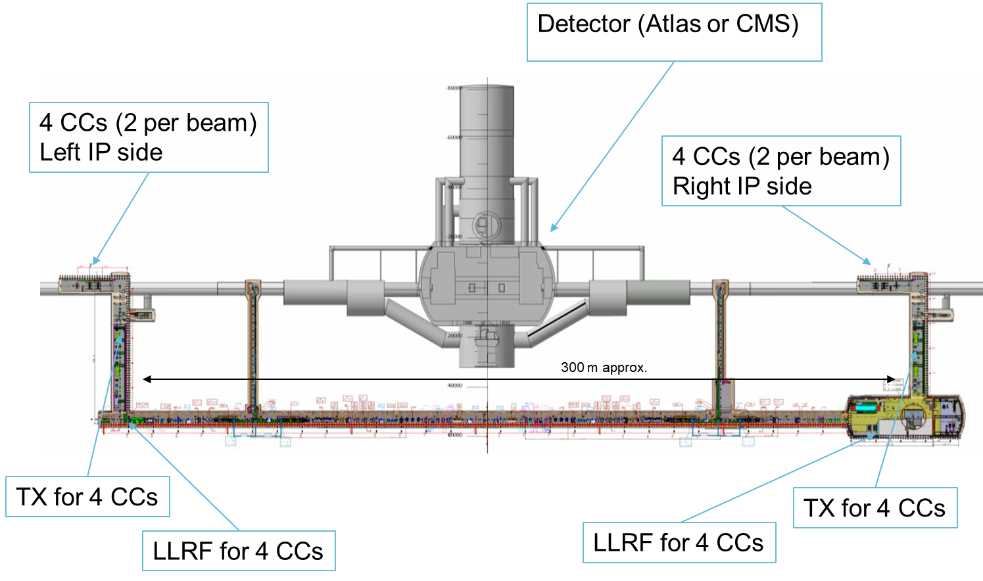
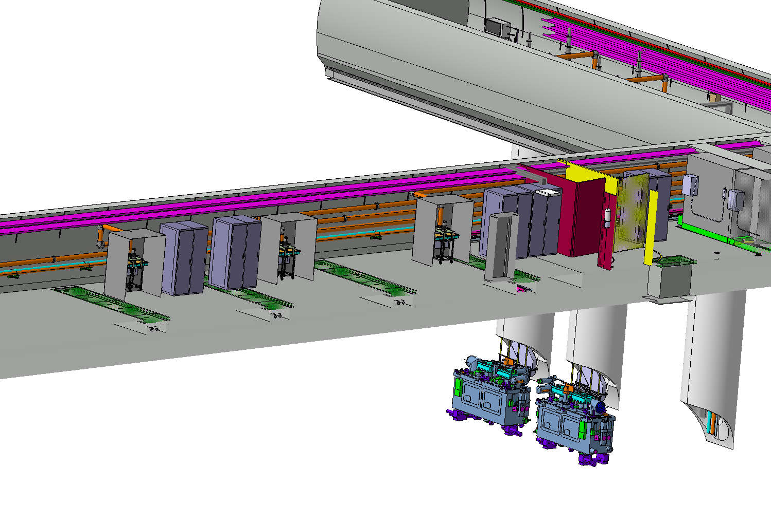
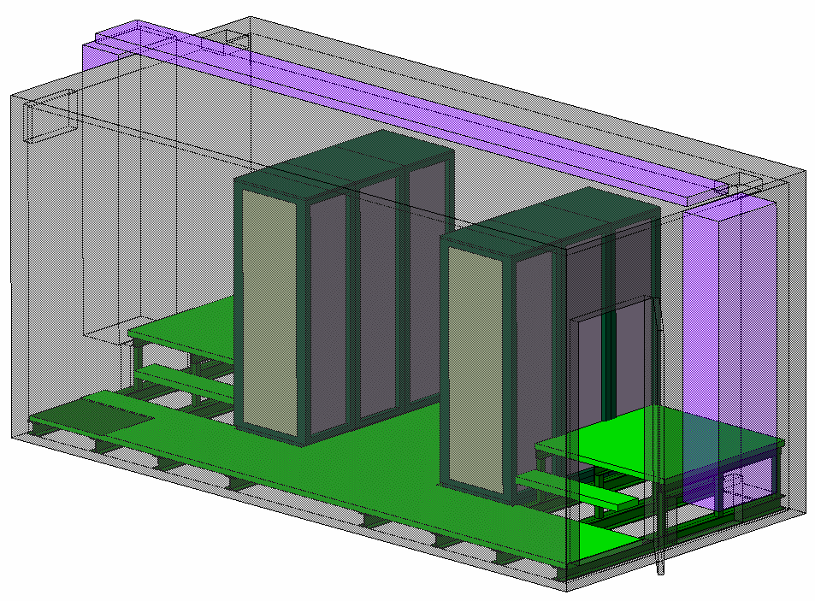
HL-LHC Crab-Cavities underground layout [1]
UAX3
ULX3
ULX7
UAX7
URX5
USX7
Fig – HL-LHC point 1 or 5 underground layout (Top view)
P. Baudrenghien, G. Hagmann

Slide 4
Why three pick-ups?
RF will cover three separate functionalities
  Functionality A: crab cavity phasing with beam using a narrow band processing representing a suitable average of the beam
    different choices for averaging (bunch-by-bunch acquisition and subsequent digital averaging or narrow band analogue filter)
    pair of buttons (sum signal: plane perpendicular to crabbing?)
  Functionality B: for removal of direct coupled beam signal from cavity antenna signal
    bunch-by-bunch signal needed
    choice of cancelling beam signal directly in the analogue domain or in the digital domain with an adaptive technique
    needed if still an issue is confirmed following the redesign of the cavity antenna coupler and no other probe available
    pair of buttons (sum signal: plane of crabbing, ok?)
    foresee dedicated cables if need confirmed

Slide 5
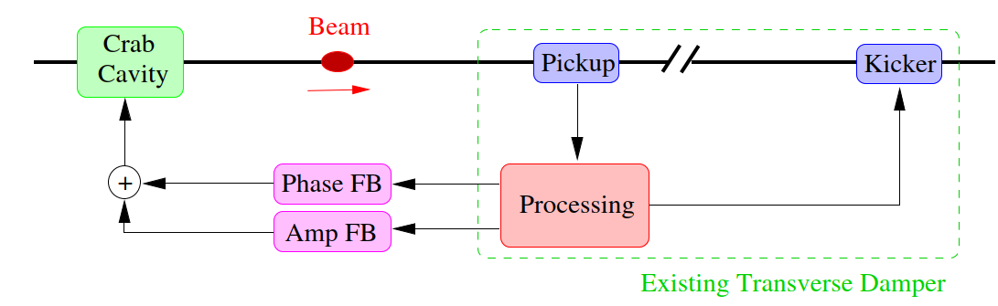
Why three pick-ups?
  Functionality C: crab cavity noise beam feedback (amplitude and phase)
    essential to mitigate effect on the beam of amplitude and phase noise in the crab cavity
    bunch-by-bunch signal needed
    feedback will act within the bandwidth defined by the cavity with the cavity RF feedback around closed
    injection of this feedback signal into the set-point for phase and amplitude
need for data exchange with the
transverse damper in point 4
not excluded (fiber)

Slide 6
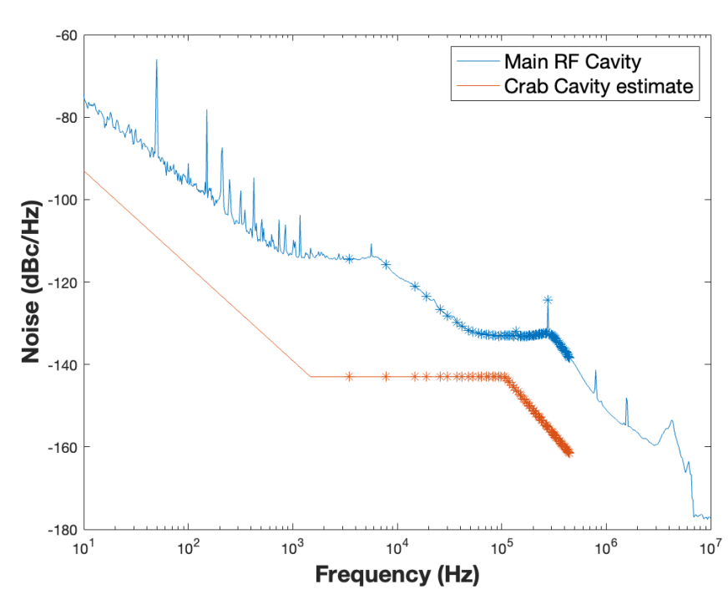
Crab cavity phase noise
The dots indicate the betatron bands
Philippe Baudrenghien

Slide 7
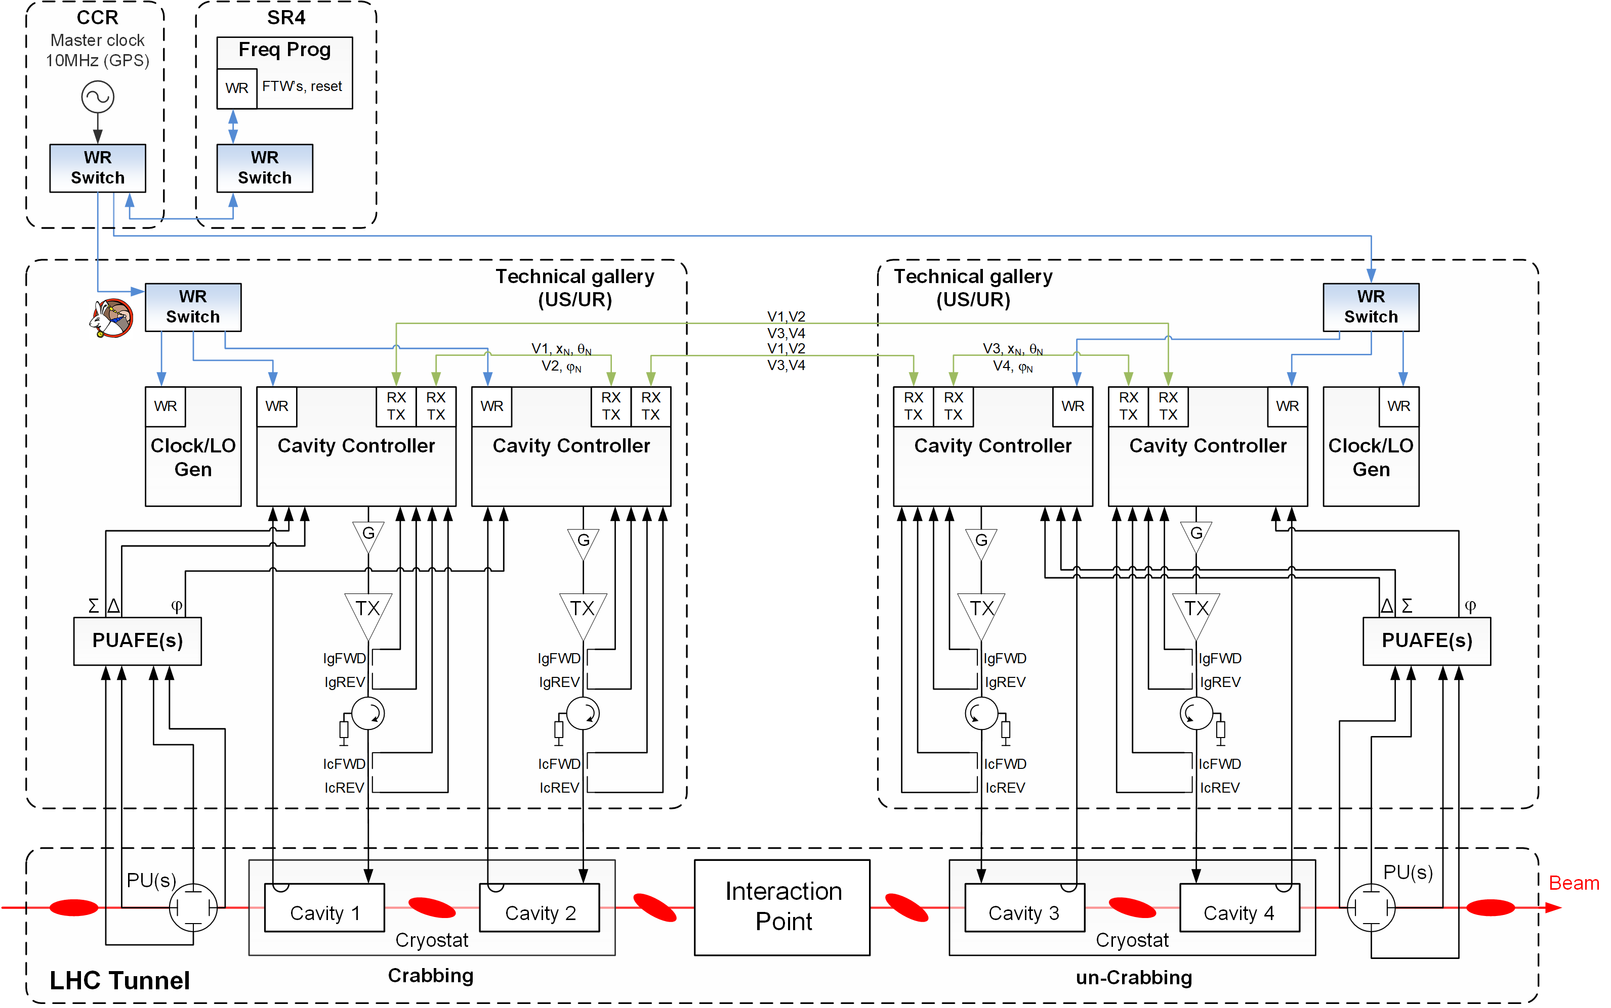
HL-LHC LLRF architecture
RF distribution (FTW) over White-Rabbit
Gb links for global regulation V∑
Low noise Master Reference (Clock, LO)
Cavity field regulation
Same cable (7/8’’) type/ length
chosen for optimum performance
For Beam phase tracking and RF noise feedback
Fig – HL-LHC Crab cavities LLRF architecture (per beam and IP!)
Pick-up ensemble of 3 PUs (functionality A,B,C only schematically shown)
G. Hagmann et al.

Slide 8
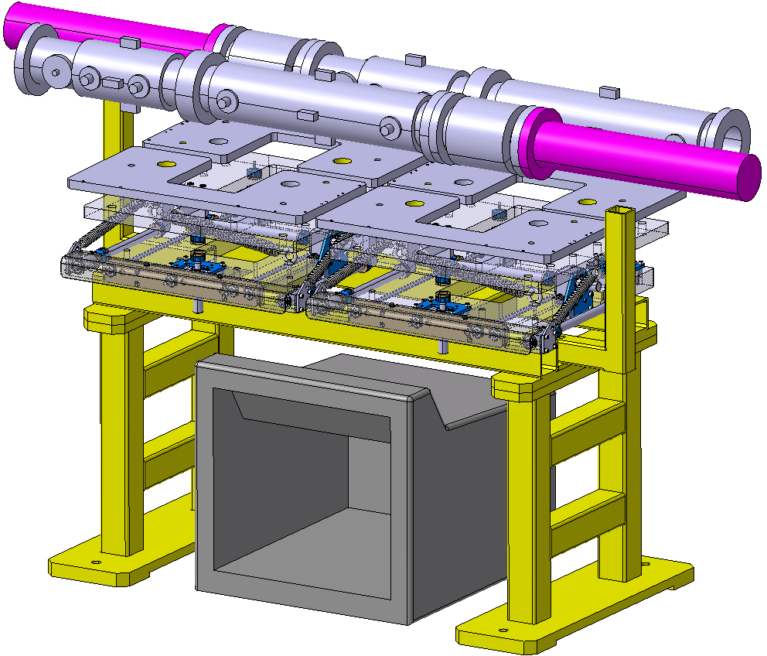
Integration
Integration of supports for the adjacent drift chambers under discussion
Requests for long cables done by WP4 in 2020:
  1 x 7/8” cable to the Faraday Cage per APWL (now BPTQR)
  updated request from WP4 will be four 7/8’’ cables at least
  This is not enough for the 4 buttons + 2 striplines
  Cabling request to be updated if all three pick-ups need to be used concurrently (using spare cables already planned may be an option)
M. Krupa et al.

Slide 9
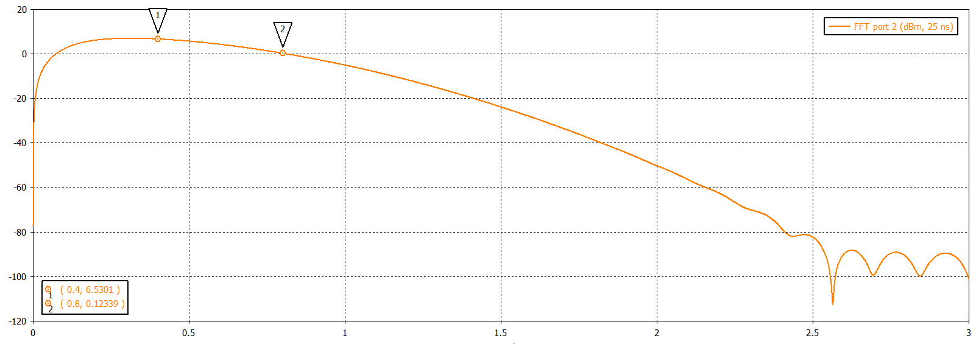
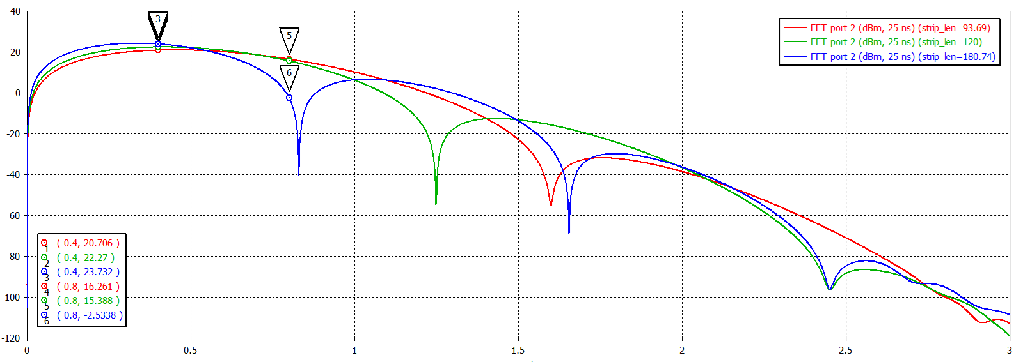
CC feedback PUs
We have a PU next to each cryostat (cavity pair)
We have 2 available PU candidates
  Button
  Stripline
We consider operation (demodulation) at 400 or 800 MHz-> 120 mm stripline (green) and button are good options
The frequency responses of the two Pus are very similar
The stripline gives ~20 dB more signal. Can we make use of it ?
Courtesy of M. Krupa
From last meeting: Philippe Baudrenghien
Demodulation also possible at other harmonics of 40 MHz
or other frequencies

Slide 10
Alignment
In operation the crab cavities can be dynamically aligned with respect to the beam without accessing the tunnel
This will result in an offset (mm range) of the beam in the pick-up
For functionality A and B the alignment of the pick-up with respect to the beam is not an issue as only the longitudinal signal is needed
For functionality C an offset has an influence on the dynamic range and during the set-up of the electronics
  Electric centering is considered to be an option
    https://accelconf.web.cern.ch/IBIC2013/papers/wepc12.pdf
  The need to implement an electric centering can be decided once study and prototyping of the electronics is sufficiently advanced and a boundary for the beam position defined

Slide 11
Button pick-up versus strip-line
Button pick-ups
  offer well paired electrodes by design and serial manufacturing process
  not phase linear (RC, large button additional convolution with diameter/bunch length to be taken into account)
  smaller sensitivity (10x)
  need to be well matched at all frequencies within the bunch spectrum in order not to create artifacts due to reflections
    may require for this reason an additional attenuator before using the signal → additional signal loss
Strip-line pick-ups
  are phase linear and therefore more suitable for broadband applications or time domain observation
  can create artifacts if electrodes not well paired and deviate from nominal and at feedthroughs / loads

Slide 12
Strip-line pick-up
matching: feedthrough, load: -35 dB (WP4 wish)
uniformity: 50 Ω +/- 1.5 Ω (WP4 wish)
above specs were found to give balanced result with imperfections introduced by commercially available hybrid (H9) in the past (https://accelconf.web.cern.ch/IBIC2013/papers/wepc12.pdf)
length suggested by WP13 ok (120 mm)
Proximity of buttons and strip-line shall not lead to artifacts
  to be assessed, i.e. to be compared with the 35 dB matching quoted above
  influence of matching error of strip-line on button can be high
  need CST simulation of string of pick-ups
Cable type needs testing
  within minimum bandwidth of 40 MHz for bunch-by-bunch observation the cable can also introduce some artifacts and a non-linear phase with frequency

Slide 13
Why do I worry about these small effects?
Non-linear phase with frequency (could also be compensated in an analogue way) may entangle amplitude and phase modulation in the detection, we want the detection system to separate these contributions (how much cross talk can we tolerate?)
Ideally the detection is bunch-by-bunch and there is no crosstalk of the detected signal from one bunch to the adjacent bunches.
Reflections will lead to a cross talk between bunches and, overall, the signal we use for the noise feedback (although the cavity averages), will contain a contamination, this could be like an additional noise contribution

Slide 14
Questions needing attention
Power required for the crab cavity noise feedback
  as it is a noise like signal the extra power will have peaks in time domain (usually a factor 3 compared to the rms in voltage)
  power requirements will be higher for large frequency offsets
    the signal is injected into the set-point, RF feedback will push cavity drive for the signal contents with large f-offsets
The orbit response function is valid to my understanding in the steady state case (same kick every turn)
  There is a part of the noise (close to 400 MHz) that is correlated indeed ~100% from turn to turn
  The noise with contributions further away from the carrier is less or not correlated from turn to turn
  For this latter part the validity of the orbit response function deserves a check (for case of wanted noise feedback damping time being of the same order of, or exceeding the settling time of the orbit response function (in turns)

Slide 15
My Conclusions
String of pick-ups suggested by WP13 looks ok
  Maintain short strip-line in baseline
  CST simulations to exclude mutual influence of pick-ups
  Matching and uniformity of strip-line
  Influence of finite size of button on transfer function
  Cable sample measurement
  No active mechanical alignment requested by WP4
Check of a number of questions within WP4 and between WP2 and WP4 needed

Slide 16
Spare Slides from contributors to previous meetings and discussions

Slide 17
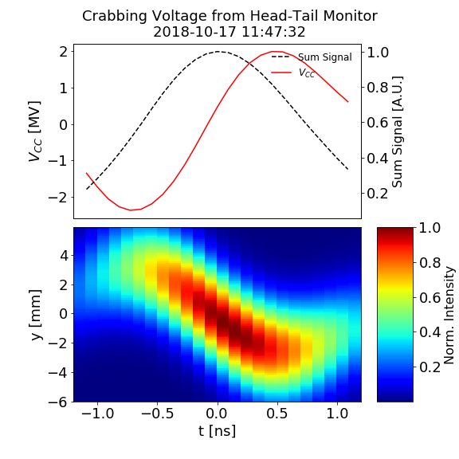
Functionality A: CC-beam phasing
Longitudinal beam position defined by the 400 MHz system in SR4 / UX45
CCs controlled by electronics installed in 4 Faraday cages in IP1/5
WP requirement: monitoring of the phase of the 400 MHz beam current component close to the CC location to correct the crabbing phase
ECR proposal: 2 button electrodes for narrowband longitudinal measurements, next to the CC

Slide 18
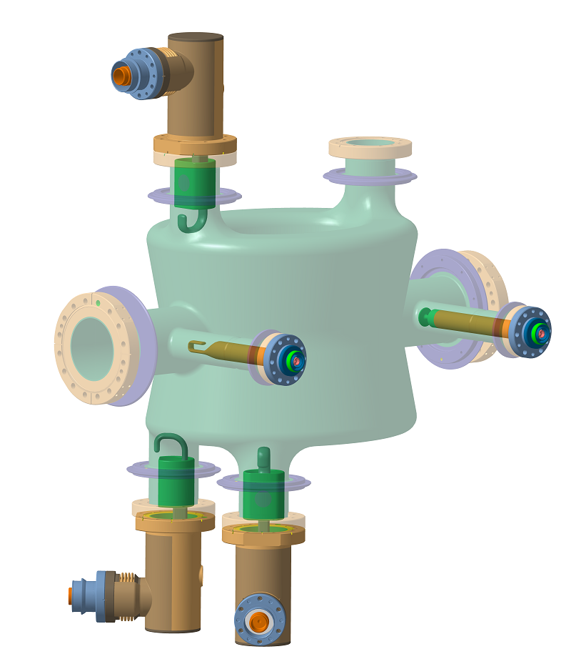
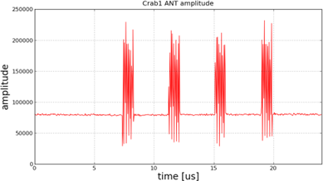
Functionality B: Filtering of beam interference on the CC antenna signal
An antenna installed outside the CC generates a signal used to regulated the CC field
Undesired coupling to the beam field to be removed through Adaptive Noise Cancelling techniques
WP4 requirement: Monitoring of the beam current in the 360–440 MHz band close to the CC location. Sensitivity from a single pilot bunch to a full nominal beam
ECR proposal: 2 button electrodes for longitudinal measurements, next to the CC

Slide 19
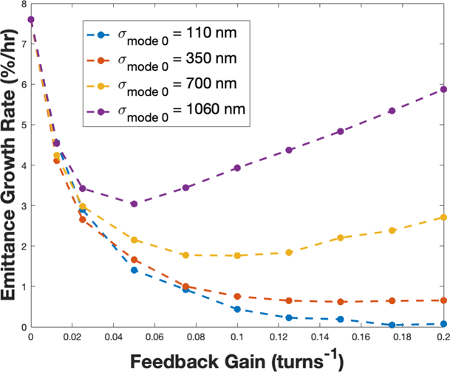
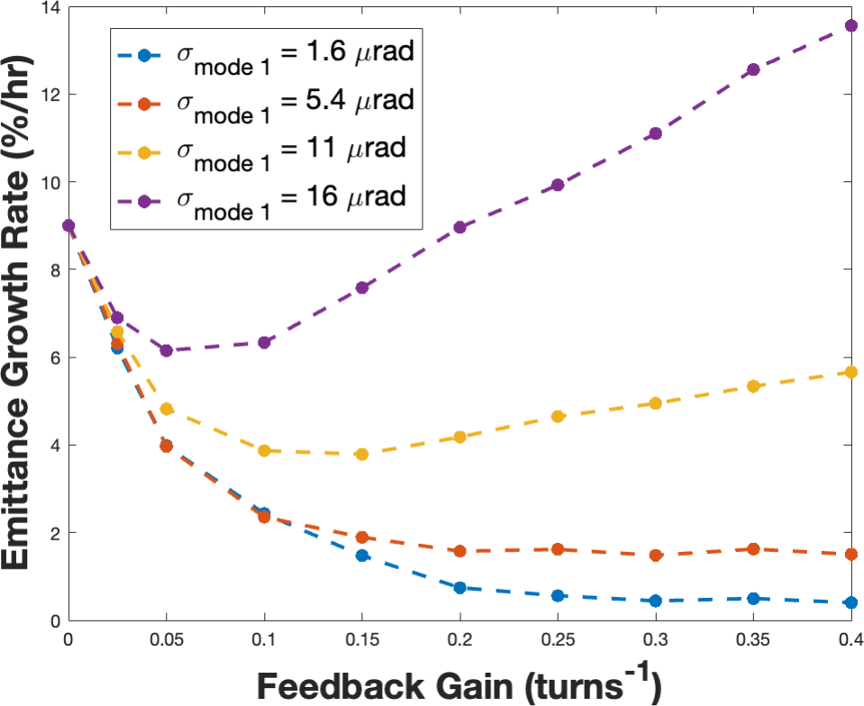
Functionality C: CC noise FB
Excessive CC noise results in an additional bunch tilt outside of the crabbing region
WP4 requirement: Monitoring of bunch tilt in a high β location with a suitable phase advance from the CC
Noise floor of 5.3 μm for rigid bunch displacement, 55 μrad for bunch tilt
  Assumes β=2000 at the BPTQR location
  Assumes FB regulation BW of 136 kHz
  (~ 150 bunches)
ECR proposal: 2 stripline electrodes for transverse HT measurements

Slide 20
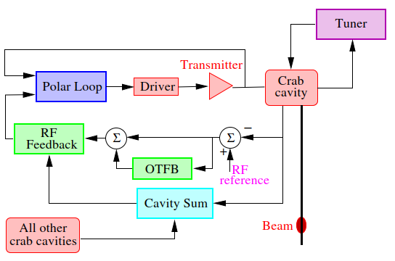
LLRF Solutions: Cavity-Controller
Power amplifier: IOT
Tuning loop
  We must keep the cavity on-tune the entire LHC fill (filling/rampling/collision)
Polar-loop
  Slow regulation around the amplifier (Gain&phase drift, reduce amplifier noise)
RF feedback
  Control cavity field + Impedance reduction
    Fast loop around cavity-amplifier
    Slow global loop regulating the vector sum: crabbing-uncrabbing voltages
Fig – Crab Cavity Low-Level RF block diagram [13]

Slide 21
Mitigation 2. CC feedback
Dedicated feedback system to counteract crab cavity noise could be developed [6],[8] to provide the extra factor 10
  Such a system could work in conjunction with the ADT
  Its performance will be limited by the pickup measurement noise (pickup specs later in this presentation.
  Theory and simulations have shown very promising performance [6][8].
Feedback system using CC as kicker

Slide 22
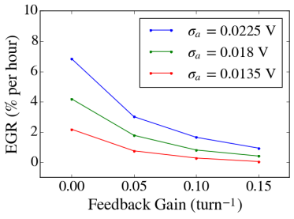
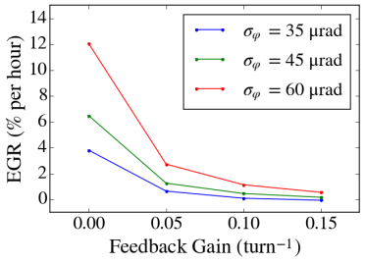
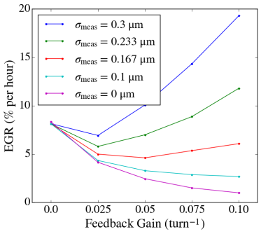
This system is very promising in simulations
But the performance is limited by the measurement noise level. Emittance growth rate curves with varying magnitudes of measurement error in the presence of both phase and amplitude noise
Need for a low-noise bunch displacement (mode 0) and tilt (mode 1) measurement chain.

Slide 23
Mitigation 1. Low noise LLRF
The LLRF includes a proportional RF feedback that must reduce the cavity impedance at the fundamental by >100 linear. This results in a 136 kHz regulation BW [4] (Sec. 1)
Comparison of the ACS phase noise and the CC target
We aim at -143 dBc/Hz SSB phase noise and amplitude noise in the 3 kHz-136 kHz band [4]
That is 10 dB better than ACS
This will result in
  7.6%/h e-growth due to phase noise
  9%/h due to amplitude noise
Factor 10 excess!
The dots indicate the betatron bands
Low noise by
  Fixed-frequency clocks and LO, we can use narrow phase-lock loops to improve the demodulator LO and thereby reduce the RF phase noise at the first two betatron sidebands
  Using IOTs instead of klystrons
  Reducing the RF demodulator noise by at least 10 dB

Slide 24
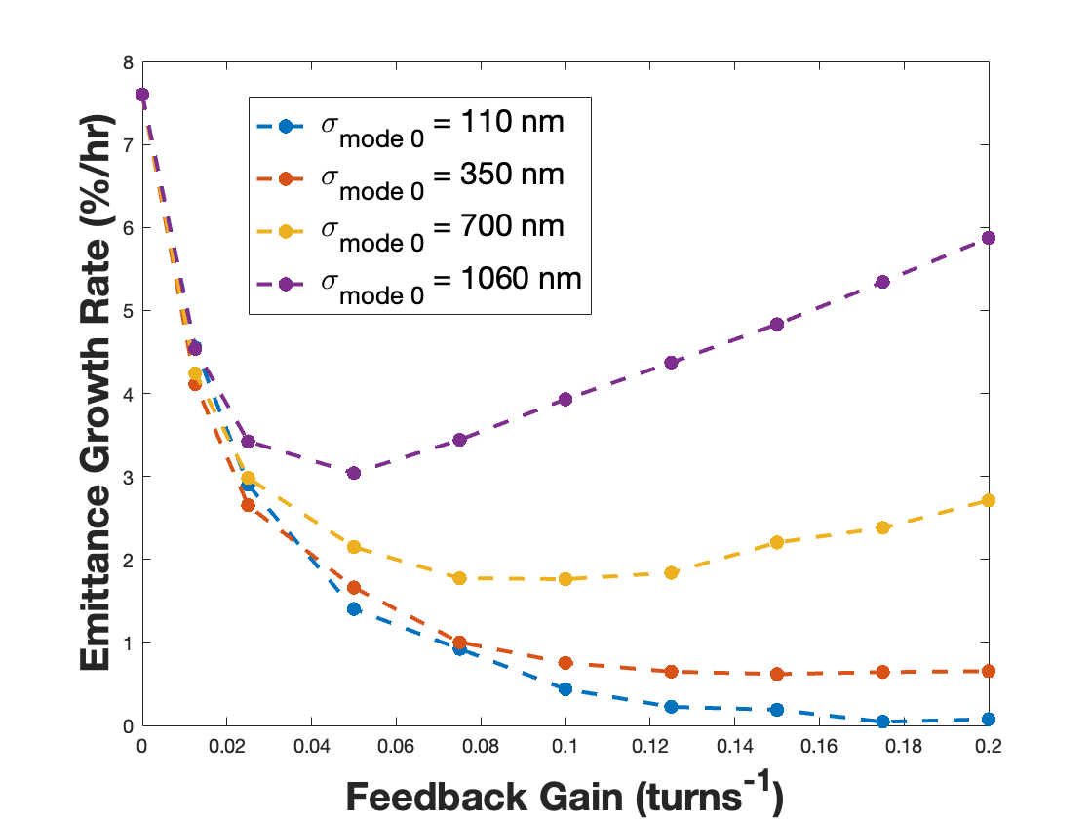
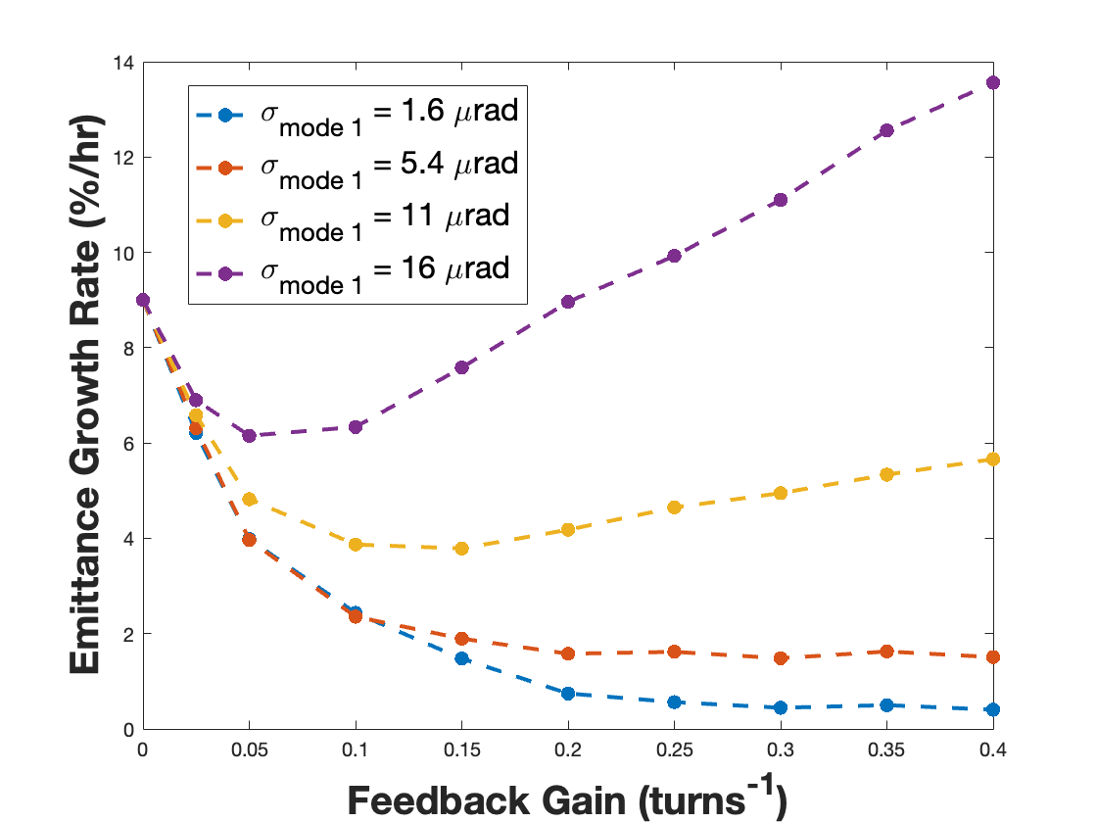
What measurement precision is required?
For single bunch we get 440 nm for mode 0 and 4.5 μrad for mode 1
As the CC noise spectrum extends to 136 kHz only, while measurement noise is white (25 ns spacing -> 20 MHz BW), an optimal filter will reduce measurement noise by 12 linear-> in batch mode
  5.3 μm for mode 0
  55 μrad for mode 1
See [6] for analytical derivations and more simulations.

Slide 25
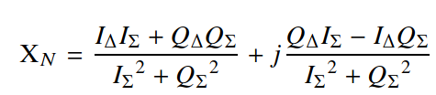
LLRF processing (tentative)
  Except for the novel use of a CC as kicker, it is a classic transverse feedback with mode 0 (displacement) and 1 (tilt)
  We plan to follow processing shown in [7] Eq. (16) to extract mode 0 and 1 signals, at least for SPS test bench
    Delta/Sigma signals from WB PU
    Filtering with 400 MHz BPF
    Analog mixer with 375 MHz LO
    ADC clocked at 100 MHz
    I/Q demodulation
    Optimal filter to increase SNR
    Then we compute Delta/Sigma. The signal has both dipole (real-valued I = mode 0) and tilt (imaginary Q = mode 1) info. See [7]
  We then apply phase shift (around betatron tune) to have 90 degrees, including latency and PU-CC phase advance, plus BPF for SNR
  We modulate CC set-point in phase (phase fdbk) and amplitude (amplitude fdbk)
  To be tested in SPS in 2024.

Slide 26
CC feedback PU
We have a PU next to each cryostat (cavity pair)
We have 2 available PU candidates
  Button
  Stripline
We consider operation (demodulation) at 400 or 800 MHz-> 120 mm stripline (green) and button are good options
The frequency responses of the two Pus are very similar
The stripline gives ~20 dB more signal. Can we make use of it ?
Courtesy of M. Krupa

Slide 27
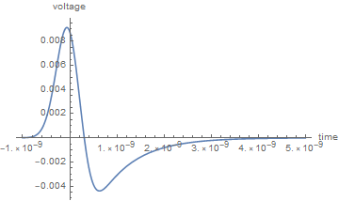
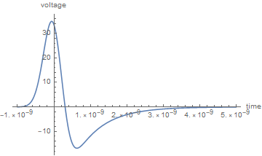
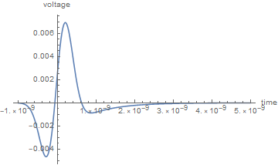
Signals from button PU before demodulation
PU signal. Common mode. ~35 Vpk
PU signal. Differential mode 0 for 5.3 um displacement. ~9 mVpk
Single bunch, 1.05 ns, 2.3e11 ppb
For the required resolution (5.3 um and 55 urad) the mode 0 and 1 signals have similar peak amplitude. Good
But they are 4000-5000 below common mode
Assuming 20 dB rejection from delta hybrid (can we get more?) we would still have common mode 400-500 times larger than mode 0 or 1 measurements
PU signal. Differential mode 1 for 55 urad tilt. ~7 mVpk

Slide 28
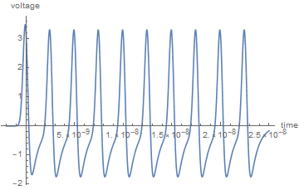
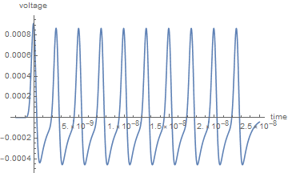
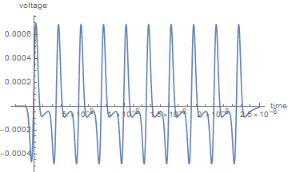
Signals from button PU after 400 MHz BPF
Common mode. ~5 Vpkpk (blue).
Differential mode 0 for 5.3 um displacement. ~1.3 mVpkpk
Again, for the required resolution (5.3 μm and 55 μrad) the mode 0 and 1 signals have similar 400 MHz component. Good
But they are still 4000-5000 below common mode
Note that the mode 0 and mode 1 signals, after 400 MHz BPF, are indeed in quadrature.
Differential mode 1 for 55 urad tilt. ~1.1 mVpkpk

