Slide 1



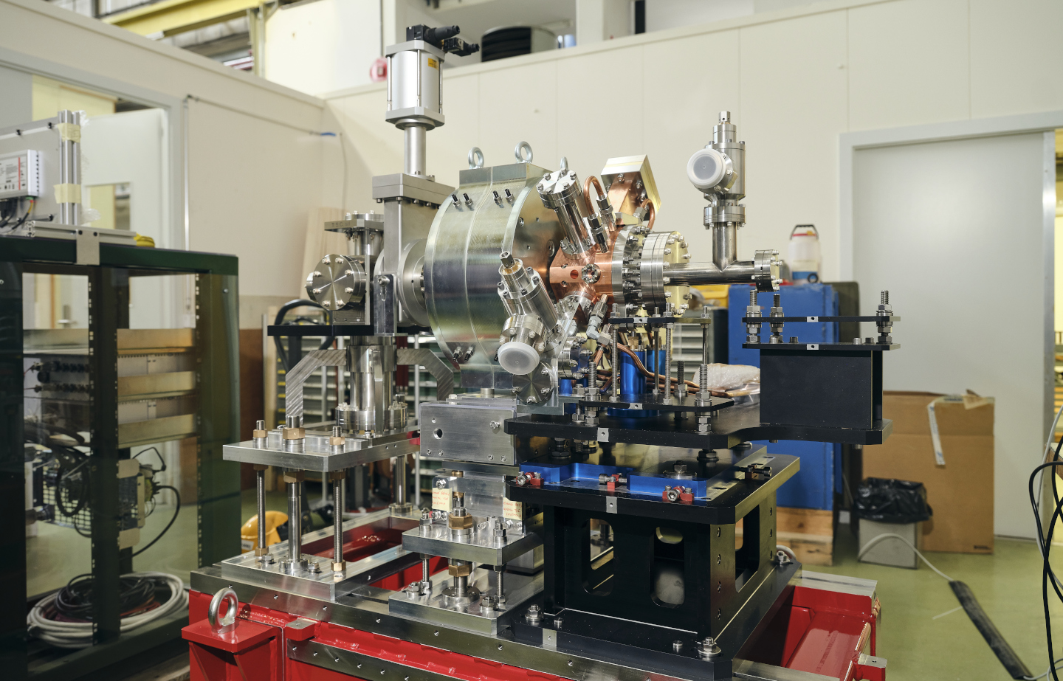
CTF2 CBS set-up
Vlad Musat, Andrea Latina, Eduardo Granados, Steffen Döbert

Slide 2
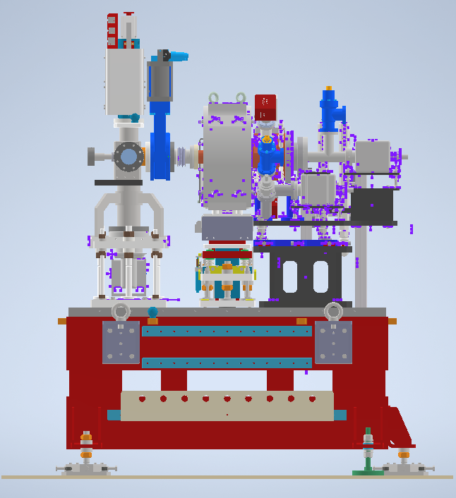
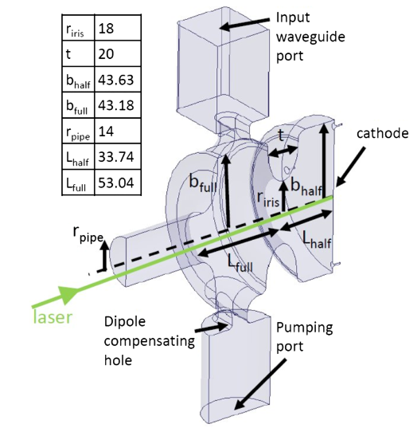
CTF2 gun
0.75 m
0.5 m
S-band standing wave 1.5 cell RF-gun intended for the new AWAKE injector.
Prototype constructed by INFN-Frascati and commissioned at CTF2.

Slide 3
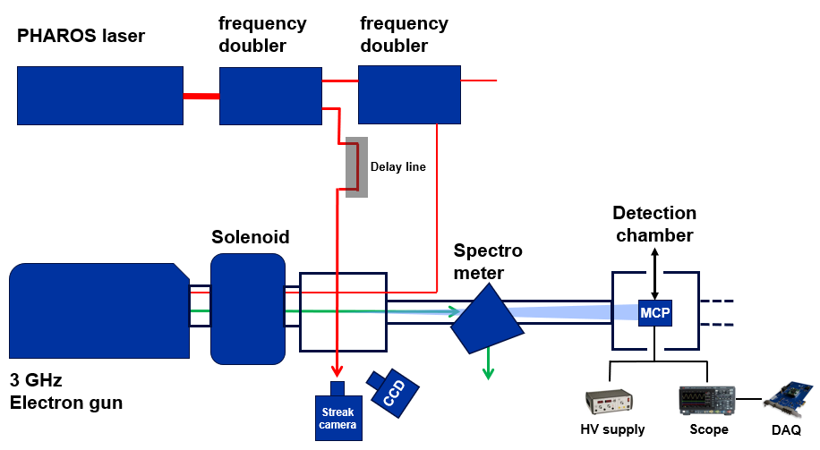
Experimental set-up
2.1 mJ, 1030 nm, 0.17 ps
Laser beam
Electron beam
X-ray beam
5 MeV, 400 pC

Slide 4
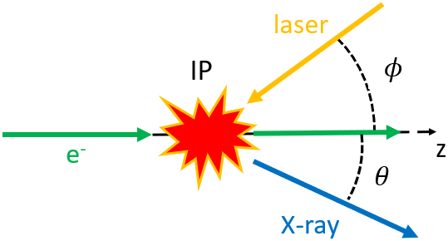
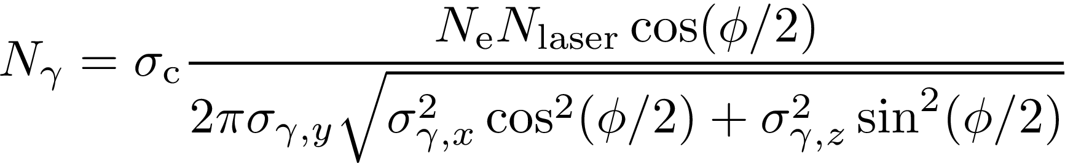
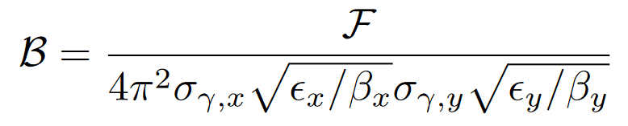
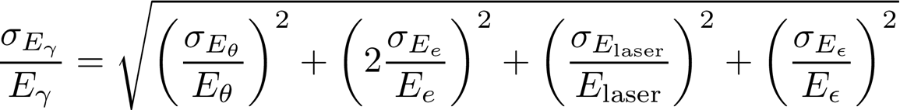
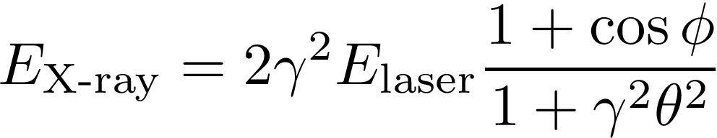
Compton backscattering
= The scattering of a low energy photon from an EM field to a high-energy photon (X-ray or gamma ray) during the interaction with a charged particle.
Total flux
Average brilliance
Photon bandwidth
Photon energy

Slide 5
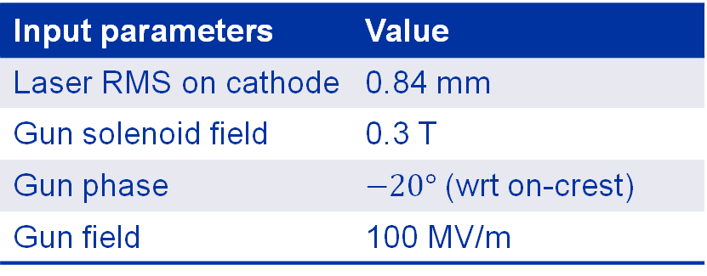
Input beam parameters
Electron beam parameter | Value
Beam energy | 5 MeV
Bunch charge | 400 pC
RMS beam size at IP | 140 µm
RMS bunch length | 2 ps
Repetition rate | 10 Hz
Laser beam IP parameter | Value
Wavelength | 1030 nm
Laser pulse energy | 0.9 mJ
RMS pulse length | 0.17 ps
M2 | 1.3
Laser waist at IP | 15 µm
Input parameters | Value
Laser RMS on cathode | 0.84 mm
Gun solenoid field | 0.3 T
Gun phase | $−20°$ (wrt on-crest)
Gun field | 100 MV/m
18 mrad
13.5 mm
0.75 m

Slide 6
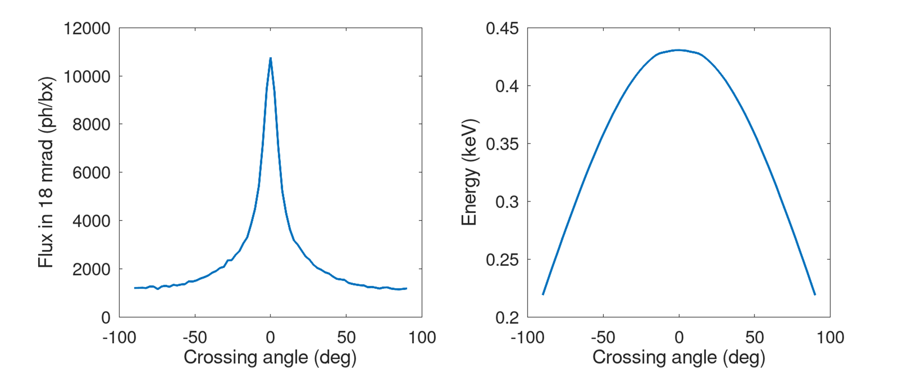
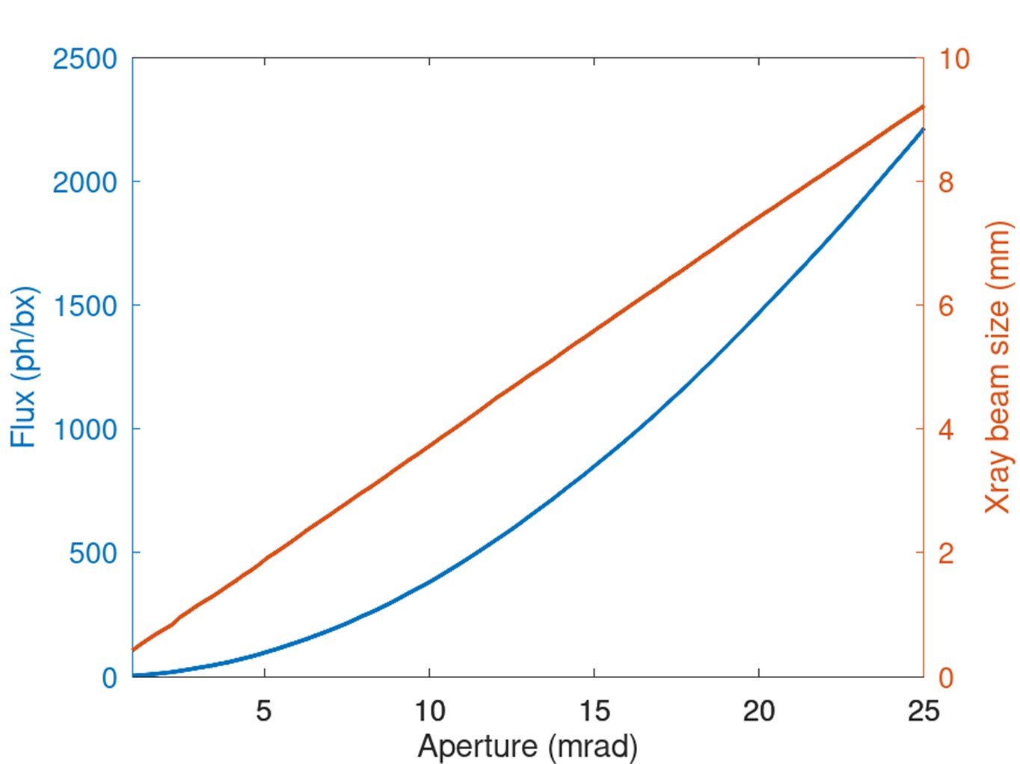
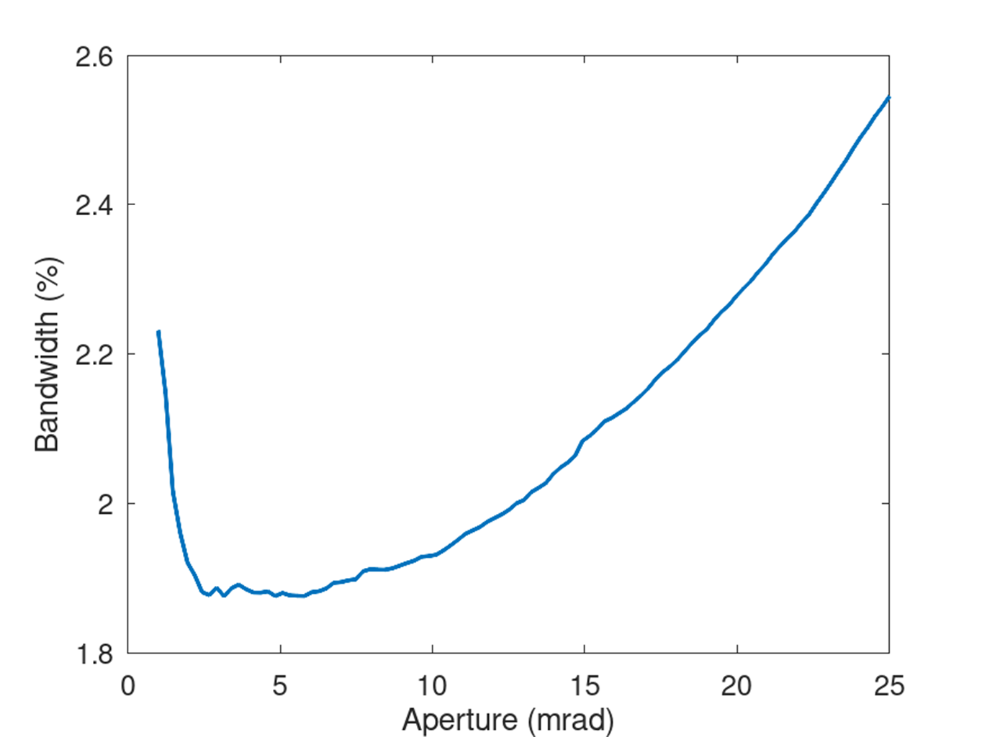
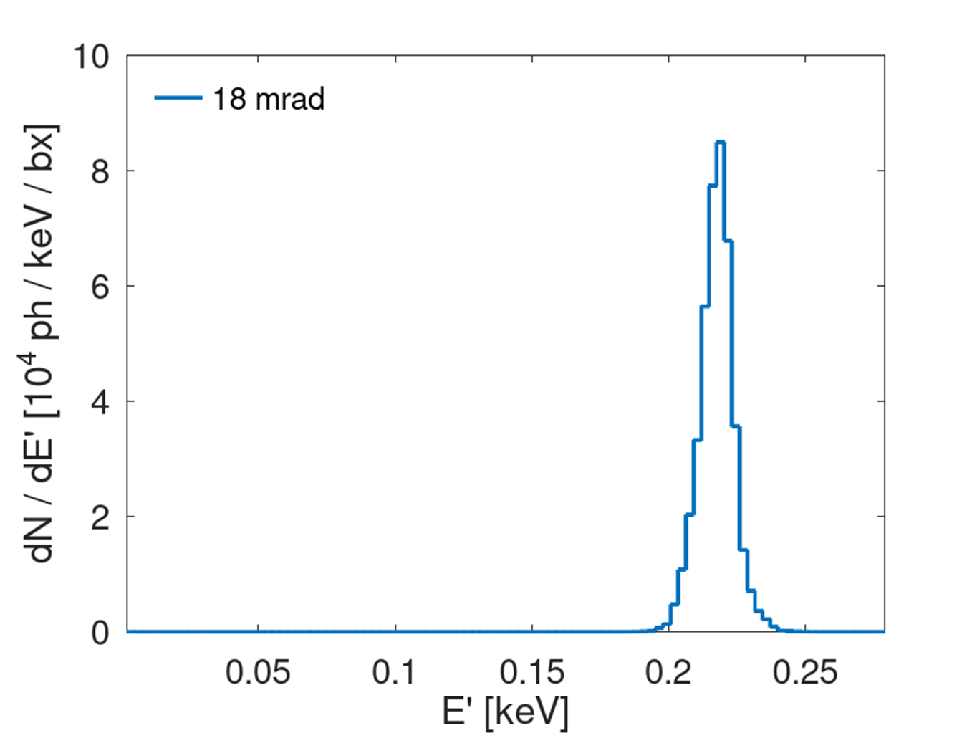
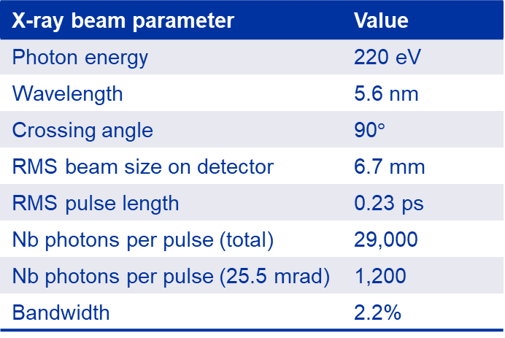

X-ray parameters
At 90$°$ crossing angle (and 100–110 MV/m), the photon energy is 220–250 eV (5.6–4.9 nm)
X-ray beam parameter | Value
Photon energy | 220 eV
Wavelength | 5.6 nm
Crossing angle | 90$°$
RMS beam size on detector | 6.7 mm
RMS pulse length | 0.23 ps
Nb photons per pulse (total) | 29,000
Nb photons per pulse (25.5 mrad) | 1,200
Bandwidth | 2.2%

Slide 7
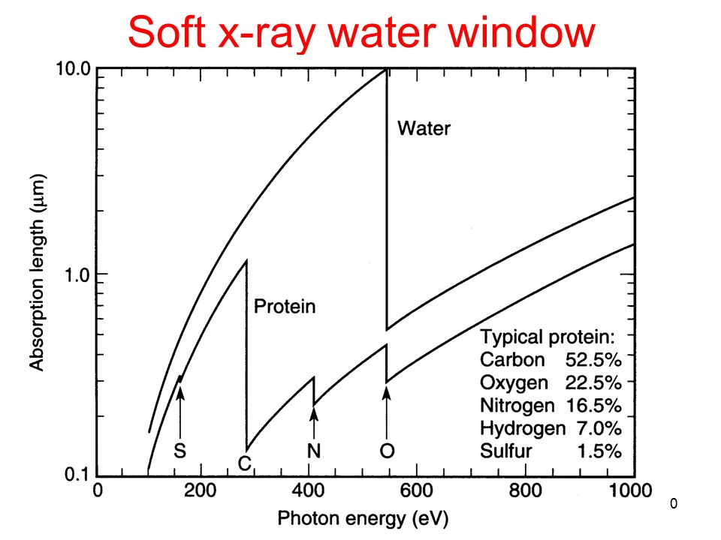
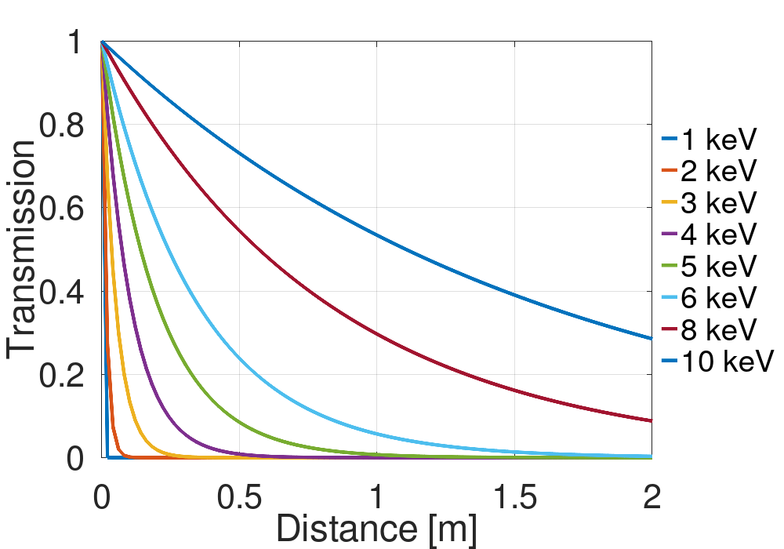
Detection: initial considerations
CBS sources can be used as table-top soft X-ray sources in the water window regime (282 – 533 eV).
Because of the high absorption in air of soft X-rays, the detector will need to be placed in vacuum.

Slide 8
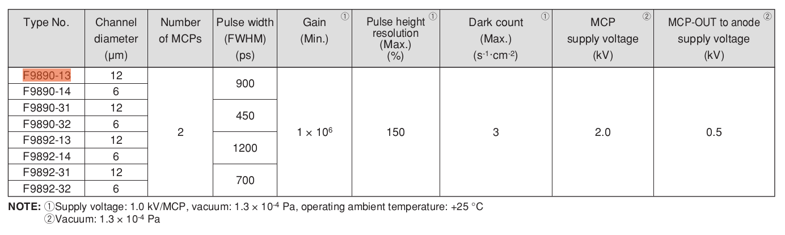
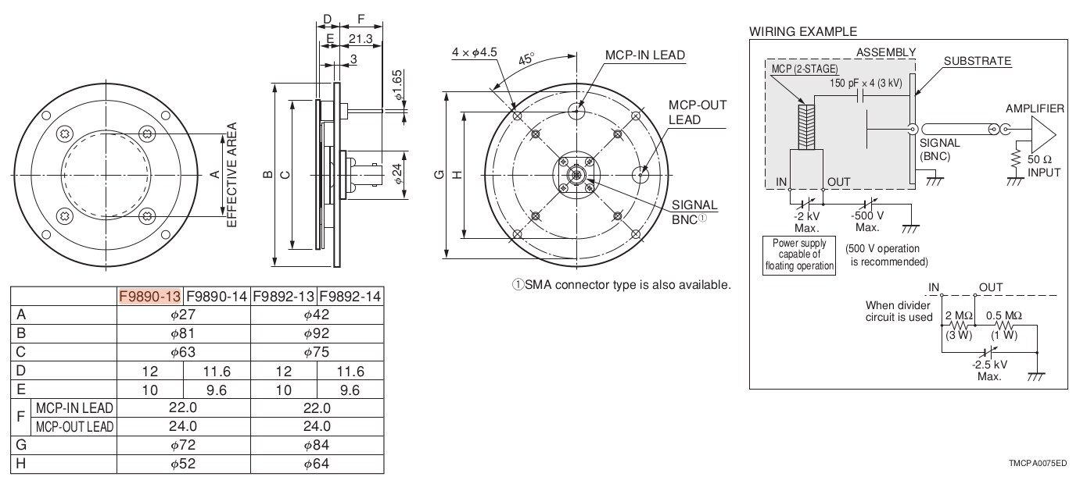
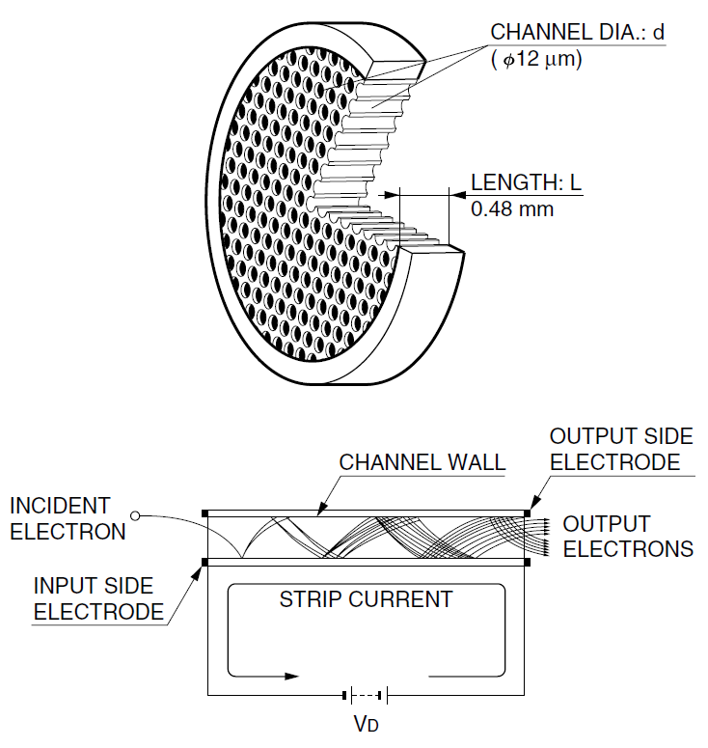
The MCP detector
(F9890-13)
Max dimensions: 81 by 36 mm
Operated in vacuum (< 1.3e-4 Pa)
Electrical feedthrough: HV power supply and oscilloscope
Provides 10⁶ gain with a 27 mm effective diameter

Slide 9
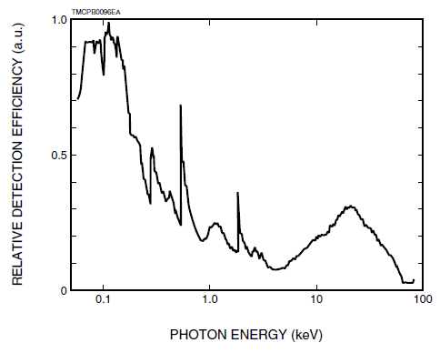
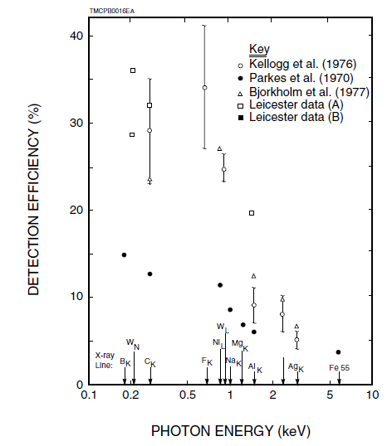
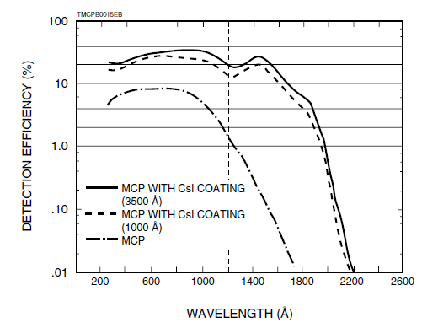
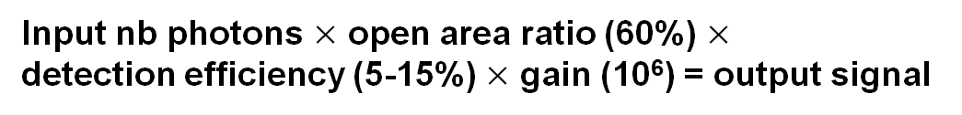
The MCP detector
Detection efficiency
Input nb photons $×$ open area ratio (60%) $×$
detection efficiency (5-15%) $×$ gain (10⁶) = output signal
Good detection efficiency for X-rays in the water window
The MCP is invisible to visible light and UV photons from the cathode laser
Source: MCP assembly technical information document (Hamamatsu)

Slide 10
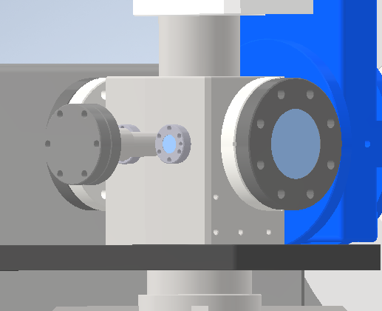
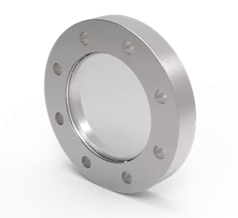
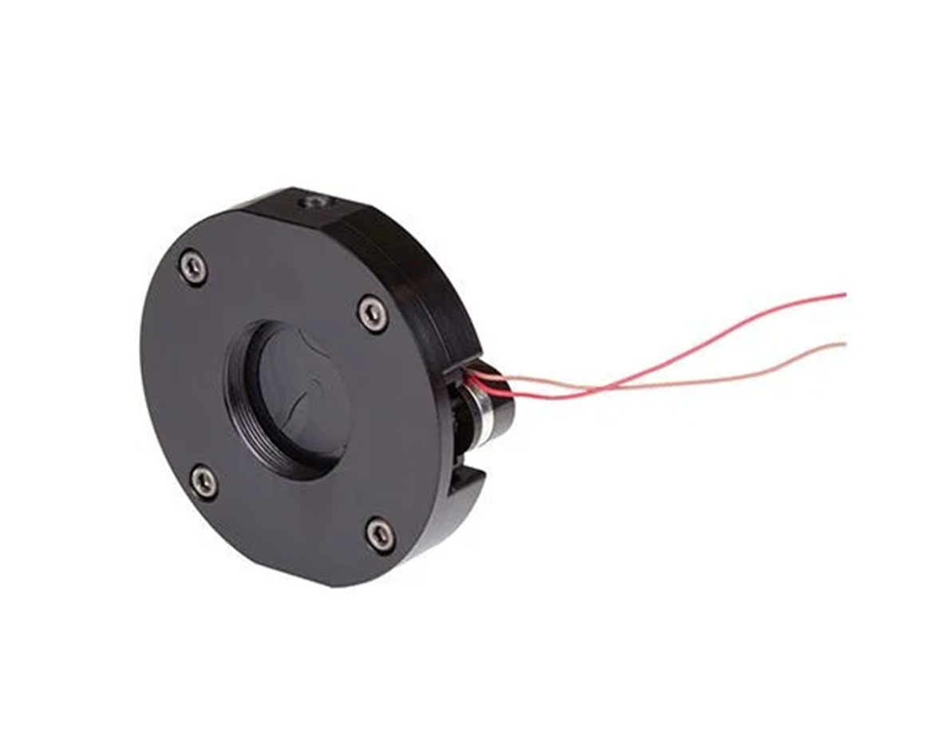
Interaction chamber: modifications
Install laser grade viewport for 515 or 1030 nm IP laser
Electrical shutter for electron/laser beam imaging CCD (out of vacuum)
Interaction chamber
CF63

Slide 11
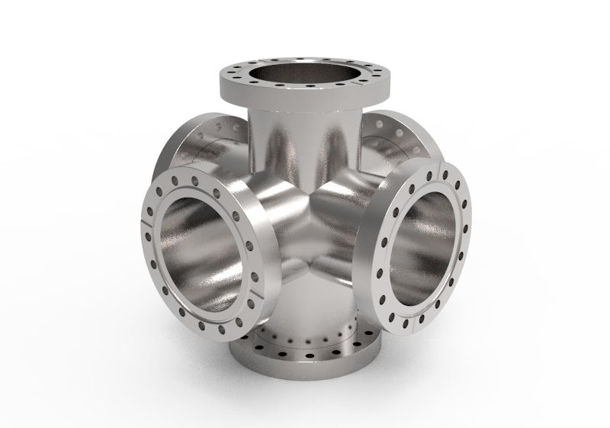
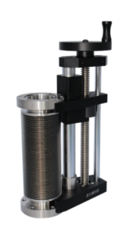
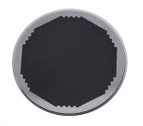
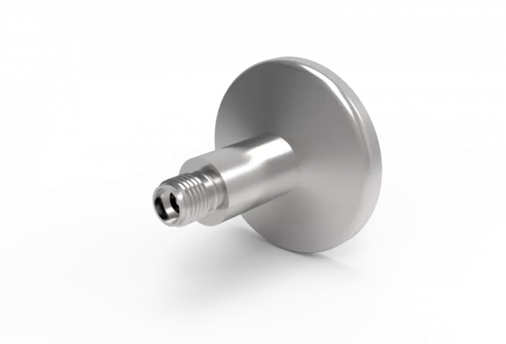
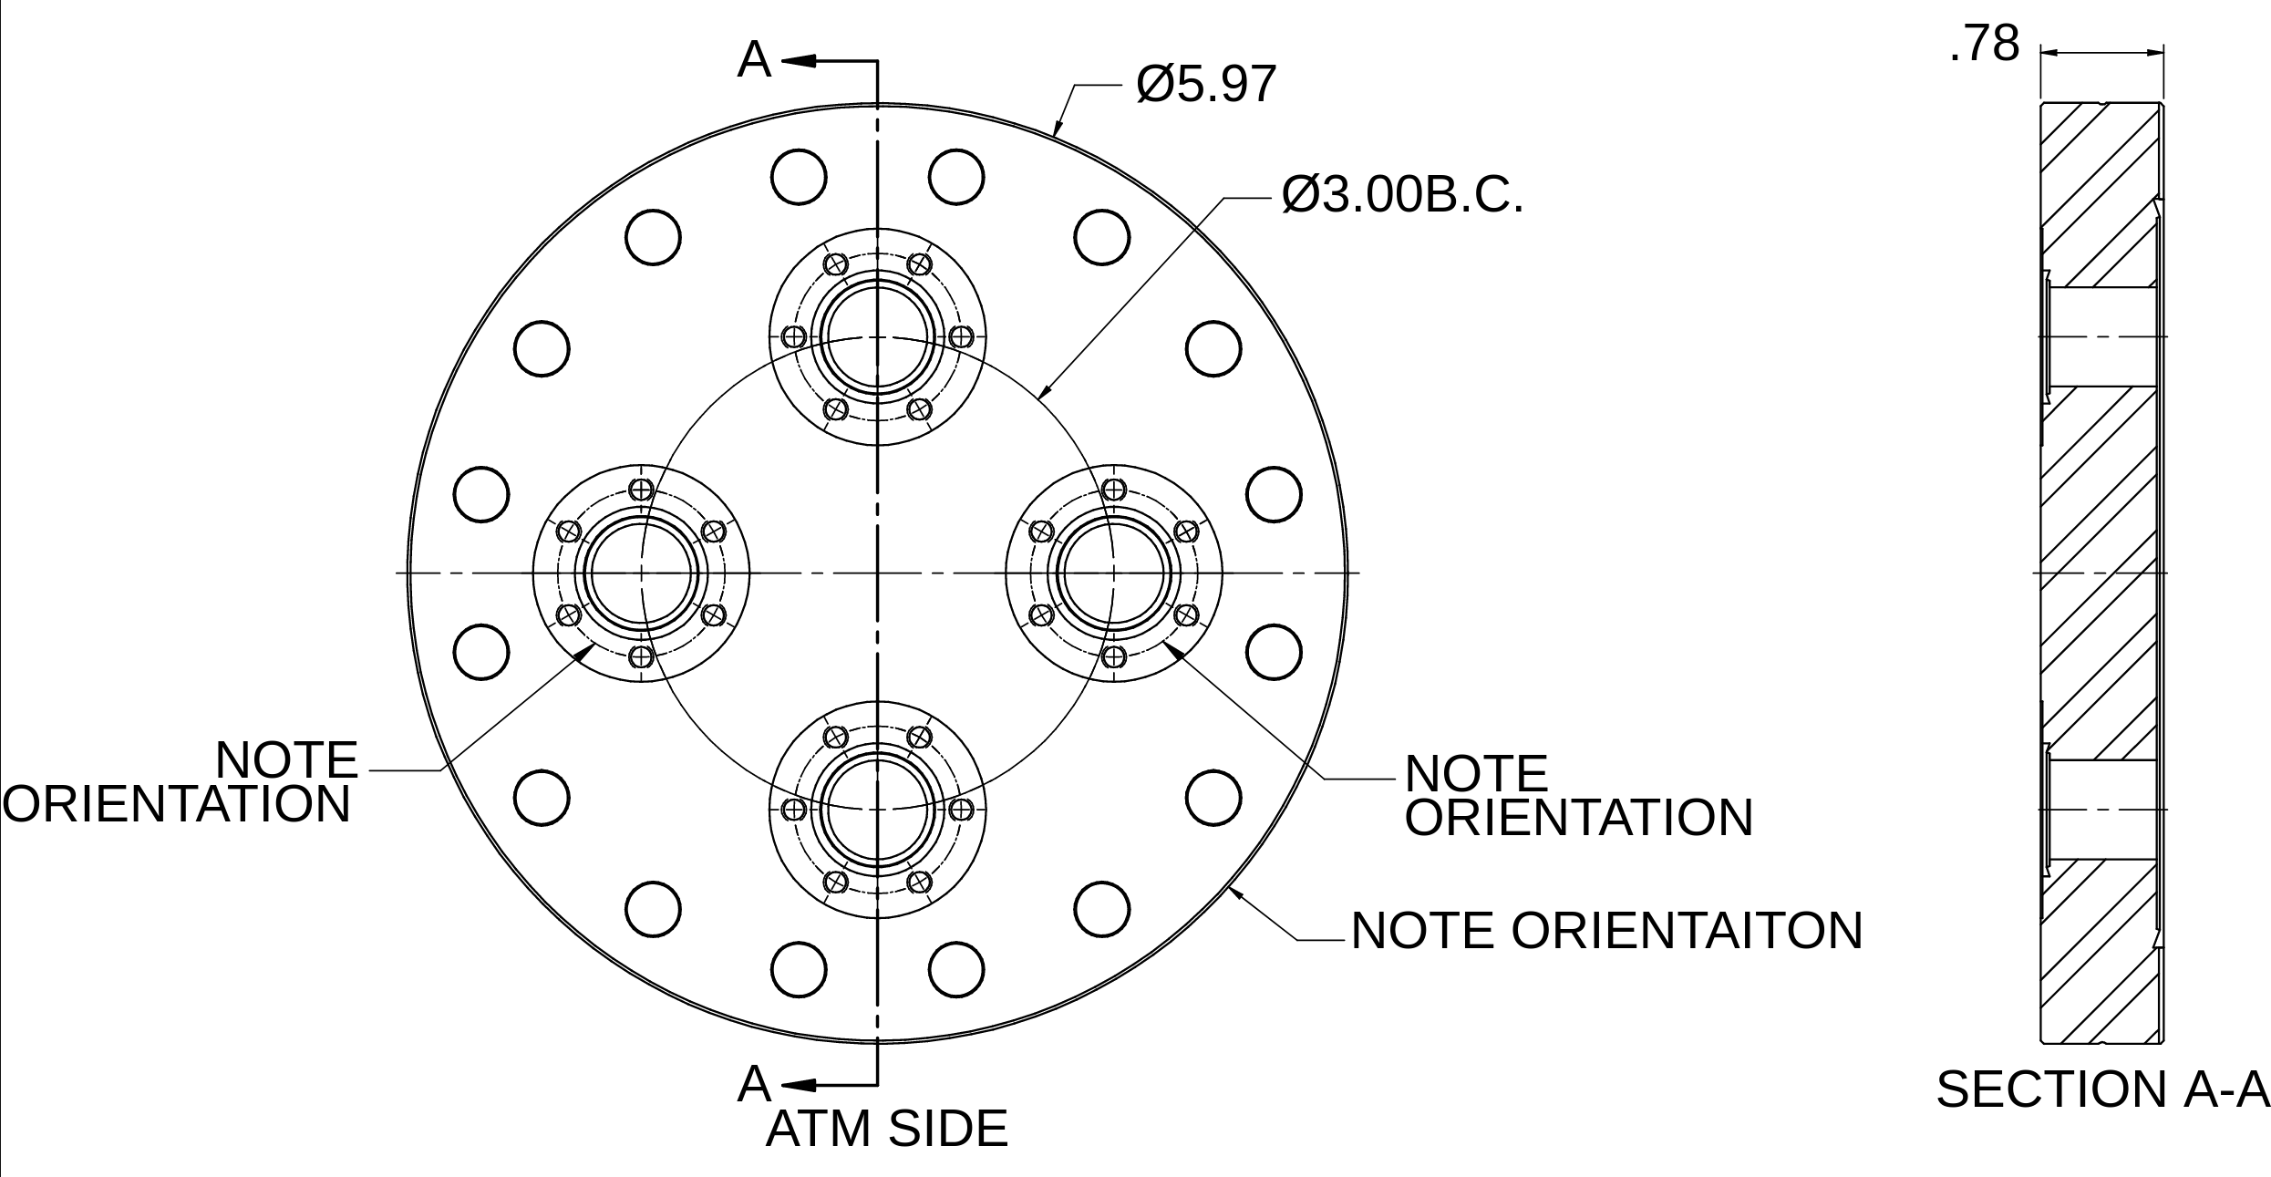
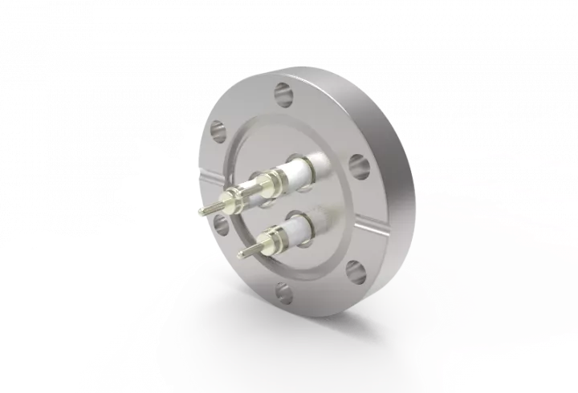
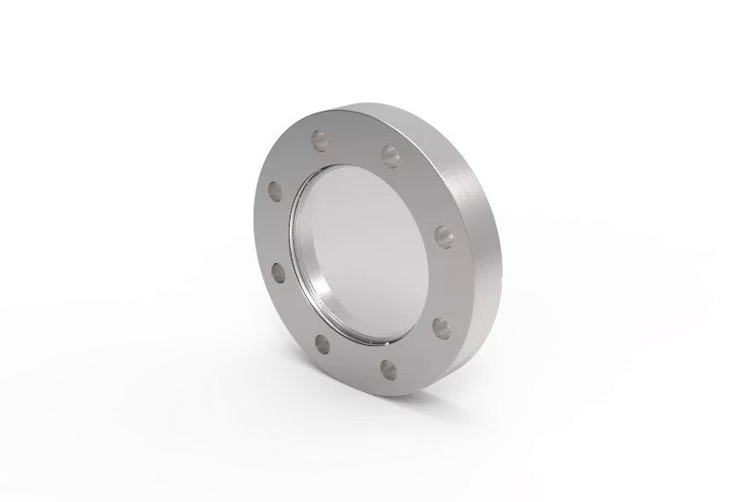
Detection chamber
Detection chamber with mover allows for transparency wrt the rest of the beamline
Electron beam in
Electron beam out
Vacuum pumping
Detector + mover
Electrical feedthrough
Optional: optical viewport
5
3
2
1
4
5 kV
SMA
CF100 6-way cross
CF100 cluster flange

Slide 12
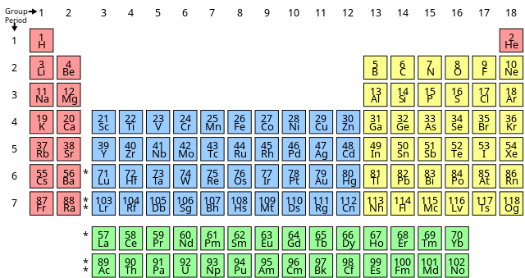
Calibration
Closest X-ray radiation source: Iron-55 (5.9 keV)
Closest X-ray lines: Carbon K-line (277 eV) & Boron K-line (183.3 eV)

Slide 13
Spatial/temporal alignment
Motorised mirror
YAG screen used to image the electron beam.
CCD/streak camera captures both electron and laser beam
CCD
Streak camera

Slide 14
Conclusions
Experimental set-up for the CBS soft X-ray detection would be integrated with a maximum transparency with respect to the rest of the beamline.
Even at the larger crossing angle, the number of photons generated is sufficient for detection by the MCP.
Generation of soft X-rays planned for next year.

Slide 15
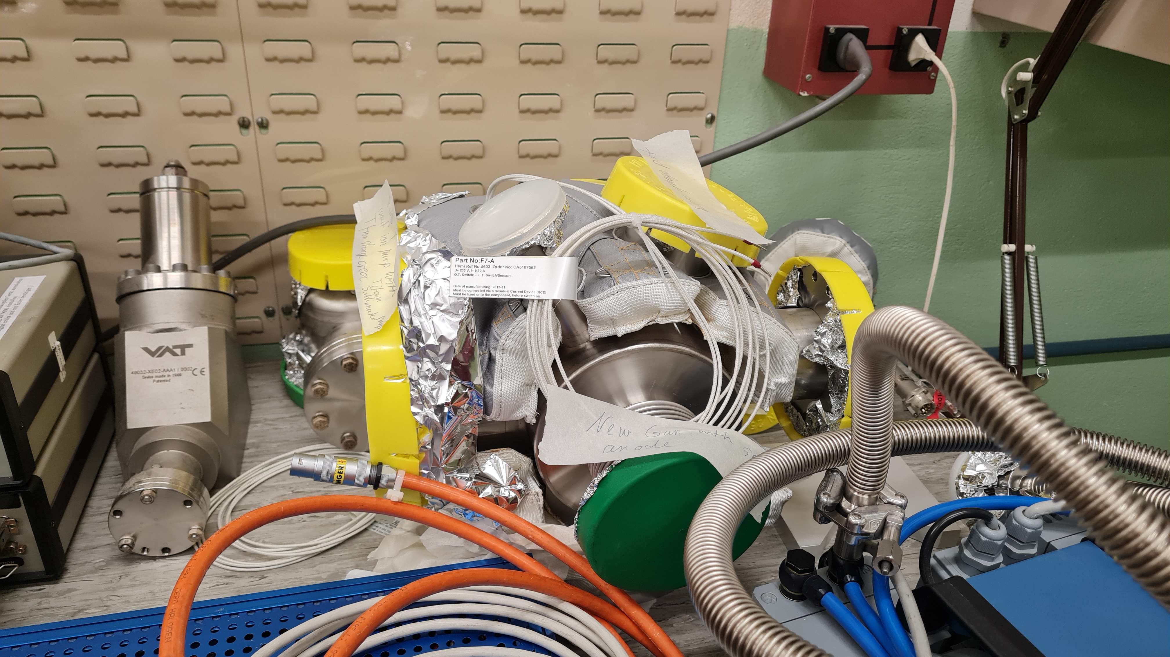
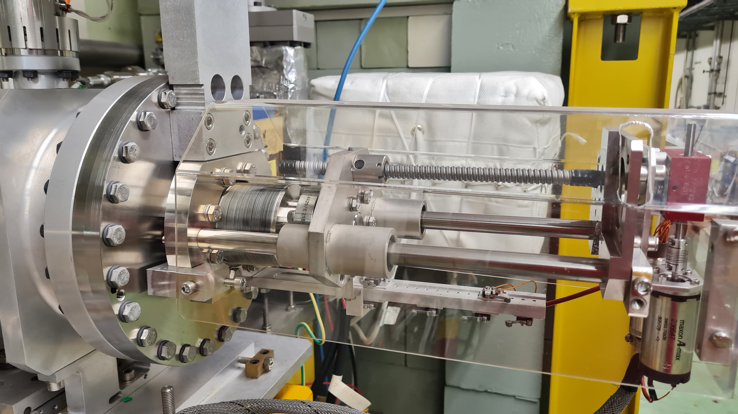
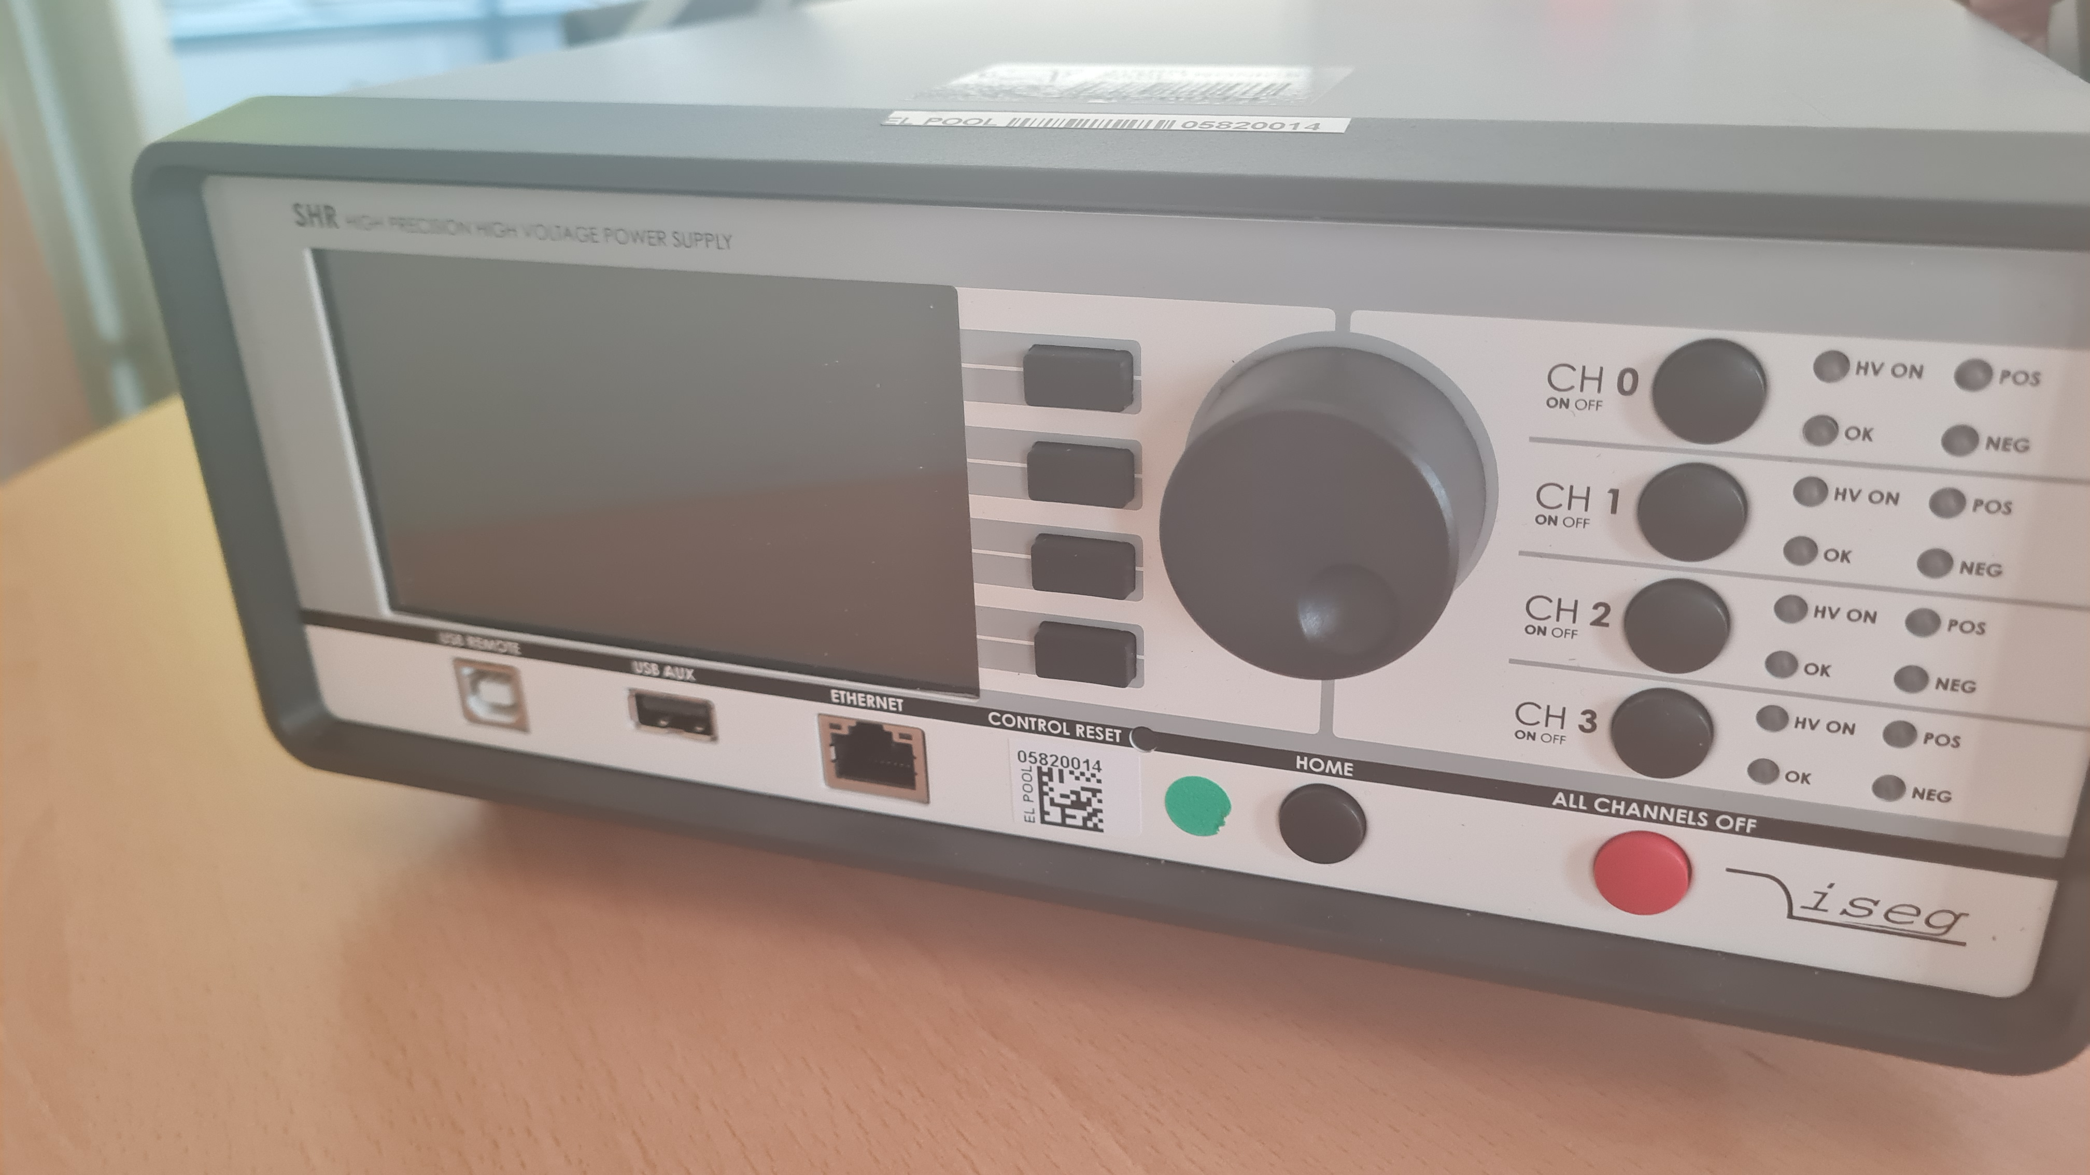
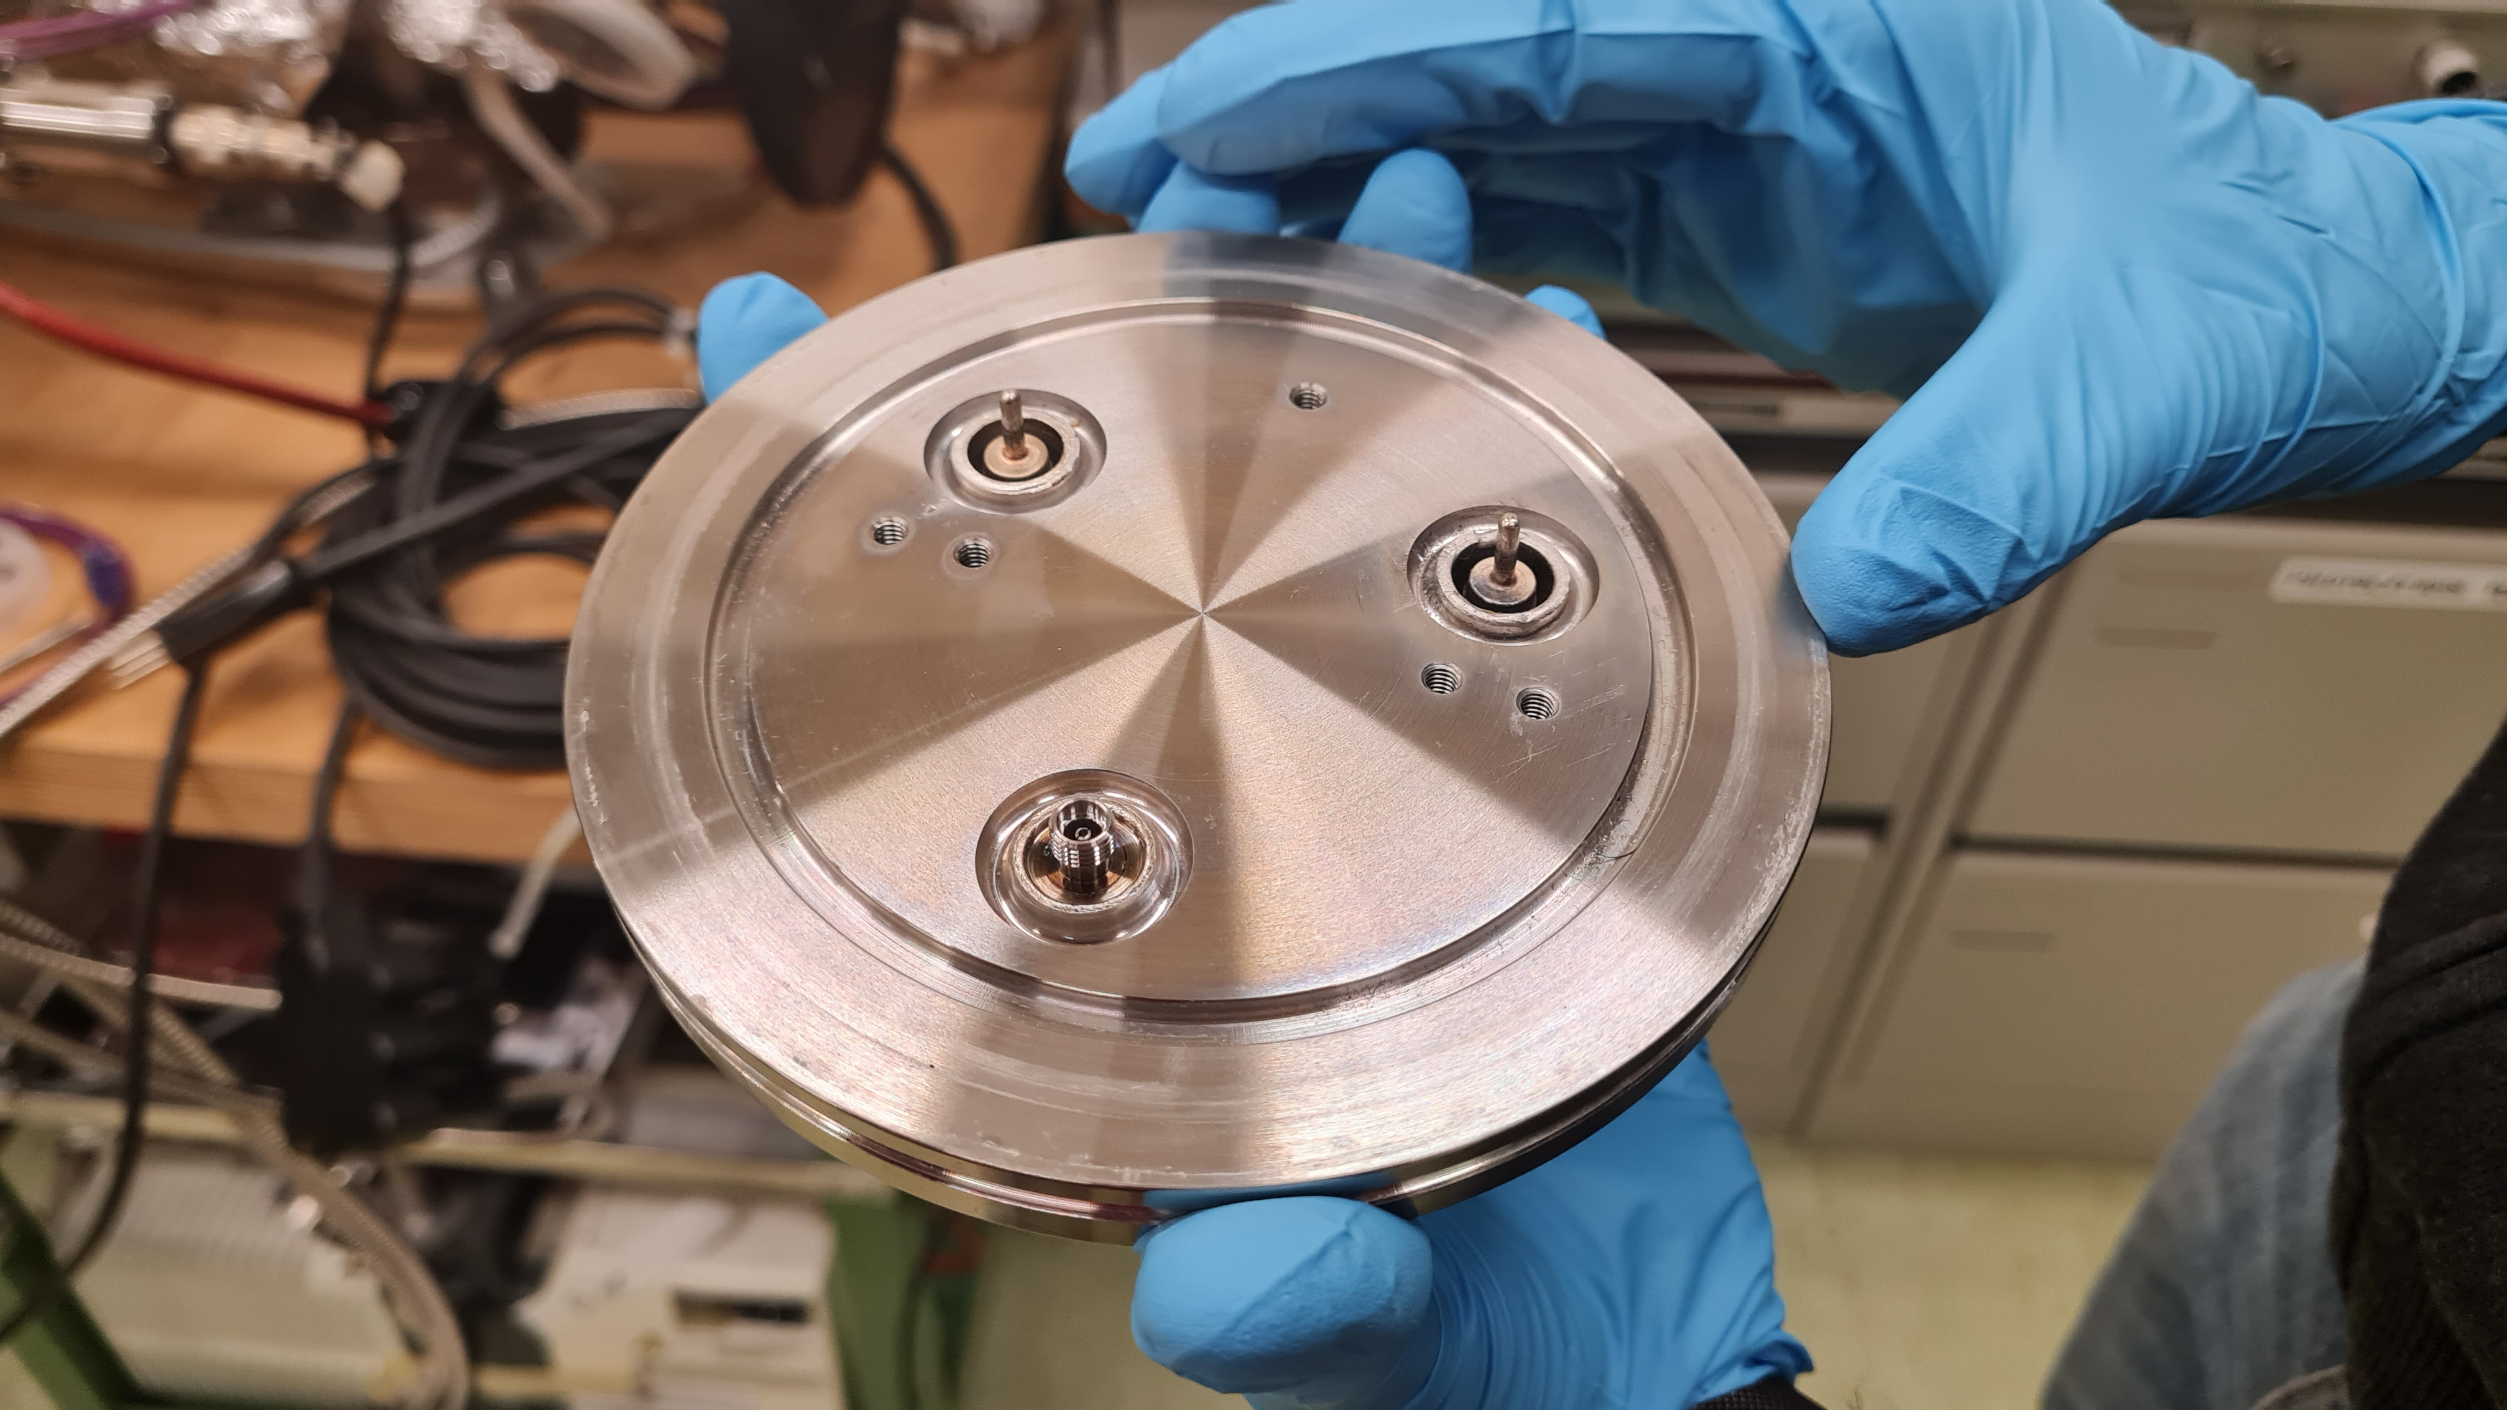
What we have

Slide 17
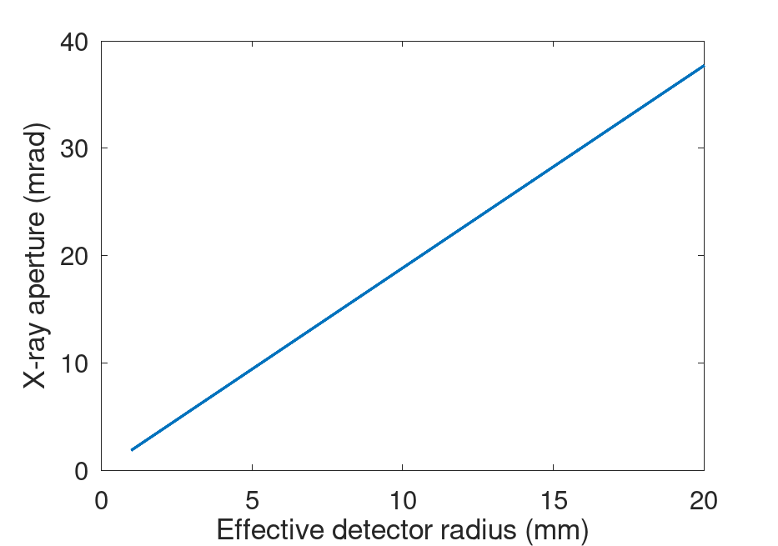
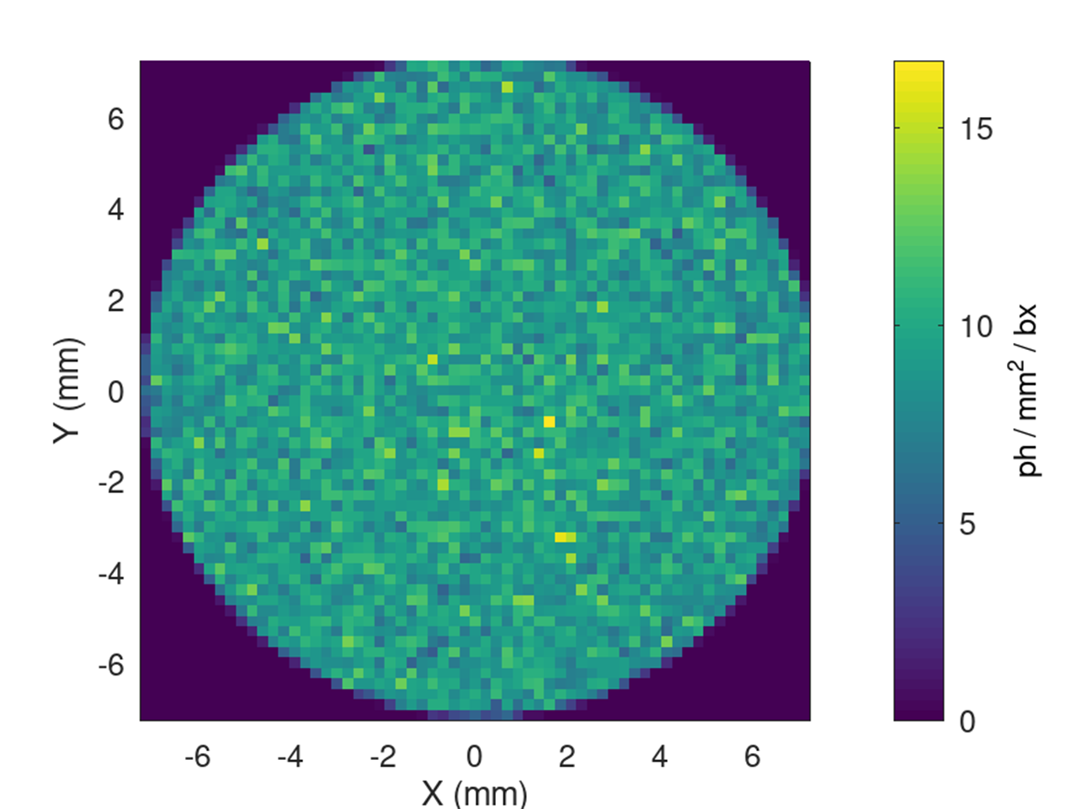
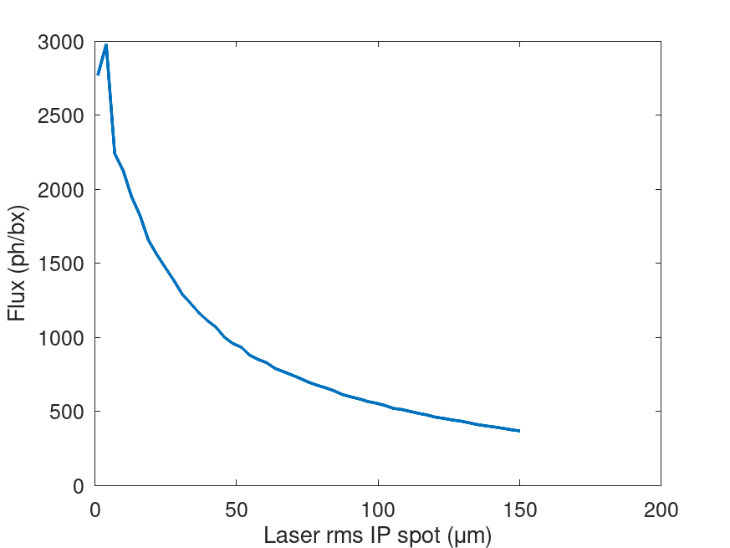
X-ray parameters 2
X-ray spot through 14 mrad cone

Slide 18
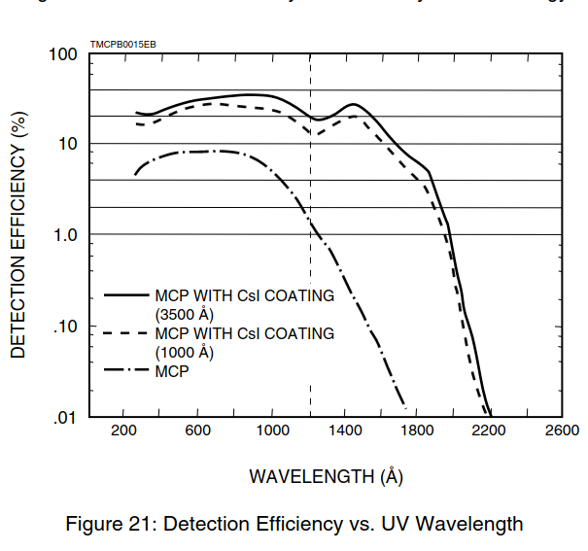
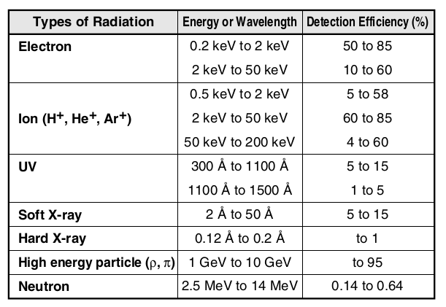
No need for UV filter (253 nm) for MCP

Slide 19
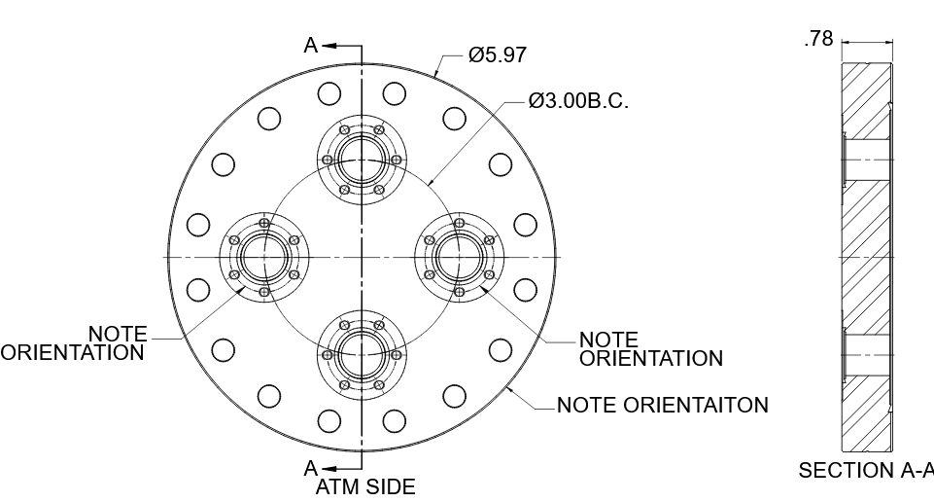
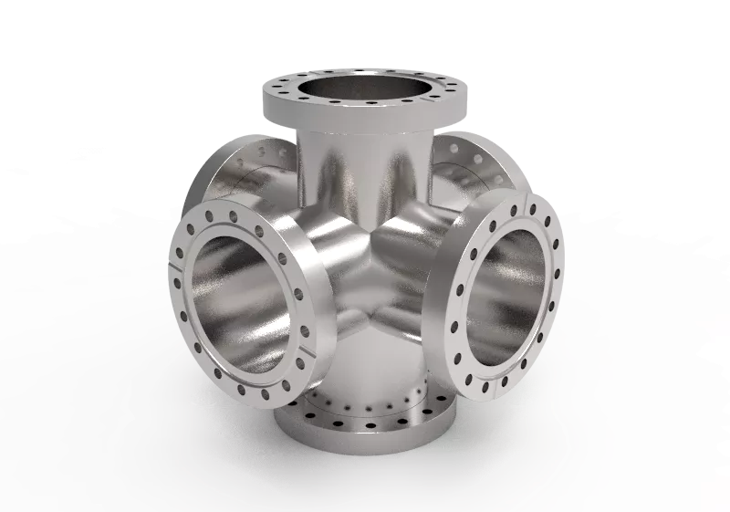
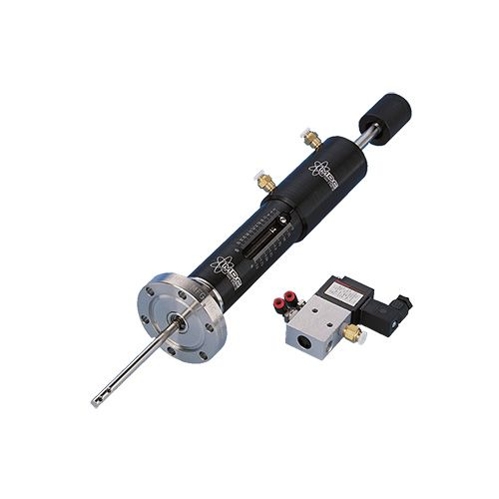
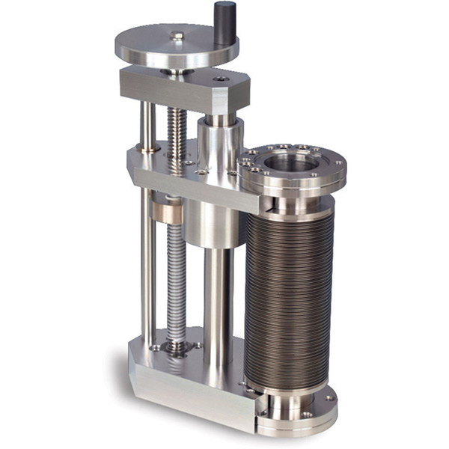
Critical equipment
Equipment | Supplier | Model | Price (Euros)
CF63 Anti-reflective laser viewport (< 0.75%) | Kurt J Lesker Vacom | VPZL-450DUC3 VPCF63DUVQ-L-BBAR3-316L | 1579.25 2844
Mover | DMC precision Kurt J Lesker | 662014 (pneumatic) LSM38-100-H (manual) | 1260 2745
CF100 6-way cross | Vacom | XX100-304 | 1204
CF100 feedthrough flange | Kurt J Lesker | CF0600P4M | 611

Slide 20
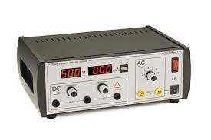
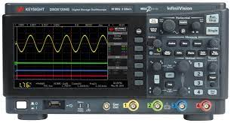

Experimental set-up
Laser beam
Electron beam
X-ray beam
PHAROS laser
frequency doubler
frequency doubler
Delay line
Detection chamber
Solenoid
Spectrometer
MCP
3 GHz
Electron gun
CCD
Streak camera
HV supply
Scope
DAQ

Slide 21

Vacuum considerations
Add gate valve
Gun + Solenoid
Interaction chamber
Detection chamber
Want to reduce time needed to release the detection chamber from vacuum, in case of necessary adjustments.
Implement a gate valve with interlock between the interaction chamber and the detection chamber.
Establish vacuum under 1e-9 mbar in the detection chamber.

Slide 22


Temporal alignment
“Traditional” method of using the YAG screen to image both the electron and laser beam on a streak camera.
Temporally align the UV cathode laser and IR interaction laser instead $→$ align the two beams using an interferometer-like scheme $→$ beam splitter emits light when two lasers are aligned
The electron beam will then be delayed wrt the IP laser by:
42 ps (time diff between accelerated e⁻ beam and photon beam) – 2 ps (e⁻ beam diff in path length wrt UV laser, 2.55 deg) = 40 ps
Motorised mirror
Cathode
Beam splitter
IR IP laser beam
UV cathode laser beam
Electron beam

