Slide 1



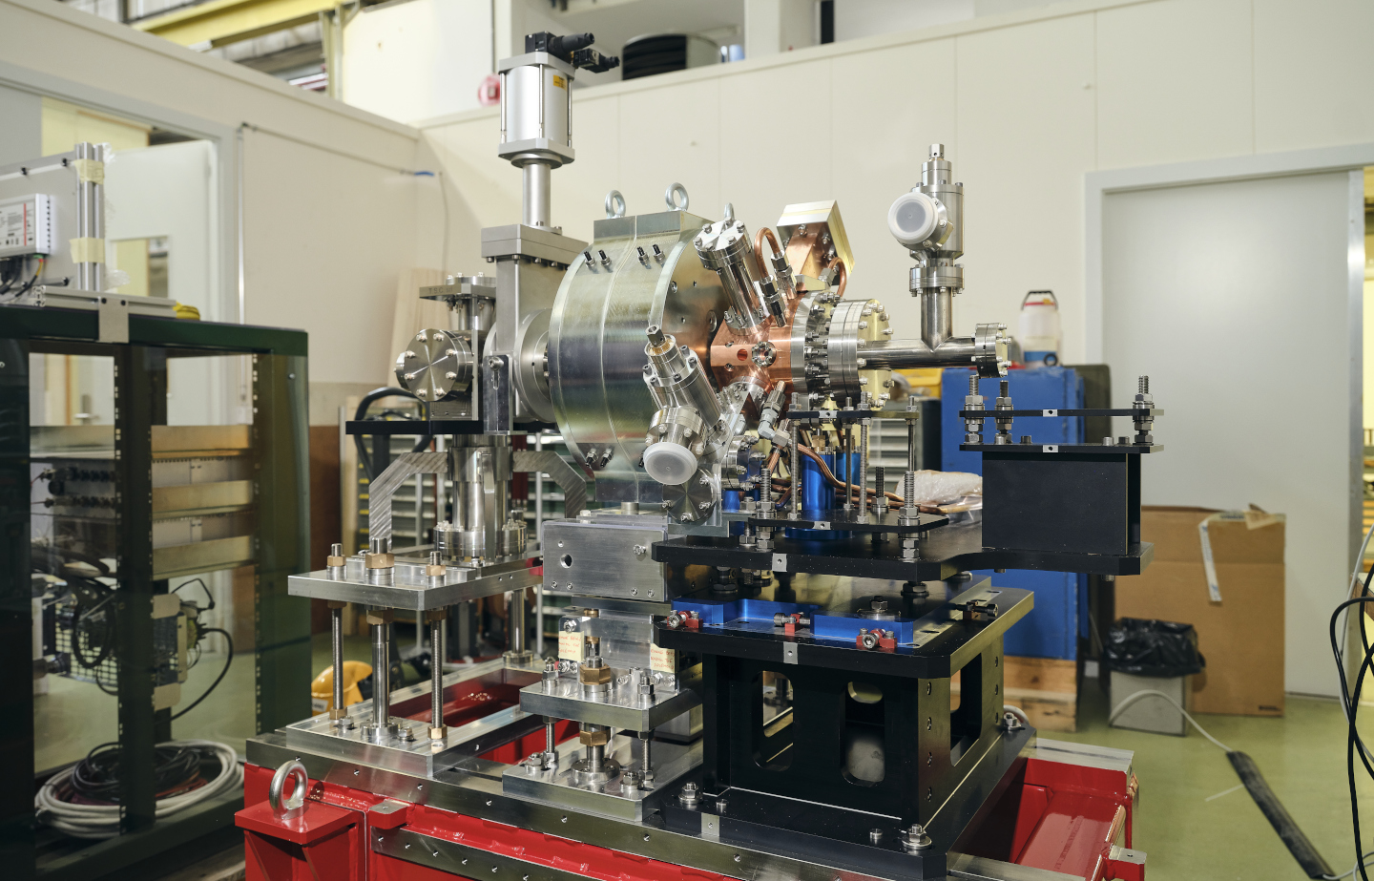
CTF2 CBS set-up
Vlad Musat, Steffen Dobert, Eduardo Granados, Andrea Latina

Slide 2
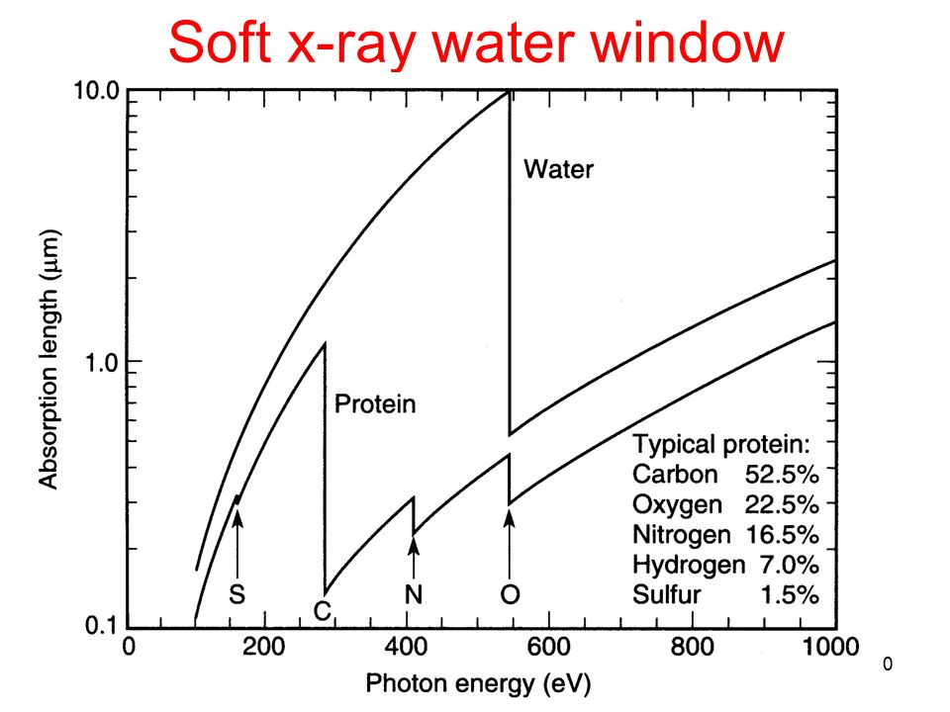
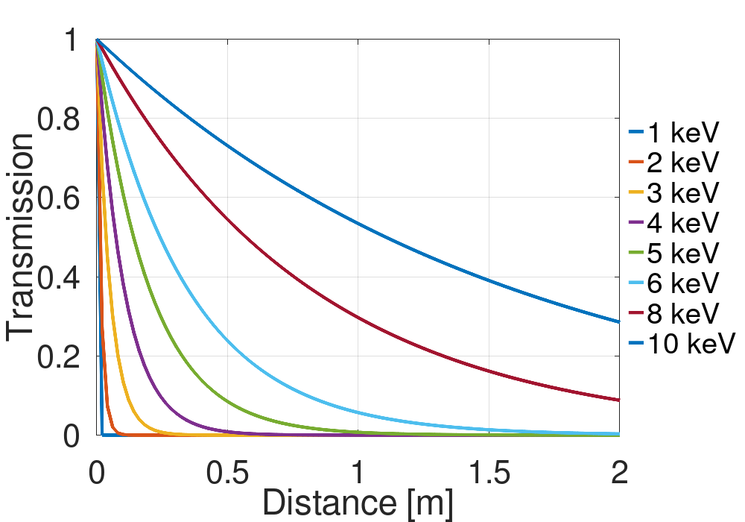
Detection: initial considerations
CBS sources can be used as table-top soft X-ray sources in the water window regime (282 – 533 eV).
Because of the high absorption in air of soft X-rays, the detector will need to be placed in vacuum.

Slide 3
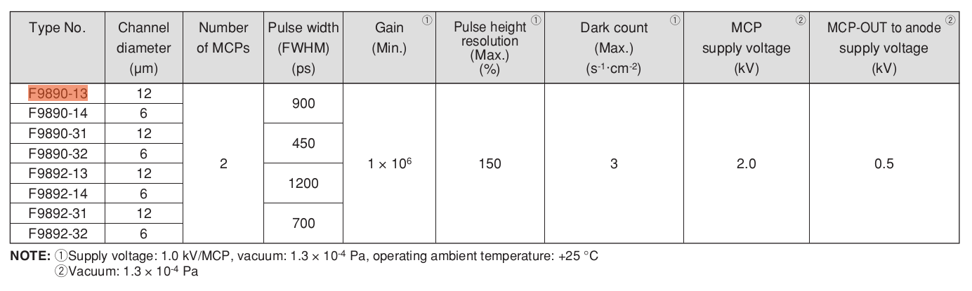
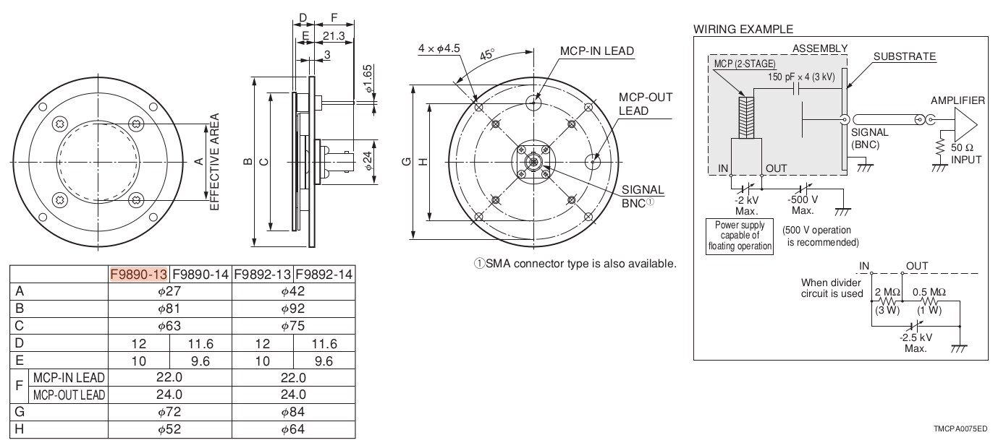
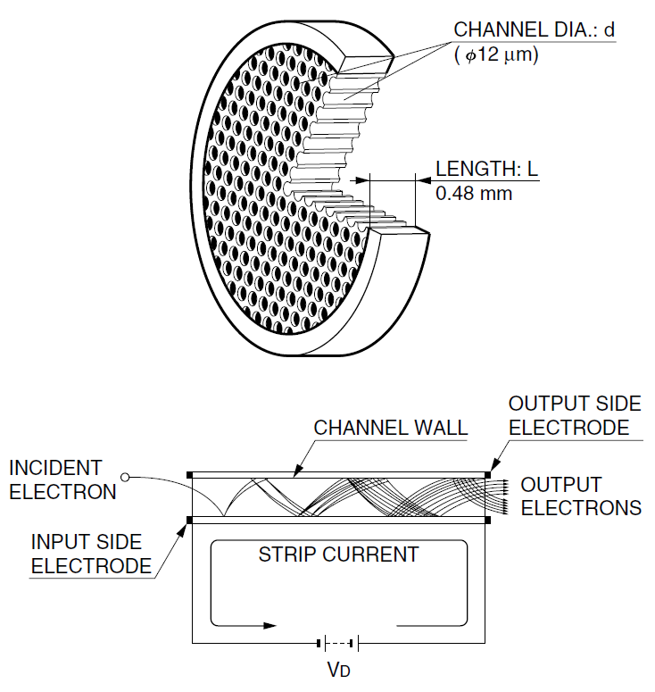
The MCP detector
(F9890-13)
Max dimensions: 81 by 36 mm
Operated in vacuum (< 1.3e-4 mbar)
Electrical feedthrough: HV power supply and oscilloscope
Provides 10⁶ gain with a 27 mm effective diameter

Slide 4
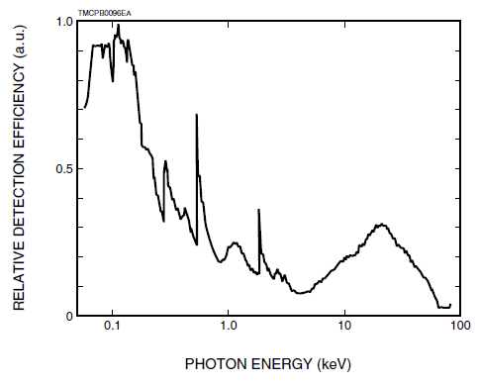
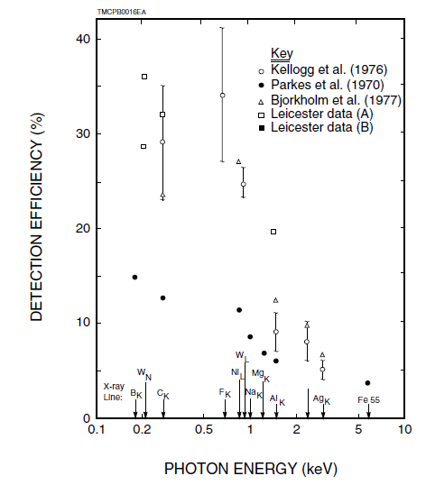
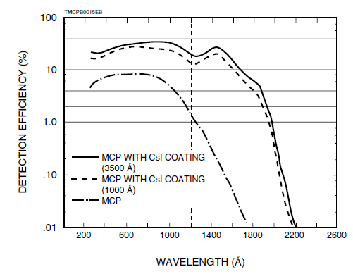
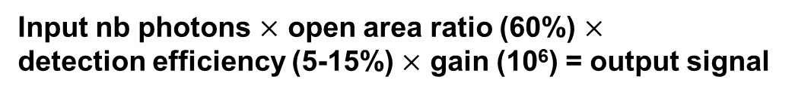
The MCP detector
Detection efficiency
Input nb photons $×$ open area ratio (60%) $×$
detection efficiency (5-15%) $×$ gain (10⁶) = output signal
Good detection efficiency for X-rays in the water window
The MCP is invisible to visible light and UV photons from the cathode laser
Source: MCP assembly technical information document (Hamamatsu)

Slide 5
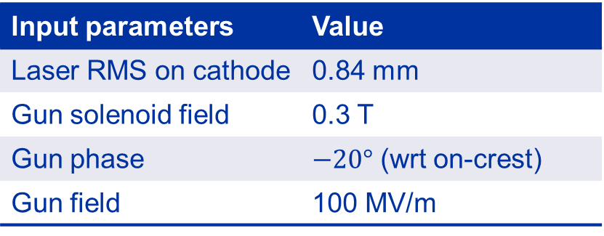
Input beam parameters
Electron beam parameter | Value
Beam energy | 5 MeV
Bunch charge | 400 pC
RMS beam size at IP | 140 µm
RMS bunch length | 2 ps
Repetition rate | 10 Hz
Laser beam IP parameter | Value
Wavelength | 1030 nm
Laser pulse energy | 0.9 mJ
RMS pulse length | 0.17 ps
M2 | 1.3
Laser waist at IP | 50 µm
Input parameters | Value
Laser RMS on cathode | 0.84 mm
Gun solenoid field | 0.3 T
Gun phase | $−20°$ (wrt on-crest)
Gun field | 100 MV/m
25.5 mrad
13.5 mm
0.53 m

Slide 6
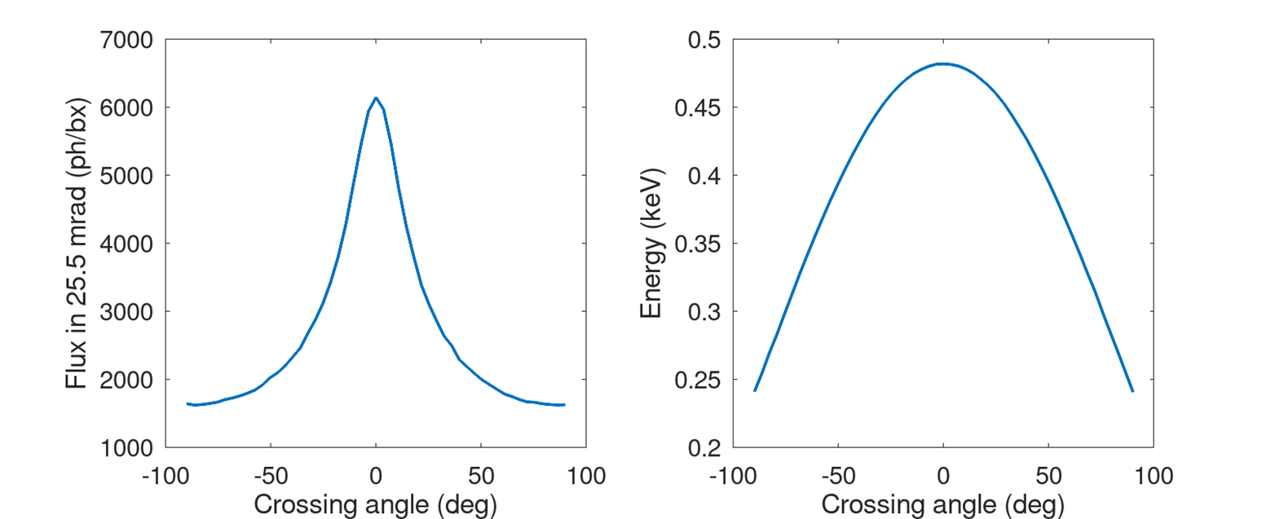
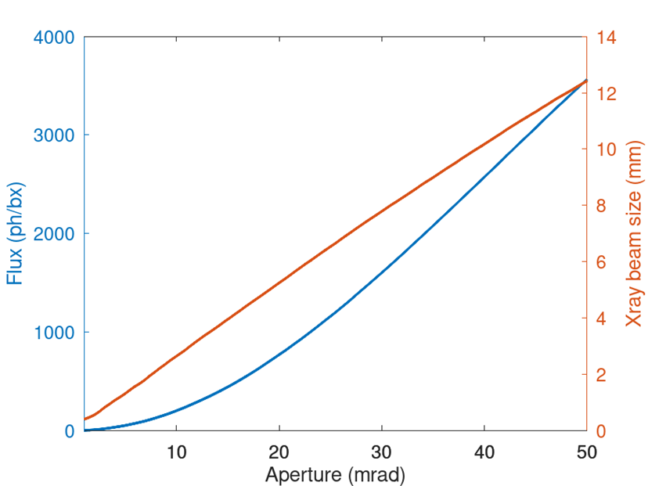
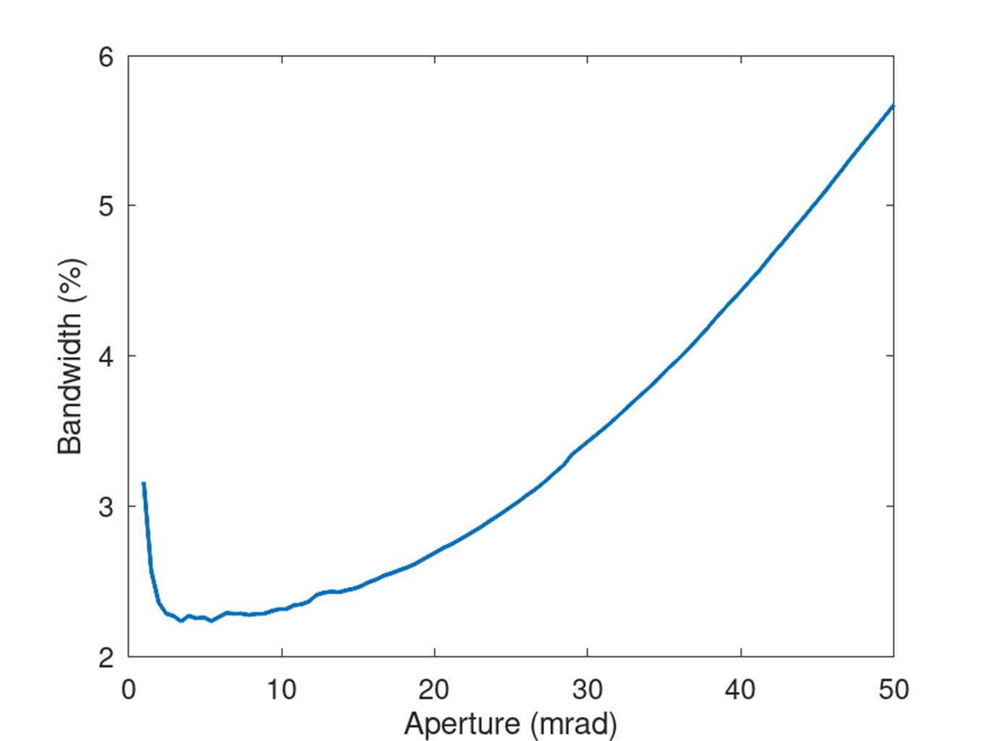
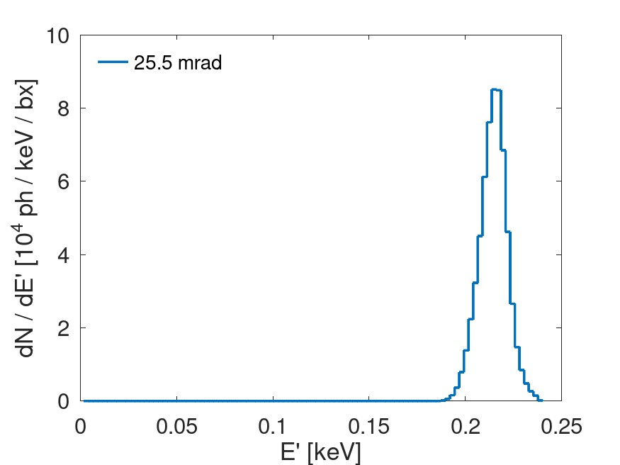
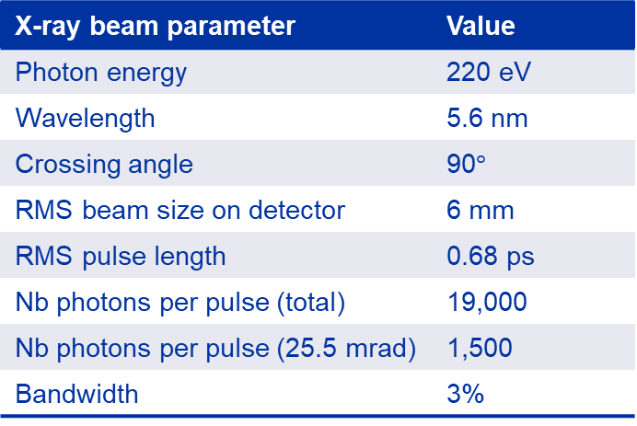

X-ray parameters
At 90$°$ crossing angle (and 100–110 MV/m), the photon energy is 220–250 eV (5.6–4.9 nm)
X-ray beam parameter | Value
Photon energy | 220 eV
Wavelength | 5.6 nm
Crossing angle | 90$°$
RMS beam size on detector | 6 mm
RMS pulse length | 0.68 ps
Nb photons per pulse (total) | 19,000
Nb photons per pulse (25.5 mrad) | 1,500
Bandwidth | 3%
Beam pipe aperture

Slide 7
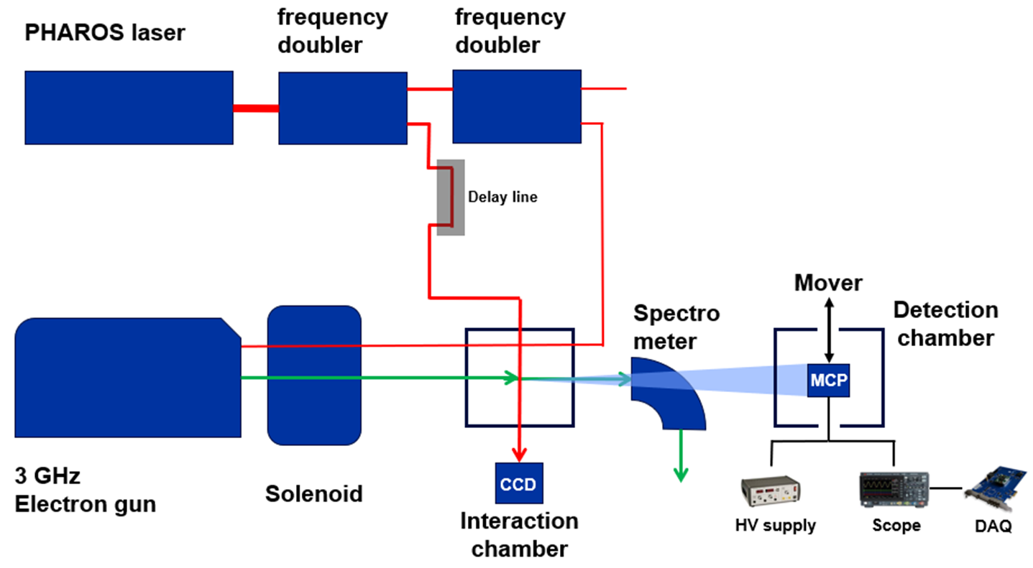
Experimental set-up
Laser beam
Electron beam
X-ray beam

Slide 8
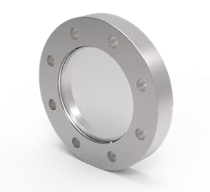
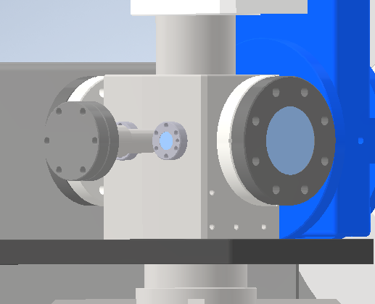
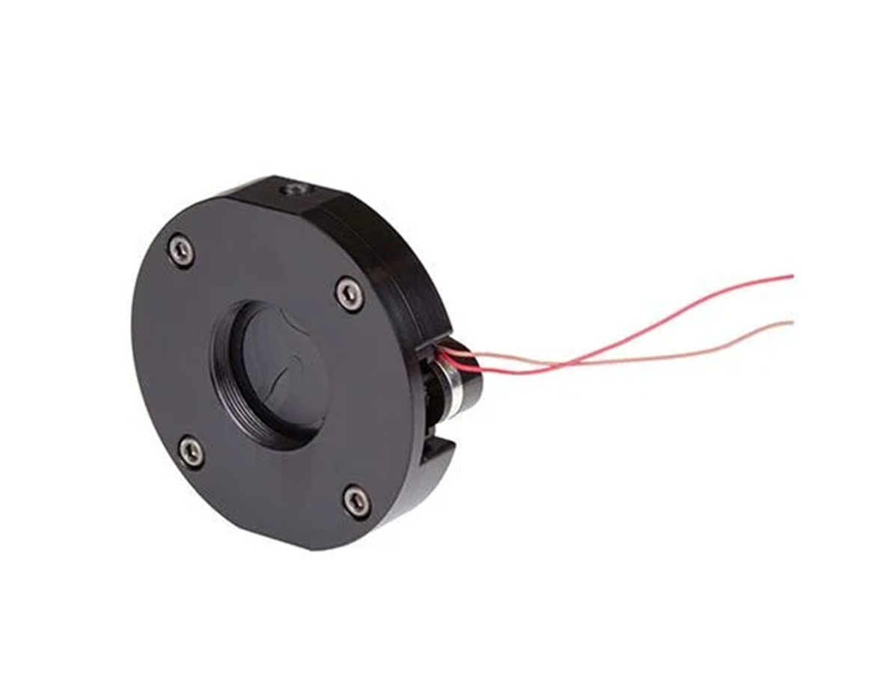
Interaction chamber: modifications
Install laser grade viewport for 515-1030 nm IP laser
Electrical shutter for electron/laser beam imaging CCD
Interaction chamber
CF63

Slide 9
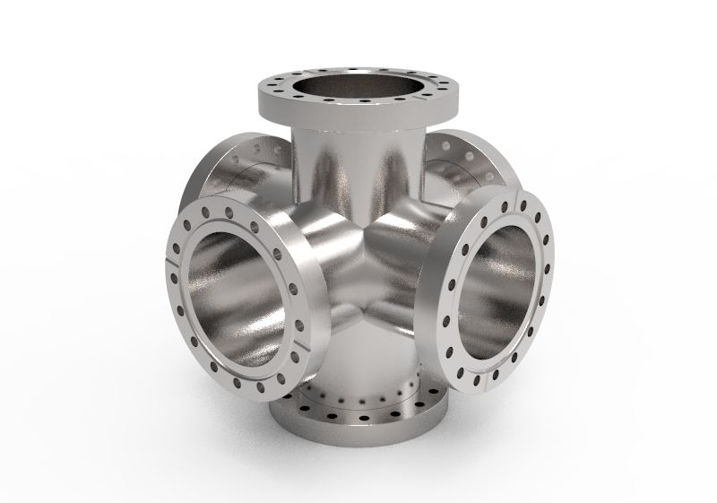
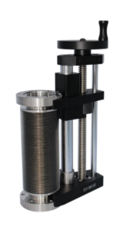
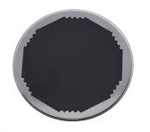
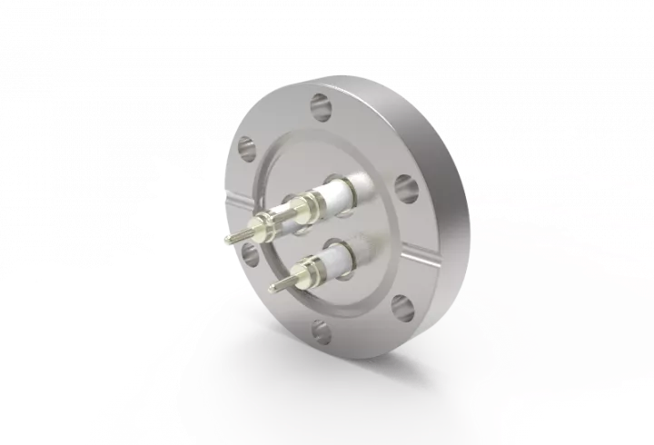
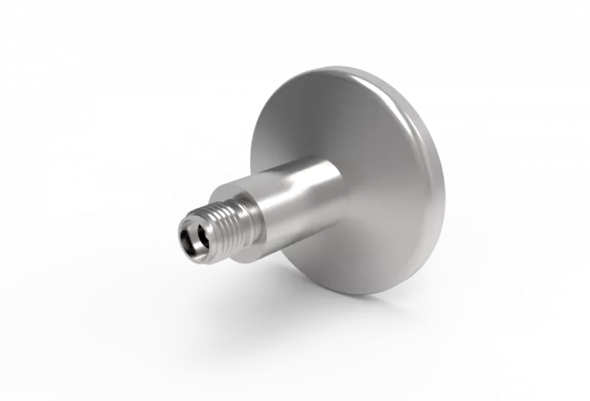
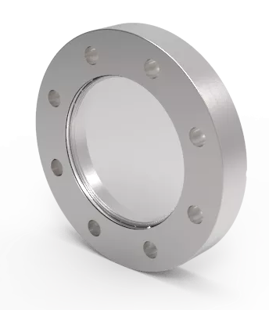
Detection chamber
Detection chamber with mover allows for transparency wrt the rest of the beamline
Electron beam in
Electron beam out
Vacuum pumping
Detectors + mover
Electrical feedthrough
(Laser grade) optical viewport
CF100 6-way cross

Slide 10
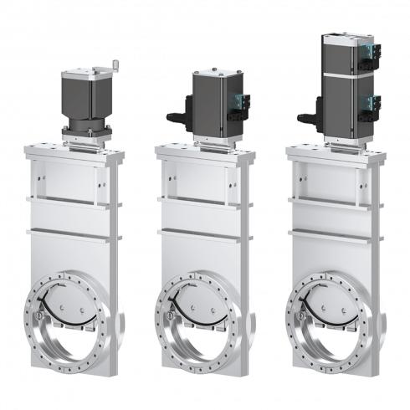
Vacuum considerations
Add gate valve
Gun + Solenoid
Interaction chamber
Detection chamber
Want to reduce time needed to release the detection chamber from vacuum, in case of necessary adjustments.
Implement a gate valve with interlock between the interaction chamber and the detection chamber.
Establish vacuum under 1e-9 mbar in the detection chamber.

Slide 11
Conclusions
Experimental set-up for the CBS soft X-ray detection would be integrated with a maximum transparency with respect to the rest of the beamline.
Even at the larger crossing angle, the number of photons generated is sufficient for detection by the MCP.
First X-ray measurements expected before the end of 2023.

Slide 13
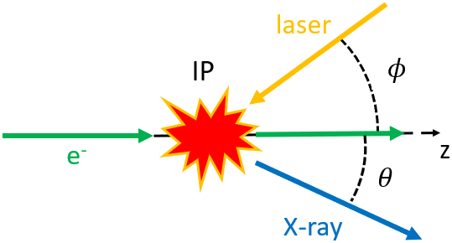
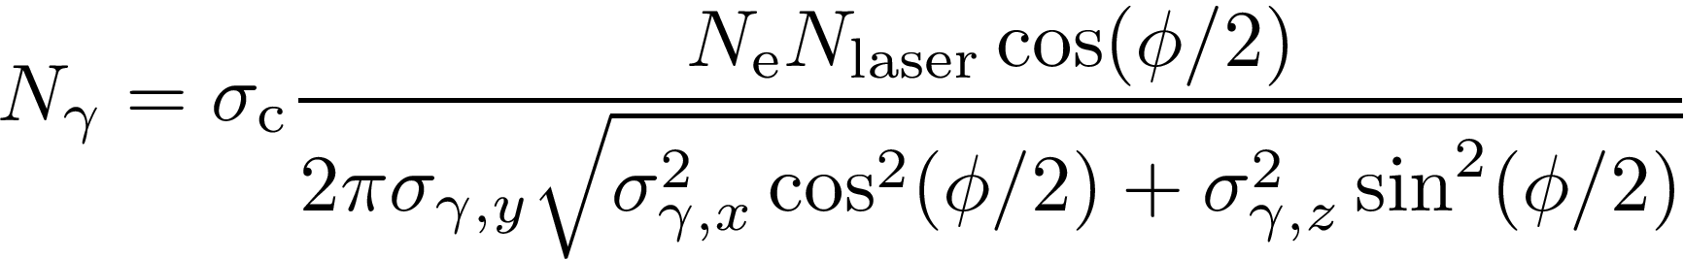
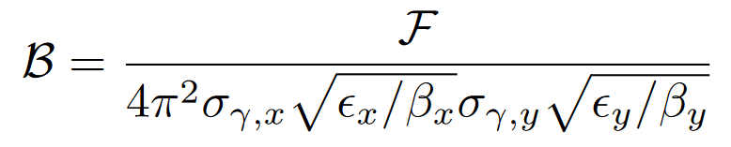
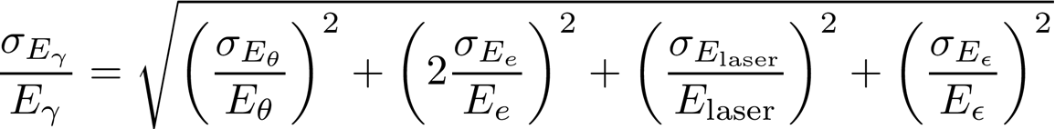
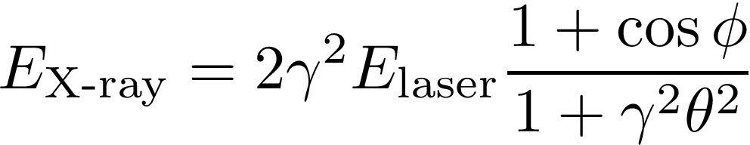
Compton backscattering
= The scattering of a low energy photon from an EM field to a high-energy photon (X-ray or gamma ray) during the interaction with a charged particle.
Total flux
Average brilliance
Photon bandwidth
Photon energy

Slide 14
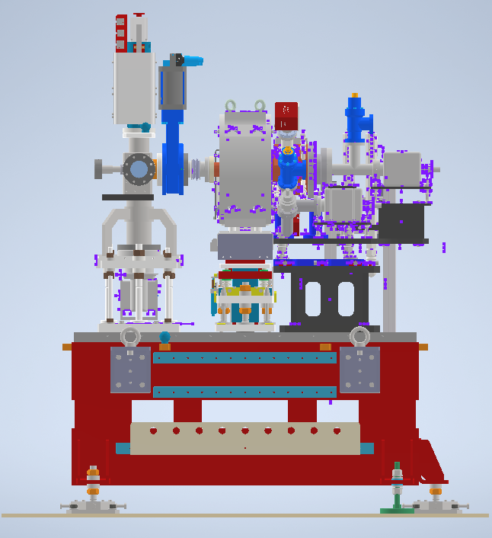
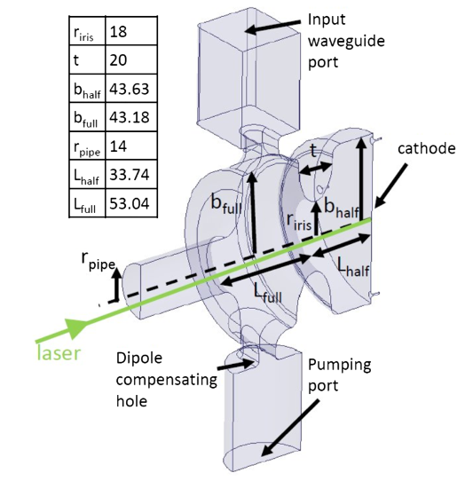
CTF2 gun
0.75 m
0.5 m
S-band standing wave 1.5 cell RF-gun intended for the new AWAKE injector.
Prototype constructed by INFN-Frascati and commissioned at CTF2.

Slide 15
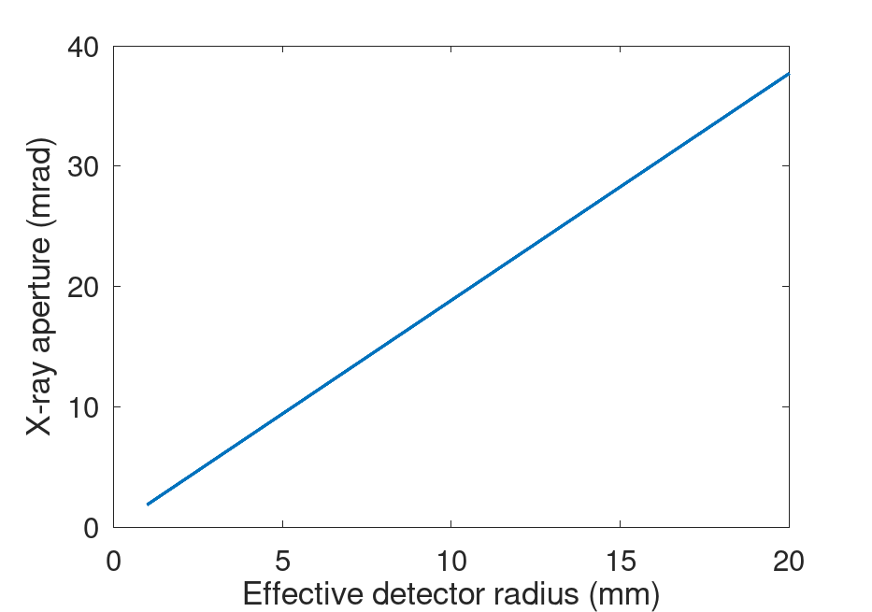
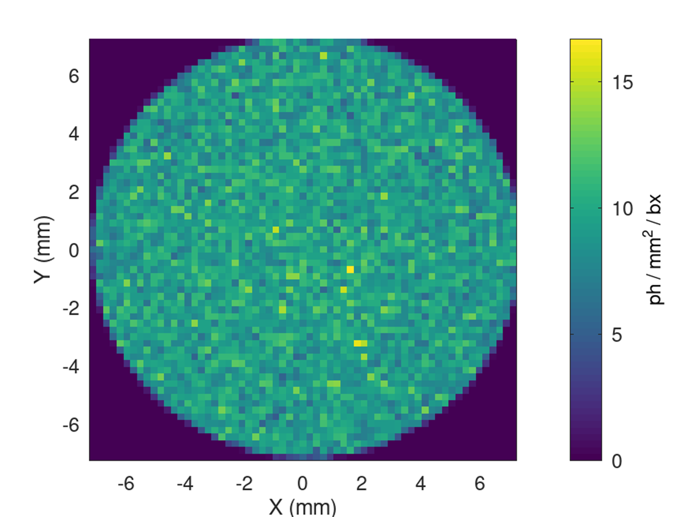
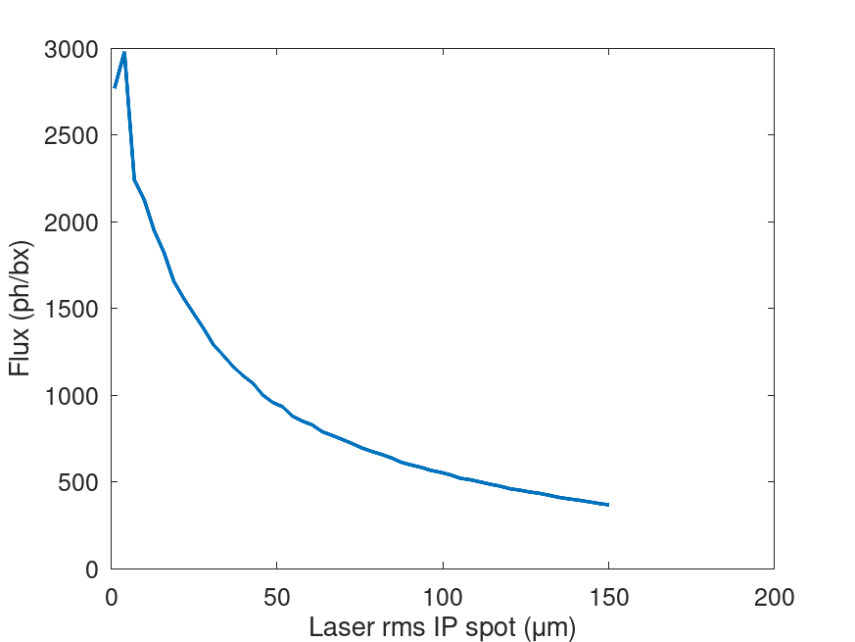
X-ray parameters 2
X-ray spot through 14 mrad cone

