Slide 1



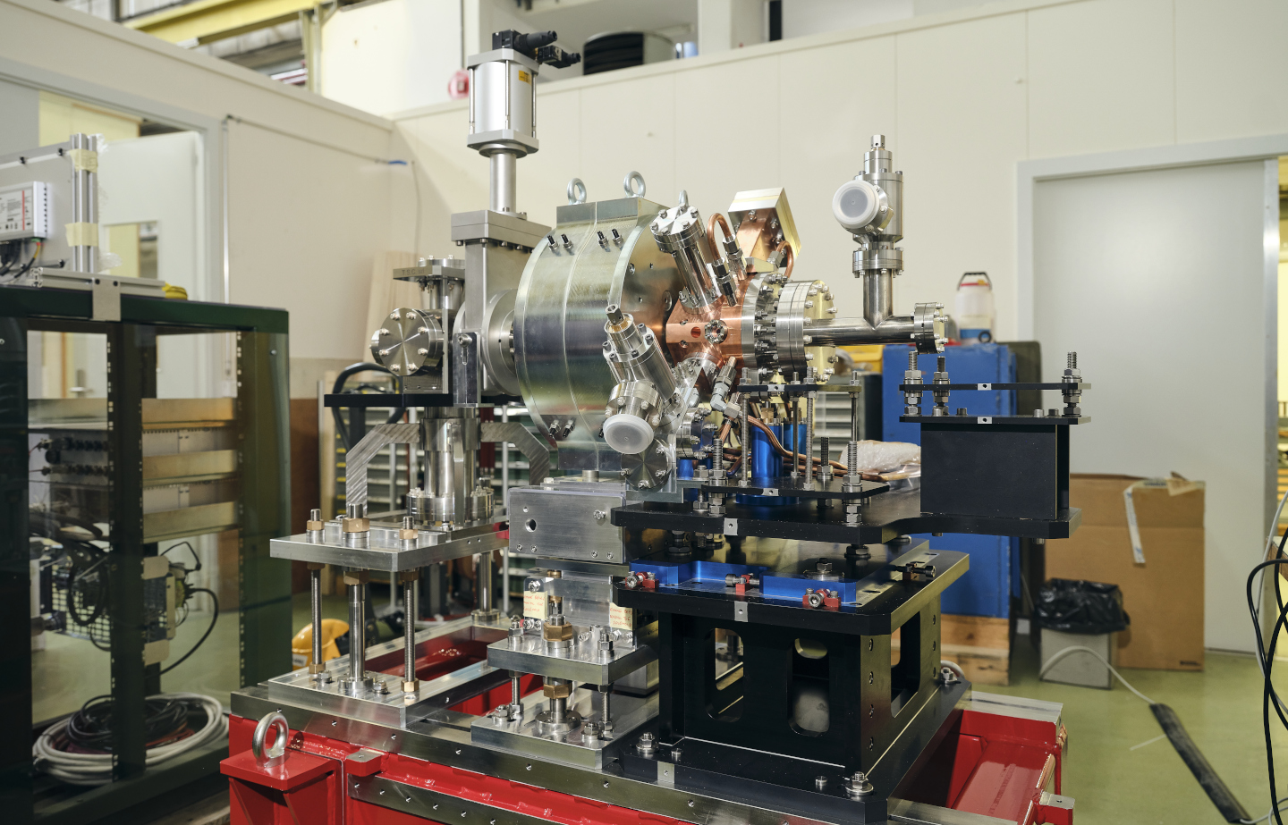
CTF2 detection
Vlad Musat, Andrea Latina

Slide 2
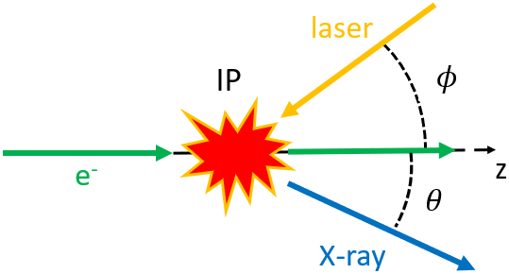
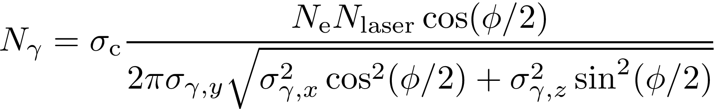
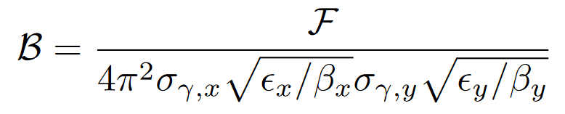
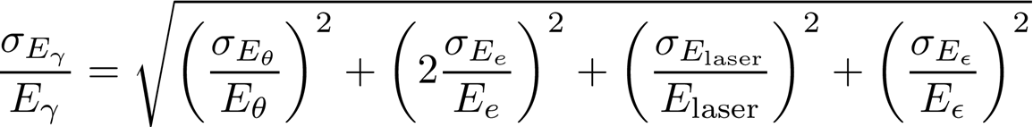
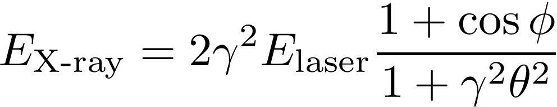
Inverse Compton scattering
= The scattering of a low energy photon from an EM field to a high-energy photon (X-ray or gamma ray) during the interaction with a charged particle.
Total flux
Average brilliance
Photon bandwidth
Photon energy

Slide 3
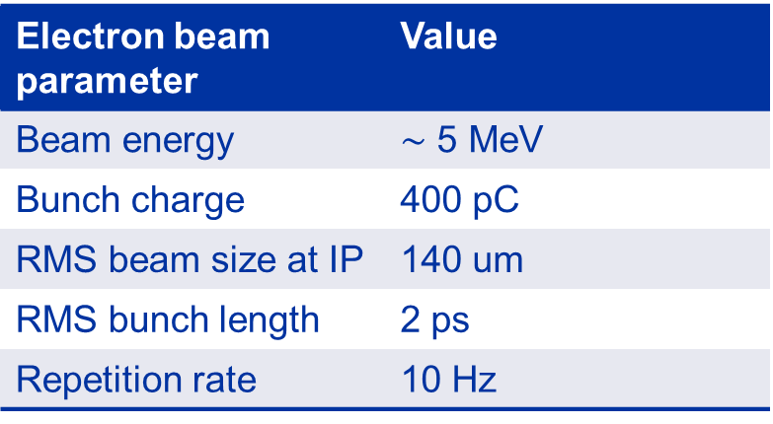
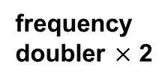
Experimental set-up
Laser beam parameter | Value
Wavelength | 1030 nm
Laser pulse energy | 2.1 mJ
RMS pulse length | 0.17 ps
M2 | 1.2 - 1.3
Waist at IP | 50 um
frequency doubler $×$ 2
PHAROS laser
Laser beam
Electron beam
X-ray beam
X-ray detector
Electron beam parameter | Value
Beam energy | $∼$ 5 MeV
Bunch charge | 400 pC
RMS beam size at IP | 140 um
RMS bunch length | 2 ps
Repetition rate | 10 Hz
Interaction chamber
3 GHz
Electron gun
Spectro
meter
Solenoid
< 35.8 mrad
< 19 mm
0.53 m

Slide 4
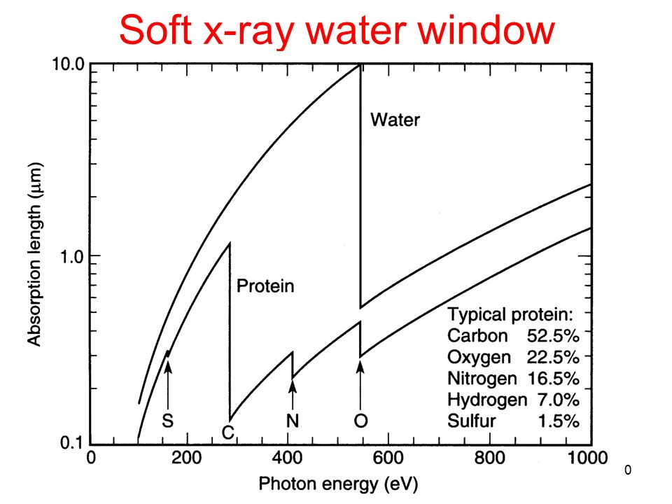
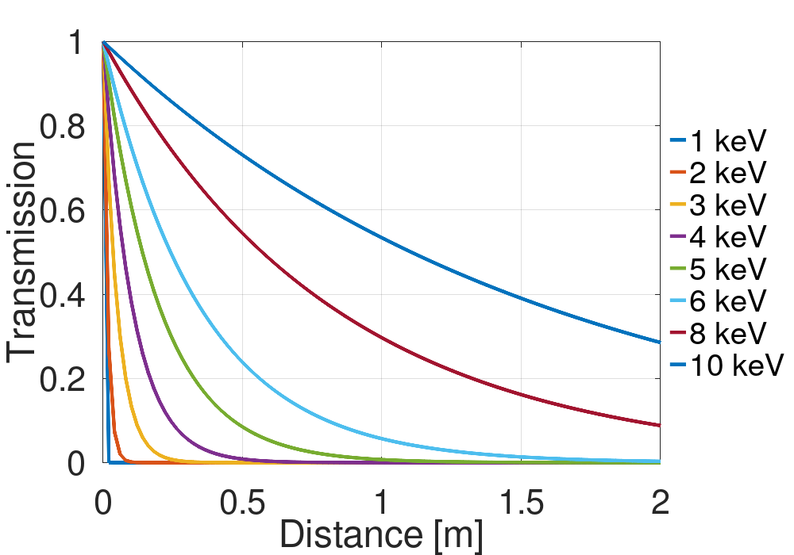
Detection: initial considerations
ICS sources can be used as table-top soft X-ray sources in the water window regime (282 – 533 eV).
Because of the high absorption in air of soft X-rays, the detector will need to be placed in vacuum.

Slide 5
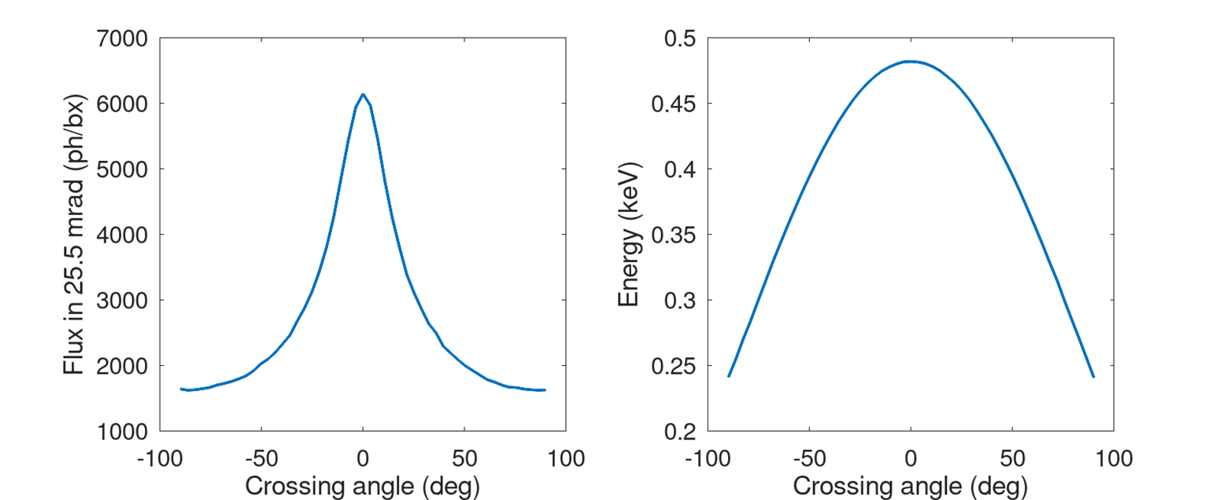
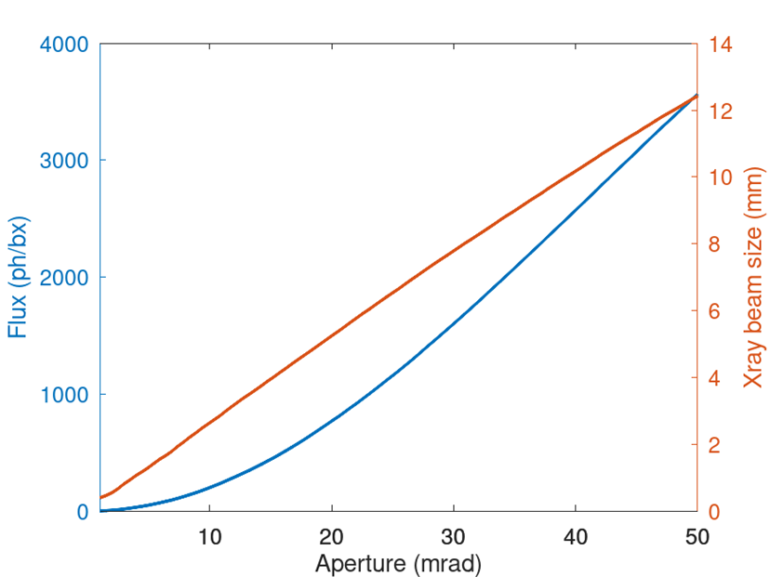
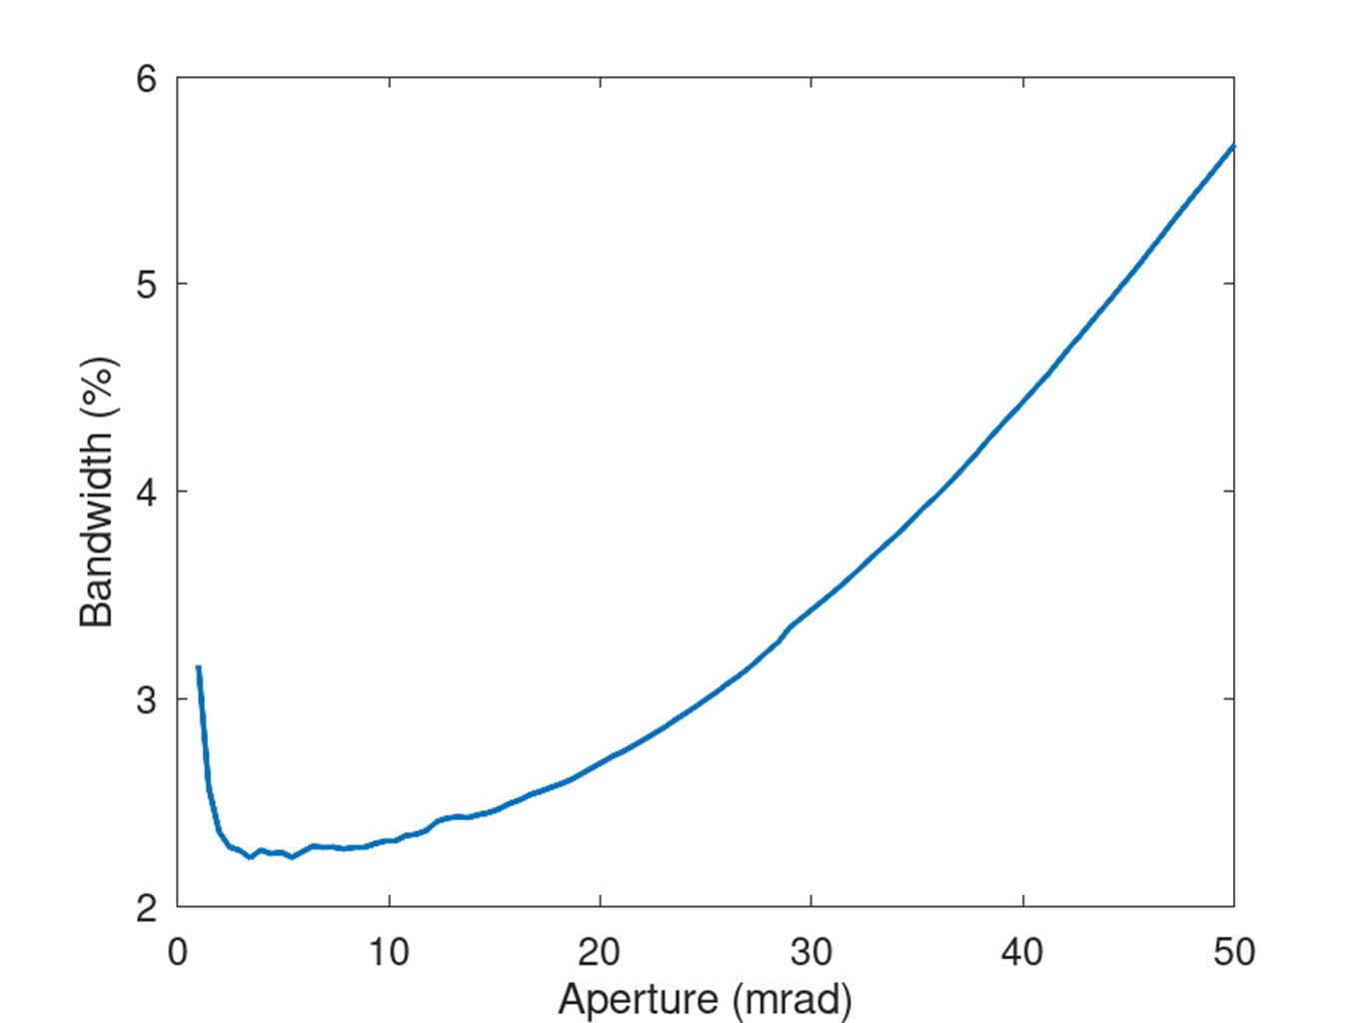
X-ray parameters
At 90 deg crossing angle (and 100–110 MV/m), the photon energy is 240–285 eV (5.16–4.35 nm)
X-ray beam parameter | Value
Photon energy | 200 – 500 eV
Wavelength | 2.5 nm – 6 nm
Crossing angle | 90 deg
RMS beam size on detector | 6 mm
RMS pulse length | 0.68 ps
Nb photons per pulse (total) | 19,000
Nb photons per pulse (25 mrad) | 1,500
Bandwidth | 3%
Pulse spacing | 10 Hz
Beam pipe aperture

Slide 6
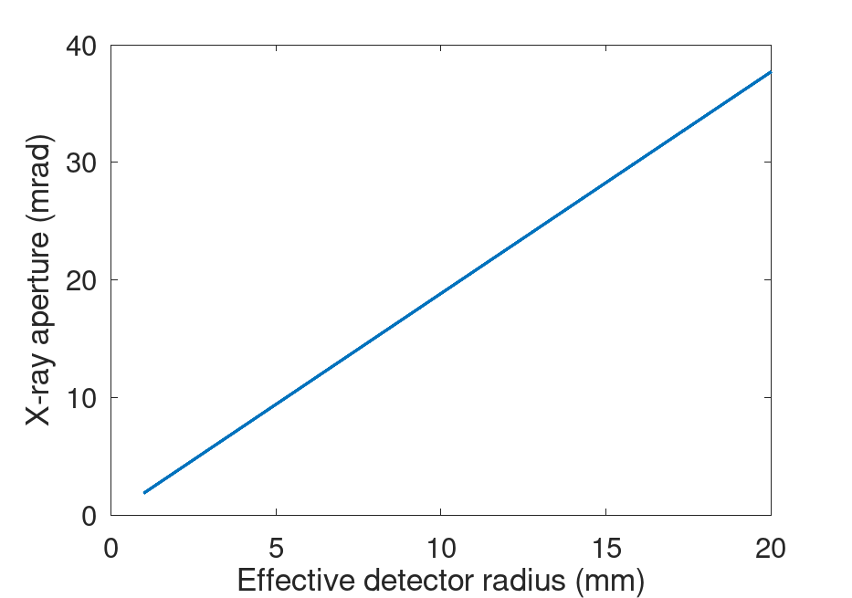
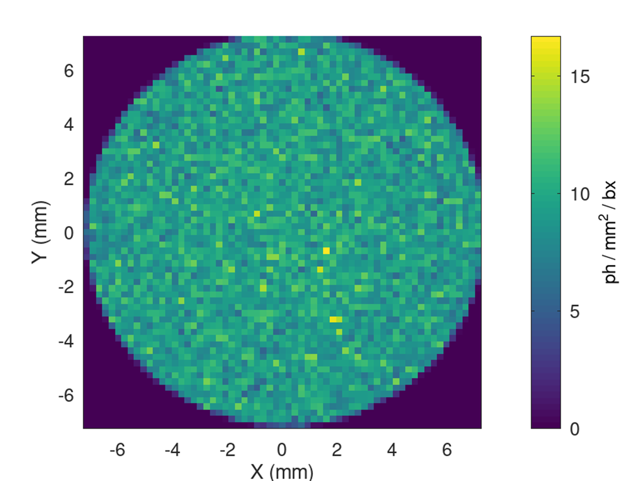
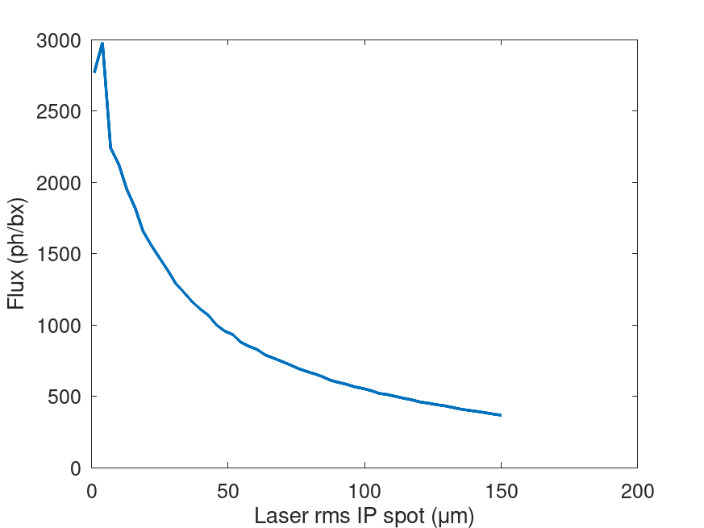
X-ray parameters 2
X-ray spot through 14 mrad cone

Slide 7
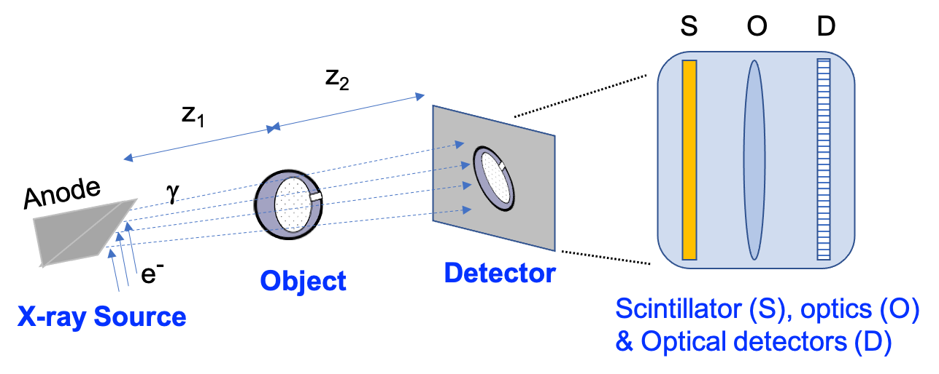
Detector requirements
Can be operated (at least in part) in vacuum
Capable of charge multiplication
Low dark current
High sensitivity
Small size
Cheap
+ allows for imaging
+ Fast timing (narrow detection down to X-ray pulse)

Slide 8
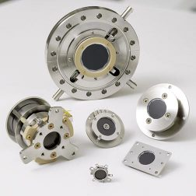
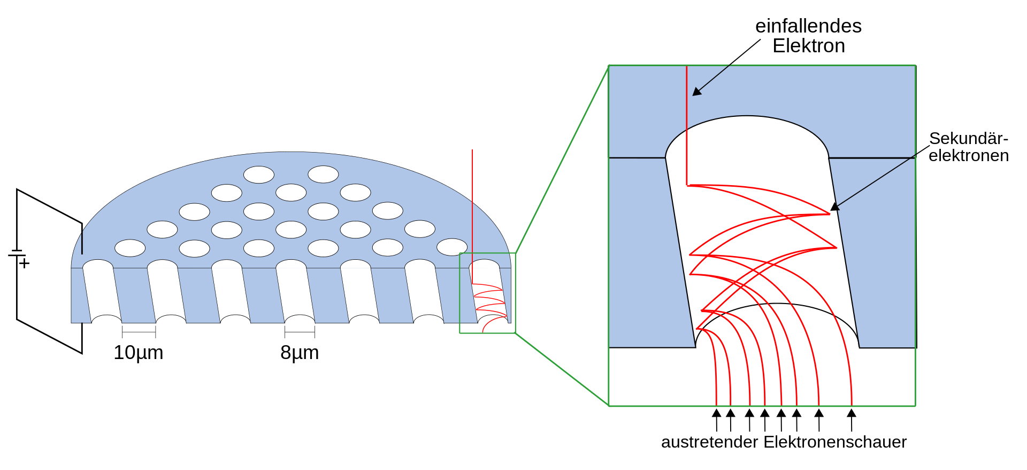
Option #1: MCP
PROS
Small enough to fit vacuum pipe
Large effective area (20 mm diameter)
High signal gain (10⁴ to 10⁷)
Capable of single photon detection
Can be mounted on standard CF flange
Signal output from metal anode
Visual output also possible by coupling to phosphor screen and CCD
CONS
Not so commonly used
Low QE for soft X-rays (6-16%) -> can increase to 25% with a CsI cathode

Slide 9
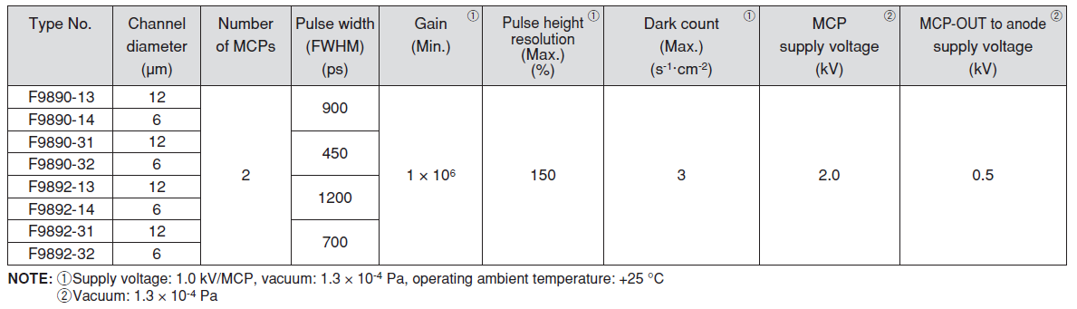
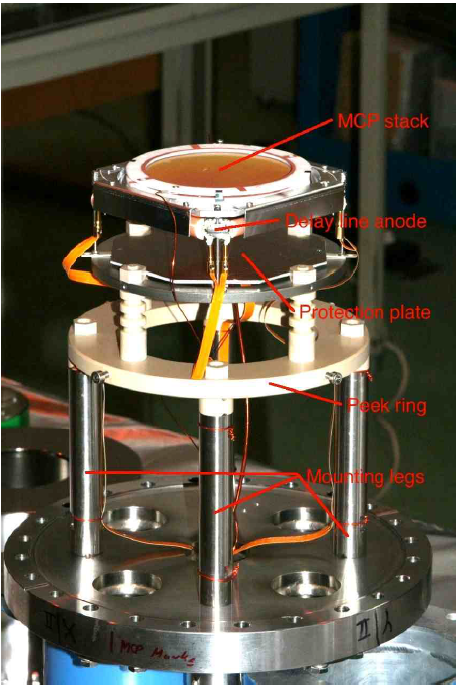
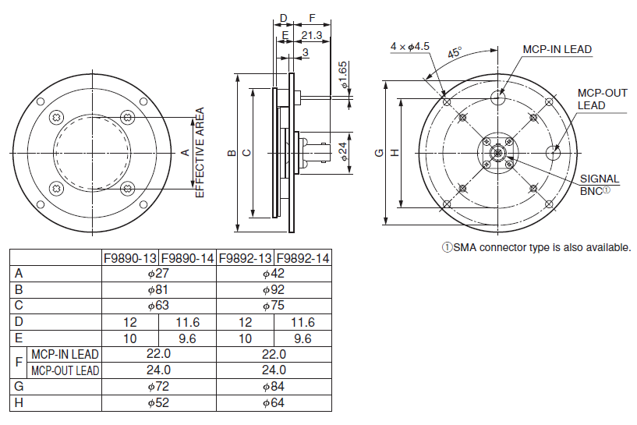
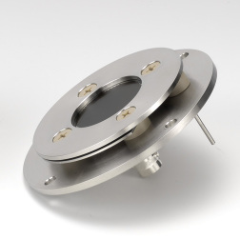
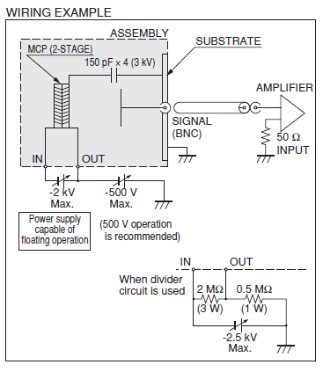
Example: Micro-Channel Plate

Slide 10
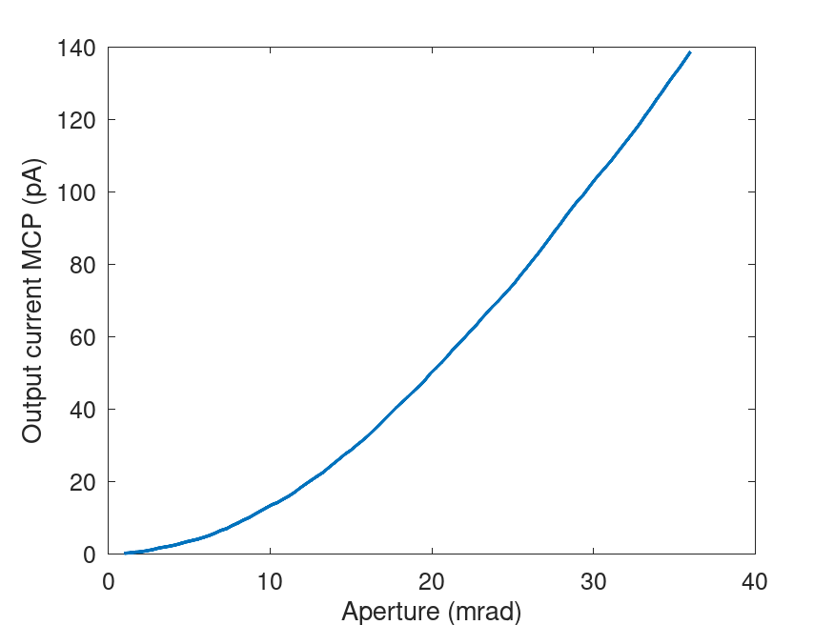
Signal output from MCP
Open area ratio: standard 60%
Detection efficiency: 6-20% (assume 6%)
For 1,500 incident photons in 25.5 mrad cone: 54
Gain: 1e6
Effective area: 27 mm (diam) -> 5.72 cm²
Dark count (max): 3 el/s/cm² = 17.1 el/s
Dark current: 0.5 pA cm⁻² = 2.86 pA
Current: 540,000,000 e/s = 86 pA (for 1e6 gain)
Maximum linear output: 7% of strip current = 7% * (1 kV / 100 MOhms) = 0.7 uA

Slide 11
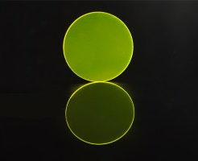
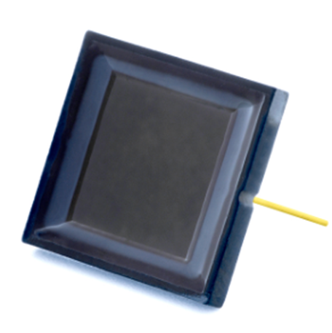
Option #2: YAG screen + (optical lens) + photodiode
PROS
YAG screen absorbs 100% of incoming soft X-rays and has a light yield of 8 ph/keV
Photodiodes have a relatively large effective area (10 by 10 mm)
YAG screen installed in vacuum + in-air photodiode
Very high QE (90%)
CONS
Photodiode provides no gain
Limited to photon counting (no imaging)
The larger photodiode size comes with a larger dark current (200 pA) -> optical lens

Slide 12
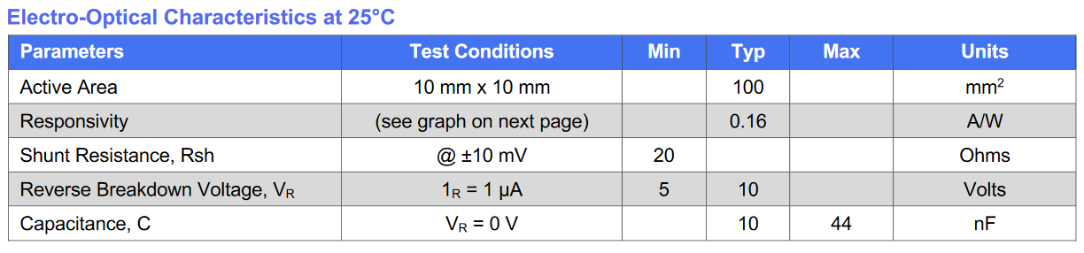
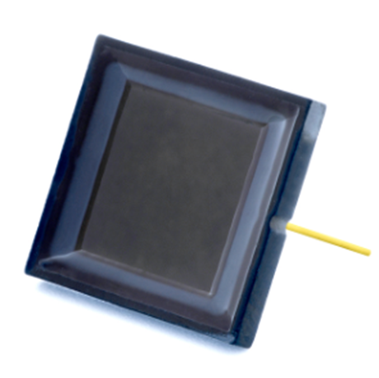
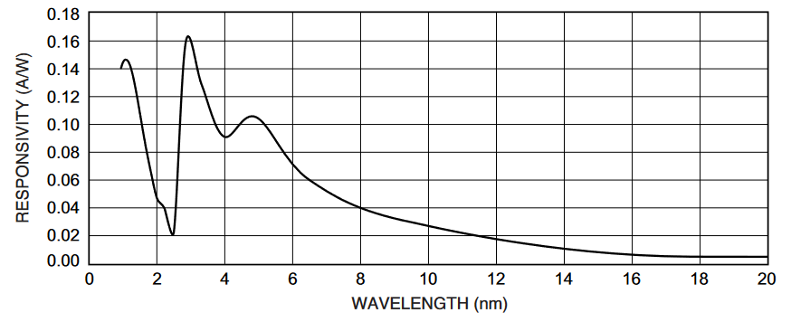
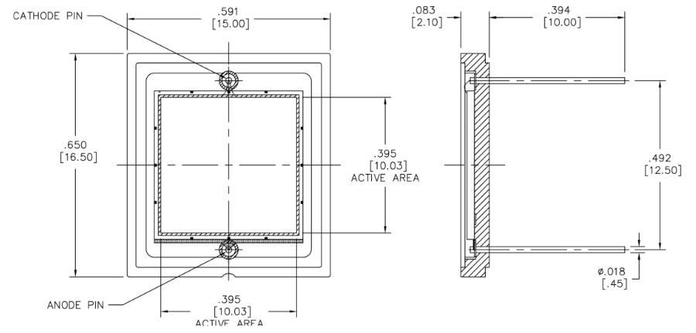
Si PIN photodiode (AXUV100TF030)

Slide 13
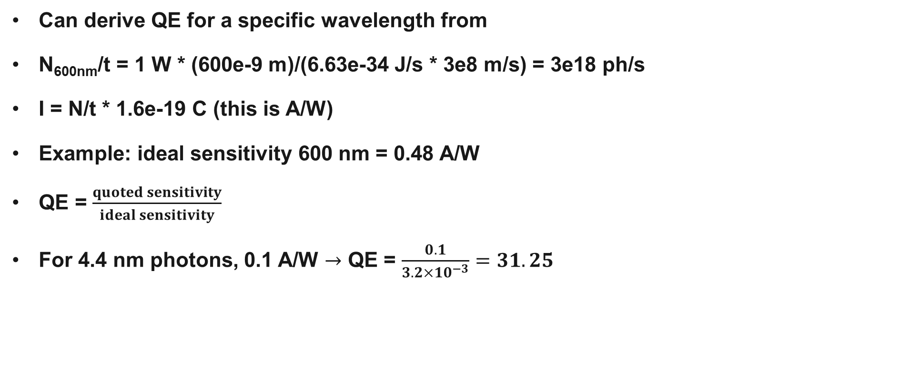
Photosensitivity vs QE
Can derive QE for a specific wavelength from
N_{600nm}/t = 1 W * (600e-9 m)/(6.63e-34 J/s * 3e8 m/s) = 3e18 ph/s
I = N/t * 1.6e-19 C (this is A/W)
Example: ideal sensitivity 600 nm = 0.48 A/W
QE = $\frac{quoted sensitivity}{ideal sensitivity}$
For 4.4 nm photons, 0.1 A/W $→$ QE = $\frac{0.1}{3.2×10^{−3}}=31.25$

Slide 14
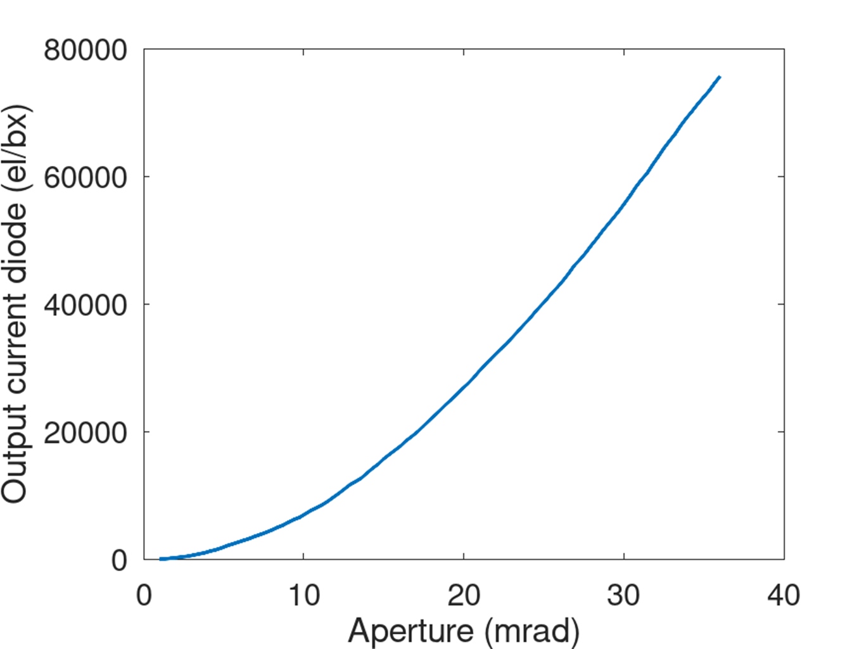
Signal output from scintillator + photodiode
Photon energy = 250 eV
Nb photons in 9.4 mrad cone = 200
photodiode QE = 31.25
Nb electrons detected by diode = 6,250 ph/bx
Dark counts = 7 el/pixel
Dark current = 1 nA

Slide 15
Final comparison
Parameter | MCP | Photodiode | CMOS
QE | 6% | 90% | 70%
Dark counts | 0.5 pA cm⁻² | 200 pA | 7 el/pixel
Nb photons through aperture | 1,500 | 722 | 571
Nb photons on detector | 54 | 2,900 | 2,285
Output electrons/pulse | 54e6 | 2,600 | 1,600

Slide 16
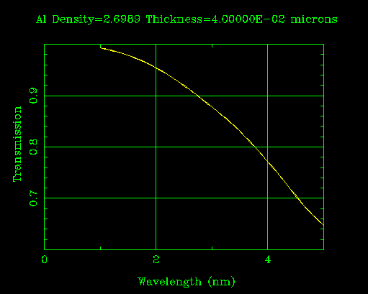
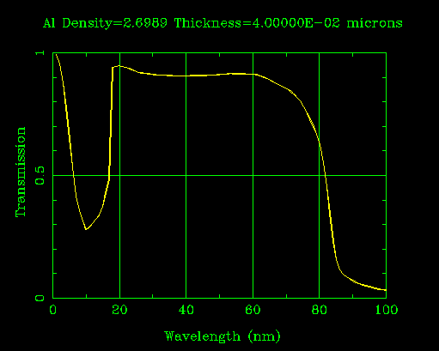
Soft X-ray filters (Aluminium)
40 – 50 nm Al foil good for blocking UV photons and letting soft X-rays pass

Slide 17
Detector calibration
Need monochromatic radiation source with photon energy equivalent to deposited photon energy per pulse.
Iron 55 has a photon energy of 5.9 keV, and is readily available at CERN.

Slide 19
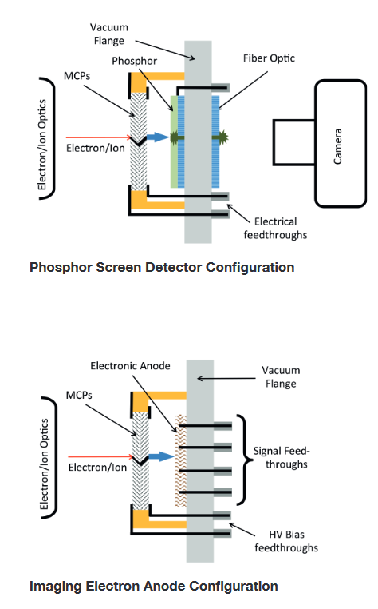
MCP: read-out device
Phosphor Screen
Image conversion
Spatial resolution
Imaging with MCP gain
Immediate visual feedback (alignment)
Single Anode
High sensitivity
Energy resolution
Fast timing
Counting experiments
Reduced background

Slide 20
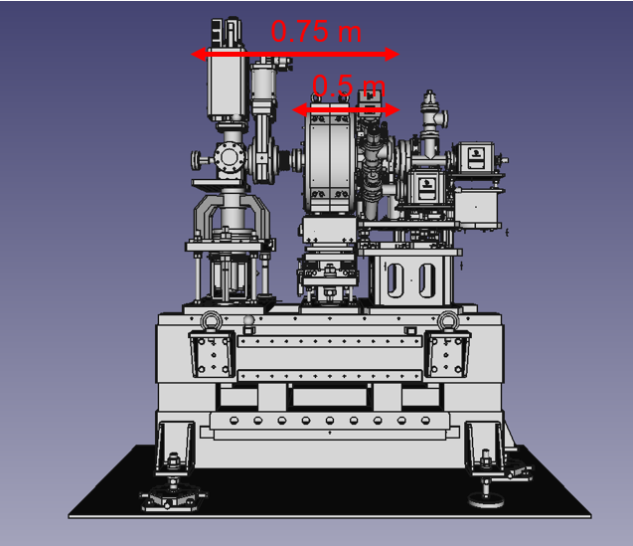
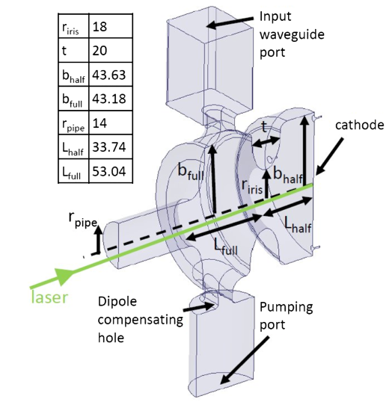
Interaction geometry
Beam pipe aperture:
20 mm from cathode to dipole entrance
40 mm from dipole entrance to photon detector
YAG screen, pepperpot screen.
spectrometer
detector

Slide 21
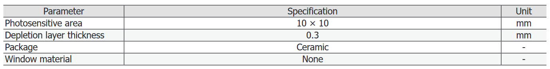
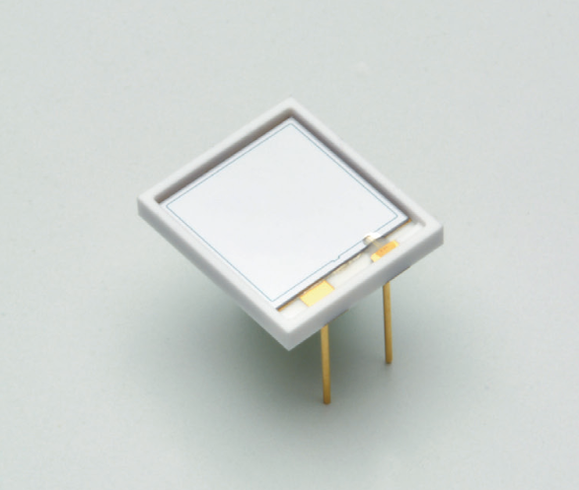
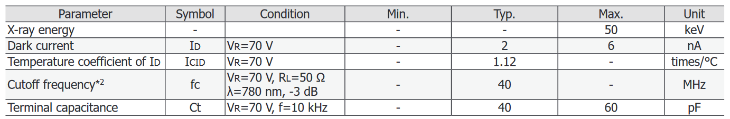
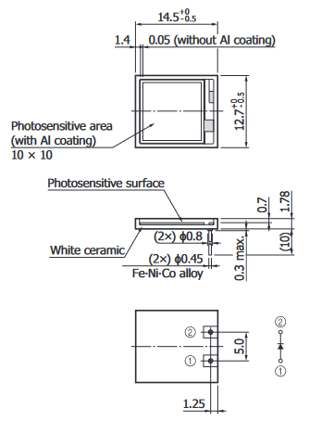
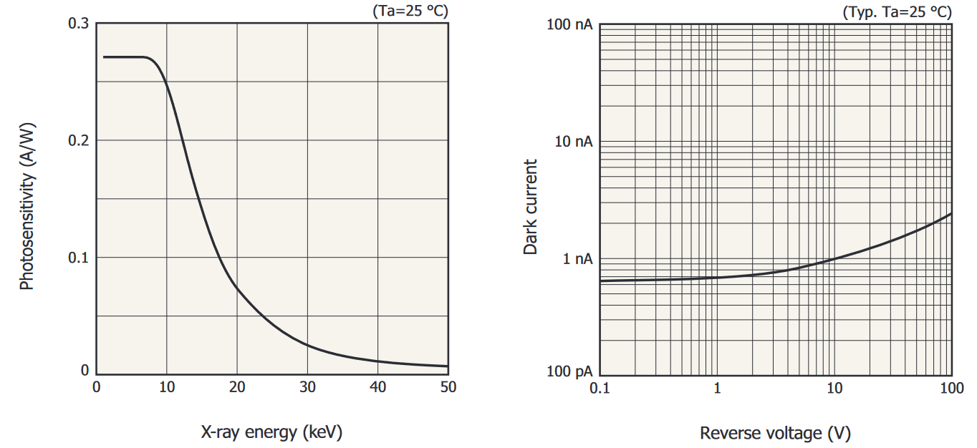
Si PIN photodiode (direct X-ray detection)

Slide 22
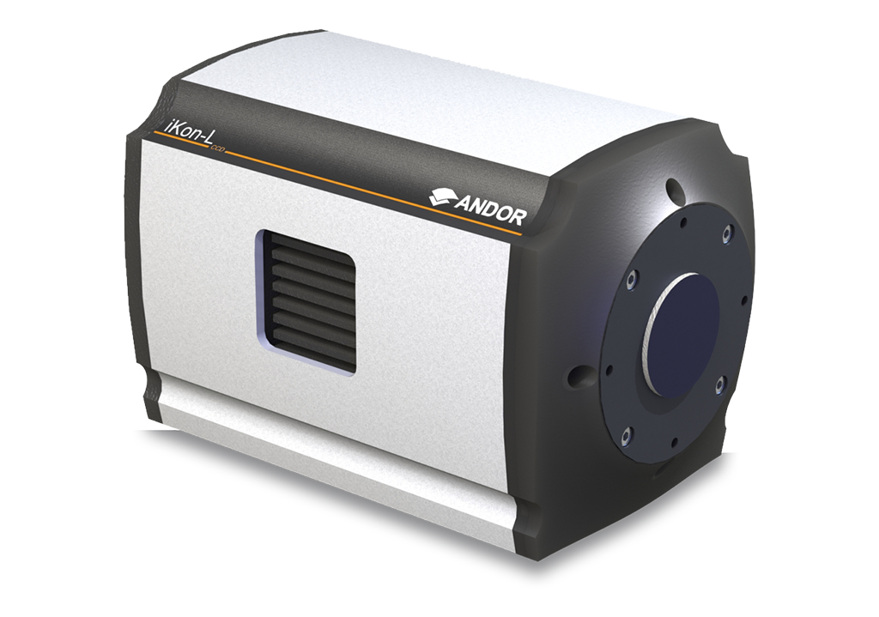
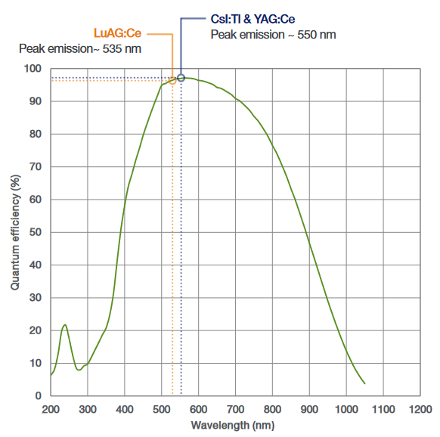
Signal output from scintillator + CCD
Photon energy = 400 eV
YAG screen photon yield = 8 ph/keV -
Scintillator detection efficiency = 100%
Nb photons in 14 mrad cone = 1,500
Nb emitted optical photons (incident on CCD) = 6,000
CCD QE = 95%
Nb optical photons detected by CCD = 5,700 ph/s
(assuming each photon goes to a different pixel)
Dark current = 540 el/s
iKon-L HF CCD
CCD specifications
Minimum temperature = -35ºC
Dark current @ min temperature = 0.09 el/pixel/s
Pixel readout rate = 5, 3, 1, 0.05 MHz
Pixel well depth = 100,000 el
Output node capacity = 250,000 el
Max throughput per pixel = 5 MHz
Pixel size = 13.5 by 13.5 um
Quantum efficiency = 95%
YAG out wavelength = 550 nm

Slide 23
MCP suppliers
In Europe
Baspik
Photek
PHOTONIS
Topag (not supplying)
Vigo
GIDS GmbH
Outside Europe
Hamamatsu Photonics
IL photonics
Incom
McPherson
SZPHOTON

Slide 24
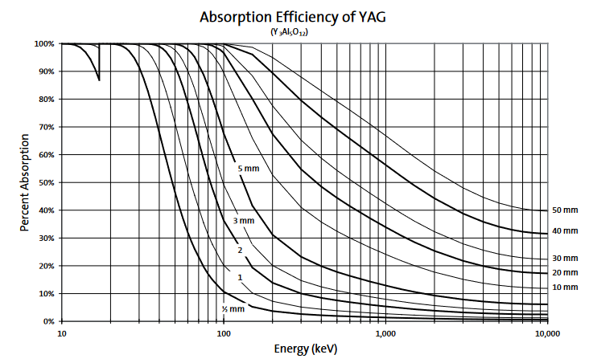
YAG screen
Properties | Value
Density [g/cm³] | 4.55
Hardness (Mho) | 8.5
Hygroscopic | No
Emission wavelength [nm] | 550
Refractive index | 1.82
Decay time [ns] | 70
Light output [ph/keV] | 8
YAG(Ce) — Yttrium Aluminum Garnet doped with Cerium [Y₃Al₅O₁₂(Ce)]
Non-hygroscopic, chemically inert inorganic scintillator
Wavelength of max emission is 550 nm (well matched to CCD)
Good resolution, mechanically rugged, long lasting, vacuum compatible

Slide 25
CMOS vs CCD
Both CCD and CMOS image sensors convert light into electrons by capturing light photons with thousands—or millions—of light-capturing wells called photosites. When an image is being taken, the photosites are uncovered to collect photons and store them as an electrical signal.
The technologies differ in quantifying the accumulated charge: in a CCD, the charge is transported across the chip and read at one corner of the array. In CMOS devices, there are transistors at each photosite that amplify and move the charge using more traditional wires.
Main differences:
CCD sensors create high-quality, low-noise images. CMOS sensors are typically more susceptible to noise.
The light sensitivity of a CMOS chip tends to be lower, as many photons hit the transistor.
CCD sensors consume as much as 100 times more power than CMOS
CMOS sensors are inexpensive to produce compared to CCD sensors.

Slide 26
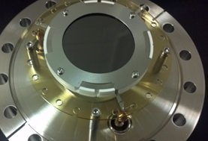
Vacuum feedthrough
Due to the assembly in UHV flanges (CF-flange) it is possible to integrate the system in any analytic instrument based on the CF standard (CF-40 flange at CTF2 end beam pipe).
For GIDS GmbH, the flanges are equipped with 3 integrated vacuum SHV feed-throughs to supply the high voltage to the MCP detector.

Slide 27
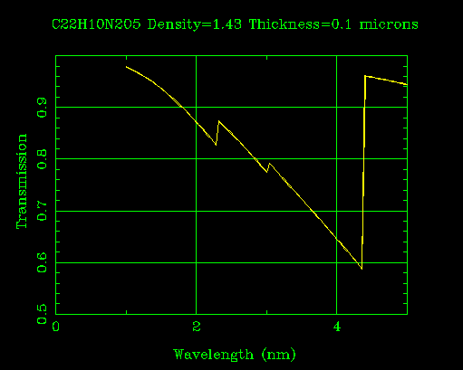
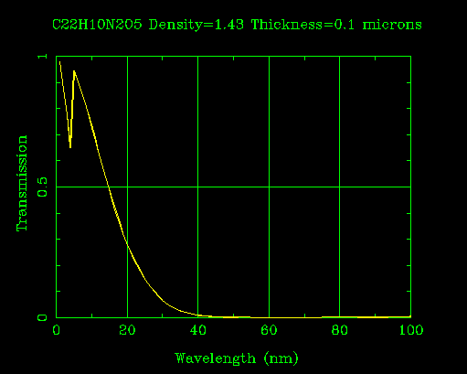
Soft X-ray filters (Polyimide)

Slide 28
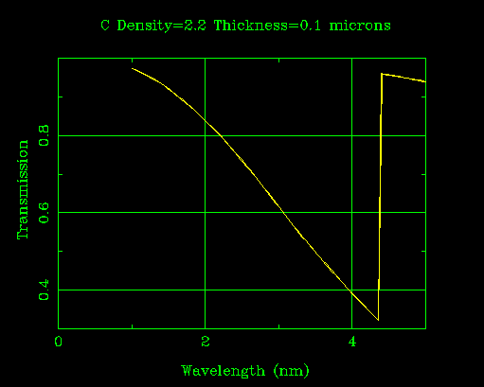

Soft X-ray filters (Carbon)

