Slide 1
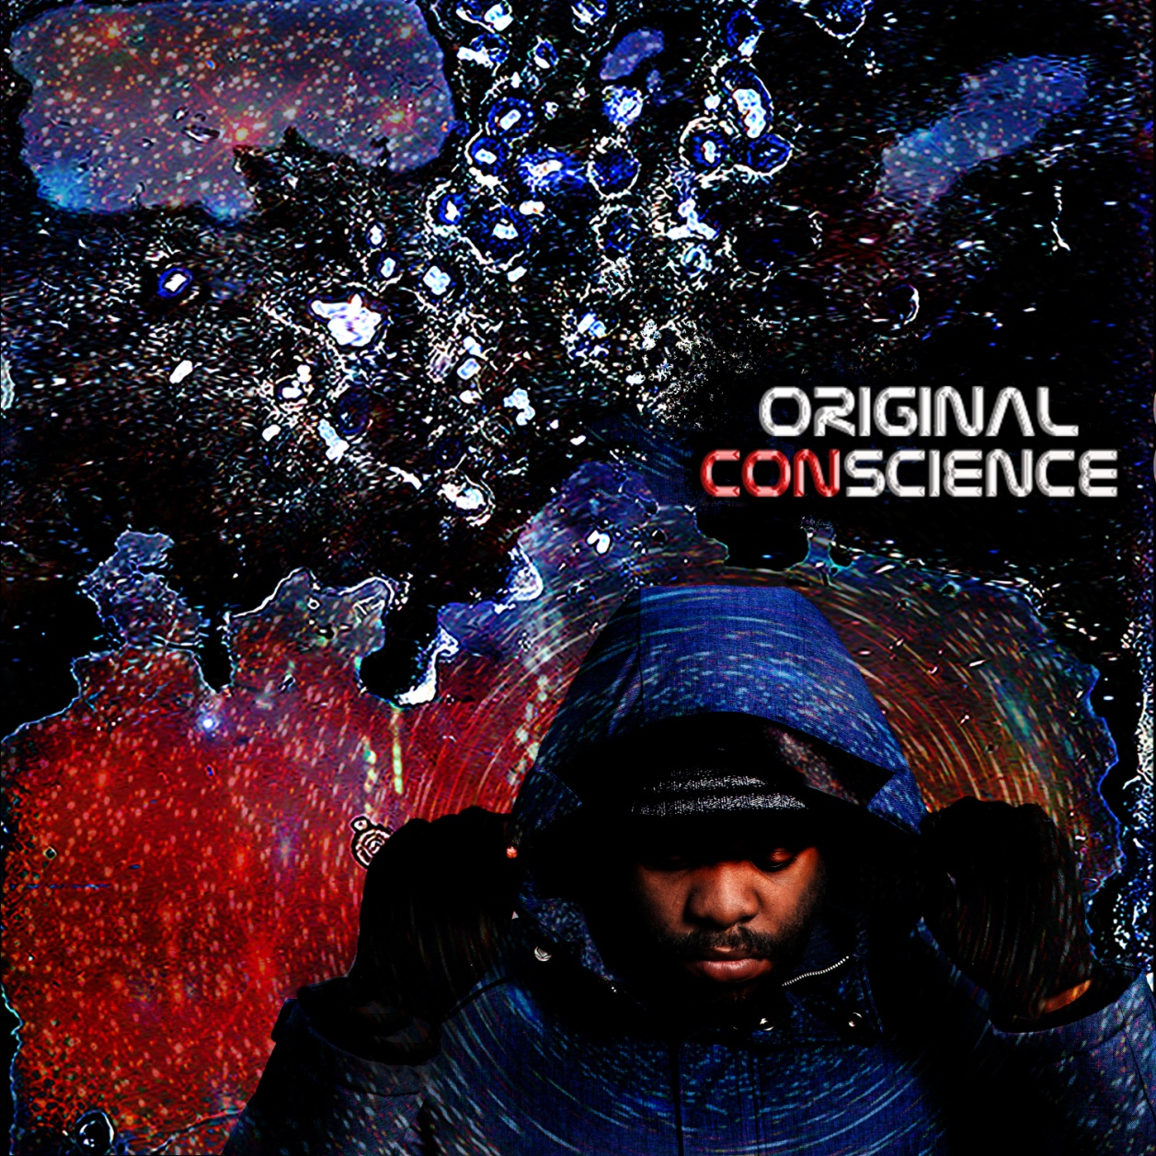
Original ConScience
DUNE MUSIC VIDEO

Slide 2
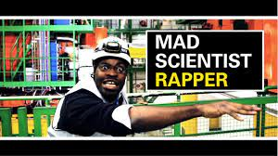

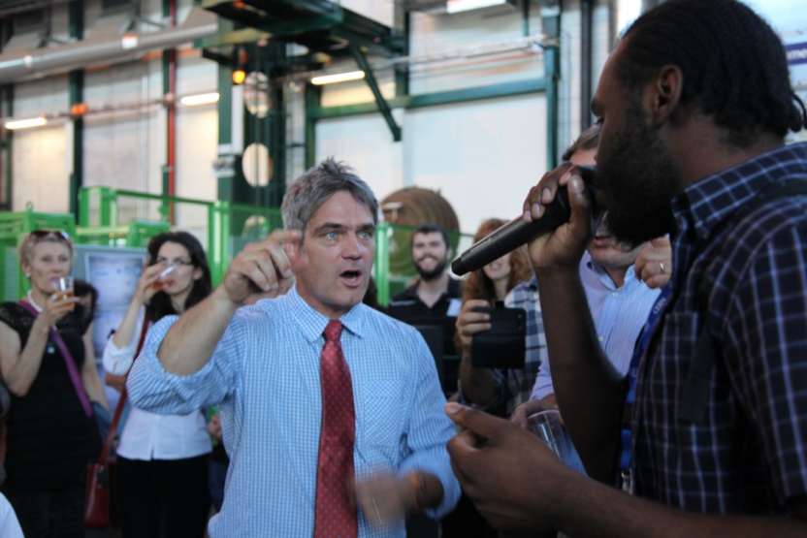
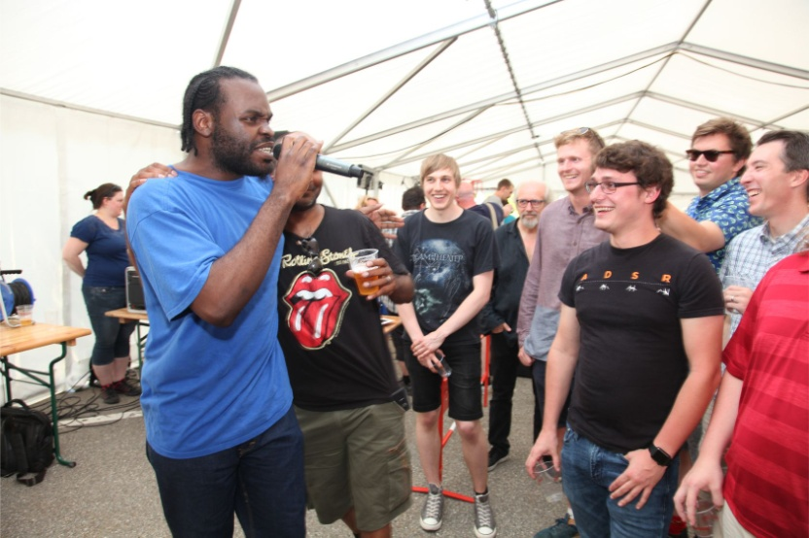
ConCERNed

Slide 3



Preliminary Research
CASE STRUDIES: ORIGIN Project,
Imperial, Bristol University, Fermilab, CERN, STEM Learning UK
A-Level
Age:16-18
GCSE
Age:14-16
General
Public

Slide 4
Album Plan
Title | Topics | Level | Syllabus Topics
Dark Energy | Dark energy, General Relativity, Cosmology | Advanced | Gravitational Constant, Mass-Energy Conservation, Pressure, Heat transfer,
Radiate | Cosmic Microwave Background | Intermediate / Advance | Nuclear Physics, radiation, black body spectrum, electromagnetic frequencies
Star Power | Energy in the stars, and on earth | Intermediate | Life cycle of a Star , Nuclear Fusion, Nuclear Fission, and Renewable Energy
Higher Amount | Space Travel | Intermediate / Advanced | Momentum, Suvat Equations, Optics eMFs
Unbreakable | Quark Gluon Plasma and the Big Bang | Intermediate / Advanced | Changes of state, states of matter, quark gluon plasma, formation of the early universe
Invisible | Particle Physics, Mass energy conservation and wave-particle duality | Advanced | Mass-energy conservation, Ions, Plancks constant, photoelectric effect, Maxwell Boltzmann particle distributions

Slide 5
Album Plan
Title | Topics | Level | Syllabus Topics
Gravitational Waves Music Video | Gravitational Waves and LIGO | Advanced | Standing waves, Wave detection resonance, General Relativity, Gravity, Black holes + Stars
The Machine Music video | Experiments physics and it’s machinery | Intermediate | Electrical circuits, resistors, charge, current and voltage.
Out of this World | Newtonian Physics and Planetary motions | Intermediate | Newton's laws, Kepler's laws, Gravitational constant, Earthquakes Friction and the Solar System
D.U.N.E. Music video | Deep underground Neutrino Experiment | Advanced | Particle Physics, electrons Atoms, Temperature.

Slide 6

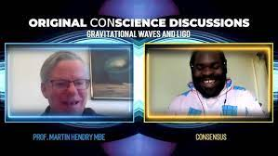
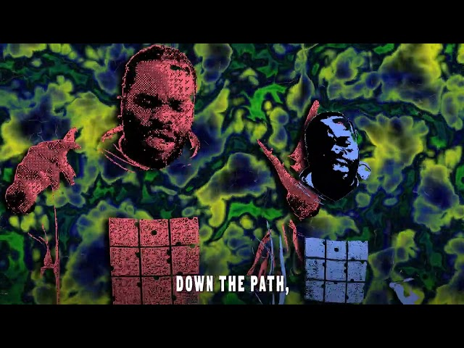

Album Plan

Slide 7
Album Plan
General Tracks | Topics | Level
Original Code Music Video | History of Astronomy / Cosmology | Beginner / Intermediate | Taking a journey with humans from the Egyptians and Greeks looking at the stars, all the way through to CERN, The JWT , LIGO and D.U.N.E.
Of Philosophy & Science | Overview Of Philosophy of science | Intermediate / Advance | Musings around the philosophy of science addressing ideas of scientific knowledge, evidence, inference, logic and reasoning, statistical analysis and justification.
Outer Space Original | General Preamble / | General | Social commentary on Science , Physics and the Universe
Universal Problems | Uses of STEM in problem solving | Intermediate / Advance | Social commentary on the uses of STEM analysis in society, inc. cosmology, economics and engineering.

Slide 8

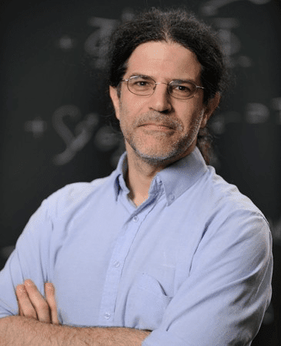
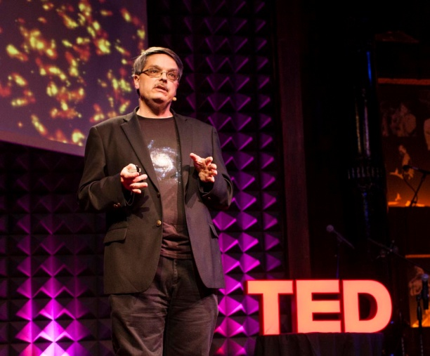
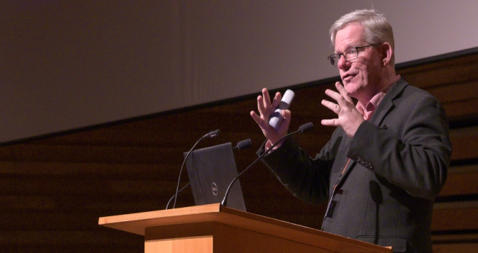
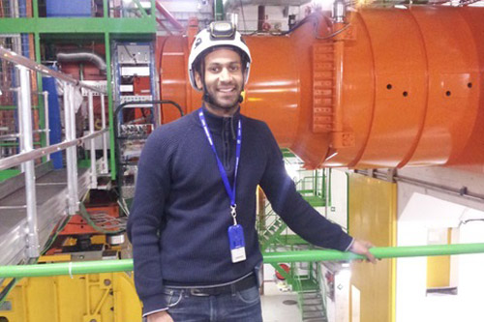
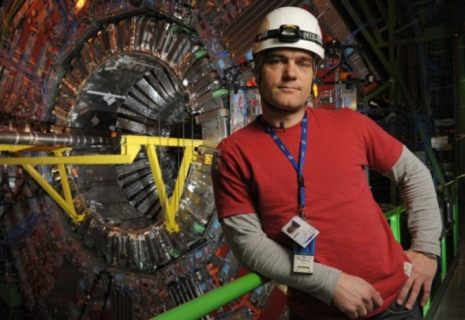
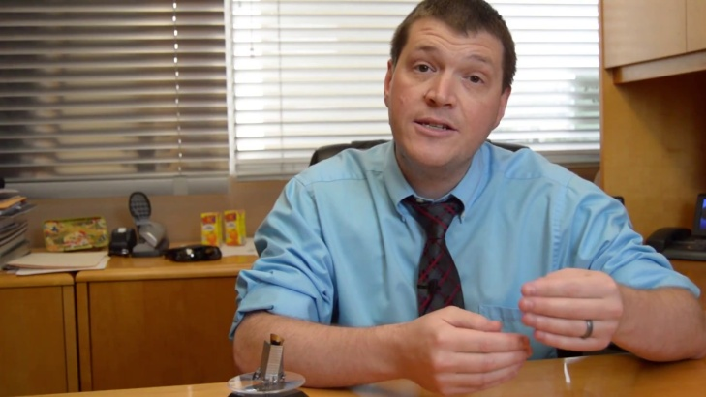
Collaboration
Agnes Mocsy,
Pratt Institute / YALE
David E. Kaplan,
Johns Hopkins
Don Lincoln
Fermilab
Martin Hendry, LIGO
Sudan Paramesvaran
CERN, DUNE
Michael Hoch, CERN
Dan Batcheldor, NASA

Slide 9
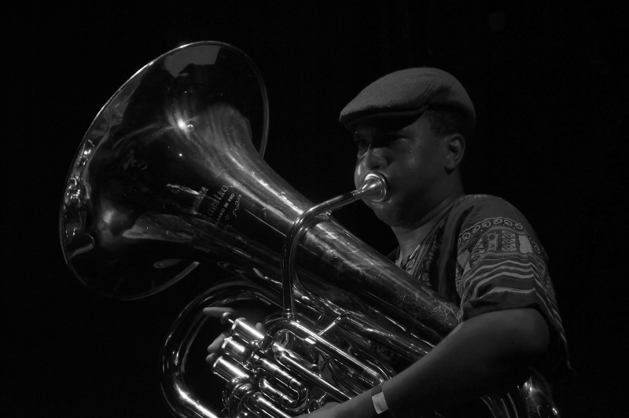
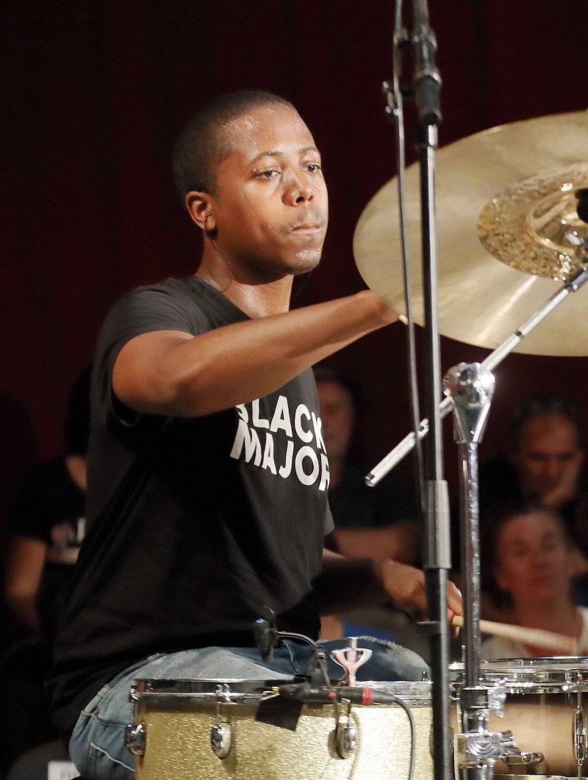




Collaboration
Theon Cross
Jazz / Multi-Genre
Teshay Makeda,
Reggae/ Rnb / Soul
Moses Boyd
Jazz / Hip-hop / Multi-genre
Dana Mckeon
Pop, Commercial
Clapper Priest,
Reggae / Sound System Culture
Matt Green
Rapping Science Teacher

Slide 10

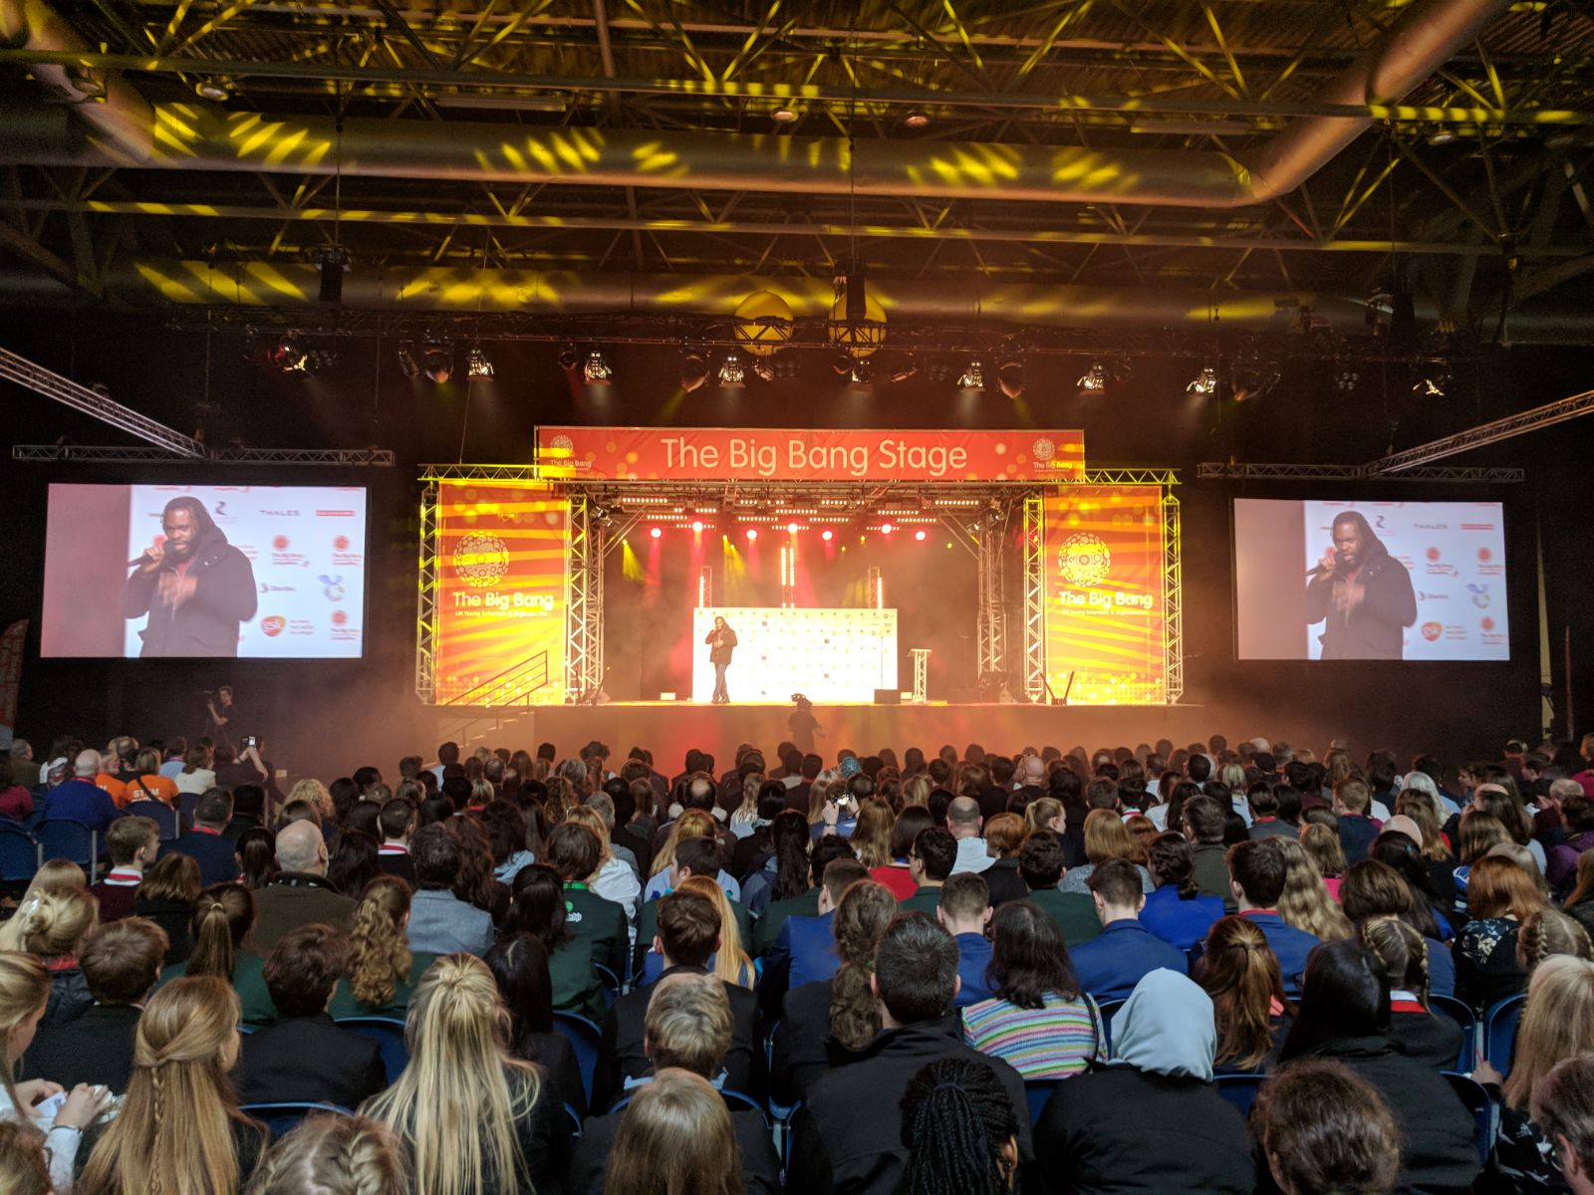
Live Performance
Clubs, live band, bars, lecture theatres, festivals

Slide 11
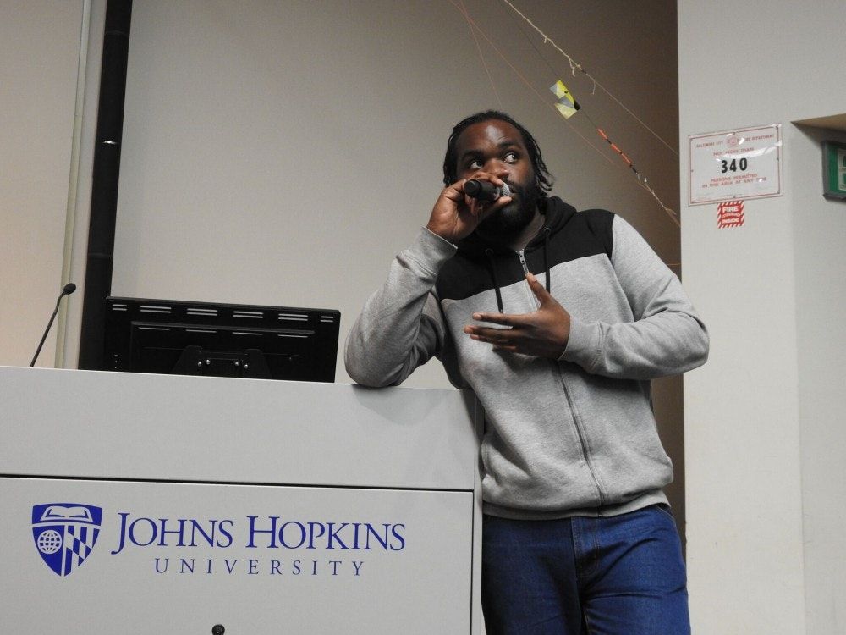
Live Performance
Clubs, live band, bars, lecture theatres, festivals

Slide 12
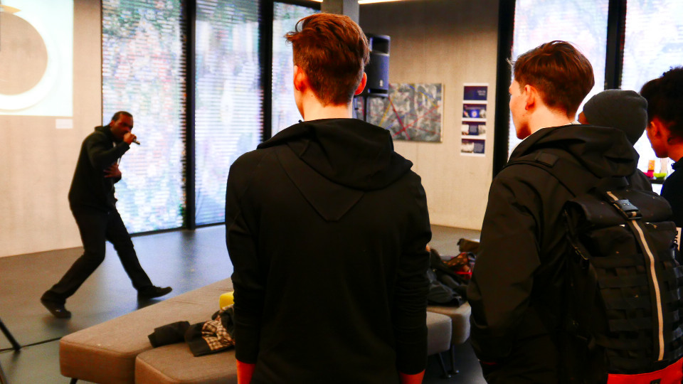
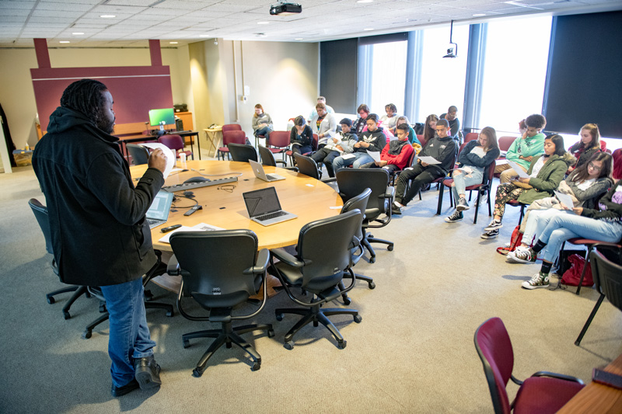
In the Classroom
Online
In the Classroom
Universities
Research institutions
Multiple Choice
Find the Relevant Phrases
Fill in the Missing Words
Group Quizzes / Raise of Hands
Comprehension Style Questions

Slide 13
LIVE DEMO TIME!

Slide 14
Thanks for Listening!
What Next
Release Party
UK Album Tour
Workshops
Colloquiums
Materials Dissemination
Evaluation
Book??
Future Songs?
Website: consensus.avr-music.com
Contact:
avr.truth@gmail.com
manaagement@avr-music.com

