Slide 1


Status of the straight Nb-Ti CCT demonstrator magnet fabrication at CIEMAT
This project has received funding from the European Union’s Horizon 2020 Research and Innovation programme under GA No 101004730.
Jesús jiménez, Javier munilla, Fernando toraL (CIEMAT)
Zoom meeting, Nov 16th, 2023

Slide 2
Layout
Engineering design
Progress
Next steps

Slide 3
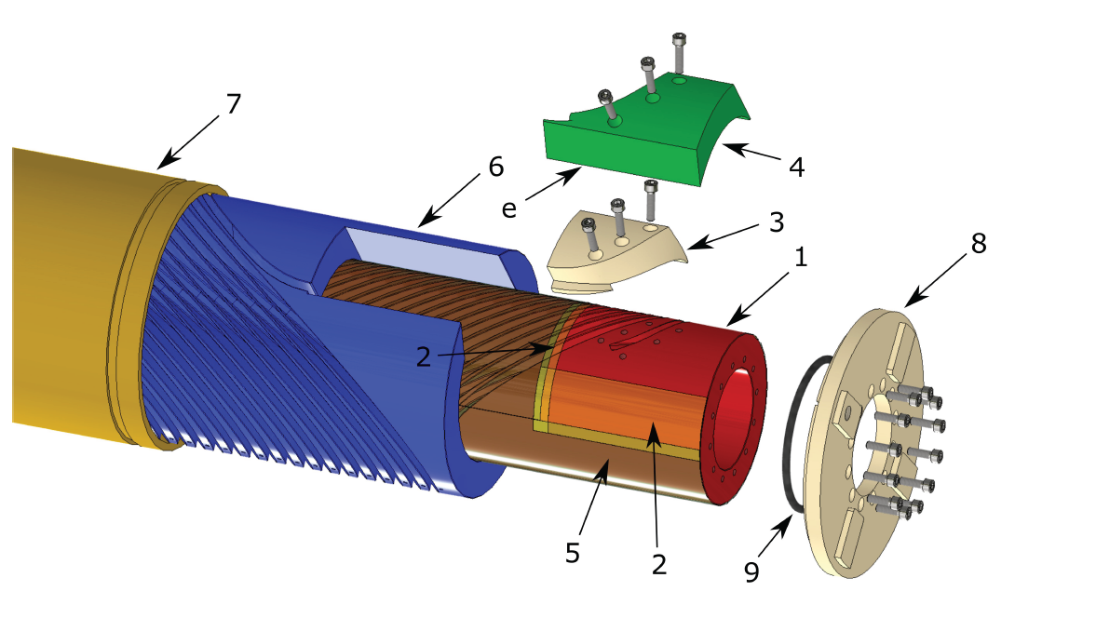
Engineering design

Slide 4
Progress
The tubes for the formers are in house (sent by INFN).
The order for the machining has been placed (Arquimea, Spain). They will use a 4-axis CNC milling machine.
The order for a new winding machine has been placed.
The design of a structure to hold 2x8 spools of wires is ongoing.
The commissioning of the new prototype magnet laboratory at CIEMAT is ongoing.
The spools of superconducting ropes are in house (sent by INFN).
Revision of 3D model made by D. Barna is ongoing.
Study of a short simplified mock-up is ongoing.

Slide 5
Next steps
Quality control of the superconducting ropes.
To finish the review of 3D model to go on with fabrication drawings.
To finish the study of the mock-up to go on with modeling and fabrication drawings.

