Slide 1

Report on the senior fellowship activities
98th ISOLDE Collaboration Committee meeting
Niels Bidault (BE-OP-ISO)
CERN, 1211 Geneva 23, Switzerland
November 17th, 2023

Slide 2

Report on the senior fellowship activities
    Beam transport elements for future ISOLDE low-energy upgrades
    Beam dynamics simulations
    Emittance measurements at ISOLDE and OFFLINE2
    Other projects and conclusion
Table of contents

Slide 3
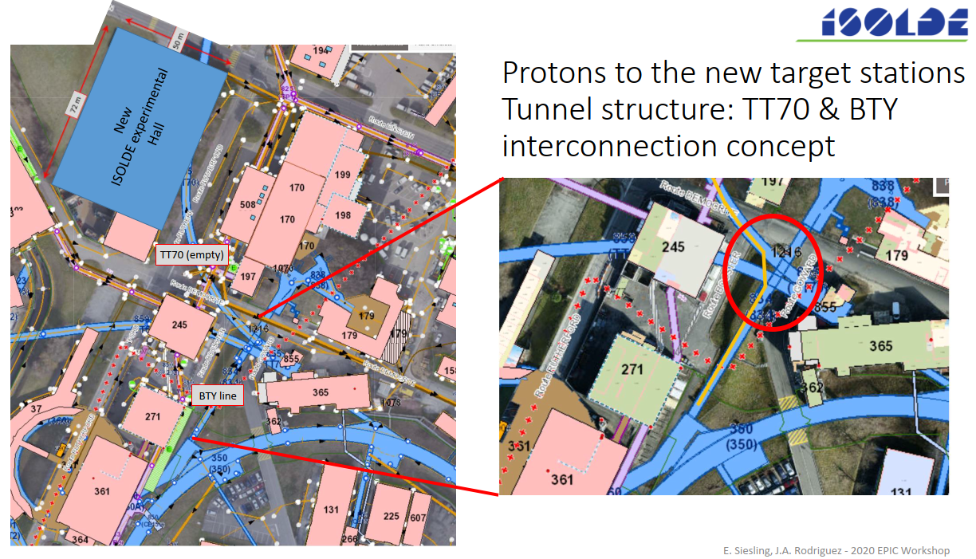
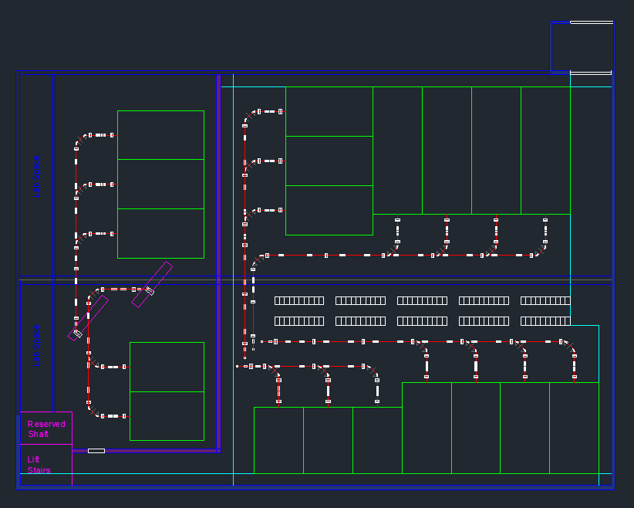
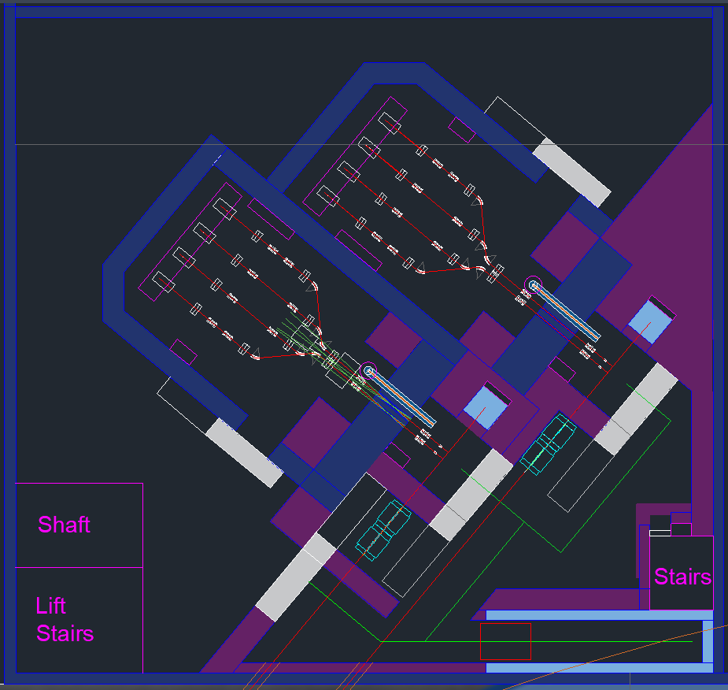
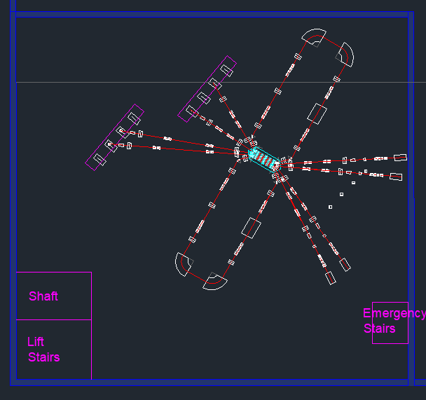
Preliminary concepts
EPIC Workshop 2020, J. A. Rodriguez & E. Siesling
Objectives
Parallel experiments and maximize the use of protons
Assure maximum beam transport from the target ion sources
Maximize the repeatability of FODO lattices
Minimize the amount of specific transport elements
Beam matching optimized for the separators and switchyards
Control over the waist for injection into the experimental stations
First layouts of the beamlines in the experimental area, the frontends and separator zone, and of the compact beam switchyard.
Switching between the fast and slow release for collections.
Work by J. A. Rodriguez.
Beam transport elements for future ISOLDE low-energy upgrades

Slide 4
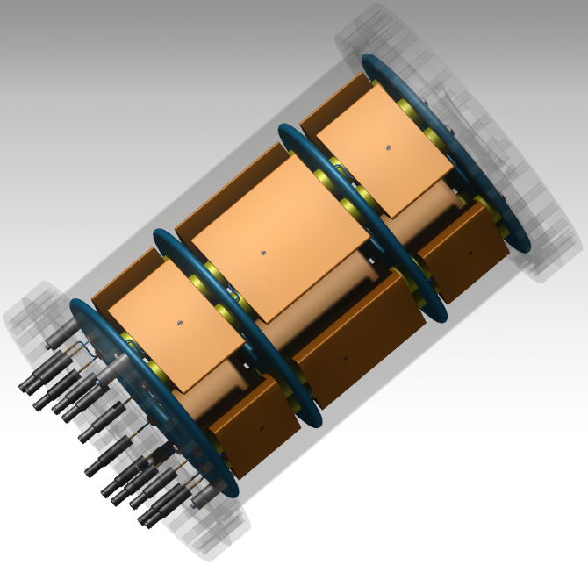
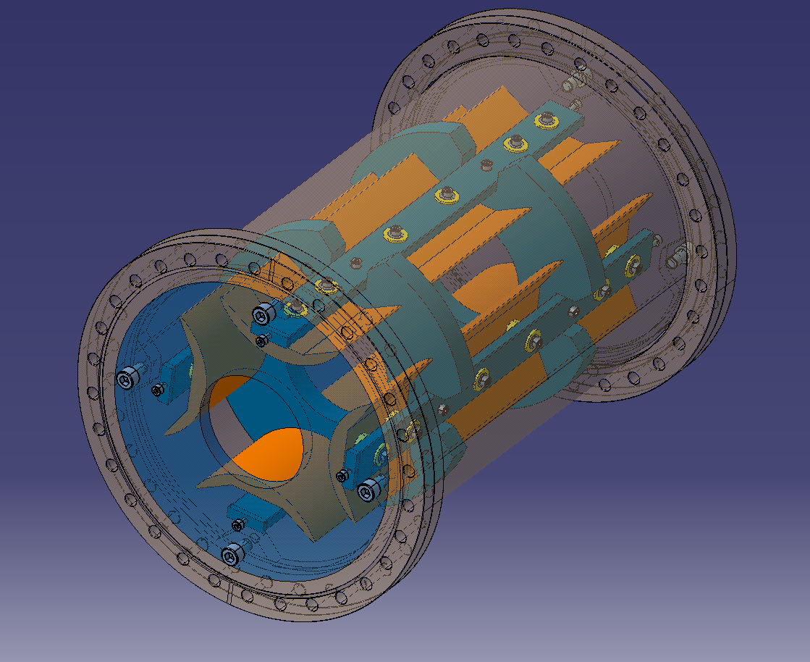
Mechanical design of electrostatic elements
Design rules
      Cost effective technological solutions
      Guarantee the field quality with respect to the beam dynamics constrains
      Vacuum compatible and respecting electrical standards preventing sparking or creepage
      Practical assembly, alignment and disassembly
Triplet
Electrodes built
by machining
Deflector
Spherical with hole for beam switching
Triplet
Electrodes built
by extrusion
Acknowledgements to Thomas Marroux (summer student), EN-MME-FS, EN-MME-EDS, BE-GM-ESA, TE-VSC-BVO and SY-ABT-SE.
Beam transport elements for future ISOLDE low-energy upgrades

Slide 5
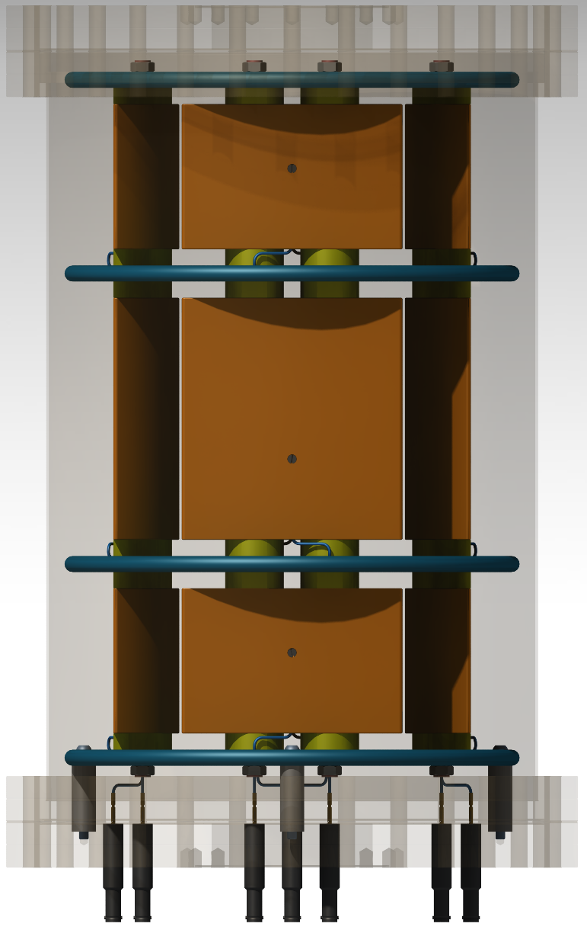
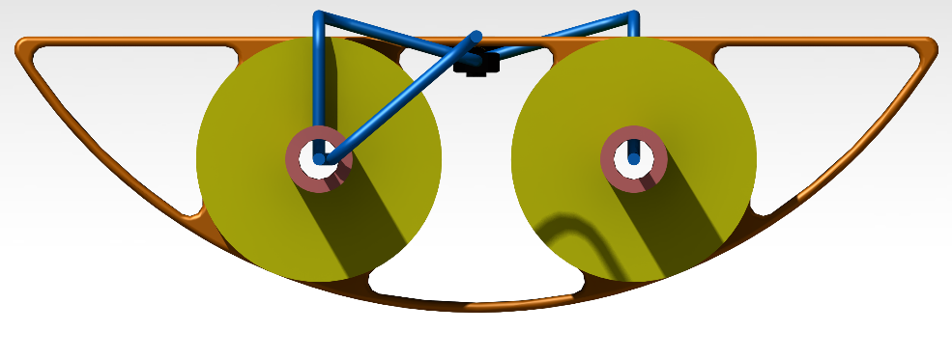
CAD models of quadrupoles
Advantages Low cost of fabrication, high repeatability, control over the geometry, low rugosity.
Disadvantages Potential need of end caps to prevent sparking, prototyping may be costly.
Inner flanges to limit fringe fields are connected to the chamber (grounded)
Models of triplets, doublets and single quadrupole were designed, with the characteristic dimensions as free parameters:
Electrode gap
Lengths of the electrodes and in between them
Radius of the electrodes
Technological solutions:
Standard CF fixed and rotatable flanges to the vacuum chamber and standard CF zero length flanges.
Commercial alumina insulators with standard geometry
Commercial feedthroughs (10 kV), connectors and coaxial cables to the electrodes
Rounded edges
Complexity of the assembly reduced
Feedthroughs only on one CF flange
Beam transport elements for future ISOLDE low-energy upgrades

Slide 6
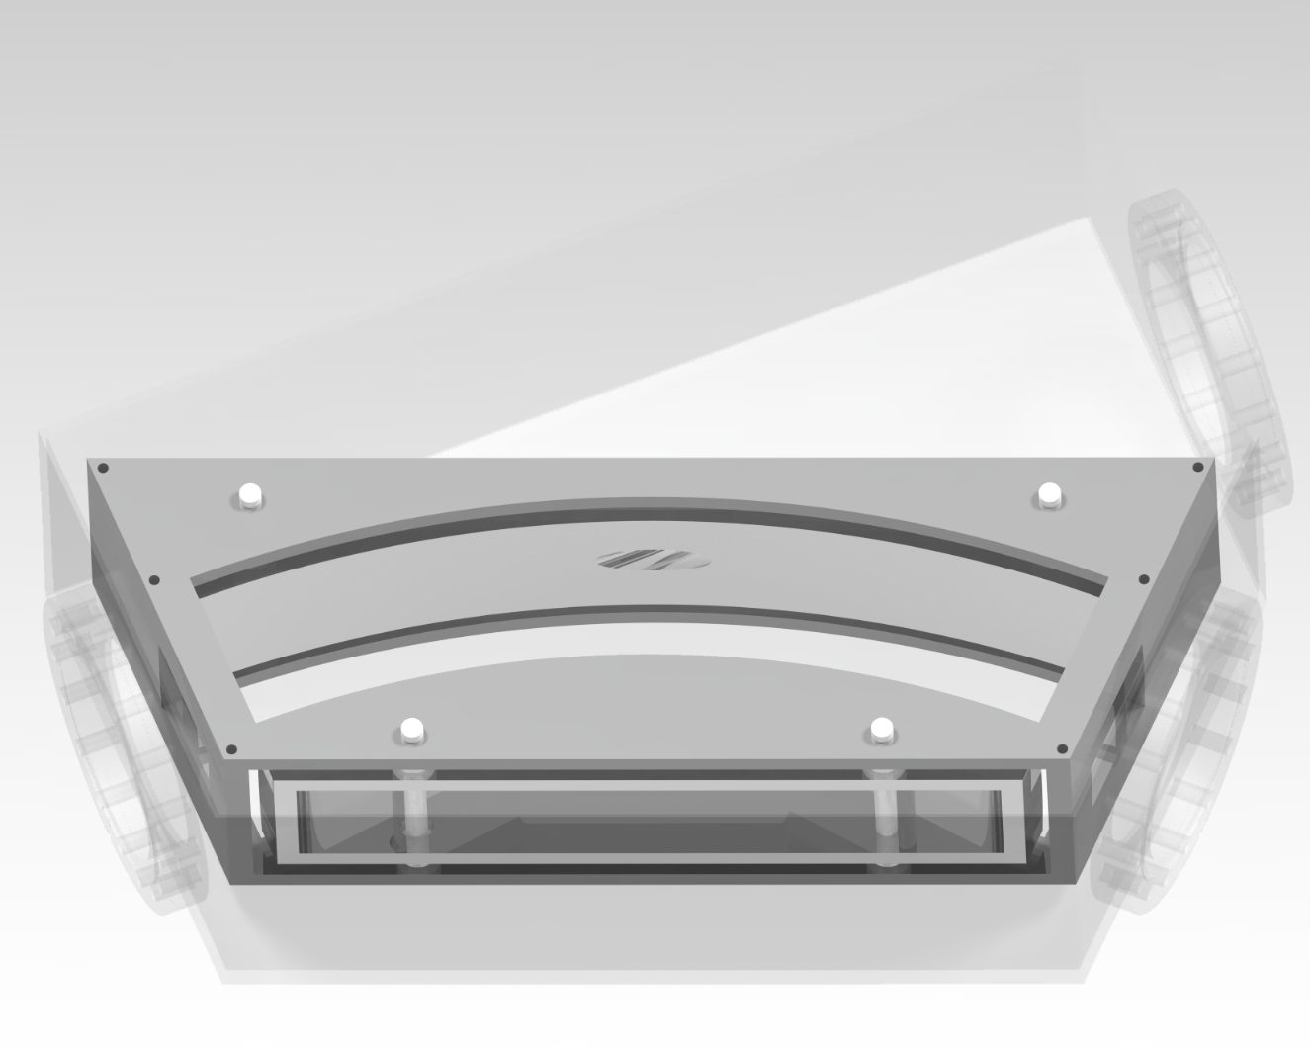
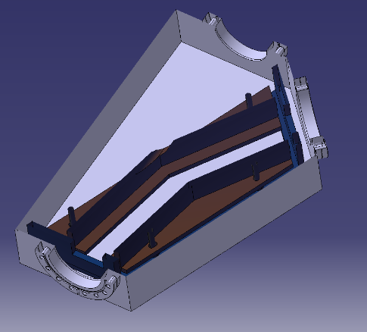
CAD models of deflectors
Plate
Models of spherical deflectors were designed, with the characteristic dimensions:
Bending radius and angle: 0.4 m and 45 deg.
Gap between electrodes: 4 cm.
Hole size for straight transport:
For different electrode geometries:
Perfectly spherical
Emulating the spherical electrode fields with flat electrodes
Technological solutions
Inner assembly frame inspired by the deflector designs for ELENA
Chamber manufactured from metal sheets
Commercial alumina insulators with standard geometry, feedthroughs (15 kV) and connectors
Remaining questions
Another iteration on the fabrication processes and possible plate geometries would be beneficial.
Shoulder
Hole
Spherical electrode
Beam transport elements for future ISOLDE low-energy upgrades

Slide 7
Report on the senior fellowship activities
    Beam transport elements for future ISOLDE low-energy upgrades
    Beam dynamics simulations
    Emittance measurements at ISOLDE and OFFLINE2
    Other projects and conclusion
Table of contents

Slide 8
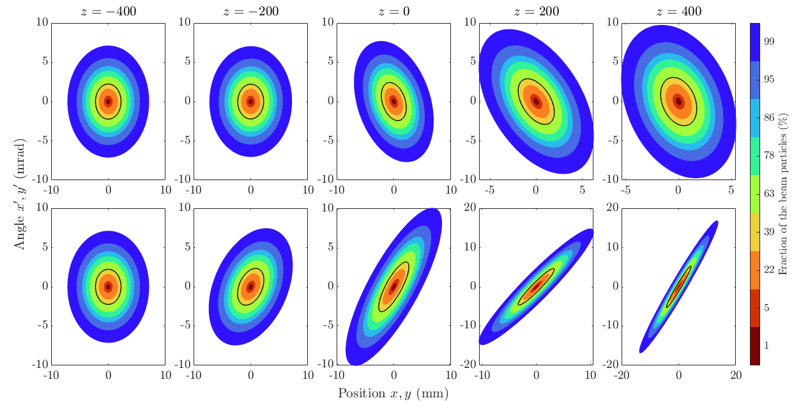
Simulations with CST: quadrupoles
Studies on the electrode gap, radius and shape:
The cylindrical shape present no significant difference compared with hyperbolic shape
Pole to pole diameter of 140 mm, so electrode radius if 80.28 mm - ratio from H. Wollnik Optics of Charged Particles
Studies on the fringe field:
Optimization on the inner grounded flanges
Approach theoretical transfer matrix
Determination of the effective voltage or the effective focusing strength
Example of ellipse tracking through a quadrupole with CST:
Beam dynamics simulations

Slide 9
Beam dynamics with COSY Infinity
Separator zone Source -> Triplet -> Concrete wall -> Triplet -> Two 45 deg. Deflections -> Triplets to Separator magnets
Output phase space for symmetric beam
High-level Matlab application to model with COSY Infinity any beam transport line with modulable characteristic lengths, comprised of:
FODO: doublet lattices.
Triplet lattices
45-deg. deflectors
Conclusion
Voltages < 10 kV for quadrupoles / 20 kV for deflectors
Focusing distance to the magnet < 2 m
Control the waist of the beam in x or y planes
Matching into the separator magnets
Beam matching to the separator magnets:
Triplet L_{QP} = 0.09 m / 0.15 m / 0.09 m
Last Distance to the magnets of 1 m
Control the waist of the beam in x or y planes
Beam dynamics simulations

Slide 10
Injection into experimental stations
Einzel lens
Compact element to provide strong focusing
High voltage required
Einzel focusing power is dependent on the geometry and the voltage ratio
Decelerating mode requires lower voltage
Less spherical aberrations with accelerating mode
Triplet
Single triplet will not necessarily preserve the beam symmetry
Not a lot of margin on the focusing distance
Voltages can be kept < 10kV
Focusing for a Triplet L_{QP} = 0.25 / 0.4 / 0.25 m
Maximum voltage required for a 60 keV beam
Gridded Einzel lens
Spherical Aberration Corrections for an Electrostatic Gridded Lens, 2008, A. Pikin
Numerical simulation of gridded electrostatic lens Rev. Sci. Instrum. 83, 02B907 (2012) G. N. Kropachev, N. N. Alexeev, A. I. Balabin, et al
Beam dynamics simulations

Slide 11
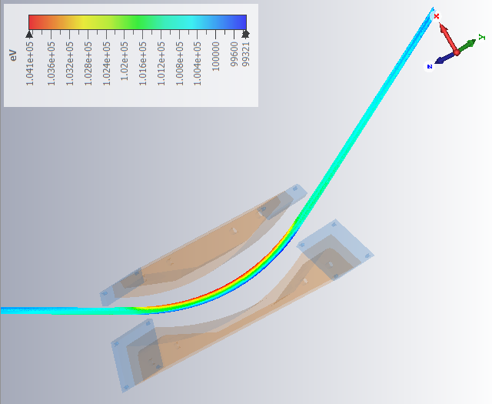
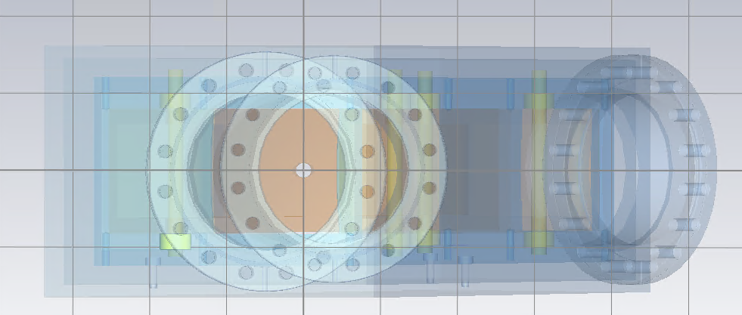
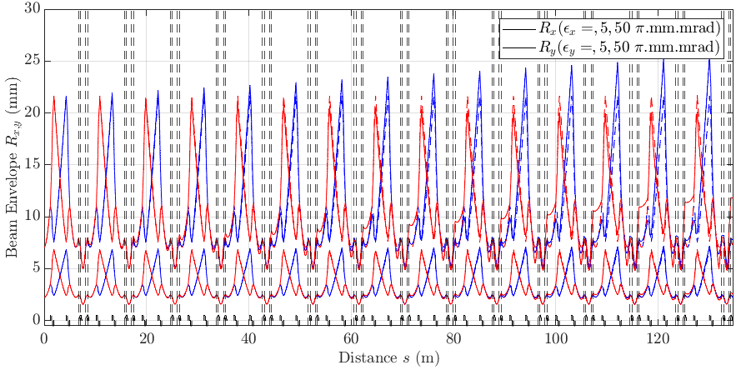
Simulations with CST: deflectors
Deflector studies on the electrode gap, radius
  Gap values of a minimum 4 cm
  Radius 0.4 – 0.7 m. Ideal 0.5 m
  Voltages < 20 kV
Hole in deflector with a radius 5 mm (< envelope for 50 pi.mm.mrad)
Example of beam tracking through multiple 45 deg.-spherical benders to illustrate the effect of the bending radius
R_{i}
R_{i}
Horizontal phase space after tracking for bending radii 0.5 and 0.7 m
Beam dynamics simulations

Slide 12
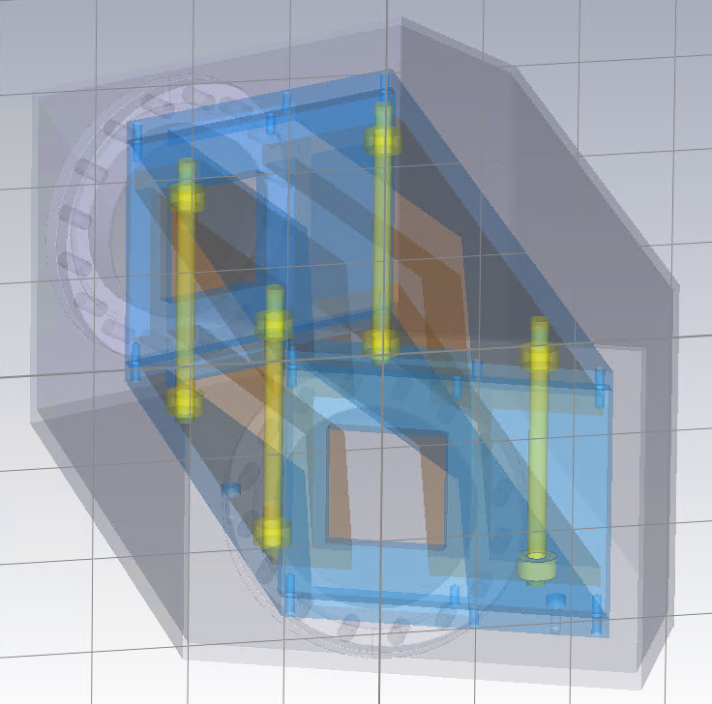
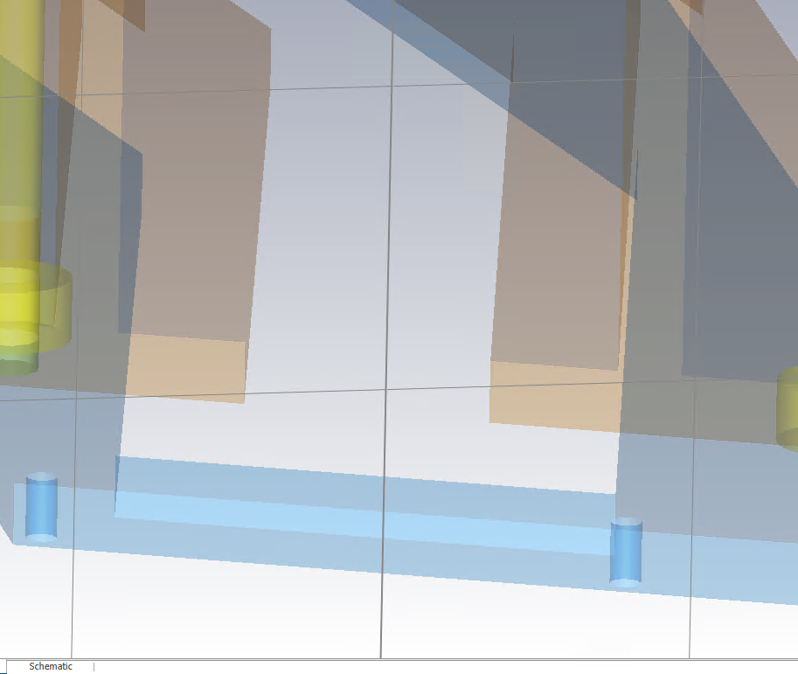
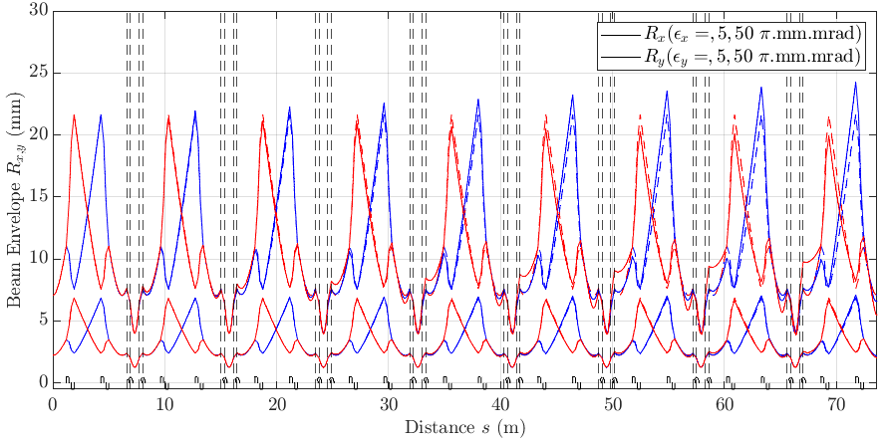
Simulations with CST: deflectors
Deflector studies on the electrode shape
Vertical phase space tracking for different deflectors: spherical, cylindrical and two different sizes h
Spherical Cylindrical Flat with shoulder h₁ Flat with shoulder h₂
  Transmission with a virtual aperture the size of the initial beam’s envelope R_{i}
d
h
Beam dynamics simulations

Slide 13
Report on the senior fellowship activities
    Beam transport elements for future ISOLDE low-energy upgrades
    Beam dynamics simulations
    Emittance measurements at ISOLDE and OFFLINE2
    Other projects and conclusion
Table of contents

Slide 14
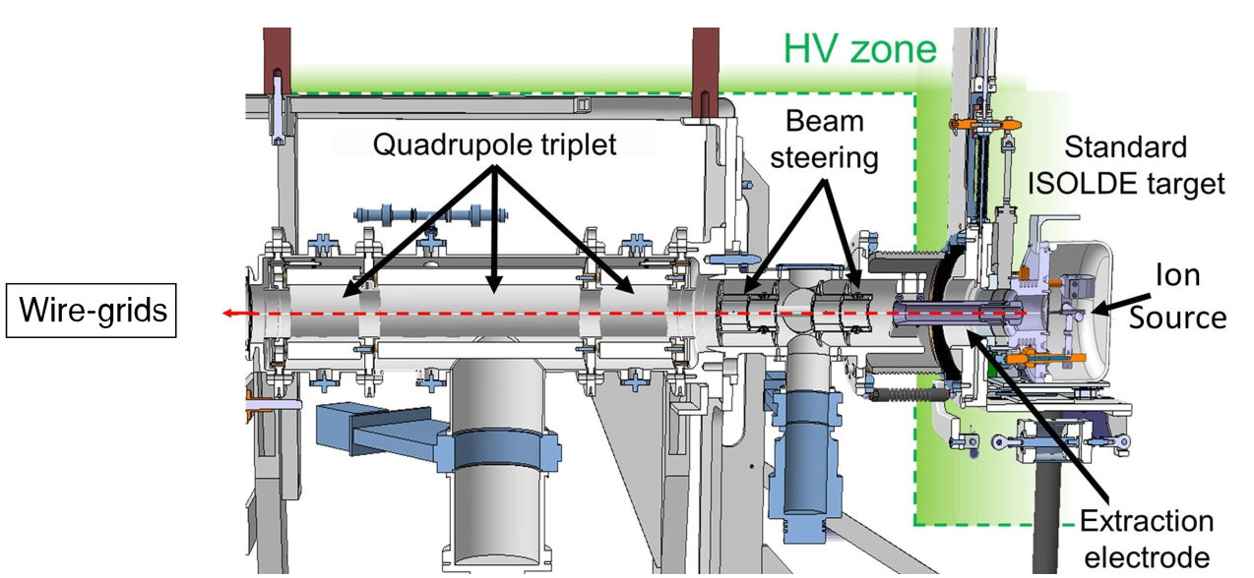
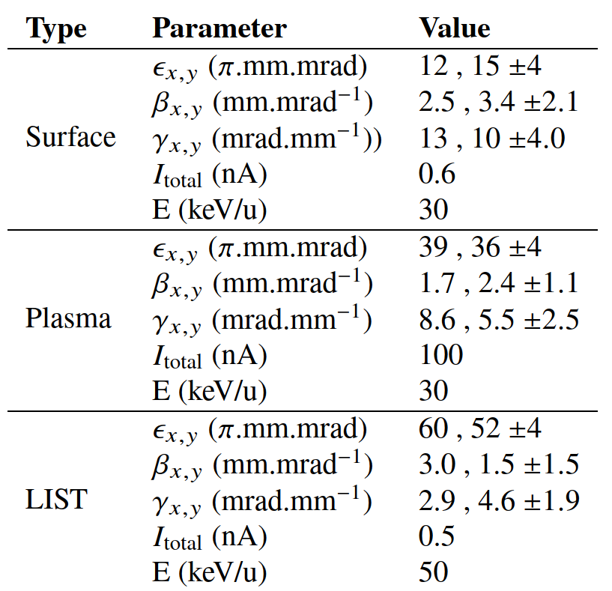
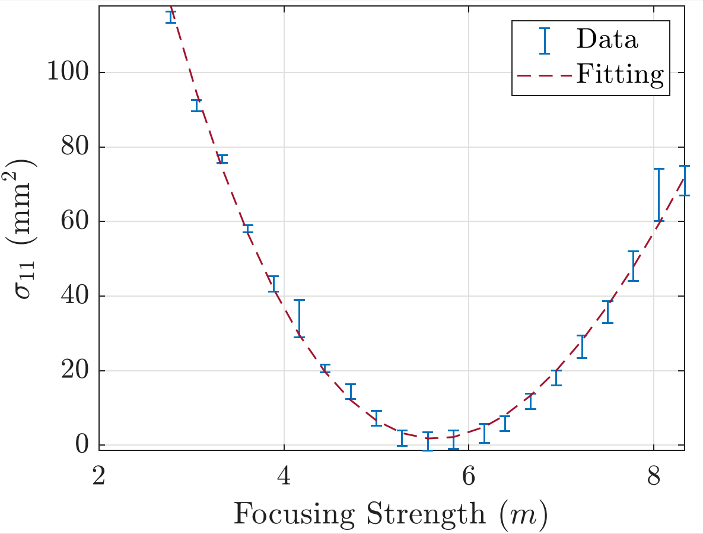
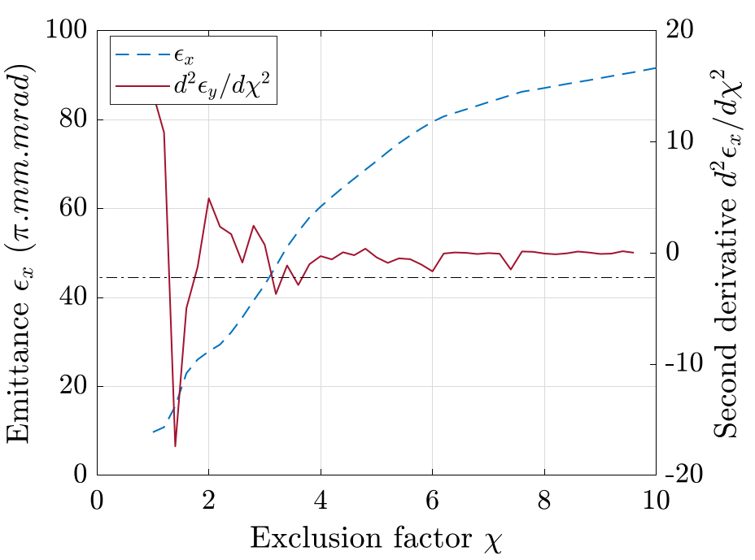
Emittance from the target ion sources
Setup and results
Use the wire grids at ISOLDE, with a spacing of 0.5 mm.
Quadrupole-scan emittances are larger than historical measurements, and Allison scans:
After integration in CST to determine a realistic transfer matrix:
  The focusing strength relative uncertainty is about 10 %
  The discrepancy with other methods cannot be fully explained
Transverse emittance investigation of the ISOLDE target-ion sources F. Wenander, NIM Phy. Res. B, Vol. 204, May 2003, Pages 261-266.
Transverse Emittance Measurements of the Beams Produced by the ISOLDE Target Ion Sources, N. Bidault, Proceedings of IPAC2022, Bangkok, Thailand.
Emittance measurements at ISOLDE and OFFLINE2

Slide 15
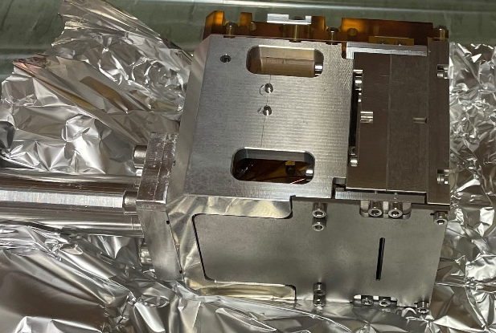
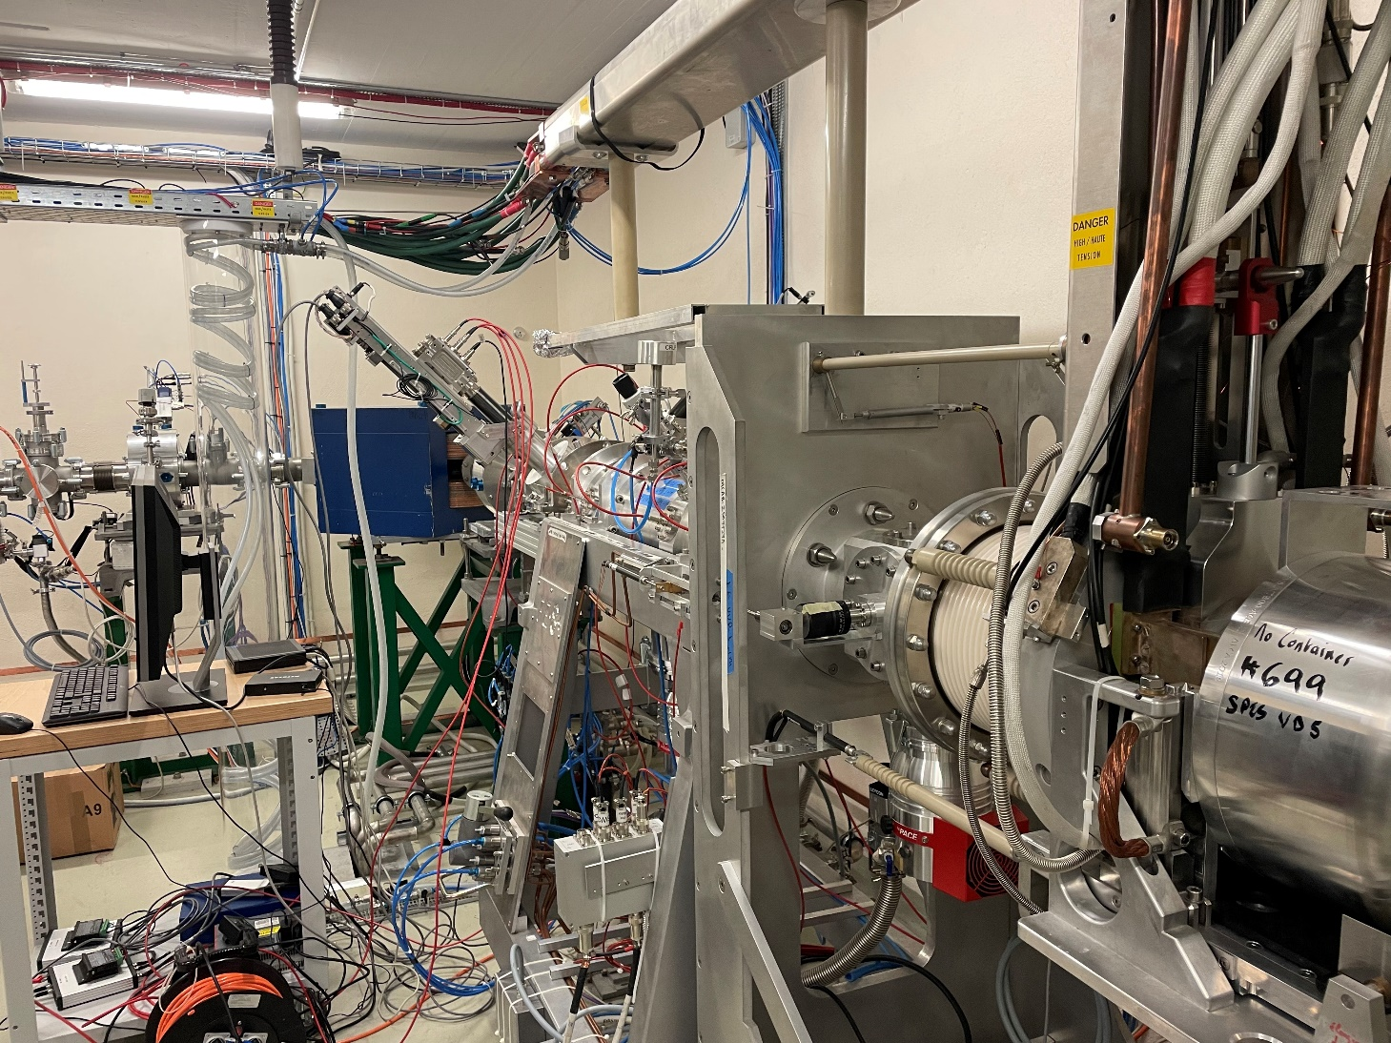
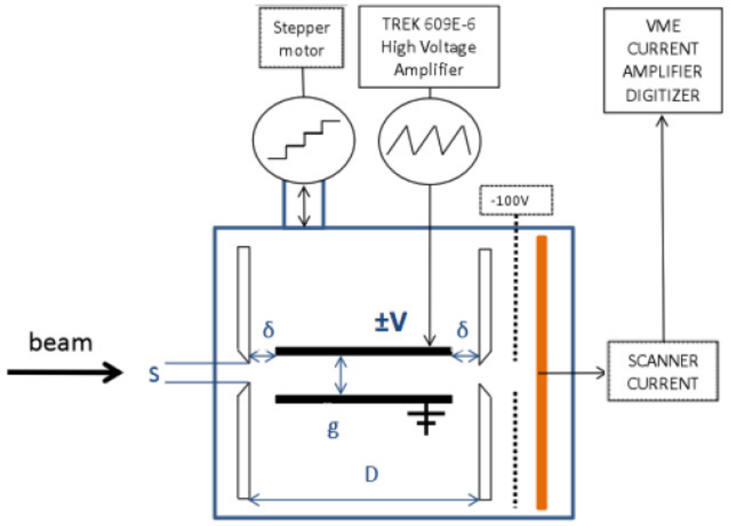
Allison scanners from TRIUMF
Triplet
Allison scanner
x/y deflectors
Front slit
Controls
Specifications
Can be used for beams up 100 keV
Geometrical resolution of 0.03 mm-mrad
Faraday cup for beams > 1 nA or a channeltron for lower intensities
Schedule
2022: Received from TRIUMF, troubleshooting, installation at ISOLDE
2023: Troubleshooting and installation at OFFLINE2
Documentation
CERN-wiki procedure on how to use the scanners and on the data treatment associated (link).
HV at 30 kV
Power supply
Ion source
Rasp. Pi
Allison Scanner Emittance Diagnostic Development At TRIUMF, A. Laxdal et al., Proceedings of LINAC2014, Geneva, Switzerland.
Emittance measurements at ISOLDE and OFFLINE2

Slide 16
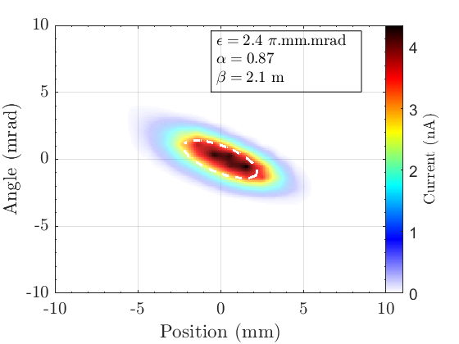
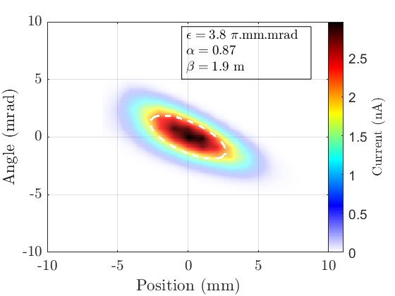
Emittance measurements at ISOLDE - RC6 Beamline
Results from the Allison scanners
³⁹K⁺ at 30 keV from a surface ion source. 80 nA beam intensity with 95% transmission from CA0 to RC6.
Transverse phase space (u, u’)
Transverse phase space (v, v’)
Conclusion and Perspectives
Documentation in https://edms.cern.ch/document/2995924/1. Phase space data shared with Lukas Nies and Pablo Arrutia (SY-ABT-BTP).
The measurements can serve as estimates for choosing the focusing systems required by the Penning trap in the PUMA project.
More systematic characterization of the beam parameters in ISOLDE low-energy lines compared with simulations would be beneficial.
Emittance measurements at ISOLDE and OFFLINE2

Slide 17
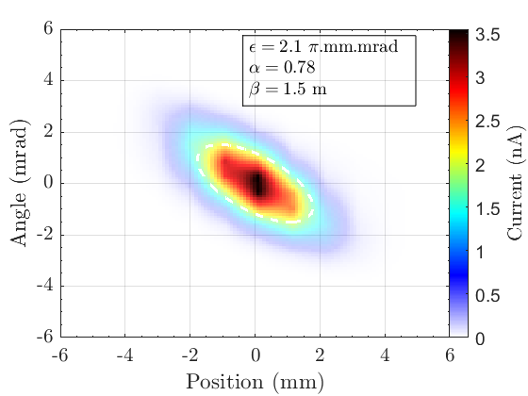
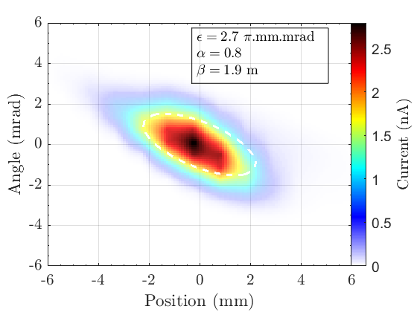
Emittance measurements at OFFLINE2
Plasma Ion Source
Target #794 VD7 Prismap, with 30 nA beam intensity, mainly Ar with constant gas injection.
Transverse phase space scans for different operational parameters
      Source B-field
      Anode voltage
      Line heating
      Beam energy
      Beam focusing
Example Variation of the extracted beam emittance as a function of the plasma B-field by changing the coil current.
With B-field (u, u’) Without B-field (v, v’)
Evolution of the emittance
Evolution Twiss parameters
Emittance measurements at ISOLDE and OFFLINE2
Notes:
More or less constant extracted beam intensity

Slide 18
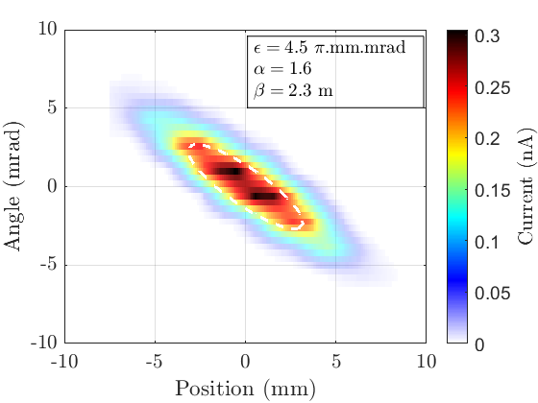
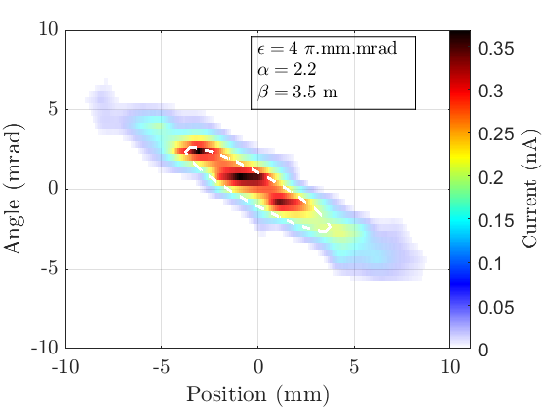
Emittance measurements at OFFLINE2
Surface Ion Source
Target #719, with CF4 injection. With 10 nA of beam intensity, mainly BaF. Fixed line heating (270 A).
Evolution of the emittance
Phase space (u, u’) Phase space (v, v’)
Evolution Twiss parameters
Laser Ion Source and Trap (LIST)
  Measurements will occur next week.
  Unfortunately, the current setup does not allow the combination of lasers on target with the Allison scanners.
Conclusion and Perspectives
SY-STI can use the Allison scanners: L. Le is trained, and the documentation is available.
Thorough characterisation of VD7 Plasma Ion Source for different operational parameters. Less information on LIST.
- Need to evaluate whether the current results can be published or wait until more measurements on LIST with lasers are done.
Emittance measurements at ISOLDE and OFFLINE2

Slide 19
Report on the senior fellowship activities
    Beam transport elements for future ISOLDE low-energy upgrades
    Beam dynamics simulations
    Emittance measurements at ISOLDE and OFFLINE2
    Other projects and conclusion
Table of contents

Slide 20
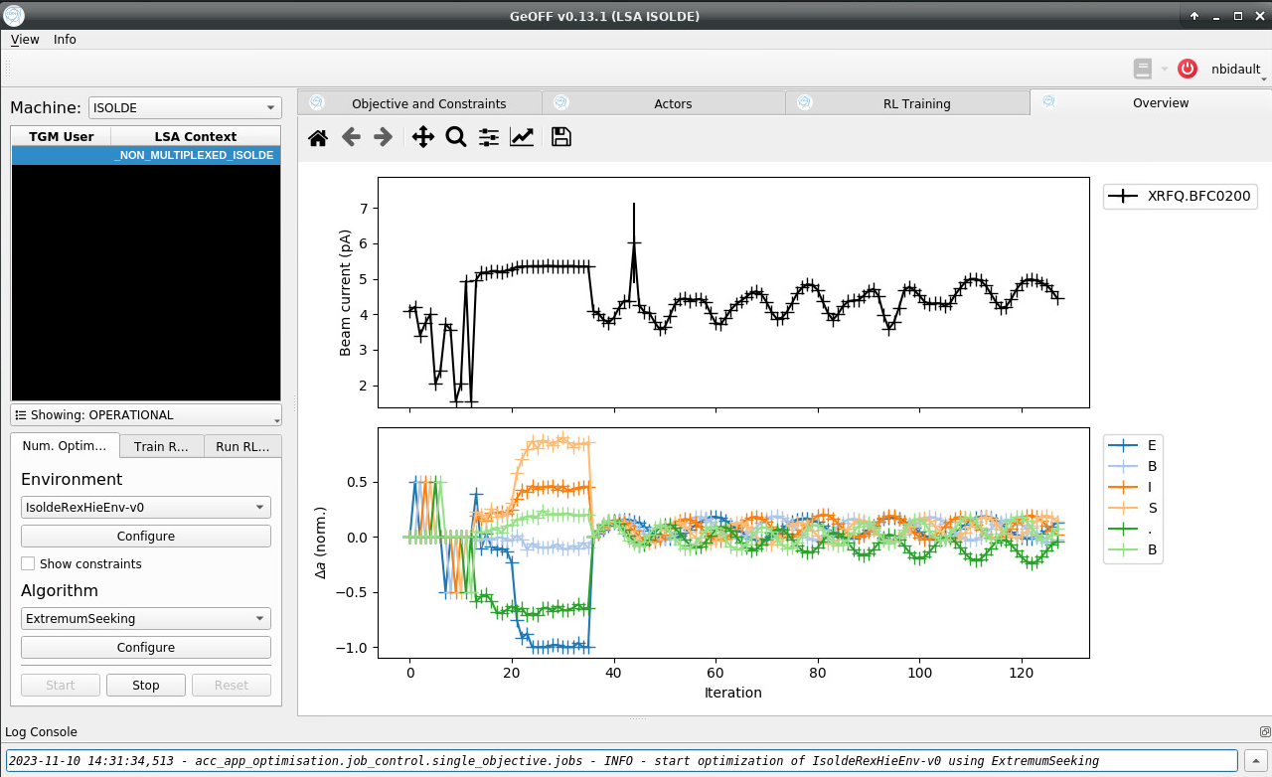
Other projects: GeOFF Optimizer
GeOFF developed by BE-CSS-DSB
Implementation at ISOLDE
  Communication with pjlsa
  All optics of REX/HIE-ISOLDE
  OFFLINE and OFFLINE2
  Pulsed devices (functions)
Detectors
  Faraday-cup
  Wire-scanners
  Wire-grids
Objective functions
  Max Intensity
  Symmetric beam
  Find waist
  Beam positioning
Wiki: https://wikis.cern.ch/pages/viewpage.action?spaceKey=RBS&title=GeOFF+manual+ISOLDE+and+Offline
Averaging to smooth out beam/machine instabilities
BOBYQA (Bound Optimization BY Quadratic Approximation)
Extremum-seeking algorithm
Other projects and conclusion

Slide 21
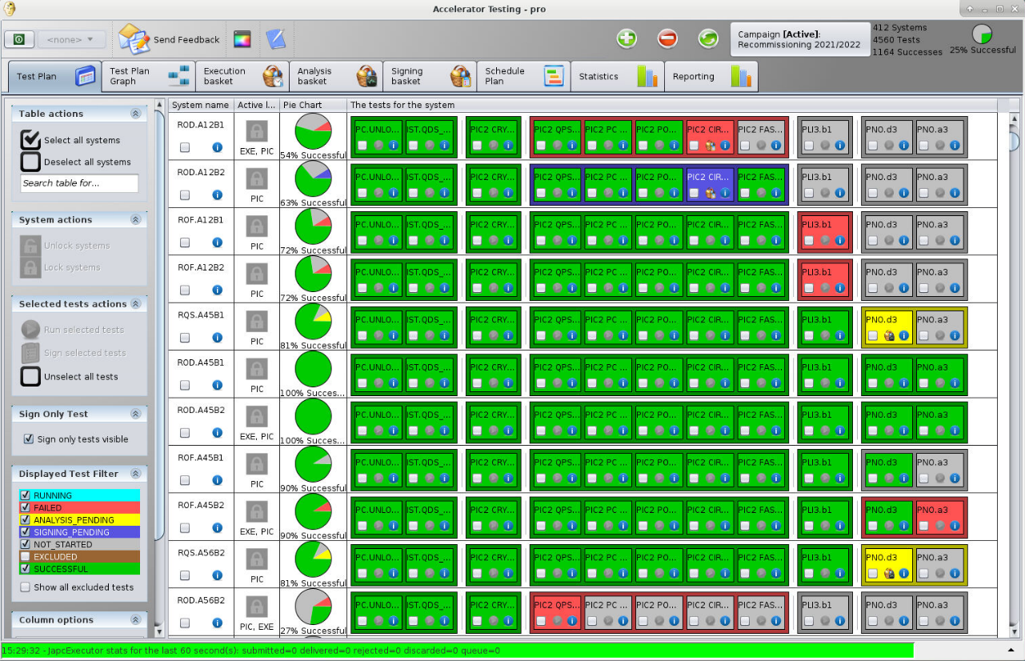
Other projects: OP-TM and Hardware Commissioning
OP-Technical Meeting co-chair, representing ISOLDE
  UCAP
  References
  SIS, FESA snap, announcer, etc.
Hardware Commissioning
  Orchestration with AccTesting (TE-MPE)
  Sequencers
  Reporting tools
Objectives
  Extend the use of AccTesting across the accelerators
  Facilitate the test completion, analysis, and reporting
  Better follow-up on the equipment performance
At ISOLDE
  Start familiarising with AccTesting during the 2024 HWC
  Establish a consolidated wish list of devices to integrate
  Be ready to use the new AccTesting version after LS3
https://mpe-cb.web.cern.ch/projects/acctesting/
Other projects and conclusion
Notes:
I was at the interface between OP and MPE
For the moment it is only by LHC-OP during the powering of their magnets
Gather the needs from OP
Make sure MPE has all the information they need
Refonte during LS3

Slide 22
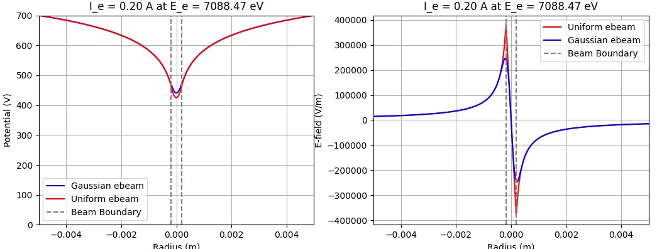
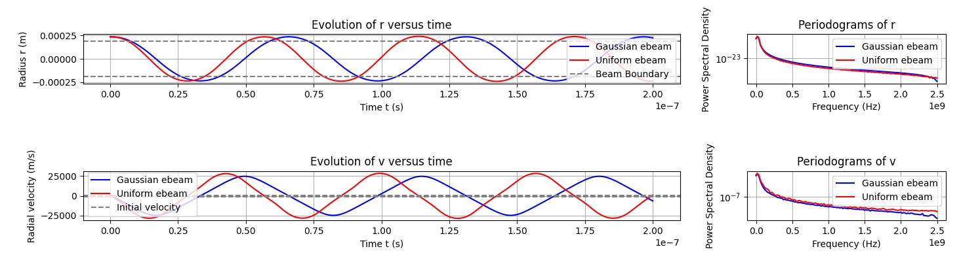
Other activities
EBIS studies with Fredrik Wenander (BE-ABP-HSL)
        Python code the ion dynamics inside an arbitrary electron beam
        Python code to study plasma instabilities using the dispersion relation
        Characterization of the REXEBIS electron gun performance and residual gas composition
        Review of the diagnostic tools for charge-breeders: Rev. of Sci. Instrum. 93, 021101 (2022)
Facilities Operation Meeting former scientific secretary and new PS-CSAP secretary
Documentations and wikis for GLM/GHM beam sweeping application, the Scripting tools, GeOFF optimiser and the Allison scanners
Other projects and conclusion

Slide 23
Conclusion
Beam optics elements for future ISOLDE upgrades
    CAD models of multiple elements - and beam transfer matrix equivalents using CST
    Beam dynamics simulations with COSY infinity to optimise key design factors
    More accurate modelling of the dipole magnets requires CAD models
    Different options of arrangement inside the building
Emittance measurements
    Measurement at the end of the RC6 line
    Characterization of plasma and surface ion sources with varying operational parameters
    More insights into beams produced with lasers require moving the Allison scanners
Conclusion

Slide 24
Thank you for your attention

Slide 25
…and thank you for 8 wonderful years at IS♡LDE

