Slide 1
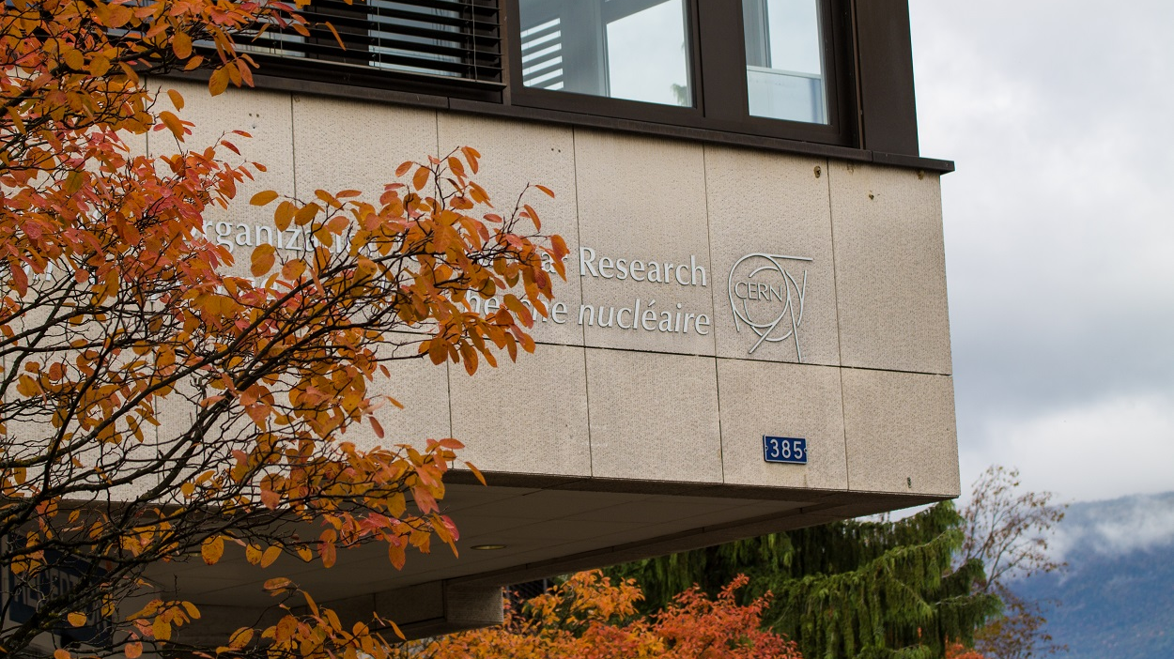
98th ISOLDE Collaboration Committee meeting -
INTC summary
Schedule for 2023 and restart in 2024
Feedback from runs 2023
TISD report
HIE-ISOLDE issues
Picture credits: Raffaele Salvemini
Hanne Heylen, material from Joachim Vollaire, Erwin Siesling and Mia Au

Slide 2
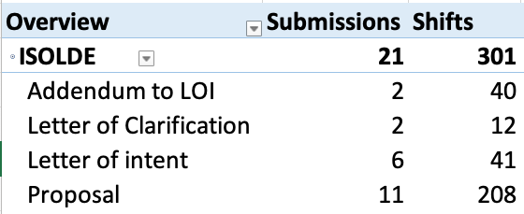
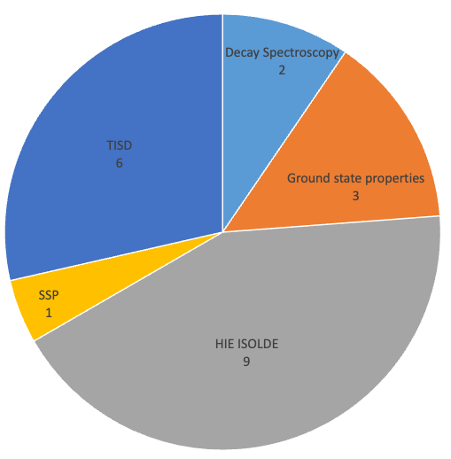
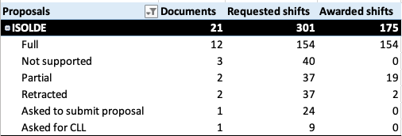
INTC 74 summary (ISOLDE only)
Submitted documents per subject area

Slide 3
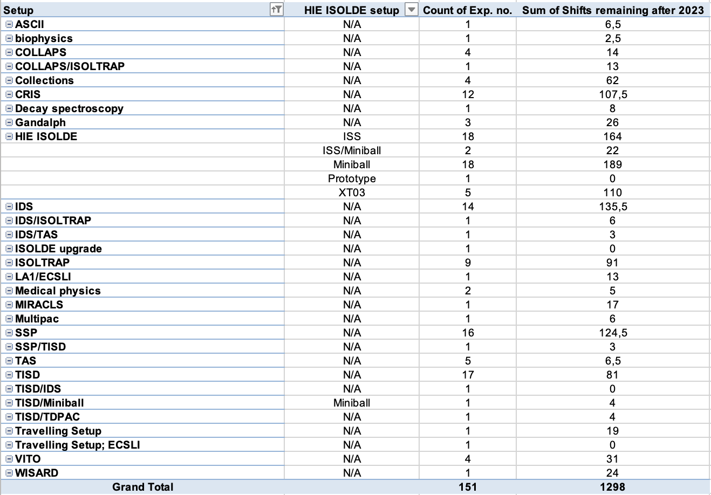
Experimental shifts on the books
HIE-ISOLDE:
485 shifts (out of 1298 total) → ~40%
Includes:
outcome of INTC74 (Nov2023)
Preliminary shift counting for 2023

Slide 4
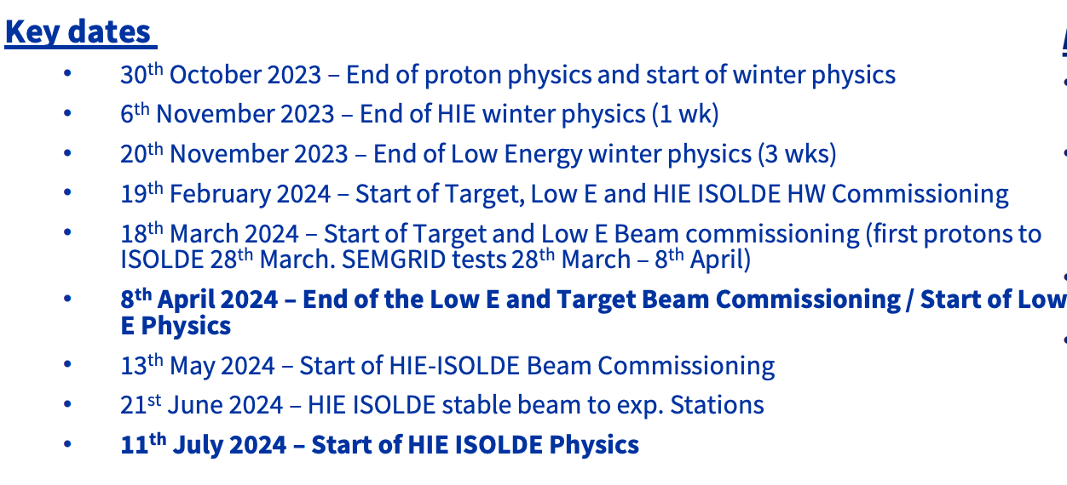
Yearly Technical Stop (YETS) and 2024 Restart
28th October 2024 – End of protons

Slide 5
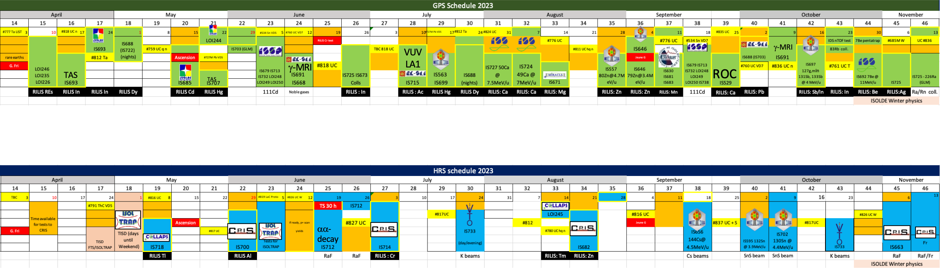
ISOLDE schedule 2023
Protons for physics to ISOLDE from 10 April – 30 October
→ 20% less than 2022 due to energy considerations
HIE-ISOLDE: 21 July
Winter Physics: 30 Oct.
59 scheduled experiments
  10 HIE-ISOLDE experiments
470 shifts for physics and beam development
  122 HIE-ISOLDE shifts
Most runs were at least partly successful (few issues from machine and target side but also from experimental side)
Busy Winter Physics programme, 3 targets were irradiated cold October + external Ag sample from PSI

Slide 6
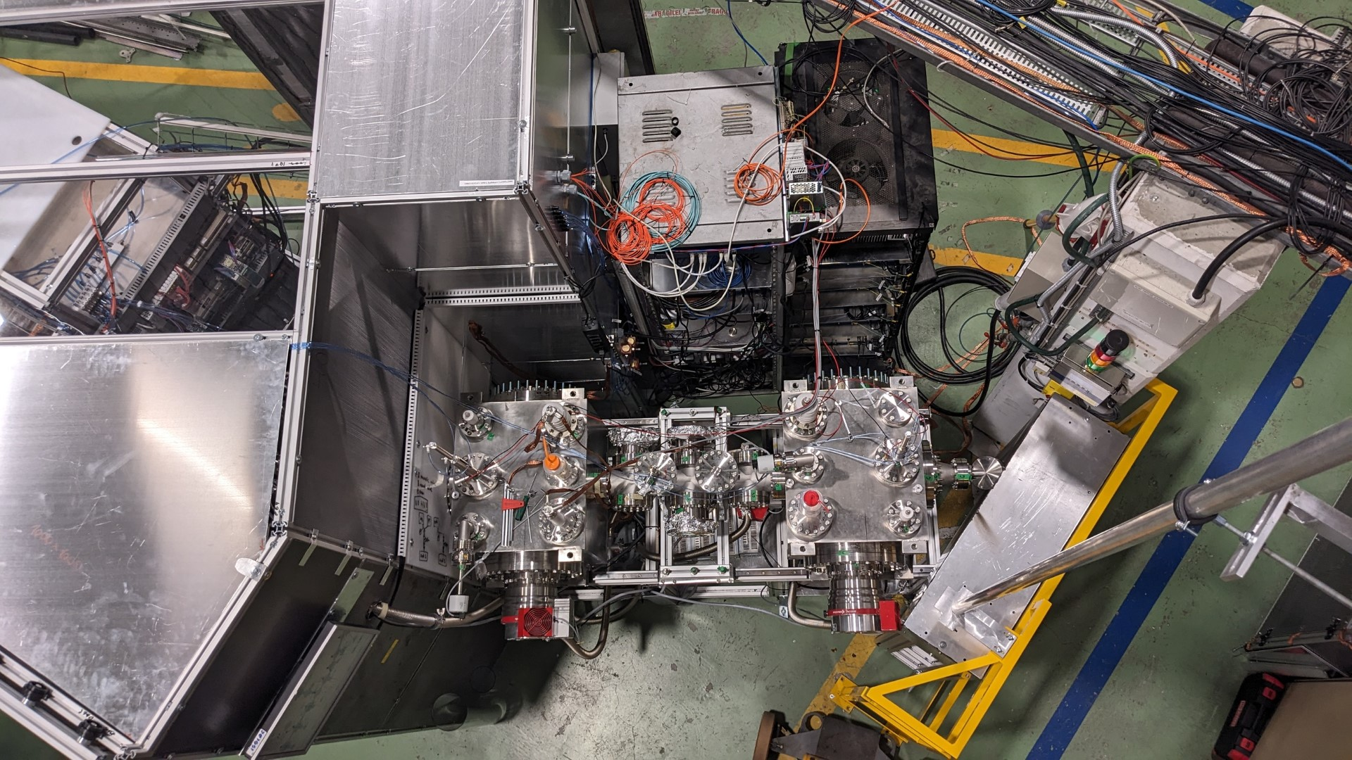
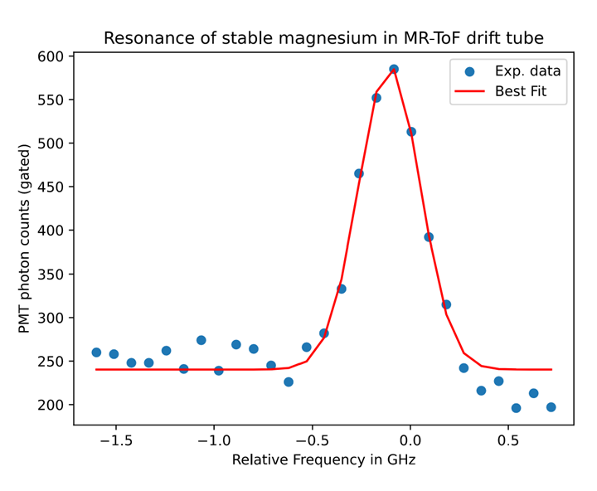
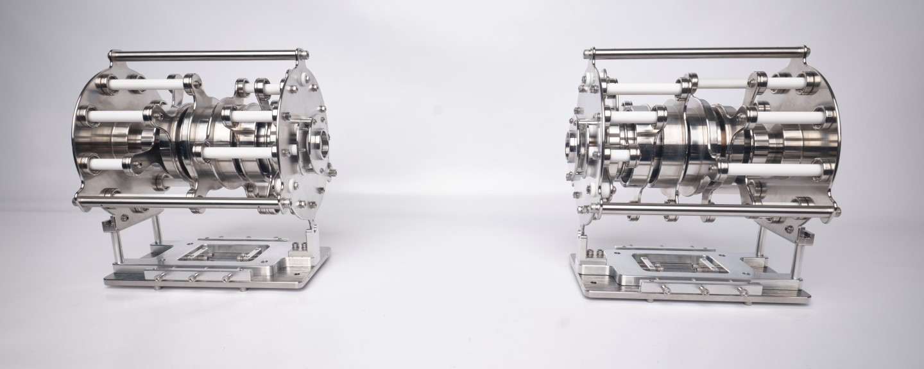
Feedback from runs
Material provided by Simon Lechner
MIRACLS
New MIRACLS setup fully operational for the first time
Trap ions in MR-ToF for 16 revolutions
First CLS spectra of 26Mg from ISOLDE

Slide 7
Feedback from runs
Material provided by Louis Lalanne
CRIS
Setup
Upgrade of the end of the beam line: beam transport efficiency toward the ion and particle detectors improved by a factor 4.
Installation and commissioning of the CRIS decay spectroscopy station: tape system synchronised with lasers and ion release. Allows to perform decay assisted laser spectroscopy and decay spectroscopy with isometrically purified beams. System commissioned successfully with 75Zn during the Zn beam time.
Physics
High res. 29-34Al, charge radii across N=20 in the island of inversion
High res. 80,81,82Zn, Charge radii across N=50 and moments of N=51 in the vicinity of 78Ni
High res. 50-62Cr. Charge radii and moments from N=28 to N=40 entering the N=40 island of inversion
Low ress of 221Fr. New states discovered. Successful preparation of the 2024 run.
Low and high res. of 226,225RaF. New state discovered. Pin down the rotational constants of 225RaF (maybe more in the next few days!)

Slide 8
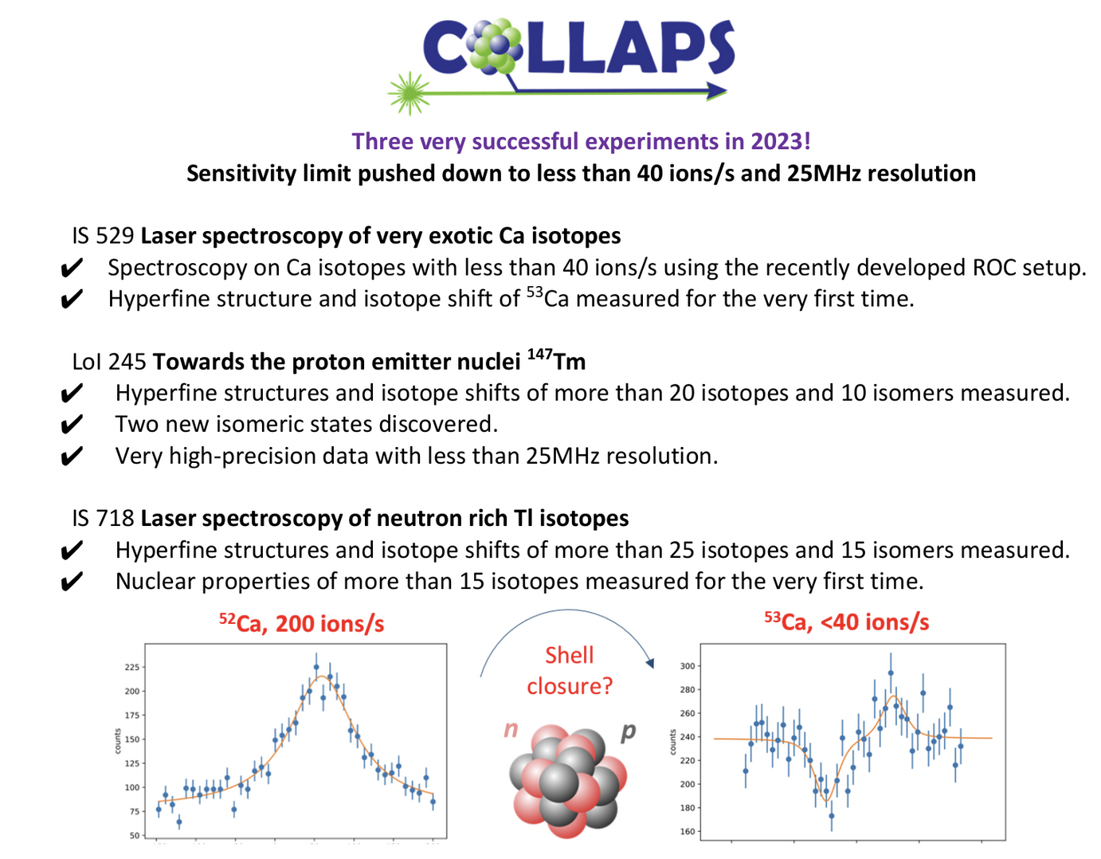
Feedback from runs
Material provided by Liss Vazquez-Rodriguez

Slide 9
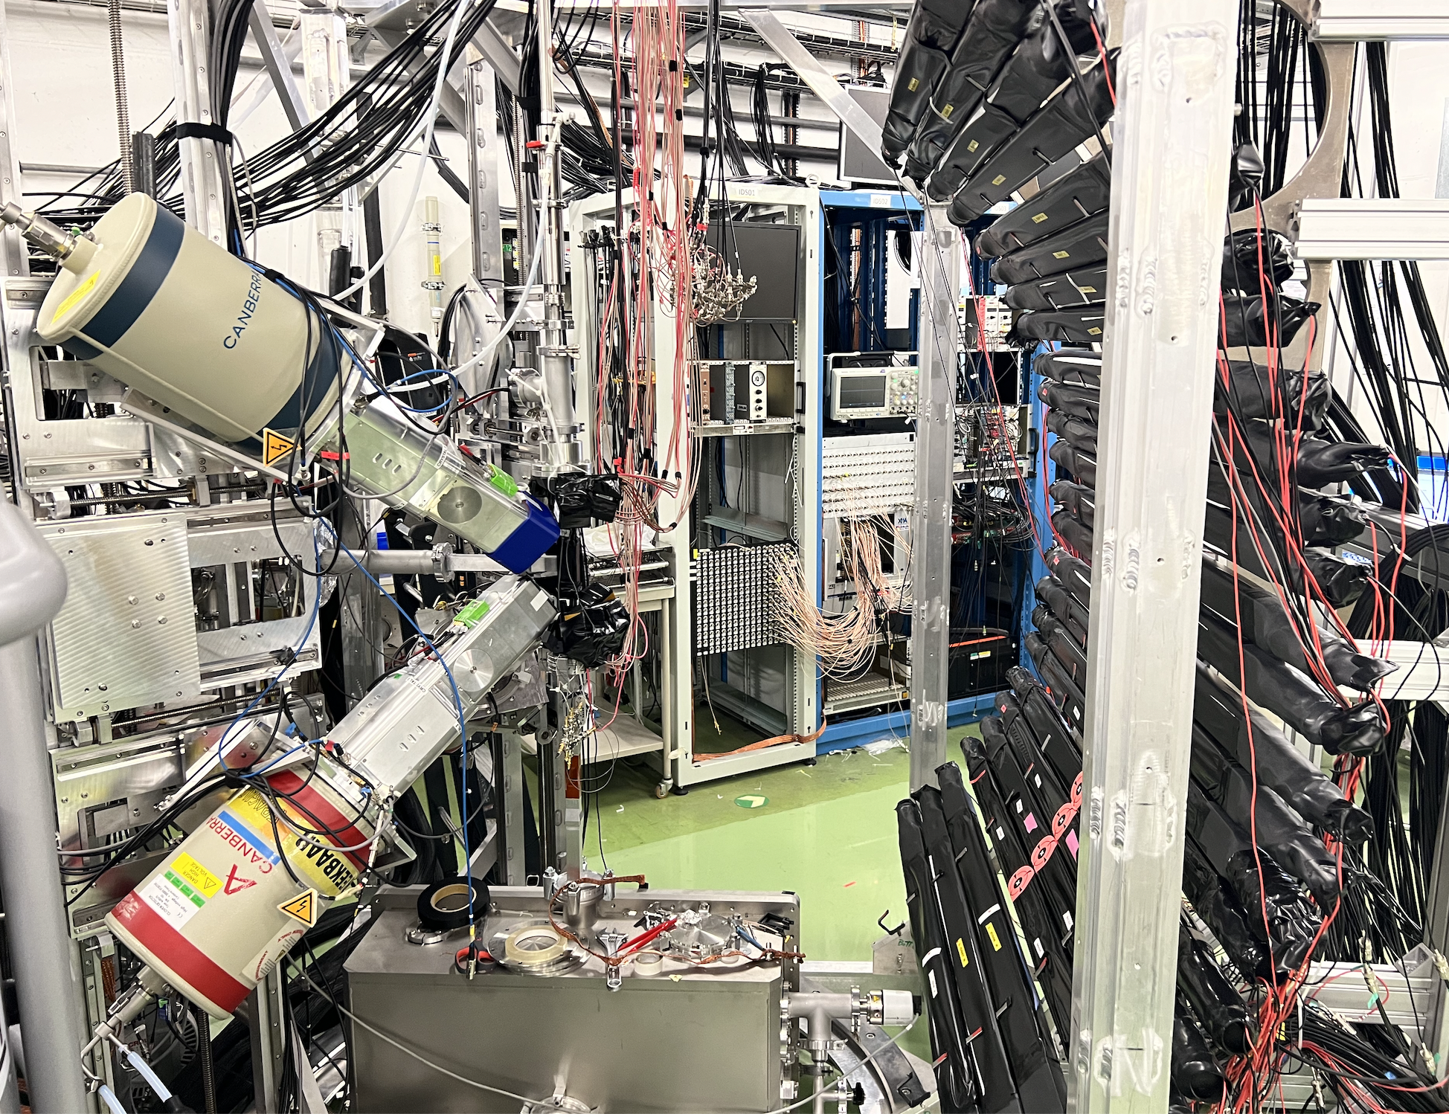
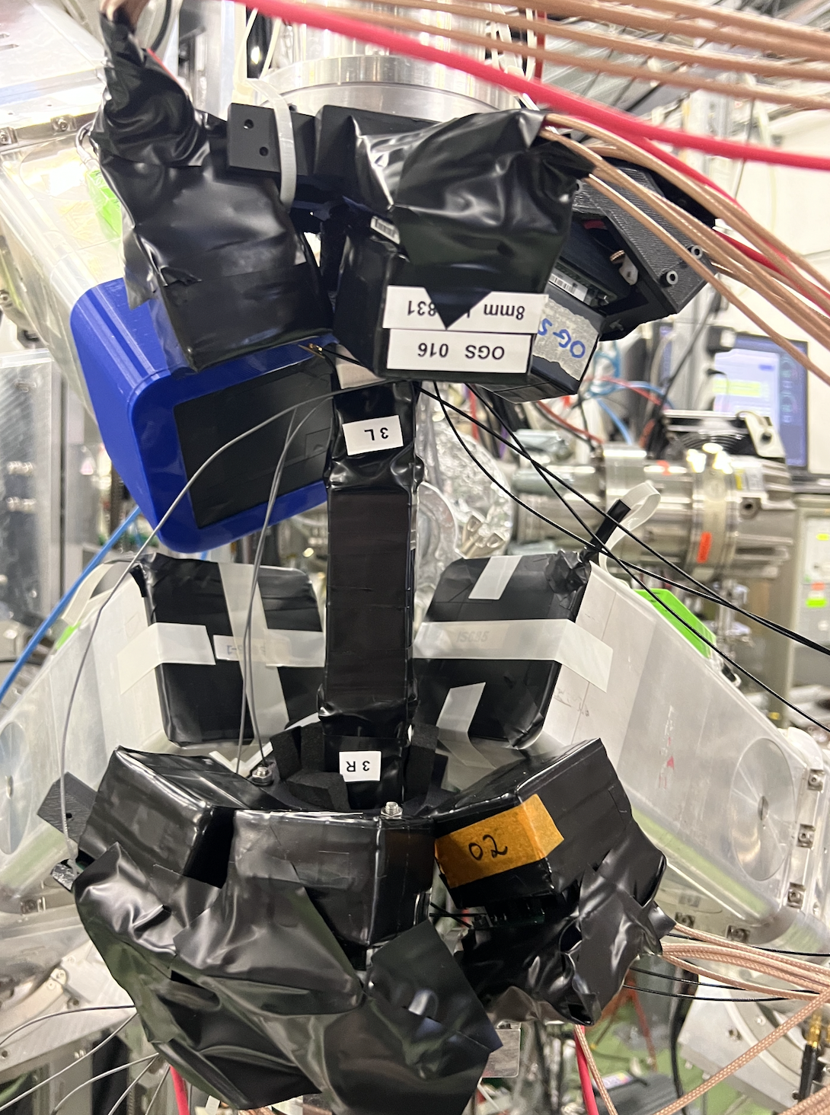
Feedback from runs
Material provided by Zixuan Yue
IDS
Test run for IS702
132-135In neutron decay measurements
Setup
  Installation of 6 new OGS detectors
    Low-energy neutrons + higher efficiency
  INDiE bars
  4 clovers for gammas and 3 beta detectors
Ad-hoc 29-31Na experiment as VITO replacement
Ready for neutron spectroscopy campaign next year!

Slide 10
Feedback from runs
Material provided by Juliana Schell
SSP
Successful commissioning of MULTIPAC setup (currently installed in b. 275):
  Hardware is fully operational, including detectors
  Good energy resolution (2.8% for 60Co)
  At the moment, poor time resolution (10 ns), working on improvements to reach 220 ps
    Limited to simple magnetic elements so far
  Ready for online installation in 2024
Tested new emission Mossbauer setup

Slide 11
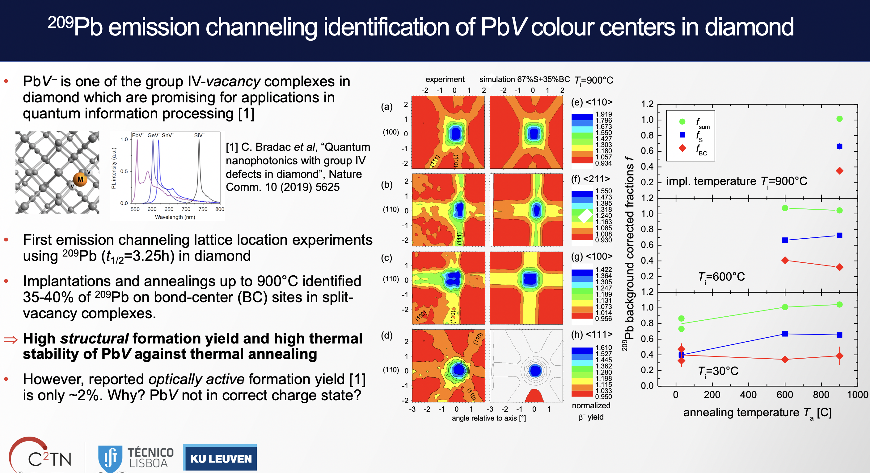
Feedback from runs
Material provided by Uli Wahl
SSP

Slide 12
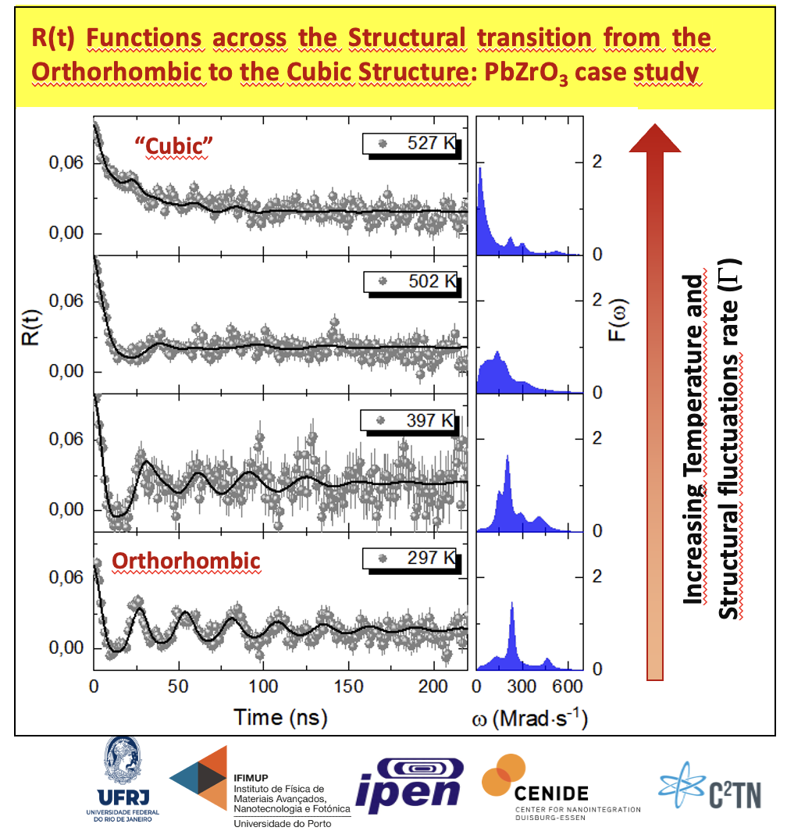
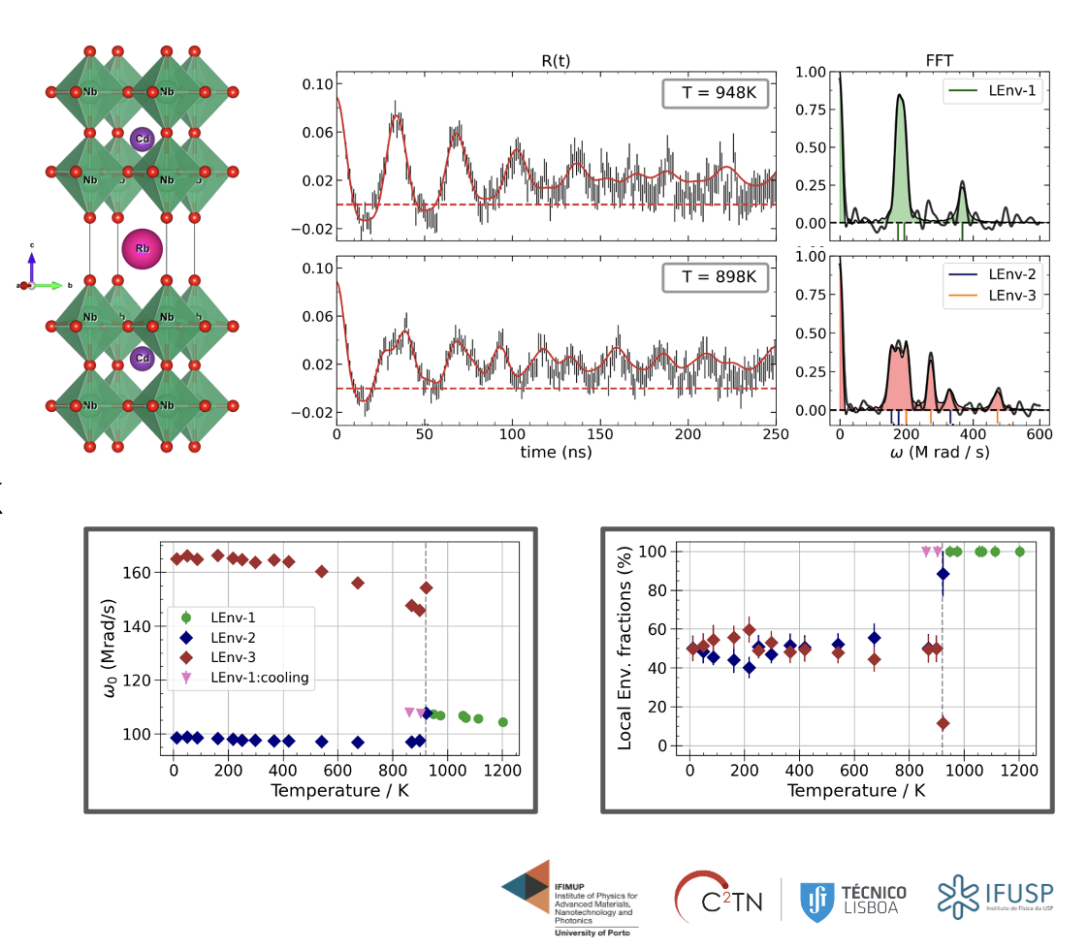
Feedback from runs
Material provided by Pedro Rodrigues
IS730 - ^{111m}Cd Perturbed Angular Correlation (PAC) Study of Dynamic Order-Disorder Structural transitions in Halide and Oxide Perovskite Systems
IS738 ^{111m}Cd Microscopic insight by nuclear hyperfine methods on ferroic Perovskites
new 1st order phase transition at 920K

Slide 13
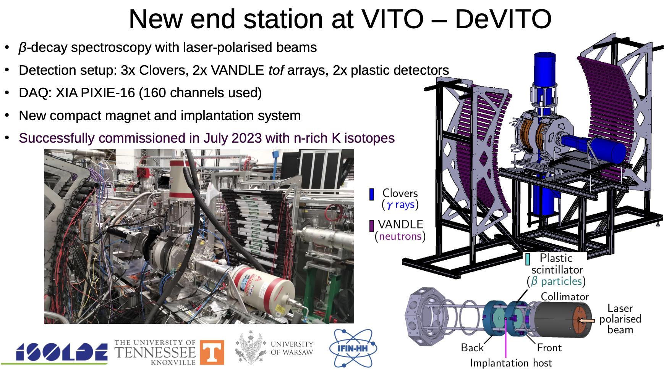
Feedback from runs
Material provided by Monika Piersa-Silkowska

Slide 14
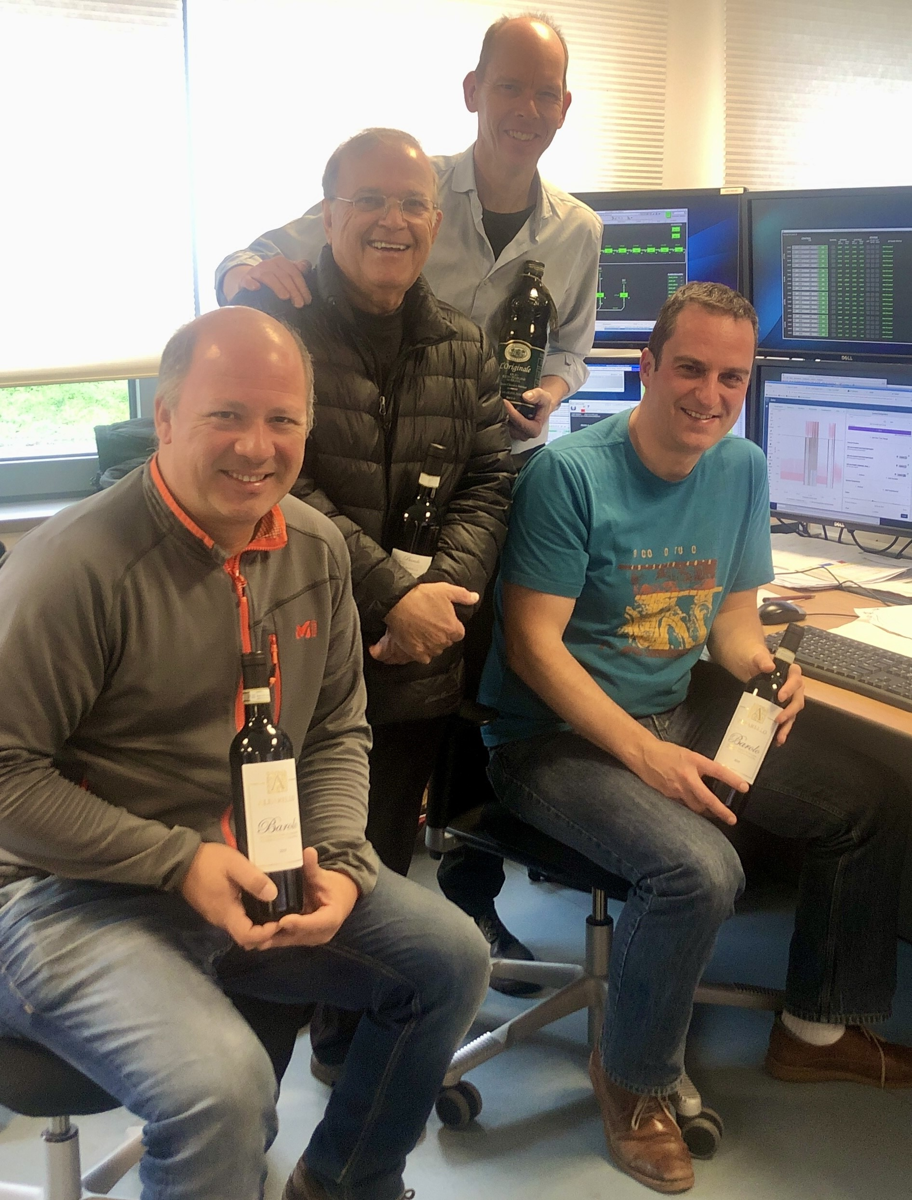
Feedback from runs since last ISCC
Material provided by Patrick Macgregor
ISOLDE Solenoidal Spectrometer
3 successful runs
IS692
7Be(d,p) @ 11 MeV/A to populate high-lying rotational bands in 8Be
“ISOLDE is the only facility that can provide the necessary yield and energy” → Happy users
Winter Physics (less influence of 7Li contamination)

Slide 15
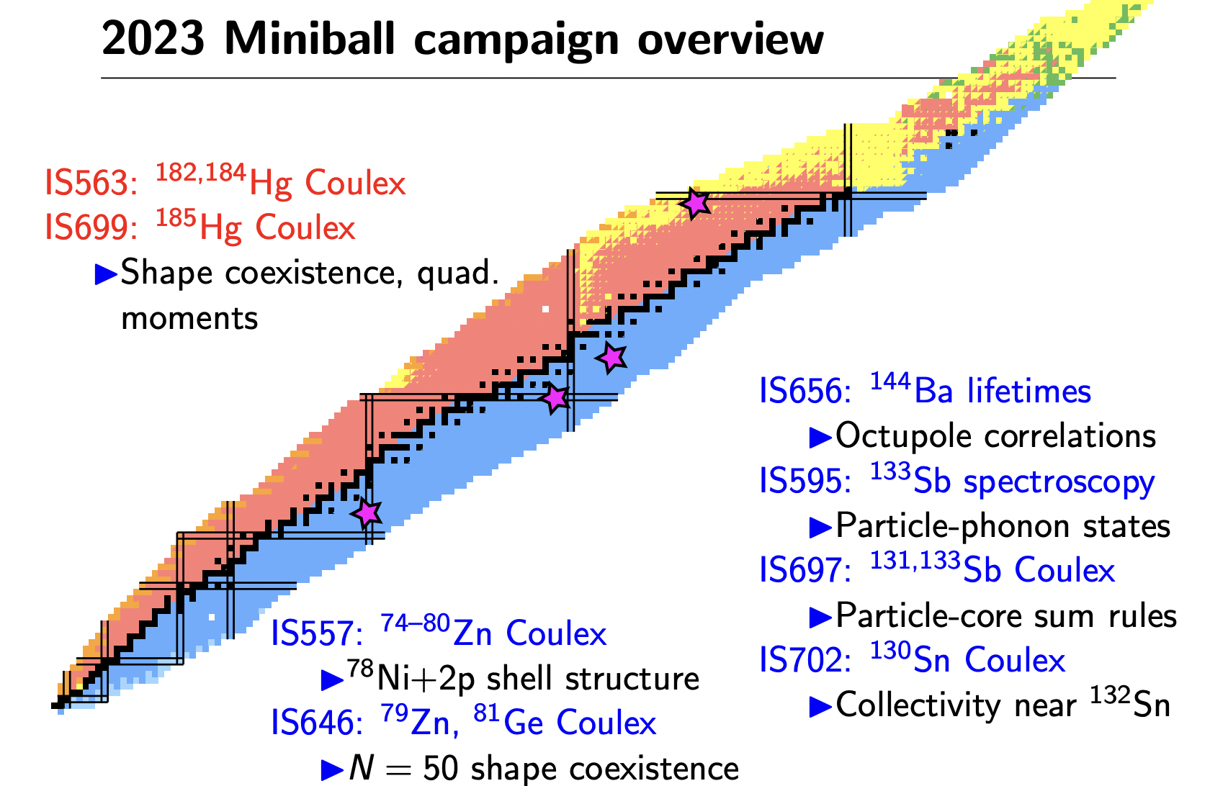
Feedback from runs
Material provided by Frank Browne
3 mass changes; not compatible with working hours
Smooth SnS
Production ☺
Many target problems ☹

Slide 16
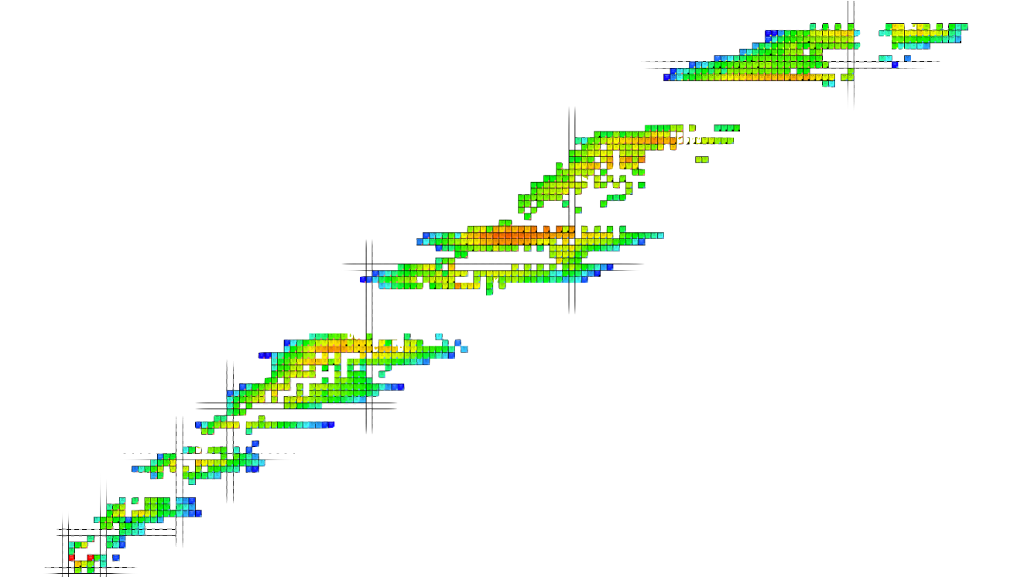
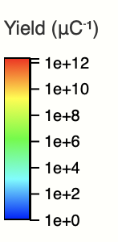
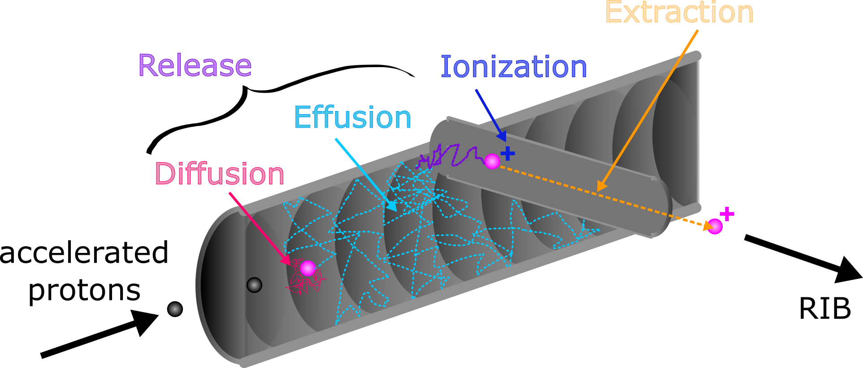
TISD challenges
Refractory properties
Contamination
Yield and purity

Slide 17
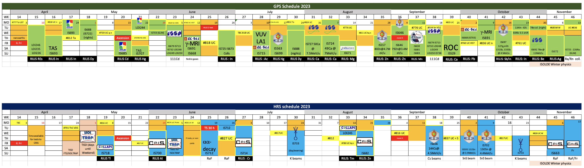
TISD 2023
Material provided by Mia Au
Back-of-line heating:
Dy collections
Yield measurements, proton scans, setup
LIST: actinides
Batch mode: Ra → Ac
LIST: lanthanides
Prototype hot quartz: CRIS Zn
SnS
Prototype target +
prototype ion source:
ISOLTRAP Cd
ThC_{x} VD5+CF₄
RaF online + winter physics
now standard beam

Slide 18
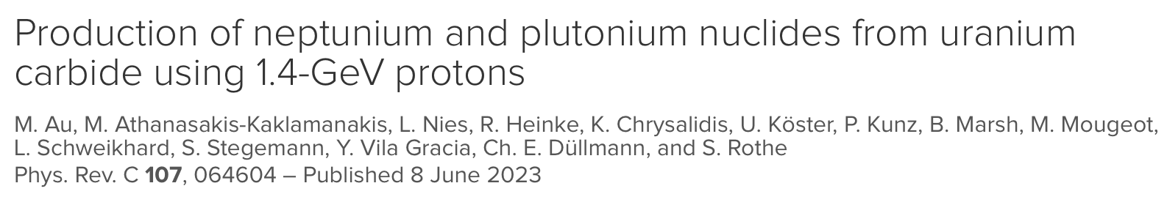
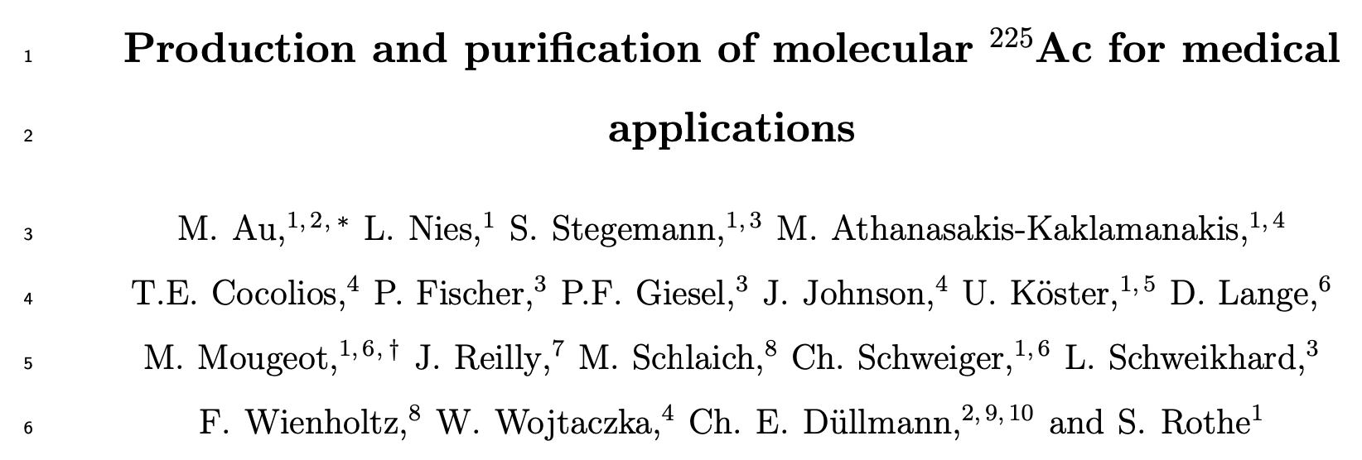
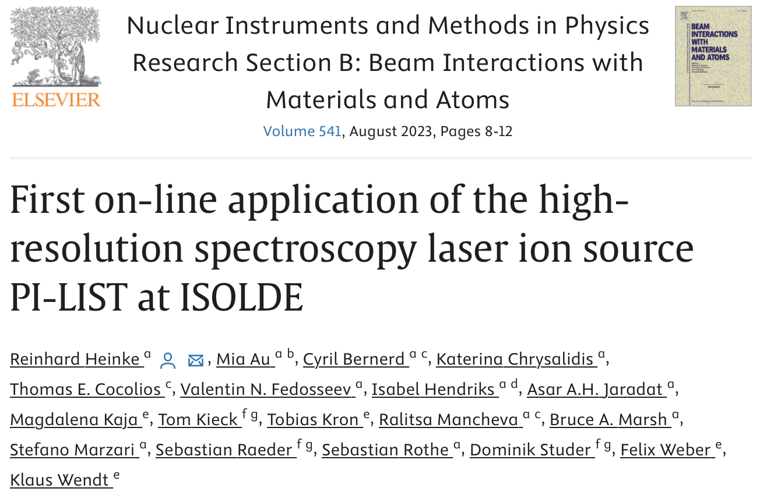
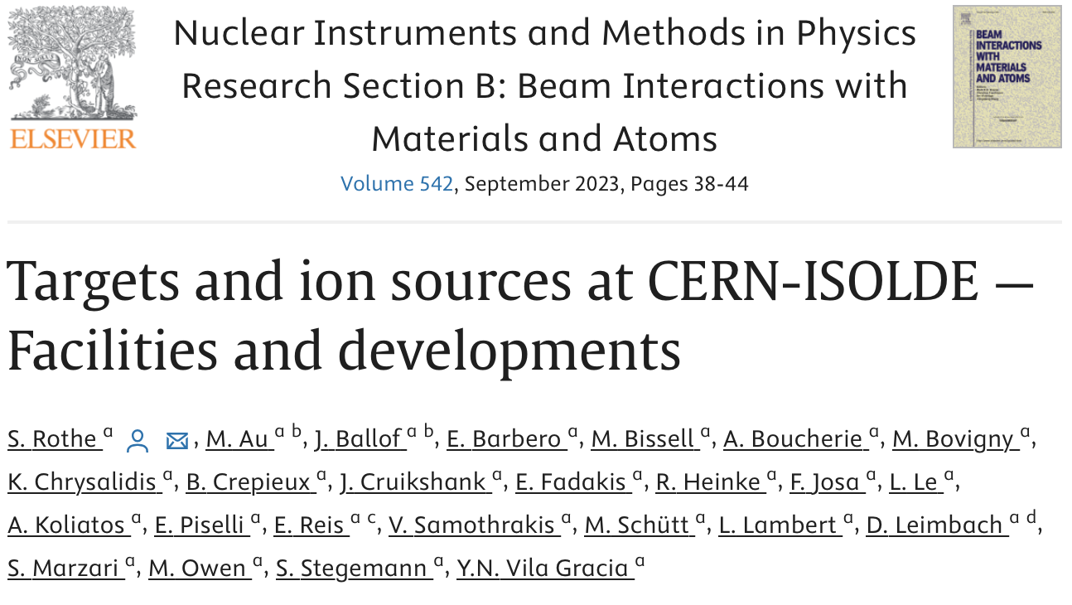
TISD highlights
New elements
  Np, Pu
New molecules
  AcF_{x}
New targets and ion sources
  Thermal screening
  Back-of-line heating
  LIST
In preparation

Slide 19
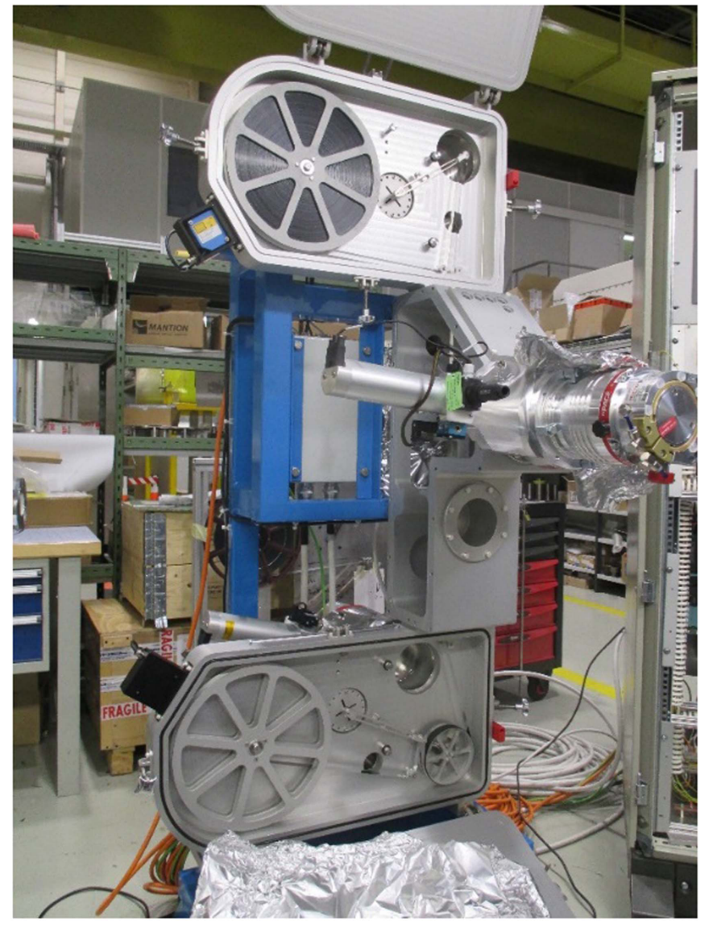
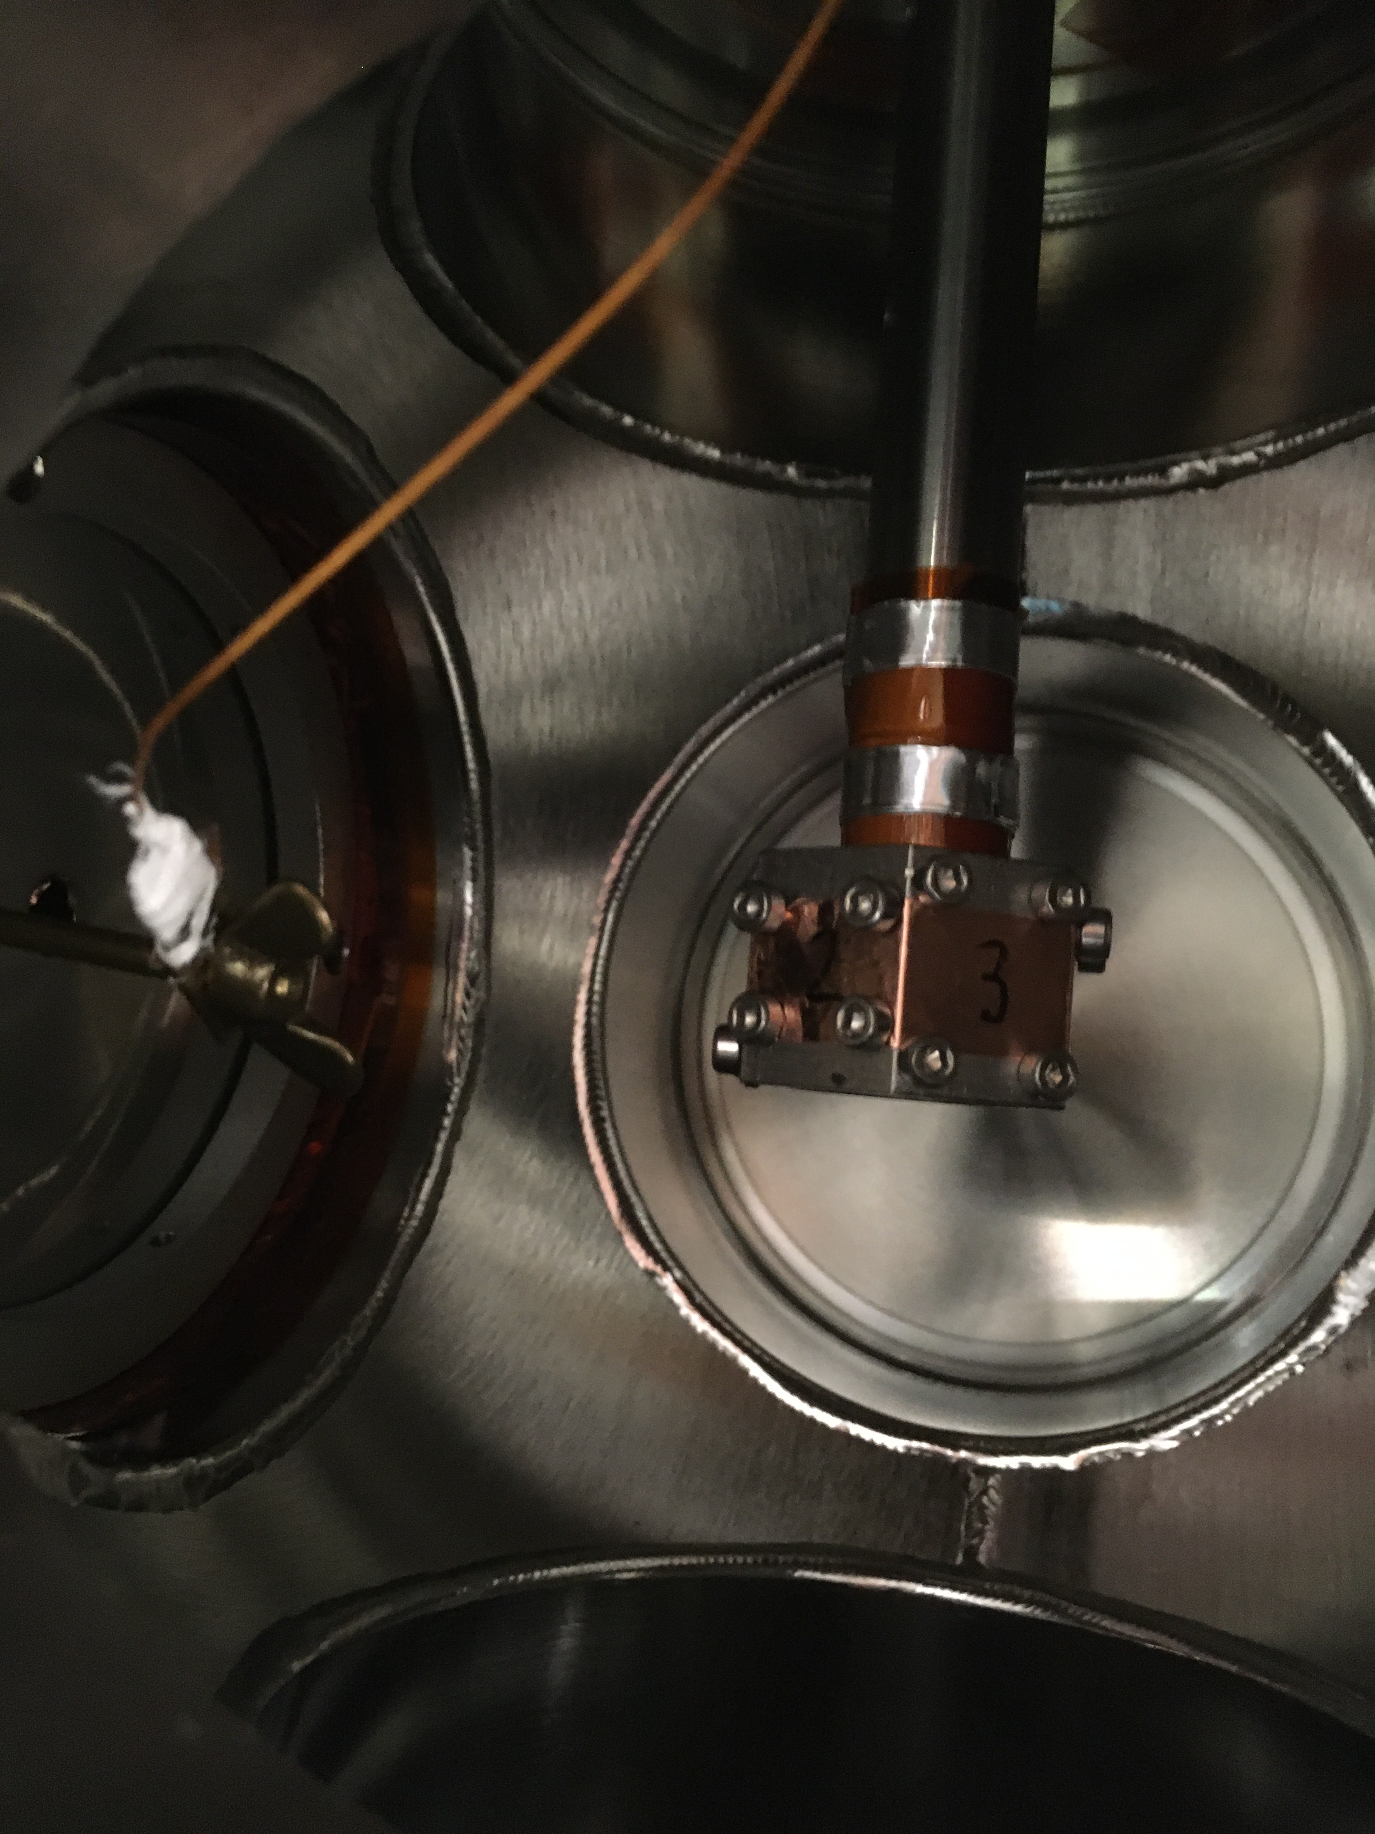
TISD beamtime
target
Contaminant ions
Catherall, R. et al. (2017) J. Phys. G. 44, 9
ISOLDE FTS
Ion source
p+
Contaminant neutrals
Extraction electrode
Ion beam
Isotope of interest
In-beam detector
β
Neutral molecule of interest
β
β
Molecular ion of interest
4-π
Reactive gas
ϒ
Ge
Buffer gas
ISOLDE HRS
Mass separator
ISOLTRAP
MR-ToF MS
ISOLTRAP
RFQ-cb
ISOLDE LA1
collections chamber

Slide 20
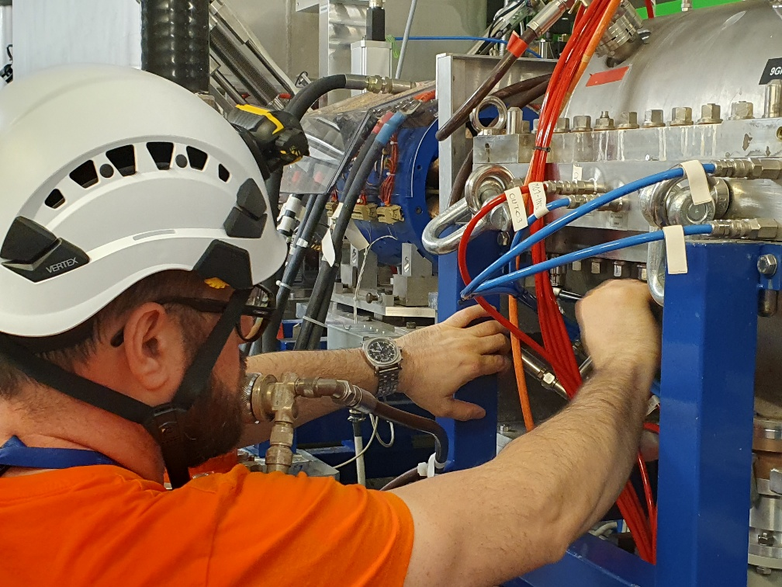
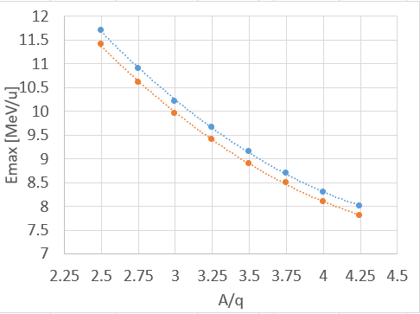

REX/HIE-ISOLDE issues
Issues with nearly all aspects of the post-accelerator
  REX low energy
  REX NC linac
  HIE SC Linac
    Problams with CM1 (cavity 2 and 5)
  Cryo
Close to zero commissioning time → no reference files → part of setting up machine
Planned experiments could be maintained
Machine development
  Investigation of using ISCOOL instead of REXTRAP in case of failure → seems promising
  New methods of rephasing the HIE LINAC in case of a failing or running at reduced gradient SRF cavity → reduce necessary rephasing time in case of issues (days → hours)
  Test to see if it is possible to run without CM1
9GAP vacuum leak: tightening the bolts
Cav 5 out of order:
Lower E versus A/q curve

Slide 21
98th ISOLDE Collaboration Committee meeting -
Additional slides

Slide 22
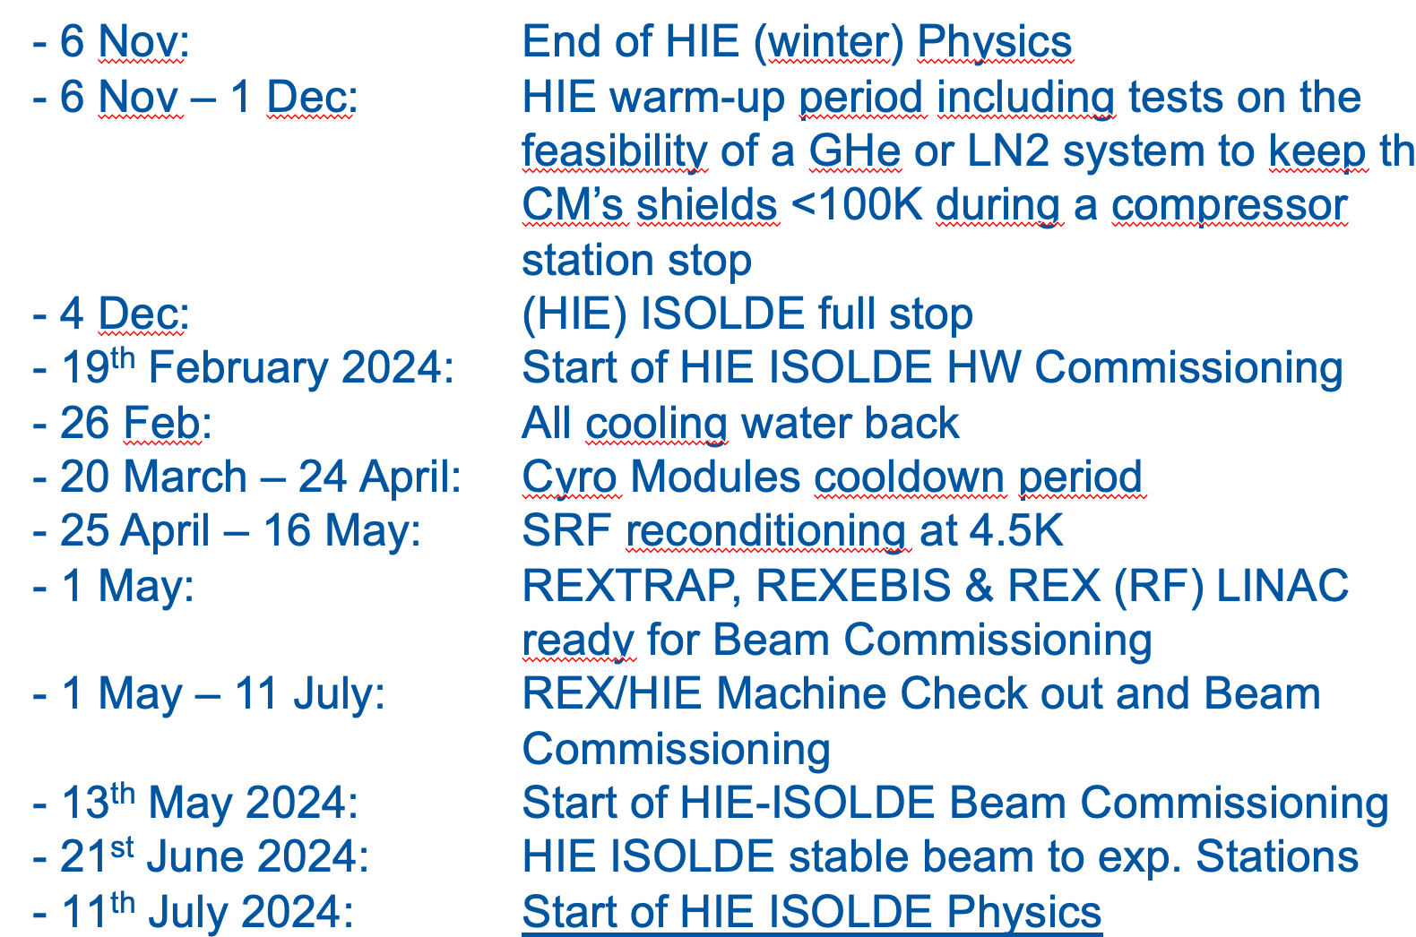
YETS activities
ISOLDE primary areas
Targets removal from the target area
Yearly maintenance of the two Frontends and handling systems
Consolidation of systems for targets coupling and un-coupling (several issues this year)
Replacement of HRSFC0600 Faraday Cup Scanner (mostly unused in ‘23 due to vacuum leak)
Exchange of beam dumps thermo-couples
Replacement of the two 30 years old SEMGRIDs in the proton beam lines (just before the targets)
BTY line survey (alignment checks) between the PS Booster side and ISOLDE target area.
Installation of fire detection in the GPS and HRS separator zones (interfaced to fire doors).
Installation of fan coil units to regulate the temperature in the HRS separator area (above 40 degree due to equipment thermal load and absence of fresh air supply).
HIE-ISOLDE

Slide 23
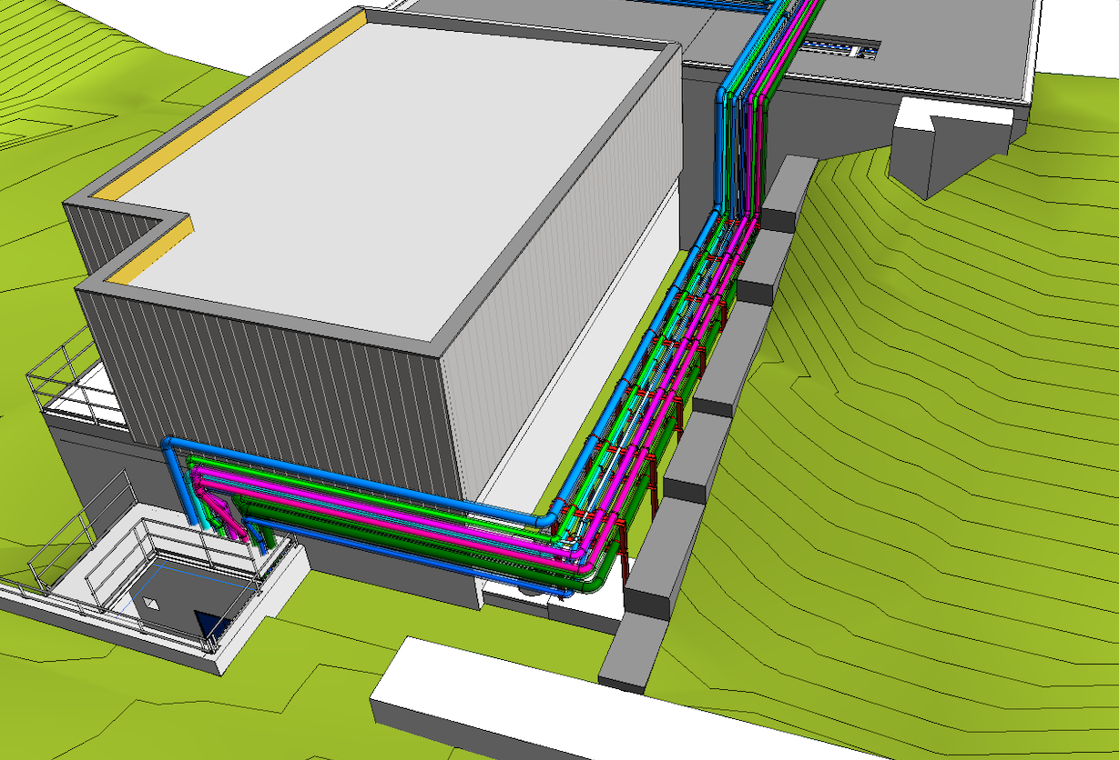
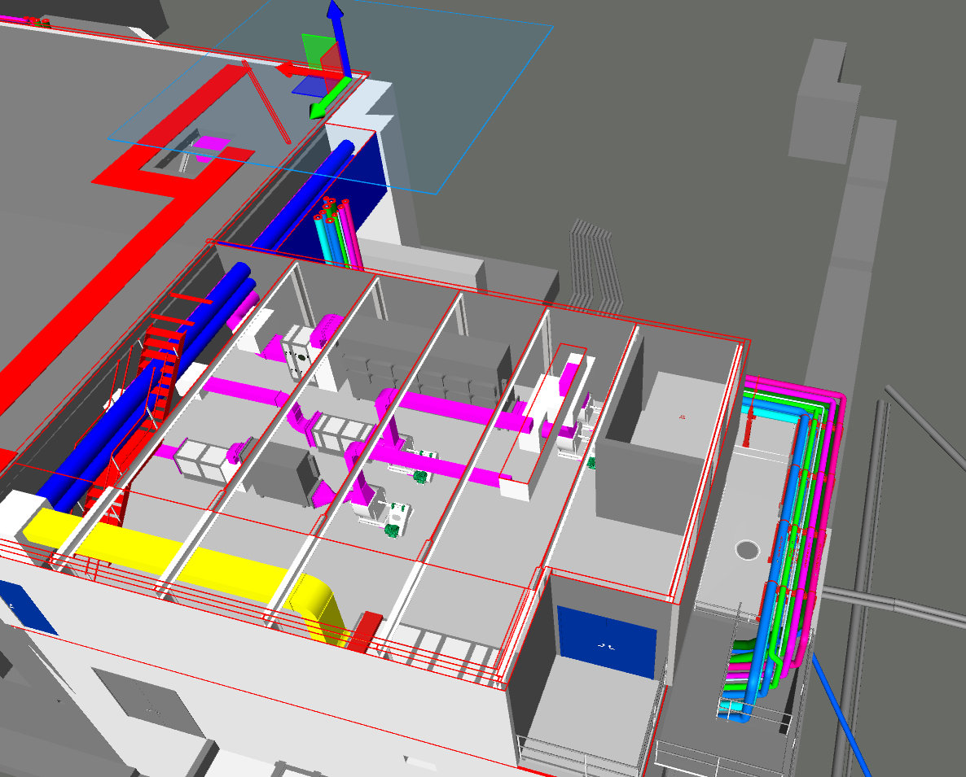
Preparatory work for Building 197 extension
Building 197 extension required close to the existing ventilation technical room (B.170 – 3-402) to modernize (safety) and upgrade the primary areas ventilation (fire dampers, charcoal filters…)
Work started on the 30/10 (just after the proton beam stop) and services running along the Building 197 will be relocated during the YETS to allow the building construction to start in 2024 in parallel to operation
Preliminary integration of ventilation equipment
Inside the new building
Future extension
Extension (B 197)
Shaft with ventilation ducts

Slide 24
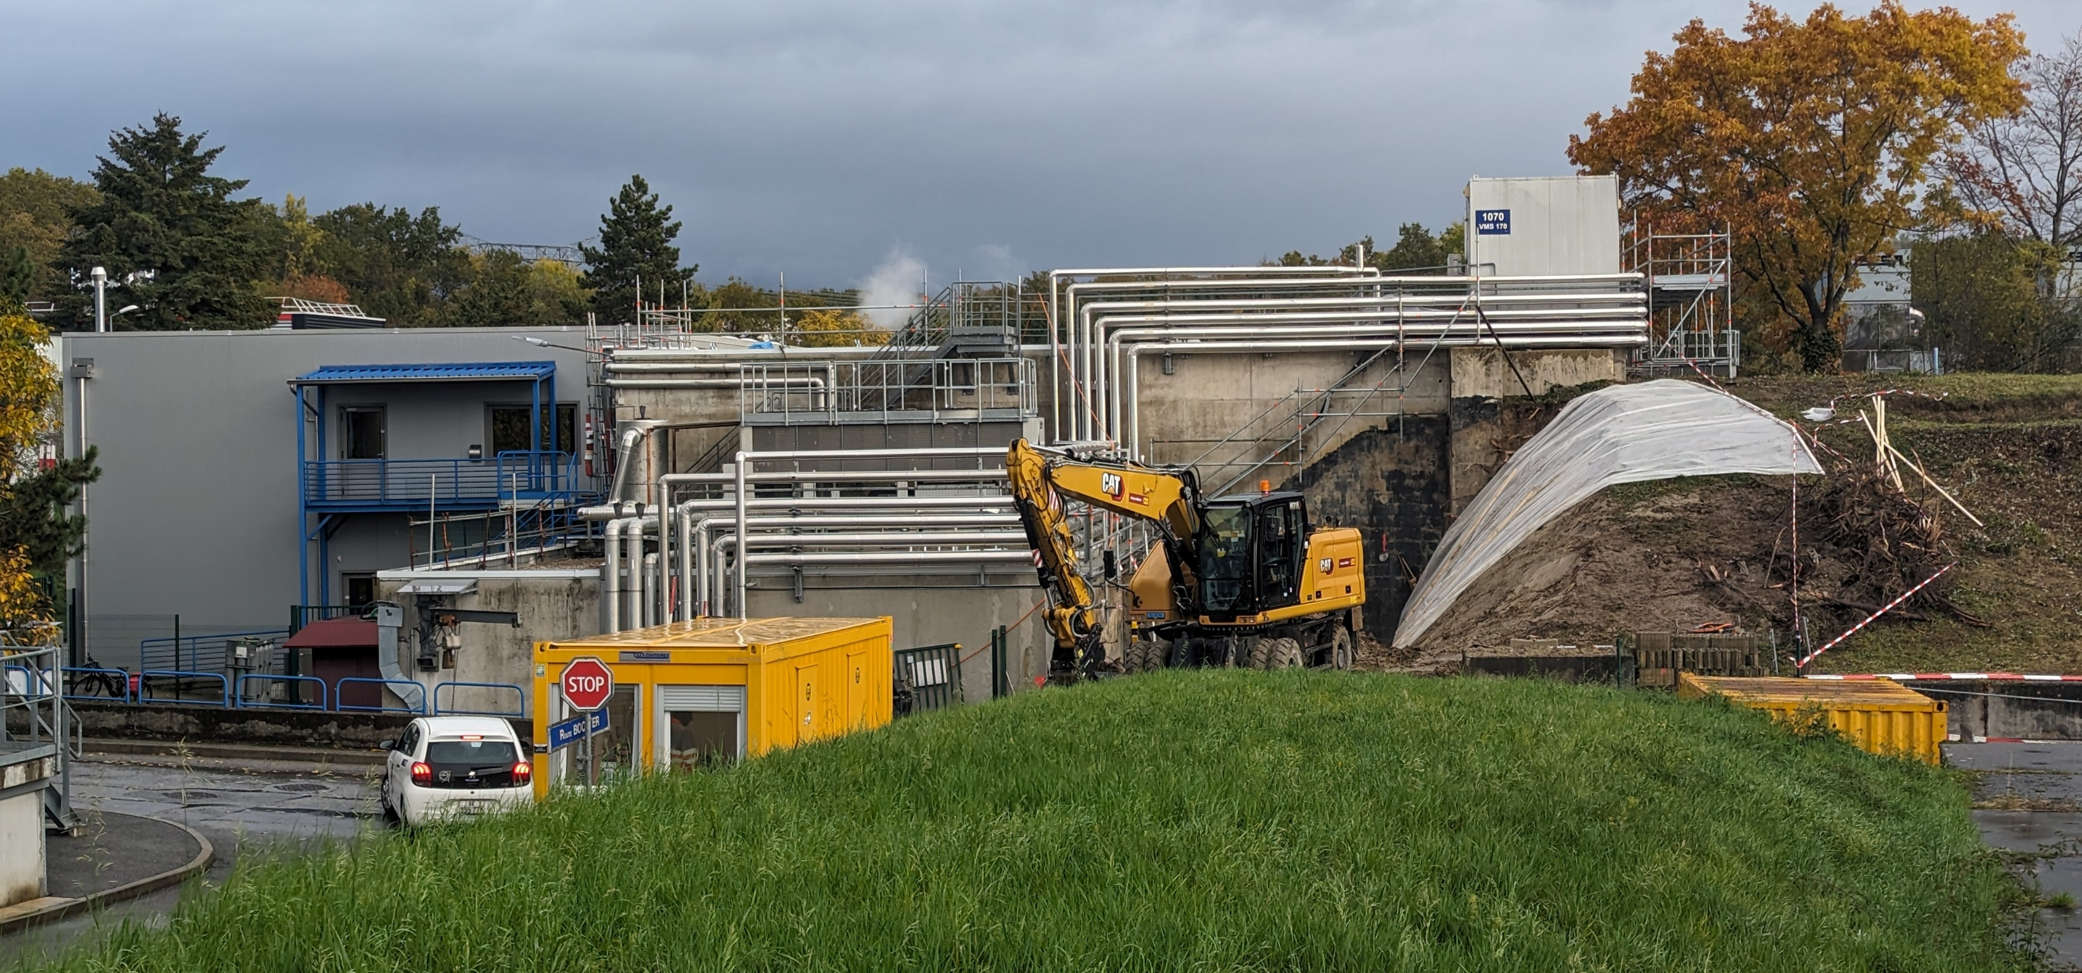
Worksite (situation on the 06/11/2023)
Soil removal has started to construct a new wall and concrete slab which will host a supporting structure for the different services currently running along Building 197
The chiller currently on top of Building 197 will be moved to the roof of the Building 199 during during the YETS
Final connection of the ventilation to the new process equipment will take place during LS3
Shaft with ventilation ducts
Water chiller
Services

Slide 25
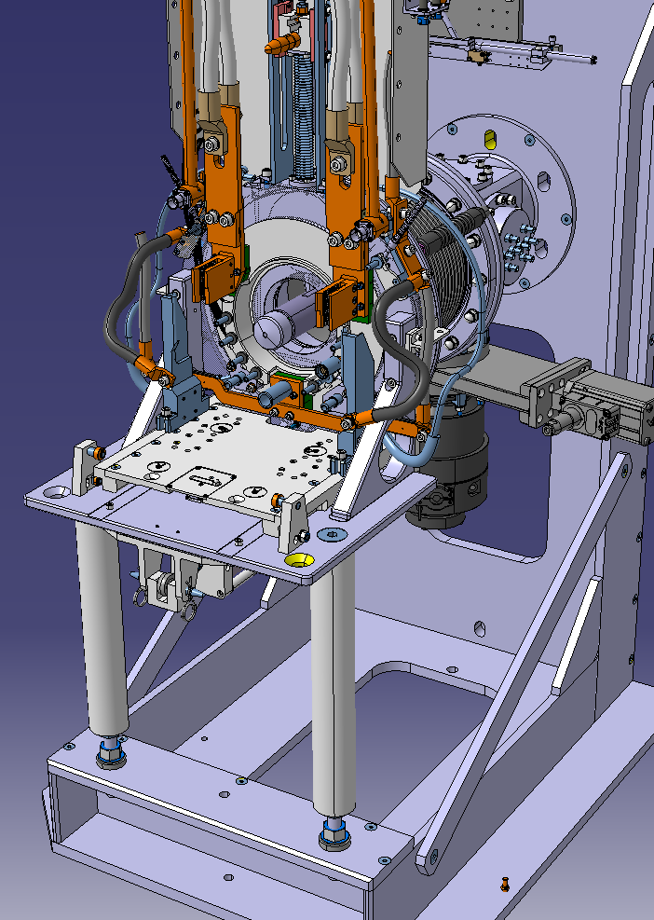
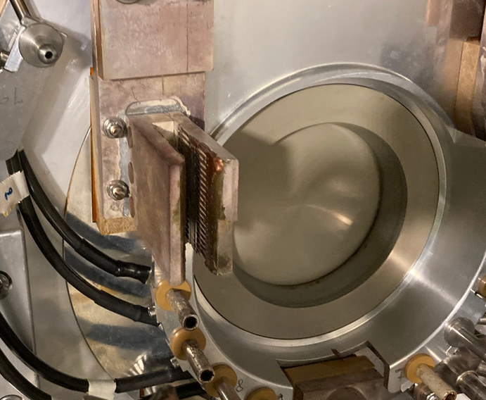
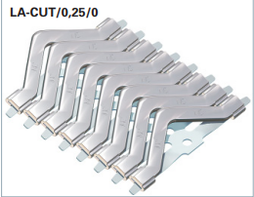
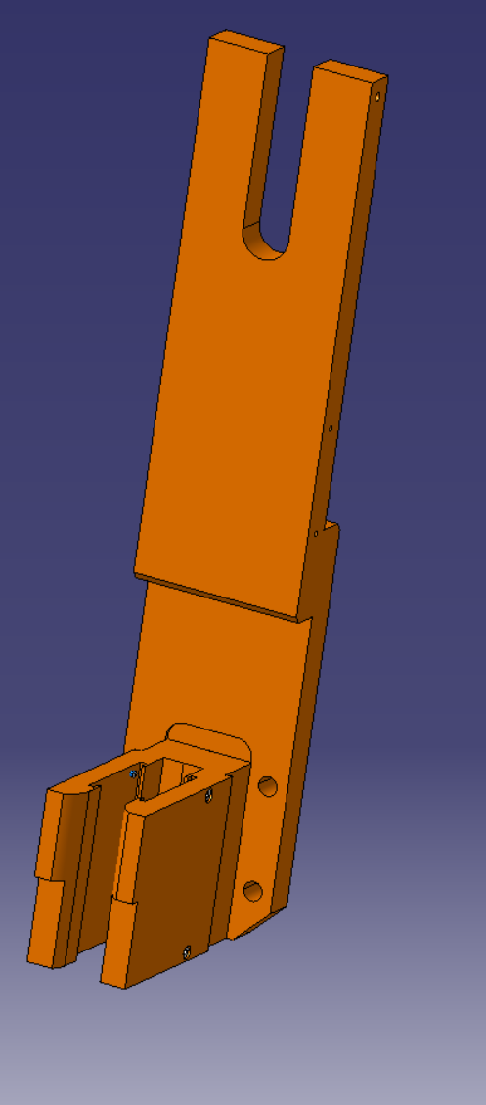
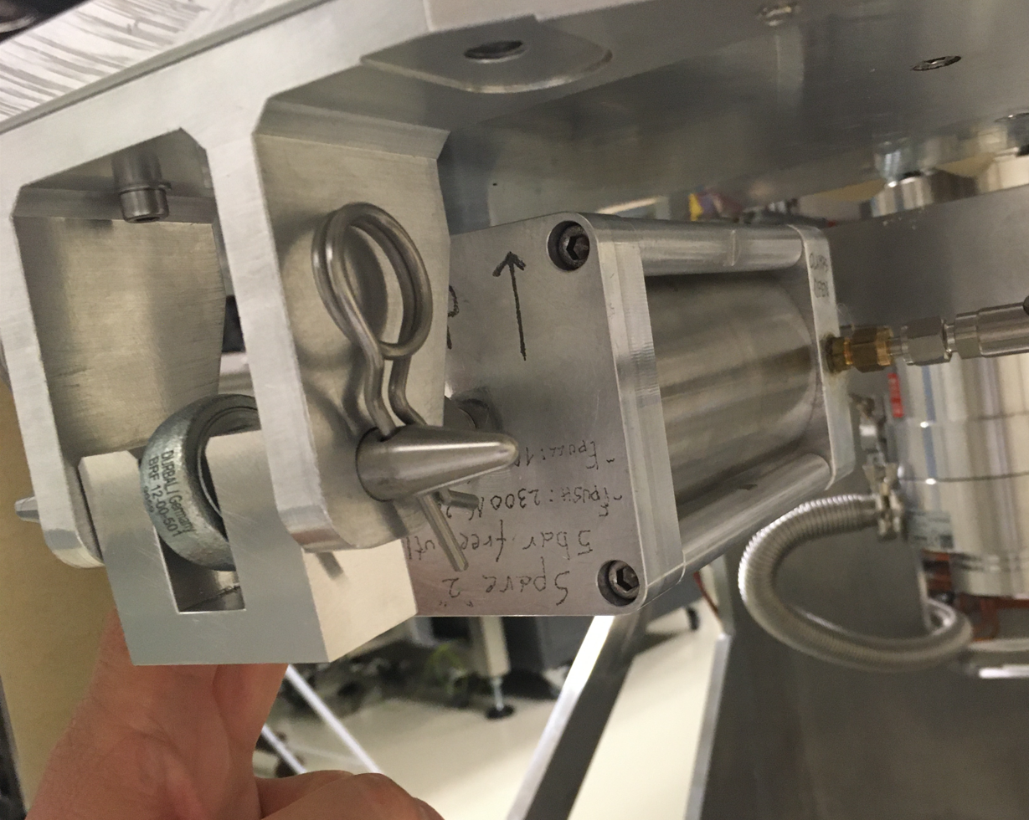
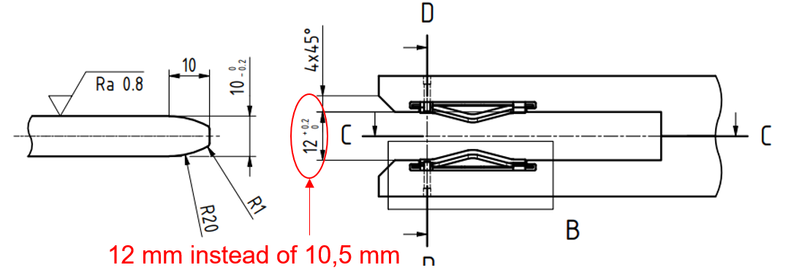
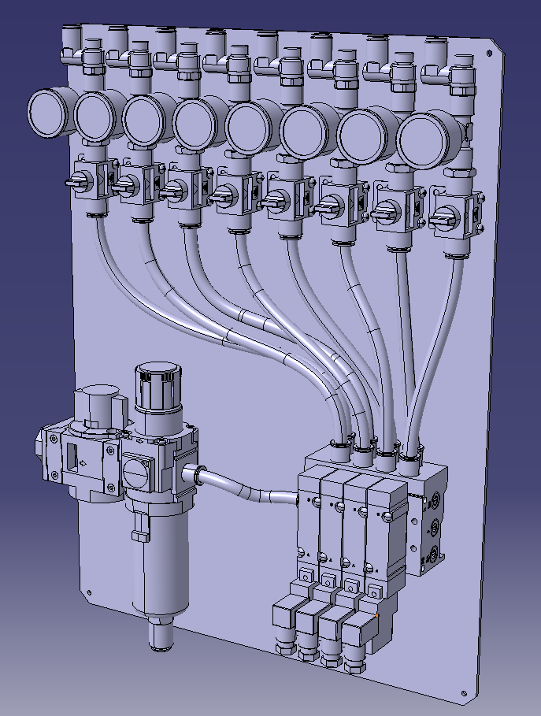
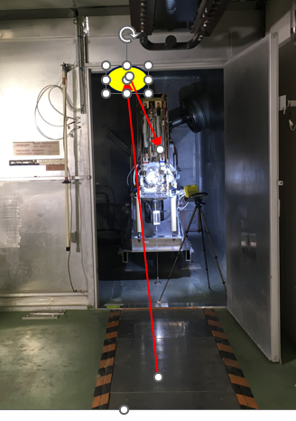
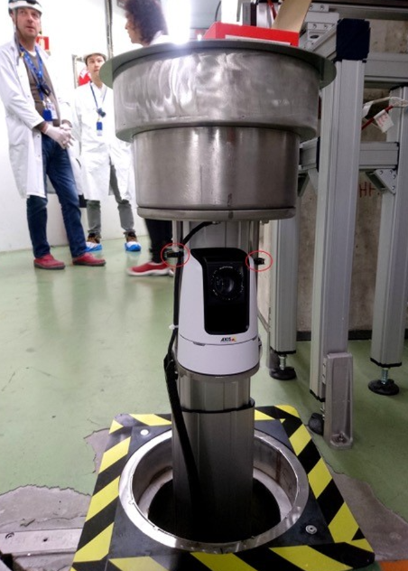
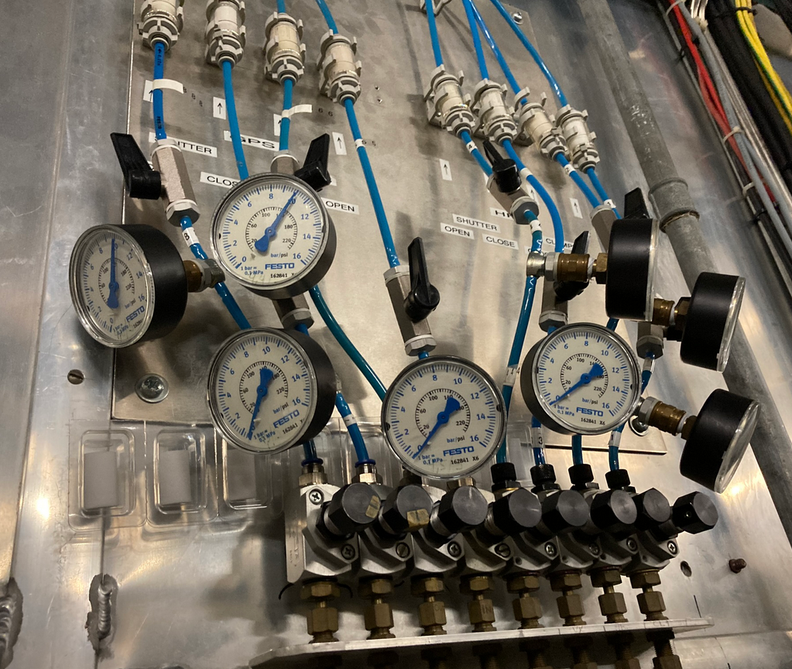
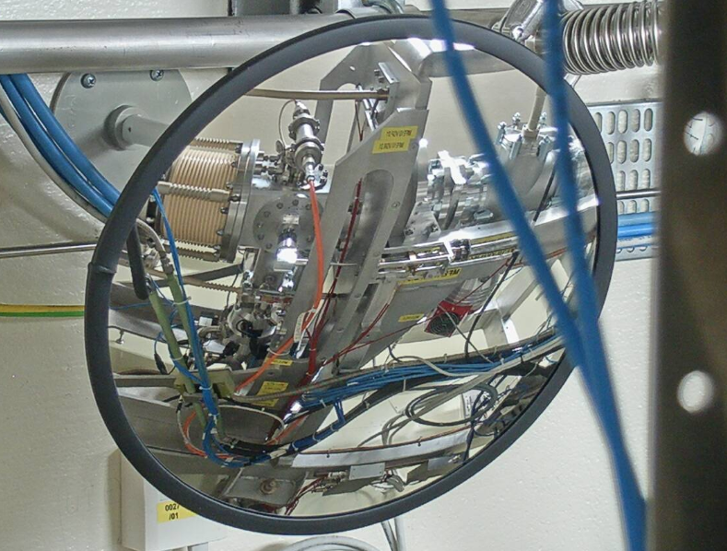
YETS activities: targets coupling
Improved Rad-Hard piston design (reliability)
New Multicontact for main power connectors (more elastic, less friction…)
Improved compressed air distribution
Improved visualization
Like in MEDICIS bunker
Telescopic camera

Slide 26
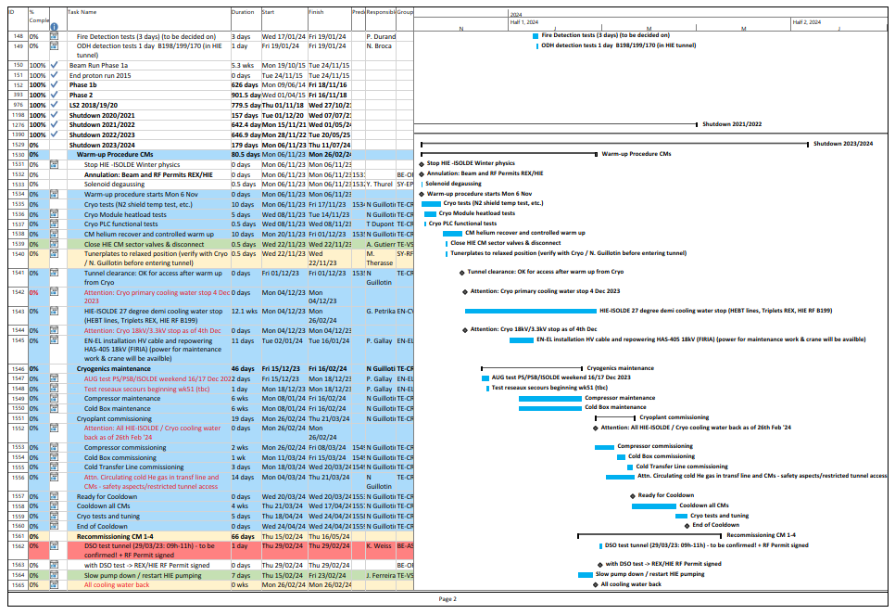
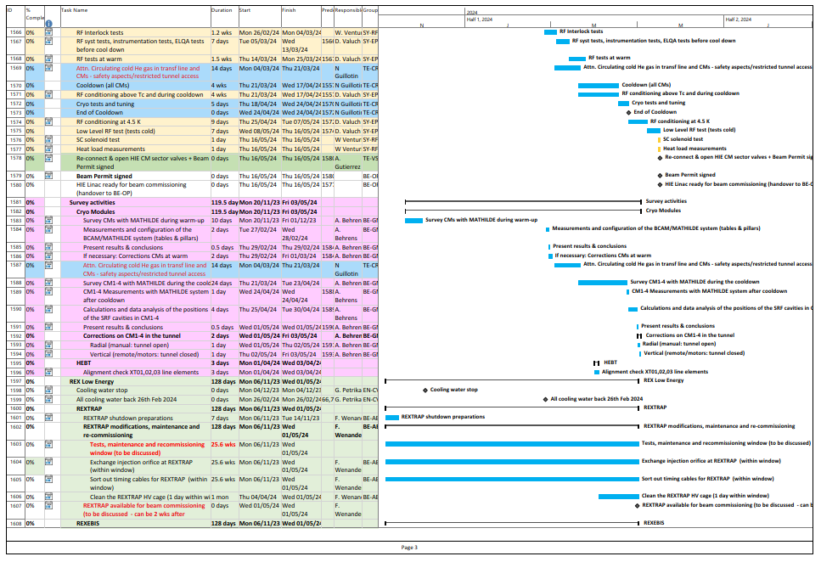
YETS ‘23-’24 key-dates:
- 6 Nov: End of HIE (winter) Physics
- 6 Nov – 1 Dec: HIE warm-up period including tests on the feasibility of a GHe or LN2 system to keep the CM’s shields <100K during a compressor station stop
- 4 Dec: (HIE) ISOLDE full stop
- 19th February 2024: Start of HIE ISOLDE HW Commissioning
- 26 Feb: All cooling water back
- 20 March – 24 April: Cyro Modules cooldown period
- 25 April – 16 May: SRF reconditioning at 4.5K
- 1 May: REXTRAP, REXEBIS & REX (RF) LINAC ready for Beam Commissioning
- 1 May – 11 July: REX/HIE Machine Check out and Beam Commissioning
- 13th May 2024: Start of HIE-ISOLDE Beam Commissioning
- 21st June 2024: HIE ISOLDE stable beam to exp. Stations
- 11th July 2024: Start of HIE ISOLDE Physics

Slide 27
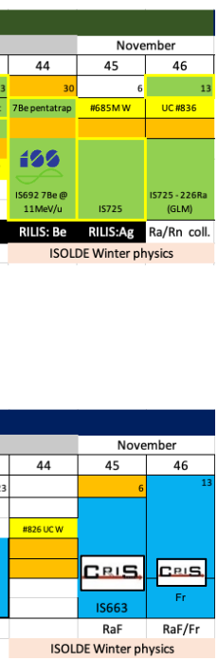
Winter physics programme
GPS
3 targets were irradiated cold for several shifts in October
Busy programme with collections at GLM in parallel with HRS
  GPS
    HIE-ISOLDE: ISS with 7Be
    Collections at GLM (7Be for pentatrap, 226Ra)
    External sample of 110mAg from PSI for efficiency test
  HRS
    RaF for CRIS
HRS

Slide 28
Key dates 2023
Protons for physics to ISOLDE from 10 April – 30 October 2023
20% than 2022 due to energy considerations
HIE-ISOLDE ready
21 July 2023
Relatively short run
Prolonged Winter physics run
30 October – 20 November 2023
This year included in CERN’s master accelerator schedule

Slide 29
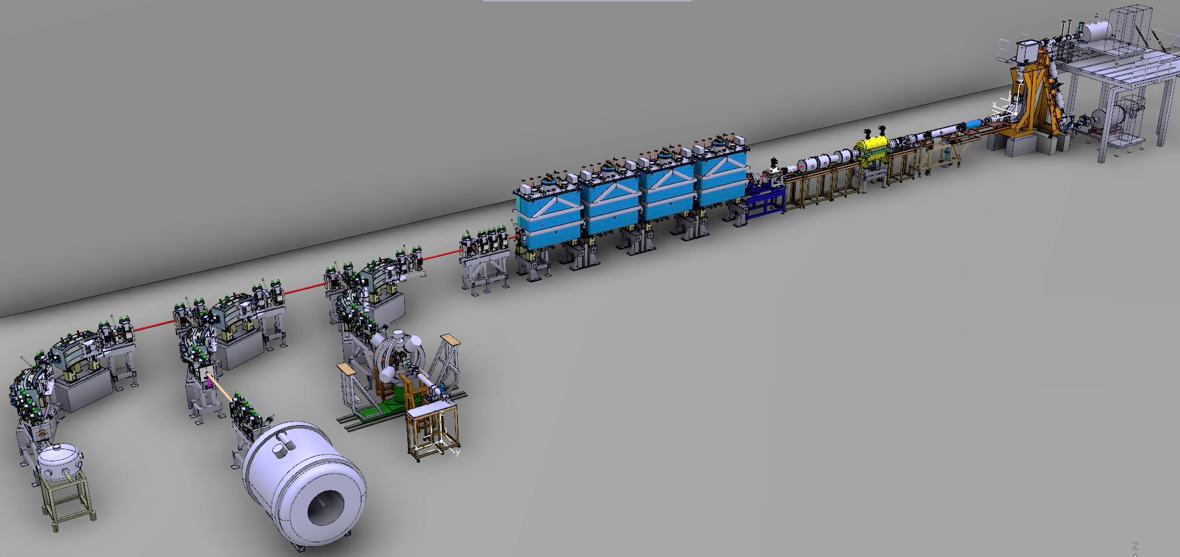
Status of REX/HIE ISOLDE and YETS activities:
EBIS
TRAP
REX LINAC
HEBT lines
HIE SC LINAC
Miniball
ISS
SEC

Slide 30


REX Low Energy:
REXTRAP:
- During the recommissioning in June issues with the REXTRAP efficiency worsened. It was opened up by F. Wenander & team (ABP). The trap was available again for beam commissioning in July.
REXEBIS:
- Last year’s severe issues with LHe boil off and quenches were adddressed during the YETS by a complete EBIS dis- and reassembly. A serious mechanical issue occured during work on the inner drift-tube. A swift crash repair was carried out so that the EBIS was available in time end of May for the beam commissioning of REX by OP.
- The work on EBIS paid off and it has been running well during the ‘23 run.
REX EBIS re-assembly Feb.’23

Slide 31

REX NC LINAC:
REX LINAC:
Several issues with REX RF during the recommissioning:
Tuner of the REX Buncher overheating: cooling water problem has been addressed.
7GAP1 last years instabilities were still there and not completely understood. A permanent Seismic measurment system has been installed to observe possible vibrations.
The 7GAP1 instabilities limit the A/q (from 4.5) to 4.25.
(No significant or explaining vibrations have been observed throughout the year).
7GAP1 and 7GAP3 amplifier issues were addressed
9GAP developed a serious vacuum leak in April which has been addressed by tightening the bolts of the structure.
REX 9GAP vacuum leak: tightening the bolts

Slide 32



HIE SC LINAC:
In June Cavity 5 in CM1 (XLL2) quenched. Assumed pollution on the Nb layer.
The total gradient efficiency reduced from 79% (May ‘23) to 76% (91.8 out of 120 MV/m).
Cavity 2 in CM1 caused issues later during the run reducing the total gradient further.
To reach maximum HIE energy at the end of the run, Cavity 2 and 5 were put back in action, the latter at reduced gradient
HIE SC LINAC
Cav 5 out of order:
Lower E versus A/q curve
79% -> 76%
4 HIE SRF Cryo Modules

Slide 33


HIE Cryo issues:
A power cut end of June took down the cryo plant and introduced pollution in the Coldbox which limited the cooling power making it hard to keep the Cryo Modules’ thermal shields at nominal temperatures.
Another unplanned power cut in September was used by the cryo team to replace a failing heat exchanger on the compressor gearbox.
A very positive effect was that at the restart of the plant the process uncloggged the Coldbox from its pollution and nominal cooling power was back again.
HIE Cryo Compressor station
HIE Cryo Controls

Slide 34
Operations:
- The severe issues with REX during the restart reduced the Beam Commissioning severely. Despite, first stable beam to ISS (6th July) and first physics at Miniball (19 July) could be maintained.
- The reduced time for Beam Commisioning played up throughout the whole run: No reference files could be done and became part of the setting up of the various experiments.
- Despite many issues throughout the year, HIE ISOLDE managed to deliver beam according to schedule and physics requests.
Some promissing MDs could be carried out towards the end of the ‘:
REX Low Energy:
ISCOOL buncher / EBIS efficiency tests by F. Wenander: Proof of principal: triggered by EBIS the ISCOOL can send bunches through the TRAP in ‘fly-through’ mode. This could open the way to replace the TRAP solenoid by a doublet in case of a serious TRAP failure.
HIE Linac:
New methods of rephasing the HIE LINAC in case of a failing or running at reduced gradient SRF cavity were tested successfully by OP. This might significantly reduce the painstaking time to rephase cavities in case of issues.

Slide 35
YETS ‘23-’24 key-dates:
- 6 Nov: End of HIE (winter) Physics
- 6 Nov – 1 Dec: HIE warm-up period including tests on the feasibility of a GHe or LN2 system to keep the CM’s shields <100K during a compressor station stop
- 4 Dec: (HIE) ISOLDE full stop
- 19th February 2024: Start of HIE ISOLDE HW Commissioning
- 26 Feb: All cooling water back
- 20 March – 24 April: Cyro Modules cooldown period
- 25 April – 16 May: SRF reconditioning at 4.5K
- 1 May: REXTRAP, REXEBIS & REX (RF) LINAC ready for Beam Commissioning
- 1 May – 11 July: REX/HIE Machine Check out and Beam Commissioning
- 13th May 2024: Start of HIE-ISOLDE Beam Commissioning
- 21st June 2024: HIE ISOLDE stable beam to exp. Stations
- 11th July 2024: Start of HIE ISOLDE Physics

