Slide 1
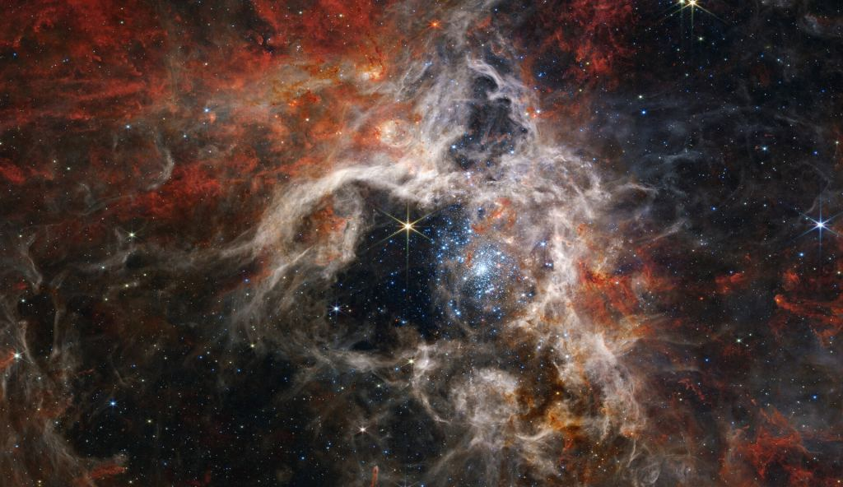
Universal Questions
How we measure what we can’t see

Slide 2
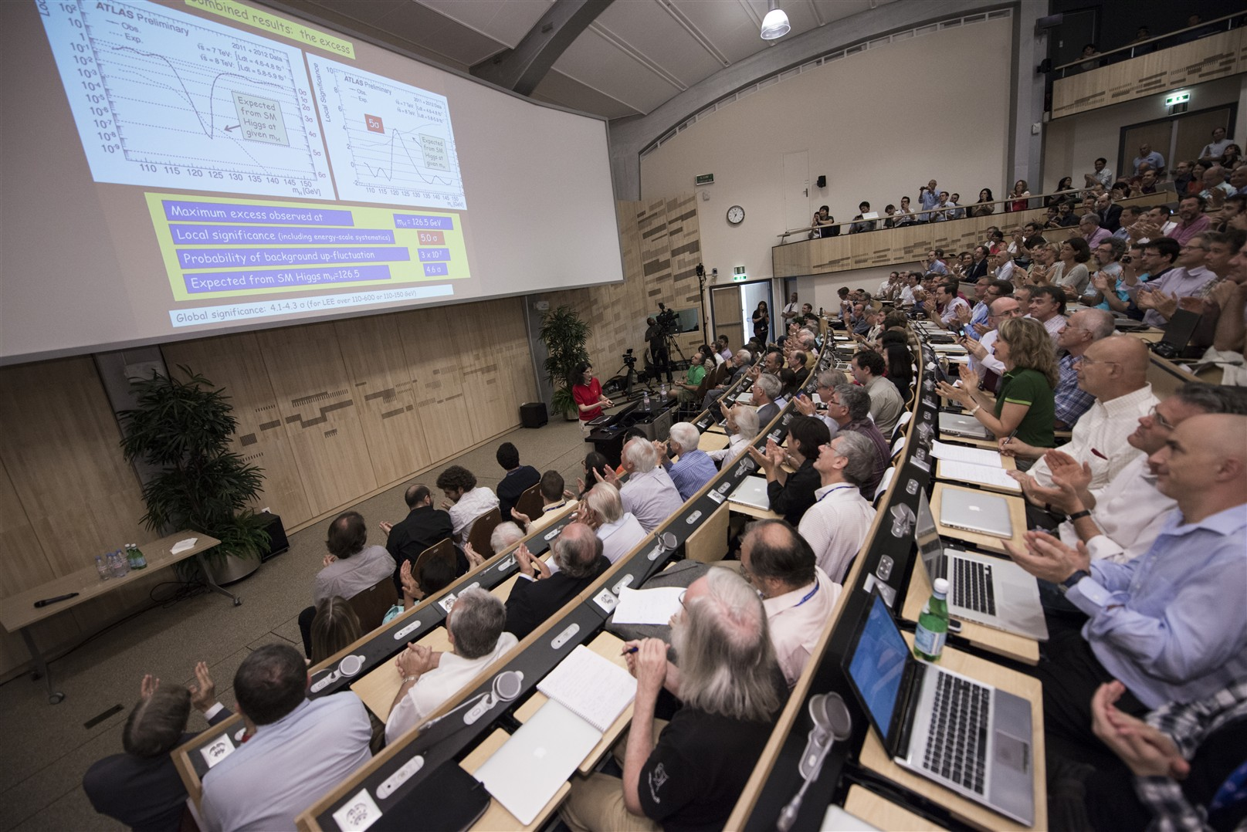
Physics Seminar – 4 July 2012

Slide 3
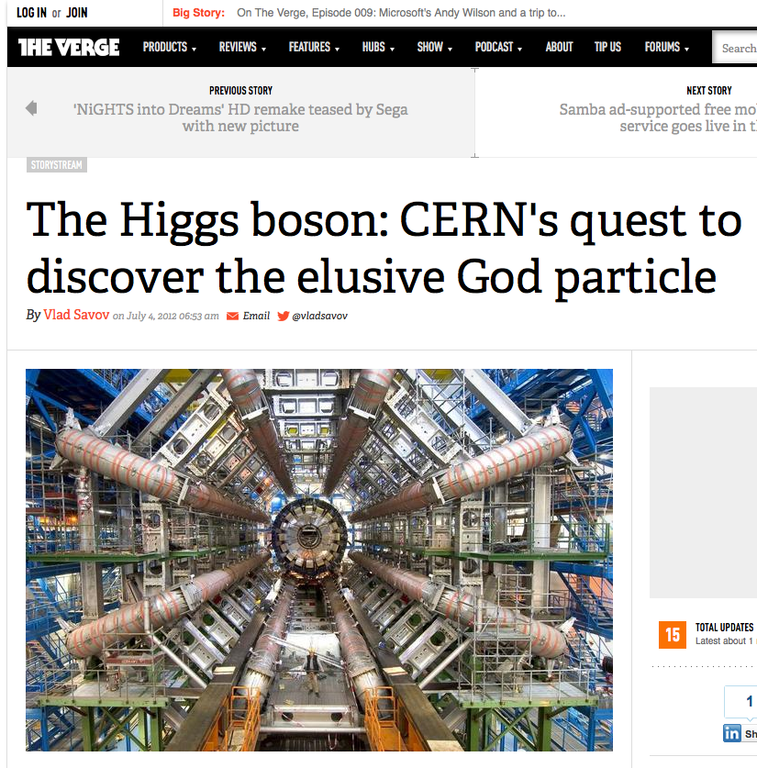
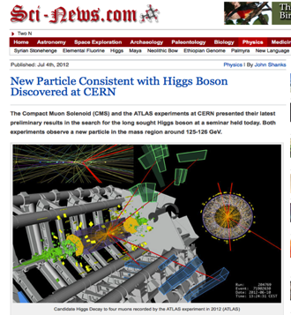
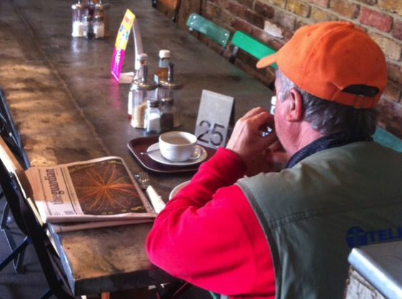
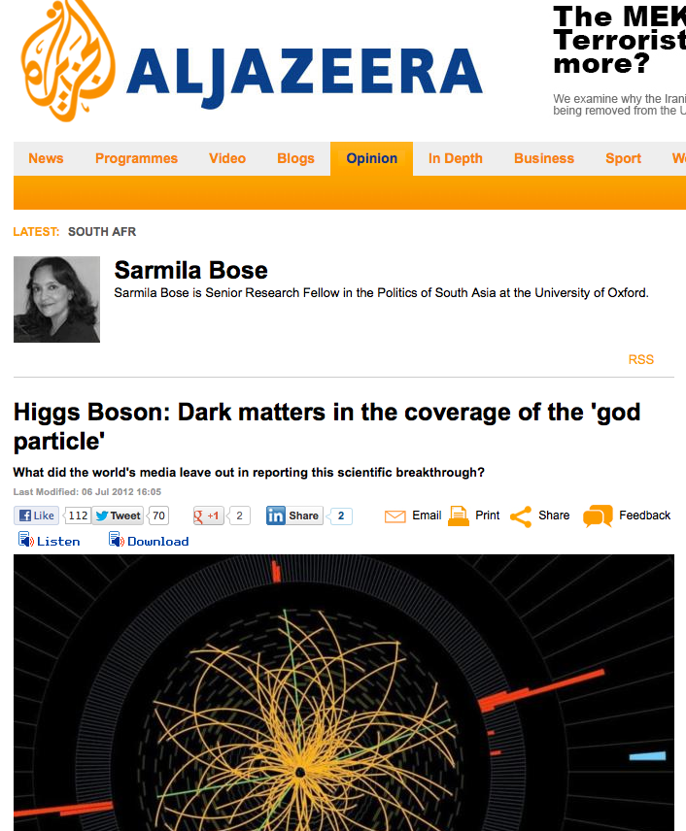
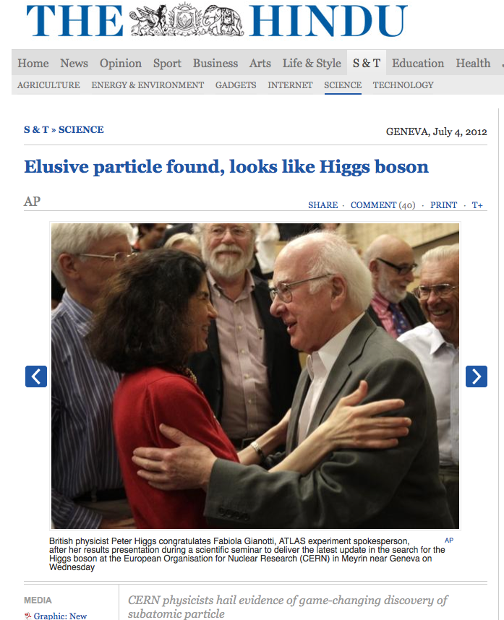
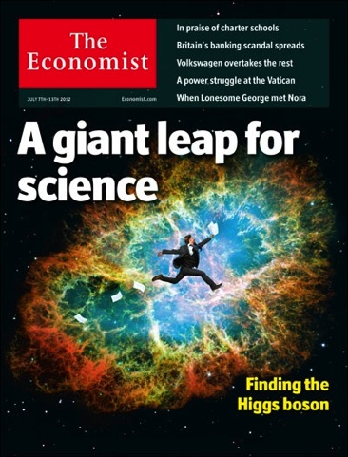
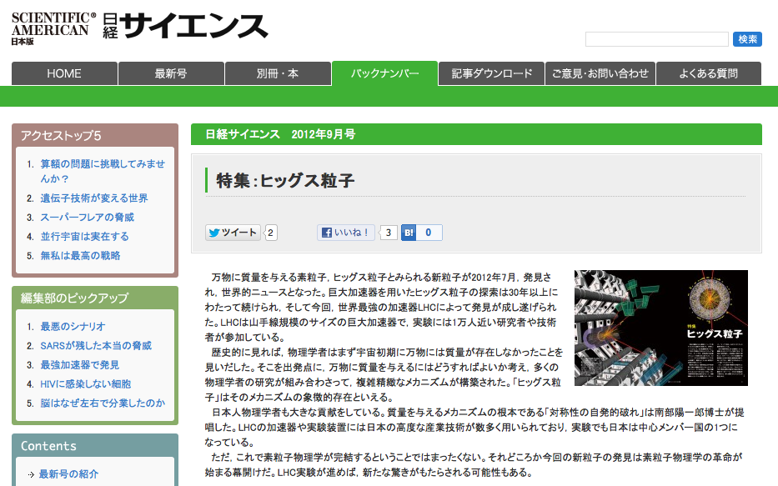
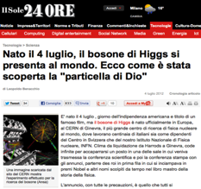
One Billion Viewers

Slide 4
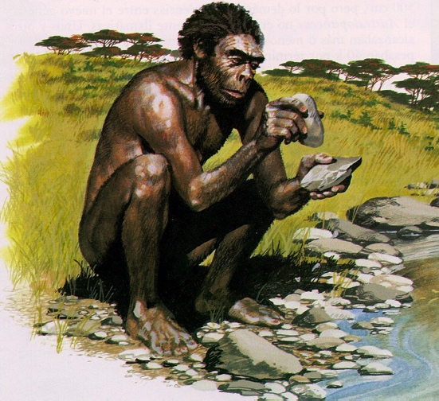
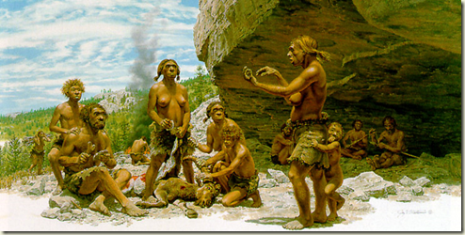
Physics Seminar – 4 July 2000012 BCE

Slide 5
What were Zog’s questions?

Slide 6
Where do we come from?

Slide 7
What are we made of?

Slide 8
Where are we going?

Slide 9
What are the rules behind all this?

Slide 10
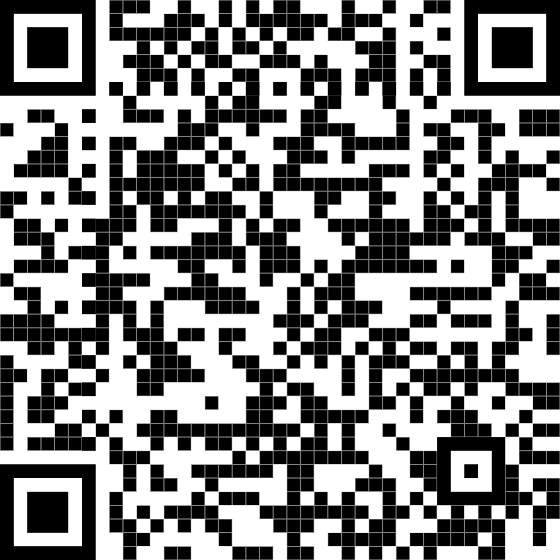

Slide 11
How do we measure what we can’t see?

Slide 12
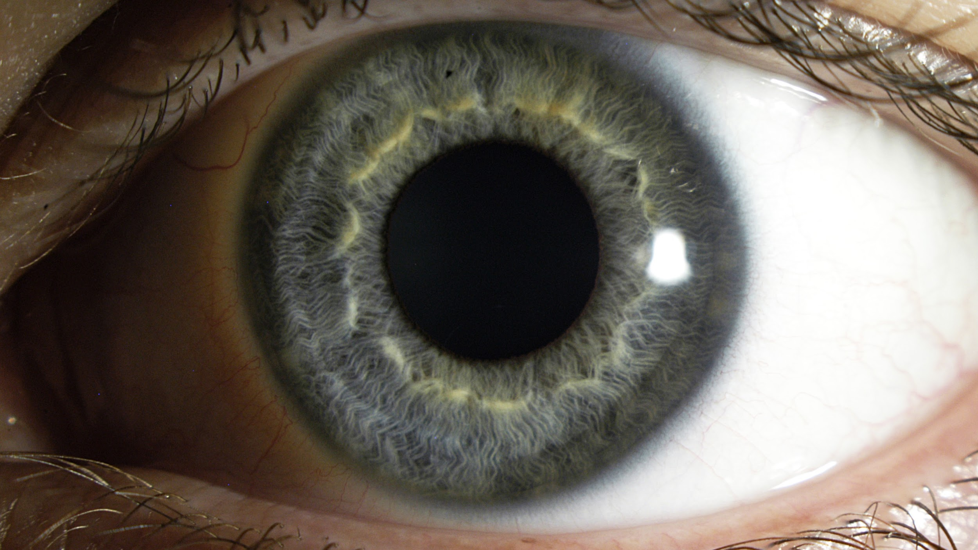
Photo: Eric Wiessner CC-BY-SA

Slide 13
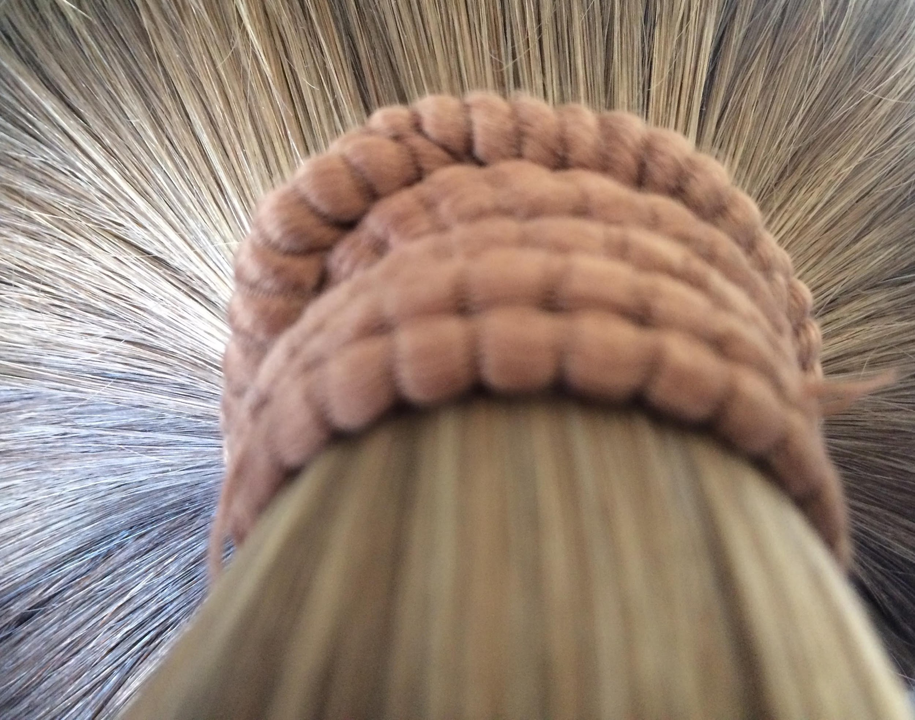

Human Hair (15cm away)
Andromeda (2.5 million light years away)
Photo: Steven Goldfarb, CC-BY-SA
Photo: Thomas Bresson, CC-BY-SA

Slide 14
Good enough?

Slide 15
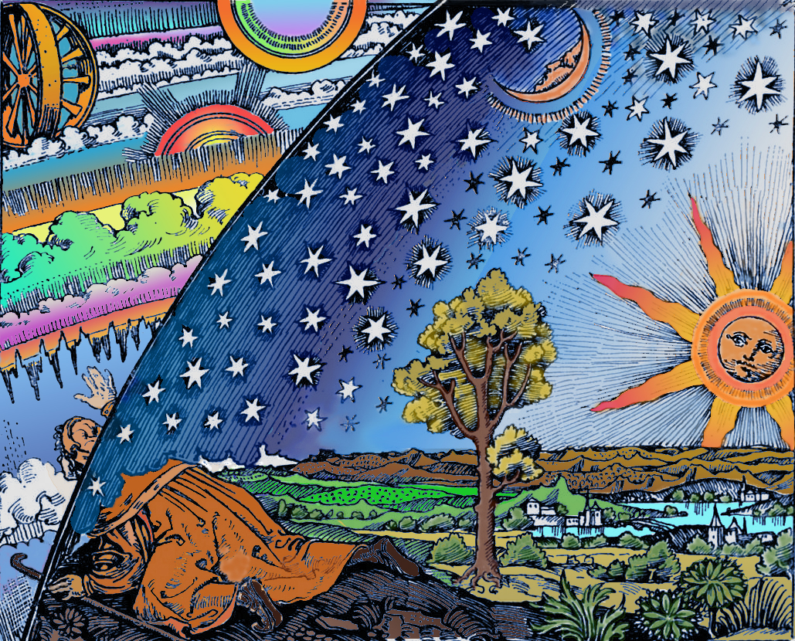
Never!
Flammarion Woodcut 1888, Public Domain

Slide 16
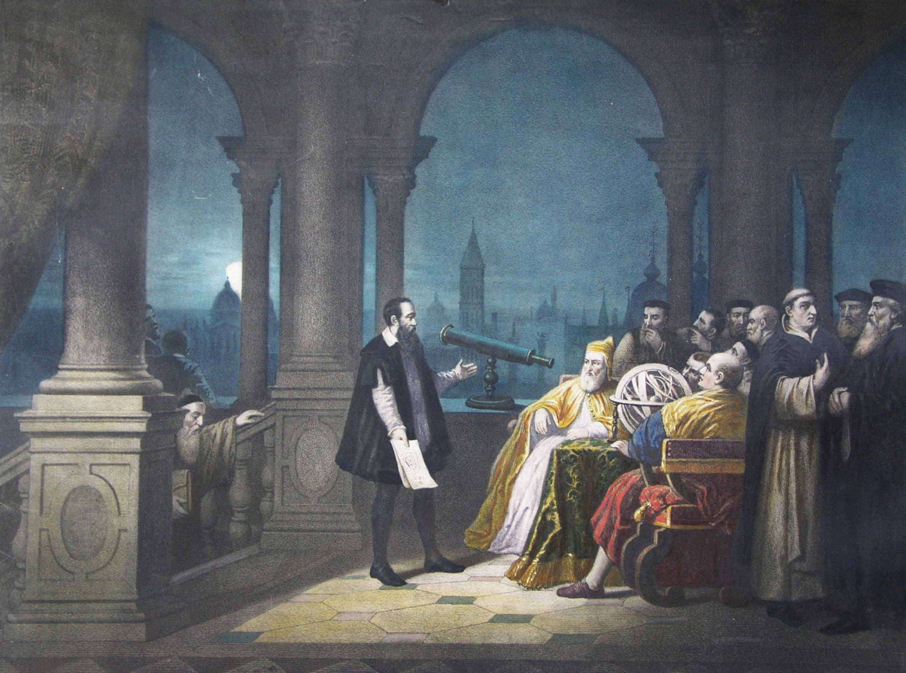
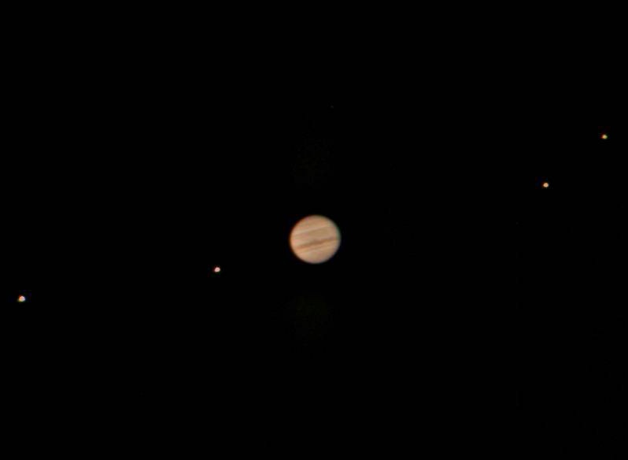
Upgrades
Galileo, Public Domain
Jupiter & Moons, Public Domain

Slide 17
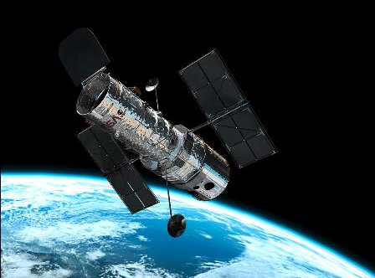
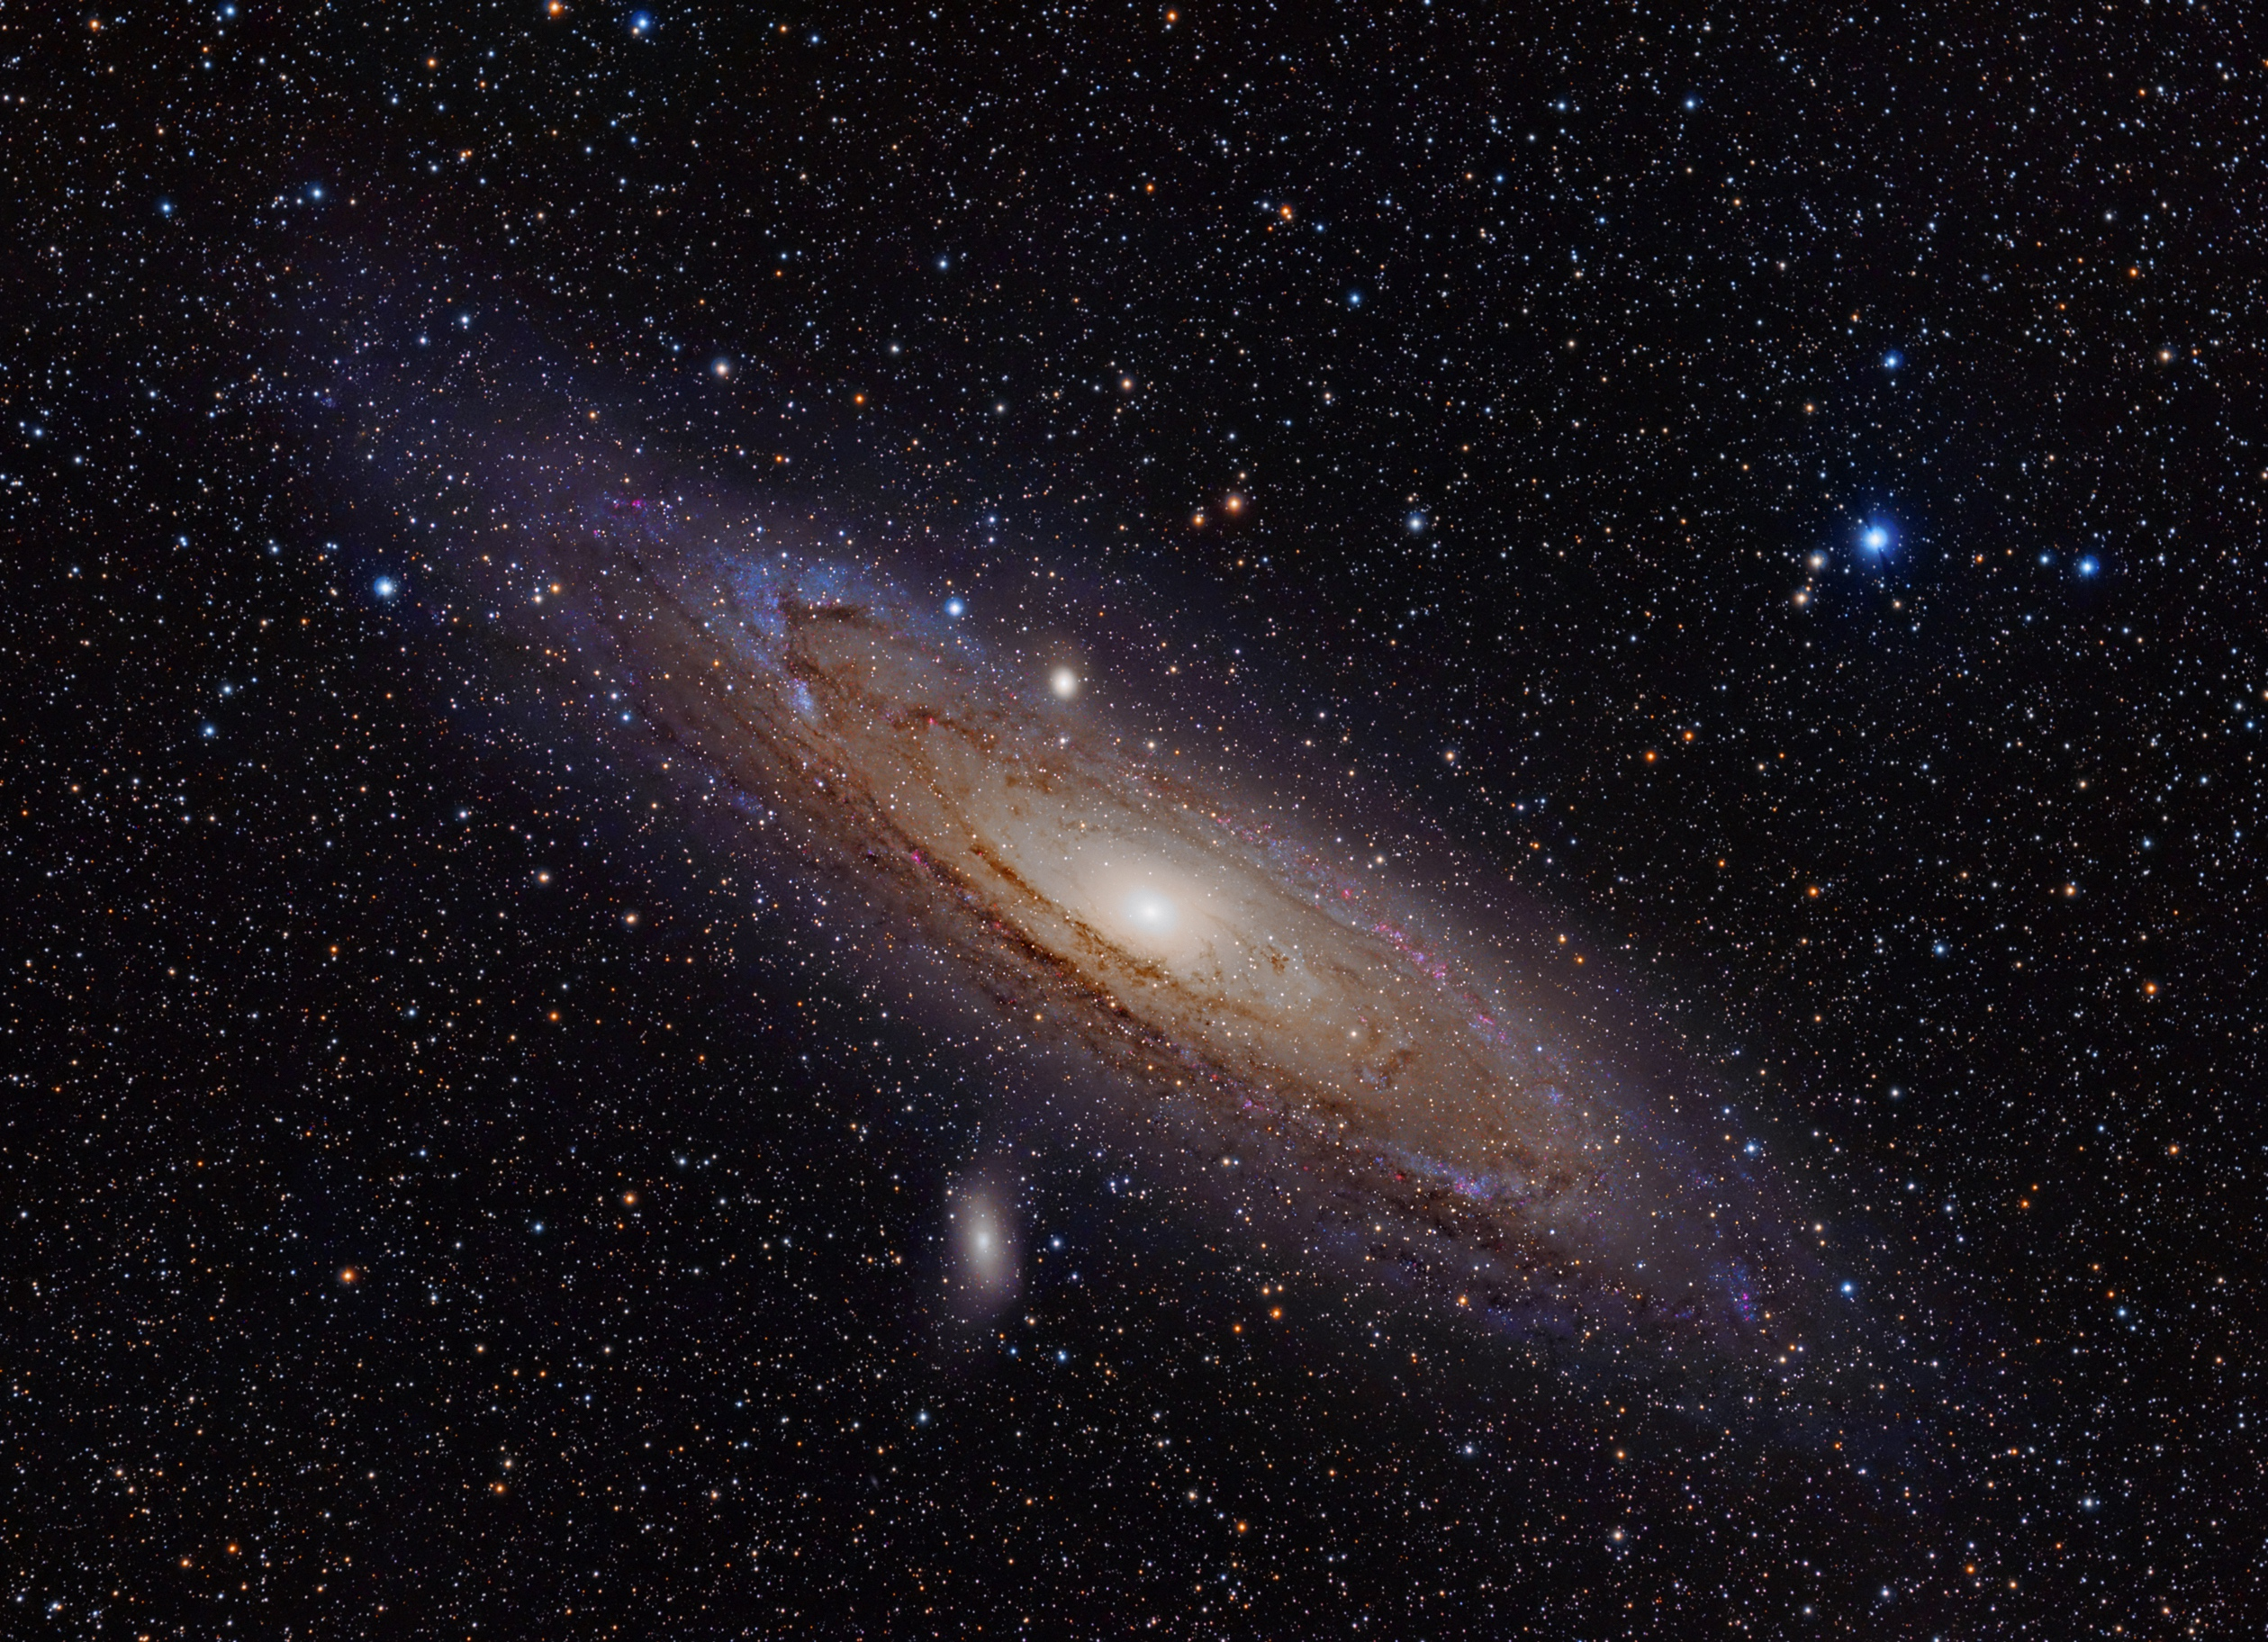
Upgrades
Image: ESA, Public Domain
Photo: Adam Evans, CC-BY-SA

Slide 18
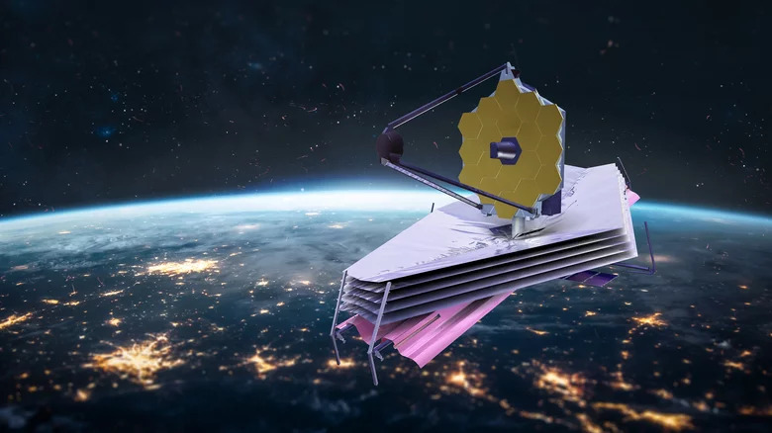
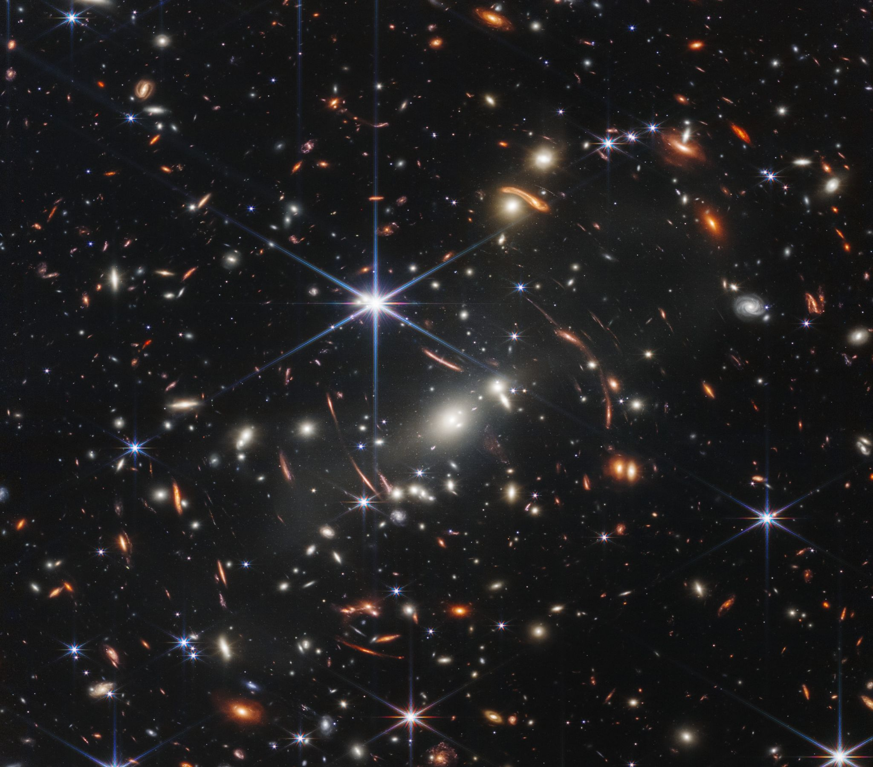
Upgrades
Dima Zel/Shutterstock
Courtesy NASA

Slide 19
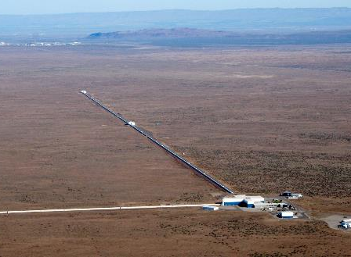
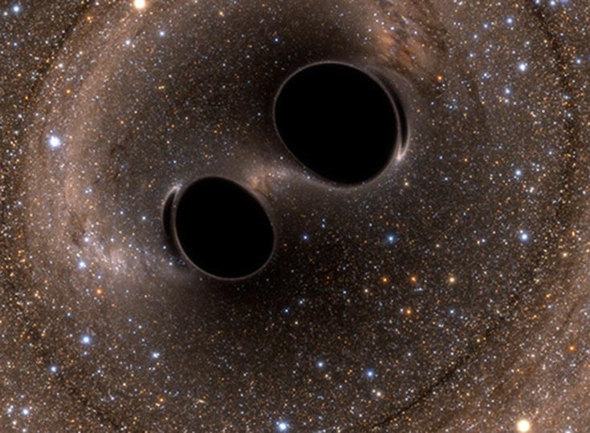
Upgrades
LIGO, NASA, Tobin/Flickr (CC BY-SA))
Image: SXS, Public Domain

Slide 20
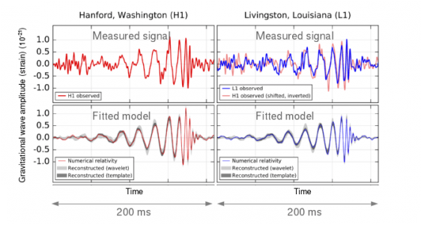
How did they do that?

Slide 21

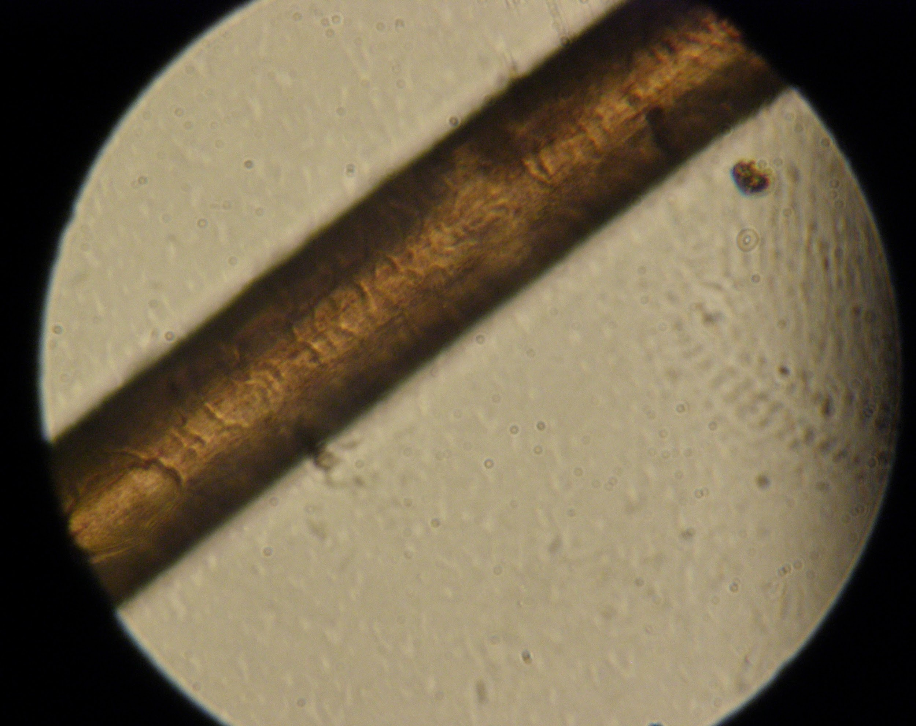
Upgrades
Image: Aurélie Troccon et Manon Mauguin, CC-SA
Photo: Juan de Vojníkov, CC-BY-SA

Slide 22
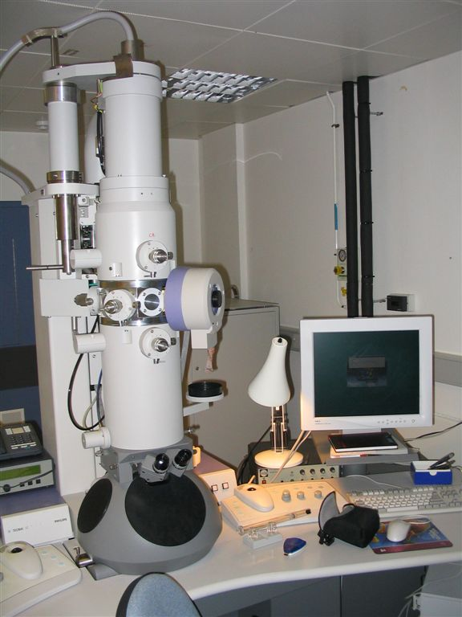
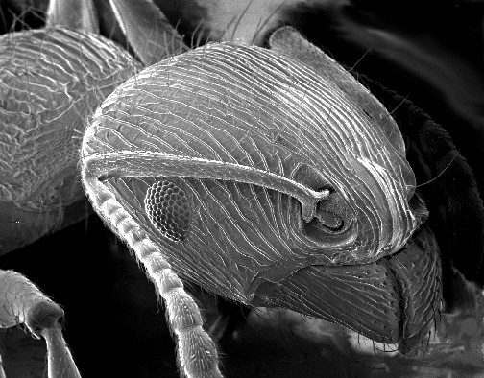
Upgrades
Image: David J Morgan, CC BY-SA
Image: USGS, Public Domain

Slide 23


Slide 24
How to probe smaller distances
E = h𝝂

Slide 25
How to probe smaller distances
What’s 𝝂 ?

Slide 26
How to probe smaller distances
C / 𝛌

Slide 27
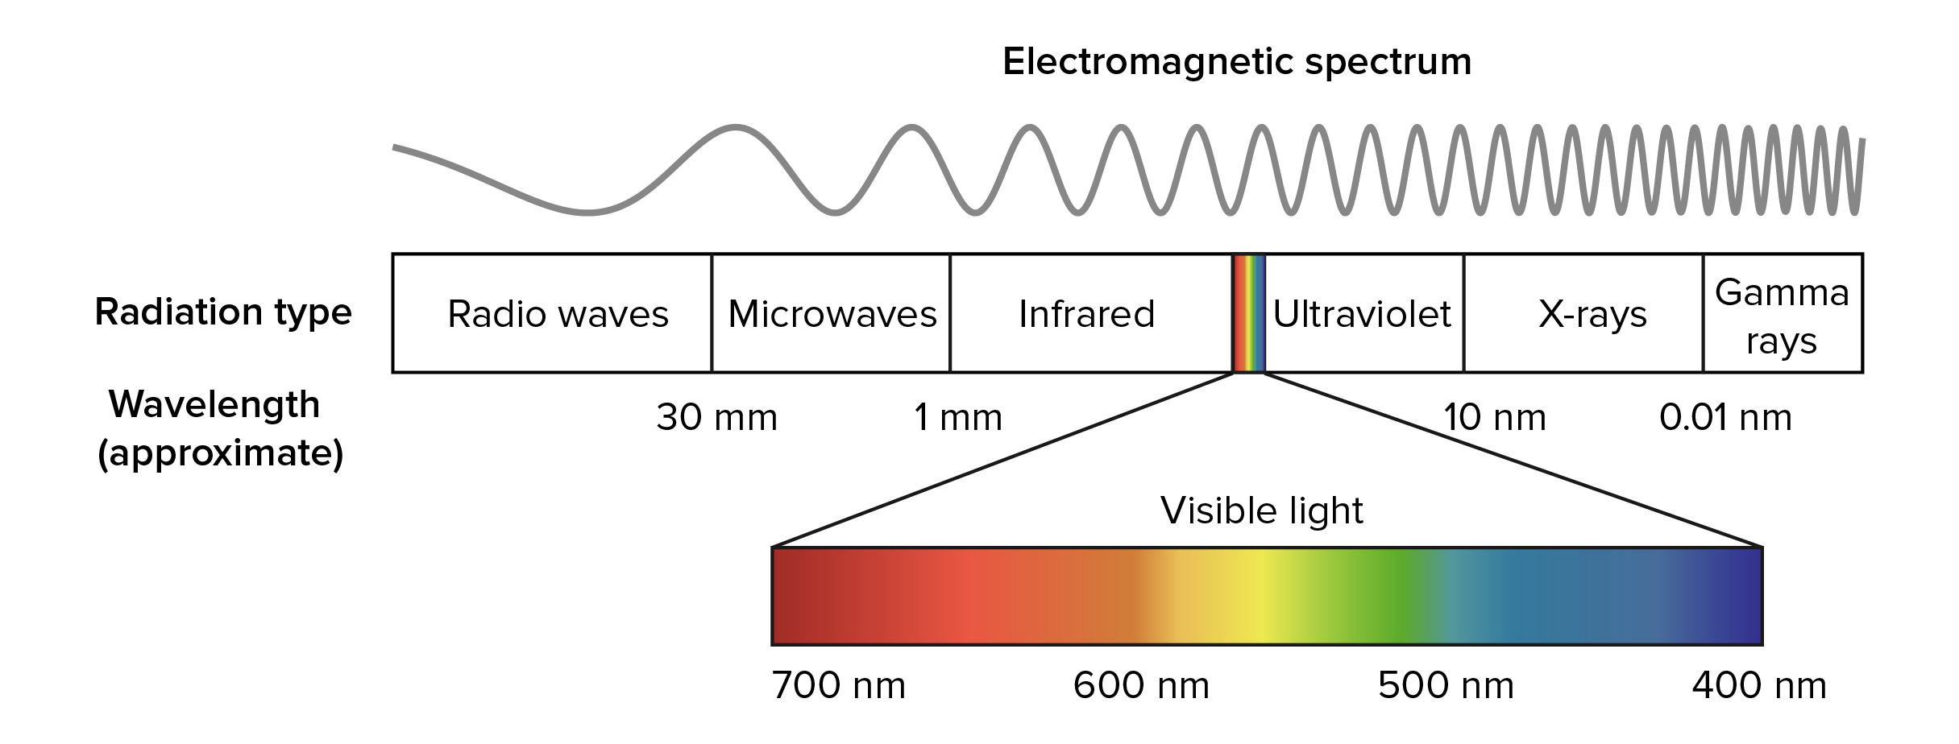
How to probe smaller distances

Slide 28
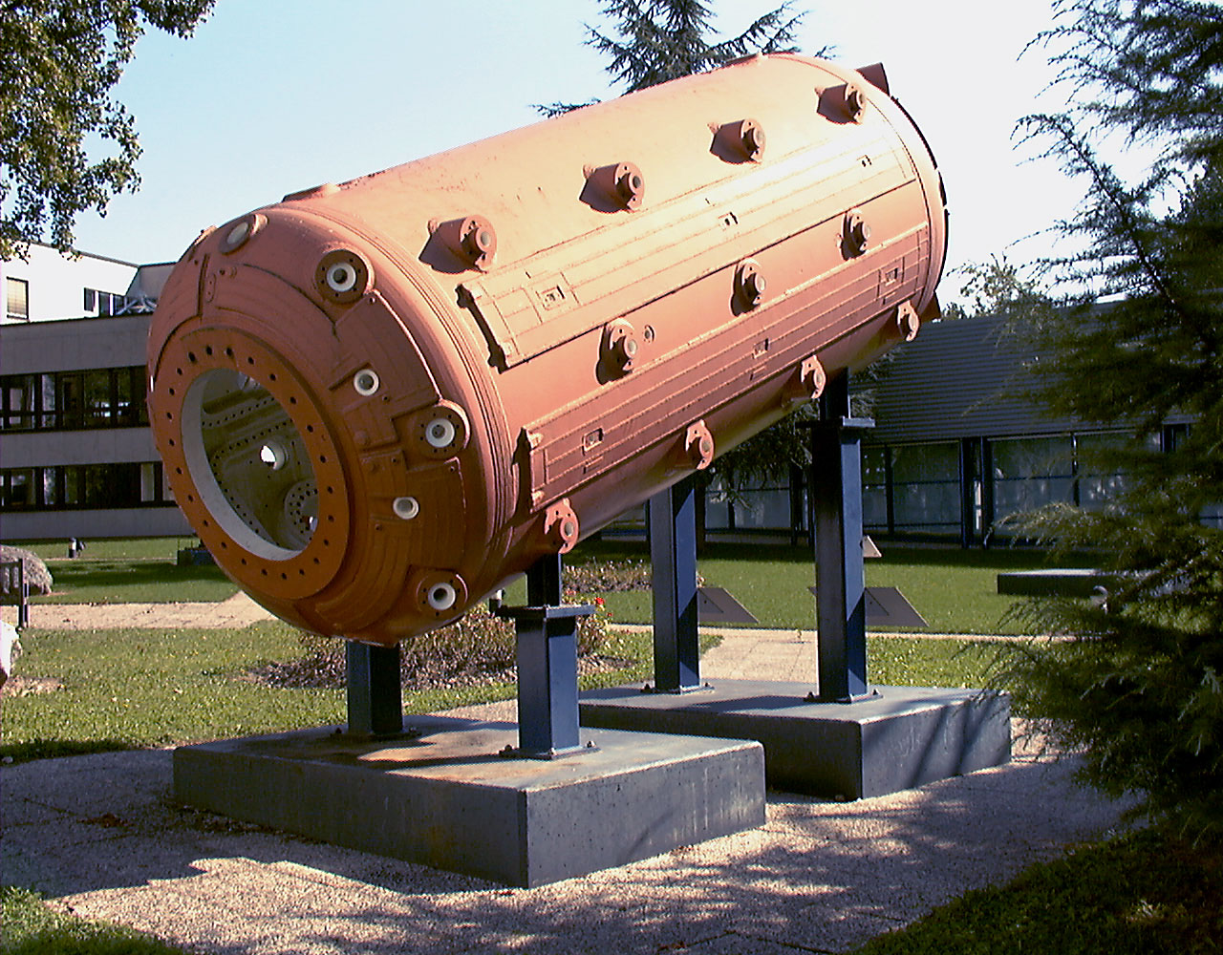
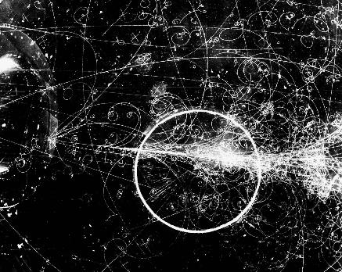
Upgrades

Slide 29
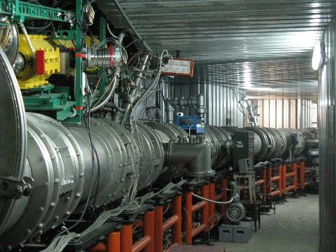
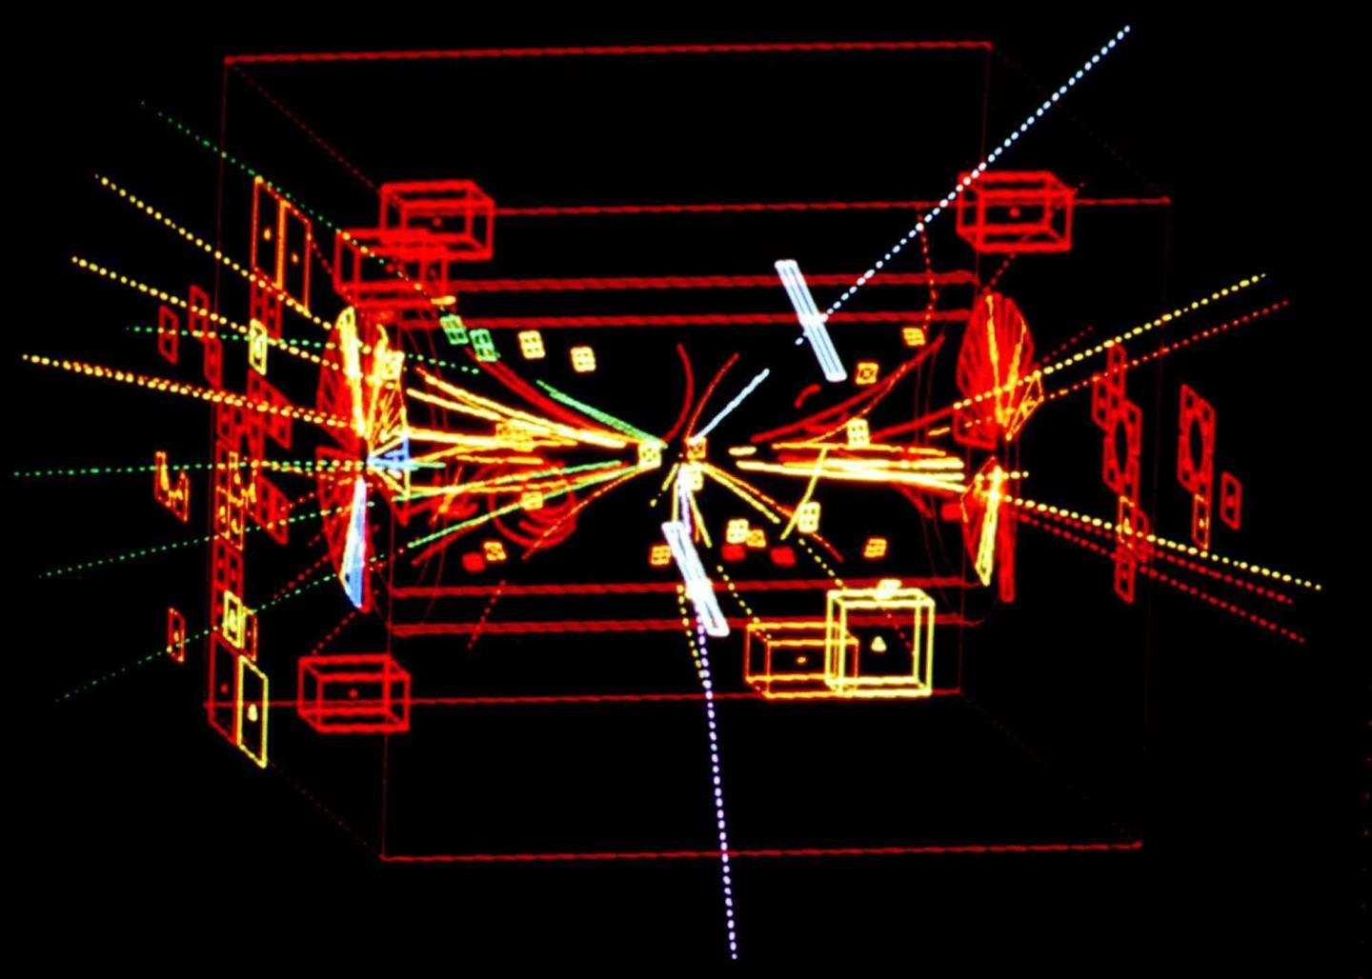
Upgrades

Slide 30
What have we learned?

Slide 31
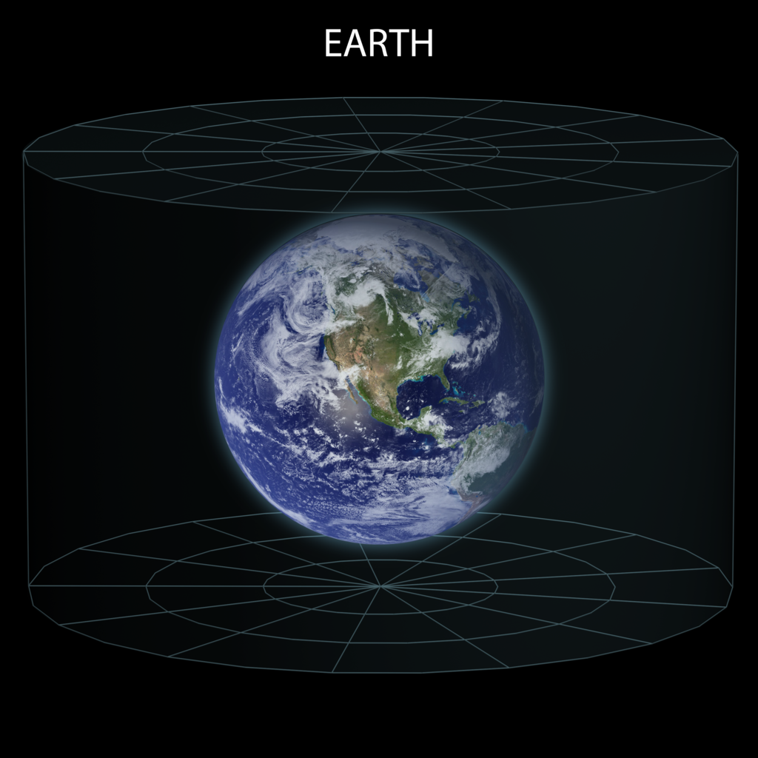

Slide 32
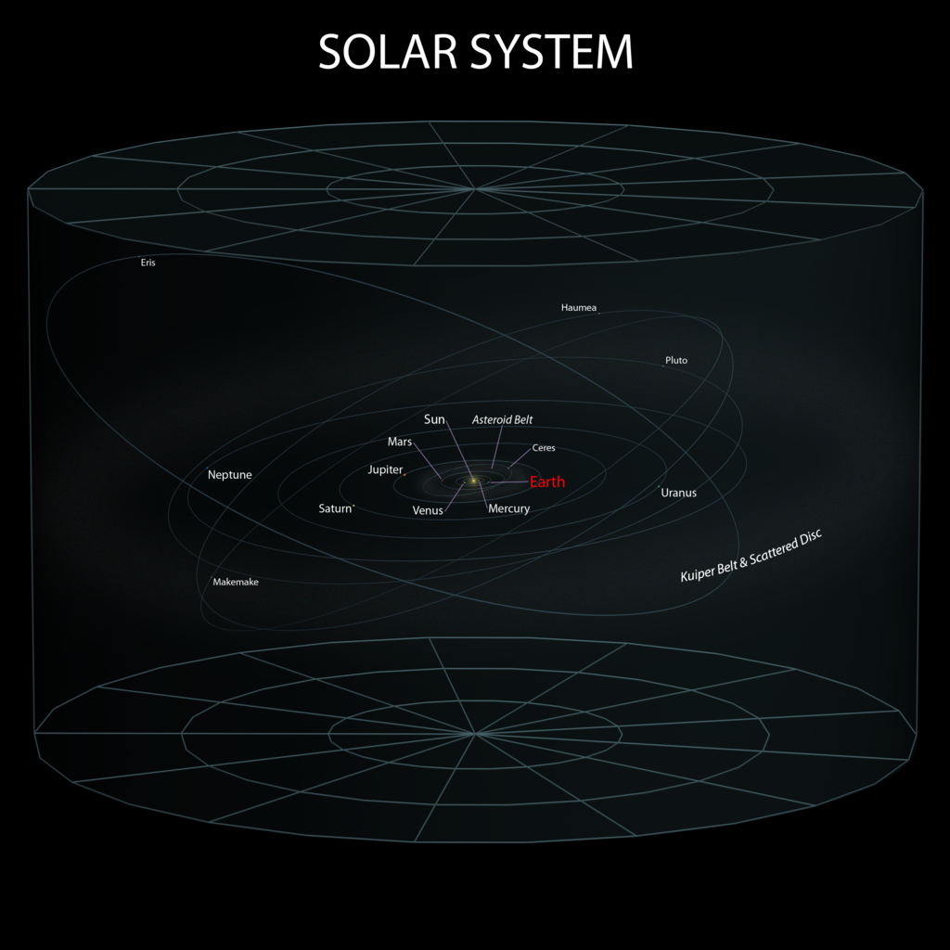

Slide 33
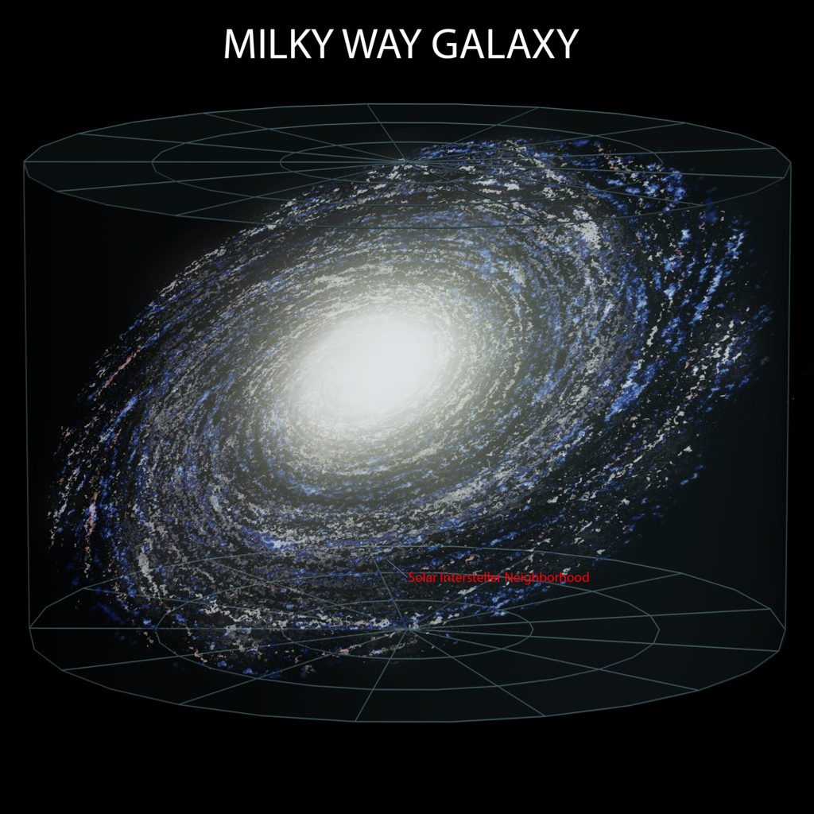

Slide 34
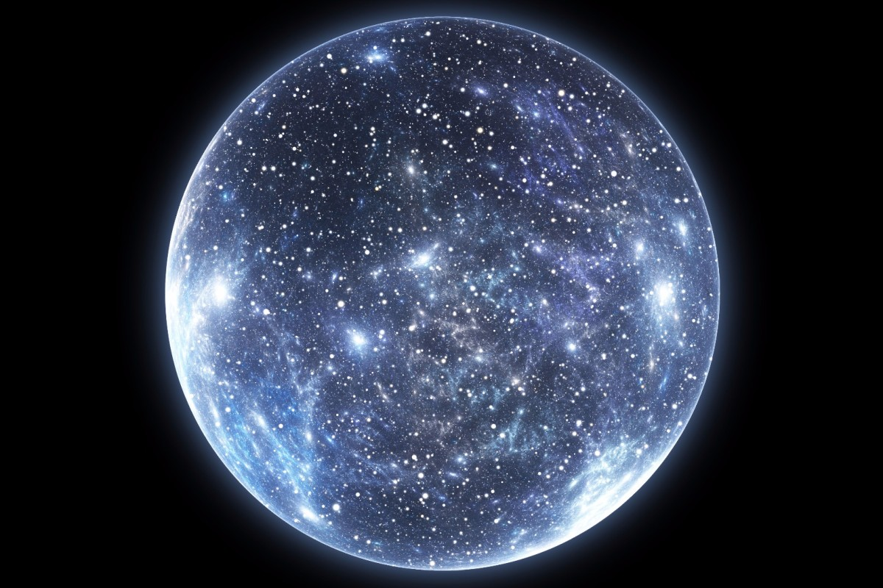
UNIVERSE

Slide 35

UNIVERSE

Slide 36
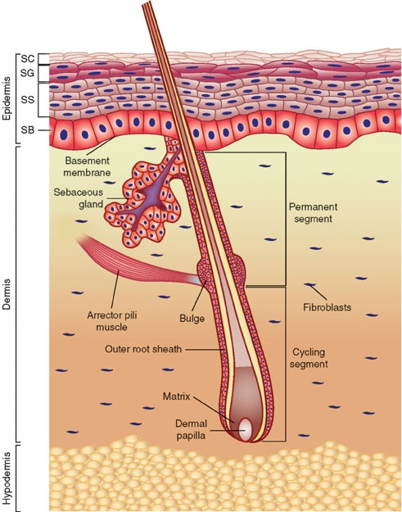
CELL

Slide 37
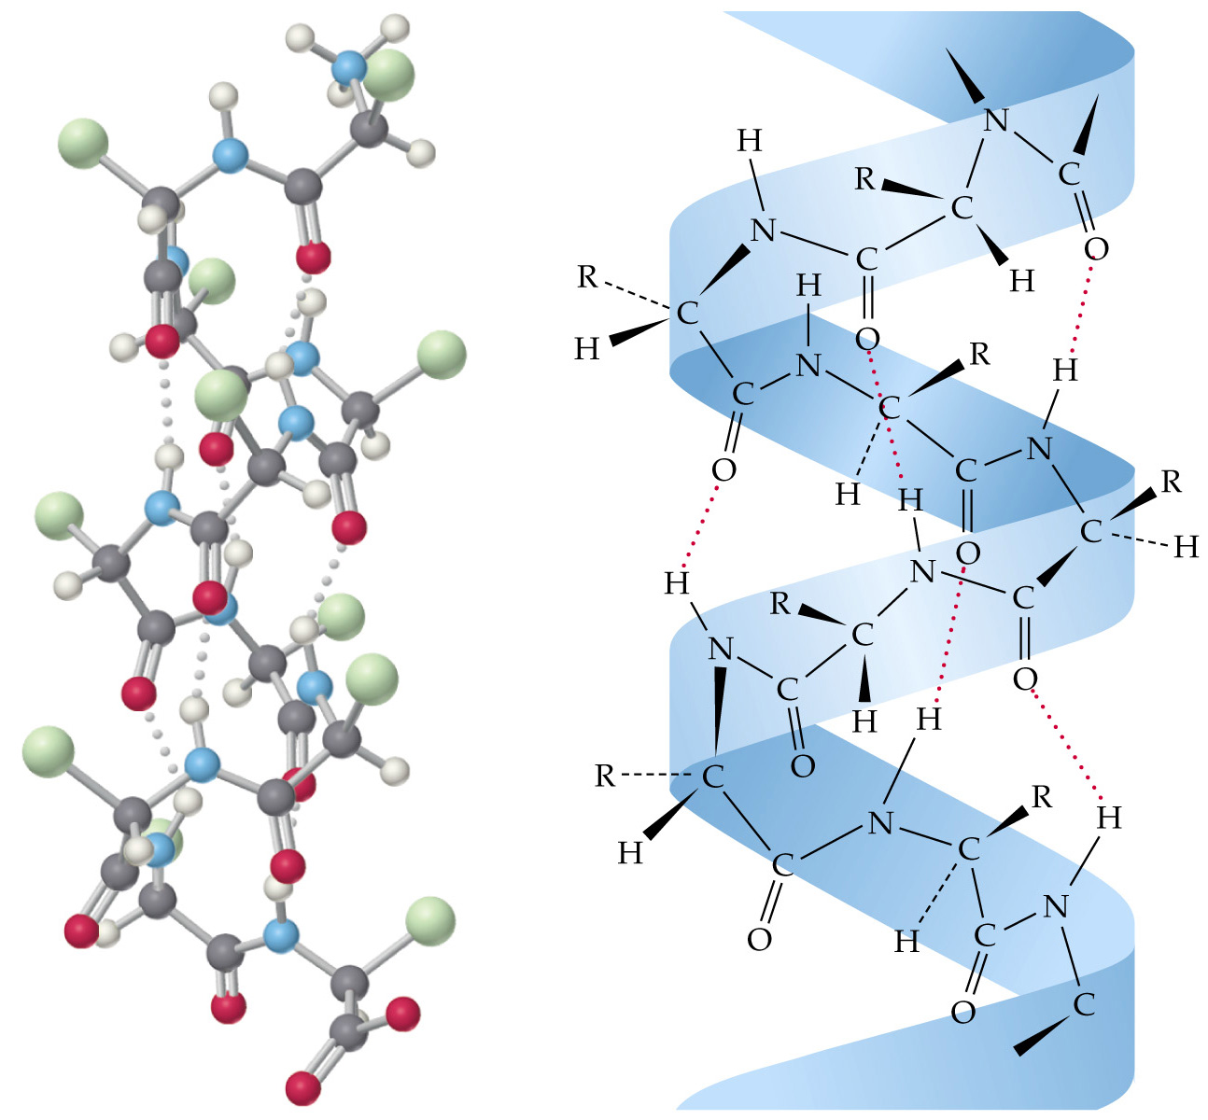
MOLECULE

Slide 38
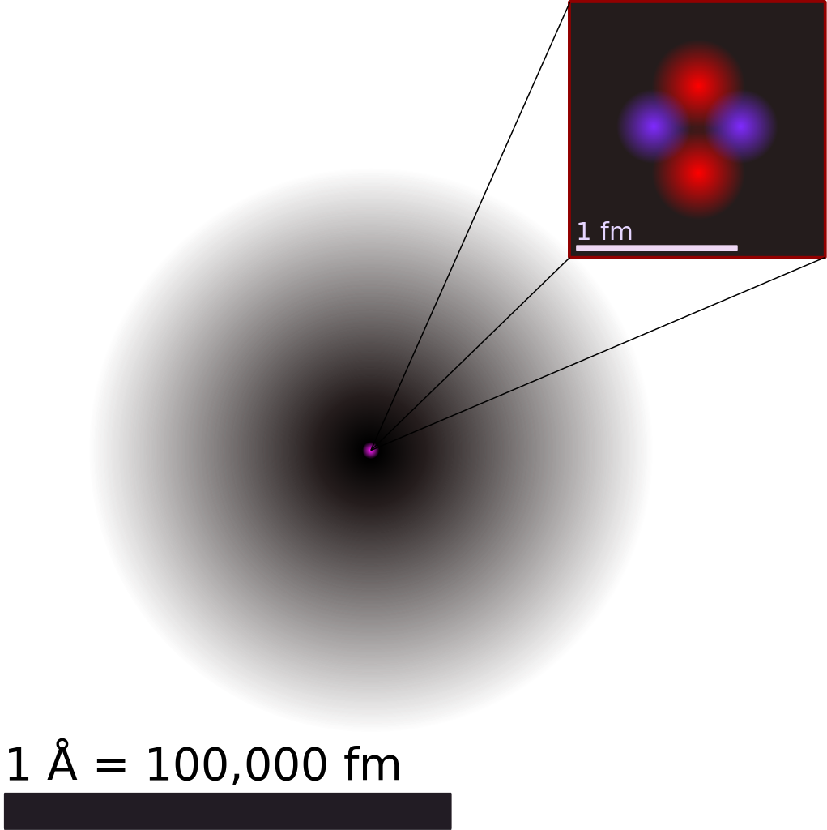
ATOM

Slide 39
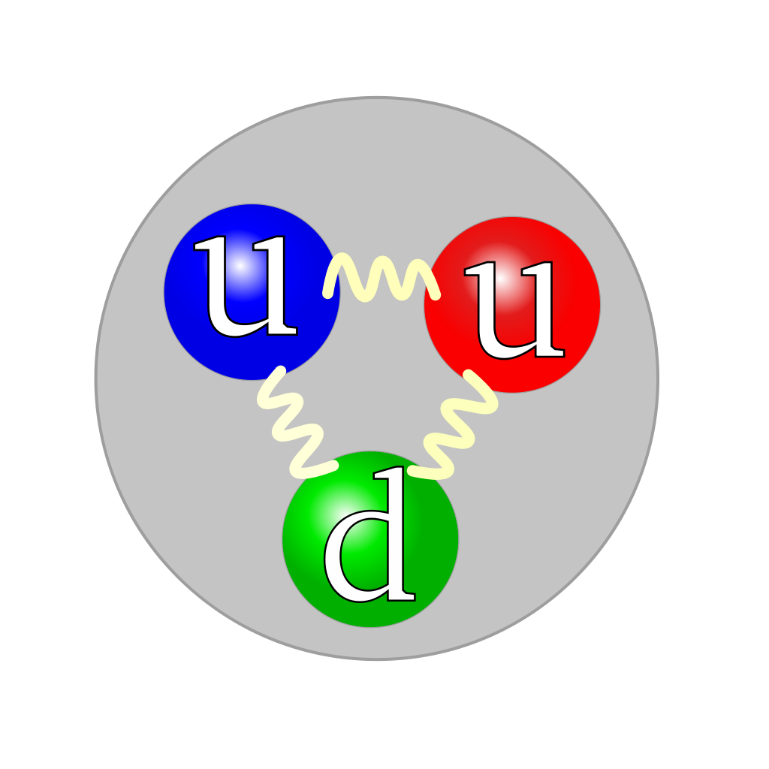
PROTON

Slide 40
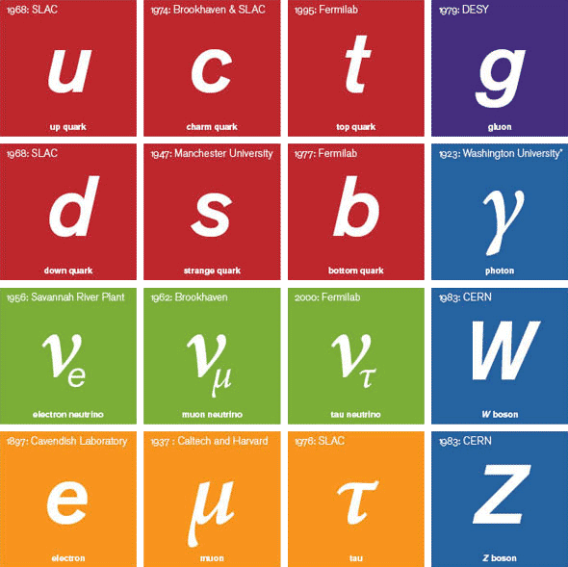
ELEMENTARY PARTICLES

Slide 41
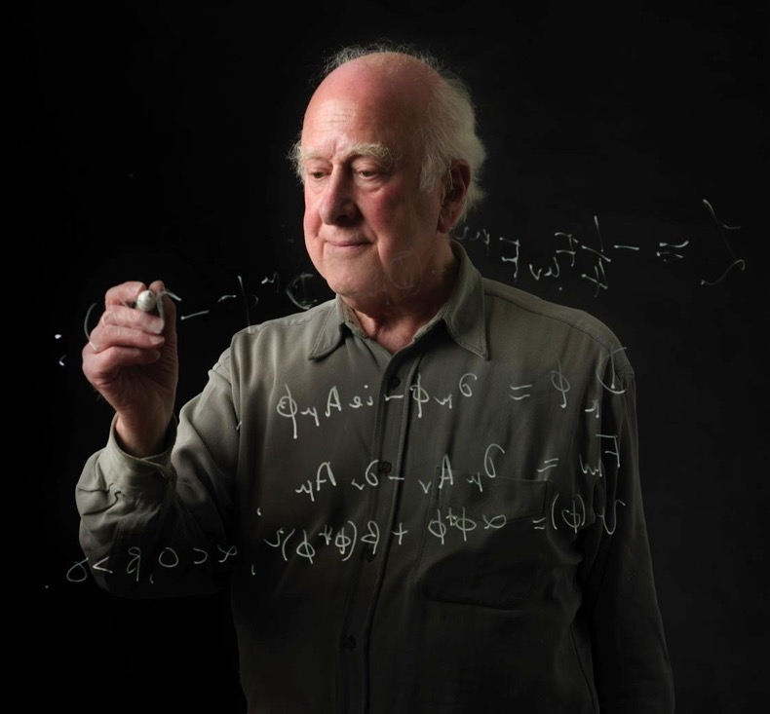
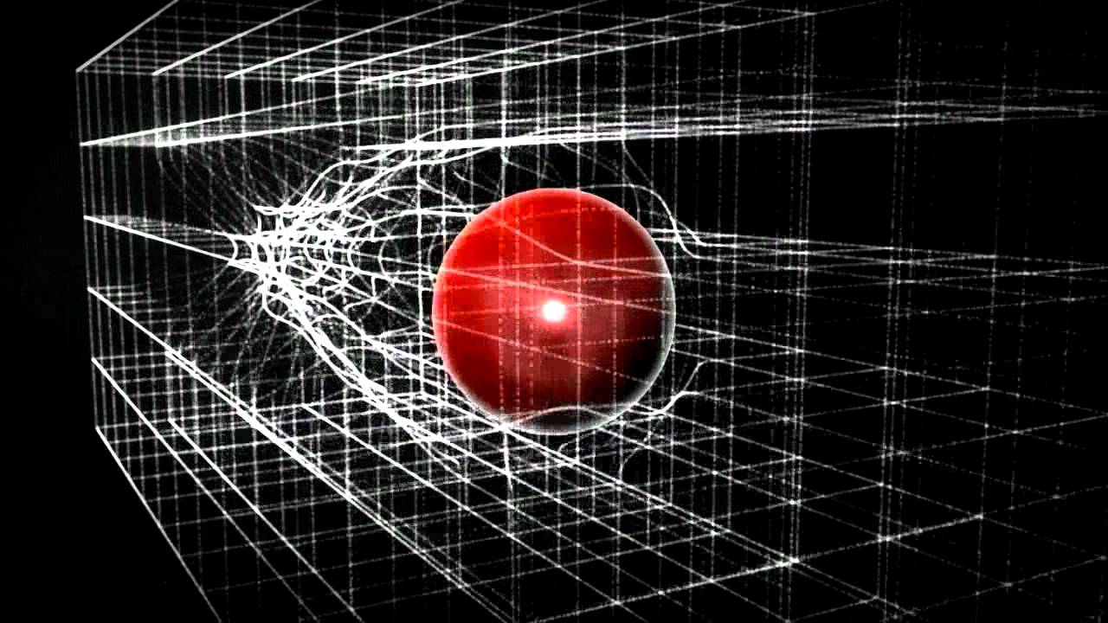
How do elementary particles attain mass?
Proposed in 1964

Slide 42
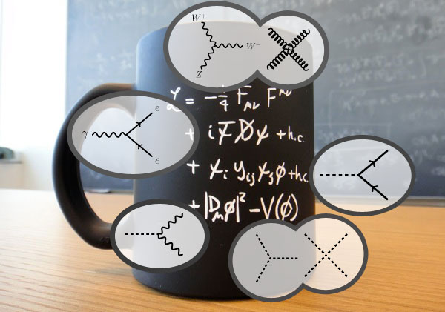
ELEMENTARY PARTICLE INTERACTIONS

Slide 43

The Large Hadron Collider at CERN
CMS
27 km
LHCb
ALICE
ATLAS

Slide 44
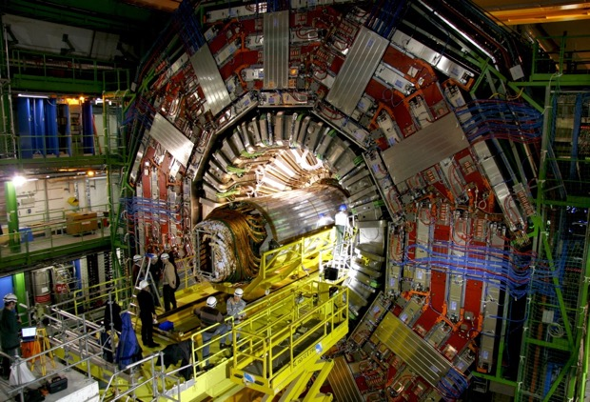
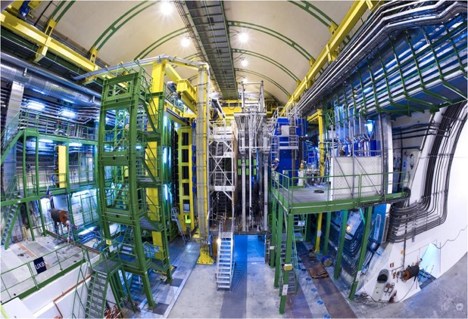
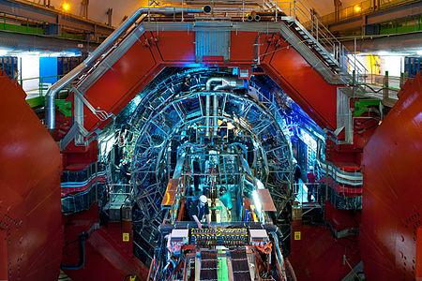
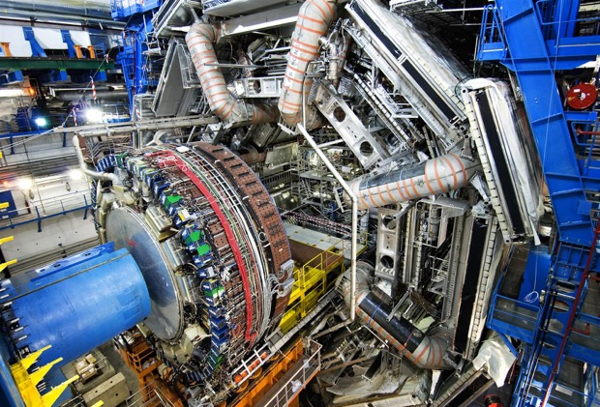
CMS
LHCb
ALICE
ATLAS

Slide 45
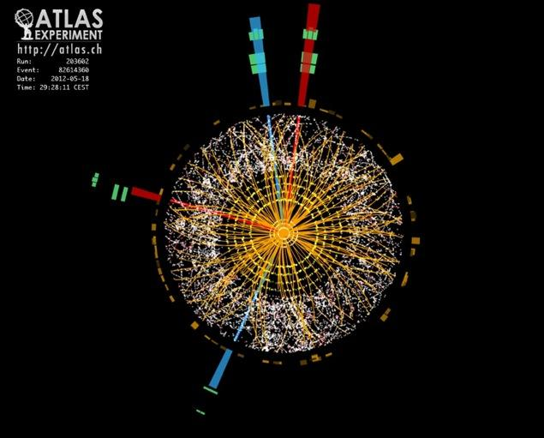

Higgs boson
Discovered in 2012

Slide 46

Higgs boson today
Notes:
Ashesh on Drums

Slide 47

Higgs boson today
How strongly
each particle interacts with
the Higgs field
Notes:
Ashesh on Drums

Slide 48
A sample of other LHC discoveries

Slide 49

The world before protons were born

Slide 50


Quarks can connect in fours and fives

Slide 51

Photons can collide

Slide 52


Nuclei play games!

Slide 53


Antihydrogen behaves like hydrogen (so far)

Slide 54
So, What’s Next?

Slide 55





Some post-LHC possibilities
CLIC
FCC
CEPC / SppC
IMC
ILC

Slide 56

The Future Circular Collider

Slide 57

The International Linear Collider

Slide 58

The International Muon Collider
The muon challenge:
  Lifetime = 2.2 μs (at 98% speed of light, that’s 660m)
  But with relativity it can go 5 times as far!
Why?
  A muon’s mass is 200 times that of an electron
  But a muon is elementary, as well

Slide 59
Why?
What questions remain?

Slide 60

Where do we come from?
Where are we going?
What?

Slide 61

Why do we exist at all?

Slide 62








What are we made of?
10⁻¹ m
visible stuff
10⁻⁹ m
molecule
10⁻¹⁰ m
atom
10⁻¹⁴ m
nucleus
10⁻¹⁵ m
proton
neutron
< 10⁻¹⁸ m
quark
electron

Slide 63




Why is gravity so weak?
Strong Nuclear
60
Electromagnetism
1
Weak Nuclear
10⁻⁴
Gravity
10⁻⁴¹
Relative force strengths specified at scale of quarks and gluons

Slide 64

Could there be other dimensions?

Slide 65


What is holding this together?
Vera Rubin

Slide 66

0.5%
Stars, Planets, etc.
Interstellar Gas
4.5%
27%
Dark Matter
Dark Energy
68%

Slide 67
Economists might still insist on know how this affects us today…

Slide 68

Microstrip Detectors → Retina Analysis

Slide 69

Diamon Sensors → Hadron Therapy

Slide 70

Ultrasound Gas Analysis → Anaesthesia

Slide 71

3D Sensors → Medical Imaging

Slide 72

Optical Metrology → Sound Reproduction

Slide 73
What’s the most important experiment at CERN?

Slide 74

Human Collaboration

Slide 75

Voyager

Slide 76


Carl Sagan
“Look again at that dot. That’s here. That’s home. That’s us. On it everyone you love, everyone you know, everyone you’ve ever heard of, every human being who ever was, lived out their lives.”
“There is perhaps no better demonstration of the folly of human conceits than this distant image of our tiny world. To me, it underscores our responsibility to deal more kindly with one another and to preserve and cherish the pale blue dot, the only home we've ever known."

Slide 77


Slide 78

Thank you!

