Slide 1
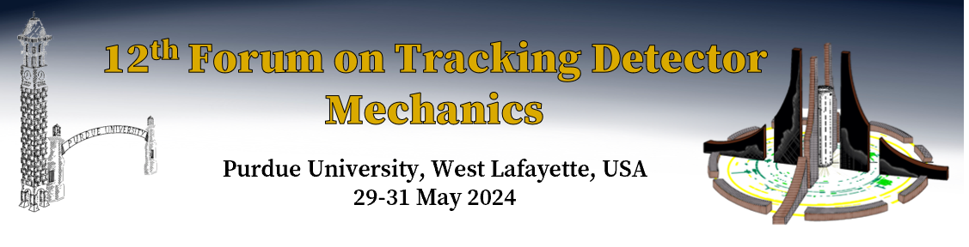
Assembly and installation of the MVTX silicon vertex detector into the sPHENIX experiment
Walter Sondheim
Los Alamos National Laboratory
May 29th, 2025

Slide 2
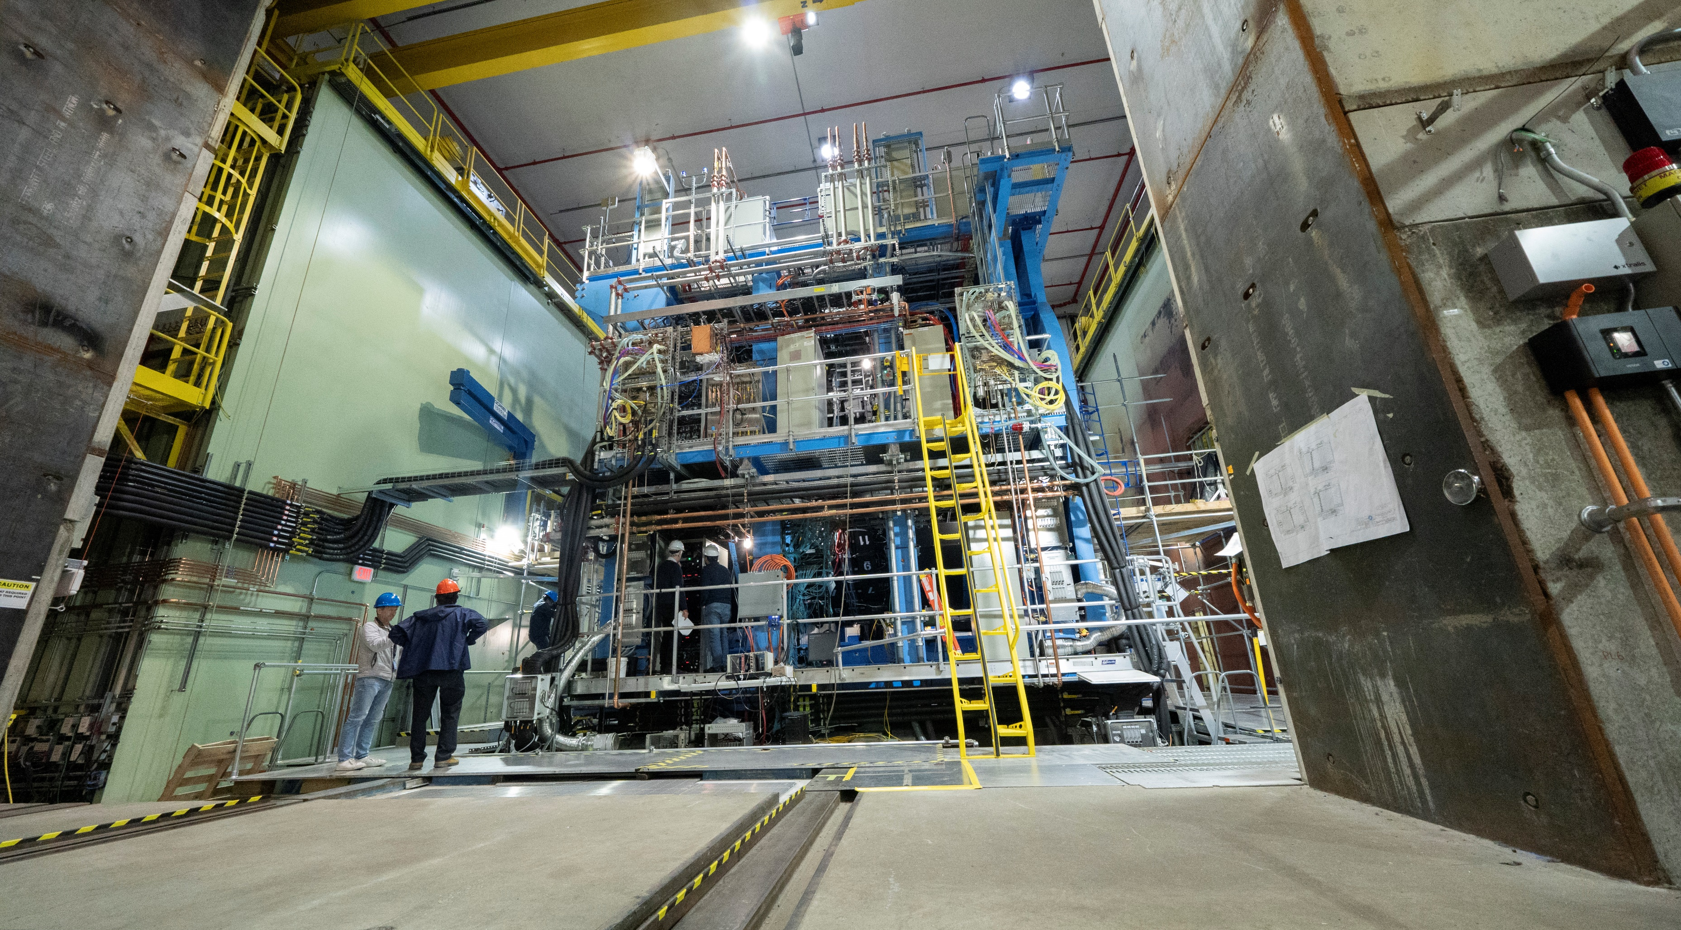
sPHENIX experiment at RHIC
Collider physics experiment using the RHIC accelerator at BNL, major facility hall;
  Physics goal take data with P-P and Au-Au collisions at 200 GeV
  Overall size: length 7556.5 mm, width 7620.0 mm height 7473.0 mm
  Solenoid magnet coil – BABAR experiment, SLAC, 1.4 tesla magnetic field

Slide 3
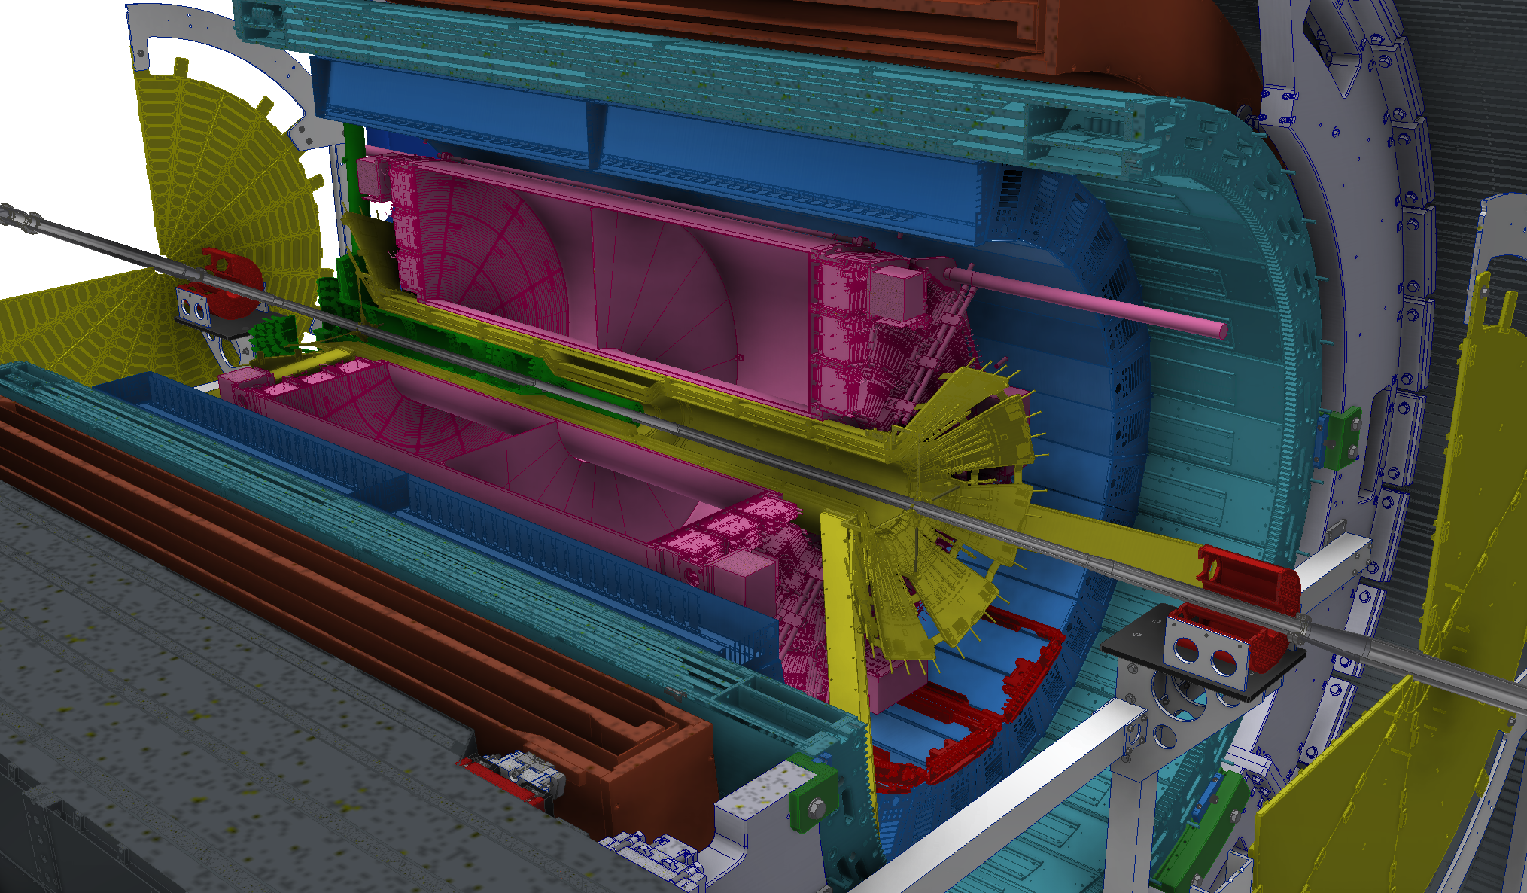

sEPD
MVTX
EMCAL
TPC
iHCAL
MAGNET
MinBIAS
oHCAL
INTT
TPOT

Slide 4
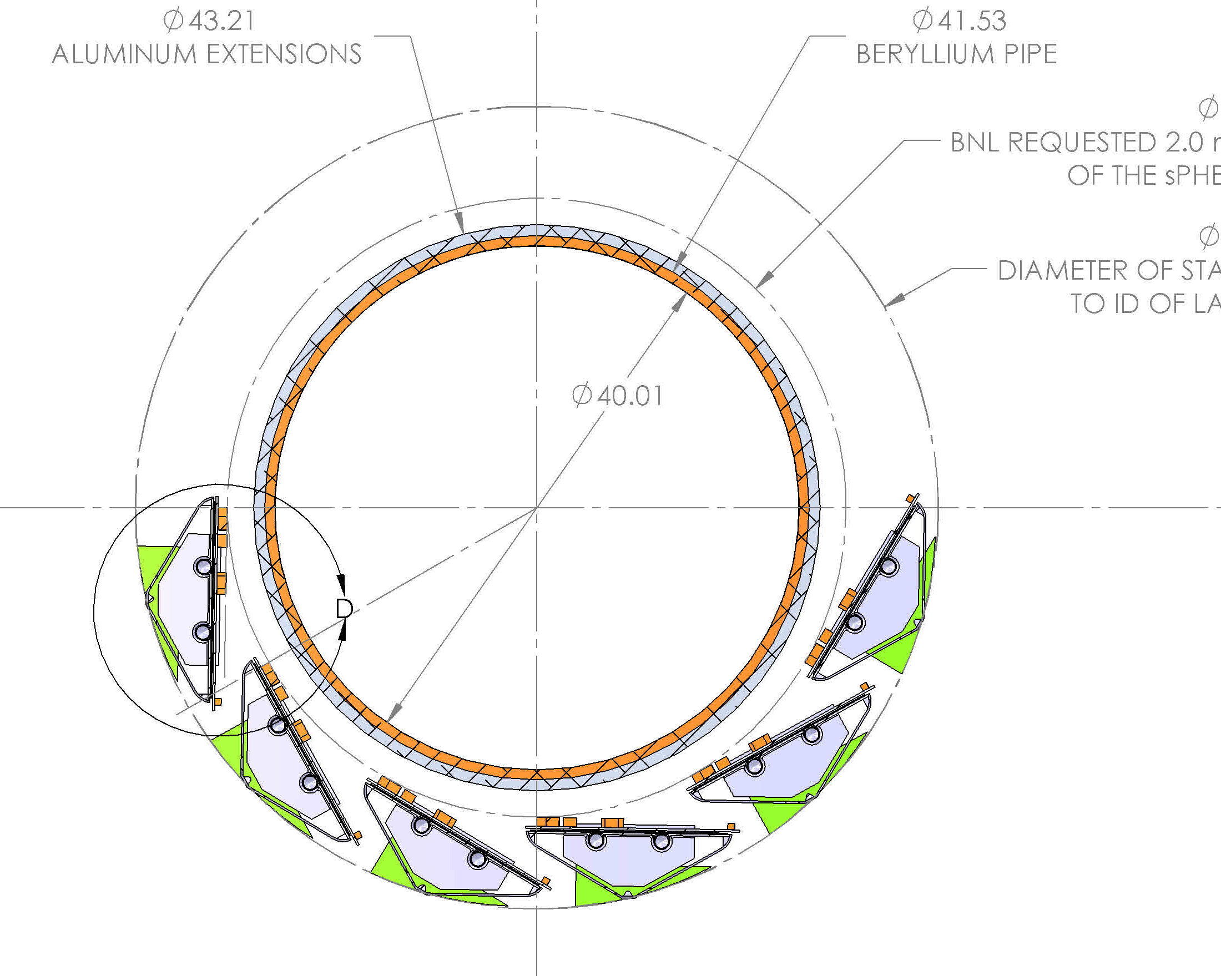
Engineering challenge; to construct a silicon vertex detector as close as possible to the installed collider Beryllium beampipe and be able to install this detector with the other two tracking detectors in place – the INTT and the TPC
The MVTX detector will be designed to make use of the same stave/ladders used in the ALICE ITS2 vertex detector.
Different geometric constraint:
ELEMENTS | ALICE ITS2 | sPHENIX MVTX
# Staves, 3 radial layers | 48 (inner barrels) | 48
Cantilevered Length (support-to- IP) | ~1.0 m | ~1.8 m
Beampipe radius | 19.0 mm | 20.76 mm (Be) / 21.7 mm (Al)
Inner Layer L0 sensors radius | 22.38 mm | 23.61 mm
Beampipe clearance (to sensors) | 3.38 mm | 3.85 mm (Be) / 2.91 mm (Al)
Beampipe clearance (to nose flange) | 3.38 mm | 2.07 mm (Be) / 1.125 mm (Al)
Primary structural construction | Foam core carbon fiber | Carbon fiber
Detector split configuration | Top / Bottom | Left / Right
Expected total radiation dose | 2700 kRad | < 100 kRad
43.21 mm dia.
aluminum
Extension
41.53 mm beryllium dia.
47.21 mm dia.
61.21 mm dia.
Innermost layer, L0, radial envelope

Slide 5
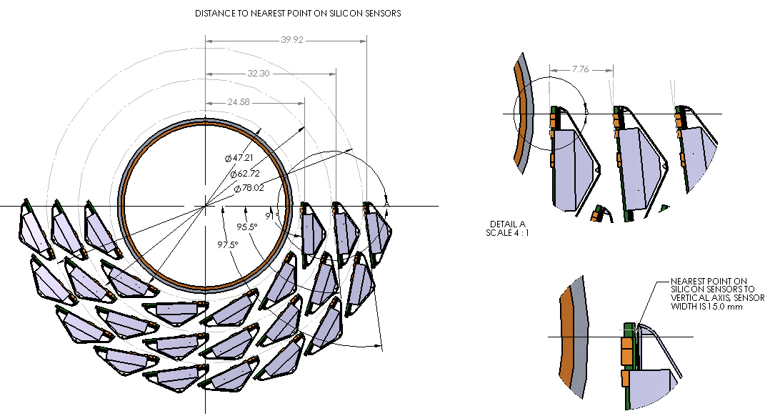
New radial configuration for three layers of staves for the MVTX detector in sPHENIX
Radial distance to closest point on silicon sensors:
39.01 mm
7.76 mm
31.36 mm
23.605 mm
Detail view
L2 L1 L0

Slide 6
Modification to ITS2 stave assembly, extended power cable by 40.0 cm, needed because of radial space restriction – INTT for patch panels
Location for patch panel for power cables in service cylinder down stream of CYSS
Location for patch panel at CYSS, signal cables
With the tested extended length of the power cables from the stave we now have a path forward to reduce the diameter of the patch panels in the conical region of the MVTX detector

Slide 7
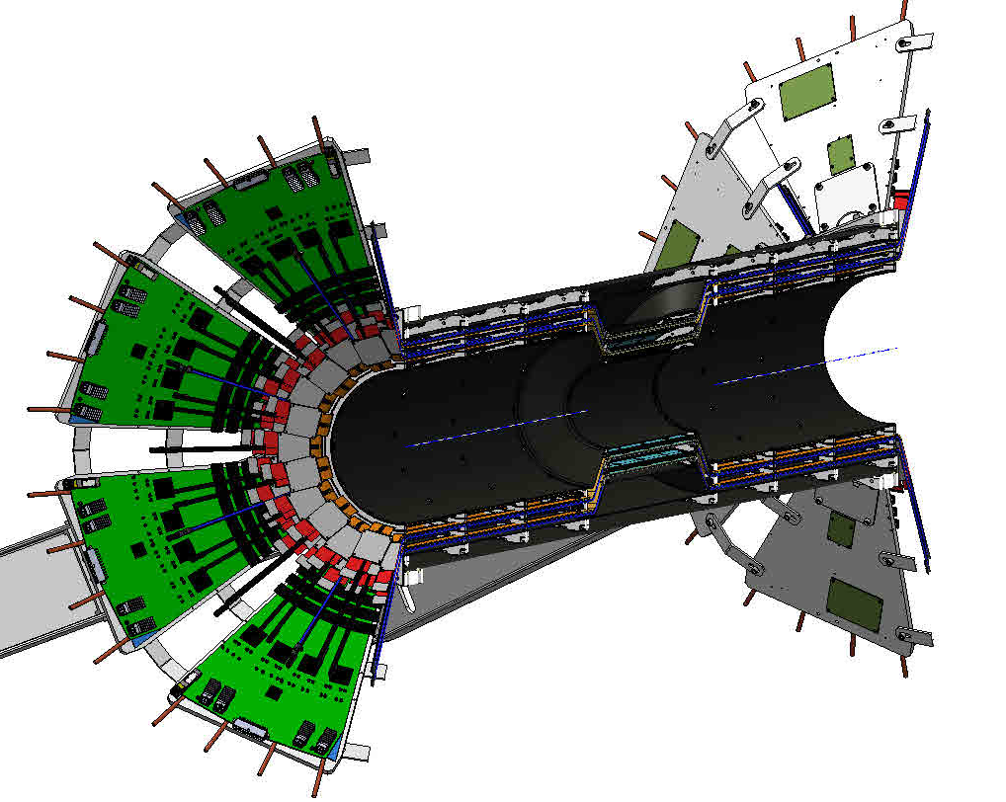
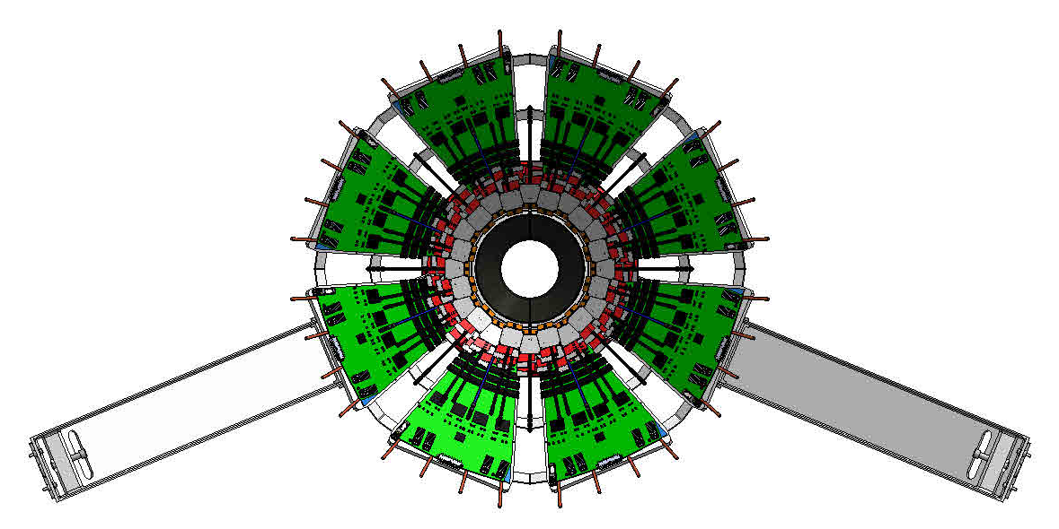
INTT sets the maximum outer diameter for the MVTX
Inner diameter of INTT inner shell 129.7 mm, this sets the OD of the MVTX
INTT read-out cards, six at each end
End view with support structure
Section view, lengthwise, inner carbon shell defines outer MVTX envelope

Slide 8
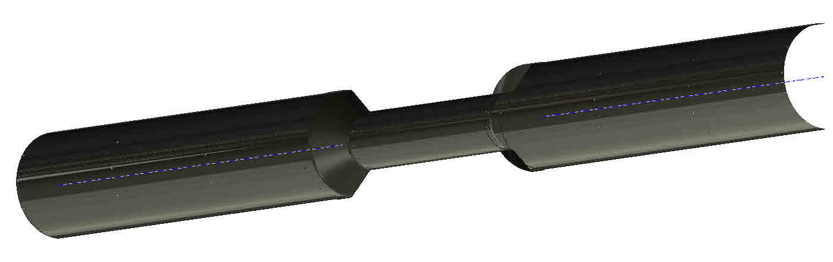
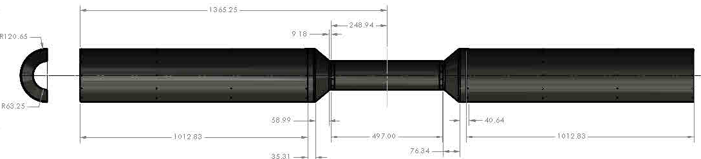
INTT inner carbon tube, the MVTX vertex detector will be designed that the staves center about the IP, 1365.25 mm at a minimum from the insertion end
Section view, isometric
1365.25 mm
IP
R 120.65 mm
248.94mm
R 64.85 mm, sets OD of MVTX
497.0 mm

Slide 9
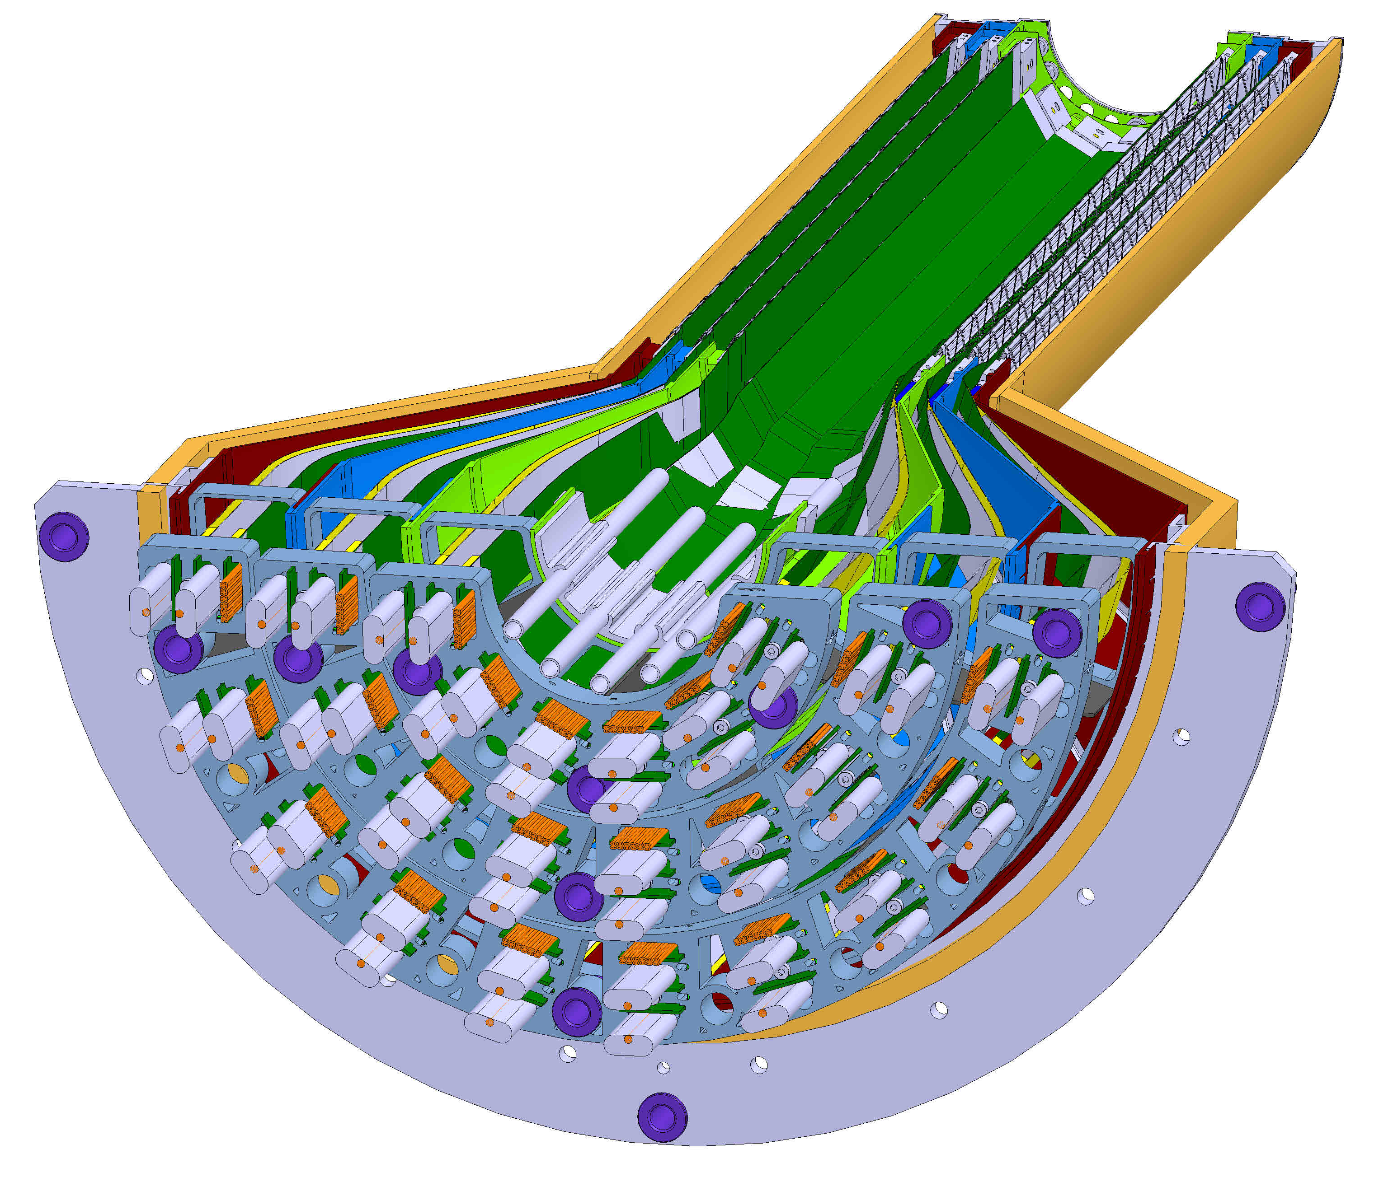
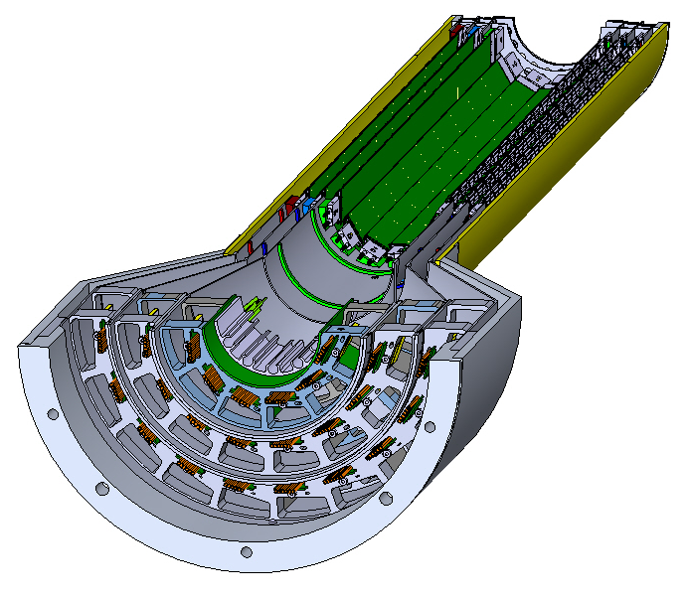
Conical sections of MVTX needs to have smaller diameter from ALICE ITS2 design
Integration with INTT detector prohibited by original larger diameter of conical region:
ALICE ITS2 inner tracker
MVTX inner tracker
Dia.=105.64mm
R=128.6mm
Patch panels for stave signal cables
3D print
Pass-through ports for stave power cables
CYSS
R=140.0mm
R=107.5mm

Slide 10
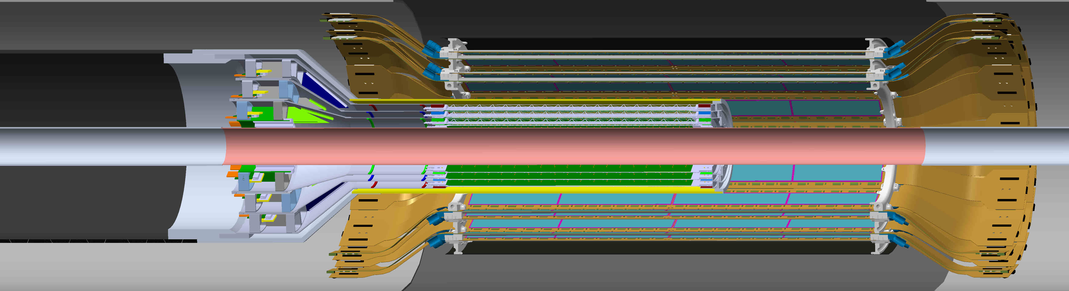
Thread the needle, integrate the MVTX with the INTT and the beam-pipe
Two layer silicon strip INTT detector,,
Extension cables go out each end
Three layer MVTX detector
Extension cables only in service cylinder

Slide 11
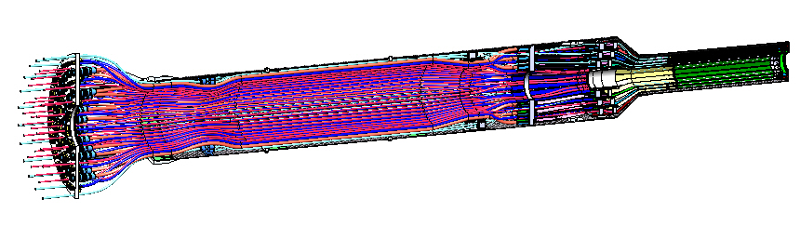
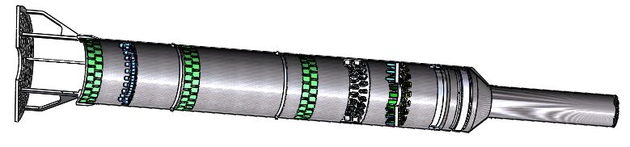
Initial CAD model for a half MVTX assembly
Aluminum interconnect patch panel
MVTX with all services, signal, power, cooling – water and air
CYSS length 608.9 mm
Service barrel length 1214.4 mm
Radius of service barrel 107.66 mm
Proposed MVTX exterior carbon composite structure

Slide 12
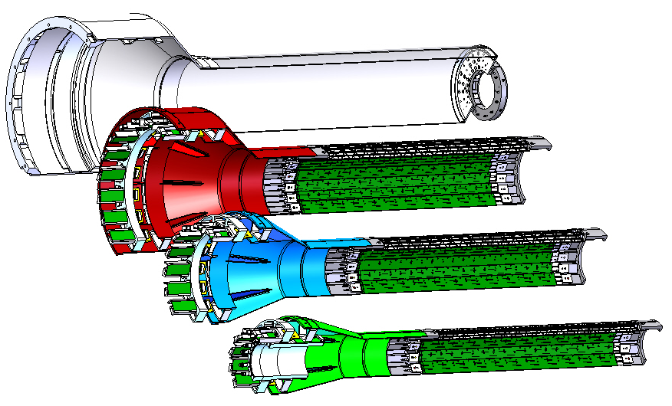
Composite fabrication: Work-shape, La Roche-de-Glum, France
Fabricated composite pieces for ALICE ITS2 assembly
Owner Simon Rubet
Contract to fabricate all composite pieces and pre-assemblies for the MVTX detector, 26 individual pieces; including end wheels for each of the three layers, CYSS outer shell for the stave assembly, long half service barrel assy.
Material choice: NGF Granoc; F8A03-1437 fiber with NM31 resin
CYSS indexed end flange
CYSS
L3
L2
L0
All three layers nestle with in each other using alignment pins and an indexed end flange as a part of the CYSS shell

Slide 13
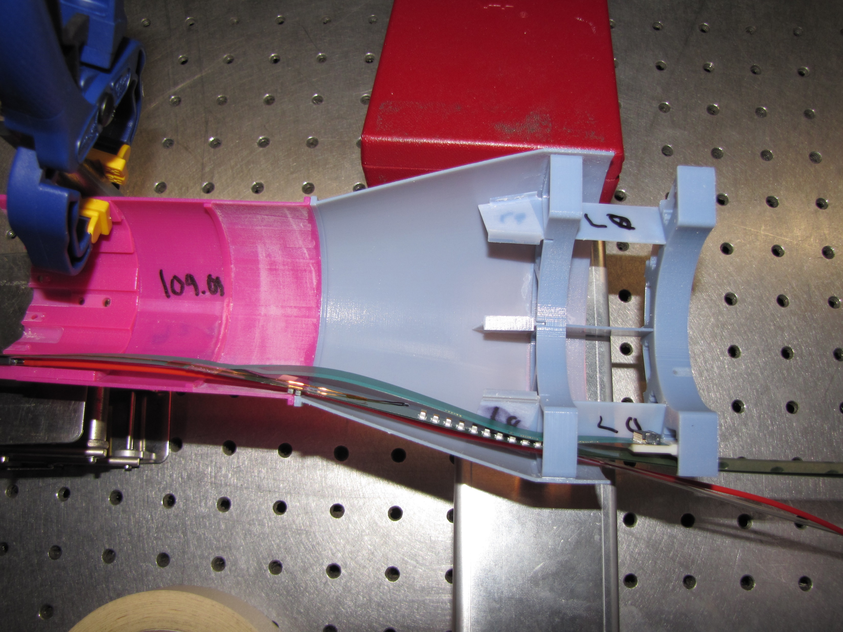
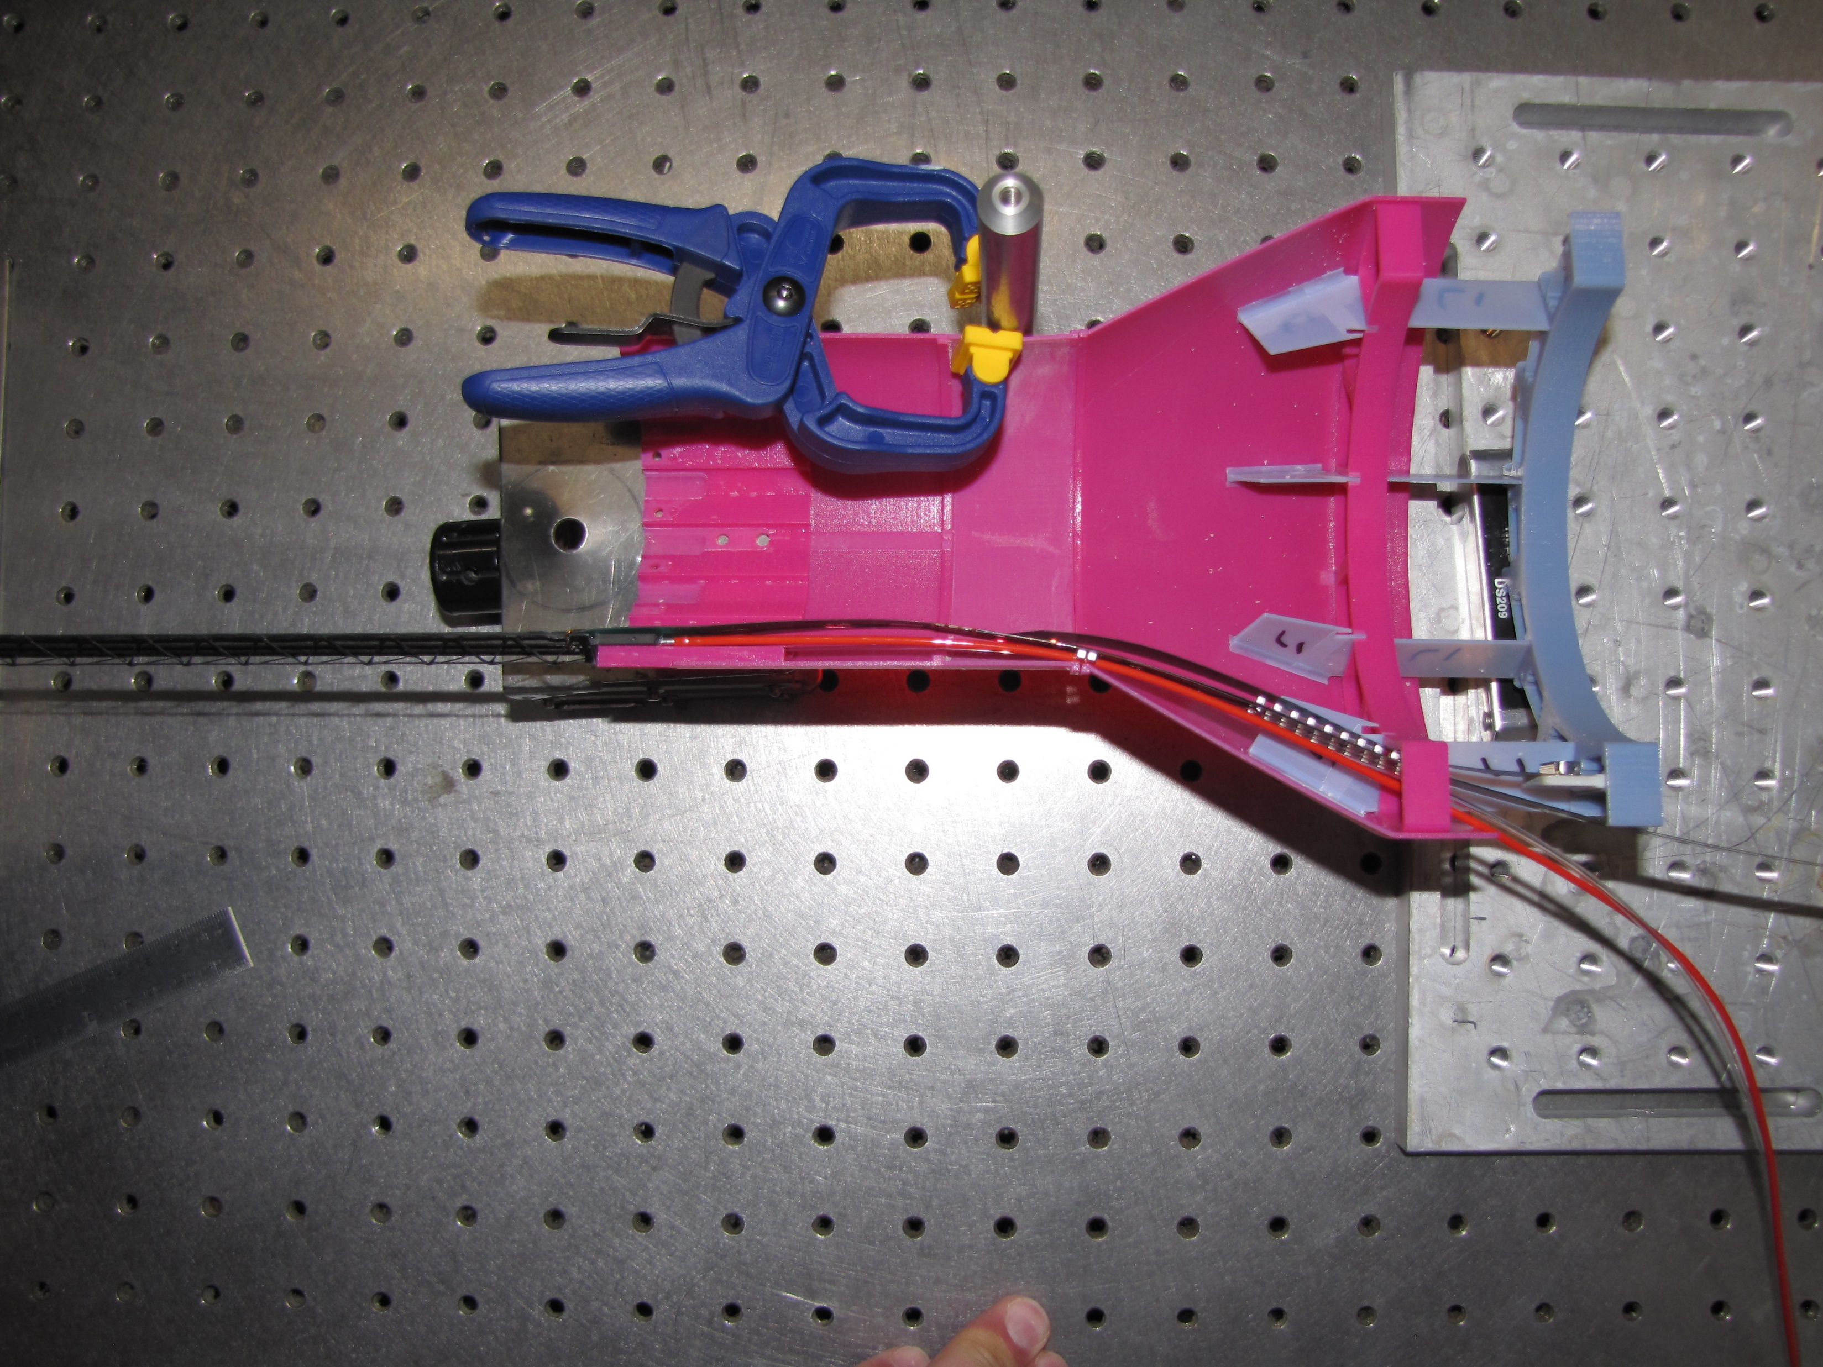
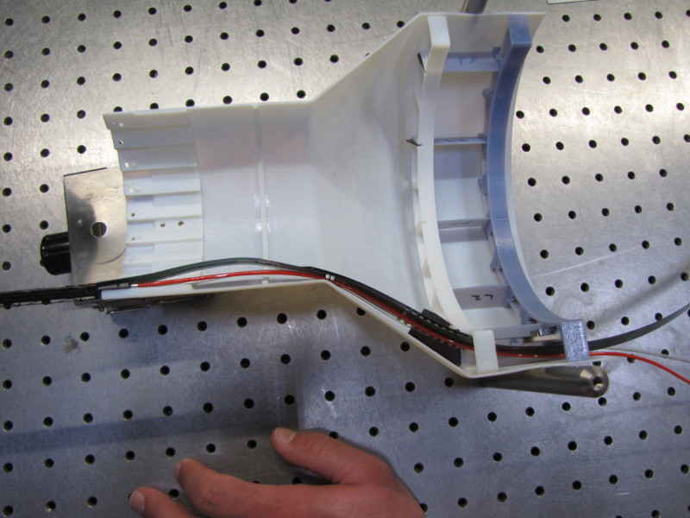
3D print prototype pieces to verify design will function with routing of service, before finalizing design for fabrication
Layer 0, stave services side
Layer 1, stave services side
Layer 2, stave services side

Slide 14
Work-Shape designs fixtures for composite layups, example L0

Slide 15
Work-Shape aluminum and 3D printed parts for L0 stave pass-through and stave signal cable termination interface
7075 aluminum pass-through and divider mount
Accura25 PP1

Slide 16
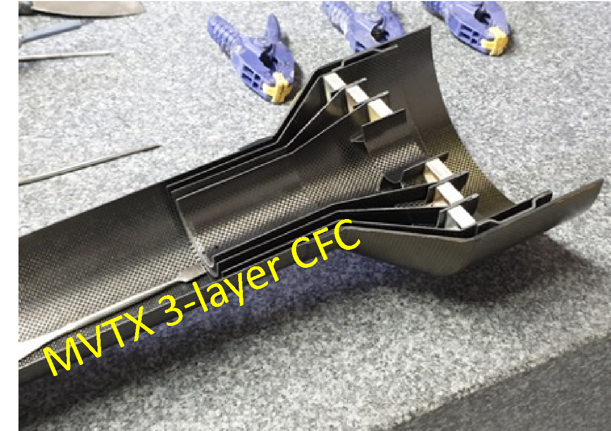
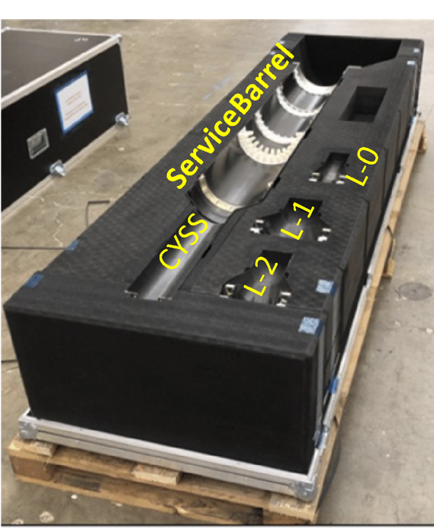
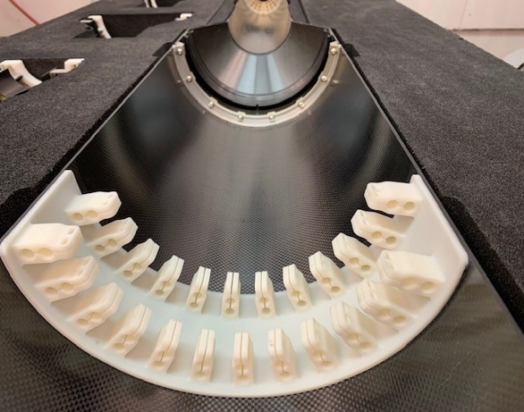
Delivery of composite pieces at LBNL from Work-Shape for layer assembly
Carbon fiber components:
  in hand & meet design specifications/tolerances, verify with CMM.
  Pre-assembled sections bonded using Scotch DP490 epoxy, this includes services supports, patch-panel and support ribs in interior of service barrel.
  Similar bonding of detector layer end assemblies, like the one shown in the upper left picture.
  All bonding was performed at Work-Shape prior to shipping.
3D print services support, Accura Bluestone

Slide 17
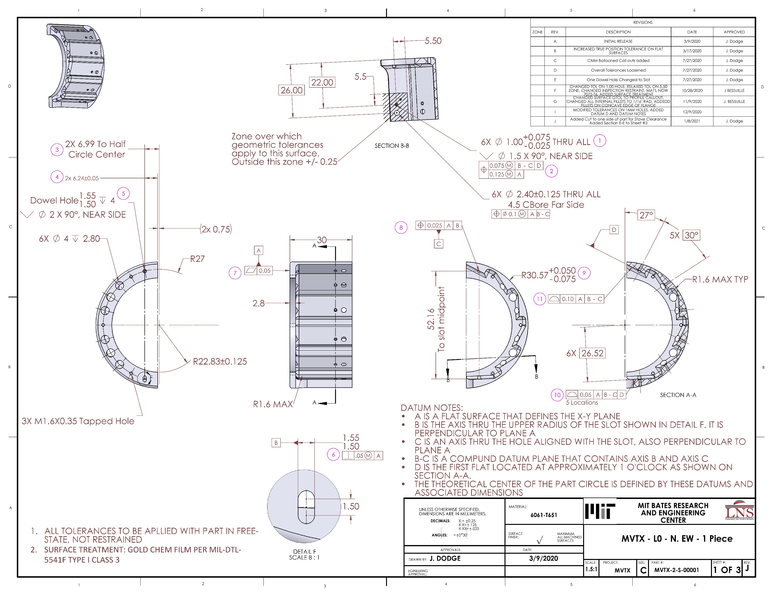
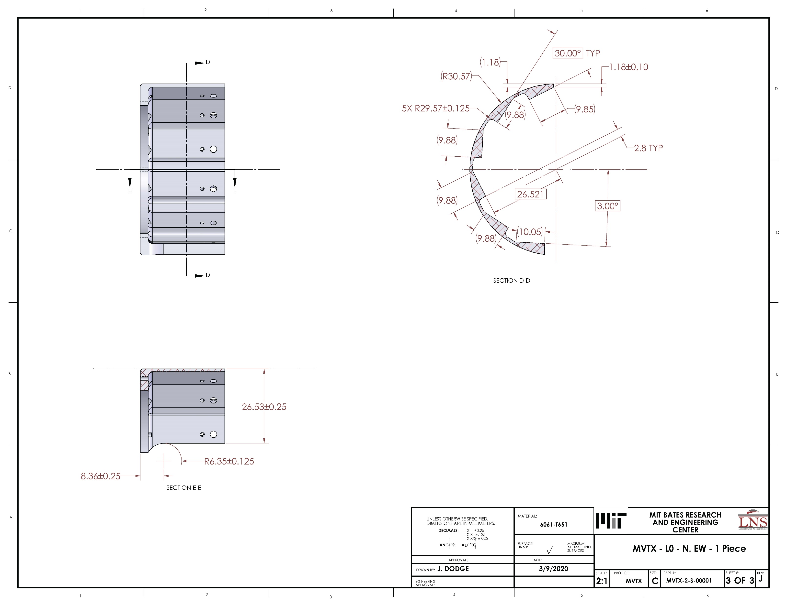
Precision machined end wheels to locate staves in each layer
To simplify each layer assembly a single machined piece was chosen
  Material 6061 T651 aluminum, anodized, five axis machined, Layer 0 drawings:
    Staves located using ruby ball in end wheels that aligns with hole and a slot in stave assembly
    End wheels machined to very tight tolerances
L0 South end wheel, sheets 1 & 3

Slide 18
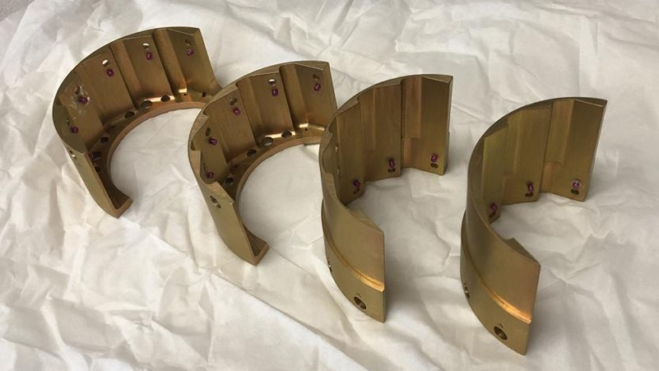
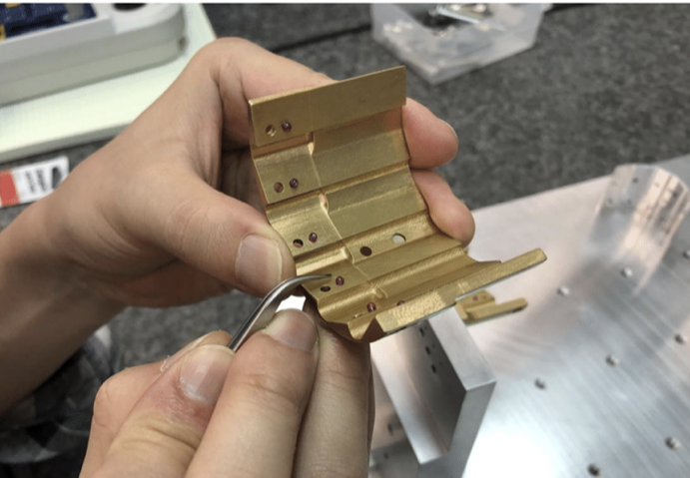
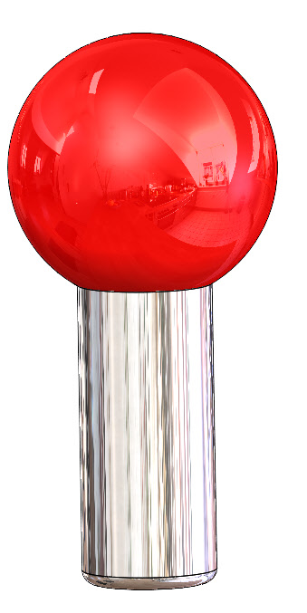
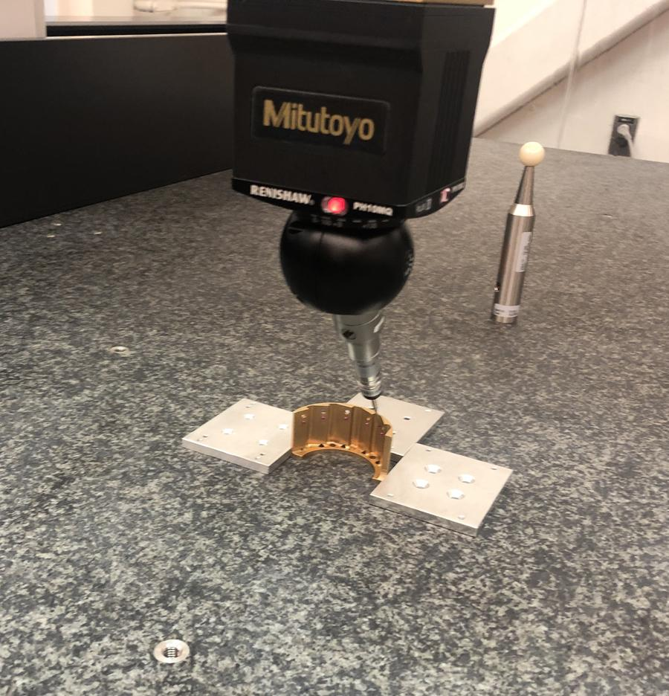
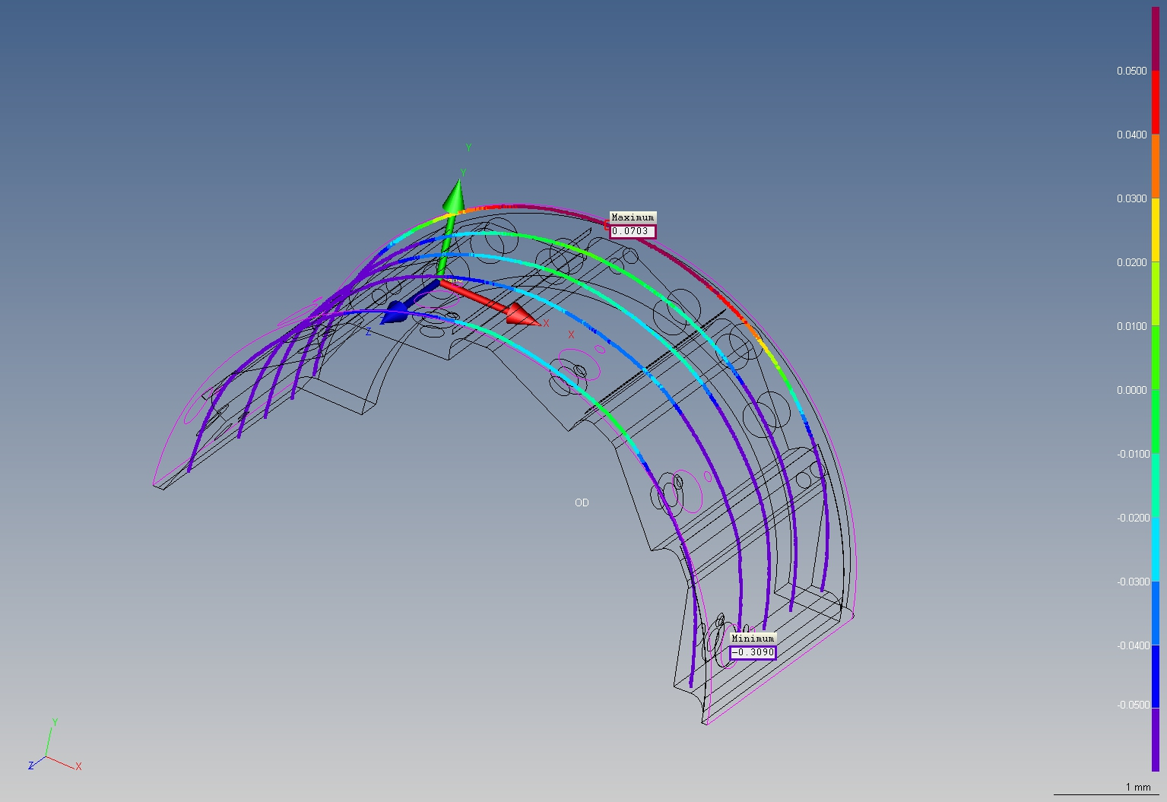
Fabricated aluminum end wheels prior to final assembly
Locate stave to end wheels;
1.0 mm dia. pin,
3.1 mm dia. ball.
Key match pin to hole in end wheel
CMM Study end wheel

Slide 19
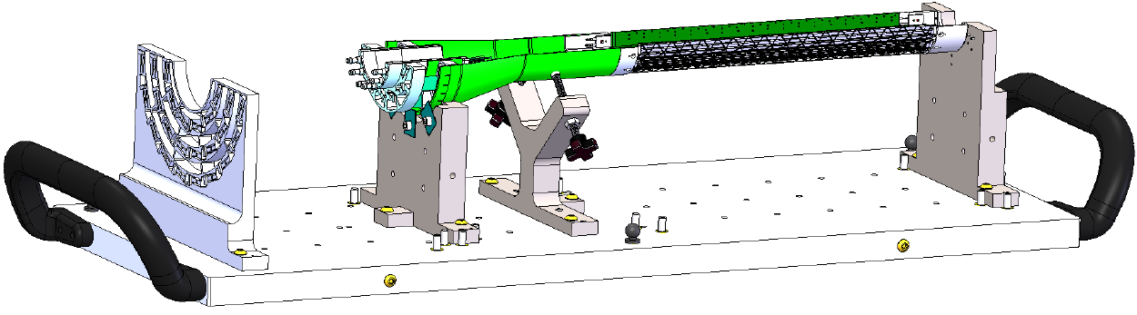
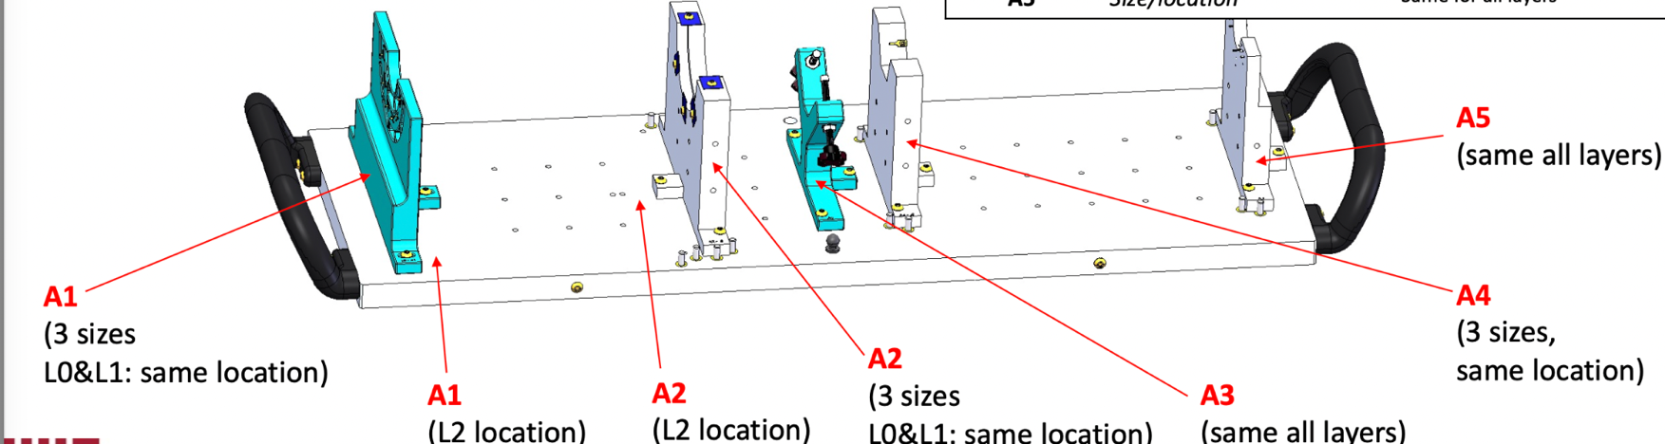
Fixtures; critical to the assembly of the three inner layers
Precision fixtures necessary so the two half detector assemblies come together around the beam-pipe to make 2π coverage.
L0 assembly fixture, used in one of 35 step assembly procedure for just this layer!
Using CMM is necessary to verify the dimensional
tolerance of a fixture.

Slide 20
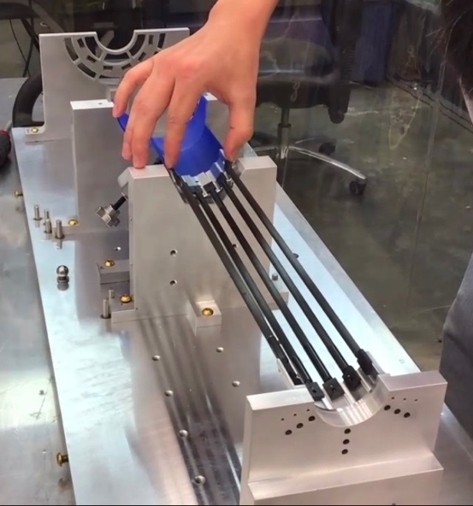
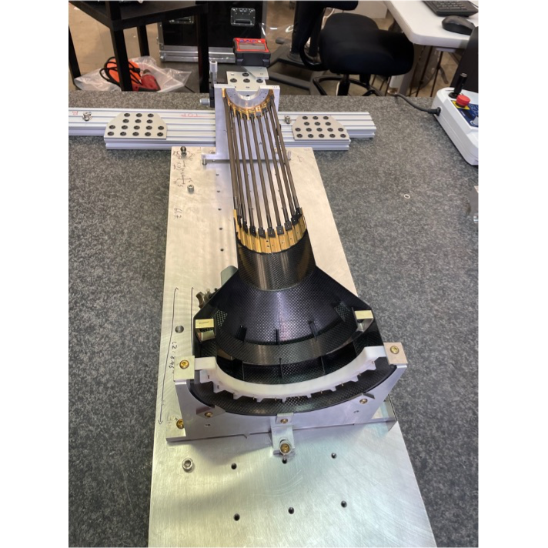
Layers L0 and L2 in assembly fixture with dummy staves
L0
L2

Slide 21
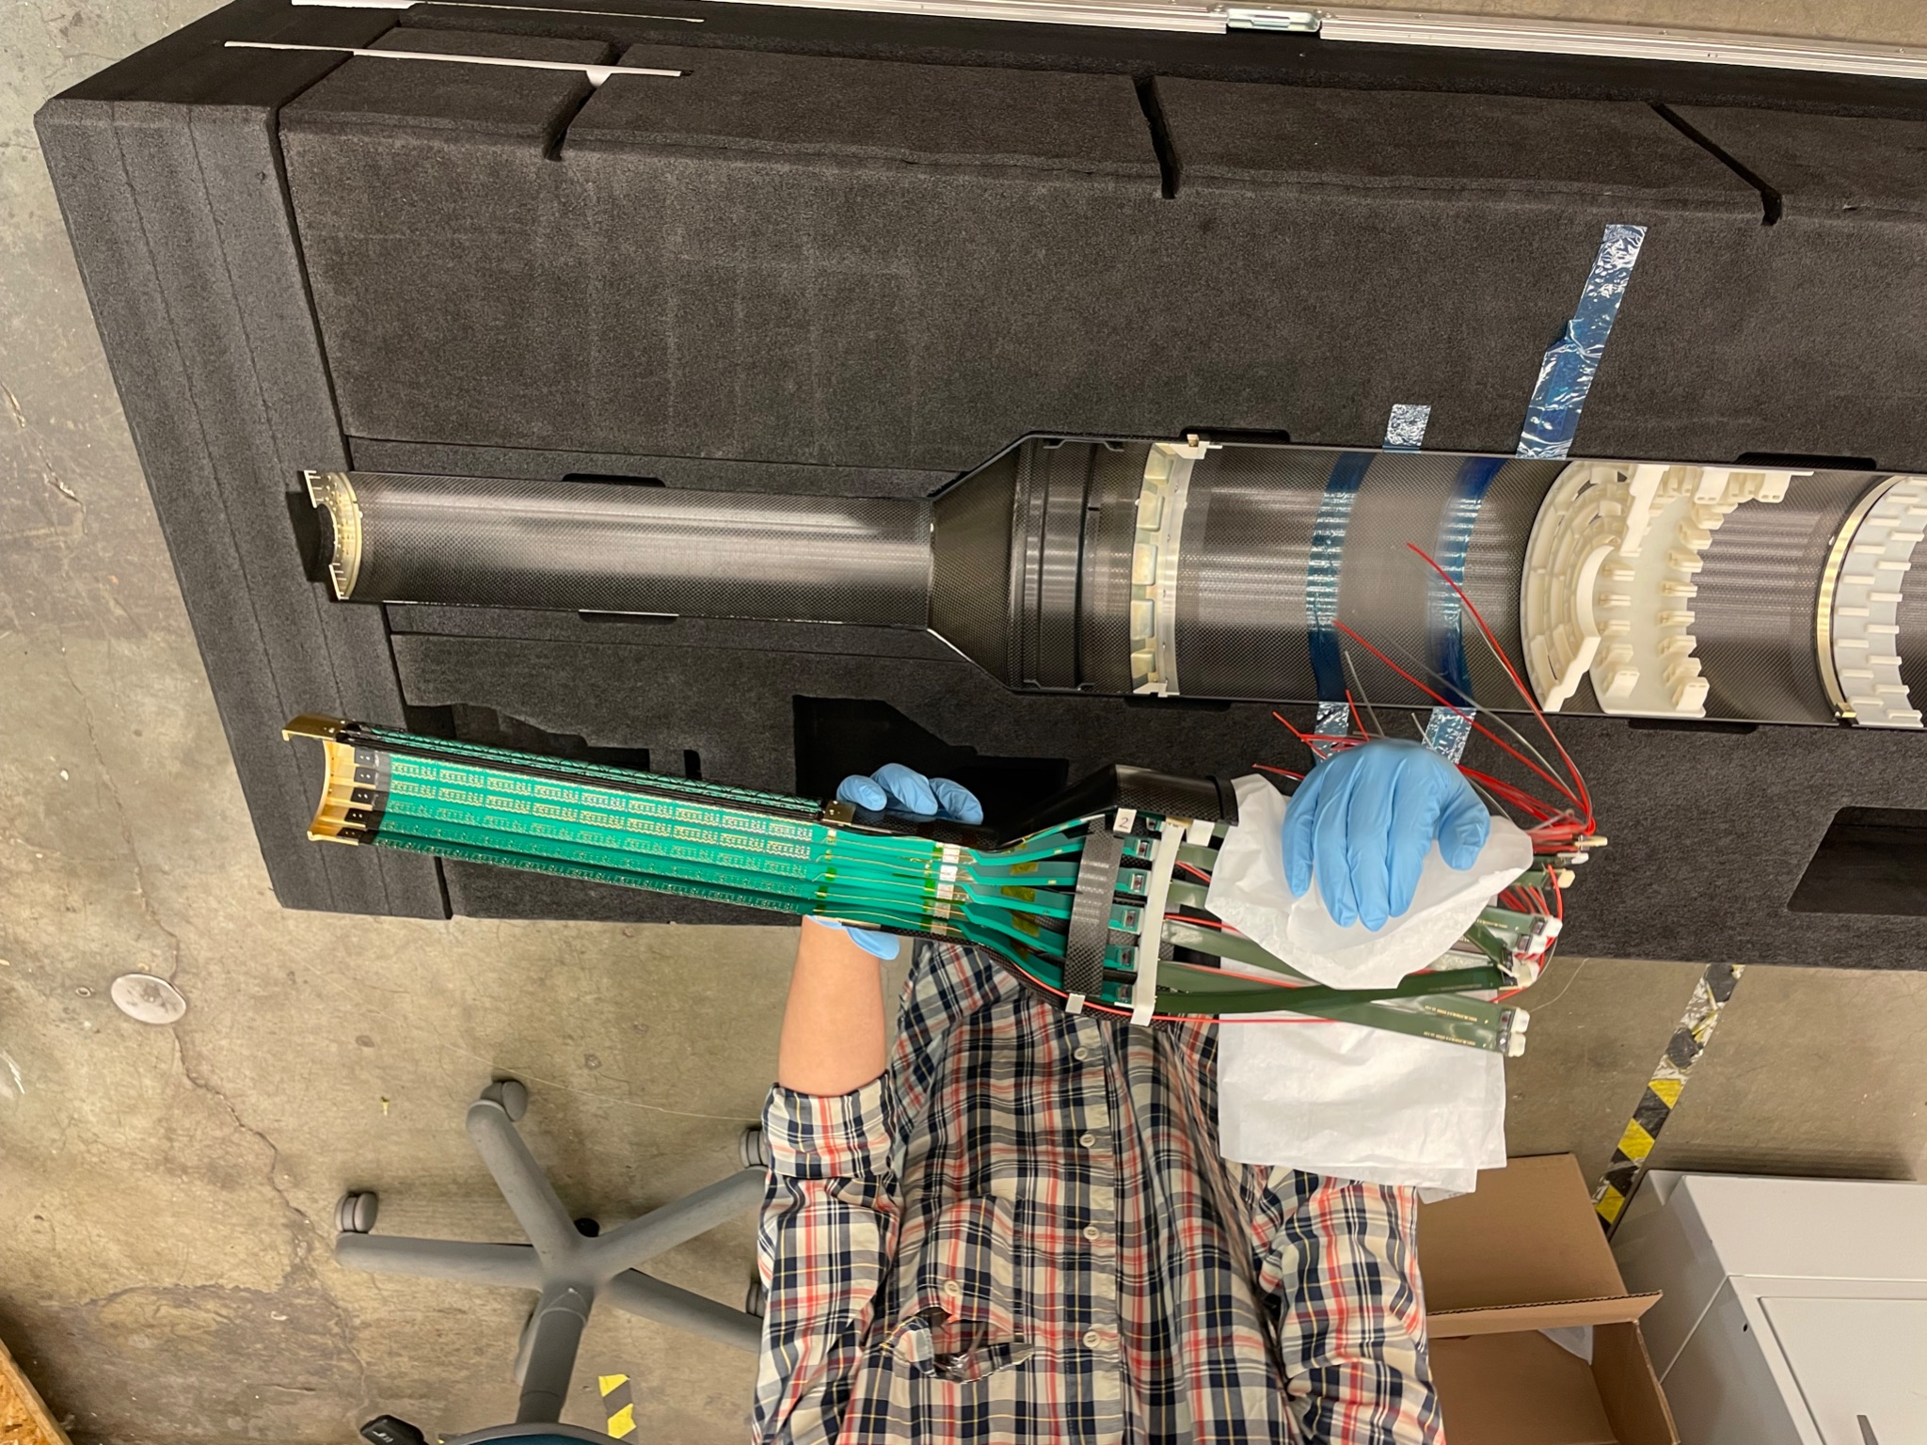
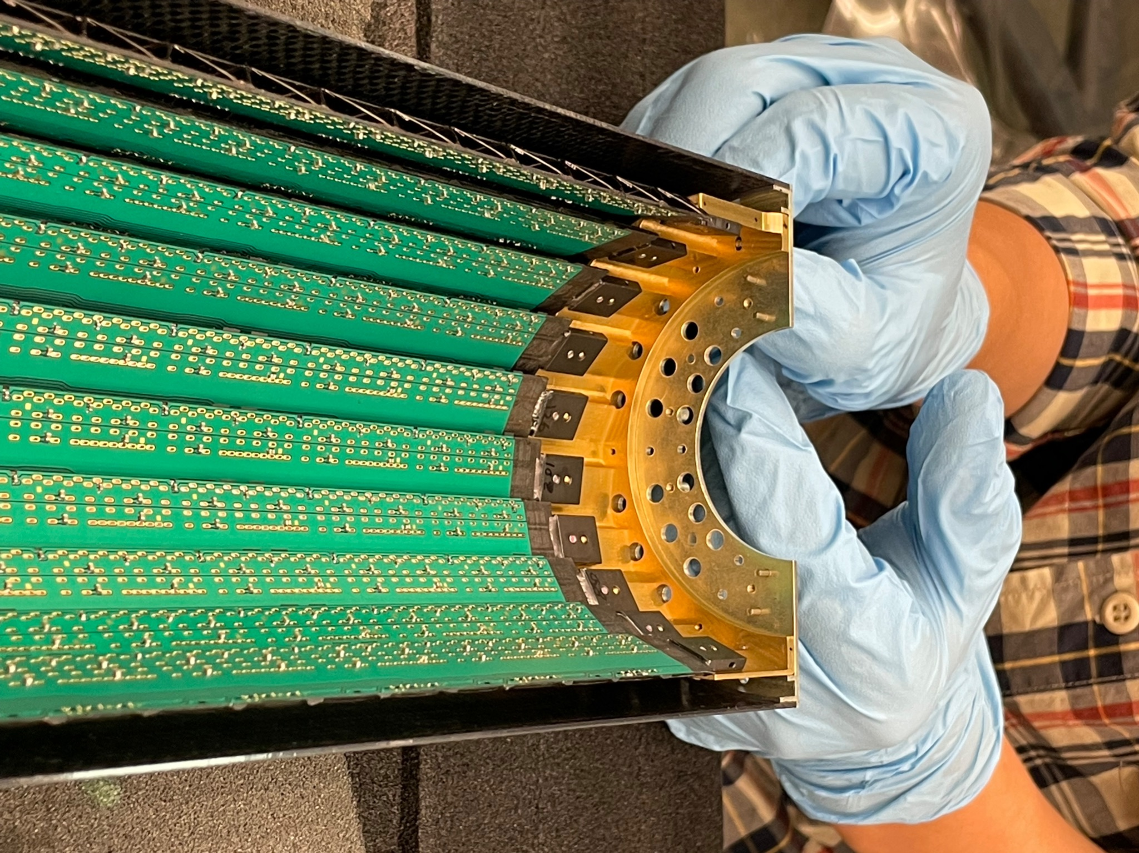
Mating assembledL2 with service barrel

Slide 22
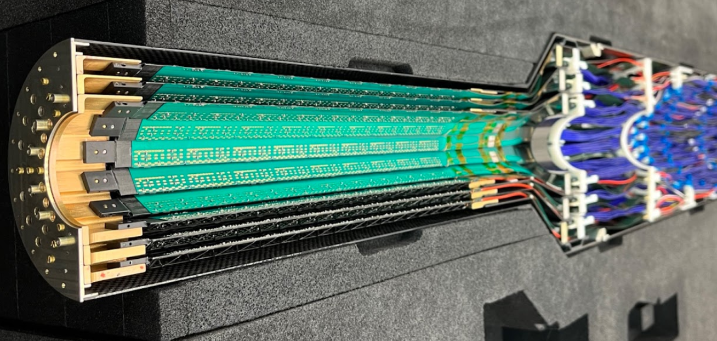
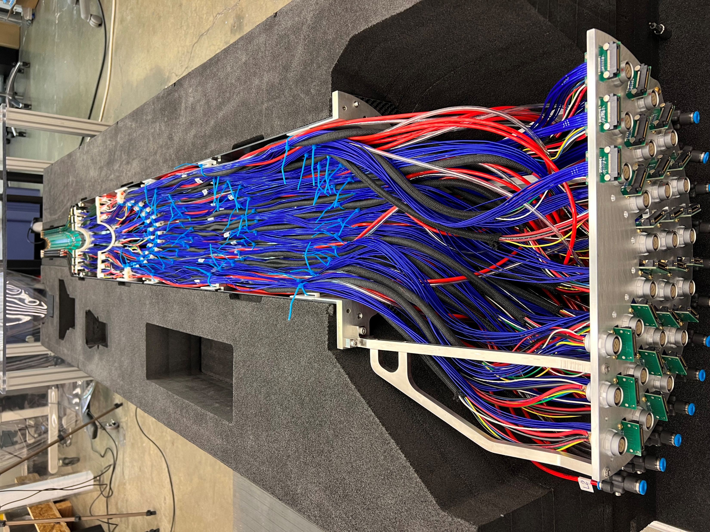
Half MVTX assembly, three layers with attached services
When you bring the two half detectors, there is the possibility that the FPC extension may come in contact between the two halves instead of leafing between them. We used 3D scans to see if there may be an interference – and if, place strategic spacers to help create adequate gaps so they would not interfere; one half with the other.

Slide 23
Grounding composite and aluminum pieces in half assembly
Use POLYTEC, PU1000 conductive glue as an interconnection between all the composite and aluminum pieces, scratch a patch 1 X 2 mm in composite surface
After application is cured check for continuity –
The aluminum anodized pieces have a gold chem film applied per MIL DTL 5541F

Slide 24
Stave assemblies have a ground wire incorporated in their assembly, it is brought out through the power connector

Slide 25
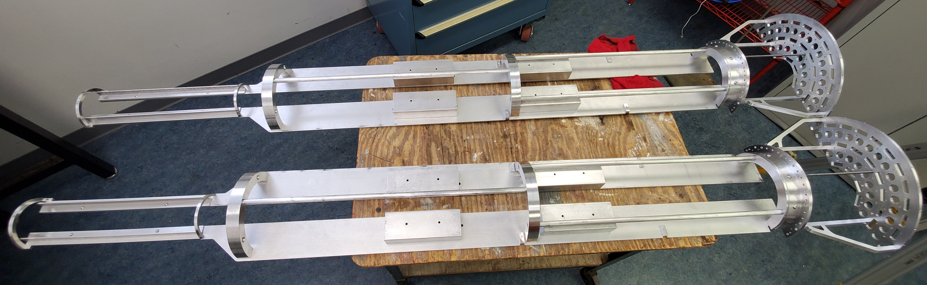
MVTX mechanical mock-up, same mass, staves and services
This mechanical mock-up is critical to test installation scenarios, it too would be mounted so the detector is cantilevered from the end flanges of the service barrels.
Each half same mass as the MVTX detector – uses ballast blocks:

Slide 26
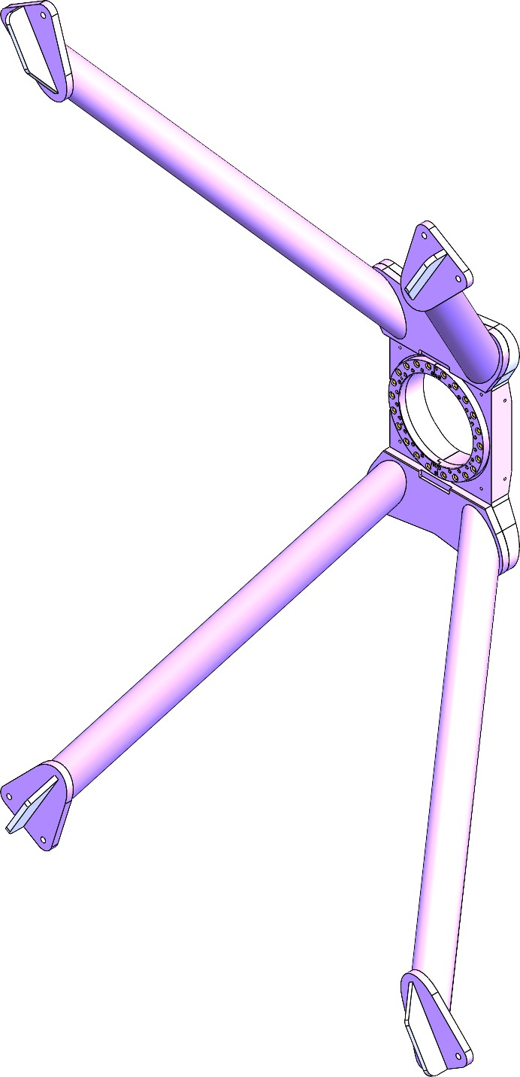
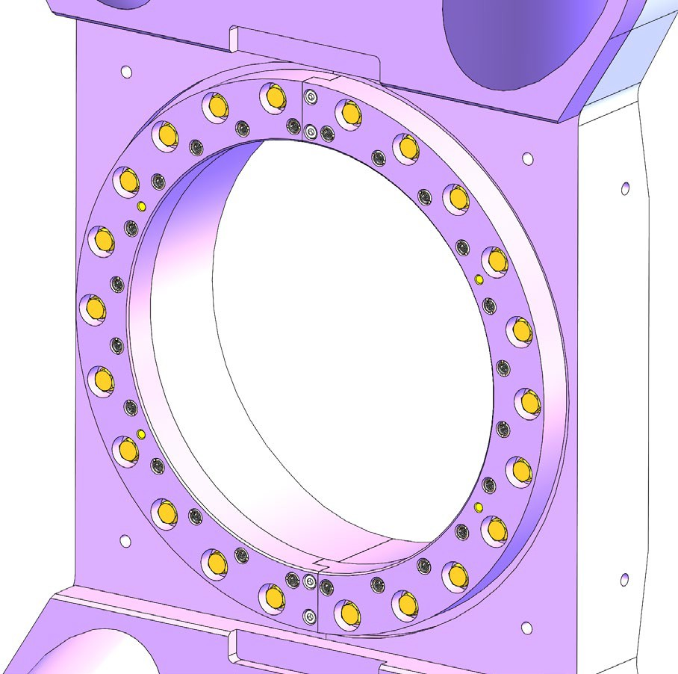
Integrate the MVTX detector with sPHENIX – X wing
 | New (Mk8)
 | Mass: 41 kg
 | Aluminum with Bronze & Nitronic inserts
 | Adjustable
 | No interference – installation bracket can be retracted without any disassembly
Once mounted to inner HCAL support ring, surveyed to +- .5 mm
In X and Y.

Slide 27
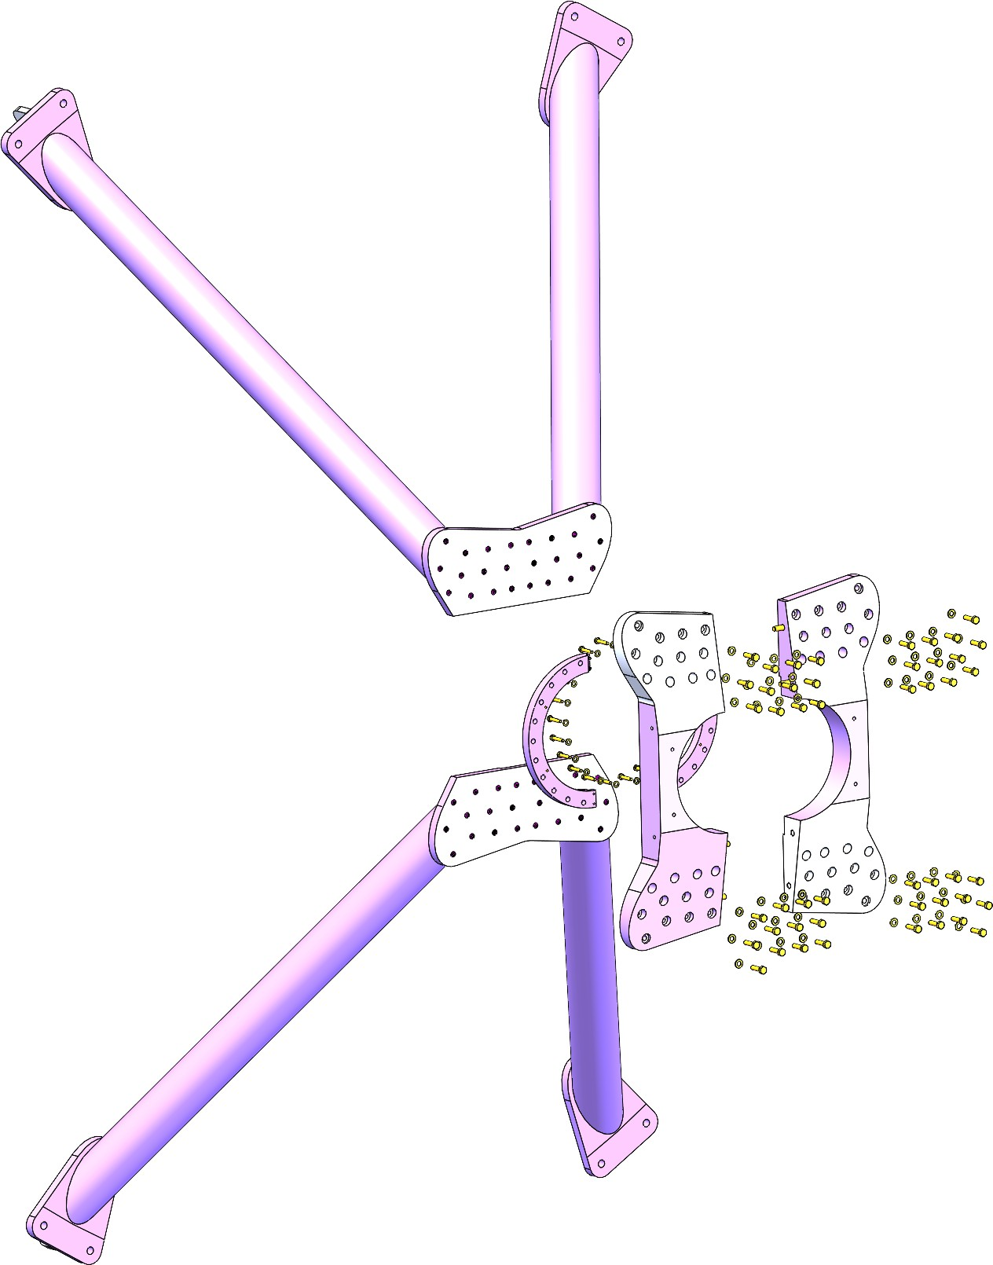
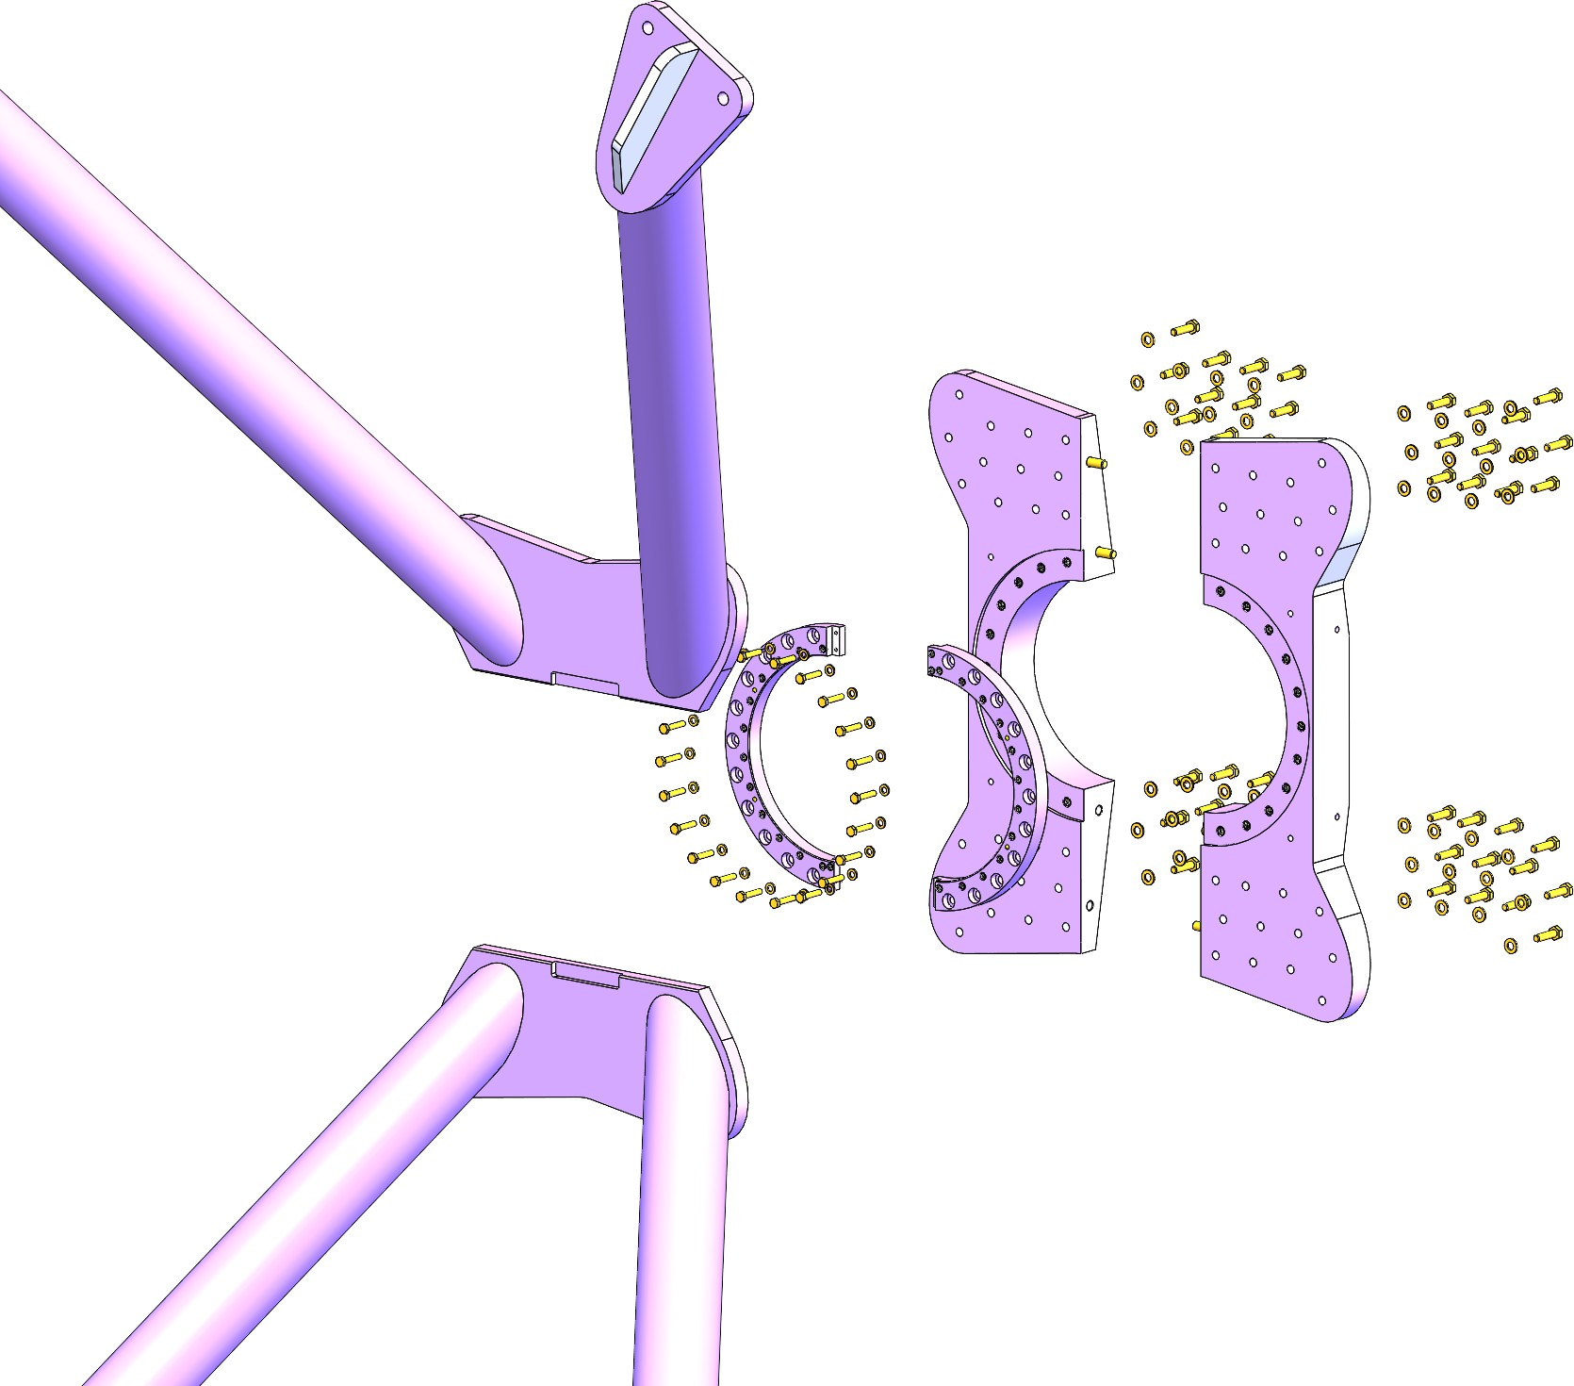

Slide 28
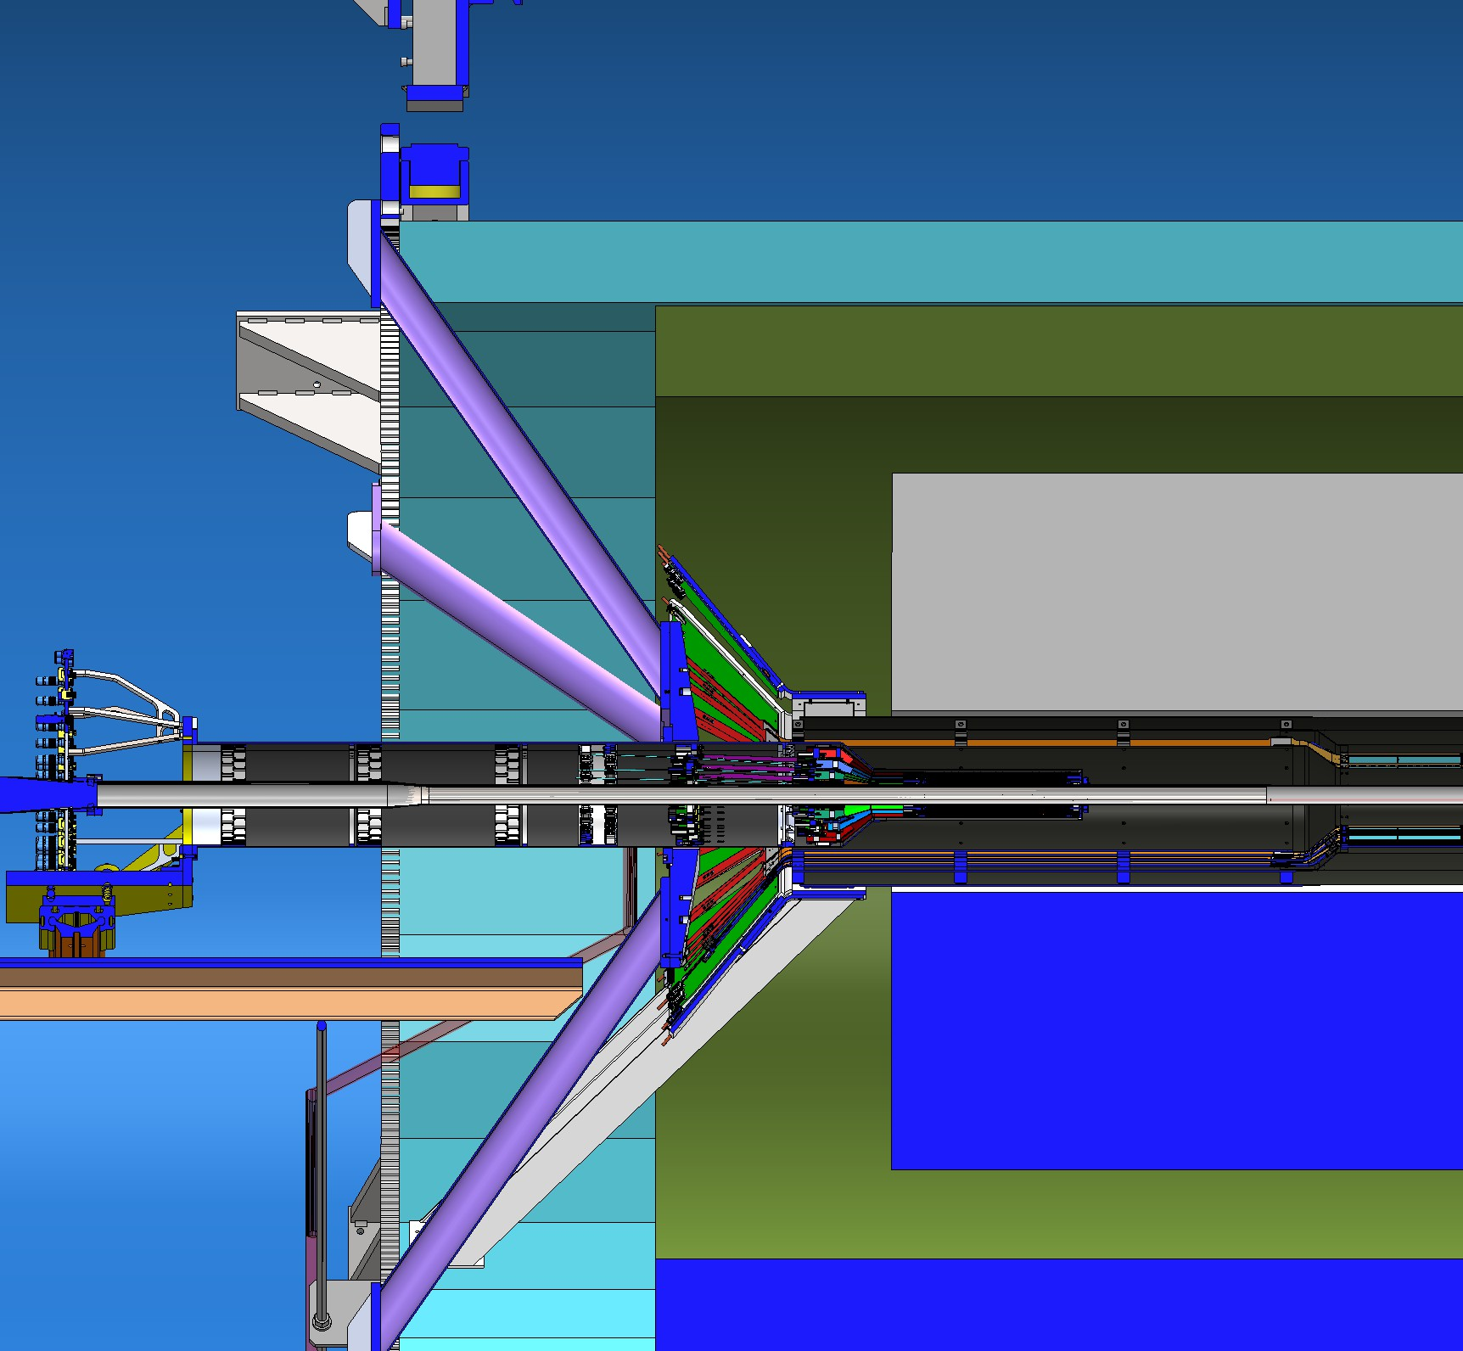
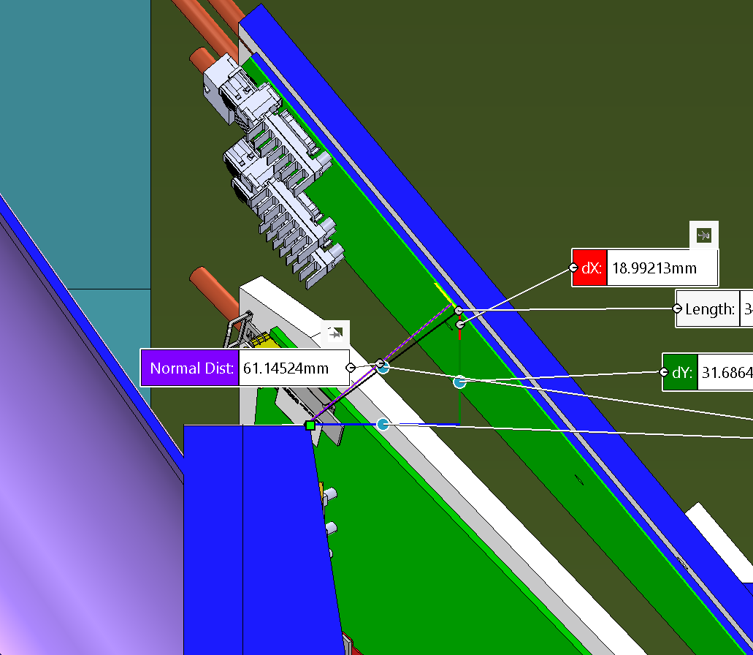
X-wing clearance to INTT read-out electronic boards
Cross section through XWing Truss (nearest approach to INTT)

Slide 29
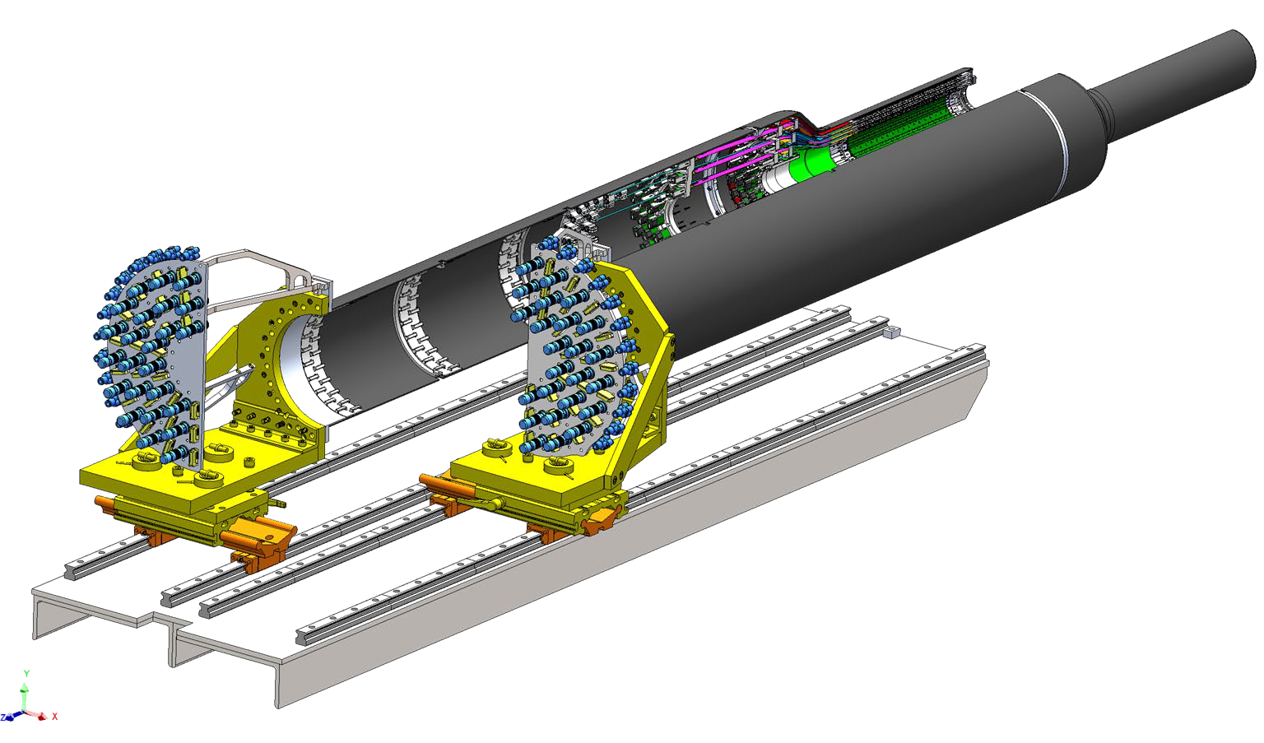
Insertion Mechanism – with X-Y rails, stainless steel table
Mass of a half MVTX assembly 12.05 kgm
Installation table aligned to the X-wing
8 splice plates lock the two half detector assemblies together from the CYSS to the end of the service barrel.

Slide 30
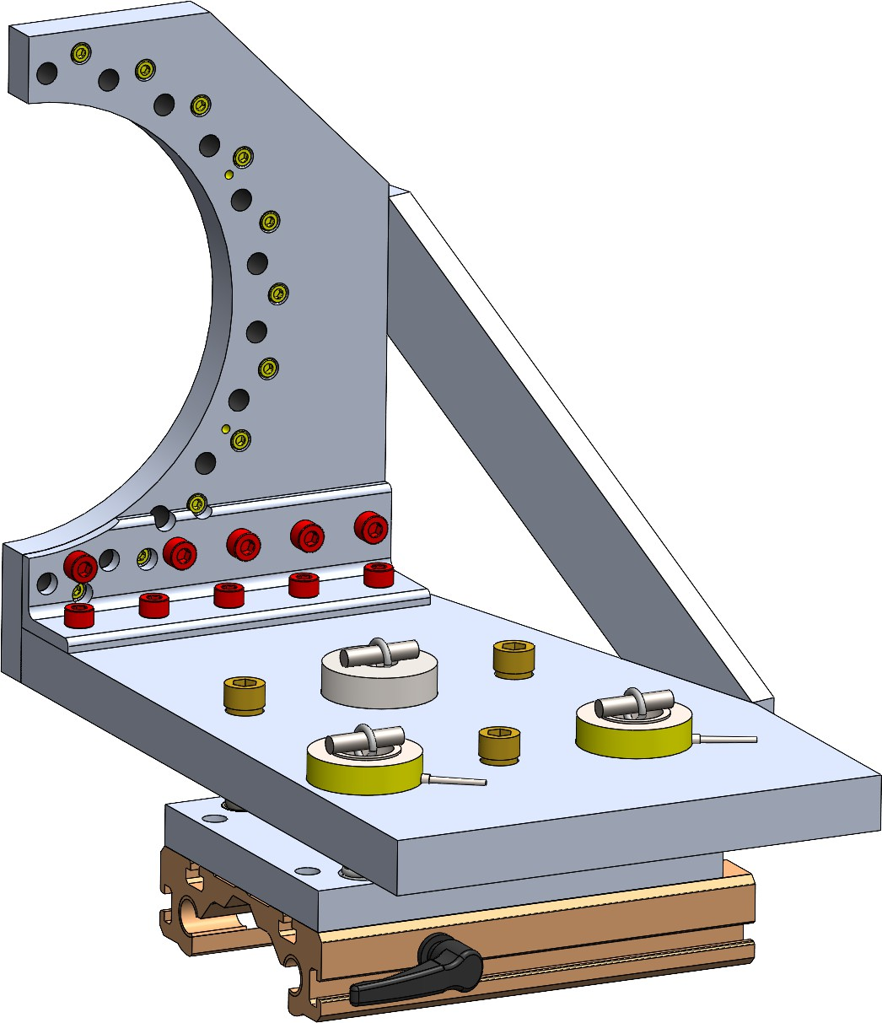
Insertion mechanism continued, half detector mount
Front plate robust with more attachment points to MVTX.
Material, 316 stainless steel
Removable side plate during installation
Kinematic roll / pitch / yaw adjustment
Three load cells added
Cross-slide length 125 mm
Locking slider

Slide 31
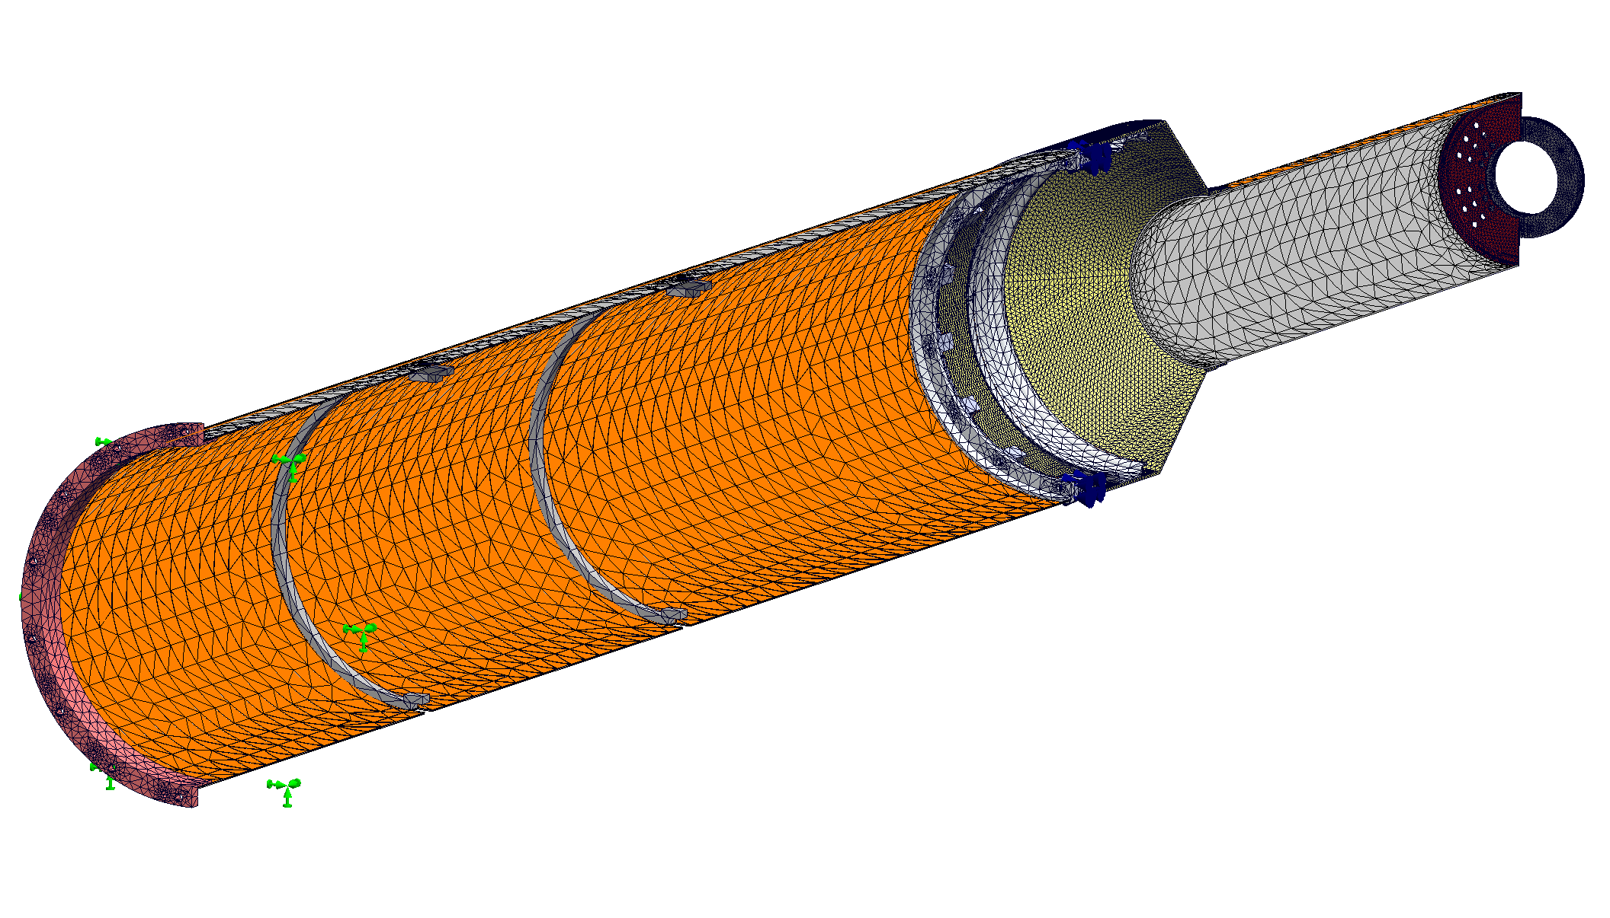
MVTX FEA (Remodel) 2.SLDASM, mesh -

Slide 32
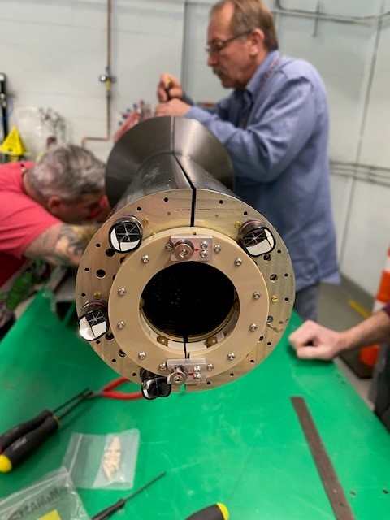
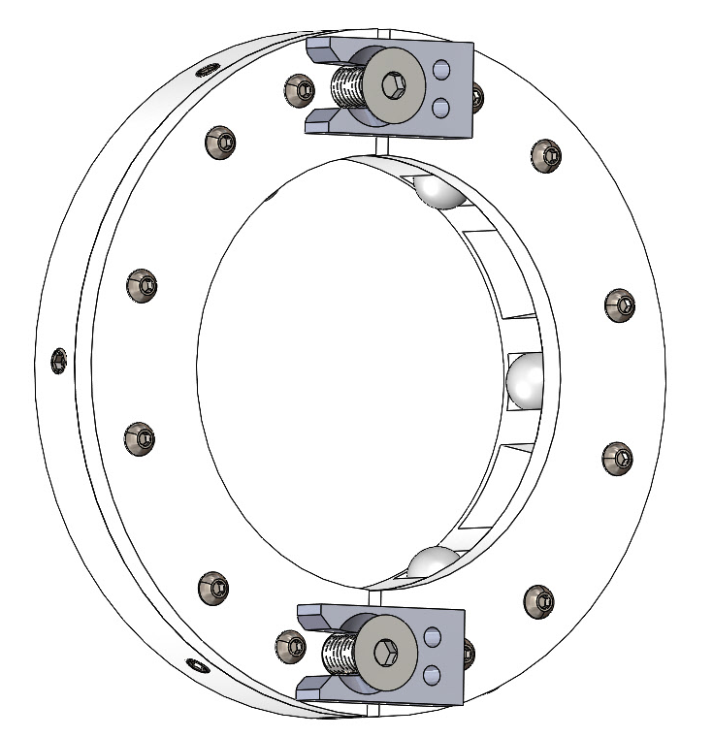
Nose roller ball assembly
Two halves locked together using two M4 flat head screws, access from North end -

Slide 33
Mass values used in FEA calculation of deflection due to gravity
Loads | Value | Type | Location
Gravity | -9.81 m/s2 | Global free body | Everywhere
Signal Cables | 2226 g | Distributed Force, per side | SB inside face
Power Cables | 3612.3 g | Distributed Force, per side | SB inside face
L0 | 261.26 g | Remote mass, per side | CYSS Clamp ring and Nose Plate
L1 | 312.9 g | Remote mass, per side | CYSS Clamp ring and Nose Plate
L2 | 418.9 g | Remote mass, per side | CYSS Clamp ring and Nose Plate
water 4mm + Air Tubes | 1122.054 g | Distributed Force, per side | SB Inside face
Nose rollers | Self weight | Mass | Self
Total Mass: 18.75 kg

Slide 34
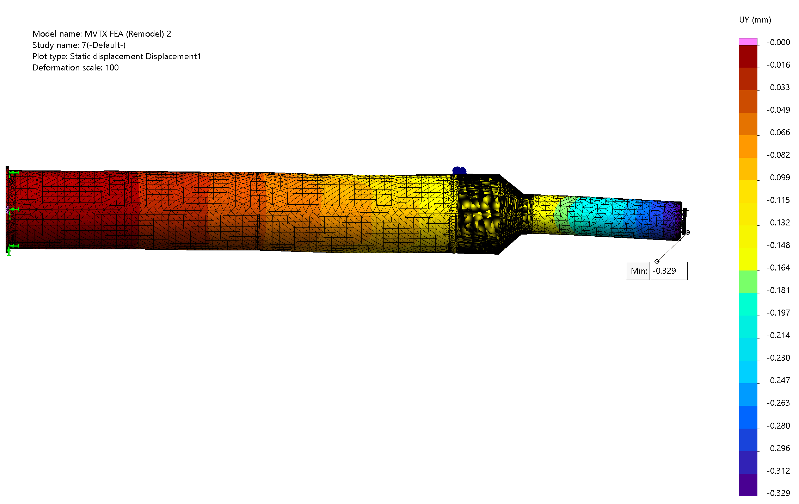
Vertical Displacement with Nose-Ball-Roller assembly

Slide 35
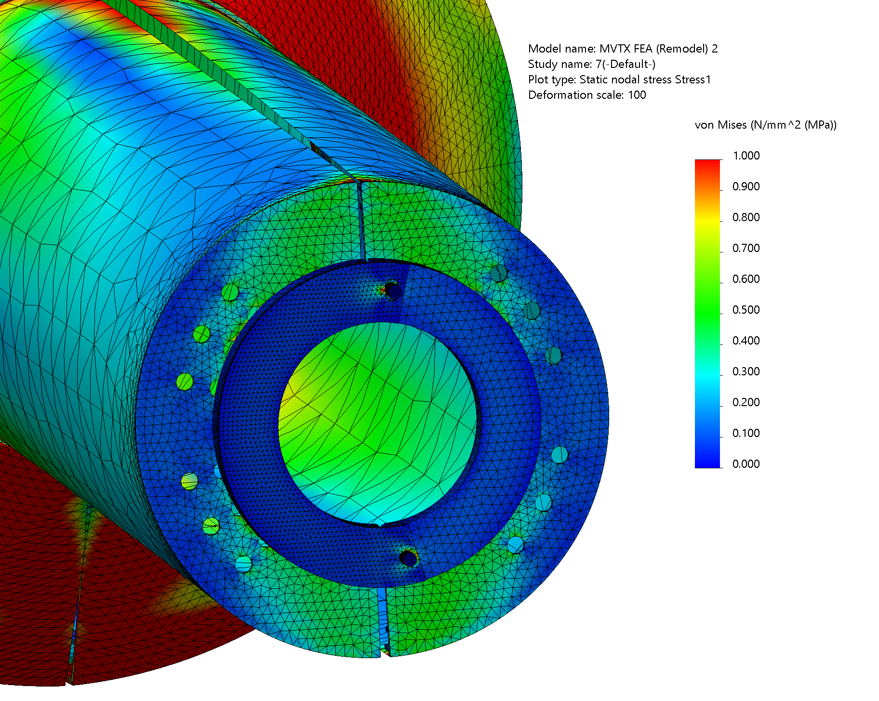

Stress at nose, showing proper contact mesh behavior

Slide 36
Roller Ball Assembly is effective at reducing nose sag
0.043 mm increase
No nose connection
Rigid nose connection
With nose roller assy.

Slide 37


X-wing, insertion table, detector mock-up, test insertion, with dump beam-pipe

Slide 38



X-wing installation on 80-20 rails, connects to inner HCAL
X-wing translates on rails
X-wing attachment to rails, angle bracket
X-wing after installation rails removed
Existing flange in beam-pipe assembly prohibits closure of the two MVTX half detectors until the stave assembly passes this flange

Slide 39


Installation of the MVTX detector

Slide 40


MVTX detector after installation and services connected

Slide 41
MVTX design, fabrication, assembly and installation team:
LANL;
Walter Sondheim, Christopher O’Shaughnessy, Eric Renner, Jakub Kvapil, Zhaozhong Shi,
Ming Liu*, Anton Navazo, Yasser Morales Corrales, Sho Uemura, Alex Tkatchev
MIT:
James Kelsey*, Ross Corliss, Jason Bessuille, Joseph Dodge, Danielle Petterson, Cameron Thomas Dean
BNL:
Dan Cacace, Russell Feder*, Mike Lenz, James Labounty, Richie Ruggiero, Mickey Chiu – sPHENIX integration coordinator
LBNL:
Abdennacer Hamdi, Yu Hu, Ho-San Ko, Richard Lew, Yuan Mei, Grazyna Odyniec*, Hanseul Oh, Joseph Silber, Eric Anderssen
ORNL:
Joe Schambach*
CERN:
Antonello Di Mauro, Corrado Gargiulo
CNRS, France:
Camelia Mironov – project management
***** designates institute PI on this project

Slide 42
Back up slides:

Slide 43

Detail drawing of stave assembly for ITS2 and MVTX
290.0 mm
A ladder has 9 silicon MAPS sensors, each draws 41.0 mW/cm², each chip 50.0 microns thick, (0.3%X₀) Alpide3 chip
5.0 mm
16.35 mm

Slide 44
Fixtures and assembly steps to make a layer assembly, one of six

Slide 45


Slide 46










Rev 10: All bolt holes; dowel holes Bolted connections included
FEA analysis MVTX attached to X-wing
All parts Bonded
Deflection = 659 um
Correction for simplified MVTX model = 140 um
→ Corrected deflection = 519 um

Slide 47
X-wing FEA with MVTX detector
Study shown is done with a simplified MVTX model:
  MVTX with isotropic titanium in place of orthotropic carbon fiber composite
    Titanium has a similar stiffness to weight ratio, important for self-supporting structure
  it uses 1/8” thick tubes; (final design uses ¼” thick aluminum)
  Shown maximum deflection is 0.617 mm
After correcting for thicker tubes and simplified MVTX model, the total
Predicted deflection is 0.37 mm at nose roller end (nb, clearance to BP ~1.15mm)
Maximum Deflection (mm)
Shown: the deflection field for the simplified model
Design Iteration

Slide 48


MIT, LANL engineers study prototype detector at CERN

Slide 49
Radiation budget for stave assembly, ITS2 and MVTX
Water cooling

Slide 50
Proposed power cable bundle assembly, note they call out 16 wires, only 10 are used, 2 our 16 gauge for digital power and return, 2 our 22 gauge for analog power and return and 6 are 24 gauge wires for sensors, bias and ground.
If we order these cable assemblies we will request they NOT to include the Heat-shrink jacket, we may request the labels.

Slide 51
Fisher panel mount for
the end of the stave
power cable in PP3, with solder pins, and female sockets for a cable connector.

Slide 52
SAMTEC signal cable assembly from PP1 to PP3, individual wires are 14 gauge Twinax,
measure .073 inches in diameter. Approximate diameter of cable bundle 6.5 mm

Slide 53
Composite material data sheets:

Slide 54

The Work-Shape
Composite lay-up
Details:

Slide 55
MVTX composite manufacturing notes, Jason Bessuille, MIT

Slide 56




Pictures at Work-Shape facility, La Roche-de-Glum, France
Simon Rubet, owner

Slide 57


Two half detector assemblies mounted to insertion table

