Slide 1
Large-Scale Comprehensive Thermal Simulation of the CBM Silicon Tracking System (STS) on the Virgo Cluster at GSI

Slide 2
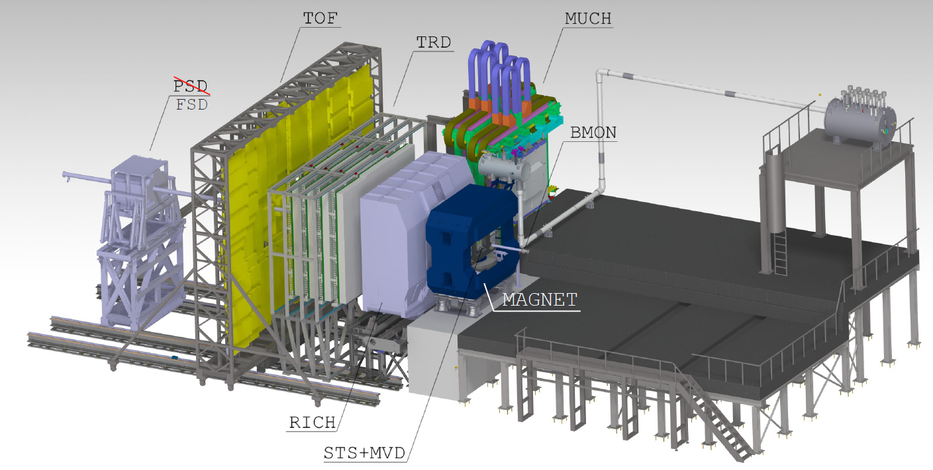
Compressed Baryonic Matter (CBM) Experiment
BEAM
F. Matejcek. CBM-MVD Integration. FTDM 2023 | Link

Slide 3
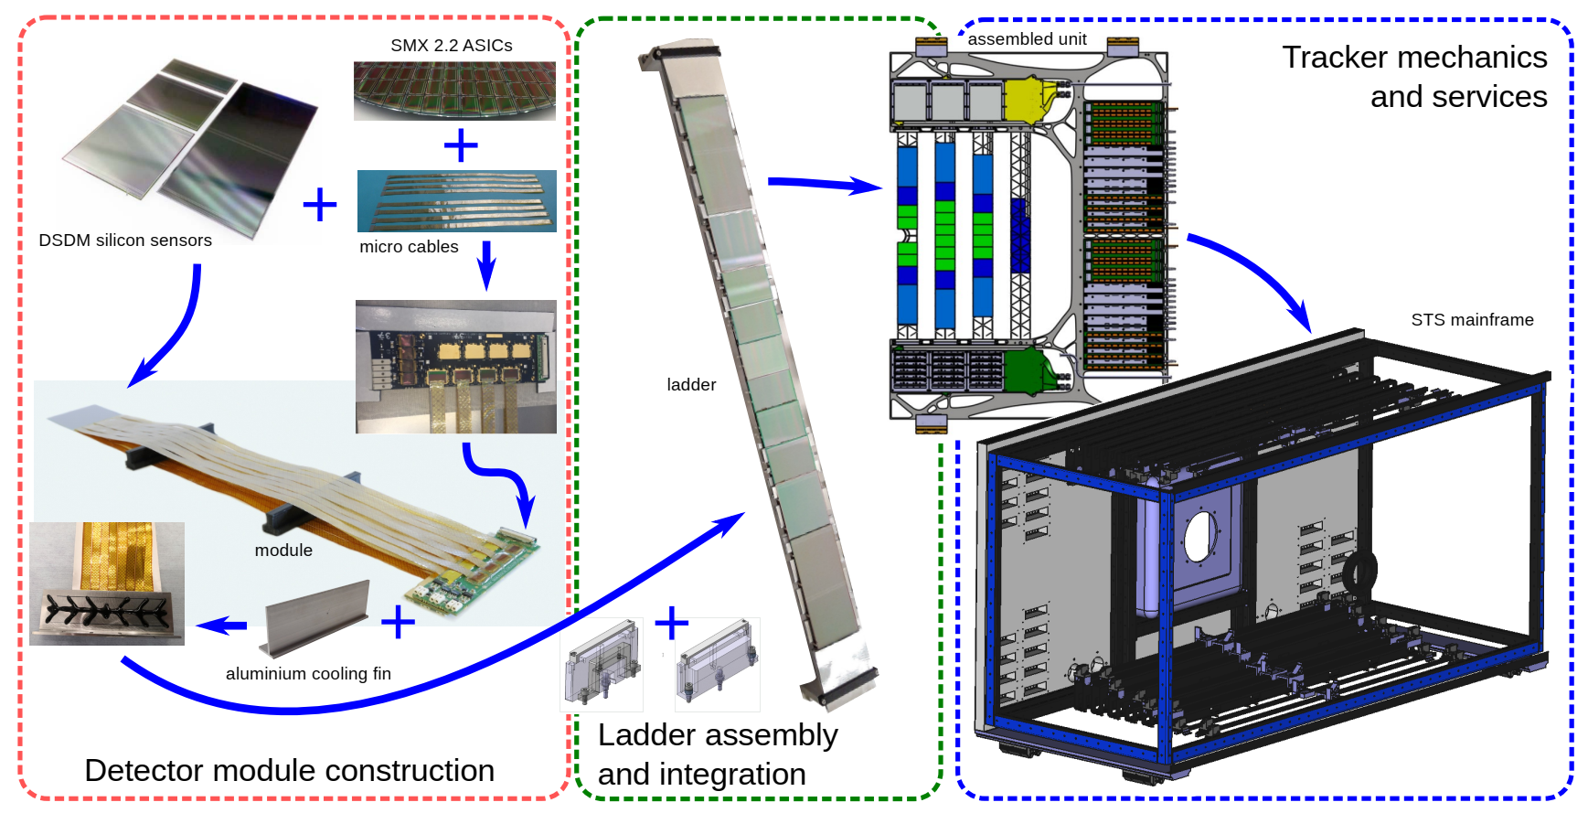
Silicon Tracking System (STS) Detector Structure
M. Teklishyn. CBM-STS Integration. FTDM 2022 | Link

Slide 4
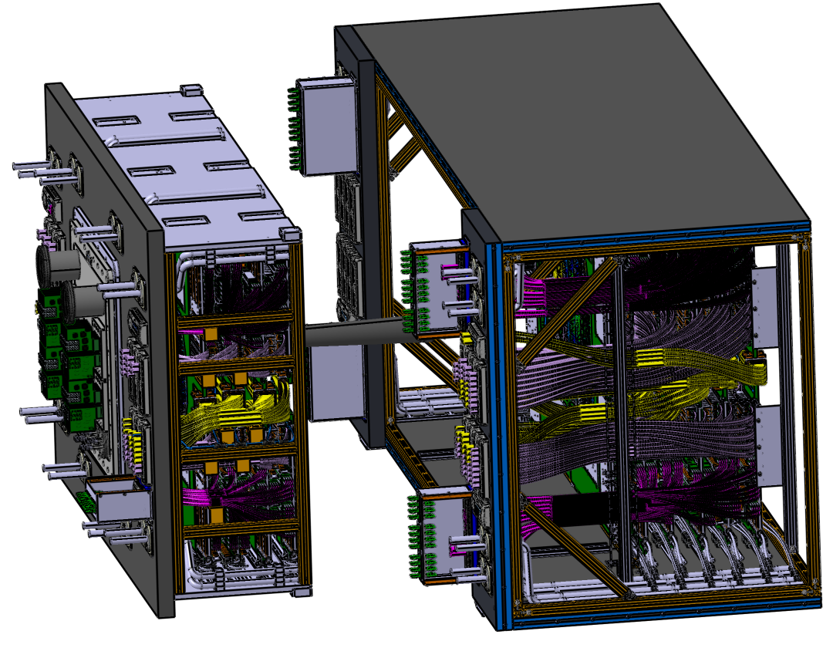
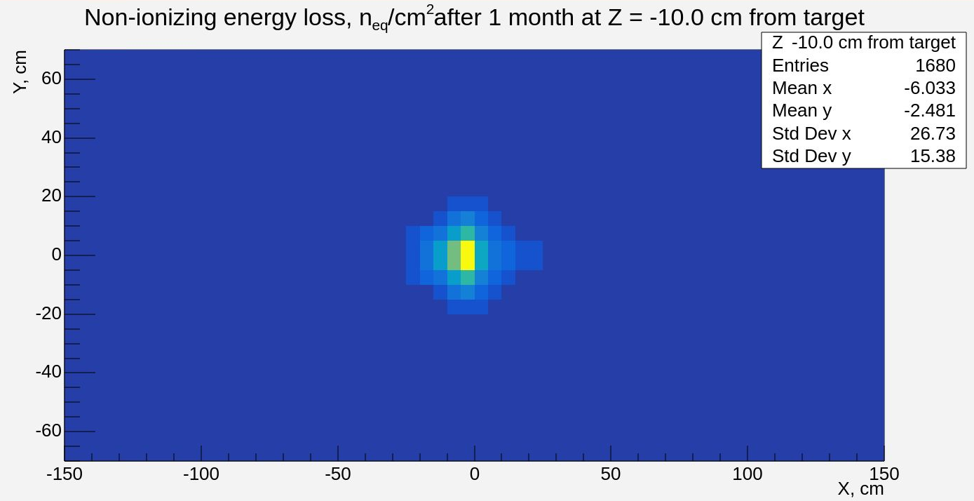
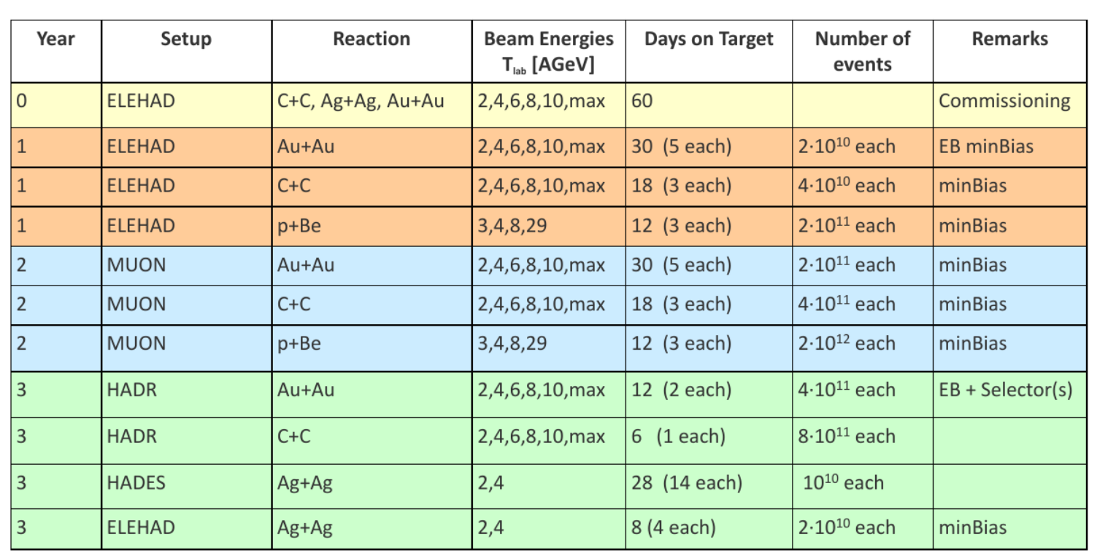
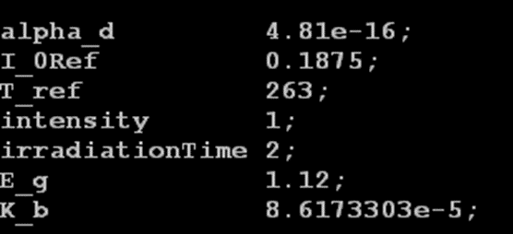
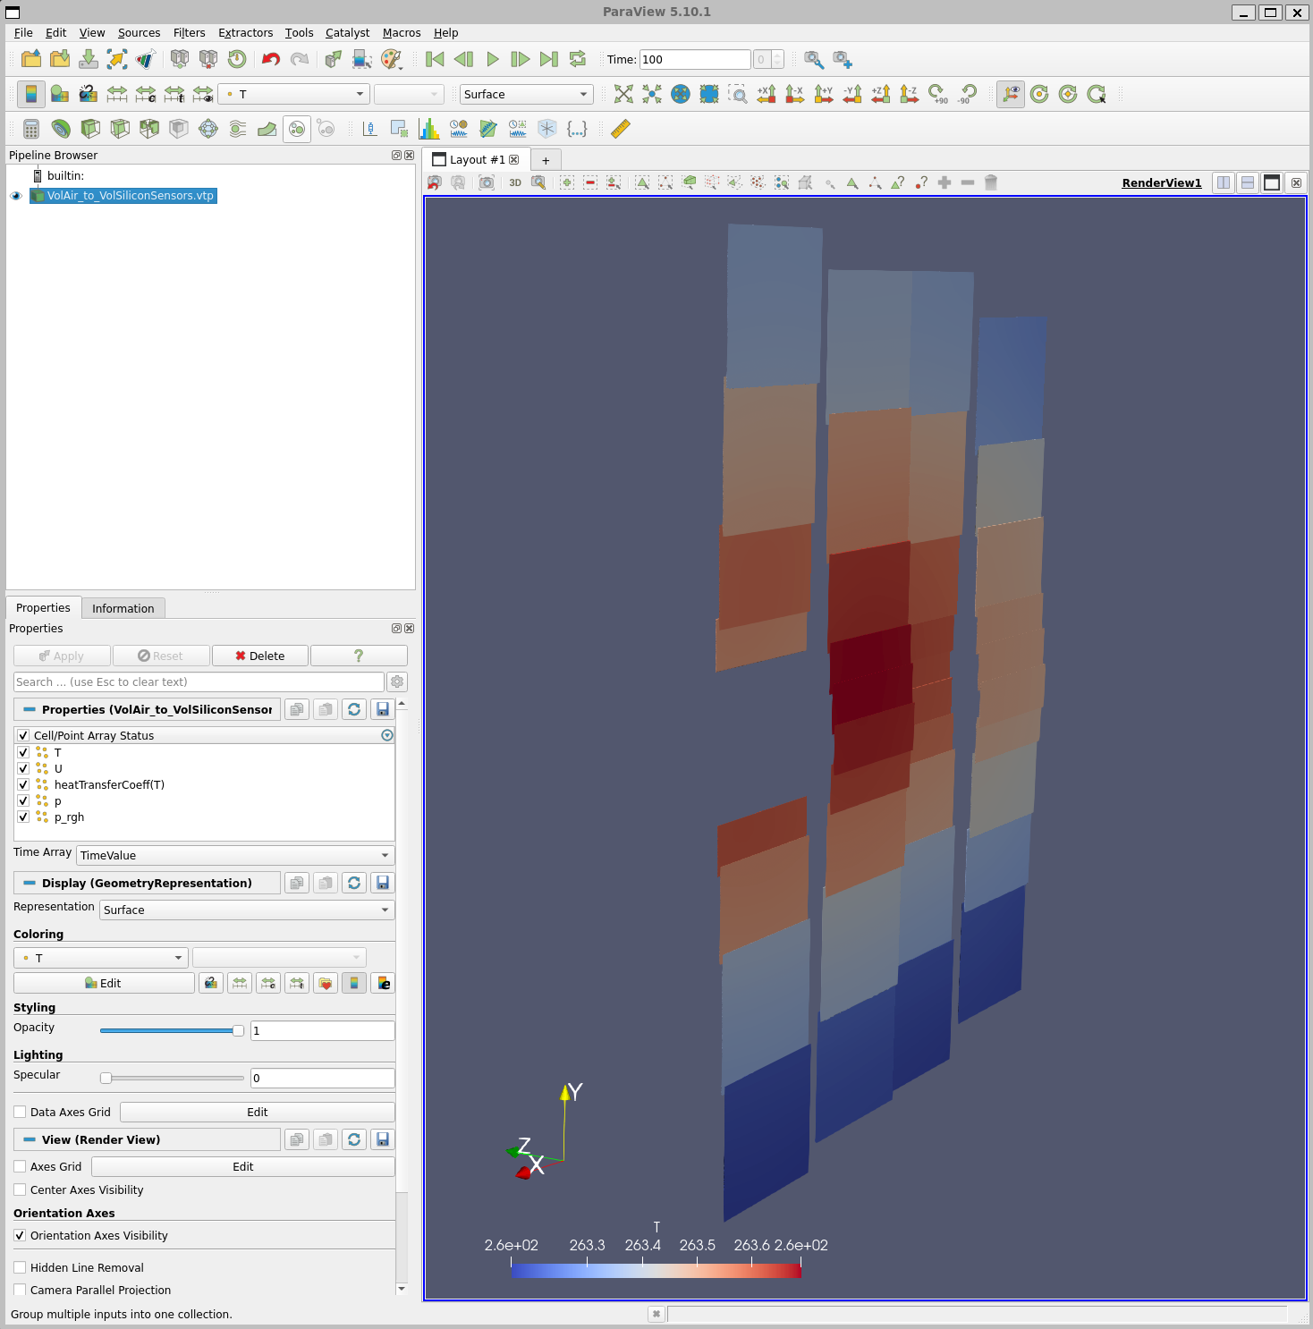



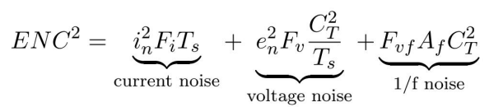
Challenges for the Thermal Simulations
How does every silicon sensor perform
in complex 3D geometry?
How does irradiation scenarios affect
the sensors thermal performance?
Can particles physics related effects
be integrated in the thermal performance?
Can a broad group of scientists, students and engineers be involved?

Slide 5



Open Source Computational Software
OpenFOAM (Open Field Operation And Manipulation) is the free, open source computational software that utilizes finite volume method for thermofluidic simulations
Allows parallel computations, as a result, suitable for high performance computing in computer clusters
Can be easily customized for specific tasks
The Salome platform is an open-source software for pre-processing
Allows for simplifying geometry for simulations and initial meshing
Power open source visualization engine
Allows for results analysis

Slide 6
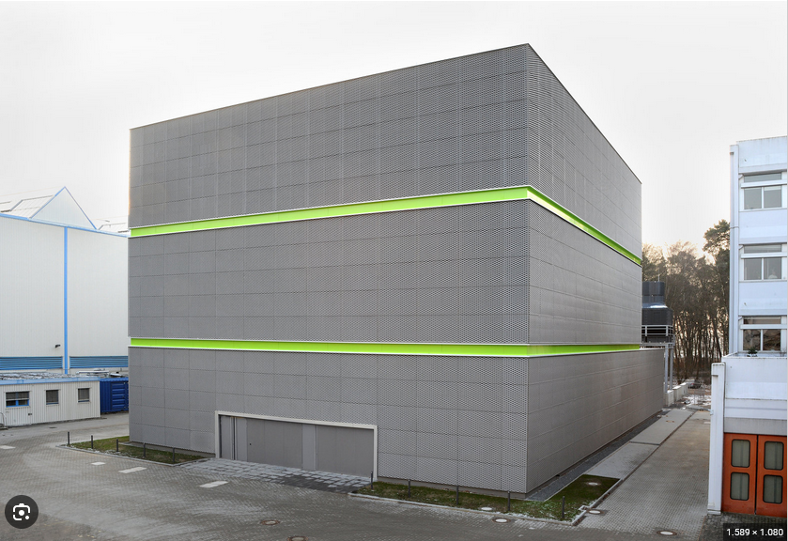
High Performance Computing at GSI – Green IT Cube
The Green IT Cube is one of the largest high-performance data centers in the world
Two regions (conjugate heat transfer)
Region VolAir 20,4 million cells
Region VolSiliconSensors: 1 million cells
Partition | CPUs max | RAM max [TB] | Time limit
debug | 2048 | 8 | 30 minutes
main | 2048 | 8 | 8 hours
high_mem | 2048 | 16 | 7 days

Slide 7
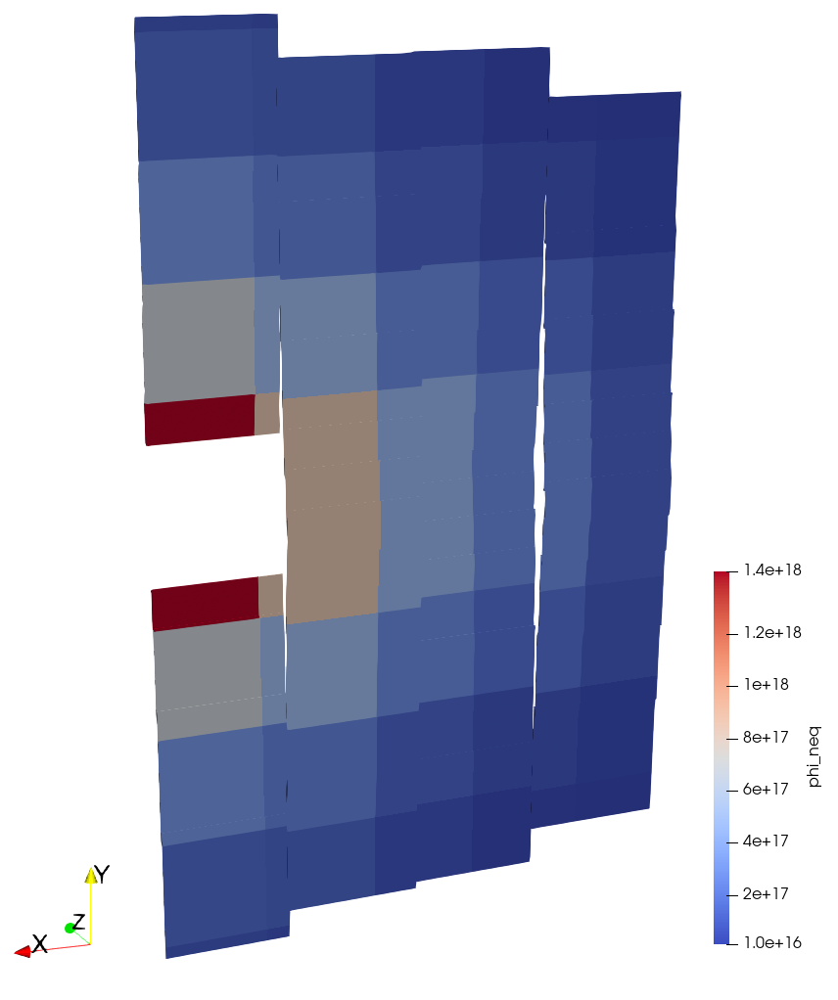
Customization for STS: Non-Ionizing Energy Loss (NIEL)
FLUKA diagrams in Root-format can be converted into OpenFOAM directly
[n_{eq}/cm²]

Slide 8
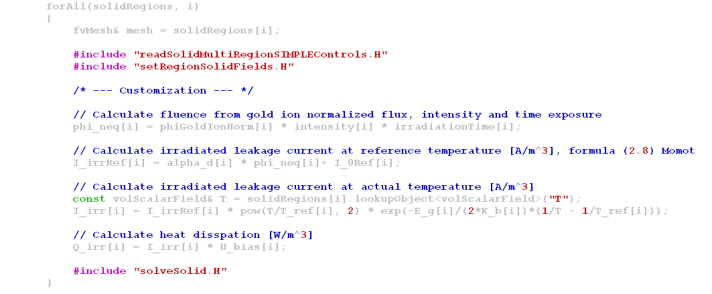
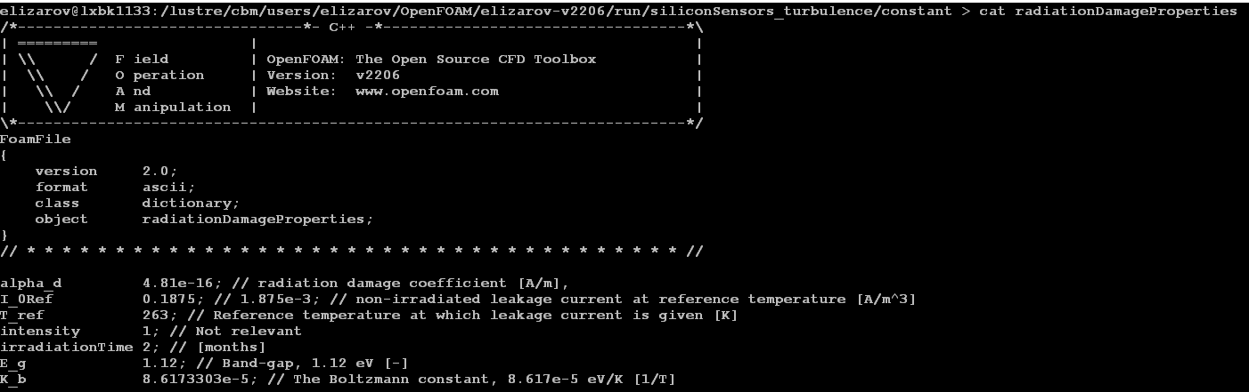
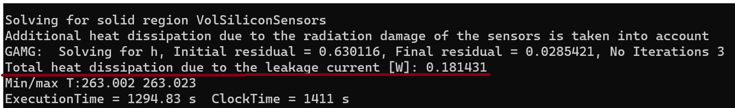
Customization for STS: Thermal Model for Sensors
Conjugate heat transfer solver was modified to account power dissipation caused by radiation damage
Q = I x U
The solver prints power dissipation every time step
for controlling computation
Radiation damage properties are combined in one file

Slide 9
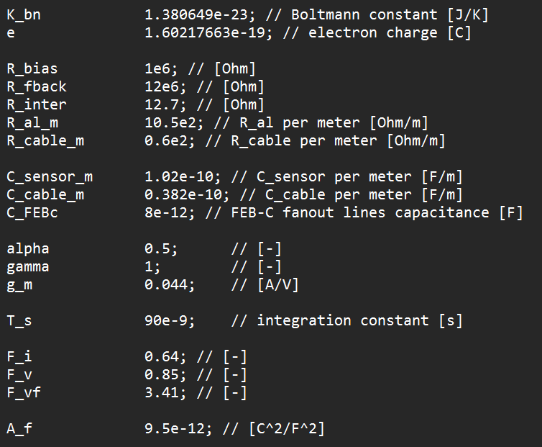
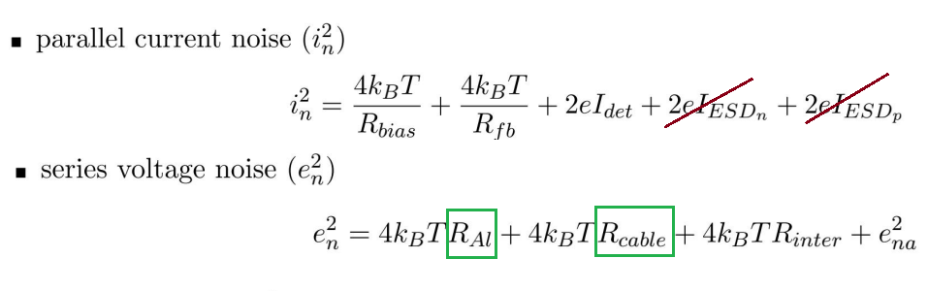
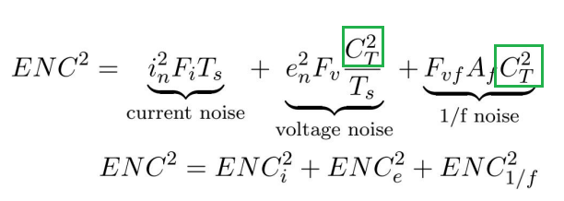
Analytical Noise Estimation Model
Electronics
Sensor
From sensors thermal model
Electronics
Sensor
Cable
C_{T}=C_{sensor} + C_{cable}
Need to know heights of sensors and lengths of cables
Source: Rodriguez Rodriguez, Adrian “STS FRONT-END ELECTRONICS ENC measurements & estimation”

Slide 10
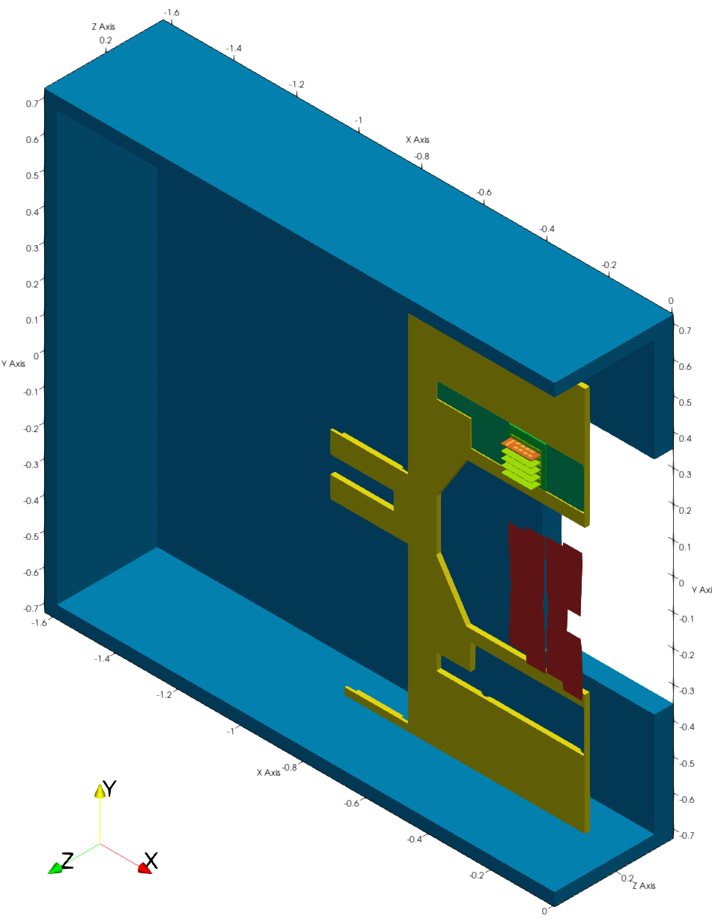
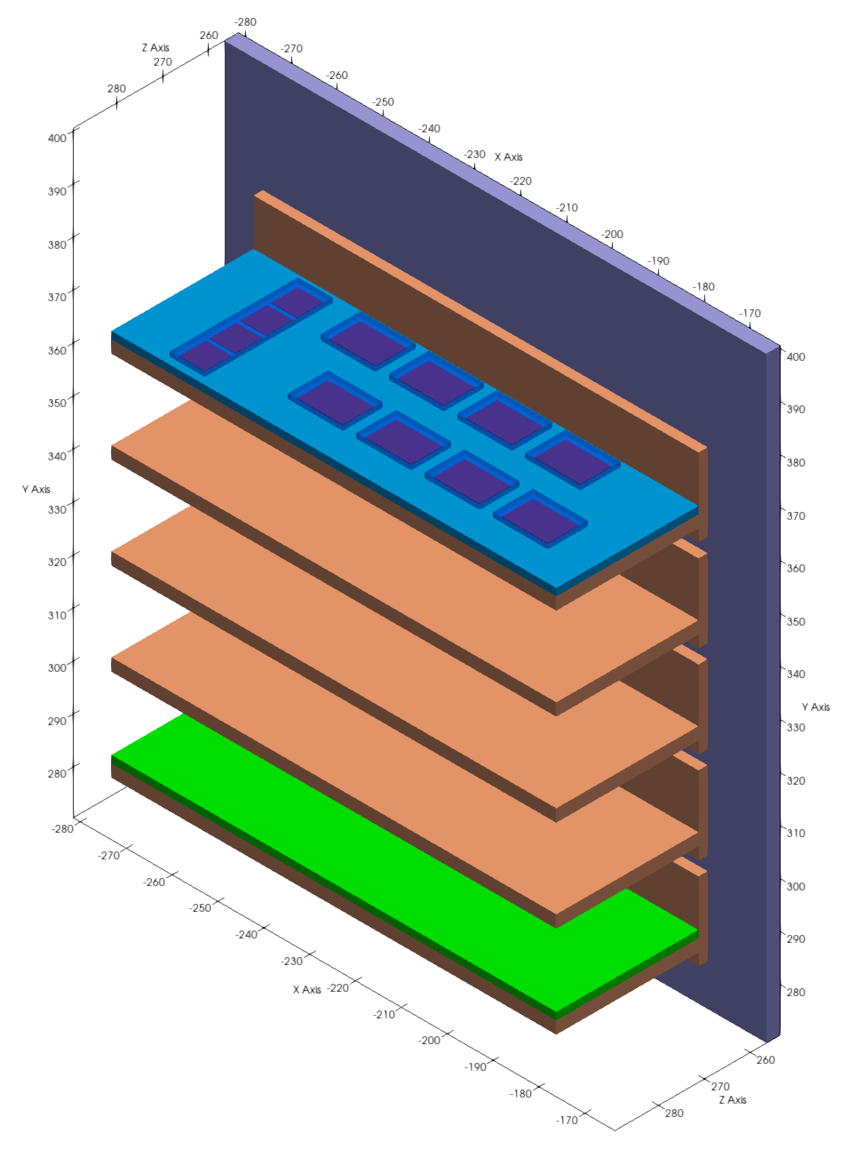
Work on the STS Detector’s Model: Geometry
Thermal enclosure
Front-end electronics PCB with chips
Cooling plate
Front-end electronics (FEB) box
C-Frame
Silicon
sensors
STS detector simplified geometry
Front-end electronics Box

Slide 11
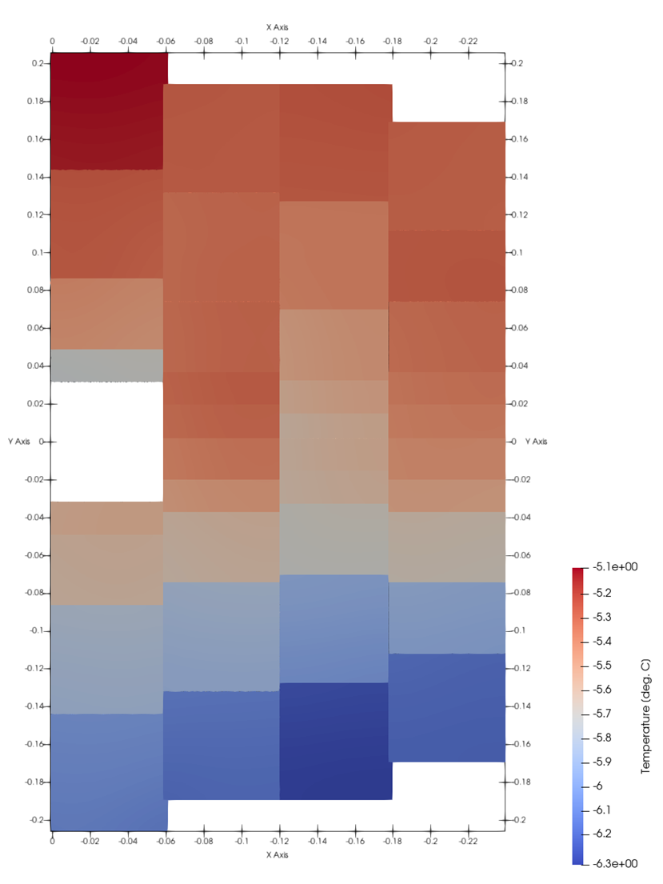
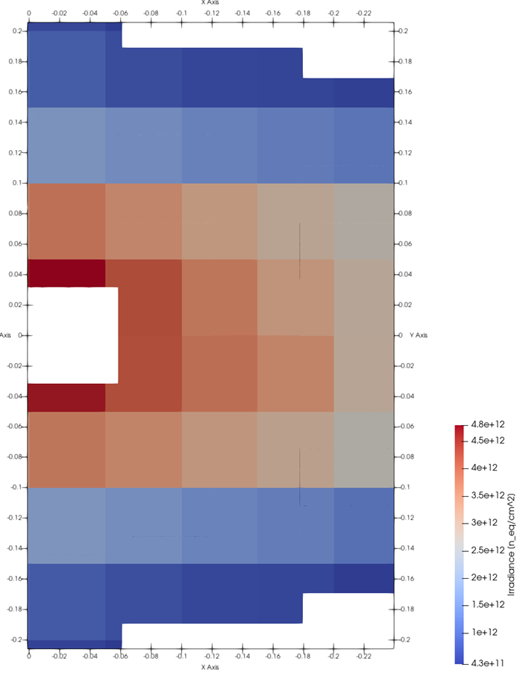
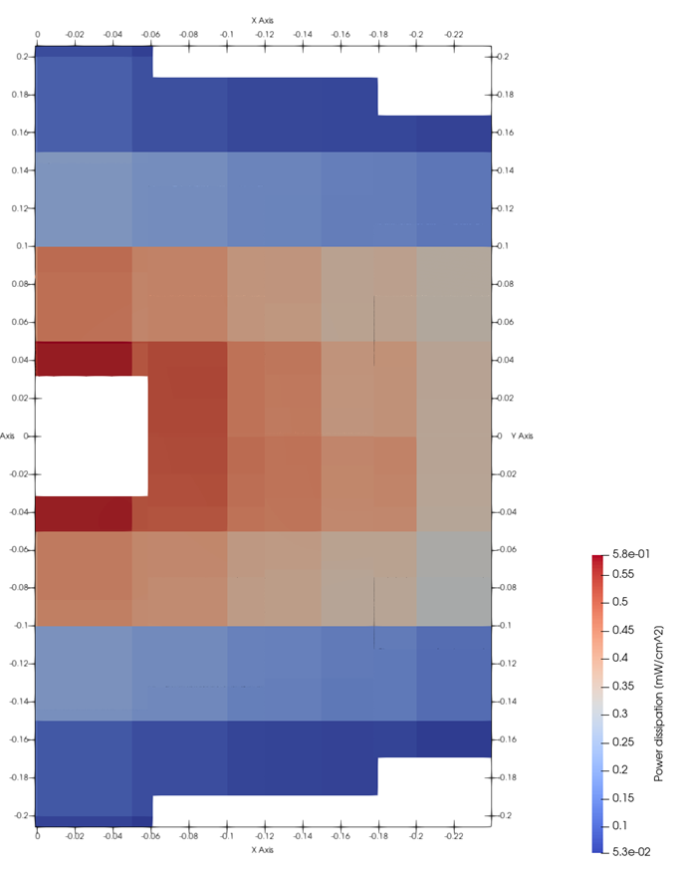
First Results from the Detector Thermal Simulation: Sensors
Non-ionizing energy loss
Power dissipation
Temperature field

Slide 12
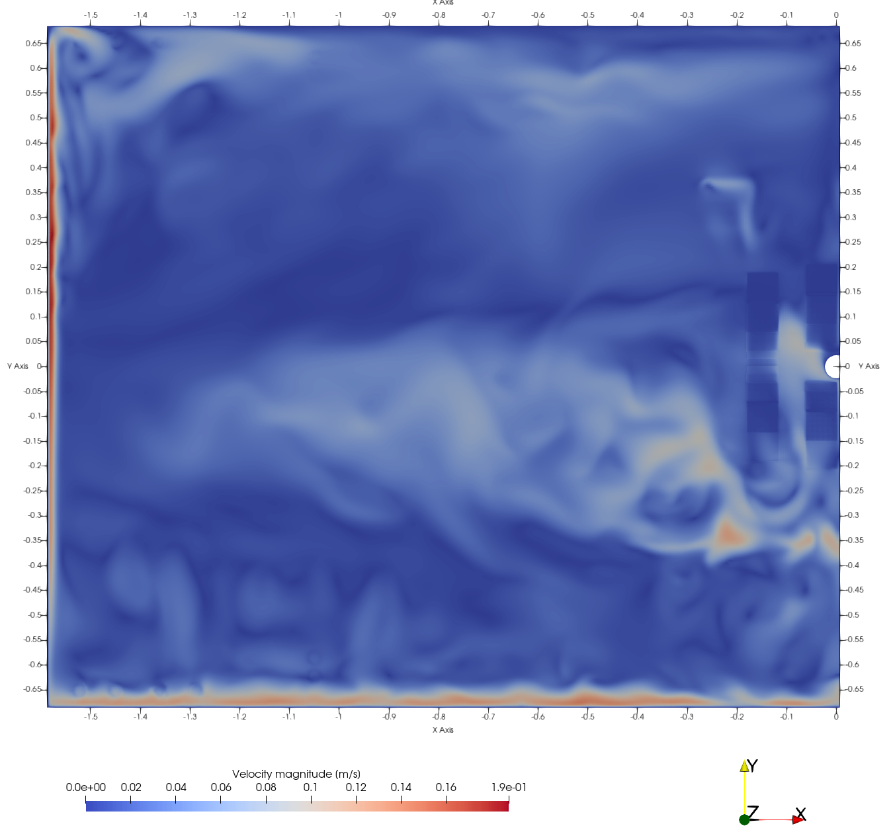
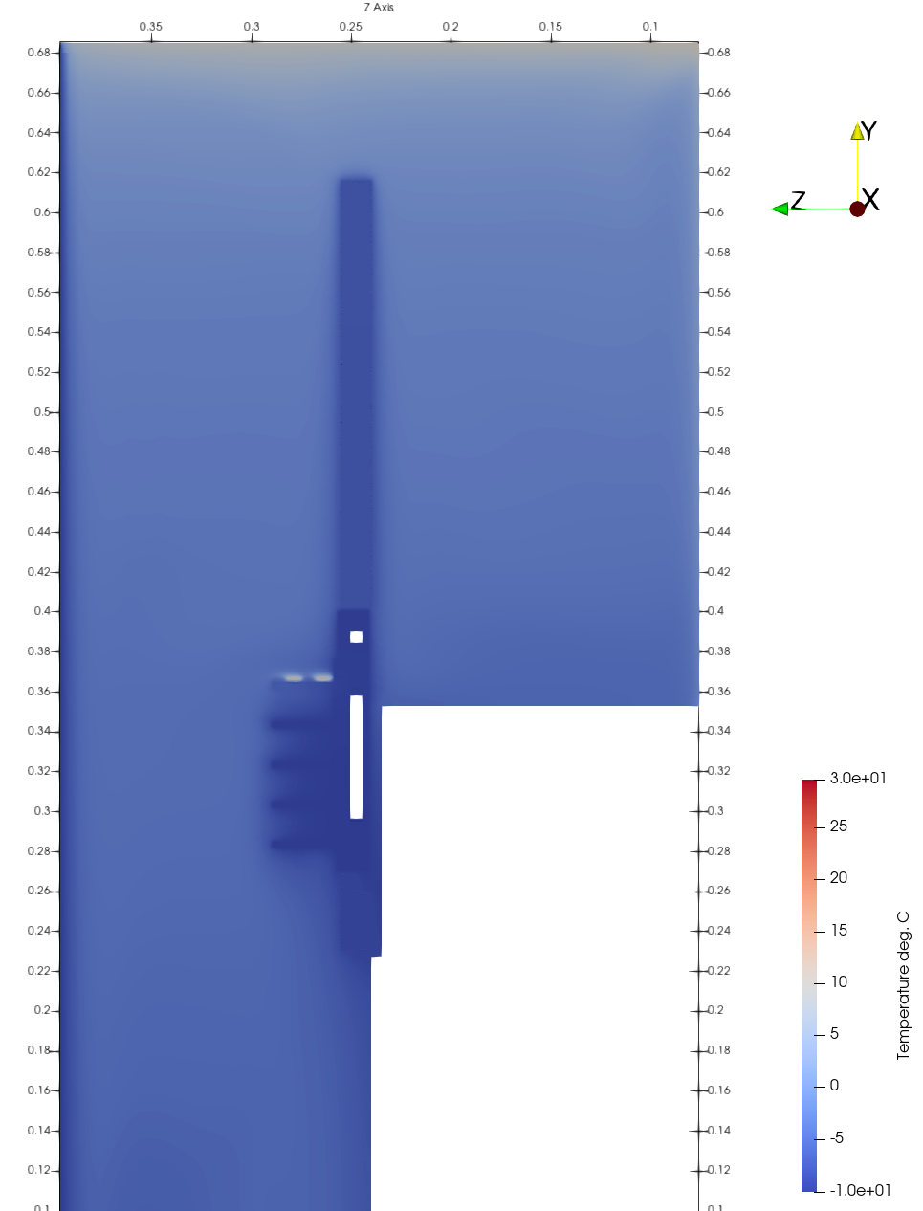
First Results from the Detector Thermal Simulation: Air Convection
Air temperature around the cooling plate
Air velocity field inside the thermal enclosure

Slide 13
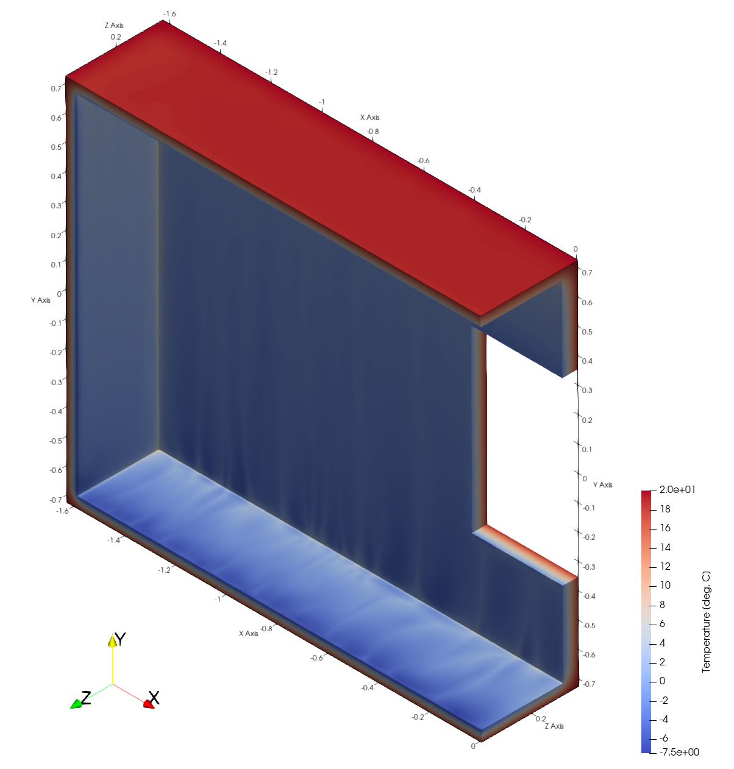
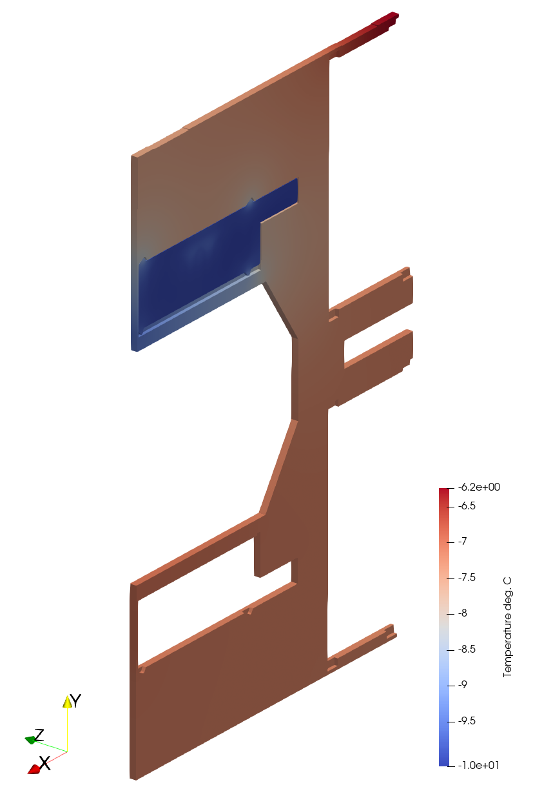
First Results from the Detector Thermal Simulation: Supplementary Results
Temperature field:
Thermal enclosure walls
Temperature field:
C-Frame

Slide 14
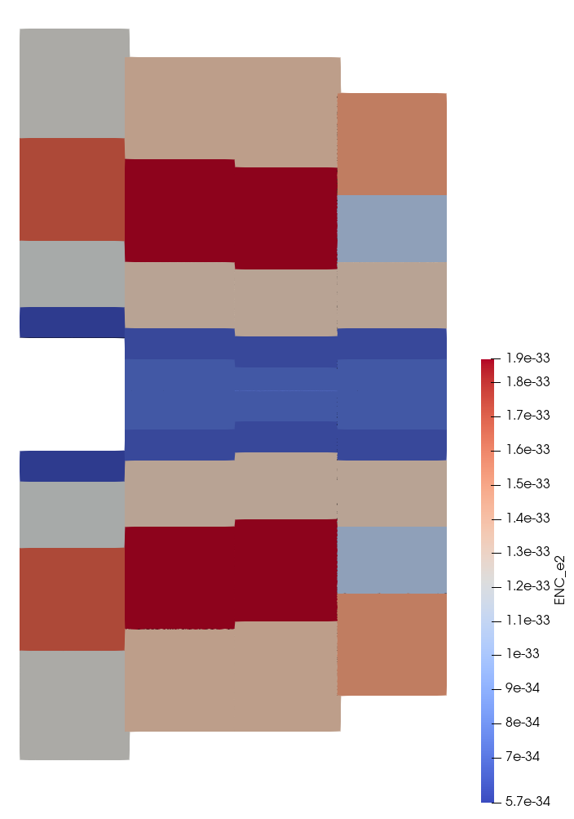
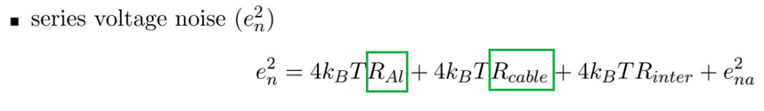
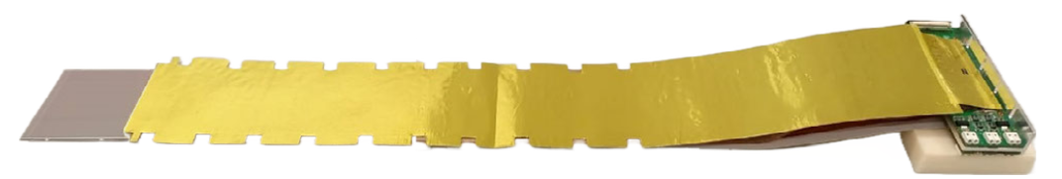
First Results from the Detector Thermal Simulation: Noise analytical model
[arbitrary units]
Silicon sensor module
Series voltage noise

Slide 15
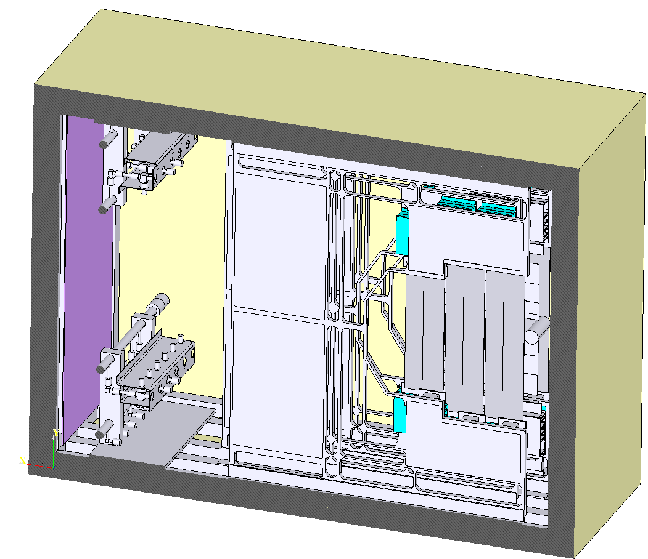
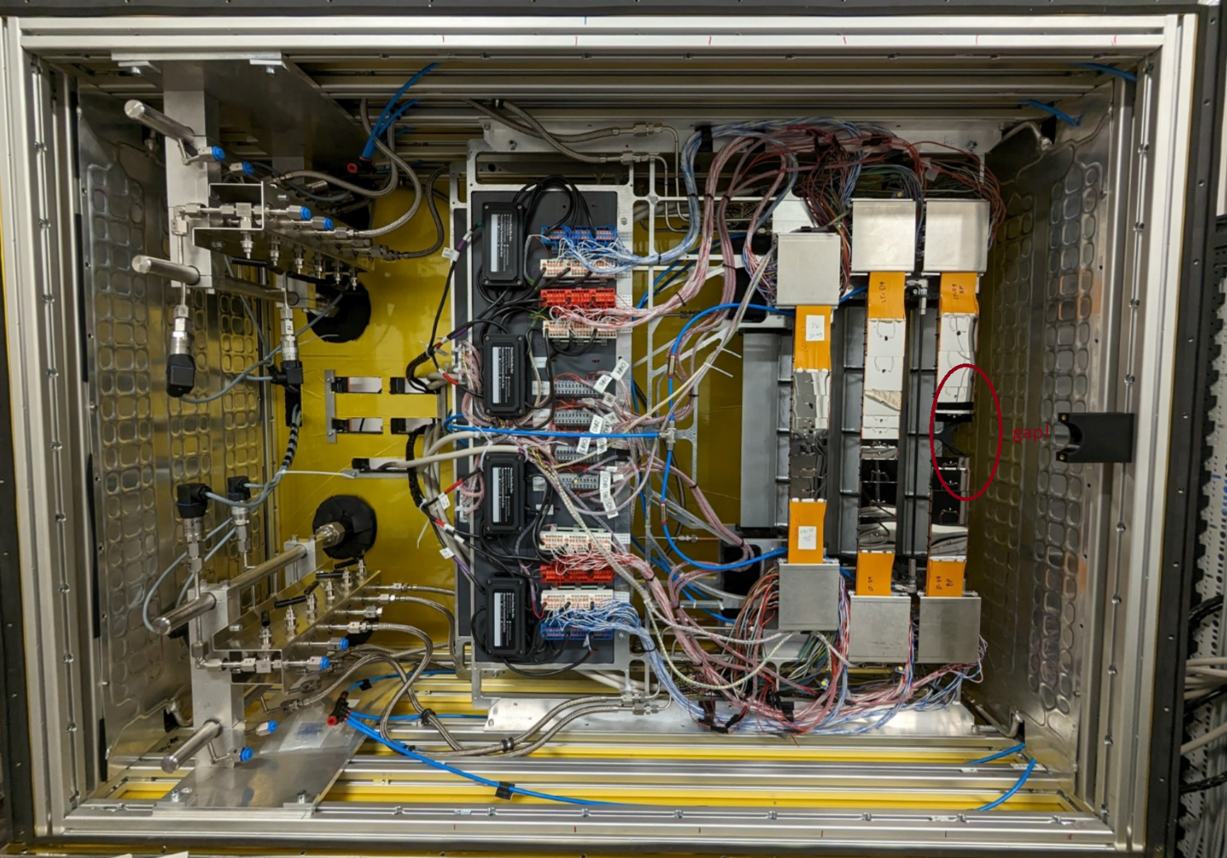
Experimental Verification of the Model
Geometry
of the thermal demonstrator
prepared for the simulation
Actual assembly
of the thermal demonstrator

Slide 16
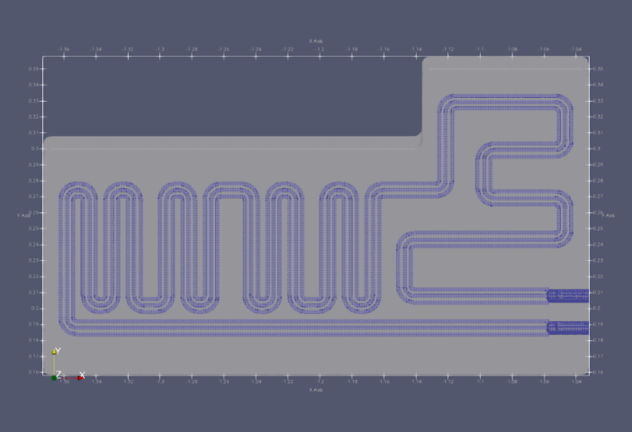
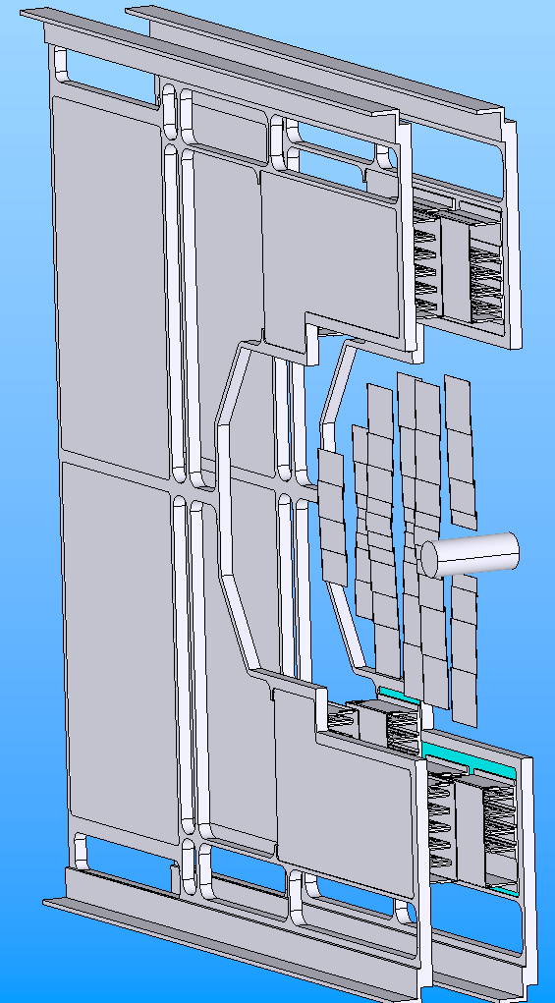
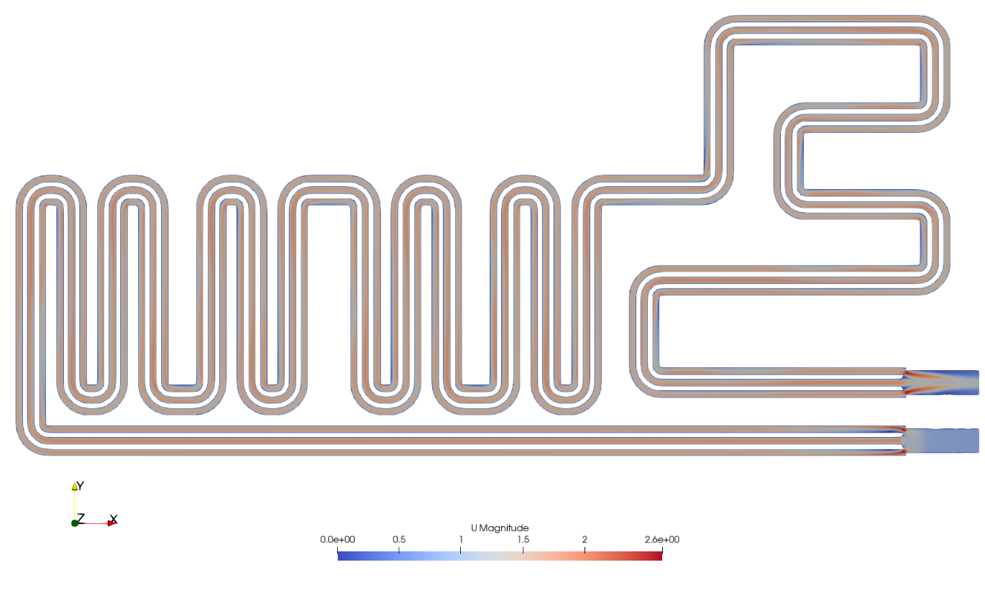
First Simulation Results of the Thermal Demonstrator: Pressure Loss
Cooling plate
 | Pressure difference, Pa
Mesh w/o inflation layers | 47462
Mesh w/ inflation layers | 54403,7

Slide 17
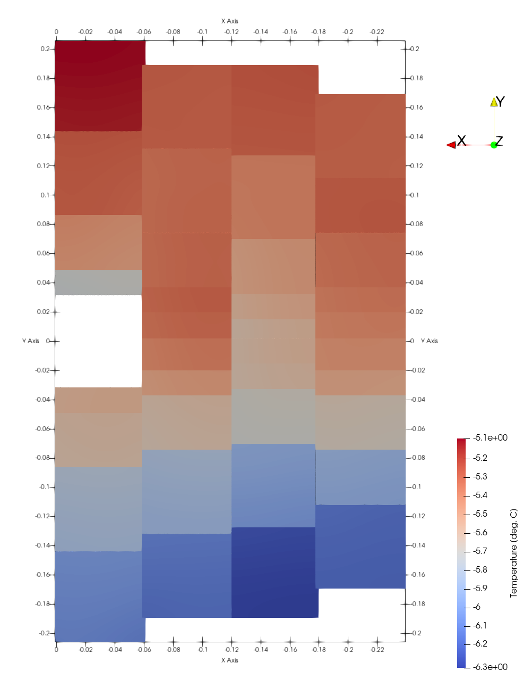
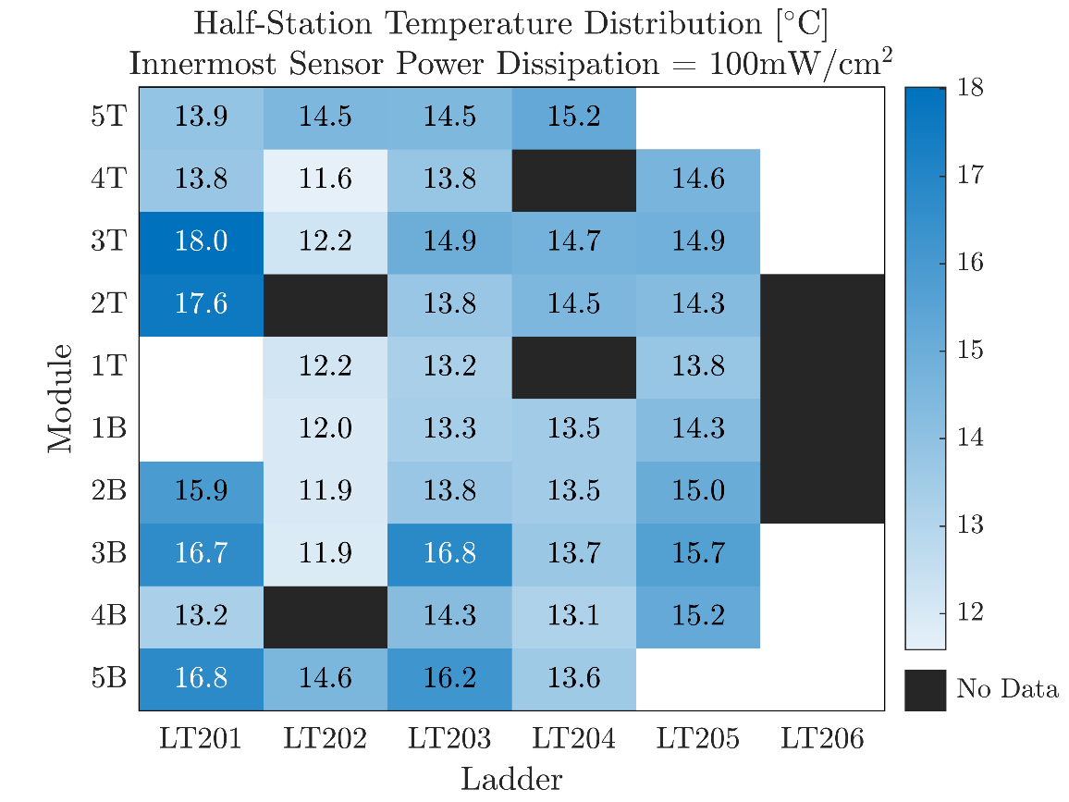
Results from thermal demonstrator
Thermal demonstrator measurements
of the sensors dummies temperatures
Preliminary simulation
of the STS sensors temperatures
Courtesy of K. Agarwal

Slide 18
Summary
A comprehensive thermal model of the STS detector is being prepared
OpenFOAM® allows for implementation of the specific features for the detector
Power dissipation of the silicon sensors with respect to irradiation and signal-to-noise model is implemented
This model is suitable for high performance computing on the Virgo cluster at GSI
Utilizing open-source software allows for the broad usage of the model and results analysis
Outlook and future work
Experimental results have been acquired from the thermal demonstrator
These results will be used for cross-validation of our detector model
Geometry of the thermal demonstrator was prepared for the simulation
Simulated results has been acquired for the pressure loss in the cooling plates
The results of this work (know-how) is foreseen as a contribution for DRD8

