Slide 1
Overview of the CO2 cooling DEMO obtained results and a prediction of future system behaviour
Viren Bhanot, Loic Davoine, Yann Herpin, Cedric Landraud, Jerome Noel, Youri Penders, Kzrysztof Sliwa, Dani Texeira, Bart Verlaat, Michal Zimny
29/05/2024

Slide 2

Challenges & Goals

Slide 3
Challenges for Phase 2
High cooling capacities required
  300 kW for ATLAS → 7 plants, 6 accumulators
  550 kW for CMS → 9 plants, 8 accumulators
  Redundancy important for continuous operation
Operation temperatures down to -45°C
  -45°C close to CO2 triple point
  Increased gradients at lower temperatures
  Stable primary cooling is required in limited range temperature zones
Need for surface facilities
  Smaller accumulators in cavern, therefore surface storage of CO2
  Primary cooling system on surface, therefore large transferlines to service cavern
Energy efficiency considerations
  Improvement of energy efficiency with scaled up systems

Slide 4
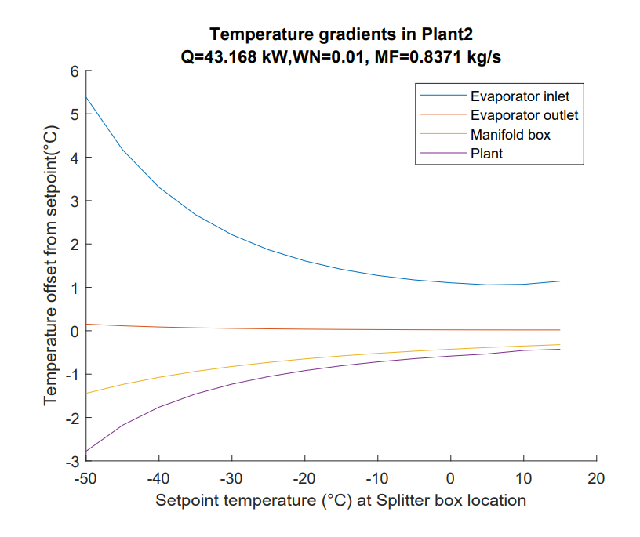

The cold challenge
Minimum liquid temperature
Sub cool margin
Detector inlet
Detector outlet
PP2 Manifold
T variation
Plant
A cold and very stable primary cooling is needed
Accumulator
From -30°C to -40 °C the gradients double!
10
2PACL plant
Condenser
Flow control by-pass
8
Evaporators
7
9
Transferline (~100m)
11
1
2
3
4
Pump
5
6

Slide 5







The surface challenge
2PACL cooling plants located in USA-15 / USC-55 underground
Detector evaporator loops are connected via manifolds and concentric transfer lines to the 2PACL plants
The 2PACL plants are cooled by the primary R744, which is located on the surface
The primary R744 plants are cooled by water from the towers and air cooling
Surface storage of CO2 to control the charges of the underground 2PACL plants
Air cooled & low power back-up chiller
to keep surface storage pressure low
Up to 100°C
Trans critical CO2-primary
+15/-20°C
Down to -20°C
27°C
Refrigerated low pressure surface storage of CO2
Water cooling tower
-53°C
+ Dry-air and vacuum systems
Experimental cavern
Uninsulated transfer lines
  Requires warm liquid supply and warm return gas to cavern to avoid condensation
Multiple 2PACLs with reduced accumulator
ATLAS
CMS
80m
Service cavern
+15 to -40°C
Reduced accumulator sizes
  Good interaction required between cavern plants and surface storage
Manifolds
and distribution
+15 to -45°C

Slide 6
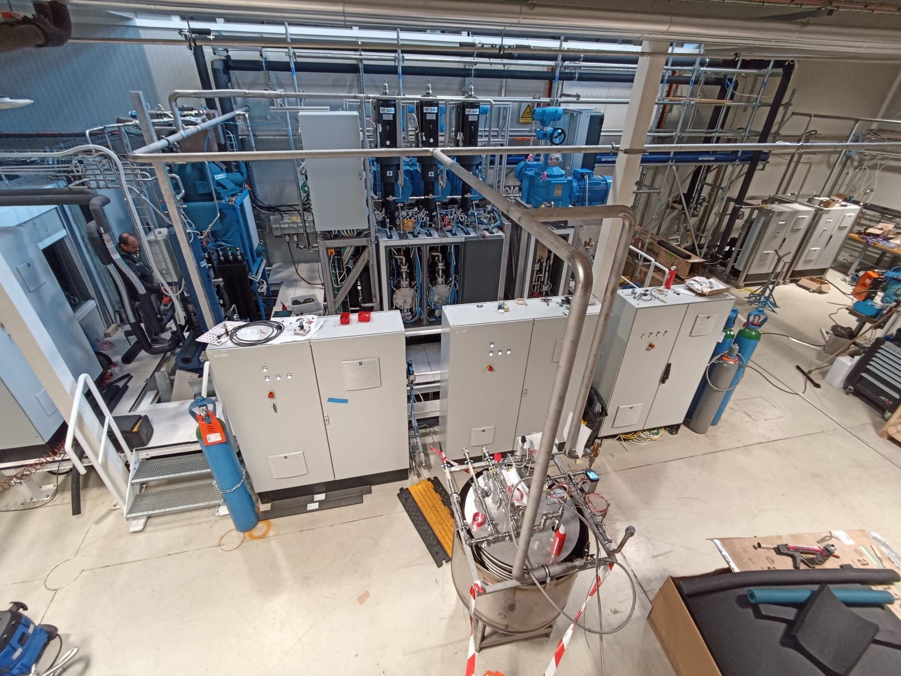
Scaled-up DEMO system
Accumulator
Safety exhaust
Transfer line
R744 primary
3H-Plant
Back-up Plant
Dummy load
DEMO
Full scale system containing all system elements
Real size plant and accumulator
Short low-capacity transferline
100 kW dummy load to simulate detector heat
Able to circulate 1.58 kg/s of CO2
Includes one-head back-up plant for redundancy swap
Surface Storage Simulator unit
Control cabinets
Surface storage simulator

Slide 7
Challenges for Phase 2
  Demonstrate operation with 100 kW cooling power at -45°C at the plant
  Demonstrate automatic procedures
High cooling capacities required
  300 kW for ATLAS → 7 plants, 6 accumulators
  550 kW for CMS → 9 plants, 8 accumulators
  Redundancy important for continuous operation
Operation temperatures down to -45°C
  -45°C close to CO2 triple point
  Increased gradients at lower temperatures
  Stable primary cooling is required in limited range temperature zones
  Demonstrate stable operation in all conditions, especially at cold temperatures
  Demonstrate specific design updates
    Surface storage interaction
    A reliable accumulator level control
  Demonstrate the warm return of the R744 gas (R744 transfer is without insulation)
Need for surface facilities
  Smaller accumulators in cavern, therefore surface storage of CO2
  Primary cooling system on surface, therefore large transferlines to service cavern
Energy efficiency considerations
  Improvement of energy efficiency with scaled up systems
  Demonstrate the new method of accumulator flow-through (2PACL-FT)

Slide 8
Operation and Performance

Slide 9

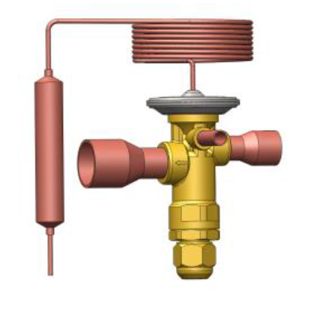
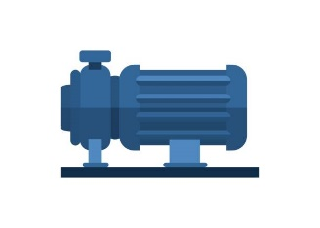

Flow-through vs. non-flow-through
A good phase separation is needed not to cool the vapor with incoming cold liquid
Heating and cooling is pressure controlled
R744 cooling
R744 cooling
Only cooling is pressure controlled
Cooling = pressure decrease
Heating = pressure increase
Cooling = pressure decrease
No cooling = pressure increase
Diffuser
Electrical heater
Heater is only needed in special occasions
2-Phase
2-Phase
Saturated liquid
Super heated gas
CO₂ Condenser / sub cooler
Super heated gas
CO₂ sub cooler
R744 Evaporator
Subcooled liquid
R744 Evaporator
Subcooled liquid
Subcooled liquid
Subcooled liquid
Traditional 2PACL
2PACL-FT
(Flow through Accumulator)
2-Phase
Pump
2-Phase
Pump
Schematic by Bart Verlaat

Slide 10
Typical system behavior in 2PACL-FT mode
2PACL-FT mode shows a very stable and easy to control system
It has a very good liquid temperature controllability so that at high temperature set-points there is no risk of cold drift anymore
  Very good experience with a liquid dT of only 5°C
No need to condense pump flow to -50°C, as a few degrees subcooling is sufficient
Dummy load
Accu control and SC liquid following
Accu deviation due to accu HX limitation
(More severe at low SP)
5°C liquid dT
Plant return
Accu Tsat
Subcooled liquid
Perfect control of sub cooled liquid
Chiller
Chiller deviation due to high load

Slide 11
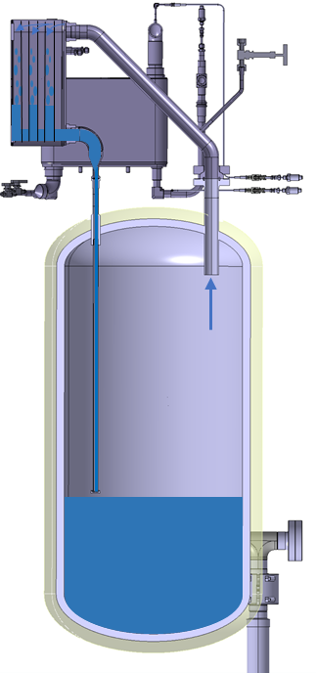
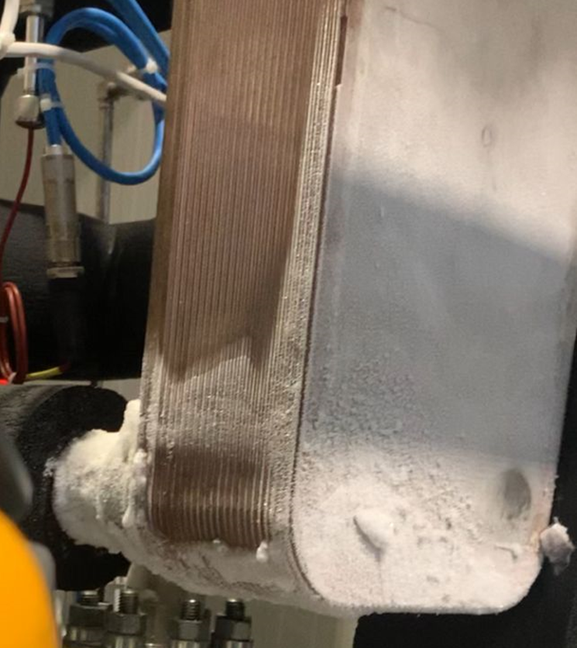
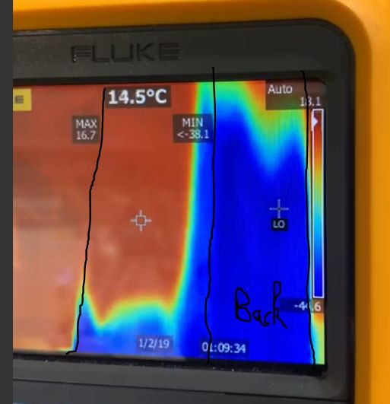
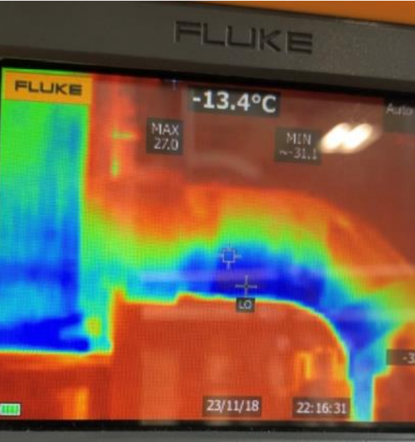
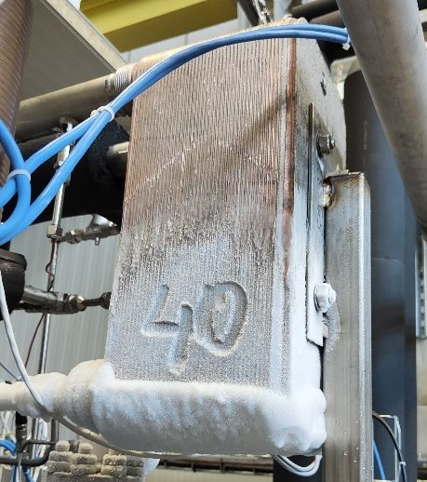
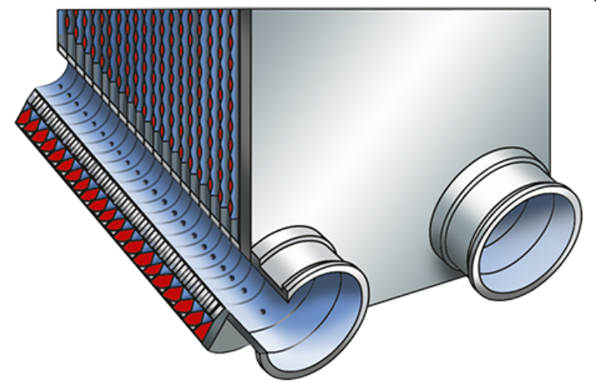
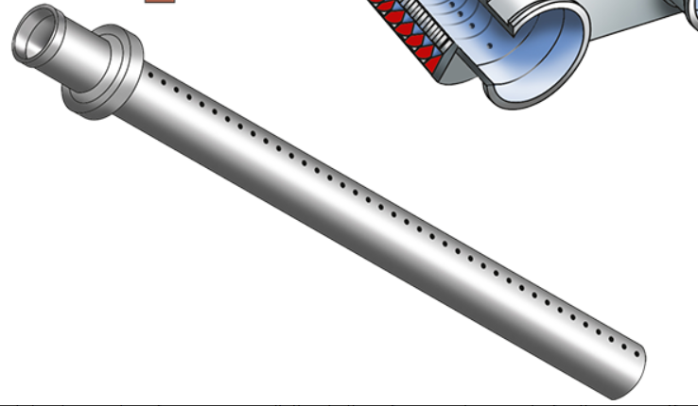

Accumulator Redesign
Installation of a Q-pipe in heat exchanger to improve flow distribution in the heat exchanger
Addition of a plunger tube to keep heat exchanger flooded
No Q-pipe shows liquid flowing through the back
Plunger tube
Too little convective flow without a plunger tube
Flow distribution much better with Q-pipe
Plunger and Q-pipe have increased cooling capacity from 15 kW at -35°C to 50 kW at -45°C
Q-pipe
Schematics by Yann Herpin

Slide 12
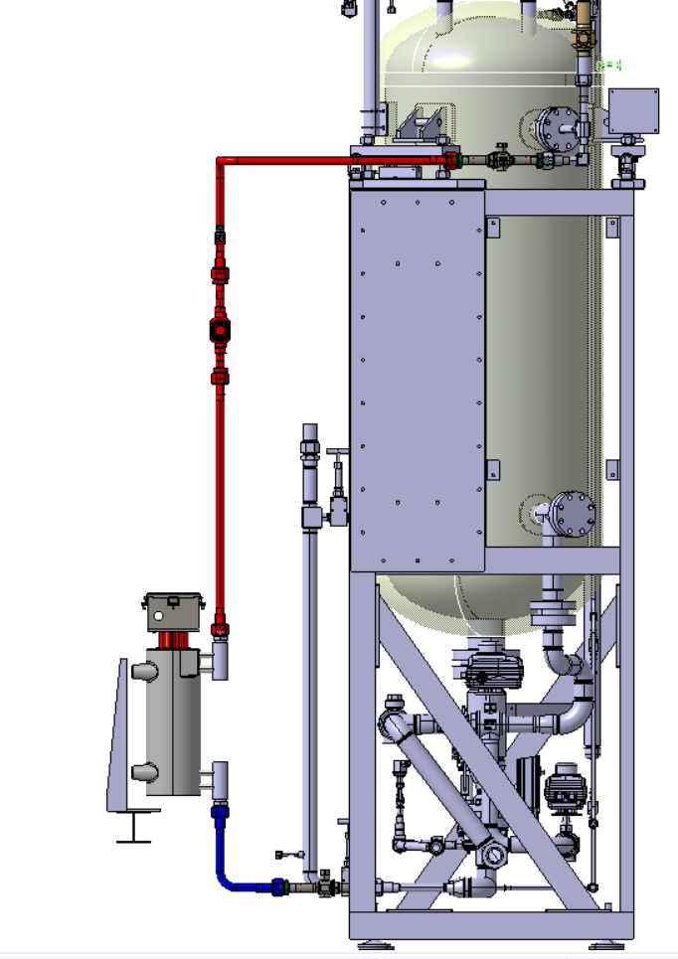
Accumulator Redesign
Cast heater block temperature is kept constant and flow is regulated with a control valve
This concept keeps the heater surface warm and hence reduces moisture problems
Addition of a plunger tube to keep heat exchanger flooded
Installation of a Q-pipe in heat exchanger to improve flow distribution in the heat exchanger
Plunger tube
Control valve
Q-pipe
Aluminium Cast Heater Block
Schematics by Yann Herpin

Slide 13
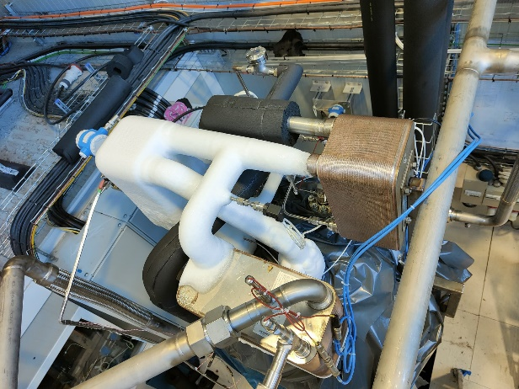
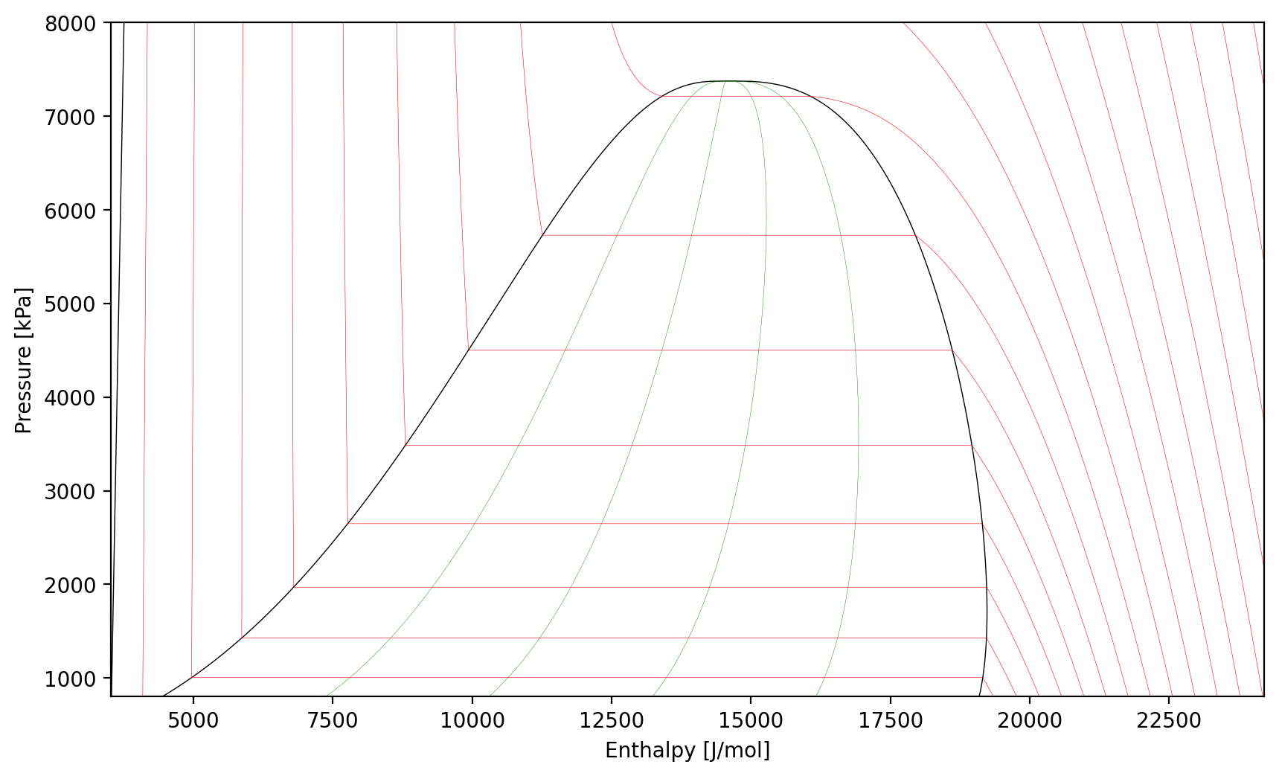
Heat Exchanger Configuration
Double HEX Configuration
Dew Point
Warm return gas
Evaporator
from Detector
Superheater
Laminar-Turbulent transition
Warm liquid from primary
to Accu
Cold in
Warm out
Old HEX Orientation
Accu HEX Orientation
Plant HEX Orientation

Slide 14
Our performance goal: 100kW @ -45°C
Superheating collapse shows
Superheating
Superheating
Accu = -40°C
Accu = -45°C
DEMO chiller is not powerful enough to remain at -53°C above 60kW, slowly drift up
As a result of chiller drift, accumulator saturation also starts drifting at 70kW
The DEMO R744 chiller is not powerful enough to maintain -53°C above 60kW, a drift to -45 °C is observed at 100kW, and is therefore not able to cool down the accumulator sufficiently

Slide 15
Our performance goal: 100kW @ -45°C
Injection valve has proper size
Accu = -45°C
Accumulator heat exchanger reaches 50 kW at -45°C
We have two heat exchangers operated in parallel on the accumulator
-45°C was kept at 50kW on a single heat exchanger!
With two heat exchangers, our goal of 100 kW at -45°C would be reached!
ATLAS maximum systems power: 60 kW; CMS maximum systems power: 90 kW

Slide 16
Heat Exchanger Configuration
Double HEX Configuration
Dew Point
Warm return gas
Evaporator
from Detector
Superheater
Warm liquid from primary
to Pump
Cold in
Warm out
Old HEX Orientation
Accu HEX Orientation
Plant HEX Orientation

Slide 17
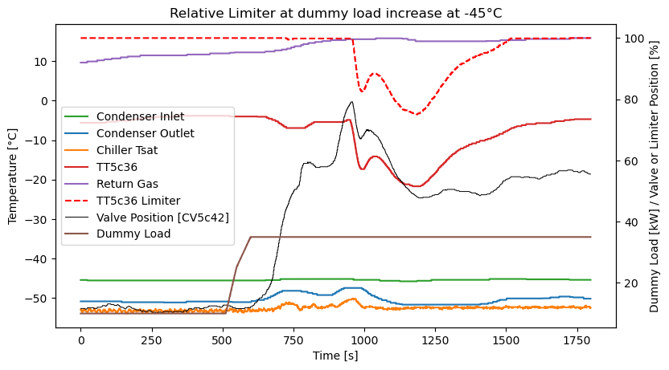
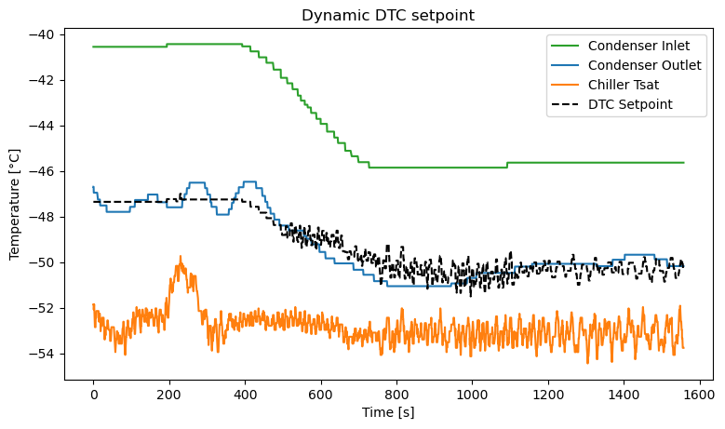
Operation of the Condenser/Subcooler
  Recently implemented new control strategy ensures sufficient pump subcooling at -45°C at high and low load cases
    Dynamic dT setpoint only requests no more than what the chiller can provide in cooling
    Output high limiter on the valve to keep return gas warm
    ‘Boost mode’ implemented to speed up valve action at low subcooling
Control strategy in action at 30 kW load step at -45°C in T2PACL
DTC setpoint
Accu setpoint change
Step of 30 kW induced
Subcooling is ensured and does not drop too low
DTC setpoint decreases with available temperature differential
Valve opens quickly due to a ‘boost mode’
Plant HEX Orientation
Valve opening is limited to ensure warm return gas

Slide 18
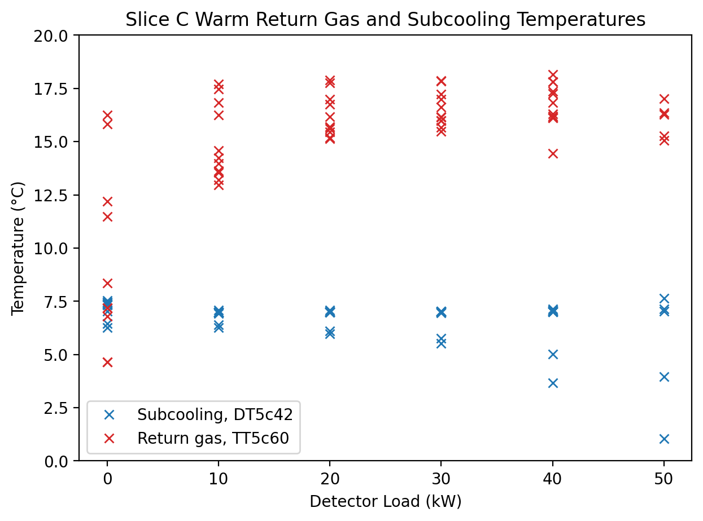
Operation of the Condenser/Subcooler
  Recently implemented new control strategy ensures sufficient pump subcooling at -45°C at high and low load cases
    Dynamic dT setpoint only requests no more than what the chiller can provide in cooling
    Output high limiter on the valve to keep return gas warm
    ‘Boost mode’ implemented to speed up valve action at low subcooling
Control strategy in action at 30 kW load step at -45°C in T2PACL
Dew Point
Step of 30 kW induced
Subcooling is ensured and does not drop too low
Valve opens quickly due to a ‘boost mode’
HEX slice target
Subcooling ensured in all detector cases !!
Plant HEX Orientation
Valve opening is limited to ensure warm return gas

Slide 19
Surface Storage

Slide 20
Surface Storage Concept
The surface storage is in fact 1 large common accumulator for all systems
The pressure is controlled by heating and cooling
  Electrical heating
  R744 branch cooling connection
  Small back-up chiller for maximum pressure safety
SS cooling
Surface Storage (SS)
Surface Storage System
Accu cooling
Accumulator Unit
SS heating
Accumulator
On surface
3-Way selection
CV8078
Accu heating
20
19
18
17
16
15
21
22
Flow control by-pass
CV1a16
Condenser
Start-up by-pass
PV2a22
Evaporators
7
14
8
23
25
Transfer line
24
1
2
3
4
Plant Unit
Pump
5
6

Slide 21
Surface Storage Concept
The surface storage is in fact 1 large common accumulator for all systems
The pressure is controlled by heating and cooling
  Electrical heating
  R744 branch cooling connection
  Small back-up chiller for maximum pressure safety
The liquid must be brought underground, which goes by a natural convection thermosiphon
Several degrees sub cooling is needed before sending down the flow
A heater is present underground in return line to help start-up the convective flow
SS cooling
Surface Storage (SS)
Surface Storage System
Accu cooling
Accumulator Unit
SS heating
SS pre cooling
Thermosiphon loop
Accumulator
On surface
In cavern
3-Way selection
CV8078
SS start up heater
Accu heating
20
19
18
17
16
15
21
22
Flow control by-pass
CV1a16
Condenser
Start-up by-pass
PV2a22
Evaporators
7
14
8
23
25
Transfer line
24
1
2
3
4
Plant Unit
Pump
5
6

Slide 22
Surface Storage Concept
The surface storage is in fact 1 large common accumulator for all systems
The pressure is controlled by heating and cooling
  Electrical heating
  R744 branch cooling connection
  Small back-up chiller for maximum pressure safety
The liquid must be brought underground, which goes by a natural convection thermosiphon
Several degrees sub cooling is needed before sending down the flow
A heater is present underground in return line to help start-up the convective flow
A supply valve is used to inject liquid at the condenser inlet, while a return valve is used to take liquid at the pump discharge
SS cooling
Surface Storage (SS)
Surface Storage System
Accu cooling
Accumulator Unit
SS heating
SS pre cooling
Thermosiphon loop
Accumulator
On surface
In cavern
3-Way selection
CV8078
SS start up heater
to plants
Accu heating
20
19
18
17
16
15
21
By-pass
PV9s82
SS supply
CV9s82
22
Flow control by-pass
CV1a16
Condenser
SS return
CV1s14
Start-up by-pass
PV2a22
Evaporators
7
14
8
23
25
Transfer line
24
1
2
3
4
Plant Unit
Pump
5
6

Slide 23
Surface Storage Concept
The surface storage is in fact 1 large common accumulator for all systems
The pressure is controlled by heating and cooling
  Electrical heating
  R744 branch cooling connection
  Small back-up chiller for maximum pressure safety
The liquid must be brought underground, which goes by a natural convection thermosiphon
Several degrees sub cooling is needed before sending down the flow
A heater is present underground in return line to help start-up the convective flow
A supply valve is used to inject liquid at the condenser inlet, while a return valve is used to take liquid at the pump discharge
A discharge control valve keeps discharge pressure above surface storage pressure
A back-pressure regulation valve will allow detector pressure to be high, such that the accumulator can always be kept below surface storage pressure
SS cooling
Surface Storage (SS)
Surface Storage System
Accu cooling
Accumulator Unit
SS heating
SS pre cooling
Thermosiphon loop
Accumulator
On surface
In cavern
3-Way selection
CV8078
SS start up heater
to plants
System BPR
CV8076
Accu heating
20
19
18
17
16
15
21
By-pass
PV9s82
SS supply
CV9s82
22
Flow control by-pass
CV1a16
Condenser
SS return
CV1s14
Start-up by-pass
PV2a22
Evaporators
7
14
8
23
25
Transfer line
24
1
2
3
4
Pump
Discharge control
CV1014
5
6
Plant Unit

Slide 24
Surface Storage 2PACL Operation
The Surface storage pressure underground is foreseen to work between 20 bar and 56 bar (~14-51 bar in SS-tank)
Discharge valve will keep discharge pressure 5 bar above surface storage setpoint, such that emptying will always be possible
Back pressure regulator (BPR) will be able to keep detector pressure at higher setpoints than surface storage setpoint, allowing us to keep the accumulator below surface storage setpoint
  This will allow us to always be able to fill
Surface storage and accumulator setpoints will be aligned as much as possible, but with multiple plants, BPR will be required in some cases
SP=-40’C
1
SS=45 bar
2
24
Simulation by Viren Bhanot
Pump outlet pressure
SP=15’C
1,2
SS=45 bar
Detector pressure
SS pressure
dP by BPR
15
Accu pressure
24
16
Setpoint change

Slide 25
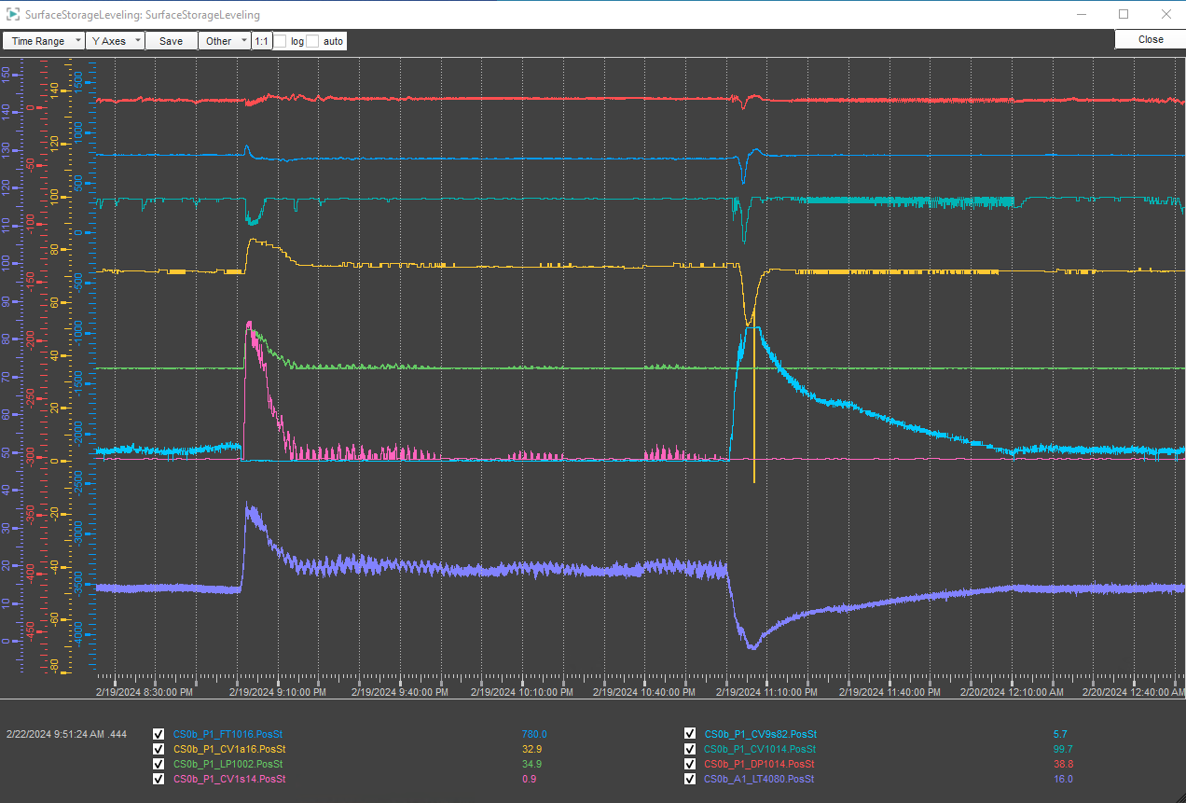
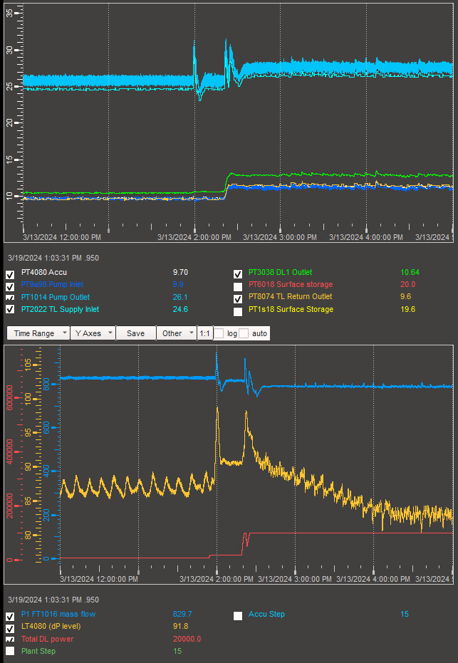
Accumulator Level Control
Level plot at -40°C accumulator setpoint and 20 bar surface storage pressure
Implementation of level control will of the accumulator will keep the liquid level of the accumulator always in a specified range
If level is low, surface storage valves will open to fill the plant until accumulator reaches the desired level
Vice versa, if the accumulator level is high, surface storage emptying valve will regulate until level setpoint is reached
Pump speed will be boosted during emptying to keep detector flow steady
Detector dP
Mass Flow
Pump Speed
Accumulator Level

Slide 26
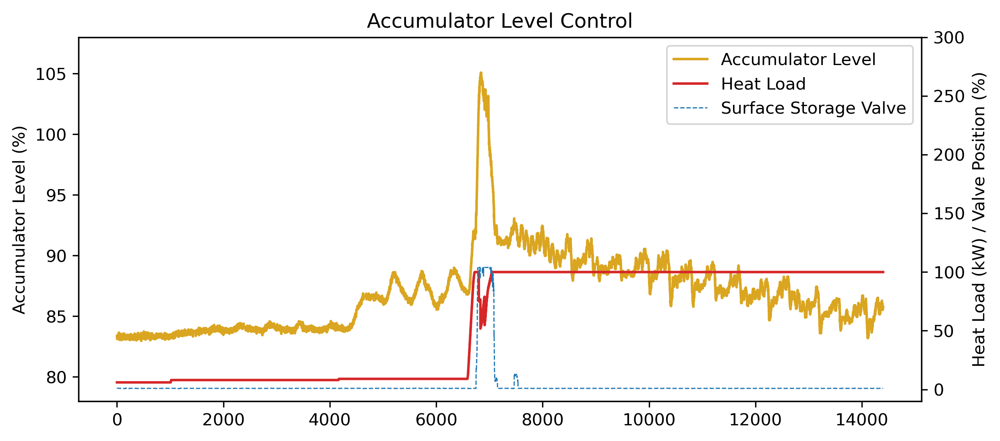
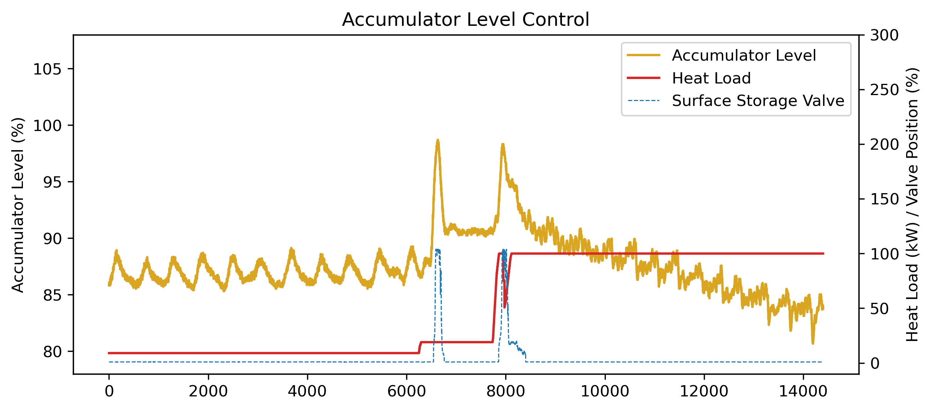
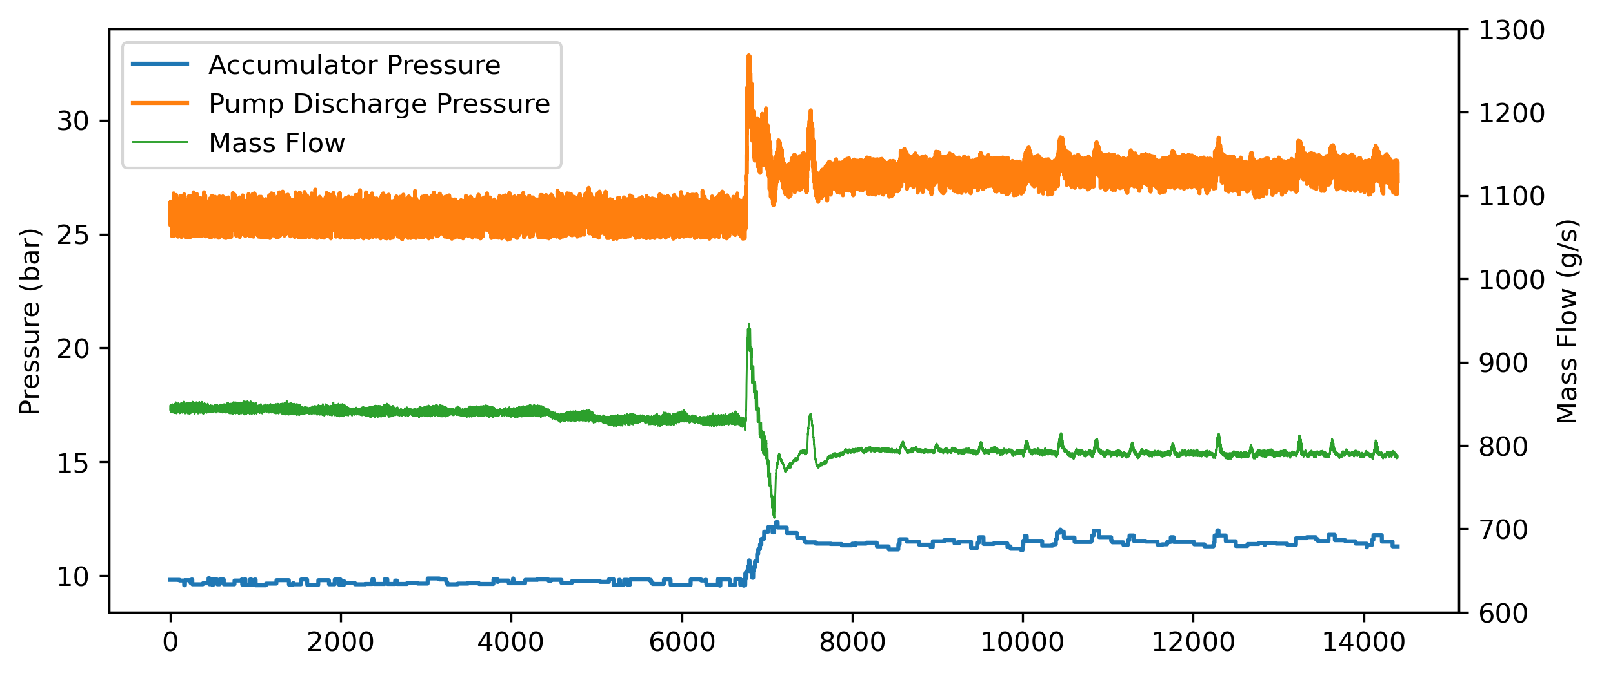
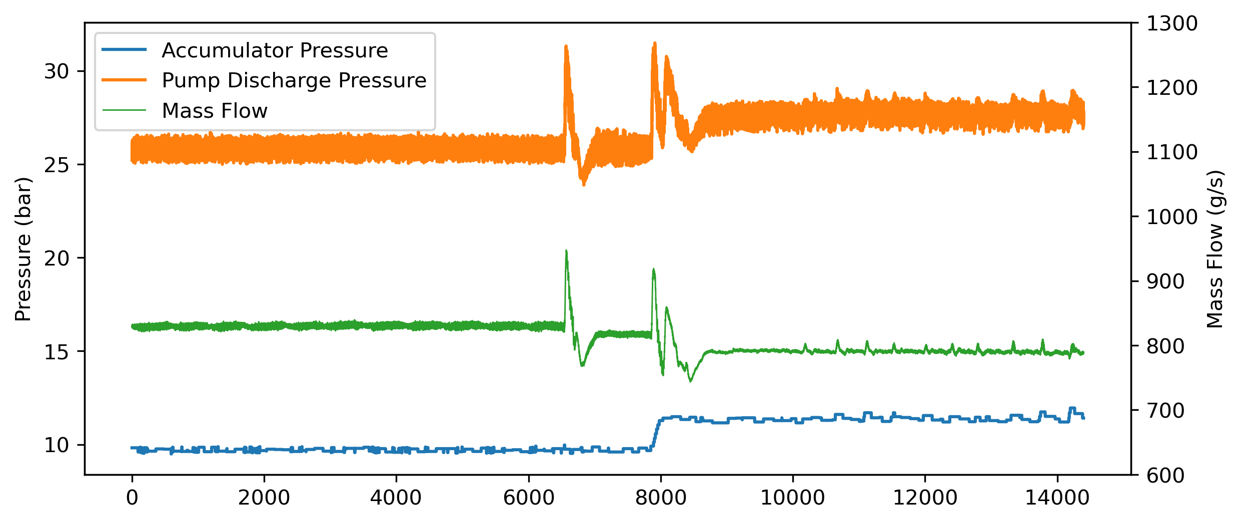
Pre-vaporization
Without Pre-vaporization
With Pre-vaporization
Accumulator level rises at heat load increase
Pre-vaporization helps contain level
Surface storage will pump off the liquid

Slide 27
Pre-vaporization
With Pre-vaporization
Density change as a function of start VQ and Tsat
in transfer line at a VQ increase of 0.3
Pre-vaporization helps contain level
1200
Tsat=-50°C
Tsat=-40°C
Tsat=-30°C
Tsat=-20°C
Tsat=-10°C
1000
Tsat=0°C
Tsat=10°C
½ the density to accumulate = half accumulator size needed
Tsat=20°C
800
600
Pre-vaporizing to 5% necessary in a manifold heater when using a 50% accumulator
400
200
0
0
0.1
0.2
0.3
0.4
0.5
0.6
0.7
Start vapor quality (-)
Pre-vaporizing of the transfer line helps a lot, 5% VQ reduces the vapor volume with 50%
Accumulator charge reduction after pre vaporization and detector powering
With pre vaporization a power cycle will require less accumulator volume

Slide 28
Plant and Accumulator start-up
Traditional Start-up Procedure
Start-up Procedure with Surface Storage
Plant Start-up
Accumulator Start-up
Detector Liquification
Surface Storage Pressure Equalization
Detector Liquification (by BPR)
Detector Circulation
Pump Liquification
Detector Circulation
Accumulator Control
Plant Circulation
Accumulator Control
Operation
Accumulator Skid Circulation
Operation
Start-up with surface storage starts from plant vapour state

Slide 29
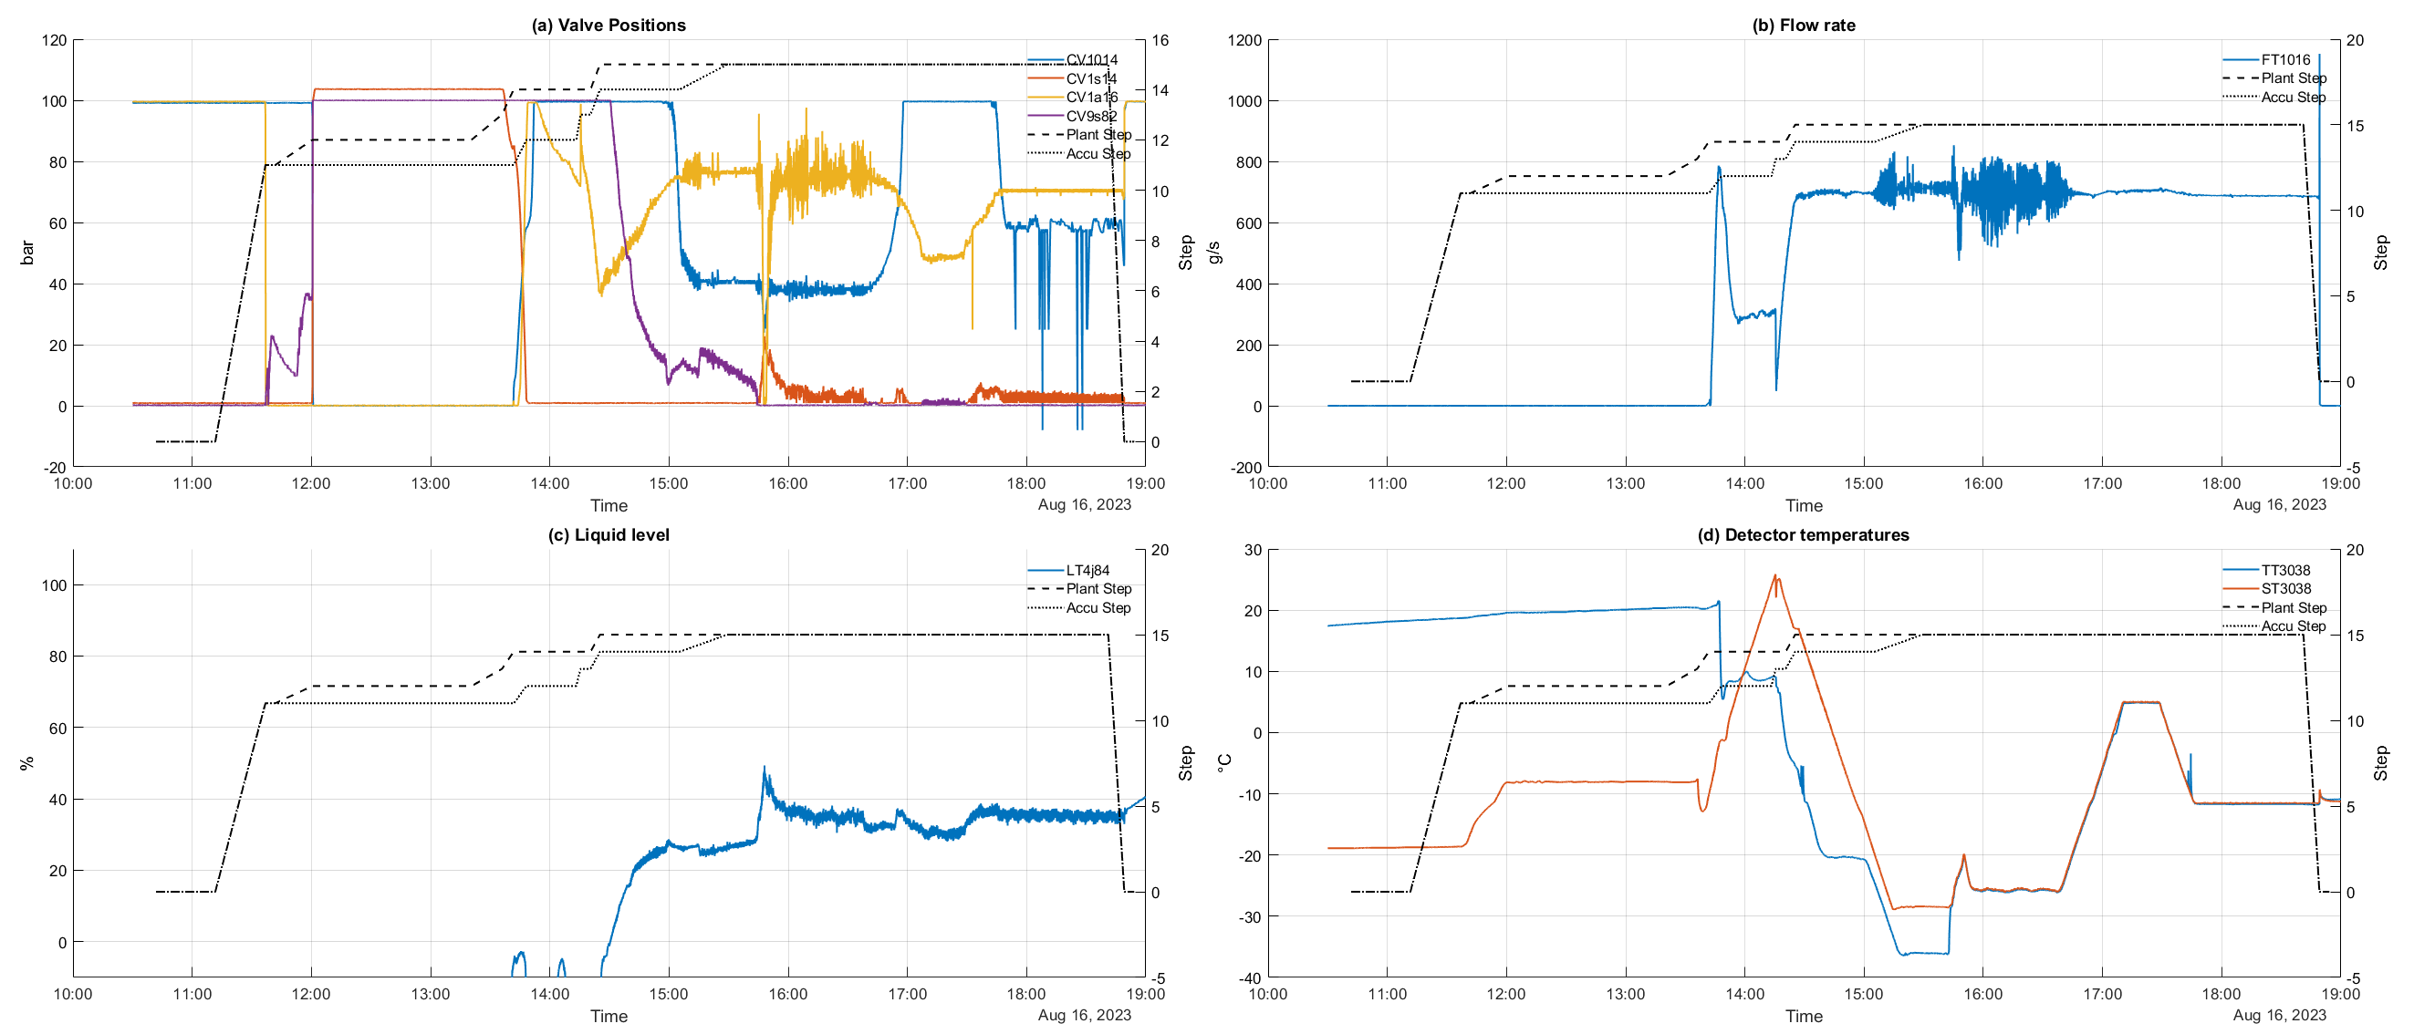
Plant and Accumulator start-up
Liquefying detector
Setpoint change
Filling Accu using “Surface Storage”
Cooldown
System starts from empty
Power on

Slide 30
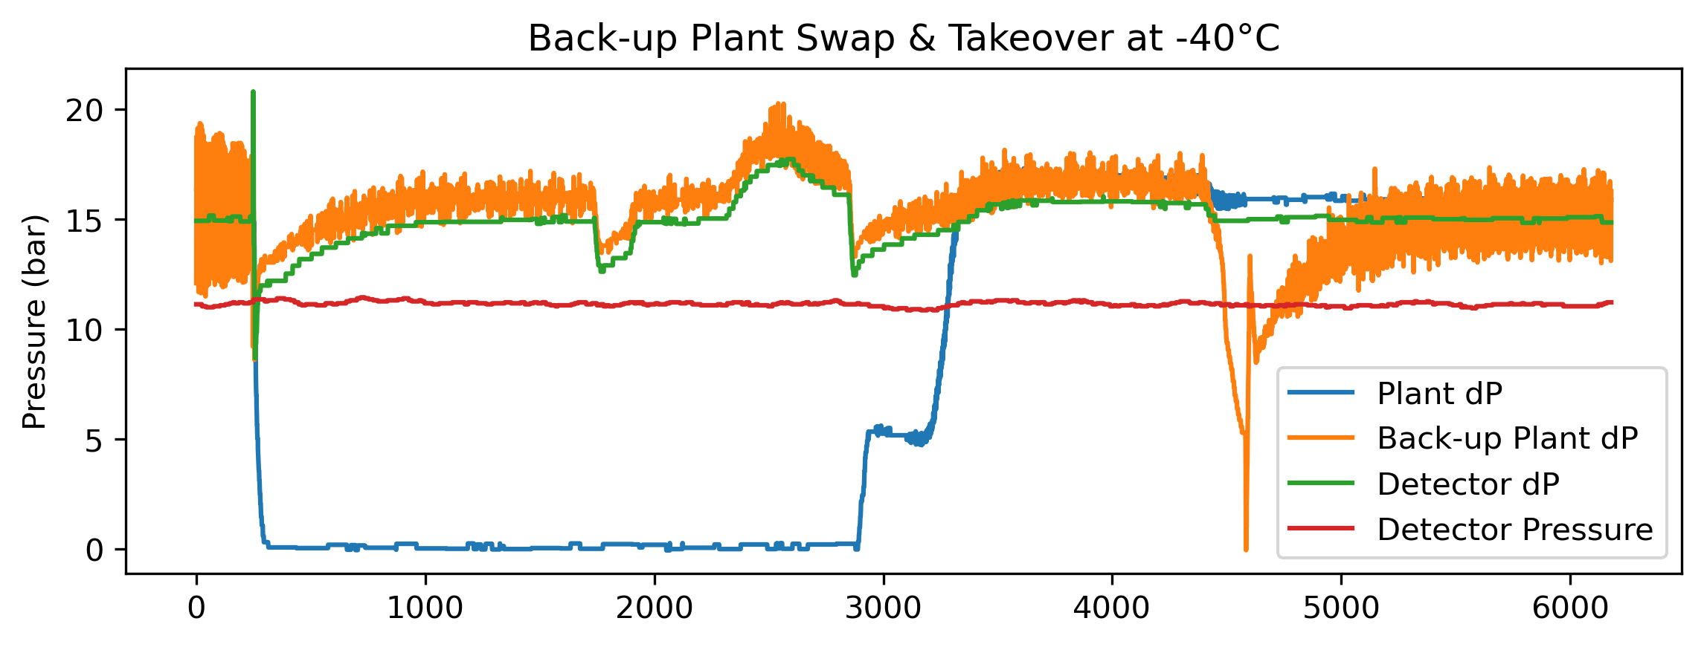
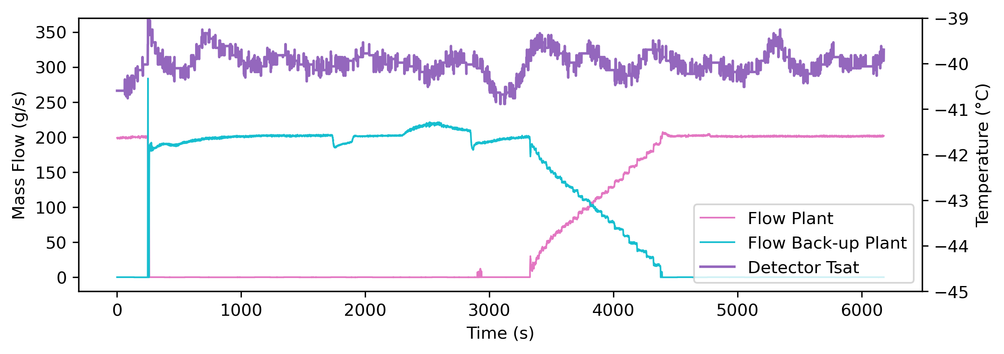
Back-up Plant Functionality
  Back-up plant is circulating in standby instantly kicks in and starts sending liquid to detector in case of main plant failure
  A temporary high flow is given due to the discharging of the higher pressurized back-up plant
  Pressure differential is maintained, and flow has not dipped to interlock values. Therefore, detector continues running during a swap
  Once the main plant is restarted, a swap takeover is performed in return, and the back-up plant returns to standby
Back-up plant
(running in stand-by)
Detector pressure & Tsat remain stable
Surface storage
To detector
Plants
Plant is back → gradual takeover
Plant fails → swap to back-up
Primary R744 chiller

Slide 31
Summary & Conclusions

Slide 32
Summary & Conclusions
The DEMO has successfully been operated full time since October 2022
  Including some technical stops for upgrades
Many aspects of DEMO operation have been thoroughly tested
Design load of 100 kW at -45°C is attainable
  Both in flow-through and traditional mode
Stable performance at different heat loads at -45°C has been achieved
  Heat exchanger performance considerably improved
  Flow-through mode tested and applied successfully as baseline operation
  Good control strategies for stable detector cooling at ultimate conditions
  Also good temperature control when in liquid
Surface storage interaction
  Accurate accumulator level control has turned out to be possible
  New start-up procedures have been run through using surface storage interactions
Back-up plant functionality has successfully been tested at different temperature setpoints and configurations

Slide 33
Predictions for the Final Systems
Stable operation at temperatures from +15°C to -40°C at the detectors is expected from DEMO operation, irrespective of the load
Performance of DEMO meets foreseen detector heat loads, and the system is expected to handle heat load deviations and other perturbations well
With thorough commissioning campaign, good performance is expected throughout the final system lifetime

Slide 34
Thank you!!
On behalf of the EP-DT team!

Slide 35
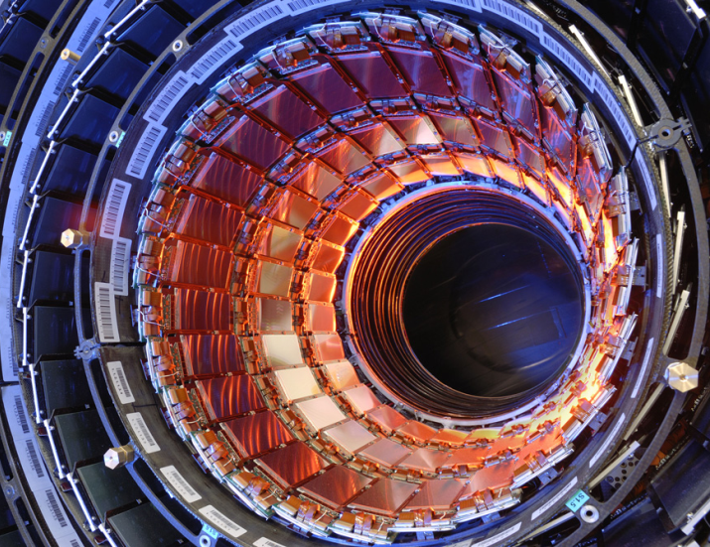
The basic concept: 2PACL
Two-Phase Accumulator Controlled Loop → 2PACL
Low vapor quality cooling for best heat transfer in small tubes
Large temperature range
  +20°C / -45°C
  Independent to applied heat load
Liquid loop start-up
  No thermal shocks
Very stable evaporator temperature control at a distance
  Detector Pressure ≈ Accumulator Pressure
All active control in distant plant in an accessible area
Successful in first LHCb Velo detector and Velo upgrades, CMS Pixel detector and ATLAS IBL

Slide 36
Detector Specifications

