Slide 1
Flow distribution capillary tube testing for the CMS silicon detector upgrades
Forum on Tracking Detector Mechanics 2024
Purdue University, Indianapolis, Indiana U.S.
Derek Jan Langedijk
CERN, CMS Cooling Integration
May 29th, 2024

Slide 2
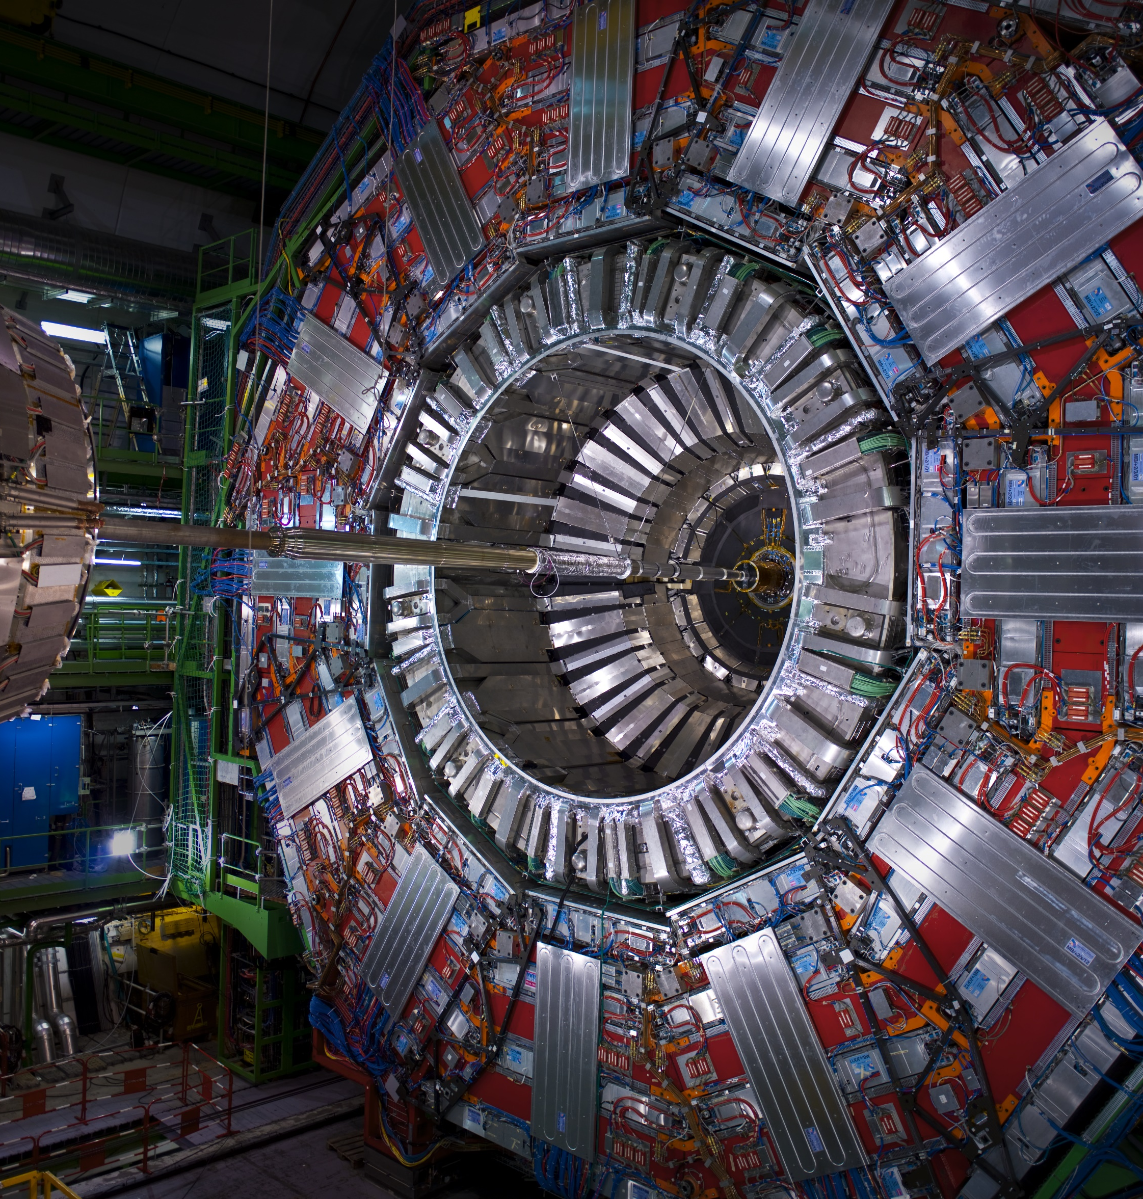
Content
Introduction
  The 2PACL Principle
  Capillaries in CO2 Cooling – Why?
Theoretical Prediction
  Principle
  Example
  Effectiveness & Difficulties
  Conclusion
Capillary Open System
  Working Principle
  Mechanical Design
In practise
  Capillary manufacturing
  Testing
  Consistency
Conclusion

Slide 3
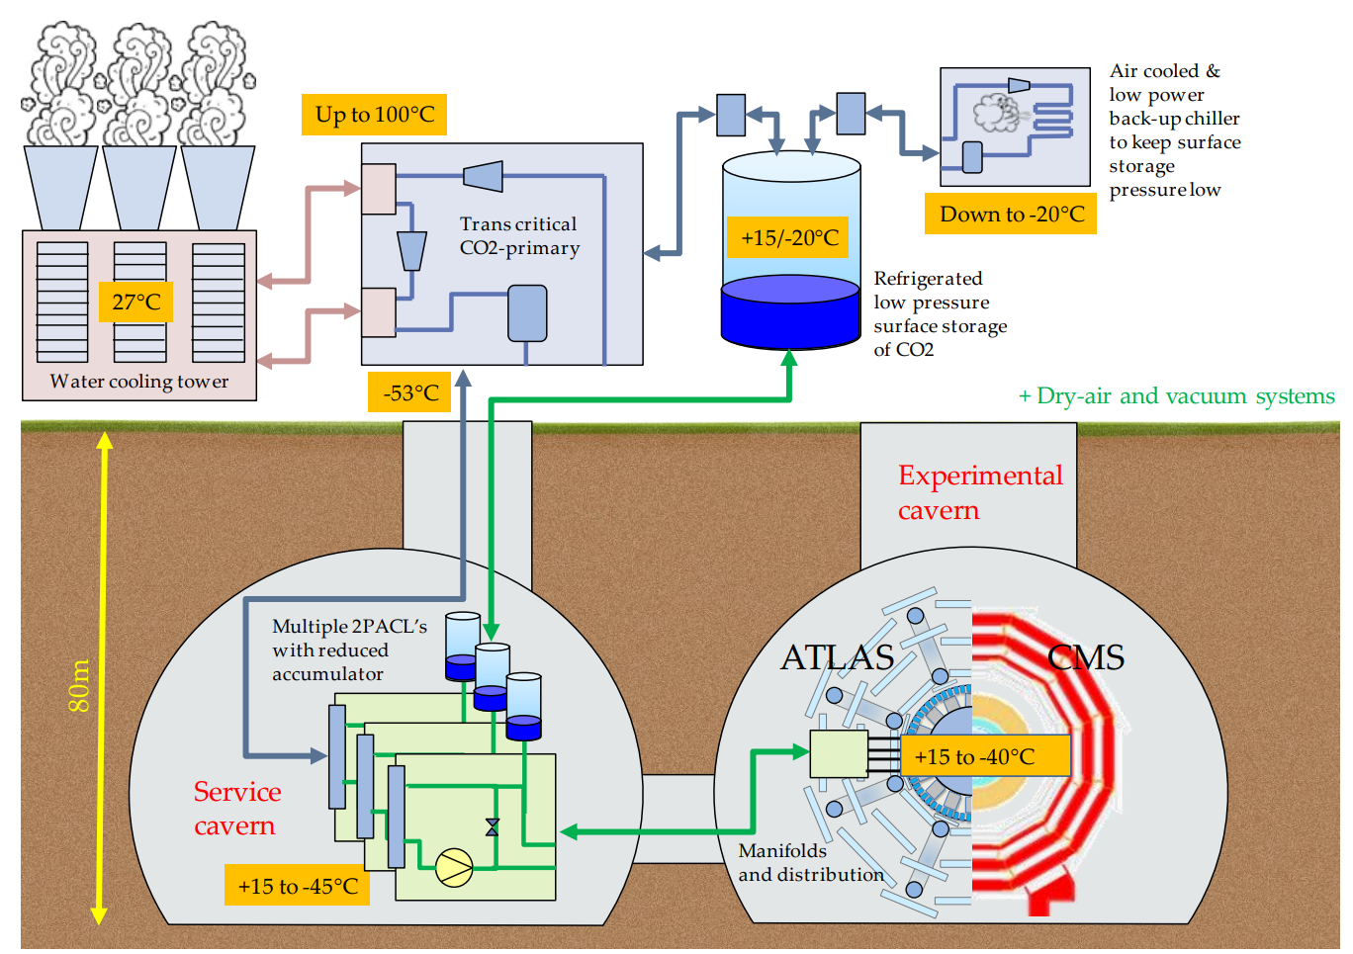
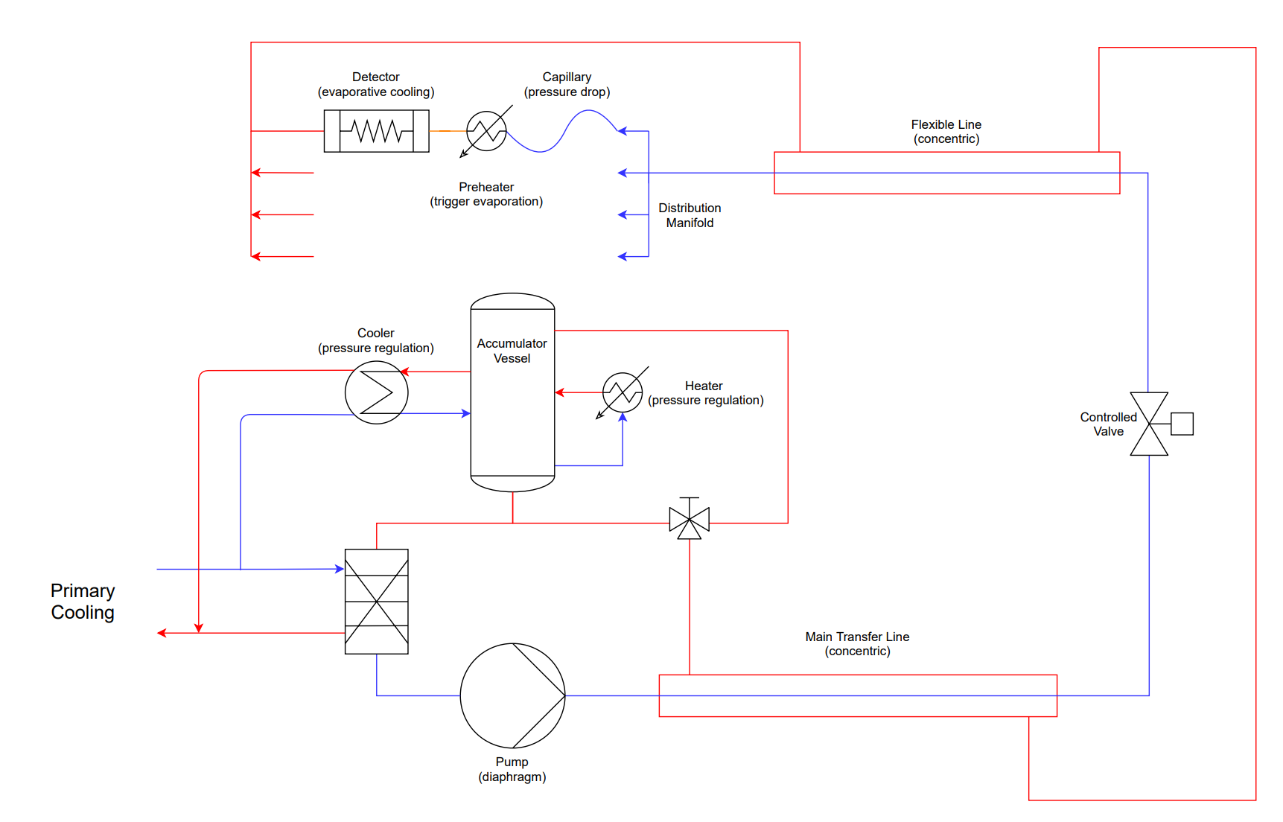
The 2PACL Principle – Components and Layout
Surface and Underground layout with schematic system overview
Schematic overview of 2PACL system
Surface and underground layout

Slide 4
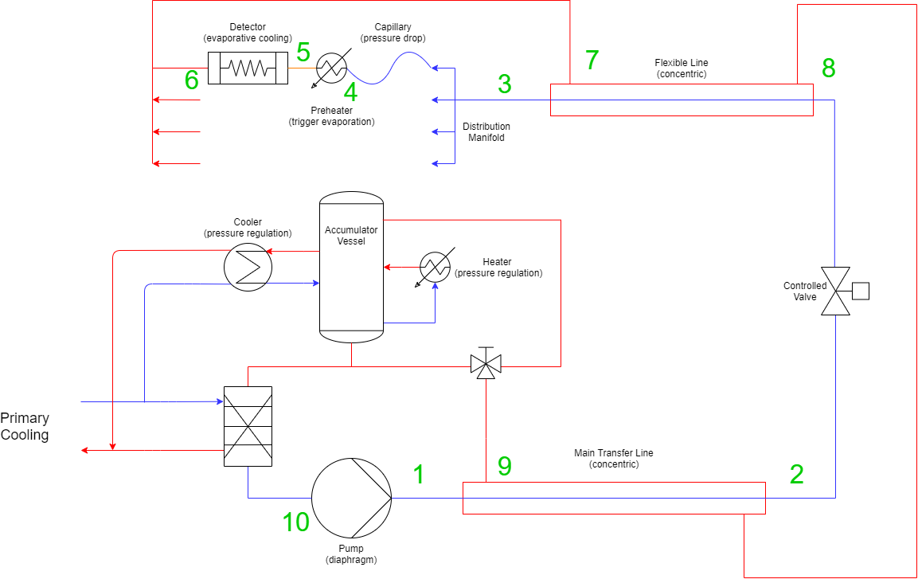
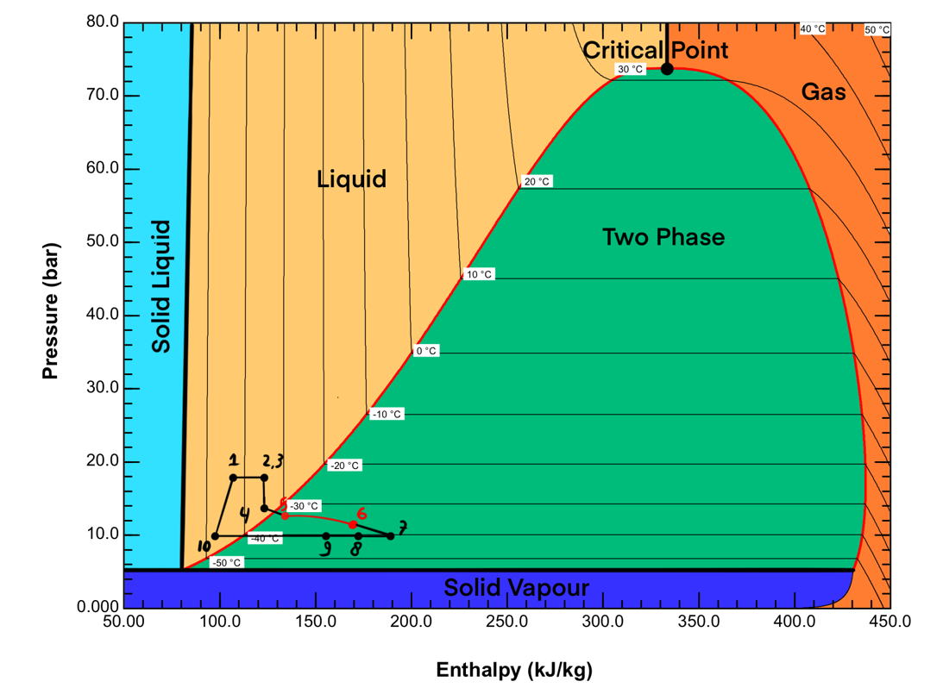
The 2PACL Principle – Thermodynamic Cycle
Components visualized in PH-Diagram

Slide 5
Capillaries in CO2 Cooling – Why?
Trigger Boiling
Passive Flow Distribution
Detector Loop Failure
10 bar
~2 bar
~8 bar

Slide 6



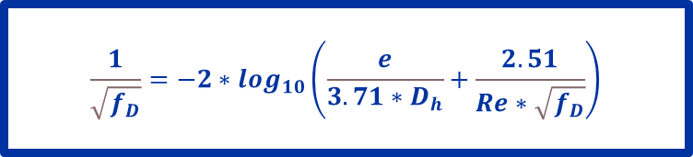

Theoretical Prediction – Principle
Prediction based on the Darcy-Weisbach equations modelled in MatLab
$∆p$using Darcy-Weisbach:
Differential Pressure (∆p) [Pa]
Length of Tube (L) [m]
Darcy friction factor (f_{D}) [-]
Density of the Fluid (ρ) [kg/m³]
Fluid Velocity (W_{v}) [m/s]
Hydraulic Diameter of the Tube (D_{h}) [m]
Inner Surface Roughness (e) [mm]
Reynolds Number (Re) [-]
$$∆p=f_{D}∗\frac{ρ}{2}∗\frac{{W_{v}}^{2}}{D_{h}}∗L$$
f_{D} during laminar flow:
$$f_{D}=\frac{64}{Re}$$
f_{D} during turbulent flow:
Reynolds number:
$$\frac{1}{\sqrt{f_{D}}}=−2∗\log_{10}\left(\frac{e}{3.71∗D_{h}}+\frac{2.51}{Re∗\sqrt{f_{D}}}\right)$$
$$Re= ρ∗W_{v}∗\frac{D_{h}}{µ}$$

Slide 7
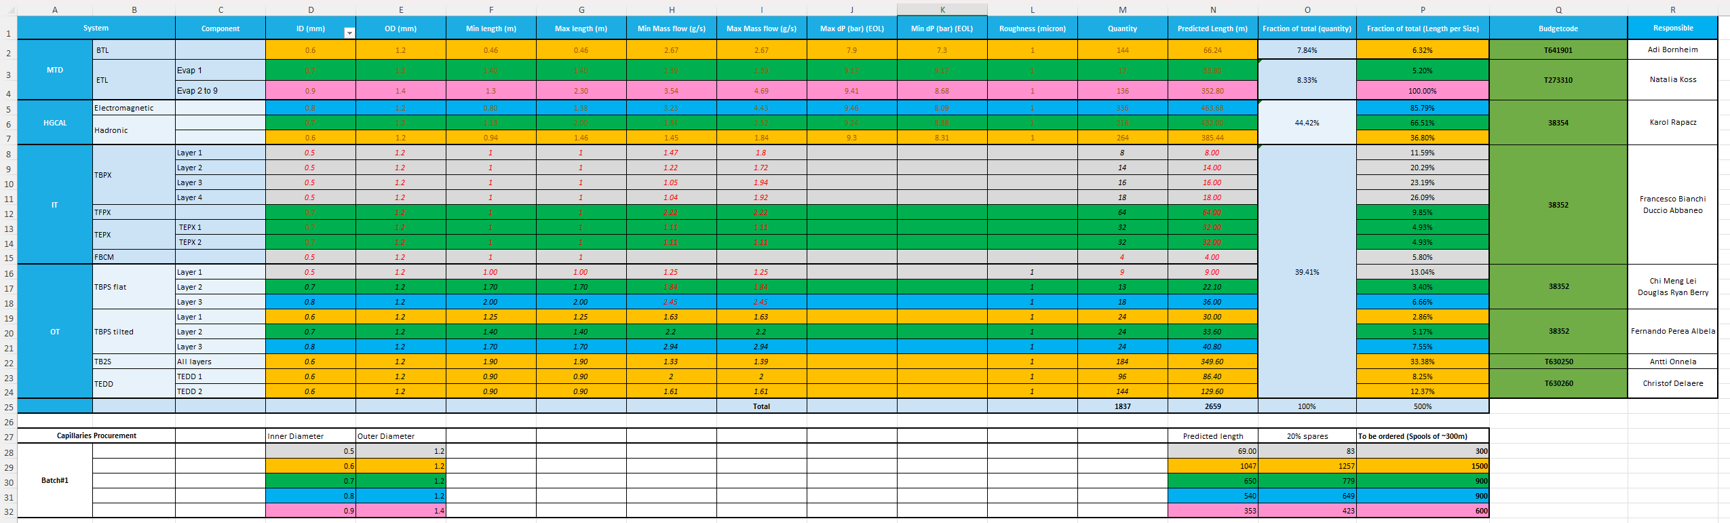
Theoretical Prediction – Example from Detector List
Prediction based on the Darcy-Weisbach equations modelled in MatLab
Desired
∆p
Capillary
Detector System
Capillary Properties
Sub-System
Quantity

Slide 8
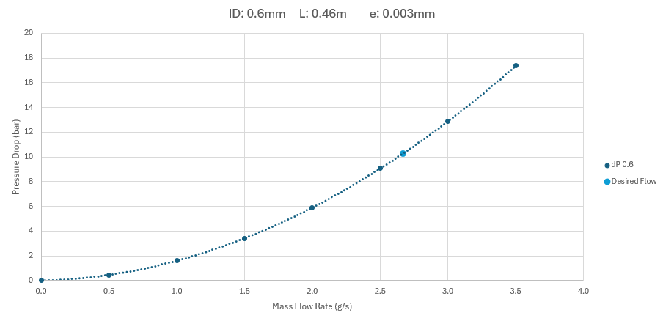
Theoretical Prediction – Example from Detector List
Result Theoretical Prediction:
Super easy!
Right…?

Slide 9
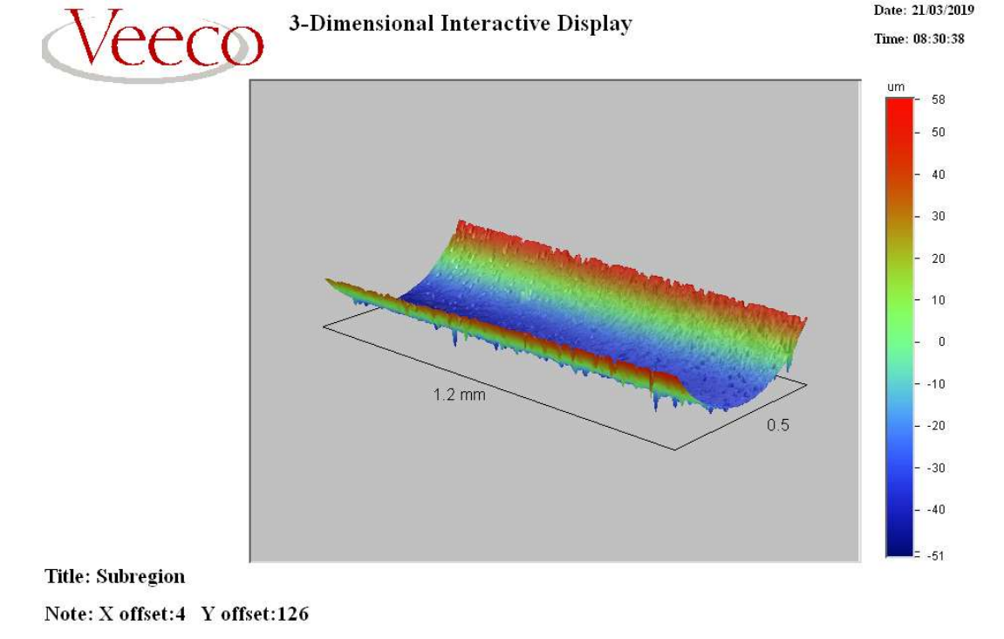
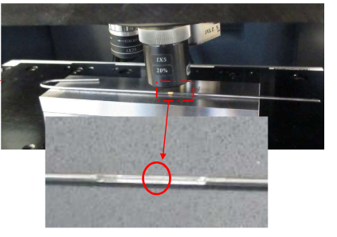
Theoretical Prediction – Why is it still so difficult?
Capillaries are not perfect…

Slide 10
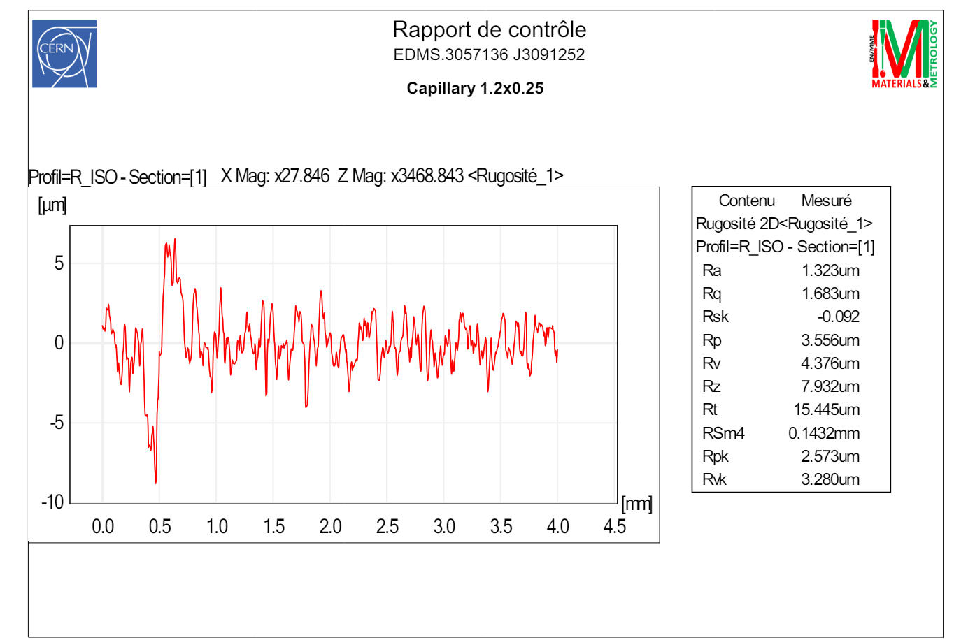
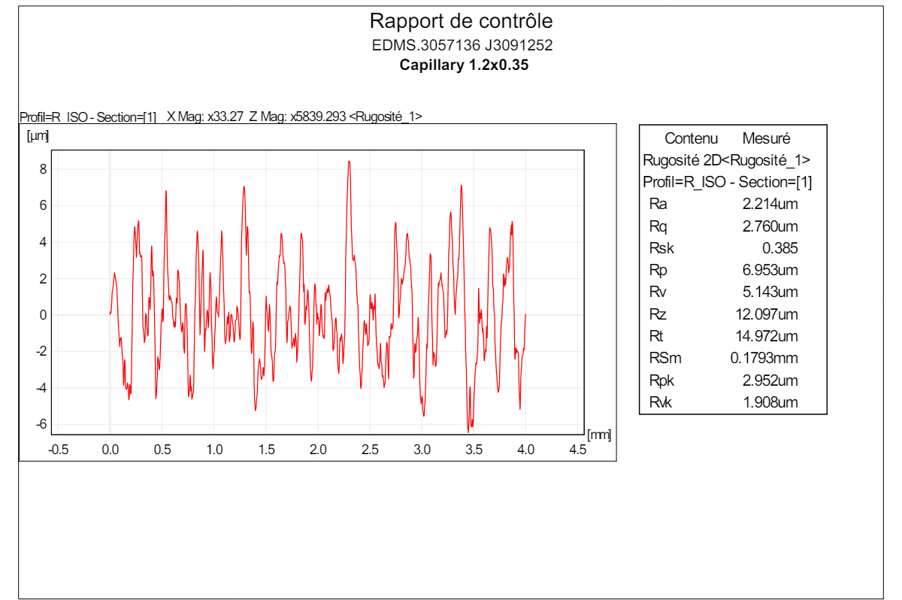
Theoretical Prediction – Why is it still so difficult?
Same Manufacturer!

Slide 11
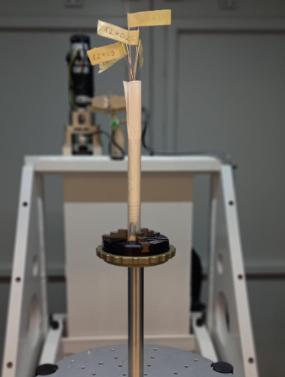
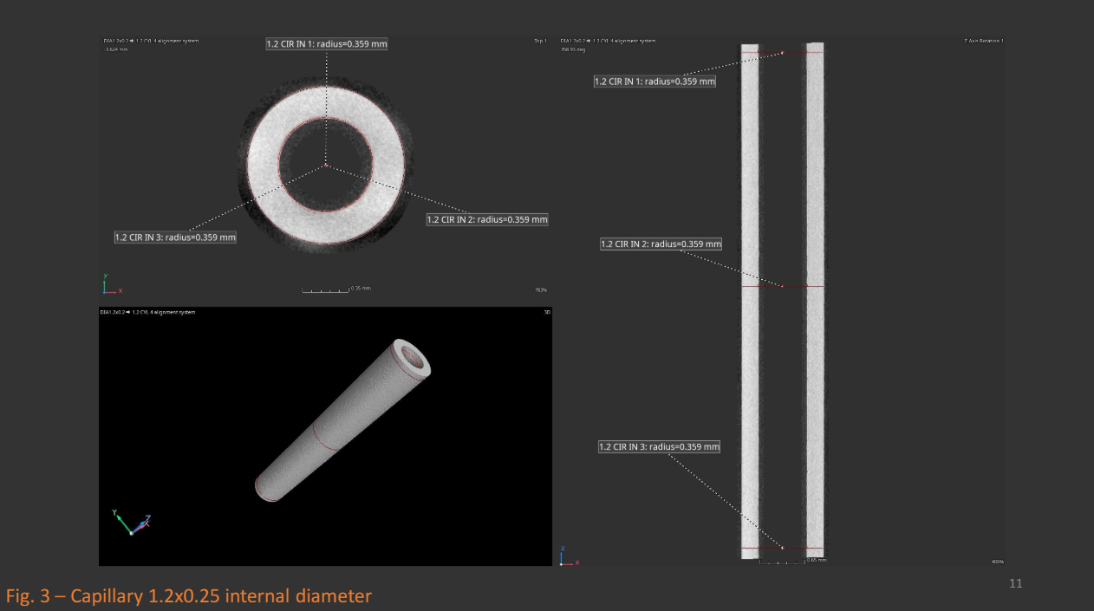
Theoretical Prediction – Why is it still so difficult?
CT Scan on capillaries… BIGGER Inner Diameters

Slide 12
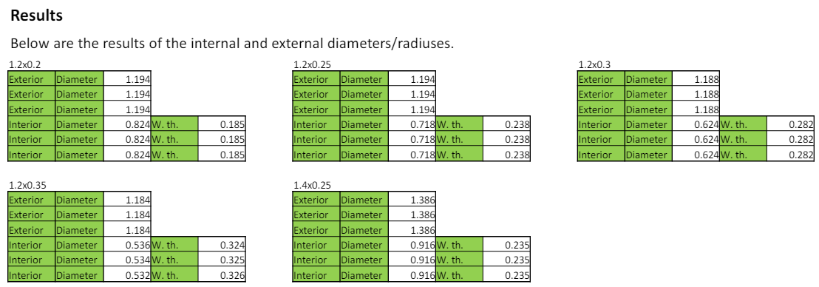
Theoretical Prediction – Why is it still so difficult?
Overview of Results – Tolerance between +0.01mm and +0.03 mm
0.8mm
0.7mm
0.6mm
0.5mm
0.9mm

Slide 13
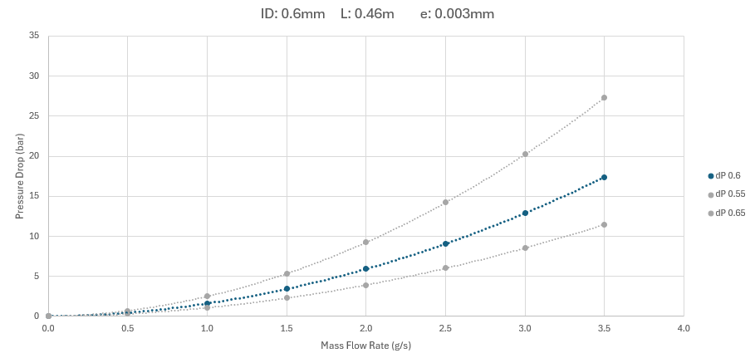
Theoretical Prediction – Why is it still difficult?
How strong is a 0.05mm ID tolerance influencing the pressure drop?
Strong… →

Slide 14
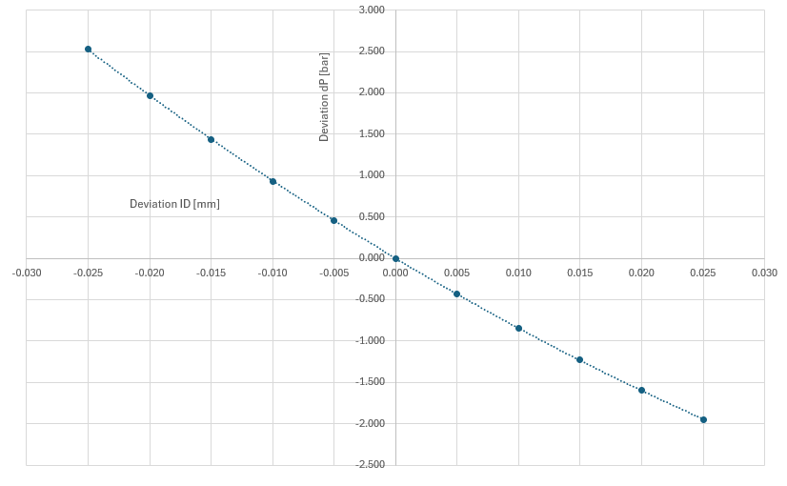
Theoretical Prediction – Why is it still difficult?
How strong is a 0.05mm ID tolerance influencing the pressure drop?
Small inaccuracies, make a big difference for pressure drop
0.624mm Capillary
2 bar decrease

Slide 15
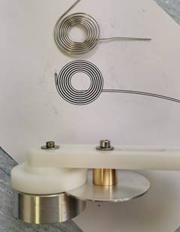
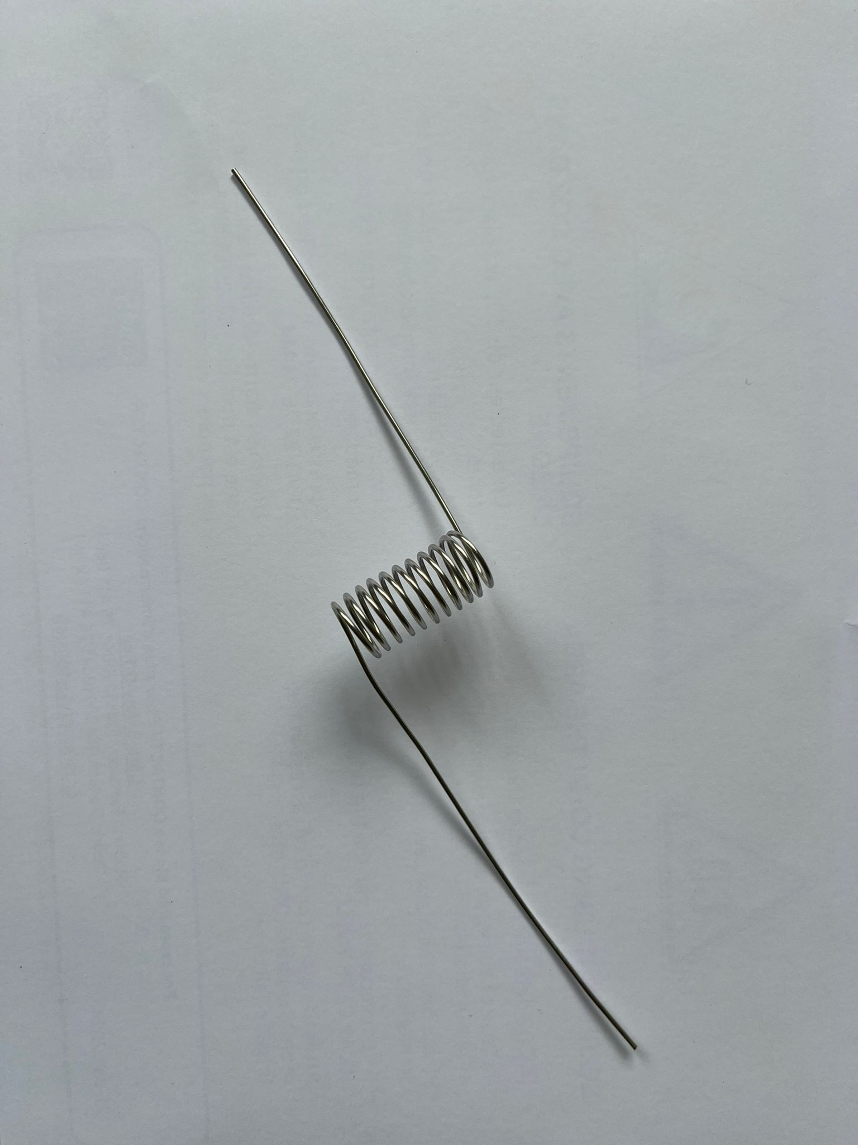
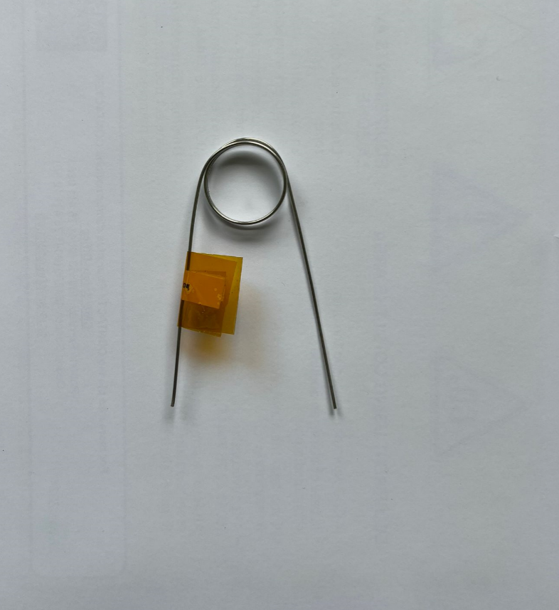
Theoretical Prediction – Why is it still difficult?
Coiling increases pressure drop.
Also, coiling is subjective… see below:
Research is ongoing to better understand the effects of coiling on pressure drop!

Slide 16
Theoretical Prediction – Testing each capillary!
Conclusion: Testing is a necessity; theory does not give sufficient accuracy.
Capillaries are not consistent:
Uncertainties with roughness
Uncertainties with inner diameter
Uncertainties with coiling
Solution: Build a test factory that can test all capillaries!

Slide 17
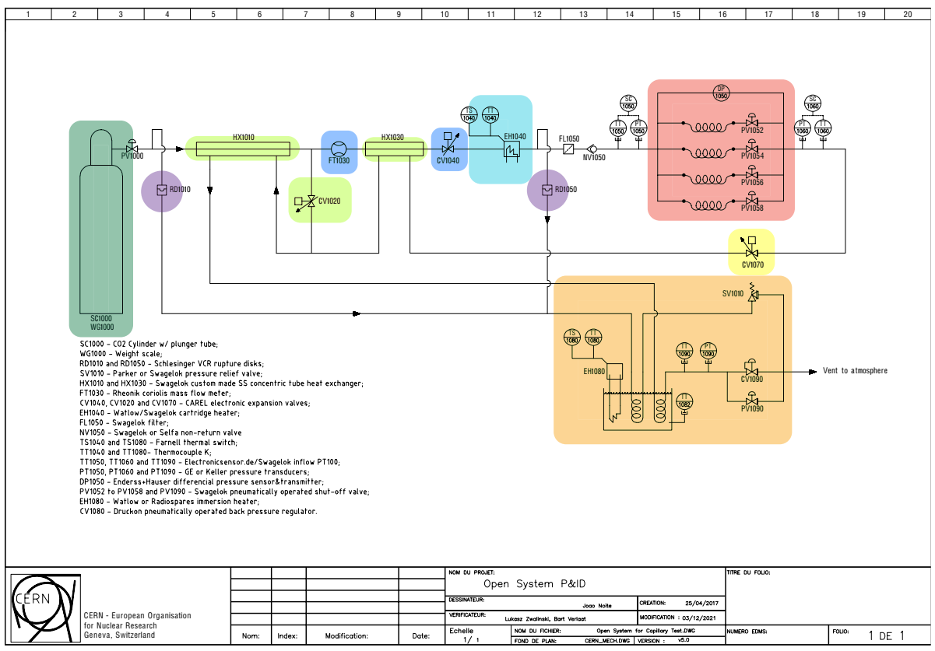
Capillary Open System – Principle
“2 Identical Setups for ATLAS and CMS”
Capillaries
  ∆p sensor
  Shut-off valves
Flow measurement and regulation
Bottle supply
Exhaust system (Single phase, gas)
Safety Burst Discs
Supply Subcooling
  Heat exchangers
  Bypass Valve
Subcooling regulator
Warm Nose Heater (ATLAS Only)

Slide 18
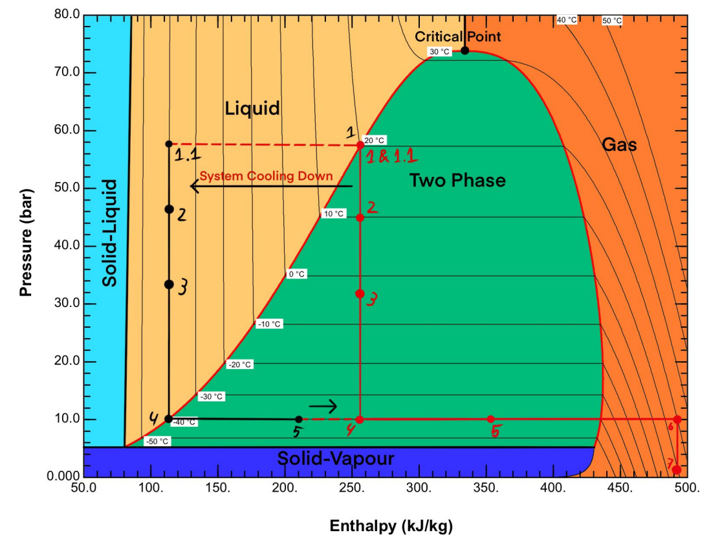
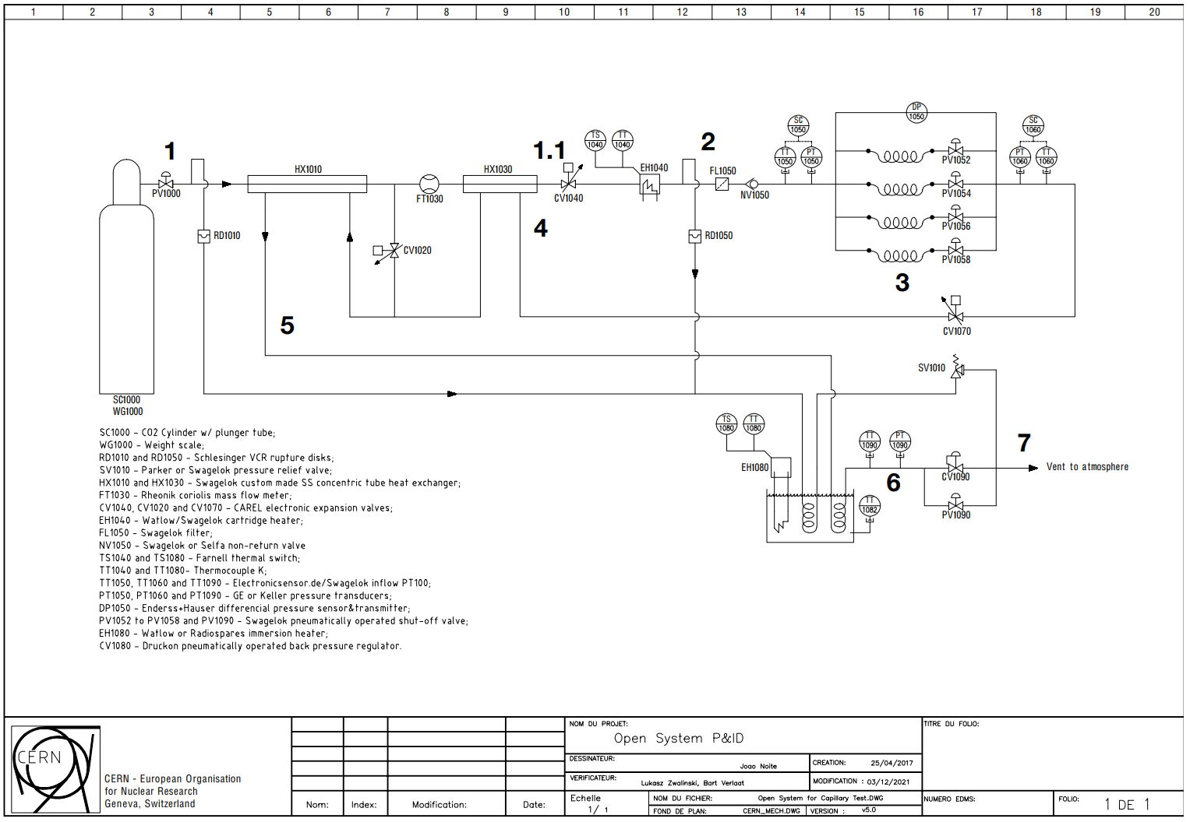
Capillary Open System – Principle
P&ID COS – Joao Noite, ATLAS Collaboration

Slide 19
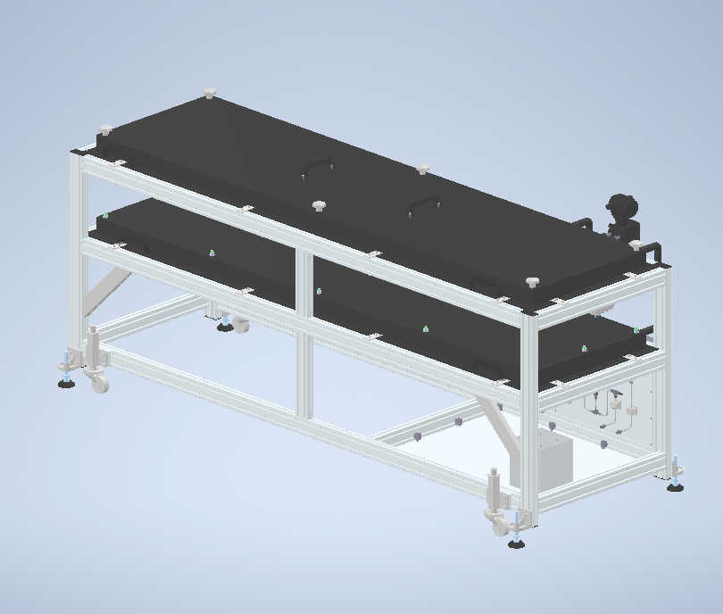
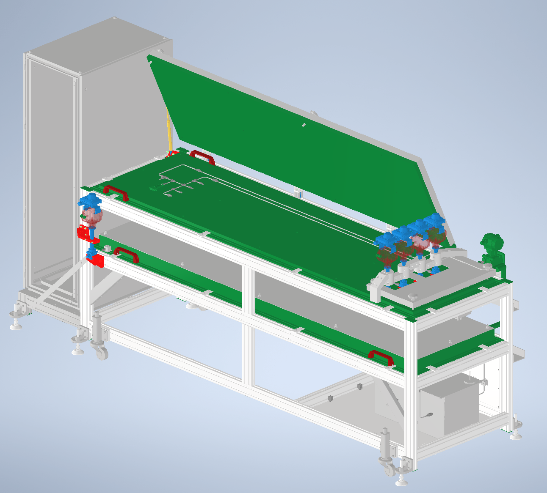
Capillary Open System – Mechanical Design
Original Design
Liam Cooper
Science & Technology Facilities Council, United Kingdom
Final Design
Martin Machac & Derek Jan Langedijk
CERN

Slide 20
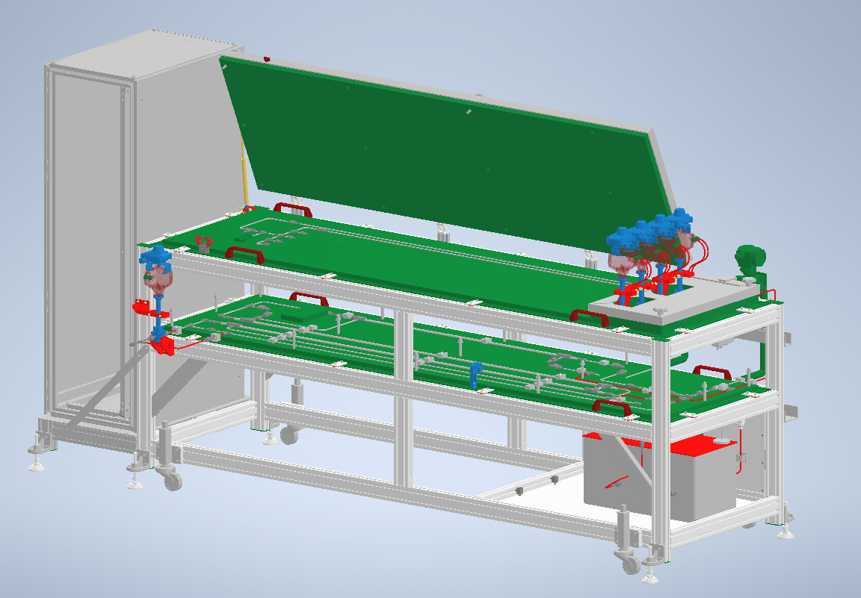
Capillary Open System – Mechanical Design
Capillaries
Bottle connection
Capillary shut off valves
Heat exchangers
Exhaust system (water tank)

Slide 21
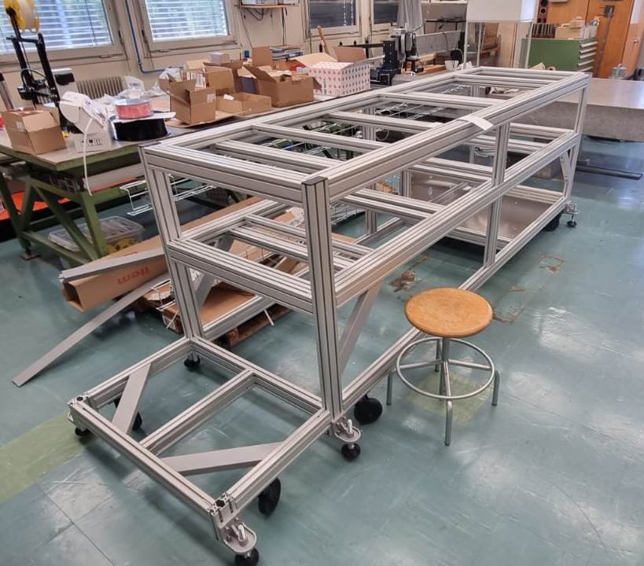
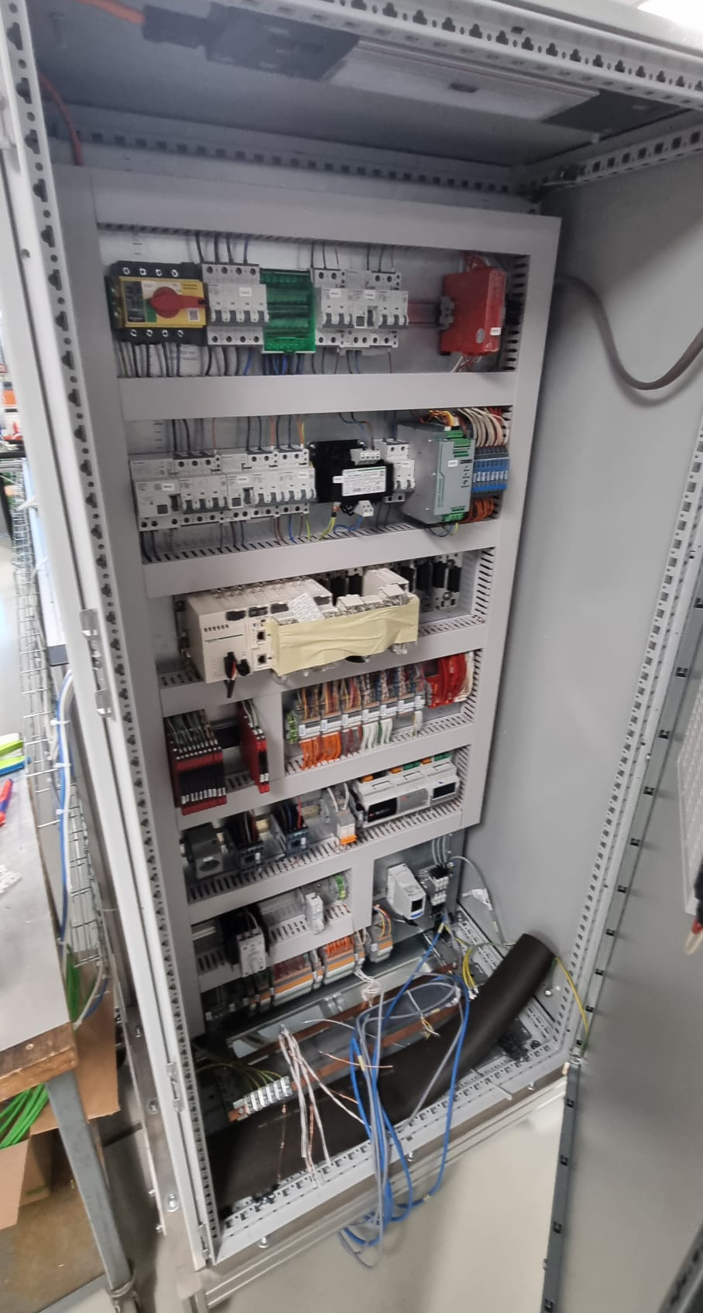
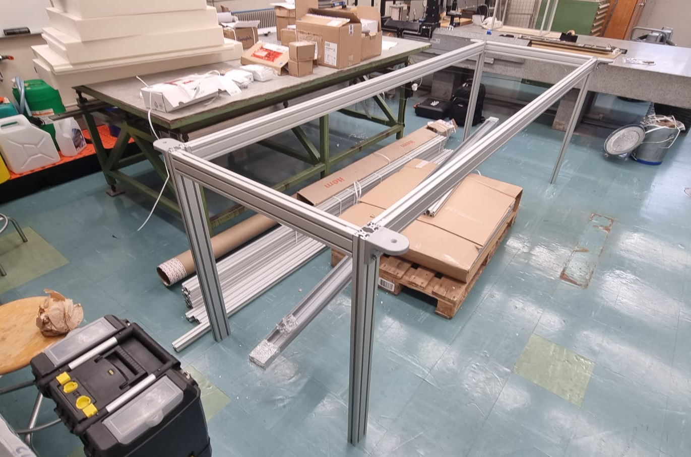
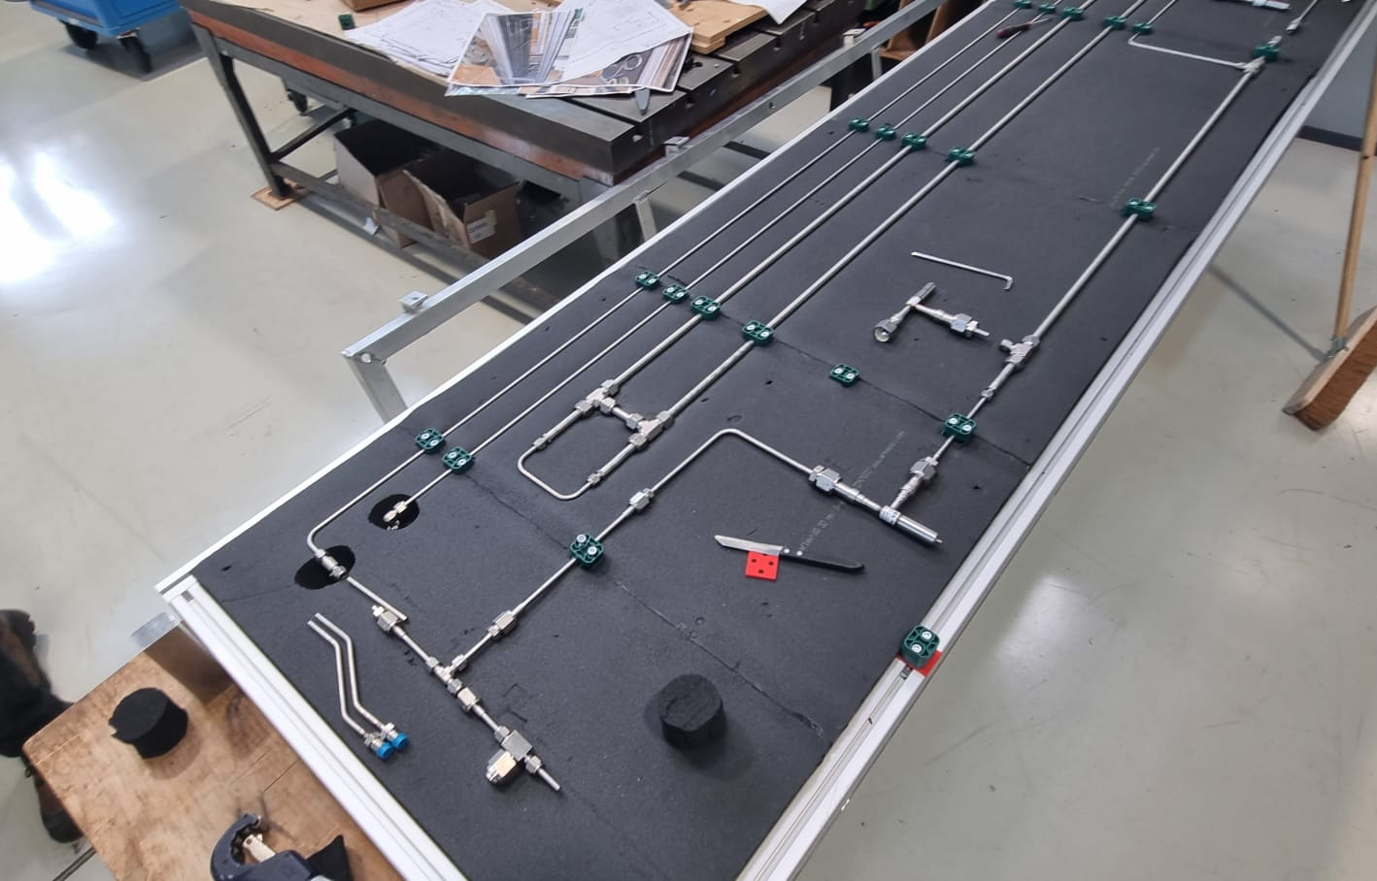
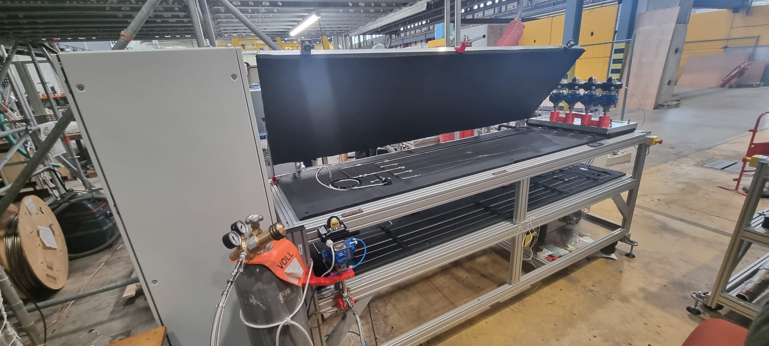
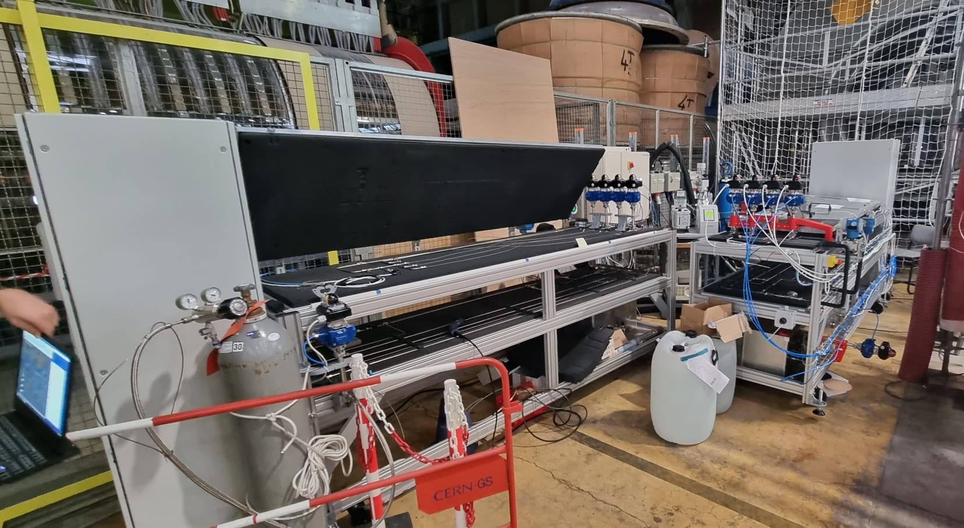
Capillary Open System – Constructed @ CERN
February 2023
Commissioning with ATLAS Setup
October 2023

Slide 22
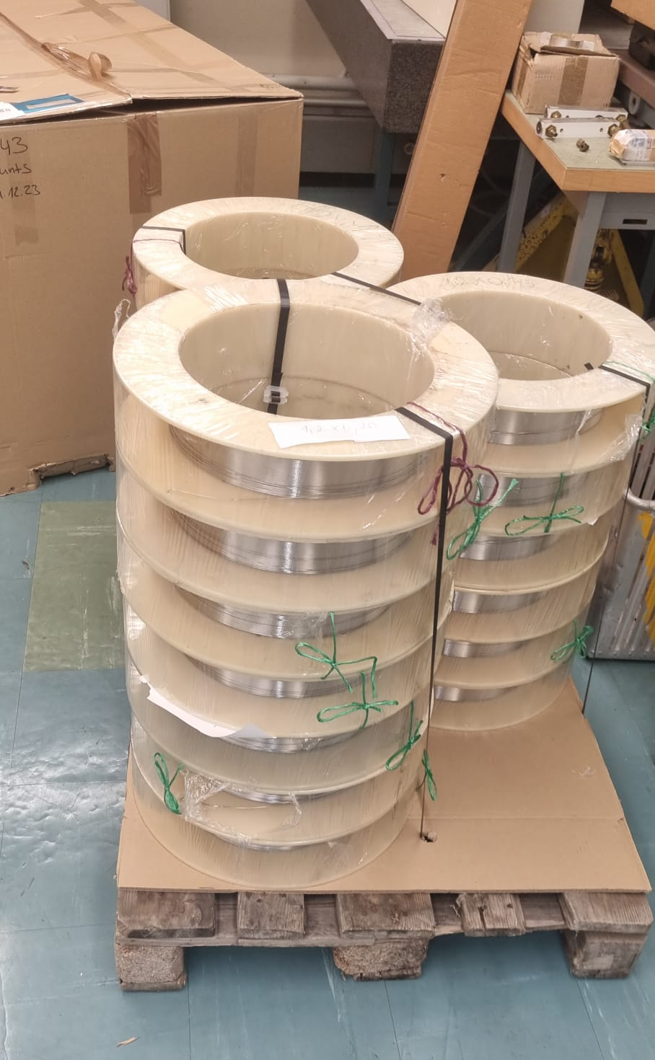
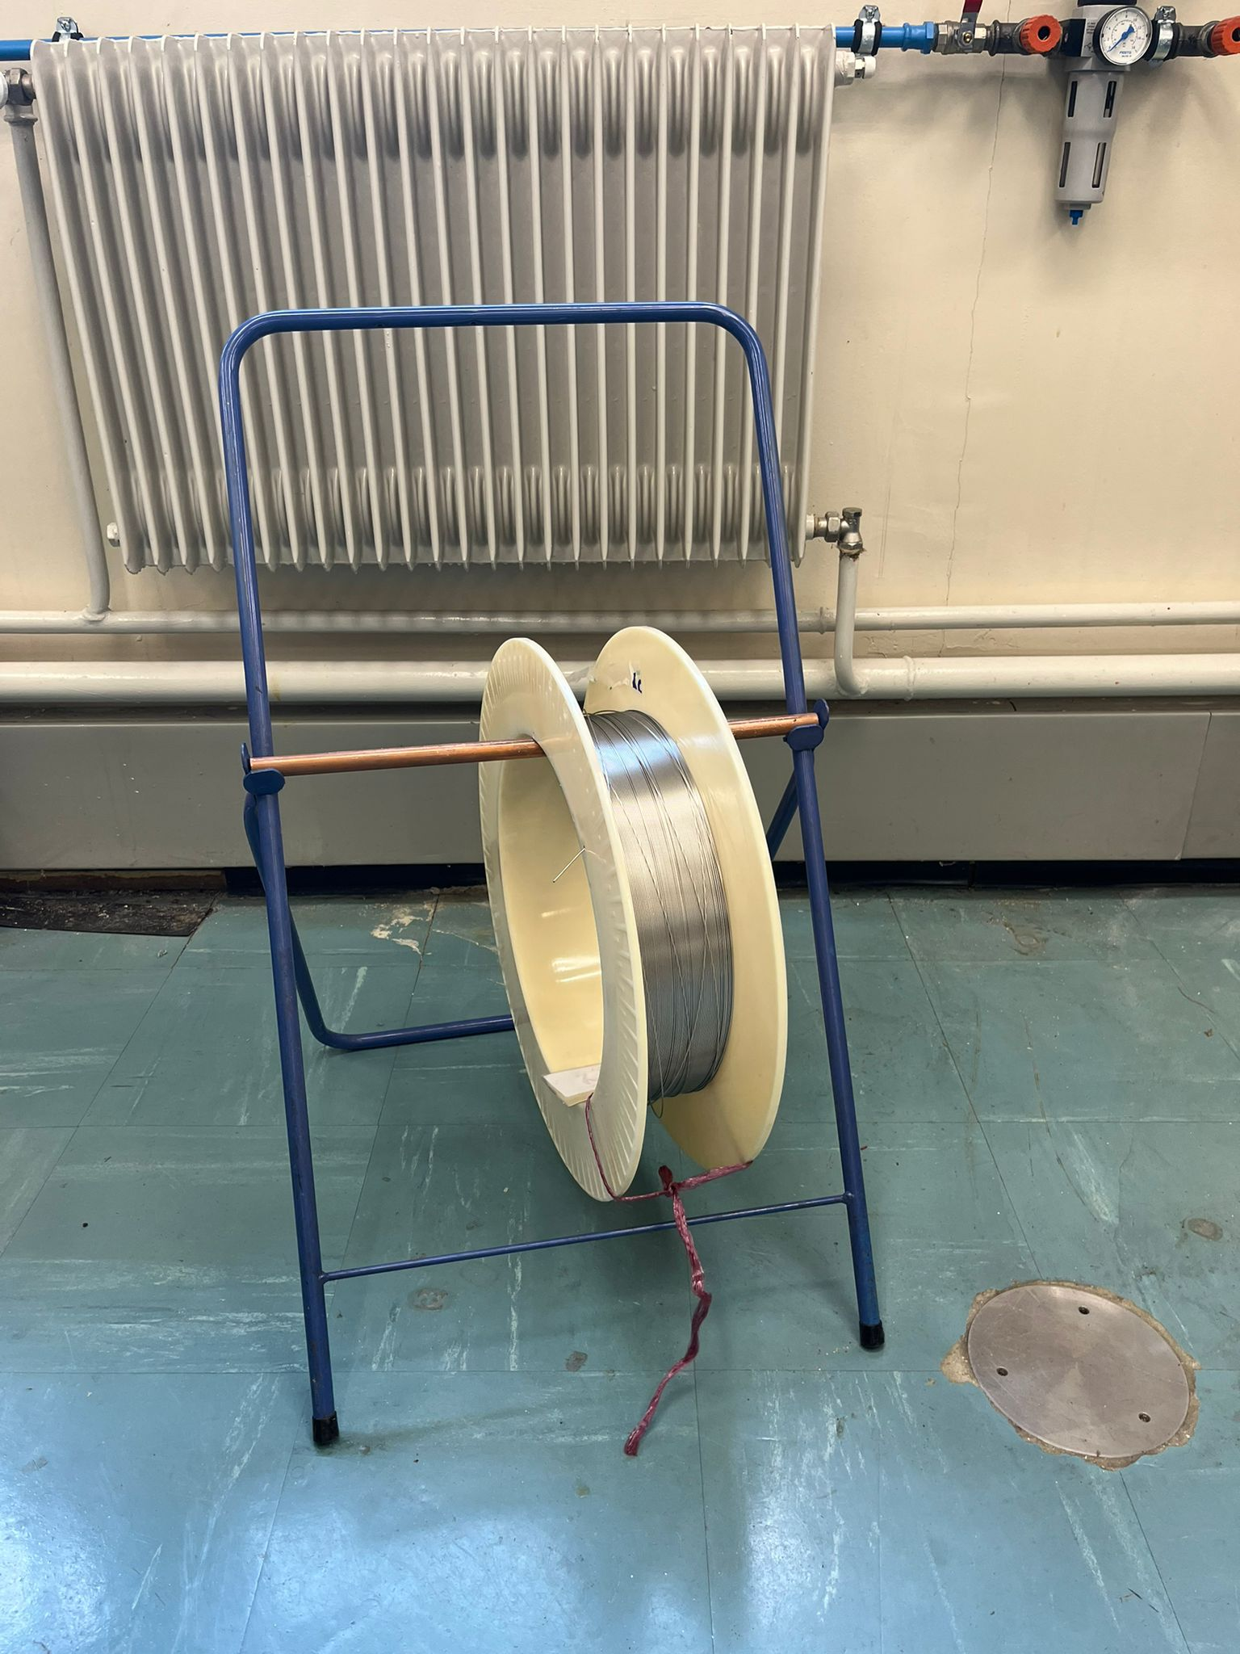
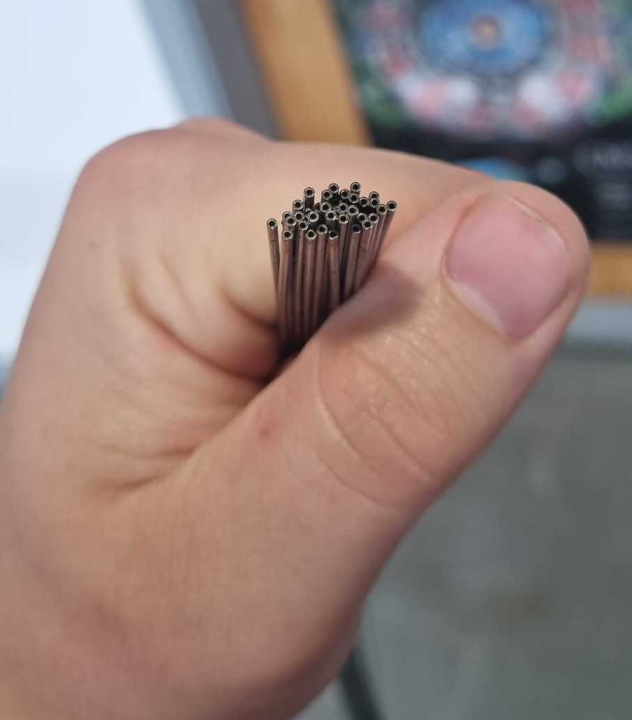
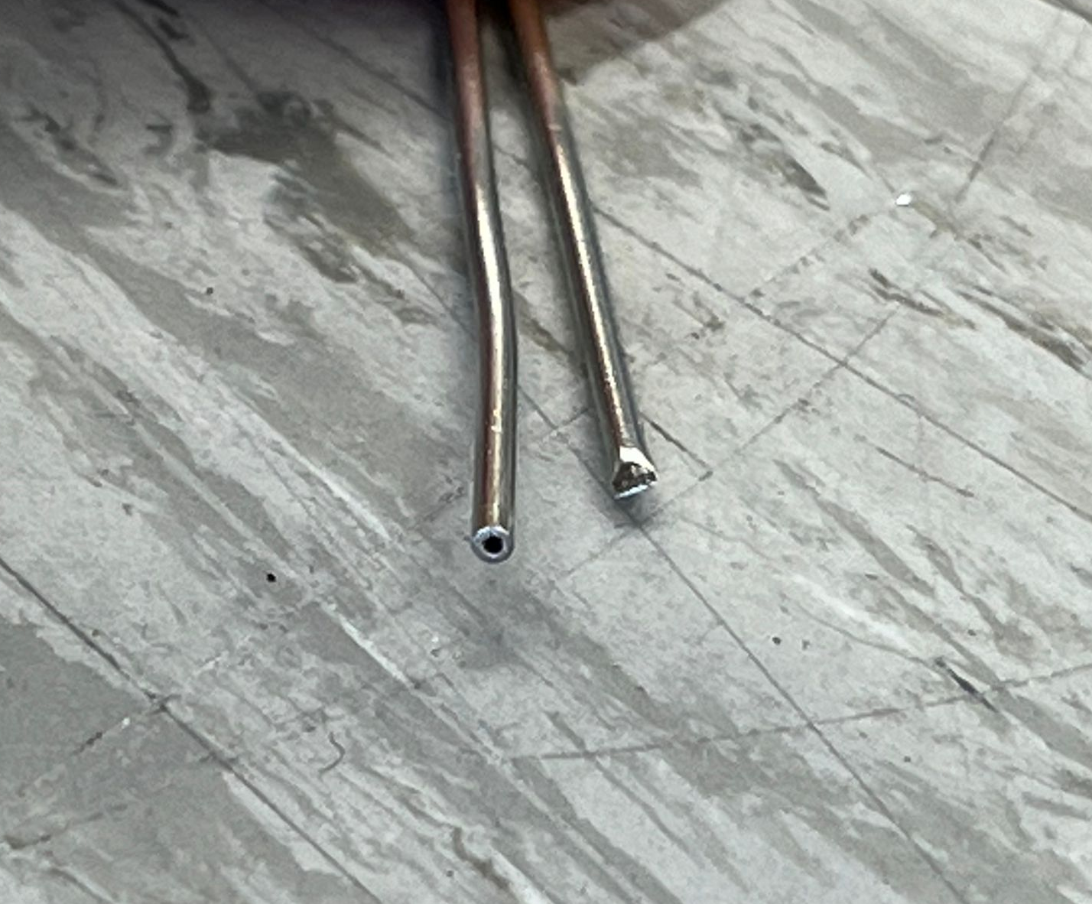
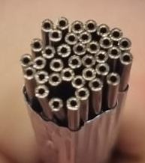
Making a Capillary – Electronic Discharge Machining
Spools with different ID’s
Over 2km (1.25mi) total
Cut from Spool using pliers
Flattened ends…
because of pliers
(right side)
Remove ends with EDM Wire Cutting
Result

Slide 23
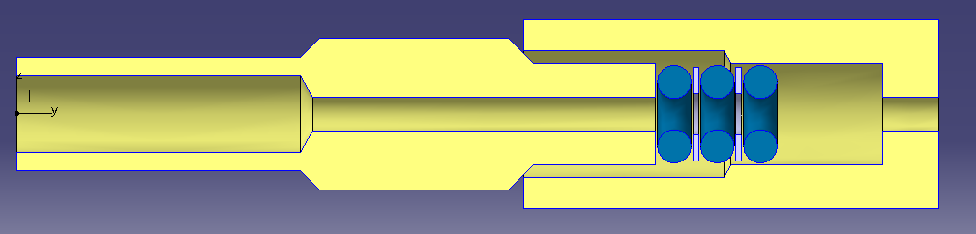
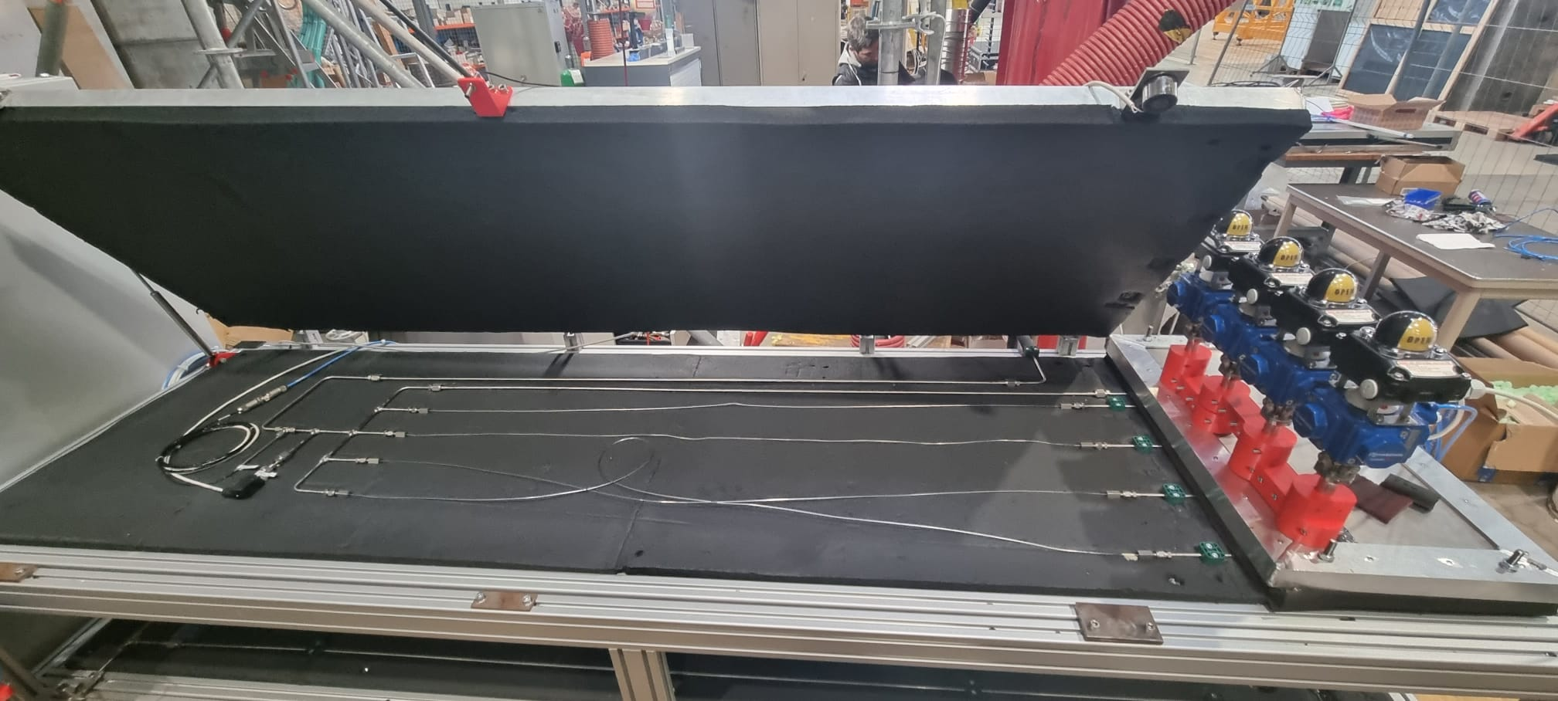
Measurement – Example in Practise
Connector used in the Capillary Open System does not affect the capillary in any way:
No deformation
No welding/brazing
Design by Fernando Albela Perea
4 Installed capillaries

Slide 24
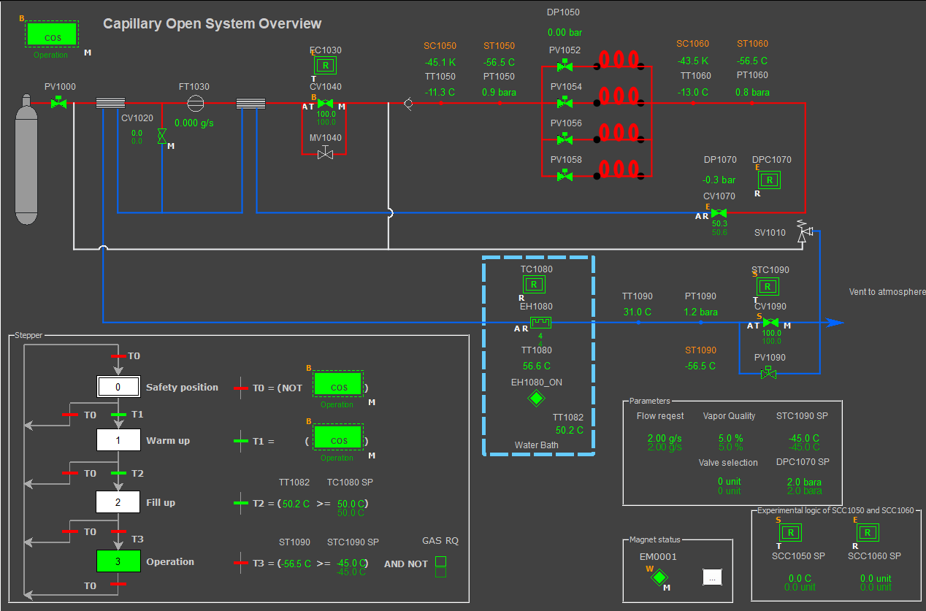
Measurement – SCADA Data Acquisition
Operation and Data Acquisition through SCADA
Important: Always ensure stable conditions on inlet and outlet of the capillary.
After which, data is recorded for 5 minutes and averaged.

Slide 25
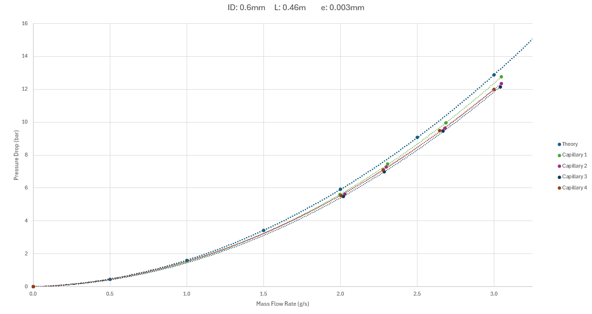
Measurement – Example in Practise
First measurements compared to theory from earlier:

Slide 26
Measurement – Example in Practise
First measurements compared to theory from earlier:

Slide 27
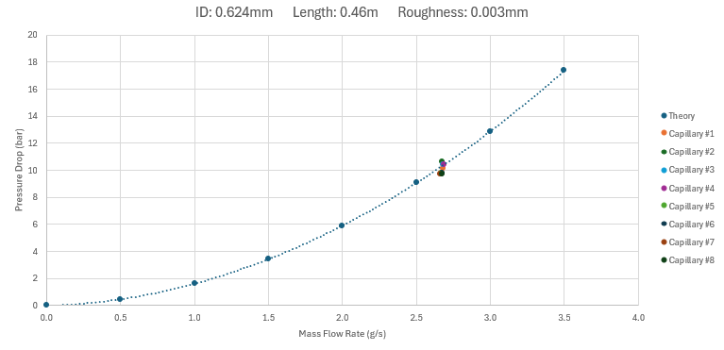
Measurement – Consistency in larger batches
A batch of 8 capillaries, what consistency are we measuring?
Calculation based on
measurements at Micro-lab.

Slide 28
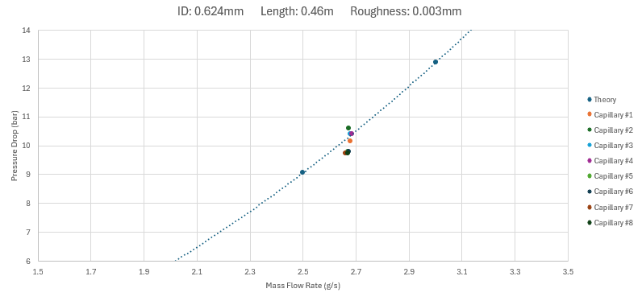
Measurement – Example in Practise
Performance of the Theoretical prediction when compared to measured data
Result: +-5%
Still acceptable for flow distribution inside the detector

Slide 29
Capillary Tested – Now what?
Capillary is done, and ready for installation in the detector system:
Vacuum Brazing of end connections
Installation and routing into the detector
Future:
We are currently waiting for the detector teams to give us the final pressure drops of the evaporators, after this we can size the capillaries accordingly…

Slide 30
The End
Thank you for your attention
Thank you to all the contributors of the project:
Derek Jan LANGEDIJK^{(a)}, Joao NOITE^{(a)}, Liam COOPER^{(b)}, Leonid HLUSHENKO^{(a)}, Szymon MLECZKO^{(a)}, Karol GORNY^{(a)}, Martin MACHAC^{(a)}, Szymon GALUSZKA^{(a)}, Aleksandra ONUFRENA^{(a)}, Michal ZIMNY^{(a)}, Loic DAVOINE^{(a)}, Lukasz ZWALINSKI^{(a)}, Jerome DAGUIN^{(a)}, Bart VERLAAT^{(a)}
^{(a)} CERN, Geneva, 1211, Switzerland, derek.jan.langedijk@cern.ch
^{(b)} STFC, Polaris House, North Star Avenue, Swindon, SN2 1SZ, United Kingdom

Slide 32
Measurement – Example in Practise
First measurements compared to theory from earlier:

Slide 33
Capillaries in CO2 Cooling – Why?
Pressure drop for triggering of boiling? → Orifice or Expansion Valve…
Transport & Pressure drop? → Capillary!

Slide 34
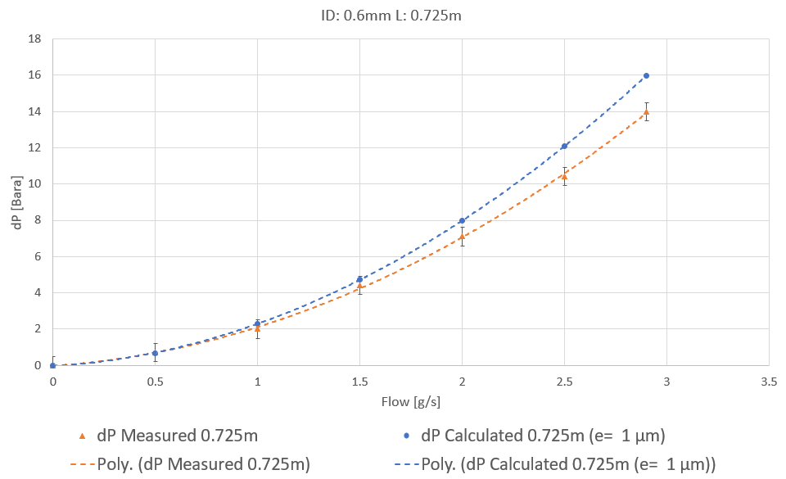
Measurement – More Data

Slide 35
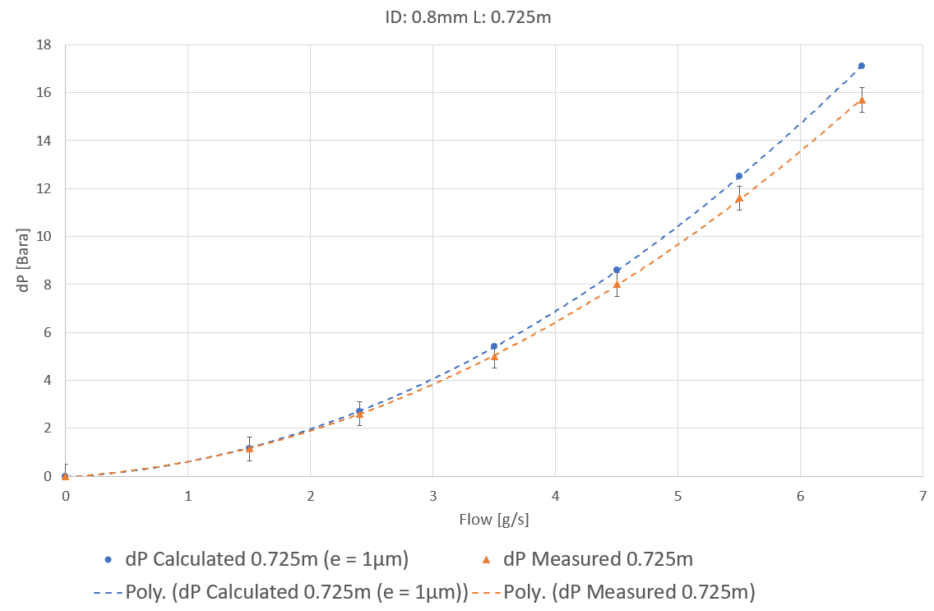
Measurement – More Data

Slide 36
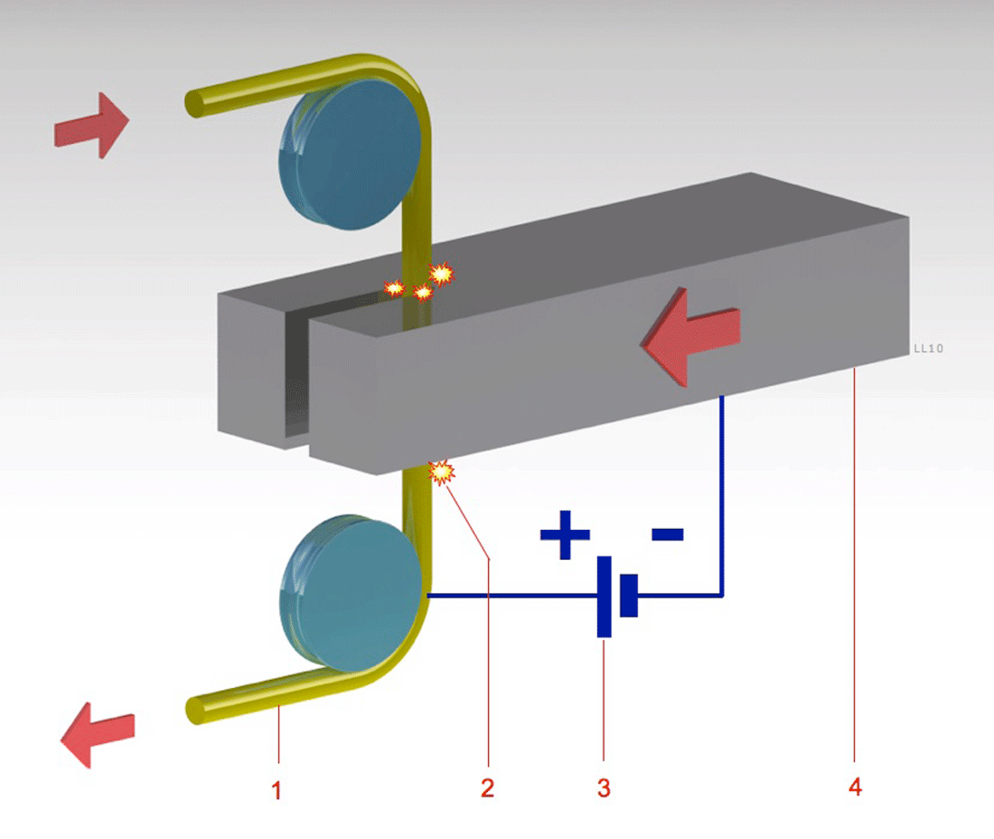
Testing and Cutting – EDM Wire Cutting
Normal cut/saw
Burs
Uneven surface
Deformation
Electronic Discharge Machining
Precise cut
No burs
No deformation
Square surfaces
We are planning on bundling a capillary set with (roughly) the same length to cut 100s at a time, saving us costly time in the Main Workshop.
The principle of Wire EDM

Slide 37
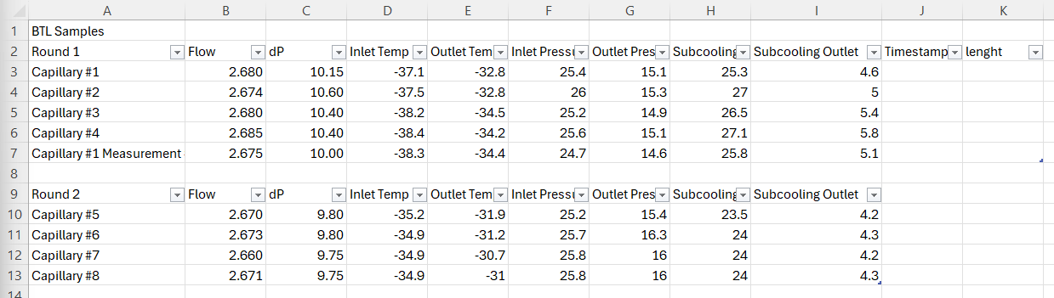
Back-up – BTL Measurements

Slide 38

Theoretical Prediction – Why is it still so difficult?
Inconsistencies in capillary manufacturing tolerances

