Slide 1





DRD7: Cooling plates
On behalf of the DRD7.4c collaborators
DRD7.4: EXTREME ENVIRONMENT AND LONGEVITY
IMPLEMENTING DRD7:
AN R&D COLLABORATION ON ELECTRONICS AND ON-DETECTOR PROCESSING
Oscar Augusto de Aguiar Francisco (The University of Manchester)
oscar.augusto@cern.ch

Slide 2
Introduction
Three (sub-)projects will be described today:
Microchannel cooling and active interconnection developments (CNM, DESY, IFIC)
Microchannel cooling manufacturing via thermocompression (CPPM)
No single solution for the cooling structure nor coolant
Different material budget constraints, power dissipation, …
DRD7:
DRD7.4c – “covers the cooling structures in direct contact with electronics”
Cooling plates are included (e.g.: coolant R&D not included)
Ceramics cooling plate and metal 3D printing (UoM)
Recently approved
DRDC open session on June 3rd (link)

Slide 3
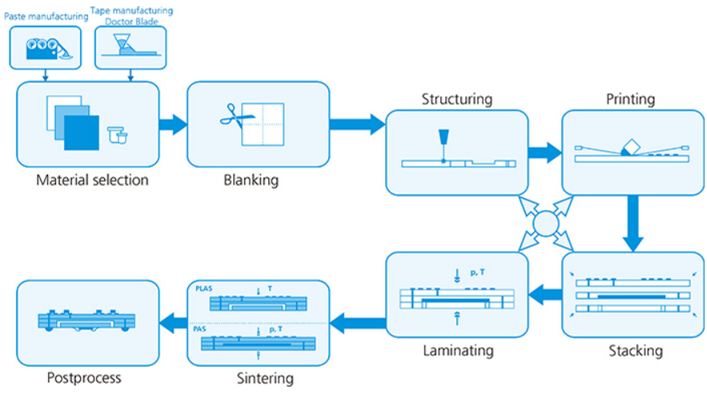
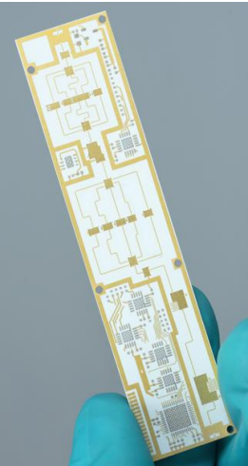
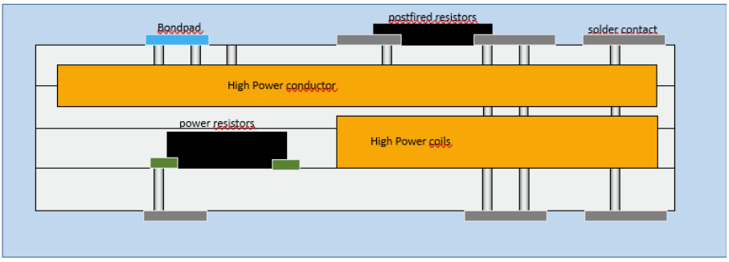
Ceramics
Why?
Robustness, reliability, stability in ultra-high-vacuum
Manufacturing at IKTS Fraunhofer (Germany)
Possible to embed conductive layers in between ceramics layers and metalize the surface
Potential to integrate electronics or high conductivity elements
Mechanically robust and compatible with high ultra vacuum
Different base materials: YSZ, $Al_{2}O_{3}$, … including SiC and AlN
Different base materials: YSZ, Al_2 O_3, … including SiC and AlN
Manufacturing based on several layers
©Fraunhofer IKTS

Slide 4
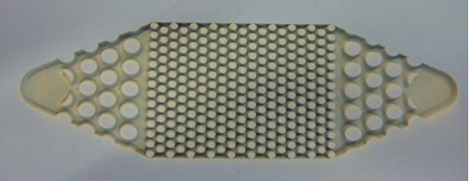

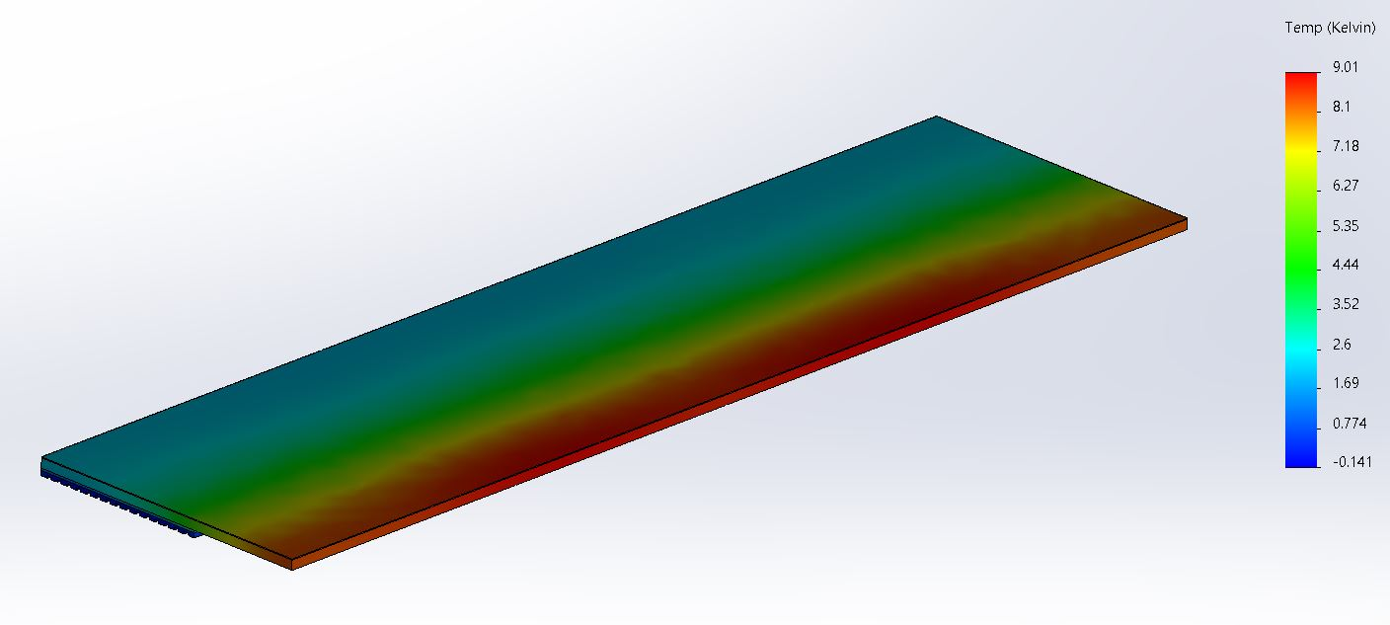
Ceramics
Experience with fluidic applications
First prototype based on the early VELO Upgrade I CERN design
Initial channel with $70μm$ width (restrictions)
Initial channel with 70μm width (restrictions)
Channels height $100μm$
Channels height 100𝜇𝑚
Overall dimensions: $40×60mm^{2}$
Overall dimensions: 40×60mm^2
Based on LTCC
Possible to move to SiC or AlN
Encouraging results from FEA studies
Geometry based on the VELO Upgrade I design (5 mm overhang)
For $2W/cm^{2}$, $ΔT \sim 9^{∘}C$ (coolant heat transfer coefficient not considered)
For 2W/cm^2, ΔT ~9^∘ C (coolant heat transfer coefficient not considered)
$Al_{2}O_{3}$ HTCC is $\sim 96\%$
Al_2 O_3 HTCC is ~96%
$Al_{2}O_{3}/Glass$ $\sim 1:1$
Al_2 O_3/Glass ~1:1
©Fraunhofer IKTS
SNAKEI based design to optimize printing parameters/test feasibility
Simplified FEA focusing on the 5 mm overhang. Substrate in alumina and heat conduction on one side of the cooling plate and Stycast (100um).

Slide 5
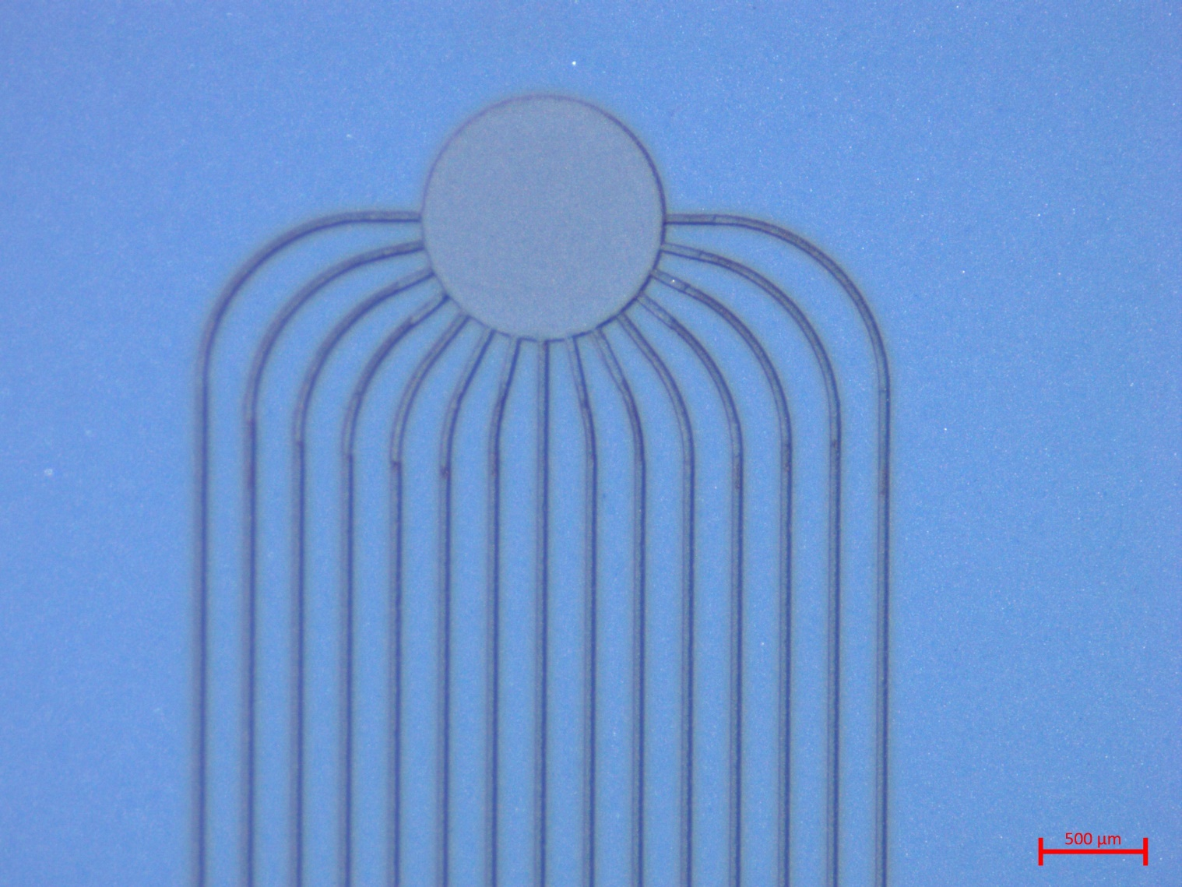
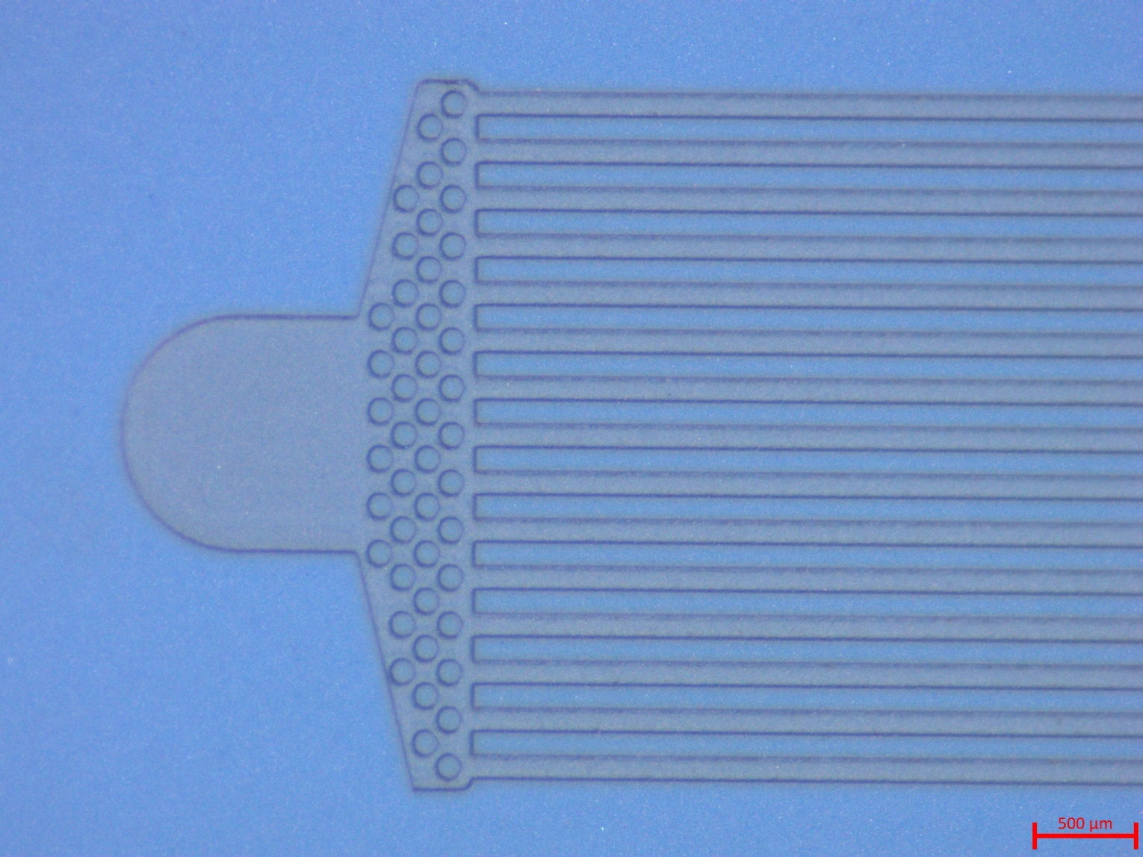
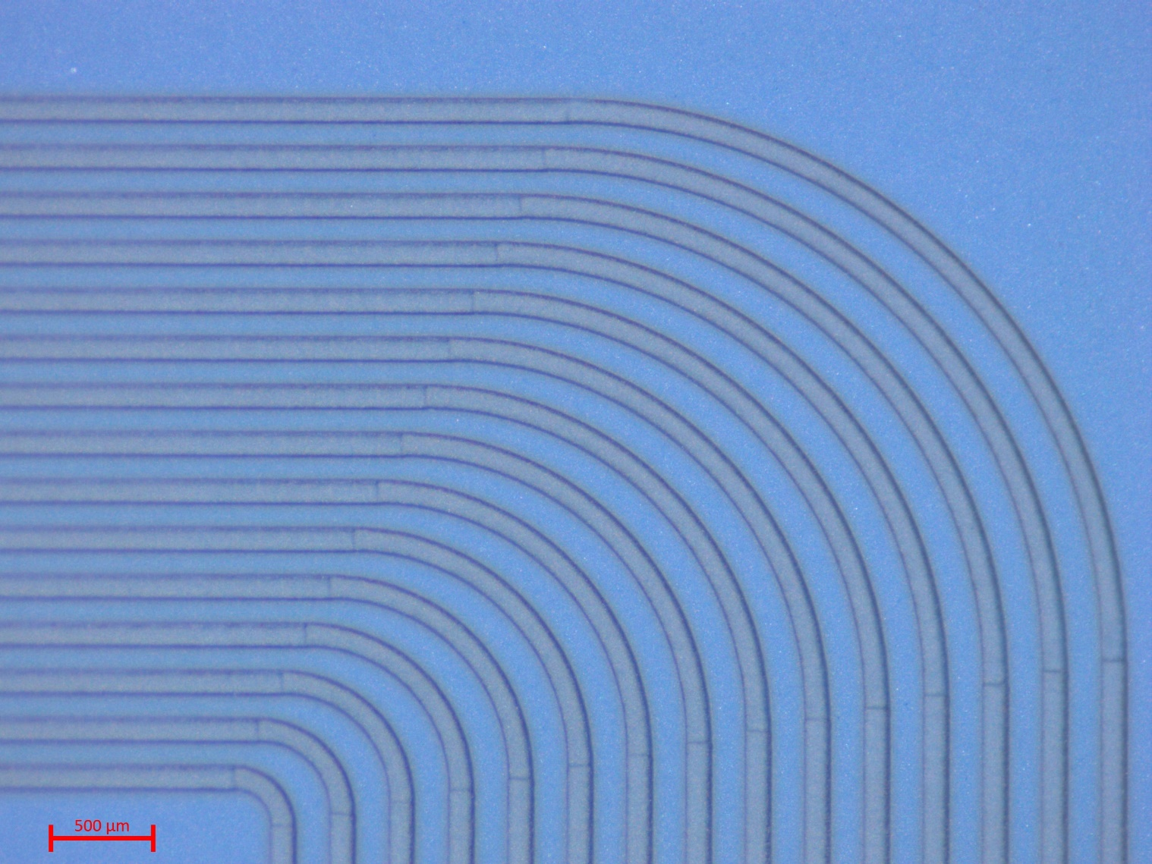
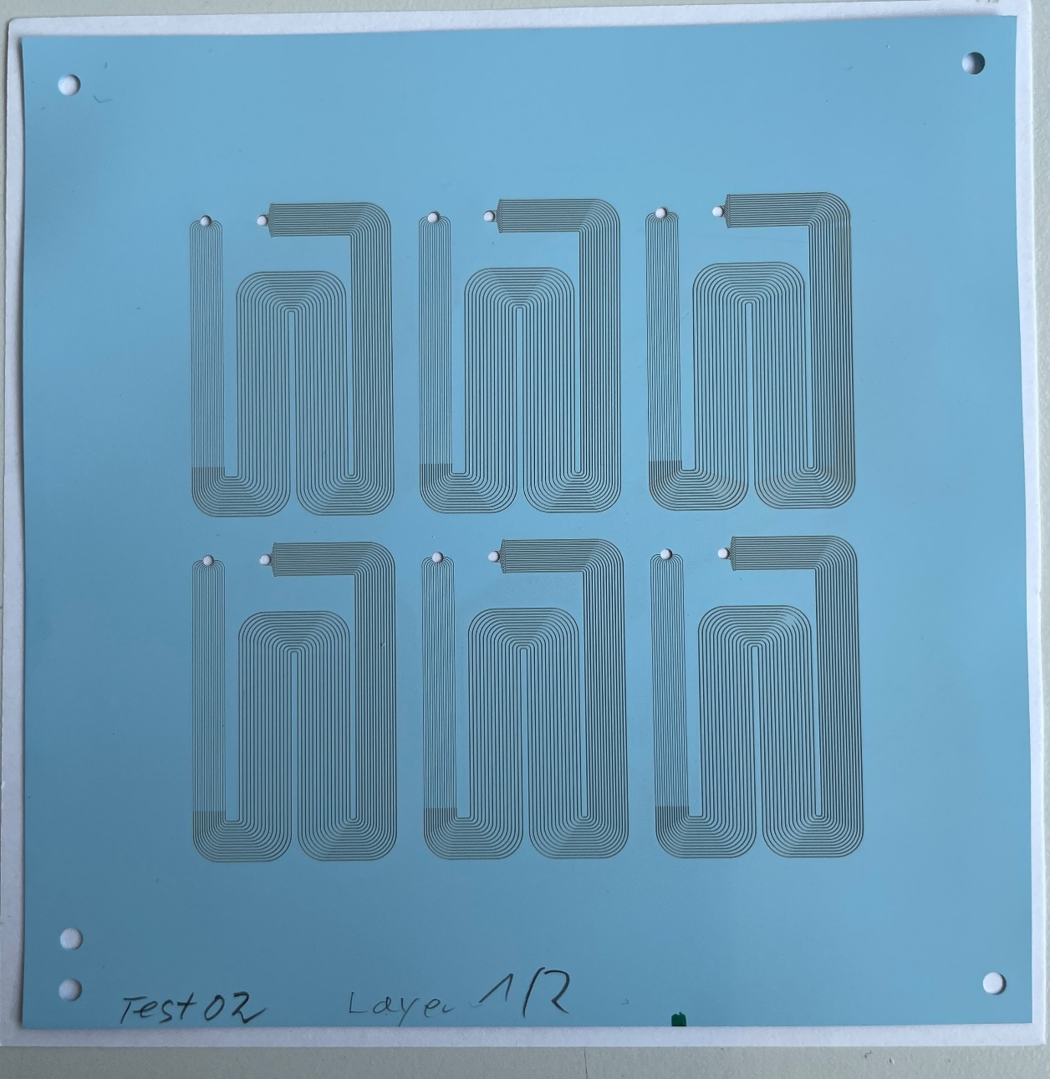
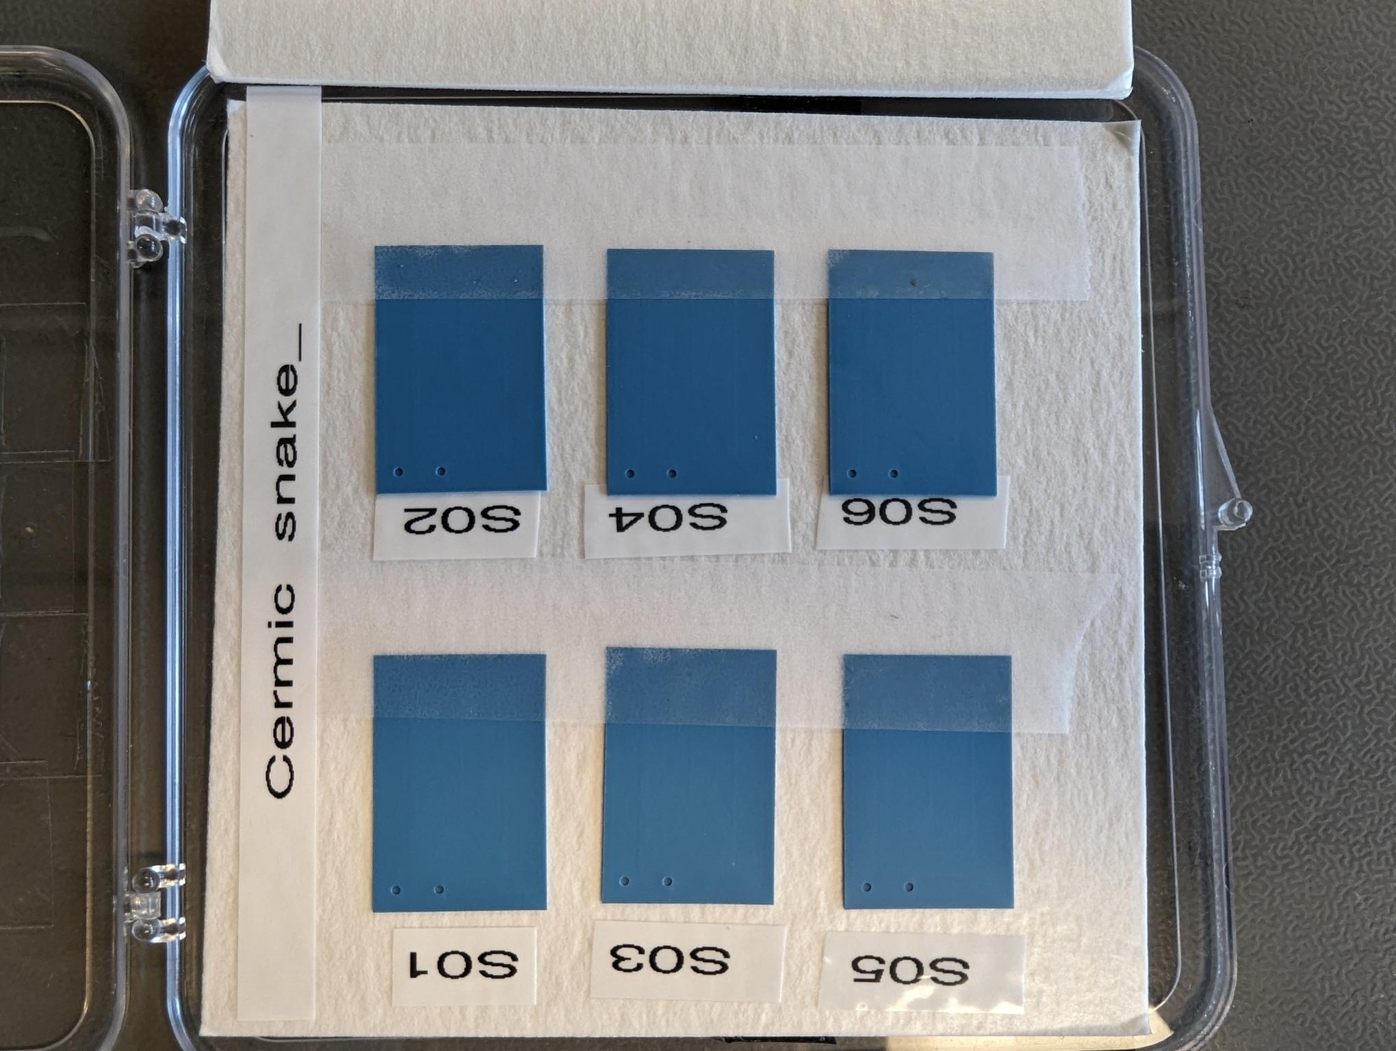
Ceramics: Goal and status
Very encouraging first manufacturing results!!!
Goal:
Manufacture first samples (IKTS)
Second round being prepared
Validate initial prototypes to high pressure, leak tightness and cooling performance
Benchmark: LHCb VELO Upgrade 2 requirements (High pressure 186 bar, leak tight (vacuum operation) and excellent thermal performance
Miniaturized version (2x smaller in-plane)
Expected 35um and 100um width restrictions and main channels respectively!
IKTS Fraunhoffer ©
IKTS Fraunhoffer ©
IKTS Fraunhoffer ©
Fraunhoffer ©
First samples in-house
(eagerly waiting to be tested)

Slide 6
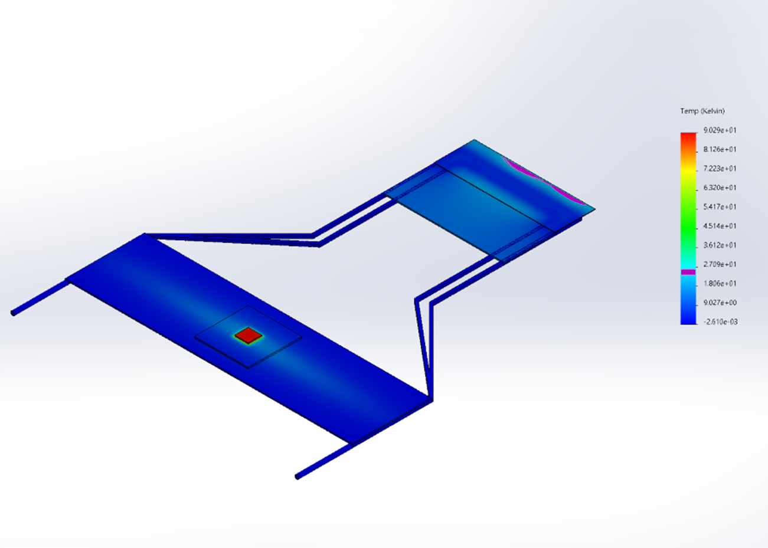
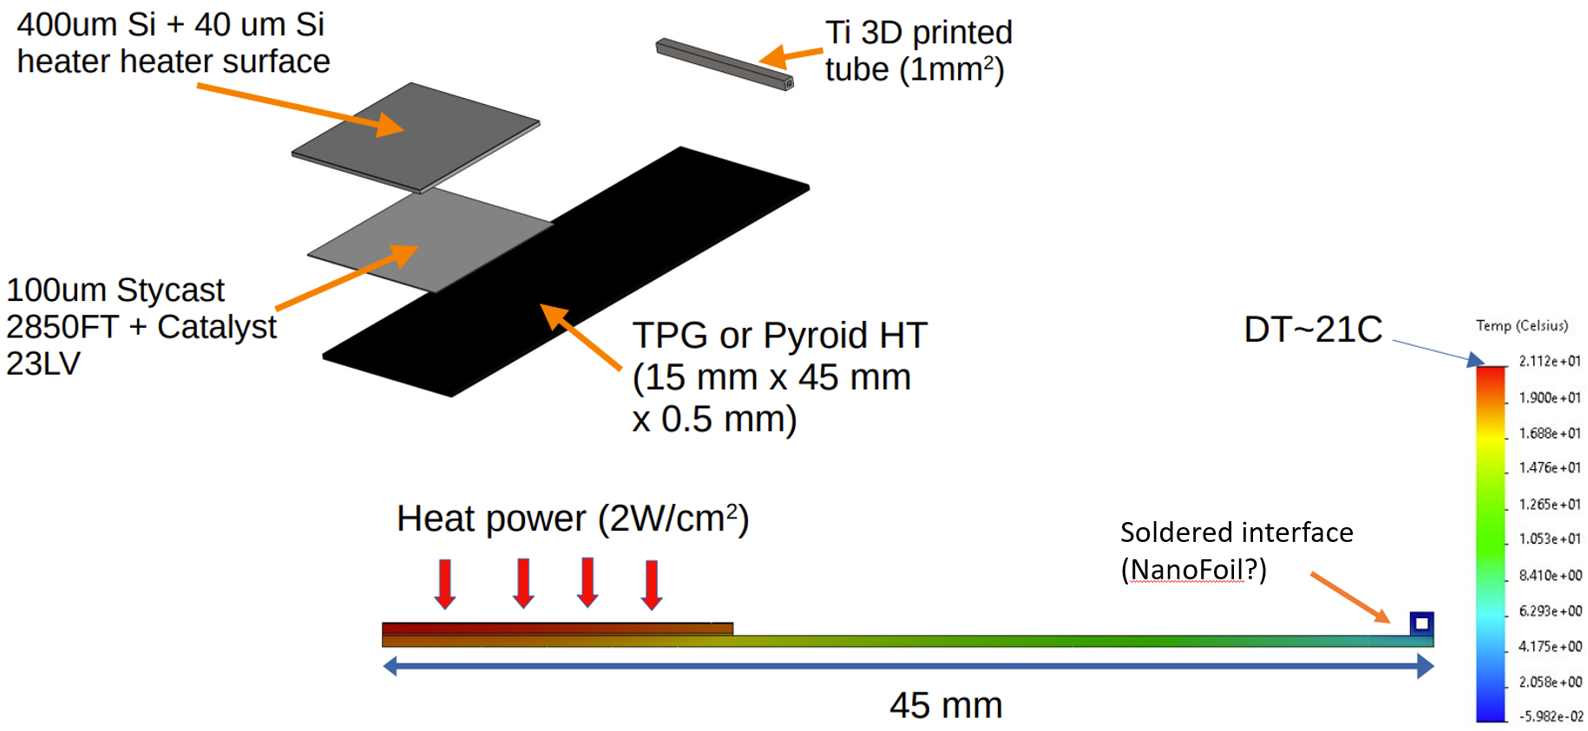
3D metal
Exploration phase
Considering evaporative $CO_{2}$ as baseline solution
Considering evaporative CO_2 as baseline solution
Power dissipation of up to $2W/cm^{2}$
Power dissipation of up to 2W/cm^2
Larger $ΔT$ would have to be compensated by the coolant working temperature
Larger ΔT would have to be compensated by the coolant working temperature
More aggressive design for reduced material budget due to the cooling substrate
Largest variation of temperature on the sensor part around $25℃$ (with respect to the inner side wall)
Largest variation of temperature on the sensor part around 25℃ (with respect to the inner side wall)
Alternative strategy to cooldown off-chip electronics would have to be improved (cooling routing lines)
Passive medium integration
Aggressive U-track like design
Lower material budget contribution compared to same silicon thickness (factor x2)
Cooling line integration via soldering (NanoFoil, 35–50W/mK)
FEA indicates a $ΔT\sim 21℃$ when pushing away the Ti2 cooling lines by $\sim 30mm$
FEA indicates a ΔT~21℃ when pushing away the Ti2 cooling lines by ~30mm

Slide 7

3D metal: LHCb VELO
Different designs were submitted to Royce Institute (Innovation Center - Sheffield)
Filling factor being improved, and different approaches being tested
Single squared tubes and easier integration with a plate-like design
Potential to also explore better integration
U-shaped design
Squared tube and connector prototypes
X-ray tomography via NXCT
New round of printing on-going:
Half of the samples will be electro-polished (easier integration?)
Different printing parameters to improve distortions and fill factor
X-ray 2D tomography (one projection)
Printing distortion and blockage
0.5mm
Fill factor issue
1.0mm

Slide 8
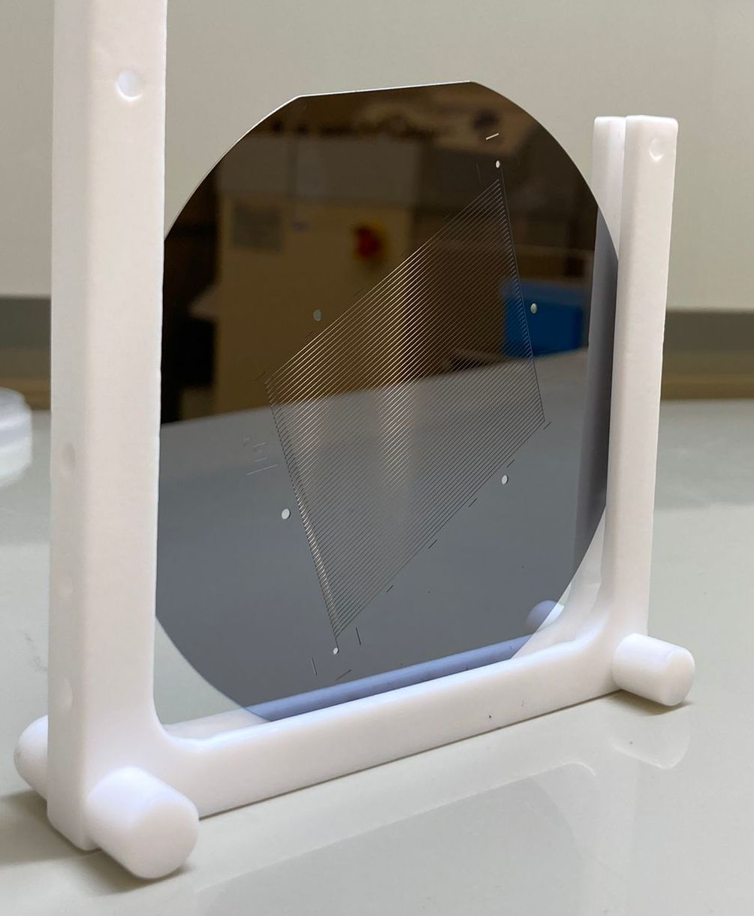
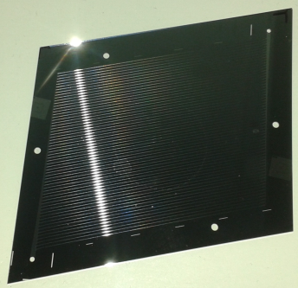
Microchannel cooling and active interconnection developments
In the past, we developed a technology of micro-channel cooling for High Energy Physics detectors
N. Flaschel, et al. “Thermal and hydrodynamic studies for micro-channel cooling for large area silicon sensors in high energy physics experiments”, NIMA, vol. 863, pp. 26-34, 2017. (link)
Ph.D Thesis: Micro-channel Cooling For Silicon Detectors. Nils Flaschel. Hamburg University. 2017 (link)
Miguel Ullán (IMB-CNM, CSIC), Carlos Mariñas (IFIC-UV, CSIC), Marcel Vos (IFIC, CSIC-UV), Ingrid Gregor (DESY), Sergio Díez (DESY) and Jonathan Correa (from DESY)

Slide 9
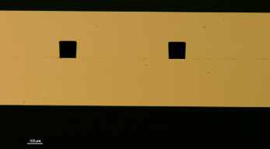
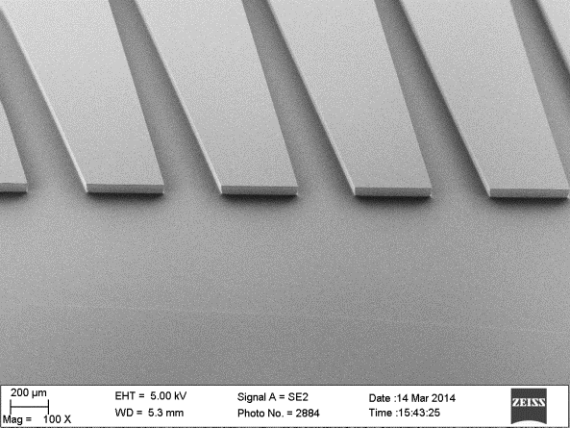
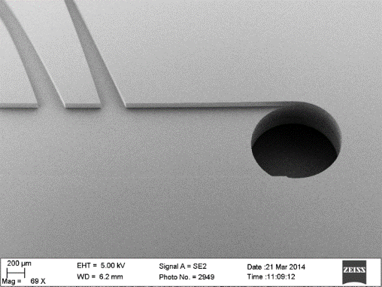
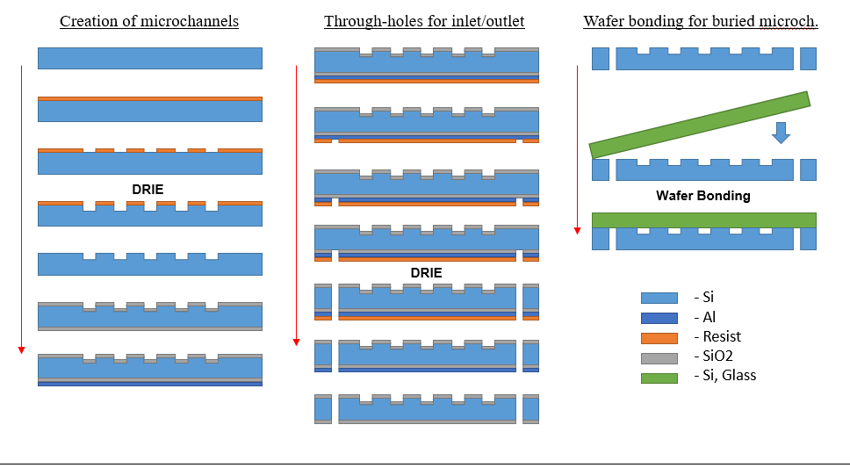
Microchannel cooling and active interconnection developments
Technological process for micro-channels at IMB-CNM
Creation of microchannels:
Deep Reactive ion etching (DRIE)
Microchannels enclosure via:
Wafer bonding

Slide 10
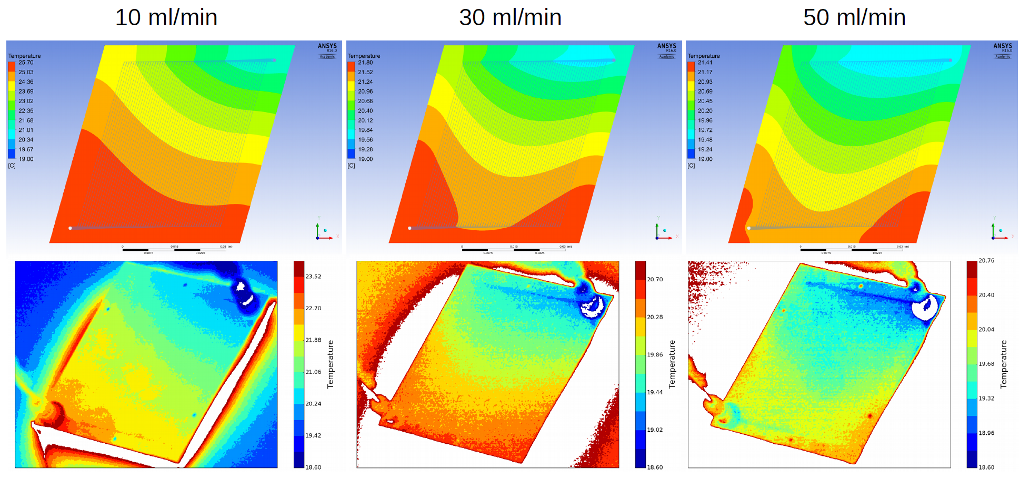
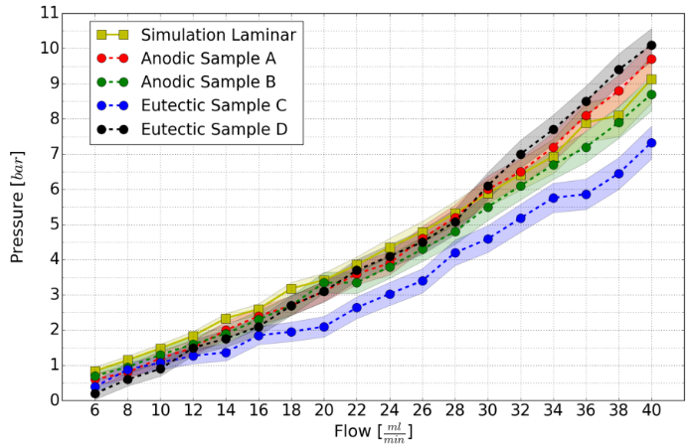
Microchannel cooling and active interconnection developments
Previous results on fluidic and thermal tests
Laminar flow
Thermal homogeneity across the sample($\sim 4×4 {cm}^{2}$ large),
< ±1 ºC (for lowest flow rate)
Thermal homogeneity across the sample(~4×4 cm^2 large),
< ±1 ºC (for lowest flow rate)
Good agreement with simulation
Low power density: $30.8mW/cm^{2}$
Low power density: 30.8mW/cm^2
Coolant: 3M HFE7100

Slide 11
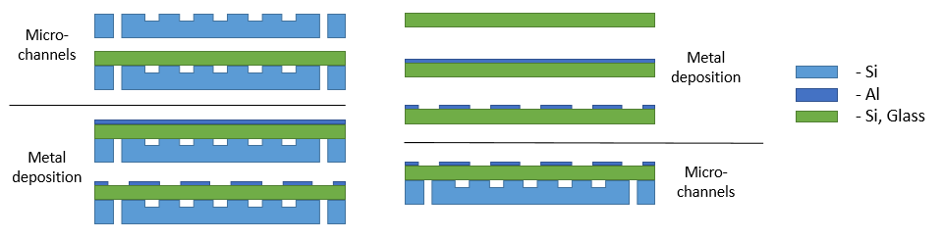
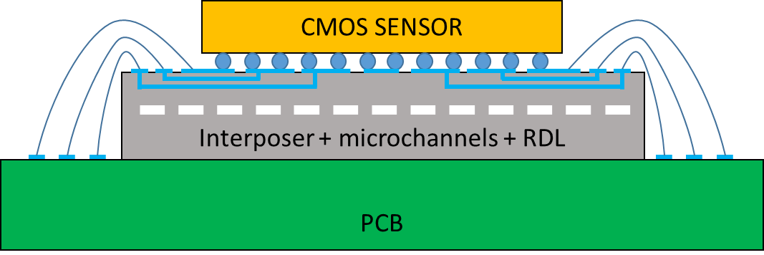
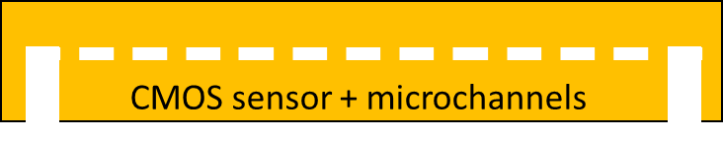

Microchannel cooling and active interconnection developments
Main Objective I: Integration of micro-channels in silicon interposers with integrated signal and power routing (RDL)
Main Objective II: Full integration of the sensor (CMOS technology) with the microchannel cooling in a single silicon piece
Full integration of DMAPS chip with the microchannels in a single monolithic piece
Post-processing at wafer level with a CMOS compatible process
Following the “post-processing” technique developed previously
Additional technological developments
  Low temperature (${350}^{∘}C$) anodic bonding
  Microchannels created on glass substrates (isotropic wet etching)
  Eutectic and/or fusion bonding
  Improve post-processing compatibility
  Full demonstrator

Slide 12
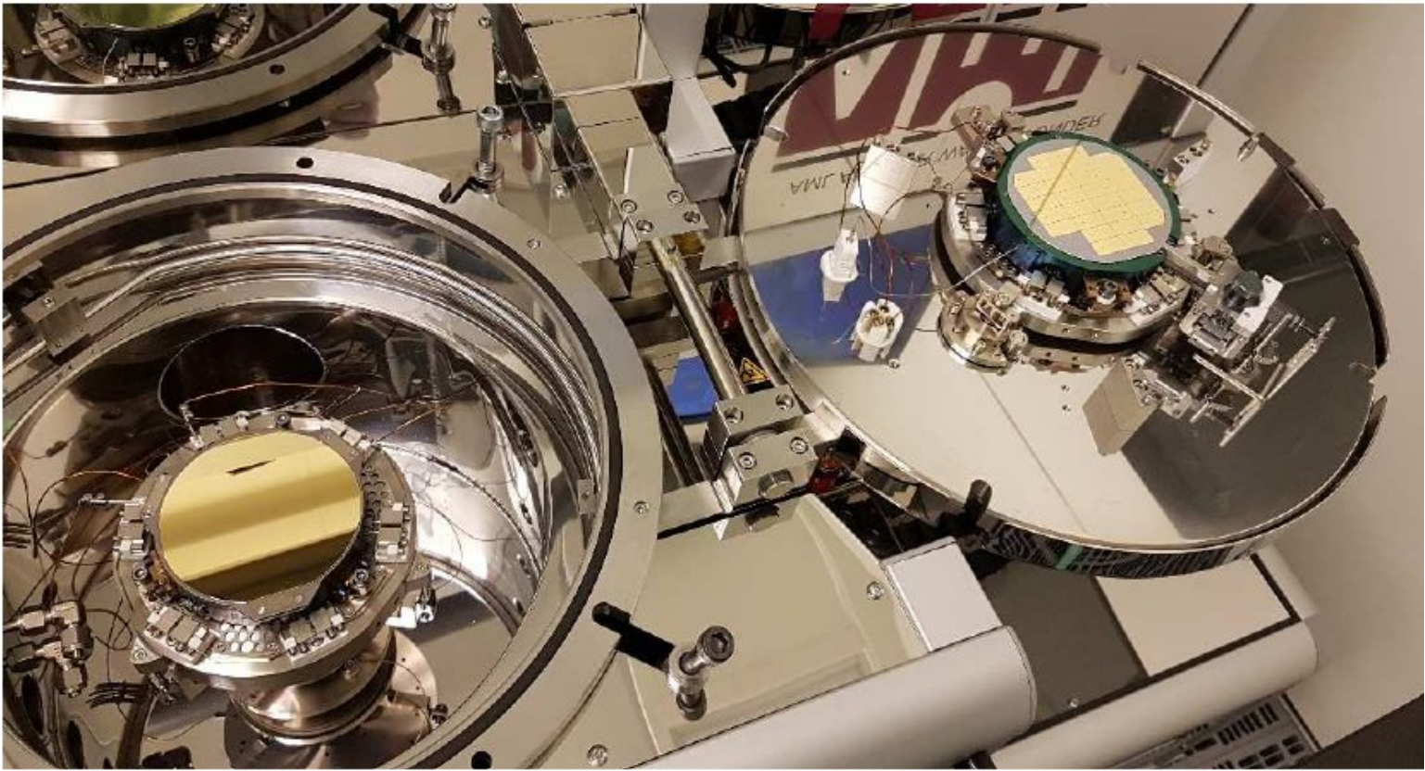
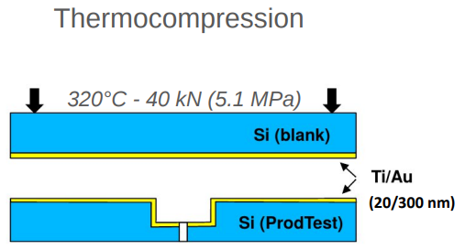
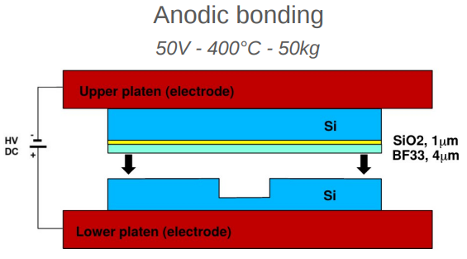
Microchannel cooling manufacturing via thermocompression
Bargiel et al., Micromachines 2023, 14, 1297
R&D to develop a low-cost micro-channel production process
As an alternative to the complicated and costly direct Si/Si bonding, investigate bonding techniques with intermediate thin layers:
  Anodic bonding with glass (BF33)
  Thermocompression with gold

Slide 13
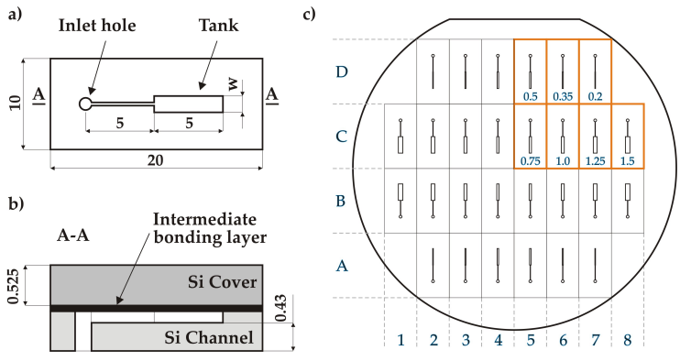
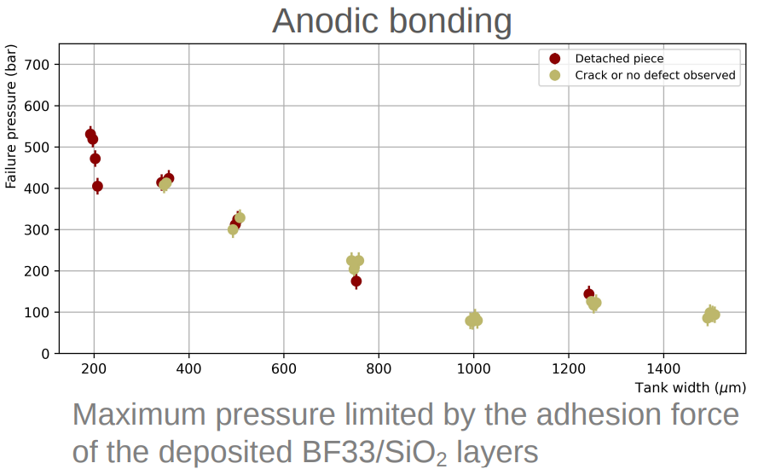
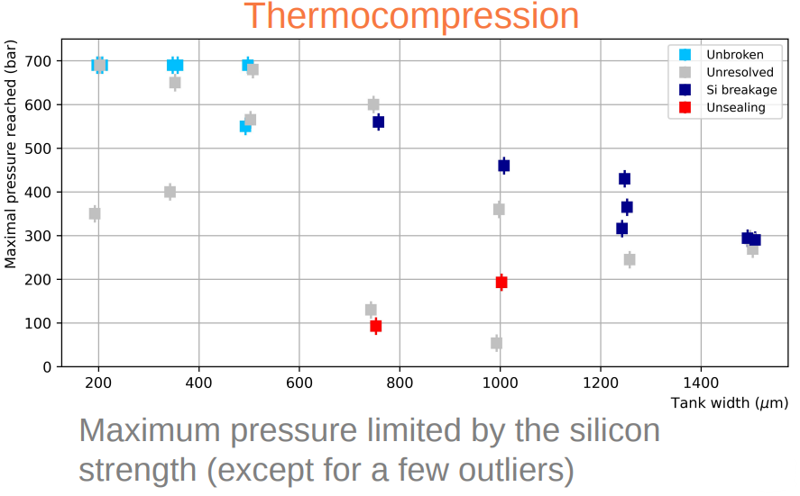
Microchannel cooling manufacturing via thermocompression
Bargiel et al., Micromachines 2023, 14, 1297
Bonding strength evaluated through a series of destructive pressure burst tests, recording the maximum pressure reached in microfluidic test structures before breakage (à la LHCb)
⇒ Test chips produced both with the anodic and with the thermocompression bondings can sustain very high pressure
⇒ Focus on thermocompression as
  – It generally allows to reach higher maximal pressures
  – It is a widespread technique available in most clean room facilities

Slide 14
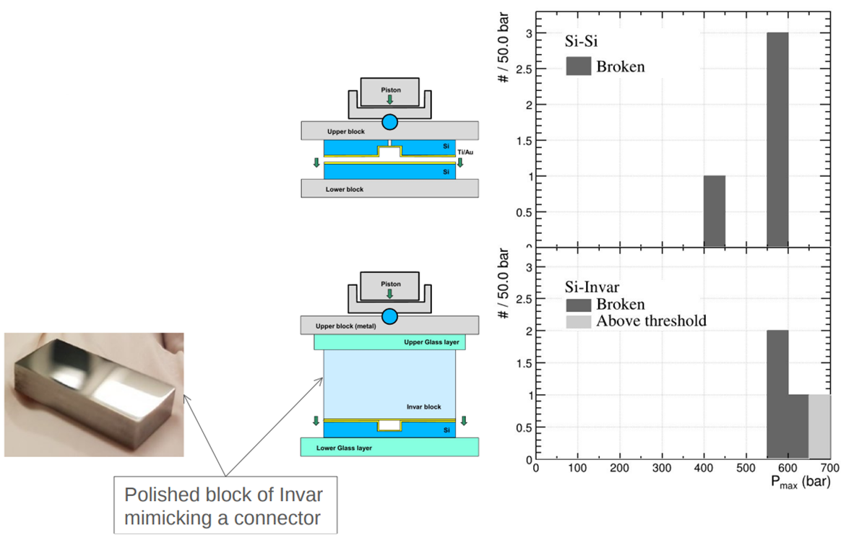
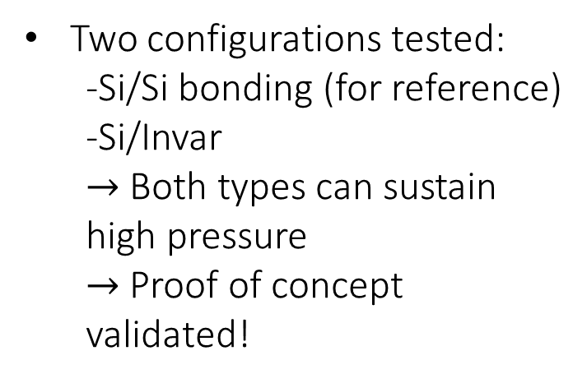
Microchannel cooling manufacturing via thermocompression
Towards the bonding of a connector using thermocompression process:
Investigate chip level bonding replacing the bonder with a mechanical press at atmospheric pressure outside the clean room
Two configurations tested:
  -Si/Si bonding (for reference)
  -Si/Invar
  $→$ Both types can sustain high pressure
  $→$ Proof of concept validated!

Slide 15
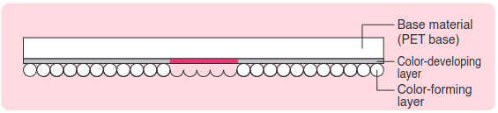
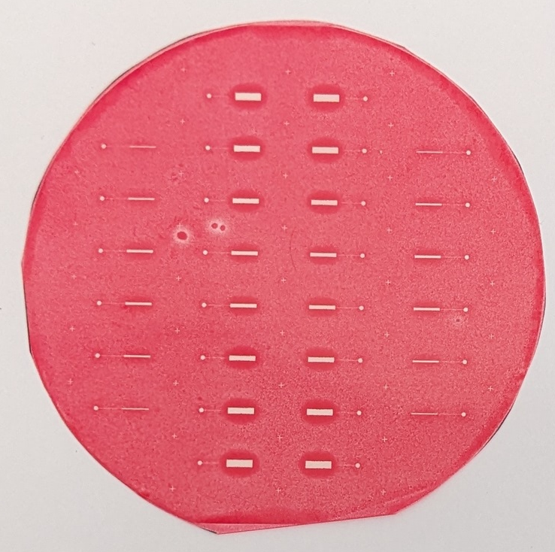
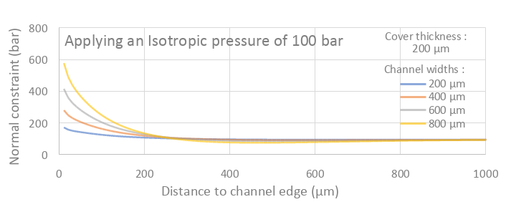
Hyperbar bonding
Replace the mechanical press with an hyperbar chamber
Allow to reach very high pressure on large surface
≥ 400 bar in chamber
Force applied in bonder typically limited to 40kN
(i.e. 5.1MPa for 4” wafer, 2.3MPa for 6” wafer)
Pressure more uniform
Less stress applied on wafer
Bonding at room temperature
Can adapt various geometries
Visualizing the pressure applied in the hyperbar chamber
Using a pressure sensitive film
“Pressure boost” around the channel
as expected from numerical simulation

Slide 16
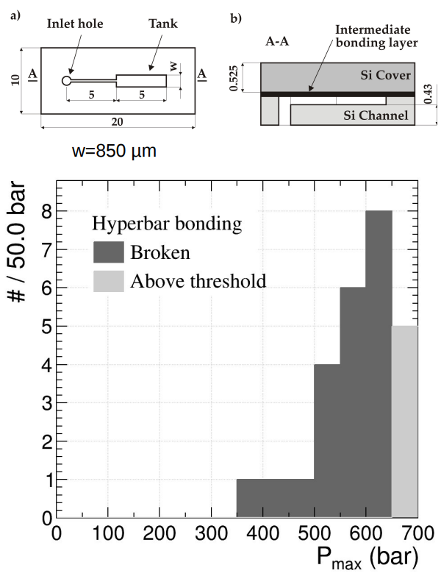
Microchannel cooling manufacturing via thermocompression
Replace the mechanical press with an hyperbar chamber
– ≥ 400 bar in chamber
– Force applied in bonder limited to 40kN
– (i.e. 5.1MPa for 4” wafer, 2.3MPa for 6” wafer)
– Pressure more uniform
– Less stress applied on wafer
– Bonding at room temperature
– Can adapt various geometries
⇒ All samples sustained very high pressure
⇒ All breakage occurred in the silicon (i.e. bonding has held)
⇒ Proof of concept validated !
– Allow to reach very high pressure
Test wafer bonding with fixed width pressure test structures (w=850µm)

Slide 17
Microchannel cooling manufacturing via thermocompression
R&D to develop low-cost micro-channel production process is being pursued at CPPM
Currently focusing on the bonding process, very appealing technique identified:
– “Hyperbar” bonding with thin intermediate Au layers
– Can be used to bond wafer
– Bonding of connector in hyperbar chamber being investigated
Goal is a functional prototype in the coming years
Part of a global R&T effort in CNRS/IN2P3, shared among 3 French laboratories and including developments on boiling flow modelling and testing.

Slide 18
Conclusion
Ceramics
Fully validated initial prototypes in the coming years to high pressure, leak tightness and cooling performance in the following years
LHCb VELO Upgrade 2 as benchmark requirements (High pressure, $CO_{2}$ evaporative cooling)
LHCb VELO Upgrade 2 as benchmark requirements (High pressure, CO_2 evaporative cooling)
Microchannel cooling and active interconnection developments (CNM, DESY, IFIC)
Aiming to bring more functionalities to the cooling plate
Redistribution layer could be an interesting solution for ASICs with through-silicon vias
CMOS compatible process to integrate the cooling to the sensor
Microchannel cooling manufacturing via thermocompression (CPPM)
Main motivation to reduce the manufacturing cost
Very promising results “hyperbar” chamber (resistance to high pressure)
Techniques developed can be also explored for integration (chips and connecturization)
It has also the potential to include electronic features
Metal 3D printing
Next run: focus on improving distortion and fill factor and investigation of electropolishing (material reduction/easier integration?)
X-ray tomography indicates issue with the fill factor
Distortion observed created a choke point

Slide 19
Contacts
Ceramics and Metal 3D printing
Microchannel cooling and active interconnection developments (CNM, DESY, IFIC)
Miguel Ullan (miguel.ullan at imb-cnm.csic.es)
Microchannel cooling manufacturing via thermocompression (CPPM)
Julien Cogan (cogan at cppm.in2p3.fr)
Oscar Augusto de Aguiar Francisco (oscar.augusto at manchester.ac.uk)

Slide 20
Backup slides

Slide 21
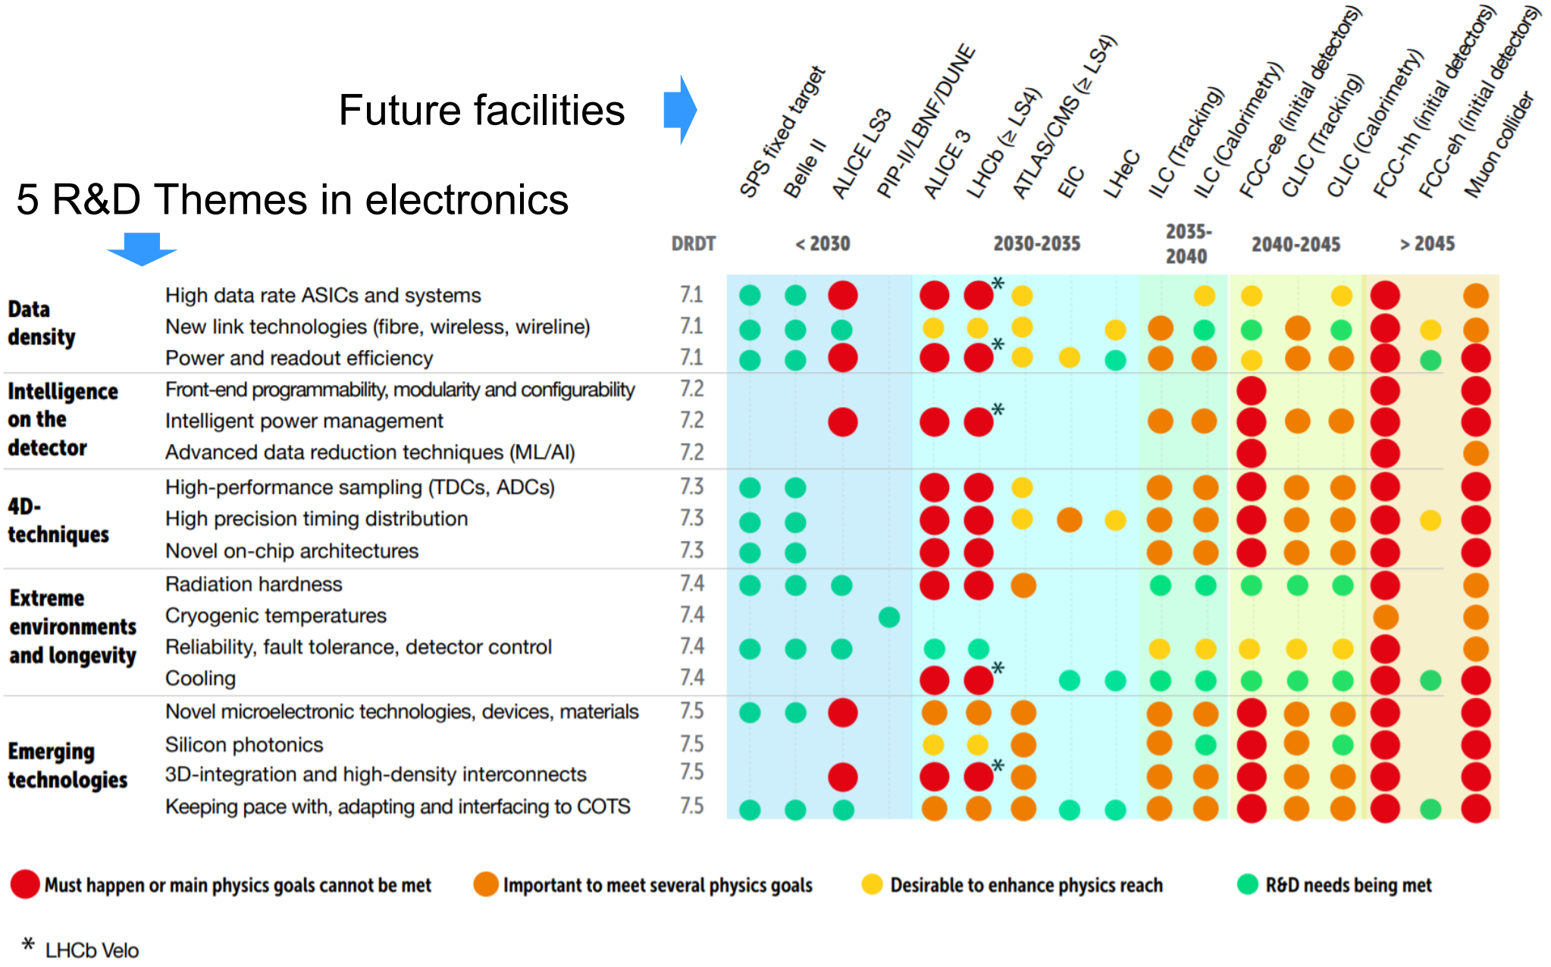

Slide 22
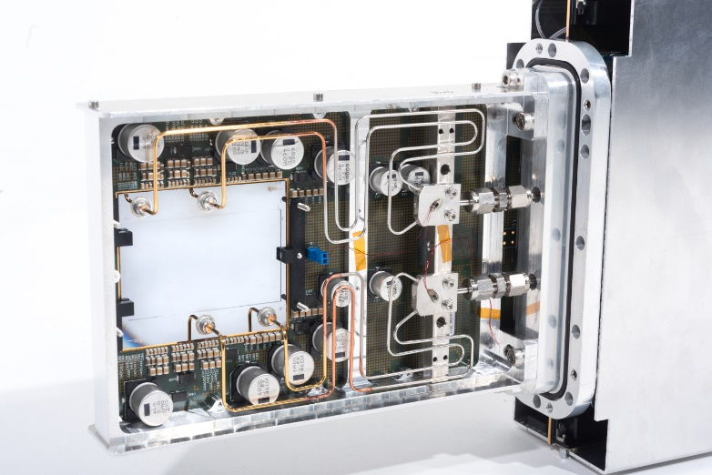
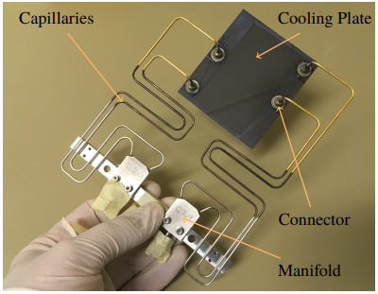
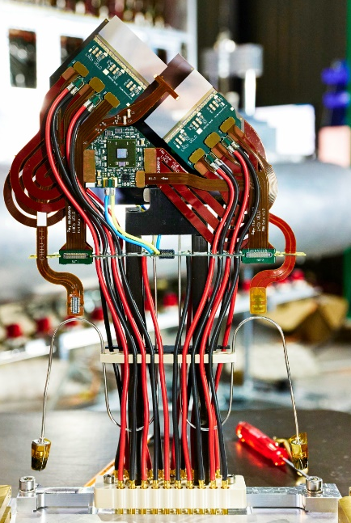
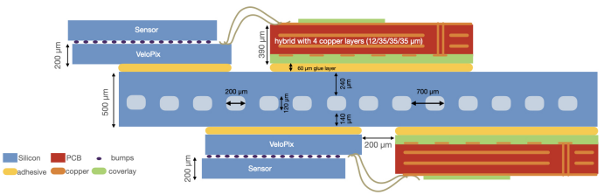
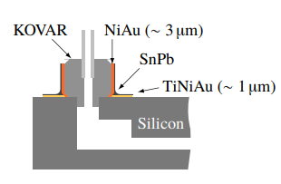
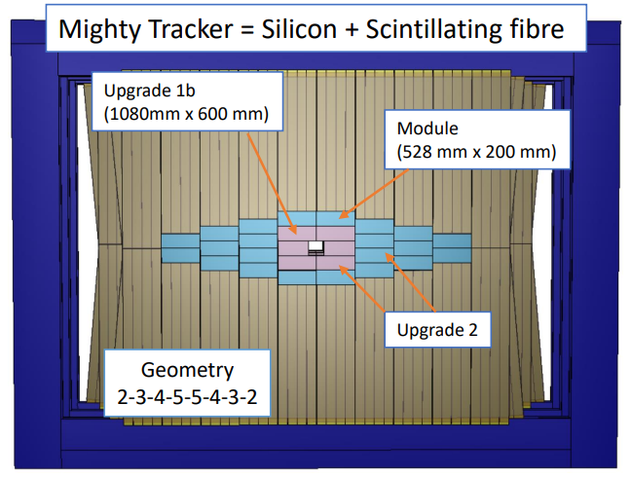
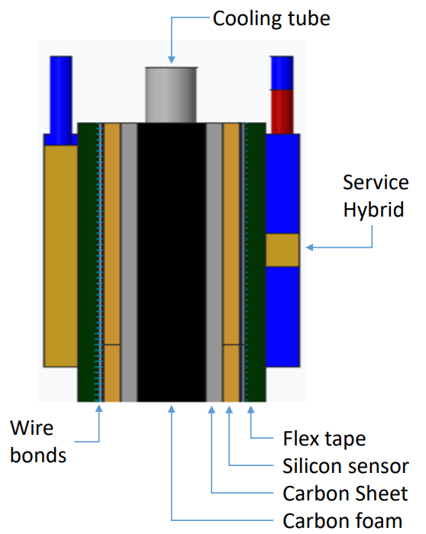
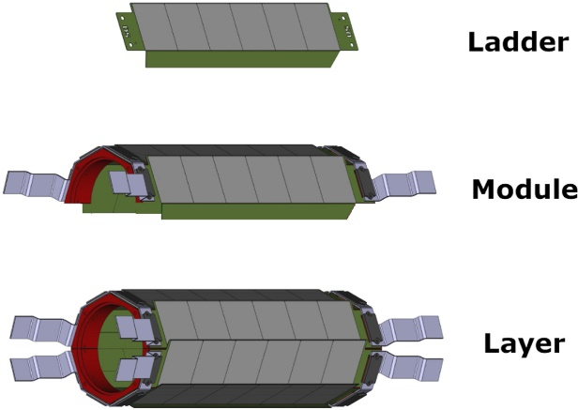
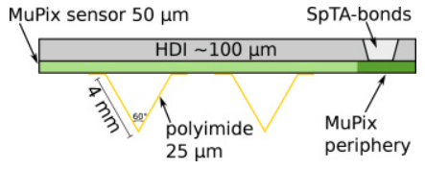


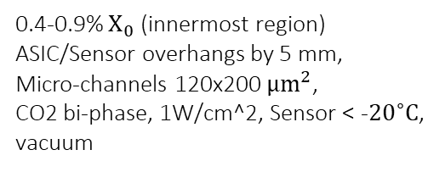
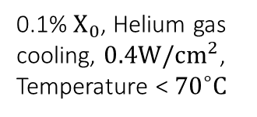
Cooling
NA62 GTK
JINST 14 P07010
LHCb VELO Upgrade I
Brice, Maximilien; Ordan, Julien Marius (CERN)
5 mm
j.nima.2022.166874
Bennett, Sophia Elizabeth (CERN)
Vacuum
Operating Temperature
0.4-0.9% $X_{0}$ (innermost region)
ASIC/Sensor overhangs by 5 mm,
Micro-channels 120x200 $μm^{2}$,
CO2 bi-phase, 1W/cm^2, Sensor < -${20}^{∘}C$,
vacuum
Material Budget
0.5% $X_{0}$, 200 × 70 $µm^{2}$ micro-channels, C6F14 liquid coolant, vacuum, $0.32 W/cm^{2}$in the pixel matrix, < 5C
Power density
Mu3e
SciPost Phys. Proc. 5, 020 (2021)
LHCb Mighty Tracker (2032)
FTDR
Thermal figure of merit
0.1% $X_{0}$, Helium gas cooling, $0.4W/cm^{2}$,
Temperature < ${70}^{∘}C$
Integration
Area/Cost
$18m^{2}$, 1-2% $X_{0}$, Kapton tubes, Liquid cooling (?), 0.3W/$cm^{2}$, Temperature $≤0^{∘}C$

