Slide 1

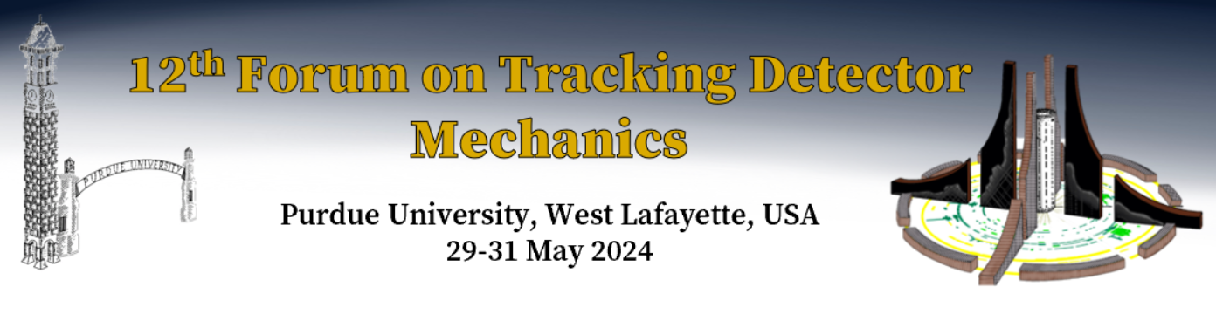

DRD8 WG3
Bart Verlaat and Oscar Augusto de Aguiar Francisco
On behalf of the DRD8 preparation group
Forum on Tracking Mechanics
29-31 May 2024
Purdue University, West Lafayette, USA

Slide 2
Goal of the DRD8 WG3
To identify the development directions for cooling related topics.
To find partner institutes to setup and define research
To coordinate the activities and funding
To indicate existing and available research facilities

Slide 3
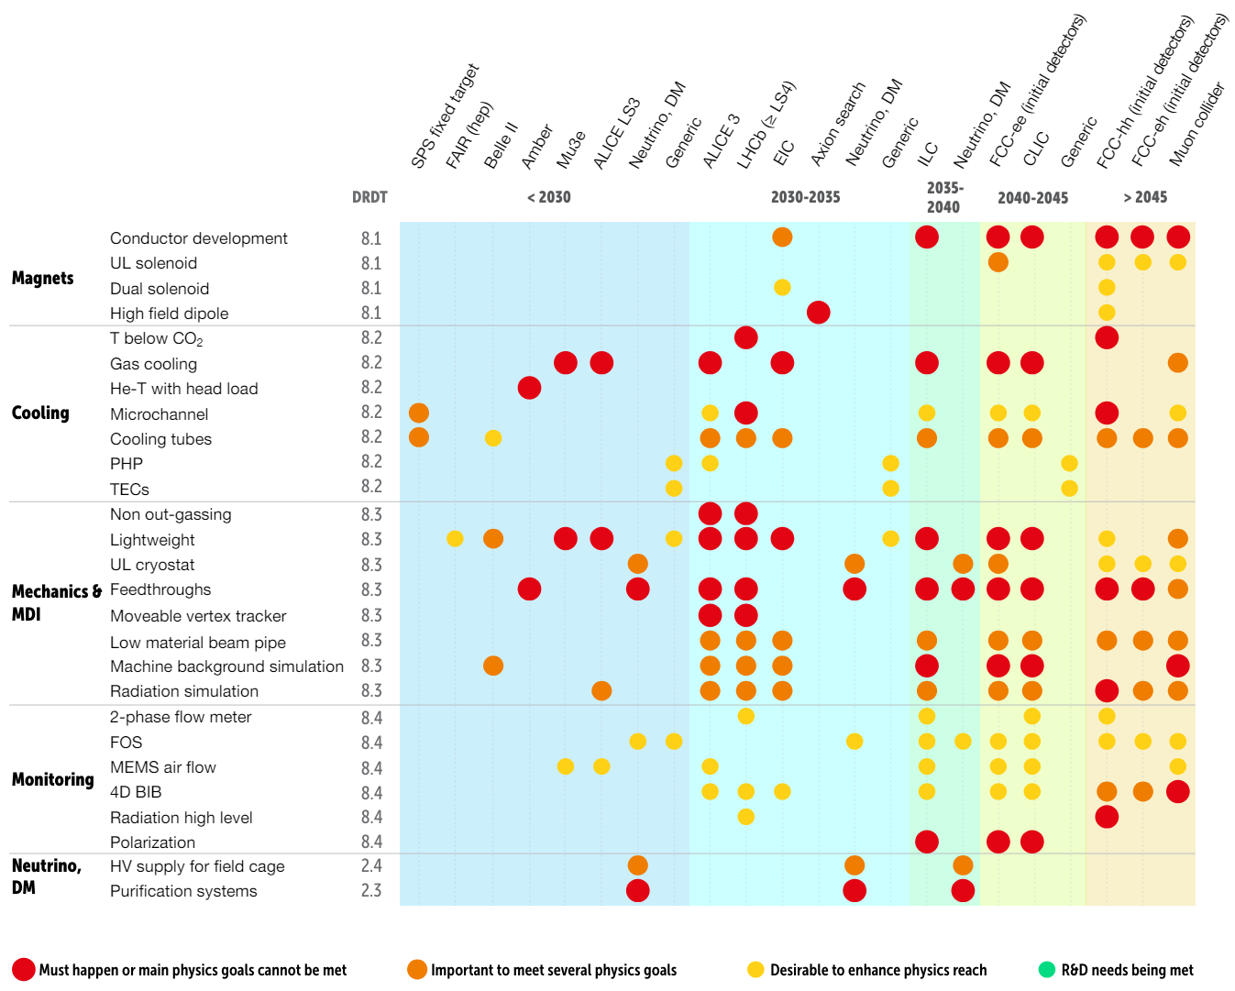
ECFA roadmap
The 2021 ECFA detector research and development roadmap - CERN Document Server
WG2 and WG3

Slide 4
Boundary between WG3/2 from LOI
Current identified research topics
All red are directly cooling related
WG 8.2: Low Mass Mechanics and thermal management:
Novel materials for structural and thermal management applications, including qualification for operation in harsh environments;
Advanced manufacturing techniques, including additive manufacturing;
Support structures with integrated cooling circuits, including silicon or ceramic substrates with embedded microchannels, composite substrates with embedded pipe-less networks and cold plates with thin-walled pipes;
Modular, scalable designs for detectors with large surface areas;
Vacuum-tight composite structures.
WG 8.3: Detector Cooling:
Evaporative and liquid cooling for both low and warm temperatures, based on natural or eco-friendly refrigerants and new cycles;
Gas cooling solutions for detectors, including flow design and heat transfer through porous media;
Connection technologies for cooling circuits, including leak repair methods;
Instrumentation, including flow measurements for gases and liquids.
These two groups cannot be disentangled in many aspects
(coolant – cooling plate, integration-local cooling plate, coolant-material compatibility, scalability-integration, …)

Slide 5
Similarities between WG3/2
WG 8.2: Low Mass Mechanics and thermal management:
Novel materials for structural and thermal management applications, including qualification for operation in harsh environments;
Advanced manufacturing techniques, including additive manufacturing;
Support structures with integrated cooling circuits, including silicon or ceramic substrates with embedded microchannels, composite substrates with embedded pipe-less networks and cold plates with thin-walled pipes;
Modular, scalable designs for detectors with large surface areas;
Vacuum-tight composite structures.
WG 8.3: Detector Cooling:
Evaporative and liquid cooling for both low and warm temperatures, based on natural or eco-friendly refrigerants and new cycles;
Gas cooling solutions for detectors, including flow design and heat transfer through porous media;
Connection technologies for cooling circuits, including leak repair methods;
Instrumentation, including flow measurements for gases and liquids.
You cannot separate the same colors from each other. Developing integrated cooling means you need to integrate the right geometry for best heat transfer, not just integrate a channel .
Connection methods and new instrumentation are often based on additive manufacturing

Slide 6
Fluid comparison and temperature performance
-40°C
+5°C
L=2m, Q=200Watt
Slides from FCC workshop 2020
https://indico.cern.ch/event/932973/contributions/4102407/attachments/2142143/3609779/CoolingTalkFCCworkshop10nov20.pdf
Plot of maximums
Heat transfer is best close to the critical point
CO₂
What about this mysterious critical point?
The cooling optimization fluid comparison is explained in detail at:
  Slides of the 2013 Forum in Oxford (UK), https://indico.cern.ch/event/233332/contributions/1546088/attachments/388971/540971/ForumSlides18jun2013.pdf
In the Encyclopaedia of Two-Phase Heat Transfer and Flow:
  P. Petagna, B. Verlaat, A. Francescon, “Two-Phase Thermal Management of Silicon Detectors for High Energy Physics”, in J.R. Thome (Ed), Encyclopaedia of Two-Phase Heat Transfer and Flow III, World Scientific, 2018, pp. 335-412

Slide 7
Optimize design for the detector
Minimize the cooling pipe only is not necessary the optimum.
A small pipe makes the cooling hardware light but depending on the design it can be replaced by other material.
The pipe interface becomes smaller and hence temperature gradients can increase over this interface
  Glued pipes are critical for small glue surfaces
A full conductance picture must be included in the analyses for optimization
This combined cooling pipe/detector conductive path optimization is needed and is a combined WG2 and WG3 activity
IBL-like properties:
  T_tube=0.1 mm
  T_glue=0.1 mm
  k_tube=7.2 W/mk
  k_foam=35 W/mk
  k_glue=1.02 W/mk
  d_glue=2400 kg/m3
  d_foam=198 kg/m3
  d_tube=4400; kg/m3
ATLAS IBL optimization
Slides from FCC workshop 2020
https://indico.cern.ch/event/932973/contributions/4102407/attachments/2142143/3609779/CoolingTalkFCCworkshop10nov20.pdf
1.5mm

Slide 8
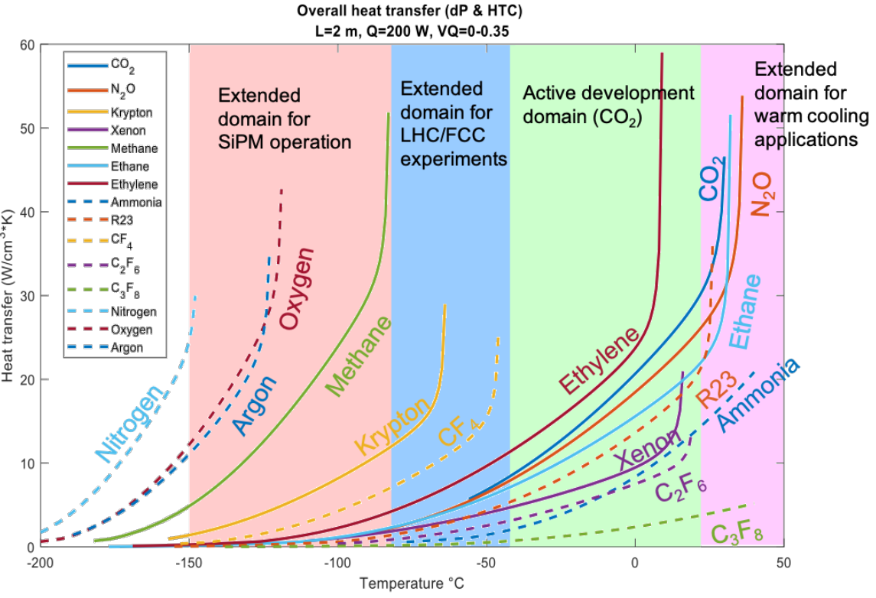
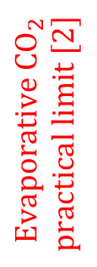
Coolants
$$Evaporative CO_{2}$$
$$practical limit [2]$$
Interesting candidate fluid for temperatures below CO2
No R&D is advised for any fluorocarbon or other greenhouse cooling liquid. (roadmap)

Slide 9

Next generation of synthetic refrigerants?
The use of F-gasses in the past decades has a severe impact on humans and the environment:
Depletion of the ozone layer (CFCs)
Global warming (CFCs, HCFs, HFCs)
Poisonous decomposition products in new HFO class (PFAS*)
  Acidification of our waters by TFA
  New “allowed” HFO-1234yf is a serious treat to the environment
  See warning report: https://atmosphere.cool/hfo-tfa-report/
Fluorocarbons @ CERN
NOVEC @ CERN
*PFAS (Per- and polyfluorinated alkyl substances), also known as the Forever Chemicals.
Large chemical family of over 9,000 highly persistent chemicals that don't occur in nature.
Investigations by NIST (M. McLinden @ ICR2019) show that by theoretical analyses of all possible molecule combinations that the options for the use of efficient cooling fluids without the risk of a future ban by regulations are the use of natural refrigerants only. Any other chemical fluid will sooner or later be banned by regulations.
Slides: Armin Hafner
CERN and the Environment (12-13 October 2022): Overview · Indico

Slide 10
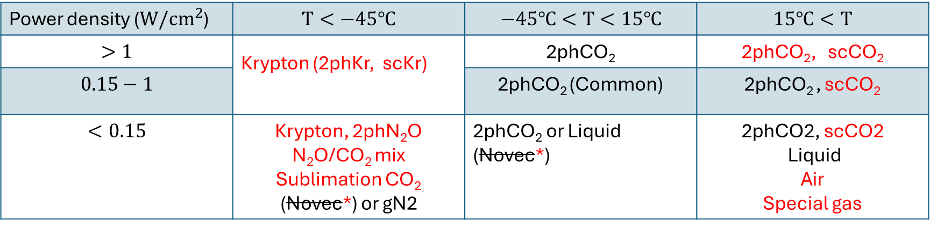
Operating field (simplified)
Sc=Super critical
2ph=2-phase
l=Liquid
G=gas
RED= R&D needed
Power density ($W/cm^{2}$) | $$T<−45℃$$ | $$−45℃<T<15℃$$ | $$15℃<T$$
$$>1$$ | Krypton (2phKr, scKr) | 2phCO₂ | 2phCO₂, scCO₂
$$0.15−1$$ |  | 2phCO₂ (Common) | 2phCO₂ , scCO₂
$$<0.15$$ | Krypton, 2phN₂O N₂O/CO₂ mix Sublimation CO₂ (Novec*) or gN2 | $\text{2}\text{phCO}\text{2}$ or Liquid (Novec*) | 2phCO2, scCO2 Liquid Air Special gas
Future cooling should only focus on natural refrigerants (CO₂, N₂O, Kr, Air, Water)
What about flammable gasses? There are some thermally very good candidates (Methane, Ethylene)
*Fluorocarbon-based coolants are not recommended, and if approved the European Chemical Agency Restriction draft
will limit their usage even more (Annex XV, June Status Update EDMS) => GWP & PFAS regulations

Slide 11

Pre-DRD8 discussion
Indico page link
At 6 December 2023, groups have expressed their interests and available facilities for the different research topics.
https://indico.cern.ch/event/1344395\
We will contact the groups to discuss their whishes and ideas.
If you were not yet involved but interested in joining some related RnD let me know
If you are at forum its good forum coffee talk
Please contact me or Oscar:
  "Bart Verlaat" <Bart.Verlaat@cern.ch>
  "Oscar Augusto De Aguiar Francisco" <oscar.augusto@cern.ch>

Slide 12
Pre-DRD8 discussion
WG 8.2: Low Mass Mechanics and thermal management:
Novel materials for structural and thermal management applications, including qualification for operation in harsh environments;
Advanced manufacturing techniques, including additive manufacturing; (4x, Sheffield, Manchester, GSI, CERN)
Support structures with integrated cooling circuits, including silicon or ceramic substrates with embedded microchannels, composite substrates with embedded pipe-less networks and cold plates with thin-walled pipes; (7x, Strasbourg, Perugia, Manchester, GSI, DESY, Perdue, CERN)
Modular, scalable designs for detectors with large surface areas;
Vacuum-tight composite structures.
WG 8.3: Detector Cooling:
Evaporative and liquid cooling for both low and warm temperatures, based on natural or eco-friendly refrigerants and new cycles; (4x, Perugia, Manchester, DESY, CERN)
Gas cooling solutions for detectors, including flow design and heat transfer through porous media; (4x, Strasbourg, Perugia, DESY, CERN )
Connection technologies for cooling circuits, including leak repair methods; (2x, Sheffield, Manchester )
Instrumentation, including flow measurements for gases and liquids. (1x, CERN)
We will contact you soon to discuss your ideas for input. If you are at the forum, lets have a coffee…

Slide 13

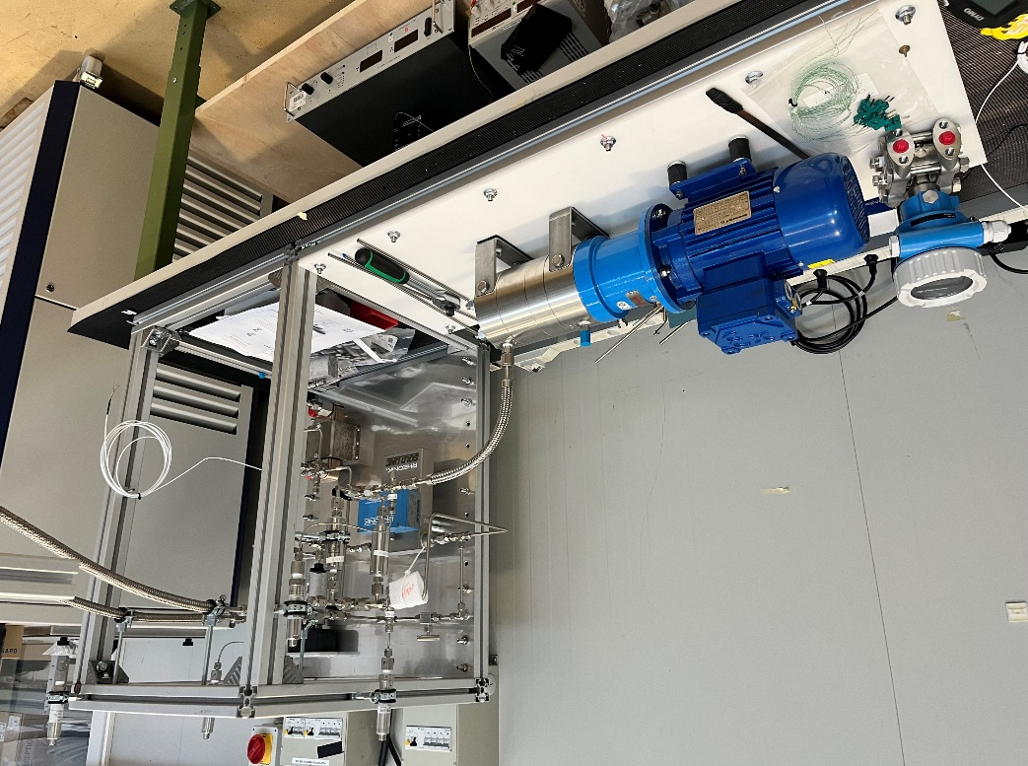
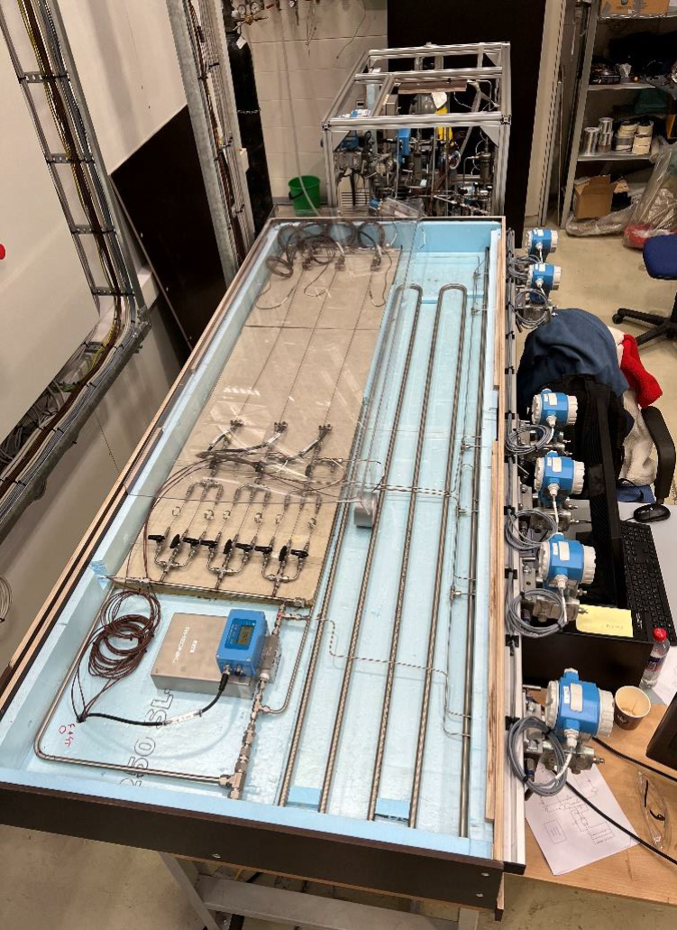
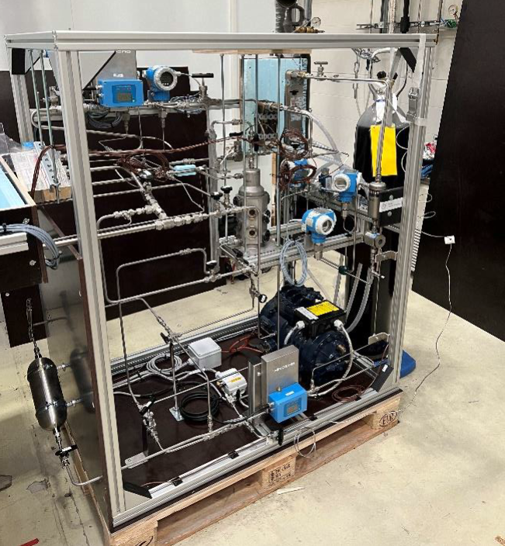



Cooling system cycle and fluid research at CERN
Supercritical CO2 for warm applications
Super and subcritical Kr for cold applications
In the range +32 C to + 40 C
Advantages:
Simplicity of a single-phase cooling-like
Hydraulic pressure drop➔ gas-like
Better heat and mass transfer properties than water.
Dielectric fluid, Natural refrigerant
(L. Contiero)
(C. Pedano)
As low as -90C
Advantages:
Expected similar behaviour as CO2 but then at cold. (The CO2 of the cold)
New cycle in development, also applicable to other fluids.
Dielectric fluid, Natural refrigerant
Cooling cycle
Detector simulator
Cooling cycle
External partners
Collaboration
with
Experimental setup almost completed @CERN,
Start of experimental activity planned for June
(after setup commissioning and calibration)
Experimental setup completed @NTNU,
transfer at CERN planned for June
Commissioning and calibration planned with CO₂

Slide 14


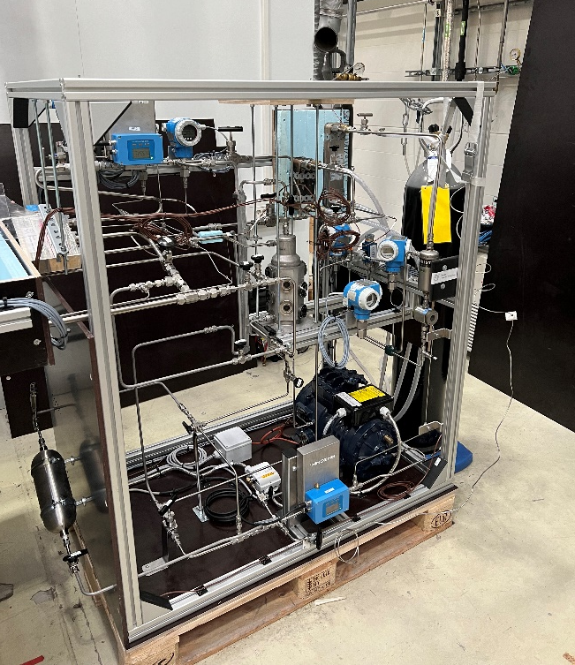
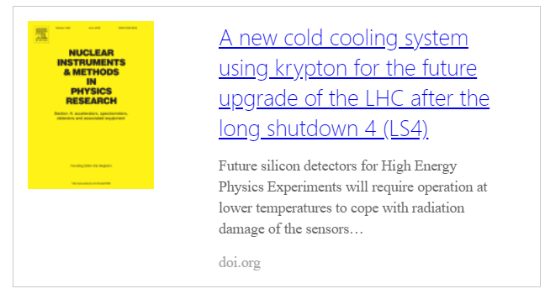
From -40°C to -70 °C and below
=> from R744 to R784
Is Krypton the CO₂ for colder temperatures?
Development of a new cycle with a new coolant
An ejector driven cycle with potential also for other fluids (Full control, no thermal chocks)
Maneuvering through the PH-diagram
Prototype ready at NTNU
A PhD project by Luca Contiero
1st paper published
https://doi.org/10.1016/j.nima.2024.169420

Slide 15
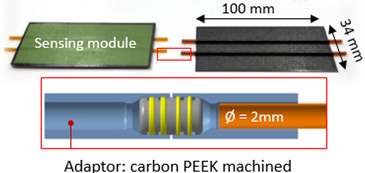
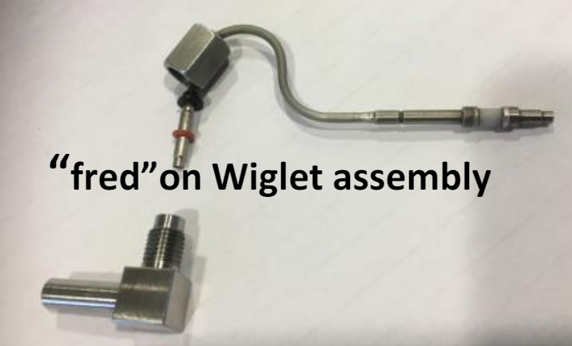
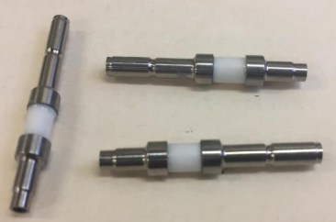
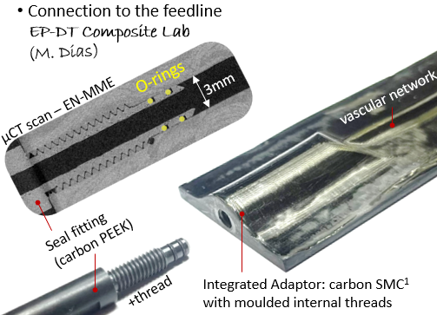
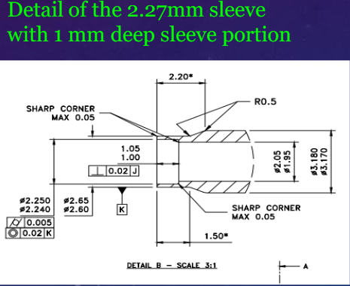
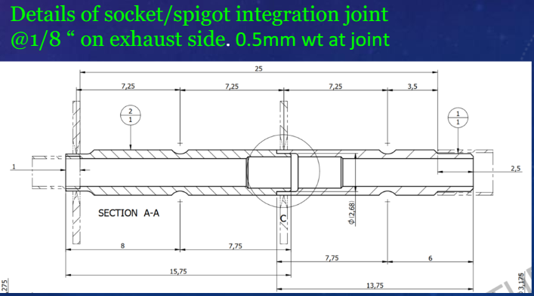
Interconnections
University of Sheffield
CERN
C. Gargiulo (EP-DT day)
Custom-made removable connection
(welding)
Experience with electrically
Insulating with ceramics

Slide 16
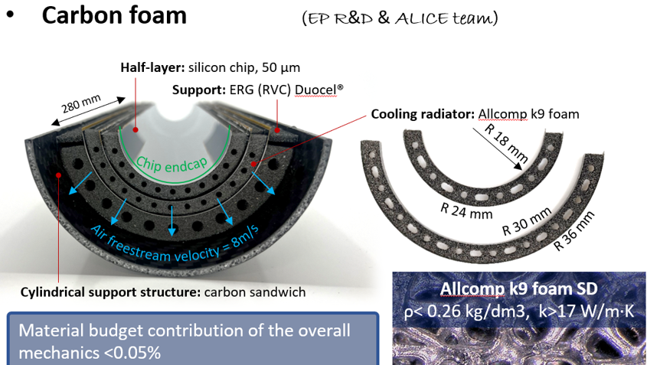
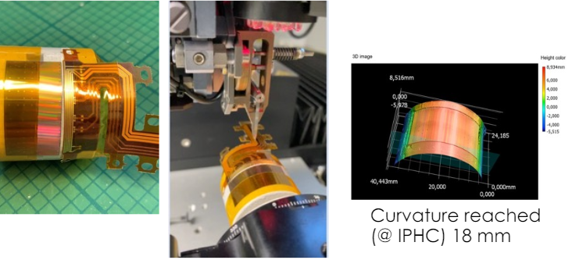
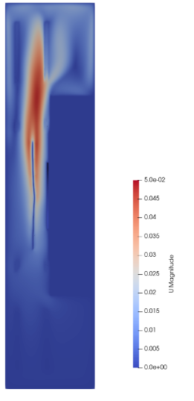

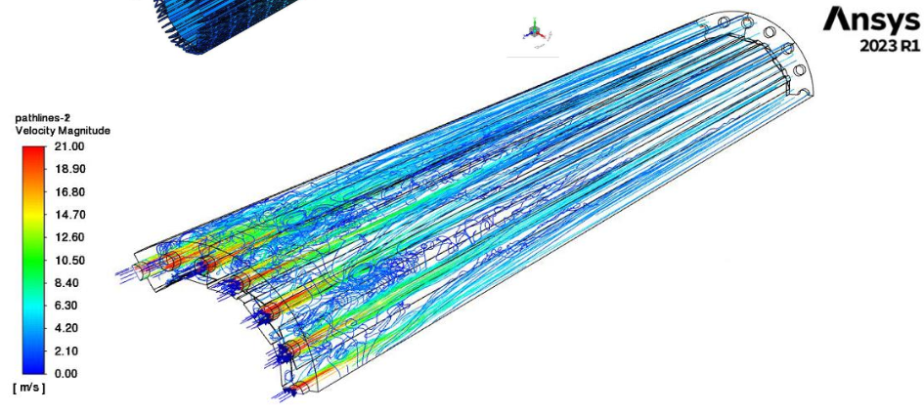
Gas Cooling for warm low power detectors (Typical e-e coliders)
CERN
IPHC/ CNRS/ University Strasbourg, J. Baudot
Sensor bending (Goal: reduce radius down to 1-3 cm)
C. Gargiulo
(EP-DT day)
INFN Perugia, C. Turrioni
Air flow cooling simulation
Air flow
Open source Air flow
simulation(OpenFoam)
GSI-Darmstadt, M. Teklishyn
Temperature
Some talks were shown on the forum

Slide 17
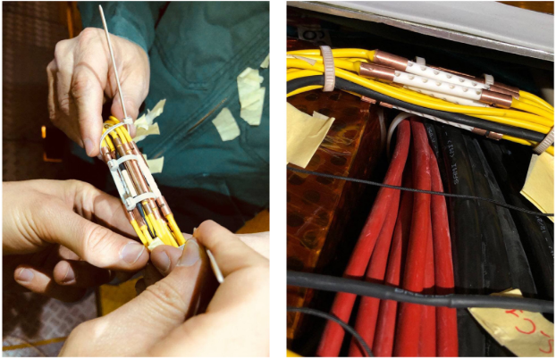
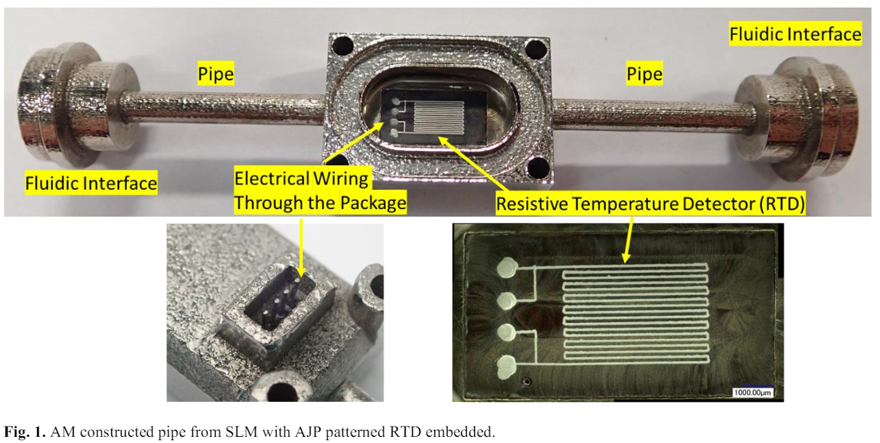
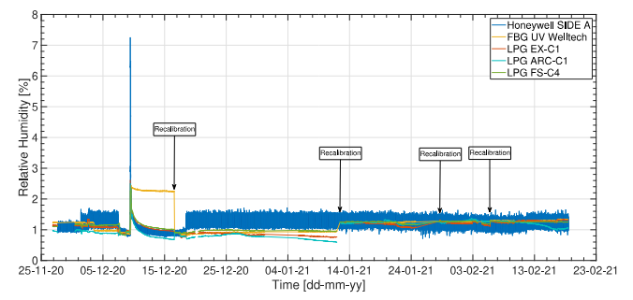
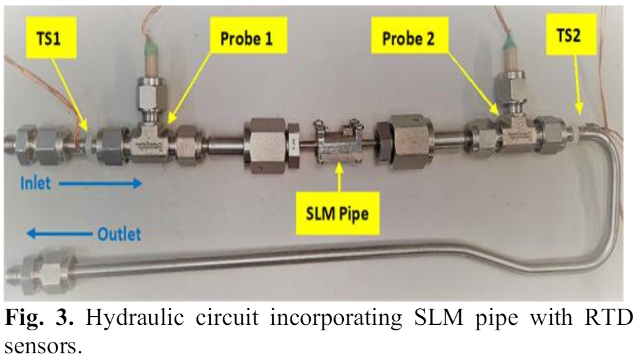
Monitoring
In combination with additive manufacturing
In-line temperature sensor
C. Manoli et al (Attract final report)
Humidity fibre sensors (L. Scherino et al)
New potential contributions not mentioned in the pre-DRD8 meeting(?)
More contributions welcomed
New monitoring applications with fibers?
Large volume temperature mapping, integrated flow and pressure measurements?

Slide 18
Backup slides

Slide 19
DRD8 letter of intent
Because of the dependence on design choices for sensors, front-end electronics, and electrical and readout services, the work on mechanics and cooling is highly reliant on the system specifications. To enable targeted and collaborative R&D work in our field, we propose to focus on solutions within two application frameworks.
Low intensity (LI): In this framework the mechanics and cooling will support sensors and electronics that have been designed for low power densities, possibly involving pulsed powering. The number and cross-section of electrical services will be small. Radiation damage levels will be low, and thus there will be no need to operate these systems cold (< 15 °C). Where possible, gas cooling will be an appealing solution. Radiation hardness levels of materials will be moderate. This will be the framework that will target, although not exclusively, experiments at future lepton colliders.
High intensity (HI): Detector systems within this framework will have to cope with high particle densities of signal and background particles. The high channel density and complexity of the front-end electronics will result in high power densities, which will need to be supplied (likely by advanced powering systems like serial powering or DC-DC conversion), and removed by potent evaporative cooling systems. Significant radiation damage will require cold (< -35 °C) operation to keep leakage currents under control. Materials will need to be qualified for the high radiation environment. This will be the framework that will aim for experiments at future hadron machines.
Material minimisation and a good thermal connection between local heat sources and sinks will be major goals in both cases, but the optimisation will be different. Nevertheless, we do expect that some of the solutions we will develop will be of benefit for both frameworks.
To verify and benchmark the performance of the solutions developed in this R&D effort, and as physical deliverables, we propose the construction of demonstrators which take into account the specifications defined in the context of other DRD efforts like DRD3 or DRD7. These demonstrators should be exercised in realistic environments, in a test-beam and/or real physics experiments, where possible.

Slide 20
DRD8 letter of intent
Low intensity
low power
low radiation
$$T<15℃$$
T<15℃
$$targeting future lepton colliders$$
targeting future lepton colliders
High intensity
high power
high radiation
$$T<−35℃$$
𝑇<−35℃
evaporative systems preferred
targeting future hadron colliders
Liquid and gas cooling can be considered
Mechanics is highly reliant on the system specifications
Two potential optimization paths:
Within the DRD8 framework, the proposal is to construct demonstrators defined in the context of DRD efforts like DRD3 and DRD7 to be tested in realistic environments (testbeam or physics experiments)

Slide 21
Timeline
Suggestion:
To have the DRD8 Proposal ready for submission in autumn, we must start now nominating a team of people preparing and collecting the contents of the proposed R&D for each WG.
  We should create mailing lists for each WG and a general mailing list for DRD8.
  It would be good to have one contact person per institute and WG to facilitate the collection of information.
  We should nominate WG conveners asap, ideally 2-3 per WG.
We certainly need at least one more DRD8 meeting after the summer before submission of the Proposal.
  Boundaries of WG2 and WG3 should be discussed.
  We need an overall editorial team, which could be the Steering Committee.

Slide 22
Presented interest in cooling related matters (1)
IPHC/ CNRS/ University Strasbourg, J. Baudot
  8.2.3 Integrated support structure and cooling
  8.3.2 Direct sensor air cooling
University of Sheffield/ Lancaster University/ RAL/ QMUL, Paul Kemp-Russel
  8.2.2 Additive manufacturing
  8.3.3 Connection technologies
INFN Perugia, C. Turrioni
  8.2.3 Integrated support structure and cooling
  8.3.1 Evaporative cooling and thermodynamics
  8.3.2 Direct sensor air cooling
University of Manchester, O. Augusto de Aguiar Francisco
  Included in the “Microchannels cooling plates” at Forum on Tracking Mechanics 2024
  8.2.2 Additive manufacturing
  8.2.3 Integrated support structure and cooling
  8.3.1 Evaporative cooling and thermodynamics
  8.3.3 Connection technologies

Slide 23
Presented interest in cooling related matters (2)
GSI-Darmstadt, M. Teklishyn
  8.2.2 Additive manufacturing
  8.2.3 Integrated support structure and cooling
Desy-Hamburg, A. Mussgiller
  8.2.3 Integrated support structure and cooling
  8.3.1 Evaporative cooling and thermodynamics
  8.3.2 Direct sensor air cooling
Perdue University, S. Karmarkar
  8.2.3 Integrated support structure and cooling
CERN, C. Gargiulo, P. Petagna, B.Verlaat
  8.2.1 Novel materials
  8.2.2 Additive manufacturing
  8.2.3 Integrated support structure and cooling
  8.3.1 Evaporative cooling and thermodynamics
  8.3.2 Direct sensor air cooling
  8.3.4 Instrumentation

Slide 24
