Slide 1
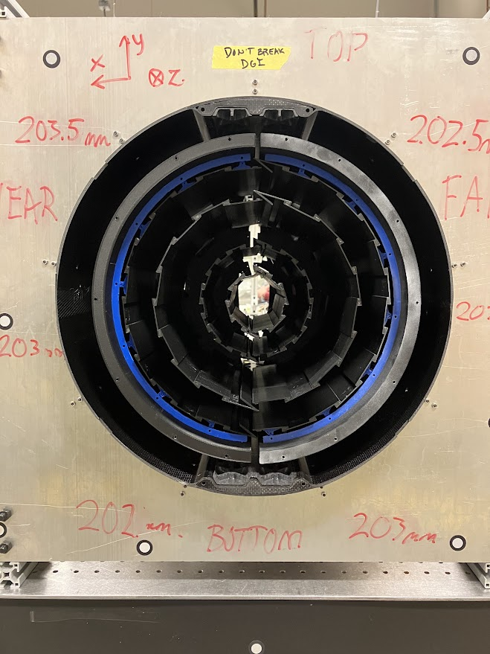
TFPX-TBPX adjustable mechanical connection tests for the Phase II integration of the CMS Inner Tracker
28/05/24
D. Benvenuti
A. Basti, R. Dell’Orso, S. Coli, S. Garrafa
On behalf of CMS Tracker group

Slide 2


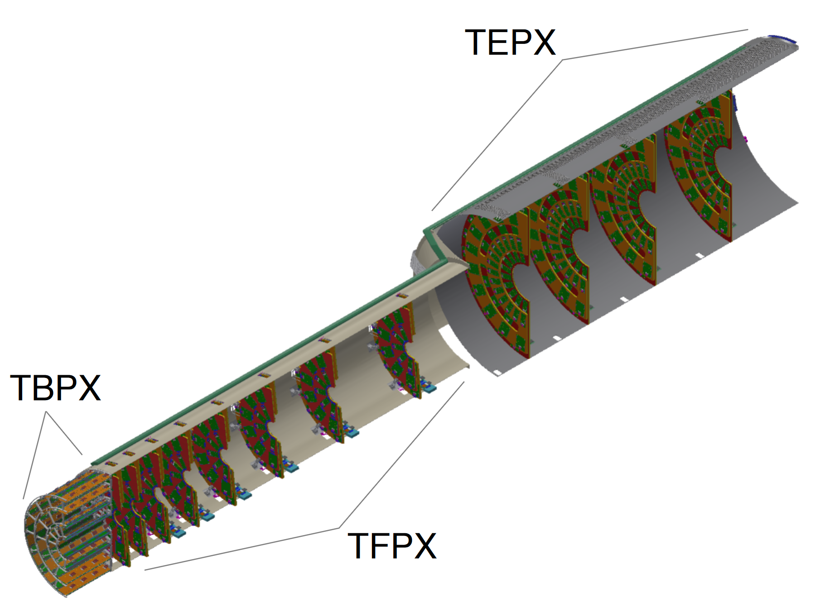
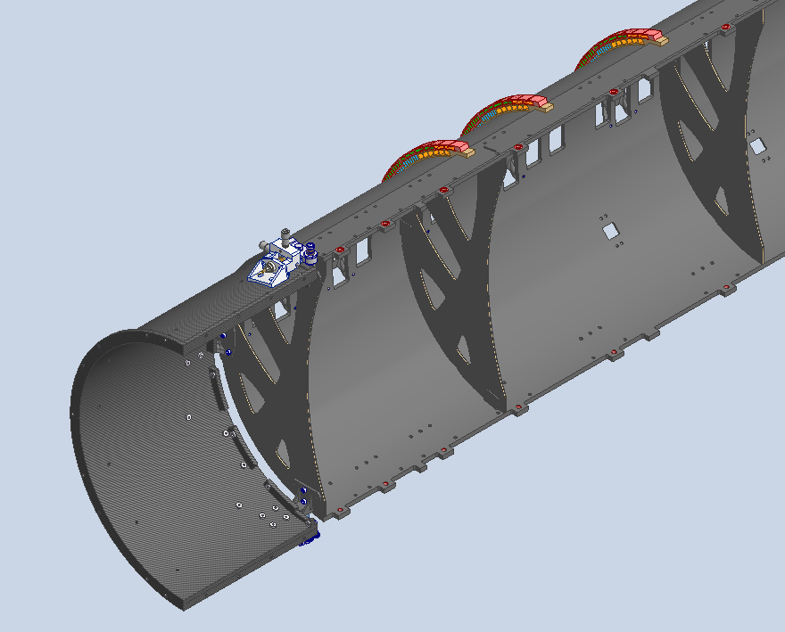
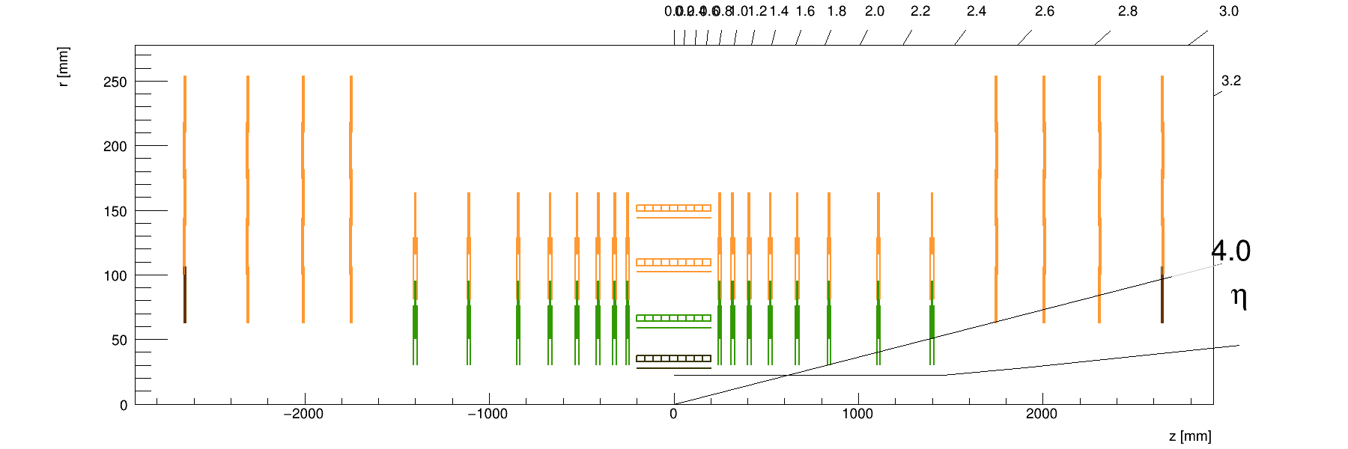
The Phase-2 Inner Tracker
During LHC Phase II, the CMS Inner tracker will be updated. The goal of this upgrade is to maintain or even improve the tracking performance compared to the Phase I detector. The main improvements are the increase of the tracker coverage and the increase of detector resolution
Made of barrel part with four layers (Tracker Barrel Pixel Detector, TBPX), eight small double-discs per side (Tracker Forward Pixel Detector, TFPX) and four large double-disks per side (Tracker Endcap Pixel Detector, TEPX). The whole Inner tracker slides inside ITST rails (Inner Tracker Support Tube)
Placed all around the beam pipe, it is installed inside the Outer Tracker
→ possibility to replace innermost degraded parts over an Extended Technical Stop
TBPX
TFPX
TFPX
TEPX
TEPX

Slide 3
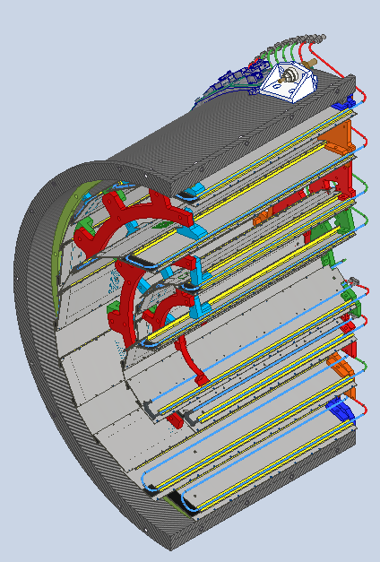
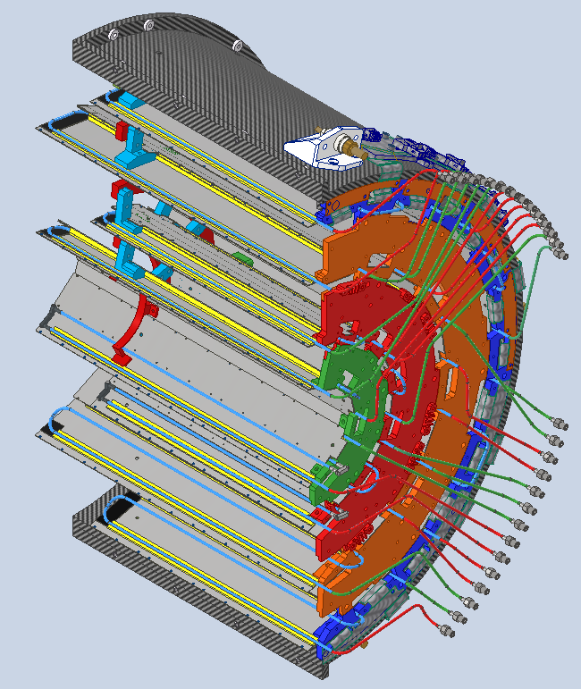
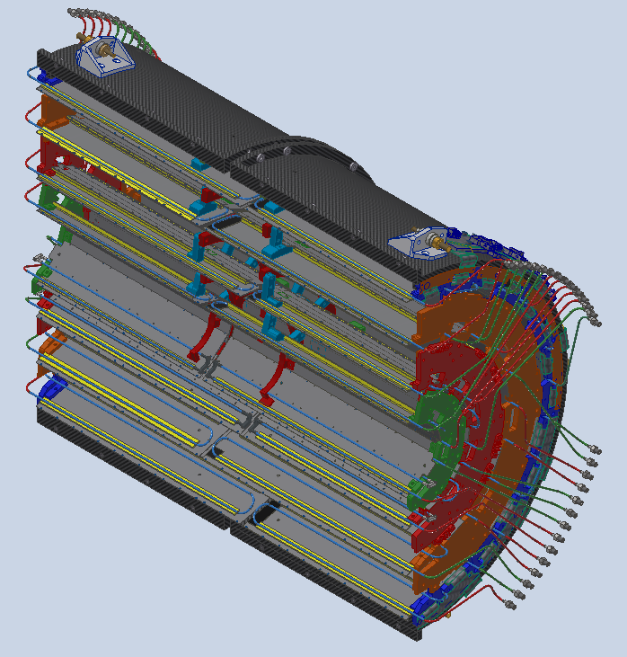
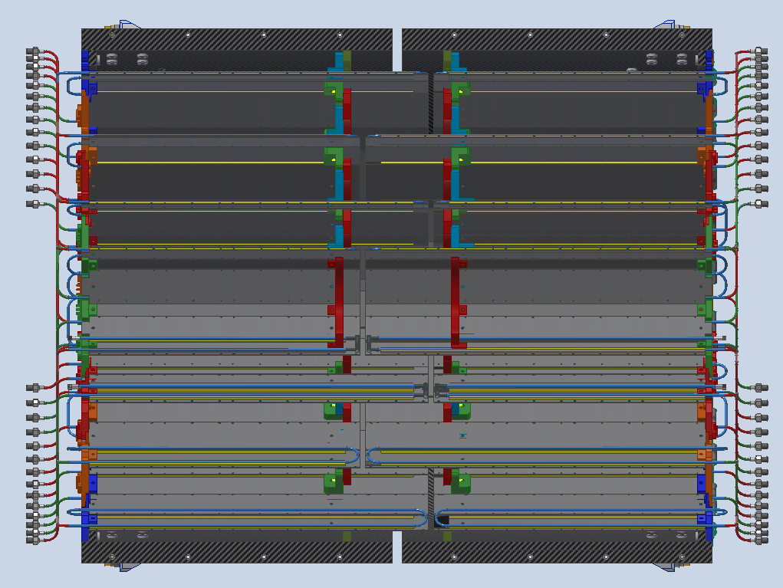
TBPX design
External cylinder
Brackets
Cooling loops
The TBPX detector is made of four quarters, each quarter is made of four Layers. To increase the Tracker coverage the ladders of each layer of the two halves are staggered around the interaction point. In the intersection of the quarters the ladders are skewed to increase the gap
TBPX is composed by an external carbon fiber shell, the External cylinder, which holds all the TBPX load and allows the connection with TFPX. Inside ladder are connected one by one to the External cylinder by some mechanical flanges, which connect one layer to the other.
Since the parts are connected one by one from the External cylinder up to the innermost layer, this propagate their positioning error, that might cause collision between the two halves during the installation.
Ladders
Flanges
Z -
Z -
Z +
Flanges
Z +

Slide 4
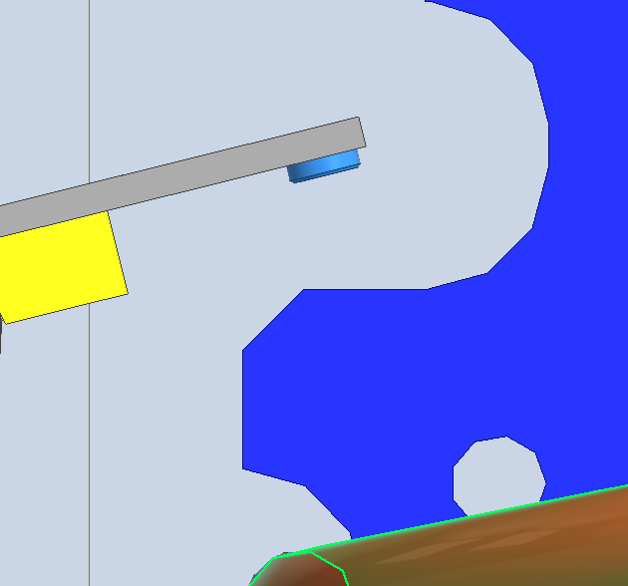
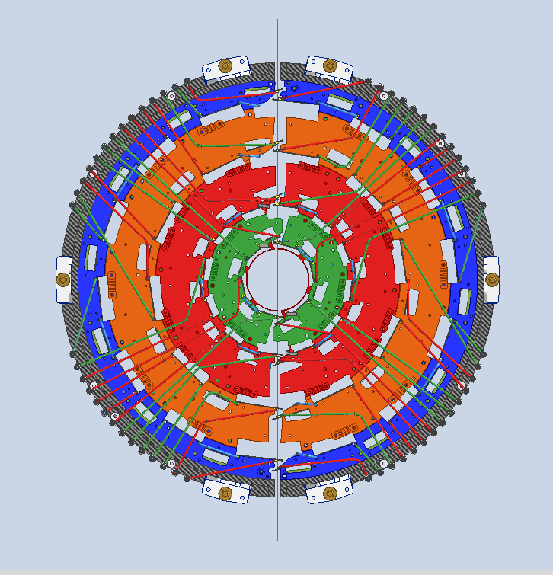
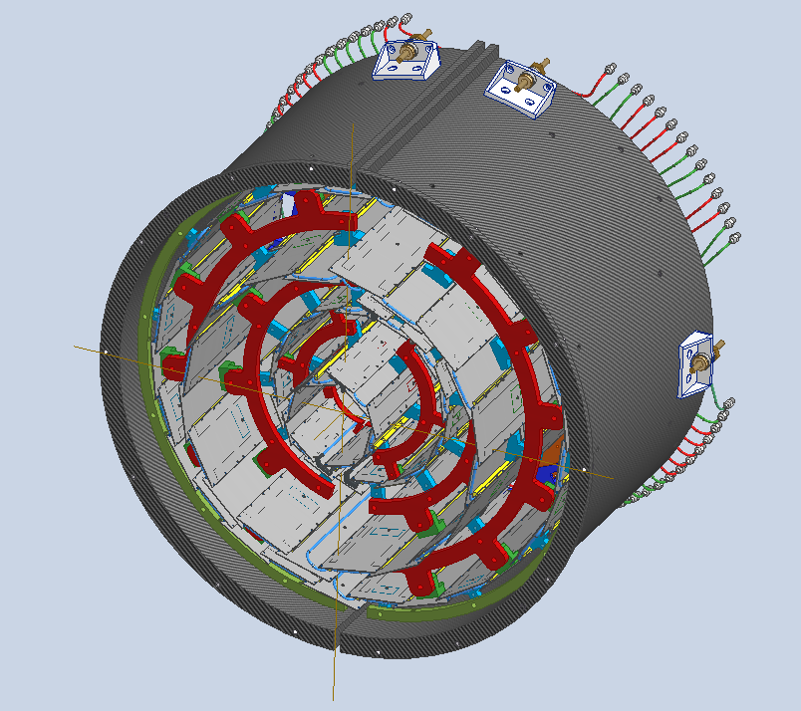
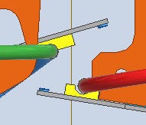
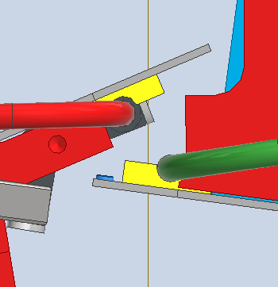
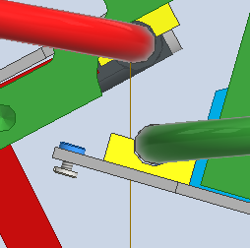
TBPX Z+ Nominal gaps
L4
L3
2.1 mm
2.1 mm
L2
L1
1.8 mm
1.1 mm
y
x
z

Slide 5
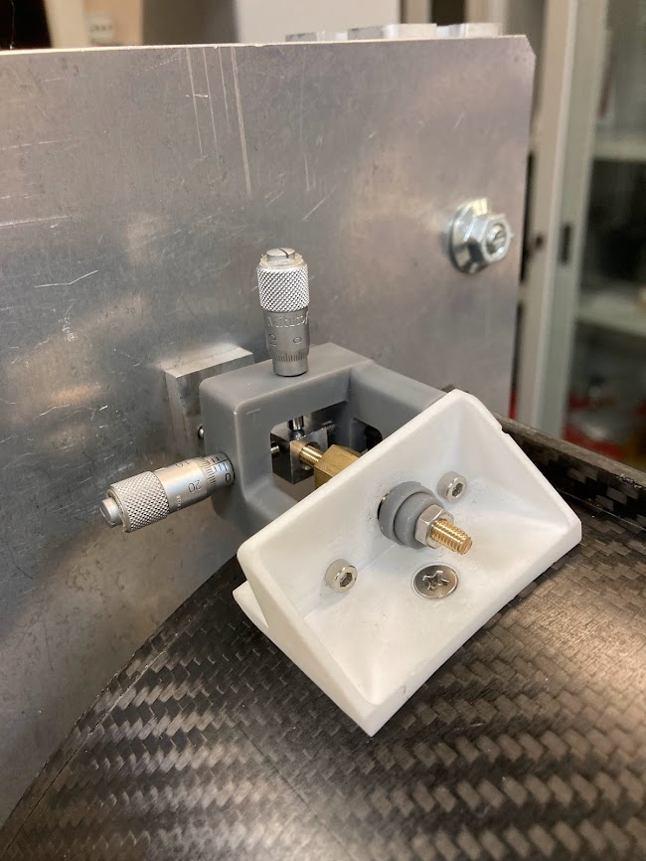
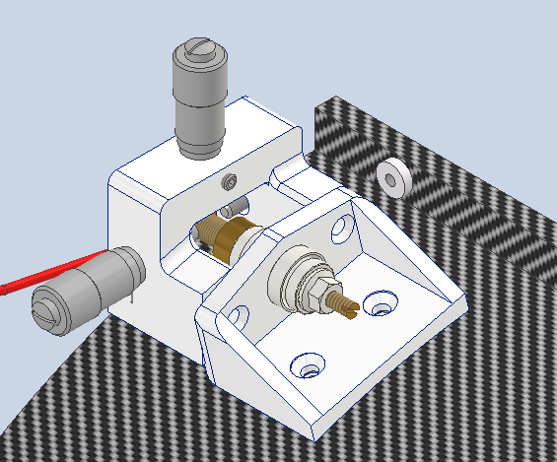
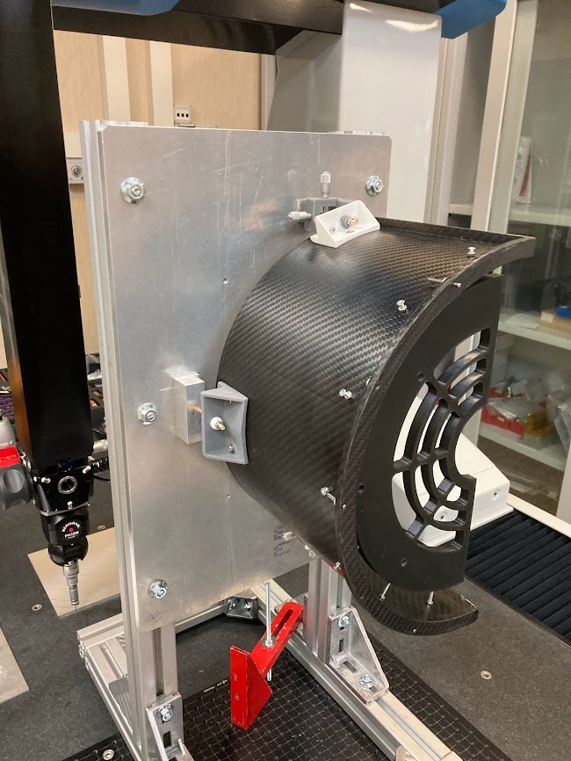
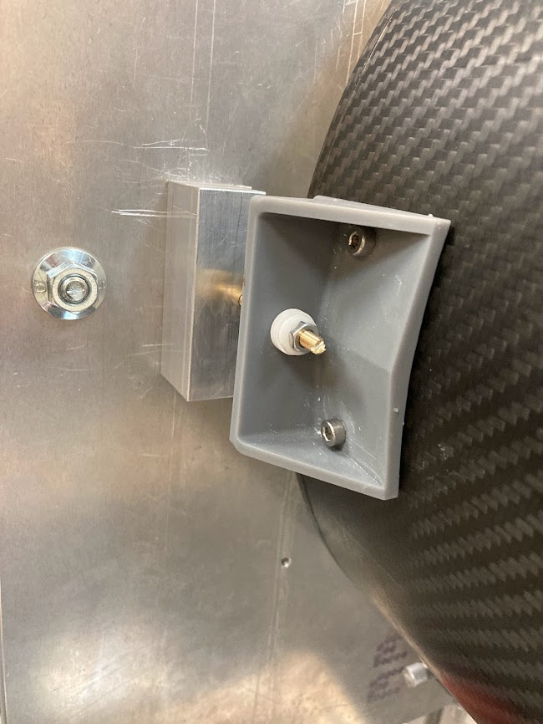
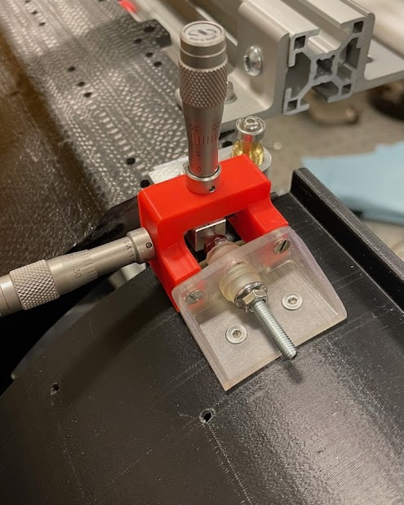
TFPX-TBPX connection design first test
Definitive design
Test setup
Reference block
Position adjuster
The first accuracy test consisted into adjusting TBPX to two reference blocks simulating TFPX wheels references. The goal was to check and fine tune the precision of the connection and the accuracy of the adjusting tool. During the alignment, the TBPX position is defined by two pinned holes placed on the rear flange of the External Cylinder, which are referred to the global Barrel Pixel reference system
Spherical washer
Lateral bracket
The tooling is attached to the TBPX brackets with two bolts
Self aligning against the TBPX external cylinder
The tool has 2x micrometric screws and one M3 set-screw, allowing precise adjustments
The adjuster is removable after the regulation
Central bracket
Relative precision | x [mm] | y [mm] | z [mm]
After adjustments | 0.050 | 0.050 | 0.050
Locked | 0.100 | 0.100 | 0.100
y
φ
x
θ
Relative angle precision | θ [°] | ψ [°] | φ [°]
After adjustments | 0.02 | 0.01 | 0.02
Locked | 0.100 | 0.01 | 0.100
ψ
z

Slide 6
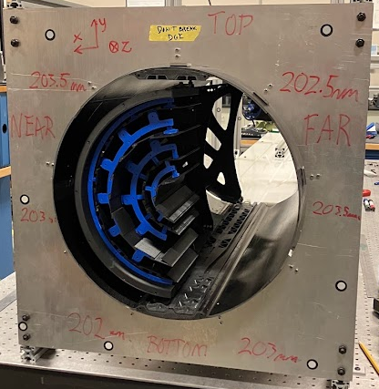
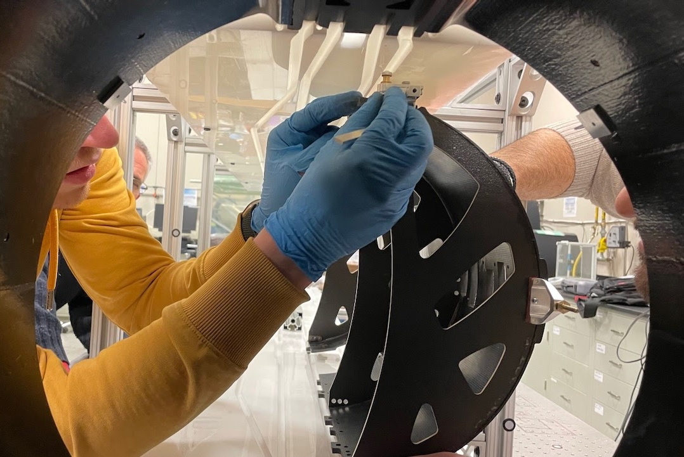
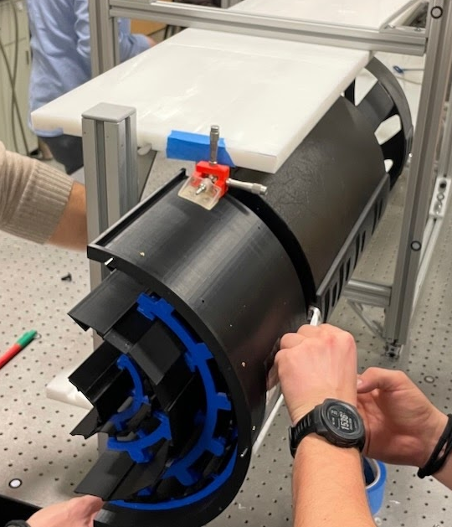
Integration test setup in Purdue
TFPX regulation
The test setup is composed by:
ITST carbon fiber mockup
TFPX short carbon fiber mockup
TBPX plastic mockup
The regulation for TFPX was done directly on the ITST rails, meanwhile for TBPX it was necessary to take out the Service cylinder and to regulate it supported by a Bosch structure
TFPX short mockup
TBPX regulation
ITST rails
TBPX mockup

Slide 7
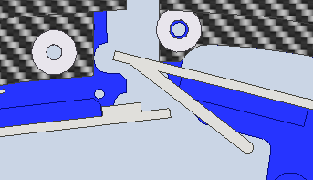
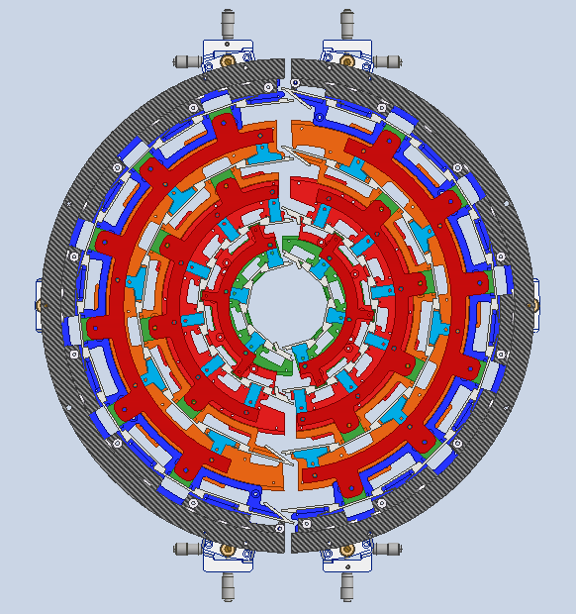
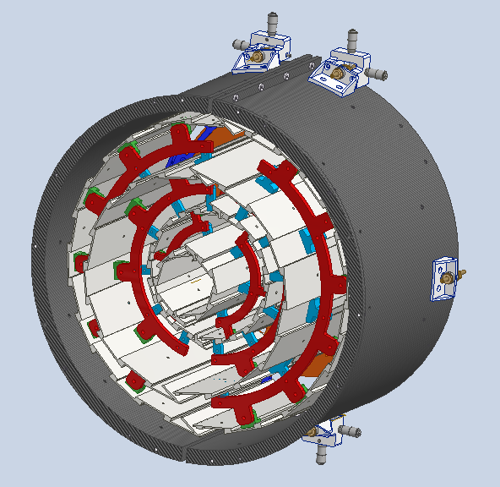
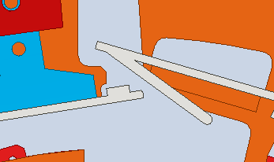
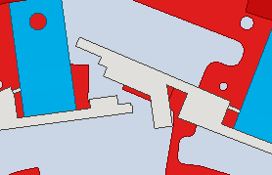
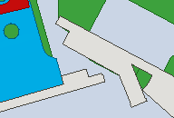
Mockup gaps
L4
L3
1.7 mm
1.7 mm
L2
1.3 mm
L1
1.0 mm
z
y
x

Slide 8
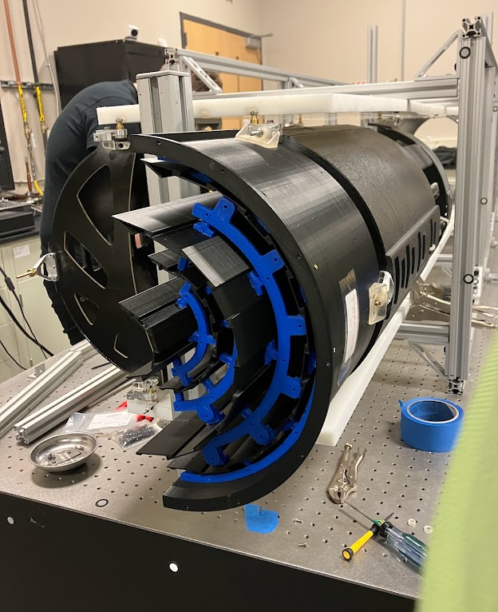
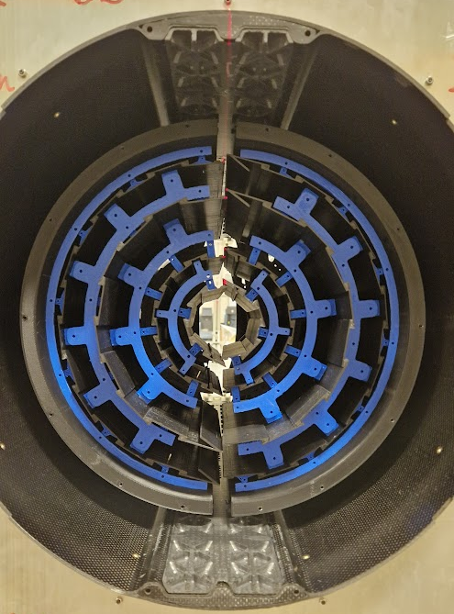
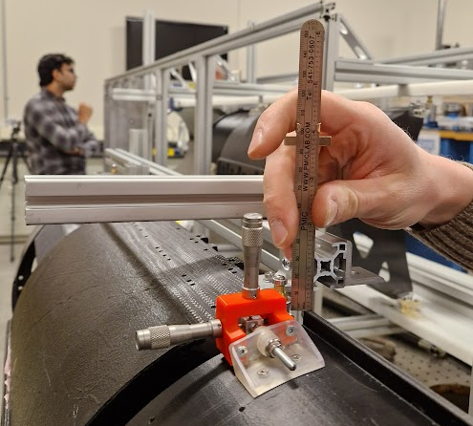
First assembly and insertion
First insertion, without applying the proper adjustments by scanning but by using a ruler.
The goal of this first insertion was to check any collision o issues during the insertion of the final assembly. We didn’t find any issues on rails, but we had collision for L1 and L2 layers, pointing out that the internal layers were tilted to the center by the internal rings. We took them off for the next insertion

Slide 9
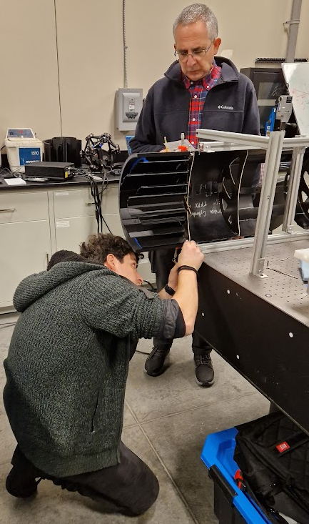
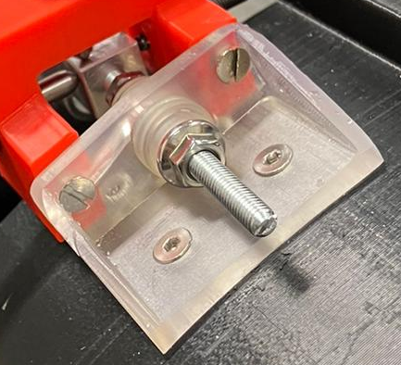
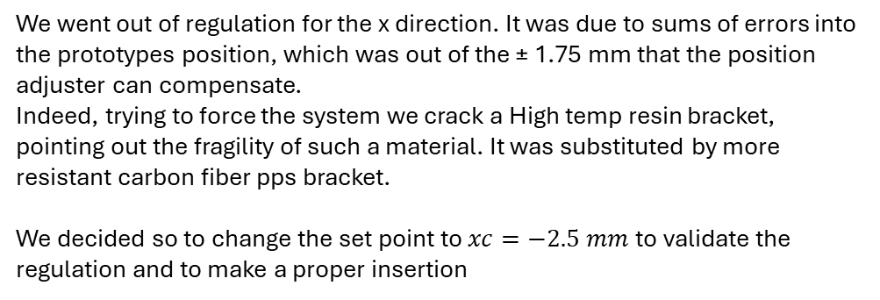
First regulation and problematics
Target | 0.000 | 0.000 | 194.500 | 0.000 | 0.000 | 0.000
1st trial | xc | yc | zp | theta | psi | phi
Position | -0.890 | 0.402 | 193.450 | 0.000 rad | -0.011 rad | -0.001 rad
 |  |  |  | 0.000 ° | -0.642 ° | -0.045 °
Adjustments | xt | xd | yt=yd | zt | zc | zd
 | -1.109 | 2.888 | -0.402 | 1.313 | 1.051 | 0.786
2nd trial | xc | yc | zp | theta | psi | phi
Position | -4.492 | -0.801 | 194.480 | 0.000 rad | -0.005 rad | -0.001 rad
 |  |  |  | 0.000 ° | -0.258 ° | -0.083 °
Adjustments | xt | xd | yt=yd | zt | zc | zd
 | 3.687 | 5.297 | 0.801 | 0.511 | 0.020 | -0.472
Where: xc and yc are the position of the center of TBPX quarter and zp is the position of the External cylinder rear plane
We went out of regulation for the x direction. It was due to sums of errors into the prototypes position, which was out of the ± 1.75 mm that the position adjuster can compensate.
Indeed, trying to force the system we crack a High temp resin bracket, pointing out the fragility of such a material. It was substituted by more resistant carbon fiber pps bracket.
We decided so to change the set point to $xc=−2.5 mm$to validate the regulation and to make a proper insertion

Slide 10
Regulation
TBPX z+ x+
TBPX z+ x-
Target | -2.500 | 0.000 | 194.500 | 0.000 | 0.000 | 0.000
1st trial | xc | yc | zp | theta | psi | phi
Position | -2.759 | -0.782 | 194.525 | 0.000 rad | 0.002 rad | 0.000 rad
 |  |  |  | 0.000 ° | 0.099 ° | 0.017 °
Adjustments | xt | xd | yt=yd | zt | zc | zd
 | 0.566 | -0.049 | 0.782 | -0.124 | -0.025 | 0.074
Target | -2.500 | 0.000 | 194.500 | 0.000 | 0.000 | 0.000
1st trial | xc | yc | zp | theta | psi | phi
Position | -2.984 | -0.272 | 193.727 | 0.000 rad | 0.000 rad | 0.005 rad
 |  |  |  | 0.000 ° | -0.009 ° | 0.274 °
Adjustments | xt | xd | yt=yd | zt | zc | zd
 | 0.454 | 0.454 | 0.272 | -0.848 | 0.773 | 2.394
4th trial | xc | yc | zp | theta | psi | phi
Position | -2.306 | -0.447 | 194.662 | 0.000 rad | 0.001 rad | 0.000 rad
 |  |  |  | 0.000 ° | 0.065 ° | 0.019 °
Adjustments | xt | xd | yt=yd | zt | zc | zd
 | 0.007 | -0.396 | 0.447 | -0.276 | -0.161 | -0.047
6th trial | xc | yc | zp | theta | psi | phi
Position | -3.078 | -0.888 | 194.340 | 0.000 rad | -0.001 rad | -0.003 rad
 |  |  |  | 0.000 ° | -0.032 ° | -0.152 °
Adjustments | xt | xd | yt=yd | zt | zc | zd
 | 0.477 | 0.679 | 0.888 | 1.060 | 0.160 | -0.740
From this two positioning tests it was pointed out:
- The precision of the connection is quite far from the one expected from previous test run in Pisa
- The regulation of x and y is accurate and simple till we stay inside the regulation range, otherwise the adjustments applied are not effective as they should.
- The z positioning it’s accurate and stable. In case we go outside of the regulation range for the x and y, the z system get blocked, allowing adjustments in just one direction.

Slide 11
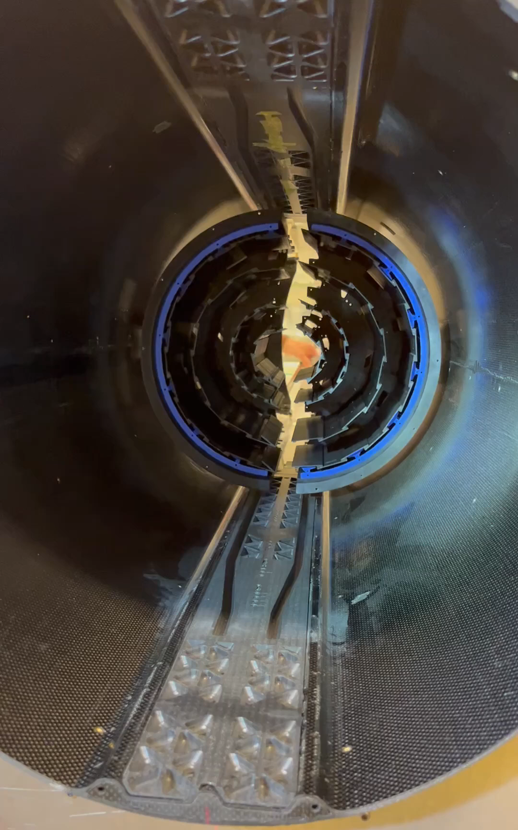
The insertion

Slide 12
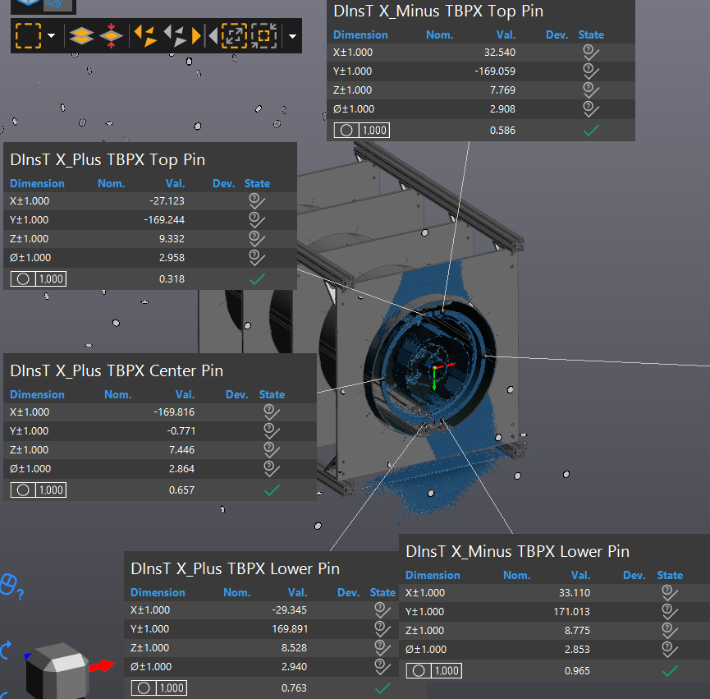
Precision after the insertion
TBPX z+ x+
Target | -2.500 | 0.000 | 194.500 | 0.000 | 0.000 | 0.000
 | xc | yc | zp | theta | psi | phi
Before insertion | -2.306 | -0.447 | 194.662 | 0.000 rad | 0.001 rad | 0.000 rad
 |  |  |  | 0.000 ° | 0.065 ° | 0.019 °
After insertion | xc | yc | zp | theta | psi | phi
 | -2.553 | -0.445 | 193.415 | 0.000 rad | 0.005 rad | 0.000 rad
 |  |  |  | 0.000 ° | 0.291 ° | 0.016 °
TBPX z+ x-
Target | -2.500 | 0.000 | 194.500 | 0.000 | 0.000 | 0.000
 | xc | yc | zp | theta | psi | phi
Before insertion | -3.078 | -0.888 | 194.340 | 0.000 rad | -0.001 rad | -0.003 rad
 |  |  |  | 0.000 ° | -0.032 ° | -0.152 °
After insertion | xc | yc | zp | theta | psi | phi
 | -3.301 | -0.868 | 194.412 | 0.000 rad | -0.002 rad | -0.003 rad
 |  |  |  | 0.000 ° | -0.132 ° | -0.152 °
After the insertion
- The precision in y direction was steady
- The precision in z was expected to be steady, but for TBPX z+ x+ we lost 1mm
- The position in x wasn’t steady. That might have been caused by a rotation of the whole mockup in ψ (perpendicular to z). The reason behind that could be the fact that TFPX wheels were touching just one side of the rails, while the adjustments were applied with the mockup locked on the service cylinder.
- θ and φ resulted steady after the insertion

Slide 13
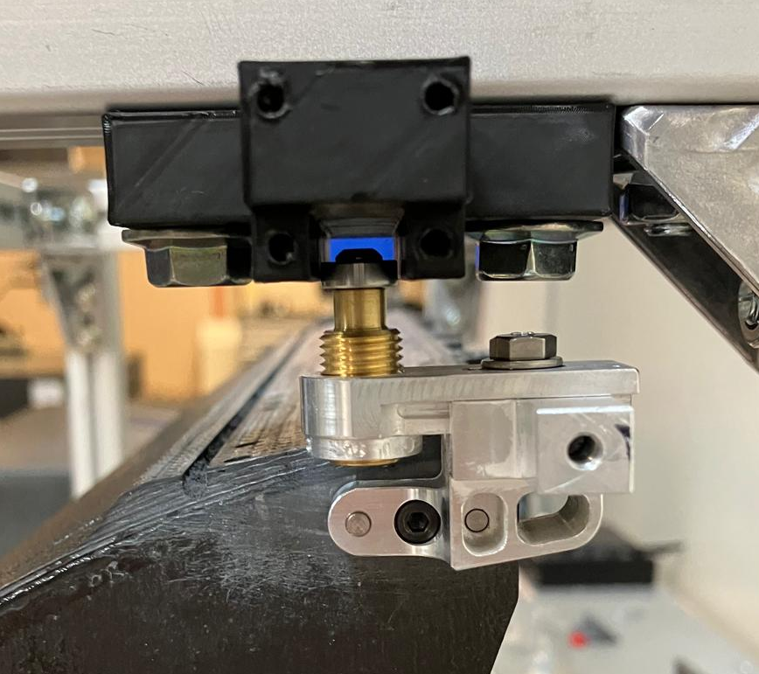
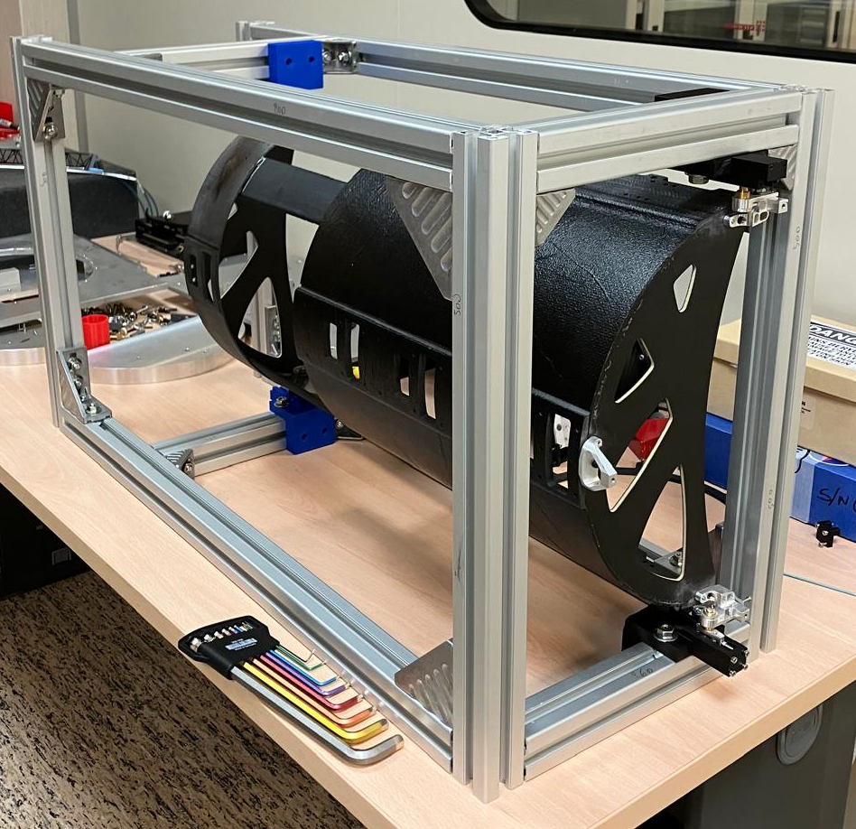
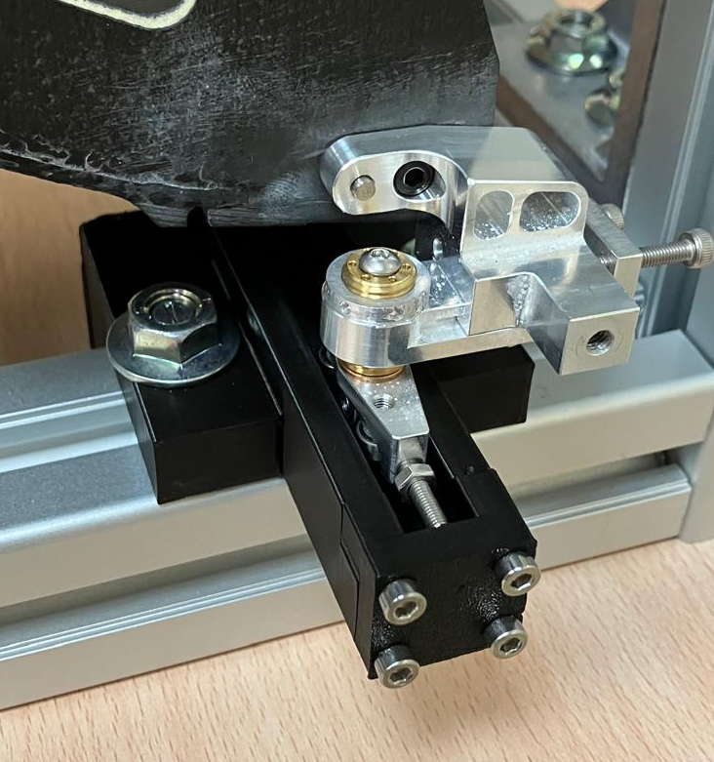
Future Test in Pisa setup and procedure
Y regulation
Test in Pisa mounting schedule
Rail alignment
Define a reference system from one rail, which is going to be a global reference system, and align the other 3 rails to it
TFPX alignment
Align TFPX to the global reference system
TBPX alignment
Align TBPX to the global reference system
Service cylinder
y
Y regulation
x
z
X regulation
Rails
Z stopper

Slide 14
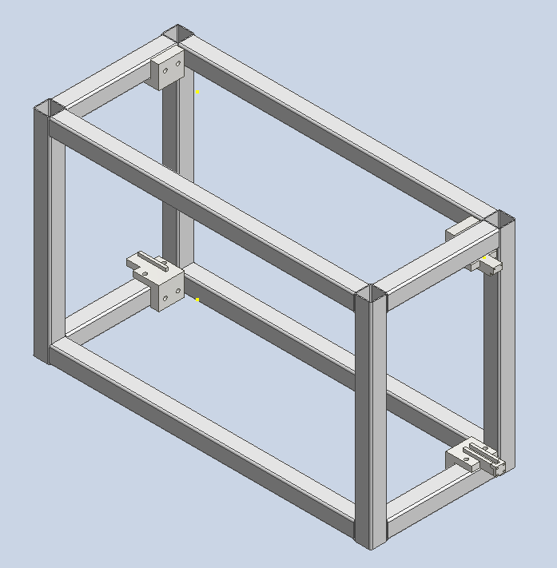
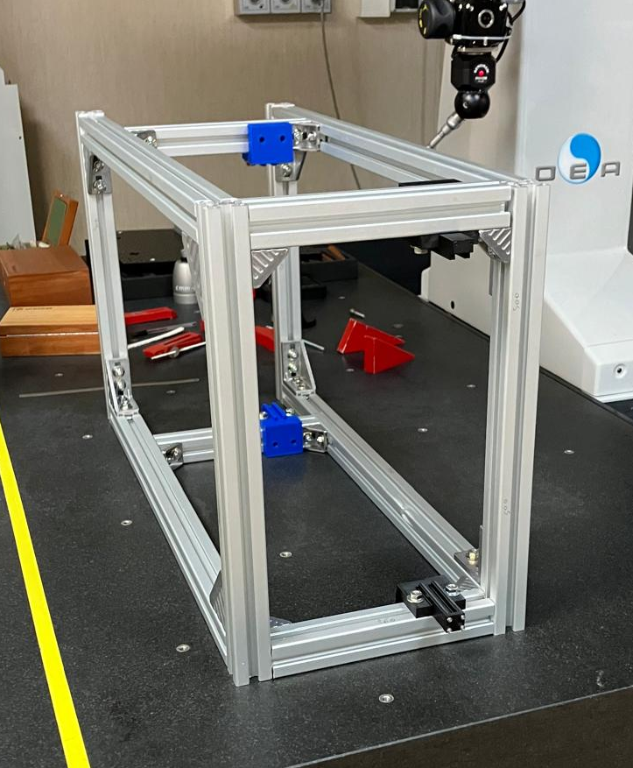
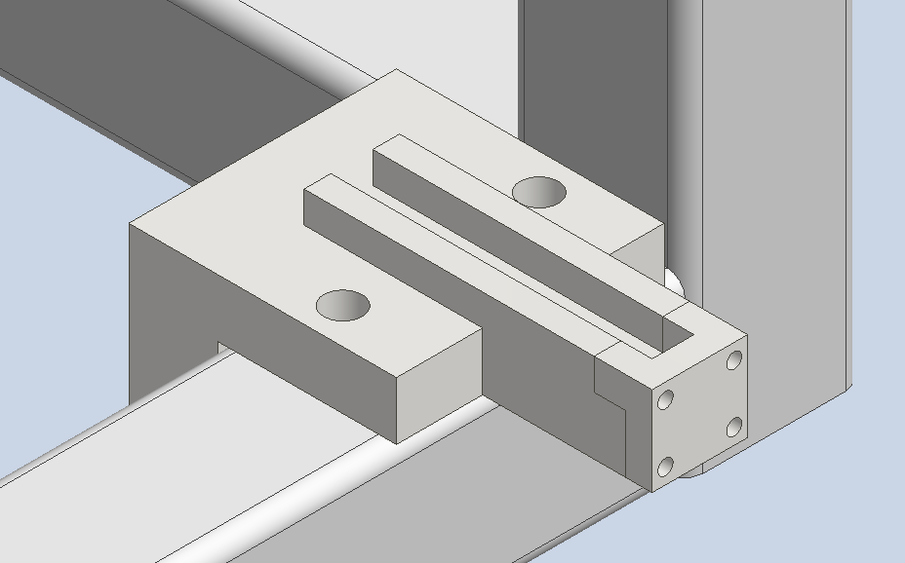
Rails pre alignment
Reference system definition:
Y plane offset by 197 mm from Y’ plane
Z direction given by the bottom right edge
Align the other 3 rails with a 0.1 mm precision
Y’ plane
y
x
z
z

Slide 15
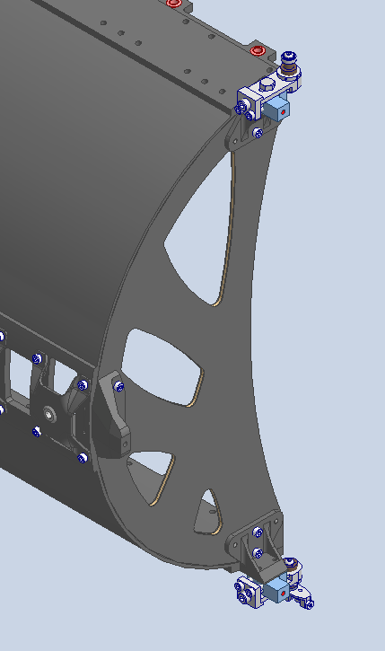
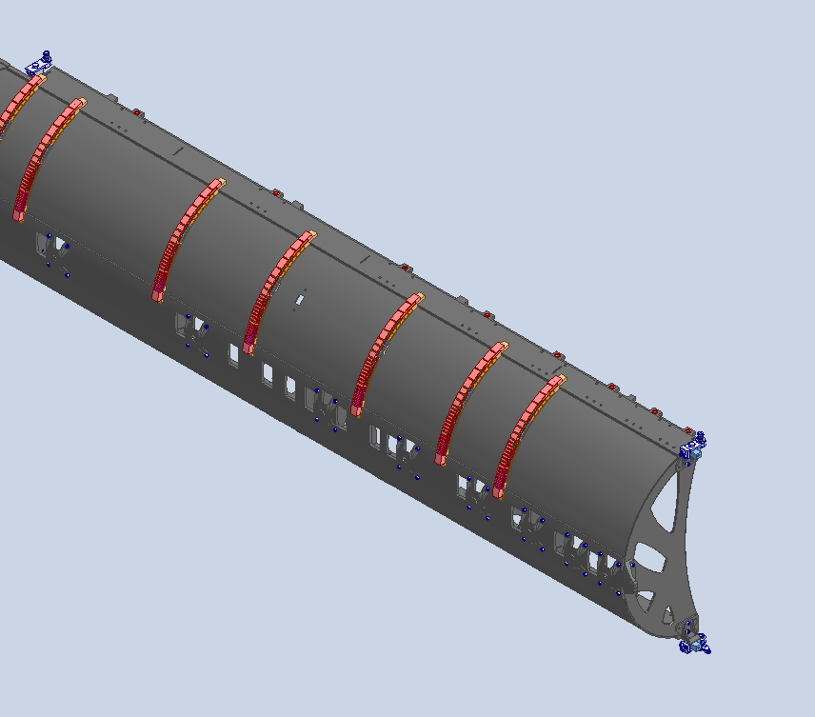
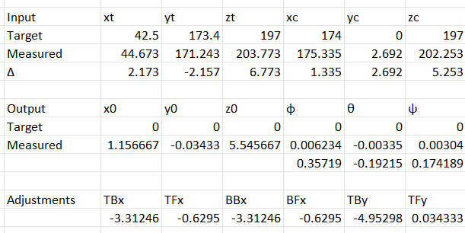


TFPX posture estimation and regulation
TFPX posture estimation
TFPX regulation
By giving the position in x, y and z of the three reference blocks it tells you:
- Center misalignment
- φ, θ, ψ
It tells you how to regulate the wheels in x and y, and the stopper in z to compensate misalignments and rotations
$$TBx=−x0+L∙θ+yT∙ψ$$
$$TFx=−x0+yT∙ψ$$
$$BBx=−x0−L∙θ+yB∙ψ$$
$$BFx=−x0−yB∙ψ$$
$$BBy=−y0−L∙φ$$
$$BFy=−y0$$
$$BFz=−z0−yT∙θ$$
T
TBx
$$x0=\frac{xT+xC+xB}{3}$$
$$y0=\frac{yT+yC+yB}{3}$$
$$z0=\frac{zT+zC+zB}{3}$$
$$φ=\frac{zT−zB}{2L}$$
$$θ=\frac{zC−\frac{zT+zB}{2}}{xC−xT}$$
$$ψ=\frac{xT−xB−x0}{2∙yT}$$
BBy
y
φ
x
BBx
θ
ψ
C
z
y
φ
TFx
x
θ
BFy
B
ψ
z
BFx
BFz

Slide 16
Conclusion
The insertion test run in Purdue has been useful, for the first time ITST, TFPX and TBPX mockups were mounted and tested together. This test pointed out many criticalities to solve, procedure to define and correction to the designs.
The system was proved to be adjustable and precise. It has been proved the possibility to align with a center offset in case of necessity. Nevertheless, the alignment precision and assembly components needs to be improved to have more margin from collision
Some criticalities of the system were pointed out, making necessary:
- a precise pre-alignment of the connection reference blocks, to avoid to run out of the regulation
- a bigger regulation range, to better compensate misalignments
- rigid connection components, to reduce elastic deflections or cracks
- define the metrology system to the final alignment to freeze mounting criteria to improve the precision and reduce the amount of time needed
- tools and structures to lock TFPX while the adjustments are applied on TBPX
Further tests are foreseen in Pisa to improve TFPX and TBPX regulation, based on a trigonometry-based system to take the parts to the nominal position

