Slide 1
PU jacks mechanical simulations and tests proposals
Luca Piacentini (RTU)
29/09/2023

Slide 2
Outline
Material model proposal for static studies
Material model validation by simulating the compression test
Compression simulation with 4 piston, no jack (SPS).
Additional discussion topics
Future tasks and proposals

Slide 3
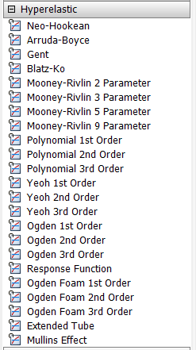
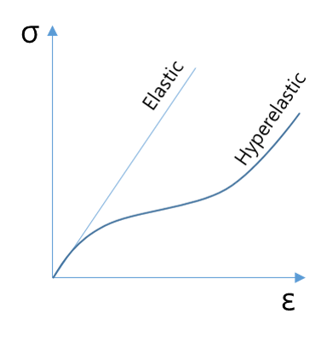
Material model proposal for static studies: hyperelastic model
Hyperelastic behaviour noted
Viscoelastic behaviour from previous load-unload tests
Stress-strain calculated curves from https://edms.cern.ch/document/2922835/1
Built in hyperelastic models on Ansys

Slide 4
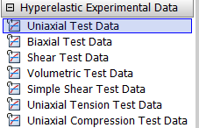
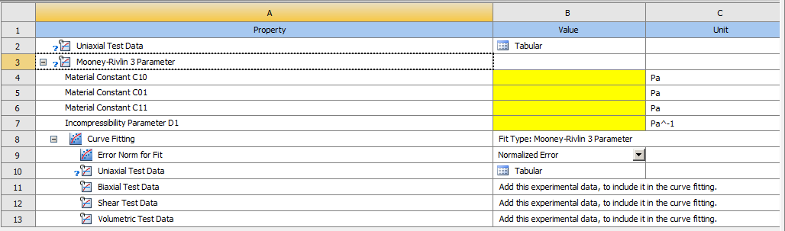
Material model proposal for static studies: hyperelastic model
Hyperelastic behaviour noted
Different proposed models from Ansys library
Ansys material definition workflow
  Import test data (true stress – true strain)
  Chose the fit model
  Fit the curve(s)
1
2
3

Slide 5


Material model proposal for static studies: hyperelastic model
https://edms.cern.ch/document/2922835/1
Hyperelastic behaviour noted
Different proposed models from Ansys library
Ansys material definition workflow
  Import test data (true stress – true strain)
  Chose the fit model
  Fit the curve(s)
Stress-strain curve calculation
  Assumed incompressibility (volume=constant)
  Assumed cylindric shape constant (no barreling)
$$ε=\ln{\frac{L_{i}}{L_{0}}}$$
$$σ=\frac{F}{S_{i}(d_{i})}$$
V0
$$d_{i}$$
V0

Slide 6
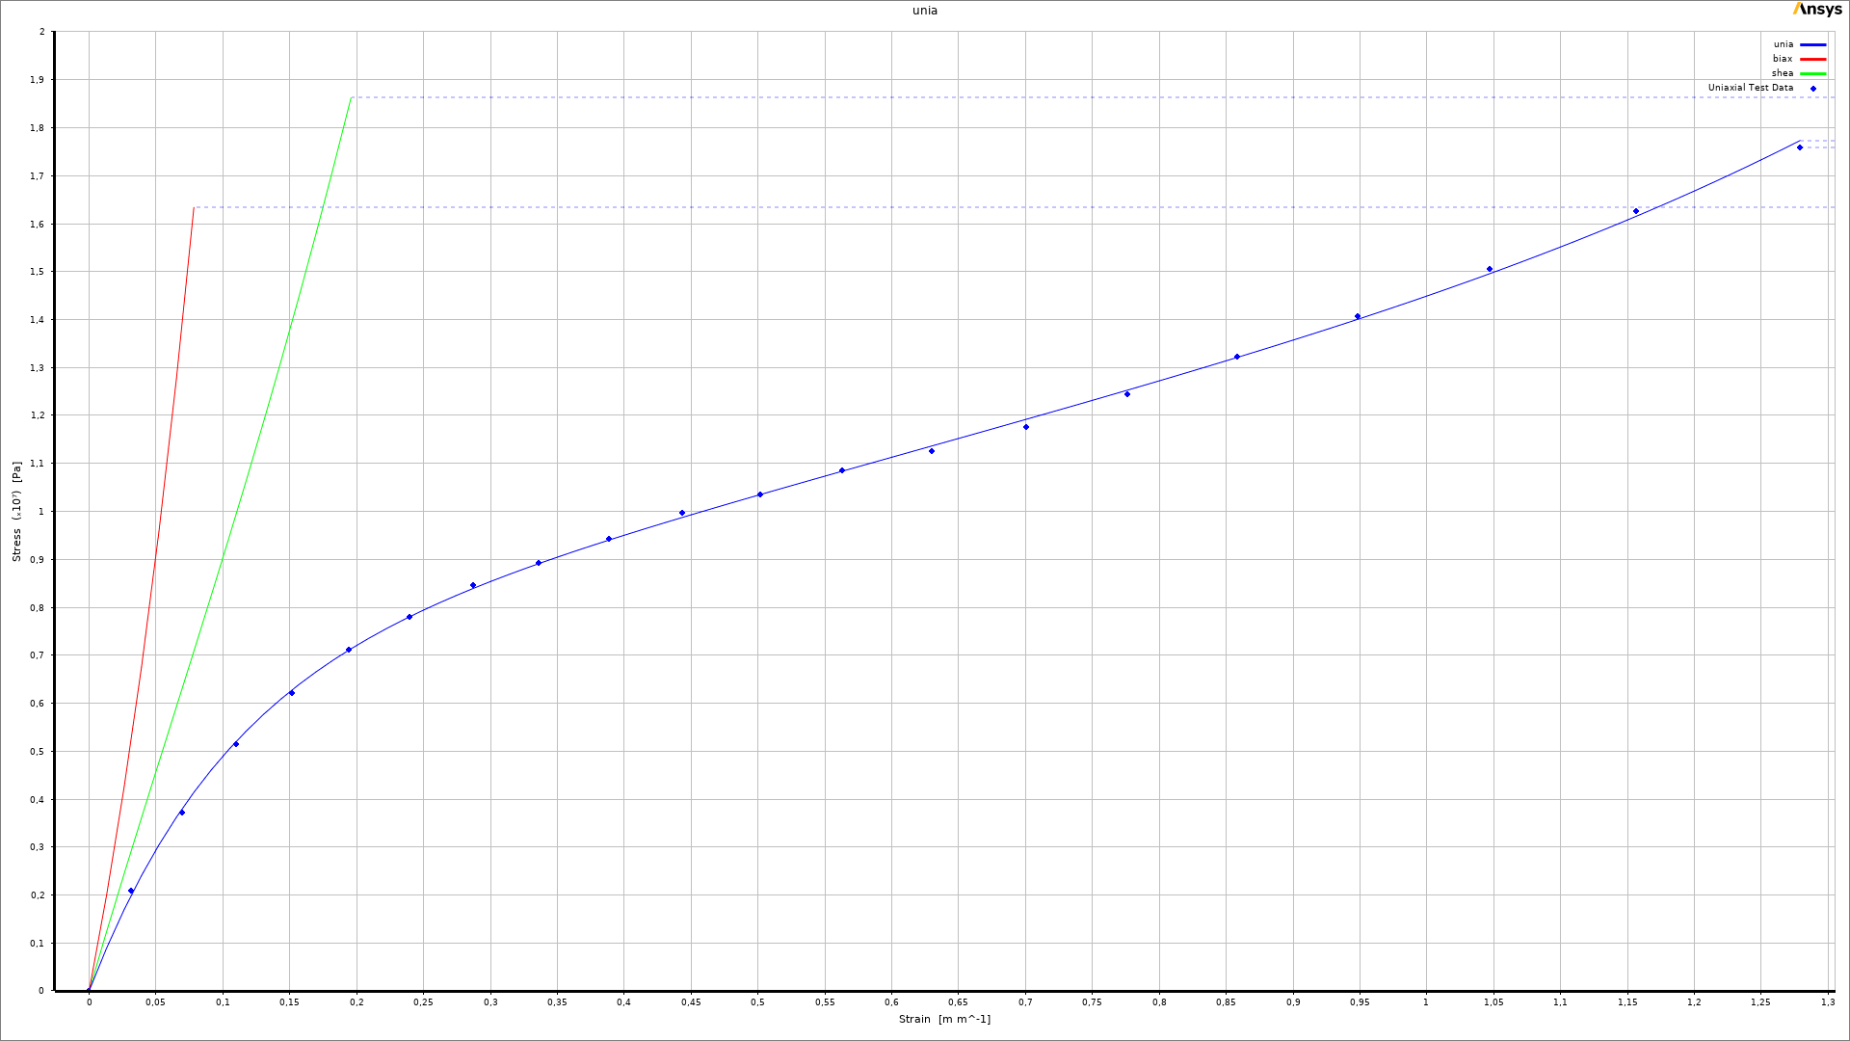
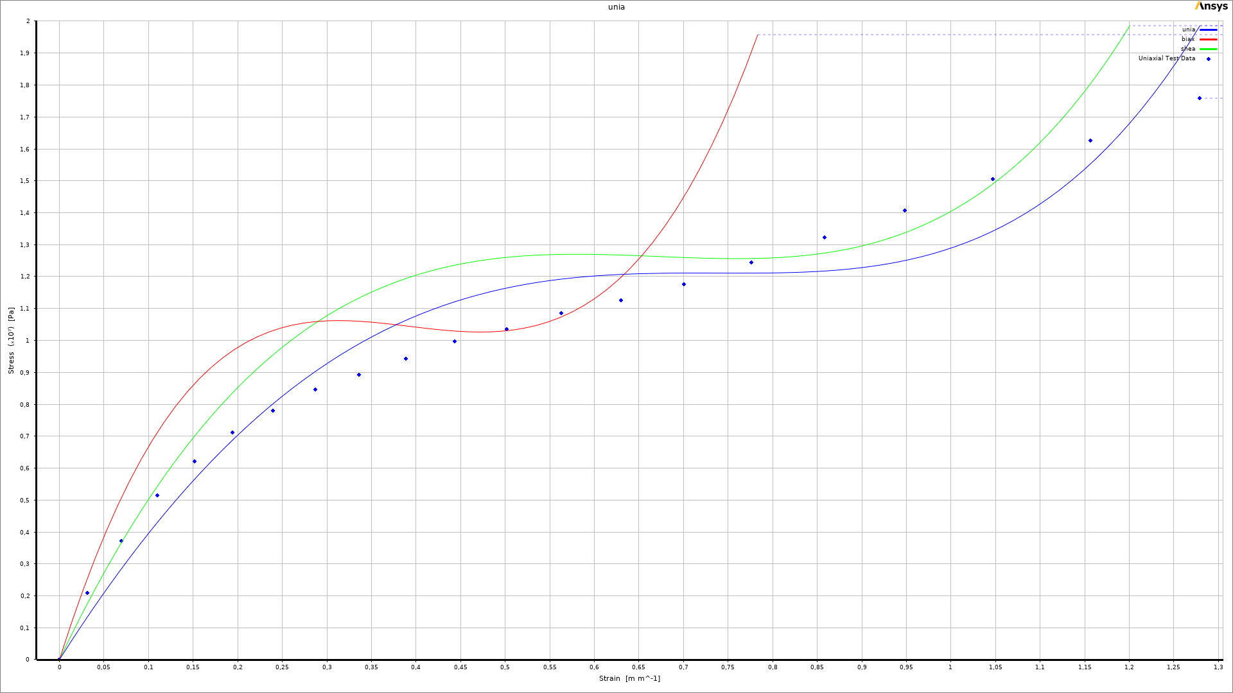
Material model proposal for static studies: hyperelastic model
Mooney Rivlin 9par
Hyperelastic behaviour noted
Different proposed models from Ansys library
Ansys material definition workflow
  Import test data (true stress – true strain)
  Chose the fit model
  Fit the curve(s)
Yeoh 3rd order
MR 9 better fit to uniaxial test data, but grows exponentially on biaxial and shear
Yeoh 3rd worse fit to uniaxial, does not explode for low strain

Slide 7
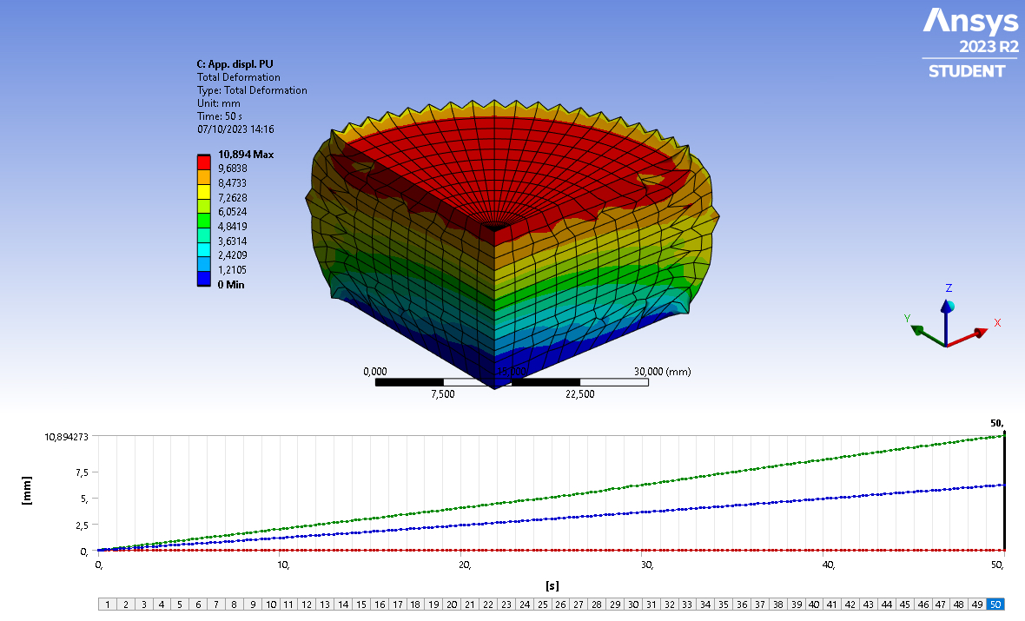
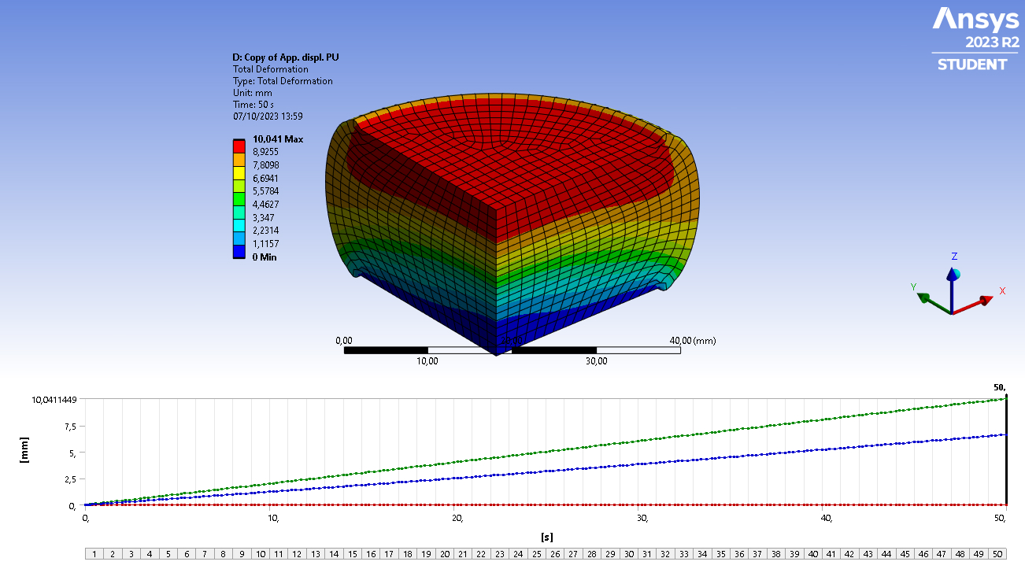
Material model validation by simulating the compression test
Simulate the compression test (hard barreling hypothesis)
Check the force displacement curve against the real tests
Mooney Rivlin 9par fails to converge when refining mesh, different measures tried, no results + high element distortion
Yeoh 3rd order: solution converges with finer mesh, the elements seem to behave better

Slide 8
Material model validation by simulating the compression test
Simulate the compression test (hard barreling hypothesis)
Check the force displacement curve against the real tests

Slide 9
Material model validation by simulating the compression test
Simulate the compression test (hard barreling hypothesis)
Check the force displacement curve against the real tests
Max vertical displacement 10 mm (2 pads, ±5 mm each)

Slide 10
Compression simulation ShA 90 with 4 piston, no jack (SPS)

Slide 11
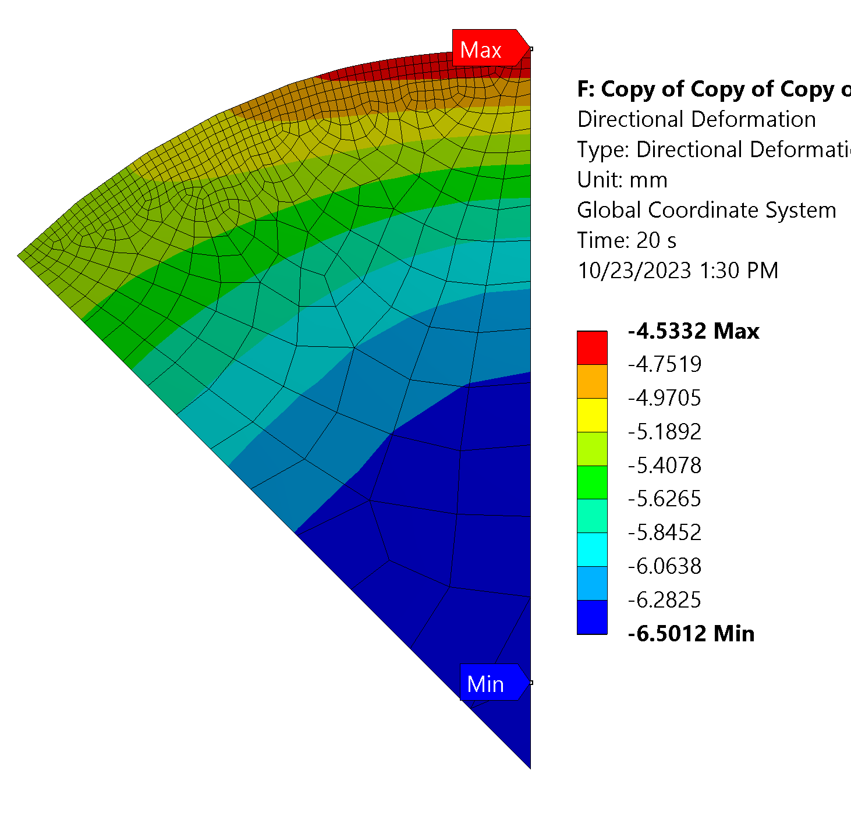
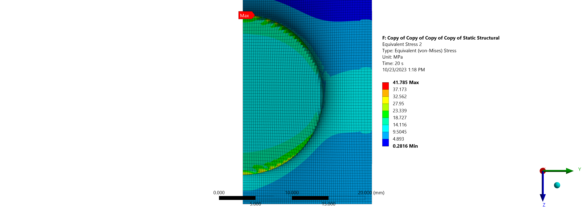
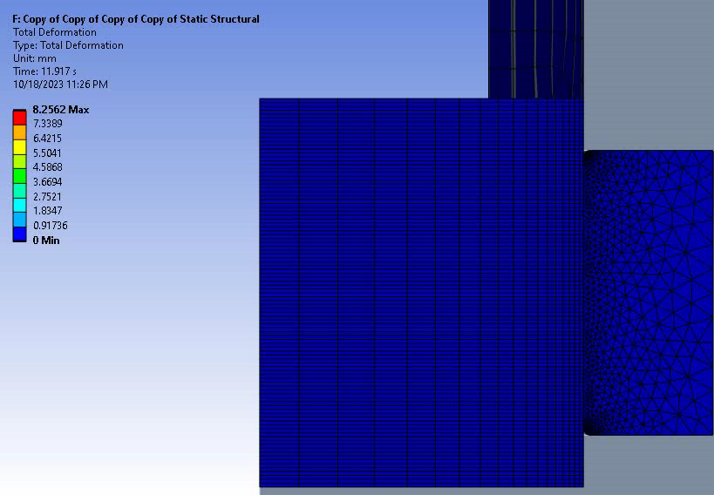
Compression simulation ShA 90 with 4 piston, no jack (SPS)
No jack influence, ShA 90 PU pad, 1/8 symmetry.
Max vertical displacement on upper face 6.5 mm (Average: 5.16 mm ½ of real case ± 10 mm)
Max Von-Mises stress 41.8 MPa, average: 8.3 MPa, SIF: 5 (lower bound due to mesh quality)

Slide 12
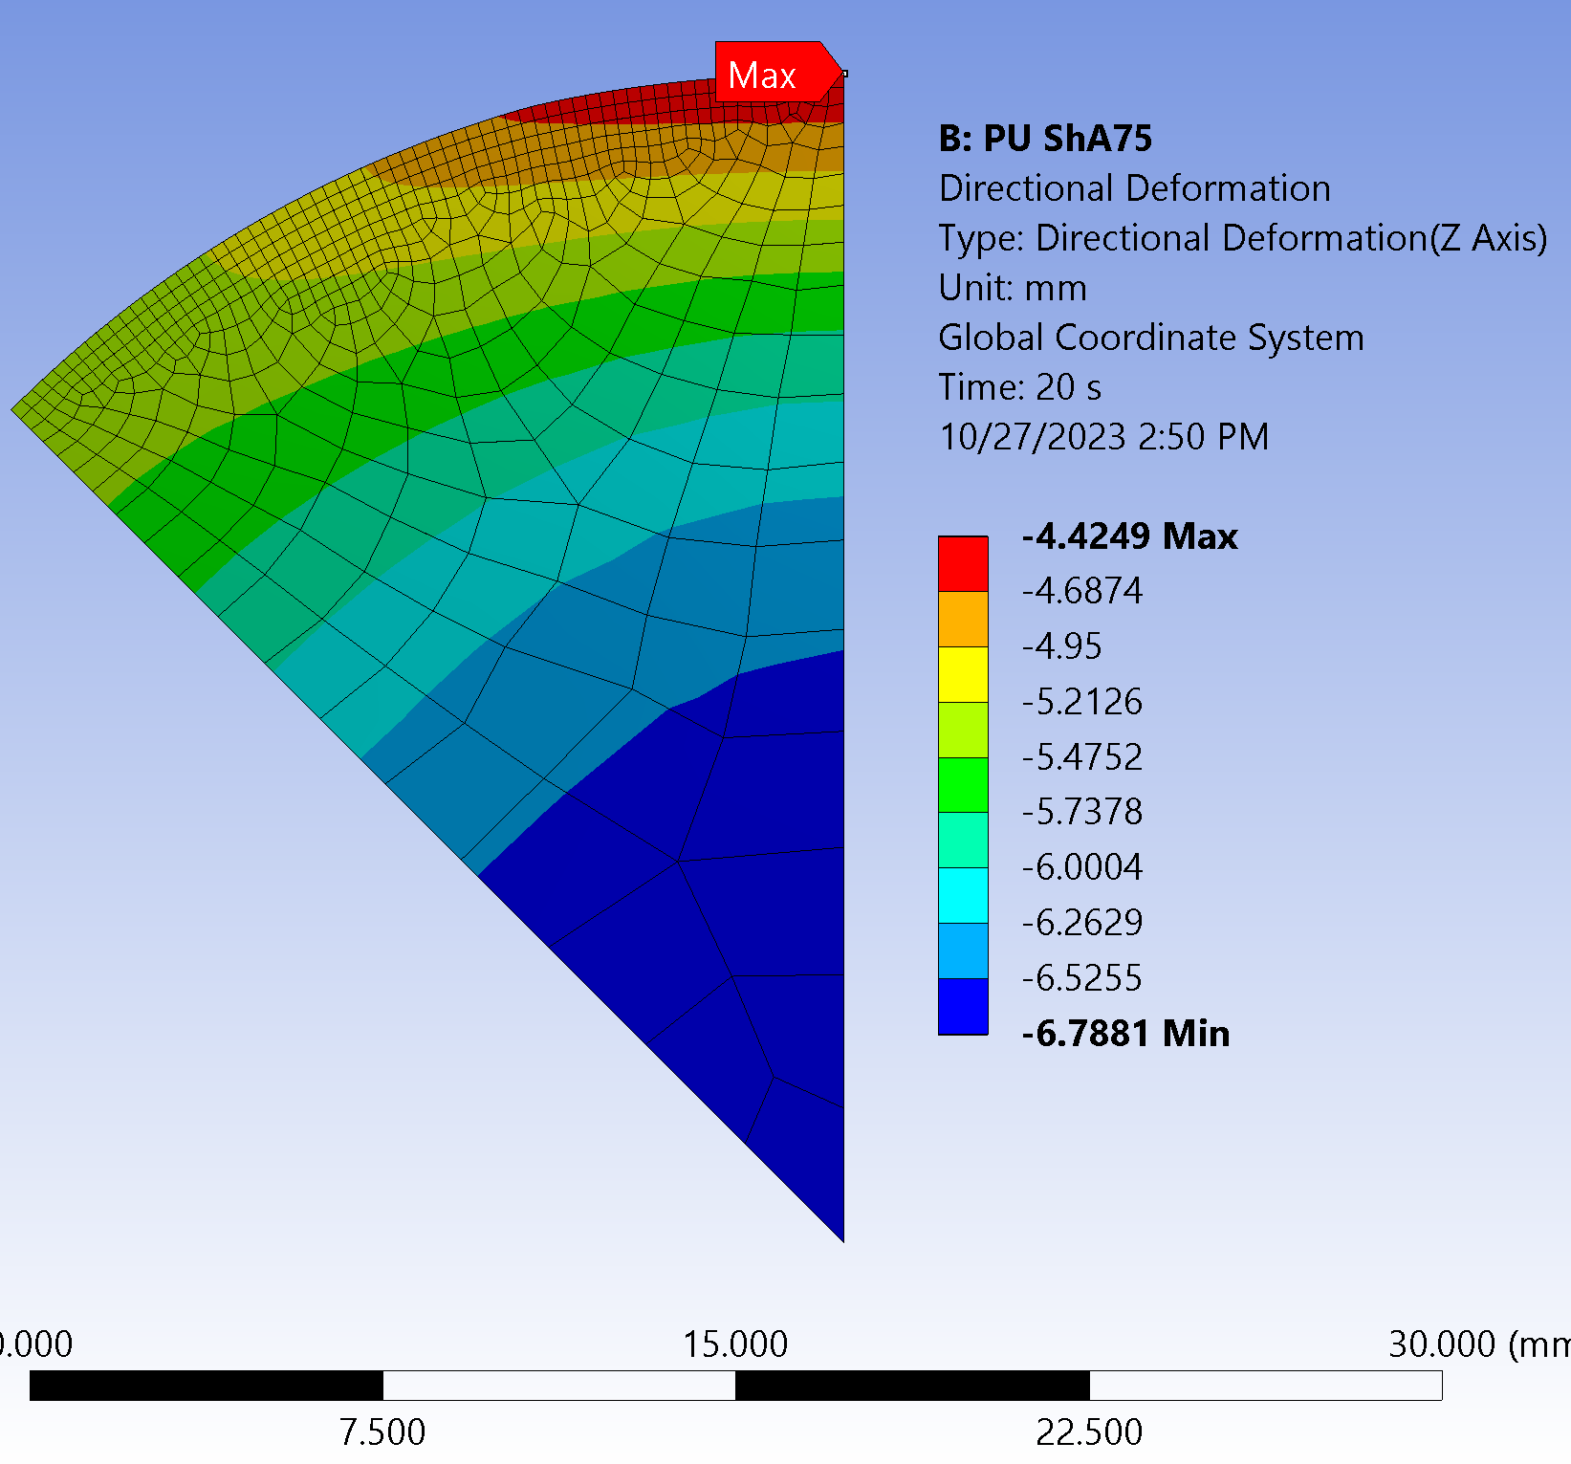
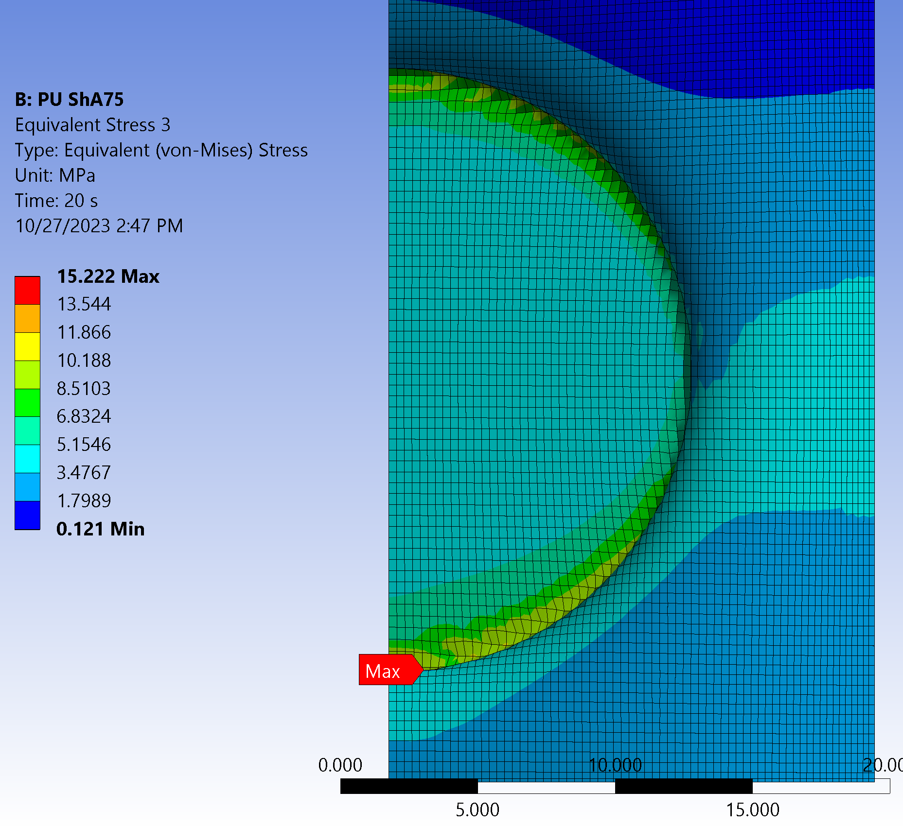
Compression simulation ShA 75 with 4 piston, no jack (SPS)
No jack influence, ShA 75 PU pad, 1/8 symmetry.
Max vertical displacement on upper face 6.7 mm (Average: 5.17 mm ½ of real case ± 10 mm)
Max Von-Mises stress 15.2 MPa, average: 3.2 MPa, SIF: 5 (lower bound due to mesh quality)

Slide 13

Additional discussion topics
Phases of PU jack alignment:
  Pre-squeeze/load/V alignment/H alignment
  Pre-squeeze/load/H alignment/V alignment
  Load/V alignment/H alignment
  Load/H alignment/V alignemnt
Stress requirement:
  Average & peak VM
  Average & $σ_{I}$, $σ_{III}$

Slide 14
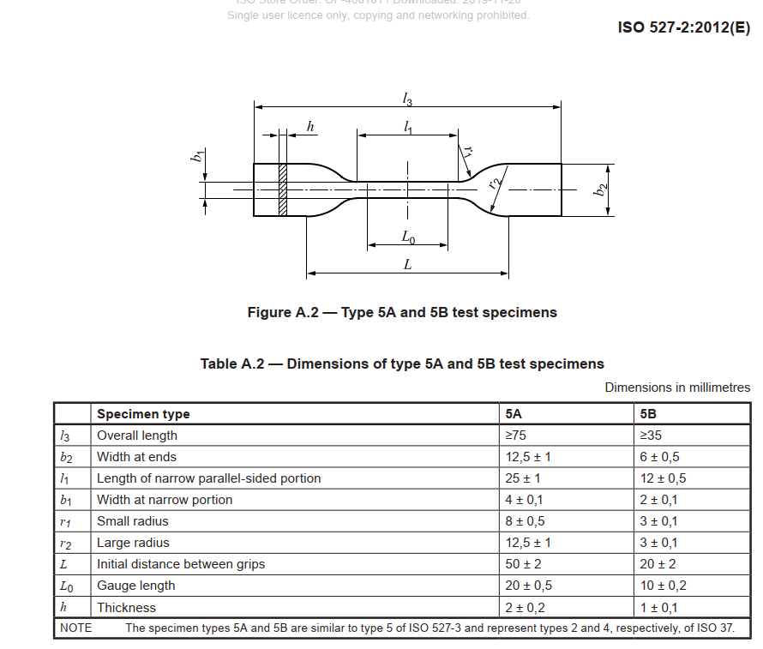
Future tasks and proposals
Tasks:
Increase the imposed deformation to meet application range
Add the effect of a loaded flat piston in SPS (WIP)
Add the effect of a loaded inclined piston in SPS
Analyse the LHC study case
Proposals to further tune the material model:
Tension test on subsize specimens
with extensometer,
(cut from pads, 10/15 axial & orthogonal)
possibility of DIC. M. Crouvizier
New compression test on pads with DIC
(10?)
Shear (long term)
Bi-axial (long term)

Slide 15
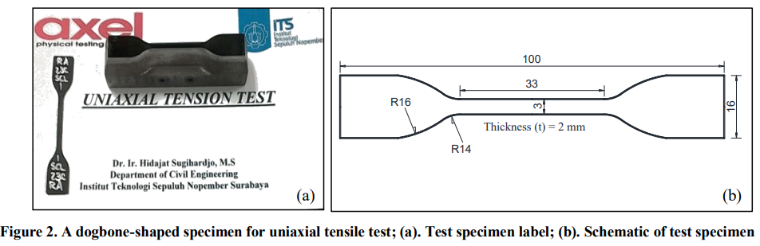
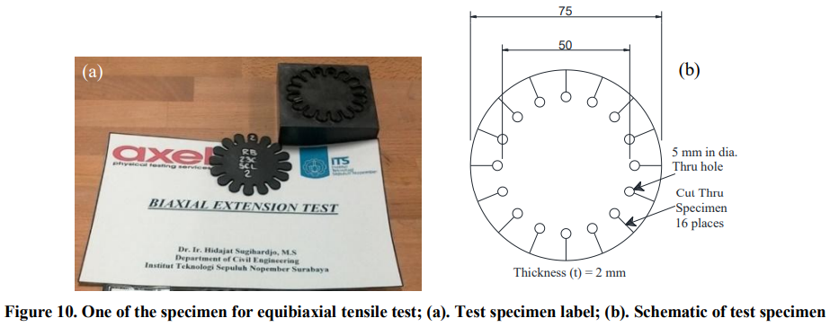
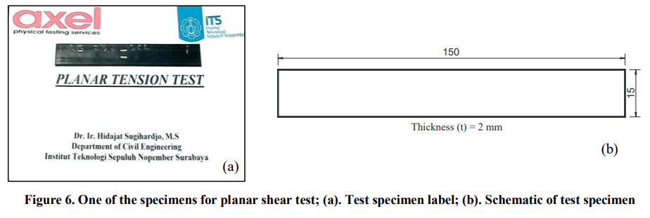
Test samples geometry
https://doi.org/10.28991/cej-030966

