Slide 1




Everything you needed to know, didn’t know you needed to know, and don’t need to know about Upgrade I
Dr. David Friday

Slide 2
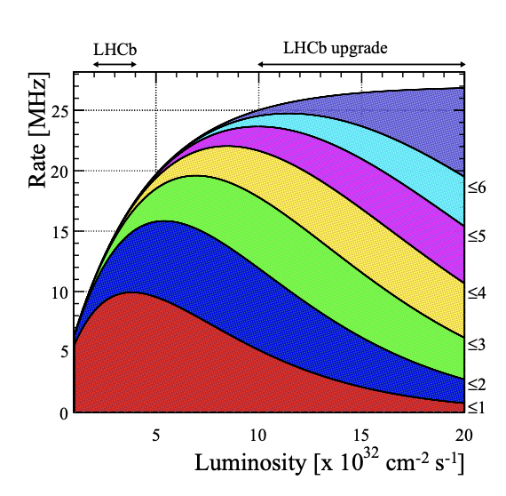
The Challenge of Run 3 (Short version)
The luminosity increase alone will (and is) pushing the Rate up significantly in LHCb.
The number of interactions per event also increases significantly so there is much more pileup.
There is also a large increase in the radiation!

Slide 3
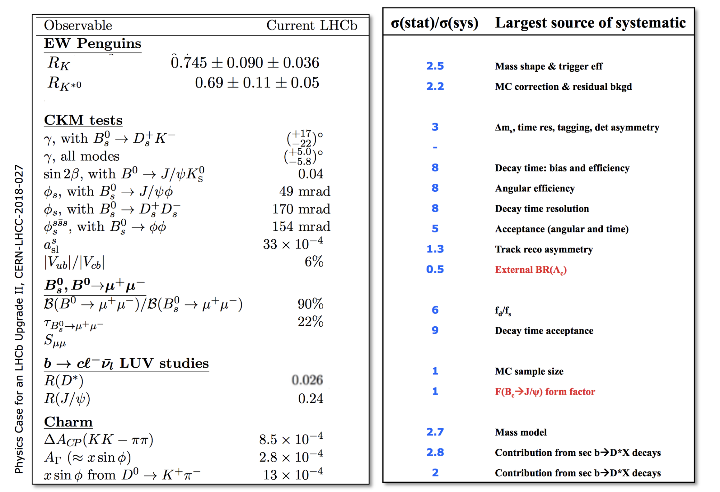
But why do it?

Slide 4
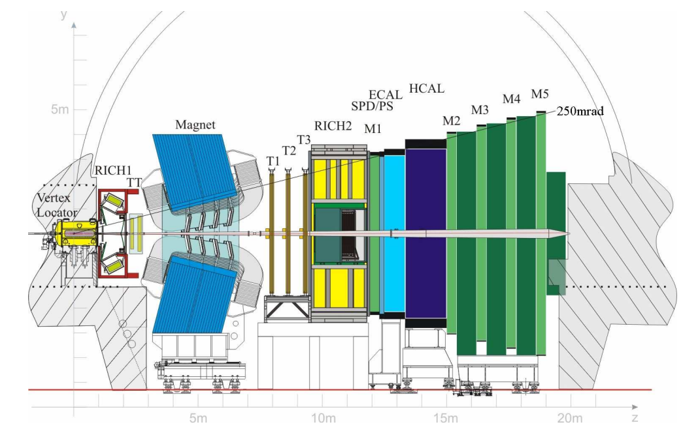
Where we started?
Single-arm spectrometer in the forward region to study beauty and charm

Slide 5
Where we started?
Strip based vertex detector

Slide 6
Where we started?
Silicon tracking system TT upstream and T1-T3 downstream

Slide 7
Where we started?
Ring Imaging Cherenkov System

Slide 8
Where we started?
Lots of Calo!

Slide 9
Where we started?
A muon system including M1 located just before the ECAL

Slide 10
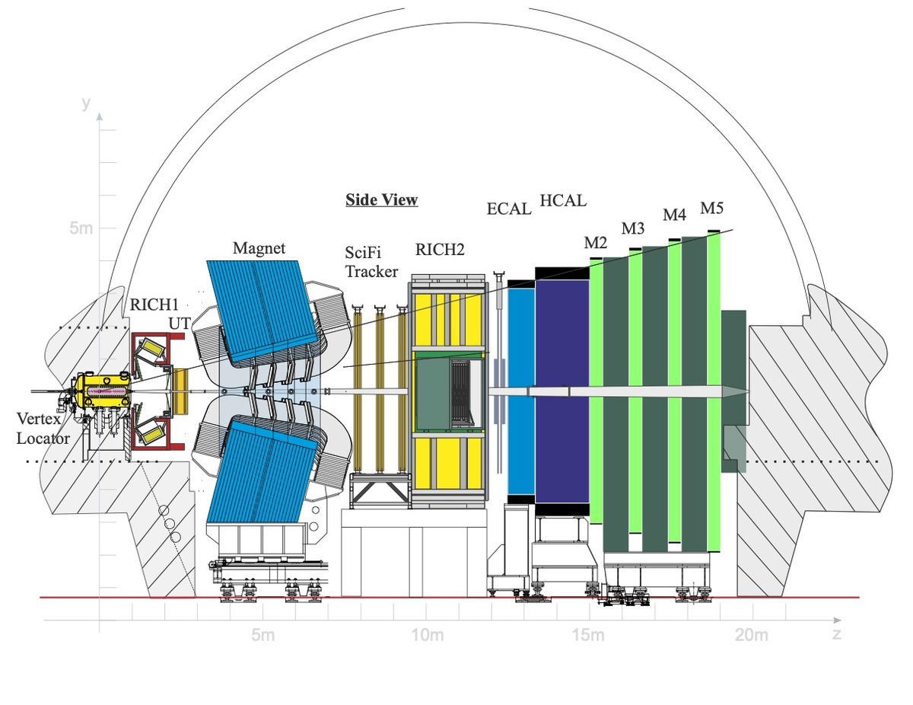
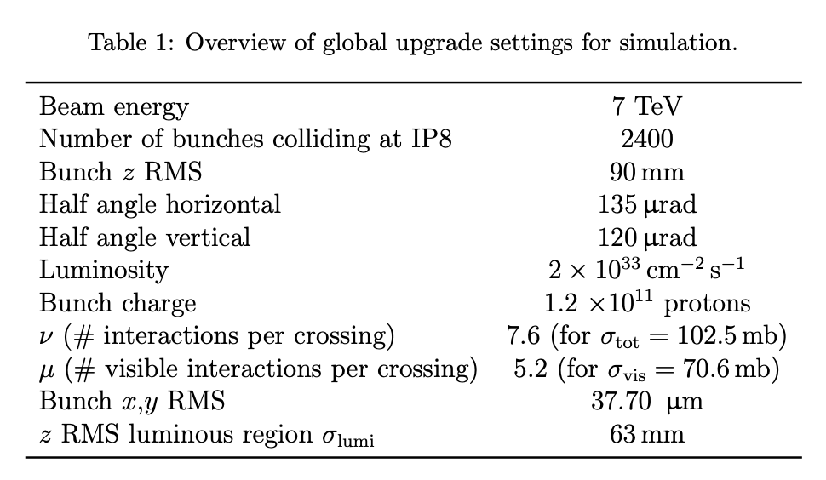
Upgrade 1
“And that's what I've done. Maintained it for 20 years. This old brooms had 17 new heads and 14 new handles in its time.”
640000

Slide 11
Upgrade 1
New Pixel Based Vertex Detector
640000

Slide 12
Upgrade 1
Upgraded Silicon Tracker
640000

Slide 13
Upgrade 1
Updated Rich PMTs and Electronics
640000

Slide 14
Upgrade 1
Removed SPD/PS and Upgraded Calo
640000

Slide 15
Upgrade 1
Removal of station M1 and upgraded FE Electronics
640000

Slide 16
Upgrade 1
L0 is gone, Only Software triggers now!
640000

Slide 17
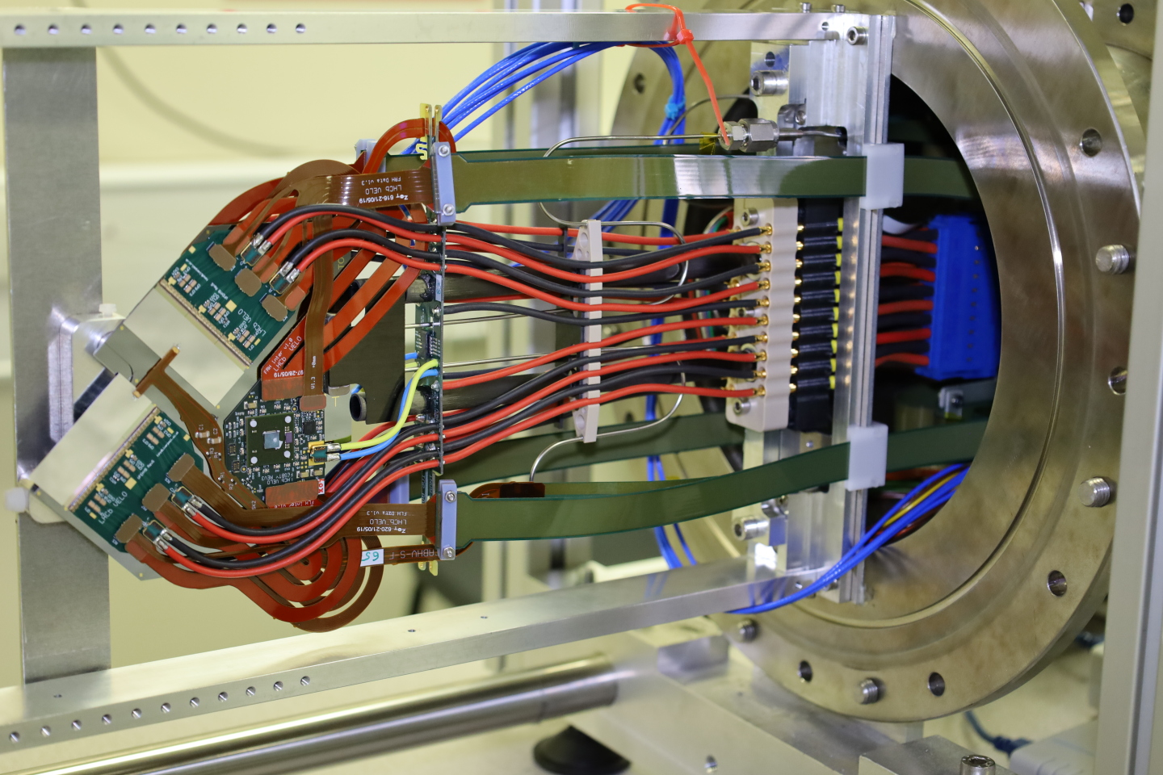
What is the VELO?
The VELO (VErtex LOcator) is a hybrid pixel detector designed to cover the forward region of the pp interaction point.
Novel features include (but are not limited to)
  Improved radiation tolerance!
  Microchannel cooling!
  Digital readout!
  Superpixels!

Slide 18
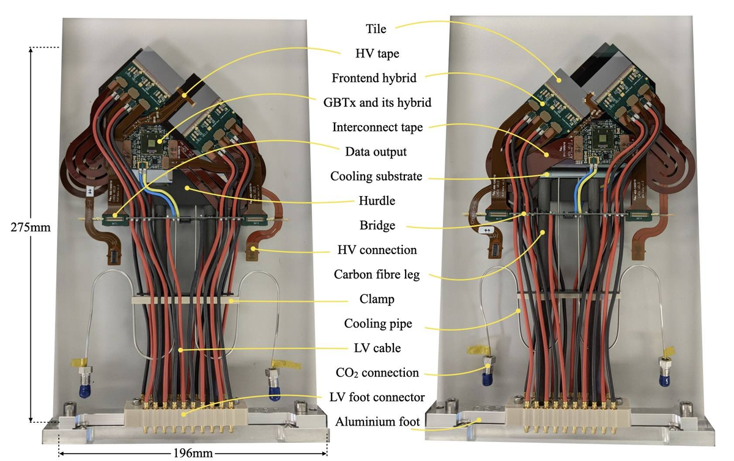
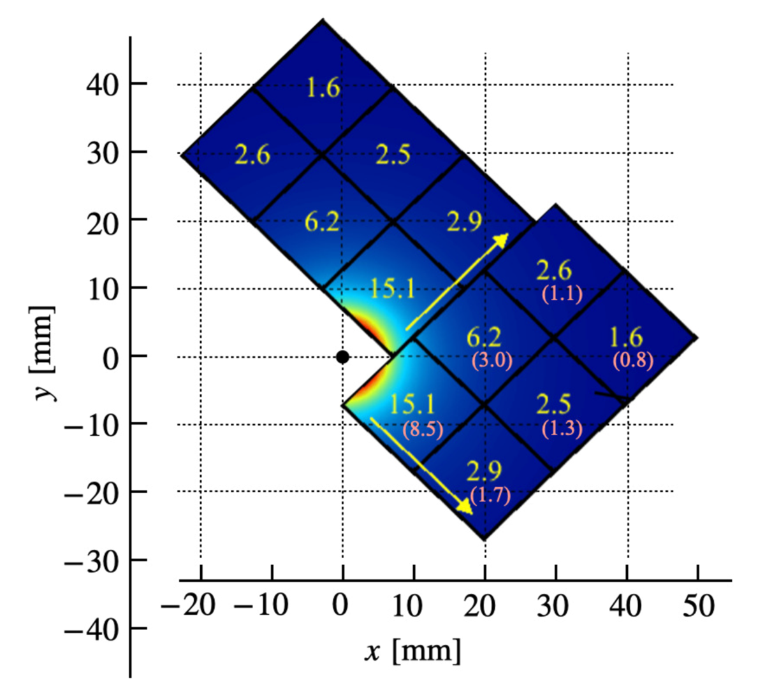
Anatomy of the VELO (small picture)

Slide 19
Anatomy of the VELO (small picture)

Slide 20
Anatomy of the VELO (small picture)

Slide 21
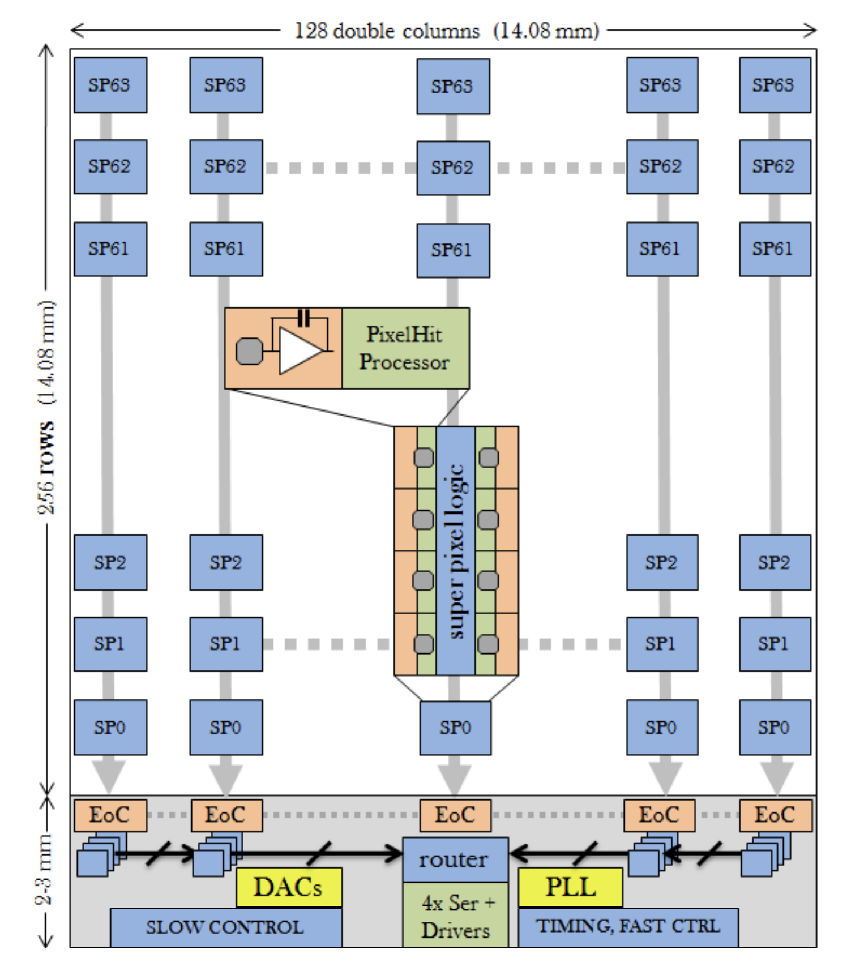
Superpixel Monitoring
Each 256 x 256 pixel array contains 64 x 128 Superpixels. This groups pixels in 2 x 4 grids.
Superpixels are read out in column form, takes 64 clock cycles to fully read out.
Superpixel packets are only 23 bits.
30% reduction in data volume.

Slide 22
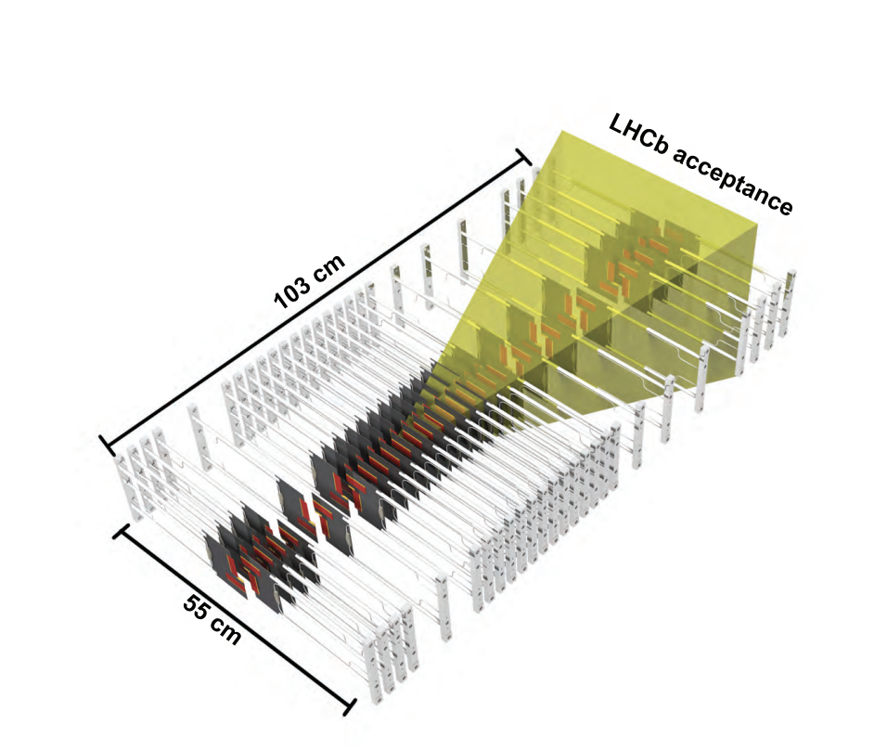
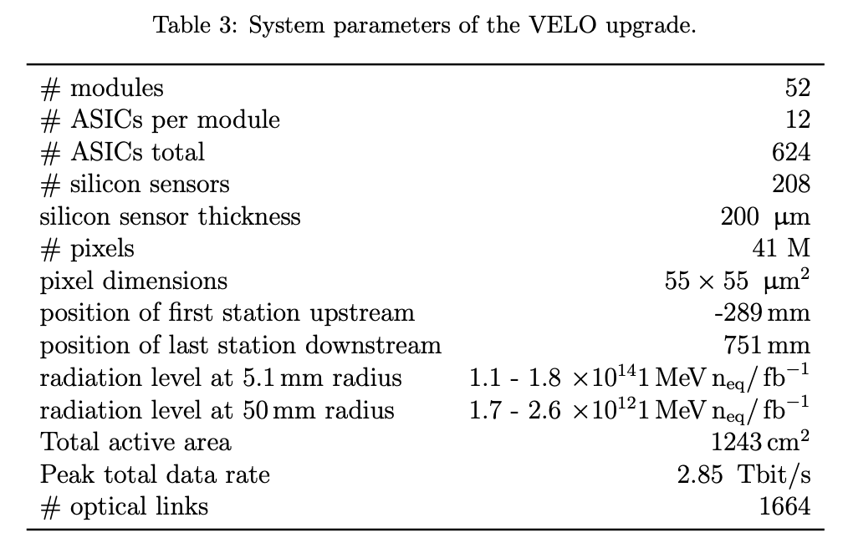
Anatomy of the VELO (big picture)

Slide 23

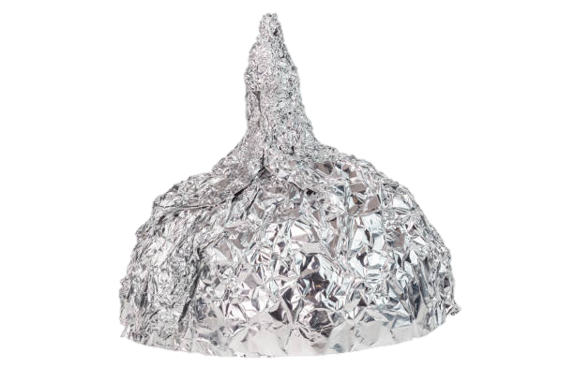
What issue faced the VELO?

Slide 24
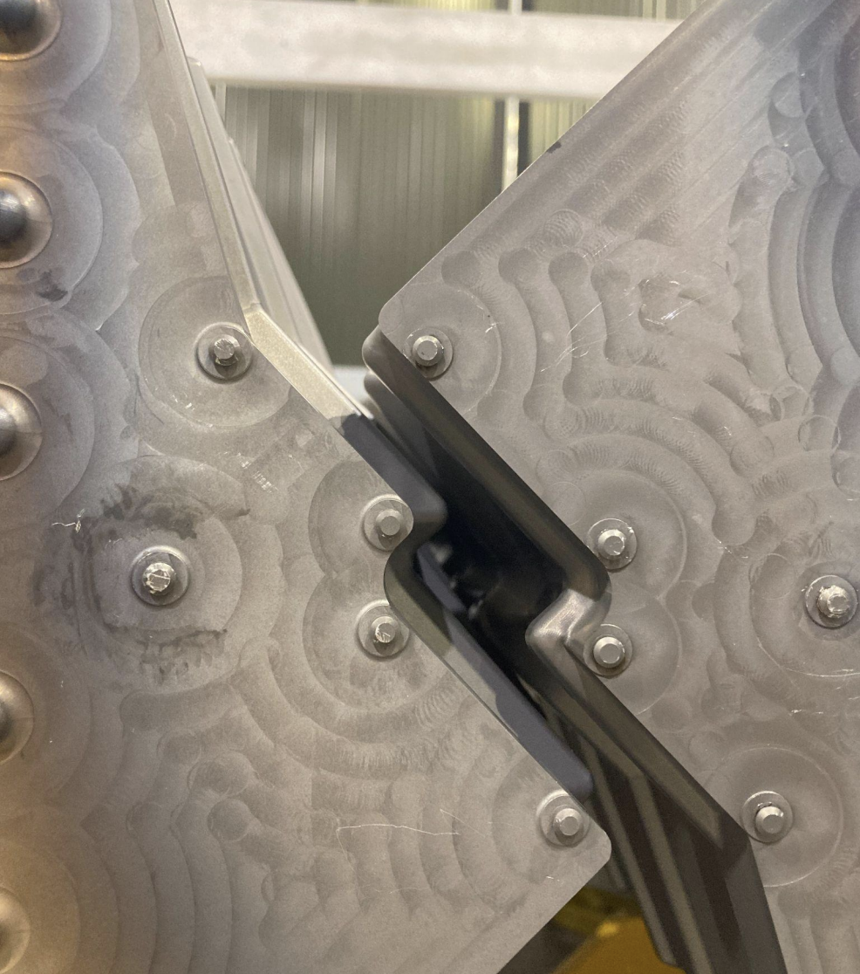
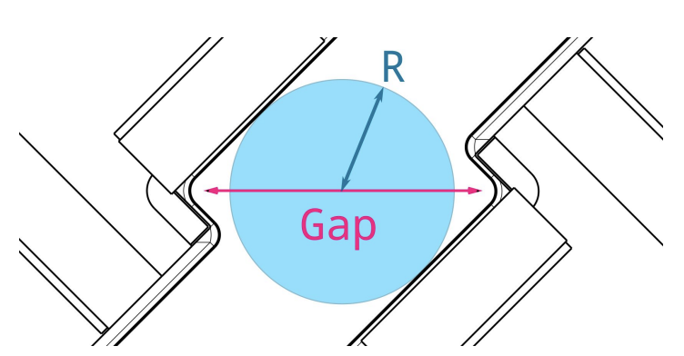
What issue faced the VELO?
Due to a vacuum incident (Just a small 200 mbar differential) the RF Foil (right) was heavily deformed reducing our closure.
However, after inspection, it appears the motion system and front end electronics were unaffected.
We maintained a closure of 49mm (Gap) 10.5mm (Radius).

Slide 25

What issue faced the VELO?
Old foil has been removed using precision tools and YETS activities progressing well!
Only 2 open questions?
How has the opening effected the Ion data?
How smoothly will commissioning the motion system go?

Slide 26
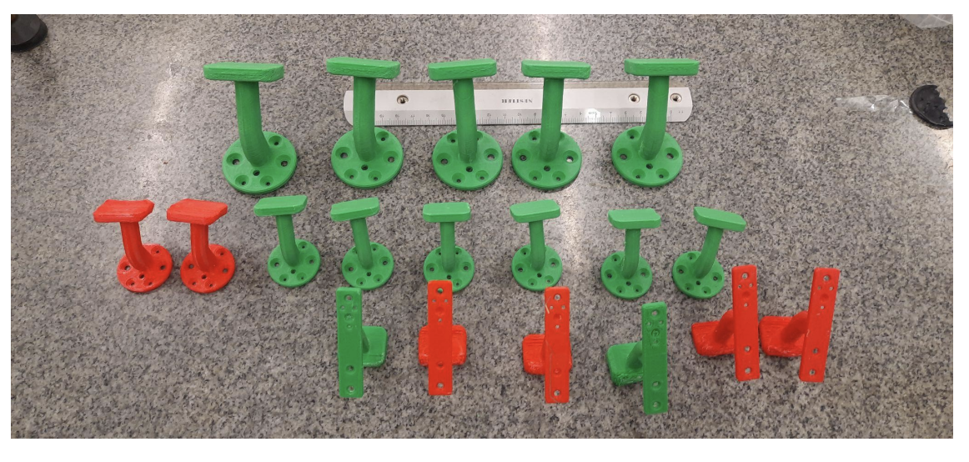
What issue faced the VELO?
Old foil has been removed using precision tools and YETS activities progressing well!
Only 2 open questions?
How has the opening effected the Ion data?
How smoothly will commissioning the motion system go?
Huge effort from the VELO team!

Slide 27
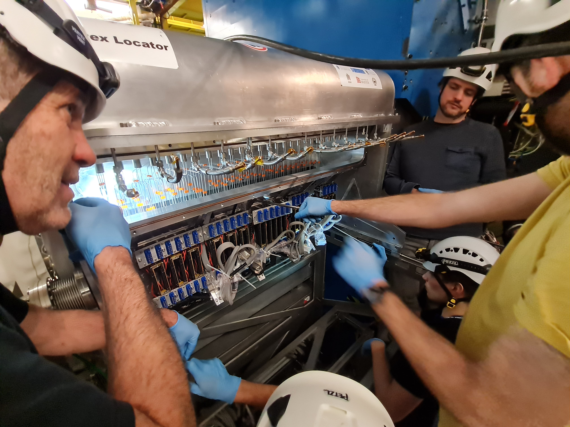
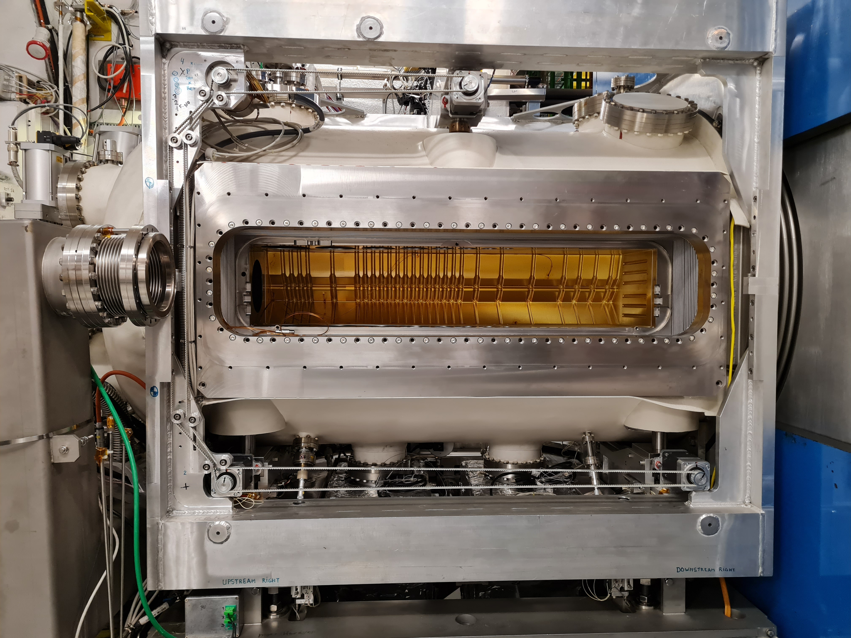
How well?

Slide 28
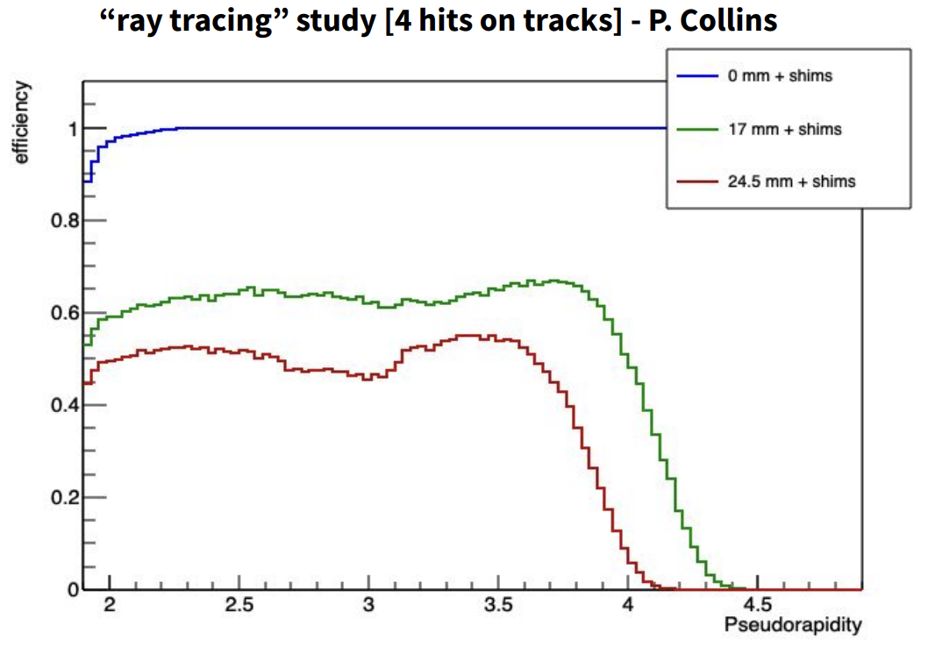
What are the current issues facing the VELO?
Old foil has been removed using precision tools and YETS activities progressing well
Only 2 open questions?
How has the opening affected the Ion data?
How smoothly will commissioning the motion system go?

Slide 29

The UT
The UT is a core part of the LHCb physics case being required to constrain important decays such as $K_{s}^{0}→ππ$ that decay beyond the VELO acceptance.
Depending on channel up to 73% of these decays are completely constrained by the UT and later trackers.
The UT also boosts the momentum resolution significantly!
Finally, the UT deals very well with spooky ghost tracks!
Notes:
Most of the events, 73%, are reconstructed from decays downstream of the VELO using the TT and the downstream tracker. Adding TT hits to tracks also significantly improves the momentum resolution. Figure 2.3 (left) shows the invariant mass of di-muon pairs in the Υ mass region. The resolution is significantly improved, by ∼25%, if the tracks have TT hits as shown in Fig. 2.3 (right).

Slide 30

The UT
The UT is a core part of the LHCb physics case being required to constrain important decays such as $K_{s}^{0}→ππ$ that decay beyond the VELO acceptance.
Depending on channel up to 73% of these decays are completely constrained by the UT and later trackers.
The UT also boosts the momentum resolution significantly!
Finally, the UT deals very well with spooky ghost tracks!
Notes:
Most of the events, 73%, are reconstructed from decays downstream of the VELO using the TT and the downstream tracker. Adding TT hits to tracks also significantly improves the momentum resolution. Figure 2.3 (left) shows the invariant mass of di-muon pairs in the Υ mass region. The resolution is significantly improved, by ∼25%, if the tracks have TT hits as shown in Fig. 2.3 (right).

Slide 31
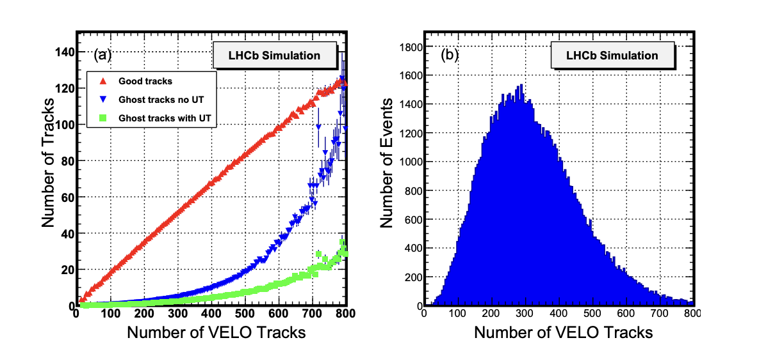
The UT
Notes:
Figure 2.4 shows a simulation, using the upgrade geometry, of the number of good tracks, and ghost tracks both with and without the UT match requirement as a function of the number of VELO tracks. Here we require that hits in at least three out of four stations match the reconstructed track projections in the UT. Then for ∼240 VELO tracks, the average multiplicity expected at a luminosity of 2 × 1033cm−2 s −1 , the ghost rate is reduced by about a factor of three. This reduction is important in speeding up trigger timings as well as for reducing backgrounds in all physics analyses.

Slide 32
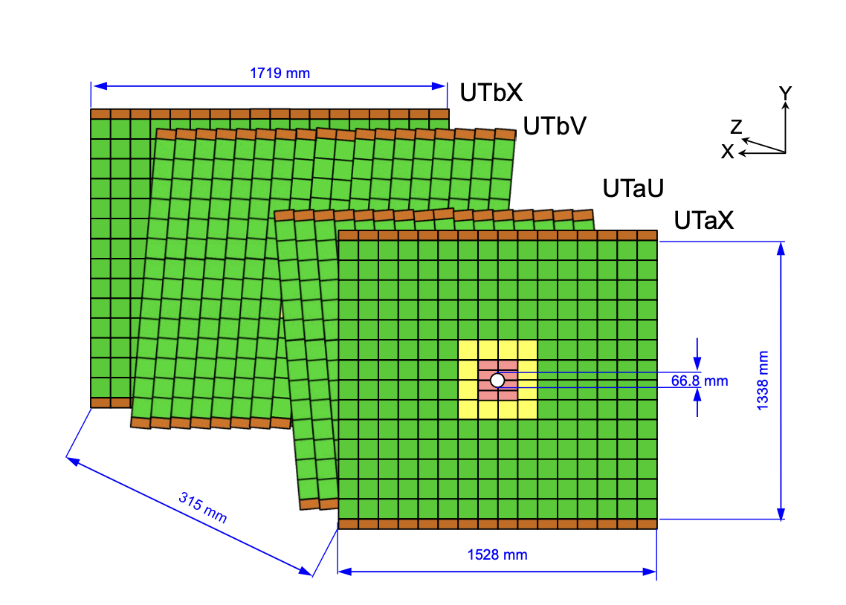
The UT – Construction
Four-layer silicon strip detector
  Finer granularity than TT, innermost sensors closer to beam pipe
  Inner layers tilted by a stereo angle (±5%)
  Four different types of sensors
  Mounted to lightweight staves (10 cm wide, 1.6 m long)
  Novel readout chip (SALT ASIC)
Notes:
The tilt is designed to increase the acceptance along with the finer resolution. called SALT (Silicon ASIC for LHCb Tracker), which is being developed by the AGH-UST Krakow LHCb 32 Figure 2.19: The SALT ASIC block diagram. group. There are a number of technological challenges related to the design arising from the required performance and harsh environment of the 14 TeV pp collisions. The SALT ASIC will read out 128 channels and will be manufactured in IBM CMOS 130 nm technology. The ASIC main blocks are shown in Fig. 2.19. Each channel comprises an analogue block with a charge sensitive preamplifier, a shaper and a single-ended to differential converter. The differential analogue signal is then sent to an Analogue to Digital Converter (ADC) implemented as a 6-bit fully differential Successive Approximation Register (SAR). The digitised data is then fed to the digital signal processing block (DSP), which performs pedestal subtraction, mean common mode subtraction and zero suppression. After the DSP the data, with added header information, are placed into a de-randomising buffer [28] and transmitted to the consecutive parts of the read out system using serial links

Slide 33
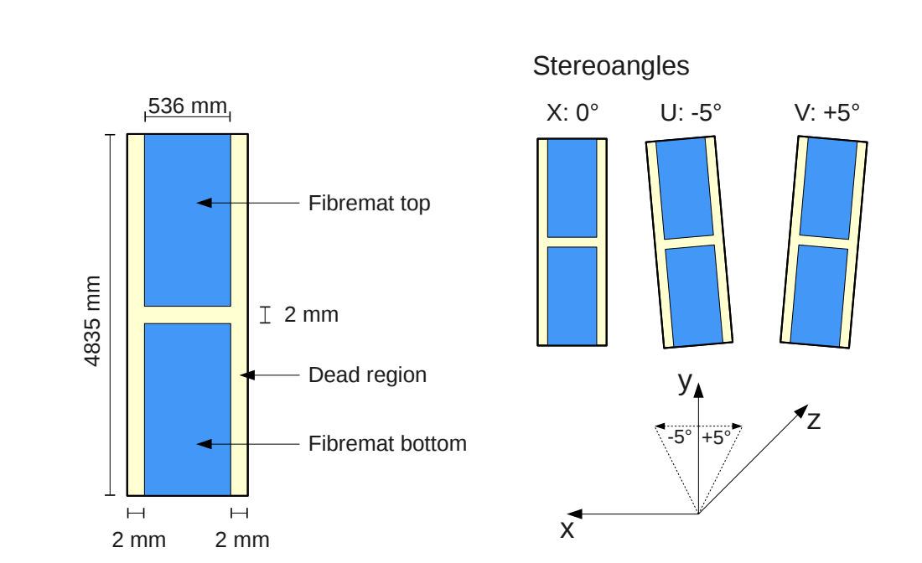
The SciFi
3 x 4 layers of scintillating fiber mats
Each mat with 6 layers of fibres
8 mats assembled into a module
11,000 km of fibres in total
Coverage up to 3m from the beam pipe
That’s stereo!
Notes:
The tilt is designed to increase the acceptance along with the finer resolution. called SALT (Silicon ASIC for LHCb Tracker), which is being developed by the AGH-UST Krakow LHCb 32 Figure 2.19: The SALT ASIC block diagram. group. There are a number of technological challenges related to the design arising from the required performance and harsh environment of the 14 TeV pp collisions. The SALT ASIC will read out 128 channels and will be manufactured in IBM CMOS 130 nm technology. The ASIC main blocks are shown in Fig. 2.19. Each channel comprises an analogue block with a charge sensitive preamplifier, a shaper and a single-ended to differential converter. The differential analogue signal is then sent to an Analogue to Digital Converter (ADC) implemented as a 6-bit fully differential Successive Approximation Register (SAR). The digitised data is then fed to the digital signal processing block (DSP), which performs pedestal subtraction, mean common mode subtraction and zero suppression. After the DSP the data, with added header information, are placed into a de-randomising buffer [28] and transmitted to the consecutive parts of the read out system using serial links

Slide 34
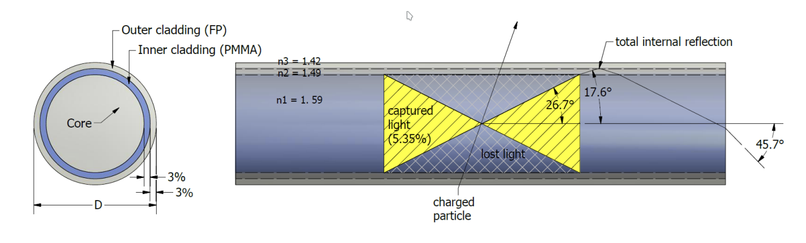
The SciFi
The scintillating fibers work by collecting light from particles travelling through them. 3 offset layers per station give the SciFi the best possible coverage of the LHCb acceptance.
Notes:
The tilt is designed to increase the acceptance along with the finer resolution. called SALT (Silicon ASIC for LHCb Tracker), which is being developed by the AGH-UST Krakow LHCb 32 Figure 2.19: The SALT ASIC block diagram. group. There are a number of technological challenges related to the design arising from the required performance and harsh environment of the 14 TeV pp collisions. The SALT ASIC will read out 128 channels and will be manufactured in IBM CMOS 130 nm technology. The ASIC main blocks are shown in Fig. 2.19. Each channel comprises an analogue block with a charge sensitive preamplifier, a shaper and a single-ended to differential converter. The differential analogue signal is then sent to an Analogue to Digital Converter (ADC) implemented as a 6-bit fully differential Successive Approximation Register (SAR). The digitised data is then fed to the digital signal processing block (DSP), which performs pedestal subtraction, mean common mode subtraction and zero suppression. After the DSP the data, with added header information, are placed into a de-randomising buffer [28] and transmitted to the consecutive parts of the read out system using serial links

Slide 35
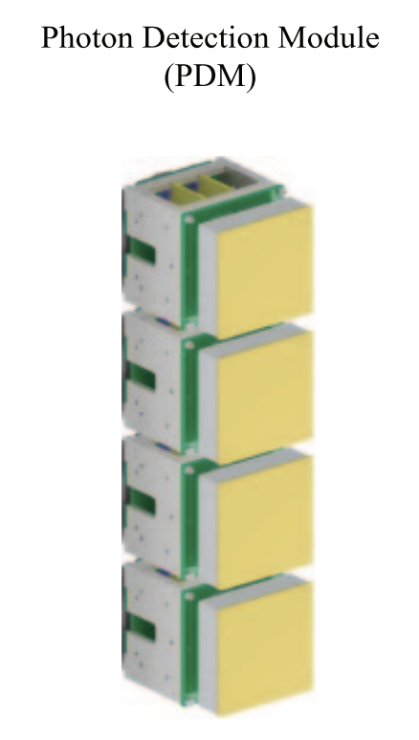
Rich
RICH1 has new flat mirrors for better photon yield
Focal plane, optics modified to increase size of Cherenkov rings
Photo-detectors have been upgraded
Two new types of multi-anode photomultiplier tubes (MaPMTs) with finer granularity have been installed
Notes:
The tilt is designed to increase the acceptance along with the finer resolution. called SALT (Silicon ASIC for LHCb Tracker), which is being developed by the AGH-UST Krakow LHCb 32 Figure 2.19: The SALT ASIC block diagram. group. There are a number of technological challenges related to the design arising from the required performance and harsh environment of the 14 TeV pp collisions. The SALT ASIC will read out 128 channels and will be manufactured in IBM CMOS 130 nm technology. The ASIC main blocks are shown in Fig. 2.19. Each channel comprises an analogue block with a charge sensitive preamplifier, a shaper and a single-ended to differential converter. The differential analogue signal is then sent to an Analogue to Digital Converter (ADC) implemented as a 6-bit fully differential Successive Approximation Register (SAR). The digitised data is then fed to the digital signal processing block (DSP), which performs pedestal subtraction, mean common mode subtraction and zero suppression. After the DSP the data, with added header information, are placed into a de-randomising buffer [28] and transmitted to the consecutive parts of the read out system using serial links

Slide 36
What I don’t go into depth on!
SMOG 2. It was installed and provides a unique fixed target program to the LHCb. Learn about anti-proton production, Central exclusive production, Strangeness production and other cool things with this targeted gas injection system!
Calo and Muon upgrades. Both have made substantial upgrades to the from ends but the technology otherwise has remained relatively stable!
Notes:
The tilt is designed to increase the acceptance along with the finer resolution. called SALT (Silicon ASIC for LHCb Tracker), which is being developed by the AGH-UST Krakow LHCb 32 Figure 2.19: The SALT ASIC block diagram. group. There are a number of technological challenges related to the design arising from the required performance and harsh environment of the 14 TeV pp collisions. The SALT ASIC will read out 128 channels and will be manufactured in IBM CMOS 130 nm technology. The ASIC main blocks are shown in Fig. 2.19. Each channel comprises an analogue block with a charge sensitive preamplifier, a shaper and a single-ended to differential converter. The differential analogue signal is then sent to an Analogue to Digital Converter (ADC) implemented as a 6-bit fully differential Successive Approximation Register (SAR). The digitised data is then fed to the digital signal processing block (DSP), which performs pedestal subtraction, mean common mode subtraction and zero suppression. After the DSP the data, with added header information, are placed into a de-randomising buffer [28] and transmitted to the consecutive parts of the read out system using serial links

Slide 37
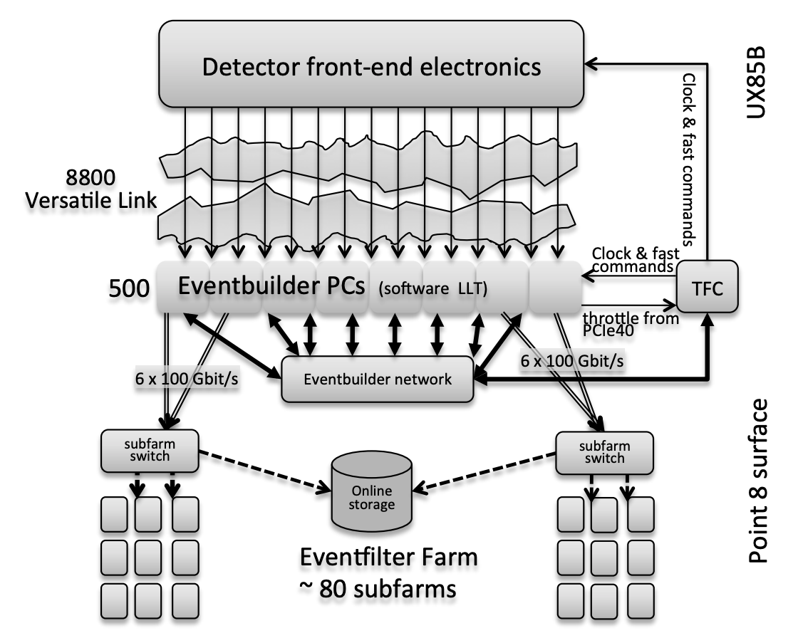
Readout!
With the removal of the L0 hardware trigger all bunch crossings can be triggered on and sent to the Event Builder nodes on the surface!
That’s around 19000m of optical fibres with a yield of 99.75%

Slide 38
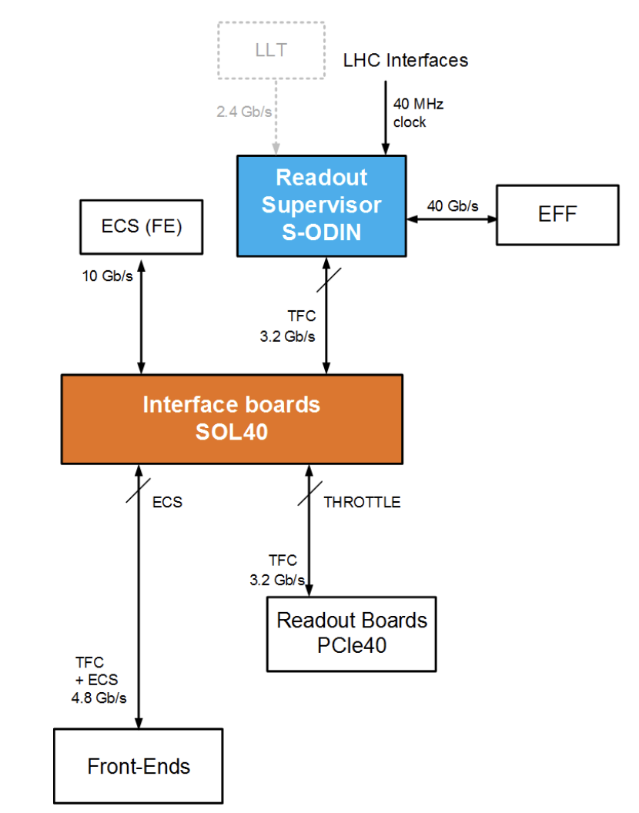
Readout
What this means at the detector end is that the LHC clock synchronizes all LHCb front end electronics via the SOL40’s
These readout the front ends and transmit them to the ECS. Timing calibration of the from ends ensure the correct packets are synchronized.

Slide 39

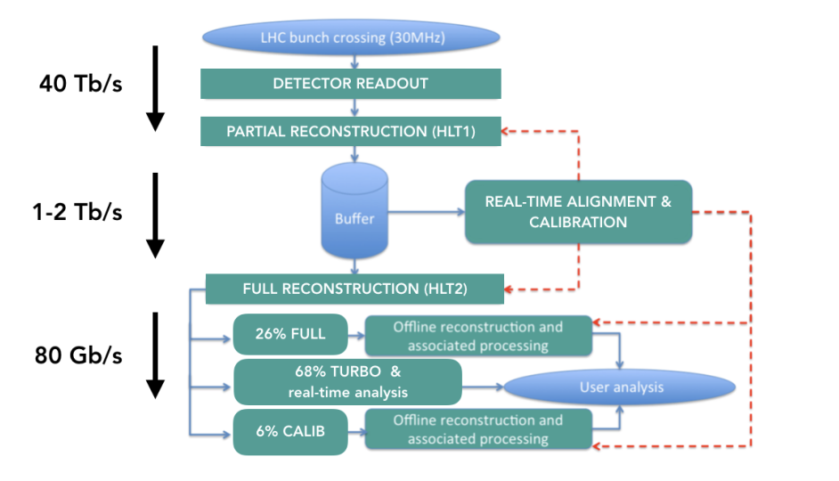
Allen! (motivation)
Traditionally the HLT sequence is made of 2 stages. HLT1 which uses a stripped down reconstruction to veto any “no physics” events before a disk buffer.
Then HLT2 that completes and triggers on the full event reconstruction. Depending on the buffer size HLT2 doesn’t need the same speed as HLT1

Slide 40
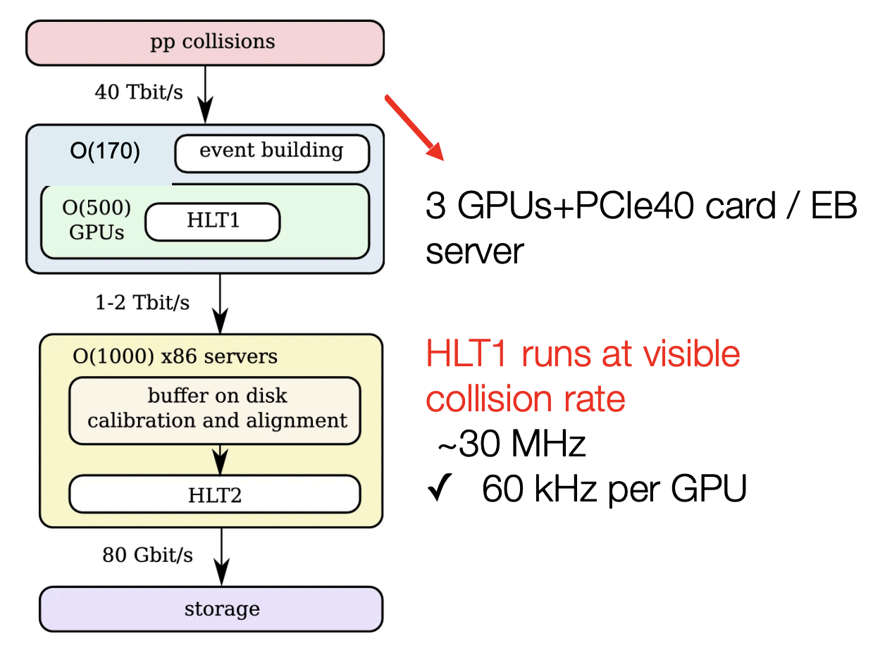
Allen
Allen project for fully software trigger on GPUs
  Implemented on C++, CUDA and python
  Running also for CPU and HIP (AMD, experimental)
  It can run standalone!

Slide 41
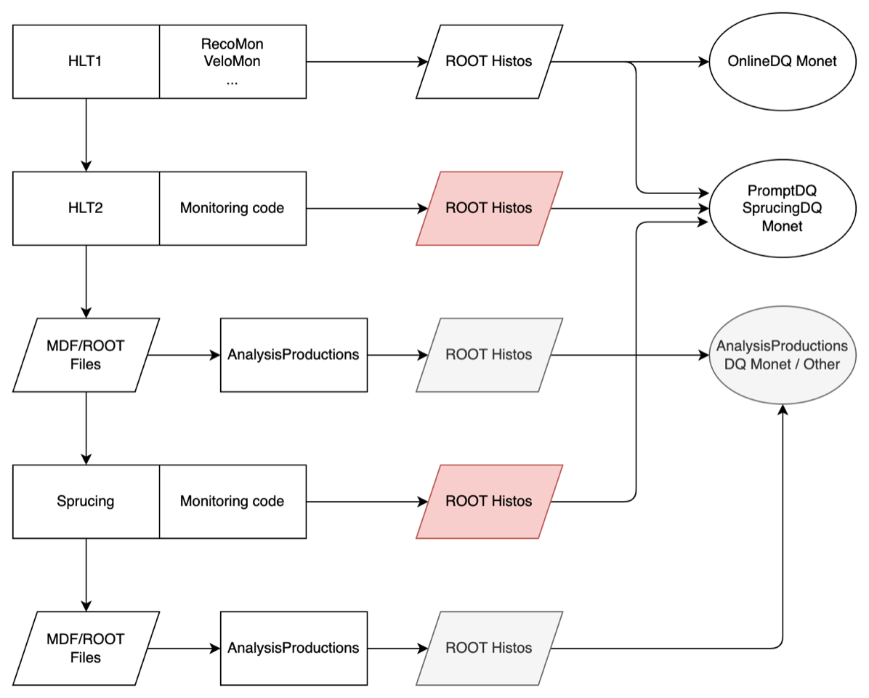
Online Monitoring workflow

Slide 42
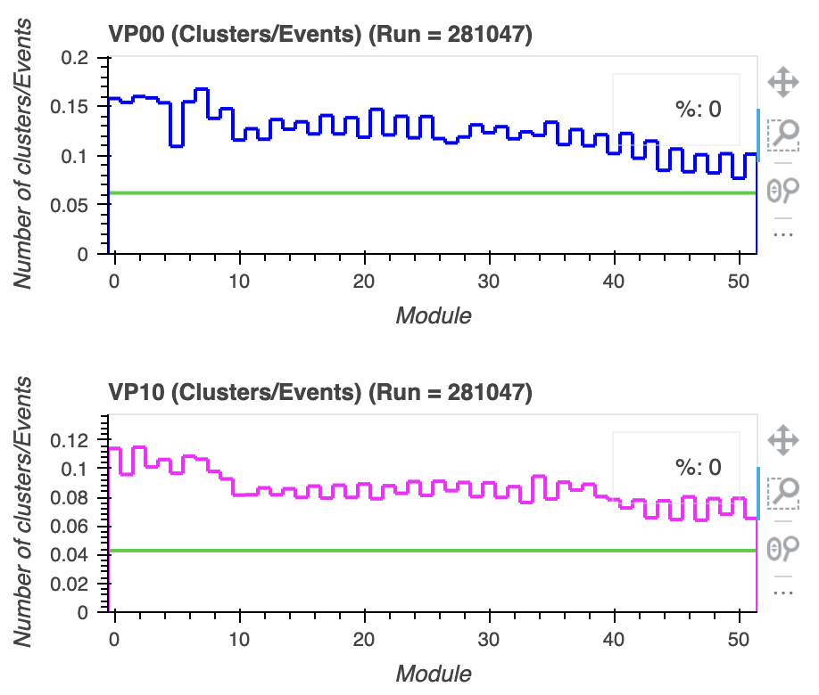
Real Time Monitoring (VELO)
We monitor the clustering across all ASIC channels from the front ends.
At a high level this allows for Data Shifters to quickly identify if an ASIC has any ‘hot pixels’ or is inefficient.
Generally, this is the first place a VELO issue will present itself.

Slide 43
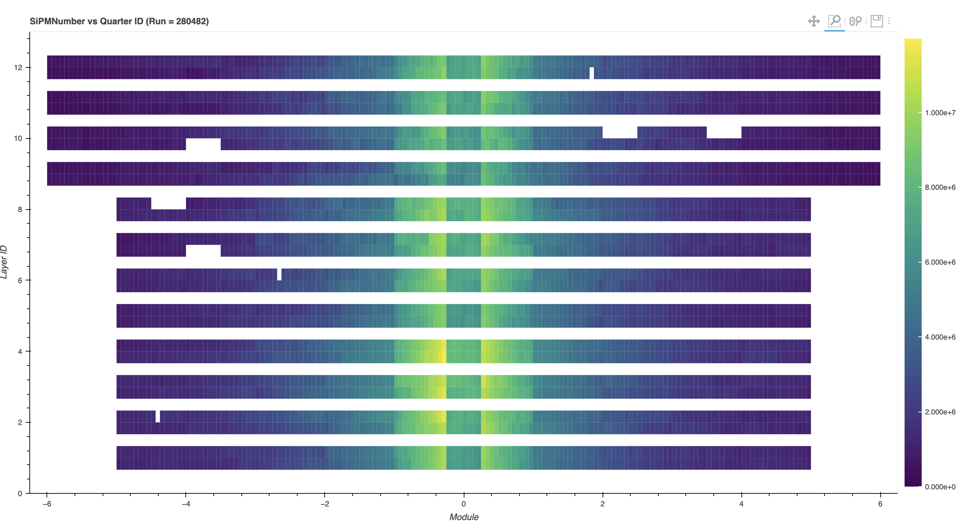
Real Time Monitoring (SciFi)!

Slide 44
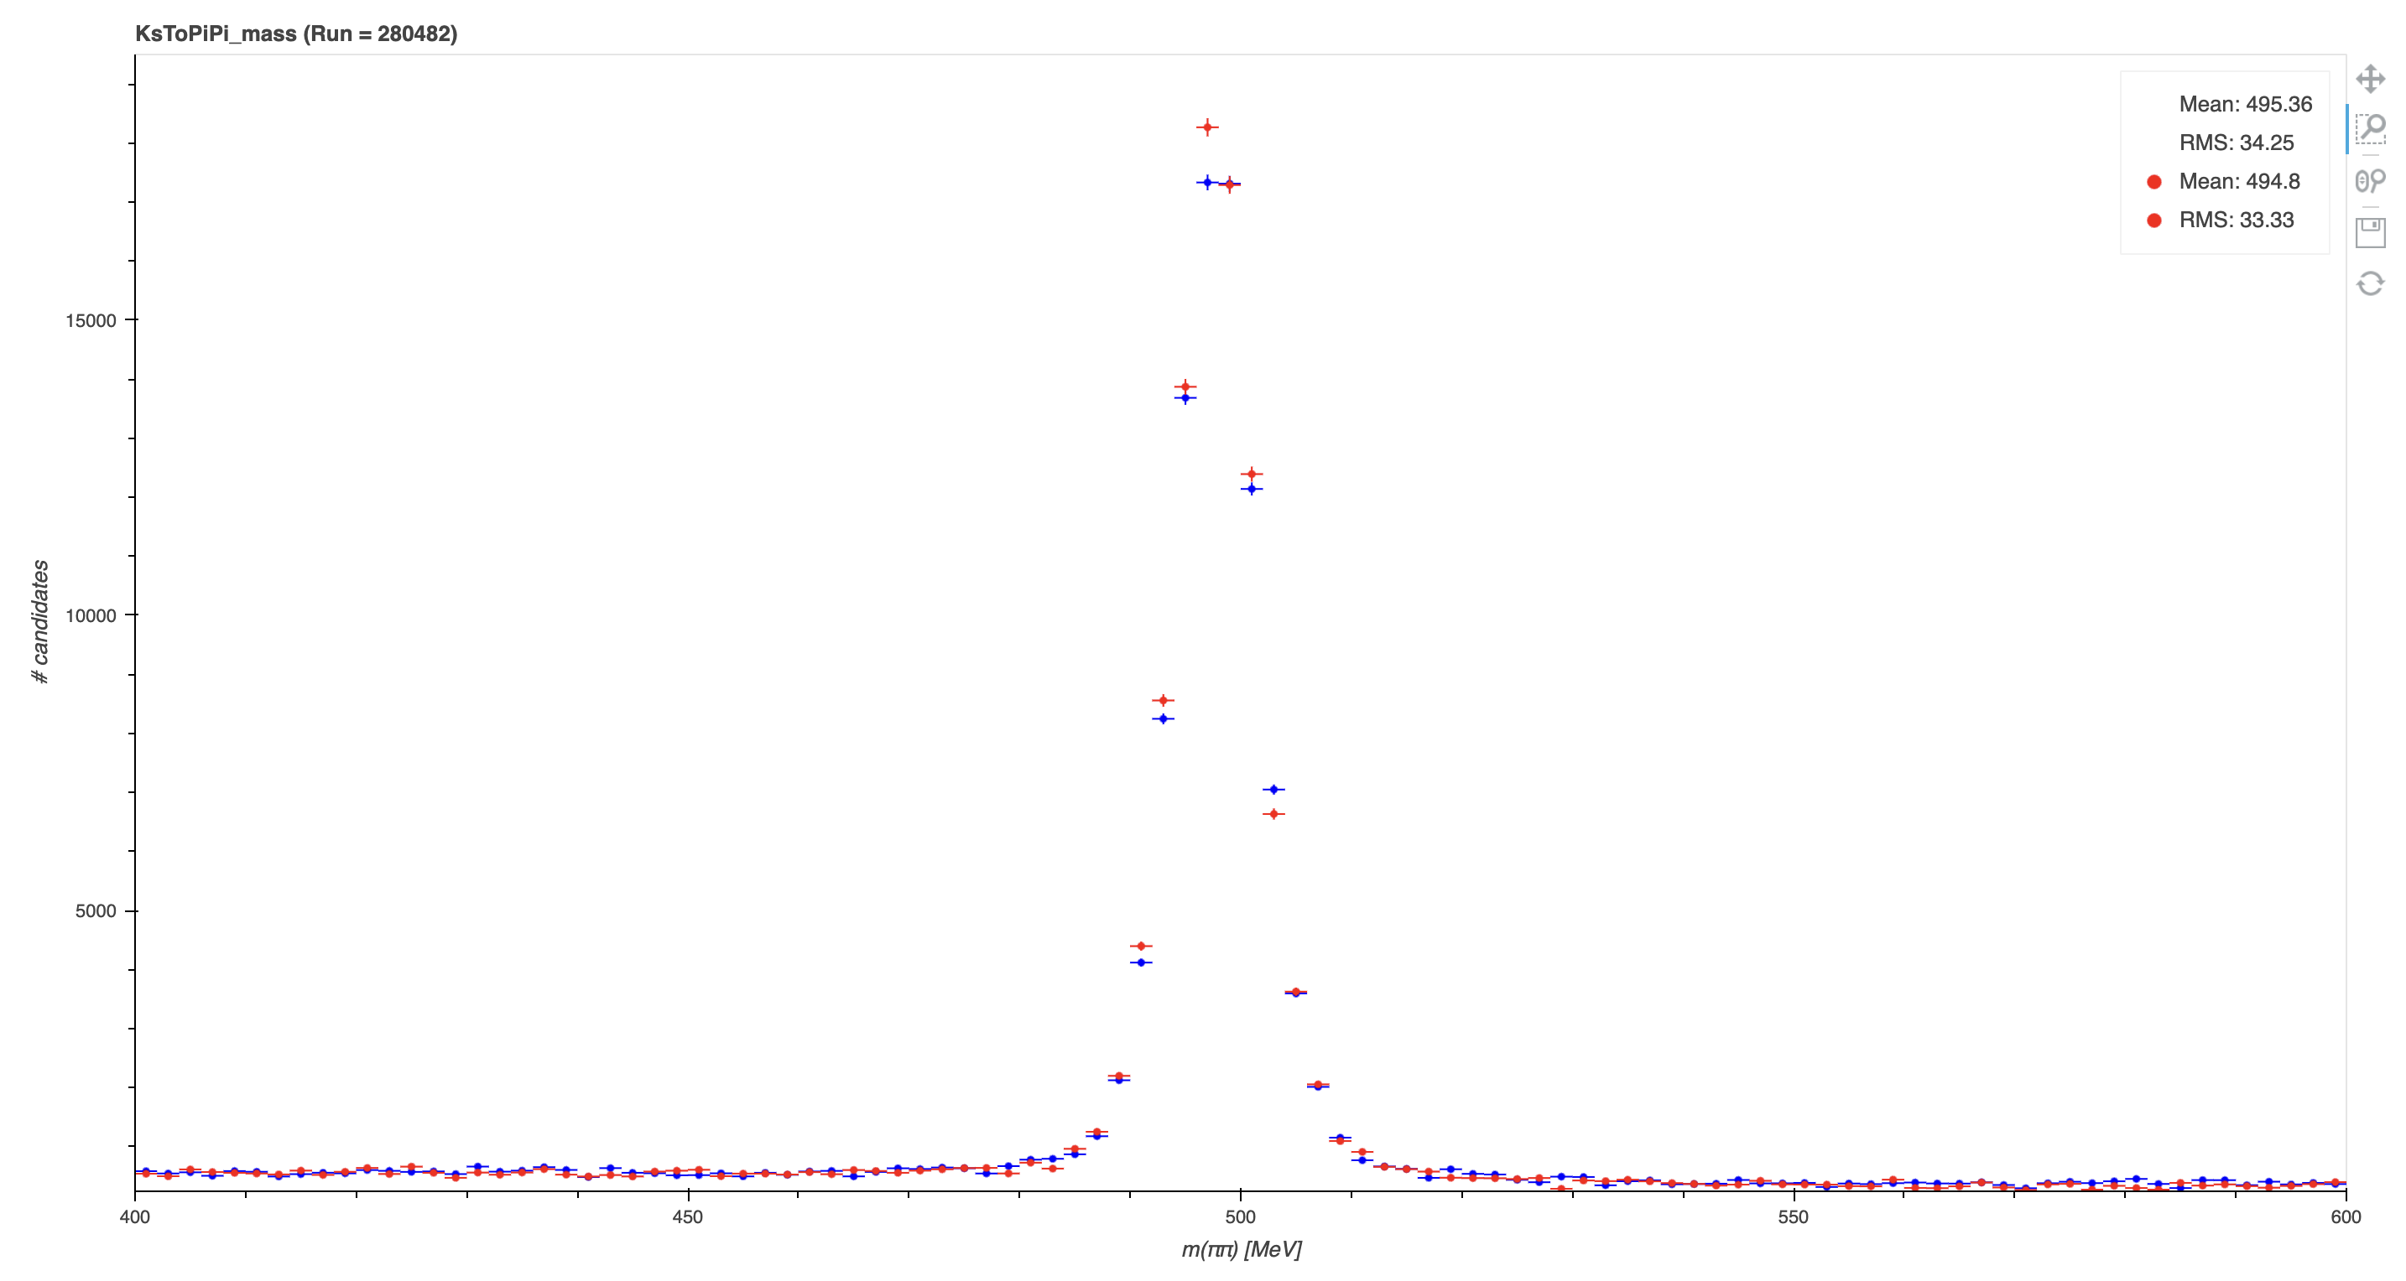
Real Time Monitoring (RTA)
We do it live!

Slide 45

The sales pitch (Supporting Run 3)
If we want to make the most of data taking we need the support of the whole collaboration!
Shifters make up the heart of the LHCb
  This includes roles such as Shift Leader (must be prepared to push buttons)
  The Data manager, who monitors the quality of data live!
  And the 24/7 piquet roles rotated across sub systems in case there’s a specific issue!
There’s no quota’s and it’s completely voluntary. But great fun, you get to learn a lot starting up and no existing technical expertise required!
Miw-on Piquet

Slide 46
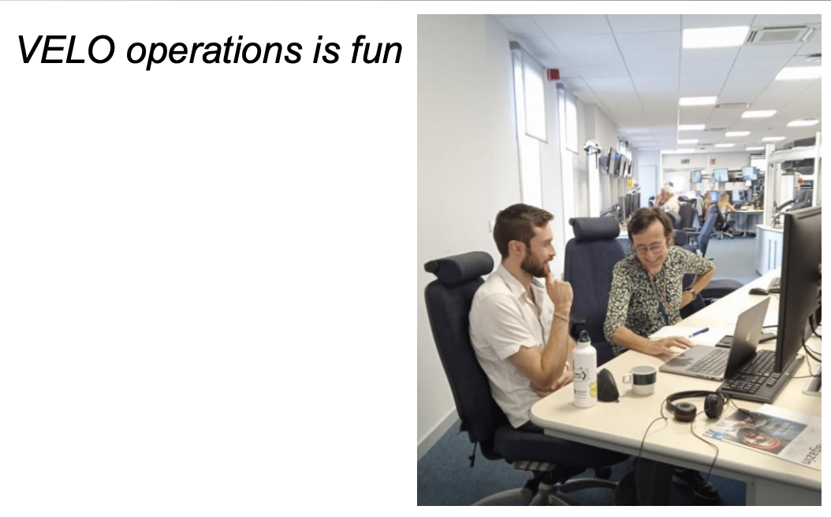
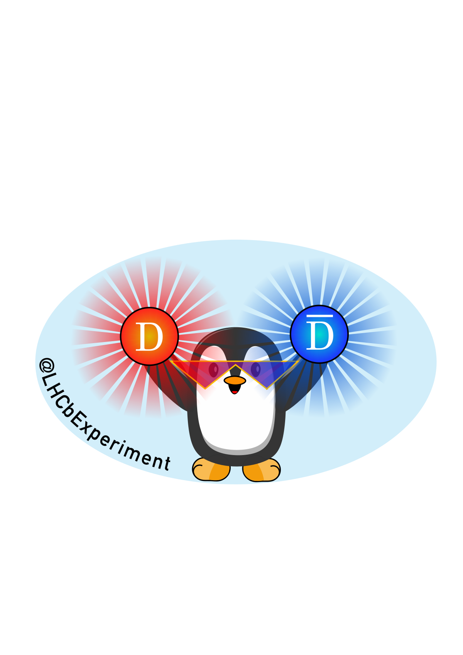
Closing thoughts
Although the Upgrade is complete we still need commissioning effort. There’s plenty of opportunity to get involved with performance and commissioning studies!
Where there’s an upgrade there’s an upgrade 2. For high luminosity we need effort on Mighty Tracker, Torch, 3D silicon tracker R&D. You might well define what the future LHCb looks like!

