Slide 1
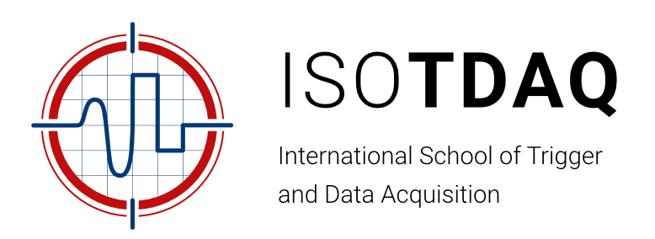

Towards pico-seconds
Time Digitization in FPGAs
Jinhong Wang
(jinhongwang@ustc.edu.cn)
June 22, 2024

Slide 2
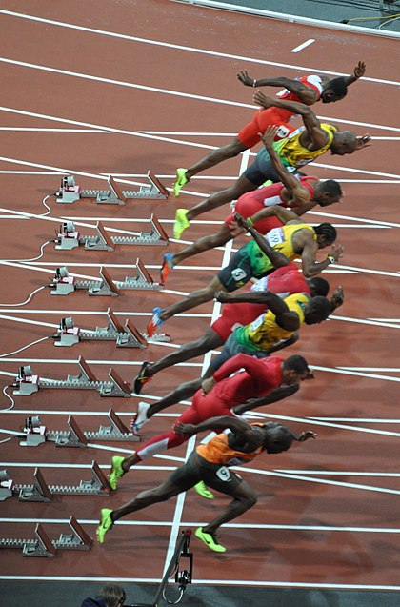
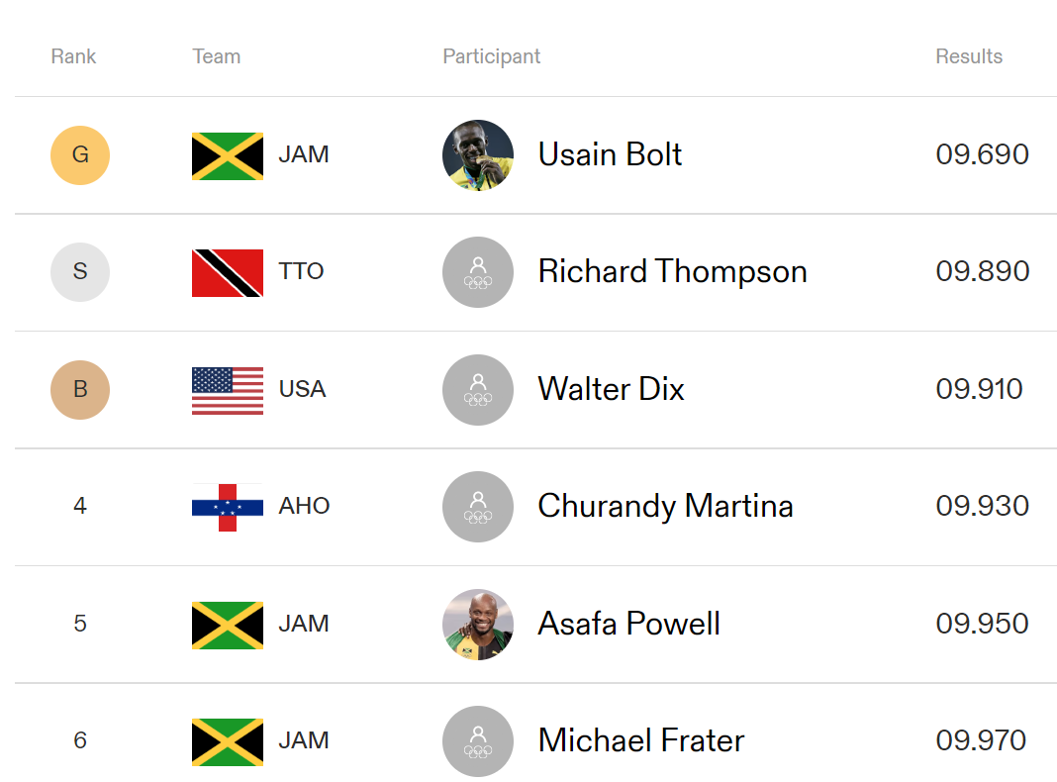
Introduction: why the timing precision matters!
2008 Beijing Olympics, 100m results (men)
World records (by now), 100m: 9.58 (men); 10.49 (women)
~10 m/s
Milliseconds!

Slide 3
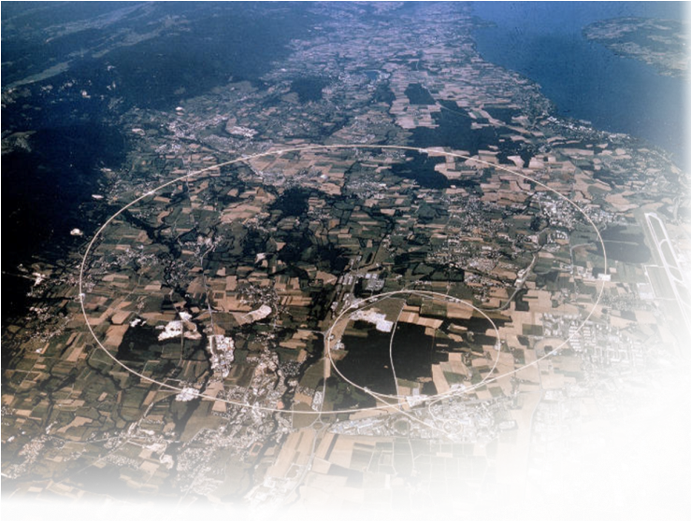
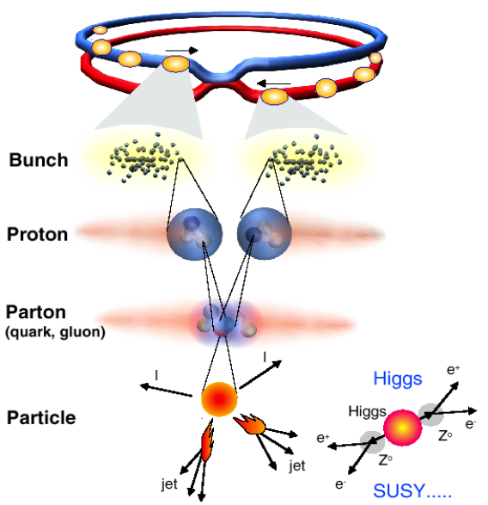
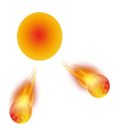

Introduction: why the timing precision matters!
Particles travelling at a speed
Approximating the speed of light!
$$\sim 3×{10}^{8} m/s$$
1 ms (10^-3) → ~ 300 km
1 ns (10^-9) → 0.3 m (30 cm)
10 ps (10^-11)→ 0.003 m (3mm)
I
I
jet
jet
Detectors

Slide 4
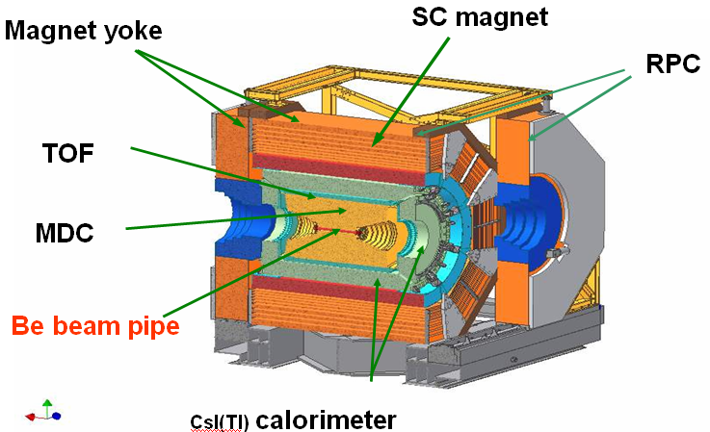
Introduction: why the timing precision matters!
BES III (Beijing Spectrometer III) , separate K/π with 2σ at 1GeV/c → 100 ps timing precision for the TOF (time of Flight)

Slide 5
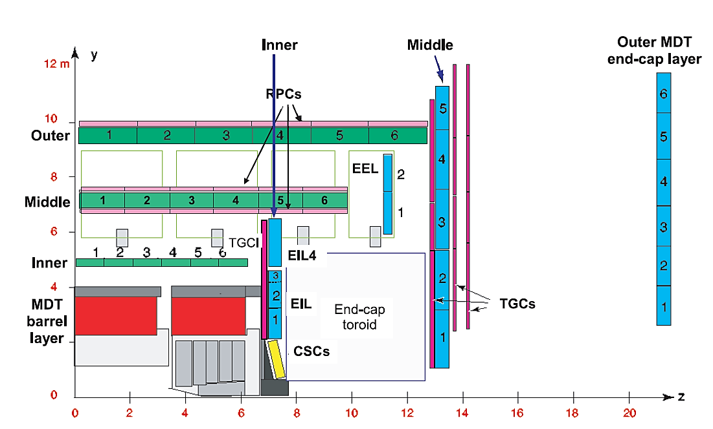
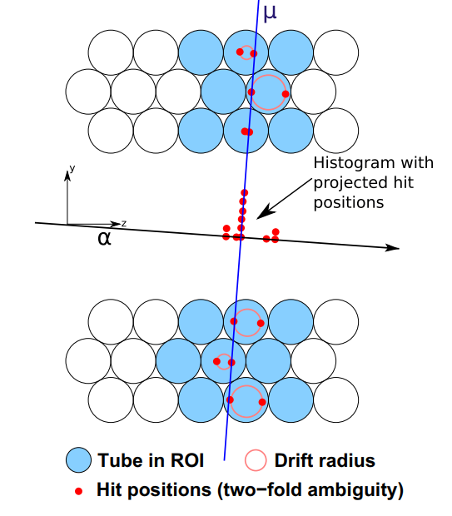
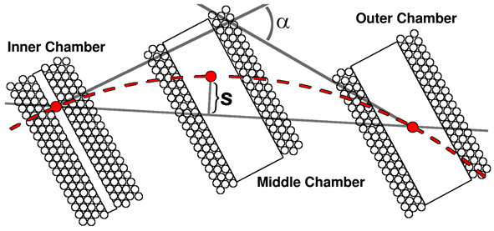
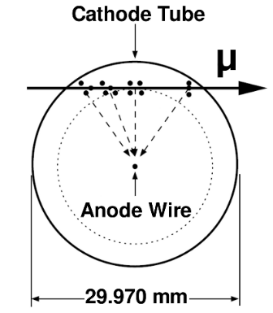
Introduction: why the timing precision matters!
Measuring muon momentum through its bending trajectories
Monitored Drift Tube
Trajectory reconstruction
Magnet field bends the trajectory of the muons
Momentum is measured through “inner-middle-outer” layers

Slide 6
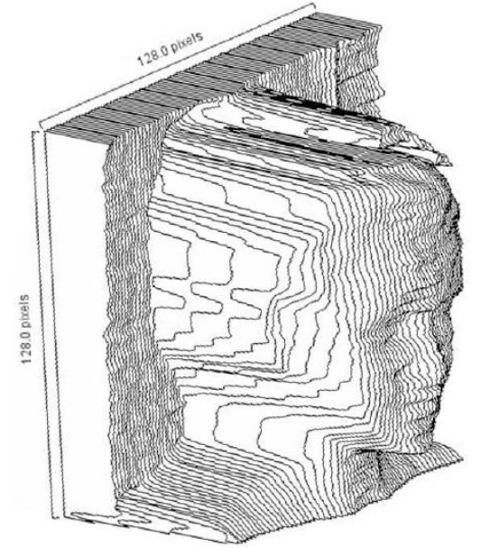
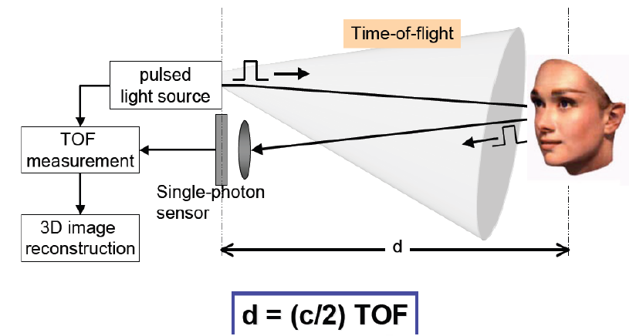
Introduction: why the timing precision matters!
3D imaging

Slide 7
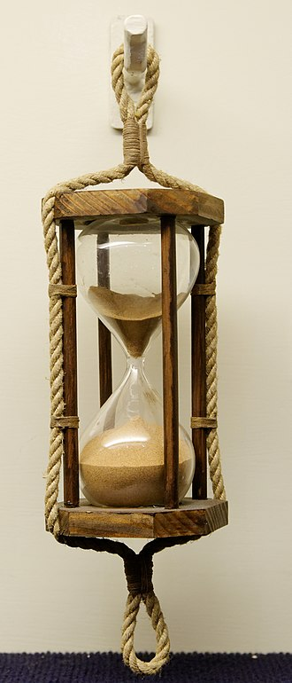
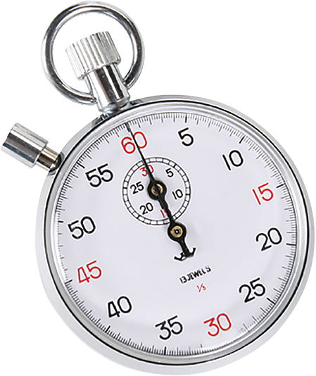

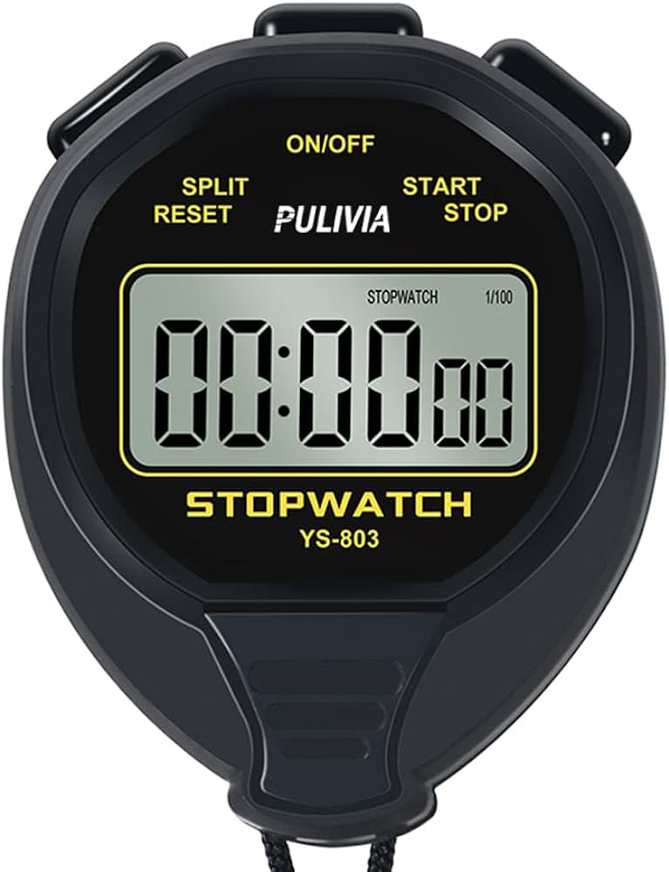
Introduction: Examples of timing techniques
See “Introduction to FPGAs” by Hannes Sakulin
In an FPGA
Scaled by 1/10^9
A XXXXX?
(picoseconds)
A marine sandglass
(seconds-minutes)
A stop watch
(milliseconds)

Slide 8
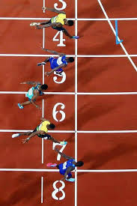
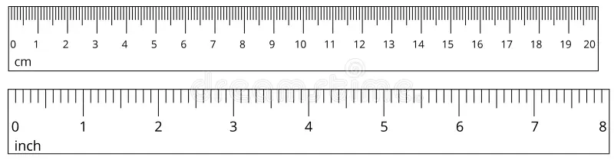
Introduction: Essentials of timing techniques
Measuring the length of a rectangle
A
B
Starting line
Finishing line
Measure by millimeters
Count at Finer Intervals
Count by milliseconds
So, let’s start counting, in an FPGA!

Slide 9
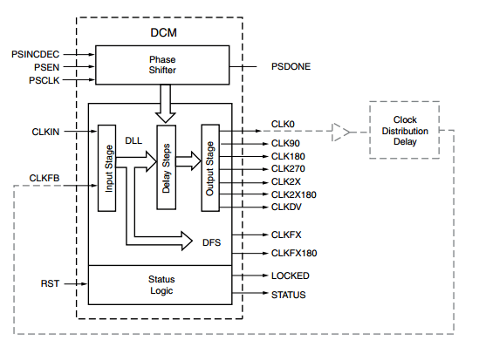
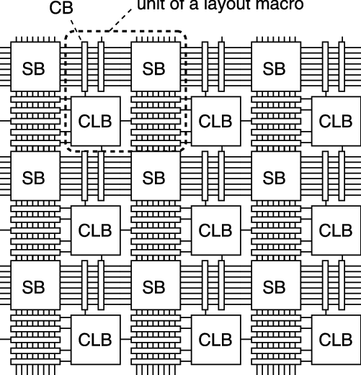

Time Digitization in FPGAs: Counter
Clock
$$T_{clock}$$
Time
digits
1
2
3
Clock Manager
Start
Stop
Logic blocks
Timing resolution corresponds to T_{clock}
min. period of Clock is limited in FPGAs
typ. in nano-seconds ranges min.
If T_{clock} is 3.125 ns (320MHz), min.,
what can we do?

Slide 10


Time Digitization in FPGAs : dual Counter
Clock
$$T_{clock}$$
Time
digits
1
2
3
Clock
180 deg
Clock Manager
1
2
3
If T_{clock} is 3.125 ns, min., what can we do?
Add a 180 deg (inverted) clock @ 3.125ns
$$\frac{1+1}{2}⋅T_{clock}$$
$$\frac{2+3}{2}⋅T_{clock}$$
Equivalently, 0.5*T_{clock} resolution is obtained, i.e., 1.5625 ns
Start
Stop
Pursuit in this line…

Slide 11
Time Digitization in FPGAs : phase interpolation
Four phases of 320 MHz, (0, 90, 180, 270), equivalently ~780 ps resolution
Limited by number of finer clock phases (generated from clock managers)
→ plus, difficulty in keeping alignment of clock edges (cons)
Pros: simple, and easy to implement with macro blocks
Achieved resolution: ~ 100s pico-seconds
Progress by now: ~ hundreds ps

Slide 12
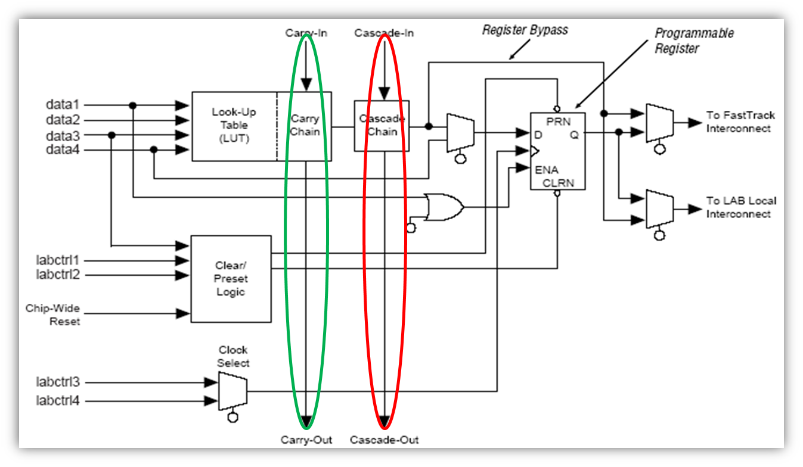
Pico-seconds ?
1: identify finer time intervals
(e.g., if a “component”/unit/cell with ~50 ps delay is found, and there are many of them to be added together uniformly)
Pioneered by Jinyuan Wu @ Fermilab
Cascade chain (2003) https://ieeexplore.ieee.org/stamp/stamp.jsp?tp=&arnumber=1352025
Inspired by Wu’s idea,
A carry-chain version was invented @ USTC
https://ieeexplore.ieee.org/stamp/stamp.jsp?tp=&arnumber=1610982
Nowadays, the delay of typical carry-chain cell is around 10s picoseconds
2: add up to a “working” range
(e.g., add as many components up to 3.125 ns, the “counter” clock period)

Slide 13
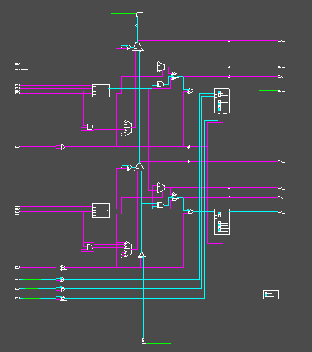
With Carry-chain as the“Delay”
a) Carry-in in a Slice
c) Carry chain of a multi-bit adder
b) Rout in a SLICE

Slide 14
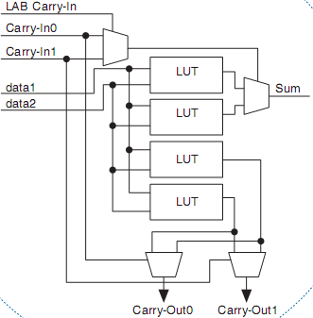
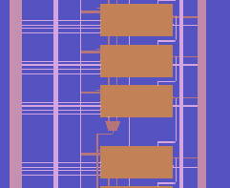
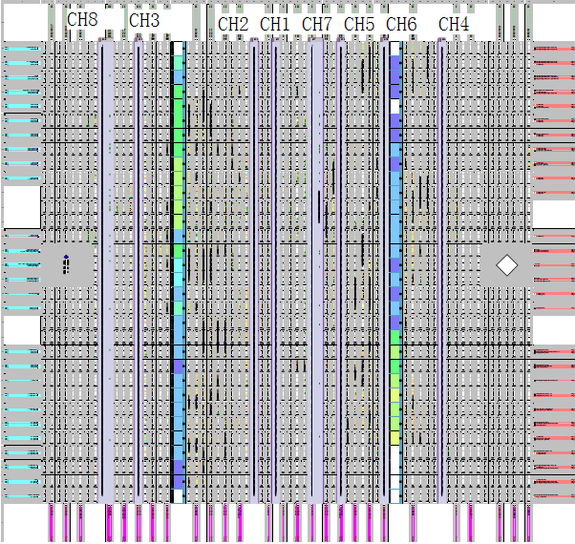
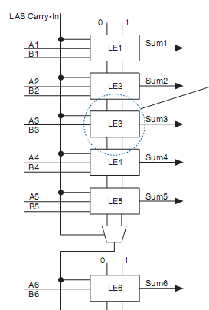
Forming a chain of“Delay”
In Altera (Intel) FPGAs
CYCLONE

Slide 15
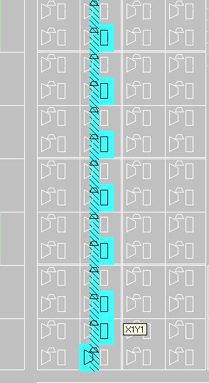
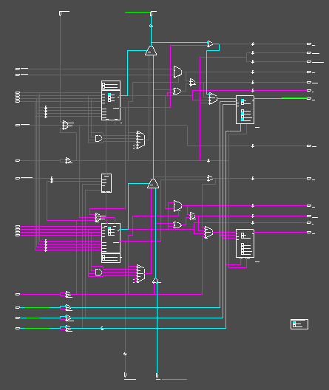
Forming a chain of "Delay”
In Xilinx (AMD) FPGAs

Slide 16
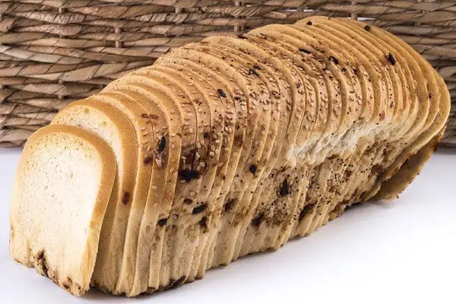
Principle: tapped-delay-line approach
Divide a clock period into finer slices (DELAY)
→ Forming a tapped-delay line (TDL)
https://ieeexplore.ieee.org/document/5446507

Slide 17
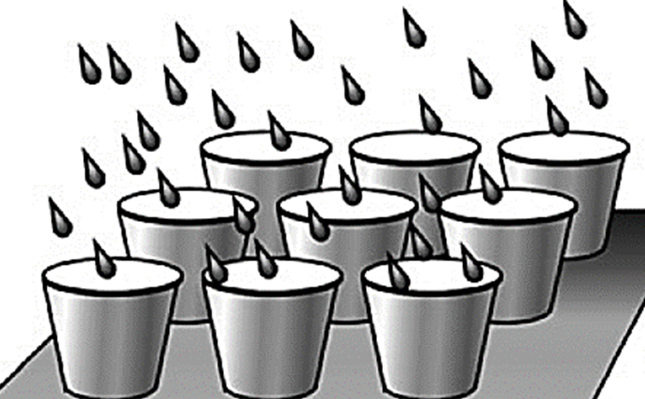
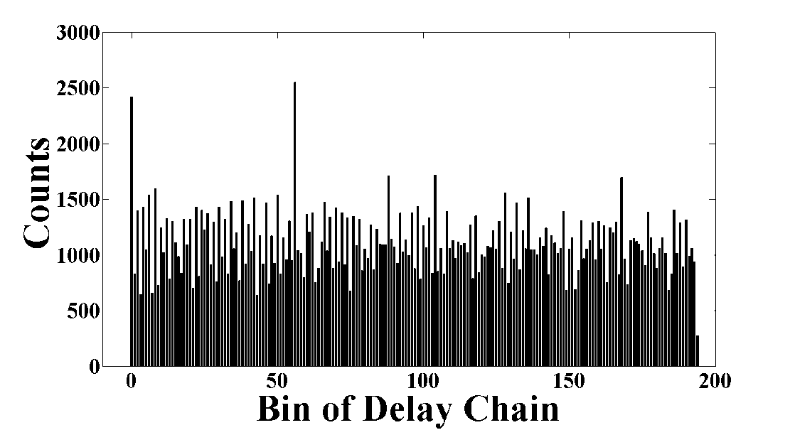
Determine delay time of “Delay”
“Random”
Signals**
Average Bin size: Tclk/n
Or, since bin width is proportional to its counts, calculate the bin width for each bin

Slide 18
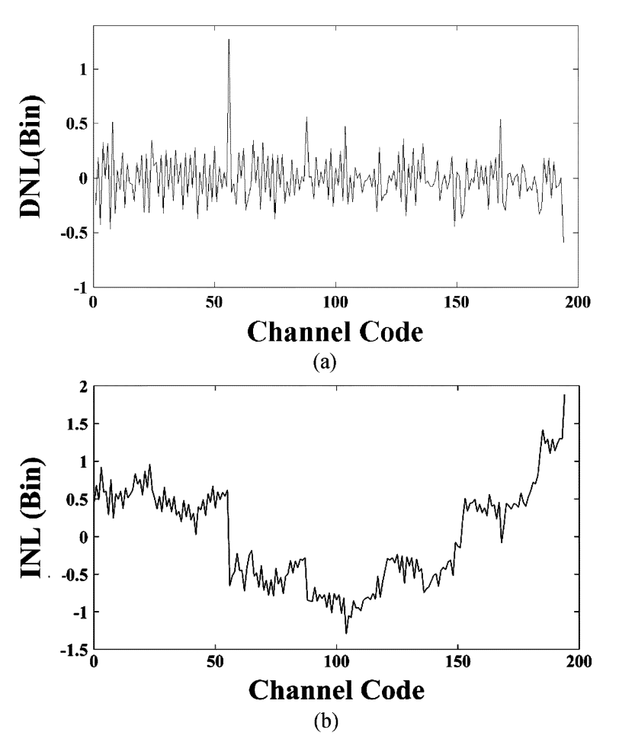


Determine delay time of “Delay”
$$DNL\left(i\right)=Bin_{i}−\overline{Bin}$$
“Random”
Signals**
Average Bin size: Tclk/n
Or, since bin width is proportional to its counts, calculate the bin width for each bin
$$INL\left(p\right)=Σ_{i=0}^{i=p}DNL\left(p\right)$$

Slide 19
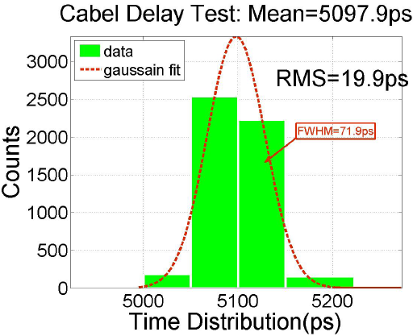
Timing Performance Evaluation
Generation of a stable time interval, pico-seconds stability
  High resolution signal generator (e.g., AWG)
  Delay line approach
  Cable delay （5 ns @1m）
A
FPGA
Pulse Generator
B
  Power splitter
Power splitter splits input pulse into two branches
Each branch share similar time uncertainty, thus could be reduced by measuring their relative difference
A/B are two “identical” channels in FPGA (TDC) → timing uncertainty for a single channel: 1/sqrt(2)
Bin size (average)
Nonlinearity (DNL/INL)
Timing uncertainty (RMS)
…
Progress by now: ~ 20 ps

Slide 20
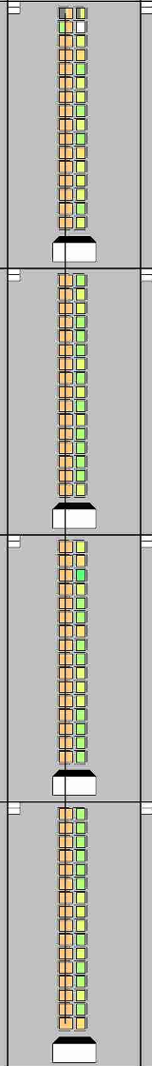
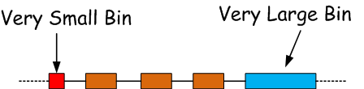
The WaveUnion Approach
Boosting the TDL-TDC approach beyond its cell delay
In
Ultra-wide Bins
Ultra-Large Bin in the Carry-chain
CLK
Ref: https://ieeexplore.ieee.org/document/4775079

Slide 21
WaveUnion A (Jinyuan Wu @Fermilab)
0: Hold
1: Unleash
Wave Union
Launcher
0
1
In
Ultra-wide Bins
Ultra-wide bins are sub-divided.
+
CLK

Slide 22
WaveUnion A (Jinyuan Wu @Fermilab)
1: Unleash
Device: EP2C8T144C6
Plain TDC:
  Max. bin width: 160 ps.
  Average bin width: 60 ps.
Wave Union TDC A:
  Max. bin width: 65 ps.
  Average bin width: 30 ps.
1
2
2
1

Slide 23
WaveUnion A (Jinyuan Wu @Fermilab)
Plain TDC:
  delta t RMS width: 40 ps
  25 ps single hit
Wave Union TDC A:
  deltat RMS width: 25 ps
  17 ps single hit

Slide 24
WaveUnion B (Jinyuan Wu @Fermilab)
Wave Union
Launcher B
0: Hold
1: Oscillate
In
CLK
Does more oscillation cycles always mean better performance?

Slide 25
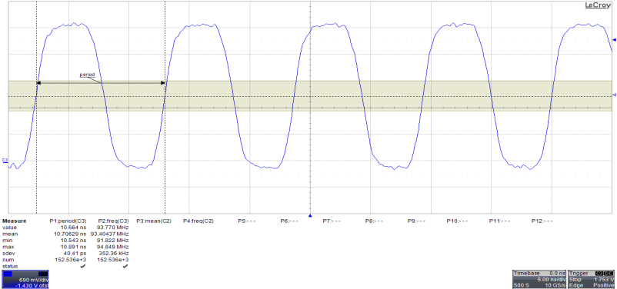
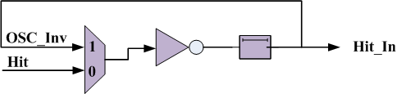
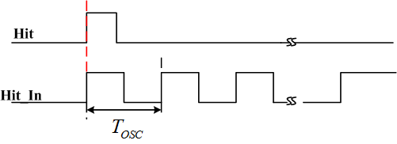
WaveUnion B (USTC)
Principle of the 10-ps FPGA TDC
Wave Union Launcher
INV+Delay+MUX
https://ieeexplore.ieee.org/stamp/stamp.jsp?tp=&arnumber=5941022

Slide 26
WaveUnion B (USTC)
Signal Processing of the Raw TDC time
N times Oscillation

Slide 27
WaveUnion B (USTC)
Signal Processing of the multi-averaging TDC
RMS timing precision (σ_{delay}) vs. N
• Non-uniformed distribution of the carry chain delay (σ_{cell} )
• Random uncertainty of the oscillation period (σ_{osc} )
• Other contributors, e.g. the steady of the clock (σ_{other})
Three possible cases:
• Case 1: σ_{osc} << σ_{cell}
• Case 2: σ_{osc} ≈ σ_{cell} The best timing @
• Case 3: σ_{osc} >> σ_{cell}

Slide 28
WaveUnion B (USTC)
Simulation and Test
Case 1: σ_{osc} << σ_{cell}
Case 2: σ_{osc} ≈ σ_{cell}
Case 3: σ_{osc} >> σ_{cell}
3
Simulation
2
Actual implementation falls in to Case 2
1
Test: RMS vs. N
Progress by now: ~ 10 ps

Slide 29
WaveUnion B (USTC)
Simulation and Test
Bin size vs. N
Effective Bin size:
Scales as 1/N
No Averaging
N=4
N=8

Slide 30

WaveUnion B (USTC)
Pros and Cons
√ Larger N results in smaller bin size, lower timing precision
× Larger N results in larger dead time
~ (N+1) * T_{CLK} ,
Trade-off should be made between TDC timing performance and N
No Averaging
N=4
B:300 ps
A:325 ps

Slide 31
Outlook
sub-10 ps resolution/precision time digitization already achieved in FPGAs (15 years ago)
→ is it possible to overcome the 1 ps barrier?
TDL approach is the most popular one in achieving sub-10 ps resolution, but not the only one, the choice of architecture is a trade off among power, resource utilization …
Timing resolution/precision is just one single measure of timing performance, among linearity, power, resource utilization…
→ Nowadays, FPGAs typically not limited by configuration logic resources, thus more attention on power efficiency might be necessary.

Slide 32

Quiz
Top secrets before class…

Slide 33
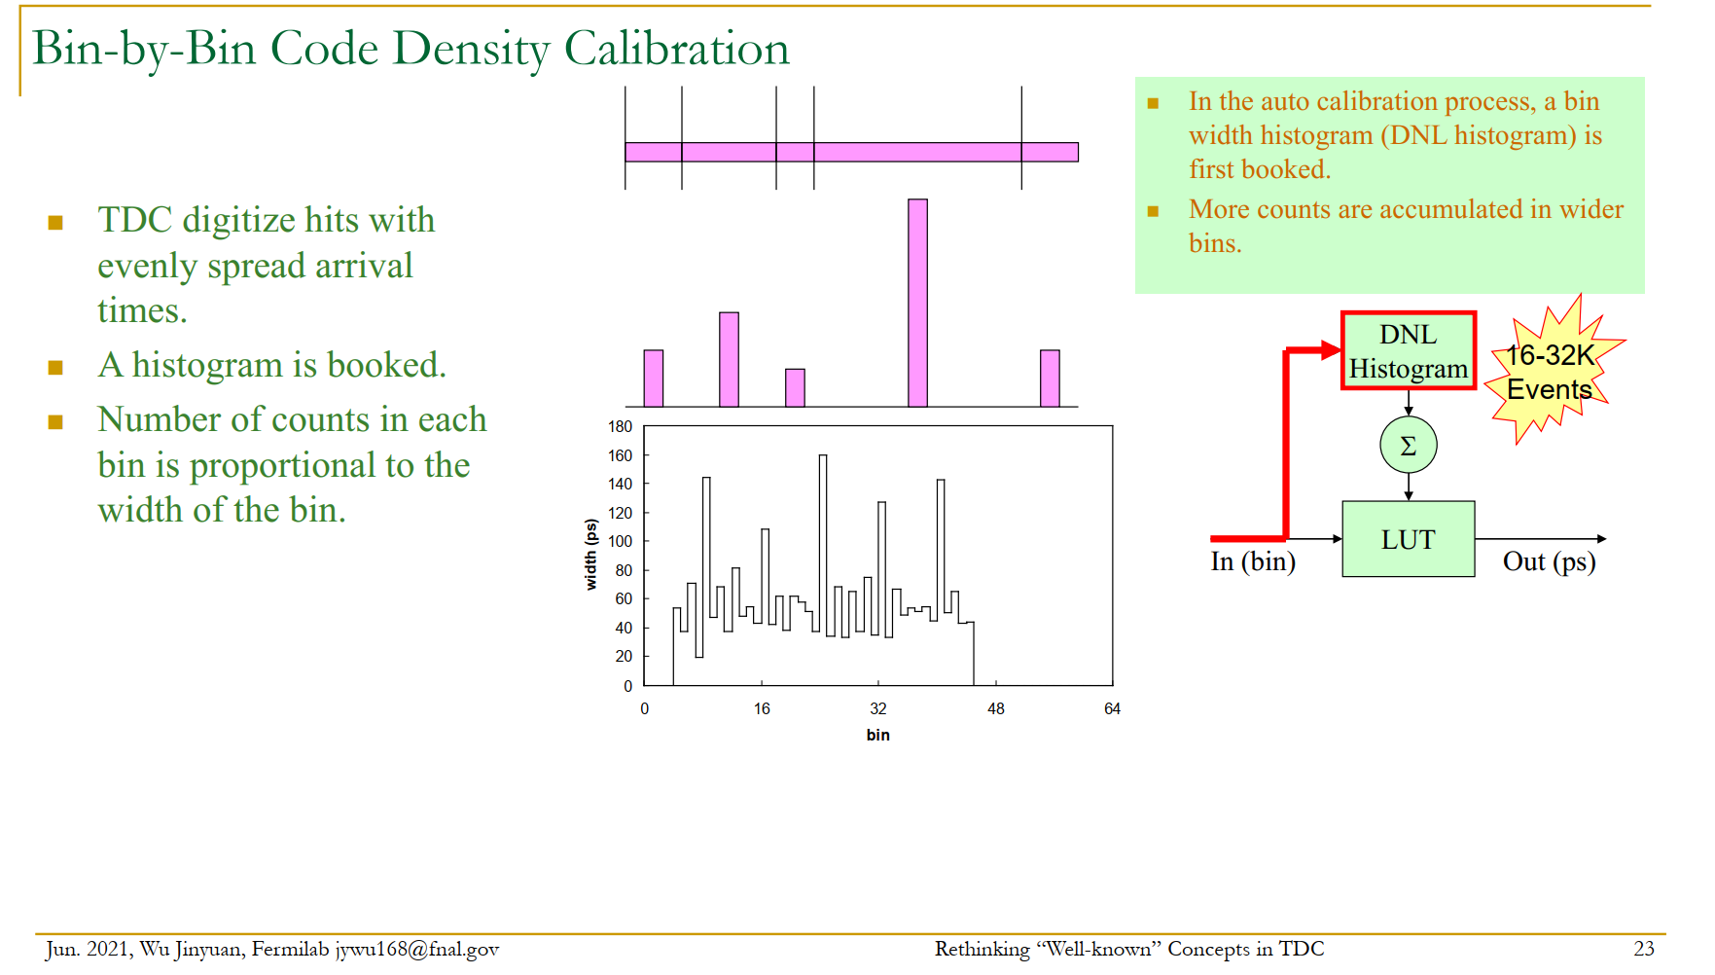

Slide 34
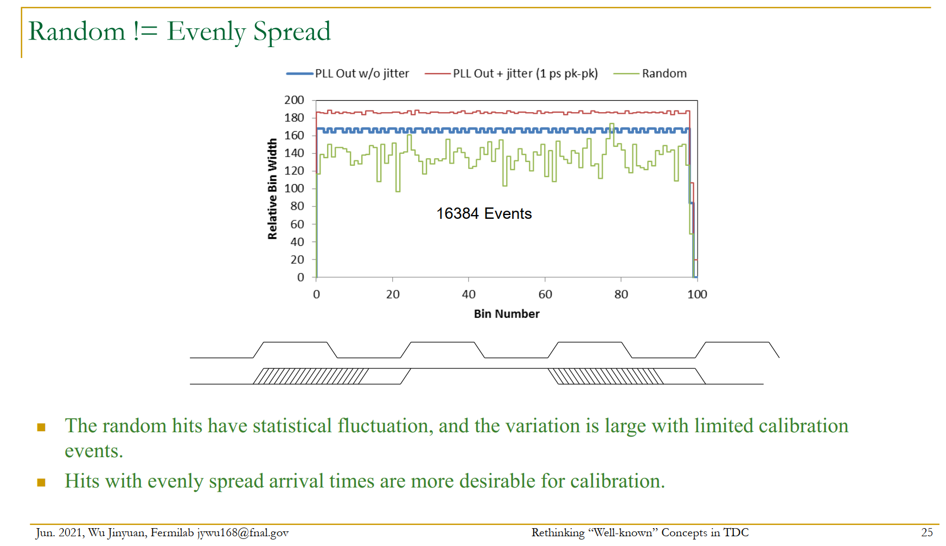

Slide 35
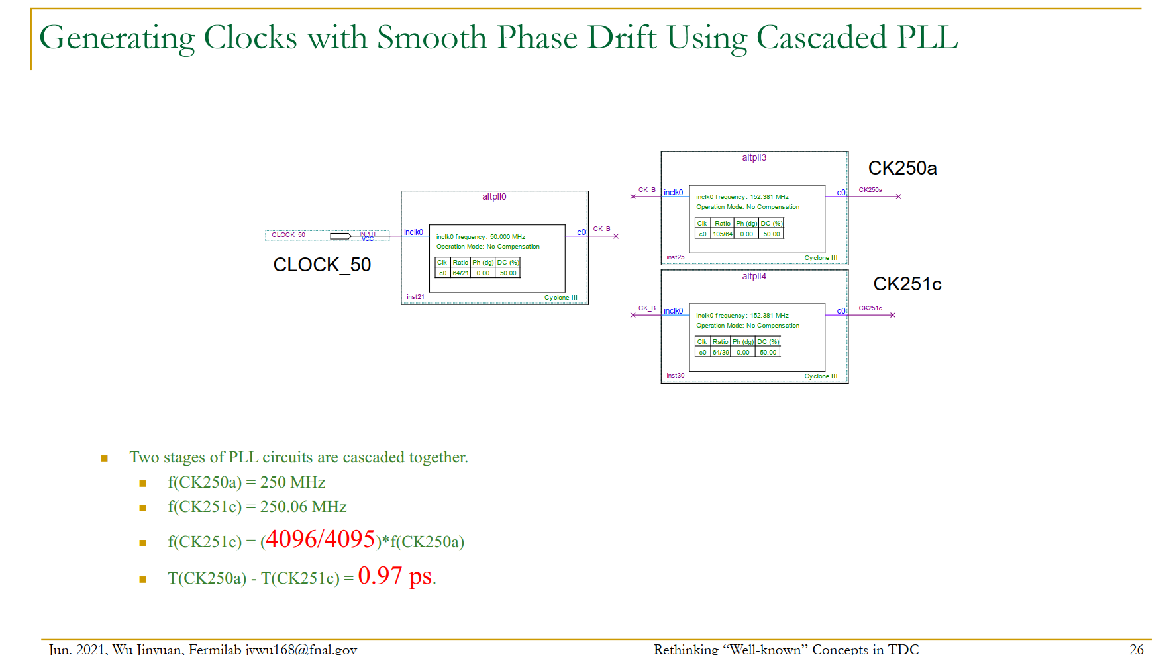

Slide 36
What if TDL is not long enough?
Typically it means clock period is relatively large!
Phase interpolation of clocks with TDL

Slide 38
ACTEL FPGA
  Flash
    IGLOO、、PROAISC3(E)
  Anti-fuse
    AXCELERATOR、SX_A、RTAX_SSL
TDC
    Flash Buffer
      Bin Size~440ps
    Anti-fuse
      Bin Size ~ 80ps

Slide 39
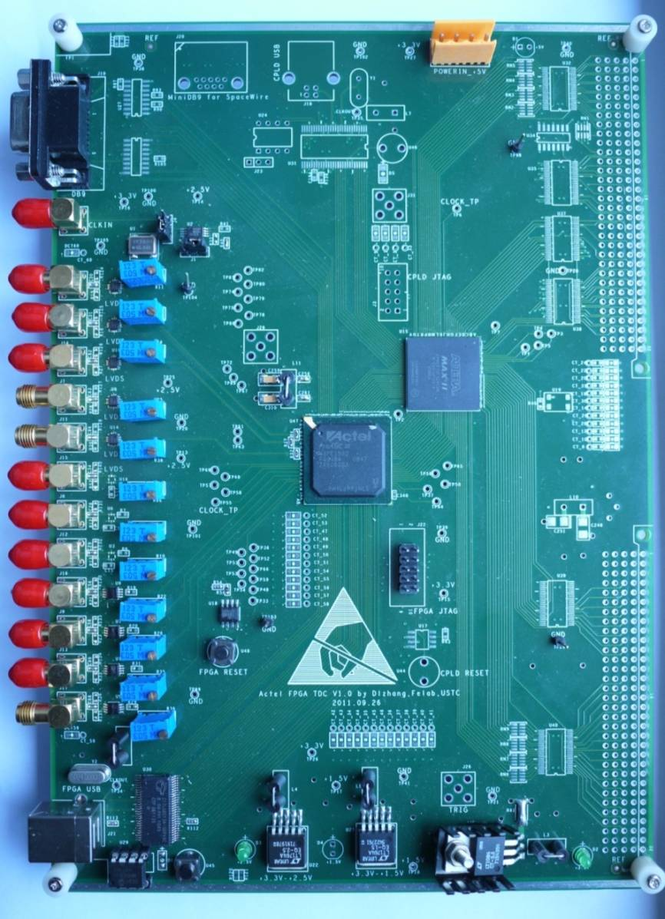
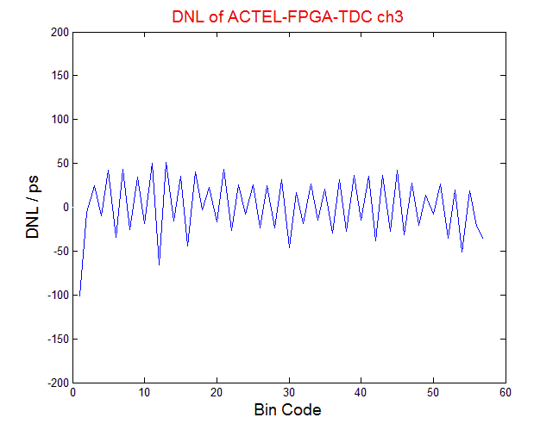
ACTEL FPGA：A3PE1500

