Slide 1


Ceph at CERN Overview on Infrastructure and Applications
Enrico Bocchi
CERN IT – Storage
CERN – Swisscom Meeting 17 October 2023

Slide 2
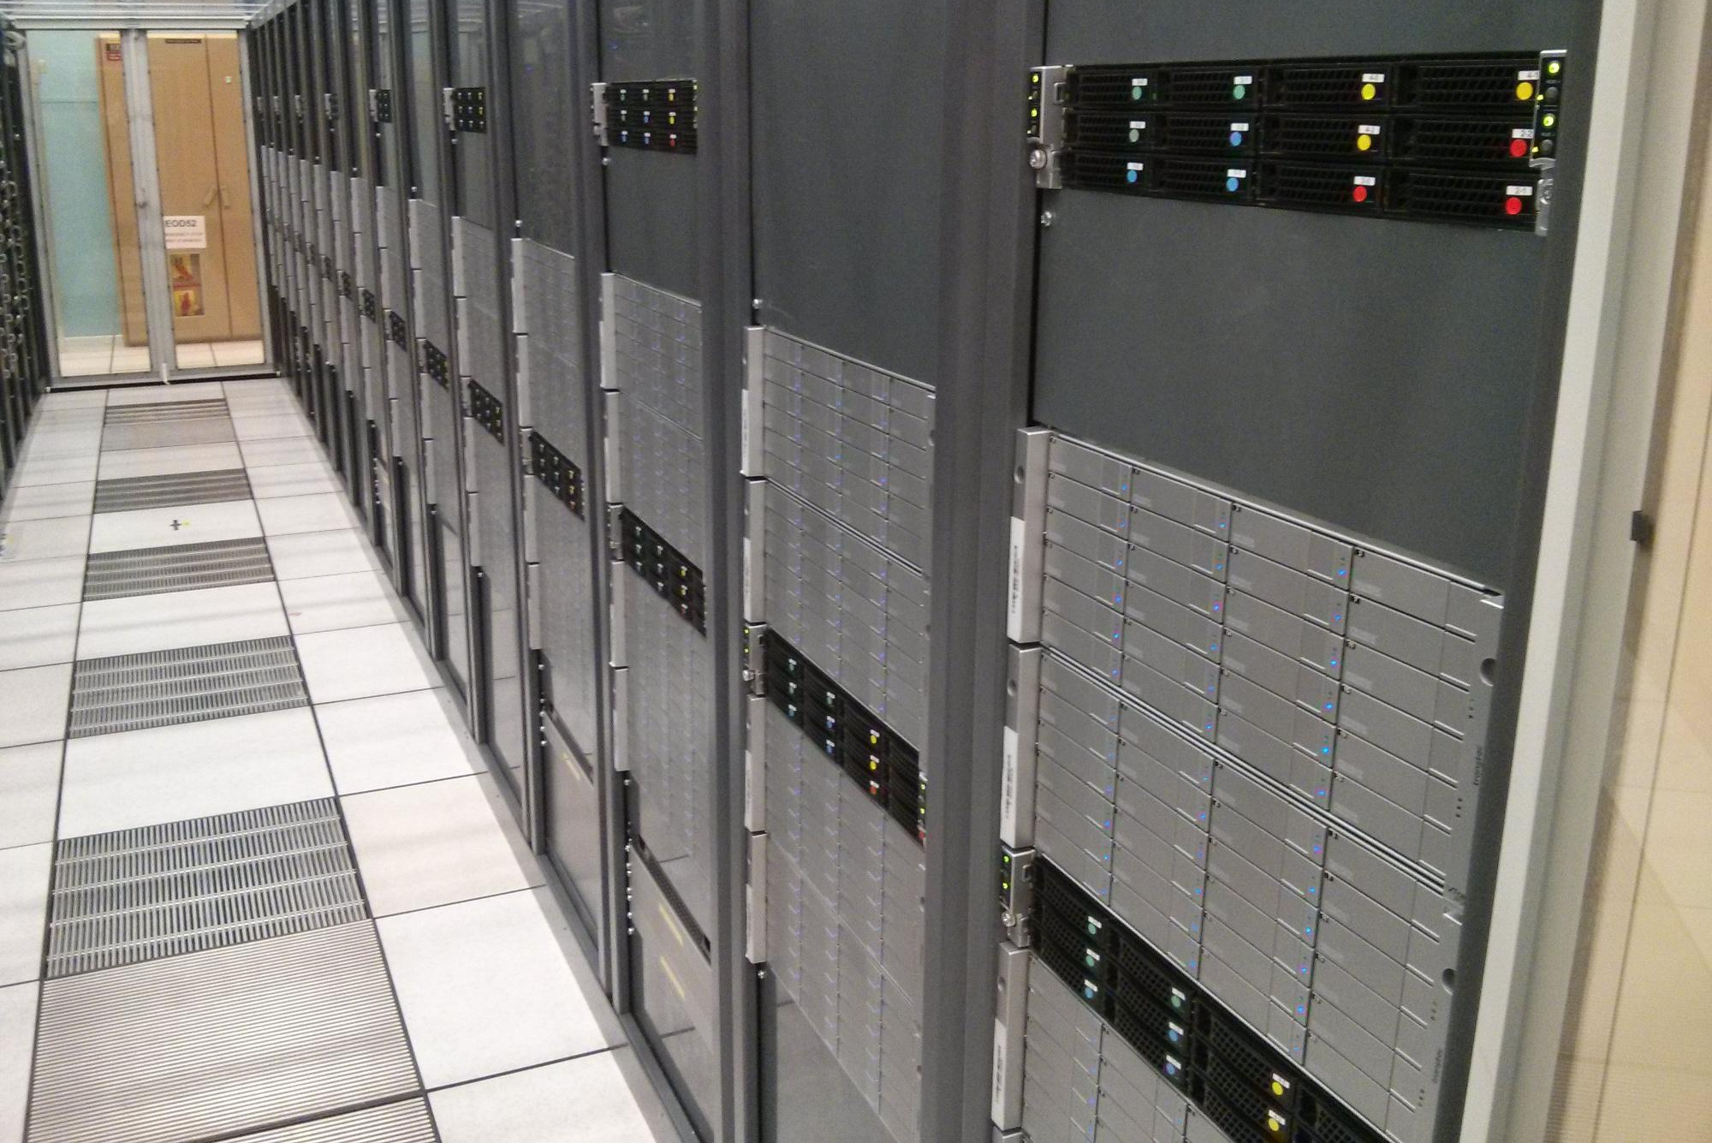
Ceph at CERN: The Early Days
First production cluster, mid 2013
OpenStack Cinder Block Storage
3 PB raw capacity
48 disk servers, 24x3 TB, 200 journaling SSDs
Ceph dumpling v0.67 on Scientific Linux 6
4 replicas initially, now 3 replicas or erasure coding

Slide 3

Service Growth
2013: 300TB proof of concept, 3 PB in production for RBD
2014-15: Erasure coding, Rados striper
2016-17: 3PB to 6PB with no downtime, 8 clusters
2018: S3 + CephFS in production
2019: Optimizing CephFS for HPC applications
2020: Backup cluster in 2nd location (S3, RBD)
2021: RBD Storage AZ, HW expansion
2022-23: 17 clusters ~74PB, BC+DR focus, DFS

Slide 4
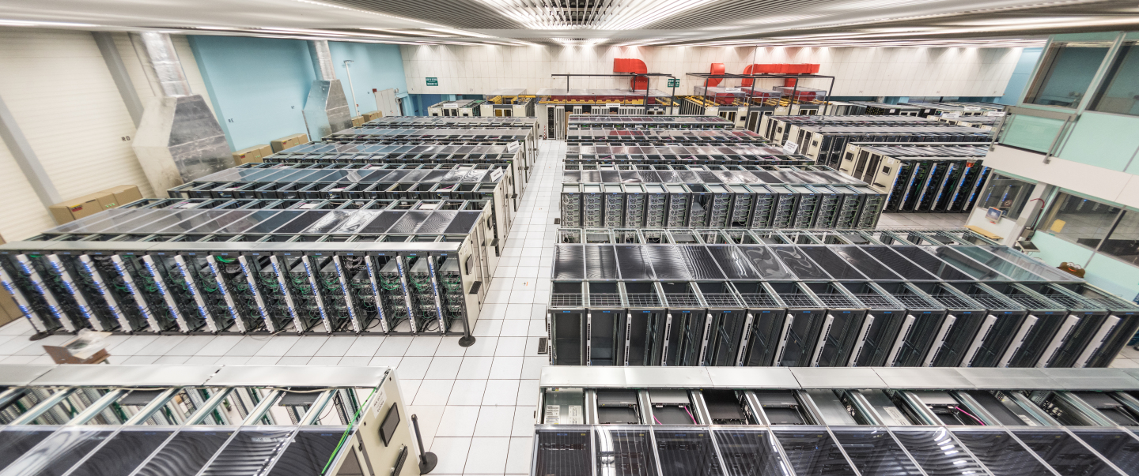
Ceph Hardware
17 clusters, 74 PiB raw
72 PiB spindles (journals on SSD/NVMe)
1.2 PiB full-flash
0.95 PiB full-flash, hyperconverged

Slide 5
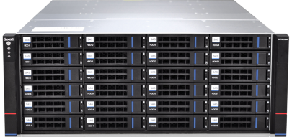
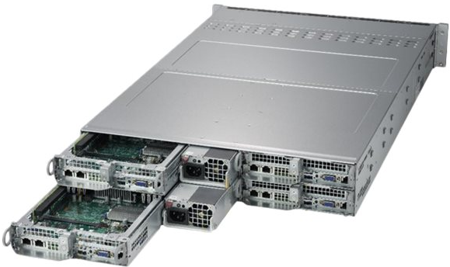
Hardware Configuration
HDD Ceph server General purpose, “Throughput Optimized” (Block: Up to 120 MB/s, 500 IOps)
Quad frontend:
1x (or 2x) SSD/NVMe M.2, 960 GB (system disk)
4x SSD/NVMes U.2, 3.84 TB each (journals)
192/256 GB, 16/24 cores, 1x 25 Gbps network
PCIe to SAS/SATA controller
2x JBODs:
24 slots 3,5” SATA
HDDs, 12/14TB (18 TB recently), 7200 rpm
Enterprise grade, CMR
24 slots JBOD
4 nodes frontend

Slide 6
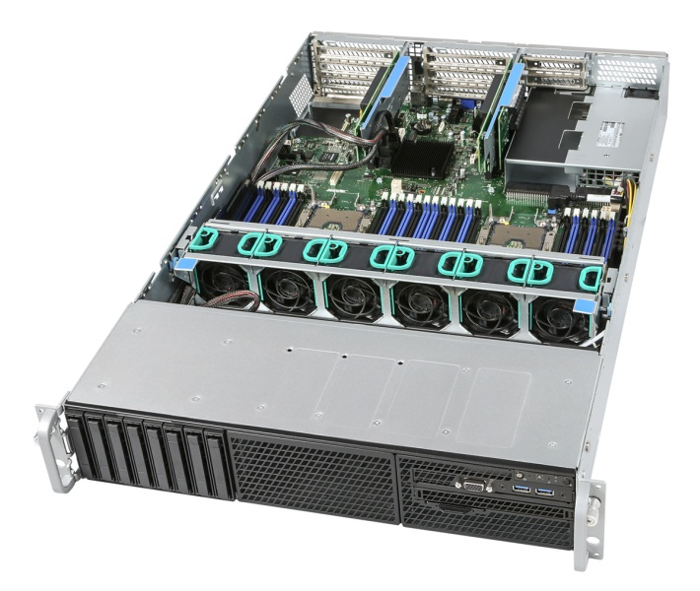
Hardware Configuration
Full-flash Ceph server “IOPS-Optimized” storage (Block: 300 MB/s, 1000 IOps)
1x SSD/NVMe, 960 GB (system disk)
16x SATA SSDs, 1.92/3.84 TB each
No dedicated devices for journals
25 Gbps network (+mgmt)
2U servers, typically installed ToR or BoR
Hyperconverged clusters
HPC servers, OpenStack Cloud hypervisors, …
Use available fast devices as osds, SSDs/NVMes 1 to 4 TB each
MONs, MGRs, MDSs run colocated or on dedicated VMs

Slide 7
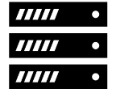


Network Configuration
Ceph has demonstrated to be very sensitive to network glitches
Over time, more problems coming from routing issues
Prefer to consolidate clusters within one broadcast domain – no need to cross routers
In most cases, one cluster behind a single L2 switch
Ceph servers have 1x 25Gbps link to ToR L2 switch
We have on network interface data (+1 for control via IPMI)
Clusters see 1 interface used for both cluster + client traffic
Switches connect to distribution routers with redundant links and LACP
Servers
Servers
L2 Switch
LACP
LACP
L3 Router
Backbone Routers

Slide 8
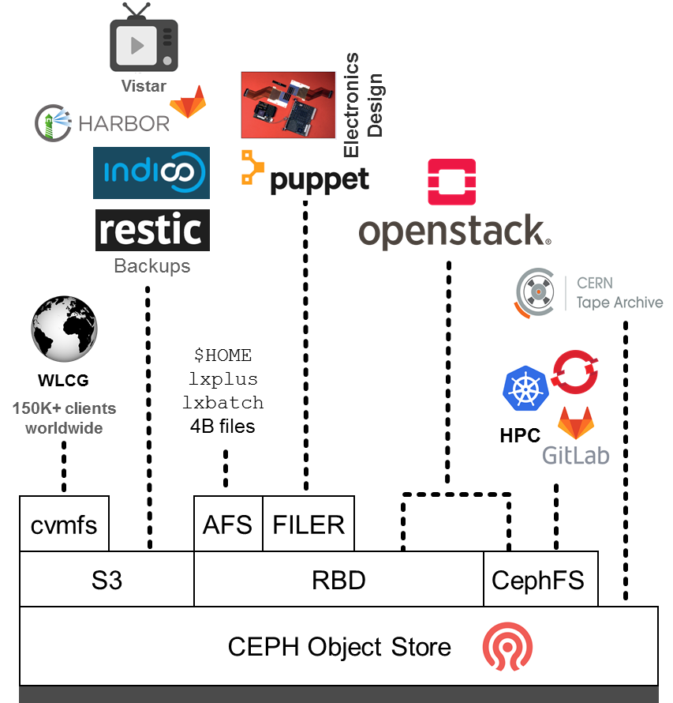
Ceph at CERN
IT Services:
Cloud Infrastructure: OpenStack, K8s, OpenShift
Code repositories, Container Registries, GitOps, Agile Infra
Monitoring: Open Search, Kafka, Gafana, InfluxDB, Kibana
Document Repositories // Web: Indico, Drupal, WordPress
Analytics: HTCondor, Slurm, Jupyter Notebooks, Apache Spark
Other Storage:
NFS Filers, AFS, CVMFS, CERN Tape Archive, …
Physics Experiments and End-Users:
Accelerator Complex Monitoring
Microelectronics Design
Engineering and Beams

Slide 9
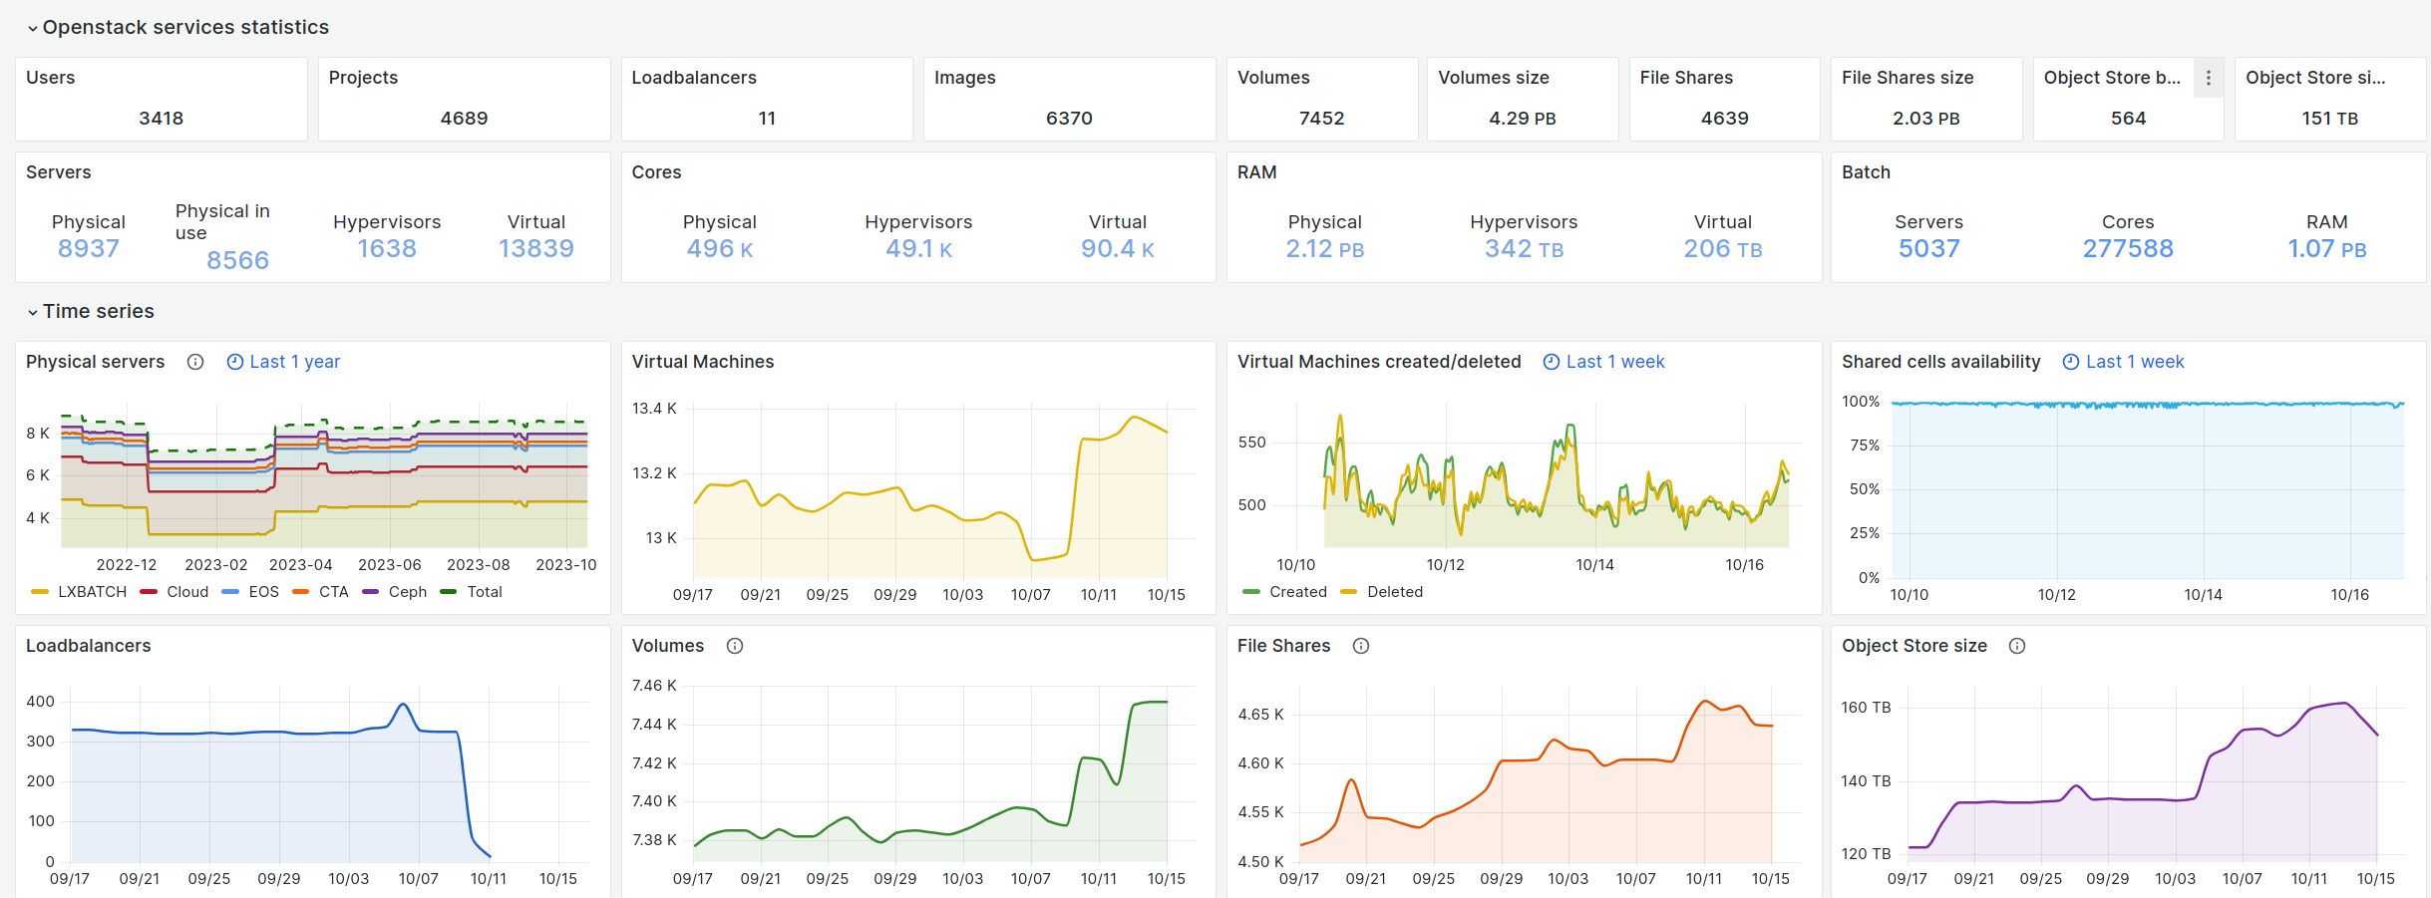
Ceph + OpenStack at CERN
Infrastructure as a Service, production since July 2013

Slide 10
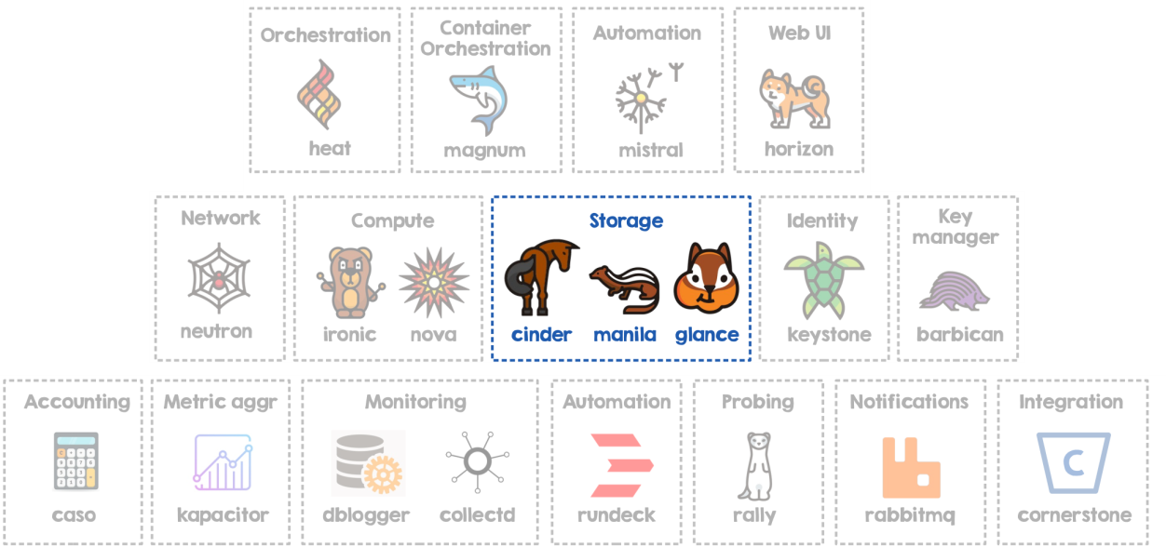
Ceph + OpenStack at CERN
OpenStack is the entry point for compute and storage resources
Cinder volumes and Glance images on Ceph RBD
Manila FileShares on CephFS
Quota management and accounting
Keystone integration for credentials:
cephx keys for CephFS access
Keypair for S3 object storage

Slide 11
Ceph Breakdown per Type
Application |  | Size (raw) | Version
RBD (OpenStack Cinder/Glance, krbd) | Production, HDDs | 25.2 PiB | Pacific, Quincy
Production, full-flash EC 4+2 |  | 703 TiB | Pacific
CephFS (OpenStack Manila – K8s/OKD PVs, HPC) | Production, HDDs | 14.3 PiB | Pacific, Quincy
Production, full-flash |  | 860 TiB | Pacific
Hyperconverged (HVs with flash storage) |  | 657 TiB | Octopus
CERN Tape Archive (CTA) | Tape DB and Disk Buffer | 235 TiB | Octopus
RGW (S3 + SWIFT) | Production (4+2 EC) | 4.7 PiB | Pacific
RGW (Backup to 2nd Location) | Production (4+2 EC, 3 replicas) | 23.2 PiB | Pacific

Slide 12
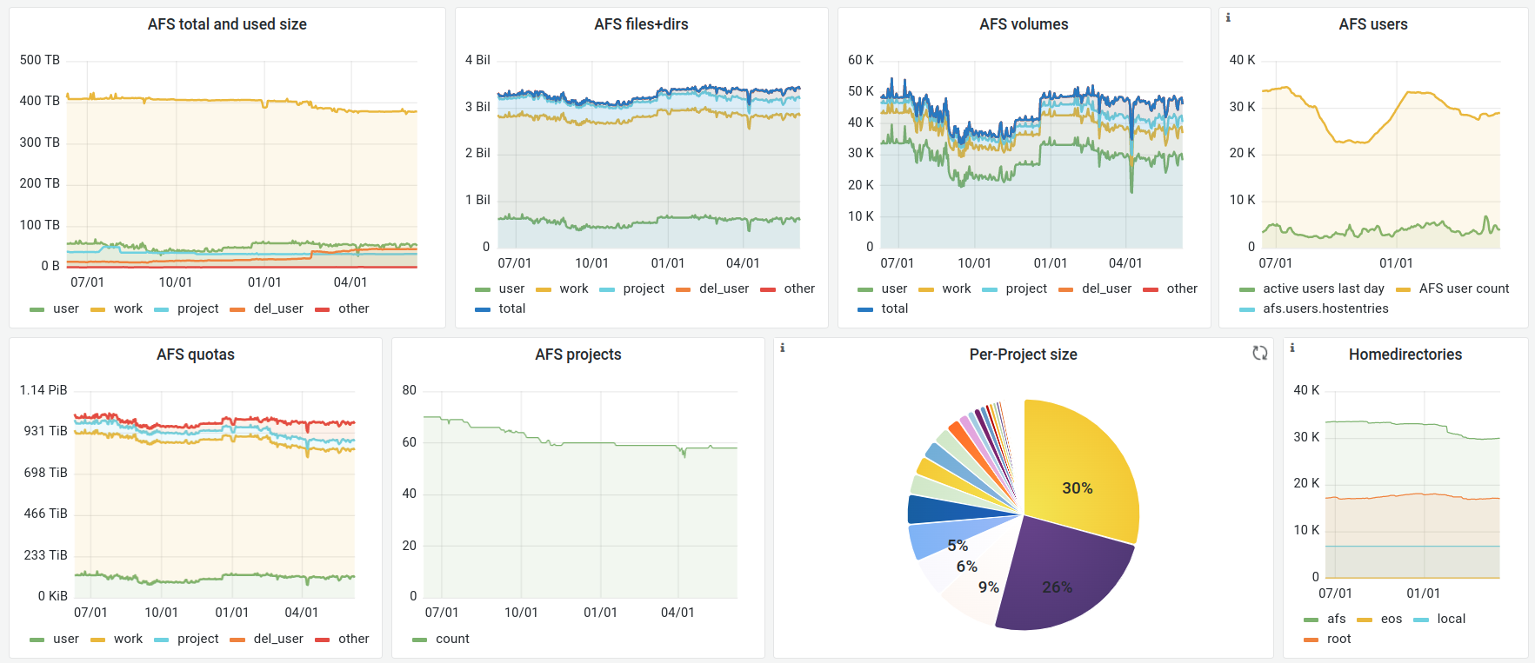
RBD: Virtualization of AFS and NFS
OpenAFS is single biggest customer on RBD
Personal storage space ($HOME), shared space for project and experiments
Scripts, docs, configuration, SW development
AFS servers are VMs with RBD attached
800 TiB over 216 volumes
NFS filers as alternative to NetApps
Cluster of VMs + RBD volume with nfsd server
ZFS – Snapshots, rollbacks, backups (zfs send/receive)
Thin-provisioned and on-line resizable
Not highly-available, but worked nicely for many use cases
We could do better using DRBD, Pacemaker, …

Slide 13
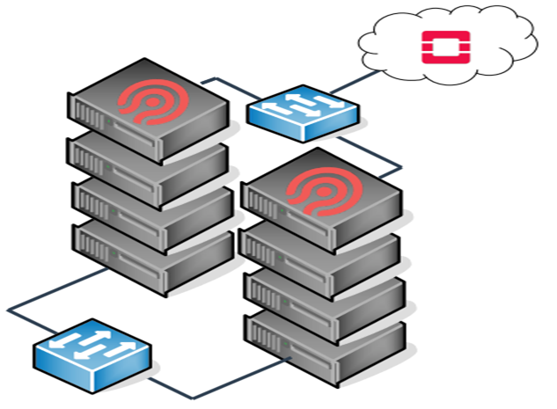




CephFS: Containers Storage and HPC
Started in 2017 as POSIX fs backing HPC resources
Build HPC clusters with commodity parts and open-source software
Compute is MPI scheduling with HTCondor + Slurm
Storage is CephFS on 2 clusters (HDD +Full-flash hyperconverged)
Integrated in OpenStack Manila since Q2 2018
Self-service provisioning of CephFS “shares”
Consumption automated via Puppet or Ceph CSI (github.com/ceph/ceph-csi)
Provides an interface between a CSI-enabled Container Orchestrator and the Ceph cluster
Supports kernel/FUSE CephFS client
Support for share expansion and snapshots
Intel Xeon E5 2630, 128GB
RDMA Interconnect (compute)
CephFS with OSDs on compute nodes
4x 960GB Intel S3520
10Gb Ethernet (storage)
Compute + Storage Hyperconverged

Slide 14



RadosGW: Object Storage
Main production cluster: s3.cern.ch
4+2 EC for data, 3x replication for Bucket Indices
Exposed through DNS load-balanced alias with 20 IPs (v4 + v6)
Traefik frontend + 16 RGWs clustered into groups of users/apps
Traefik as frontend and application-level router
TLS termination, RadosGW health-check
Dynamic routing based on pattern matching on path // virtual host
s3.cern.ch
routers:
s3_gitlab:
rule: PathPrefix(`/gitlab`) || HostRegexp(`{pattern:gitlab.*}`)
service: gitlab
services:
gitlab:
loadBalancer:
servers:
- url: http://rgwxl-gitlab1.cern.ch:8080
- url: http://rgwxl-gitlab2.cern.ch:8080
- url: http://rgwxl-gitlab3.cern.ch:8080
mybucket.s3.cern.ch
gitlab.s3.cern.ch
s3.cern.ch/gitlab

Slide 15
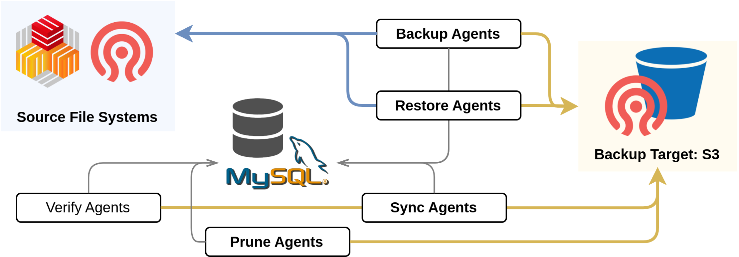
RadosGW Object Storage
Second S3 cluster for backups (~5 Km away)
~2000 OSDs, 25 PiB raw (4+2 EC)
Fully decoupled from s3.cern.ch – Not a 2nd zone (yet?)
cback – Backup orchestrator based on Restic
Addition of horizontally-scalable agents and centralized queue to keep track of jobs status
Used to backup CERNBox + (part of) CephFS – Integration with OpenStack Manila in progress
Source: (virtually) Any mounted FS
Destination: Ceph S3
~48k daily backup jobs
850+ M files processed
5.7+ PB backed up to S3

Slide 16
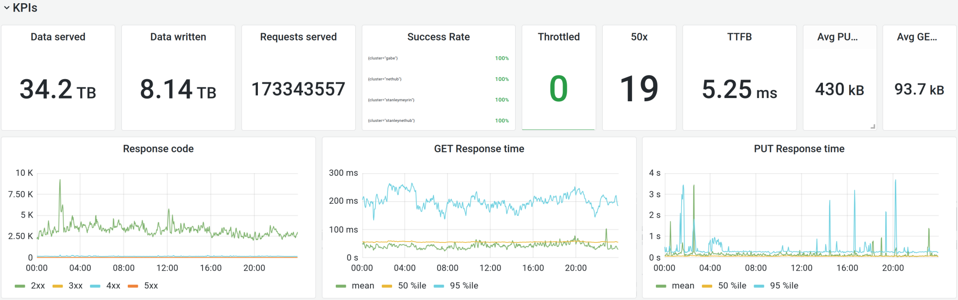
RadosGW: One Day on s3.cern.ch

Slide 17
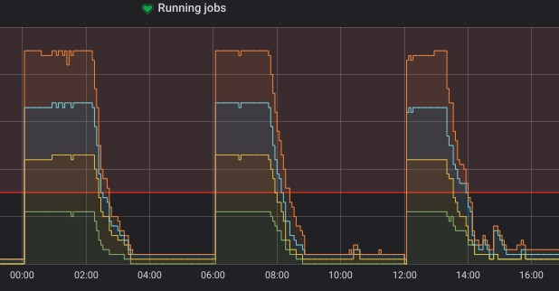
RadosGW: Impact of Flash Storage for BS’ WAL+DB
Since BlueStore (circa 2017 – Ceph Blog):
Objects (i.e., the actual payload) are read/written by directly accessing blocks of a device
BS Journal and Write-Ahead Log (WAL) which should go to a faster device
BS internal metadata are stored on RocksDB, opportunistically stored on fast devices
Early 2019, upgrade cluster to BlueStore + bucket indexes on SSD
Previous setup: 1x40GB SSD used as journal per 5-6 HDDs
Now: SSDs reused to keep BlueStore's RocksDB
Massive metadata performance increase
Sample workload:
yum-reposync from >2hr to ~1.2hr
~2KHz each on FileStore and HDD
Metric | Rate
PUT (new) | 83kHz ± 4kHz
HEAD (not found) | 63kHz ± 2kHz
DELETE | 198kHz ± 15kHz

Slide 18
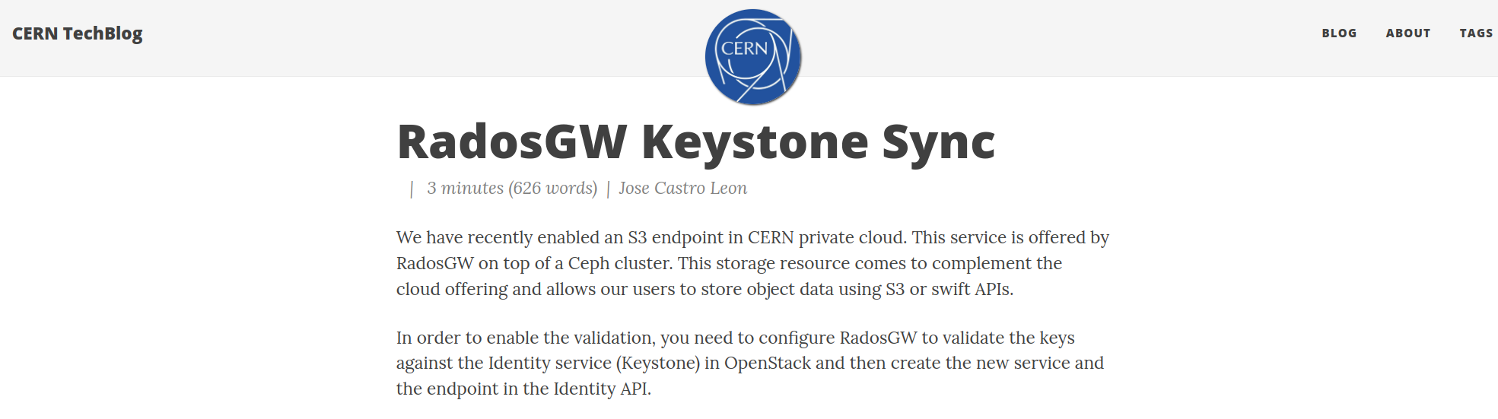
RadosGW Keystone Sync
Ceph-native integration with Keystone is slow
Each S3 operation checks OpenStack Keystone for permission
Blocking IOps at storage level resulting in very high latency
Solution: Synchronize Keystone credentials to RadosGW
OpenStack Mistral job writes the OpenStack credentials into RadosGW local users
Quota/Auth still managed by Keystone with local authentication performance

