Slide 2
Summary of LHC operation: issues and prospects for Run 3
M. Solfaroli
On behalf of the LHC team
In particular to: R.Bruce, A.Lechner, S.Redaelli, R.Steerenberg for the material

Slide 3
Outline
2023 operation recall of main events
2023 operation in numbers
Outlook for 2024
The following topics are NOT part of this presentation:
Technical details of the faults (ONLY impact on operation) - see talks by Sandrine, Chiara, Calum,…
Machine configuration – see Tobias’ & Filip’s talks
Heat Load – see tomorrow morning session (in particular Kostantinos’ talk)
Injection losses – see Yann’s talk
Commissioning & special runs – see David’s & Tobias’ talks
10 Hz – see Tobias’ & Maria’s talks
QPS-SEU during ION run – see Jens’ talk

Slide 4
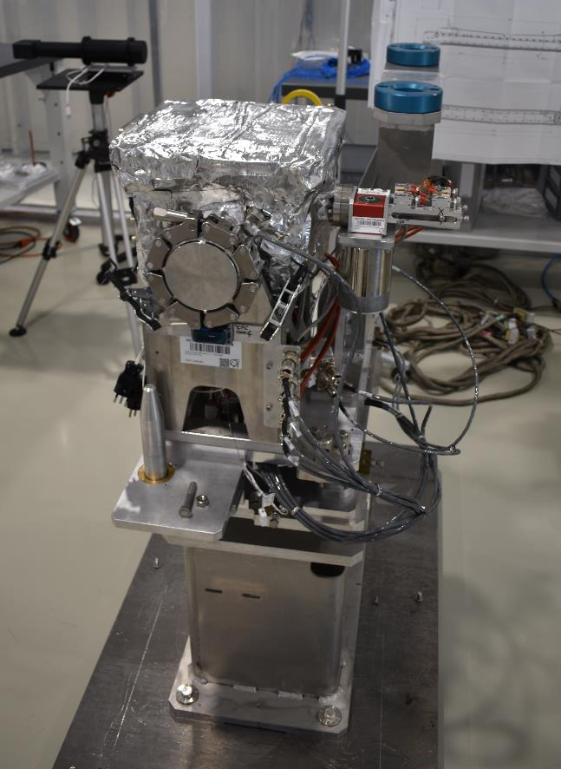
18.03.2023
Crystal collimator
Non-Conformity appeared during testing
p run
IONS run
March
April
May
June
July
August
September
October

Slide 5
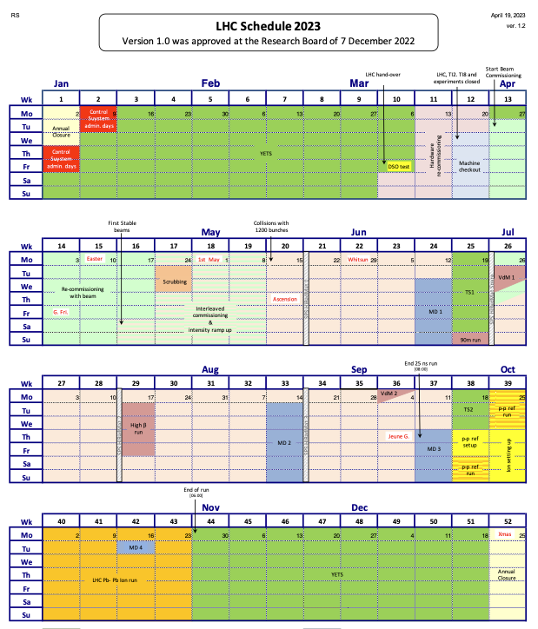
V1.0 vs V1.2
+1 day to YETS – broken crystal removal
+1 day more to TS#1 - crystal re-installation
1 wk advancement for scrubbing
Definition of the special physics runs
MD#2 postponed by ~2wks
Activity | V1.2 | V1.0
Beam Commissioning & Intensity ramp-up | 46 | 47
Scrubbing | 2 | 2
25 ns physics (>1200 bunches) | 96 | 97
Special physics runs (incl. setting-up) | 7 | 7
Pb-Pb ions & p-p ref. setting-up | 6 | 6
Pb-Pb ions physics & p-p ref. run | 32 | 32
Technical stop | 8 | 8
Technical stop recovery | 2 | 2
Other stops | 2 | 0
Machine Development blocks (incl. floating MDs) | 16 | 16
Total: | 217 | 217

Slide 6
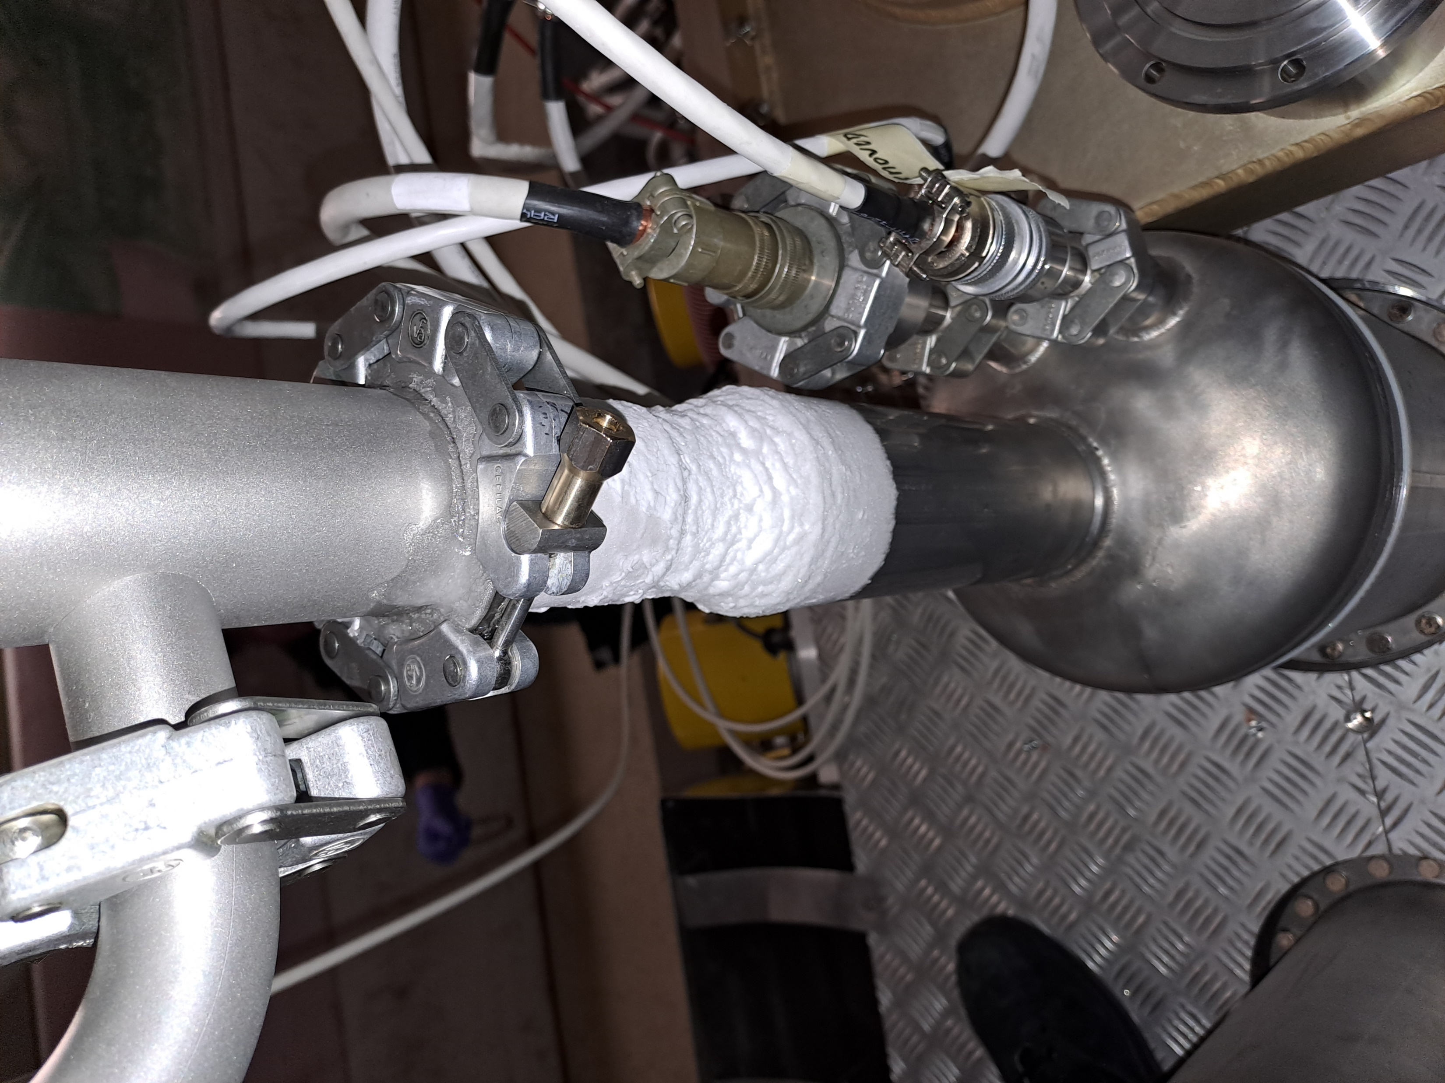
18.03.2023
Crystal collimator
Non-Conformity appeared during testing
p run
IONS run
March
April
May
June
July
August
September
October
02.04.2023
RF Rupture discs following IP4 SVC trip

Slide 7
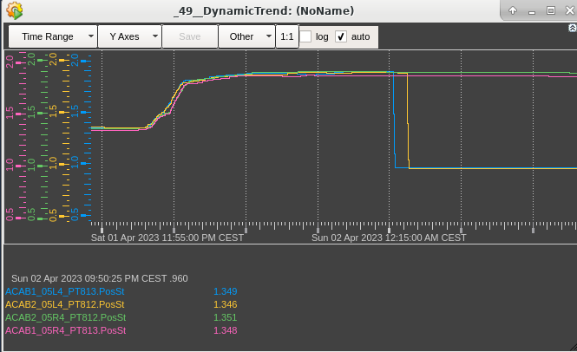
RF burnt disk
Outcome of RF taskforce (LMC #454)
New safety valve configuration (opening at 1.7 bar)
Successful commissioning of WRL ➔ in case of power cut, we still rely on passive protection
New rupture disk ➔ installed in the YETS
Review of disk replacement procedure to limit exposure time
Cryomodule
He pressures
The event
Sat (01.04) 23:57:
  Loss of IP4-SVC -> He pressure in RF cavities increased -> release valves opened @1.7 bar
  Pressure stabilized at around 1.9 bar, as expected
Sun 00:15, 00:16:
  Two rupture discs burst ➔ replaced in within 3h
Recovery
Monday morning:
  Cryo conditions re-established
  RF conditioning to check performance
  No significant degradation observed, full conditioning completed in 24h
Tue @9am: Ready for beam (~2 days)
Mitigation (ECR): Installation of a fast-depressurising valve on the ACS cryomodules

Slide 8
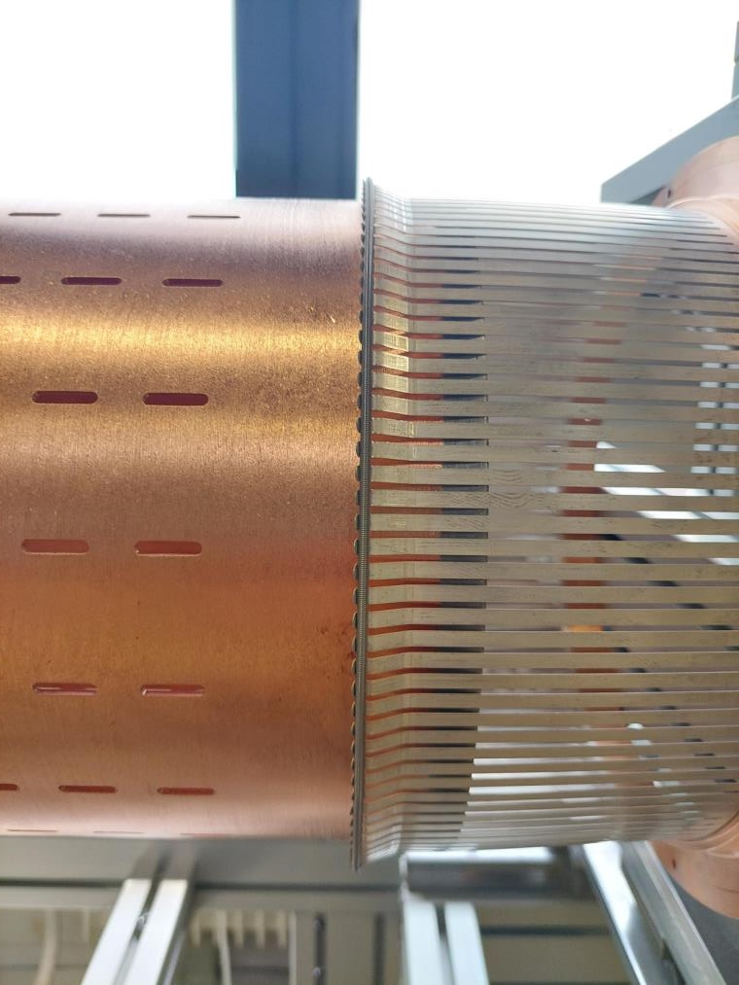
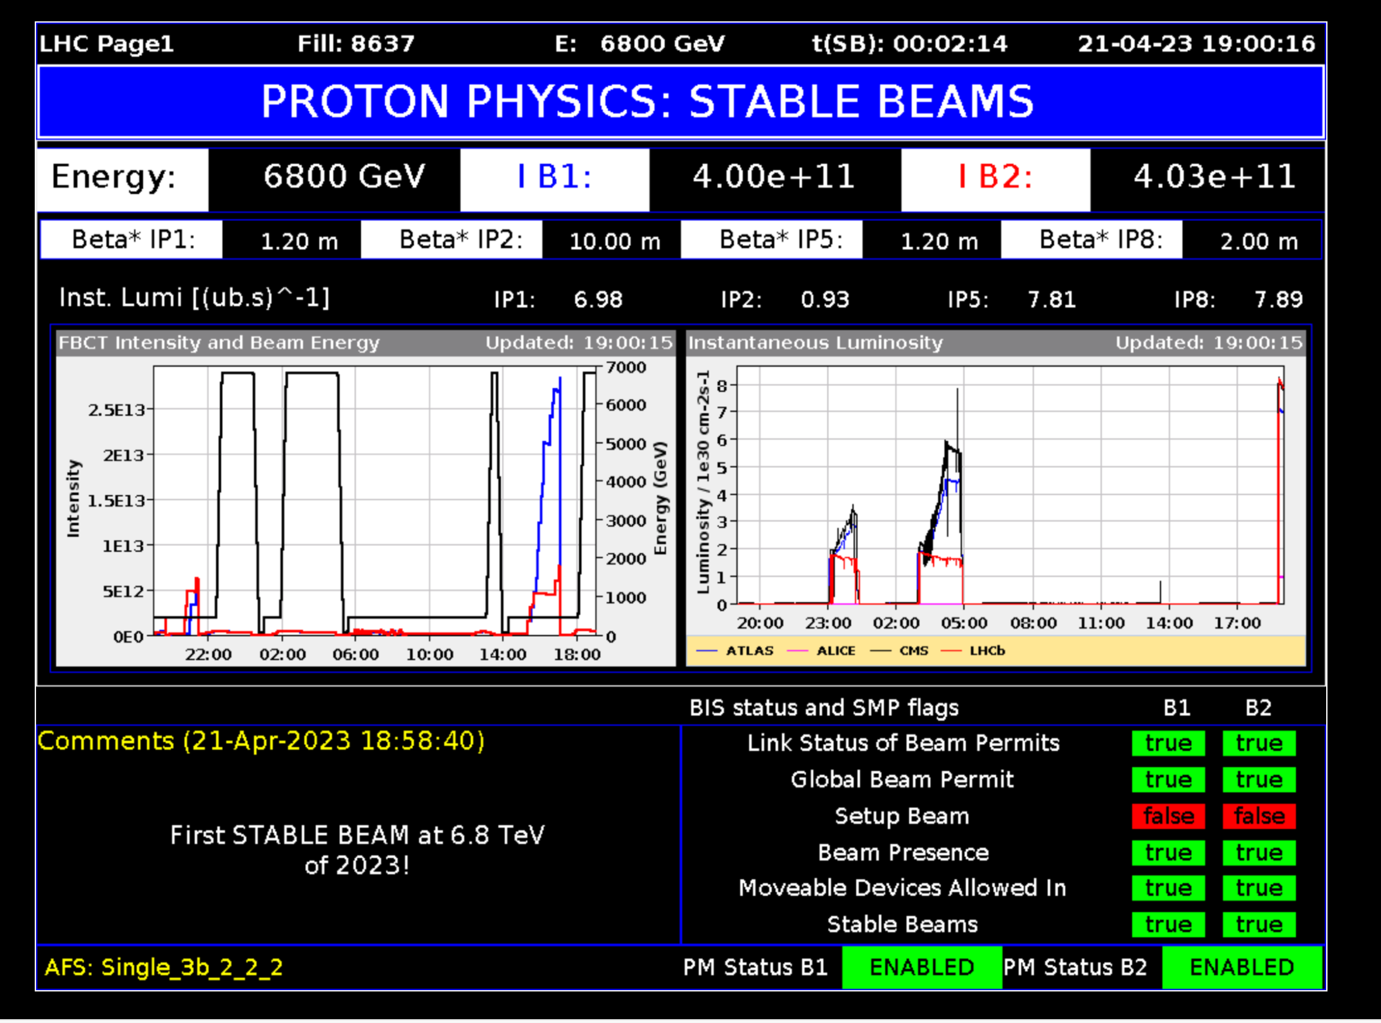
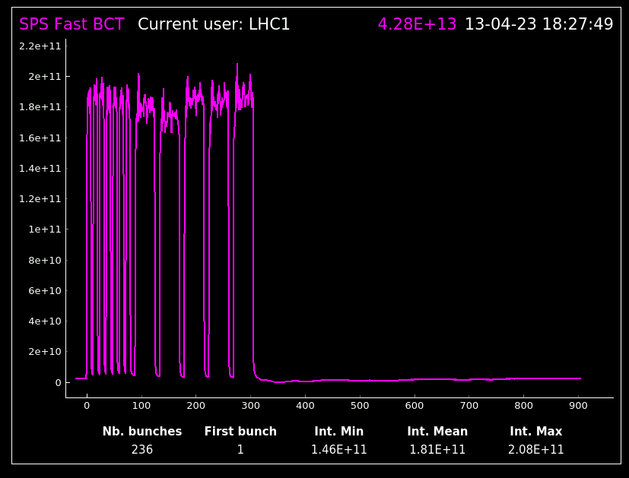
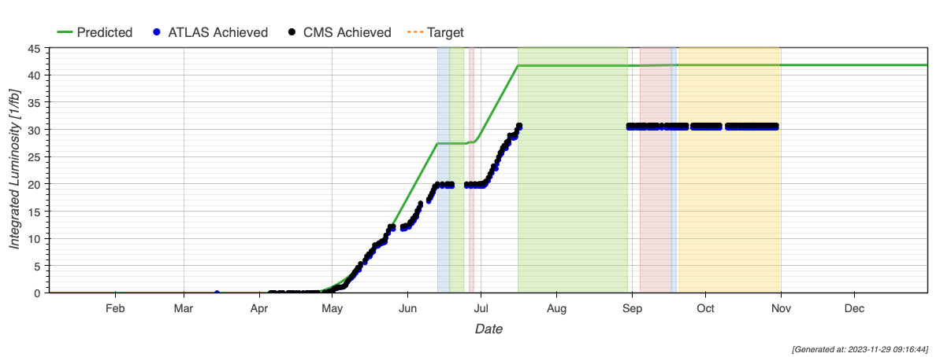
21.04.2023
1st stable beam (3bx3b)
24.05.2023
RF finger module Vacuum spikes caused by beam induced arcing/heating
18.03.2023
Crystal collimator
Non-Conformity appeared during testing
p run
IONS run
March
April
May
June
July
August
September
October
02.04.2023
RF Rupture discs following IP4 SVC trip
12 fb⁻¹ in ~1month
12.05.2023
1st collisions with 2374 b (mixed scheme to minimize HL)

Slide 9
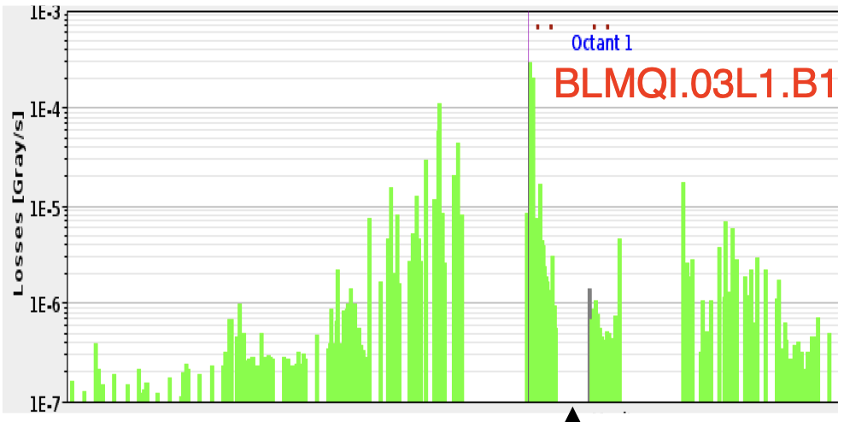
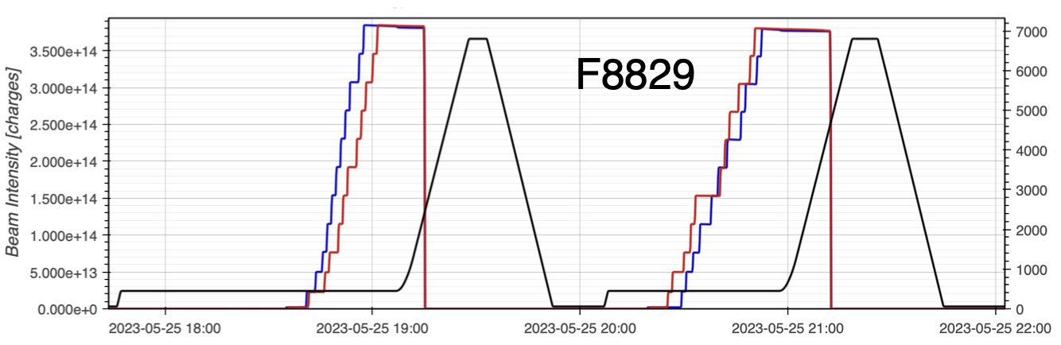
RF Finger - observation
Investigation
Losses maps and aperture check
X-rays
Installation of BatMon
New BLM layout – 3 new BLM per side
Replacement of vacuum module
ONLY partial bake-out
Dumps at beginning of the ramp by slow losses left of IP1 (peak in Q3L1)
Losses not synchronised with IP7 losses
Indication that losses are from both beams
Sign of degraded situation while injecting
Measurements indicate that vacuum activity is trigger primarily by B2
See C. Antuono for technical details

Slide 10
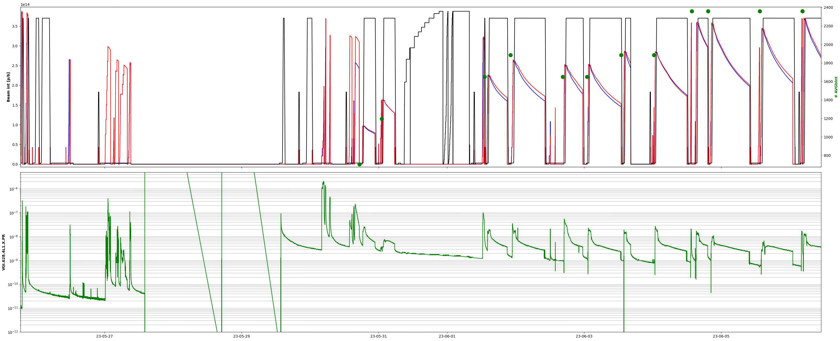
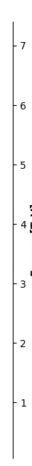
RF finger - price
Dump by losses
1886 b
1650 b
2358 b
4.5 (physics) days lost for investigation and intervention
Quick intensity ramp-up, start-up with “no major event”
About 5 days of conditioning needed
Investigation
Vacuum module replacement
MKB flashover
The issue will be (partially) addressed during YETS 23-24
LIMITATION: Max bunch intensity = 1.6x10¹¹ p/b
See C. Antuono for technical details

Slide 11
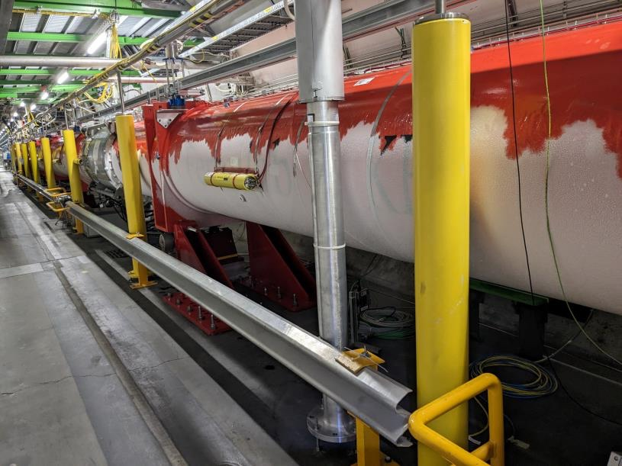
21.04.2023
1st stable beam (3bx3b)
20 fb⁻¹ in ~1.5month
24.05.2023
RF finger module Vacuum spikes caused by beam induced arcing/heating
18.03.2023
Crystal collimator
Non-Conformity appeared during testing
p run
IONS run
March
April
May
June
July
August
September
October
02.04.2023
RF Rupture discs following IP4 SVC trip
12 fb⁻¹ in ~1month
12.05.2023
1st collisions with 2374 b (mixed scheme to minimize HL)
17.07.2023
Power glitch, magnet quench, and leaking bellow in IT.L8

Slide 12
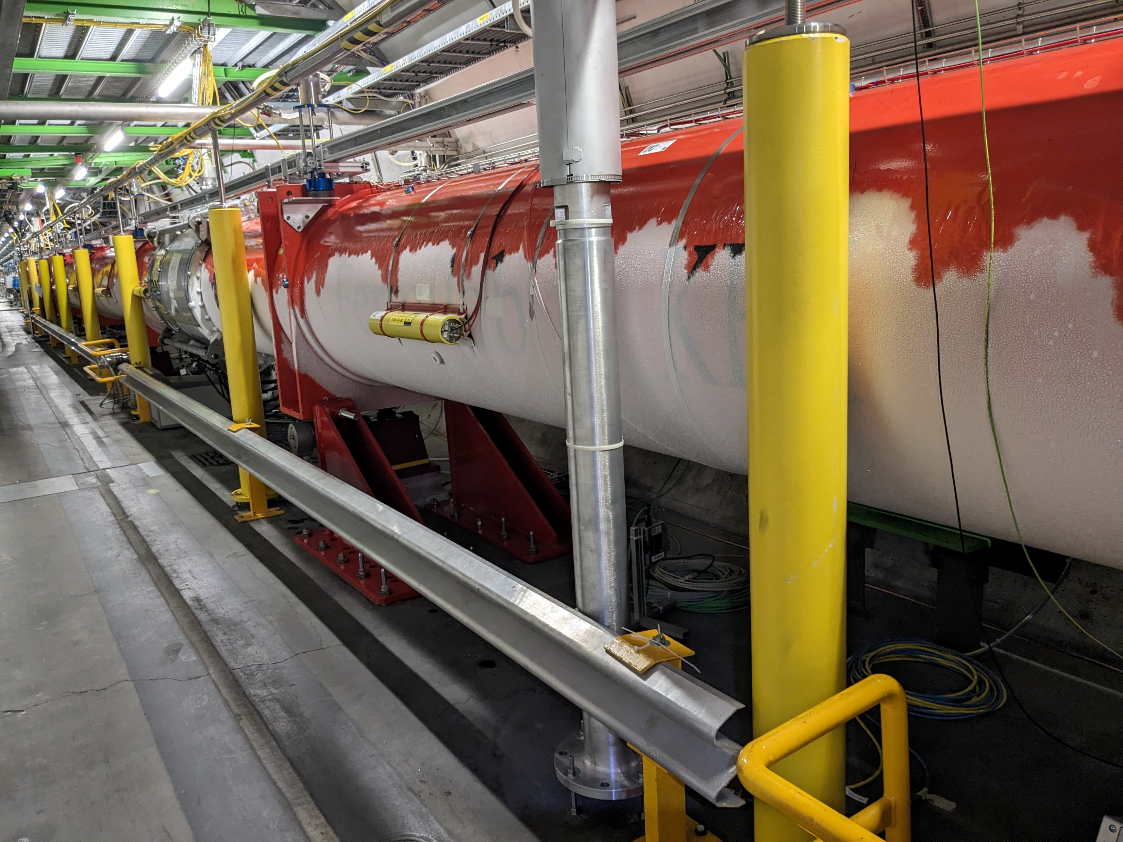
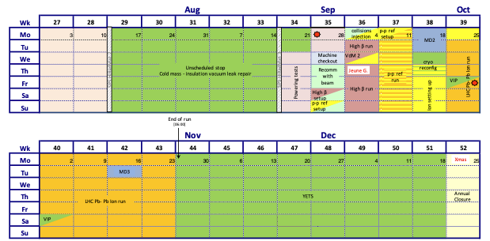
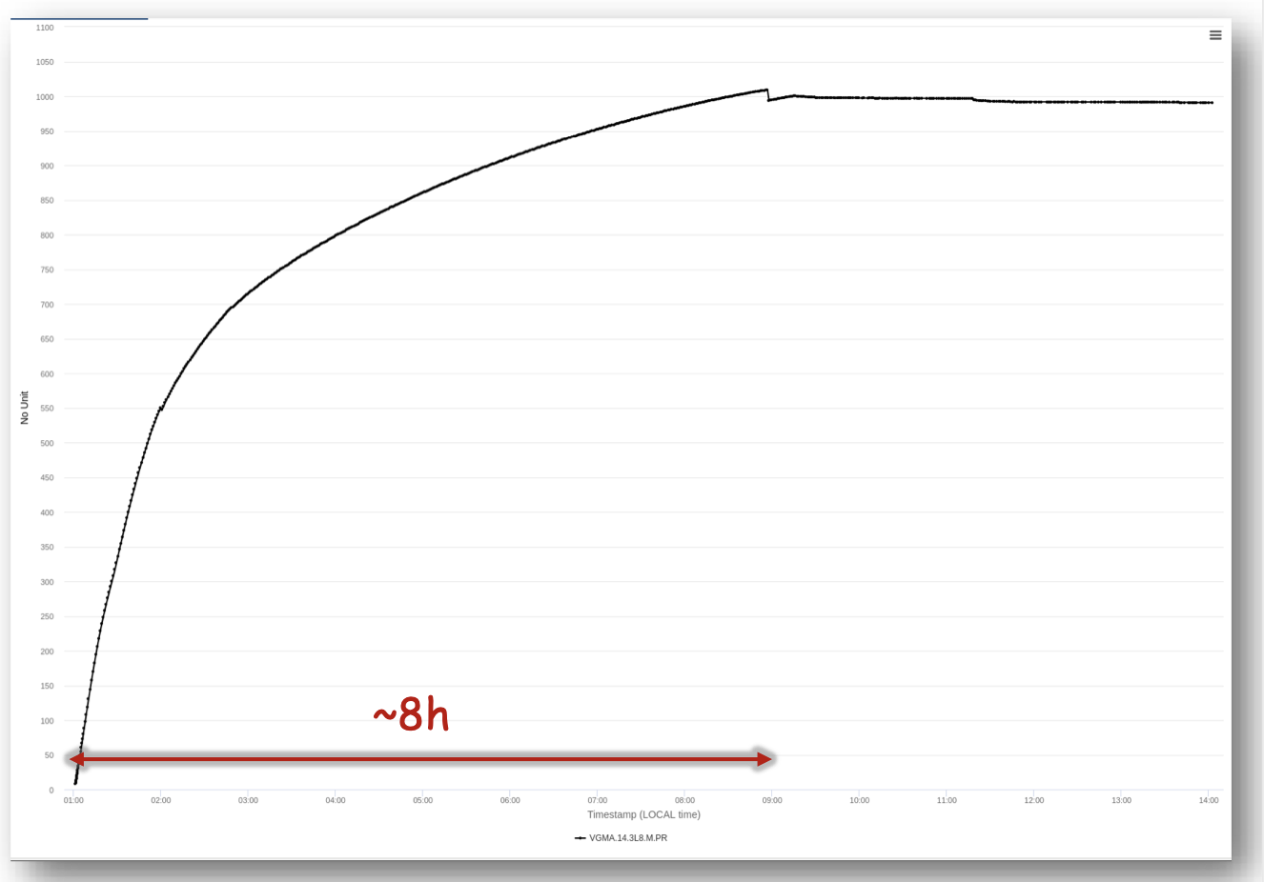
V. 1.4
V1.4 IT triplet incident
Unscheduled stop wk 29 - wk 34
Powering tests & beam re-commissioning
Anticipation of p-p reference and Pb ion runs
Reduced MD block
Plus other minor changes
Beams dumped at 01:00:17 on July 17th by RF trip, 370 ms later several magnets quenched:
RQ7/9/10.R4
RQ10.R8
RQX.L8
Insulation vacuum
See S. Le Naour for technical details

Slide 13
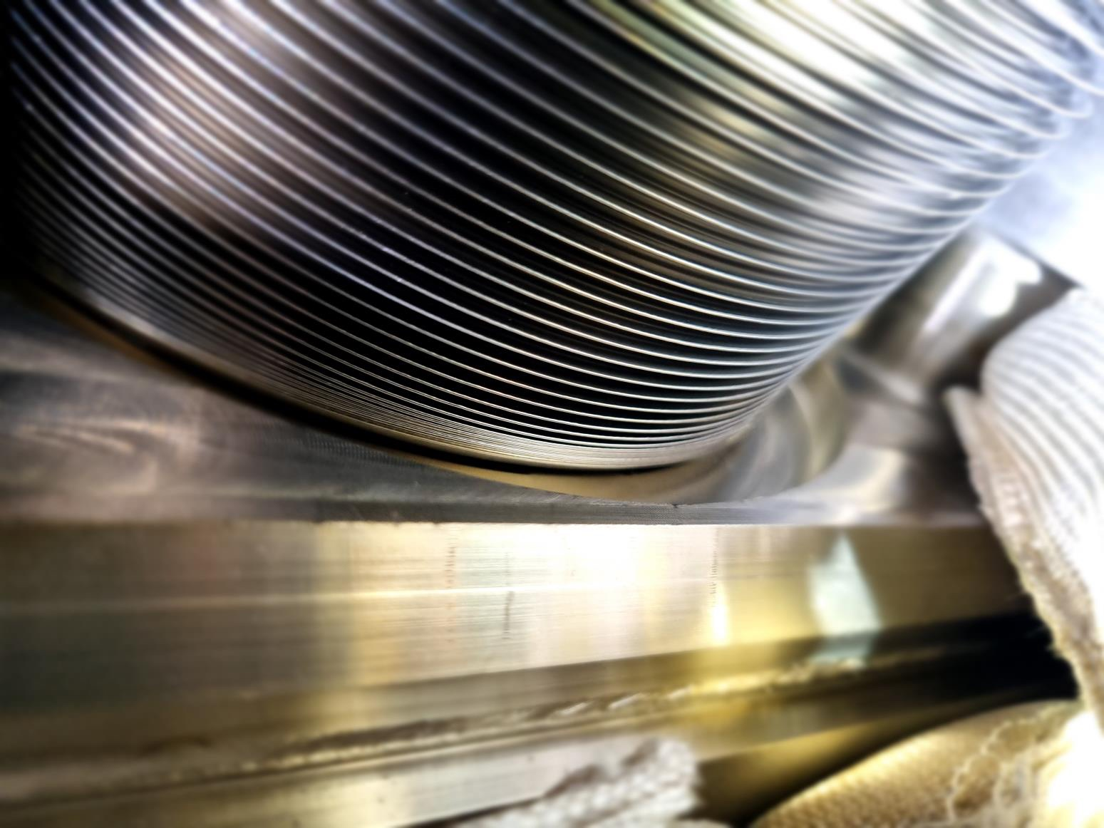
31.08.2023 (B)
08.09.2023 (A)
2 vacuum leaks on IP8-TDIS
Preventing p operation, but Pb ion possible
21.04.2023
1st stable beam (3bx3b)
20 fb⁻¹ in ~1.5month
24.05.2023
RF finger module Vacuum spikes caused by beam induced arcing/heating
18.03.2023
Crystal collimator
Non-Conformity appeared during testing
High Beta + recommissioning
p run
IT.L8 fault
IONS run
March
April
May
June
July
August
September
October
02.04.2023
RF Rupture discs following IP4 SVC trip
12 fb⁻¹ in ~1month
12.05.2023
1st collisions with 2374 b (mixed scheme to minimize HL)
17.07.2023
Power glitch, magnet quench, and leaking bellow in IT.L8

Slide 14
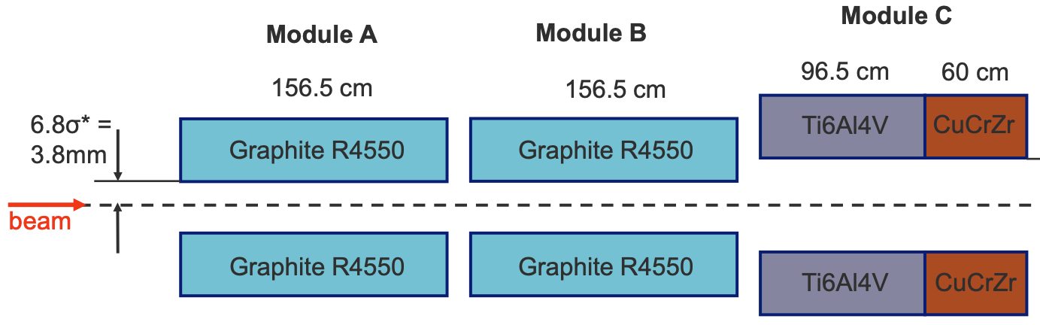
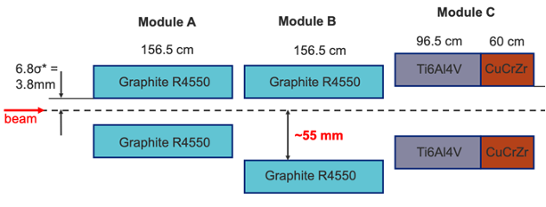
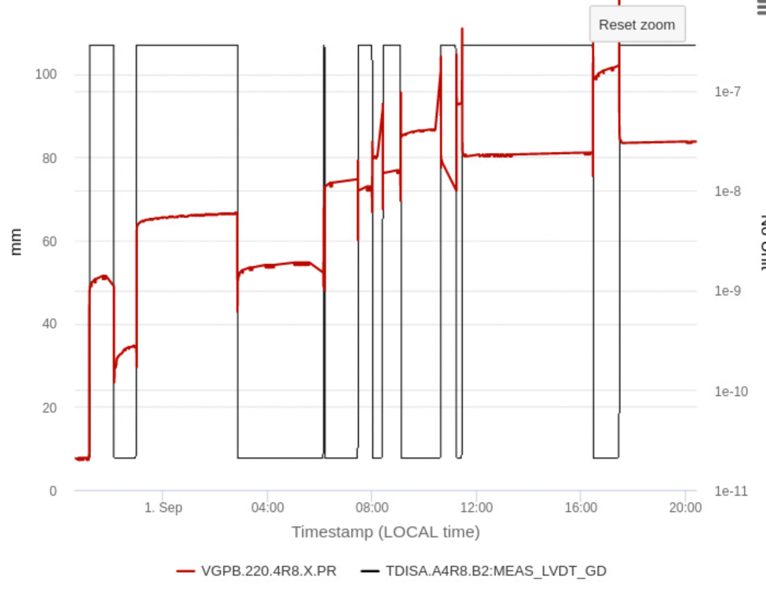
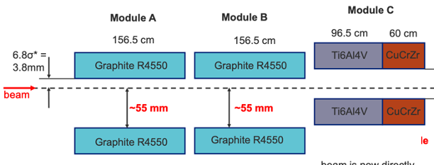
TDIS implications
Nominal
configuration
On Sep 1st beams dumped when opening TDI, as vacuum reached interlock threshold (vacuum valves closed)
A vacuum leak had developed on IP8-TDIs, starting on Aug 31st - slowly but continuously degrading at every cycle
An additional leak on another bellow appeared on Sep 9th
The areas were varnished, and the TDI configuration modified to limit mechanical stress
First leak
Degraded
configuration
Further
degraded
configuration
Second leak
See C. Sharp for technical details

Slide 15
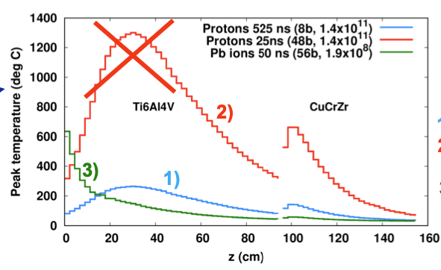
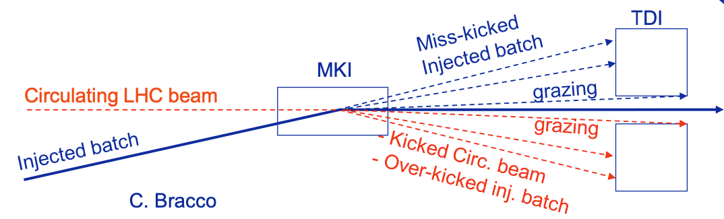
TDIS implications
Exhaustive studies (LMC#472) were done to evaluate the risks of running with TDIS in degraded configuration:
protons: recommended not to exceed 8 bunches (1.4x10¹¹ pb) per injection and not more than 8 bunches within ~4𝜇sec window (limitation to ~100 bunches)
IONS: nominal Pb (1.9x10⁸ Pb/bunch) are acceptable -> localized damage possible
➔ Cancel (postpone) the pp reference run
No additional spares until mid 2024
Both TDIS replaced by present spares during YETS 23-24
However, the spare TDIS are equipped with same non-conform bellows
  Limit mechanical stress under discussion
  Possible limitation in case of failure (NO additional spare until mid 2024)
See C. Sharp for technical details

Slide 16
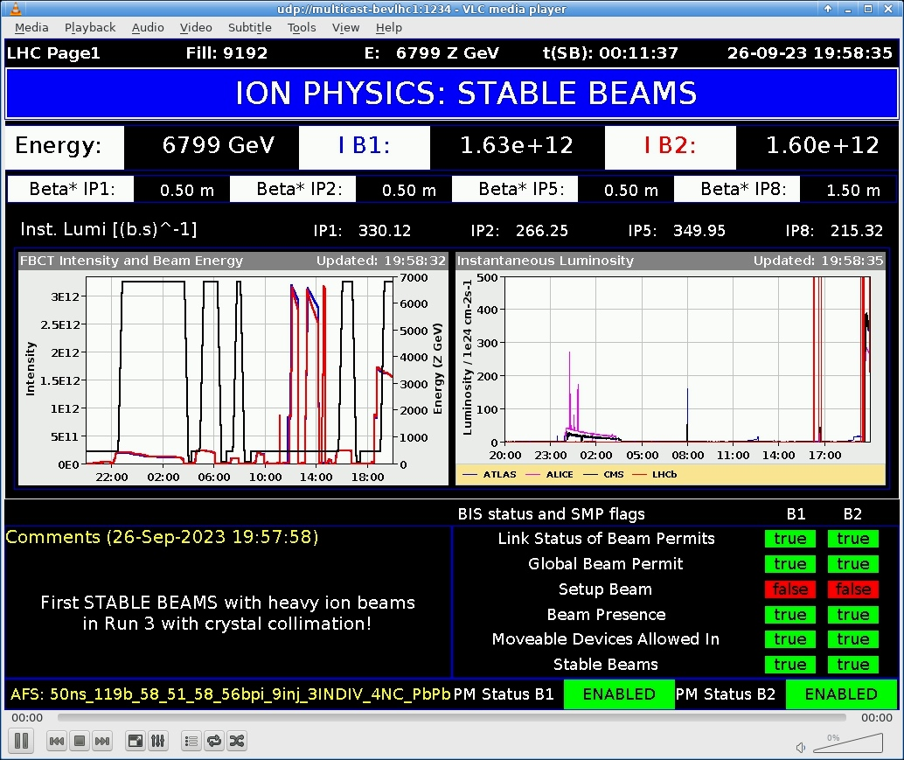
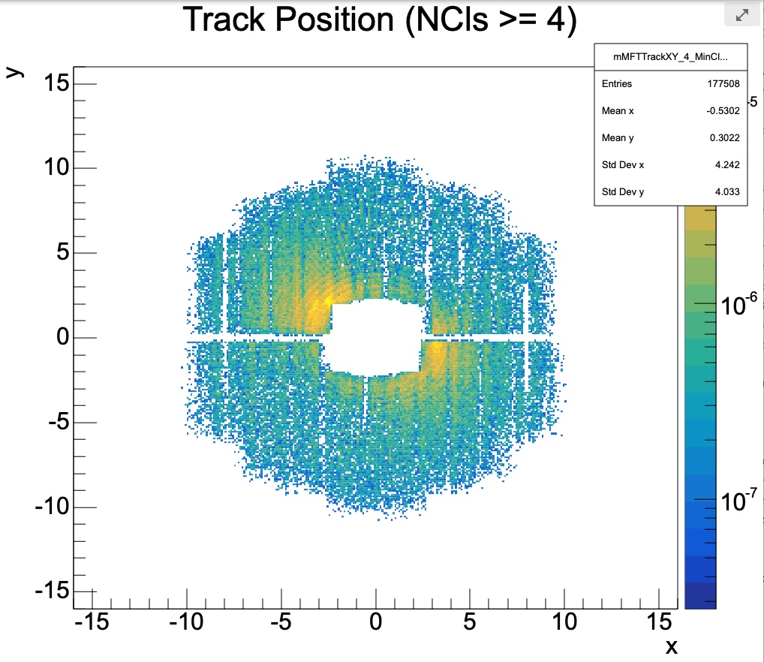
31.08.2023 (B)
08.09.2023 (A)
2 vacuum leaks on IP8-TDIS
Preventing p+ operation, but Pb ion possible
21.04.2023
1st stable beam (3bx3b)
20 fb-1 in ~1.5month
24.05.2023
RF finger module Vacuum spikes caused by beam induced arcing/heating
18.03.2023
Crystal collimator
Non-Conformity appeared during testing
26.09.2023: 1st stable Pb ion beam of 2023
High Beta + recommissioning
p run
IT.L8 fault
IONS run
March
April
May
June
July
August
September
October
02.04.2023
RF Rupture discs following IP4 SVC trip
12 fb-1 in ~1month
2.16 nb⁻¹ to ALICE
12.05.2023
1st collisions with 2374 b (mixed scheme to minimize HL)
17.07.2023
Power glitch, magnet quench, and leaking bellow in IT.L8

Slide 17
2023 operation in numbers
Major change in beam time:
Beam commissioning & intensity ramp-up achieved in about 10 days less than planned
Proton physics time only 49% of initially scheduled - integrated lumi: 32 fb⁻¹ instead of 75 fb⁻¹
Increased time to complete the high beta run – goal achieved!
Increased time for Pb-Pb run, due to cancellation of pp ref run - ~60% of the Pb ion luminosity goal
Stop for IT.L8 bellow repair: 37 days + 11.5 days to restart
Activity | V1.5 | V1.0
25 ns physics (>1200 bunches) | 47.5 | 97
Beam Commissioning & Intensity ramp-up | 46 | 47
Scrubbing | 2 | 2
Special physics runs (incl. set-up) | 12.5 | 7
Pb-Pb ions & p-p ref. setting-up | 7.5 | 6
Pb-Pb ions physics & p-p ref. run | 32 | 32
Technical stop | 7 | 8
Technical stop recovery | 13.5 | 2
Other stops | 42 | 0
Machine Development | 7 | 16
Total: | 217 | 217

Slide 18
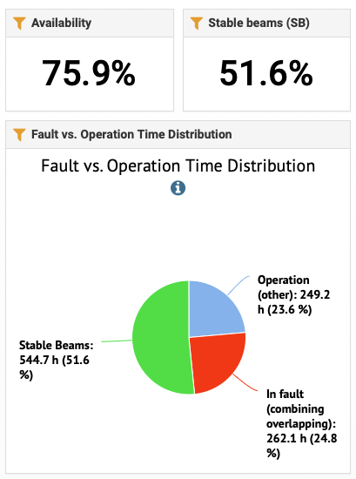
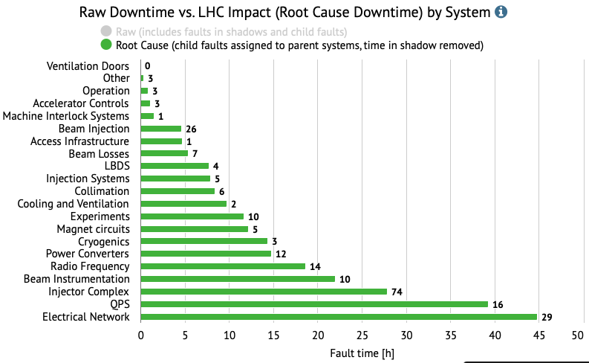
2023 in numbers
RF finger vacuum fault (and consequent intensity ramp-up) removed
See L. Felsberger for details

Slide 19
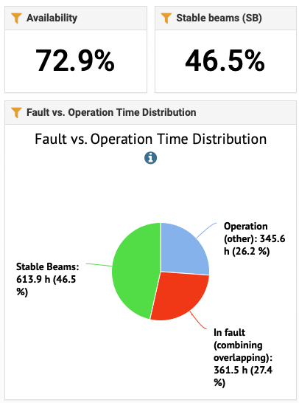
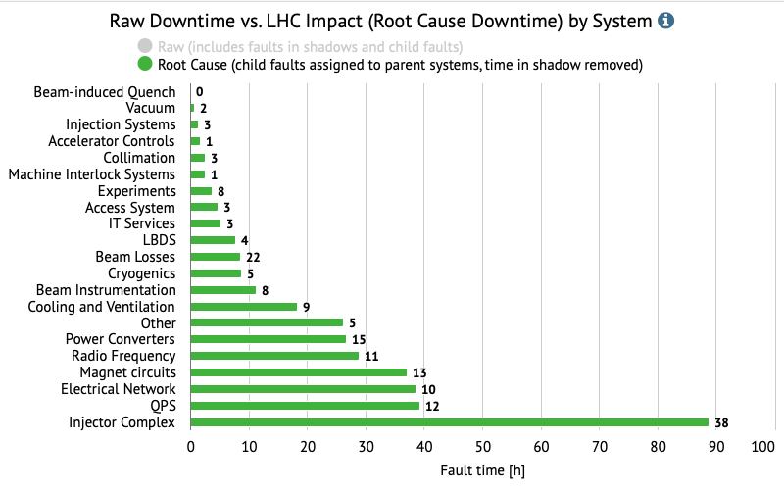
2022
Similar picture, main difference:
Magnet circuits (ONLY 1 training quench on RB circuits in 2023 operation)
Injector complex – about 30% of time

Slide 20
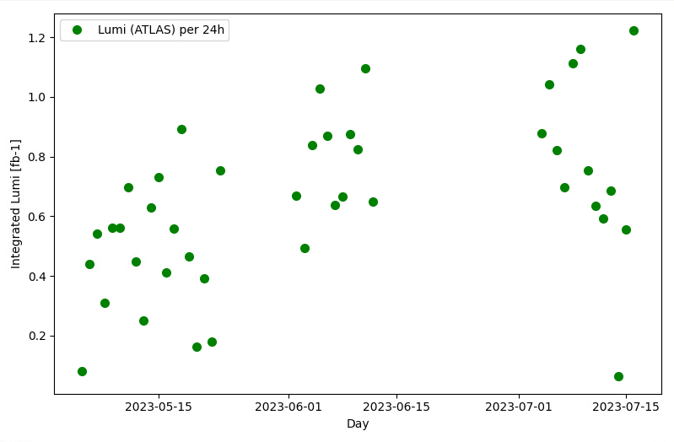
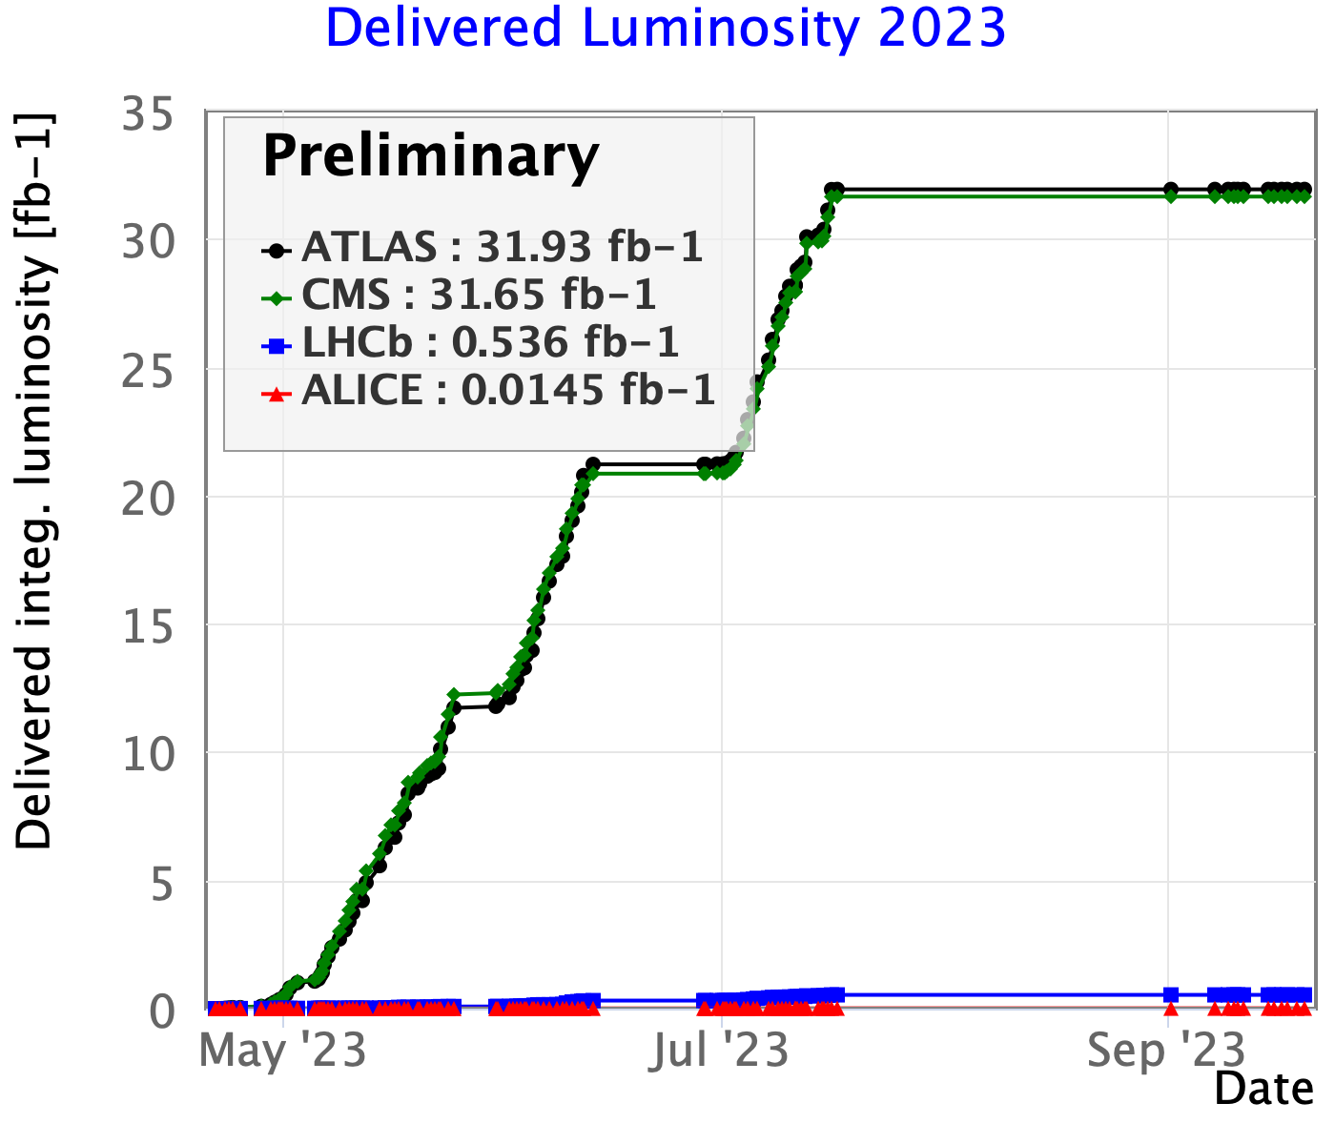
Best operational period 2023
Integrated Lumi (ATLAS) per 24h
Best production period (4th - 17th July)
AVG production = 0.79 fb⁻¹/24h
790 h in SB in 47.5 days (69% time)
Avg fill length = 7.4 h
(96 - 47.5)
* 0.79
+ 32
= 70.3 fb⁻¹
Missed
days
AVG
production
integrated
ESTIMATED

Slide 21
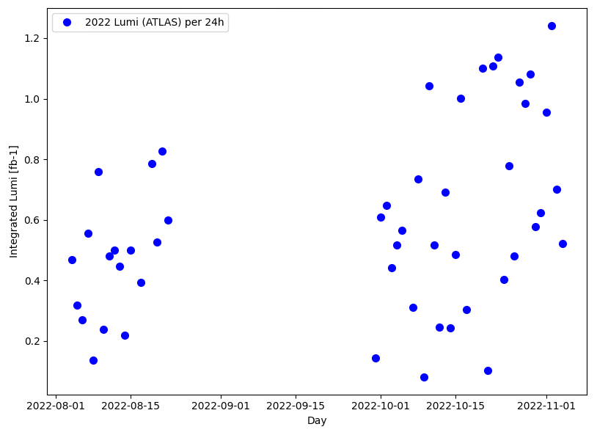
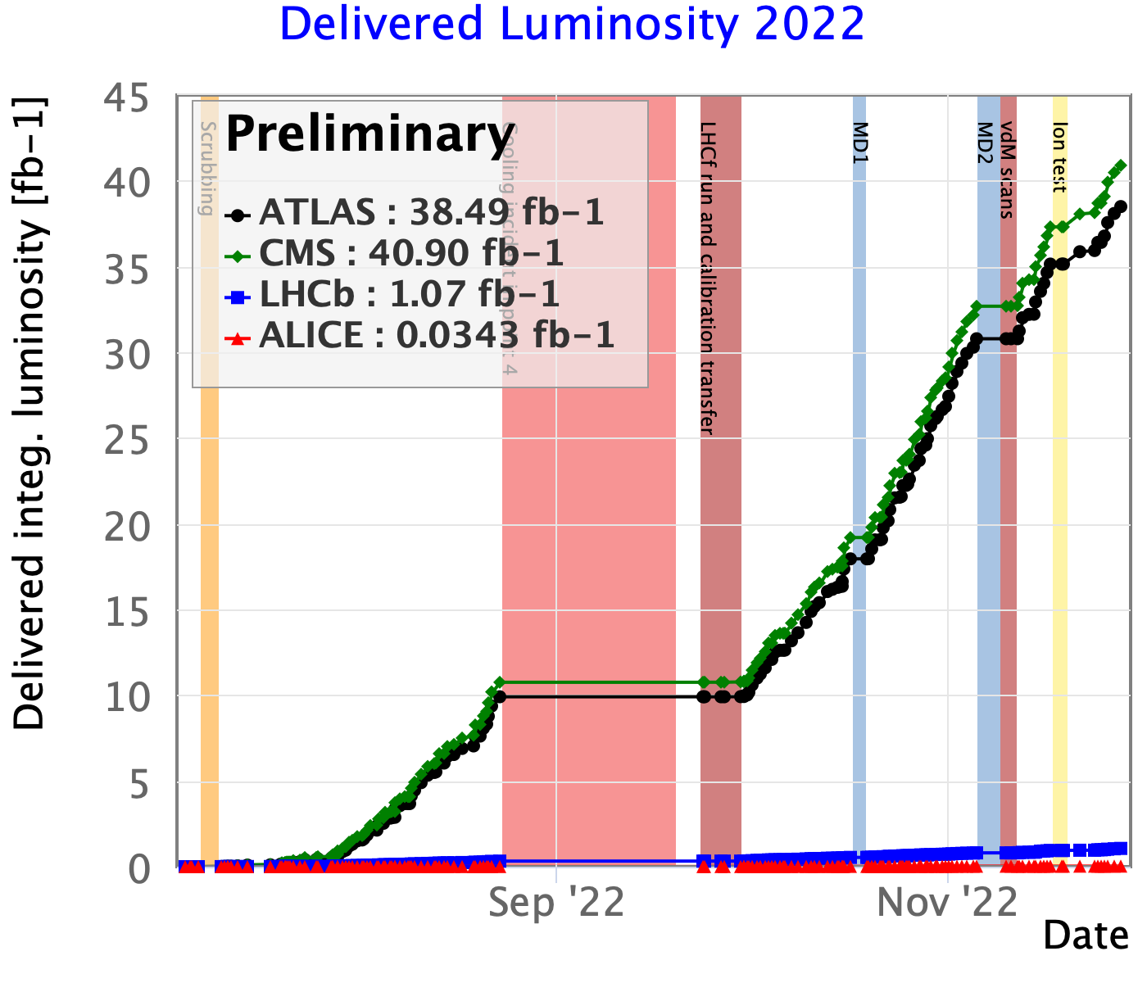
Best operational period 2022
Best production period
(30th Sep - 05th Nov)
AVG production = 0.64 fb⁻¹/24h
1171 h in SB in 70 days (68% time)
Avg fill length = 6.8 h

Slide 22
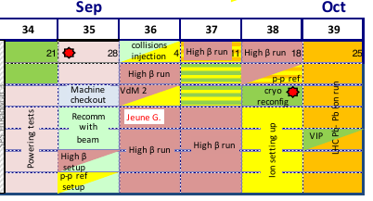
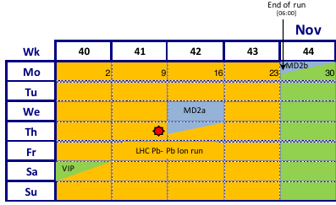
IONS
First Pb-Pb physics run @6.8 Z TeV
4 days commissioning
32 days physics
Breaks for VIP visits, MDs, VdM
Several news with respect to past IONS runs:
Slip-stacking for 50 ns beams
Crystals
TCLD collimators
BFPP orbit bump in IR2 and IR8
Full squeeze in ramp

Slide 23
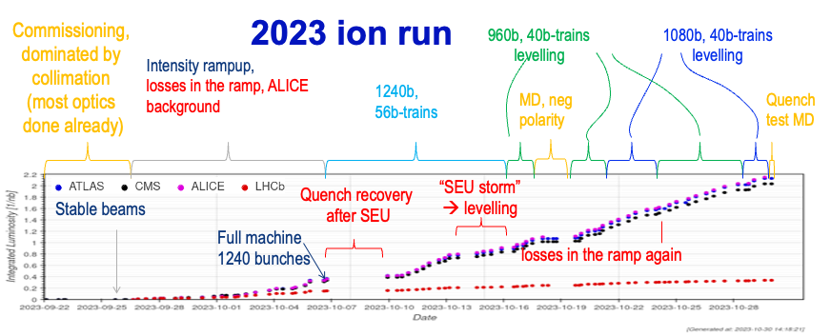
Courtesy R. Bruce

Slide 24
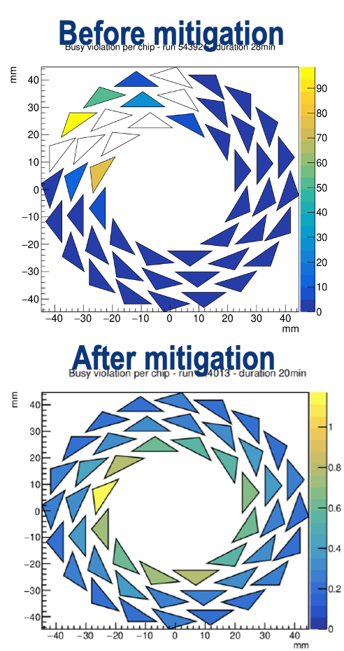
Main challenges encountered
13 Quench Protection System, radiation-induced SEU => beam dumps & magnet quench (spurious heaters firing)
  Mitigation (2023): level lumi in IP1/2/5 & cryo reconfiguration
10 Hz Horizontal orbit oscillations => sudden losses and beam dumps (7 fills dumped +1 unclear), already seen in 2018!
  NO real mitigation (2023) found
Transverse losses during the ramp (≥ 5.5 Z TeV) => Beams dump, significant slowdown of intensity ramp-up
  Mitigation (2023): orbit correction FFW + BLM thresholds increase
HW goniometer instability
  Mitigation (2023): “autopilot” for optimal channelling at top energy
Strong background in ALICE => 5 fills of studies + simulation
  Mitigation (2023): Orbit bump that modifies vertical dispersion
See R. Cai, S. Morales, J. Steckert for details

Slide 25
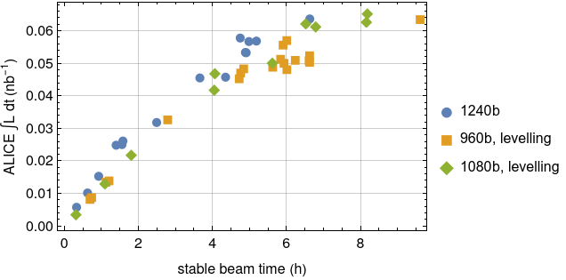
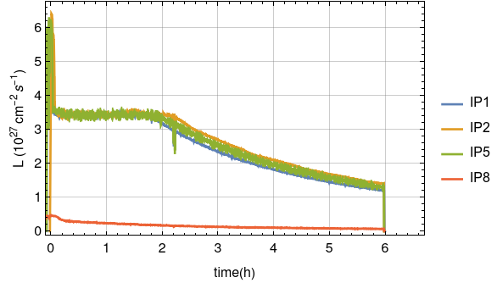
Luminosity production
Daily production: 100 µb⁻¹
  Reached 150 µb⁻¹ on two occasions
Record peak luminosity at ALICE:
  Reached 6.4x10²⁷ cm⁻²s⁻¹ with only 961 bunches (average 1.8x10⁸ Pb/bunch at start of SB)
Integrated luminosity below initial targets, but, delivered more data to all experiments than in 2018
    ALICE got more data (2.16 nb⁻¹) than in Run 1 & Run 2 combined

Slide 26
Schedule constraints/comments for 2024
2024&2025 LHC schedule had to be re-considered, in the light of the challenges & possible limitations encountered during 2023:
Lost LHC physics time will be distributed to proton physics, Pb ion physics and MDs
5.5 weeks remaining for LHC Pb ion physics
  => can be distributed over the 2 years or concentrated (Research Board)
Impact on the injectors schedules
Two schedule options:
Baseline with Pb ions in 2024
Alternative with NO Pb ions in 2024, but all in 2025 (Oxygen in 2024)
In both cases:
3.5 weeks of commissioning (see David’s presentation)
First beam in the LHC scheduled for March 11th

Slide 27
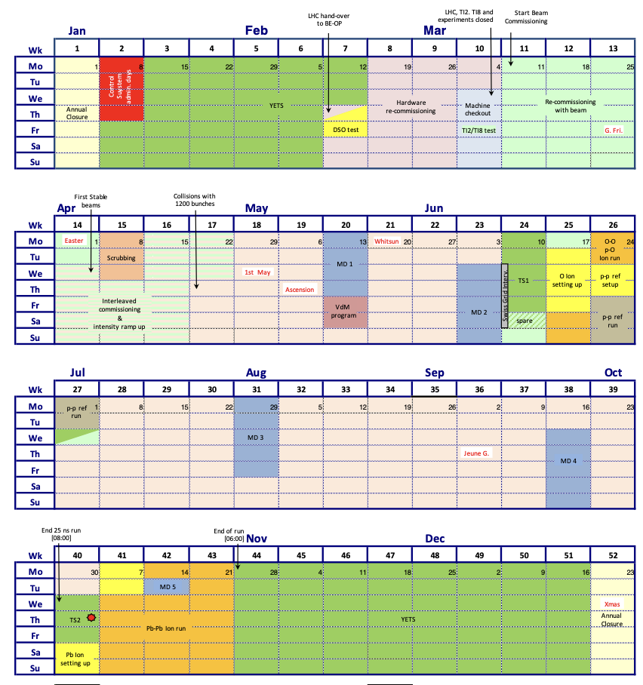
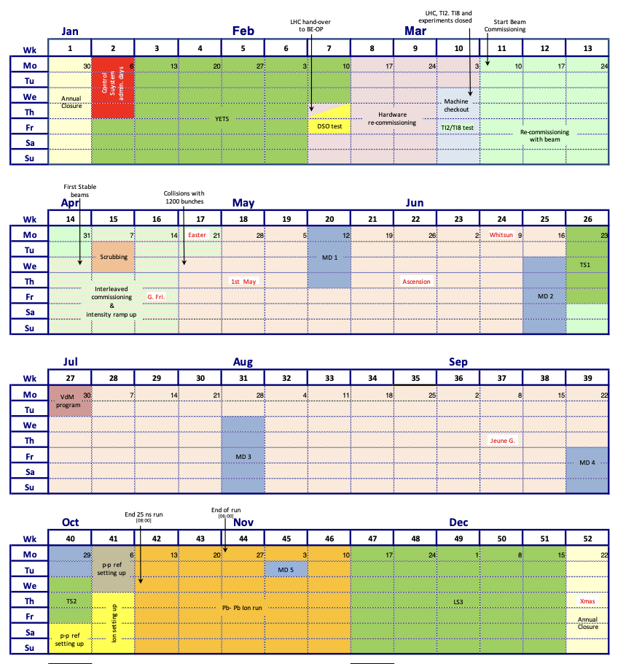
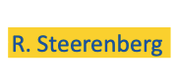
2024-2025 - option #1
Short PbPb run (2.5-3 weeks) at end of both 2024 and 2025
Less efficient, but risk distributed
Oxygen run after TS#1 in 2024, NO special run in 2025
pp reference run tentatively in 2024, after TS#1
 | 2024 | 2025
pp physics | 115 | 145
OO + pO | 4
PbPb + ref | 23 | 20
MD | 20 | 20

Slide 28
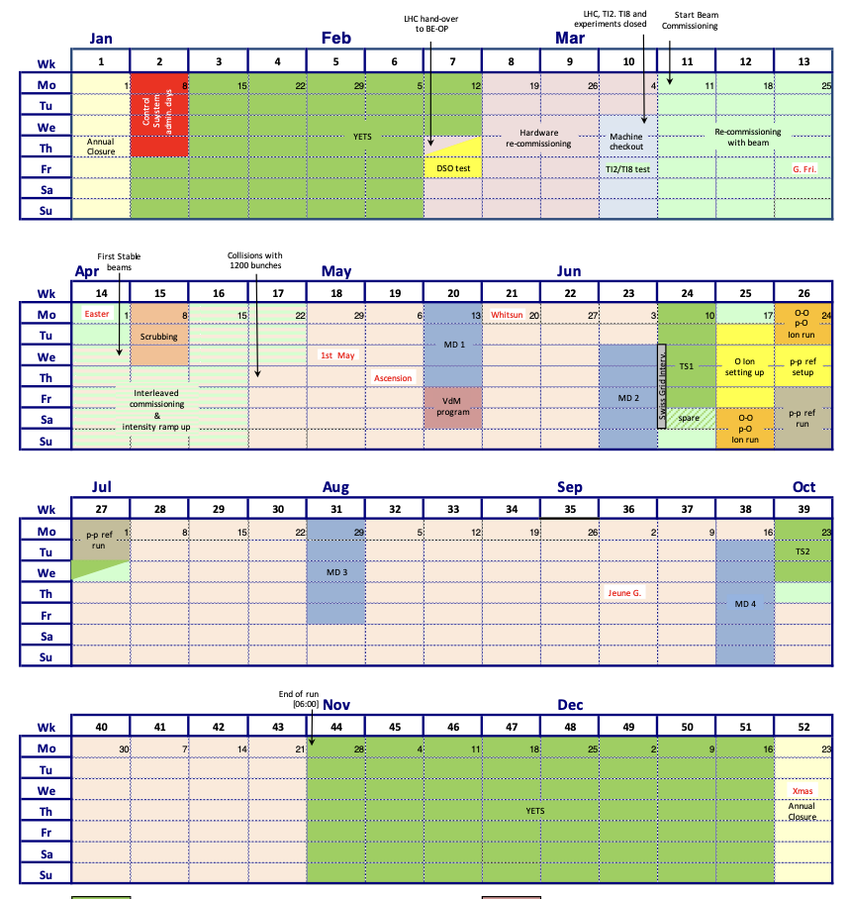

2024-2025 - option #2
Long PbPb run (5.5 weeks) at the end of 2025
More efficient + Maximal radiation cooldown before LS3
Oxygen run after TS#1 in 2024, NO special run in 2025
pp reference run tentatively in 2024, after TS#1
 | 2024 | 2025
pp physics | 135 | 132
OO + pO | 4
PbPb + ref | 5 | 39
MD | 20 | 21

Slide 29
Conclusions
Rough year, but despite of the limited availability we performed well
  Proton run was almost on track to reach the target, despite the bunch intensity limitation
  Ion run despite of the many challenges faced, good results (and records) achieved
No limitation foreseen for the rest of Run3
  Few critical points to watch closely (TDIS, RF finger,…)
2023 performance were higher than 2022 (expected)

Slide 30
Back-up slides

Slide 31
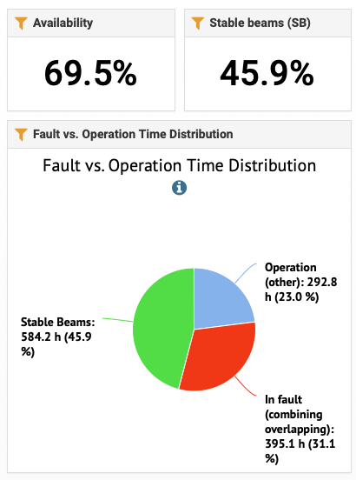
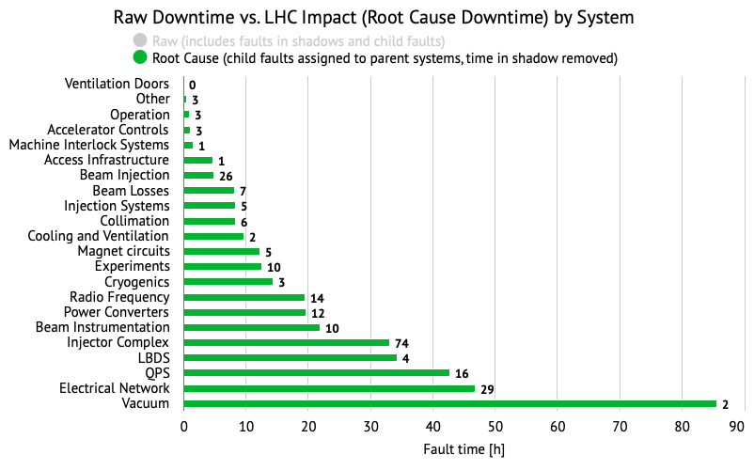
2023 in numbers
See L. Felsberger for details

Slide 32
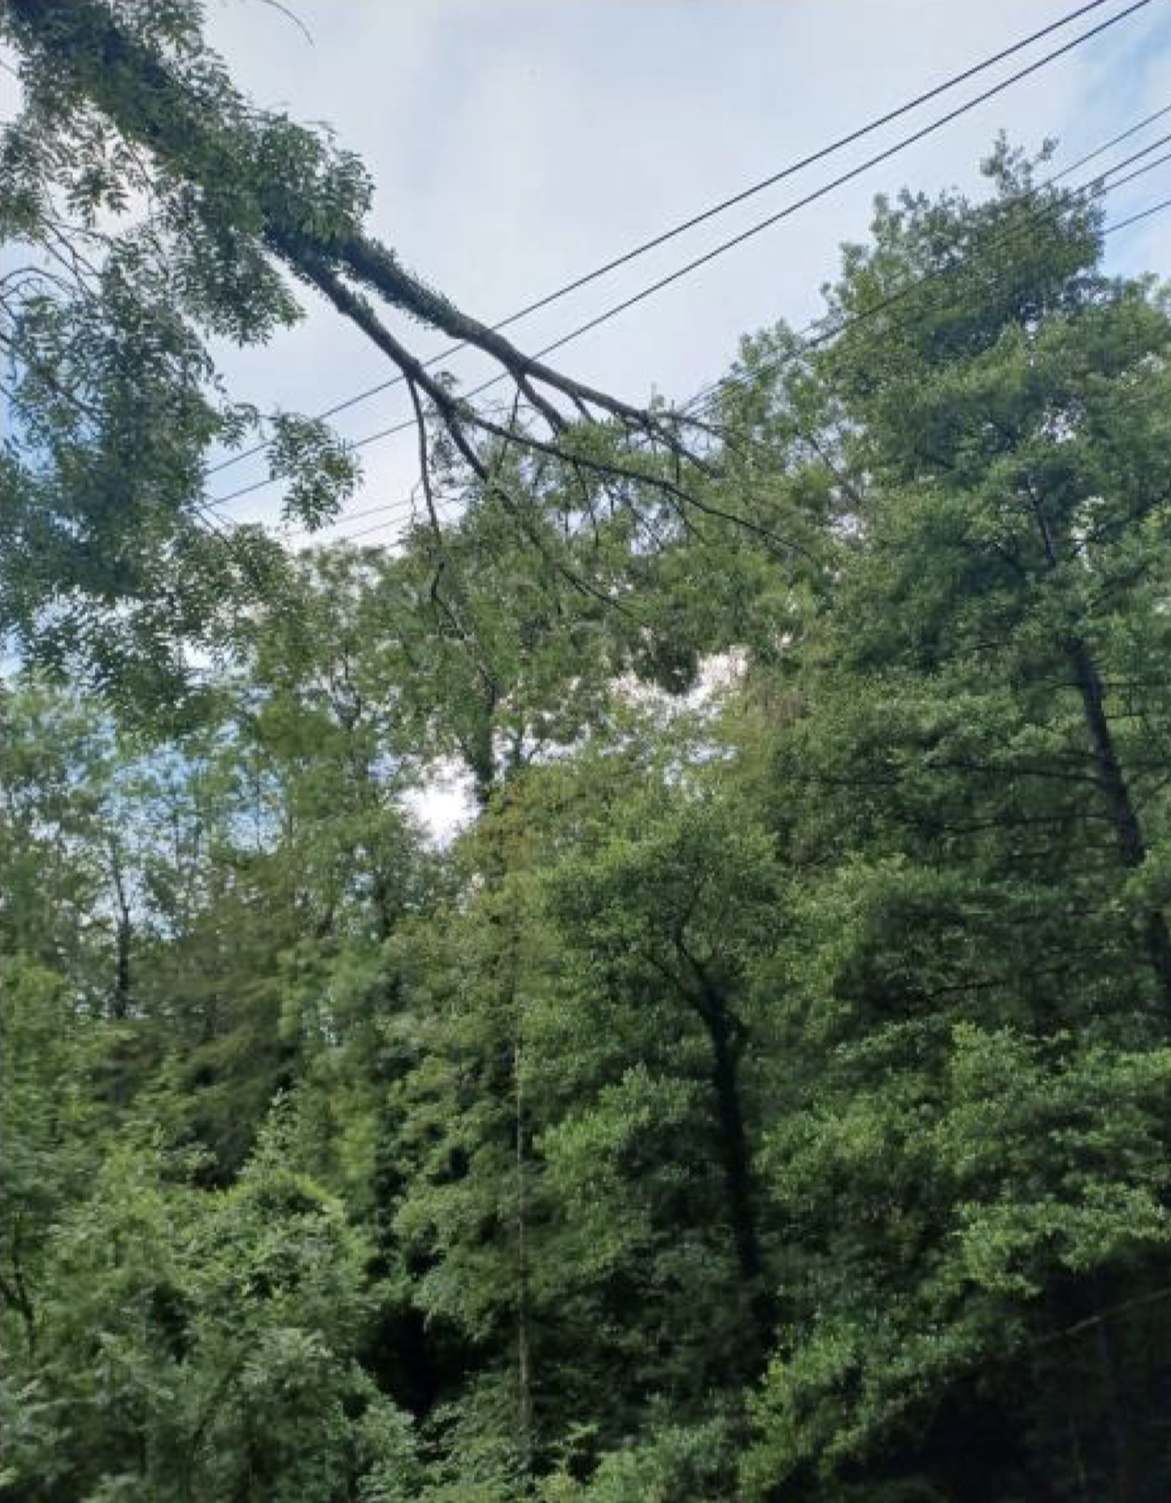
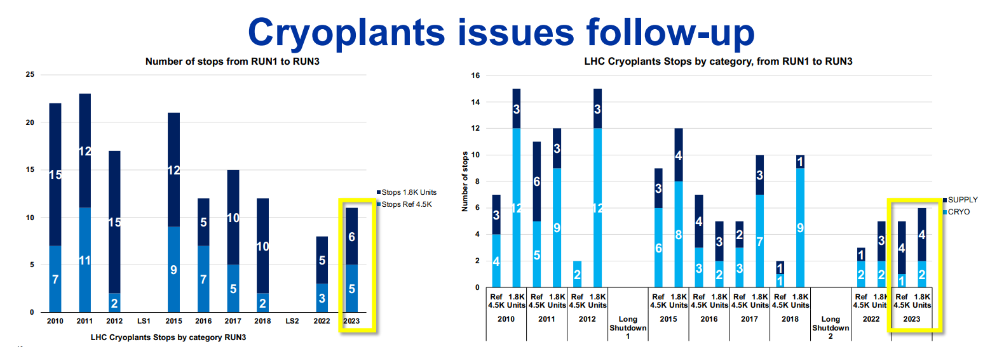
2023 operation in numbers
A tree fell on two lines 125 kV of Romande Energie which are on the same support tower
Electrical glitches:
6 electrical glitches during 2023 production period:
  3 with minor consequence (just beam dump)
  2 led to quenches of IPQs/Its (few hours)
  1 led to IT.L8 stop (several days)
Cryo compressor stops:
3 stops

Slide 33
2023 operation in numbers
 | pp run | Special runs | Pb ion run | Total physics | MD time | Comment
2016 | 139 | 10 | 10 | 159 | 21
2017 | 127 | 18 | 10 | 145 | 18
2018 | 130 | 14 | 24 | 168 | 24 | MD time increased in view of LS2
2022 | 70.5 | 7 | 2 | 77.5 | 9.5 | Post-LS commissioning
2023 | 47.5 | 12.5 | 32 | 92 | 7 | Mostly IT.L8

