Slide 1
Fixed Target Experiments Feedback from 2023 and Run 3 Outlook
Eva Barbara Holzer
SPS and PS Physics Coordinator
Joint Accelerator Performance 23 Workshop (JAP23)
December 5th, 2023
https://indico.cern.ch/event/1337597/

Slide 2

Increased focus on the injector complex user beams in recent years – improve measurements, automatic corrections, reduce losses, improve stability, increase intensity (previous workshops, long lists of action items, new projects, working groups …)
→ in 2023 we have profited big time
→ users were full of praise for the beams received – availability and quality!
Input from ATS groups and users of PSB, PS, SPS and AD/ELENA
2021 IEFW https://indico.cern.ch/event/1194548/
2022 JAPW https://indico.cern.ch/event/1194548/

Slide 3
Communication Wishlist I
Improve communication via page 1 and OP logbooks
  Bring PS and SPS FT user info to the same level of details and update frequency as the one for LHC users
  Add to the OP shut-down training explations what kind of information users need and why?
Page 1 or other means: Improve announcement of shorter-notice deterioration or unavailability of user beams – and, equally important, the end of the deterioration/beam unavailability
  Communicate as soon as possible and keep information up to date
  e.g., dedicated or parallel LHC filling, MDs, other super-cycle changes.
  → important for all users to plan their measurements accordingly (e.g., do not start a new measurement shortly before the conditions change, or the beam goes away, but rather continue with the ongoing run.)
PS and PSB vistar: add a page with a summary / statistics of, e.g.: number of cycles per user (now and last 1 hour); number of free cycles. (Because the page 1 does not fit on one page especial via the web interface it is hardly possible to extract this info – page is not scrolling but jumping.)
  Log to NXCALS

Slide 4
Communication Wishlist II
Different technical solutions exist amongst the regular users to
  Get automatically informed when Page 1 changes → make available to all the users?
  Log Page 1 messages to be able to match them with the data recorded → centrally logged Page 1 messages for all the users? NXCALS?
Make it easier to find a beam-line summary table, with beam characteristics and estimation of the number of spills/week. (Most of the information is already available but scattered on several web pages.)
Numerous option available for secondary beam parameters and compositions. Some of them have been measured by different users.
  Create repository, where users can upload their results together with the secondary beam settings, target type, target intensity etc.?
Quantify knock-on effects of future significant changes (e.g. dedicated LHC filling) → improve communication to users across the accelerators (also between LHC and injector users)

Slide 5
ISOLDE

Slide 6
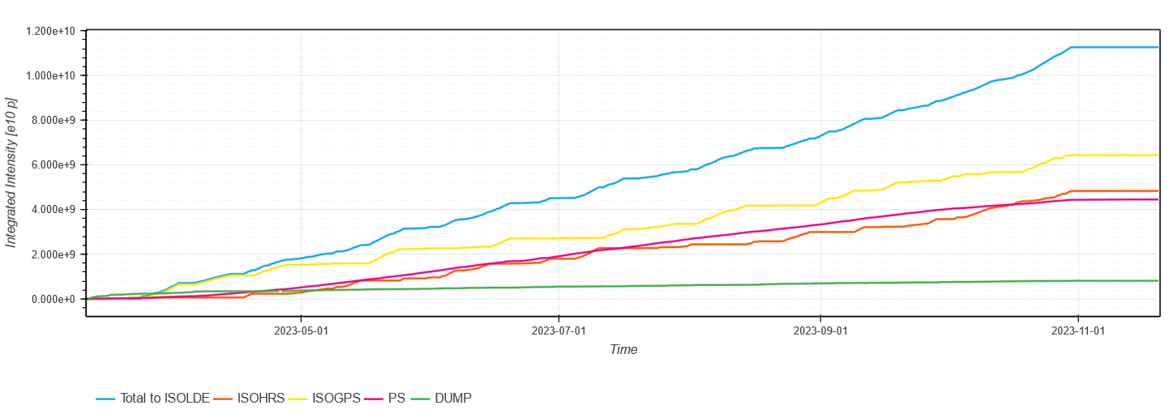
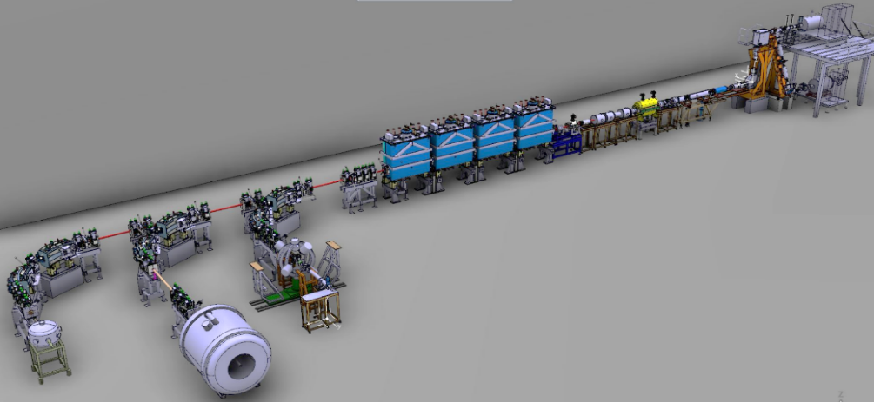
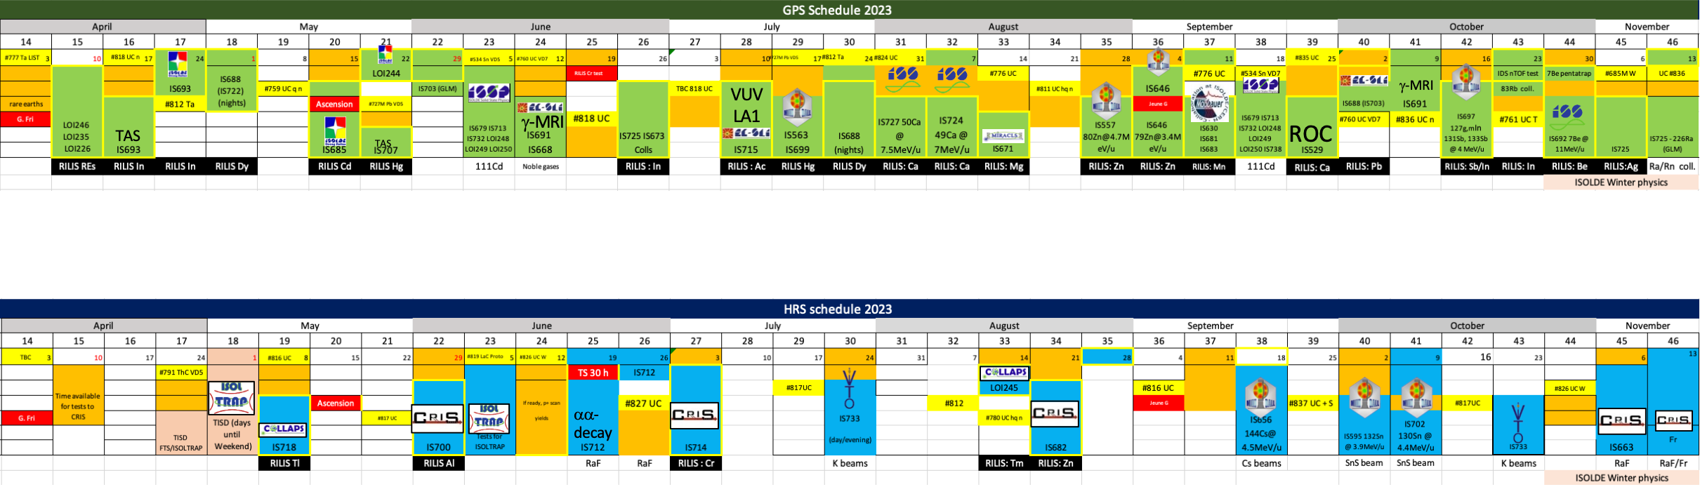
ISOLDE
Most of the protons to ISOLDE
About 470 shifts in 2023, 122 of them for HIE ISOLDE
About 40% of the shifts to be scheduled are for HIE ISOLDE
→ shorter physics period for HIE ISOLDE is problematic
Most runs were at least partly successful (few issues
from machine and target side but also from
experimental side)
REX/HIE ISOLDE: Sever issues during the restart
shortened the commissioning time. Despite many issues
throughout the year, HIE ISOLDE managed to deliver
beam according to schedule and physics requests.
TRAP
HIE SC LINAC
REX LINAC
Miniball
SEC
ISS
HIE-ISOLDE: 21 July
Winter Physics: 30 Oct.

Slide 7
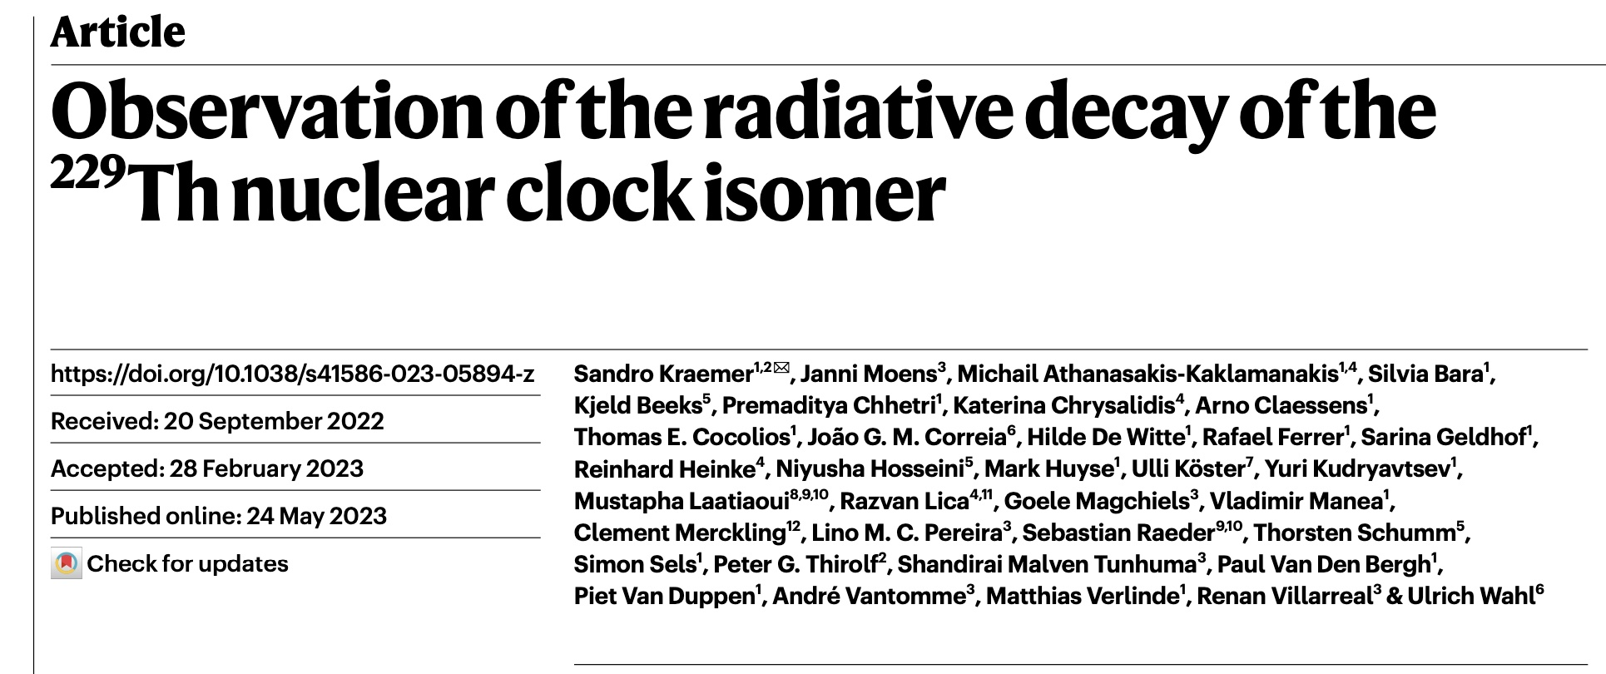
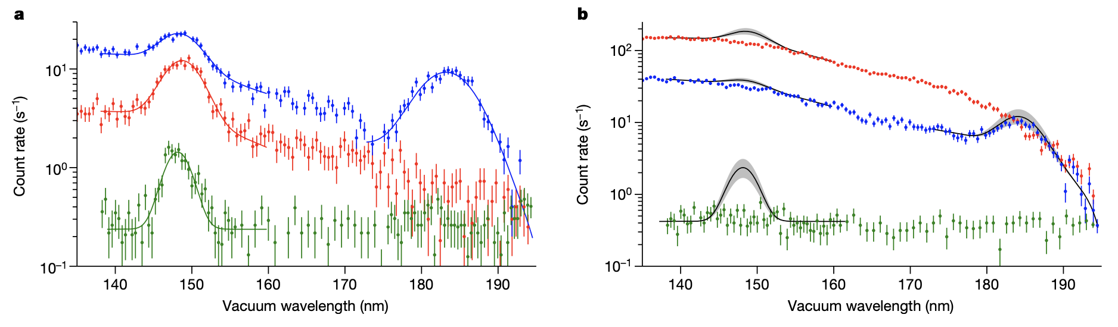
First direct evidence of very low-lying state in ²²⁹Th via measurement of the uv decay.
More precise measurement of energy than indirect measurements, giving only 8.338(24) eV
Measurement of τ_{1/2} for isomer embedded in MgF₂ 670(102)s
Implantation of A=229 and 230 in three different hosts to search for and identify the uv transitions with ²²⁹Th and to exclude artifacts.
Nucleus exited state: Low energy enables potential direct excitation by lasers and therefore use as a nuclear clock.
Nuclear clock much less sensitive to environmental effects than atomic clocks so more precise.
A nuclear clock would be a unique tool for many precision tests of fundamental physics.
The observation of radiative decay in large band-gap crystal is a huge step forward in design of such a clock.
Reduction in precision of energy significantly eases the search for direct laser excitation as lasers have narrow bandwidth compared to uncertainty in energy.
Implantation of A=229
Implantation of A=230
²²⁹Th isomer decay
no isomer
artifact: crystal defects
artifact: crystal defects
Slides from Sean Freeman
Notes:
Nature Article: The radionuclide thorium-229 features an isomer with an exceptionally low excitation energy that enables direct laser manipulation of nuclear states. It constitutes one of
the leading candidates for use in next-generation optical clocks1–3. This nuclear clock will be a unique tool for precise tests of fundamental physics4–9.
Wikipedia: A nuclear clock or nuclear optical clock is a notional clock that would use the frequency of a nuclear transition as its reference frequency,^{[1]} in the same manner as an atomic clock uses the frequency of an electronic transition in an atom's shell. Such a clock is expected to be more accurate than the best current atomic clocks by a factor of about 10, with an achievable accuracy approaching the 10⁻¹⁹ level.^{[2]} The only nuclear state suitable for the development of a nuclear clock using existing technology is thorium-229m, a nuclear isomer of thorium-229 and the lowest-energy nuclear isomer known. With an energy of about 8 eV,^{[3][4][5][6][7]} the corresponding ground-state transition is expected to be in the vacuum ultraviolet wavelength region around 150 nm, which would make it accessible to laser excitation.

Slide 8
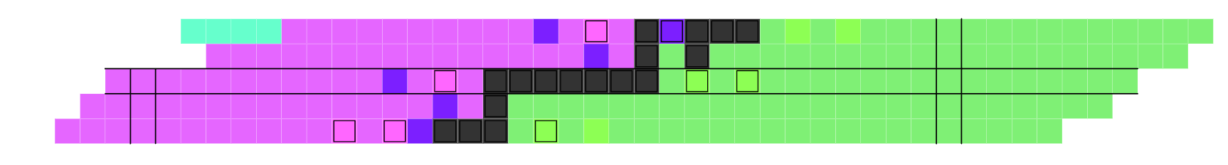
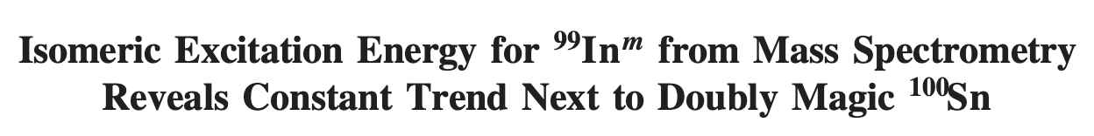
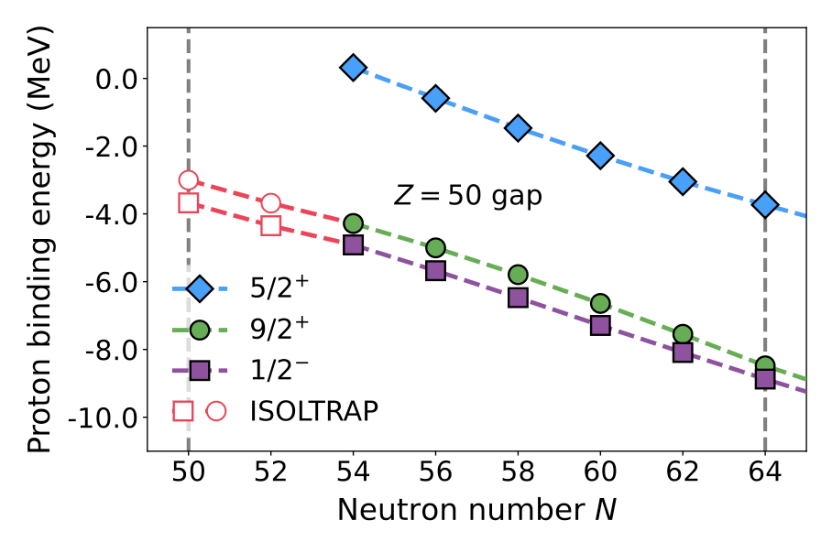
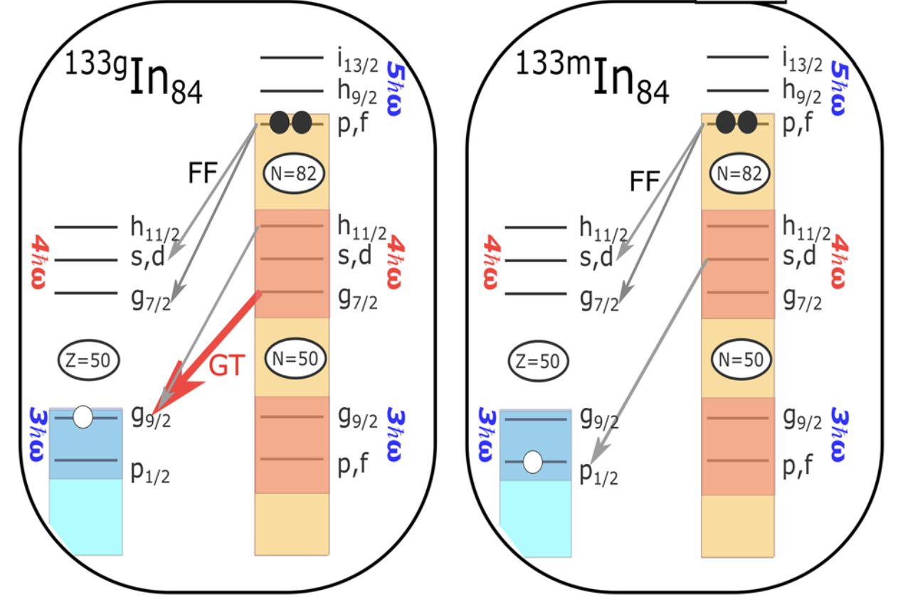
Indium – from one extreme to the other - two back-to-back ISOLDE PRL’s in July
Part of nuclear chart with corner stones of doubly-magic Sn isotopes : ¹⁰⁰Sn and ¹³²Sn (★)
N=82
Tellurium - Te
N=50
Antinomy - Sb
Tin - Sn
★
★
Z=50
Indium - In
Cadium - Cd
⁹⁹In
¹³³In
Precision measurement of ground and isomeric state using ISOLTRAP.
Excitation of isomer extremely constant across In
In contrast to measurements of magnetic moment, which increases near N=50 - also ISOLDE experiment from 2022!
Very difficult to reproduce with modern calculations and may point to missing physics.
Measured β decays from ground and isomeric levels using ISOLDE DECAY STATION.
Decays populate just a few unbound levels in ¹³³Sn.
Measured resonance properties that are critical for benchmarking models of the astrophysical r process that manufactures many of the heavy chemical elements.
Good example of versatility of ISOLDE – precision studies of both neutron-rich and neutron-deficient exotic isotopes separated by 34 neutrons!
Slides from Sean Freeman
Notes:
Indium: 49 protons: 50 neutrons or 84 neutrons

Slide 9
AD / ELENA

Slide 10
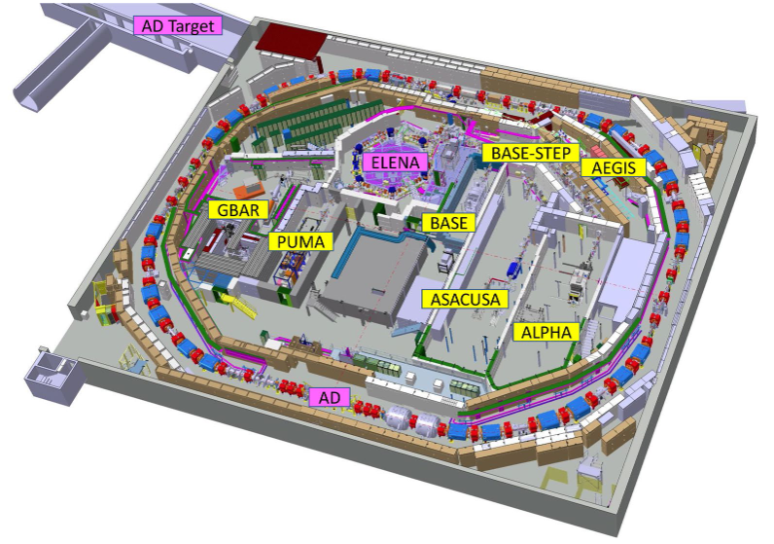
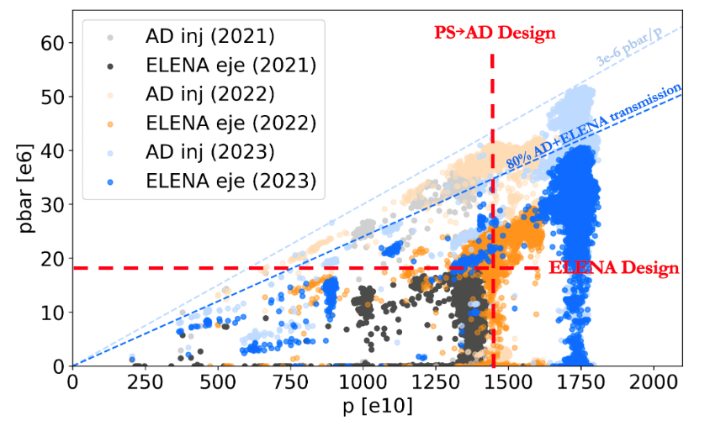
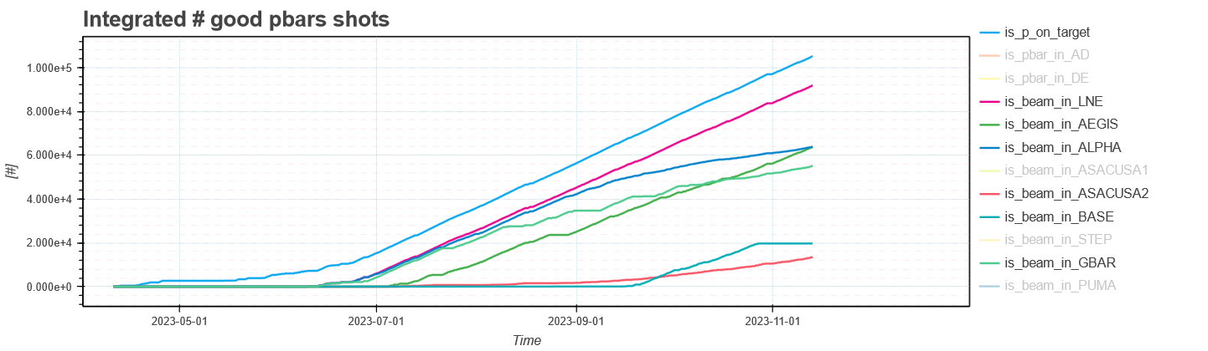
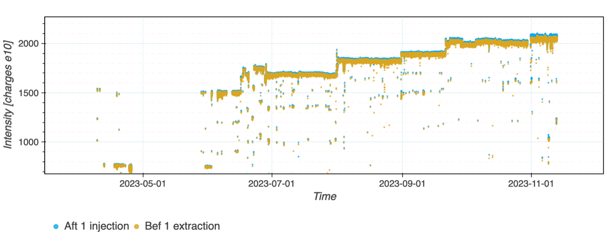
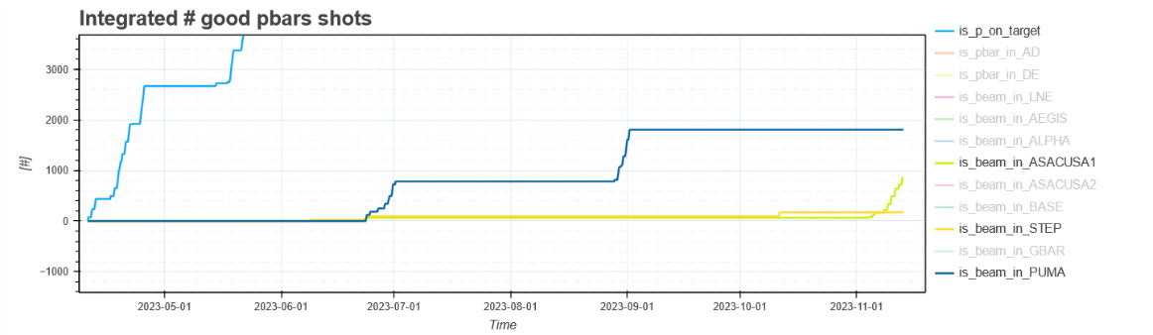
AD / ELENA
2023: twice the ELENA design pbar / shot
  Ad extraction increased to 2000e10 p (target limitation)
  Optimisation of transmission efficiency in AD and ELENA
  allowed for record bunch intensities of 1x10⁷ pbars per bunch
2024: increase the shot-to-shot stability/reproducibility
Users generally very happy with beam parameters and
repetition rate
  Experiments do not ask for higher repetition rate
  GBAR requests to operate with nominal
  emittance
AEGIS
ALPHA
GBAR
BASE
ASACUSA2
Notes:
Start-up delayed by 5 weeks (July 30 instead of May 11)
12-day run extension – partially compensation for 5 weeks
start-up delay

Slide 11
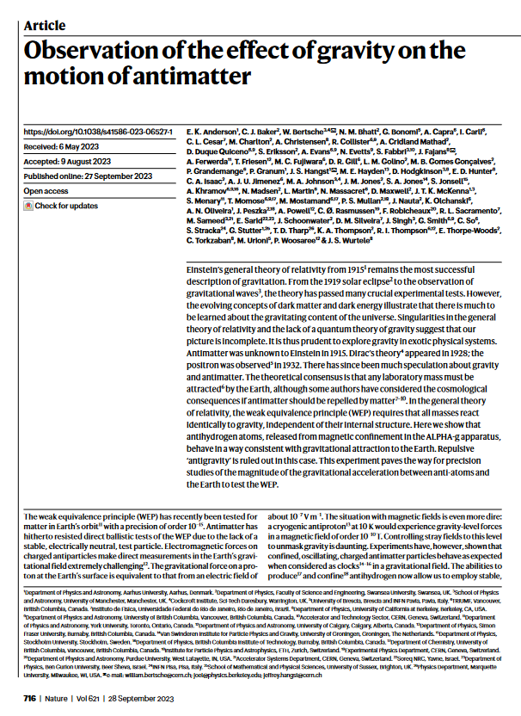
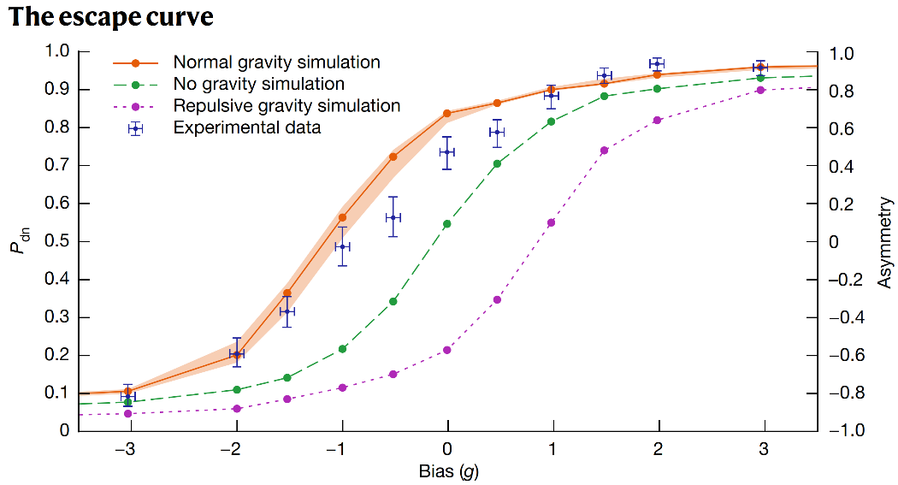
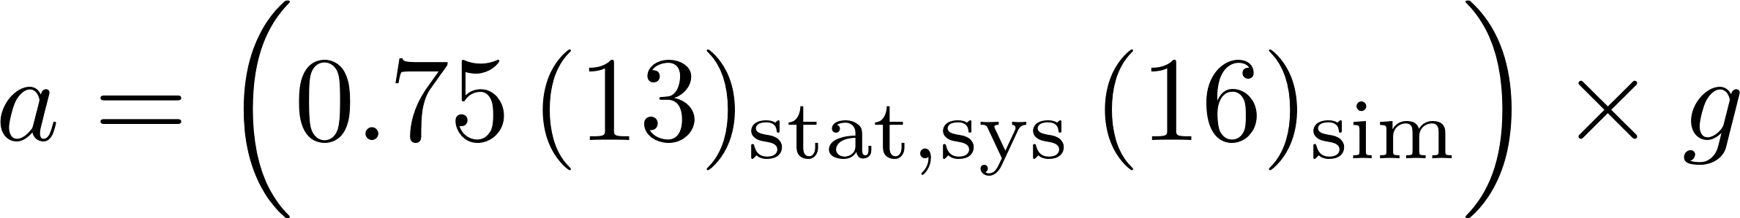
Antimatter Gravity - ALPHA
Notes:
In the general theory of relativity, the weak equivalence principle (WEP) requires that all masses react identically to gravity, independent of their internal structure. Here we show that antihydrogen atoms, released from magnetic confinement in the ALPHA-g apparatus, behave in a way consistent with gravitational attraction to the Earth. Repulsive ‘antigravity’ is ruled out in this case. This experiment paves the way for precision studies of the magnitude of the gravitational acceleration between anti-atoms and the Earth to test the WEP.
The experiment at LEAR was with antiprotons and the collaboration (PS200) was fighting against potential patches, it is almost impossible to do this experiment with charged particles, since gravity is about 38 OOM weaker than the electromagnetic force. So this experiment never published any result, except of fantastic papers about the properties of equipotential surfaces.
Then there are several experiments that test gravity based on the redshift and the clock weak equivalence principle, there are K0/K0Bar comparisons, antiproton charge/mass ratio comparisons. Here the first limit comes from the TRAP collaboration, while the most stringent is an almost model independent differential result from BASE published in 2022.
The antihydrogen ballistic experiment is entirely model independent. There is a first proof of principle measurement from ALPHA in 2013 if I recall correctly, with an uncertainty of order 70 g…, so not really a measurement. The first test of gravity with falling antimatter comes indeed from ALPHA, which is the first experiment which did this measurement with a somewhat interesting resolution, the sign is defined now and repulsive gravity models – which were so far serious candidates for alternative cosmological scenarios are ruled out now. Of course more than interesting that the ALPHA data are systematically shifted from alpha_g=1 to slightly smaller results, but the significance here is absorbed by systematics. It is an outstandingly interesting experiment, because even in 0<alpha_g<1 it would change our understanding of causality, energy conservation, general relativity, so I’m very much looking forward to a measurement with higher accuracy.

Slide 12
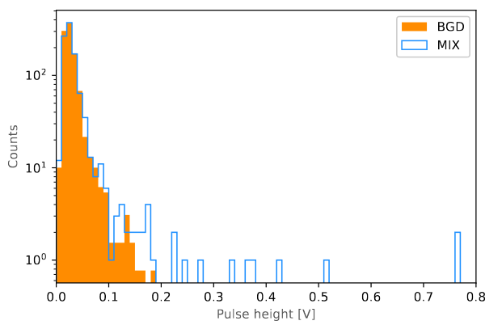
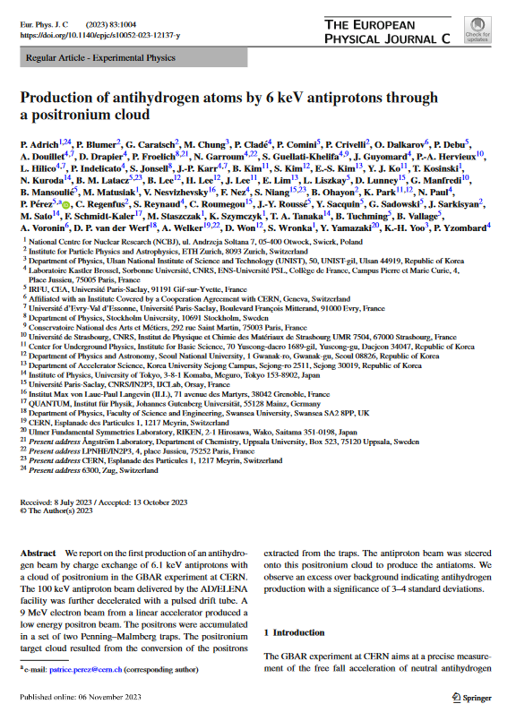
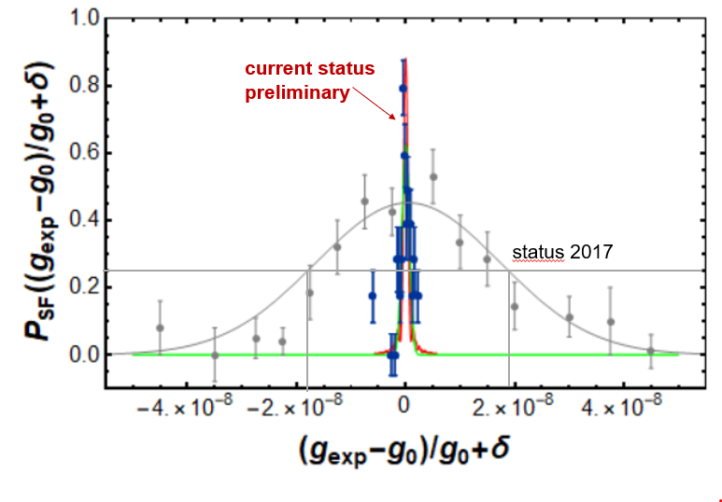
Further AD Physics Highlights
GBAR published production of antihydrogen atoms by 6 keV antiprotons through a positronium cloud
https://arxiv.org/abs/2306.15801
BASE performed the first ever coherent quantum spectroscopy with a single nuclear spin, reducing g-Factor (magnetic moment) line width by more than a factor of 20.
Notes:
We report on the first production of an antihydrogen beam by charge exchange of 6.1 keV antiprotons with a cloud of positronium in the GBAR experiment at CERN. The antiproton beam was delivered by the AD/ELENA facility. The positronium target was produced from a positron beam itself obtained from an electron linear accelerator. We observe an excess over background indicating antihydrogen production with a significance of 3-4 standard deviations
g-factor: the magnetic moment of the proton: to compare it to the antiproton g-factor. Comparing both values in high-precision measurements constitutes a stringent test of CPT invariance

Slide 13
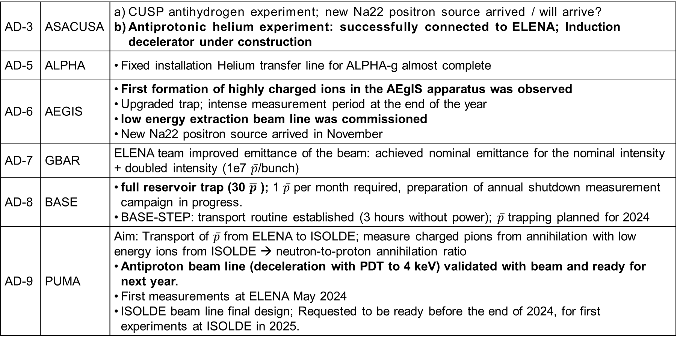
Technical Highlights
AD-3 | ASACUSA | CUSP antihydrogen experiment; new Na22 positron source arrived / will arrive? Antiprotonic helium experiment: successfully connected to ELENA; Induction decelerator under construction
AD-5 | ALPHA | Fixed installation Helium transfer line for ALPHA-g almost complete
AD-6 | AEGIS | First formation of highly charged ions in the AEgIS apparatus was observed Upgraded trap; intense measurement period at the end of the year low energy extraction beam line was commissioned New Na22 positron source arrived in November
AD-7 | GBAR | ELENA team improved emittance of the beam: achieved nominal emittance for the nominal intensity + doubled intensity (1e7 $\overline{p}$/bunch)
AD-8 | BASE | full reservoir trap (30 $\overline{p}$ ); 1 $\overline{p}$ per month required, preparation of annual shutdown measurement campaign in progress. BASE-STEP: transport routine established (3 hours without power); $\overline{p}$ trapping planned for 2024
AD-9 | PUMA | Aim: Transport of $\overline{p}$ from ELENA to ISOLDE; measure charged pions from annihilation with low energy ions from ISOLDE → neutron-to-proton annihilation ratio Antiproton beam line (deceleration with PDT to 4 keV) validated with beam and ready for next year. First measurements at ELENA May 2024 ISOLDE beam line final design; Requested to be ready before the end of 2024, for first experiments at ISOLDE in 2025.
Notes:
PUMA: A new version of the MoU has been written by CERN and is now circulated among the collaborators. They expect it will be signed in 2023.
LEAR: 1982 until 1996.[: 27 experiments performed during LEAR's 14 years of running. 1995, with the observation of the first ever produced anti-hydrogen atoms (nine of them) obtained by colliding antiprotons with a Xenon gas target in the PS210 experiment.
. It is one of the most important fundamental physics measurements of the last 50 years, an absolute milestone, entire CERN can be proud of!!!

Slide 14
PS East Area and nTOF

Slide 15

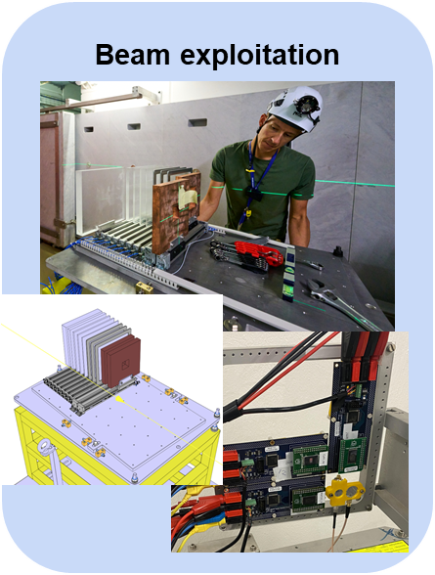
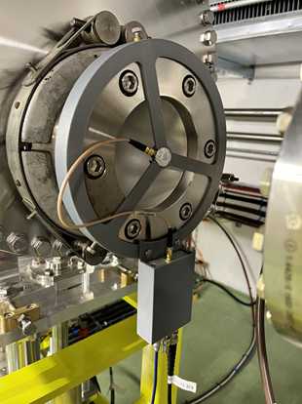
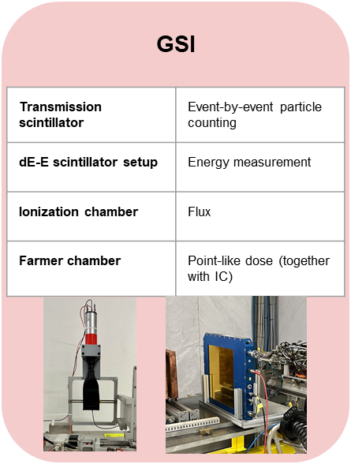
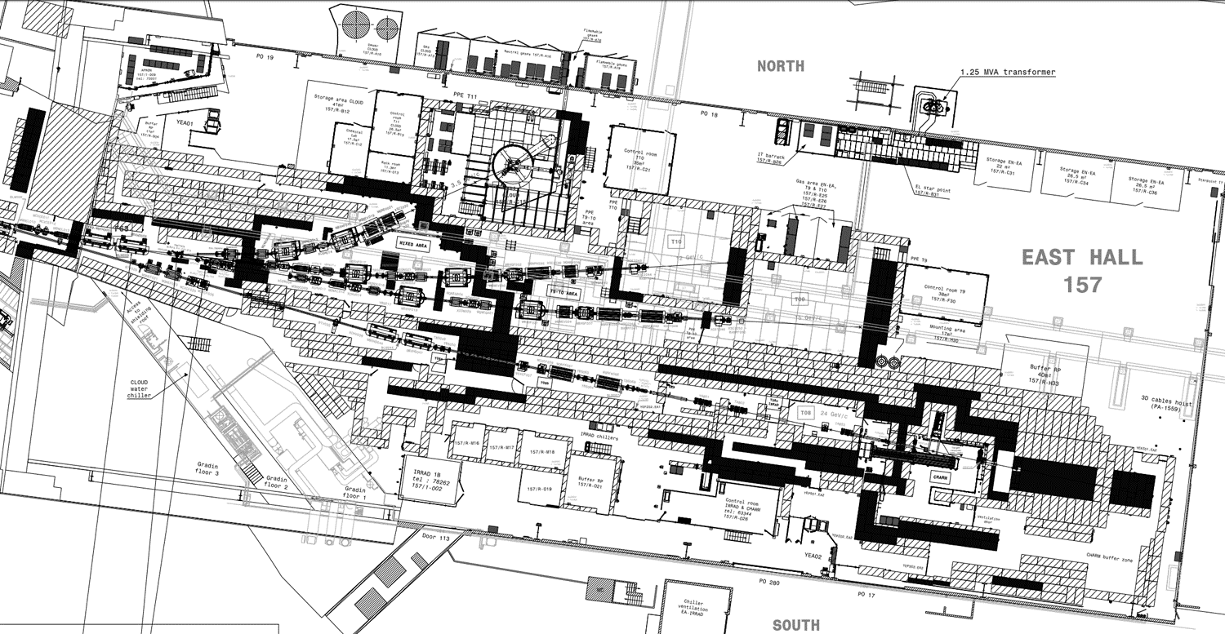
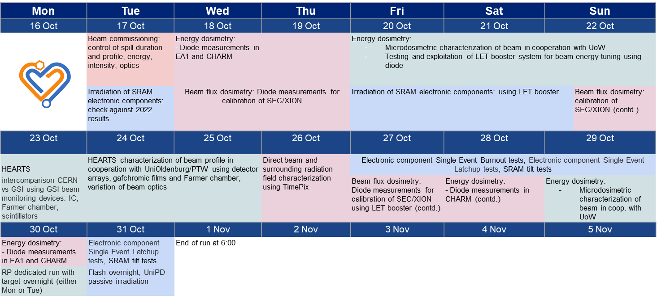
CHIMERA / HEARTS (Ion Run) in T8
2 weeks Pb ion beam with several beam energies from 650 MeV/n to 3 GeV/n in CHARM
2023 objectives largely achieved
  beam commissioning and beam characterization (regular BI + R2E detectors)
    including energy deposition measurements with diode in T8b (EA1/IRRAD)
  Measurements for detector characterization & calibration:
    including detectors from HEARTS EU
    project beneficiaries, partners &
    collaborators (GSI, Oldenburg Uni.,
    PTW, Wollongong Uni.)
    Single Event Effects testing
R2E diode in T8b
T11
T10
T09
Downstream (target):
CHARM (BE-CEM)
T08
(protons 24 GeV/c)
On the roof shielding:
CSBF
(HSE-RP)
Ion beam for electronics test:
CHIMERA
(R2E)
Upstream:
IRRAD (EP-DT)

Slide 16
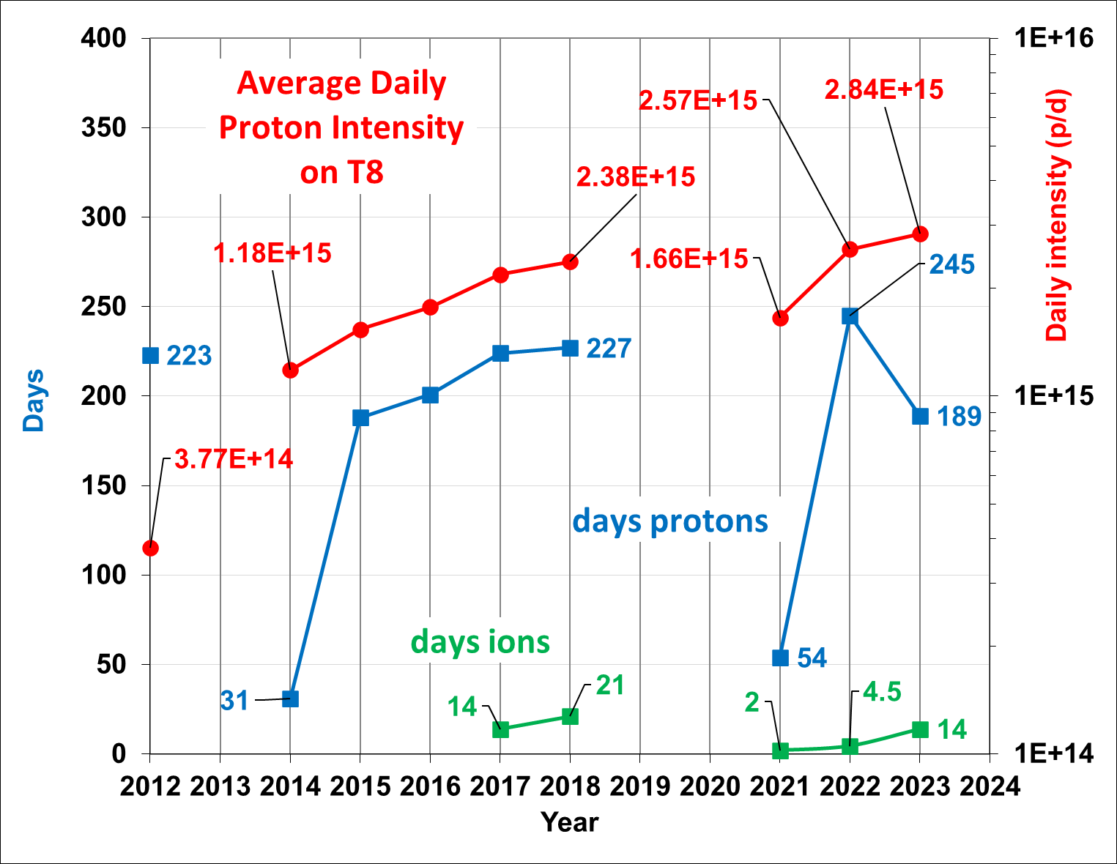
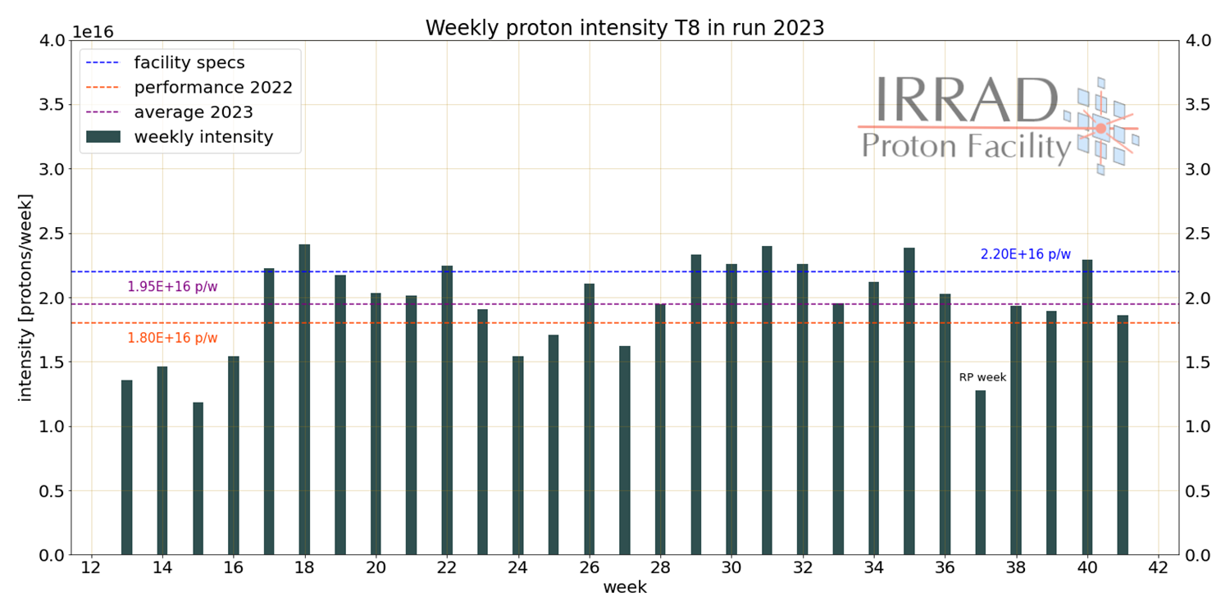
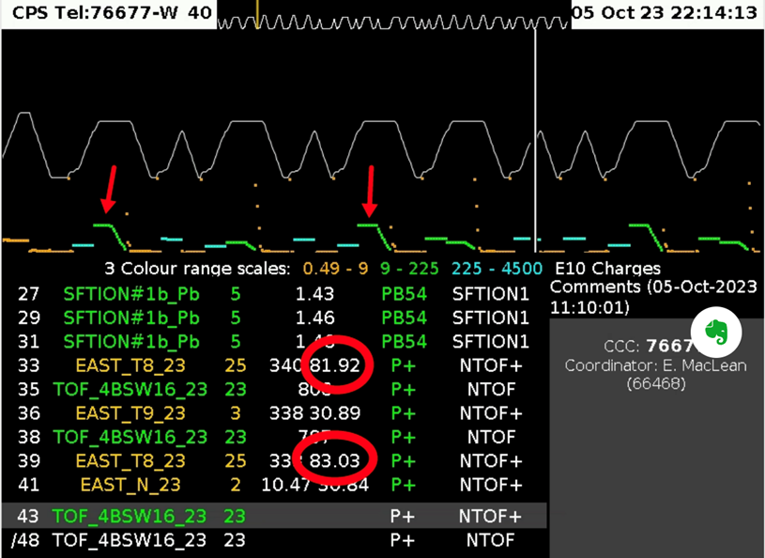
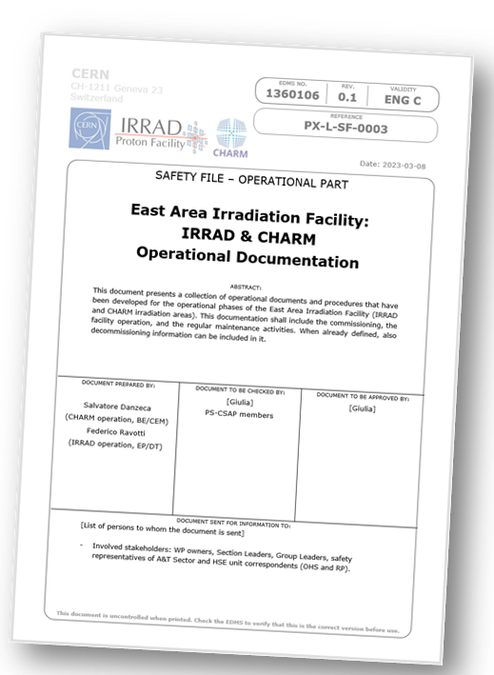
IRRAD / CHARM PS East Area T8 line
Steady improvement of the average daily intensity
Facility specification reached ~36% of the weeks in 2023 (LHC stop)
Tested high intensity spill 80E10 pps (was from 60E10)
  CHARM Target operation validated (SY-STI)
  HSE-RP: dedicated survey (EDMS 2965197) confirmed no RP
  showstopper running within EAST_T* individual limits per target
  ECR to be completed during EYETS (EDMS 2825729)
2024: Run operationally with high-intensity
EAST_T8 spill to reach the facility
specification
LHC stop
TS
Beam Commissioning
High-Intensity EAST_T8
Notes:
Run2: The standard proton irradiation beam with a momentum of 24 GeV/c is extracted from the PS ring to the T08 beamline in “spills” of about 6×10¹¹ particles (EAST_T8). The intensity of the irradiation beam depends on the number of spills per PS super-cycle (CPS). The typical duration of the basic CPS is variable and ranges between about 30 and 45 seconds (see also Table 1). Beam scheduling and sharing among the other experiments running in the East Area allow estimating a typical sharing of three spills per super-cycle delivered to the irradiation facilities during the irradiation periods: this roughly correspond to 1 EAST_T8 cycle every 10 CPS Basic Periods (BPs). This number can decrease to one or two when the other experiments require the beam or when the PS serves as injector for the other accelerators of the CERN complex [24].

Slide 17



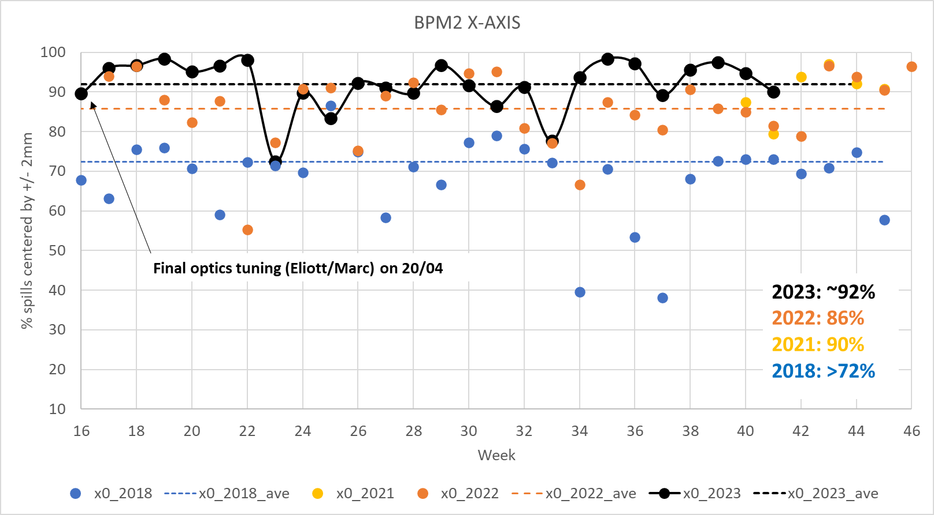
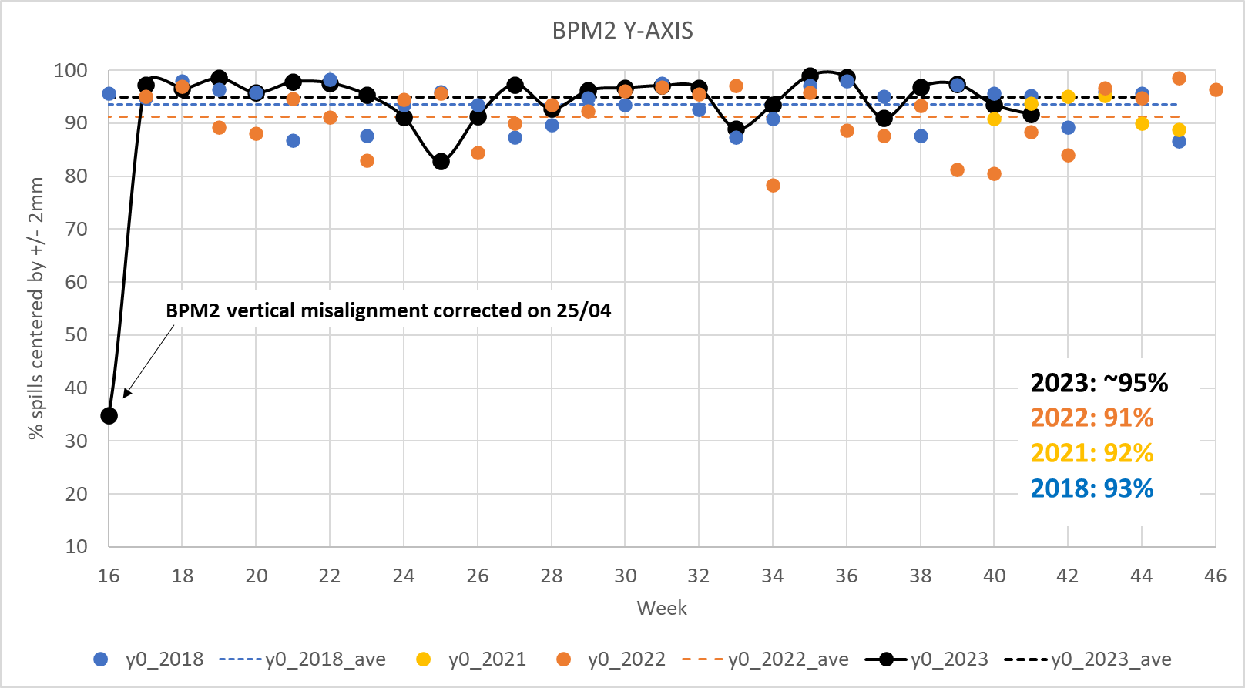
EAST_T8 Beam
2023: Significant improvement of the beam center position >90%
  Very stable until week 22; Fluctuations from week 23 onwards:
  Cycle preceding EAST_T8? Extraction to AD?
2024:
    Understand and mitigate beam center fluctuations
    Monitor and correct fluctuation of transverse beam size, fully
    exploiting IRRAD-BPM data
    Add protection against proton/ion beam wrongly sent to T8:
        external condition to T8 destination being implemented by
        BE-OP, BE-ICS and BE-CSS
    Improve communication about MD activities on T8 proton/ion beams:
      avoid unwanted (negative) feedback on the quality of the EAST_T8
      operational beam
  Further desiderata:
    For future (CSBF - CERN Shielding Benchmark Facility) runs:
    proton beams to T8 with lower momenta, down to few GeV/c
    Ions runs (CHIMERA):
      1s spill duration (including beam instrumentation)
      PS tune optimization as a function of energy
      F61/T8 vacuum extension

Slide 18
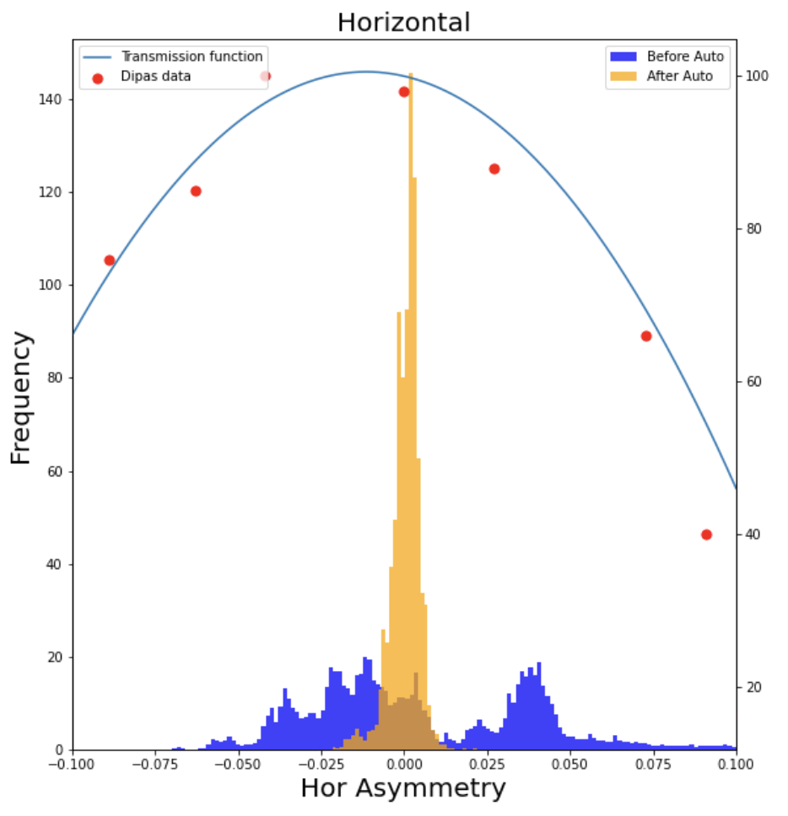
EAST_T9, EAST_N
Implemented automatic beam steering on T9 and T10/T11 target in collaboration with BE-EA during second part of the 2023 run
  Based on beam asymmetry measurement from beam loss monitors around target
Requests 2024:
Users would need more spills per super-cycle: Can spills automatically be re-assigned when T9 or T10 opens the zone?
Infrastructure:
  Cherenkov counters in T10 not working properly
  Some set-ups experienced problems with
  sunlight (through the windows) – set-ups
  usually not test for direct sunlight
  exposure in the lab
  Roof tightness
  Facilities not allowed inside a controlled zone – possible just outside? at least for washing hands?
Improvement in the horizontal beam asymmetry on the T9 target before (blue) and after (orange) automatic beam steering.
Notes:
Put in place June 2023 and added ‘asymmetry adjustment’ in September 2023

Slide 19
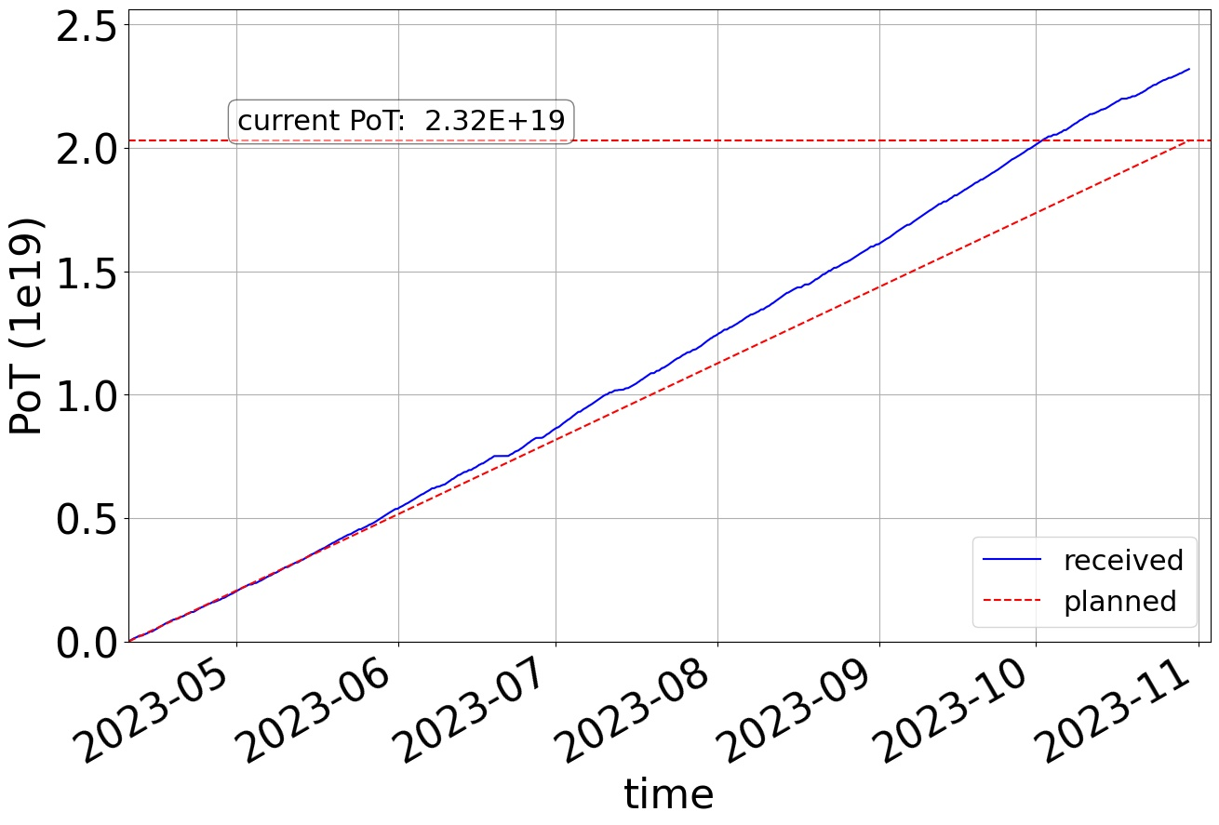
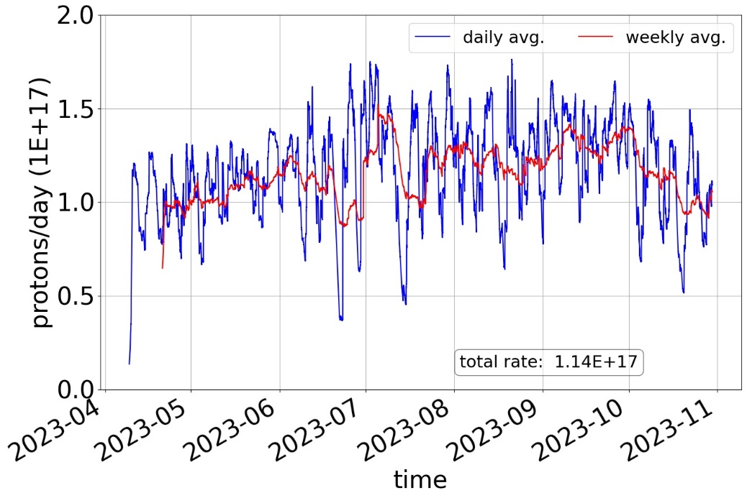
nTOF
2023 Highlights:
Received 14% more protons than anticipated (2.3E19 wrt 2.03E19). Average received: 1.14E17 p/day 😀
All experimental campaigns received the approved number of protons
Flexibility on the pulse intensity
2024
Keep 1E17 p/day as baseline average rate (expect PS EA to be fully booked, LHC running etc.) but hope for more.
2023
LHC stop
LHC stop
Average proton beam intensity upper limit: 167E10 -> 220E10; 09.06.2023

Slide 20
AWAKE and HIRADMAT

Slide 21
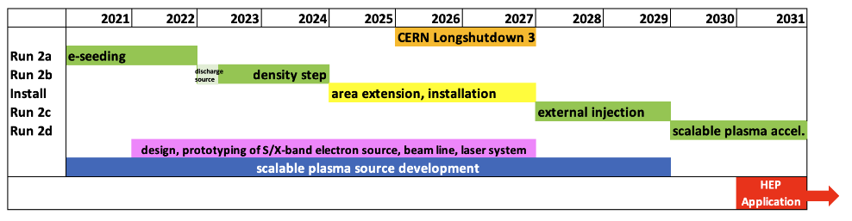
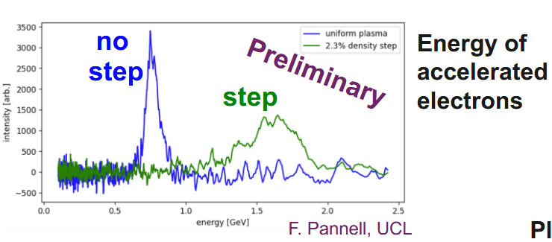
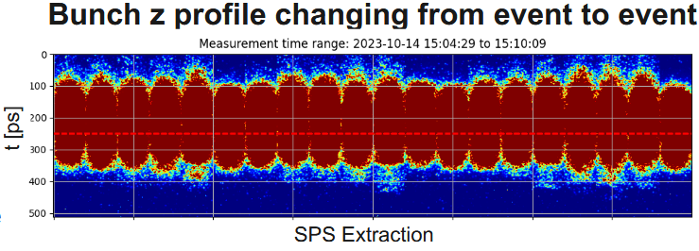
AWAKE
Highlights 2023:
  Operation of new Discharge Plasma Source – candidate technology for 2029 onwards
  Operation of Rb source with Density Step to maintain large wakefield amplitudes over long plasma distances
2023 improvements:
  Faster proton beam alignment
  Dedicated AWAKE operated when NA was in fault
  Availability of laser and electron beams during EYETS.
  Added to official injector schedule.
  Issues
    Occasional event-to-event and day-to-day changes in average
    bunch length and shape (e.g., 20% in 3 days in November).
    SY-RF proposes improved monitoring for 2024
    (https://indico.cern.ch/event/1349652/)
    Continue dedicated data-taking for proton beam jitter
    measurements to pinpoint relevant power converters
2024: need proton beam stability and reproducibility over multiple days
  Improve monitoring of proton beam (in conjunction with OP)
  to immediately spot changes and react
  Combined SPS+AWAKE effort to quickly spot know issues
Baseline plan: No beam in 2025 – dismantle CNGS
Notes:
1. Laser ionizes Rb vapor, forming a plasma
2. Rb plasma creates micro-bunches in the proton beam
3. Micro-bunched proton beam excites plasma wakefields
4. Wakefields accelerate and focus electrons

Slide 22
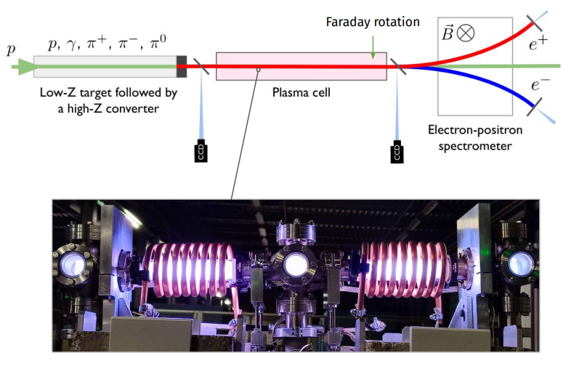
HiRadMat: Highlights and Requests
Experiment highlights
Improvements
Requests
HRMT62 FIREBALL – Oxford: Generate a quasi-neutral e⁻/e⁺ pair beam to reproduce an astrophysical jet in lab
Nature physics paper submission
https://home.cern/news/news/experiments/fireball-hiradmat
AWAKE beam parameters achieved at HiRadMat: 1 bunch with 3×10¹¹ protons (1 ns bunch length)
HiRadMat runs in 2023 very smooth (in comparison to 2021) thanks to
  Excellent communication with OP (injectors and LHC)
  Dedicated running time
All experiments finished before the end of the week, all weekends returned to physics, AWAKE & MD also recuperated days from the HiRadMat Weeks
HiRadMat Upgrade during this EYETS: require 288 bunches of 2.3x10¹¹ ppb in 2024
Define in advance the KPIs of the required beams (input from the experiments).
Pre-commission challenging beam configurations during a couple of hours the week before the actual experiment.
Faster change-over between HiRadMat cycles and faster SPS super-cycle changes in general
Extraction with momenta < 440 GeV/c : A small taskforce has been established (BE-EA, SY-ABT & BE-OP) and tests are to be scheduled for end of 2024-25
HRMT25 TPSG4 - SY/ABT: MSE protection element & bending magnet tested under the LIU scenario successfully

Slide 23
SPS North Area

Slide 24
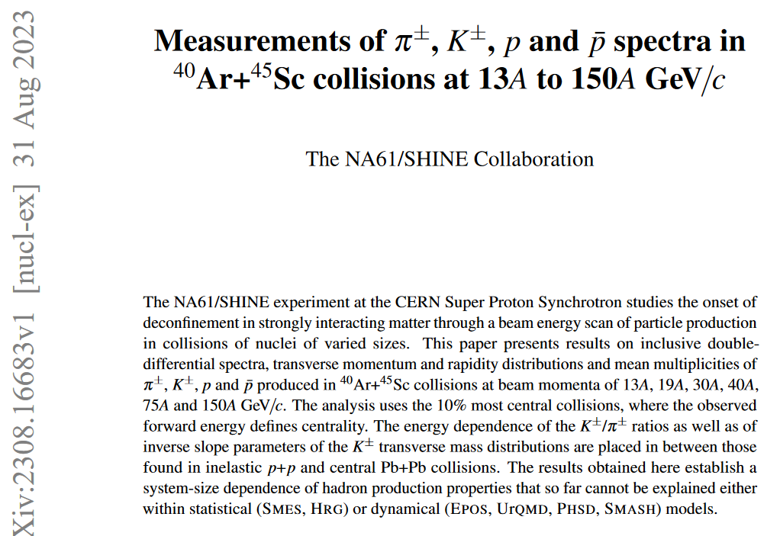
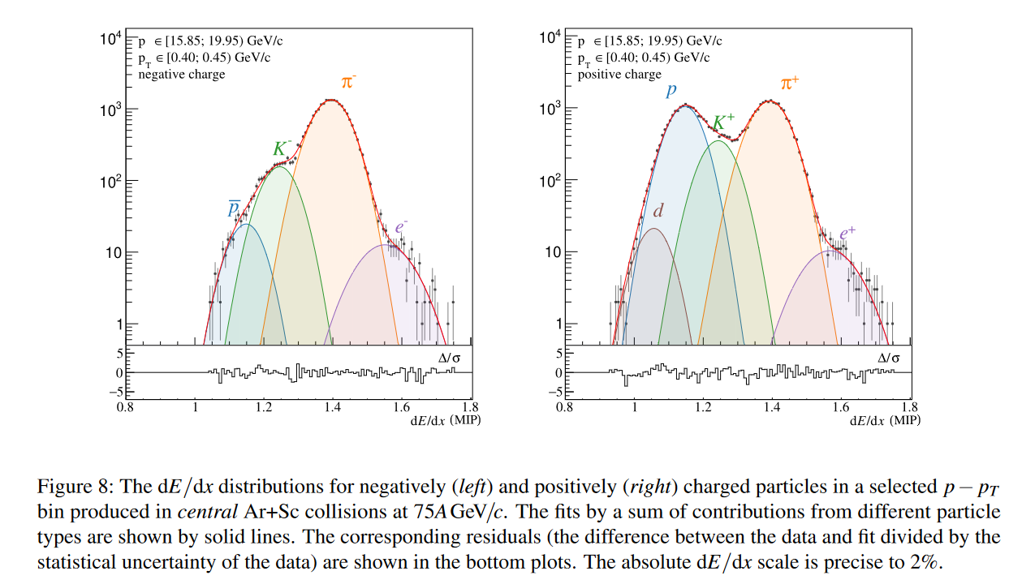
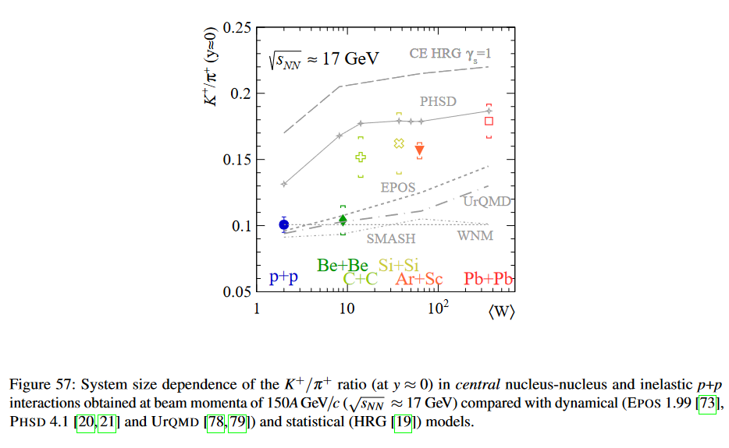
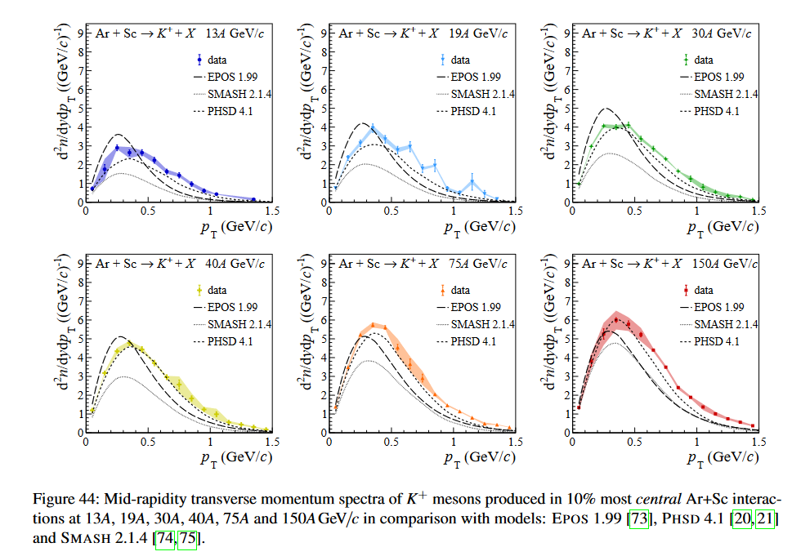
NA61/SHINE
2023:
  The quality of the ion spill structure was significantly improved in 2023 - improvement was triggered by users' meeting discussions with machine experts
  On top of known issues with beam position stability, a new thing was observed: jumps in beam position for low momentum hadron beams - caused by interference when settings in neighbouring lines are changed.
2024
  Addressing the low momentum beam position jumps.
  Better stability of ion beam intensity and position
Mayor paper on intermediate size system (Ar+Sc, 2015). https://inspirehep.net/literature/2692441
Notes:
investigating the properties
of the onset of deconfinement and searching for the possible existence of a critical point. The program
is mainly motivated by the observed rapid changes in hadron production properties in central Pb+Pb
collisions at about 30A GeV/c by the NA49 experiment [2, 3]. These findings were interpreted as the onset
of deconfinement.
As the results obtained for the Be+Be
system closely resemble inelastic p+p interactions, the collisions of Ar+Sc are the lightest of the studied
systems for which a significant increase in the K+/π+ ratio was observed. The properties of measured
spectra and multiplicities indicate that the Ar+Sc system is on a boundary between light (p+p, Be+Be) and
heavy (Pb+Pb) systems.
The NA61/SHINE experiment at the CERN Super Proton Synchrotron studies the onset of
deconfinement in strongly interacting matter through a beam energy scan of particle production
in collisions of nuclei of varied sizes. This paper presents results on inclusive double-
differential spectra, transverse momentum and rapidity distributions and mean multiplicities of
π±, K±, p and ¯p produced in 40Ar+45Sc collisions at beam momenta of 13A, 19A, 30A, 40A,
75A and 150A GeV/c. The analysis uses the 10% most central collisions, where the observed
forward energy defines centrality. The energy dependence of the K±/π± ratios as well as of
inverse slope parameters of the K± transverse mass distributions are placed in between those
found in inelastic p+p and central Pb+Pb collisions. The results obtained here establish a
system-size dependence of hadron production properties that so far cannot be explained either
within statistical (SMES, HRG) or dynamical (EPOS, UrQMD, PHSD, SMASH) models.
This paper reports measurements by the NA61/SHINE experiment at the CERN SPS of spectra and mean
multiplicities of π±, K±, p and ¯p produced in the 10% most central Ar+Sc collisions at beam momenta of
13A, 19A, 30A, 40A, 75A and 150A GeV/c. This is an intermediate-size nucleus-nucleus system investigated
in the system size scan of NA61/SHINE. In this program, data were also recorded for p+p, Be+Be, Xe+La
and Pb+Pb collisions. While the analysis for the two largest systems is still ongoing, an emerging system
size dependence already shows interesting features.
Ar+Sc system appears to be the smallest for which a significant enhancement of the K+/π+ ratio with
respect to p+p collisions is observed. Similarly, the measured charged-kaon transverse momentum spectra
are characterized by significantly larger values of the inverse slope parameter (T ) than in the case of small
systems (p+p, Be+Be). The similarity between intermediate and heavy systems becomes more evident
towards higher collision energies. At the same time, the measurements presented in this article show no
indications of a horn structure at SPS energies for intermediate-size collision systems in contrast to the
results from central Pb+Pb interactions.
The third property that distincts the Ar+Sc system from the small systems is the qualitatively different
shape of the proton rapidity spectra. Similarly as in the collisions of Pb+Pb, the spectra measured in Ar+Sc
reaction at 19A GeV/c are characterized by a convex shape near midrapidity, in contrast to the concave
structure present for p+p and Be+Be systems.
The experimental results were compared with predictions of the models: EPOS 1.99, PHSD, and SMASH.
None of the models reproduces all features of the presented results. We also highlight the failure of
analyzed models in the description of the K+/π+ ratio in terms of both collision energy and system size
dependence.

Slide 25
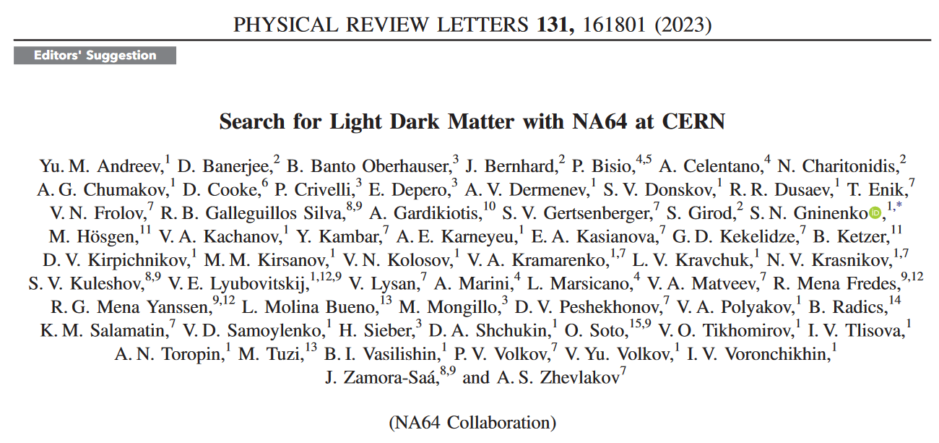
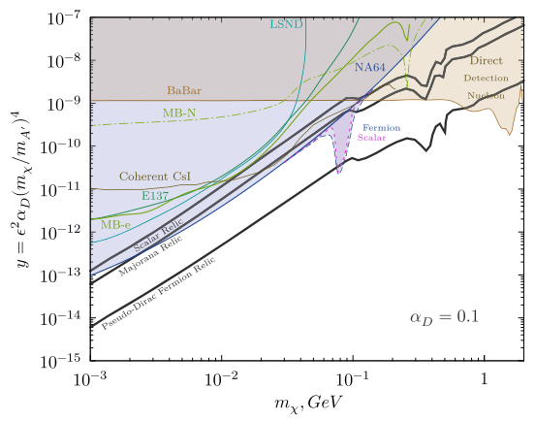
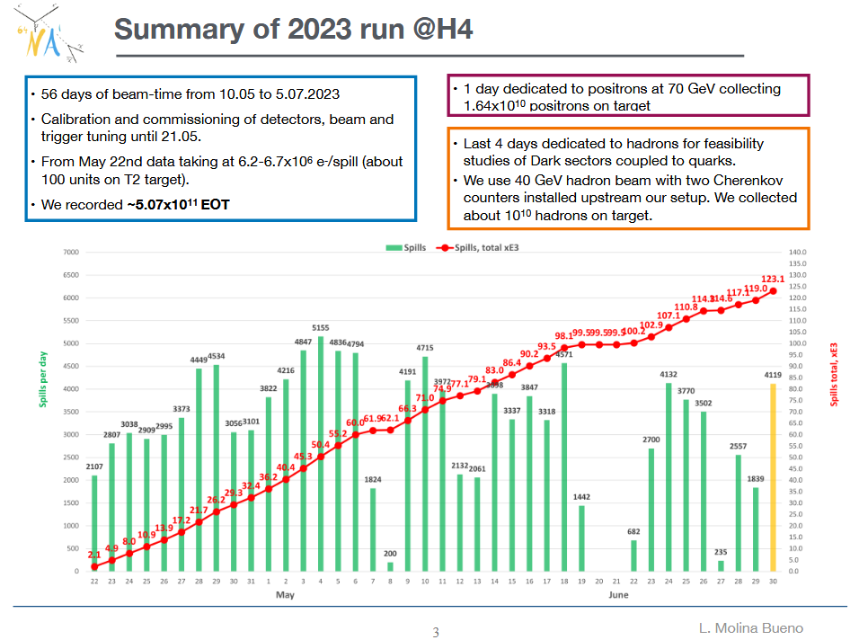
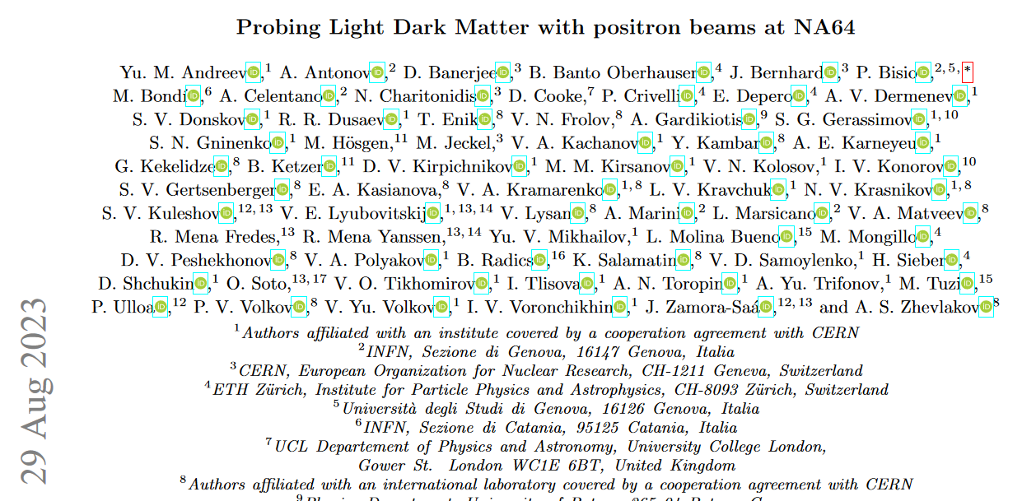
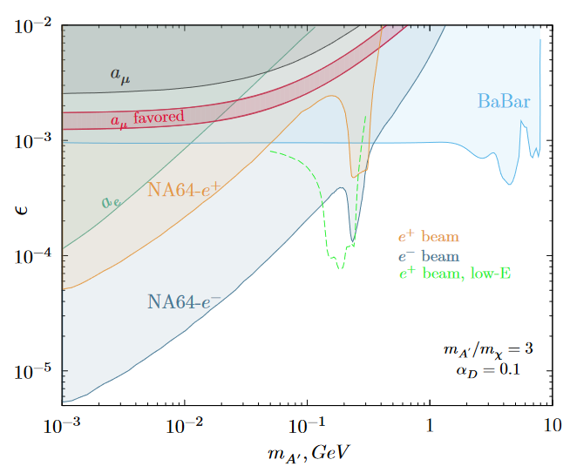
NA64
2023:
  SPS H4 high purity electron beam:
    Improved overall beam quality, stability of the spill and consistent high intensity electron beam reaching up to 6.8x10⁶ e⁻/spill (T2=100 units)
    Improved vacuum of the beam line the beam quality was excellent with the beam halo reduced from 5% to 3% even at high intensities and the hadron contamination was 0.3%.
  SPS M2 muon beam:
  Very good beam quality.
2024 / 2025: same as in 2023
“Search for Light Dark Matter with NA64” (PRL’s Editor suggestion)
https://journals.aps.org/prl/abstract/10.1103/PhysRevLett.131.161801
"Probing Light Dark Matter with positron beams at NA64,’’ CERN-EP-2023-192, [arXiv:2308.15612 [hep-ex]] (submitted to PRL)
https://arxiv.org/pdf/2308.15612.pdf
Notes:
the top left figure of figure 4 of the paper “Search for Light Dark Matter with NA64” as in this way one can see that currently NA64 starts probing the Light Dark Matter models benchmark predictions (black lines). The bottom figure of the slide contains already the coverage in epsilon, dark photon mass parameter space for electron and positron beams.

Slide 26
NA66 AMBER – M2 beamline - First physics data taking in 2023
2023:
  Beam quality and delivery very good - as far as we saw - but we are not really sensitive with the low intensity beams.
  Problems with magnet regulation (jumps in beam positions seen during 2022 most probably still exists but we were not sensitive since we changed beam settings every few days.
  The only problem was the change in intensity every time the sharing on the primary targets changed – due running at to beam low intensity
2024 – 2025:
  Better control about low beam intensity delivery
  Review of the beam instrumentation we had problems with CEDARS but also with FISC and MWPCs in the beamline.
  A beam component introduce quite high background rates on the top PMTs of both CEDARs. This was found by AMBER during the DY high intensity test. A second dedicated high intensity hadron test was performed by BE during PRM beam time to identify this component. → Aperture of Bend 6 is hit by the beam, investigations are on-going.
  Upgrade of beam-line vacuum before LS3 to make checks of the improvements before LS3

Slide 27
SPS North Area continued
NA62 – K12 beamline:
  CEDAR-H fully operational and performing well
  The work on the spill structure initiated in 2022 and consolidated in 2023 and the work of re-alignment and fix of the extraction line in April has greatly improved the performance of NA62
  In 2024 and 2025: continue with the good spill quality.
MUONE – M2 beamline:
  Preparing their proposal for the SPSC (SPS Scientific Committee)
    „An alternative evaluation of the leading-order hadronic contribution to the muon g-2 with MUonE", Phys. Lett. B 848 (2024), 138344; doi:10.1016/j.physletb.2023.138344
    https://www.sciencedirect.com/science/article/pii/S0370269323006780
  No changes in beam requested until LS3

Slide 28
Detector R&D Test Beam Users
Numerous and diverse community
New DRD collaborations being currently formed

Slide 29
General Remarks from Test Beam Users
Many test beam users have only 1 or 2 weeks to perform their measurements. Substantial time for commissioning and set-up changes → even a relatively short beam unavailability can be problematic.
Maximal rate during the spill is usually defined by the DAQ (few users limited by radioprotection)
  Spill structure often hidden behind the low data-taking rate
  The only way to improve statistics is by increasing the number of collected spills – increasing beam intensity would not improve statistics.
  The best KPI for a test beam is the number of delivered spills
Request to improve announcements for shorter-notice super-cycle and beam changes:
  Examples
    If users know that filling of the LHC will start in an hour, they can postpone their access to change their detector orientation until then.
    When there is a beam stop, up to date (including reason of stop) information about the status should be communicated, so that the people and equipment are ready when the beam comes back, not scrambling out of the experimental area once the beam gets into the machine!
User feed-back session test beams https://indico.cern.ch/event/1345699/

Slide 30
SPS NA Test Beams and CERF
CERF (CERN-EU high-energy Reference Field facility) - user facility in H6 https://cerf.web.cern.ch/ | 2023 beam very stable and highly available 2024: CERN-integrated solutions to perform beam monitoring (e.g., centralized acquisition on NXCALS, etc.) could be studied with the support of BE and SY
RD51; micropattern Gas Detectors; up to 7 set-ups; 3x2 weeks; in H4 most of the time parallel to GIF++ Future DRD1 (gaseous detectors) Larger and more divers user group! | 2023: Improved purity of the muon beam; 2024: pion beam: possibility to scan the rate densities (Hz/cm2) ? Large number of set-ups: demanding installation and dismounting; resources on the limit (power sockets, IPs, gas, tables, …) Upgrade of the Beam instrumentations & environmental sensors could bring to significant improvement in the measurements.
DRD6 Calorimetry | Large and challenging prototype setups even in early stages; Dedicated calorimeter test beam line requested
LHCb | Effort to move towards common runs with multiple subdetectors (e.g. VELO+RICH) Issue: gas leak detection and gas bottle monitoring – service not available over the week-end; monitoring of the gas levels 24/7 is crucial;

Slide 31
SPS NA Test Beams continued
EP R&D pixel sensors. 5 weeks in H6 with high secondary beam rates. All users requiring high rates run in parallel during these dedicated weeks. | Require small beam size and/or high particle rates Available rates are RP limited: up to 6x10⁶ / spill at 3 spills / 43.2 sec SC; ~ 2-3 times higher rate in 2023 than in 2022 – less upstream losses due to VXSS vacuum chamber material removal User could take rates up to ~8x10⁷ hits/s Grafana monitoring of DAQ status and environmental conditions Wishes: Automatic adjustment of rate (collimator settings) based on observed radiation levels higher instantaneous rates during periods with fewer spills / longer super-cycles Additional beam-profile monitors near H6B telescopes for easier beam tuning Possibility to run CESAR in monitoring mode on any non-Windows PC from remote (for us it currently only runs on Windows Terminal Server machines) Documented API for CESAR monitoring data (zone access status, rates, ...) Needed for integration in our Grafana monitoring

Slide 32

Towards the unified CERN Controls Systems
Integration of the Experimental Areas Controls (CESAR)
with the Accelerator Controls is advancing.
2023 Highlights
Technical design of CESAR based on Acc Controls, endorsed by EATM and CTTB.
Development work to integrate CESAR with LSA and Controls Configuration.
Progressing technical consolidation of CESAR.
Ongoing study of the future CESAR GUI.
Ongoing analysis to separate equipment-specific logic from CESAR virtual server.
2024 Plans
EA settings management based on LSA to be deployed this YETS.
CESAR Lite GUI for the EA users, based on standard Controls solutions – release candidate by the end of 2024.
Full integration of CESAR with Controls Configuration, leveraging CCDA.
Collaboration with the Equipment Groups to improve CESAR and benefit from FESA.
  The 2024 is a milestone year to bring the Experimental Areas
  operational procedures closer to the Accelerators.
Maciej Peryt BE-CSS

Slide 33
Secondary Beam Compositions
Some experiments measure the secondary particle compositions
  Preliminary data during their beam time – final data would be available on request
Also dedicated measurements by EA
→ Repository for secondary beam composition together with beam line settings, target type, target intensity?
→ trace possible improvements (or degradations)
→ Could be used by future users to plan their measurements

Slide 34
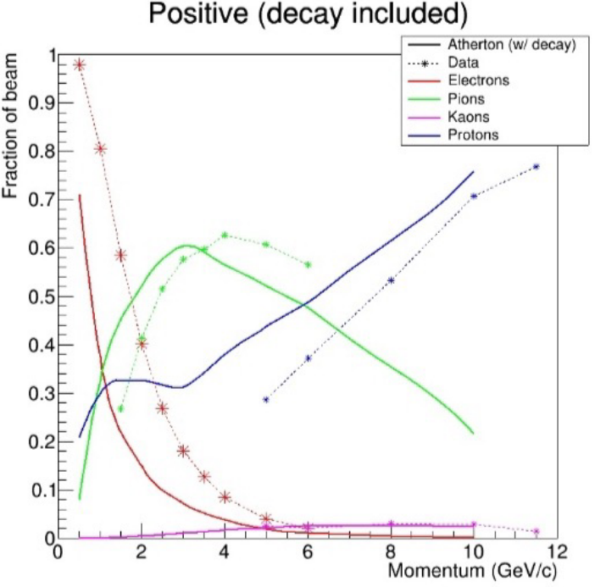
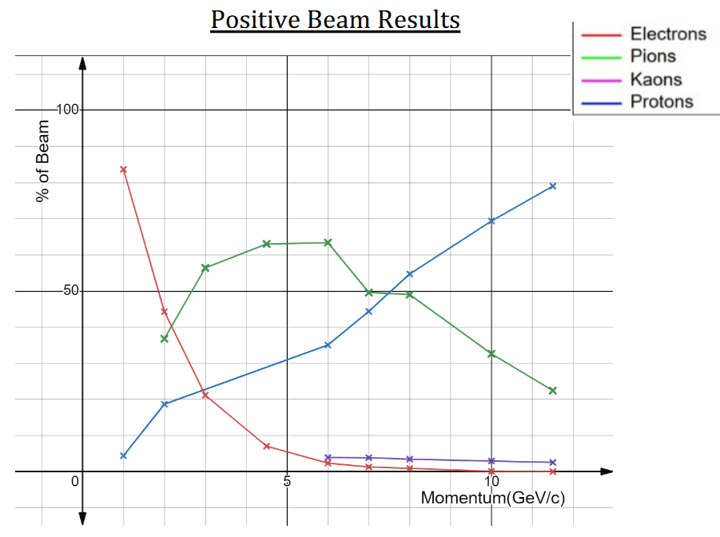




Preliminary Beam compositions
PS EA T10 beam composition by EA (Maarten van Dijk) and BL4S Pakistan Team (https://indico.cern.ch/event/1233355/contributions/5512350/attachments/2722816/4731119/Team%20Particular%20Perspective%20Final%20Presentation.pdf)
WCTE preparing paper
on T9 beam
composition
CALICE (future DRD6): e.g. 15 GeV pions: less electron contamination at PS T9 than at the SPS H2
ATLAS TILECAL in H8 2023 wrt 2022:
  Less electron contamination in hadron beam
  Improved electron beam intensity and purity
PRELINARY 2023

Slide 35








Fragmented Ion Beams – 2023 test beam users
Secondary ion beams created by nuclear fragmentation when the primary SPS Pb beam hits the target; rigidity selection of A/Z (mass/charge) ratio in the secondary beam line (H2, 2010, https://cerncourier.com/a/light-work-with-heavy-ions/)
SPS H4, HERD test beam
SPS H8, VLAST and R2E
test beams

Slide 36
Overview of Wishes and Expectations for 2024
Topics for 2024 on beam quality
  PS T8: continue to improve the position stability; measure (and correct) the shape stability
  AD/ELENA:
    shot-to-shot stability/reproducibility
    Operate with nominal emittance
  Reduce fluctuations in ion beam intensity
  Improve position stability of the EHN1 beams
    Pre-2023 position instability still present
    Additionally in 2023 especially for low secondary low beam moment, setting changes in other EHN1 lines change the beam position in H2 and H4 for proton and ion beams
NA62 is concerned about the EHN3 high intensity MDs. (Muon) beams reaching the experiment? Accident scenarios?
Ongoing Study: Smaller spot size in H6 for pixel detector R&D
More spills to everybody ;-)

Slide 37
Lots of praise from the users for the beam quality and availability and the phantastic responsiveness and support from all the teams!

Slide 38
Spare

Slide 39
Infrastructure Requests
Additional DESY tables
Counting room NA 443: minor updates requested from LHCb
RD51 PPE134 and counting room: make it fit for even larger number of parallel users with DRD1
Upgrade beam instrumentation and environment sensors, logged to NXCALS
API for CESAR monitoring data (zone access status, rates, ...) for integration in Grafana monitoring

Slide 40
Overview 2023
Highlights 2023
  Removal of material in the SPS secondary beams → K12 and H6 / H8
    Reducing losses, increasing beam quality
  Increasing intensity to users
    Increasing primary particle intensities (higher intensities in the accelerators)
      nTOF
      PS EA T8
      ELENA bunch intensity
    Secondary beam (RP limits, beam line improvements): SPS H6 test beams for pixel detector R&D (factor 2-3 to 6E6 particles/spill)
  Improved quality of delivered beams
    PS EA T8 – intensity stability ++, position stability +, shape stability - future
    PS EA T9 and T10 targets – position stability ++
    SPS NA – spill quality (reduction of frequency components, stability of the corrections):
      Proton run: K12, H4, H2
      Ion run: H2 (spill structure – initial problem was fixed by OP and spill flatness achieved was the best ever for NA61; intensity fluctuation -, position instability -)
  Loss reduction
    Empty bucket channeling and barrier-bucket operation covered in a later presentation
  Quantification of secondary beam compositions by users and EA (PS EA, H8, fragmented ions)
Challenges 2023
  The LHC operated for the first time in the high luminosity ion scheme leads to a reduced beam availability for the SPS fixed target ion program due to the dedicated LHC filling and the higher filling frequency of the LHC (faster burn-off, many non-operator LHC dumps).
  → Quantify knock-on effects of significant changes early, to better inform the user community

Slide 41
Winter Physics during EYETS 2023/2024

Slide 42

Not to forget the measurements during the YETS 2023/2024
ISOLDE: winter physics with 3 previously irradiated targets plus one external sample from PSI – 3 weeks (until Nov.20).
GBAR: ELENA runs with H- beam from 13th November until 15th December: prepare for cross section measurement for the H+Ps —> H- + e+
BASE winter physics
  Filled reservoir trap (30 $\overline{p}$); typically require 1 $\overline{p}$ per month for their measurements
GIF++ continues the gamma irradiations with its ¹³⁷Cs source
CLOUD until December 4th
AWAKE laser and e-beam
MADMAX in 2024
Notes:
Aegis had a successful winter run last year with positronium – will they have another winter run this year?
Any other AS/ELENA user continue measurements during the YETS?

Slide 43
Injectors: 2023 very good availability and beam quality
Facility | Destination | ‘21/‘22 Overall [%] | Achieved 2023 |  | Period
Facility | Destination |  | Overall [%] | Per destination [%] | Period
LINAC4 | PSB | 97.3/96.8 | 97.9 | 97.9 | 03.03.2023 – 12.11.2023
PSB | PS | 94.5/94.8 | 96.1 | 96.4 | 10.03.2023 – 12.11.2023
 | ISOLDE |  |  | 96.6 | 17.03.2023 – 30.10.2023
PS | SPS | 88.1/89.6 | 91.7 | 92.7 | 17.03.2023 – 30.10.2023
 | East Area |  |  | 93.5 | 27.03.2023 – 01.11.2023
 | nTOF |  |  | 92.8 | 03.04.2023 – 30.10.2023
 | AD |  |  | 93.9 | 12.06.2023* – 12.10.2023
SPS | LHC | 73.4/74.1 | 86.6 | 94.8 | 27.03.2023 – 30.10.2023
 | North Area |  |  | 87.3 | 24.04.2023 – 30.10.2023
 | AWAKE |  |  | 98.4 | 01.05.2023 – 22.10.2023
 | HiRadMat |  |  | 99.0 | 22.05.2023 – 27.08.2023
LHC | - | - /76.3 | 51.1 | 51.1** | 15.05.2023 – 30.10.2023
Cumulative availability
In the injectors overall
very good availability
Better than in previous years
Overall includes the whole period and all other beams such as MD etc.
Very difficult year for the LHC
Overall machine availability only 51.1% with
*Revised AD start date following quadrupole water leak
**Includes RF finger module exchange & Cold mass to insulation vacuum repair
R. Steerenberg

Slide 44


Slide 45

SPS North Area 2023 Proton Spills Delivered
Projected number of shots (in blue) depend on the program of the SPS
  AWAKE, HiRadMat, MDs, special beam preparation for LHC, LHC physics,
→ big spread already in the planned number of spills per week
Very good performance in 2023
  some weeks below expectation
  Others above, e.g. LHC not running in the middle of the year
https://bpt.web.cern.ch/sps/sftpro/2023/

Slide 46
International Test Beam Schedule
Compilation by the respective test beam coordinators https://cern.ch/international-facilities
Aim: Rough estimate on available beam time to help the users with the planning of their test beams
HEP detector R&D mostly performed at CERN, DESY and Fermilab
→ 2026 to 2028 will be difficult (future SPS/PS experiments, LS4
and LS5 upgrades, FCC, EIC)
Update from DESY expected end of 2023
Last Update 16/11/2023
Running | 1
Winter/Summer Shutdown | 2
Longer Shutdown | 3
Unclear | 4
Likely | 5
Pending Approval | 6
Notes:
Tilman Rohe: die Jahrespläne werden immer im Jan/Feb veröffentlicht. Normalerweise geht eine Run-Periode von Mitte Mai bis kurz vor Weihnachten. Das habe ich so eingetragen. Das heisst aber nicht, dass dann auch Test-Beam Zeit vergeben werden kann. Ab ~ September 26 bis Ende 28 wird es keinen Strahl geben, da eins der Produktionstargets augetauscht die PiM1-Strahllinie komplett umgebaut wird. Danach steht PiM1 nicht mehr für Teststrahl-Experimente zur Verfügung. Dann muss man auf PiE1 ausweichen (nicht Teil von EUROLABS und noch viel stärker überbucht).

Slide 47
Removal of material (displaced vacuum tank) in the secondary beam line
  Improved electron beam intensity and purity in H6 (not measured in 2023) and H8 (measured in 2023)
  Reduction in primary protons on T4 for optimal K+ beam intensity for NA62
    → allowed to use longer target (higher electron yield) for electron beam users in H6 and H8
  Smaller beam size on T10
  Factor 2 higher rate possible in H6 before hitting the radiation limit – less upstream losses?
SPS NA heavily overbooked
High number of user schedule change requests during the run ( remained high during all of Run3 already – procurement problems, transport problems since COVID)

