Slide 1
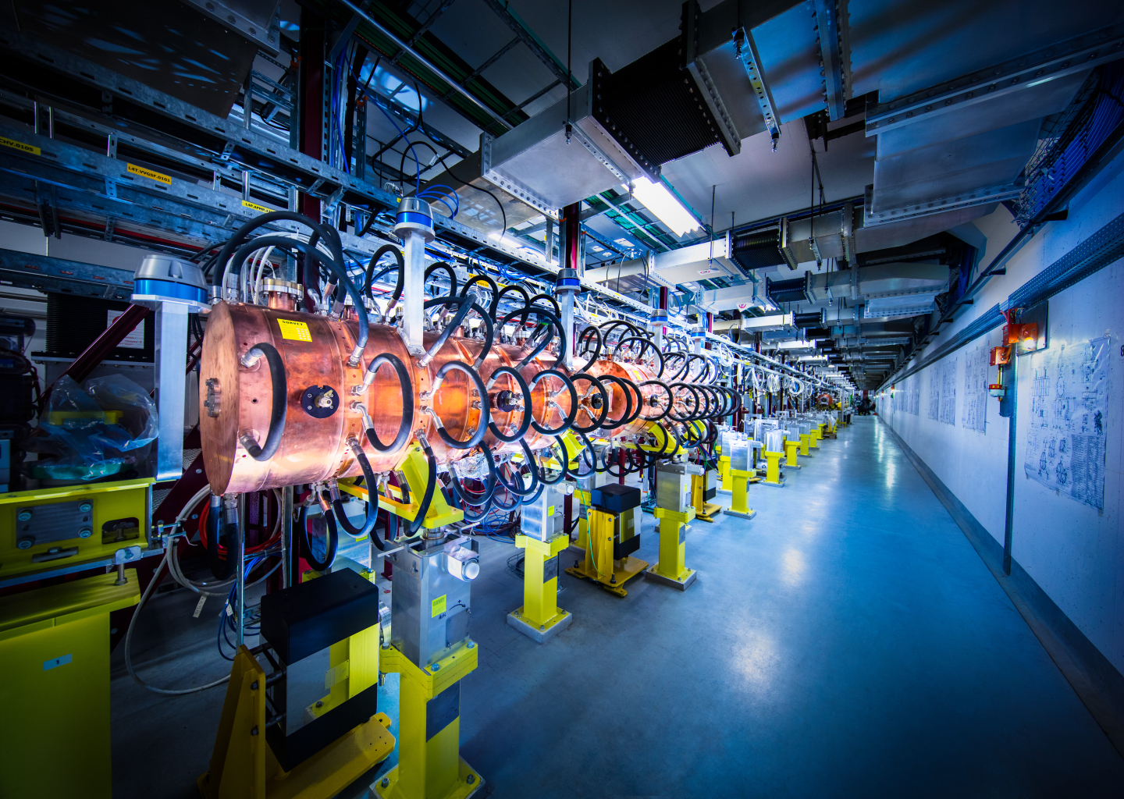
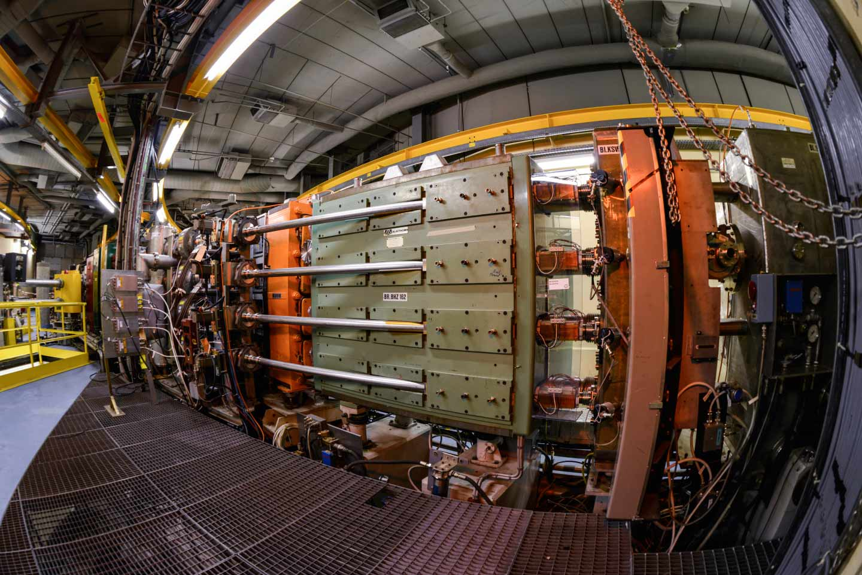
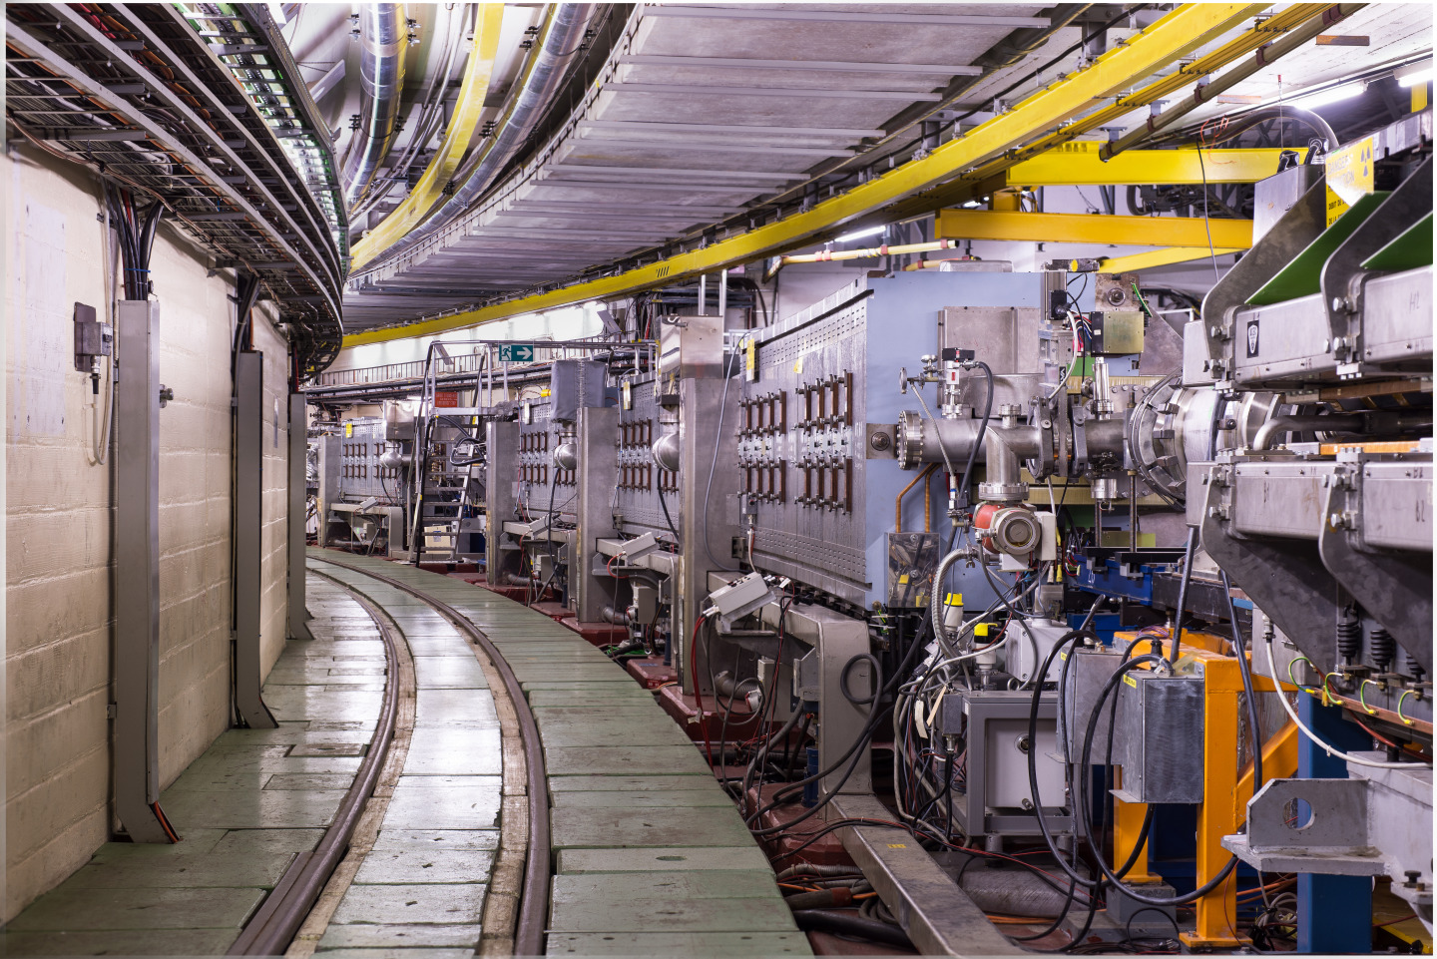
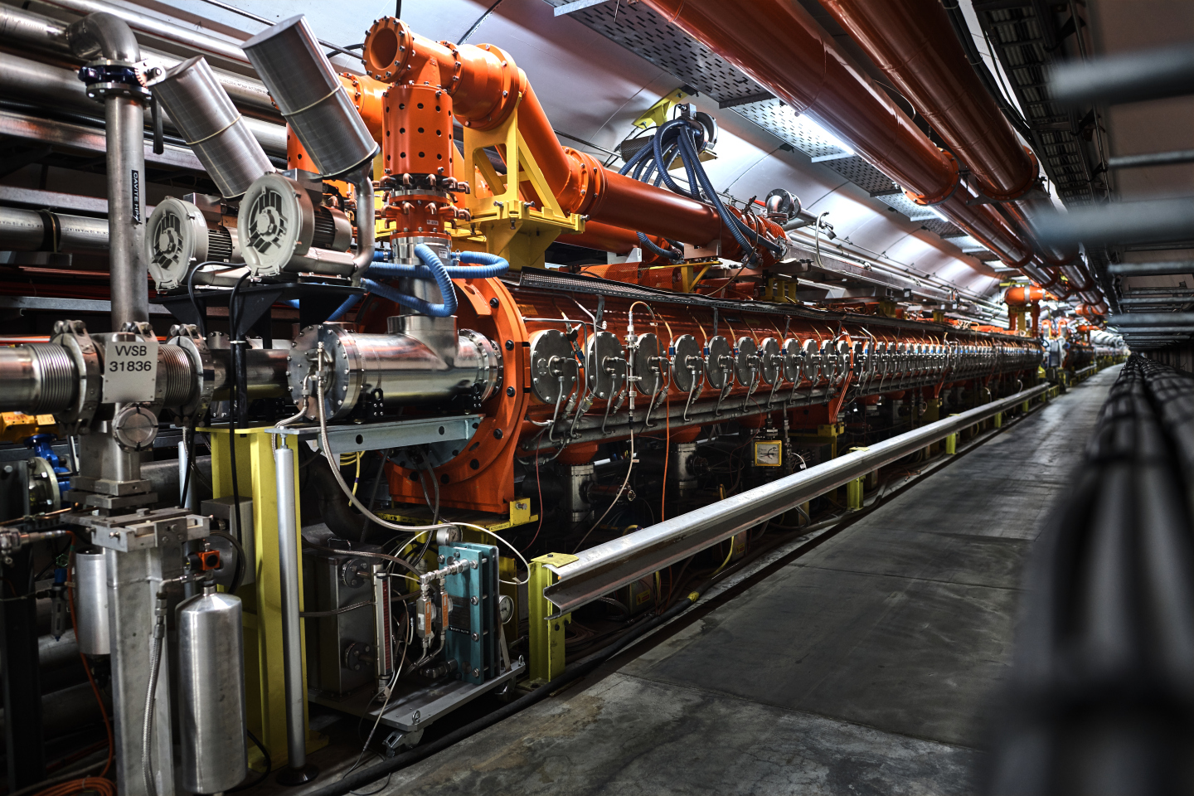
Transmission of proton fixed target beams in 2023 and beyond
T. Prebibaj, S. Albright, C. Antuono, F. Asvesta, H. Bartosik, G. Bellodi,
C. Bracco, S. Cettour-Cave, H. Damerau, L. Feliciano, A. Findlay,
M. A. Fraser, D. Gamba, G. P. Di Giovanni, A. Huschauer, A. Lasheen,
J. B. Lallement, K. Li, M. Marchi, B. Mikulec, E. Sargsyan,
P. Skowronski, M. Schenk, F. M. Velotti, C. Zannini, PSB-PS-SPS OP
05/12/2023
JAP23 Workshop

Slide 2
Transmission of proton fixed target beams in 2023 and beyond
How did the fixed target cycles perform in 2023?
Where do we lose protons across the complex?
What are the ongoing and future studies?
JAP23 Workshop
tirsi.prebibaj@cern.ch

Slide 3
Content
Part I
transmission of proton
fixed target beams in 2023
      Overview
      ISOLDE
      AD
      TOF
      EAST
      SFTPRO
Part II
…and beyond
      PSB intensity reach
      PSB instability studies
      SFTPRO studies

Slide 4
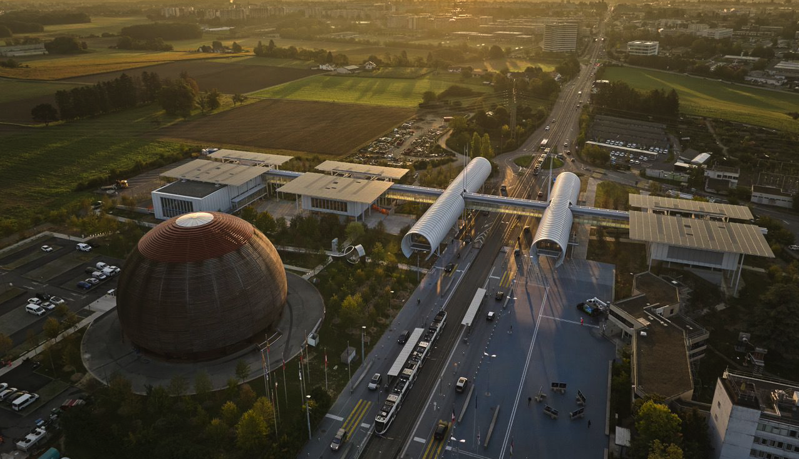
Part I transmission of proton fixed target beams in 2023

Slide 5
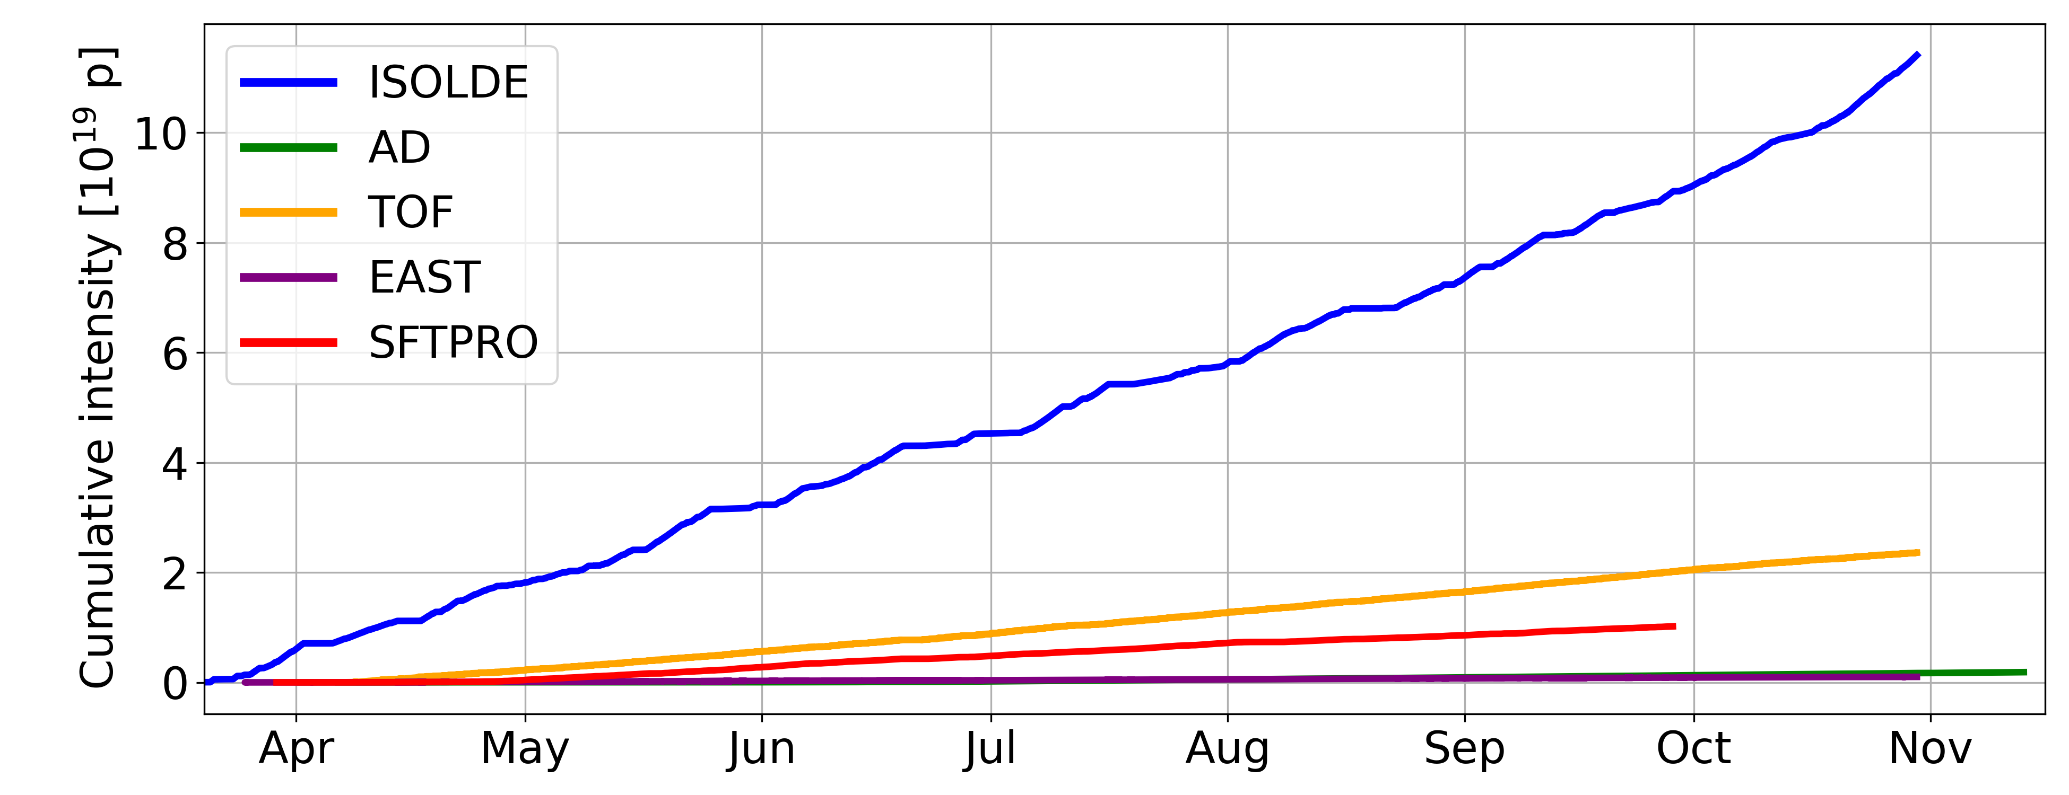
Intensity in 2023
Cumulative intensity until extraction of last synchrotron.
This talk will not cover transfer between last synchrotron and target: see session 6.
JAP23 Workshop
tirsi.prebibaj@cern.ch

Slide 6
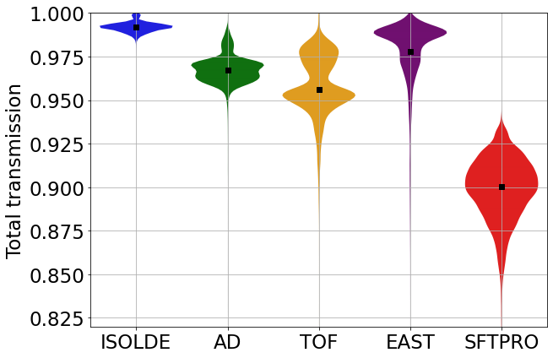
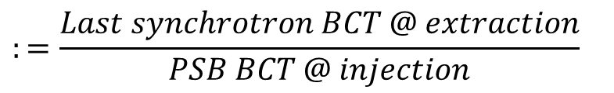

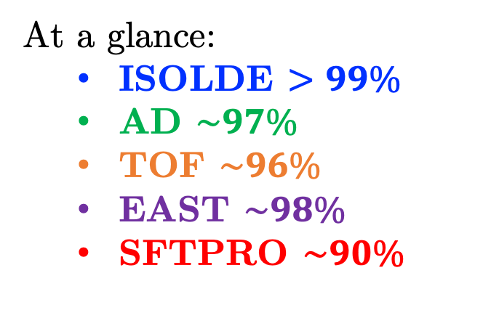
Transmission in 2023
$$Total \\ transmission$$
$$:=\frac{Last synchrotron BCT @ extraction}{PSB BCT @ injection}$$
At a glance:
  ISOLDE $>99\%$
  AD $\sim 97\%$
  TOF $\sim 96\%$
  EAST $\sim 98\%$
  SFTPRO $\sim 90\%$
Where do we lose protons across the complex?
JAP23 Workshop
tirsi.prebibaj@cern.ch

Slide 7
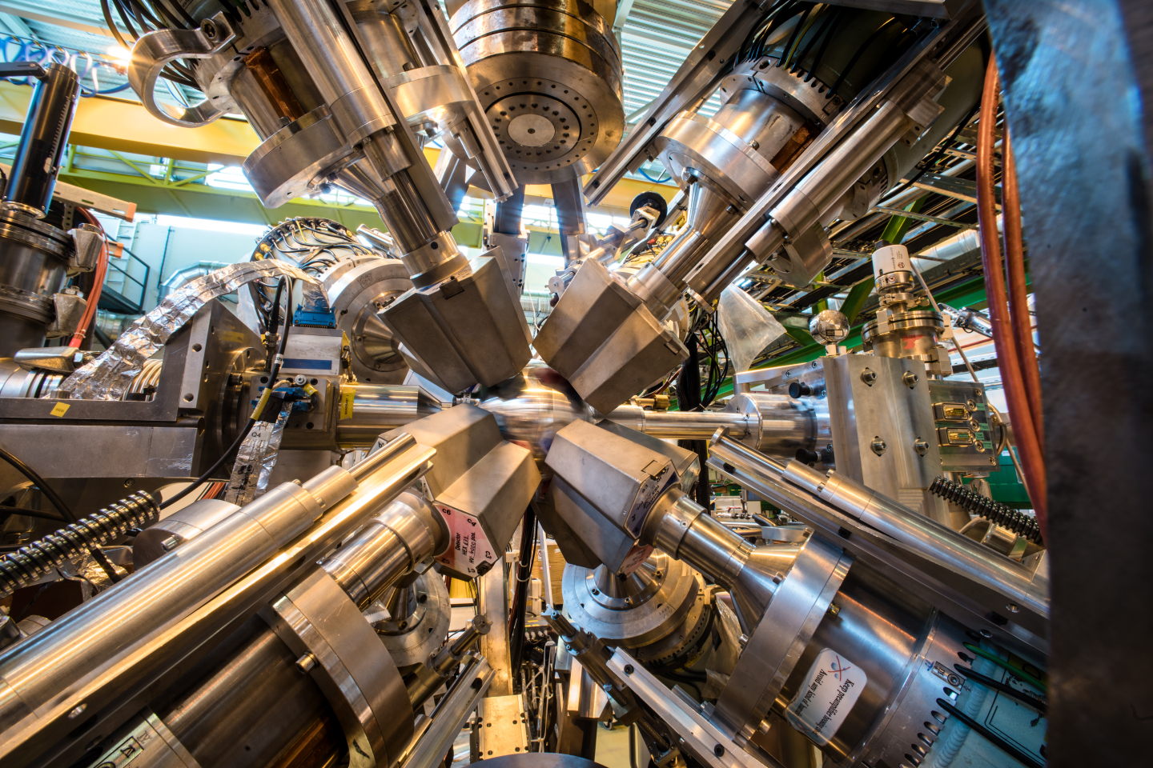
I S O L D E

Slide 8
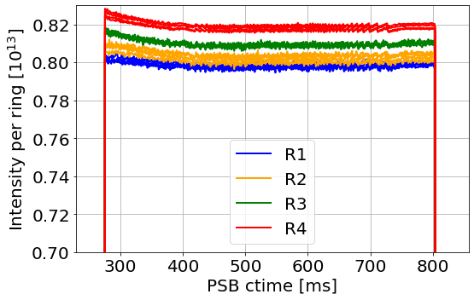
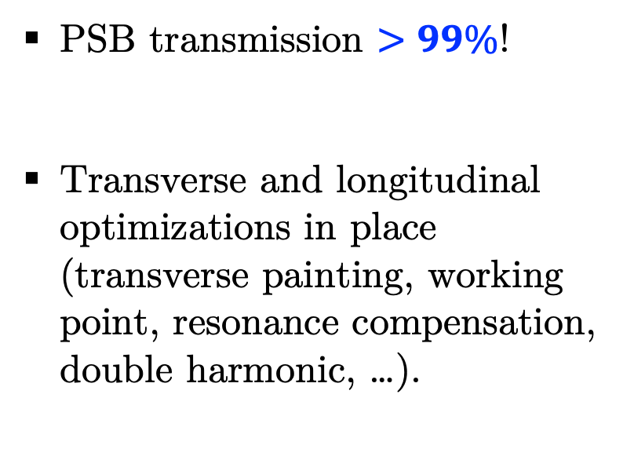
ISOLDE cycle
PSB transmission $>99\%$!
Transverse and longitudinal optimizations in place (transverse painting, working point, resonance compensation, double harmonic, …).
JAP23 Workshop
tirsi.prebibaj@cern.ch

Slide 9
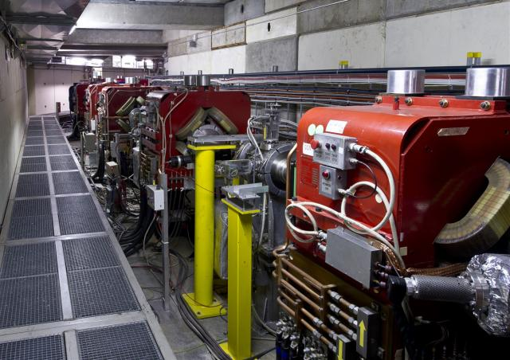
A D

Slide 10
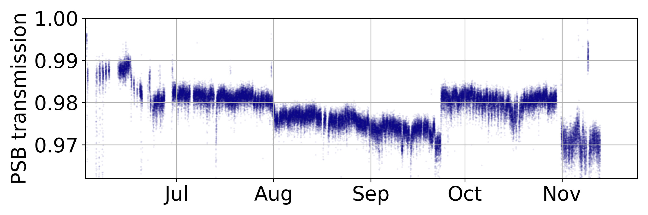
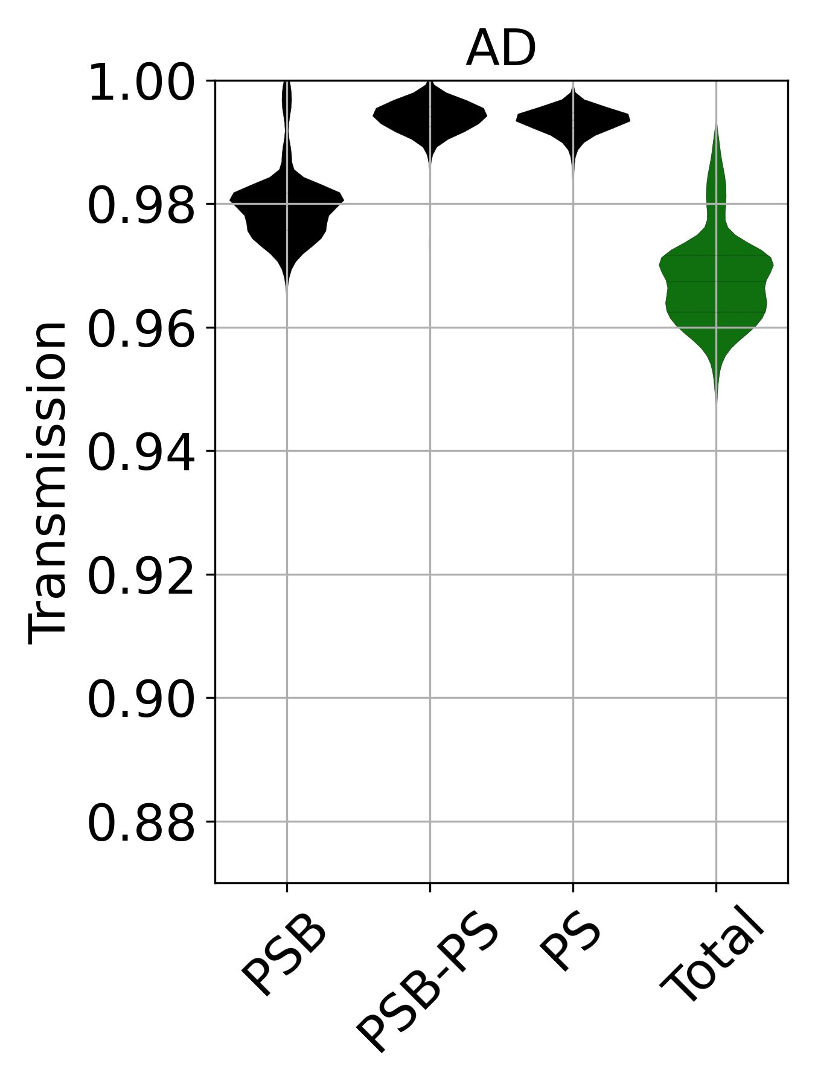
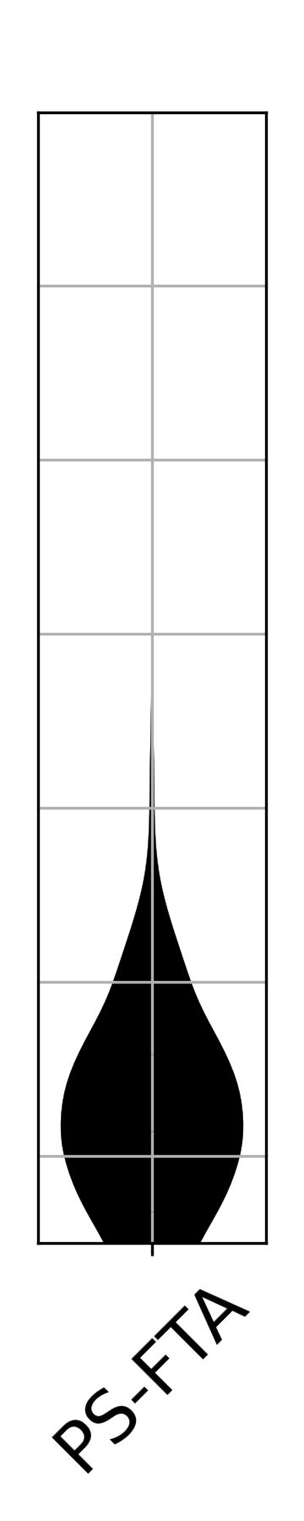
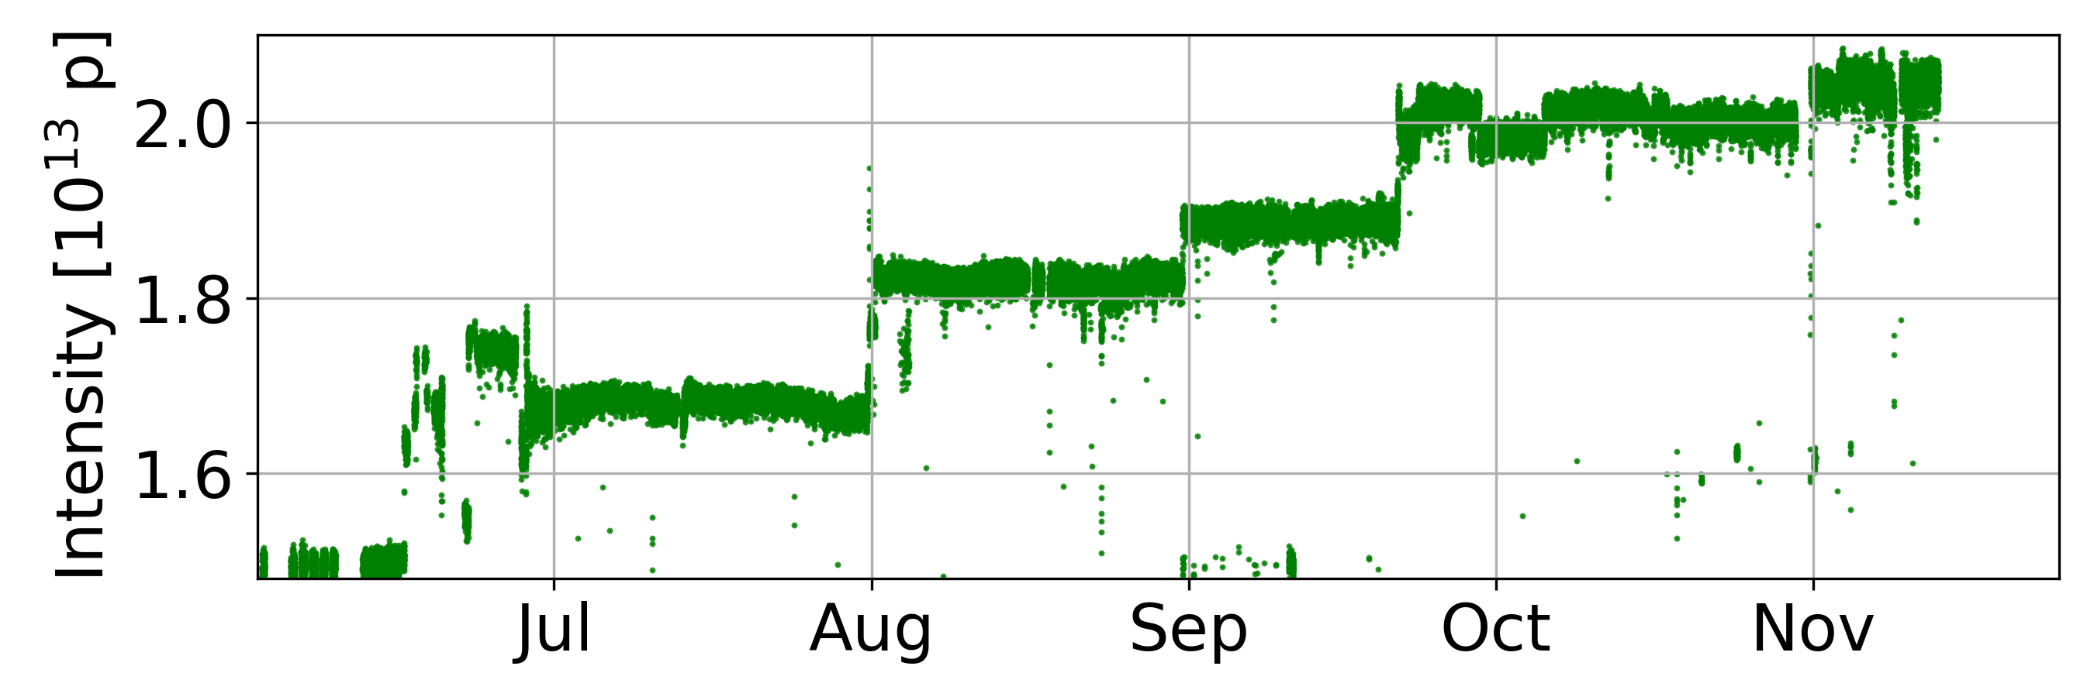
AD intensity ramp-up
Transmission degradation in PSB correlated with intensity ramp-up: beam setup at low intensity; further optimizations applied later on.
Unprecedented intensity delivered to AD!
Significant loss after PS extraction: to be discussed in D. Gamba’s talk.
JAP23 Workshop
tirsi.prebibaj@cern.ch

Slide 11
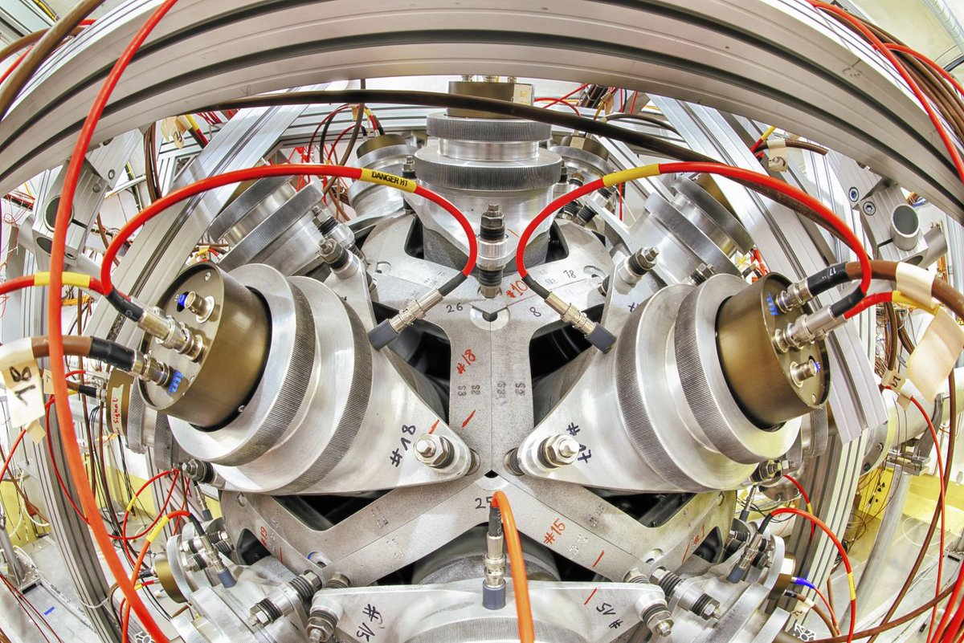
n T O F

Slide 12
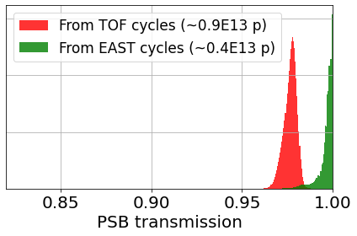
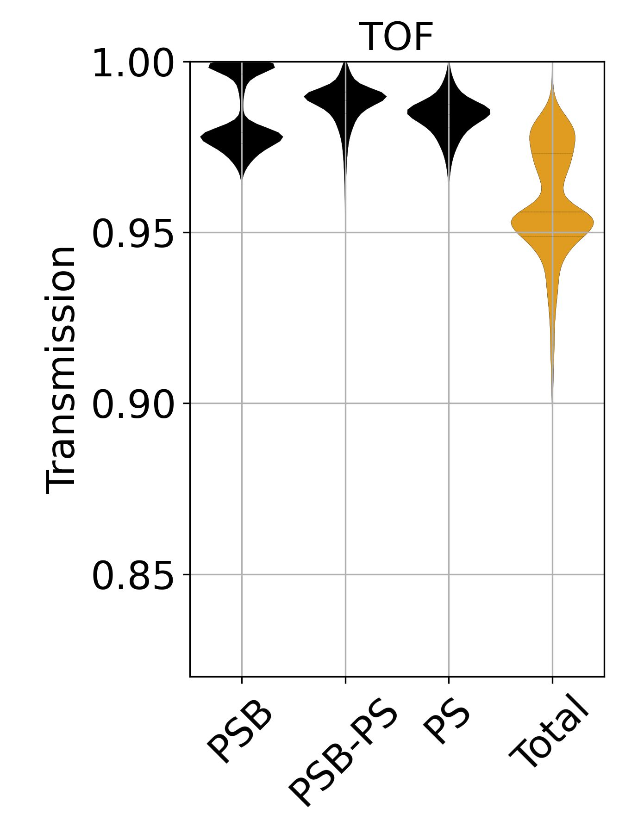
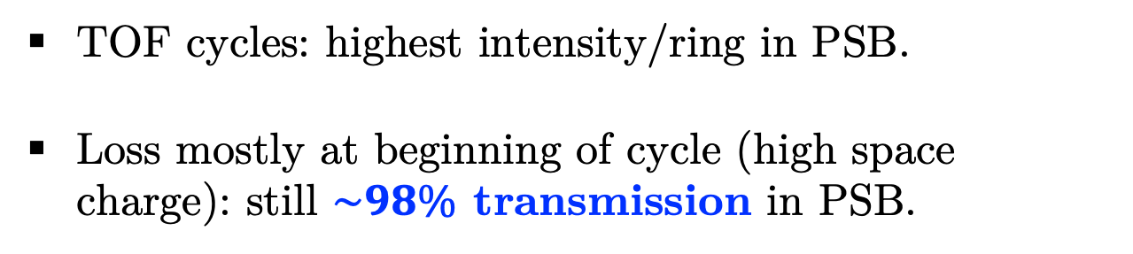
TOF
TOF cycles: highest intensity/ring in PSB.
Loss mostly at beginning of cycle (high space charge): still $\sim 98\%$ transmission in PSB.
JAP23 Workshop
tirsi.prebibaj@cern.ch

Slide 13
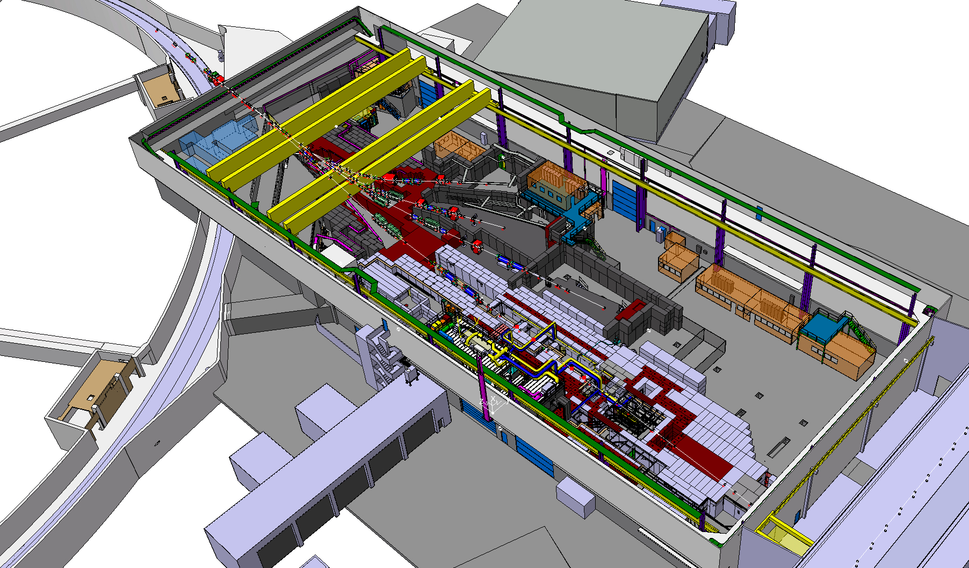
E A S T

Slide 14
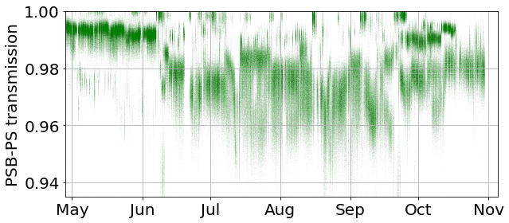
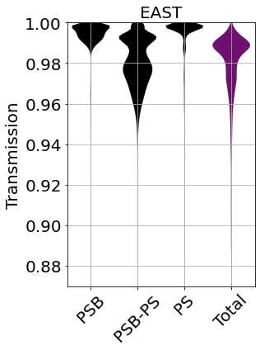
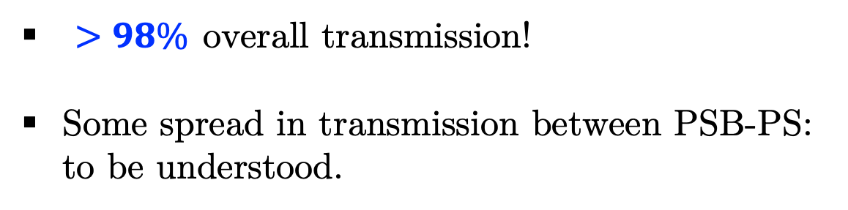
EAST
$>98\%$ overall transmission!
Some spread in transmission between PSB-PS: to be understood.
JAP23 Workshop
tirsi.prebibaj@cern.ch

Slide 15
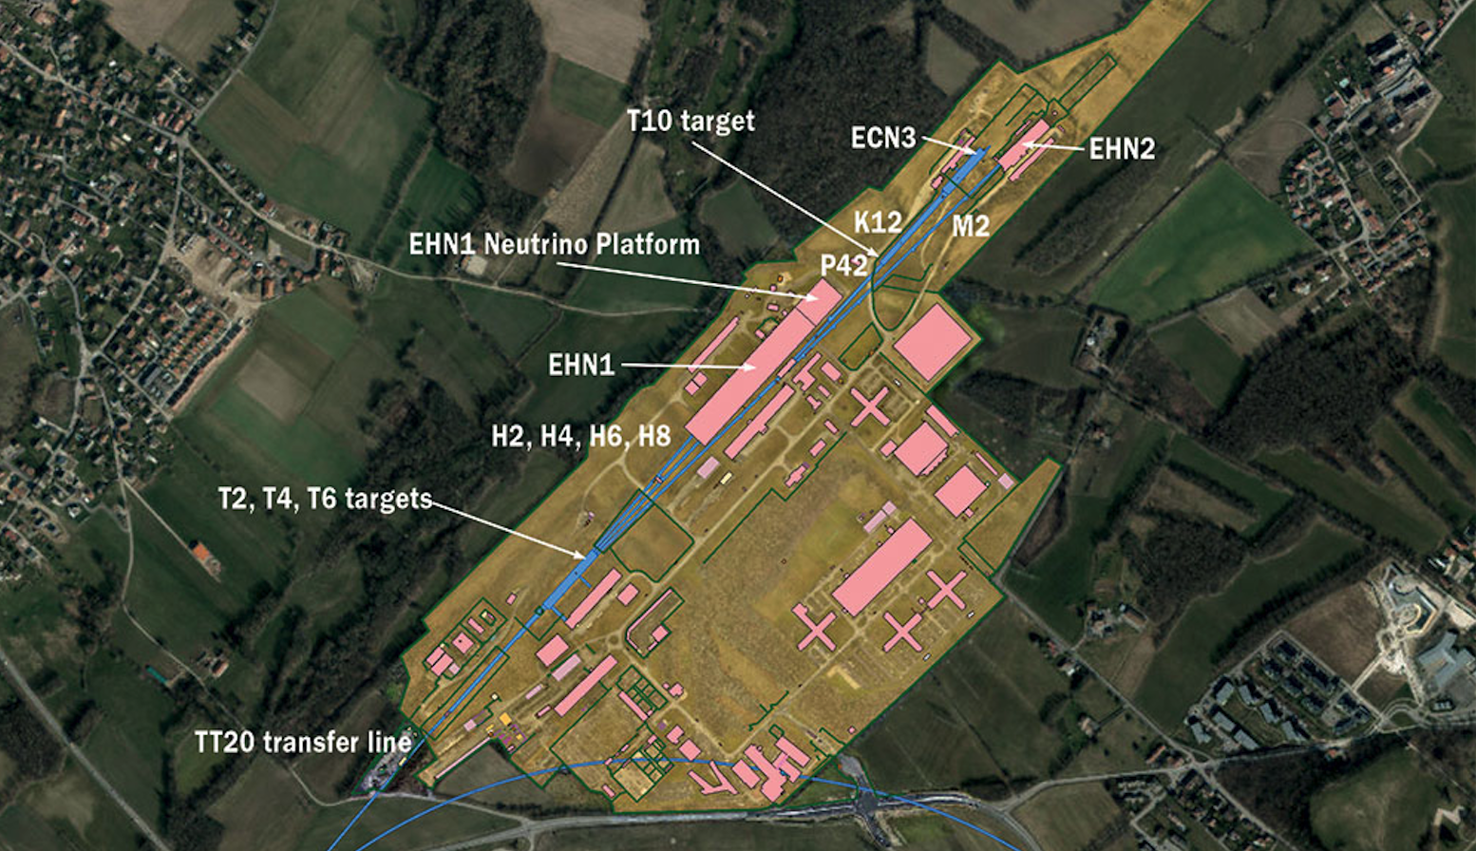
S F T P R O

Slide 16
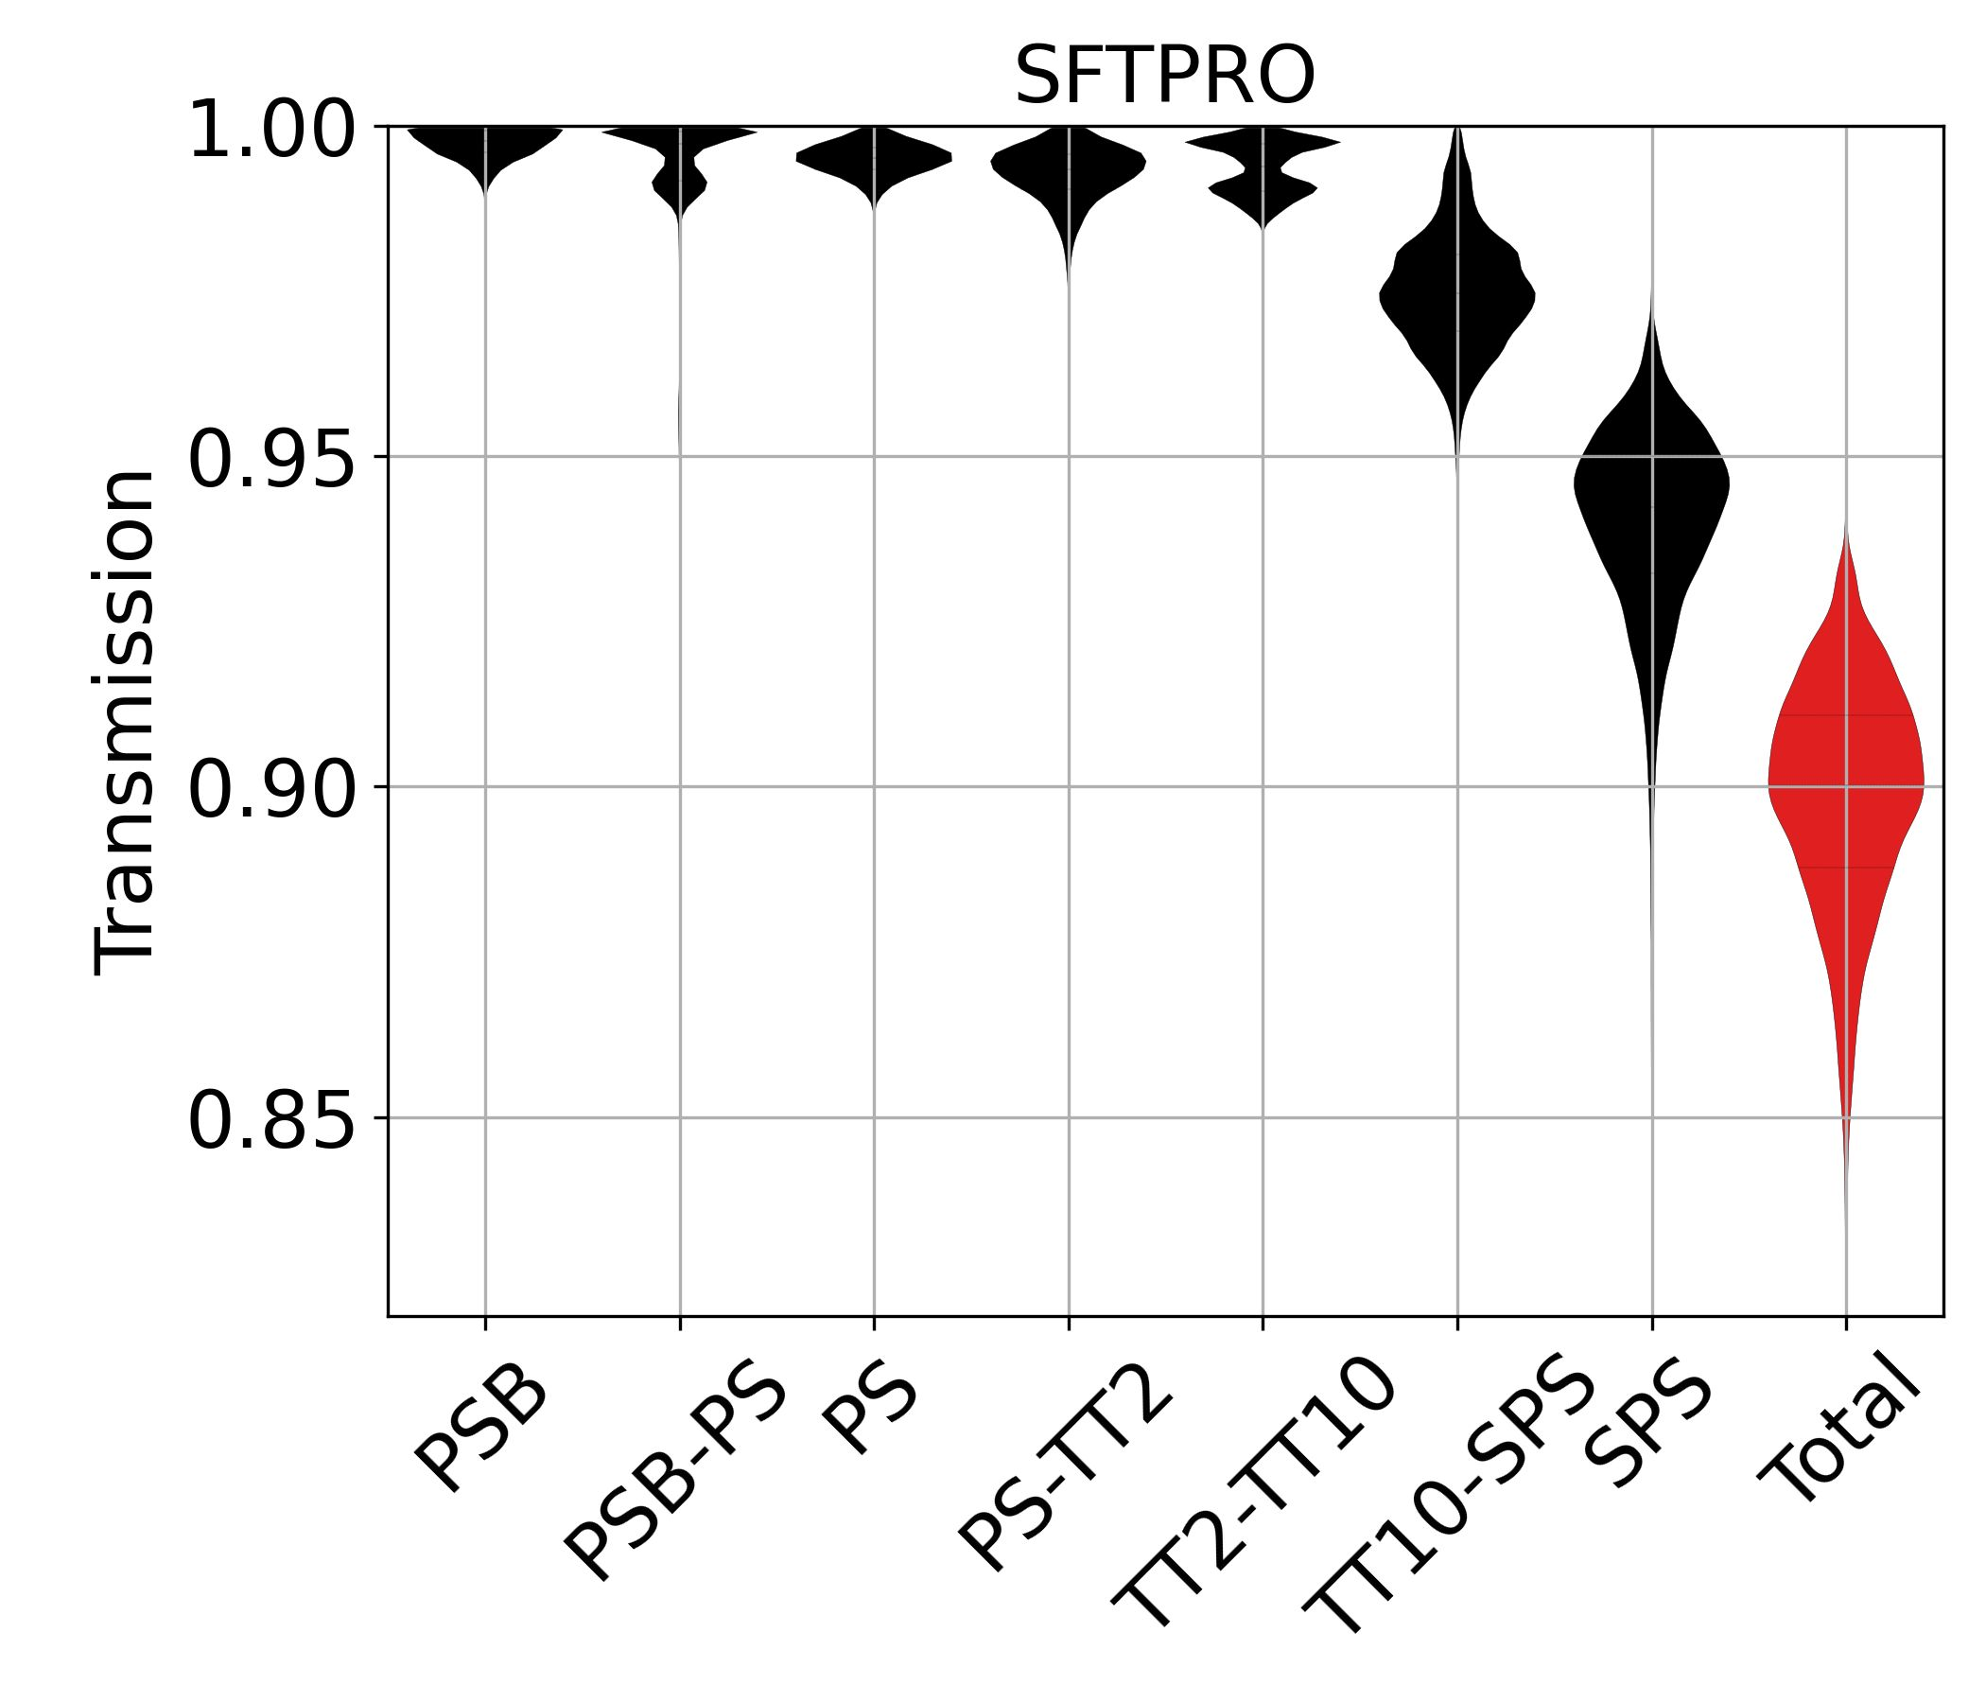
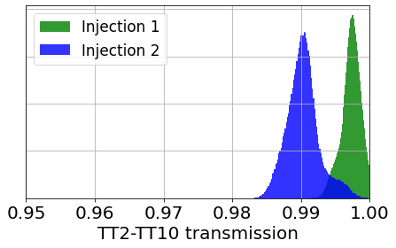
SFTPRO transmission breakdown
Reason for difference in transmission not completely understood.
Difference in extraction/steering of two injections can be one of the causes (steering is optimized for 1st injection).
Plans for: fine calibration of extraction, independent steering correction, automatic steering framework.
JAP23 Workshop
tirsi.prebibaj@cern.ch

Slide 17
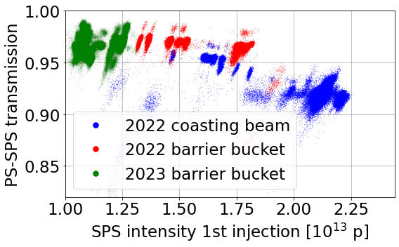
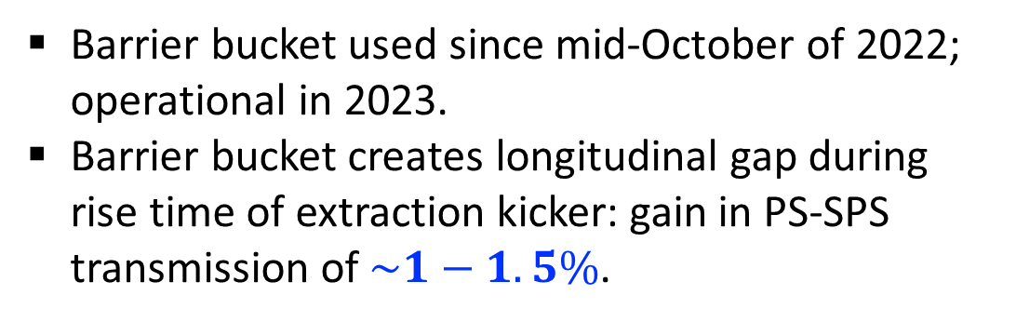
SFTPRO transmission breakdown
Barrier bucket used since mid-October of 2022; operational in 2023.
Barrier bucket creates longitudinal gap during rise time of extraction kicker: gain in PS-SPS transmission of $\sim 1−1.5\%$.
JAP23 Workshop
tirsi.prebibaj@cern.ch

Slide 18
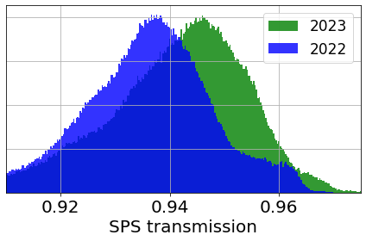
SFTPRO transmission breakdown
Better overall SPS transmission (in-ring) compared to 2022.
Compromise between SPS transmission and splitter losses (see IPP 14/07/2022).
JAP23 Workshop
tirsi.prebibaj@cern.ch

Slide 19
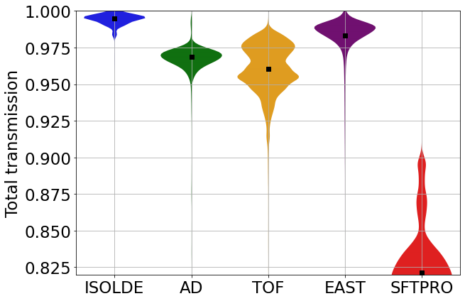
2022
2023
(Lower intensity than 2022)
In 2023, we matched or even surpassed transmission performance of 2022.
What can we expect for the next years?
JAP23 Workshop
tirsi.prebibaj@cern.ch

Slide 20
Part II
…and beyond

Slide 21
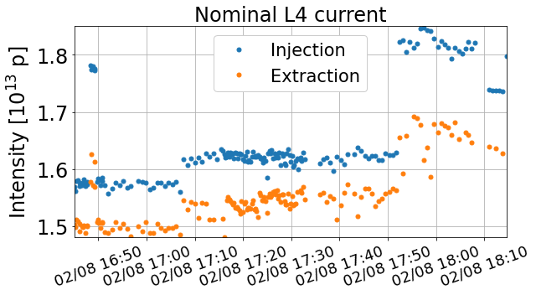
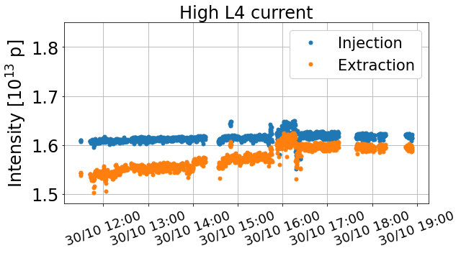
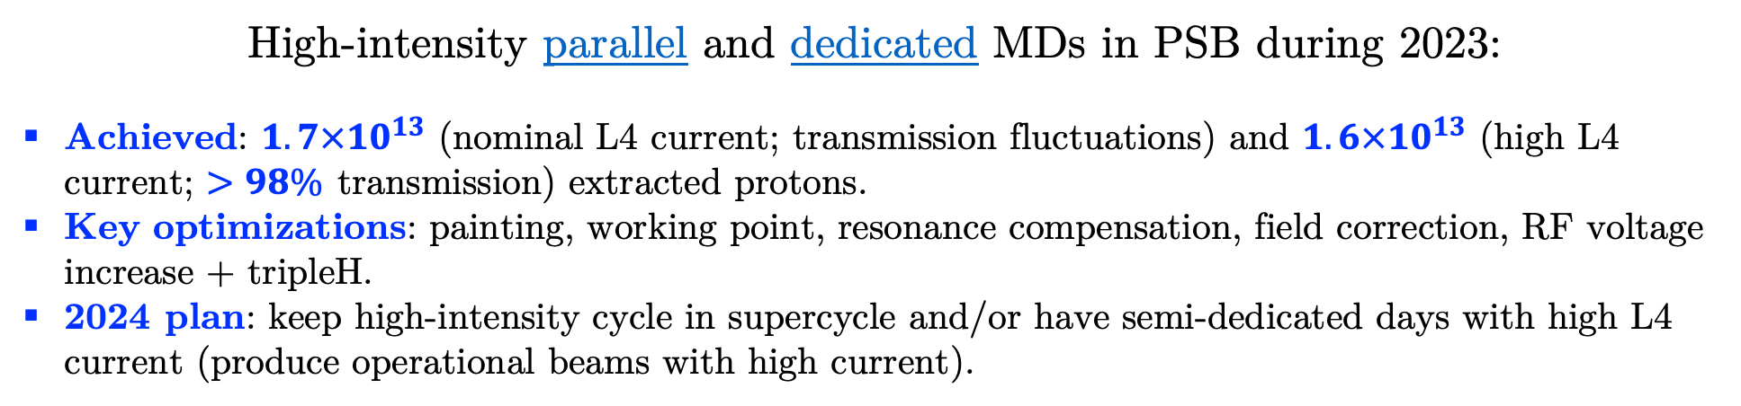
Can we push PSB intensity?
High-intensity parallel and dedicated MDs in PSB during 2023:
Achieved: $1.7×{10}^{13}$ (nominal L4 current; transmission fluctuations) and $1.6×{10}^{13}$ (high L4 current; $>98\%$ transmission) extracted protons.
Key optimizations: painting, working point, resonance compensation, field correction, RF voltage increase + tripleH.
2024 plan: keep high-intensity cycle in supercycle and/or have semi-dedicated days with high L4 current (produce operational beams with high current).
JAP23 Workshop
tirsi.prebibaj@cern.ch

Slide 22
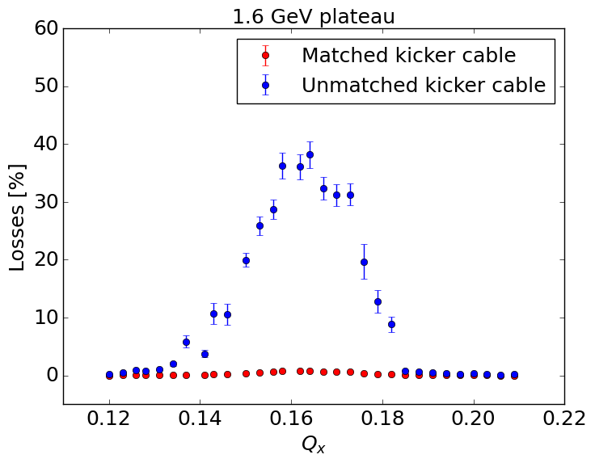
PSB instabilities at high intensities
New instability observed at ~1.6 GeV and high intensities.
Current mitigation strategy is coupling resonance: can lead to higher emittances and losses.
Dedicated MD showed that instability is coming from extraction kicker termination.
Kicker cannot pulse with matched cable: working point adjustments may help in the short term. Hardware modification options are considered.
C. Antuono, F. Asvesta, C. Zannini
JAP23 Workshop
tirsi.prebibaj@cern.ch

Slide 23
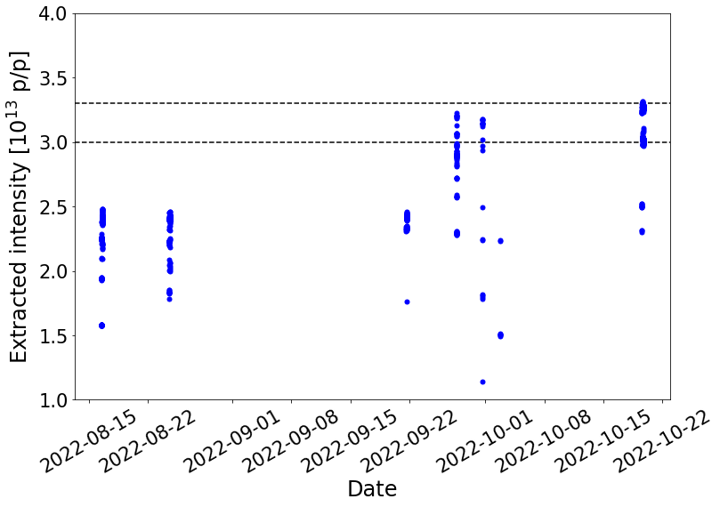
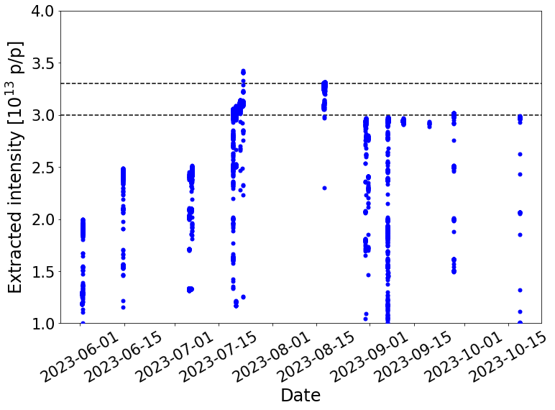
Pushing MTE intensity in the PS
High-intensity tests in the PS:
2022: no barrier bucket
2023: with barrier bucket
Max.
leak
Non-conformity with RF bypass: decided not to exceed $3×{10}^{13}$ protons during ion run.
Explore intensity reach of barrier-bucket MTE up to maximum digestible intensity in SPS.
JAP23 Workshop
tirsi.prebibaj@cern.ch

Slide 24
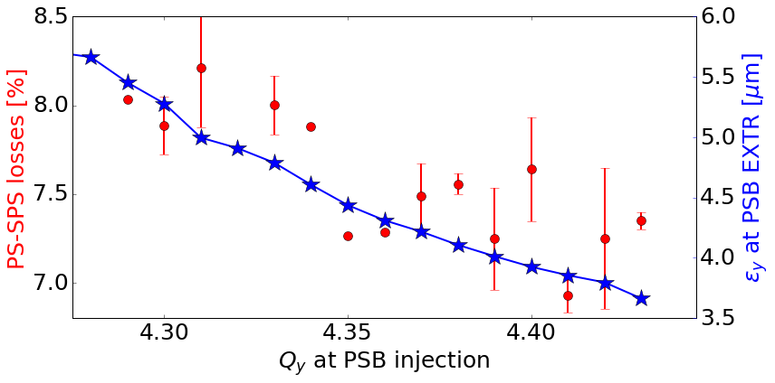
SFTPRO transmission along the chain
Short parallel MD ongoing to understand behavior of SFTPRO transmission.
Tailoring emittances in PSB to determine impact of beam size and shape.
Optimizing TFB frequency and tune to reduce TFB gain in the PS.
JAP23 Workshop
tirsi.prebibaj@cern.ch

Slide 25
Summary

Slide 26
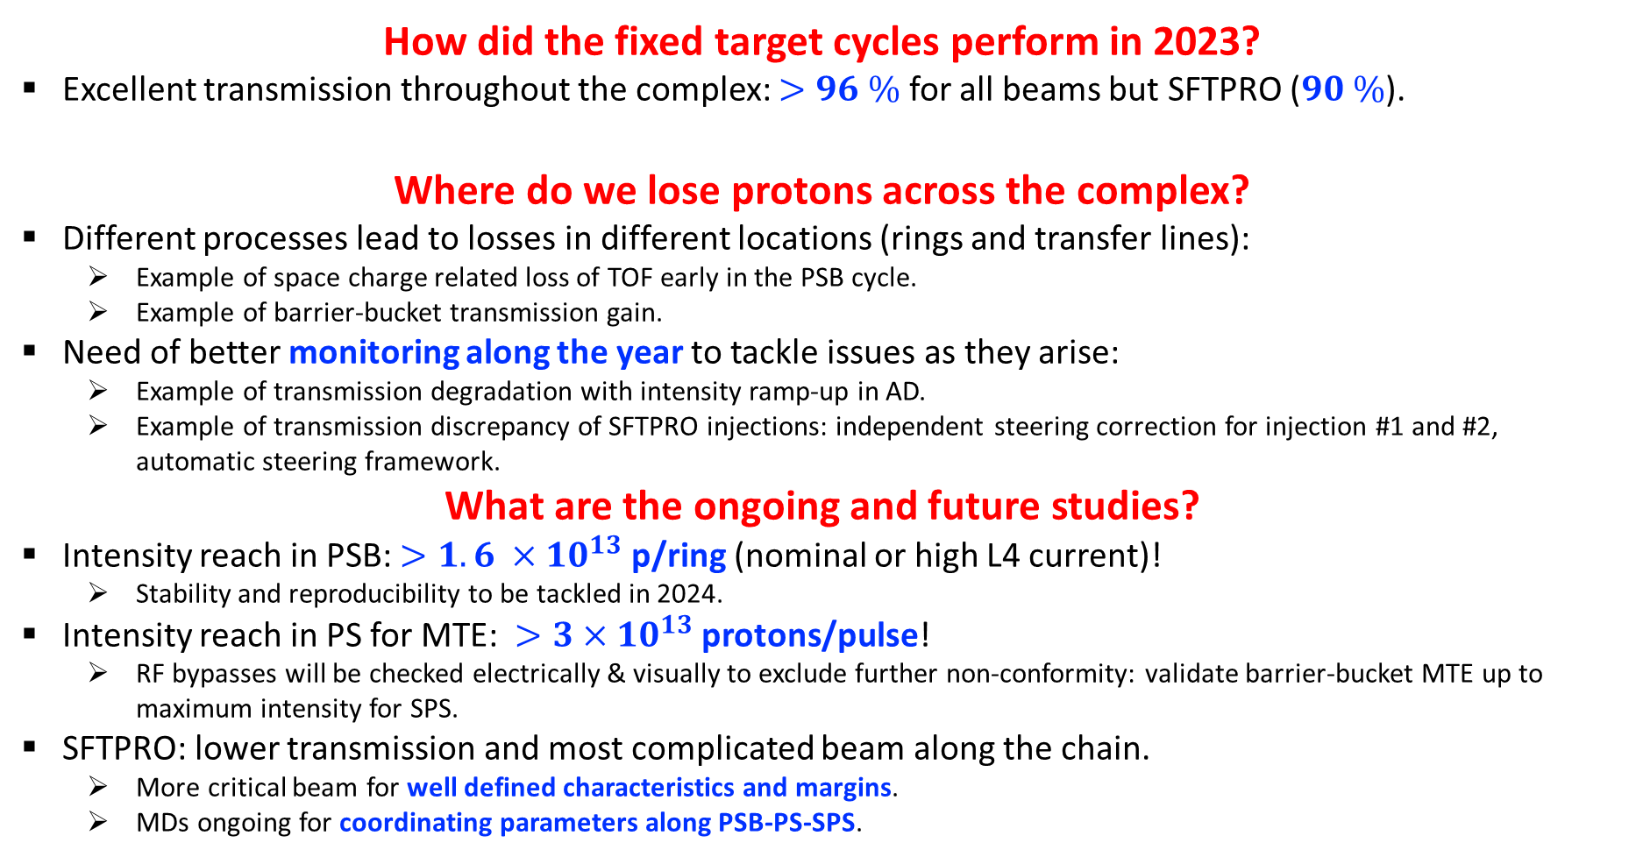
Summary
How did the fixed target cycles perform in 2023?
Excellent transmission throughout the complex: $>96 \%$ for all beams but SFTPRO ($90 \%$).
Where do we lose protons across the complex?
Different processes lead to losses in different locations (rings and transfer lines):
  Example of space charge related loss of TOF early in the PSB cycle.
  Example of barrier-bucket transmission gain.
Need of better monitoring along the year to tackle issues as they arise:
  Example of transmission degradation with intensity ramp-up in AD.
  Example of transmission discrepancy of SFTPRO injections: independent steering correction for injection #1 and #2, automatic steering framework.
What are the ongoing and future studies?
Intensity reach in PSB: $>1.6 ×{10}^{13}$ p/ring (nominal or high L4 current)!
  Stability and reproducibility to be tackled in 2024.
Intensity reach in PS for MTE: $>3×{10}^{13}$ protons/pulse!
  RF bypasses will be checked electrically & visually to exclude further non-conformity: validate barrier-bucket MTE up to maximum intensity for SPS.
SFTPRO: lower transmission and most complicated beam along the chain.
  More critical beam for well defined characteristics and margins.
  MDs ongoing for coordinating parameters along PSB-PS-SPS.
JAP23 Workshop
tirsi.prebibaj@cern.ch

Slide 27
Thank you for your attention

Slide 28
Backup

Slide 29
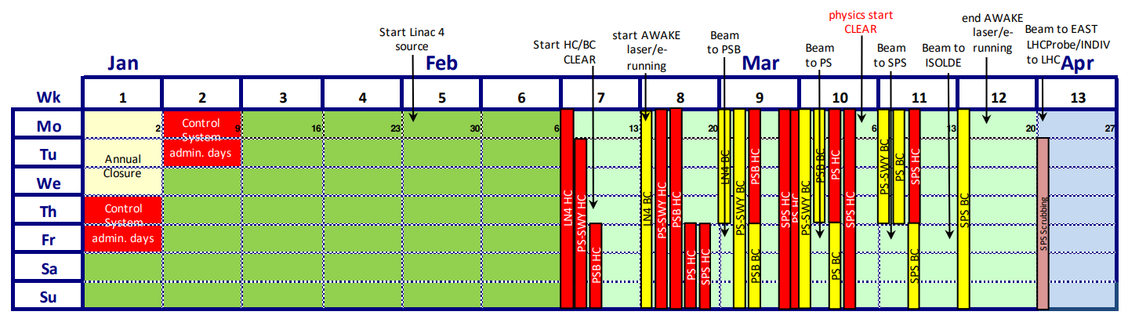
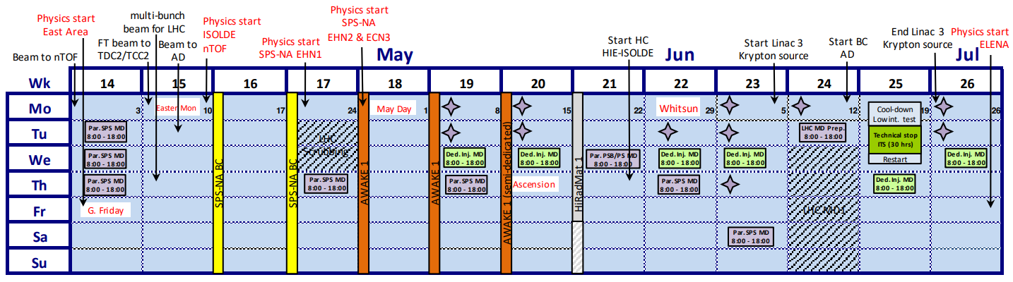
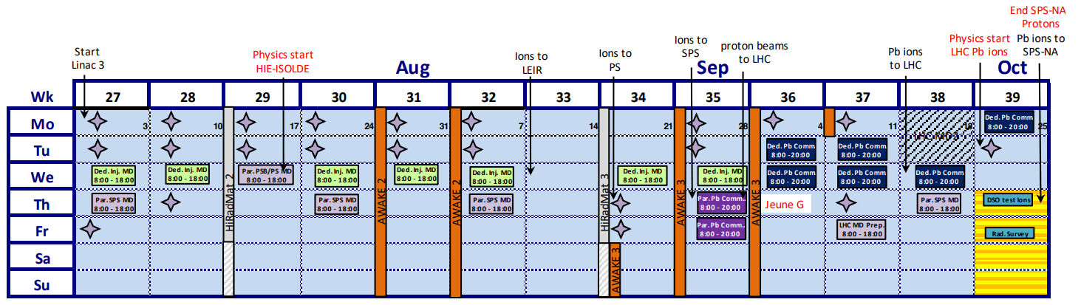
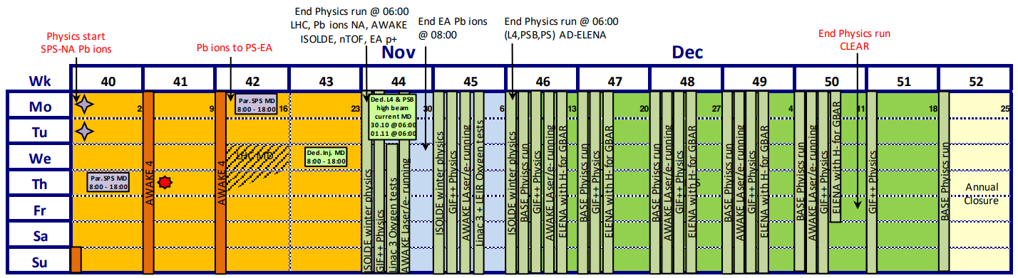
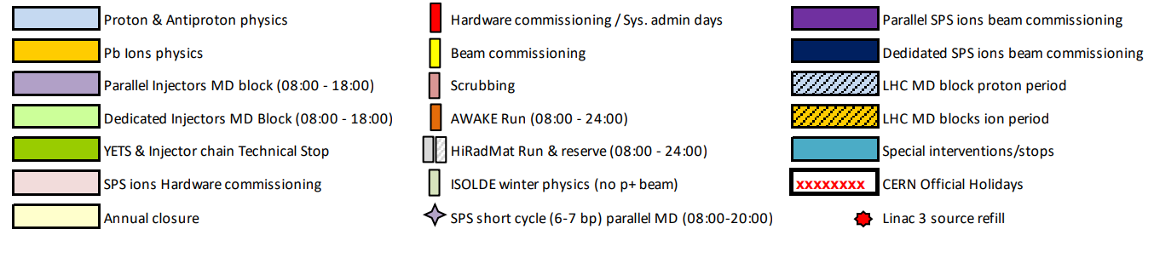
2023 schedule
JAP23 Workshop
tirsi.prebibaj@cern.ch

Slide 30
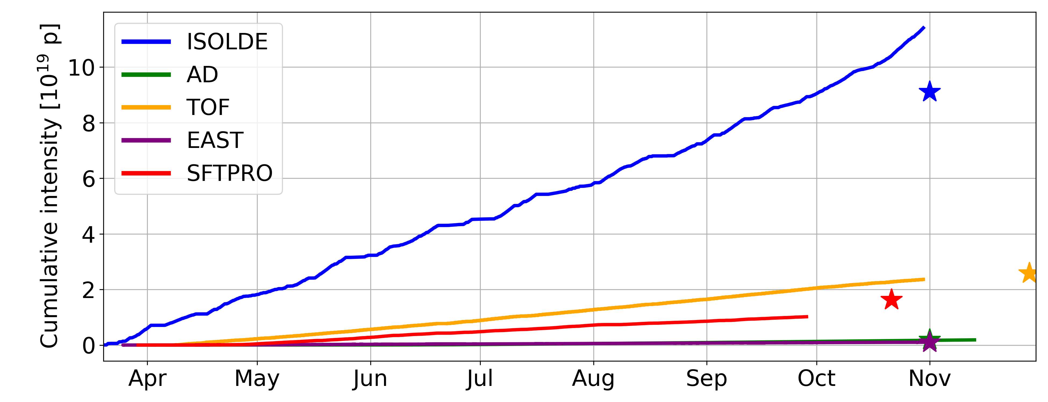
Intensity in 2023 and 2022
2022
JAP23 Workshop
tirsi.prebibaj@cern.ch

Slide 31
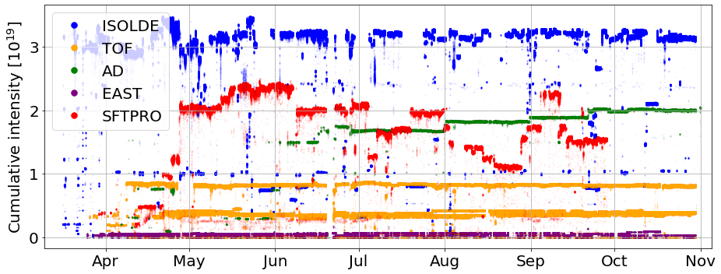
2023 intensity per day
JAP23 Workshop
tirsi.prebibaj@cern.ch

Slide 32
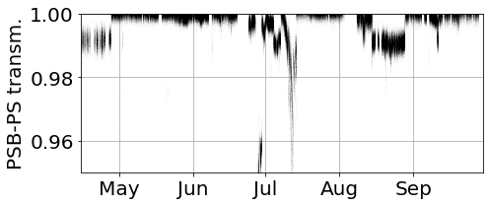
SFTPRO PSB-PS over the year
JAP23 Workshop
tirsi.prebibaj@cern.ch

Slide 33
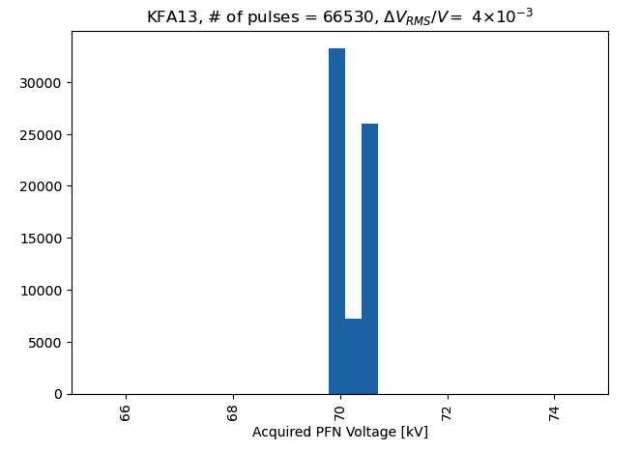
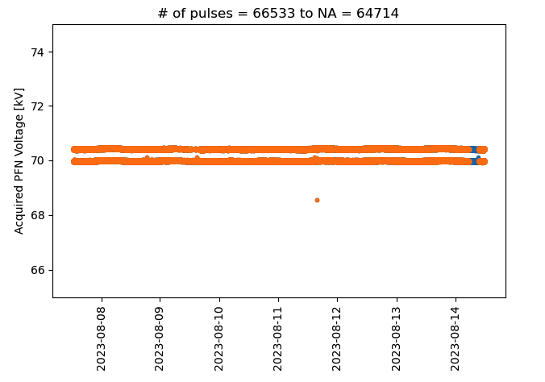
Voltage acquisition of KFA13
Two data series correspond to first and second extractions from the PS
Caused by the two different capacitor banks charging the same PFL.
JAP23 Workshop
tirsi.prebibaj@cern.ch

Slide 34

PSB instability at 1.6 GeV
C. Antuono et al., CEI section meeting 16/11/23
JAP23 Workshop
tirsi.prebibaj@cern.ch

Slide 35

PSB instability at 1.6 GeV
C. Antuono et al., CEI section meeting 16/11/23
JAP23 Workshop
tirsi.prebibaj@cern.ch

Slide 36

SFTPRO transmission in 2022
JAP23 Workshop
tirsi.prebibaj@cern.ch

Slide 37


TOF
Loss mostly at the beginning of cycle (high space charge).
Still $\sim 98\%$ transmission in PSB.
New instability observed at ~1.7GeV that TFB cannot cure.
Instability currently mitigated by approaching coupling resonance.
JAP23 Workshop
tirsi.prebibaj@cern.ch

Slide 38

EAST
JAP23 Workshop
tirsi.prebibaj@cern.ch

