Slide 2
Losses for LHC beams, up to LHC injection
Y. Dutheil, W. Bartmann, C. Bracco and F. Velotti (SY-ABT)
B. Salvachua and S. Morales (SY-BI)
Acknowledgment: BE-ABP, BE-OP, BE-CEM, SY-ABT, SY-BI, SY-STI, TE-VSC

Slide 3
Outline
SPS low energy losses
LHC injection losses
  State in 2023
  Where losses come from ?
    Data analysis
    Profiles and tails
  How many protons are we talking about ?
What did we about losses in 2023?
  MKE6 waveform
  TL momentum steering
  SPS scraping
What can we do in 2024?
  TCDIL alignment
  Scraping
  BLMs
Prospects beyond 2024
Conclusion

Slide 4
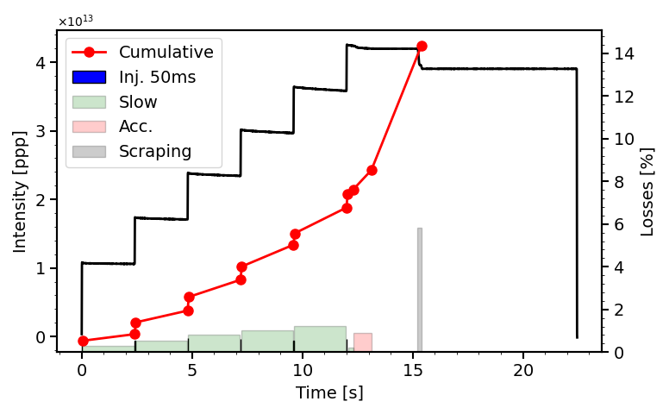
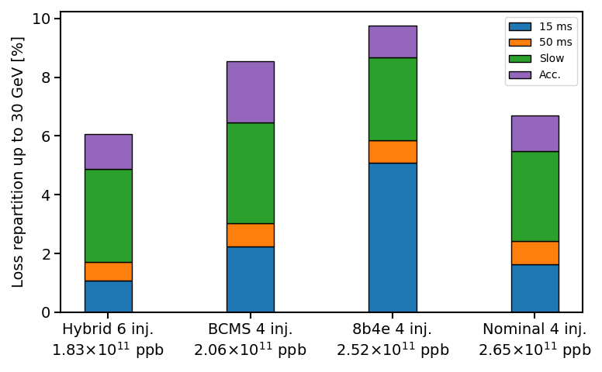
SPS low energy losses
A. Lasheen
Losses at SPS injection analysed from SPS BCT logged data
Online tools developed to monitor and optimise those losses
The transmission at LIU intensity from PS extraction to SPS 30 GeV was improved in 2023 to reach 93% (no scraping).
Nonetheless, questions remain
  What is the main mechanism behind losses right at injection and on the flat bottom ?
  Is having smaller bunches from the PS
  beneficial ?
  How to ensure good transmission in operation from one day to the next, especially at LIU intensity ?
  What are acceptable losses in the SPS, before scraping ?
[1] A. Lasheen, PS-to-SPS transfer, 2023 studies and outlook for 2024 MDs, IPP 11/23
Notes:
Online tools still being developed, refer to Simon’s talk in the same session who will address this point for the longitudinal plane.
pending we go back to 3% of scraping then we would be within the LIU budget of 10% of losses (then show that 3% is a dream…). You can also stress that the 93% is for the best condition ever in 2023

Slide 5
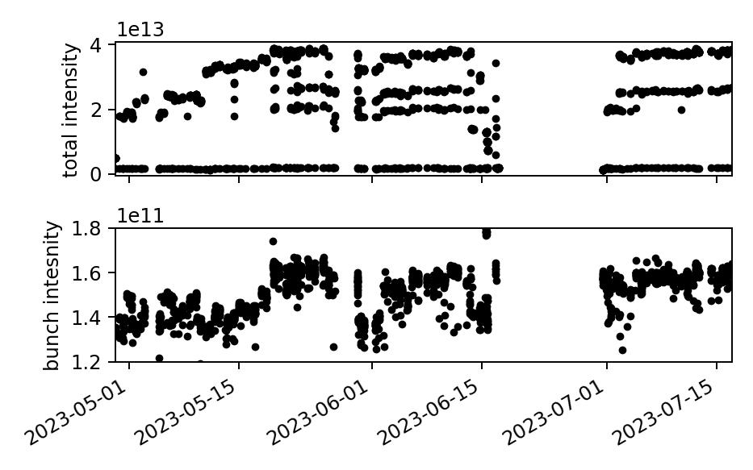
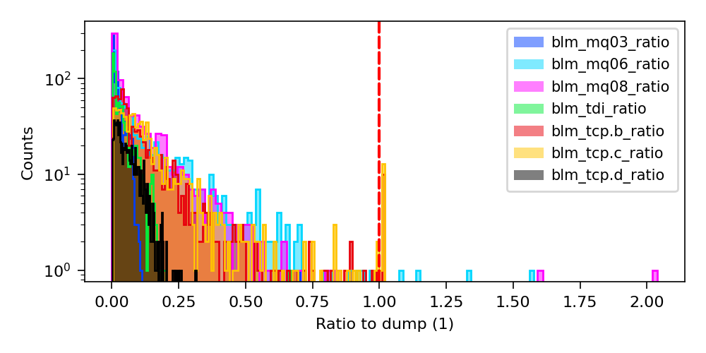
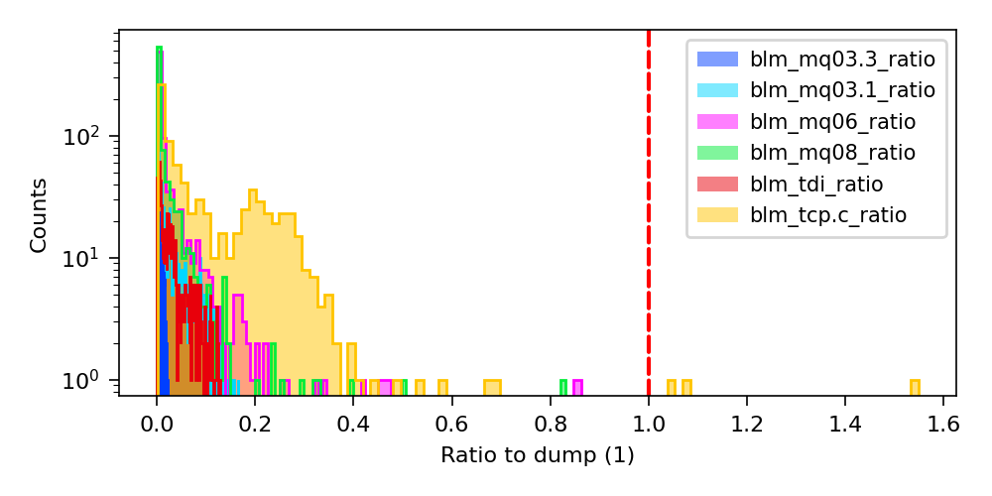
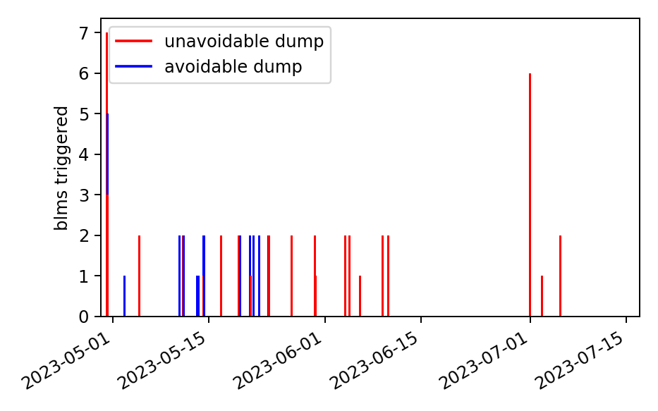
LHC injection losses in 2023
High intensity proton injections from May to July
  Up to 1.6-1.7E11 protons per bunch extracted from the SPS and 236 bunches per injection
Injection losses
  Cause dumps on the LHC side
  Total of ~1200 injections with >100b
  B1
    Total of 41 (~3%) dumps during injection
    Of which 14 could have been avoided by setting the TCPs thresholds to the electronic limit at the start of the run
    Overall tense injection with P7 BLM signals routinely close to the limit
  B2
    4 (~0.3%) dumps
    Usually reasonably clean injections
 | BLM name | triggers | hypothetical triggers | BLM limit change relative change during the run
 | B1 | 41 out of 27 unavoidable
P2 | BLMQI.06L2.B1E10_MQML | 5 | 5 | 1
 | BLMQI.08L2.B1E30_MQML | 3 | 3 | 1
 | BLMEI.06L2.B1E10_MSIB | 1 | 1 | 1
 | BLMQI.06L2.B1E20_MQML | 1 | 1 | 1
 | BLMQI.08L2.B1E10_MQML | 3 | 3 | 1
 | BLMAI.08L2.B2I23_MBA | 2 | 2 | 1
 | BLMAI.08L2.B2I22_MBA | 1 | 1 | 1
P7 | BLMTI.06L7.B1E10_TCP.C6L7.B1 | 38 | 23 | 2.5
 | BLMTI.06L7.B1E10_TCP.B6L7.B1 | 30 | 16 | 2.5
 | B2 | 4 out of 4 unavoidable
P8 | BLMQI.06R8.B1I30_MQML | 1 | 1 | 1
P7 | BLMTI.06R7.B2I10_TCP.C6R7.B2 | 4 | 4 | 1.5
 | BLMTI.06R7.B2I10_TCP.B6R7.B2 | 1 | 1 | 1.5
B1
Notes:
Two questions
- where losses come from
- Why B1 higher than B2
Then what did we do, and what can we still do about it?

Slide 6
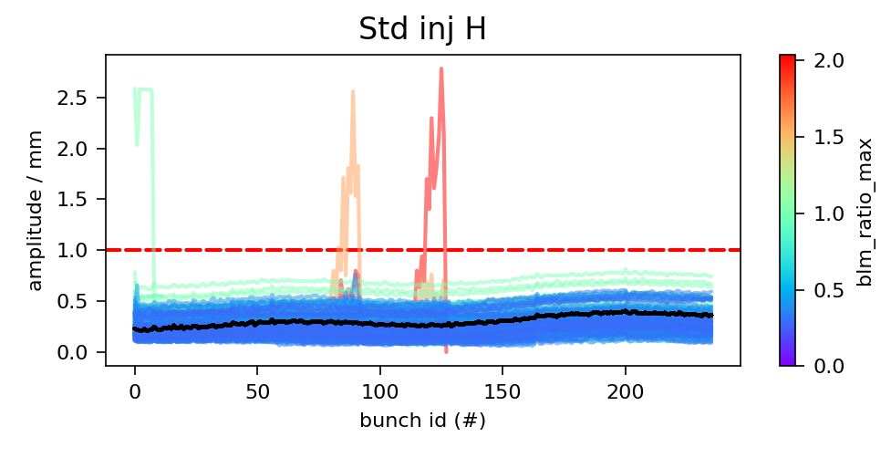
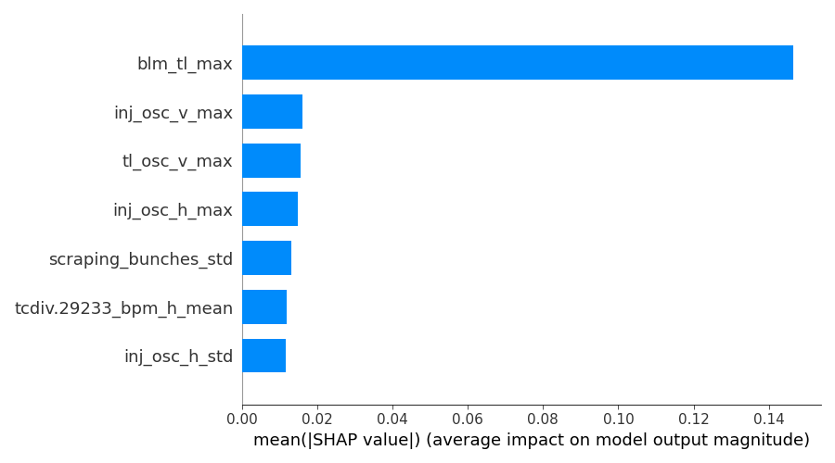
Where losses come from? Data analysis
Occasionally from instabilities
Extensive data analysis to investigate correlations
  Using PM and NXCALS data
  Carried in 2022 [2] and 2023 [1] show correlations between transfer line and P7 losses -> relates to OP and ABT experience with difficult steering
  New machine learning global analysis of ~35 parameters identified 3 important parameters [3]
    TL BLMs main contributor to the model
    Quality of steering is next
    Scraping homogeneity 3rd most important
Clear contribution from the steering across the TL collimators
Contribution to injection losses
F. Velotti
[1] F. Velotti, Why are B1 losses so high?, LBOC #152
[2] Y. Dutheil, Update on the investigations on the LHC side, IPP TF on tails, 09/2022
[3] V. Velotti, Report on SPS-LHC Transfer Issues, LMC #466
[4] B.Salvachua et al., BLMTWG Injection beam losses at the collimators, IR727 nov
[5] F.Velotti et al.,'Injection losses: do we need blindable BLMs?’, BLMTWG 16 Jun

Slide 7
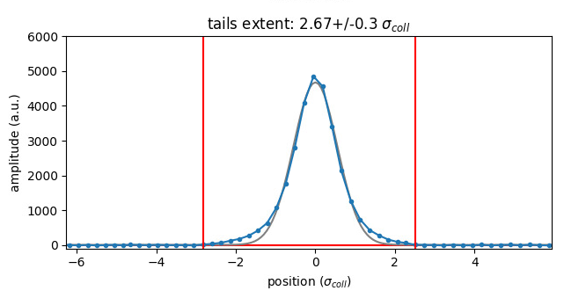
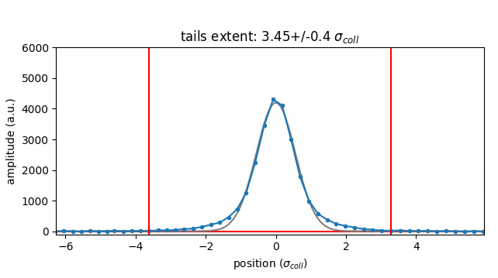
Where losses come from? A look at profiles and losses
More details in E. Lamb’s talk (next)
Profiles with and without scraping in the SPS
  Data from 2022
  After scraping and within the resolution of the measurement tails are <4σ_{coll}
  Special settings can provide better resolution of the tails
Collimator positions
  Transfer line collimators set at 5σ_{coll}
  LHC primary collimators set at 5.7 σ_{coll}
Expecting very low level of losses from the tail population, in particular after scraping
Scraping
[1]. F. Avesta, Transverse tails
and Losses at LHC injection, JAPW22

Slide 8
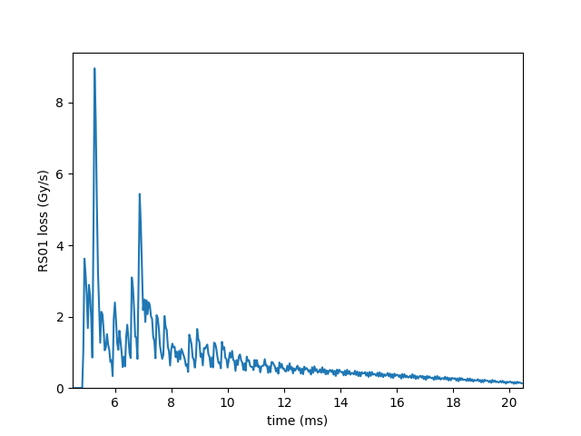
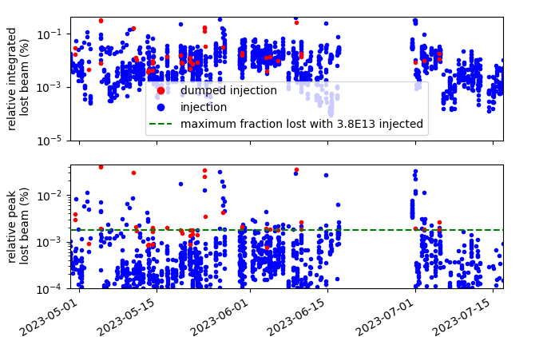
How many protons are we talking about?
236 bunches to B1 on 14/05 on TCP.C (horizontal)
LHC BLM calibration of losses
  B. Salvachua and S. Morales (SY-BI) provided the BLM calibration and the processing instructions of the data which allow to estimate the number of protons lost in P7
Using the PM BLM RS01 signal to extract peak and integrate losses
  Example of 3.3E13 protons over 236 bunches to B1 on 14/05, nominal injection with reasonable losses
  Peak loss of 2.6E8 protons or 8E-4% of the injected beam
  Integrated loss of 8.9E9 protons or 3E-2% of the injected beam*
  Integrated loss usually ~20x the peak on 40µs*
Maximum allowed number of protons lost on the TCP
  Peak loss of 0.67E9 protons within 40µs
  With 3.8E13 protons (236x1.6E11)
    Max peak loss of 0.0018% of injected beam
    Max integ loss of ~0.04% of injected beam*
* Integrated loss as defined here appears to underestimate the total loss, typical beam lost at injection computed using larger RS BLM counters is ~ 0.1% [1]
[1] B. Salvachua, Private communication, 12/2023
B1 only
Relative to injected intensity, can be large for short trains

Slide 9
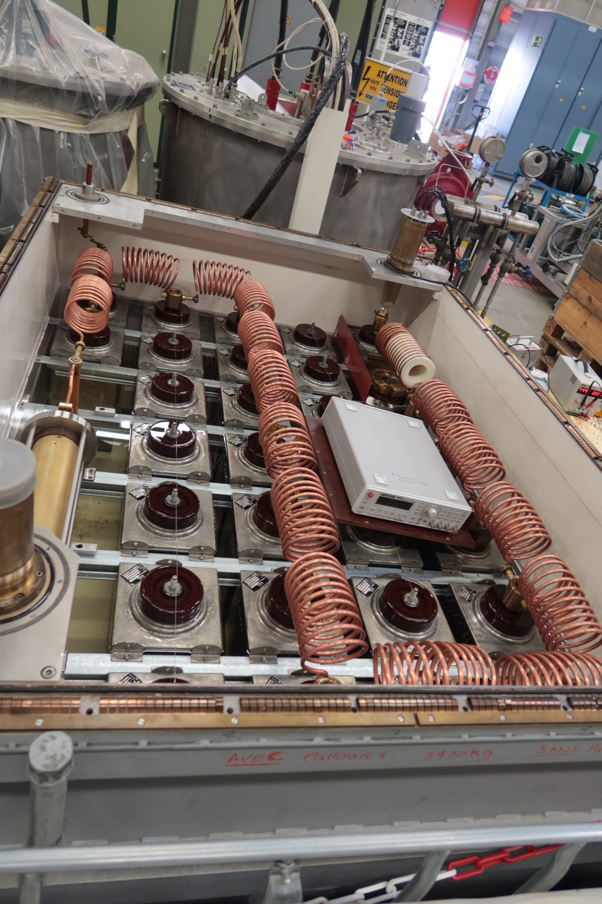
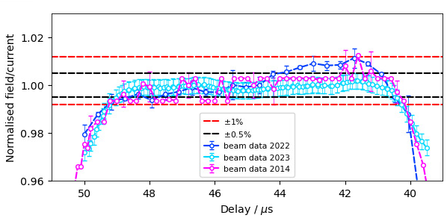
What did we do about losses? MKE6 flattening
Measurements in 2022 showed a slope along the injected train
  Tracked back to SPS extraction kicker MKE6 flatness [1]
  Caused reduced margin at some TCDILs collimators and required an adjustment of 0.5σ to the gap of a collimator
Hardware adjustment during YETS22/23 solved the issue
  Carried by ABT-PPE team on the PFN
[1] C. Bracco, LHC injection: improvements and commissioning of beam-intercepting devices, JAPW22
[1] M. Barnes, Update on adjustment of the MKE6 PFN waveform, LIBD meeting 02/2023

Slide 10
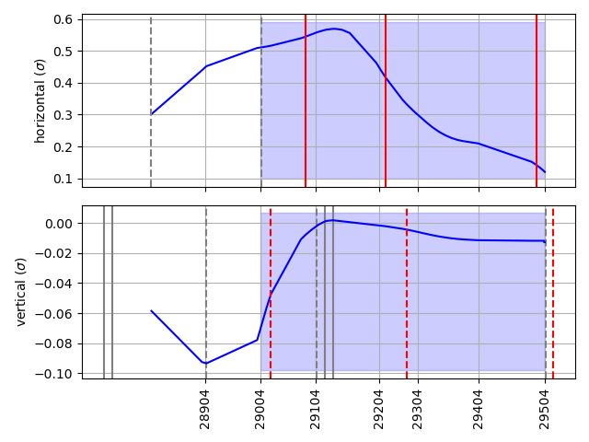
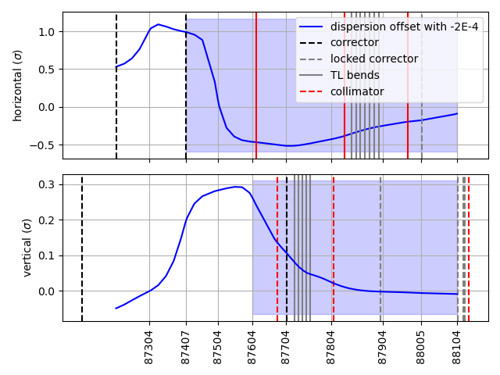
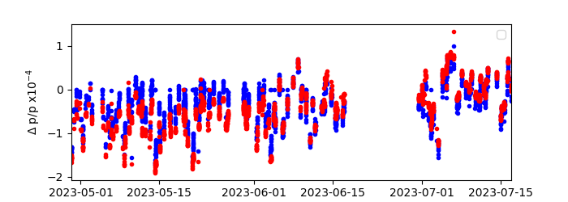
What did we do about losses? TL momentum steering
Steering identified as strongly correlated with injection losses
Momentum steering of the transfer line
  Identified by J. Wenninger as the source of steering difficulties
  Position offset caused by energy shift cannot be fully corrected with existing dipole correctors
  B1 appears more challenging
Occasional momentum steering carried by OP did improve the steering and level of losses
[1] J. Wenninger, SPS-LHC energy matching and TL momentum, LBOC #152

Slide 11
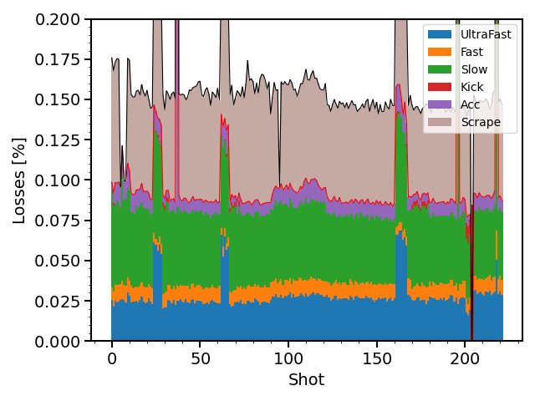
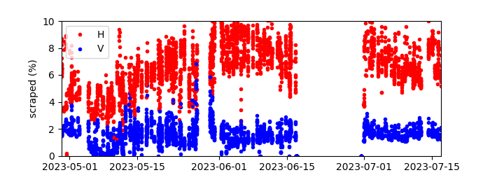
What did we do about losses? SPS scraping
Scraping is necessary and ~3% are considered in the LIU design report
Done in the SPS at low energy to minimize induced radiations
SPS beam is scraped in LSS1
  In 2023 scraping was not stable and required
  continuous OP adjustments due to lost steps
  in motors
  Some issues remain under investigations
  (see C. Sharp talk later today)
Usual scraping levels in 2023 of
~7% in horizontal ~1-2% in vertical
Example loss evolution on LHC hybrid cycle on 16/07
[2]
[1] Update on SPS scraper, SPS MPC #40
[2] A. Lasheen, PS-to-SPS transfer, 2023 studies and outlook for 2024 MDs, IPP 11/23

Slide 12
Prospects for 2024: TCDILs alignment
Converging indications that some TCDIL jaws have larger angle with the beam that what can be neglected
TCDILs alignment
  Long jaw (2m) are not meant to be angular aligned and any angle is neglected
  Out-of-spec angles effectively reduces the available gap (± 5σ) but may also reduce the protection of the downstream elements
Prospect for angular alignment
  Beam is single pass -> one pilot every ~30s
  FLUKA team investigating the possibility of measuring the jaw angle with beam and BLM signal [1]
Automatic and simultaneous alignment of TCDILs under development
  Only works for centroid alignment and does not align possible angles
[1] LIBD special LHC TCDIL, 10/2023

Slide 13
Prospects for 2024: Scraping
Hardware remains unchanged but operation and stability might be improved
Similar levels of scraping as 2023
  Present level of scraping does not seem to pose issue
  SPS BLM and BPM crates are located in the arcs, and sufficiently far from the scraper
Scraping studies
  Profile characterisation with scraping
  LHC injection losses Vs scraped fraction using trains
Increased scraping is not sustainable with limited LIU margin
  Maximum SPS injected bunch intensity specified at ~2.6E11, margin of 10% (losses + scraping)
  Present scraping level with 1.6E11 reached ~10% (horizontal + vertical)

Slide 14
Prospects for 2024: BLM
Followed by the BLM Thresholds WG
Commissioning of P2&8 BLM blinding
  Every year hardware commissioning is completed, only missing commissioning with beam which is part of the injection commissioning procedure
  Extension to P7 is not favored, and not possible in the short-term (See S. Morales talk)
BLM displacement
  Displacement of P7 BLMs to reduce their response
  Under study by BI for possible implementation during the YETS
LICs
  Proposal to replace Secondary Emission Monitors (SEM) at the collimators by Little Ionization Chambers (LIC)
  Only possible by LS3 to use for interlock, but request to populate Beam 1 with LIC during 2024 is on-going
Diamond BLMs
  Presently installed along the whole chain (SPS scraper, SPS extraction, LHC injection and LHC collimation)
  Large quantity of data that could be reviewed and analysed together with BI
see S. Morales Talk for detailed discussion on BLMs

Slide 15
Prospect beyond 2024
Scraping
  Installation of new scraper during YETS 24/25 with possibility of multiple scrapings per SPS cycle
  Reduction of the level of scraping is needed to reach LIU targets
Identify the source of the losses (tail development, TCDI alignment, other ?)
  Injection losses in the SPS, and slow losses at acceleration
  Tail development across the chain, but in particular between SPS scraping and LHC P7
  TCDI alignment and jaw angular characterisation
  Try to identify the source of losses and mechanism of the tail development, and understand the B1/B2 loss asymmetry
Reduced BLM response with different hardware (see S. Morales talk tomorrow)

Slide 16
Conclusion
SPS low energy losses
  Highest transmission of LIU beam achieved of 93%
  Improved online monitoring needed to reach and maintain optimal performances
Injection losses in the LHC
  This is a question of availability as the machine is and remains protected by the collimators
  Problem is the very sensitive BLMs in P7
What did we do in 2023?
  TL momentum steering to improve the beam alignment through the TCDIL region
  MKE6 flattening improved the effective aperture for long trains
What can we do for 2024?
  Scraping stability improvement which might reduce shot-to-shot variability
  Set the RS01 TCP threshold to the maximum at the start of the run
  BLMTWG reviewing the possibility of moving some P7 BLMs
  FLUKA team is modelling the effect of TCDILs angles on measured losses to develop a possible angular alignment method before the restart
Projection of present numbers need improvement to reach LIU target injected in the LHC
  93% transmission to 30GeV + 7-10% scraping against 10% total budget

Slide 18
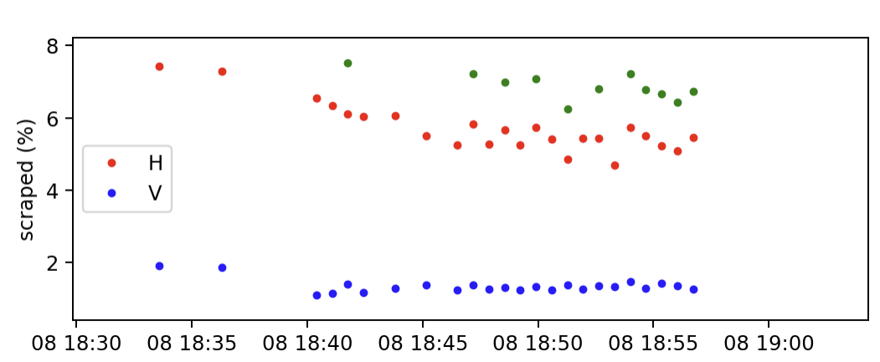
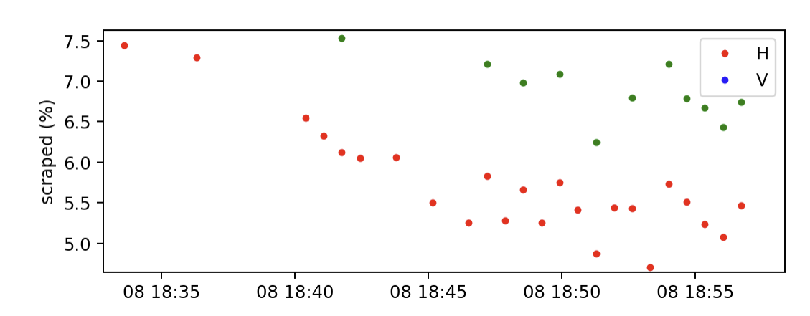
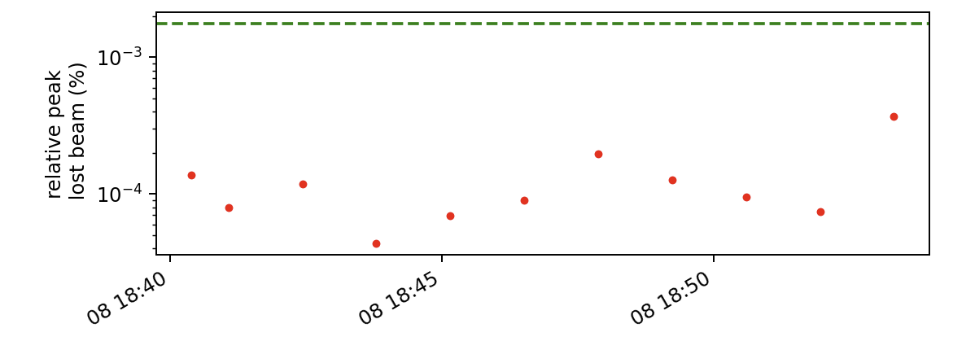
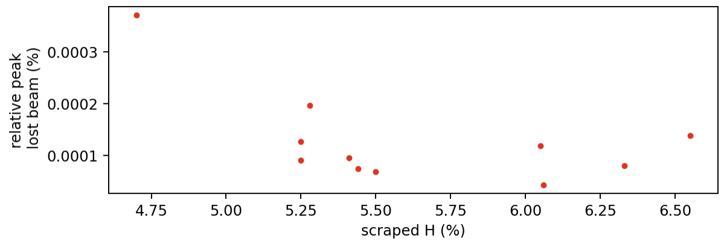
Shot-to-shot variability
Show shot-to-shot variability of losses and scraping, check correlation
Example of fill on 2023-07-08, focus on B1

Slide 19
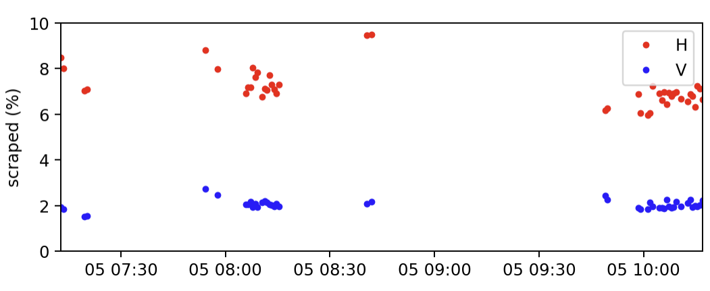
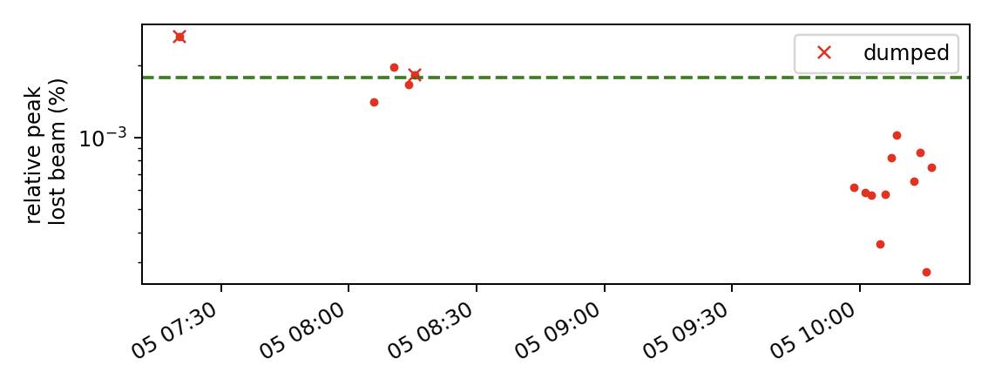
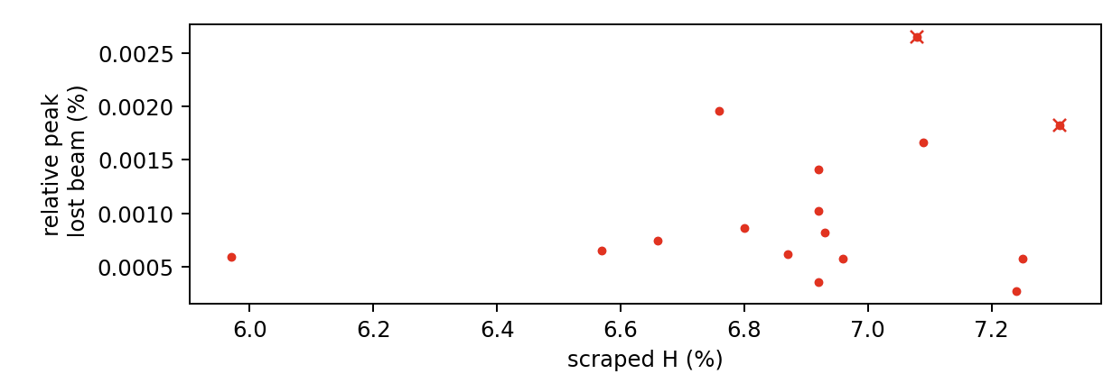
Shot-to-shot variability
Show shot-to-shot variability of losses and scraping, check correlation
Example of fill on 2023-07-05, focus on B1
This filling had 2 dumps

Slide 20
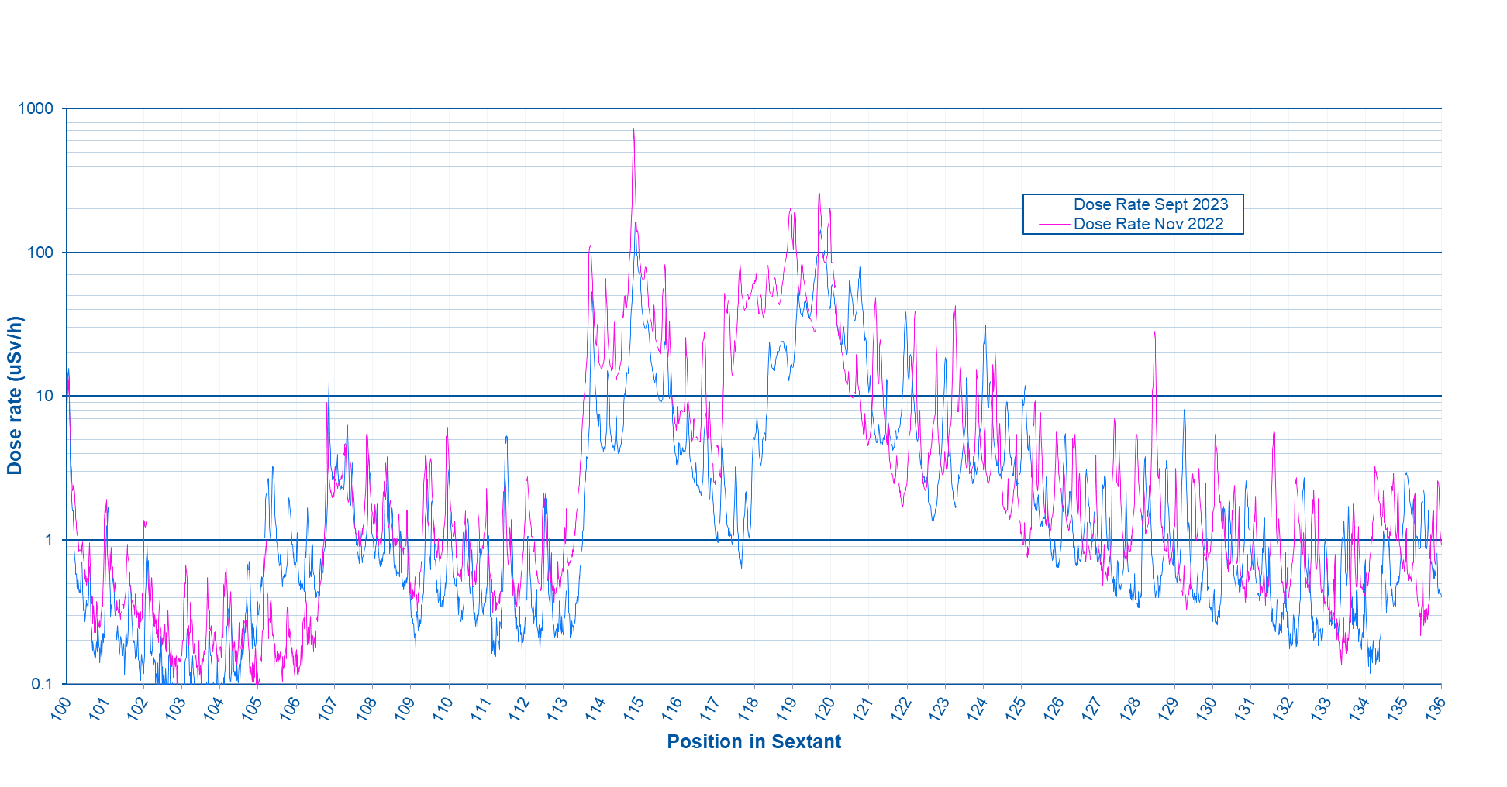
SPS radiation survey LSS1
SPS Radiation Survey Results
Comparison of 30h measurement after RUN 2022 & RUN 2023, Florent PHILIPPON (HSE-RP-AS), 29/09/23
SPS Sextant 1 – Comparison Nov 2022 – Sept 2023 (30h of cooldown)

