Slide 1
Comparing the BGI and BWS Transverse Profiles
Clara Fleisig (SY-BI-XEI) on behalf of the BGI team
5th December 2023,
Joint Accelerator Performance Workshop

Slide 2
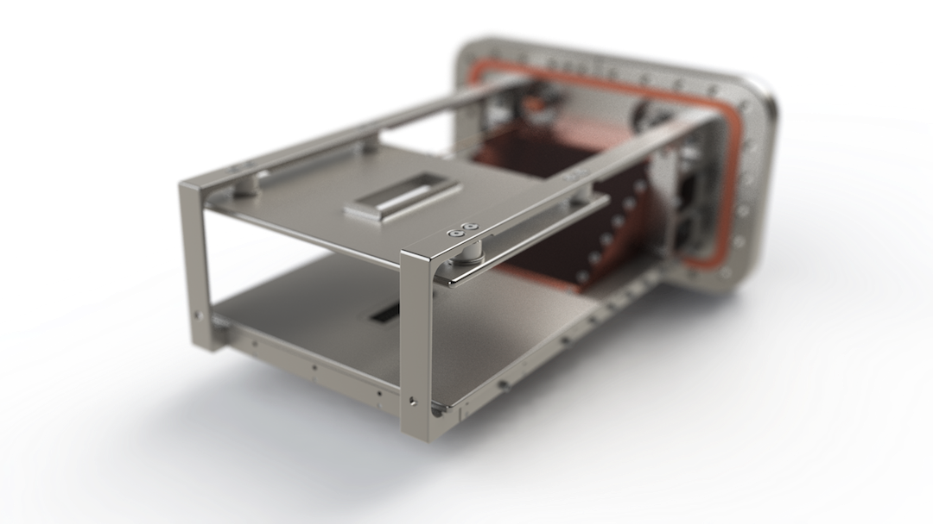
Presentation Outline
BGI Overview
  Measurement Capabilities
Benchmarking with the BWS
  Emittance Benchmarking
  Comparing Profile Distributions
Feature Development
  Measuring Beam Evolution
  Bunch-by-bunch measurements
  Measuring beam tails
Future Directions
  Making the BGI Fully Operational
  Scheduled Installations and Upgrades
Clara Fleisig | Joint Accelerator Performance Workshop

Slide 3
BGI Overview
Clara Fleisig | Joint Accelerator Performance Workshop

Slide 4
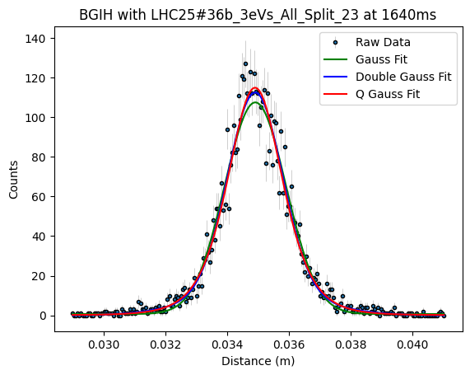
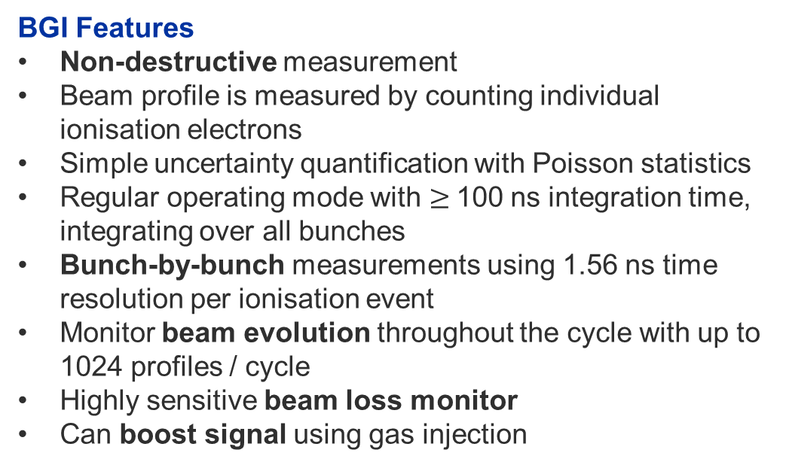
The BGI in Brief
The Beam Gas Ionisation Monitor (BGI) is an Ionisation Profile Monitor (IPM) using Timepix3 detectors, designed for transverse profile measurements.
BGI Features
Non-destructive measurement
Beam profile is measured by counting individual ionisation electrons
Simple uncertainty quantification with Poisson statistics
Regular operating mode with $≥$100 ns integration time, integrating over all bunches
Bunch-by-bunch measurements using 1.56 ns time resolution per ionisation event
Monitor beam evolution throughout the cycle with up to 1024 profiles / cycle
Highly sensitive beam loss monitor
Can boost signal using gas injection
Clara Fleisig | Joint Accelerator Performance Workshop

Slide 5
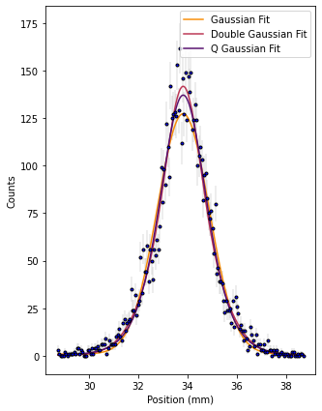
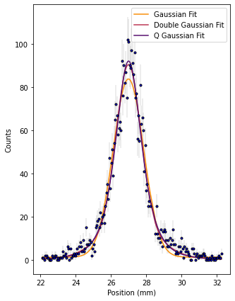
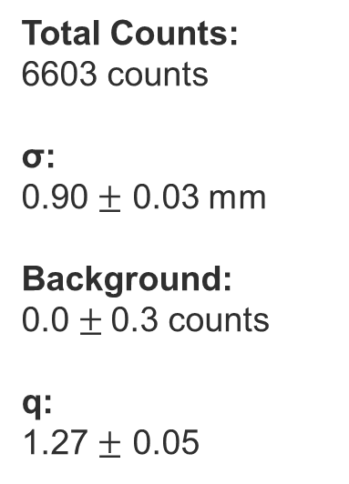
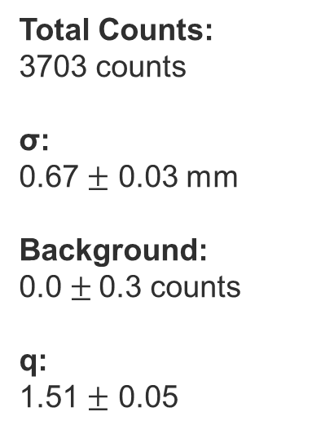
BGI Profile Examples
The following profiles are taken with a 36-bunch LHC-type beam at flat-top, with a 1.9 ms integration time, without gas injection.
BGIH Profile
BGIV Profile
Total Counts:
6603 counts
σ:
0.90 $±$ 0.03 mm
Background:
0.0 $±$0.3 counts
q:
1.27 $±$ 0.05
Total Counts:
3703 counts
σ:
0.67 $±$ 0.03 mm
Background:
0.0 $±$0.3 counts
q:
1.51 $±$ 0.05
Clara Fleisig | Joint Accelerator Performance Workshop

Slide 6
BGI-BWS Benchmarking
Using the PS-BGIs and PS-BWSs
Clara Fleisig | Joint Accelerator Performance Workshop

Slide 7
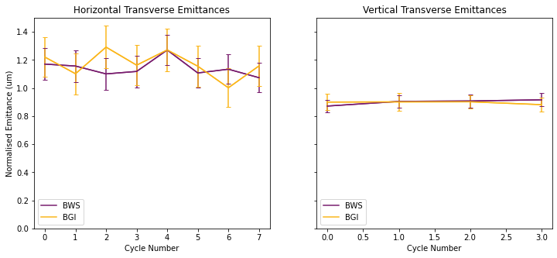
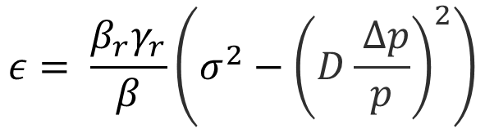


Emittance Benchmarking
Measured with tomoscope, assumed 5% uncertainty
Normalised Emittance
$$ε= \frac{β_{r}γ_{r}}{β}\left(σ^{2}−{\left(D\frac{ Δp}{p}\right)}^{2}\right)$$
$$Δ_{over all cycles}=0.0±0. 2 um$$
$$Δ_{over all cycles}=0.02±0.07 um$$
Transverse beam size, measured by BGI or BWS
Data collected with LHC-type beam at flat top with both PS-BGIs (1.9 ms integration), BWS.64.V and BWS.65.H, without gas injection
Error of the transverse beam size is taken to be one sigma from the covariance matrix
Emittances of BGI and BWS agree within less than one sigma
Taken from CERN optics repository, assumed 5% uncertainty
Clara Fleisig | Joint Accelerator Performance Workshop

Slide 8
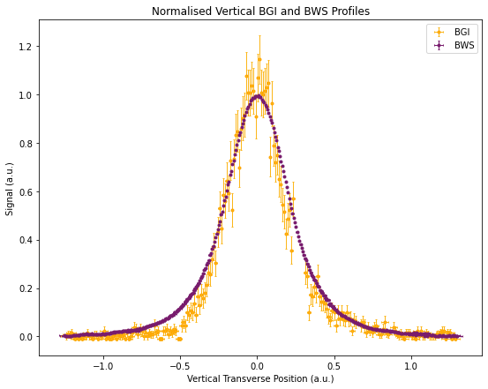
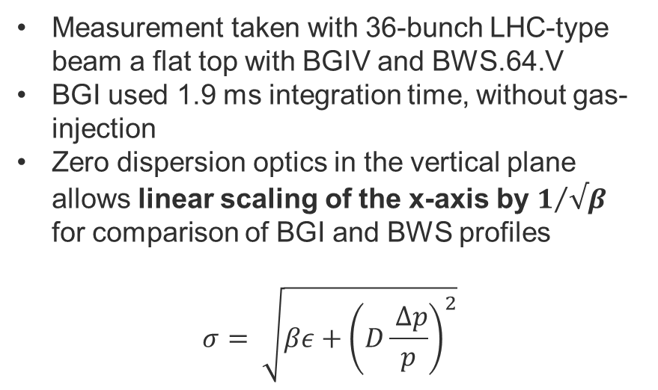
Profile Distribution Comparison
Measurement taken with 36-bunch LHC-type beam a flat top with BGIV and BWS.64.V
BGI used 1.9 ms integration time, without gas-injection
Zero dispersion optics in the vertical plane allows linear scaling of the x-axis by $1/{√β}$ for comparison of BGI and BWS profiles
$$σ= \sqrt{βε+{\left(D\frac{ Δp}{p}\right)}^{2}}$$
Clara Fleisig | Joint Accelerator Performance Workshop

Slide 9
Feature Development
Clara Fleisig | Joint Accelerator Performance Workshop

Slide 10
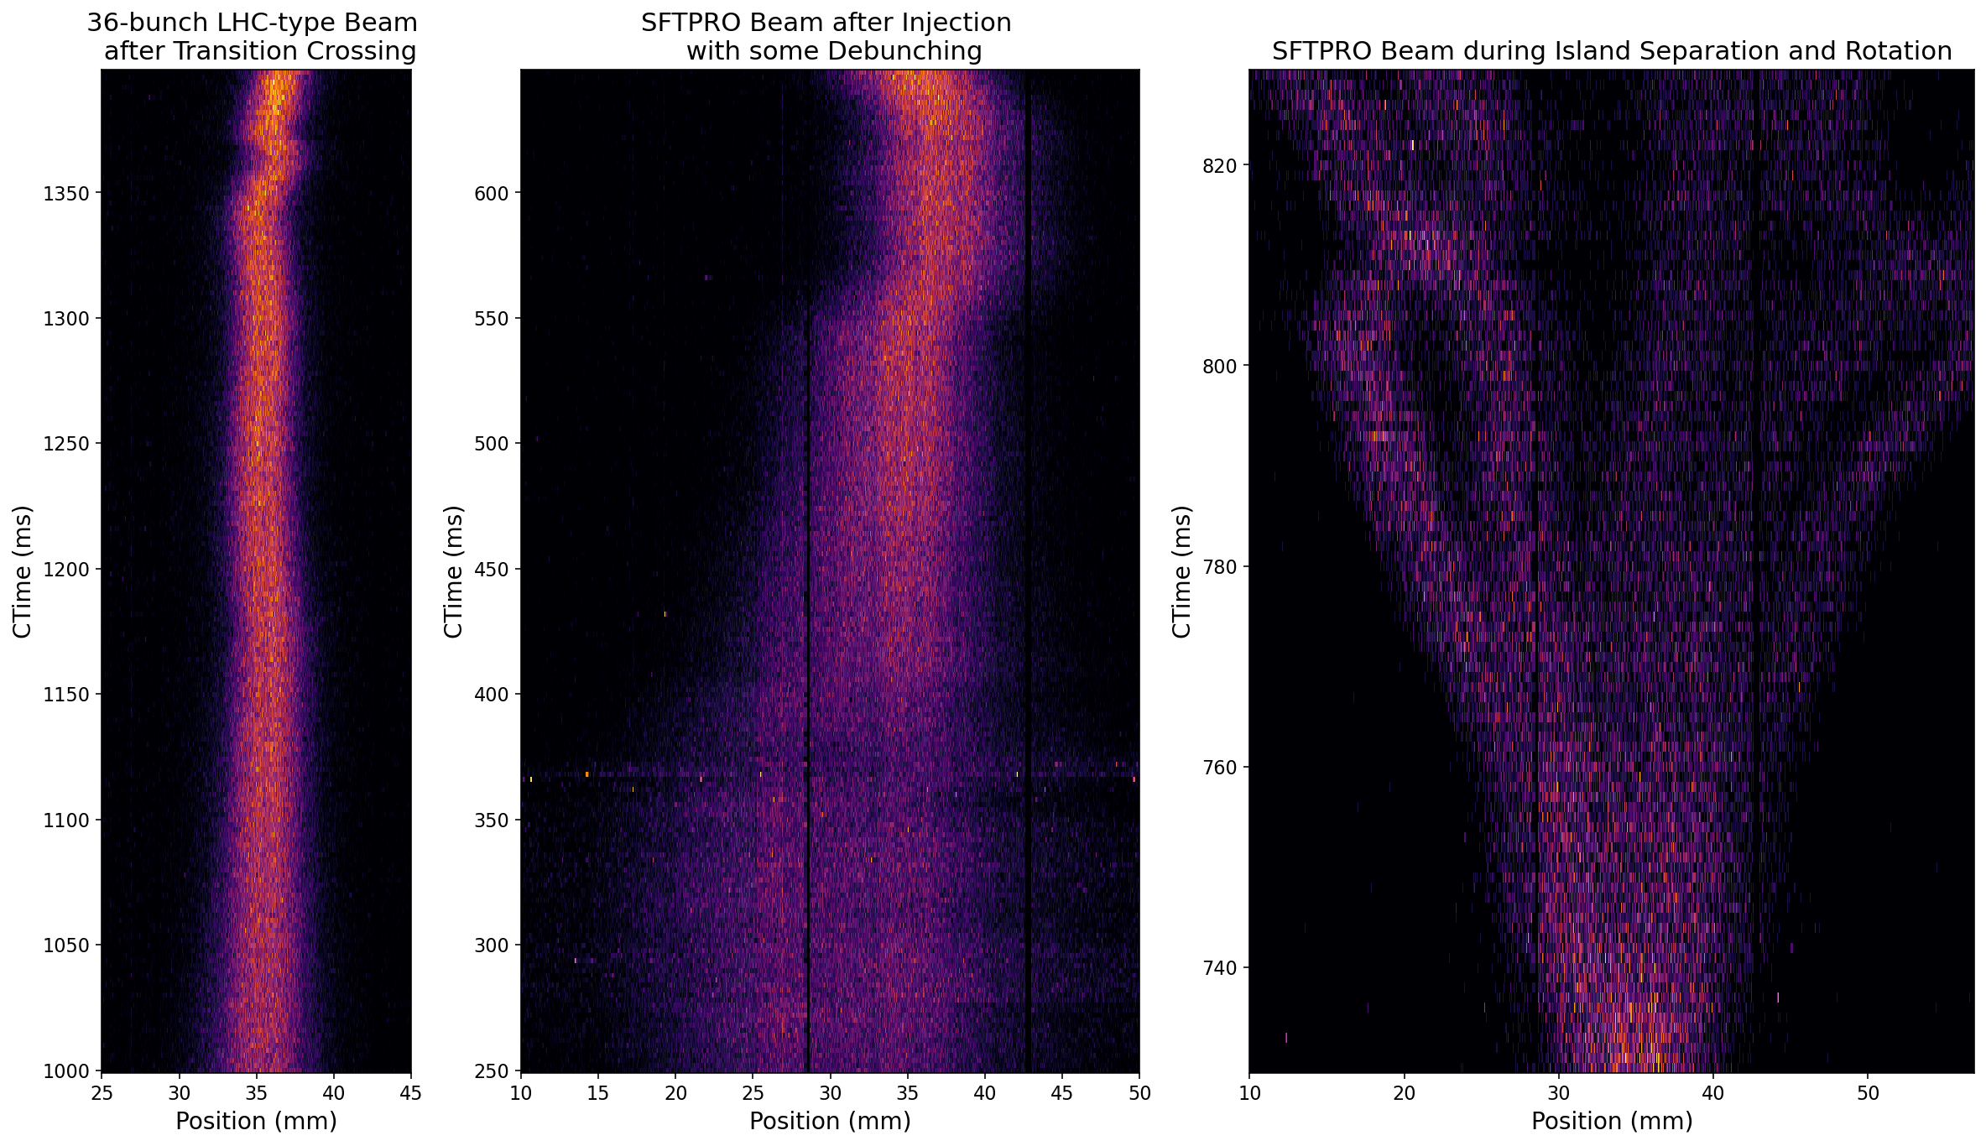
Measuring Beam Evolution
Measuring many profiles over the course of one cycle, provides information on the evolution of:
Profile distribution
Transverse emittance
Beam position
Relative intensity
Clara Fleisig | Joint Accelerator Performance Workshop

Slide 11
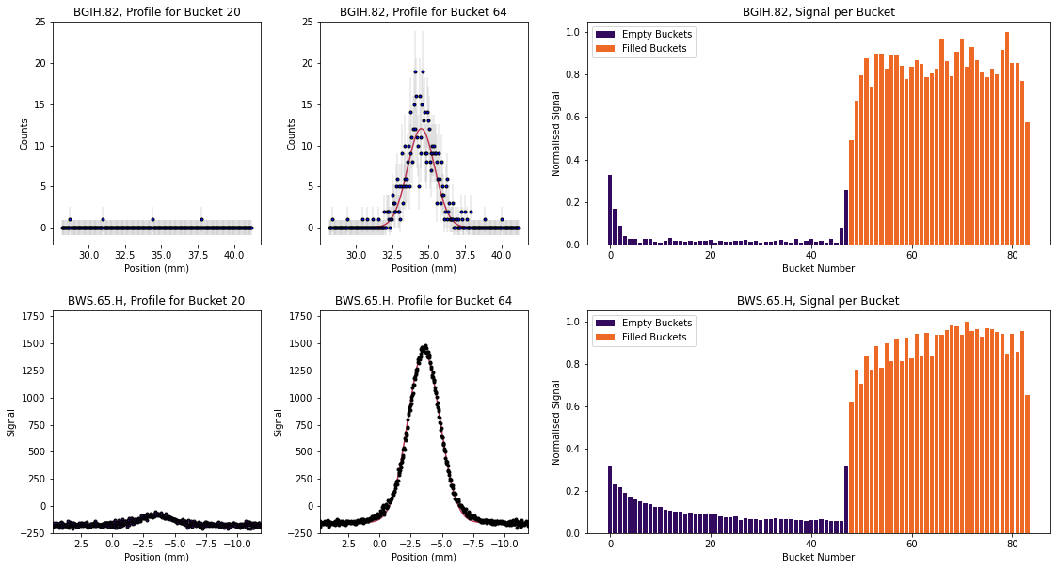
First-Steps Towards Bunch-by-Bunch Validation
Used 36-bunch LHC-type beam at flat top with harmonic 84, without gas injection
BGI operated in “RF mode”, integrating over 2000 turns
Results validate BGI bunch-by-bunch time structure
BGI signal could be increased to improve profile quality
Clara Fleisig | Joint Accelerator Performance Workshop

Slide 12
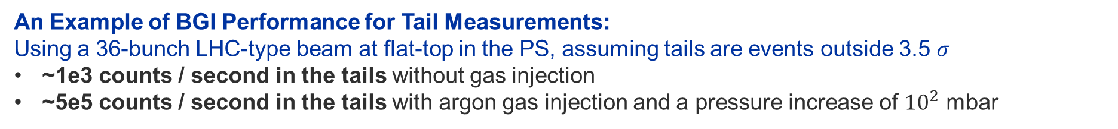

Tail/Halo Measurements
Metrics for Good Tail Measurements:
High signal to noise ratio
High count rate
Enhancing BGI Performance for Tail Measurements:
Factors such as intensity, energy, rest gas composition and vacuum pressure affect signal
Use gas injection to boost signal
Apply cluster finding algorithm to remove any noise/beam loss (previously demonstrated)
Ionisation Cross-section
Rest gas pressure
$$n∝σ\left(Z, β\right)×I×P$$
Beam Intensity
An Example of BGI Performance for Tail Measurements:
Using a 36-bunch LHC-type beam at flat-top in the PS, assuming tails are events outside 3.5 $σ$
~1e3 counts / second in the tails without gas injection
~5e5 counts / second in the tails with argon gas injection and a pressure increase of ${10}^{2}$ mbar
Clara Fleisig | Joint Accelerator Performance Workshop

Slide 13
Future Directions
Clara Fleisig | Joint Accelerator Performance Workshop

Slide 14
Vision for PS-BGI Operation
Default Configurations
Expert-chosen configurations for each beam type
Operators could choose to leave the BGI ON at all times, set to a configuration of interest
Ex. 72-bunch LHC-type beam, BGI-configurations:
Beam evolution (injection to extraction) without gas-injection
Beam evolution (injection to extraction) with gas-injection
Bunch-by-bunch at flat-top with gas injection
Turn-by-turn at flat-top with gas injection
Custom Setup Options for Studies
Modifiable settings (integration times, number of profiles per cycle etc.) of default BGI-configurations
Collect in raw-data mode, so the beam-loss removal algorithm may be applied
Ex. For tail studies, an operator simultaneously:
Uses gas injection
Operates in bunch-by-bunch mode
Collects in raw-data mode and remove beam-loss in post-processing
For All Setups
Live monitoring and automatic logging of data
Clara Fleisig | Joint Accelerator Performance Workshop
Notes:
The LHC beam settings, taken Sep 20th:
- Start 1000 ms
- Count 200
- Integration time 1 ms
- Integration interval 2 ms

Slide 15
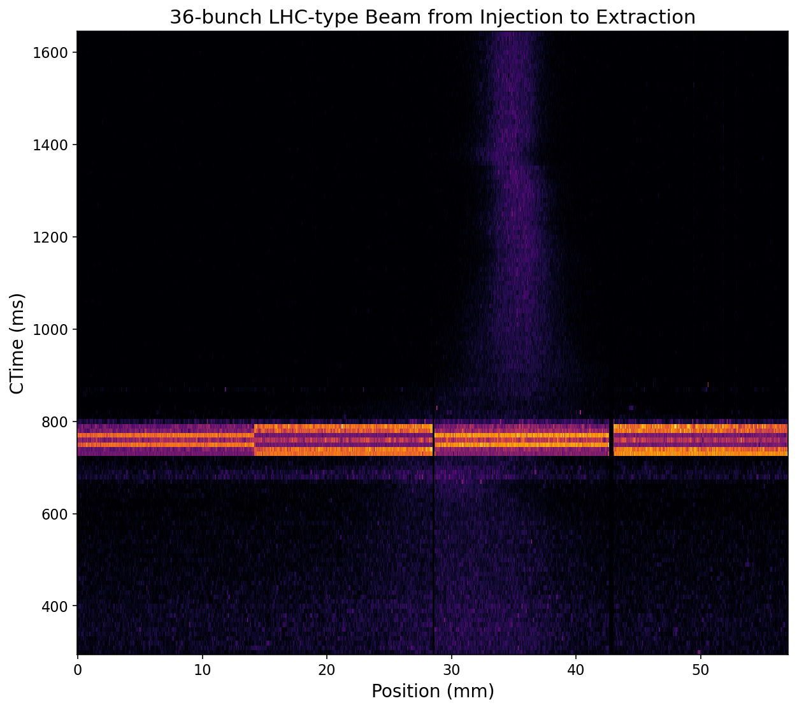
Next Steps for the PS-BGI
Overcoming Technical Challenges
Goal #1: No expert required
Automate noisy pixel masking
Determine and implement systematic calibration protocols (in progress)
Increase robustness of Timepix3 readout electronics with front-end upgrade (in progress)
Goal #2: Measuring from Injection to Extraction
Prevent data overload by allowing integration settings to vary over a cycle
Have an expert determine an optimal default configuration for each beam-type
Readout Overload due to Beam Loss at the Transition
Goal #3: Bunch-by-Bunch
Enable offset tuning with step sizes < 5 ns
Clara Fleisig | Joint Accelerator Performance Workshop

Slide 16
Future Developments for the BGI
Installations Along the Accelerator Chain
YETS 2020
YETS 2023
YETS 2024
Installed MkIII PS-BGIs
Timepix3 Readout Upgrade
PS
SPS-BGI Installation
SPS
LHC-BGI Prototype Installation with Timepix4
LHC
Clara Fleisig | Joint Accelerator Performance Workshop

Slide 17
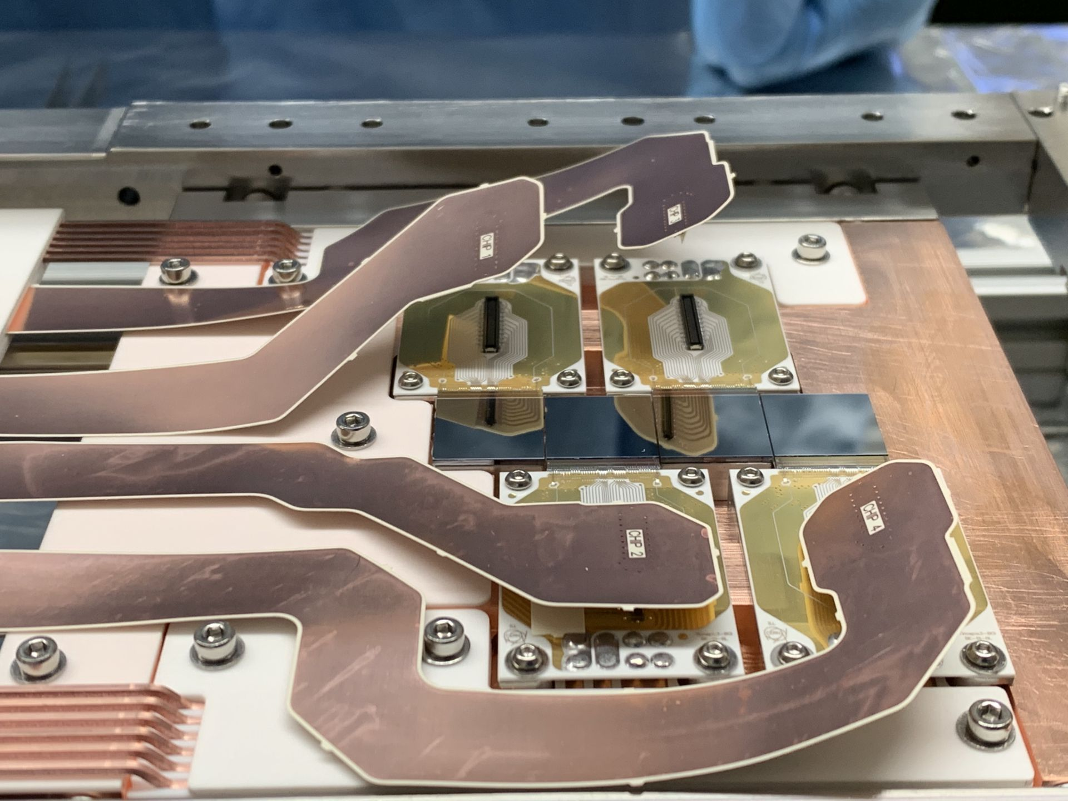
Summary
The BGI has promising features for emittance, tails/halo and transverse profile studies
Successfully validated BGI beam profiles with BWS for LHC-type beam at flat-top
Further development in progress for the instrument to be fully operational
Future installations of the BGI in the SPS and LHC in the coming years
Clara Fleisig | Joint Accelerator Performance Workshop

Slide 18
Appendix
Clara Fleisig | Joint Accelerator Performance Workshop

Slide 19
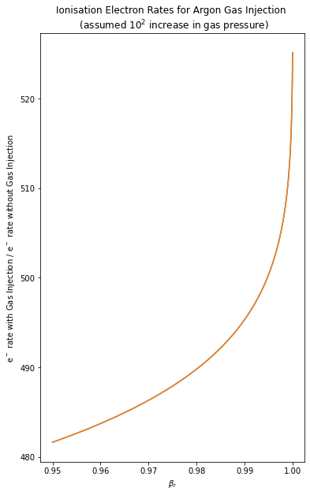
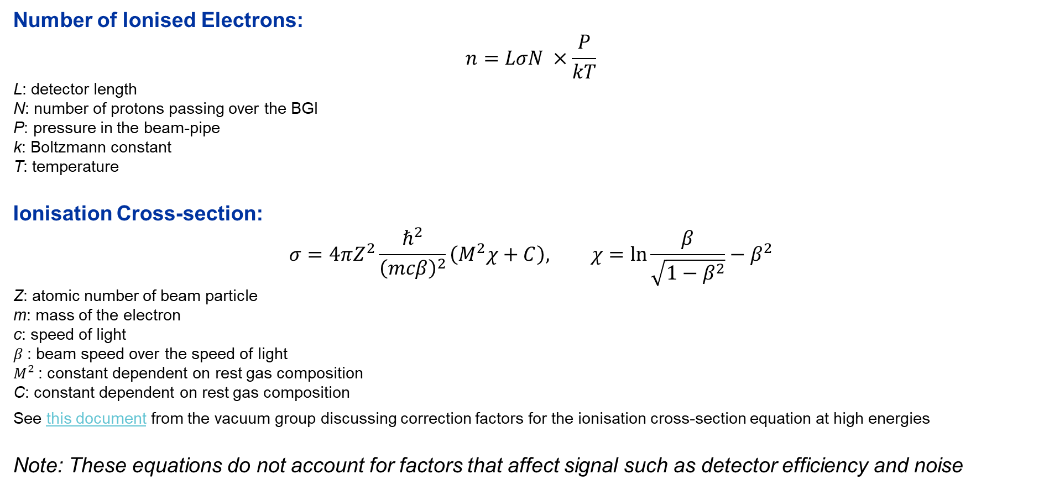
Calculating the Expected Number of Ionised Electrons
Number of Ionised Electrons:
$$n=LσN ×\frac{P}{kT}$$
L: detector length
N: number of protons passing over the BGI
P: pressure in the beam-pipe
k: Boltzmann constant
T: temperature
Ionisation Cross-section:
$$σ=4πZ^{2}\frac{ℏ^{2}}{{\left(mcβ\right)}^{2}}\left(M^{2}χ+C\right), χ=\ln{\frac{β}{\sqrt{1−β^{2}}}−β^{2}}$$
Z: atomic number of beam particle
m: mass of the electron
c: speed of light
$β$: beam speed over the speed of light
$M^{2}$: constant dependent on rest gas composition
C: constant dependent on rest gas composition
See this document from the vacuum group discussing correction factors for the ionisation cross-section equation at high energies
Note: These equations do not account for factors that affect signal such as detector efficiency and noise
Clara Fleisig | Joint Accelerator Performance Workshop
05 December 2023

Slide 20
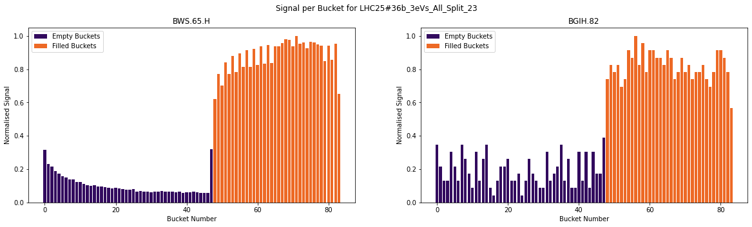
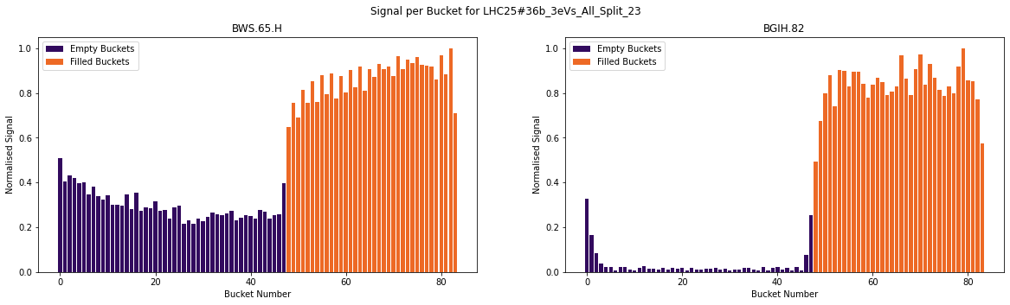
$$Signal=\max{\{y\}}−min⁡\{y\}$$
Bunch-by-Bunch Signal Metrics
Different metrics for signal give us slightly different results
Difference can be attributed to BWS linear background with a slope
Difference can be attributed to noise picked up by BGI pixel detectors, which result in outliers in the profile
Note: y in the equations on the right denotes the array of y-values that forms the transverse profile associated with each bucket
$$Signal=\sum{(y_{i}−min⁡\{y\})}$$
Clara Fleisig | Joint Accelerator Performance Workshop

Slide 21
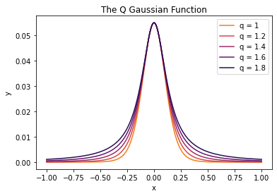
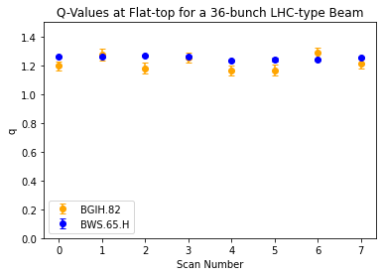
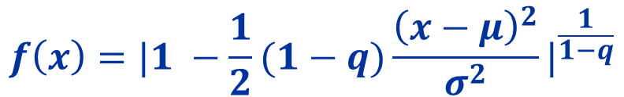

The Q Gaussian
Q Gaussian Function:
$$f\left(x\right)={|1 −\frac{1}{2}(1−q)\frac{{\left(x−μ\right)}^{2}}{σ^{2}}|}^{\frac{1}{1−q}}$$
Provides a more accurate model of the data
Q value can be used to quantify the tail population
$$Δ_{over all cycles}=0.03±0. 05$$
Clara Fleisig | Joint Accelerator Performance Workshop

Slide 22
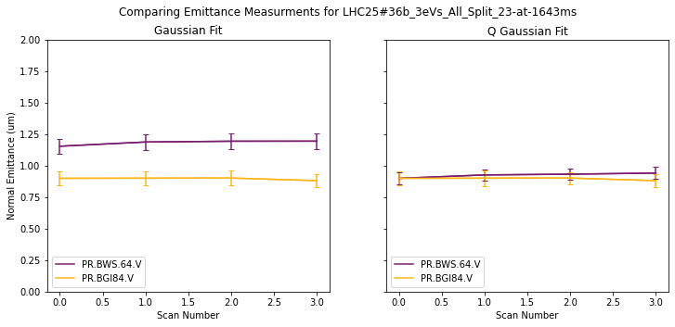
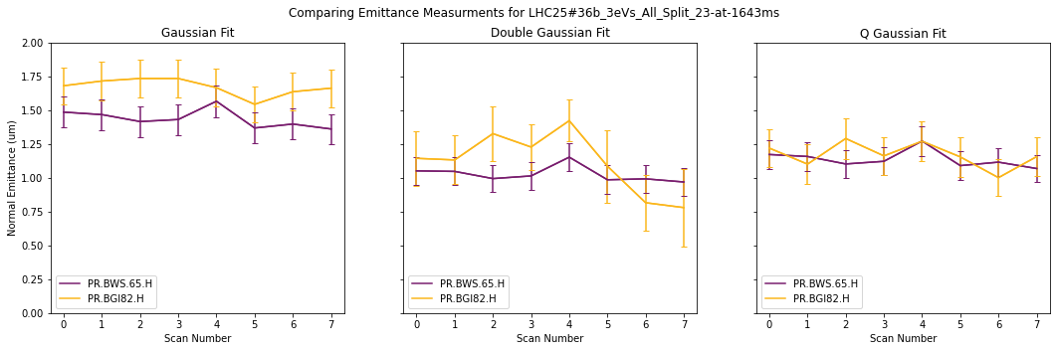





Comparing Emittances with Different Fit Types
$$Δ_{over all cycles}=0.29±0. 08 um$$
$$Δ_{over all cycles}=0.03±0. 07 um$$
$$Δ_{over all cycles}=0.24±0. 18 um$$
$$Δ_{over all cycles}=0.09±0. 24 um$$
$$Δ_{over all cycles}=0.03±0. 18 um$$
Clara Fleisig | Joint Accelerator Performance Workshop

Slide 23
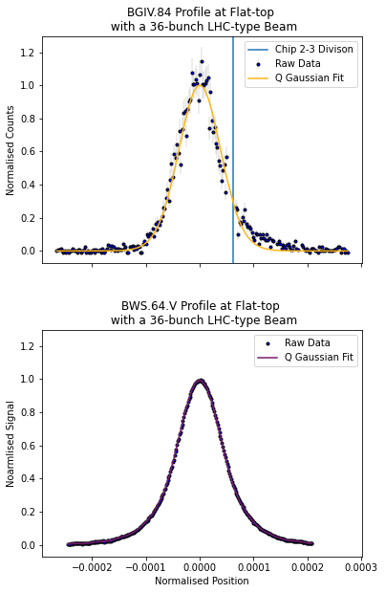
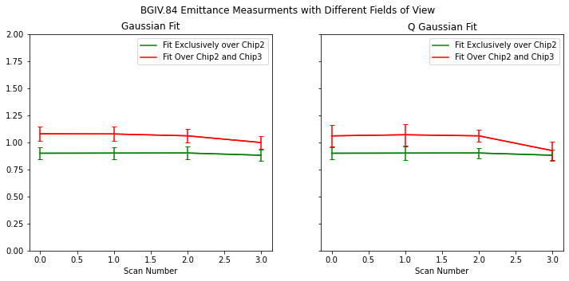


Investigating the Asymmetry on the BGIV
$$Δ_{over all cycles}=0.16±0. 09 um$$
$$Δ_{over all cycles}=0.1±0. 1 um$$
Clara Fleisig | Joint Accelerator Performance Workshop

Slide 24
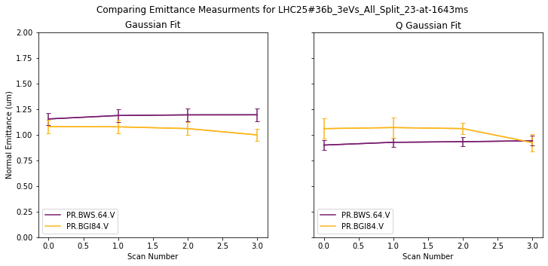


Investigating the Asymmetry in the Vertical BGI
Fitting over Both Chip2 and Chip3
$$Δ_{over all cycles}=0.13±0. 09 um$$
$$Δ_{over all cycles}=0.1±0. 1 um$$
Fitting Exclusively Over Chip2
$$Δ_{over all cycles}=0.29±0. 08 um$$
$$Δ_{over all cycles}=0.03±0. 07 um$$
Clara Fleisig | Joint Accelerator Performance Workshop

