Slide 1

Overview of intensity limitations in the injectors and transverse stability aspects
F. Asvesta, H. Bartosik, N. Bruchon, E. de la Fuente, A. Huschauer, I. Karpov, I. Mases, L. Mether, B. Mikulec, G. Papotti, G. Rumolo, B. Salvant, L. Sito, F.M. Velotti, C. Zannini
S. Albright, M. Barnes, R. Calaga, H. Damerau, G.P. Di Giovanni, G. Iadarola, V. Kain, G. Kotzian, A. Lasheen, K. Li, C. Pasquino, K. Paraschou, T. Prebibaj, M. Schenk,
PSB-PS-SPS OP teams
JAP Workshop
5 – 7 December

Slide 2
OUTLINE
PSB, PS and SPS overview
SPS
  Intensity reach and hardware limitations for different beams:
    Intensity limitations with the Standard beam
    Intensity limitations with the 8b4e beam
SPS wire scanners
SPS vertical instability at injection
SPS horizontal instability at injection
Summary

Slide 3
OUTLINE
PSB, PS and SPS overview
SPS
  Intensity reach and hardware limitations for different beams:
    Intensity limitations with the Standard beam
    Intensity limitations with the 8b4e beam
SPS wire scanners
SPS vertical instability at injection
SPS horizontal instability at injection
Summary

Slide 4
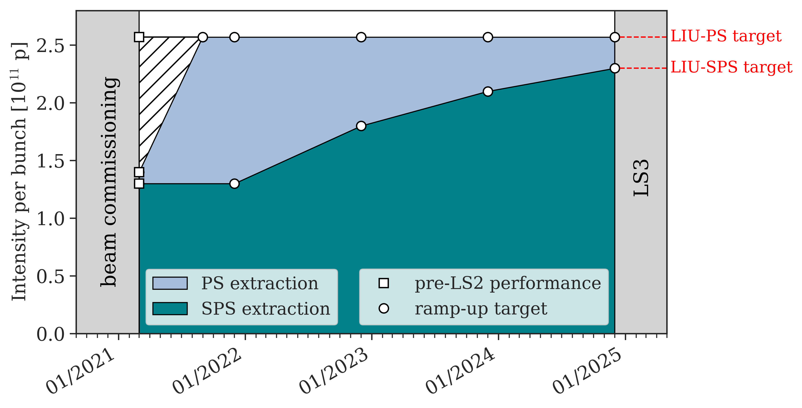
PSB, PS and SPS overview
PSB
PS
No intensity limitations in the PSB for the
LHC beams intensity range.
The LIU target for LHC brightness was already achieved in 2021.
LIU beam parameters achieved at PS extraction
No transverse instability has been observed in the currently nominal 3 eVs below ~3.0e11 p/b.
As of today, transverse instabilities do not represent a limitation in the PS.
LIU intensity ramp-up plan
At high intensities, reproducibility of beam parameters needs to be improved as it impacts SPS transverse stability (especially bunch length).
More details in I. Karpov’s talk

Slide 5
OUTLINE
PSB, PS and SPS overview
SPS
  Intensity reach and hardware limitations for different beams:
    Intensity limitations with the Standard beam
    Intensity limitations with the 8b4e beam
SPS wire scanners
SPS vertical instability at injection
SPS horizontal instability at injection
Summary

Slide 6
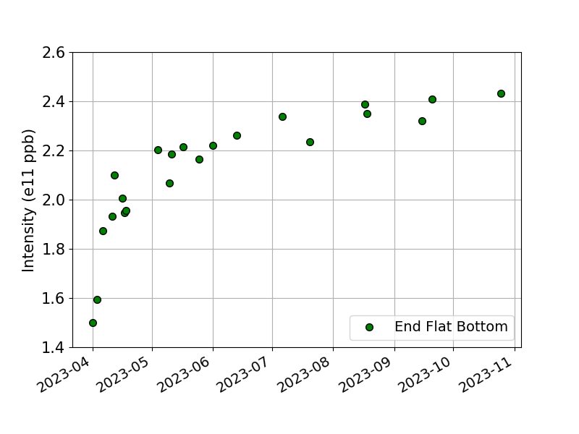
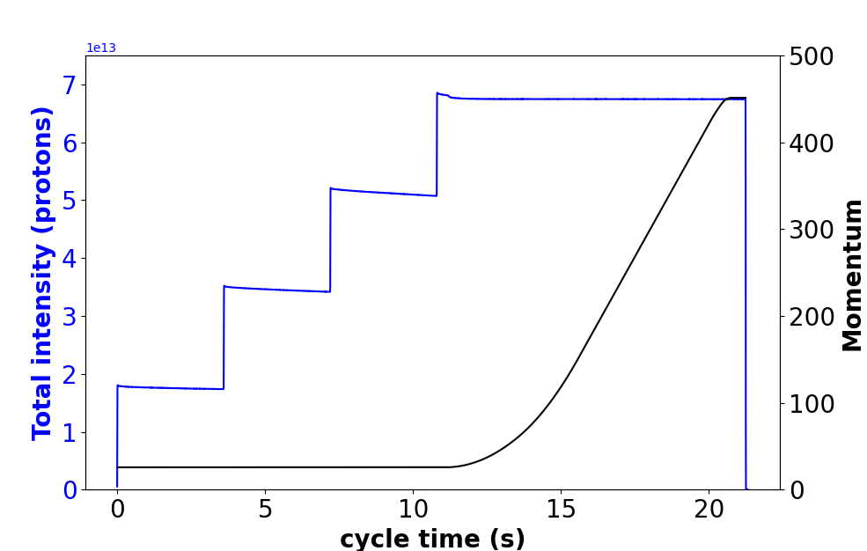
SPS intensity reach. Standard beam 4 x 72 bunches.
End flat bottom
End flat bottom (26 GeV)
High intensity MD’s in 2023
Intensity ramp-up during the year

Slide 7
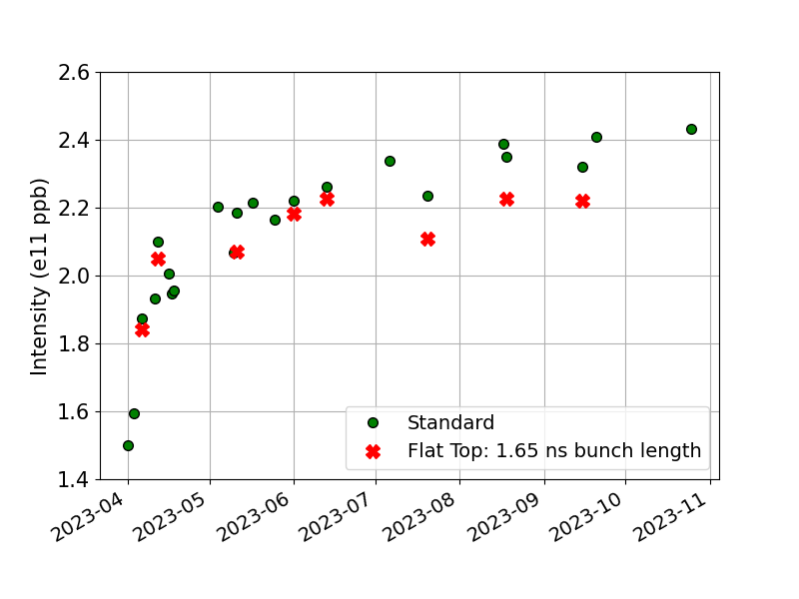
SPS intensity reach. Standard beam 4 x 72 bunches.
End flat bottom and flat top
Flat top (450 GeV)
High intensity MD’s in 2023
Long flat top at 400GeV instead of 450GeV

Slide 8
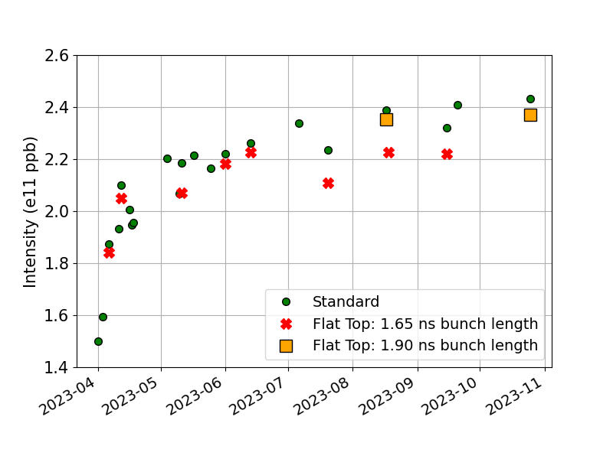
SPS intensity reach. Standard beam 4 x 72 bunches.
End flat bottom and flat top
High intensity MD’s in 2023
Very important to have high intensity beams regularly in the SPS to preserve performance

Slide 9
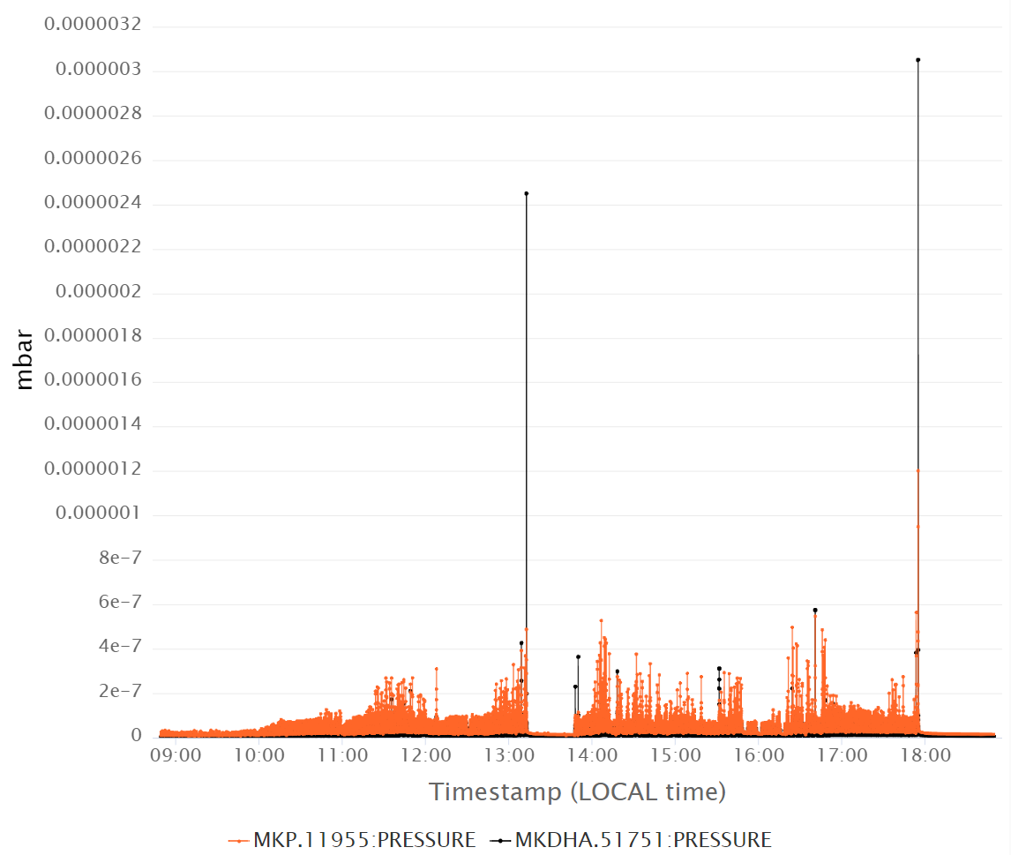
SPS Intensity limitations.
Standard beam 4 x 72 bunches.
Flat top (450 GeV)
Main limitation: high pressure spikes on MKDH.
Interlock triggered twice on August 17th when trying to go to 2.3e11 ppb.
4 x 72 bunches with 2.3e11 p/b and 1.6 ns bunch length @450 GeV was achieved on 17.08.23, but it caused an interlocking pressure spike on MKDH
Need to scrub gently for this intensity step
More details in G. Iadarola’s talk

Slide 10
OUTLINE
PSB, PS and SPS overview
SPS
  Intensity reach and hardware limitations for different beams:
    Intensity limitations with the Standard beam
    Intensity limitations with the 8b4e beam
SPS wire scanners
SPS vertical instability at injection
SPS horizontal instability at injection
Summary

Slide 11
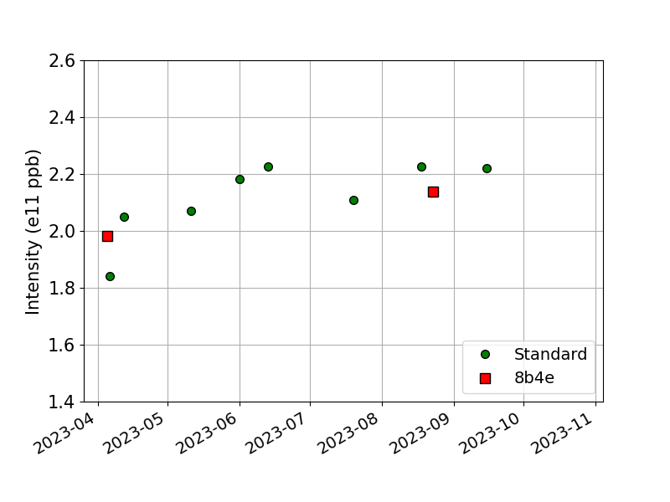
SPS intensity reach. 8b4e beam.
Flat top
Brief overview of the limitations in 2022
5 batches of 56 bunches accelerated at flat top with 1.5e11 p/b and very good transmission.
Limitations were encountered at higher intensities due to vacuum interlock on 800 MHz cavity 1
2 x 56b
4 x 56b
8b4e: 2 x 56 bunches (April)
4 x 56 bunches (August)
Standard: 4 x 72 bunches

Slide 12
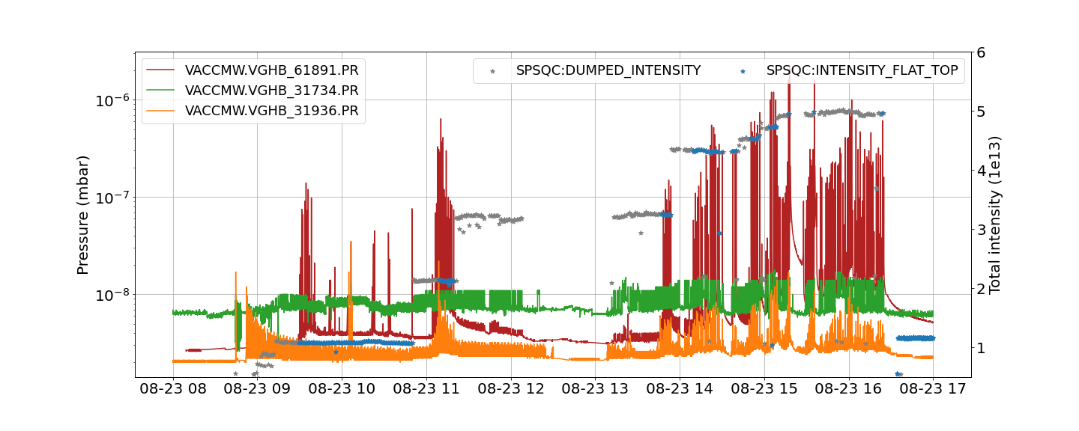
SPS Intensity limitations. 8b4e beam.
  AUGUST 2023: 4 x 56 bunches accelerated to flat top with 2.15e11 p/b with very good transmission.
    Very small vacuum activity in the 800 MHz cavity 1 (conditioning during the year)
    Intensity reach is limited by vacuum activity near the TT60 junction
    Reverse protection interlock triggered for 200 MHz cavity 4 for bunch intensities above 2.0e11 p/b. Transmission lines will be inspected during YETS.
  APRIL 2023: 2 x 56 bunches accelerated to flat top (400 GeV) with 2.0e11 p/b.
    Conditioning of the 800 MHz cavity 1 was observed
    Significant vacuum activity in Sector 6, near the TT60 junction
Vacuum activity
TT60 junction
800 MHz C1
800 MHz C2

Slide 13
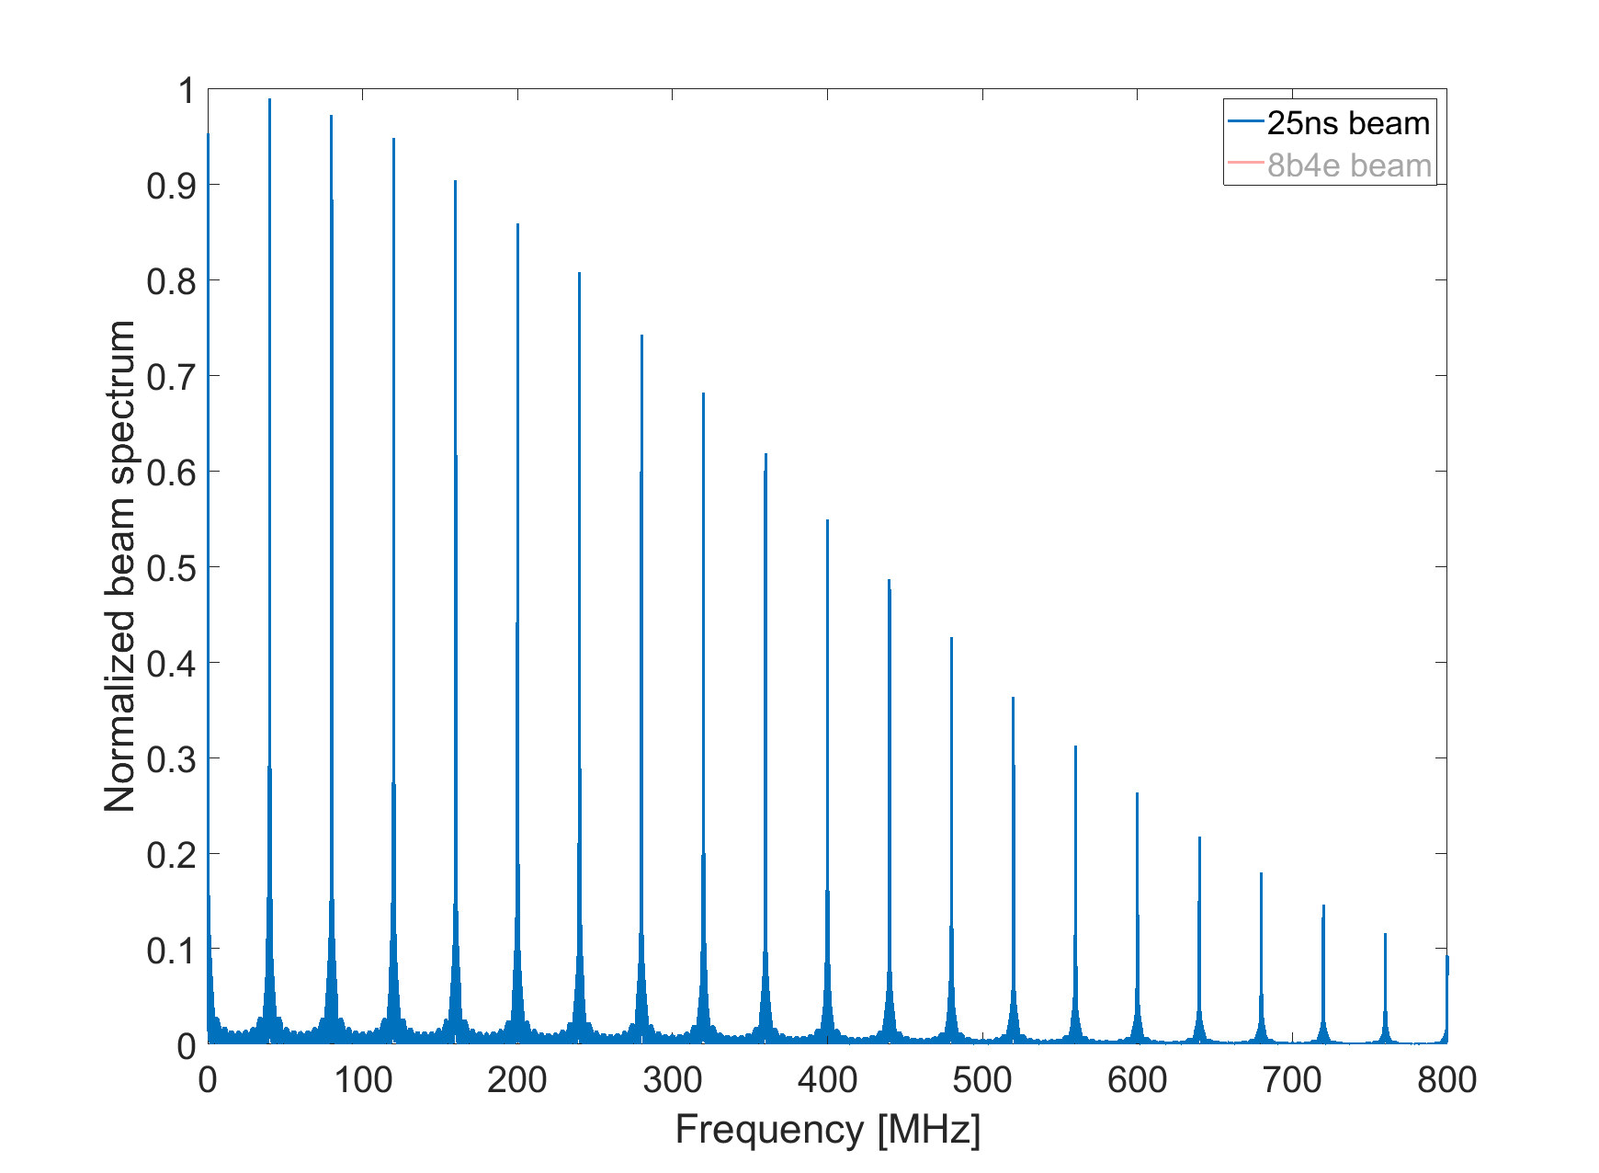
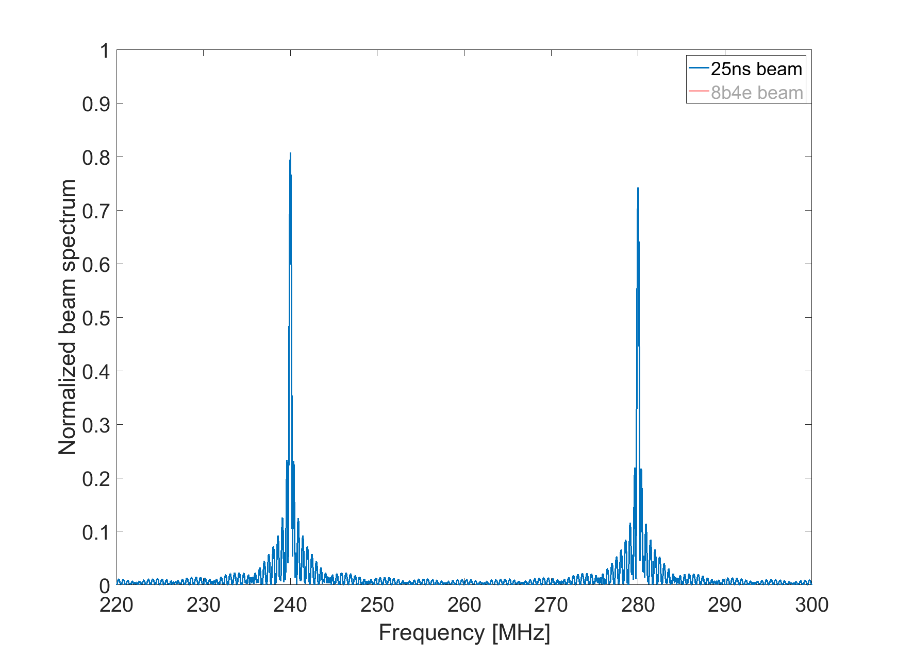
Comparing beam spectrum 25 ns standard and 8b4e beams
SPS Intensity limitations. 8b4e beam.

Slide 14
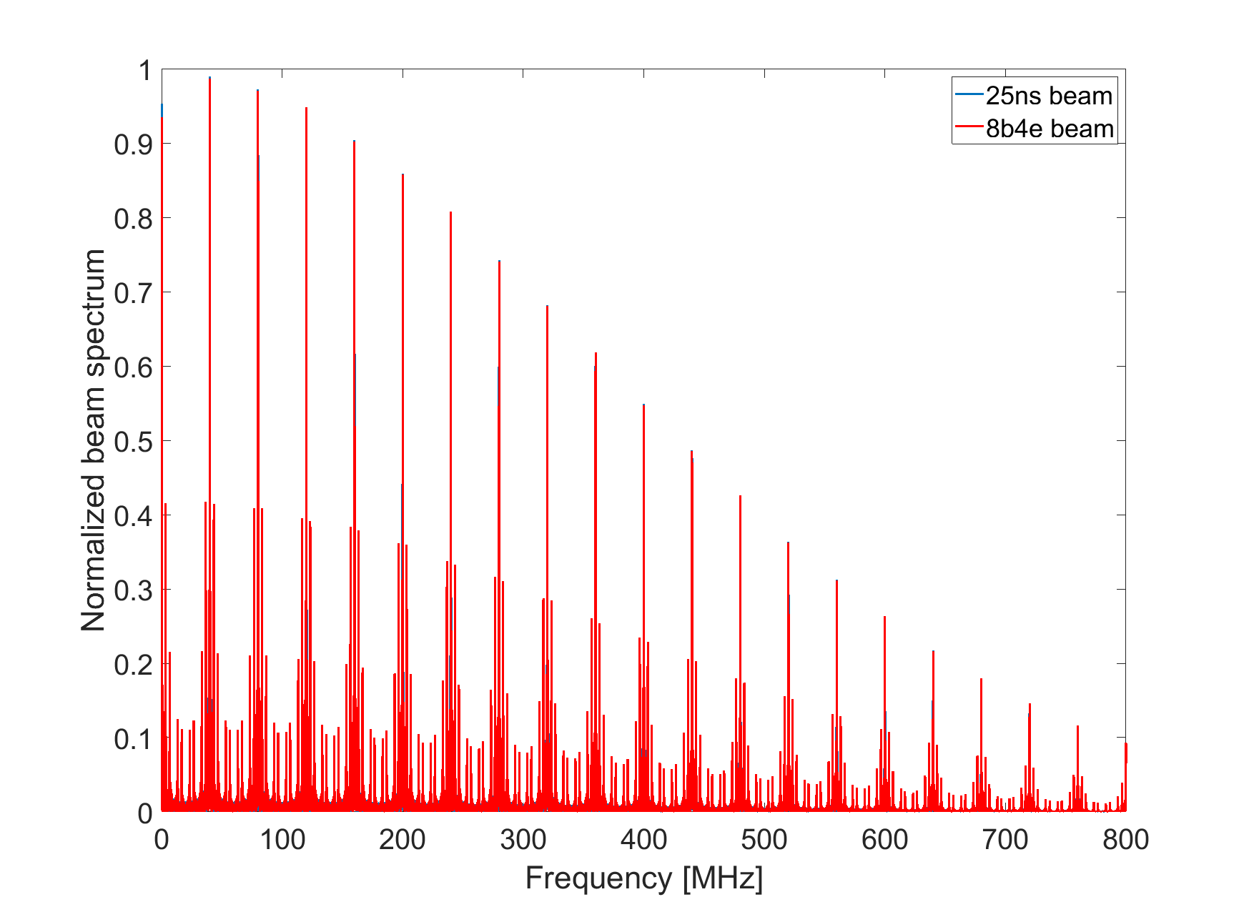
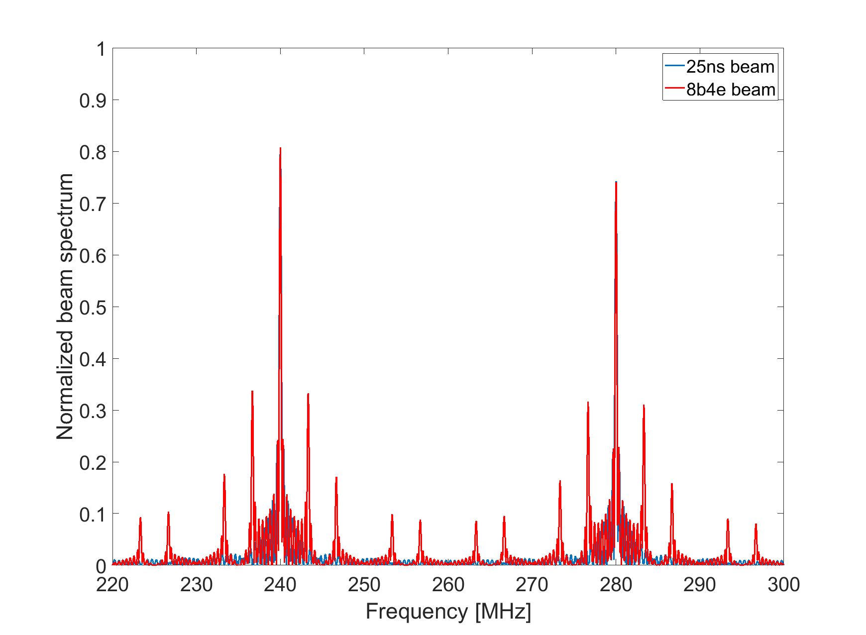
Comparing beam spectrum 25 ns standard and 8b4e beams
SPS Intensity limitations. 8b4e beam.
Additional frequencies are excited with the 8b4e beam, compared to the 25 ns standard beam.
Switching to 8b4e beam is not without risks; other devices may react to this in the future.

Slide 15
OUTLINE
PSB, PS and SPS overview
SPS
  Intensity reach and hardware limitations for different beams:
    Intensity limitations with the Standard beam
    Intensity limitations with the 8b4e beam
SPS wire scanners
SPS vertical instability at injection
SPS horizontal instability at injection
Summary

Slide 16
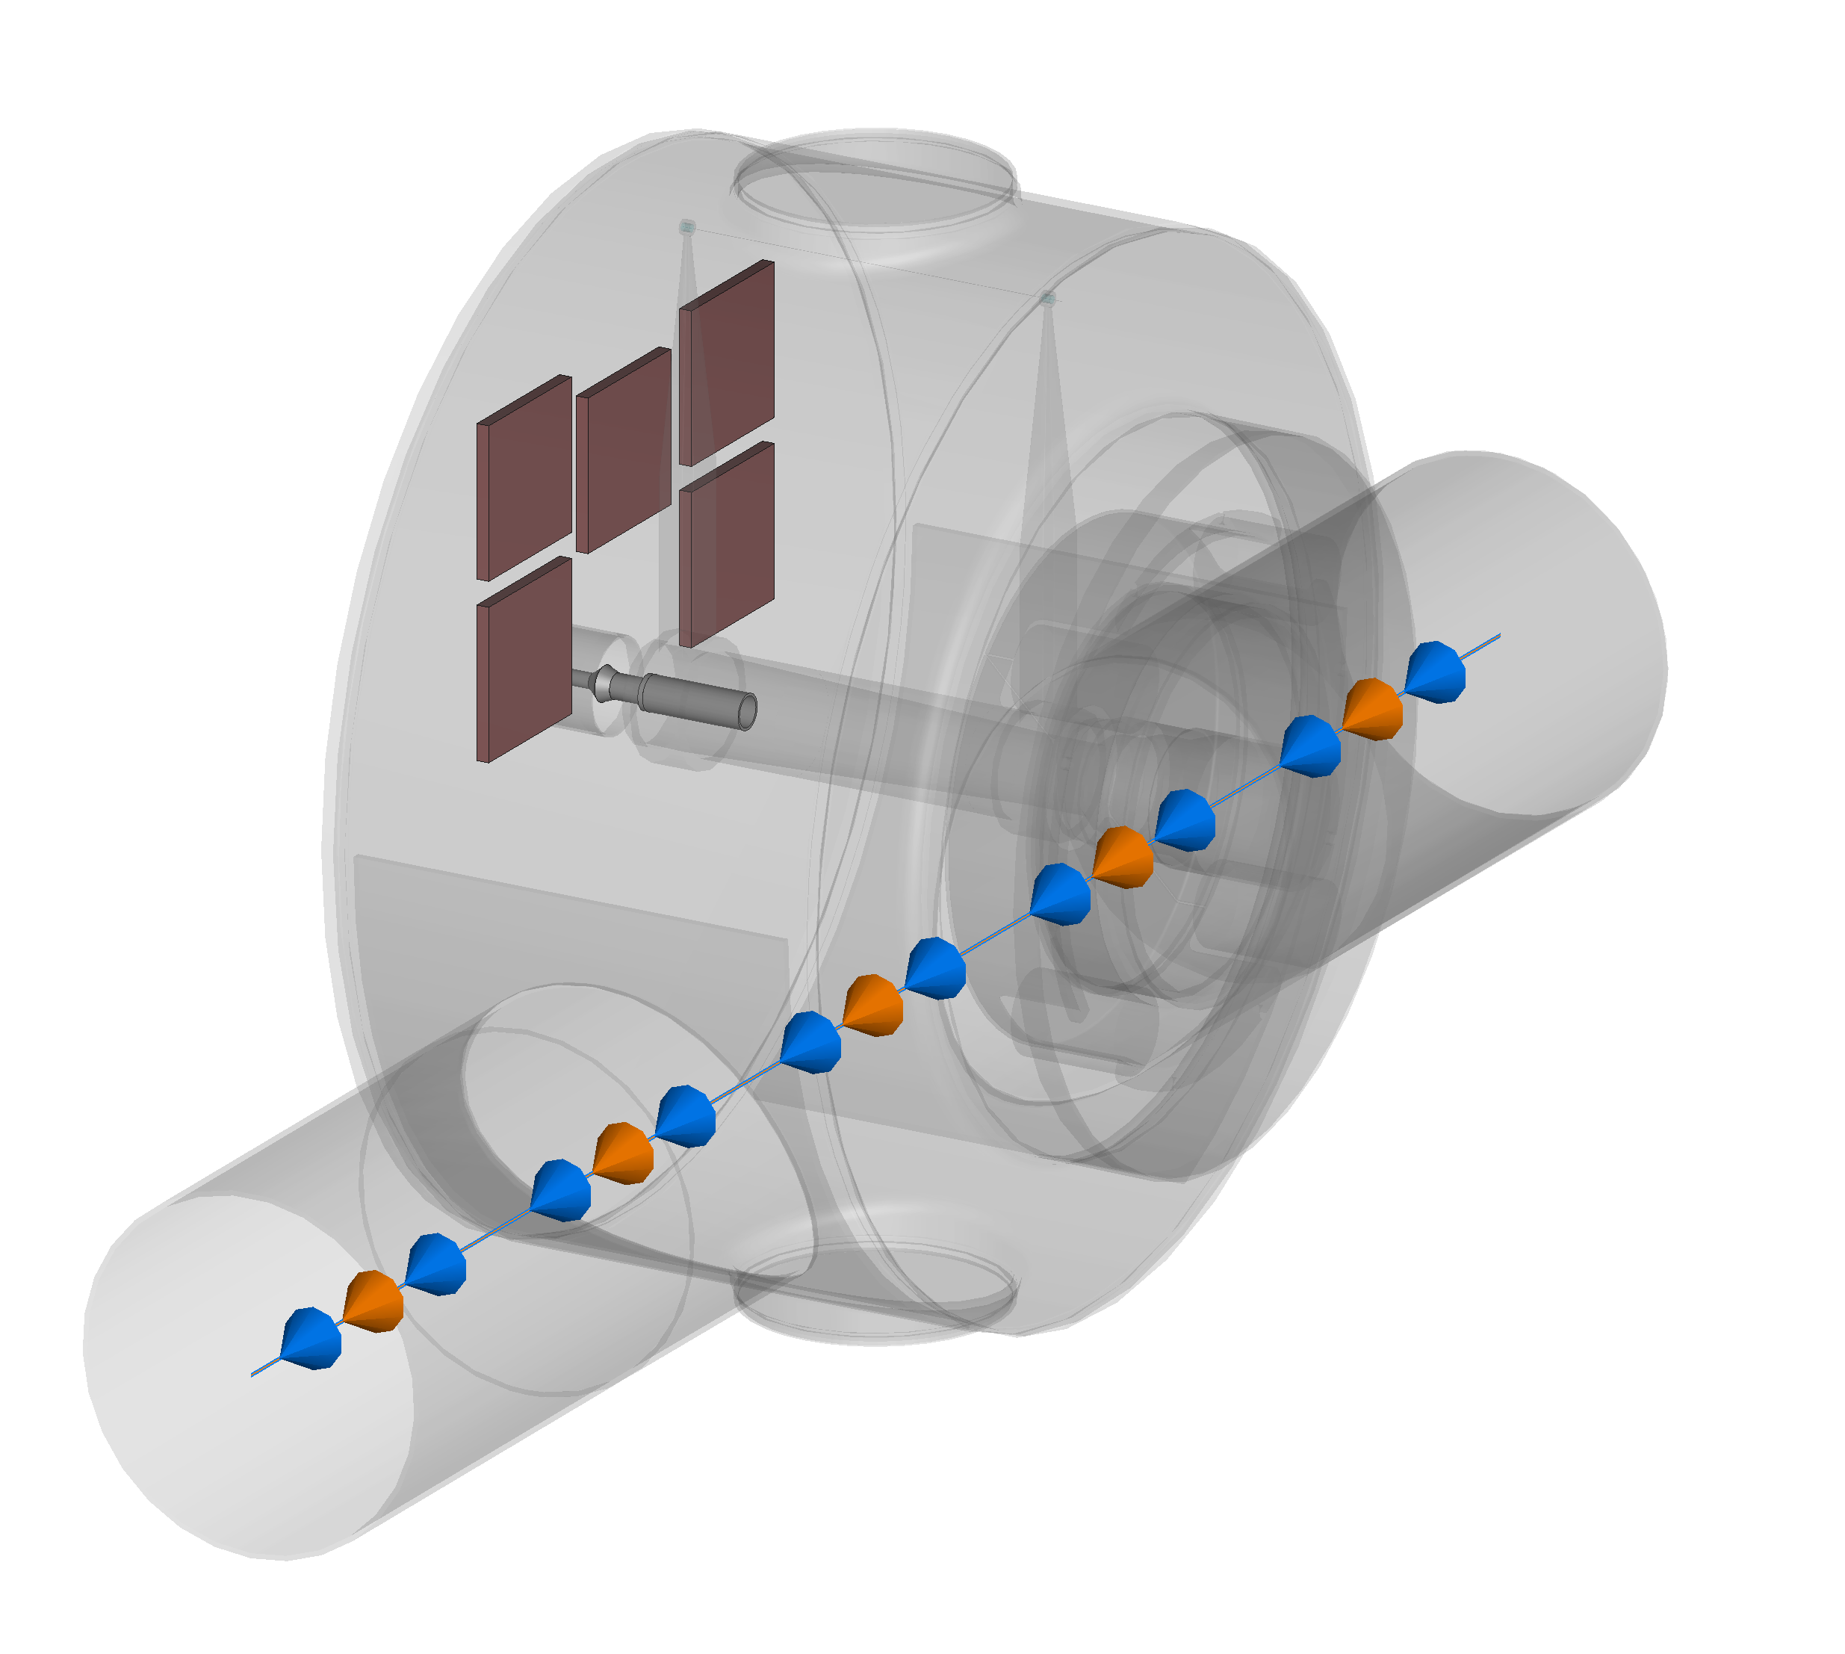
SPS Wire scanners: Breakage and mitigations
BREAKAGE during Scrubbing
Replacement
of 2 wires
SECOND BREAKAGE
12th of April 2023, SPS scrubbing run:
All four BWS’ wires found broken
when in parking position
with intensities below the LIU target.
Breakage again with the standard flat top (4 x 72b, ~1.8e11 p/b)
High repetition rate and long flat top with short bunches ~1.65 ns
MITIGATIONS IMPLEMENTED IN THE TECHNICAL STOP IN JUNE 2023
  Equipment installed in BA4 to reduce the power loss on the wires:
  ferrite tiles in the tank (horizontal)
  ferrite tiles + coupler in the tank (vertical)
References: [1, 2, 3]
Wire scanners survived up to ~2.2e11 p/b and nominal bunch length of ~1.6 ns at standard flat top

Slide 17
SPS Wire scanners: Breakage and mitigations
They have demonstrated
their efficacy up to now
  The same solution
  (FERRITES + COUPLER)
  will be used in BA5
It was not possible to perform the “stress test” planned in October 2023 with the long flat top.
Mitigations not tested with the long flat top and high repetition rate.
YETS 2023-24
Installation of four new wires.
Installation of ferrites and coupler in all 4 wire scanners tanks, both in BA4 and BA5.

Slide 18
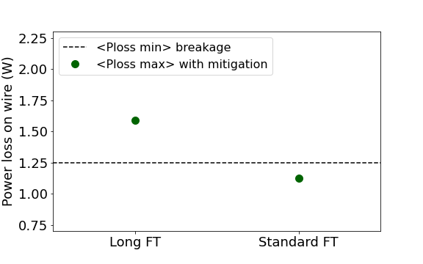
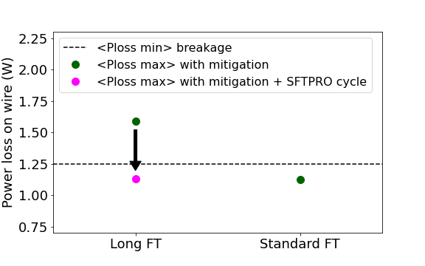
SPS Wire scanners: WHAT IS EXPECTED FOR NEXT YEAR?
The long flat top will be needed again in 2024 scrubbing run.
It is aimed to reach 2.3e11 p/b at flat top.
Will the wires survive?
From power loss calculations [4], no issues are expected if considering peak power on the wire along the cycle.
If considering average power on the wire throughout the cycle:
Average power along the cycle
From the power loss calculations (conservative approach):
No issues are expected with the standard flat top up to ultimate LIU intensity, even in dedicated mode.
But some minimum risk with high duty cycle and the long flat top due to fatigue effects.
No issues expected with the long flat top and SFTPRO cycle in parallel.
During the long flat top cycle next year, the activity of the wires will be monitored.

Slide 19
OUTLINE
PSB, PS and SPS overview
SPS
  Intensity reach and hardware limitations for different beams:
    Intensity limitations with the Standard beam
    Intensity limitations with the 8b4e beam
SPS wire scanners
SPS vertical instability at injection
SPS horizontal instability at injection
Summary

Slide 20
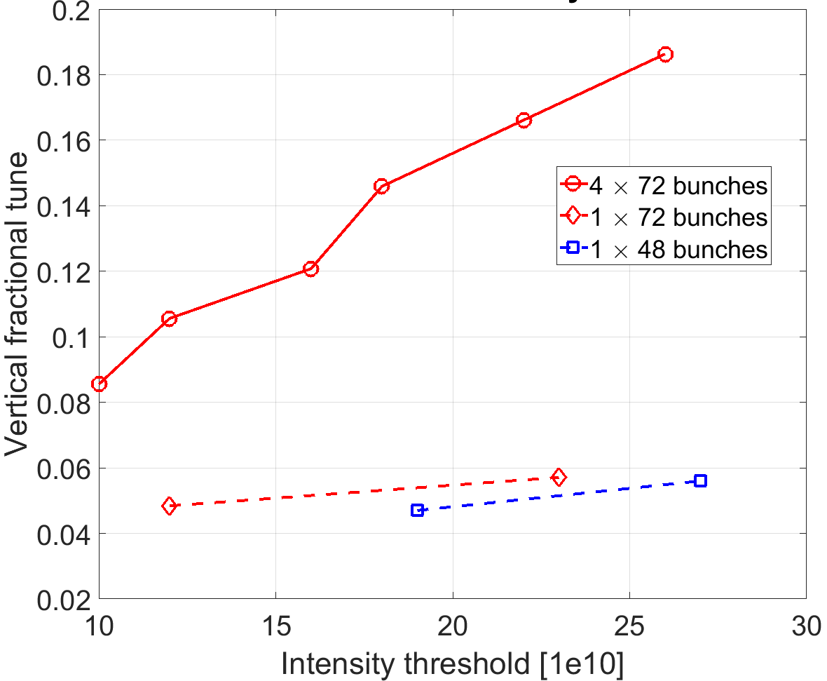
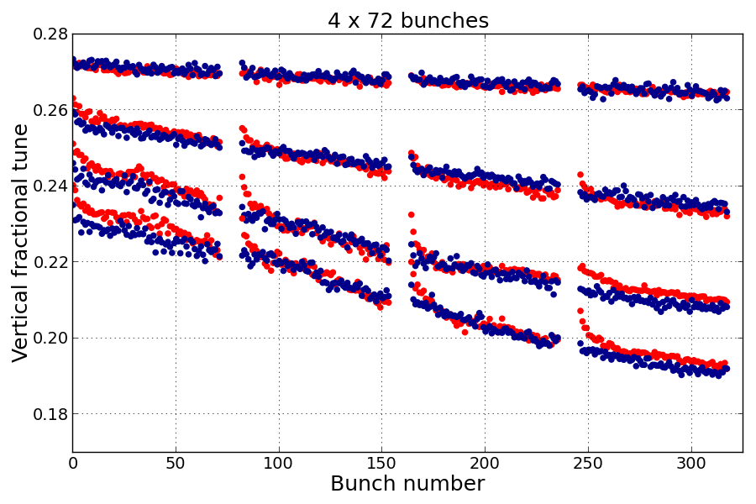
SPS Vertical stability and working point
Extremely fast vertical coupled bunch instability predicted in simulations
  Threshold depends on the set vertical tune (mainly driven by resistive wall)
  Experimentally confirmed with 1 batch and low intensity
Vertical tunes close to 20.25 resonance required for LIU parameters
  Control of tunes is critical due to large bunch-by-bunch tune shift from impedance – progress on operational correction (model-based application)
Injection (26 GeV)
0.28e11 p/b
0.84e11 p/b
1.34e11 p/b
PyHeadTail
1.68e11 p/b
Measurements

Slide 21
OUTLINE
PSB, PS and SPS overview
SPS
  Intensity reach and hardware limitations for different beams:
    Intensity limitations with the Standard beam
    Intensity limitations with the 8b4e beam
SPS wire scanners
SPS vertical instability at injection
SPS horizontal instability at injection
Summary

Slide 22
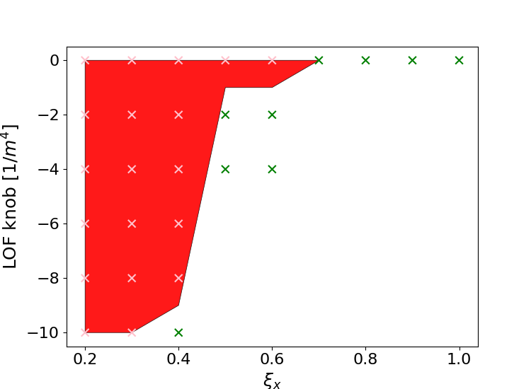
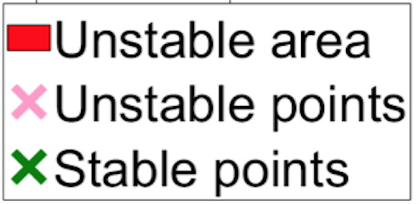
SPS Horizontal stability at injection
Horizontal headtail instability @26 GeV studied in detail in 2018 for 1.8e11 p/b
  Mitigation strategy developed in simulations: high chromaticity + octupoles
PyHT Simulations
4 x 72bunches, N = 2.6e11 p/b
Stabilization strategy
Without octupoles stabilization at ξ_{x} ≥ 0.7
With octupoles (-kLOF < 10) stabilization at ξ_{x} ≥ 0.5
Tested in 2023 with up to ~2.6e11 p/b injected
4 x 72 bunches
Discovered criticality of short bunches at injection to ensure stability

Slide 23
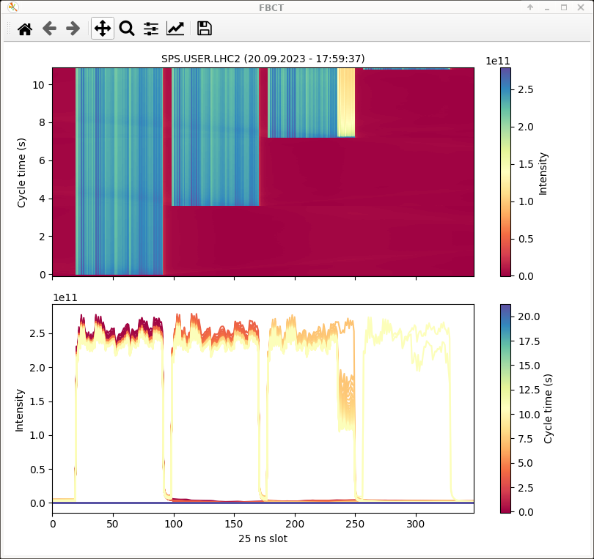
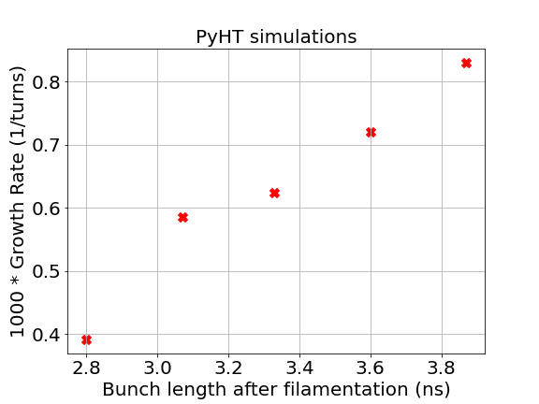
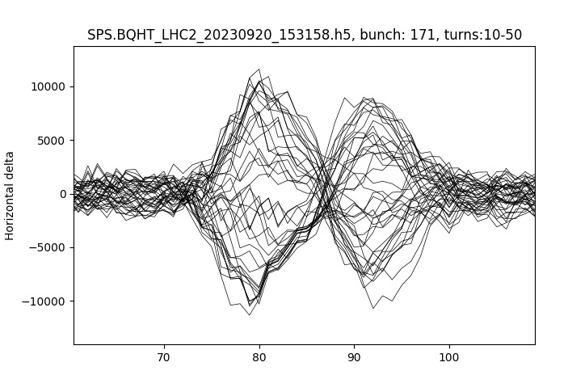
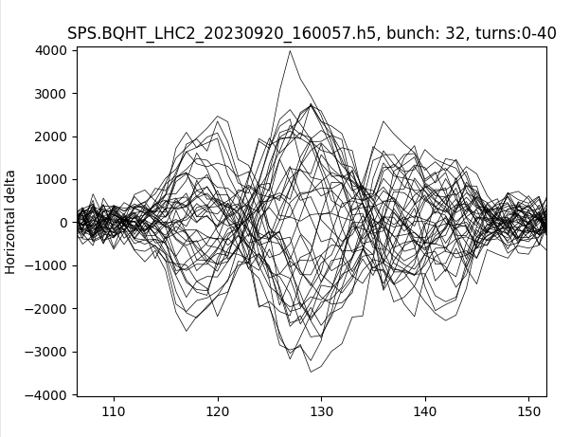
SPS Horizontal stability at injection
Instability is very sensitive to bunch length.
MD 20 September 2023
Observed a correlation between instability in the SPS and the injected bunch length:
  The longer the bunches, the more unstable
  (observed also in simulations)
Unstable beam with long bunches at injection (~4.2 ns)
With 4.2 ns injected bunch length it was not possible to stabilize the beam
(even with high chromaticity and using octupoles)
Measured mode 1 and mode 2 with the Head-Tail monitor
Mode 1 observed for 0.3 < ξ < 0.4 with 2.6e11 p/b injected
Mode 2 observed for 0.45 < ξ < 0.55 with 2.6e11 p/b injected

Slide 24
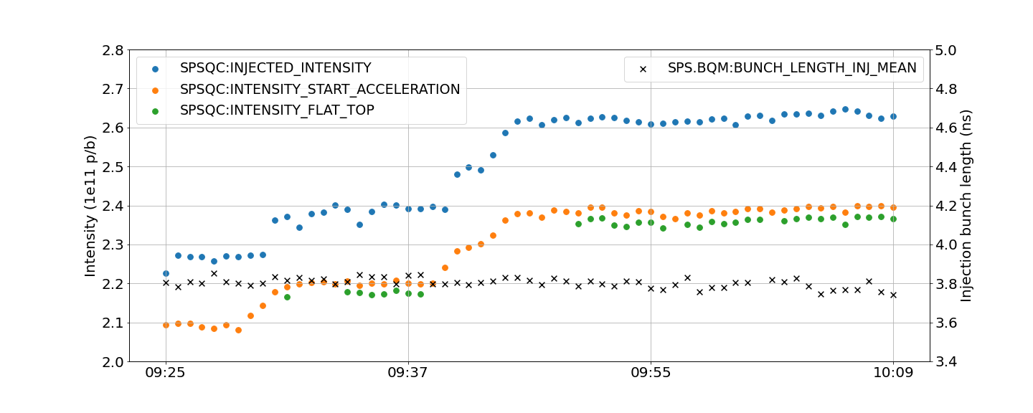
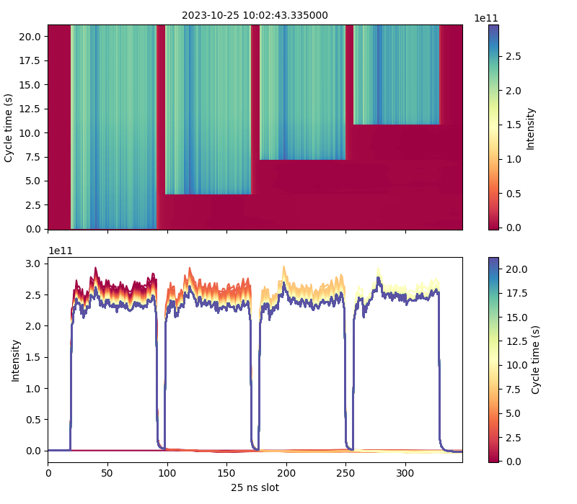
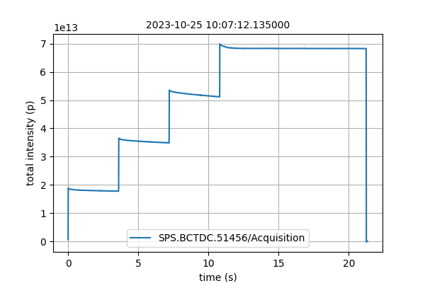
SPS Horizontal stability at injection
MD 25 October 2023
Only ~40 minutes of MD time with this beam characteristics!
LIU intensity at injection was reached with the proper bunch length at injection.
The beam was stable with an injected bunch length of ~3.8 ns,
but transmission needs to be optimized.

Slide 25
OUTLINE
PSB, PS and SPS overview
SPS
  Intensity reach and hardware limitations for different beams:
    Intensity limitations with the Standard beam
    Intensity limitations with the 8b4e beam
SPS wire scanners
SPS vertical instability at injection
SPS horizontal instability at injection
Summary

Slide 26
SUMMARY
Intensity at FT [p/b] | #bunches | Batch spacing [ns] | Bunch length [ns] | Beam type
~2.2e11 | 4 x 72 | 200 | ~1.6 | Standard
~2.15e11 | 4 x 56 | 200 | ~1.6 | 8b4e
LIU target achieved in PSB and PS
Limitations to ramp-up the intensity in the SPS
  MKDH pressure spikes limiting intensity for standard beam @450 GeV with nominal bunch length.
  Significant pressure rise in sector 6 limiting intensity for 8b4e beam @450 GeV.
Mitigations in place for the wire scanners (ferrites + coupler)
  No issues expected during 2024 run (even during scrubbing with long flat top cycle if SFTPRO in parallel).
Transverse stability with LIU target intensity at flat bottom (@ 26 GeV)
  Vertical plane. Need to operate with Q_{y} close to 20.25 resonance to ensure stability with standard beam.
  Horizontal plane. Stabilization strategy tested for standard beam with ~2.6e11 p/b
  injected intensity, but only for a short time in one MD, and only under the following conditions:
    Reproducible injected bunch length (~ 3.8 ns).
    High horizontal chromaticity.
    Given this information, is the horizontal wideband feedback system needed?

Slide 27
Thank you!

Slide 28
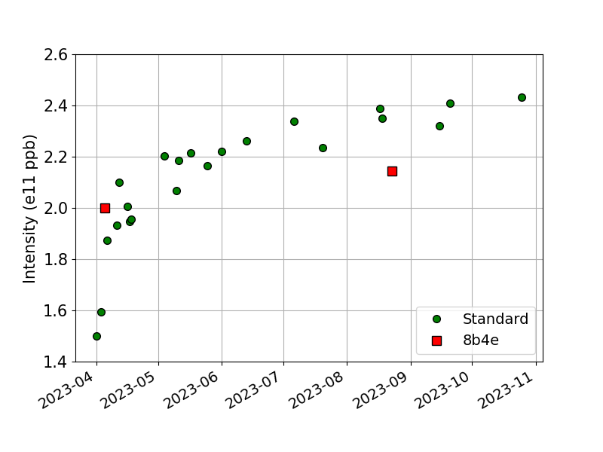
SPS intensity reach. 8b4e beam.
End flat bottom
2 x 56b
Standard: 4 x 72 bunches
8b4e: 2 x 56 bunches (April)
4 x 56 bunches (August)
4 x 56b

Slide 29
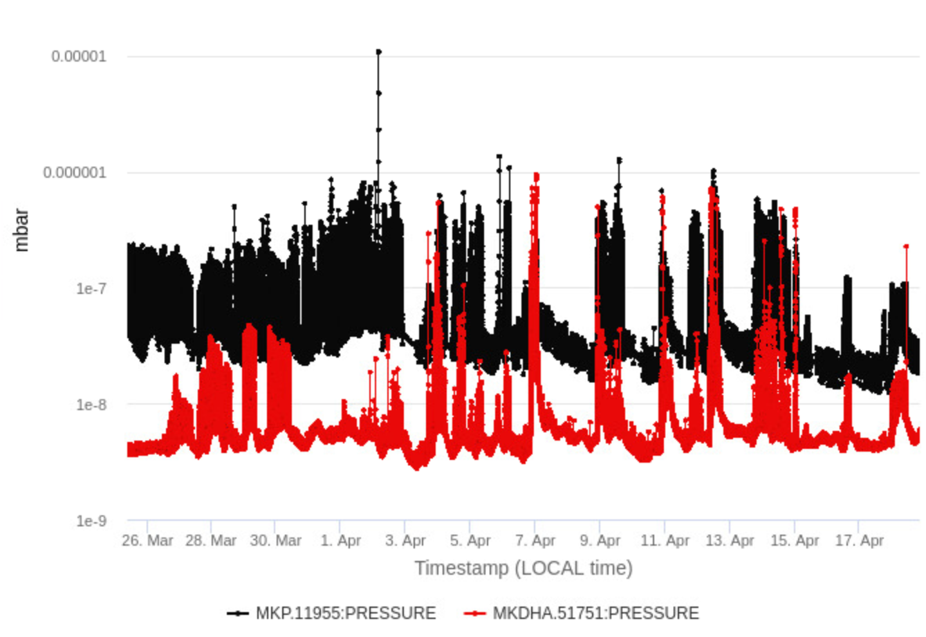
MKP-L
MKDH

Slide 30
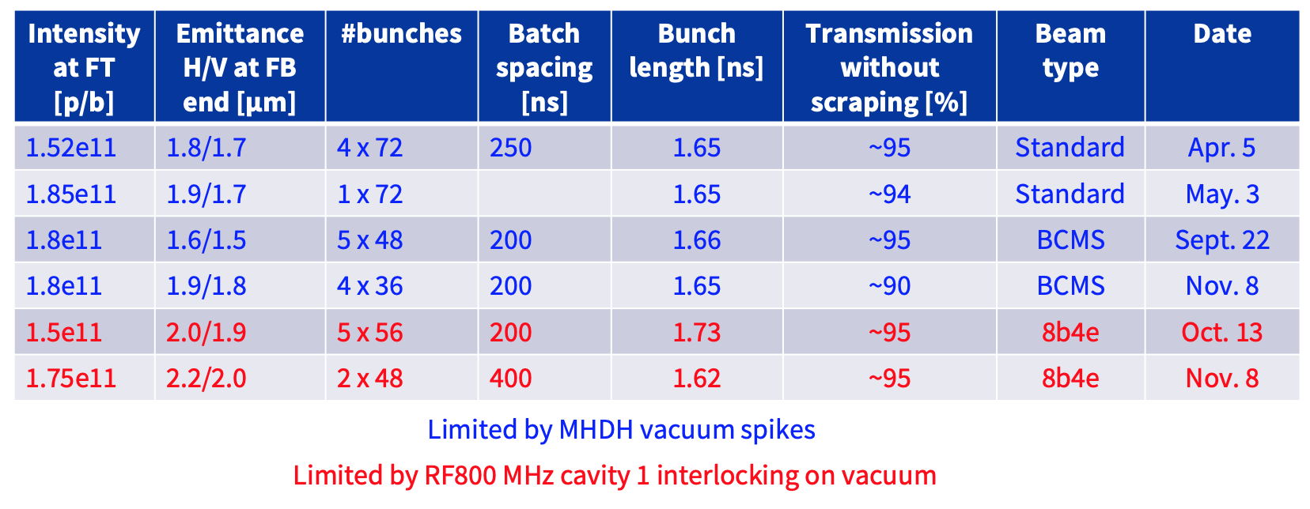
Last year’s intensity limitations due to kicker vacuum activity

Slide 31
Comparison to 2022
Year | Intensity at FT [p/b] | #bunches | Batch spacing [ns] | Bunch length [ns] | Beam type | Date
2022 | ~1.5e11 | 4 x 72 | 250 | ~1.6 | Standard | Apr. 5
2022 | ~1.75e11 | 2 x 56 | 400 | ~1.6 | 8b4e | Nov. 8
2023 | ~2.2e11 | 4 x 72 | 200 | ~1.6 | Standard | Aug. 18
2023 | ~2.15e11 | 4 x 56 | 200 | ~1.6 | 8b4e | Aug. 23
Table from Carlo’s talk on IPP:
https://indico.cern.ch/event/1322532/contributions/5565561/subcontributions/440832/attachments/2713754/4712893/LHC_HI_MDs_IPP_Sep_13th.pdf

Slide 32
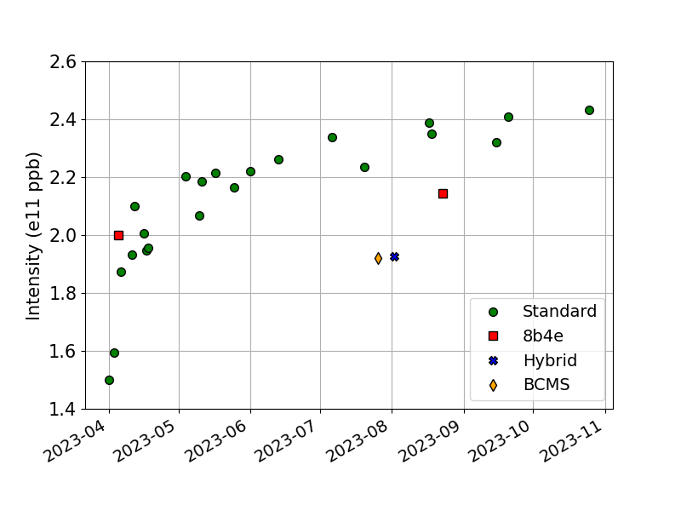
Intensity reach end flat bottom
Standard: 4 x 72 bunches
8b4e: 2 x 56 bunches (April)
4 x 56 bunches (August)
Hybrid: 1 x 56 bunches (8b4e) + 5 x 36 bunches
BCMS: 4 x 48 bunches
For hybrid and BCMS beam, the high intensity was not taken.
There was no limitation, we didn’t push intensity (just brightness measurements)

Slide 33
OVERVIEW OF SCRUBBING
Main goal of scrubbing 2023: to condition the MKP-L injection kicker upgraded during the YETS 2022-23.
In 2022, erratic and unpredictable pressure spikes were observed on the MKDH dump kicker at flat top with the standard beam of 4 x 72 bunches. Consequently, the MKDH kicker needed to undergo conditioning as well during scrubbing 2023.
A dedicated scrubbing cycle was created, in order to improve the efficiency of scrubbing,
Gradually increased bunch intensity at flat bottom from ~1.4e11 p/b up to ~2.2e11 p/b.
Scrubbing on the ramp and flat top was difficult/critical due to pressure spikes on the kickers causing interlocks.
Longer flat top
Lower energy (400 GeV).
First breakage of the 4 wires of the wire scanners during scrubbing with the long flat top

Slide 34
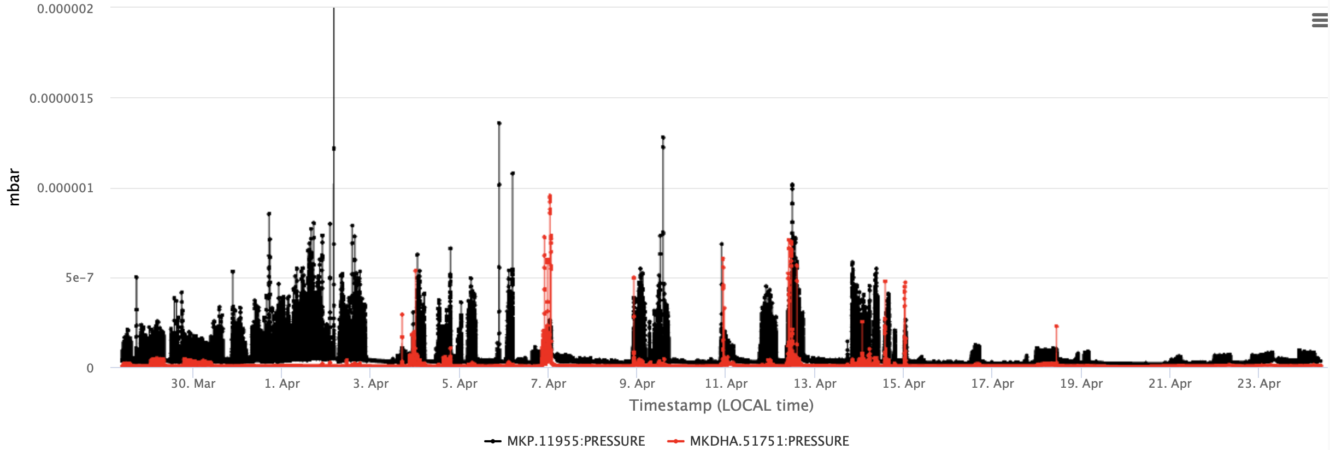
OVERVIEW OF SCRUBBING
Conditioning of kickers
Around 20 days were needed to scrub the MKP-L and MKDH at flat top.
Achievements reached during scrubbing 2023:
Intensity at extraction [p/b] | #bunches | Energy [GeV] | Bunch length [ns]
2.2e11 | 1 x 72 | 400 | 1.6
2.05e11 | 4 x 72 | 400 | 1.6
Unprecedented amount of scrubbing beam accumulated at flat top (with nominal parameters)
Erratic behaviour of MKDH can be conditioned

Slide 35
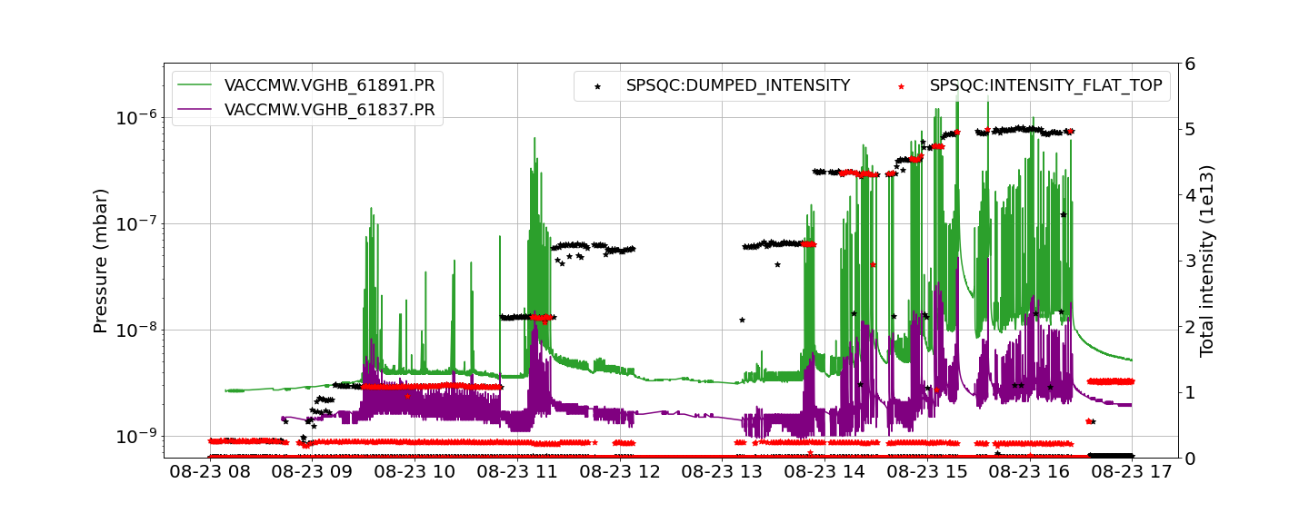
SPS Intensity limitations. 8b4e beam.
23rd August 2023
TT60 junction
MSE

Slide 36
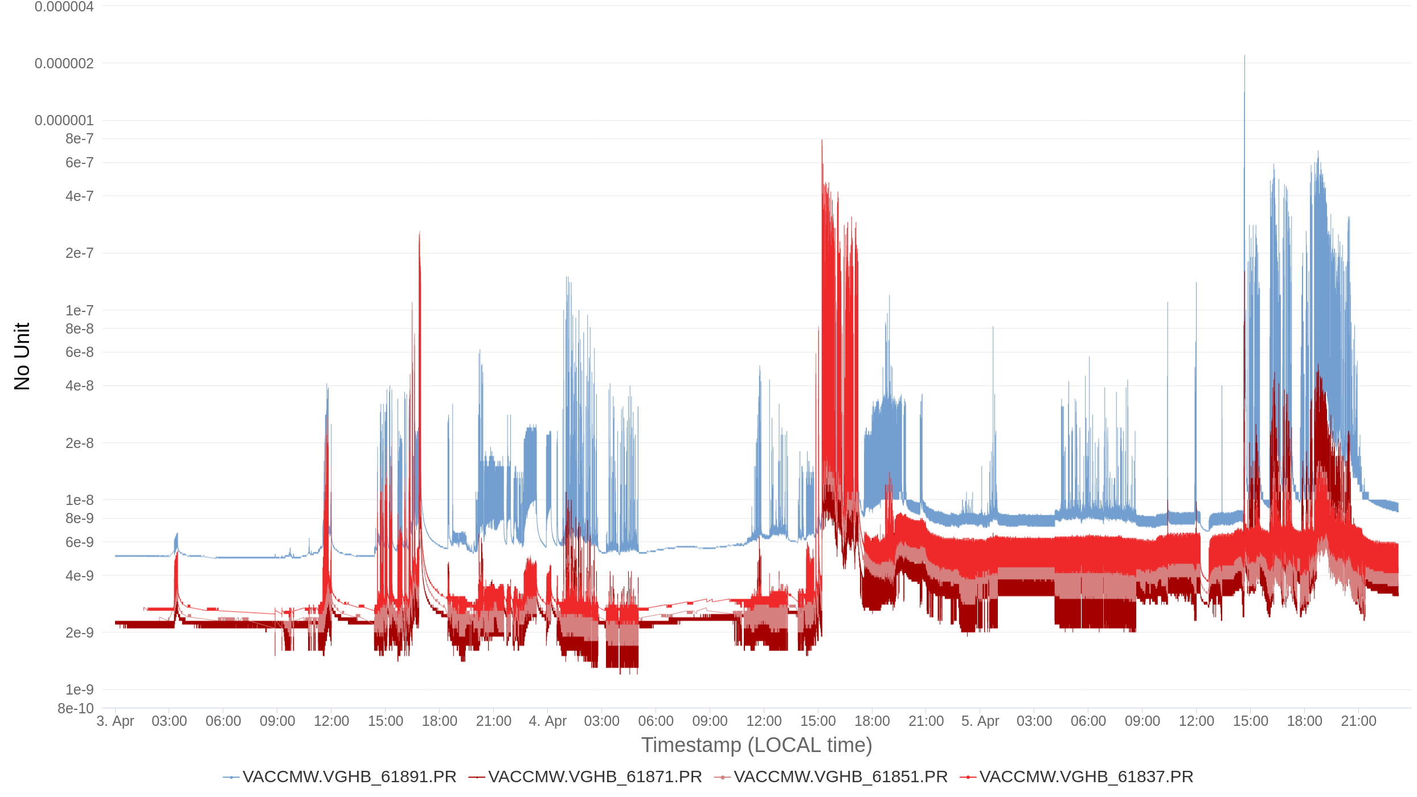
Limitations due to pressure rise in other areas with 8b4e beam.
Not always limited only by the kickers, pressure rise in various vented devices/regions was also limiting
High pressures observed in sector 6 at different points:
Large spikes on TT60 junction pressure with 8b4e beam
MSE
TT60 junction
MSE area

Slide 37
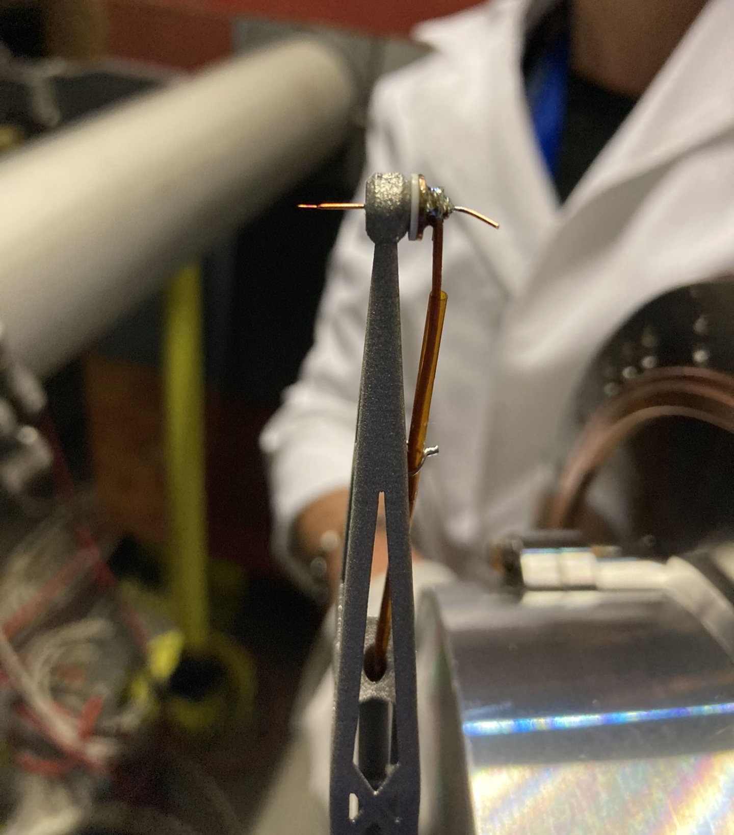
SPS Wire scanners: 1. BREAKAGE
All four SPS wire scanners (two vertical in SPS BA4 and two horizontal in SPS BA5) stopped working during the second week of scrubbing
Bunch Length @FT ~1.60ns
Higher rate and higher total number of cycles reaching FT
Conditions during the first breakage of the 4 wires:
Up to April 19 |  |  |  | Max Intensity
LHC 25 | Long FT | 1 x 72b | 2.25e11 p/b | 1.62e13
LHC 25 | Long FT | 4 x 72b | 2.05e11 p/b | 5.90e13
8b4e | Long FT | 2 x 56b | 2.00e11 p/b | 2.24e13
April 19: Two spare wires were installed, but breakage happened again
Conditions during the second breakage of the 2 new wires:
April 20 – 22 |  |  |  | Max Intensity
LHC 25 | Standard FT | 4 x 72b | 1.80e11 p/b | 5.18e13
Courtesy of F. Roncarolo et al

Slide 38
SPS Wire scanners: 2. MITIGATIONS
Technical stop in June 2023:
The orientation of the beam wire scanner instrument in position BWSRC.41677 was modified during the TS1 2023 (from vertical to horizontal)
Mitigations have been implemented to reduce power loss on the wires.
Additional equipment was installed:
  ferrite tyles in the tank (in BWSRC.41677 - horizontal)
  ferrite tyles + coupler in the tank (in BWSRC.41678 - vertical)
August 18 |  |  |  | Max Intensity
LHC 25 | Standard FT | 4 x 72b | 2.21e11 p/b | 6.37e13
August 23
8b4e | Standard FT | 4 x 56b | 2.15e11 p/b | 4.82e13
Wire scanners survived up to ~2.2e11 p/b and nominal bunch length of 1.60 ns at flat top.

Slide 39
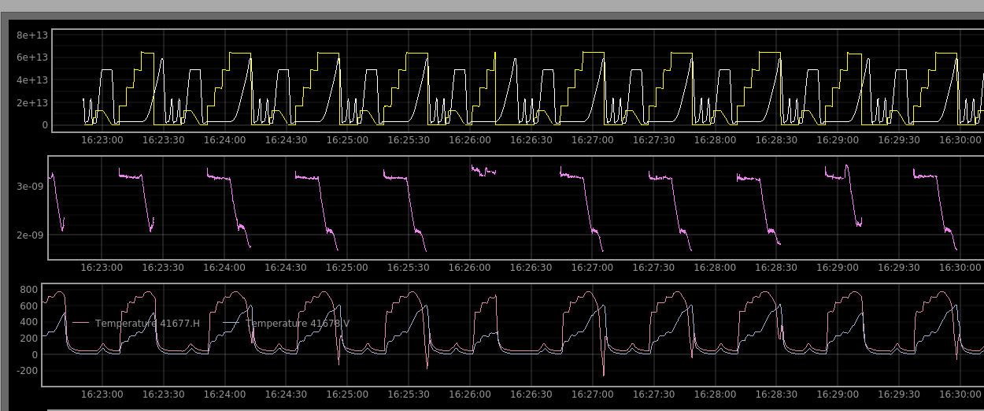
Monitorization of the wire scanners behavior during high intensity MDs

Slide 40
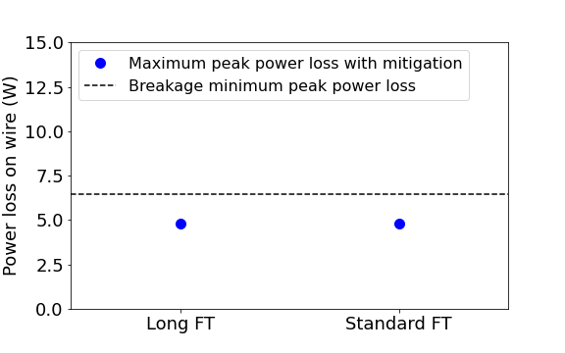
SPS Wire scanners:
WHAT IS EXPECTED FOR NEXT YEAR?
The long flat top will be needed again in 2024 scrubbing run.
It is aimed to reach 2.3e11 p/b at flat top.
Will the wires
survive?
Minimum peak power loss on the wire along the cycle with breakage conditions
Maximum peak power loss on the wire along the cycle with mitigation (ferrites + coupler)
With the implemented mitigations, no issues are expected when considering peak power

Slide 41
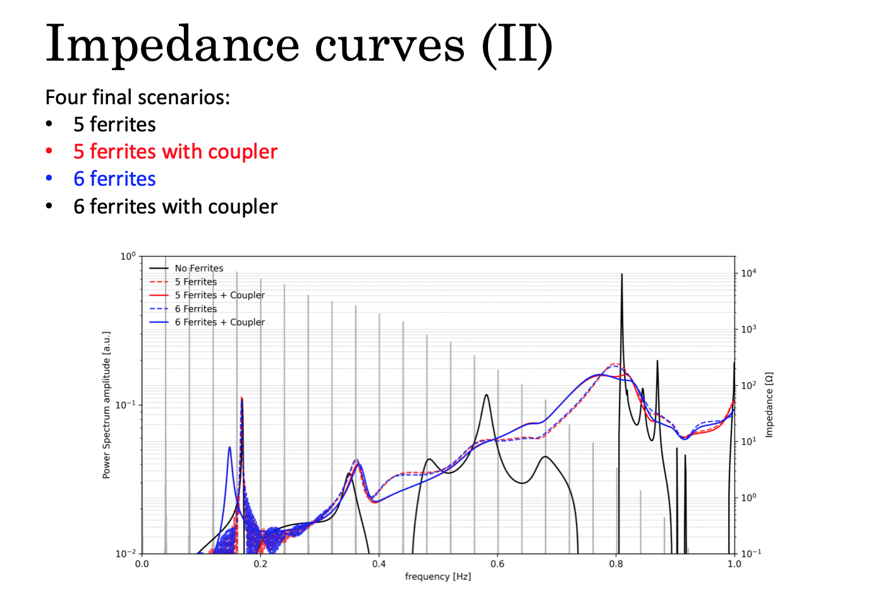
E. de la Fuente,
L. Sito

Slide 42
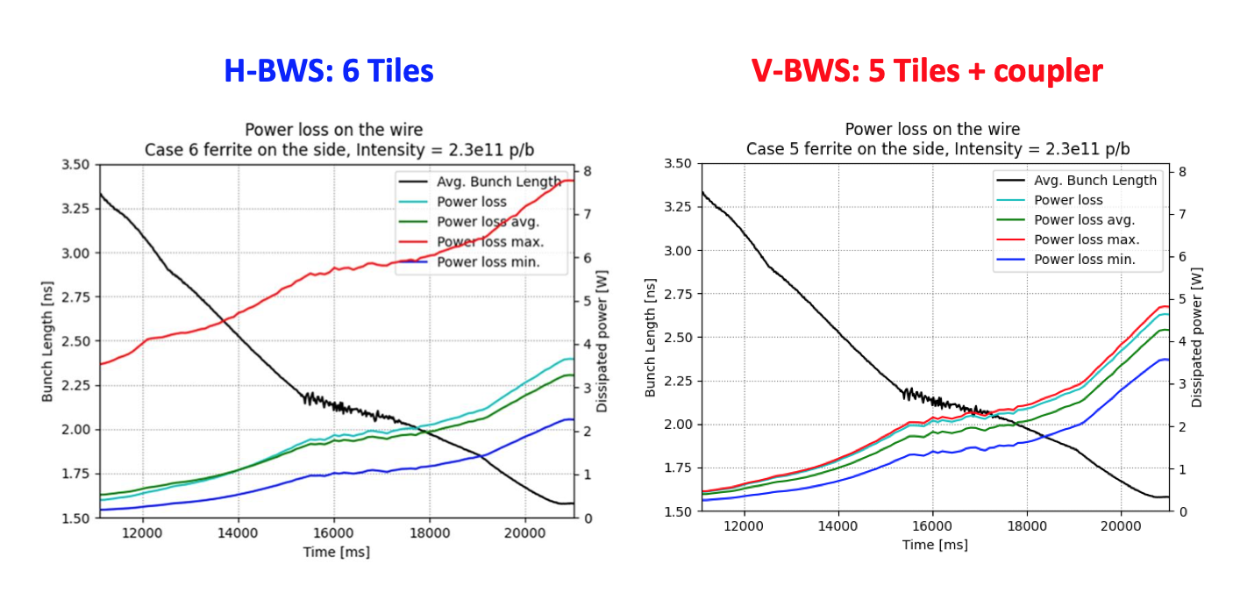
E. de la Fuente,
L. Sito

Slide 43
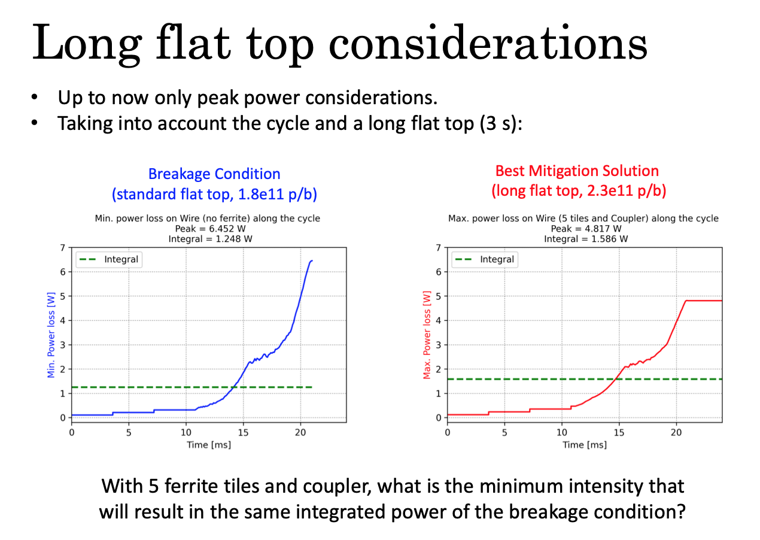
E. de la Fuente,
L. Sito

Slide 44
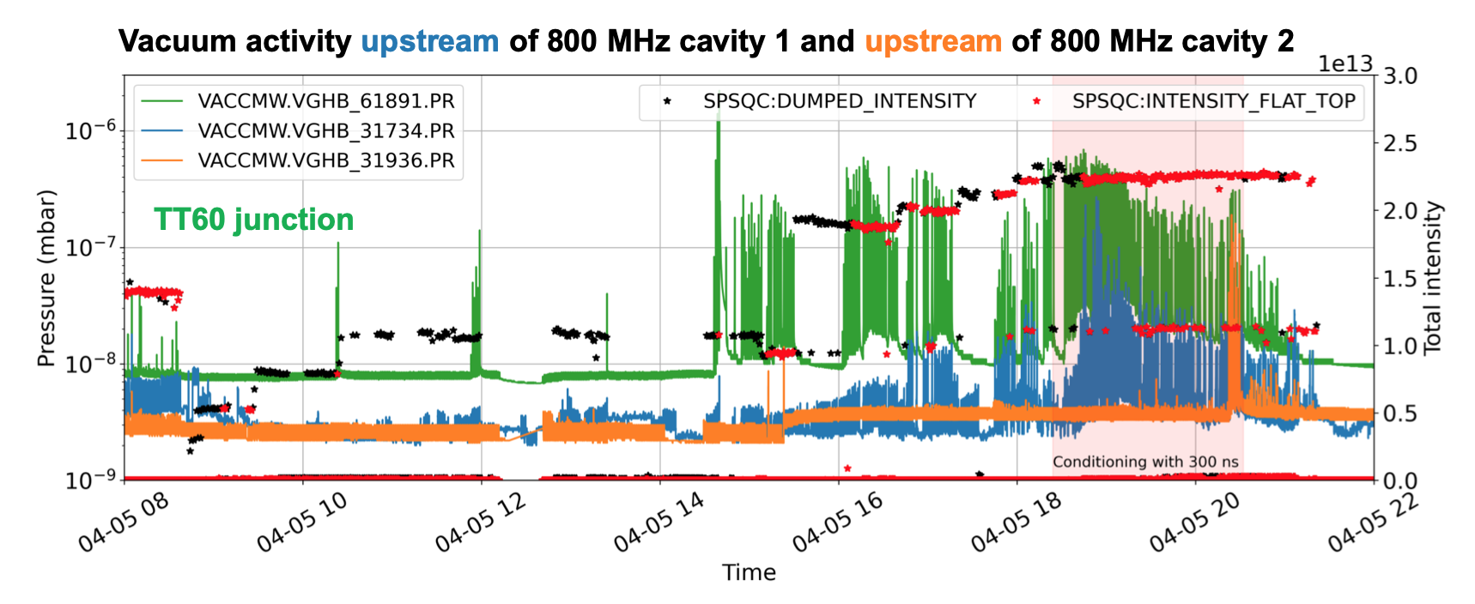
Vacuum activity with 8b4e beam (2 x 56 bunches)
5th April 2023
I. Karpov, IPP 21 April 2023

Slide 45
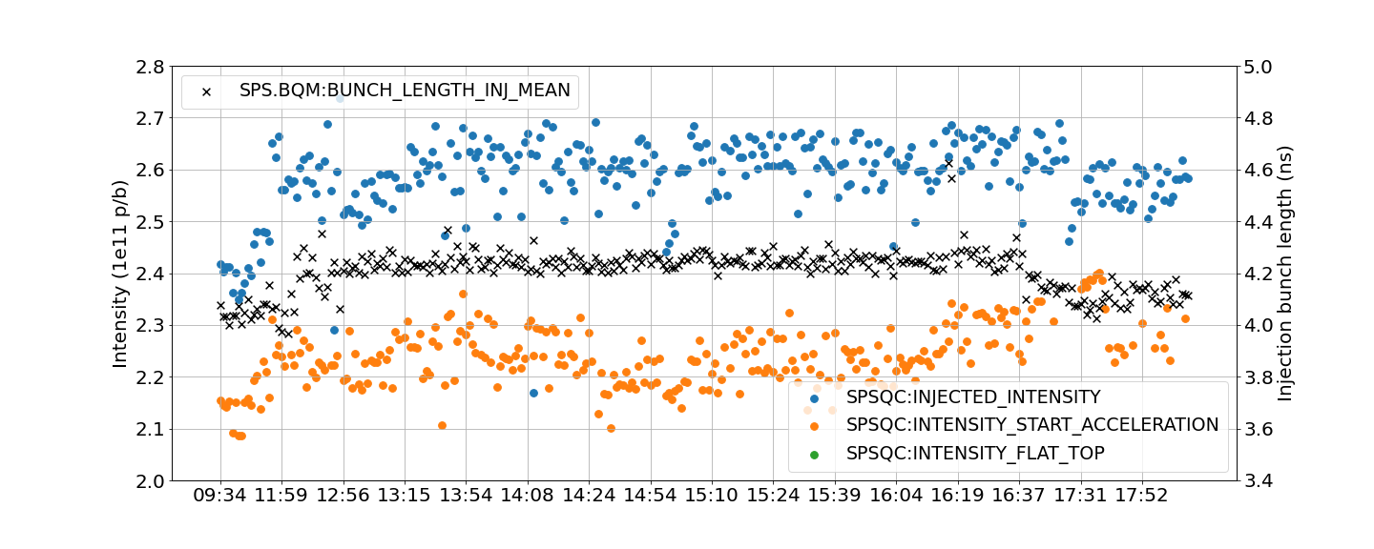
MD 20th September 2023
Injected bunch length ~4.2 → instability

Slide 46
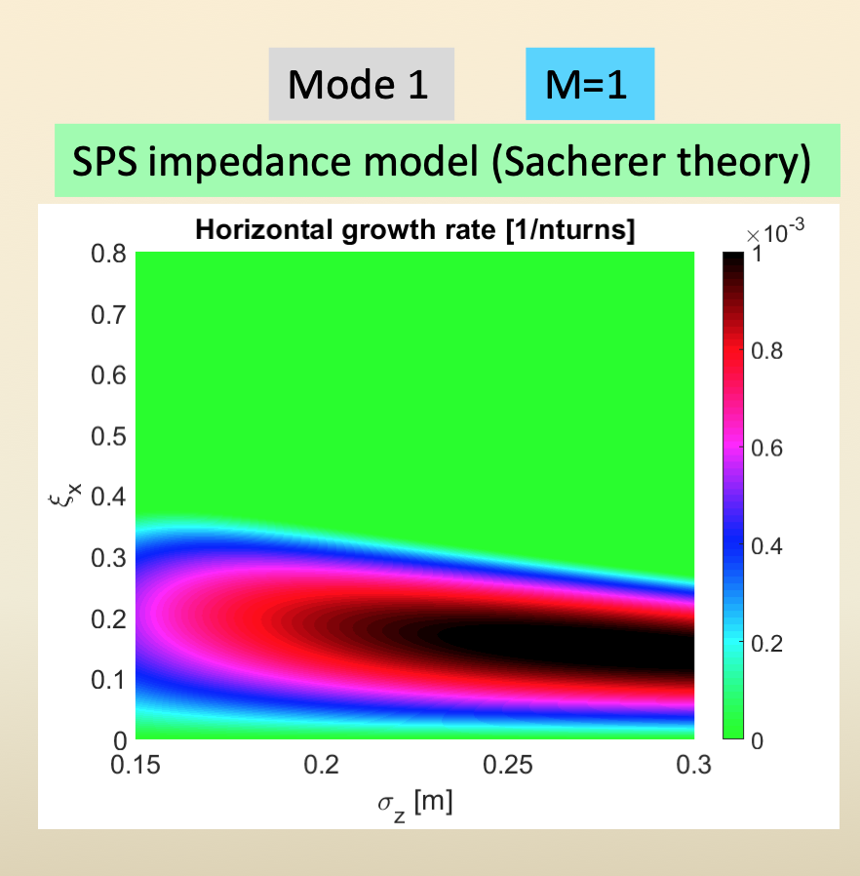
SPS growth rates with SPS impedance model from Sacherer theory

Slide 47
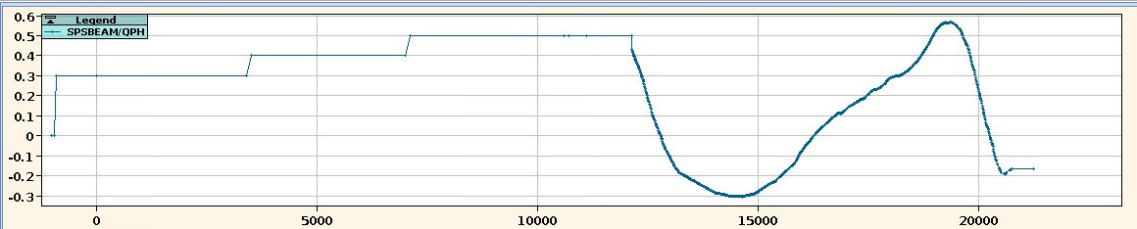
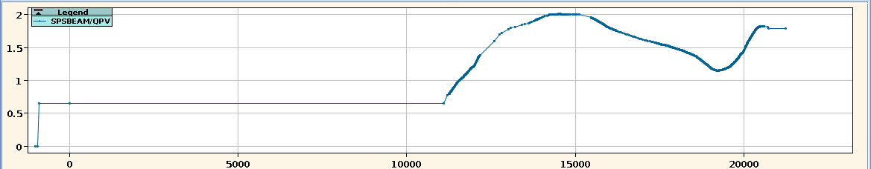
Stabilization with chromaticity the 25th October
No octupoles

Slide 48
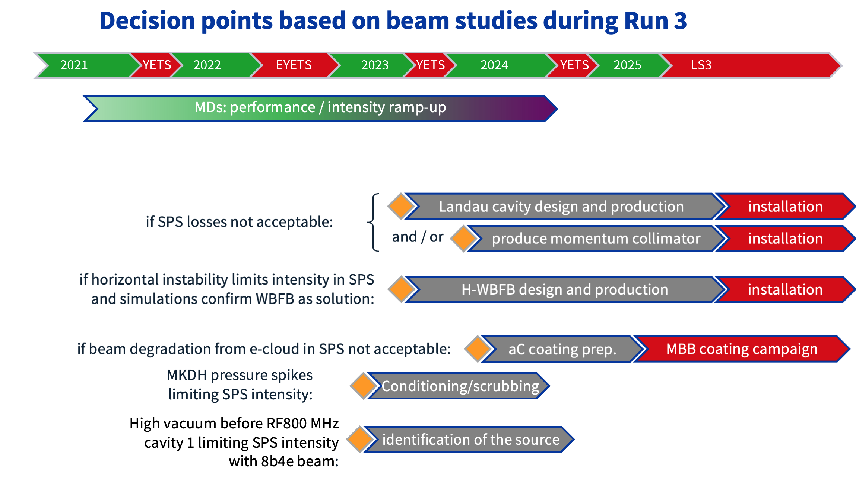
C. Zannini
JAP 2022

Slide 49
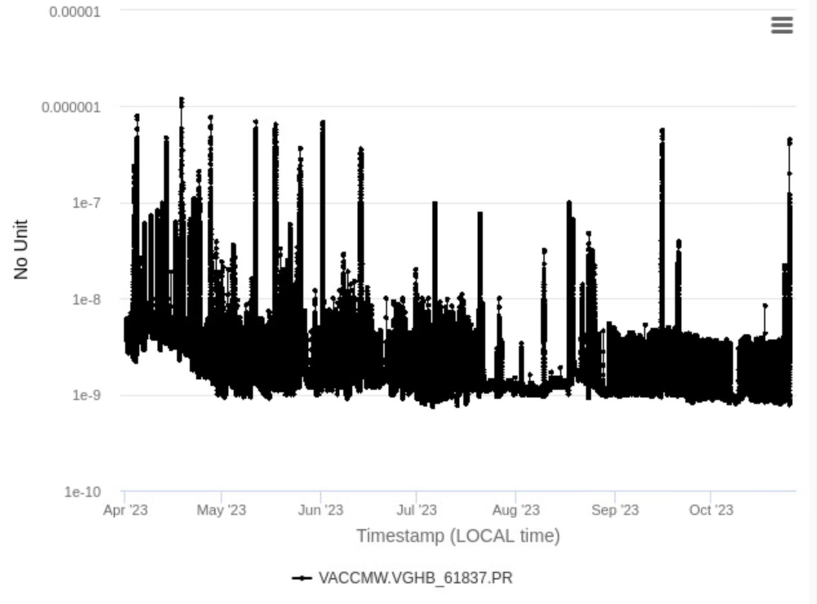
MSE pressure along the year

Slide 50
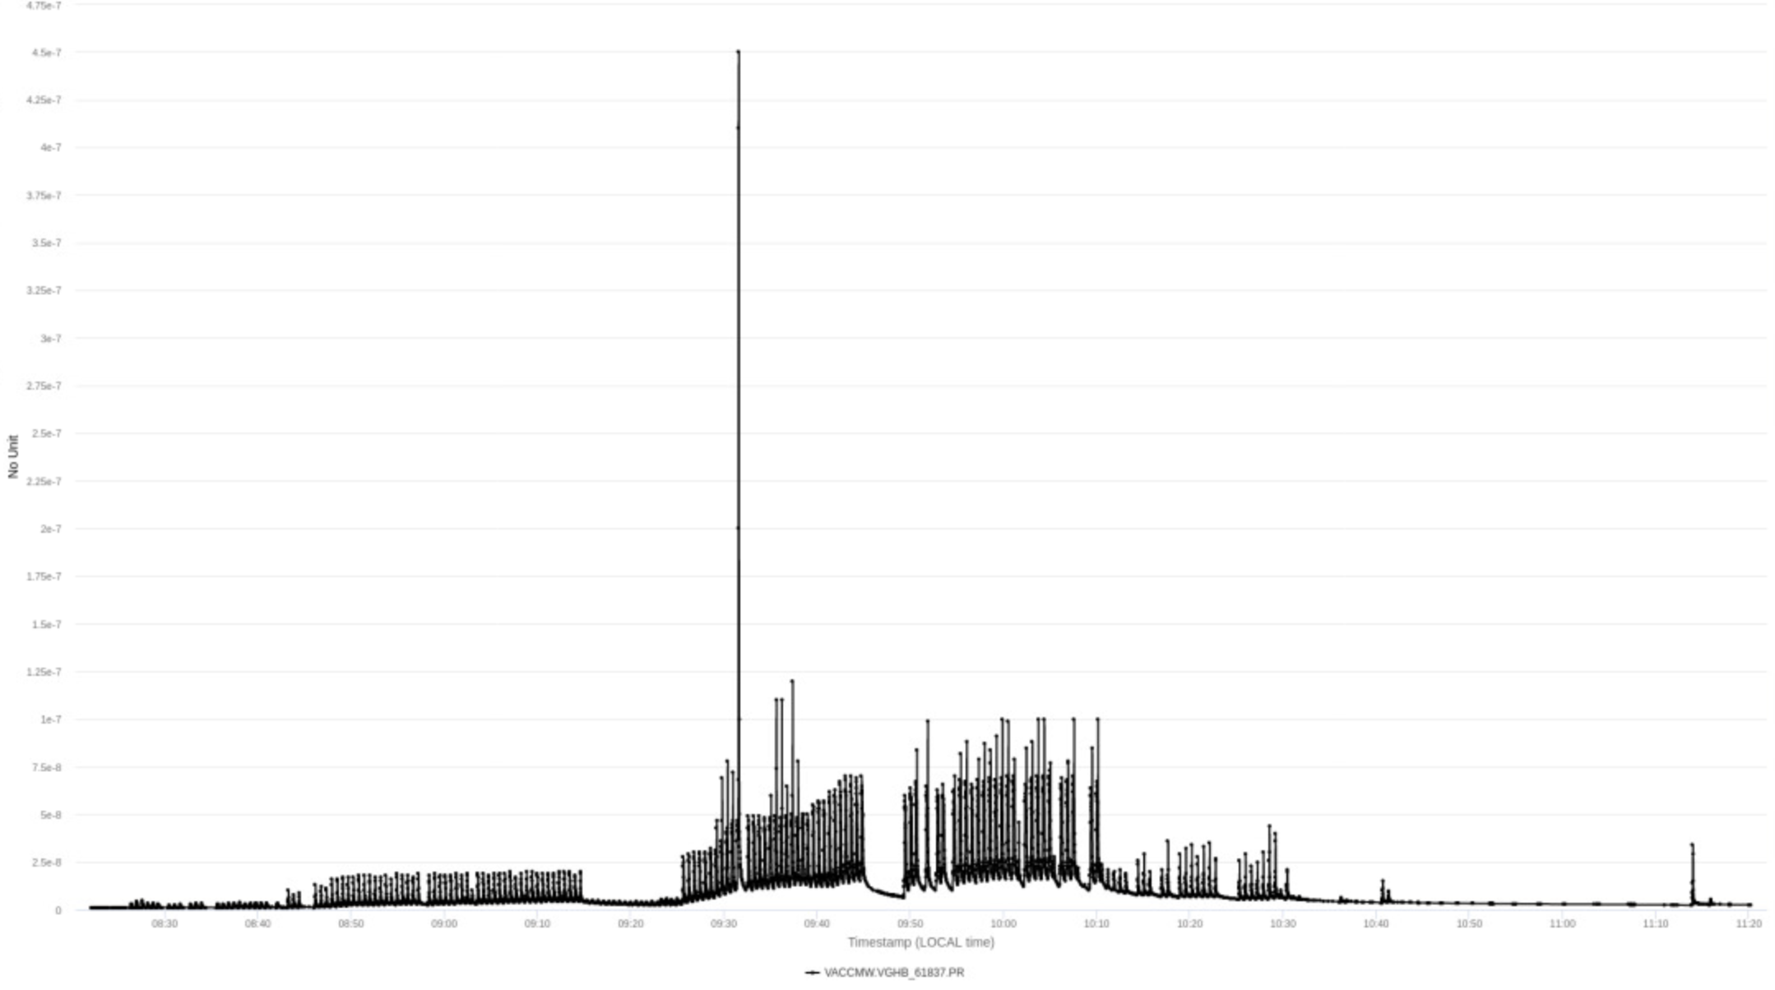
MSE pressure 25 Oct.

Slide 51
