Slide 1
Limitations from LHC RF Fingers
Presenters: Chiara Antuono and Patrick Krkotić
G. Bregliozzi, S. Calatroni, E. De La Fuente, A. Galloro, B. Salvant, L. Sito, C. Zannini
Joint Accelerator Performance Workshop, 6 December 2023

Slide 2
Contents
01
RF Finger Module Failure
Beam and X-rays revelations
02
Understanding of the Failure
Material and Production Analysis
03
Impedance Assessment
Experiments and Simulations
04
Possible Mitigation Strategies
Ongoing Impedance and Vacuum Studies

Slide 3
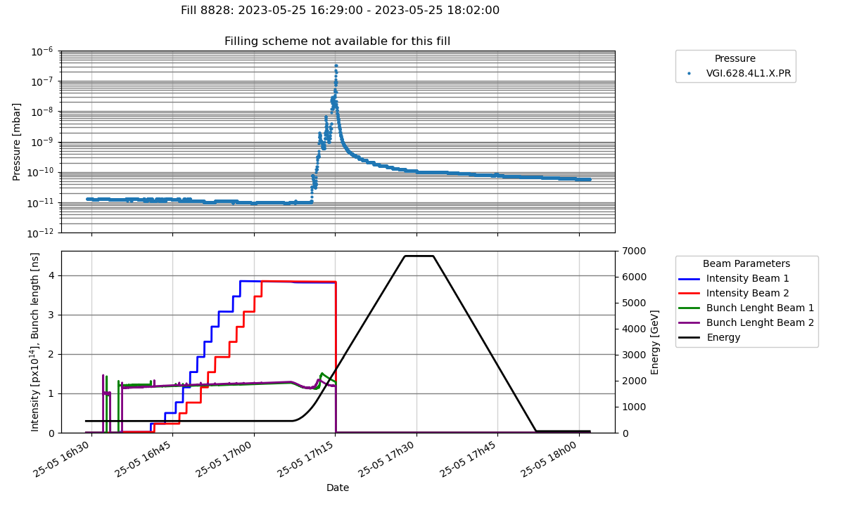
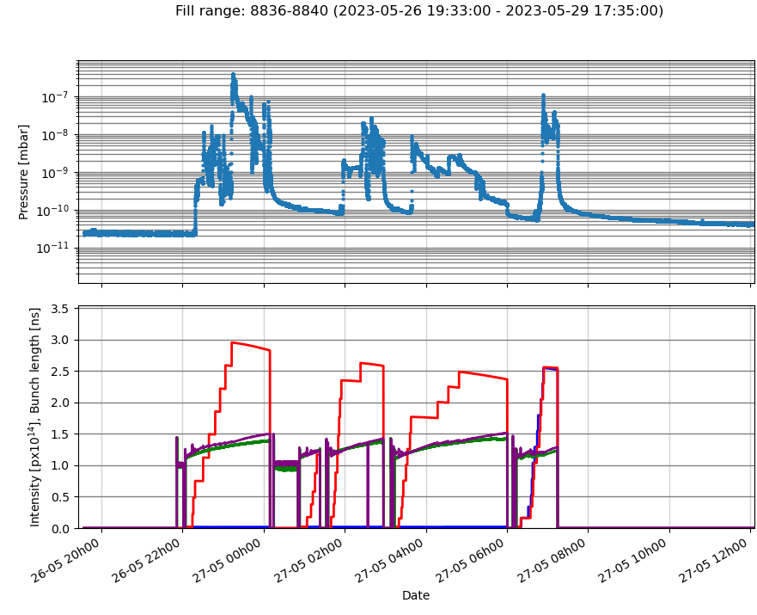
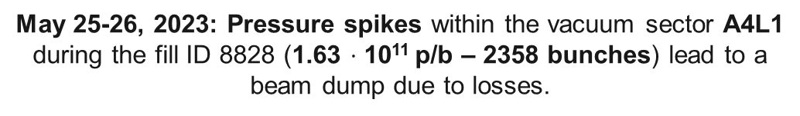
Fault recording in 2023
May 25-26, 2023: Pressure spikes within the vacuum sector A4L1 during the fill ID 8828 (1.63 $⋅$ 10¹¹ p/b – 2358 bunches) lead to a beam dump due to losses.

Slide 4
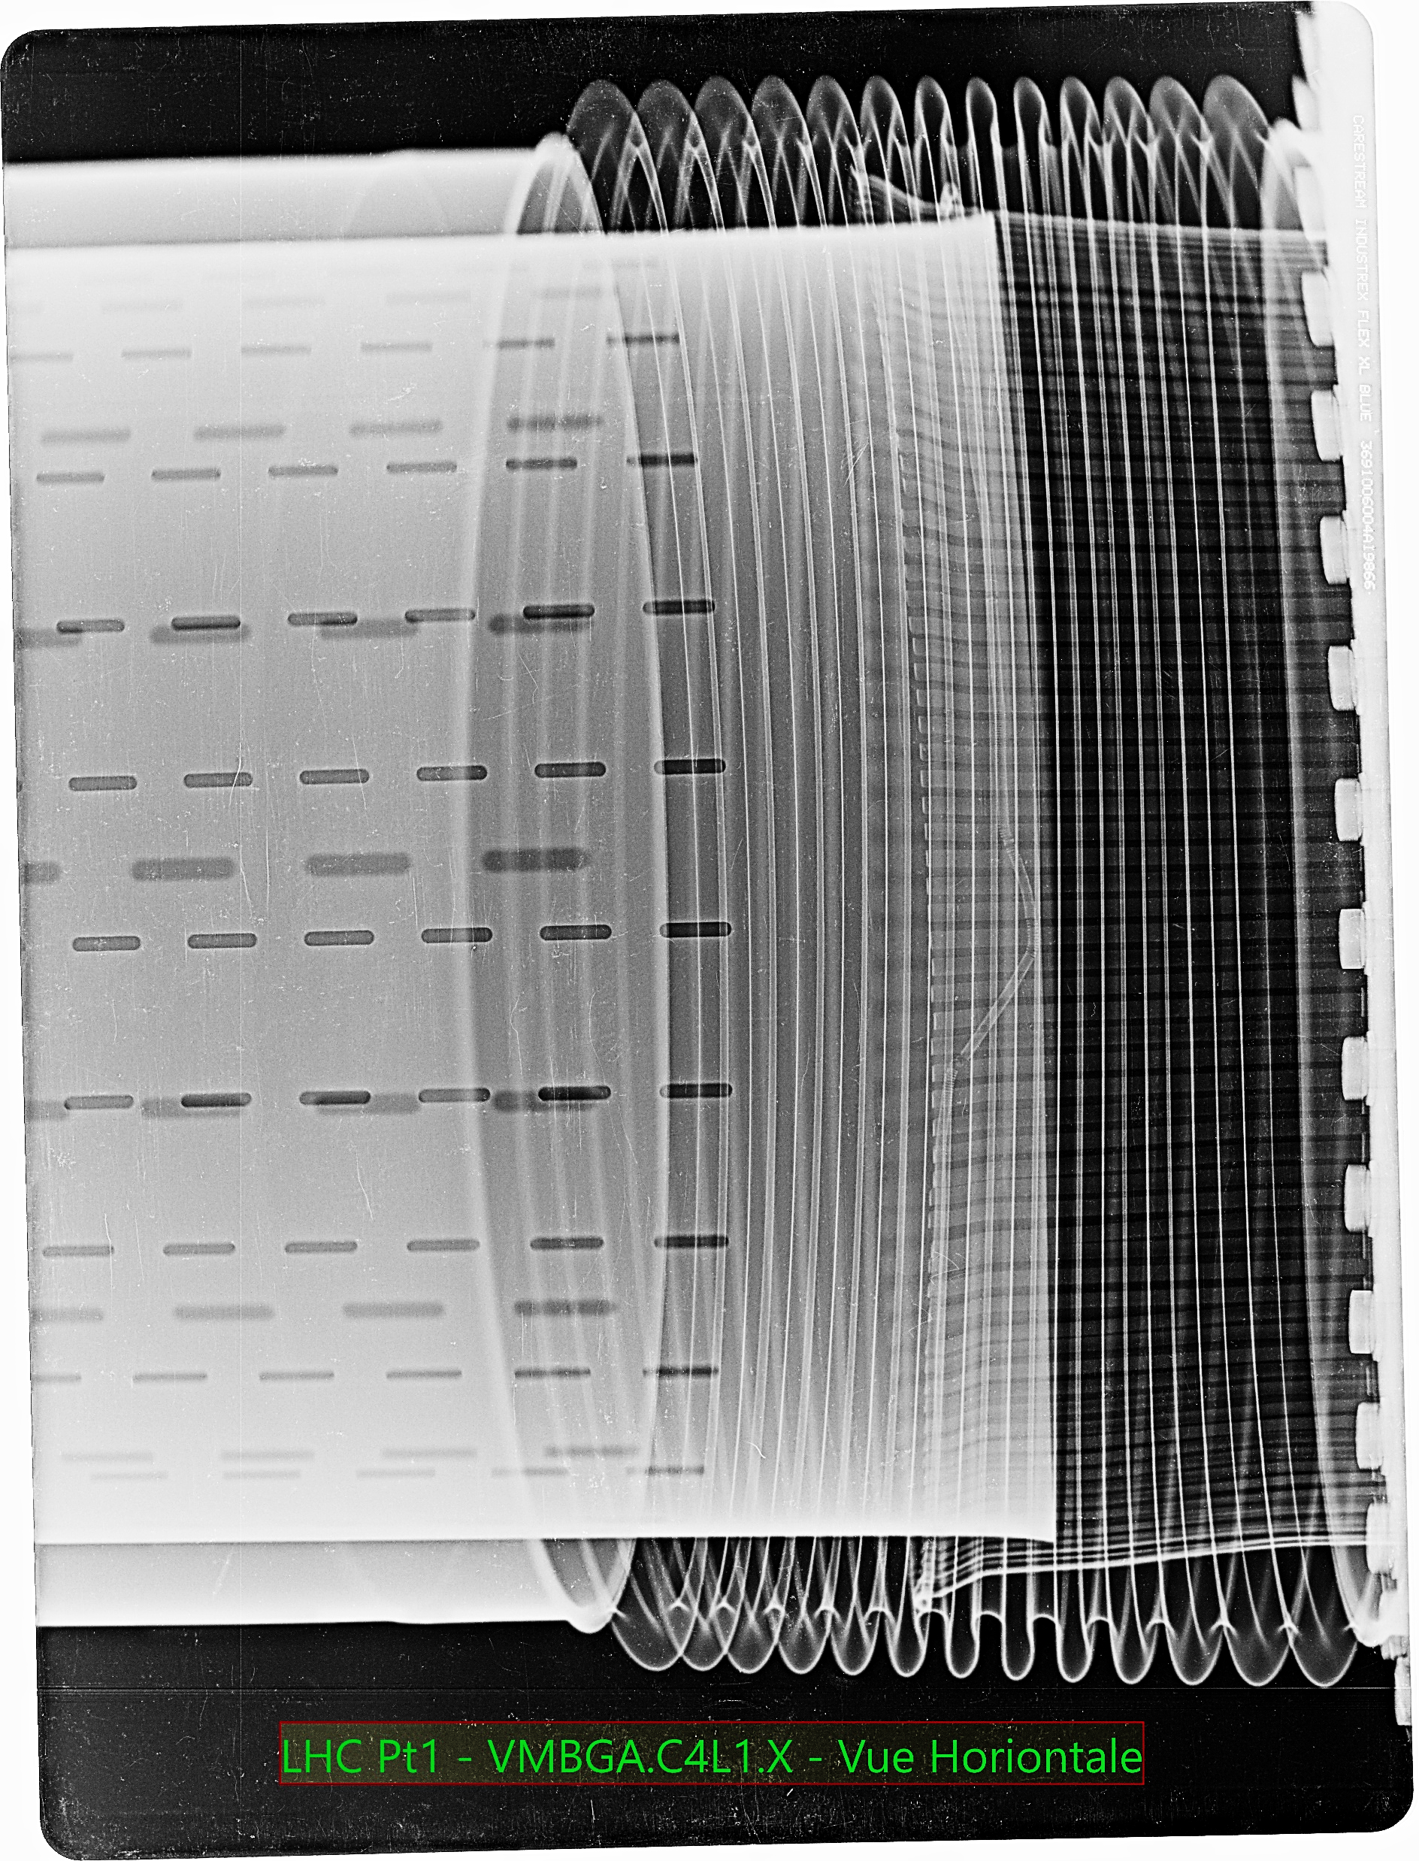
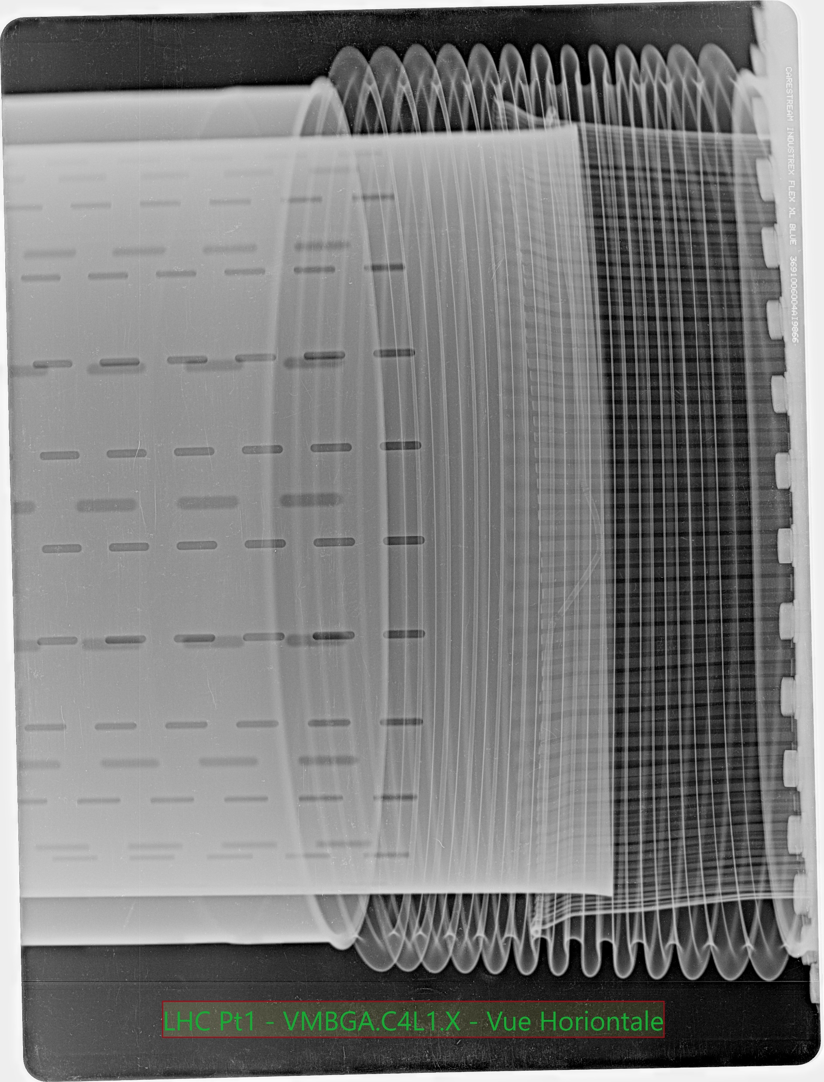
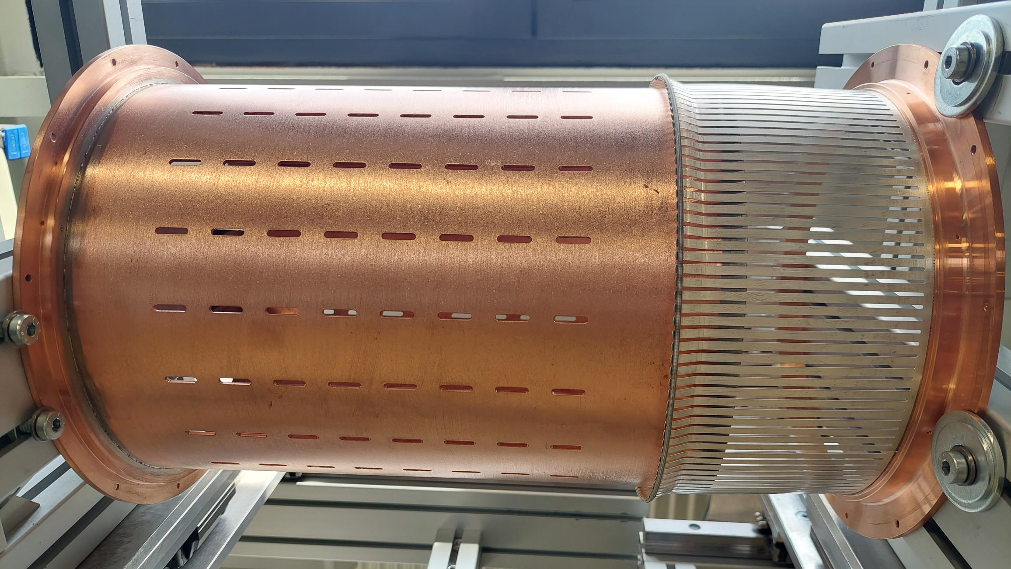
Fault recording in 2023
ID212.7 RF Finger Module
Tension spring
AISI 301
RF finger
CuBe + Ag plating
Contact point
Transition Tube
Cu OFE
Spring ensures the electrical contact between fingers/transition tube
Type of module :
Circular
Standard RF Finger
Aperture φ212.7 mm
Installation length 400 mm

Slide 5
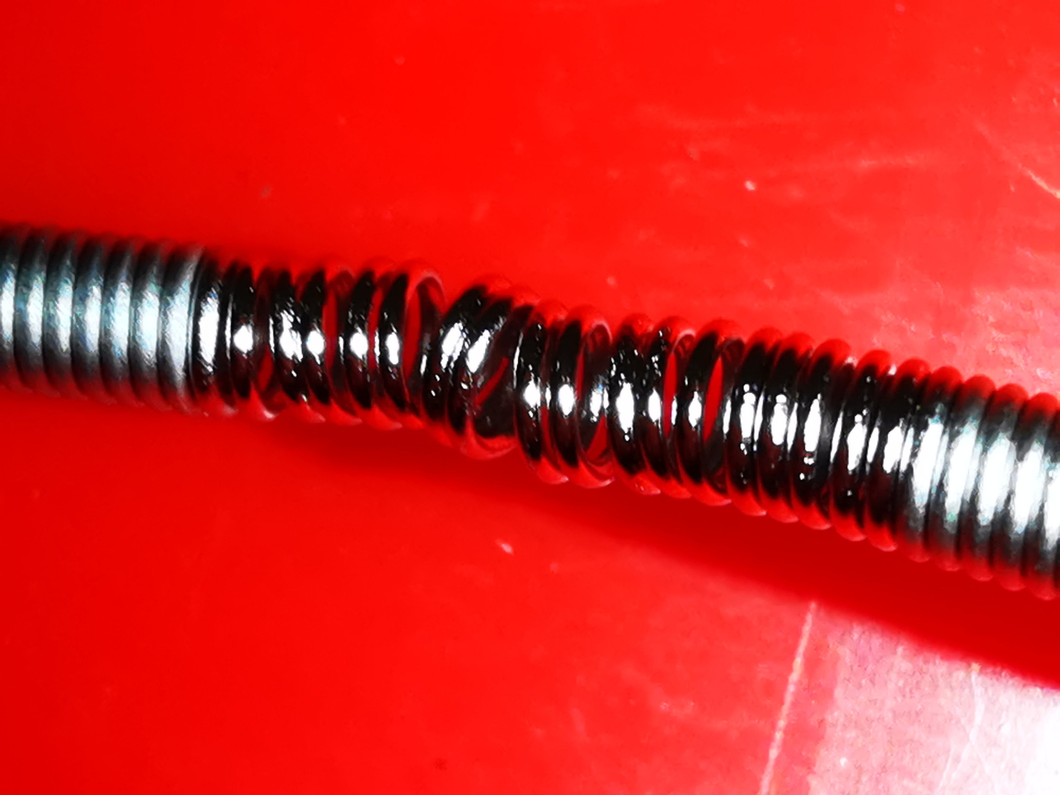
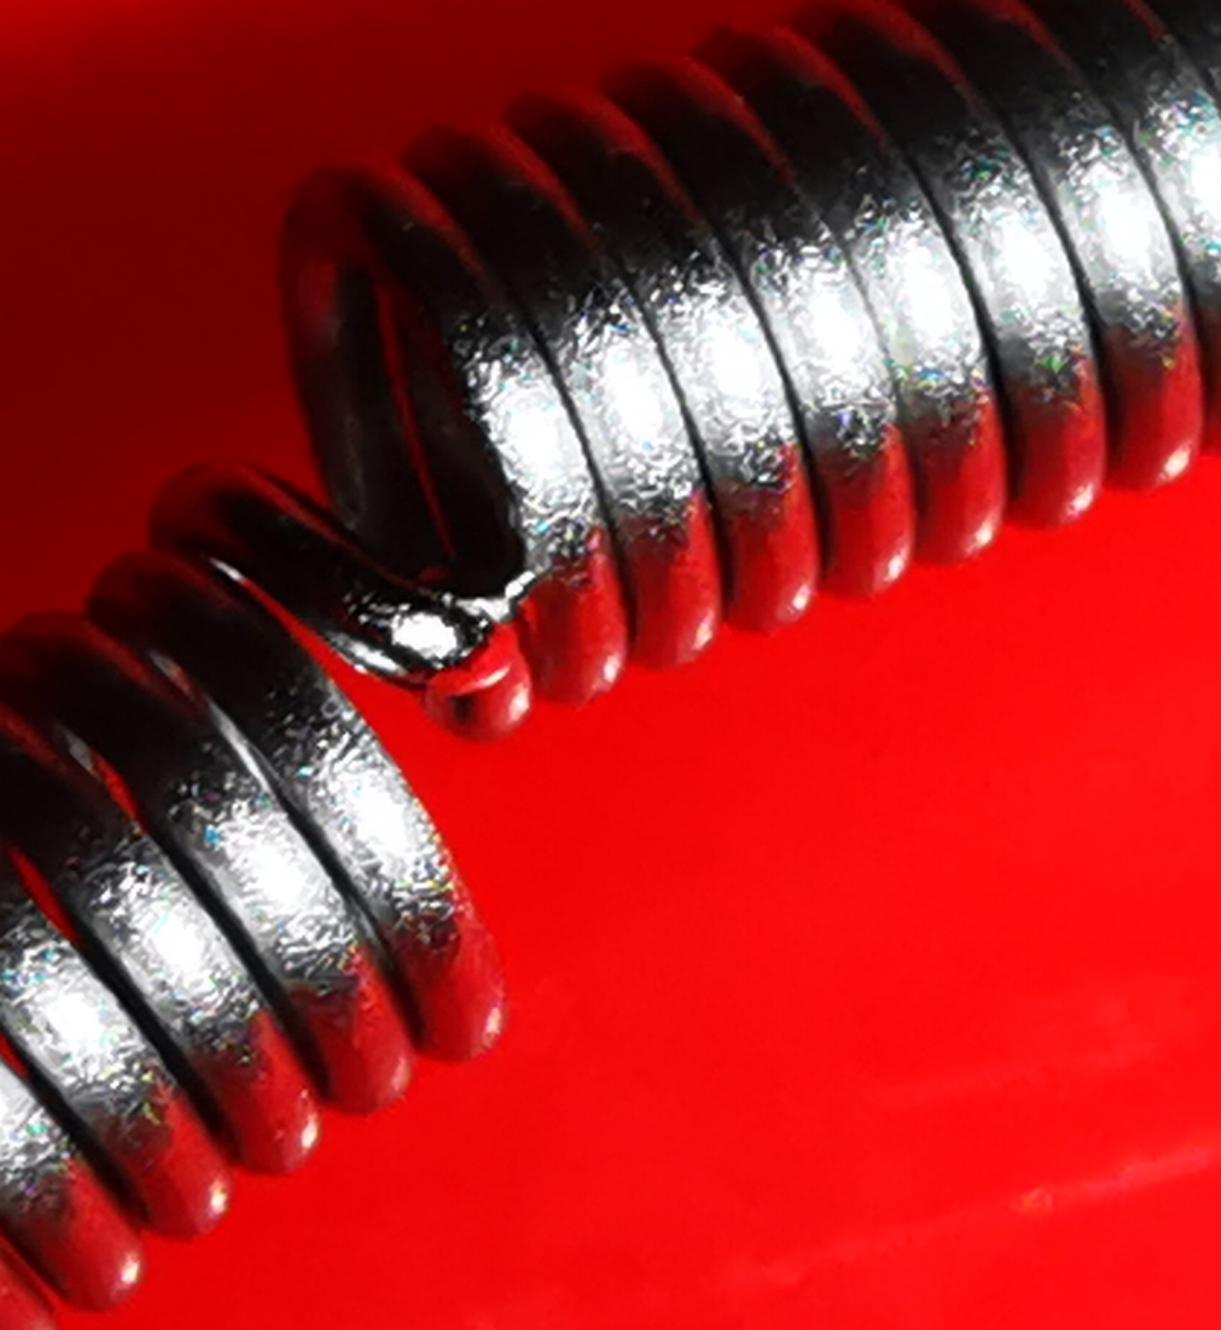
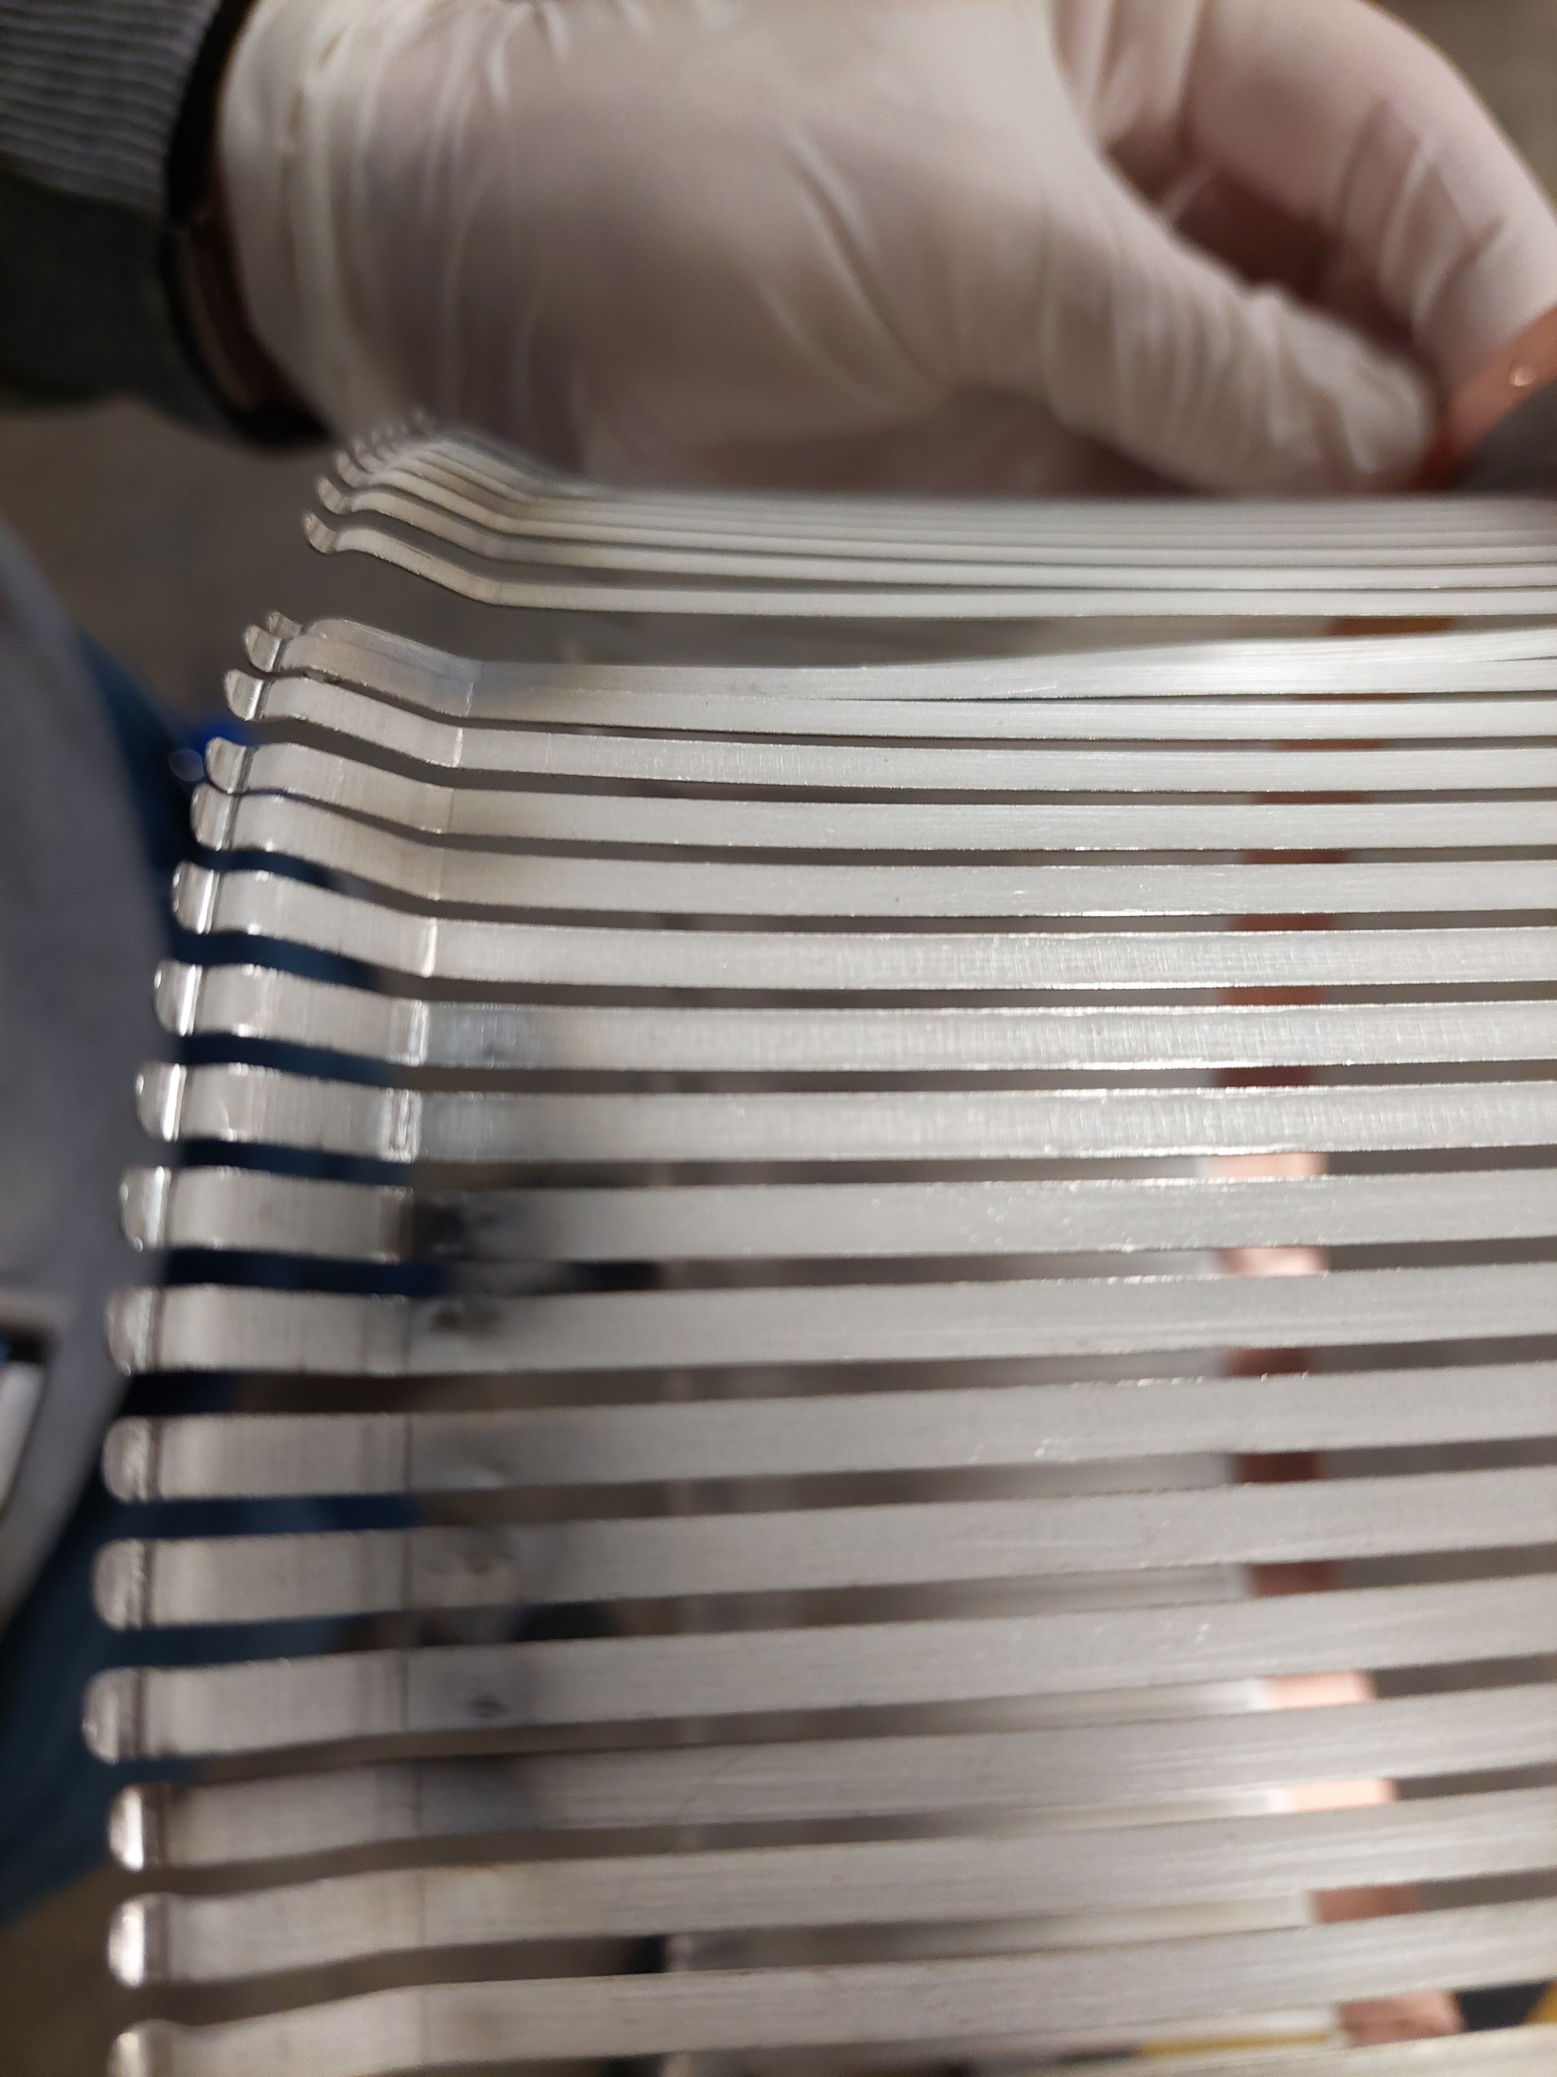
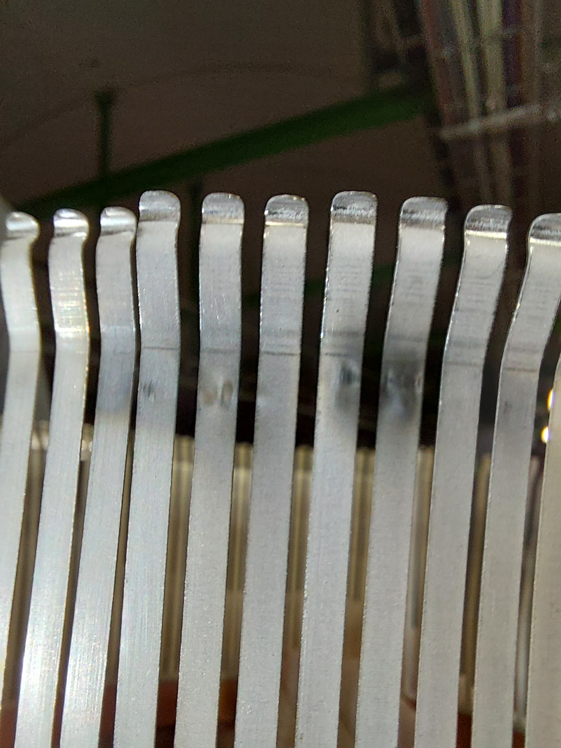
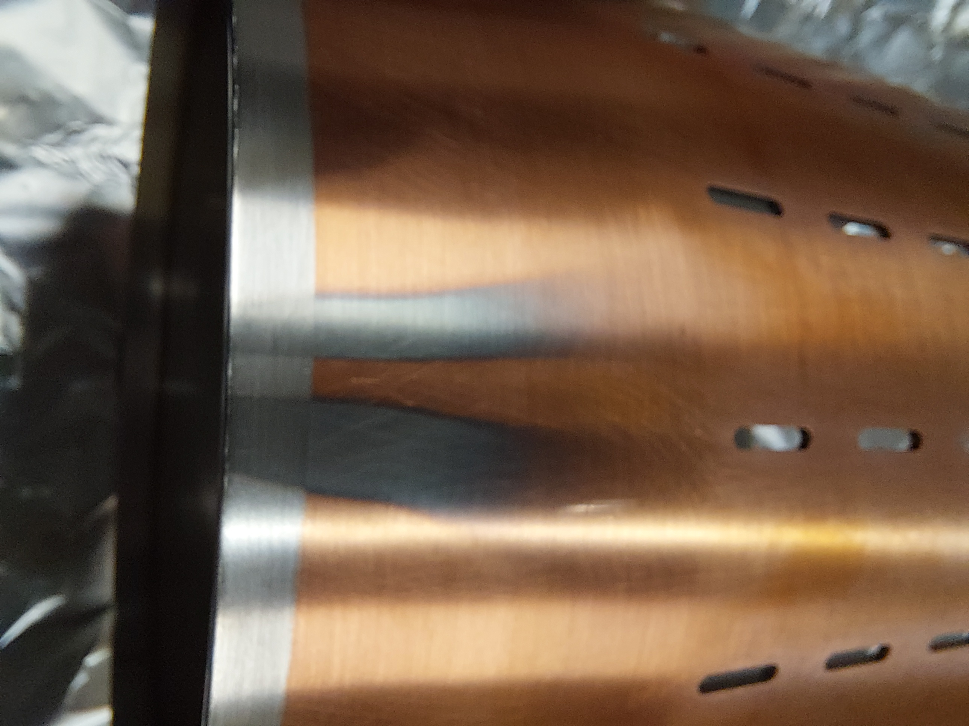
Fault recording in 2023
Visual inspection:
  annealed/plasticised spring → localized temperature increase to more than 500°C
  localised extremely high temperature producing debris, sputtering and sublimation of austenitic stainless-steel spring
  cascade of failure with consequent loss of electrical contact of RF fingers on the transition tube perimeter

Slide 6
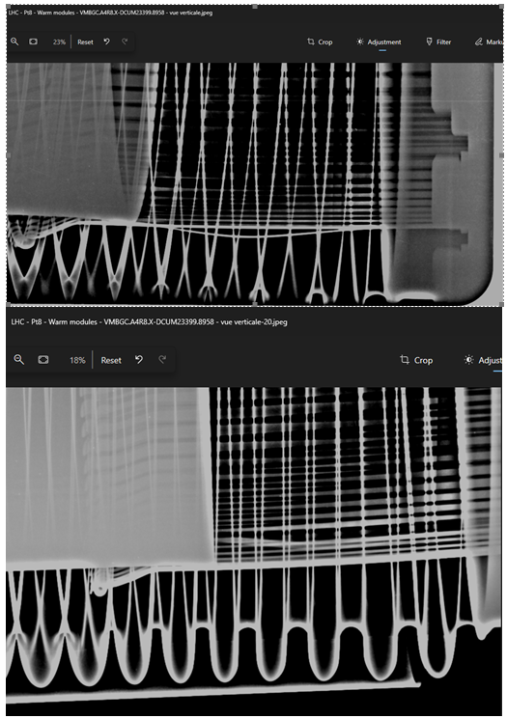
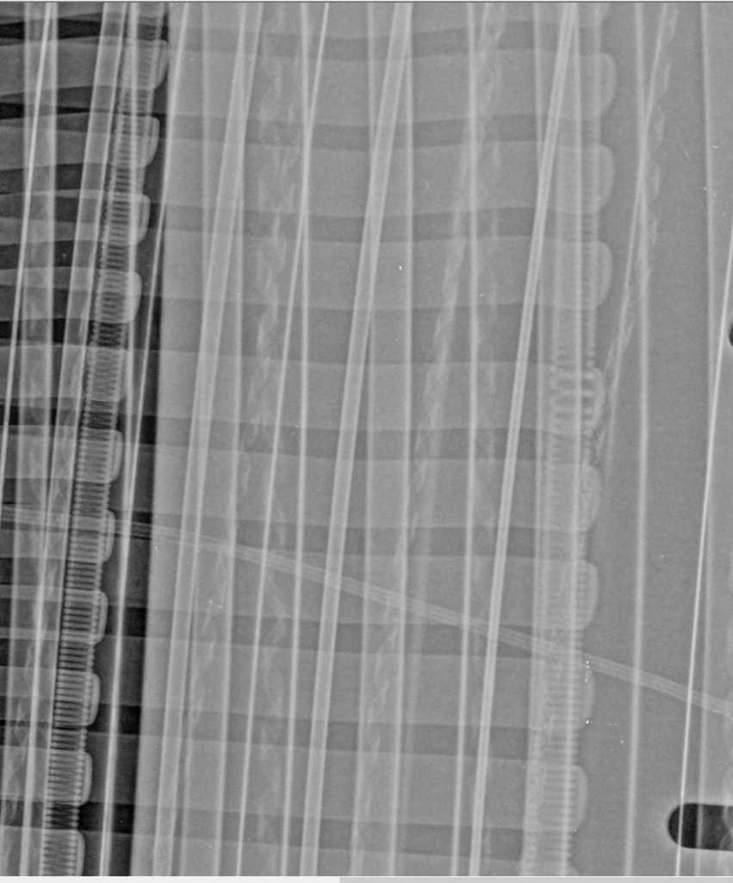
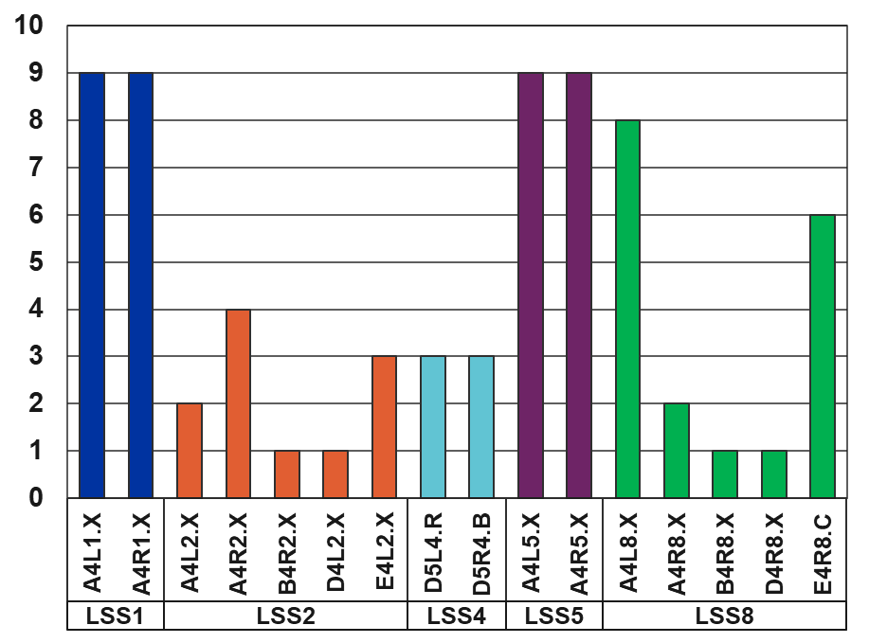
X-ray investigation
Inspection of all 71 modules present in the LHC machine
  1 failed, 8 degraded
LSS1
VMBGA.C4L1.X – A4L1.X – failed module
VMBGA.B4R1.X – A4R1.X – spring degradation
LSS5
VMBGA.C4R5.X – A4R5.X – spring degradation
VMBGA.B4R5.X – A4R5.X – spring degradation
LSS8
VMBGG.A4L8.X – A4L8.X – spring degradation
VMBGC.A4R8.X – A4R8.X – spring & finger degradation
VMBGD.A4R8.X – D4R8.X – finger degradation
LSS4
VMBGA.A5R4.B – D5R4.B – finger & spring degradation
Higher opening (≈2-3 mm) between consecutive RF fingers
2 Beams
Horizontal beam offset
1 Beam
Nominal gap 1.5 mm

Slide 7
02
Understanding of the Failure
Material and Production Analysis

Slide 8
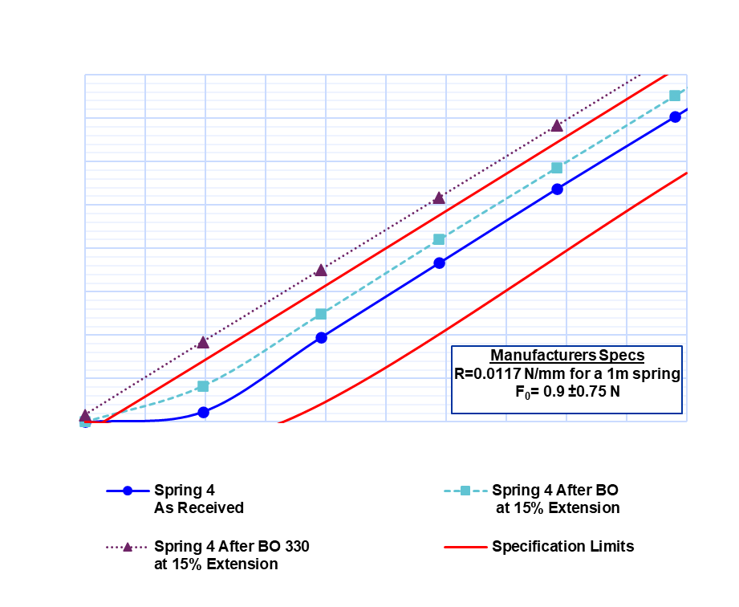
Tension spring properties
Stainless Steel 1.4310
AISI 301 (X10CrNi18-8)
Good mechanical properties and corrosion resistance
  The material can theoretically be used up to +250°C
Effects of the bake-out cycle: elasticity of the spring versus different elongations (EDMS)
  As received: compatible with specifications
  8 days 250°C bake out: no degradation
  8 days 330°C bake out: removal of pre-load and length increase

Slide 9
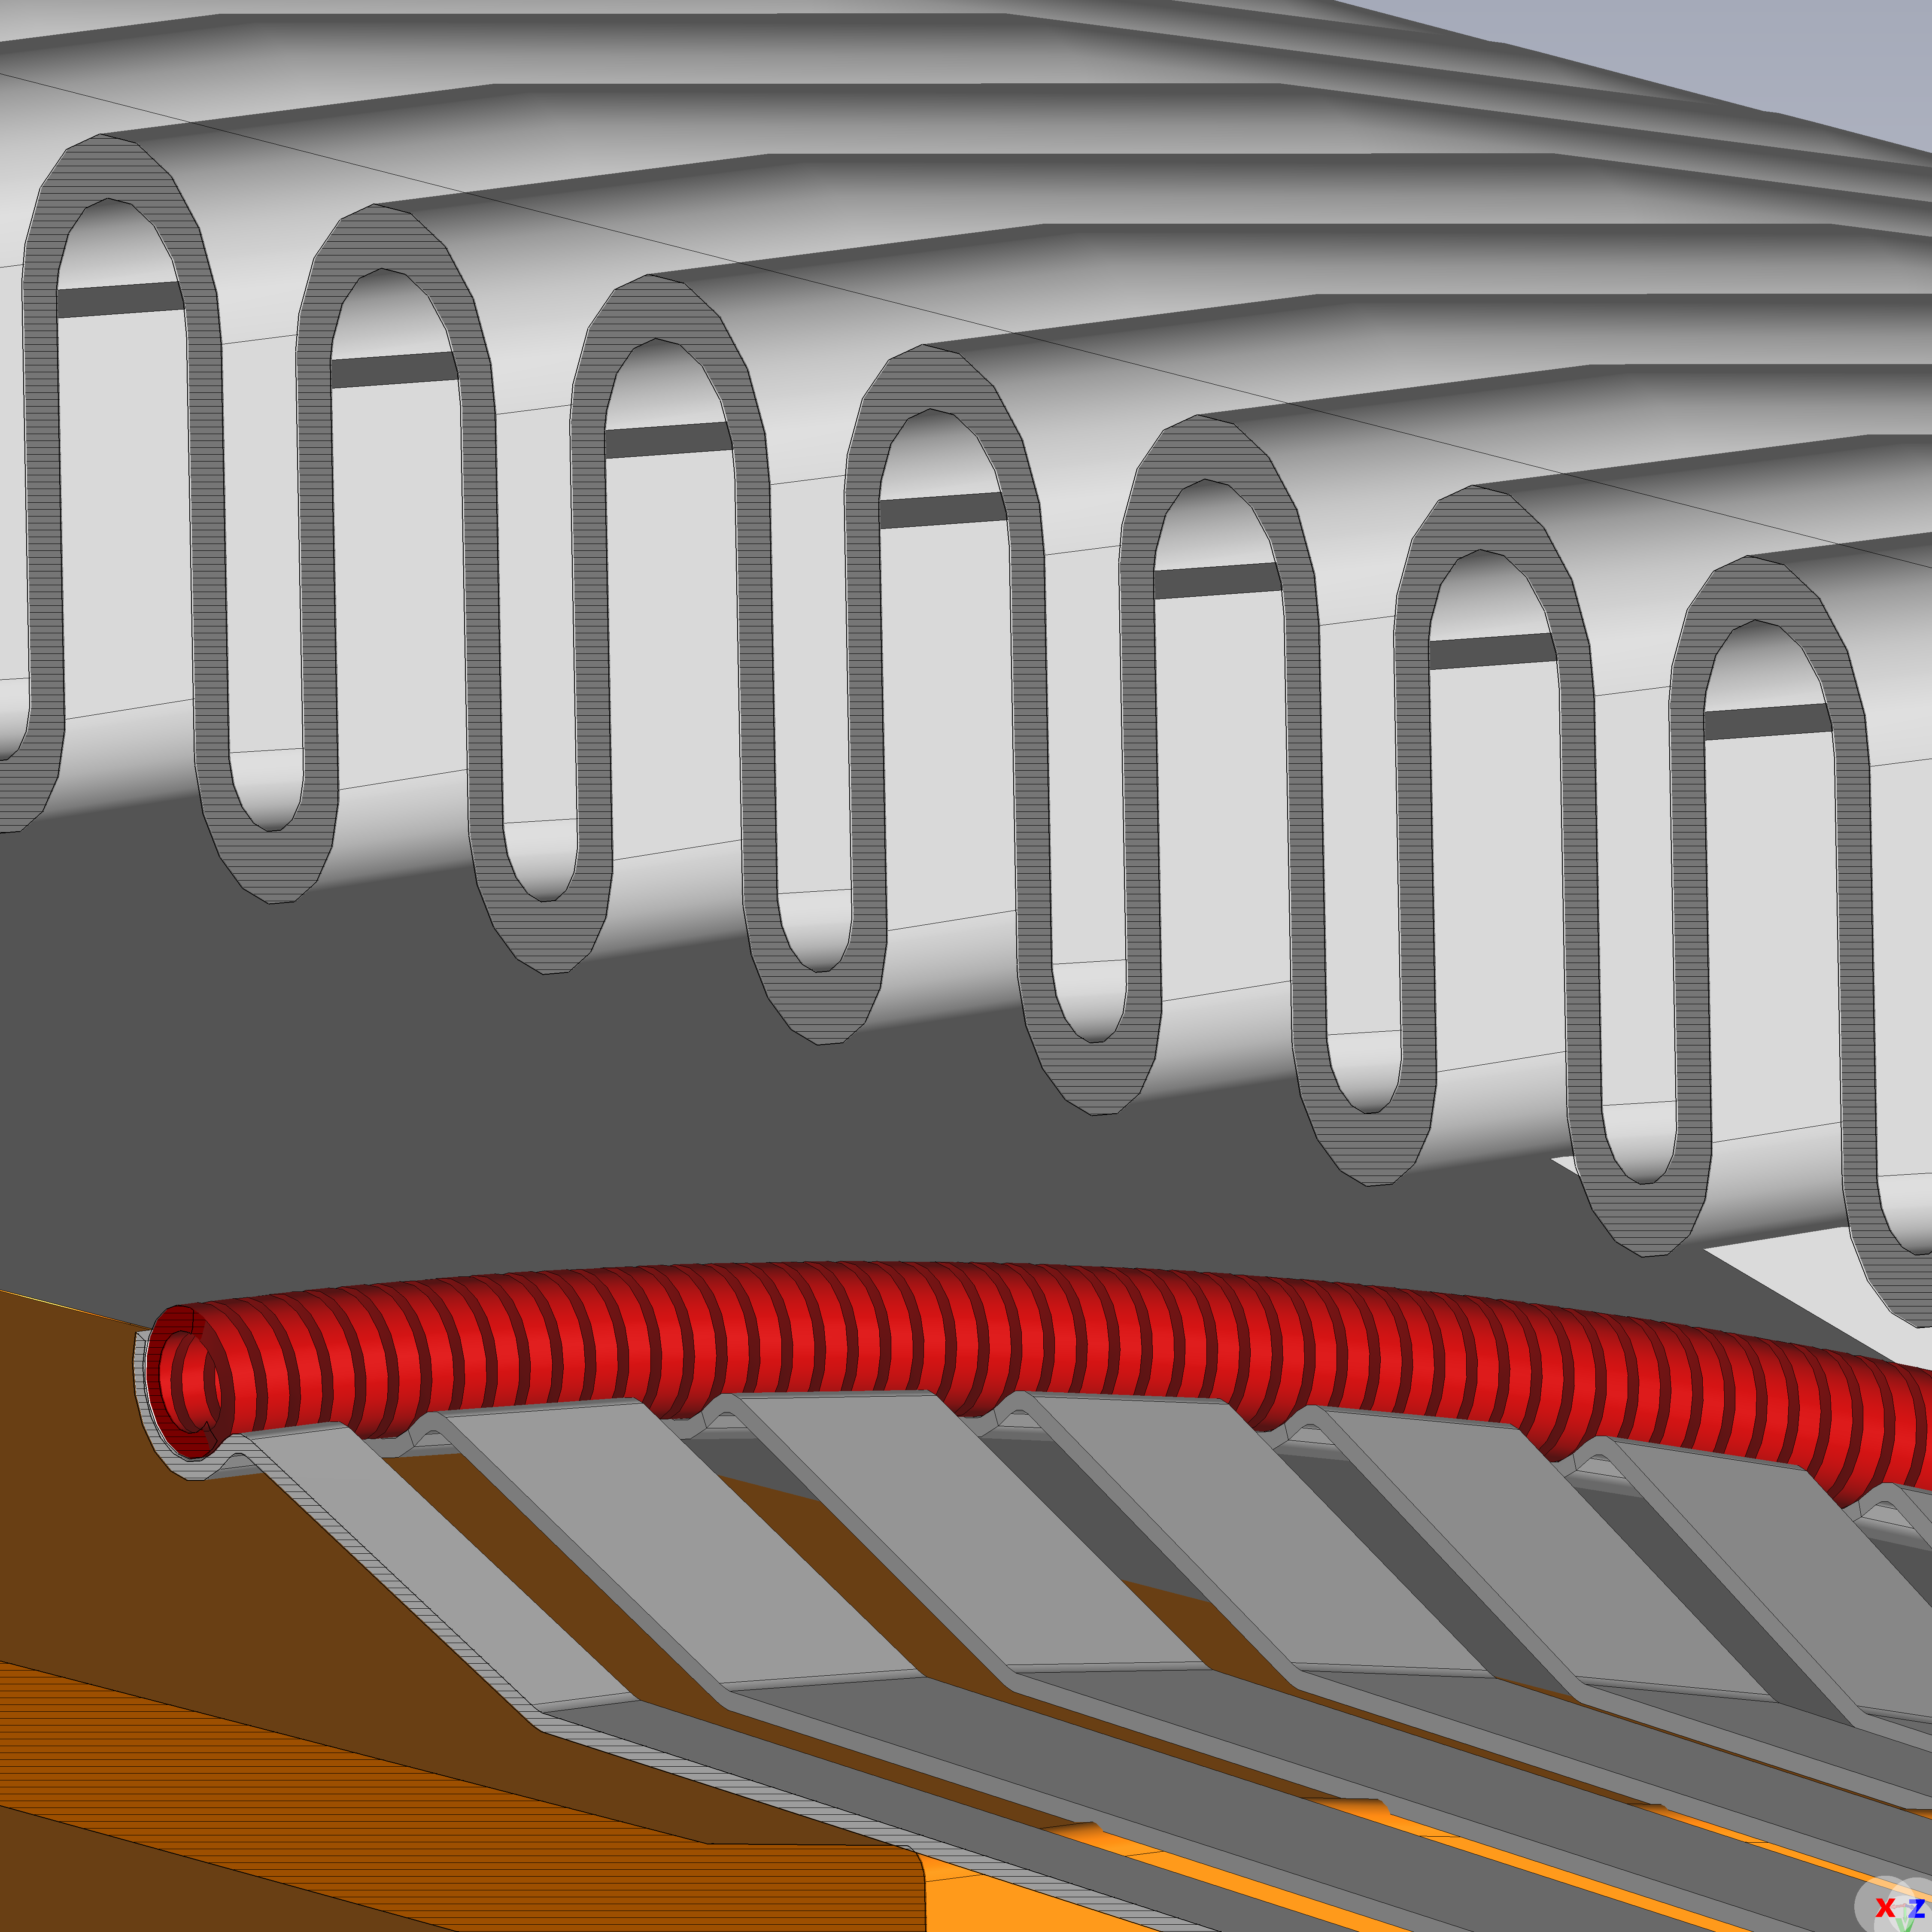
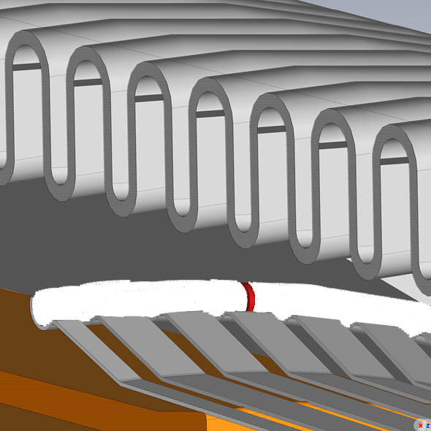
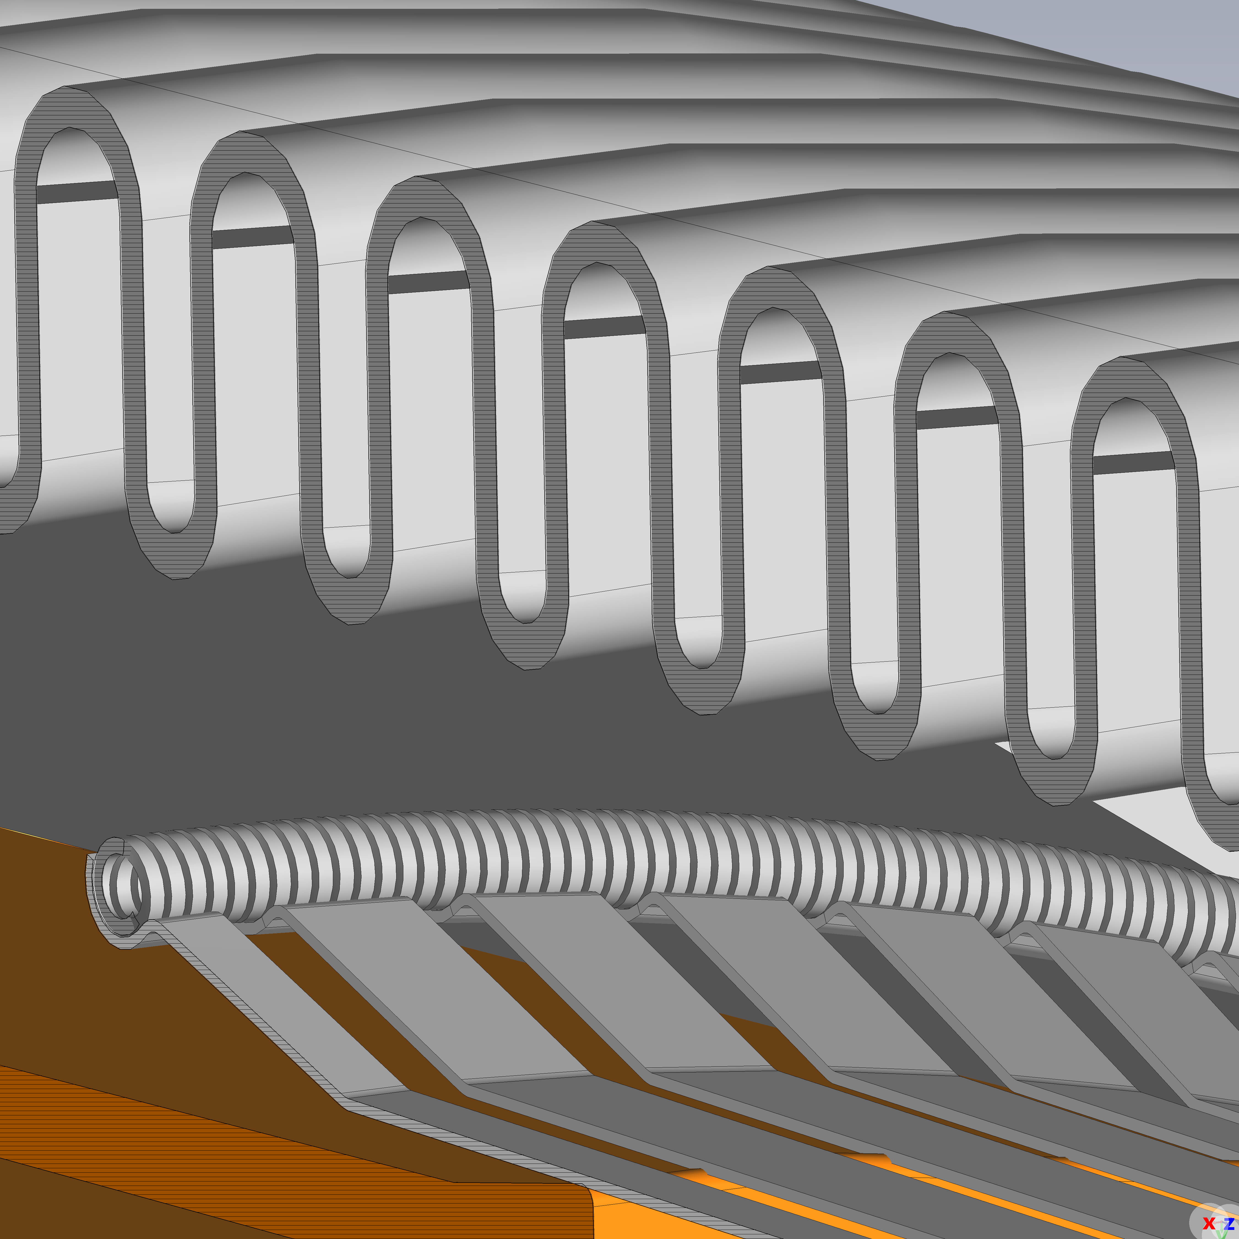
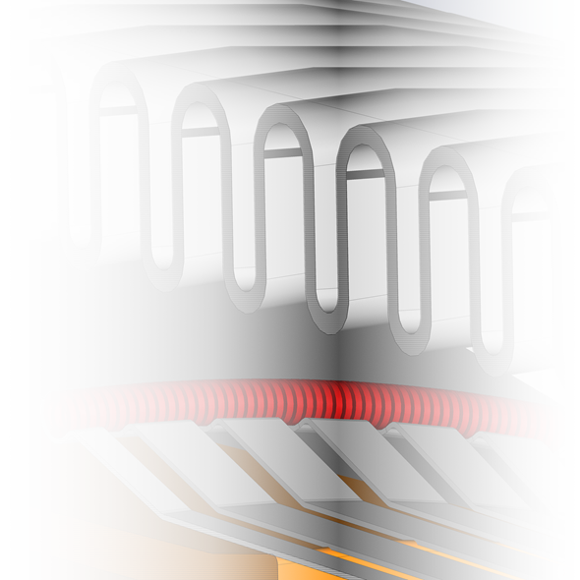
Thermal simulations
Visual inspection and radiography indicate that heating of the spring is the triggering mechanism of the first module failure
Finite Element Method simulations via COMSOL were conducted to determine the power deposition necessary to heat the spring in a steady state (EDMS)
uniform power distribution
localised power

Slide 10
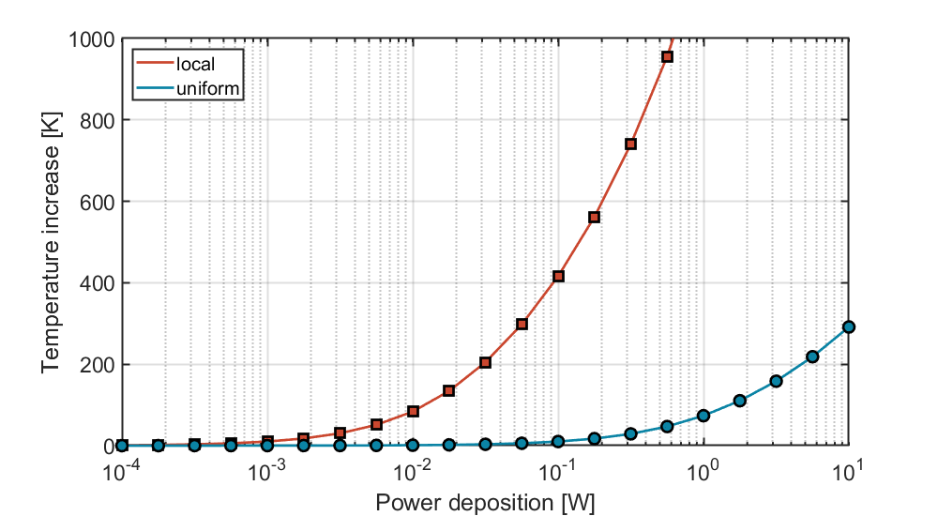
Thermal simulations
Visual inspection and radiography indicate that heating of the spring is the triggering mechanism of the first module failure
Finite Element Method simulations via COMSOL were conducted to determine the power deposition necessary to heat the spring in a steady state (EDMS)
Annealing condition of the spring: annealing/plasticisation of the spring at a temperature of 500°C
uniform power distribution
500 °C
130 mW
~ 27 W
localised power

Slide 11

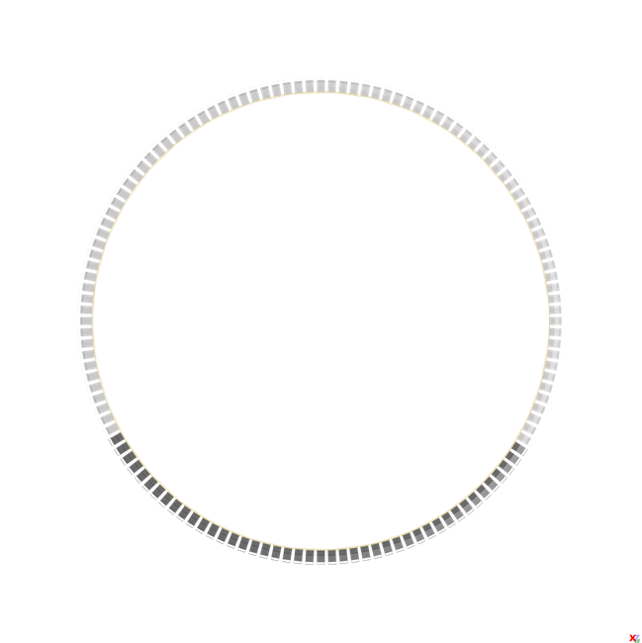
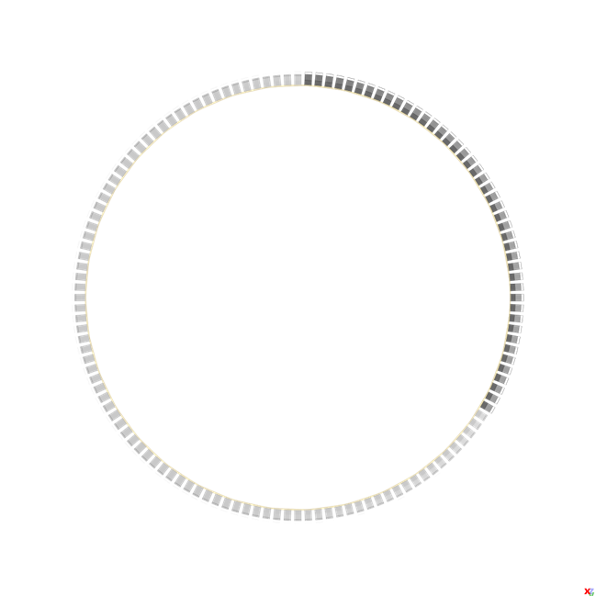
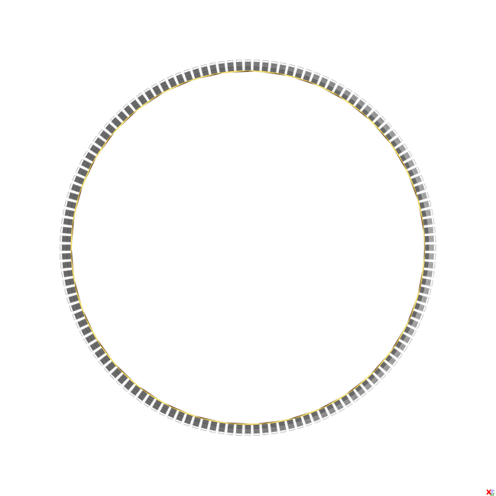
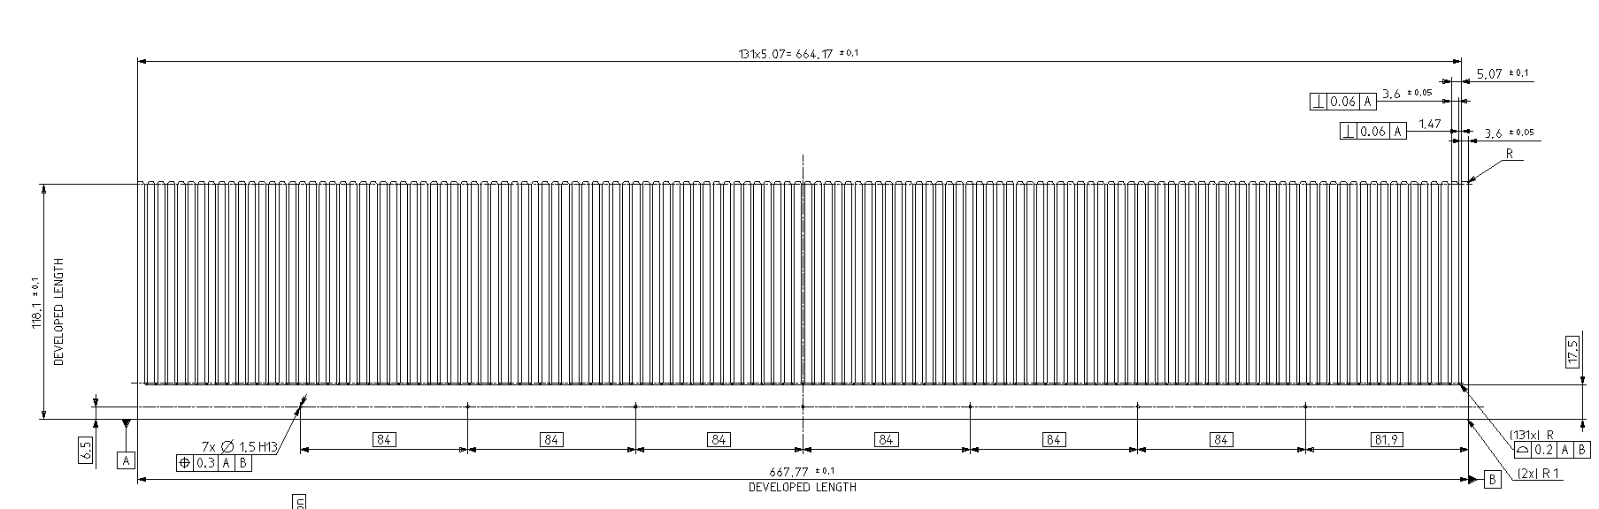
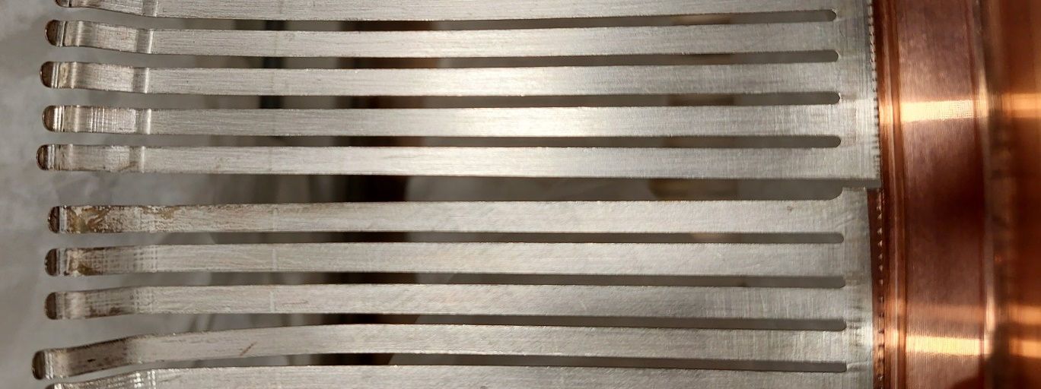
RF finger production
In 2004, BINP initiated the production using a single sheet of CuBe
  RF Finger width 3.6 mm
  Distance between fingers 1.47 mm
The RF finger was cut into 3 identically segments
  44 fingers each
  Welded individually on the bottom flange of the RF insert
smaller spacing

Slide 12
03
Impedance Assessment
Experiments and Simulations

Slide 13
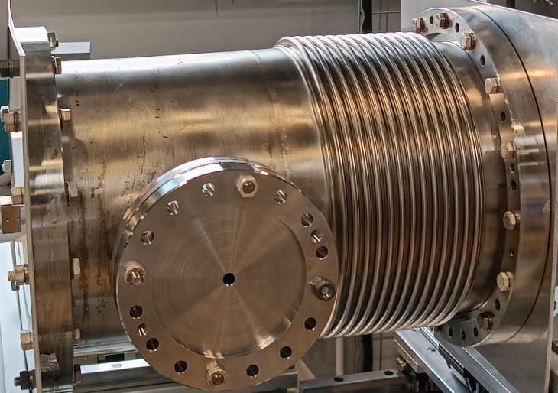
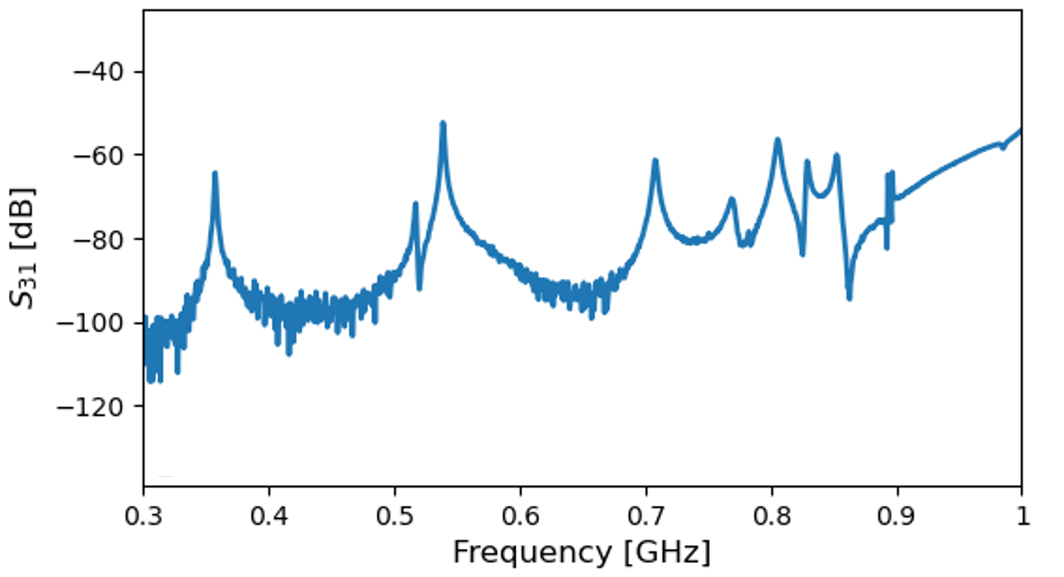
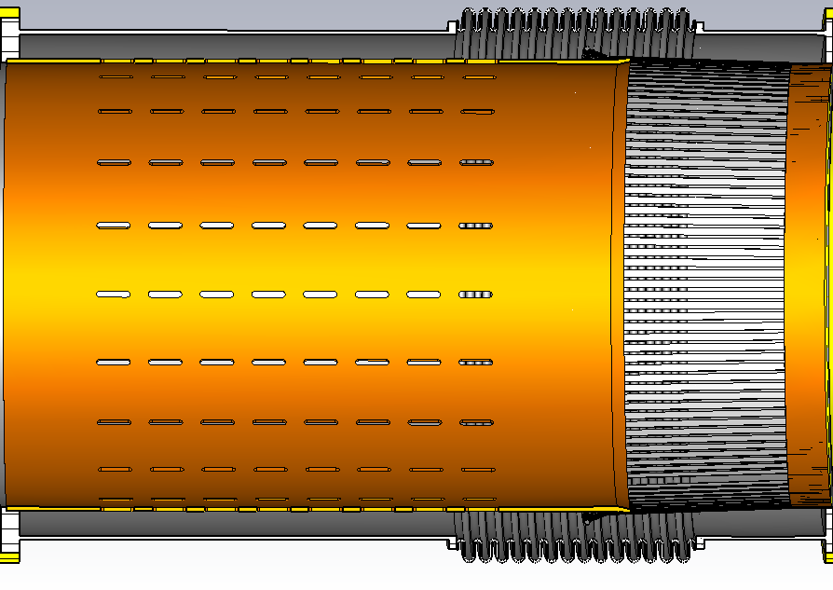
Impedance measurements - field leakage
Transmission between Port 1 and Port 3
Port 1
Port 2
Beam-like excitation on axis
Port 3
leakage
spring
Low frequency resonances (below vacuum pipe cut-off frequency)
  Field leakage through RF fingers / transition tube
It is the mechanism that allows some of the beam induced power to be dissipated on the spring
leakage
spring

Slide 14
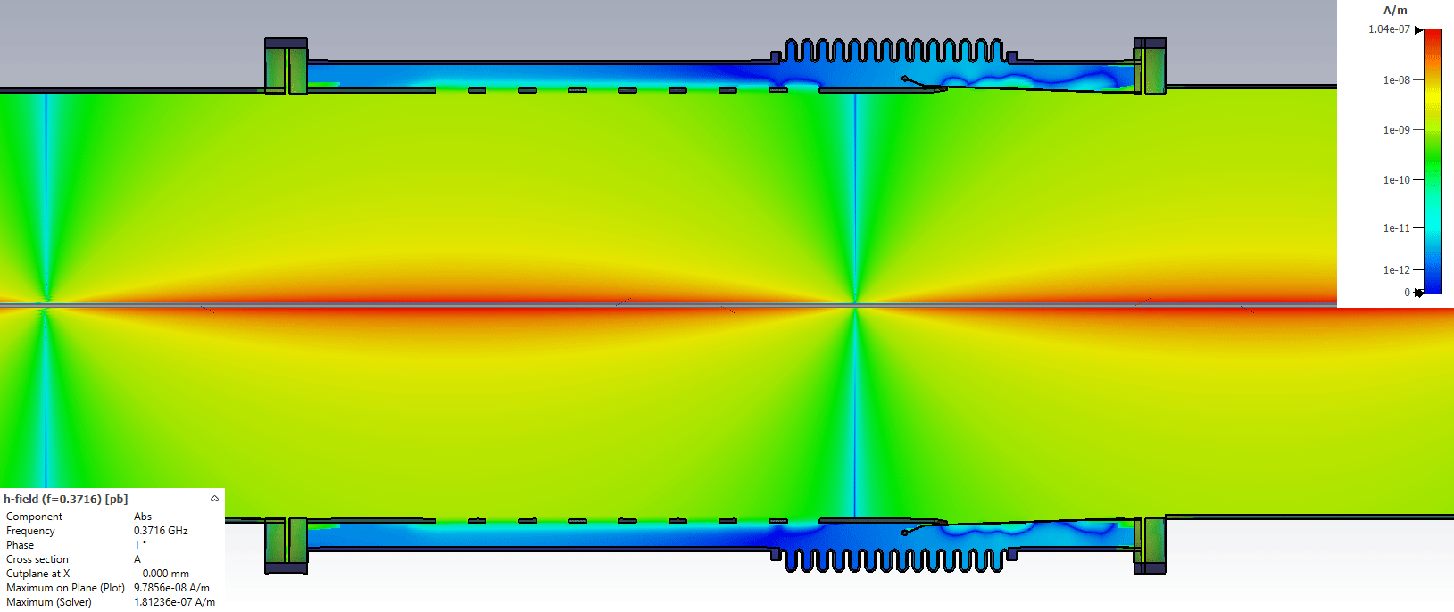
Electromagnetic simulation - field leakage
The simulations confirmed the presence of field leakage from the fingers and the transition tube
EM fields leak through the pipe slots
Even higher field leakage due to RF finger spacing

Slide 15
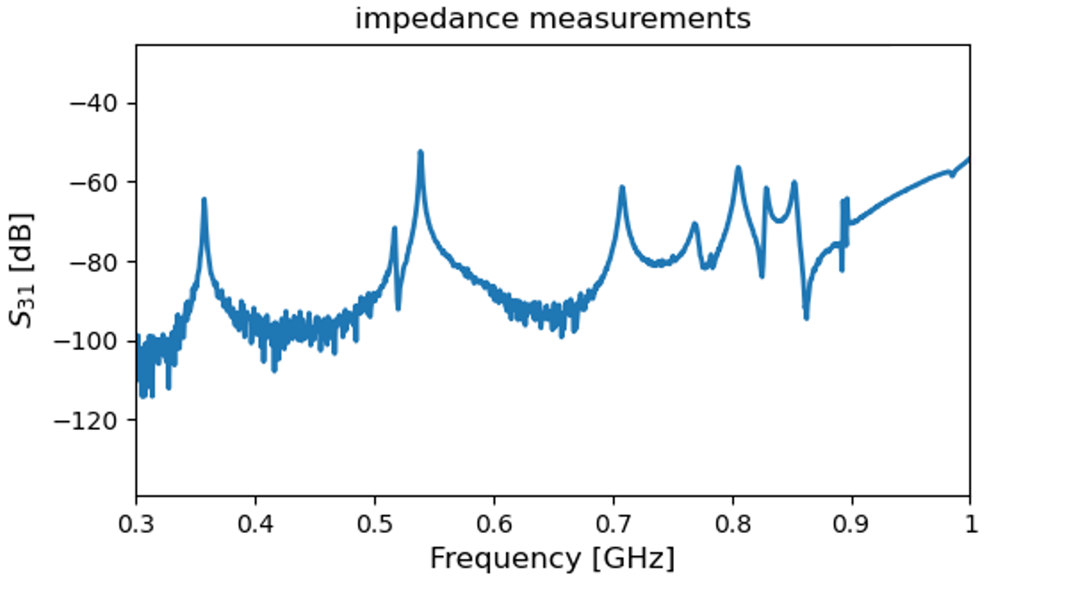
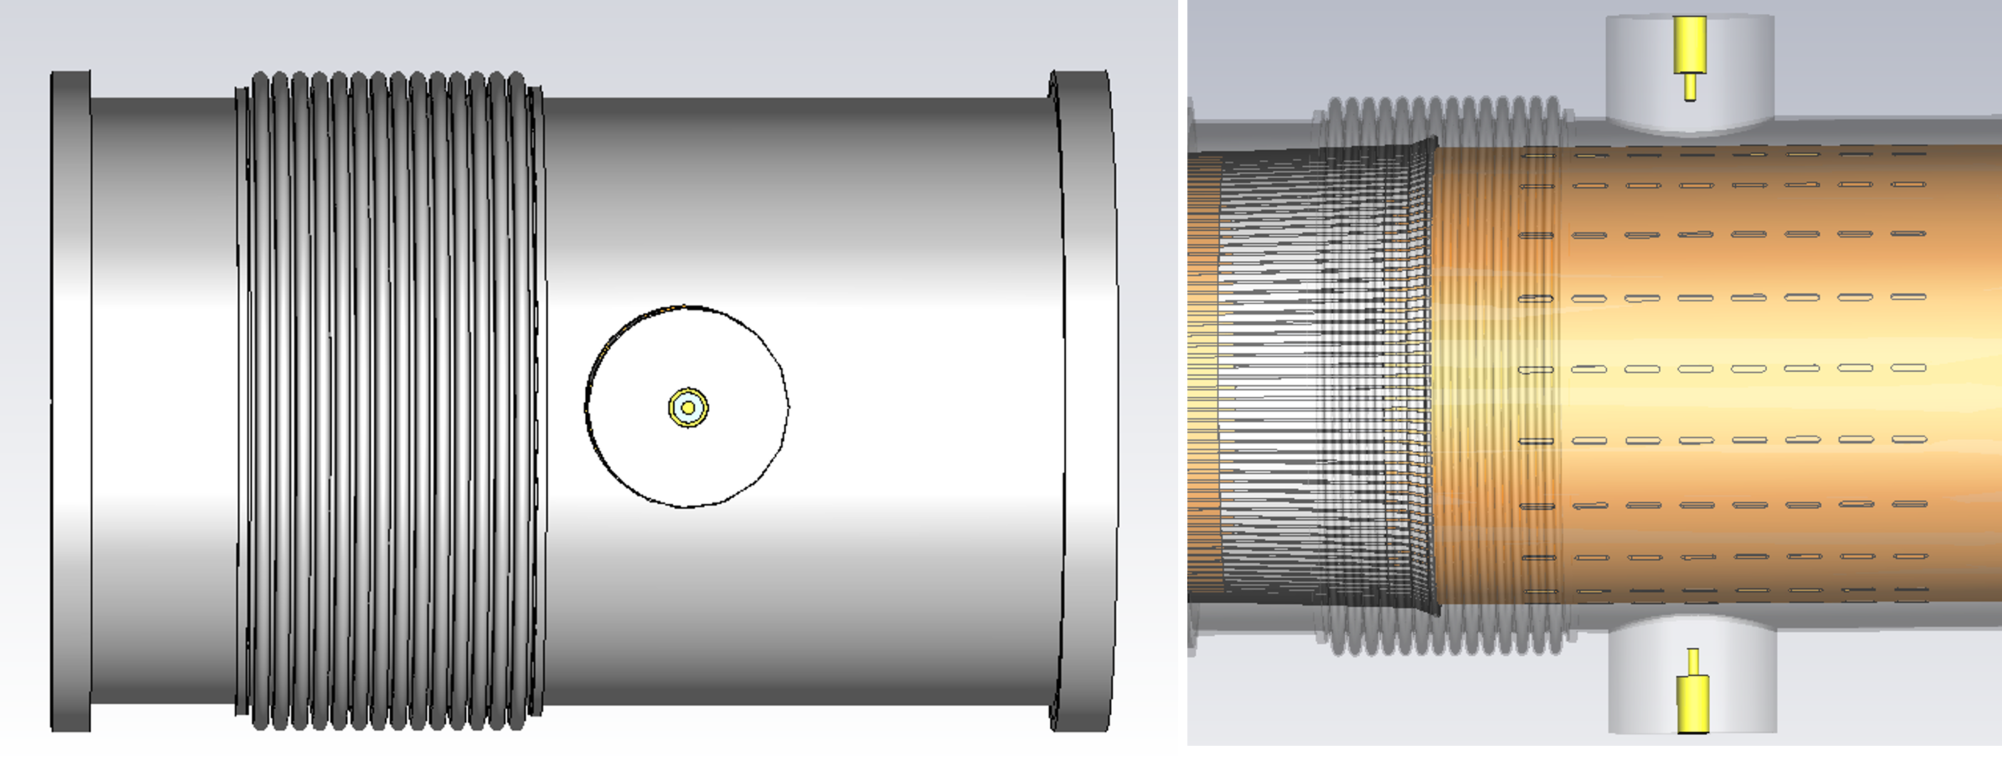
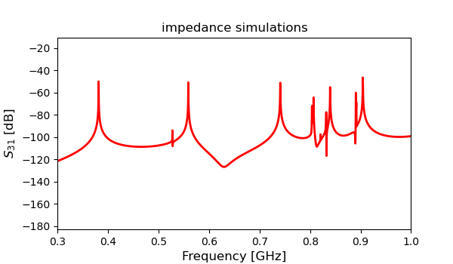
Simulations vs Measurements : validation of the model
Virtual measurement setup reproduced in e.m. simulation
Very similar frequency response between simulation and measurements
  First resonance below 400 MHz
  Several resonances below pipe cut-off frequency
The simulation model is used for impedance assessment

Slide 16
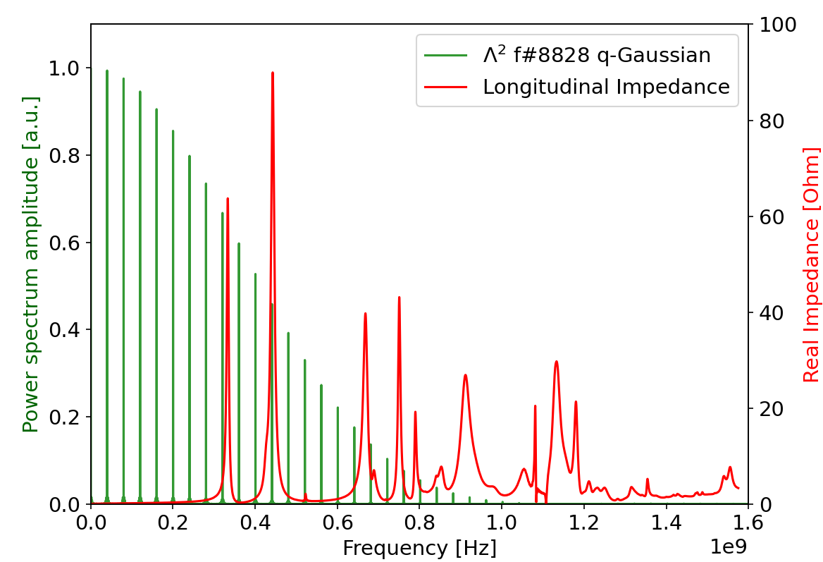
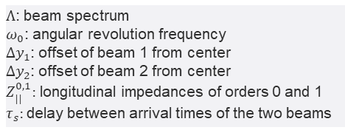
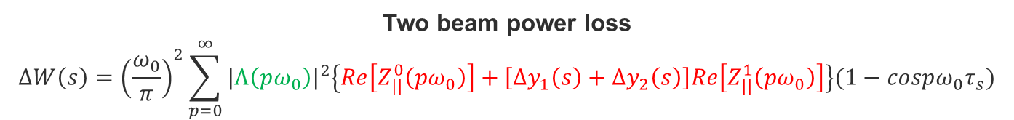
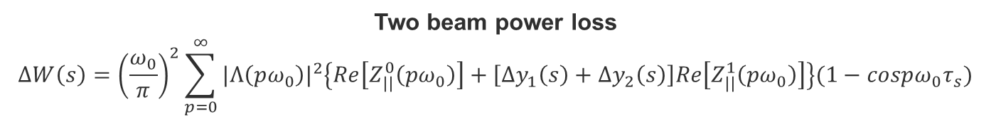
Beam induced power assessment
$Λ$: beam spectrum
$ω_{0}$: angular revolution frequency
$Δy_{1}$: offset of beam 1 from center
$Δy_{2}$: offset of beam 2 from center
$Z_{||}^{0,1}:$ longitudinal impedances of orders 0 and 1
$τ_{s}:$delay between arrival times of the two beams
Two beam power loss
$$ΔW\left(s\right)={\left(\frac{ω_{0}}{π}\right)}^{2}\sum_{p=0}^{∞}{{|Λ\left(pω_{0}\right)|}^{2}\left\{Re\left[Z_{||}^{0}\left(pω_{0}\right)\right]+\left[Δy_{1}\left(s\right)+Δy_{2}\left(s\right)\right]Re\left[Z_{||}^{1}\left(pω_{0}\right)\right]\right\}(1−cospω_{0}τ_{s})}$$
Two beam power loss
$$ΔW\left(s\right)={\left(\frac{ω_{0}}{π}\right)}^{2}\sum_{p=0}^{∞}{{|Λ\left(pω_{0}\right)|}^{2}\left\{Re\left[Z_{||}^{0}\left(pω_{0}\right)\right]+\left[Δy_{1}\left(s\right)+Δy_{2}\left(s\right)\right]Re\left[Z_{||}^{1}\left(pω_{0}\right)\right]\right\}(1−cospω_{0}τ_{s})}$$
* Power loss calculation in separated and common beam chambers of the LHC, C. Zannini, G. Rumolo, G. Iadarola, 5th International Particle Accelerator Conference, Dresden, Germany, June 2014
07/12/23

Slide 17
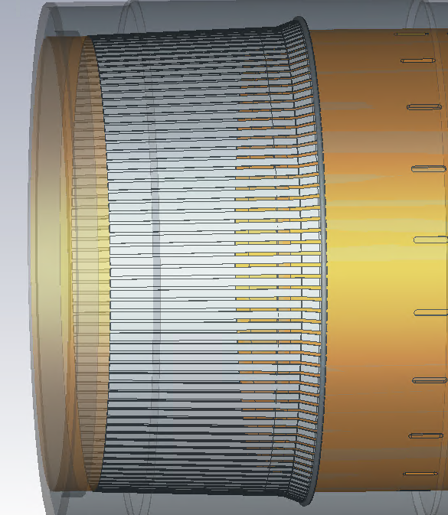
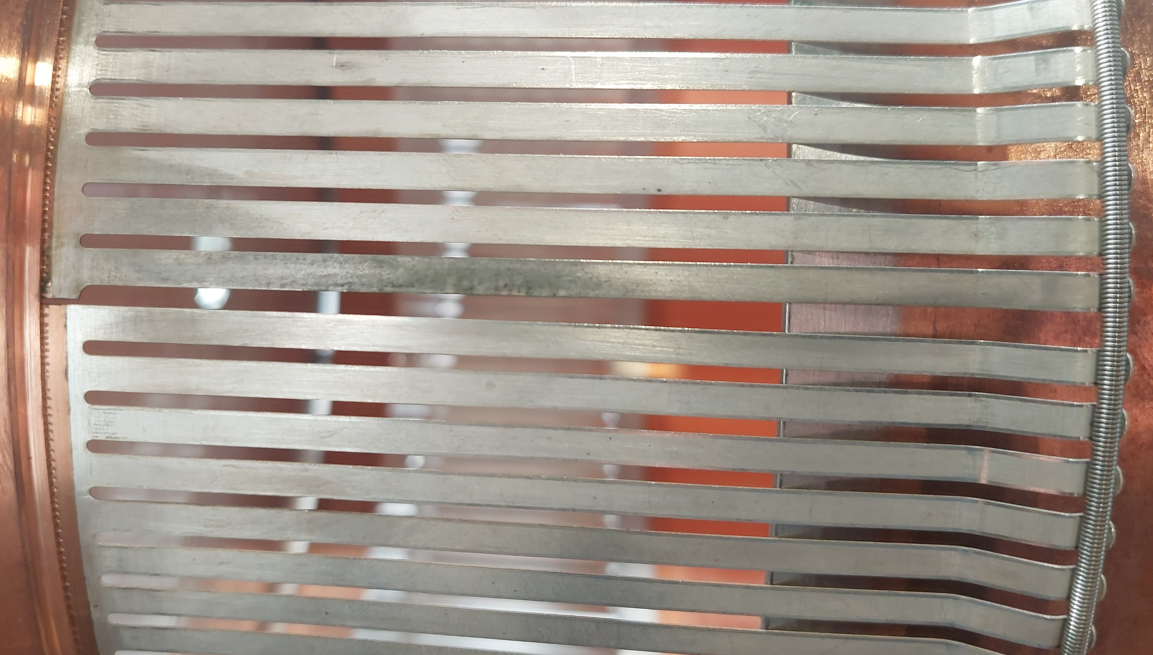
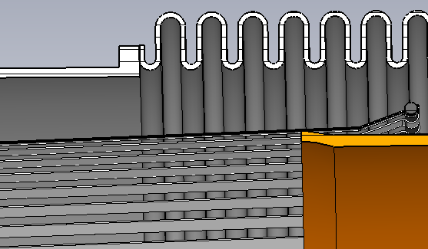
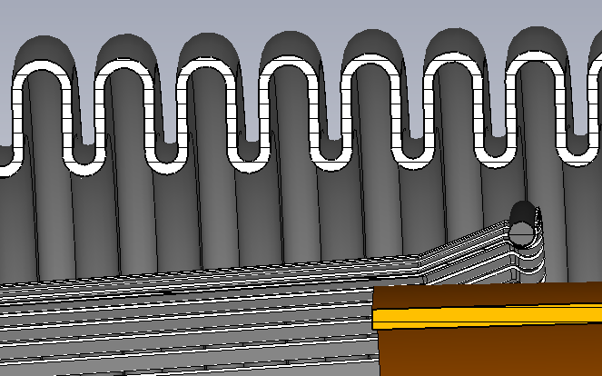
Different scenarios studied
Design case
Symmetric RF fingers distribution
Perfect contact fingers-transition tube
Ideal contact case
Non symmetric RF fingers distribution
Perfect contact fingers-transition tube
Degraded contact case
Non symmetric RF fingers distribution
Degraded contact fingers-transition tube
Lost contact case
Non symmetric RF fingers distribution
Lost contact fingers-transition tube
larger gap
Perfect contact
Loss of contact
Impedance is more affected by production defects especially in presence of beam offset
Contact degradation between fingers-transition tube largely increases the beam induced power on the spring

Slide 18
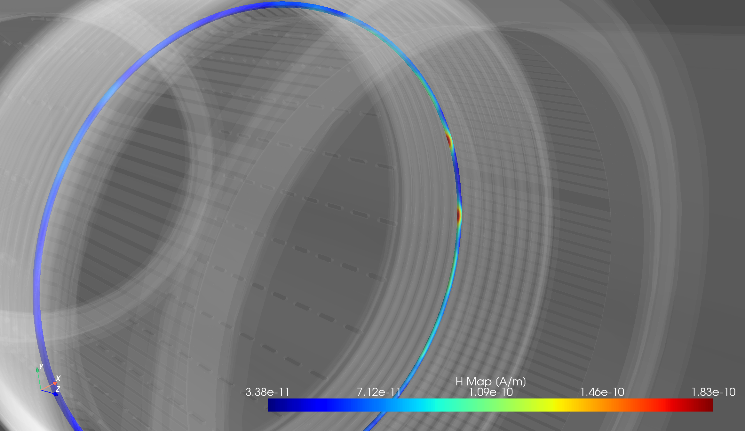
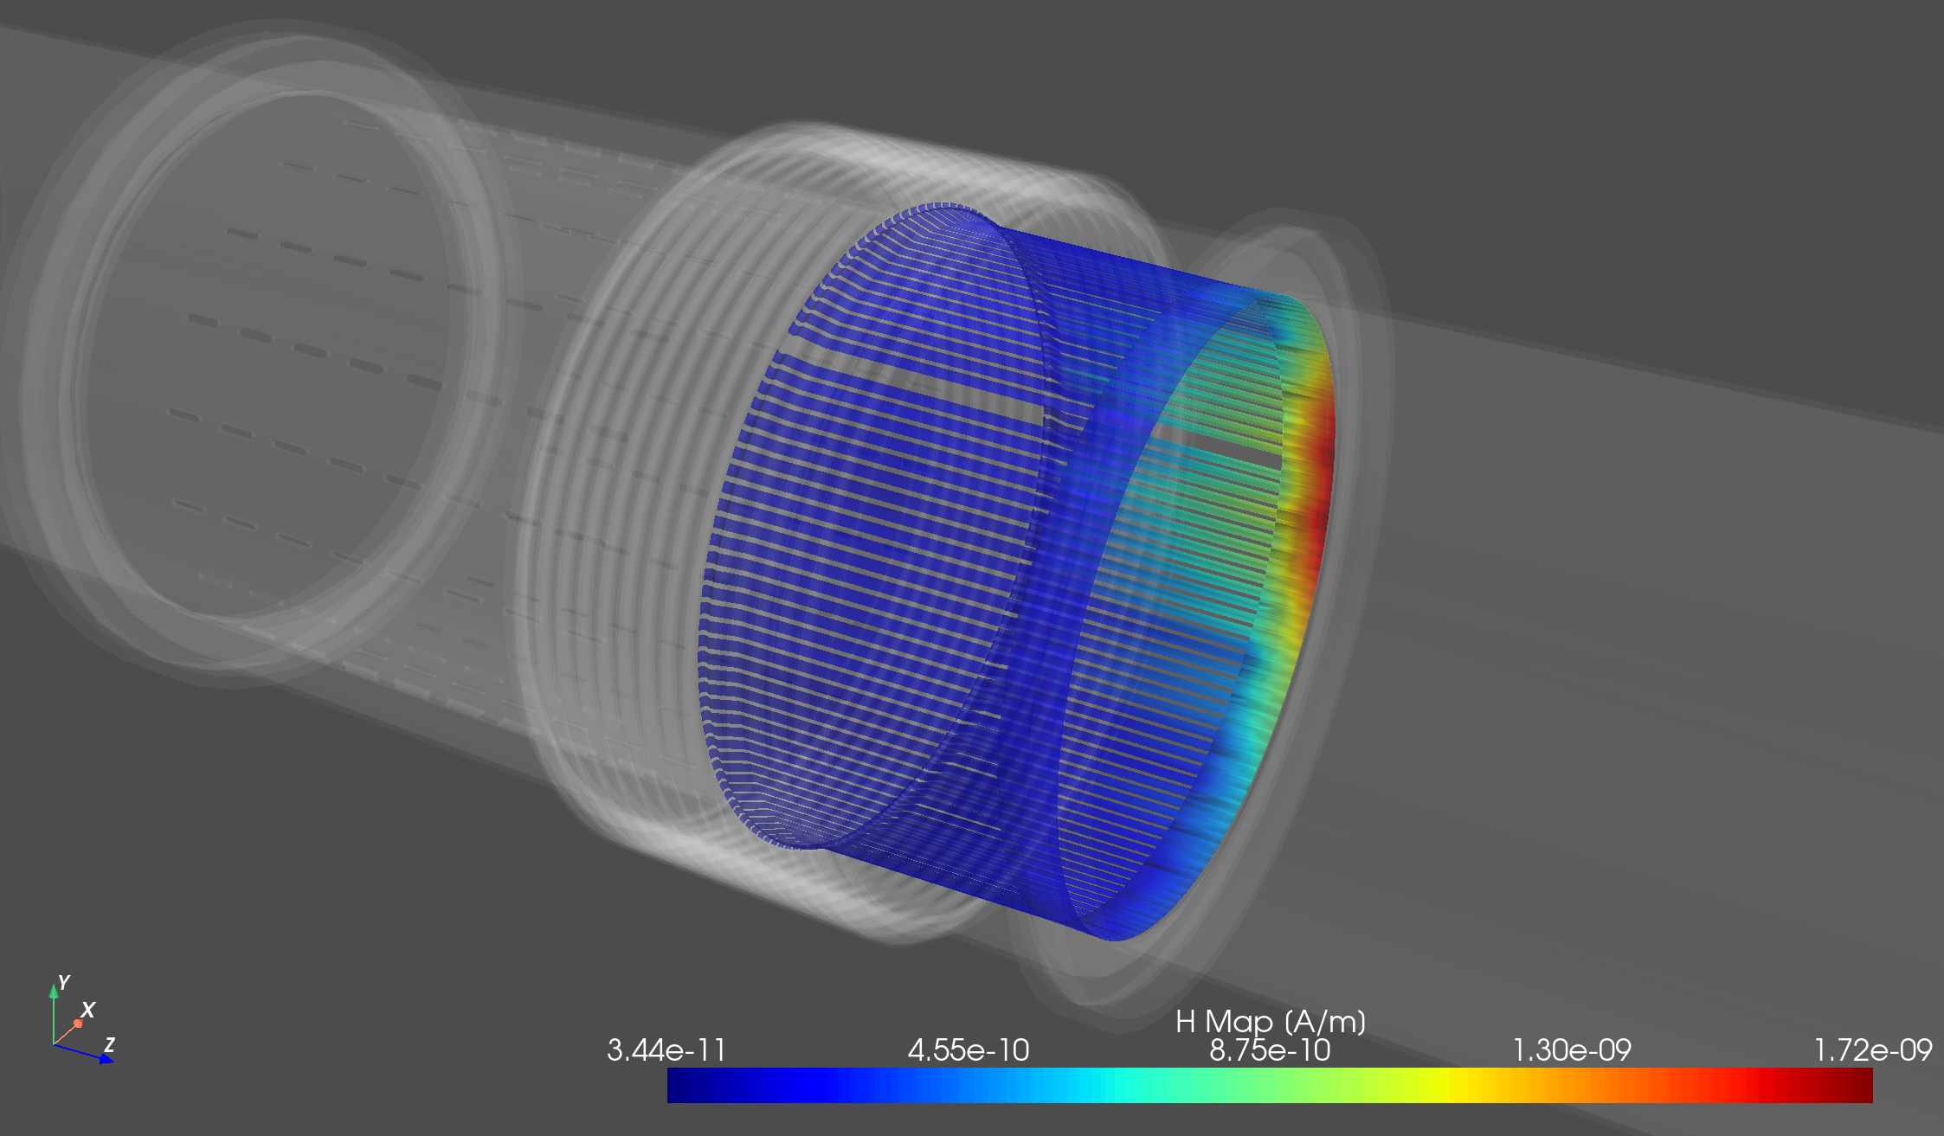

Beam induced power loss on the spring
~0.13 W
~27 W
Worsening the quality of contact
ideal contact
$\text{\sim }$0.07 W
degraded contact
~2 W
Lost contact
~200 W
Annealing condition
  Temperature above 500° C
  ~0.13 W for localized power
  ~27 W for distributed power
EM simulations show localized heating
gap
beam

Slide 19
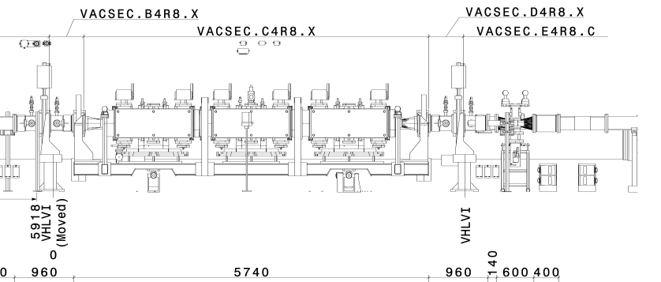
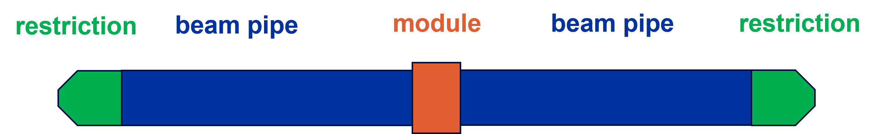
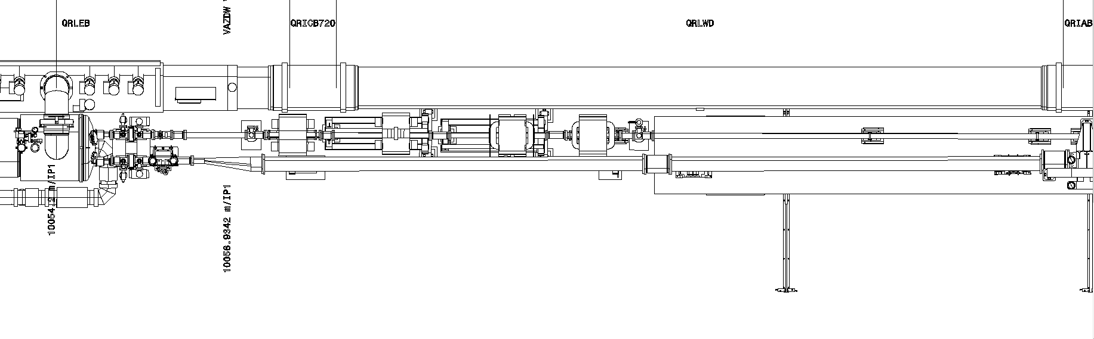
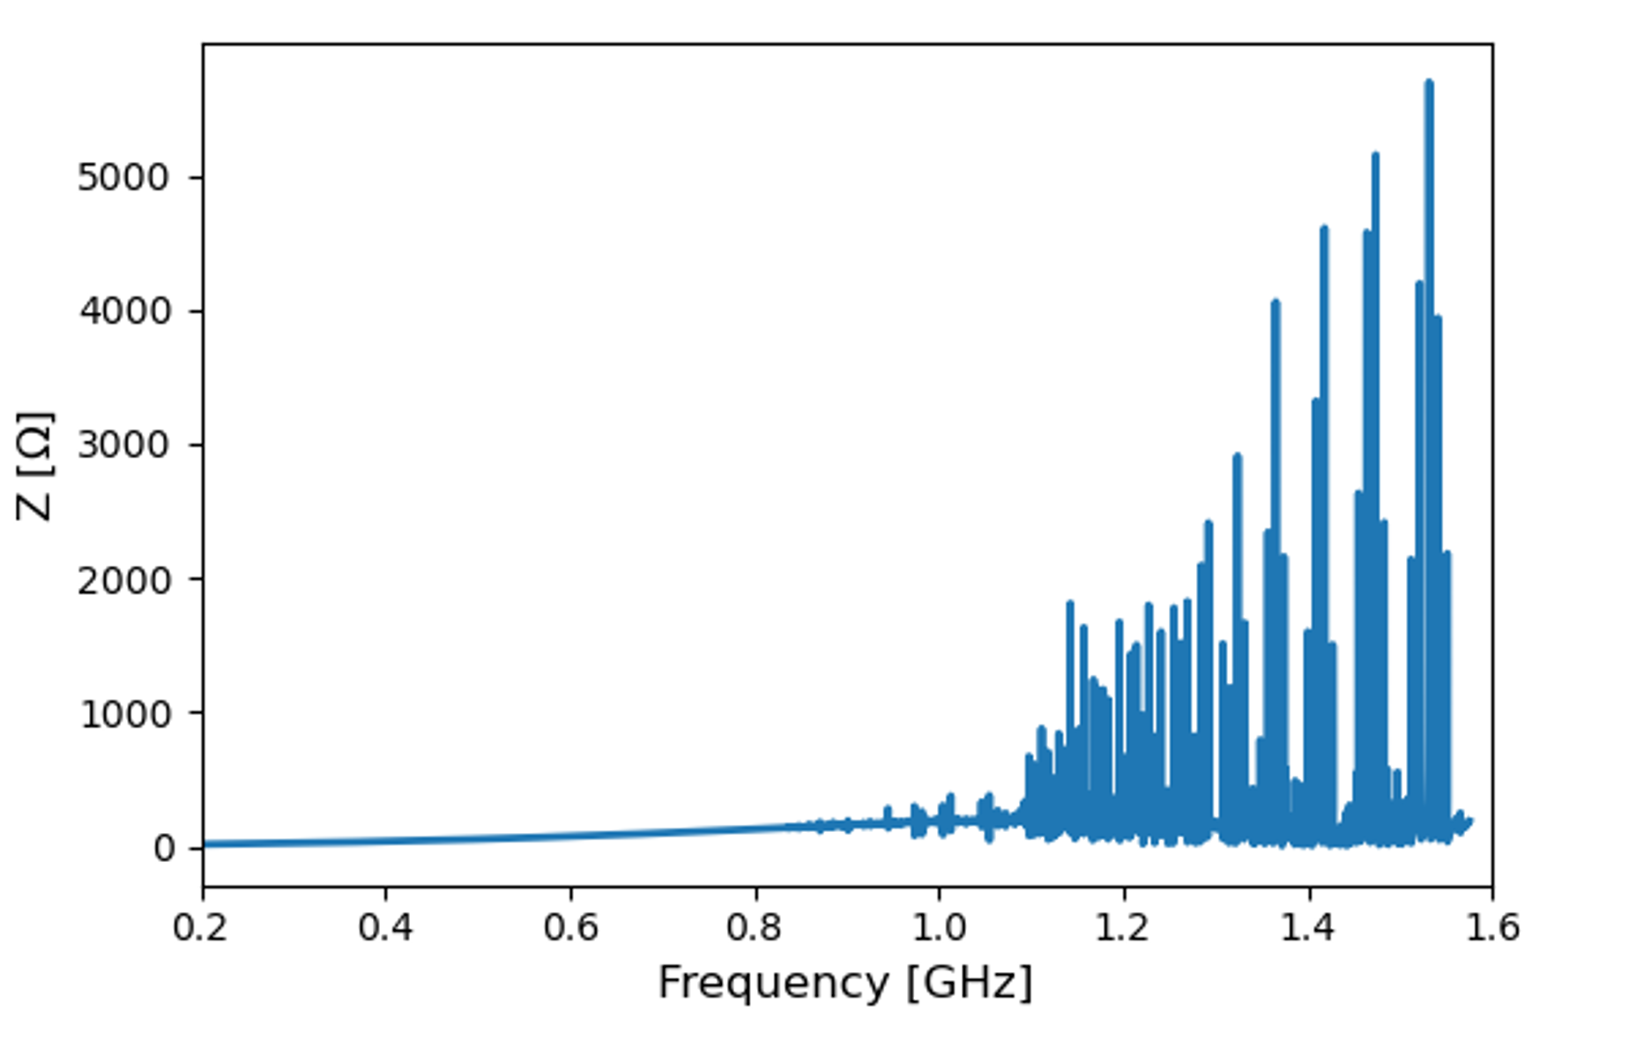
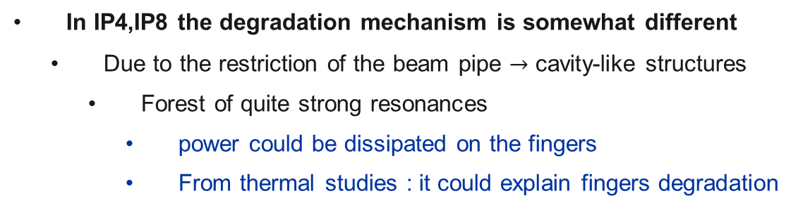
IP4, IP8: observed finger degradation
Pipe restrictions
BSRT
TDIS
Pipe restrictions
Identified Issue
Identified Issues
VMBGA.A5R4.B
VMBGC.D4R8.X
VMBGC.A4R8.X
    Beam pipe restrictions in both IP4,IP8
In IP4,IP8 the degradation mechanism is somewhat different
  Due to the restriction of the beam pipe $→$ cavity-like structures
    Forest of quite strong resonances
      power could be dissipated on the fingers
      From thermal studies : it could explain fingers degradation
Disclaimer : preliminary results

Slide 20
04
Possible Mitigation Strategies
Ongoing Impedance and Vacuum Studies

Slide 21
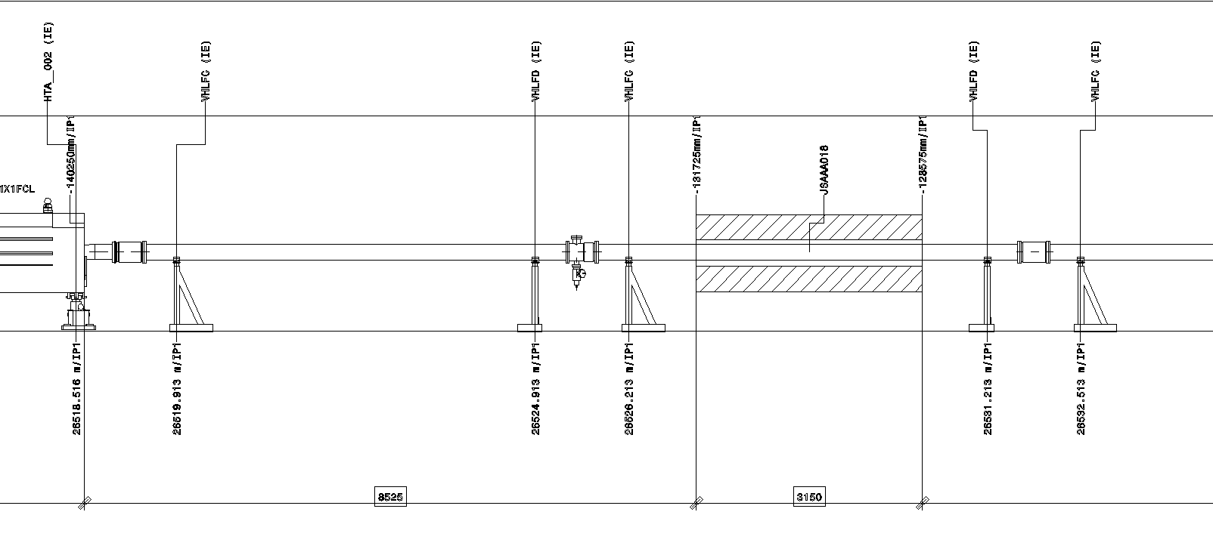
Essence of the mitigation strategy
Replace and transform the current 71 modules in the ID212.7 RF contact with newly designed modules wherever it is possible to implement such a substitution .
Anchor ‘unnecessary’ ID212.7 modules (EDMS)
Deformable RF Finger
(flexible)
Transformed ID 212.7
(anchored)
Optimised Bellows
(flexible and anchored)
Could be suppressed
WM
WM
WM
VC 5500 mm
VC 5500 mm

Slide 22
Deformable RF Fingers – DRF
Fixed extremities
No spring and no possibility to lose electric contact
A Nominal height of 2.7 mm (11° angle) is considered for the nominal operation position.
Evaluation of the cumulative impact of 25 Modules on the LHC:
  The additional impedance contribution is compatible with beam stability requirements (EDMS)
CuBe RF fingers
3 mm width
0.1 mm thickness

Slide 23
Transformed ID212.7 Module in straight vacuum chamber
Transition ring
Flange tube
Fixed Positioning
  Reallocate the thermal
  expansion during
  bake-out cycles to
  designated bellows
Robust thermal endurance
  10 mm solid copper
  material, engineered to
  withstand substantial heat loads should they manifest
New transition
Re-use part of the RF insert
Impedance
  Expected to behave as a straight vacuum chamber

Slide 24
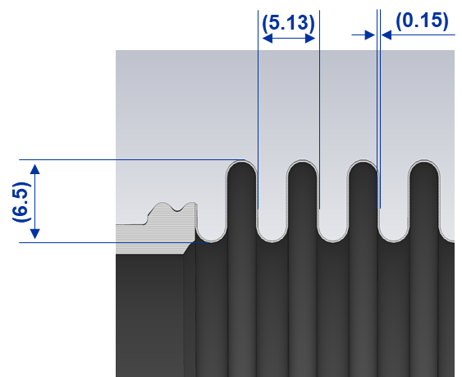
Optimised Bellows
13 Convolutions Bellow Ø 212.7 mm Stainless Steel
Secure choice concerning mechanical and thermal considerations
Rapid and cost-effective production
Higher impedance compared to the ID212.7 RF contact fingers
  Longitudinal and transverse impedance will be affected
    to be studied in detail

Slide 25
Essence of the mitigation strategy
Replace and transform the current 71 modules in the ID212.7 RF contact with newly designed modules wherever it is possible to implement such a substitution.
Anchor ‘unnecessary’ ID212.7 modules (EDMS)
Deformable RF Fingers
25 Modules
10 x IP1, 10 x IP 5, 5 x IP 8
Transformed ID 212.7 Modules
21 Modules
8 x IP 1, 8 x IP 5, 2 x IP 4, 3 x IP 8
Optimised Bellows
Production could start in Q2 2024
To be seen during 2024
Two-stages approach
Total
EYETS 23/24
YETS 24/25
Modules 71
Replaced
modules 47
Replaced modules 24
Full consolidation in YETS 24/25

Slide 26
Conclusion and Outlook

Slide 27
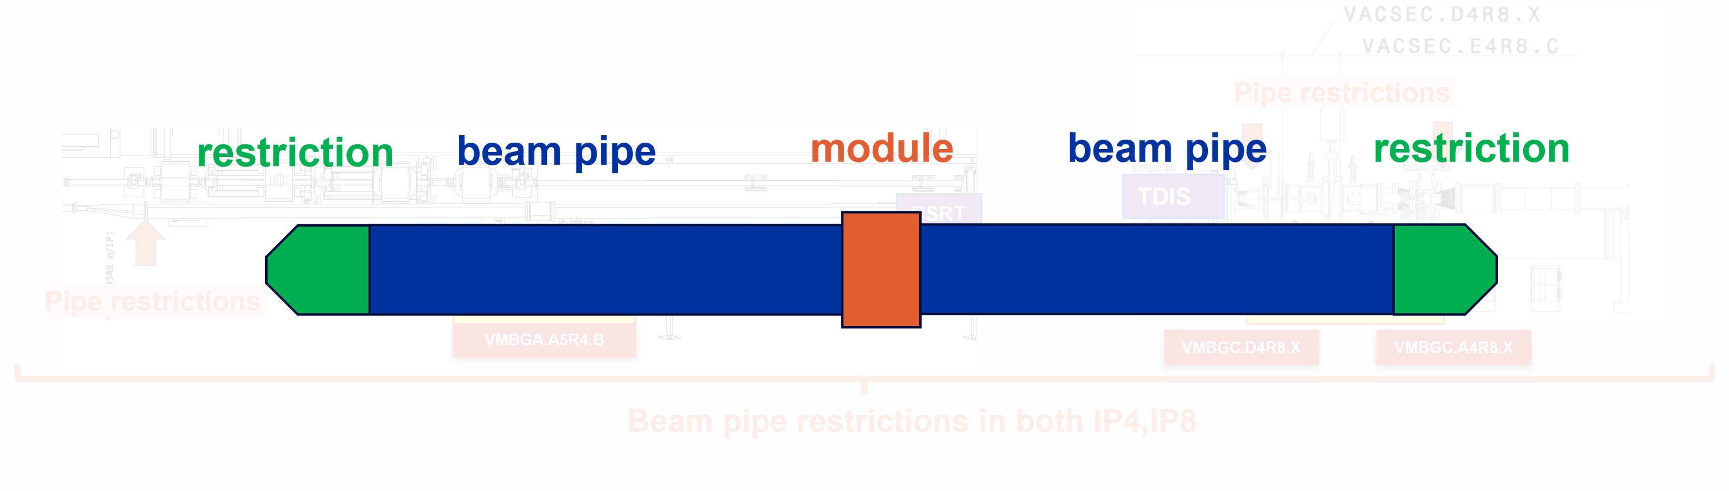
Do we expect additional failure in 2024 run?
  1 Failure observed only in 2023 with a maximum total intensity of ~3.8e14 p. (with 1.63e11 ppb)
    Localized heating on spring enhanced by the beam offset and production defects
    24 module will keep the original spring+finger design
      No failure expected with ideal contact
      Failure can occur due to degraded contact quality
        An intensity threshold cannot be identified due to the strong
        dependence on contact quality
    Other possible failure mechanism (preliminary results)
        Damage of RF fingers in IP4,8
          heating of the RF fingers due to the machine layout

Slide 28
BE-ABP
Chiara Antuono
Elena De La Fuente
Riccardo De Maria
Stéphane Fartoukh
Lorenzo Giacomel
Nicolas Mounet
Yannis Papaphilippou
Giovanni Rumolo
Benoit Salvant
Leonardo Sito
Carlo Zannini
TE-VSC
Giuseppe Bregliozzi
Sergio Calatroni
Paolo Chiggiato
Isabel Cuevaz
Thomas Da Silva
Florent Fesquet
Alessio Galloro
Jan Hansen
Patrick Krkotic
Fabrice Santangelo
Orlando Santos
Josef Sestak
Benoit Teissandier
Marc Thiebert
EN-MME
Thibaut Coiffet
Alessandro Dallocchio
Florent Fesquet
Ana Teresa P. Fontenla
Damien Jerome Foresy
Gonzalo A. Izquierdo
Jean-Marc Malzacker
Alexandre Porret
Laurent Prever-Loiri
On behalf of…
SY-RF
Ivan Karpov
Christine Vollinger
TE-MSC
Mariano Pentella

Slide 29
Thank you for your attention!
Any questions?

Slide 30
01
WHAT IS
BEAM IMPEDANCE?
Backup
Wakefields and Impedances

Slide 31

Simulations Vs measurements : validation of the model

Slide 32

Do we expect failure of the smaller modules?
Smaller diameter modules are expected to be less critical
    higher frequency modes
    Only 1 beam
    smaller beam offset
    less production defects
    lower impact of the machine layout
DN100
DN130
1 gap or 2
Easier production
Less prone to defect
Smaller transition in terms of diameter
From G. Bregliozzi, LMC
How many modules built from 3 segments do we have in the LHC machine?
    ID212.7 & ID196 -> 71 units in total
    DN130 & DN100 have 2 segments: Less prone to gap problems (Max aperture <2-3 mm)
    DN80 & DN63 one single segments: Respected the tolerances of the drawings.
Can this problem happen to the other RF inserts?
    If the problem with the increased spacing is confirmed there is no reason to have the same failure module with warm modules inserts DN80 and DN63. DN130 and DN100 need further studies.

Slide 33


Spring Properties
Spring of module 5
Stainless Steel 1.4310 – AISI 301
(X10CrNi18-8)
Good mechanical properties and corrosion resistance
Capable of high tensile strength following cold work
Tensile strength: 2239-2254 N/mm²
Magnetic following cold work
…but most of it is totally amagnetic
The material 1.4310 can theoretically be used up to +250°C.
After production, the spring is heat treated. At least 30min at 250°. Then cool at room temperature.
Bregliozzi Giuseppe – TE-TM – 12th June 2023
33

Slide 34


X rays – A4L1
B2
TAN
VGI.628.4L1.X
B1
Module 5
Module 9
Module 8
Module 7
Module 6
VMBGA.C4L1.X
≈114 m from IP1
FAULTY
MBWX
Module 4
Module 3
Module 2
Module 1

Slide 35


X Rays – VMBGA.B4R5.X – Module 3

Slide 36


X rays – A4L8
Double Beams
TCTPH & TCTPV
B1
B2
TCLIA
VMBGC.A4L8.X
Identified Issue
Bregliozzi Giuseppe – LMC – 18/10/2023
36

Slide 37
X rays – A4R8 (E4R8.X8)
Double Beams
B1
TDIS
B2
VMBGC.A4R8.X
Identified Issue
Bregliozzi Giuseppe – LMC – 18/10/2023
37

Slide 38



B4R8.X - VMBGC.E5R8.X
No spring coil degradation detected
Bregliozzi Giuseppe – LMC – 18/10/2023
38

Slide 39
X rays – D5R4
Single Beam
B2
D3R4
B1
BSRT
Identified Issue
VMBGA.A5R4.B
Bregliozzi Giuseppe – LMC – 18/10/2023
39

Slide 40



Pictures of VMBGA.A5R4.B

Slide 41

Pictures of VMBGA.A5R4.B

Slide 42



Module 5 RF & Insert with new and old spring
The OLD spring compared to a new one is about 3-4 cm longer.
Bregliozzi Giuseppe – TE-TM – 12th June 2023
42

