Slide 1
Electron clouds in the injectors
G. Iadarola, H. Bartosik, L. Mether, K. Paraschou, G. Rumolo
Many thanks to:
M. Barnes, A. Harrison, A. Huschauer, G. Favia, J. Ferreira,
K. Li, I. Mases, Y. Papaphilippou, V. Petit, F. M. Velotti, M. Taborelli,
C. Zannini, injectors OP teams
Joint Accelerator Performance Workshop 2023

Slide 2
Outline
Electron cloud in the PS
  Dedicated scrubbing in 2021
  Present situation
Electron cloud in the SPS
  Recap on past observations and LIU strategy
  Scrubbing in Run 3
  Scrubbing and kickers
  Looking forward
Summary and next steps

Slide 3
Outline
Electron cloud in the PS
  Dedicated scrubbing in 2021
  Present situation
Electron cloud in the SPS
  Recap on past observations and LIU strategy
  Scrubbing in Run 3
  Scrubbing and kickers
  Looking forward
Summary and next steps

Slide 4
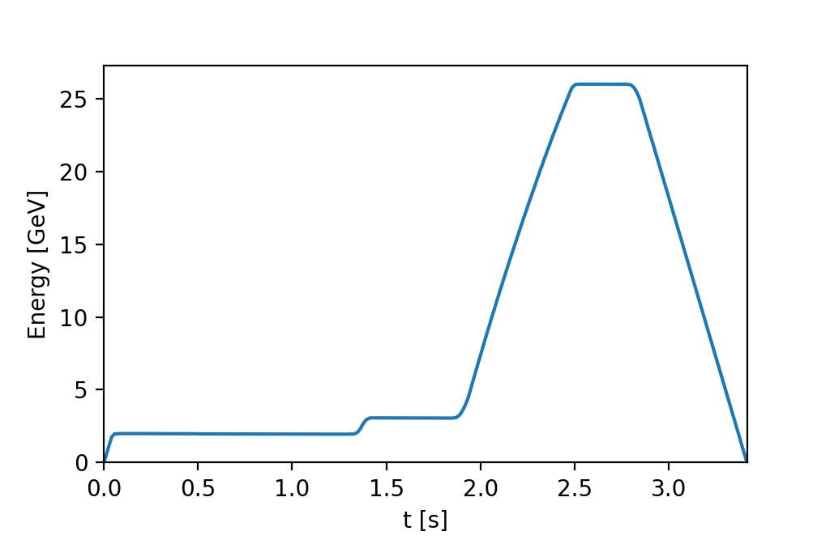
E-cloud in PS
In the PS, most of the cycle is e-cloud free. E-cloud forms only at top energy during the final RF manipulations in particular:
Last bunch splittings to achieve 25 ns bunch spacing
Bunch shortening to achieve bunch lengths compatible with the SPS bucket
h=42
b.sp.=50 ns (36 b.)
h=7
b. sp. ≈ 330 ns (4 - 6 b.)
h=21
b. sp.≈100 ns (18 b.)
h=84
b.sp.=25 ns (72 b.)
No e-cloud
Triple
splitting
Double splitting
Double splitting
Bunch shortening
4

Slide 5
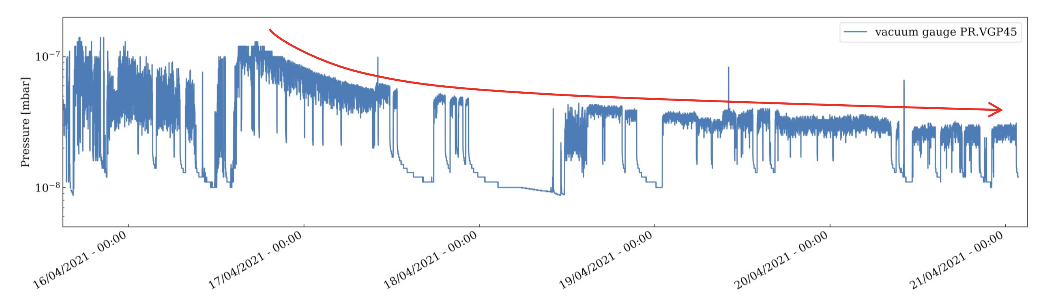
E-cloud in PS
First e-cloud observations in the PS date back to 2002.
E-cloud observed to get stronger after long shutdowns (when large fraction of beam chambers exposed to air)
  Vacuum pressure degradation and/or transverse instabilities
Situation particularly severe in 2021, when restarting 25 ns operation after LS2:
Pressure rise in injection kicker region (KFA45) triggering vacuum interlock
Needed dedicated scrubbing period to condition this areas
  Keeping several LHC-type cycles in the PS supercycle
  Continuously optimizing beam parameters (n. bunches, bunch length, total intensity) to maximize scrubbing efficiency compatibly with pressure interlocks
Situation significantly improved after four days of scrubbing
Conditioning of KFA45 area in 2021
5
For more details: see G. Rumolo, IPP#43

Slide 6
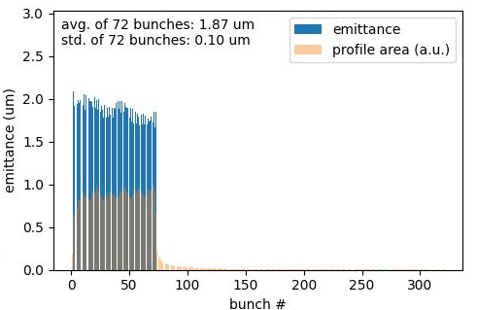
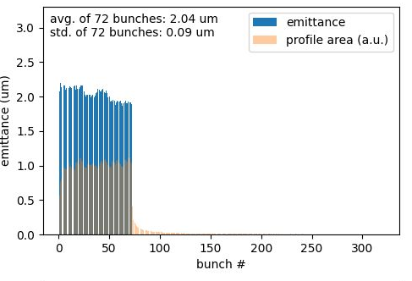
E-cloud in PS
Vacuum activity remains present in the PS during operation with 25 ns (sign that e-cloud is not fully suppressed)
Not enough to cause transverse instabilities or emittance degradation, also thanks to the fact that the beam is kept in the ring only very shortly after the last splitting
No sign of e-cloud degradation from the PS is visible on the beams injected in the SPS
Typical emittances measured at SPS injection
Horizontal
Vertical
Cortesy I. Mases
6

Slide 7
Outline
Electron cloud in the PS
  Dedicated scrubbing in 2021
  Present situation
Electron cloud in the SPS
  Recap on past observations and LIU strategy
  Scrubbing in Run 3
  Scrubbing and kickers
  Looking forward
Summary and next steps

Slide 8
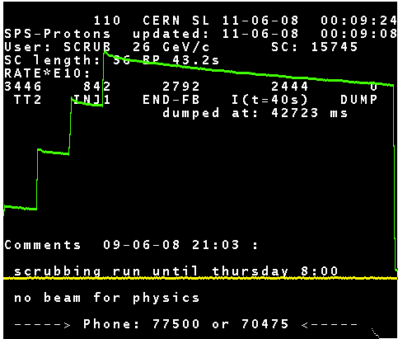
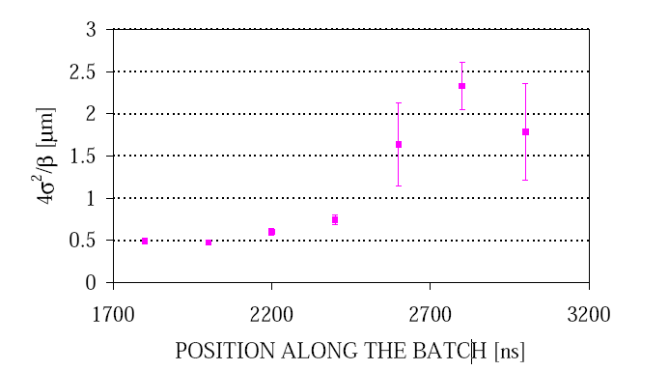
E-cloud in the SPS – early days
E-cloud was identified as a main limitation for SPS operation as LHC injector since the early 2000’s when LHC-type beams were injected for the first time
Strong beam degradation
Severe vacuum pressure rise all around the machine
It took several years with systematic scrubbing runs to reach a point at which the SPS could successfully accelerate the nominal LHC beams (4x72 bunches, 25 ns 1.2e11 p/b) without significant beam degradation
SPS page 1 during 2008 scrubbing run
2000 (48 b. - 0.8x10¹¹ p/b @inj.)
400%
3.5 μm
8

Slide 9
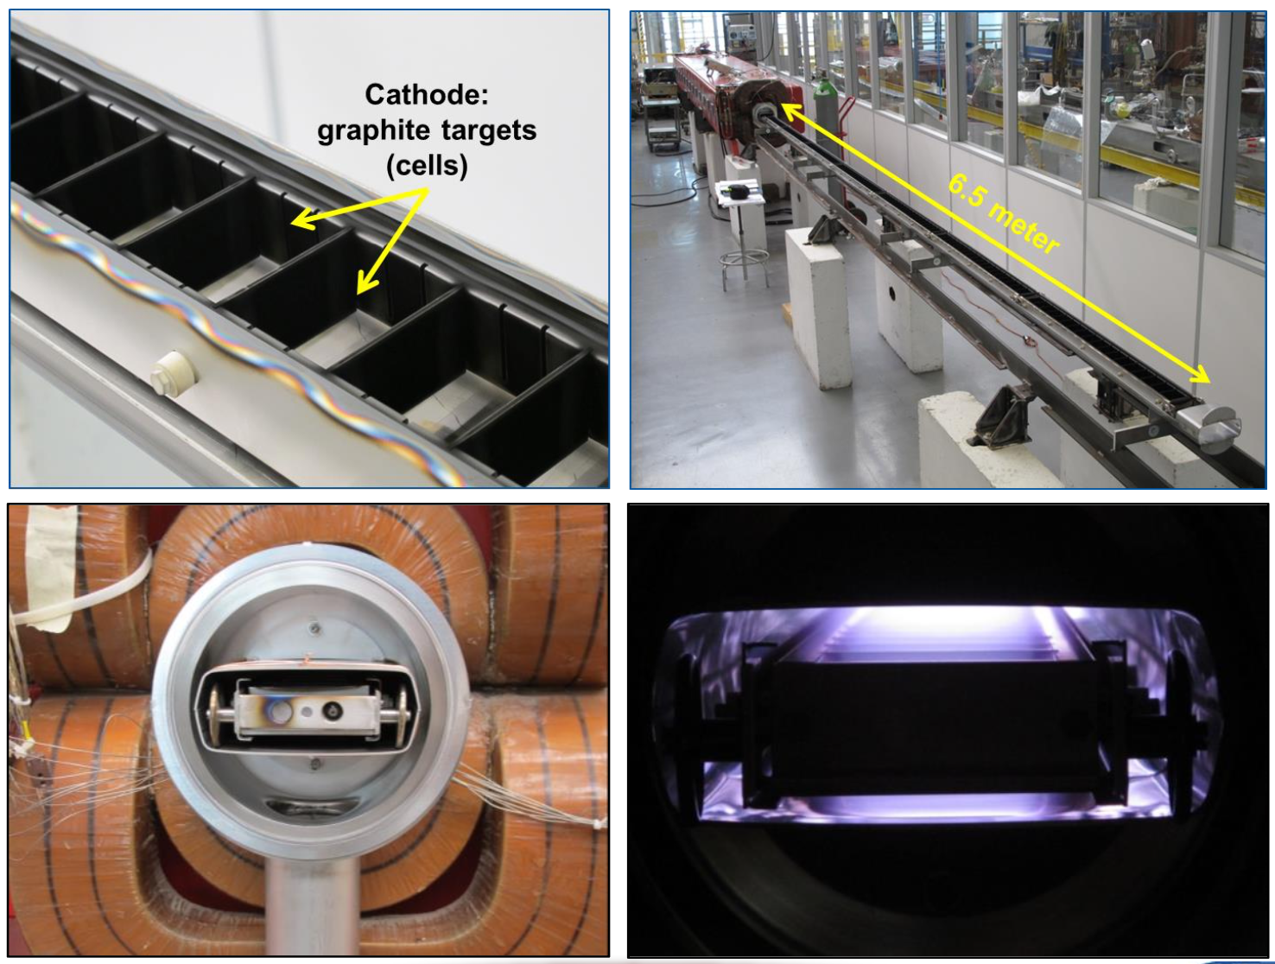
E-cloud in the SPS – LIU strategy
SPS aC coating
Anti e-cloud coating (amorphous carbon) developed as part of the LIU project but not deployed over full ring
During LS2 all quadrupoles of the QF type were coated in the tunnel, exploiting synergies with the impedance reduction campaign to practice large-scale deployment of in-situ coating
  Ensure readiness for deployment also in dipole magnets in case of need
Courtesy P. Costa Pinto
In Run 3 scrubbing runs took place at the beginning of each year as part of commissioning of the LIU beams to gradually condition the ring for operation with 25 ns beams and intensities up to 2.3e11 p/bunch at 450 GeV
  Aim at assessing whether a strategy based on scrubbing only is sufficient to reach the target beam parameters
9

Slide 10
Scrubbing in Run 3 in a nutshell
Scrubbing in 2021
3 weeks of scrubbing (interleaved with commissioning activity for MKP-L cooldown), followed by MD sessions with 25 ns beams
Recovered pre-LS2 performance, 4x72b with 1.2 x 10¹¹ p/bunch at 450 GeV
Scrubbing in 2022
Scrubbing interleaved with commissioning over 5 weeks (for MKP-L cooldown)
Achieved about 1.5 x 10¹¹ p/bunch for 4x72b at 450 GeV
Higher intensity, up to 1.8 x 10¹¹ p/b at 450 GeV, achieved during MDs but only with shorter bunch trains (limited by pressure spikes in MKDH)
Scrubbing in 2023
Scrubbing interleaved with commissioning for about 4 weeks
Achieved about 2.0 x 10¹¹ p/bunch for 4x72b at 450 GeV at the end of scrubbing
Higher intensities, up to 2.2 x 10¹¹ p/bunch, achieved during MDs
10

Slide 11
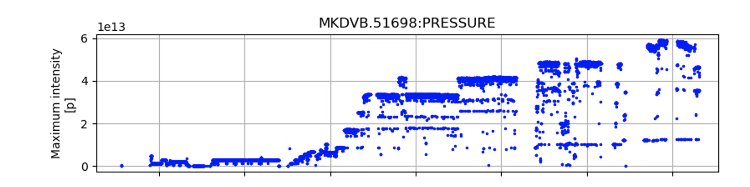
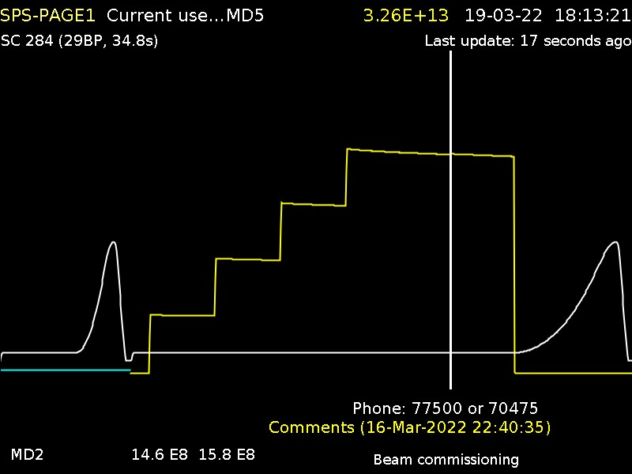
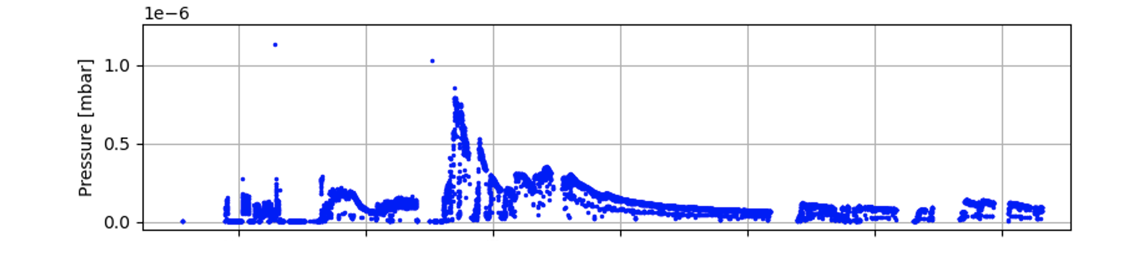
Scrubbing strategy
SPS scrubbing is typically done in stages:
First stage at 26 GeV (using cycle with no acceleration)
  Tune train length, number of batches, early dump in the cycle to maximize scrubbing efficiency while staying below vacuum pressure limit in most critical elements (those that need conditioning)
Conditioning of dump kicker (MKDV) in 2021
Thu 17.3 Fri 18.3 Sat 19.03 Sun 20.03 Mon 21.03 Tue 22.03
11

Slide 12
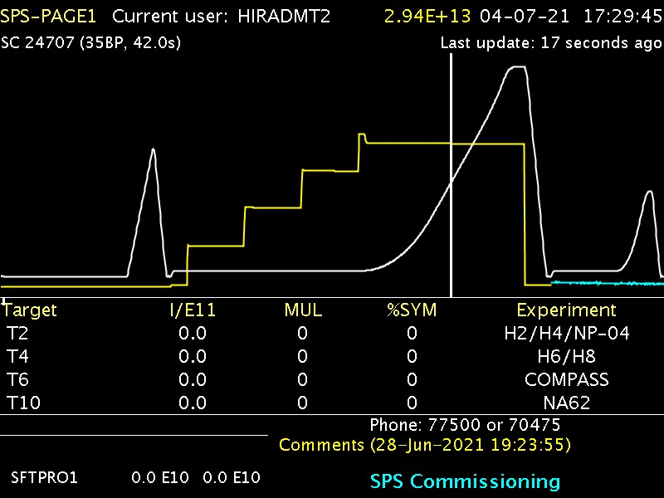
Scrubbing strategy
SPS scrubbing is typically done in stages:
First stage at 26 GeV (using cycle with no acceleration)
  Tune train length, number of batches, early dump in the cycle to maximize scrubbing efficiency while staying below vacuum pressure limit in most critical elements (those that need conditioning)
Second stage using acceleration to 450 GeV
  E-cloud enhanced by strong bunch length reduction happening during the ramp
12

Slide 13
Scrubbing strategy
Targets
Mitigate beam quality degradation from e-cloud (typically visible only when large fractions of the machine are exposed to air, i.e. after Long Shutdowns)
Improve vacuum level in machine elements that are newly installed or exposed to air (LS but also YETS)
SPS scrubbing is typically done in stages:
First stage at 26 GeV (using cycle with no acceleration)
  Tune train length, number of batches, early dump in the cycle to maximize scrubbing efficiency while staying below vacuum pressure limit in most critical elements (those that need conditioning)
Second stage suing acceleration to 450 GeV
  E-cloud enhanced by strong bunch length reduction happening during the ramp
Scrubbing pace determined by:
Vacuum pressure in elements that need scrubbing (by definition)
Impedance heating in certain sensitive elements due to prolonged use of beams with high-intensity and small bunch length
13

Slide 14
Outline
Electron cloud in the PS
  Dedicated scrubbing in 2021
  Present situation
Electron cloud in the SPS
  Recap on past observations and LIU strategy
  Scrubbing in Run 3
  Scrubbing and kickers
  Looking forward
Summary and next steps

Slide 15
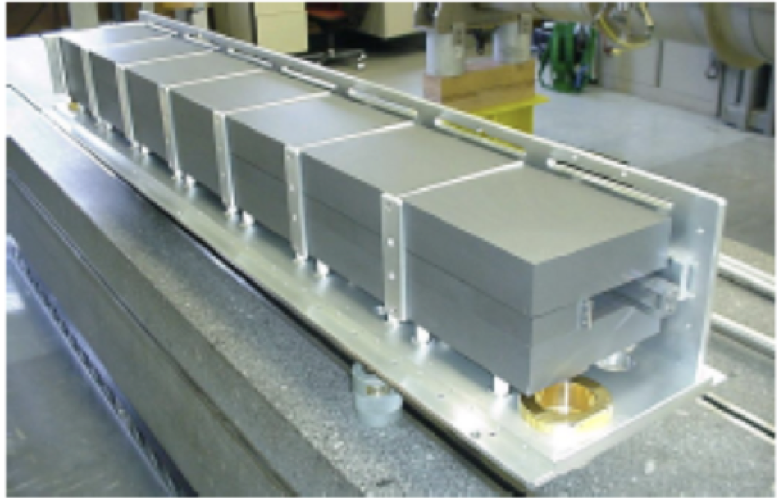
Scrubbing and kickers
In any machine, whenever we discuss scrubbing, we almost inevitably end up talking about limitations from kickers.
This is, in fact, not surprising:
Vacuum requirements in kicker magnets are significantly tighter to allow high-voltage pulses without risk of damaging the device
  Injection kickers and dump kickers need to be fully functional during scrubbing (cannot be just switched off for conditioning as done in other high-voltage devices, e.g. electrostatic septa)
Kickers are particularly subject to heating during periods of continuous operation with high bunch intensity and short bunches
Conditioning of these devices is particularly tricky:
During scrubbing periods kicker pressure interlock levels need to be increased compared to their operational values
  Necessary to allow high-enough e-cloud levels to condition device in acceptable time
Done by equipment teams, while behaviour of the devices is closely monitored by experts
For more info see: SPS kickers high intesity conditioning meeting
15

Slide 16
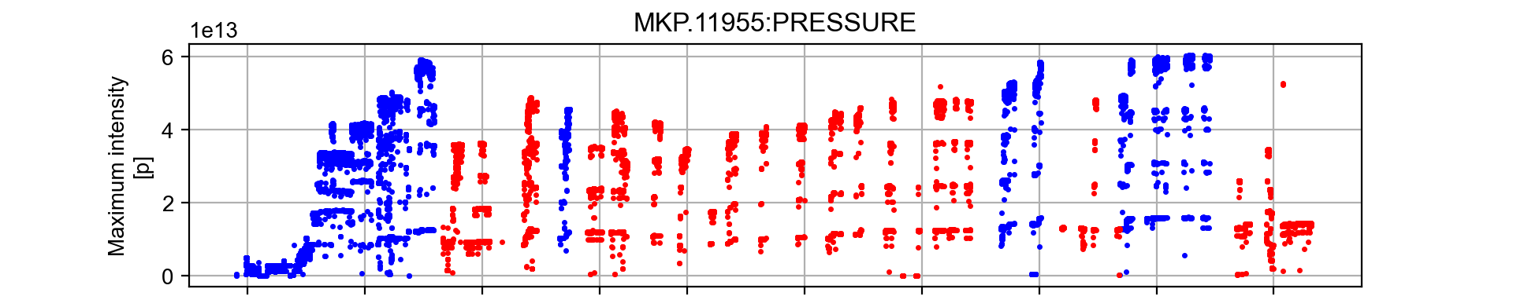
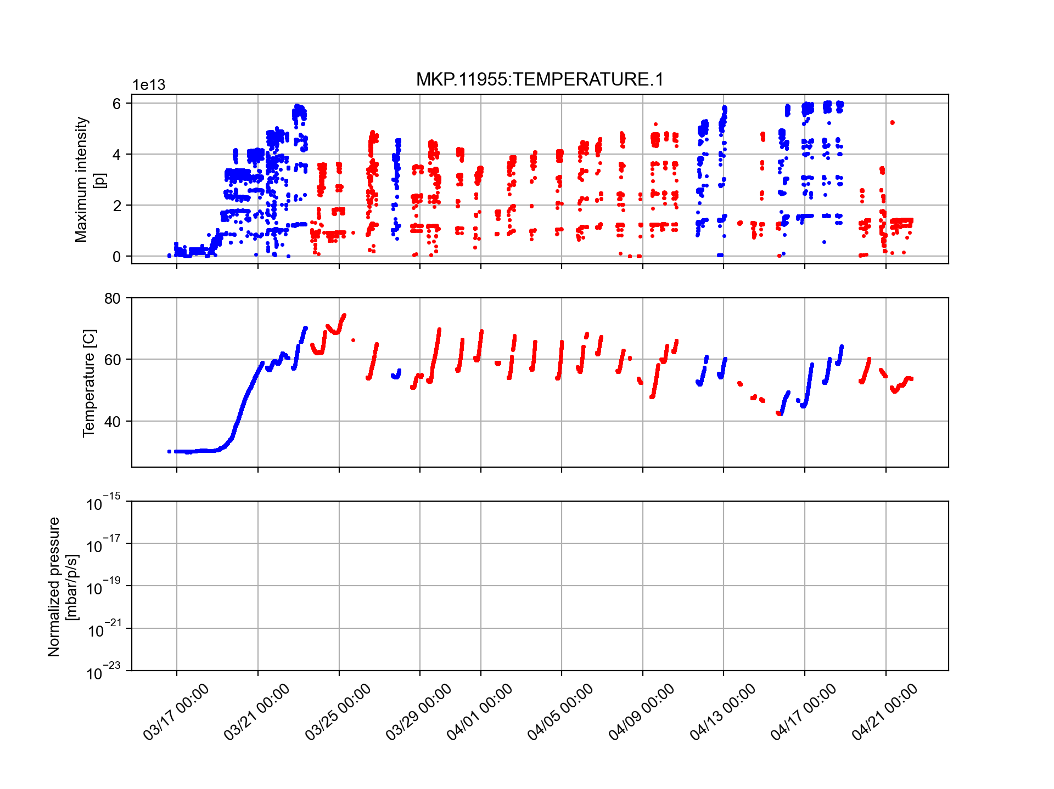
Limitations from kicker heating
Before 2023, efficiency of scrubbing runs in SPS was severely limited by impedance heating in kicker magnets
Before LS1 main limitation was from extraction kickers (MKE’s) → solved by applying serigraphy on ferrite blocks
As of Run2 main limitation became MKP-L magnet, showing a steep temperature increase when operating with 25 ns beams
  Cool down very slow, need to interleave 8h scrubbing / 16 h cooldown
2022 scrubbing run
26 GeV cycle 450 GeV cycle
16
Link to Giorgia’s contrib.

Slide 17
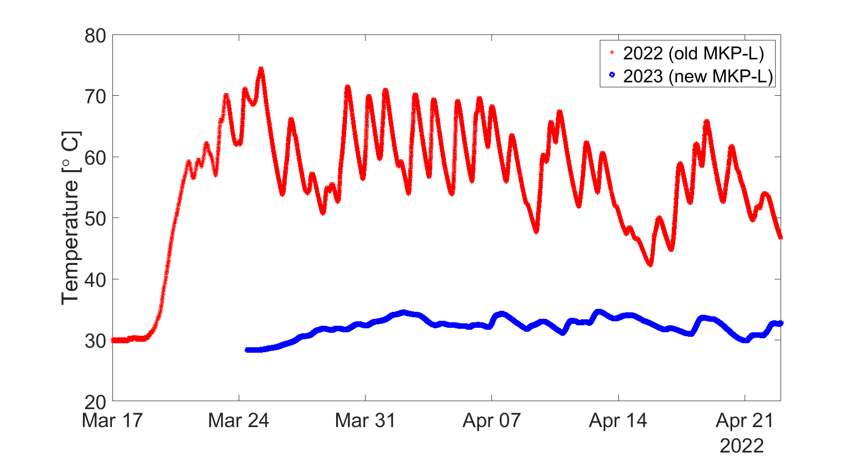
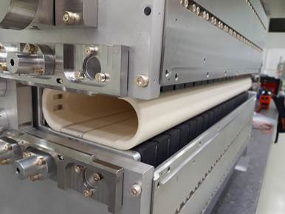
Limitations from kicker heating
Before 2023, efficiency of scrubbing runs in SPS was severely limited by impedance heating in kicker magnets
Before LS1 main limitation was from extraction kickers (MKE’s) → solved by applying serigraphy on ferrite blocks
As of Run2 main limitation became MKP-L magnet, showing a steep temperature increase when operating with 25 ns beams
  Cool down very slow, need to interleave 8h scrubbing / 16 h cooldown
Major improvement in 2023 with the installation of low-impedance MKP-L
  Efficient scrubbing up to LIU intensities became possible (still need to alternate scrubbing commissioning due to heating in MKP-S)
Fore more info see talk by G. Favia
For more info see: SPS kickers high intesity conditioning meeting
17

Slide 18
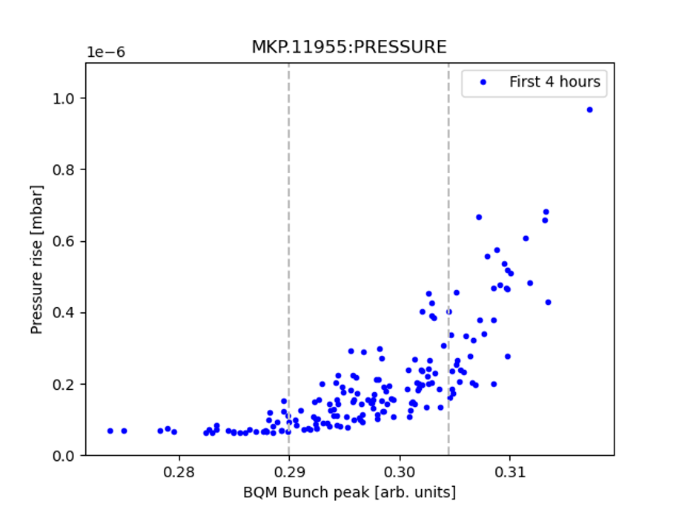
Limitations from vacuum in kickers (MKDH and MKP-L)
Pressure in MKDH (dump kicker) and newly installed MKP-L (inj. kicker) found to increase sharply toward the end of the energy ramp (due to short bunches)
Even after prolonged scrubbing at injection energy
Practically impossible to keep efficient scrubbing using standard LHC cycle
  Very poor duty cycle: less than 2 s every 30 s.
  Very sensitive to bunch length: cycle-to-cycle fluctuations made a large fraction of the cycles useless while still triggering the HW interlock on other cycles (long stop, expert/piquet intervention)
A 5% fluctuation in bunch peak
→ a factor 5 in pressure rise!
Pressure rise
For more info see: SPS kickers high intesity conditioning meeting
18

Slide 19
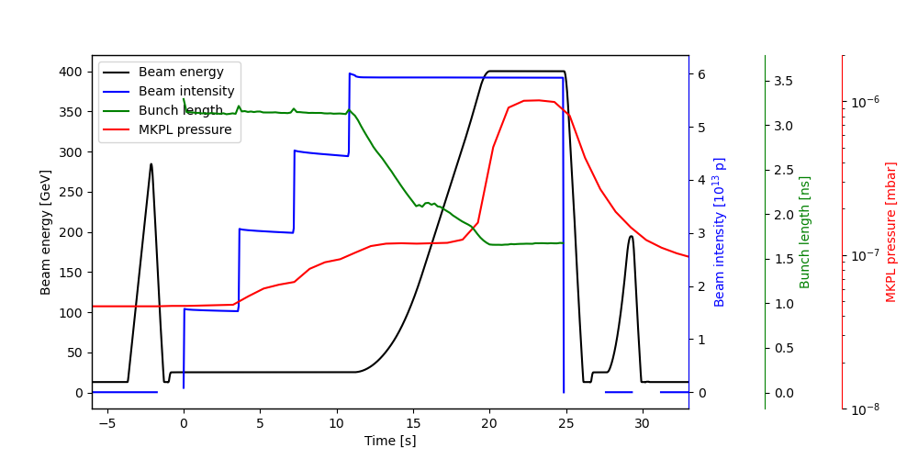
Limitations from vacuum in kickers (MKDH and MKP-L)
Pressure in MKDH (dump kicker) and newly installed MKP-L (inj. kicker) found to increase sharply toward the end of the energy ramp (due to short bunches)
To overcome these limitations, it was necessary to:
Optimize interlock logic:
  SIS interlock on MKP pressure only enforced before injection
  MKDH pressure interlock triggers only when two gauges exceed the threshold
Use a special cycle with longer flat top at 400 GeV, to allow for better duty cycle and more reproducible conditions
For more info see: SPS kickers high intesity conditioning meeting
19

Slide 20
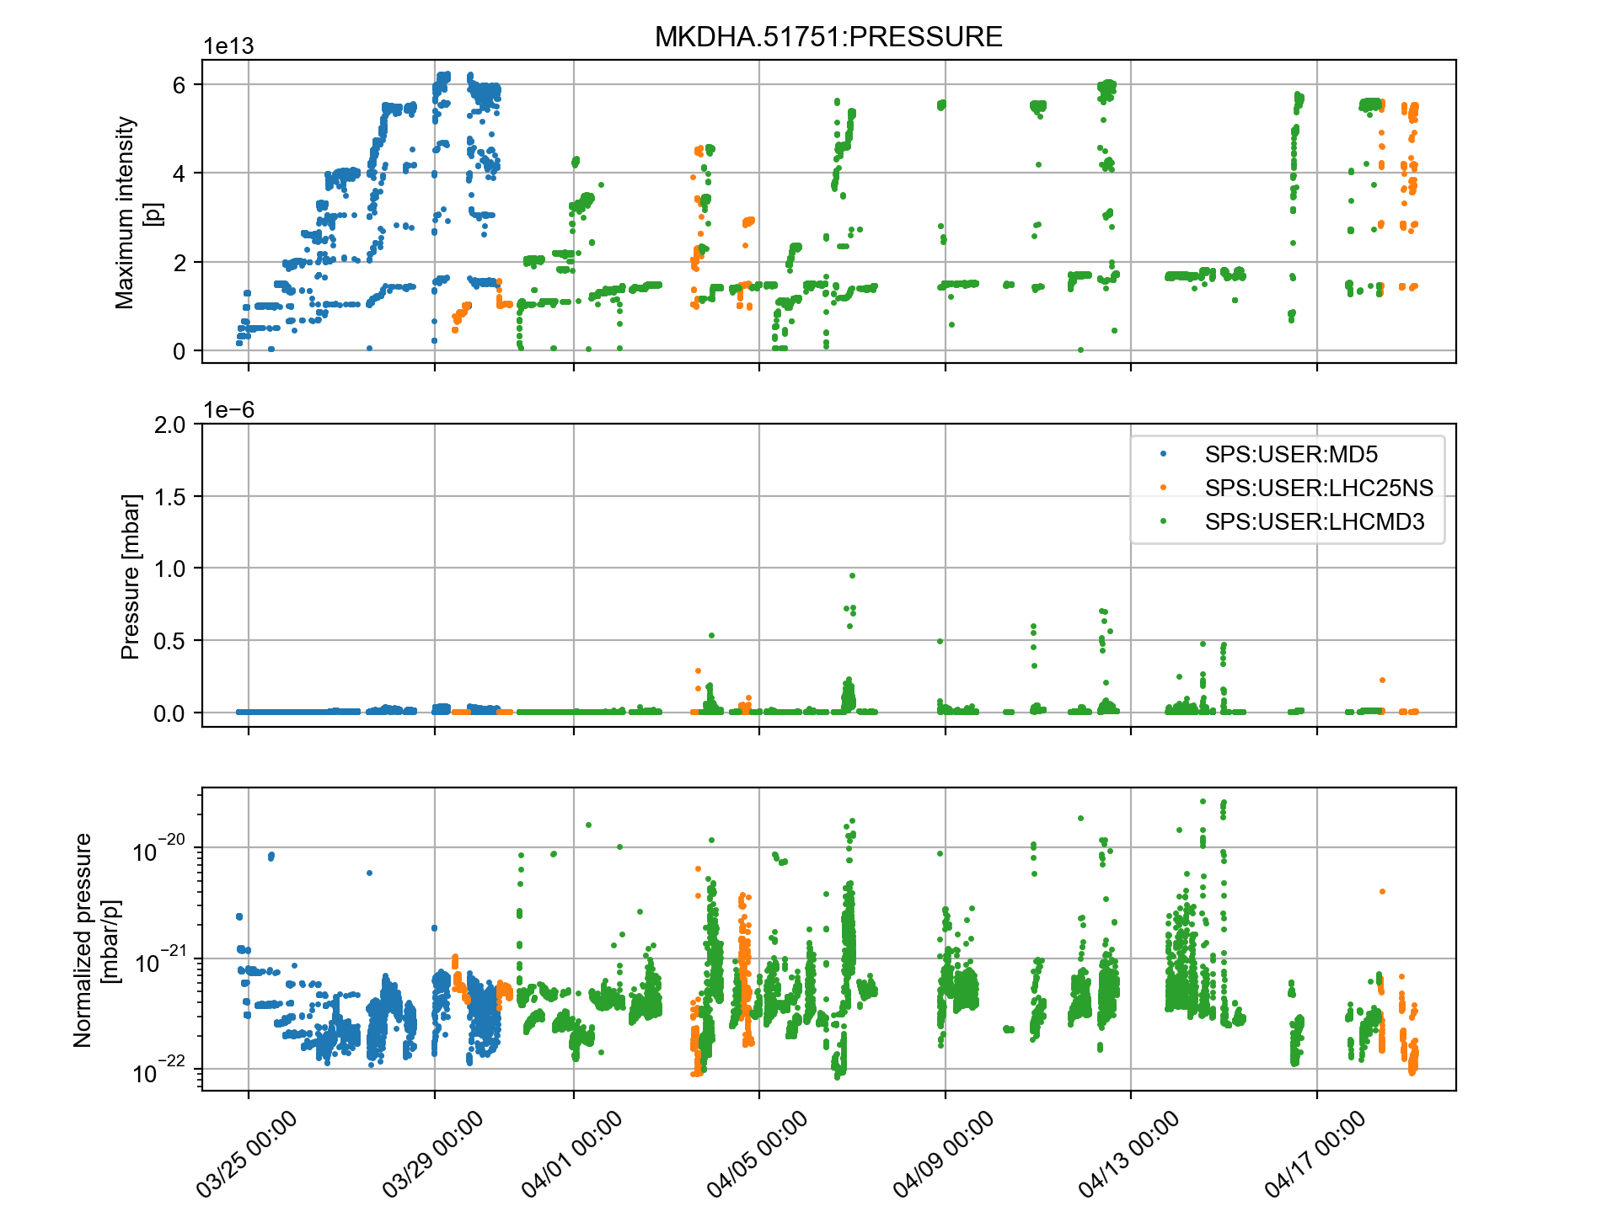
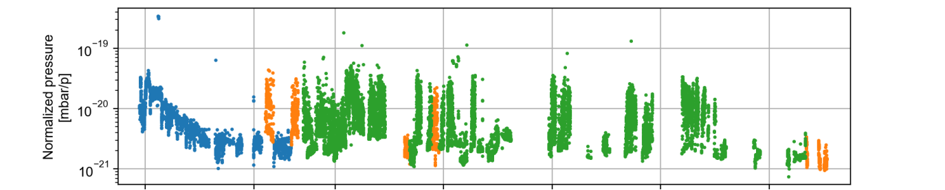
Limitations from vacuum in kickers (MKDH and MKP-L)
Conditioning with long flat-top cycle found to be very effective
After scrubbing period with long flat-top cycle it was possible to reach ~2e11 p/b on the standard LHC-type cycle without triggering the interlock neither on the MKP-L nor on the MKDH
26 GeV cycle
Std LHC-type cycle (450 GeV)
Long flat-top cycle (400 GeV)
New MKP-L
MKDH
20

Slide 21
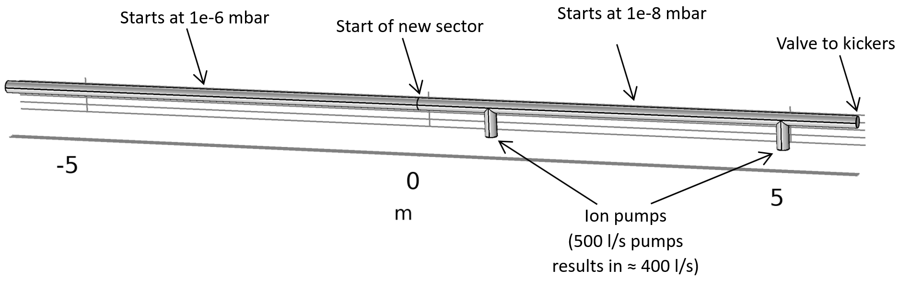
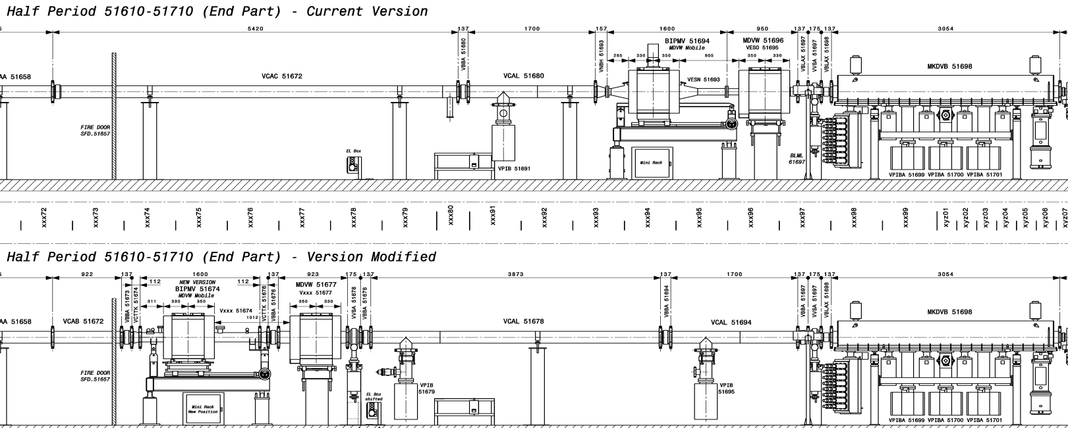
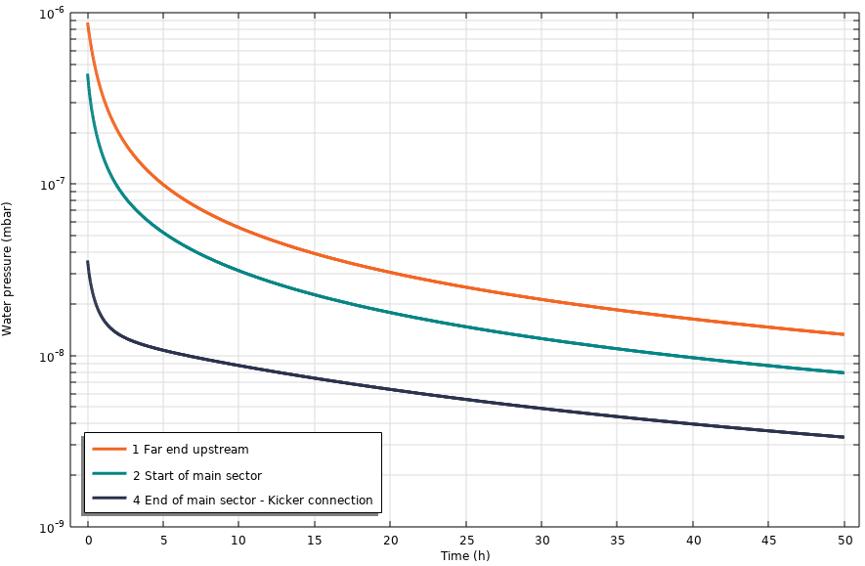
Improvement of vacuum sectorization in the kicker areas
It is evident that re-conditioning of kickers can be very time consuming, in case of replacement of exposure to air due to intervention in nearby equipment
For this reason, in 2023 the replacement of broken wire scanners close to the dump kickers in point 5, was postponed until the EYETS
Equipment layout being modified during EYETS in region close to the dump kickers
  Introduction of buffer vacuum sector
2023 configuration
2024 configuration
Pressure [mbar]
Buffer sector
Pressure profile and pump-down times evaluated with simulations → gaining one decade of pressure after 24h pumping
Courtesy A. Harrison, J. Ferreira
21

Slide 22
Outline
Electron cloud in the PS
  Dedicated scrubbing in 2021
  Present situation
Electron cloud in the SPS
  Recap on past observations and LIU strategy
  Scrubbing in Run 3
  Scrubbing and kickers
  Looking forward
Summary and next steps

Slide 23
Looking forward
Do we need to proceed with coating of SPS dipoles (MBB) in LS3?
23

Slide 24
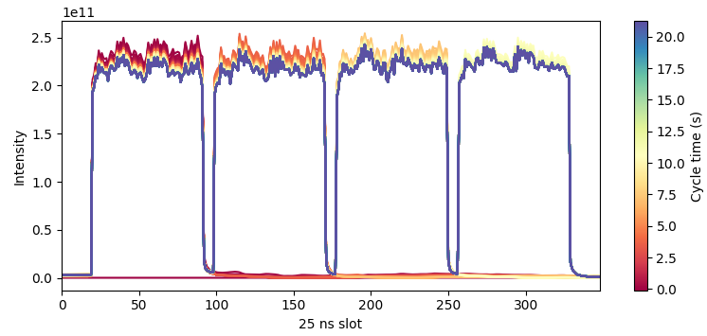
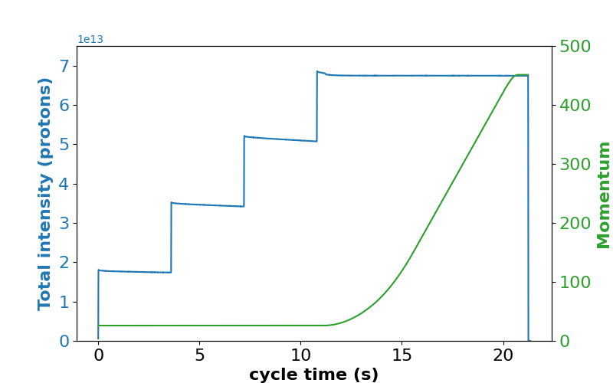
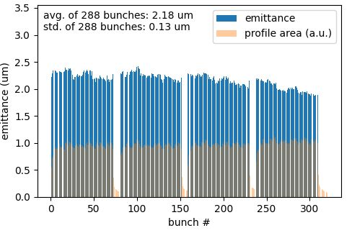
Looking forward
Do we need to proceed with coating of SPS dipoles (MBB) in LS3? → Not really!
Experience from Run 3 shows that beams with parameters very close to LIU targets can be produced without significant degradation driven by electron cloud
Coating of SPS dipoles is most likely not needed to meet the target
2.2 x 10¹¹ p/b at 450 GeV
93 - 95 % transmission
26 GeV
Courtesy I. Mases
24

Slide 25
Looking forward
Do we need to proceed with coating of SPS dipoles (MBB) in LS3? → Not really!
Experience from Run 3 shows that beams with parameters very close to LIU targets can be produced without significant degradation driven by electron cloud
Coating of SPS dipoles is most likely not needed to meet the target
Furthermore, the coating the bends would most likely not result in a significant saving in scrubbing time
In Run 3, scrubbing time was practically never determined by limitations in the arcs
Instead, the scrubbing pace and its duration were defined by conditioning of sensitive equipment (mostly kickers) which were exchanged or exposed to air.
In fact, investing e-cloud mitigations for kickers (if technically feasible) would pay off better that coating the dipoles
25

Slide 26
Outline
Electron cloud in the PS
  Dedicated scrubbing in 2021
  Present situation
Electron cloud in the SPS
  Recap on past observations and LIU strategy
  Scrubbing in Run 3
  Scrubbing and kickers
  Looking forward
Summary and next steps

Slide 27
Summary
In the PS, e-cloud formation takes place only during RF manipulations performed right before extraction
  No beam degradation observed (the beam is kept in the ring only a short time after the last splitting)
In the SPS, limitations from e-cloud are much more prominent
  Scrubbing runs interleaved with beam commissioning tool place every year in Run 3 as part of the LIU commissioning
  Encountered limitations mostly from heating and vacuum pressure rise in injection and dump kickers (notably MKP-L and MKDH)
    Largely mitigated by the installation of low-impedance MKP-L, the optimization of interlock logic and the usage of scrabbing cycle long flat top
  Bunch intensity could be gradually increased up 2.2x10¹¹ p/b at 450 GeV as scrubbing progressed
    No measurable beam degradation from e-cloud
    Not need for coating of dipole magnets in LS3
27

Slide 28
Next steps
A scrubbing run (interleaved with beam commissioning) is foreseen at the beginning of the 2024 run. It will allow:
Conditioning areas exposed to air during EYETS interventions
Further conditioning MKDH and MKP-L kickers to allow reliable operation with 2.3x10¹¹ p/b at 450 GeV
  Needs scrubbing with slightly higher intensities
It would be important to test the injection of these beams into the LHC
Only way to obtain full characterization of beam quality of LIU beams (in the SPS bunch-by-bunch emittance measurements are not possible at high energy)
Strong synergy with study of LHC intensity limitations (e-cloud, RF, and others) in view of HL-LHC
Thanks for your attention!
28

Slide 29
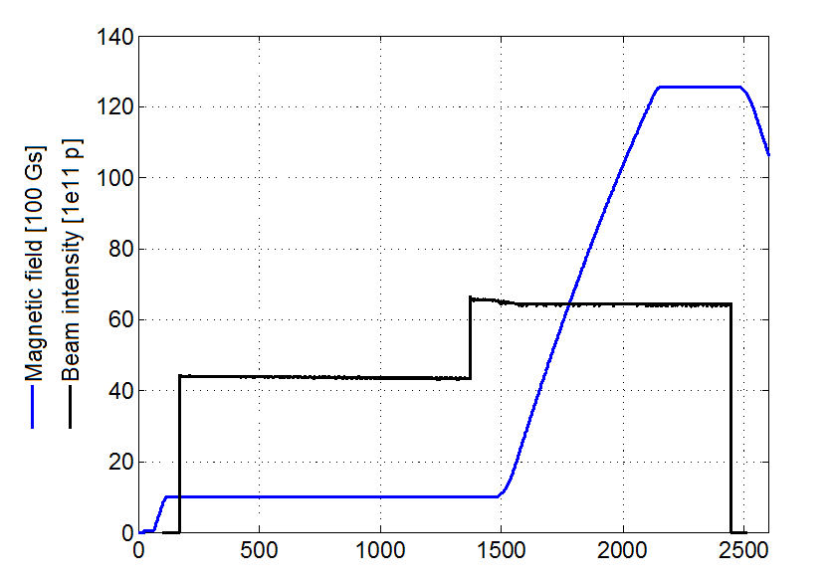
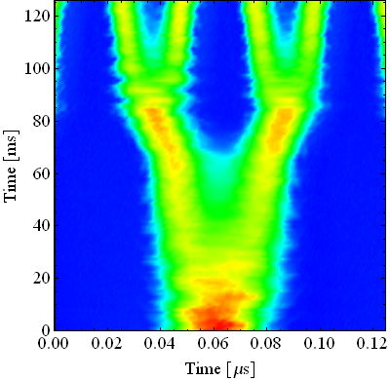
e-cloud in the PS
h=42
b.sp. = 50 ns (36 b.)
h=84
b.sp. = 25 ns (72 b.)
h=7
b. sp. ≈ 330 ns (4 - 6 b.)
h=21
b. sp.≈100 ns (18 b.)
300
4 ns
Double splitting
250
200
40 MHz RF Voltage [kV]
Bunch rotation
150
100
11 ns
50
b.l.≈14 ns
Adiabatic shortening
0
10
20
30
40
50
60
Triple
splitting
Double splitting
Double splitting
Bunch shortening
Time [ms]

