Slide 1


Electron cloud impact on LHC cryogenics
Joint Accelerator Performance Workshop 2023, Montreux
December 6th, 2023
TE-CRG
L. Delprat
https://indico.cern.ch/event/1337597/overview
B. Bradu

Slide 2
INTRODUCTION
Beam screen heat load evolution in LHC from Run 2 to Run 3
  6 years of operation @ 25ns
  First real experience of hybrid scheme induced heat loads in 2023
  Screening the heat loads: results of measurements performed in LHC instrumented half-cells
Carbon coating effect in the machine: observation in Q5L8
Heat load estimation in drift with PIMS sensors (instrumented cells)
Cryogenic capacity limitations and possible optimisations (until LS3)

Slide 3
Beam Screen Heat Load Energy @ top energy
6 years of operation @ 25 ns
  NB: All beam screen heat loads for each fill are available in the Beam Performance Tracking website + NXCALS
Notes:
Clearly see the effect of the hybrid scheme implementation in 2023, with observed lower heat loads.
The decrease of the heat load is linked to 2 factors:
- the conditioning
- the beam adjustment (injection scheme adaptation) – which can indeed decrease or increase the heat loads!

Slide 4
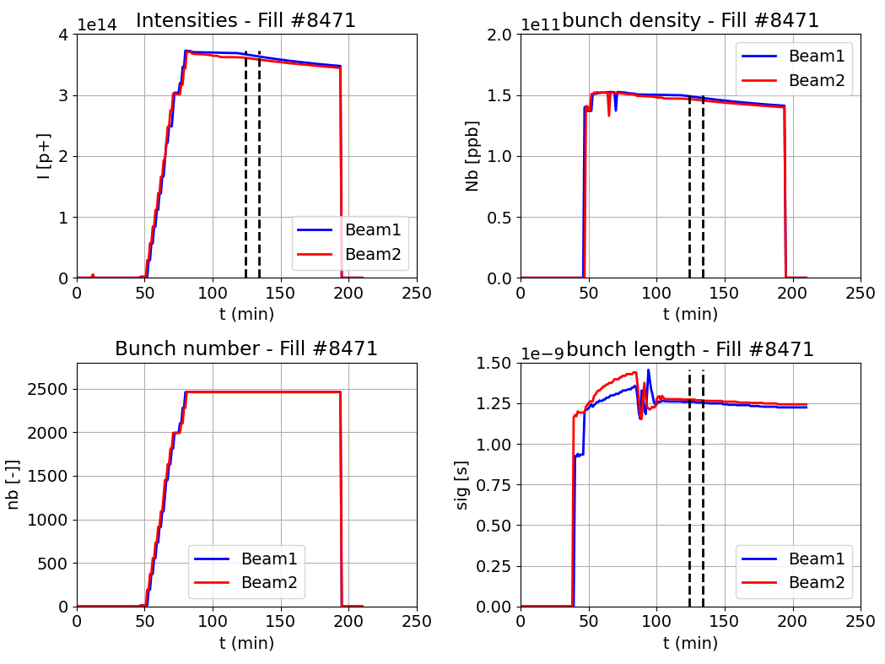
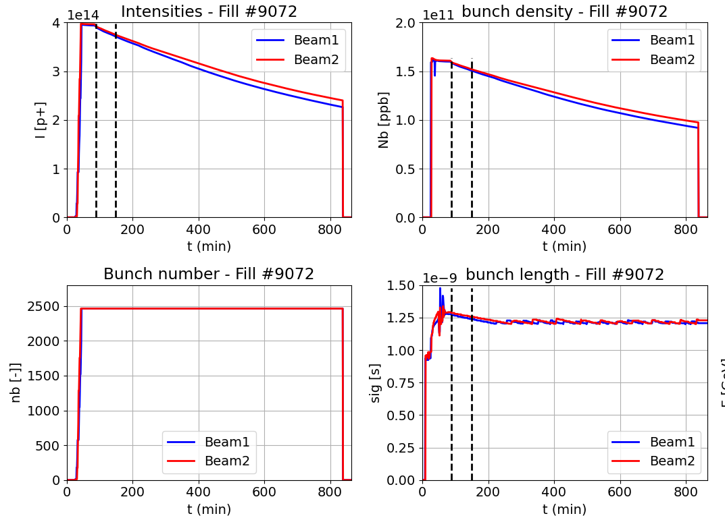
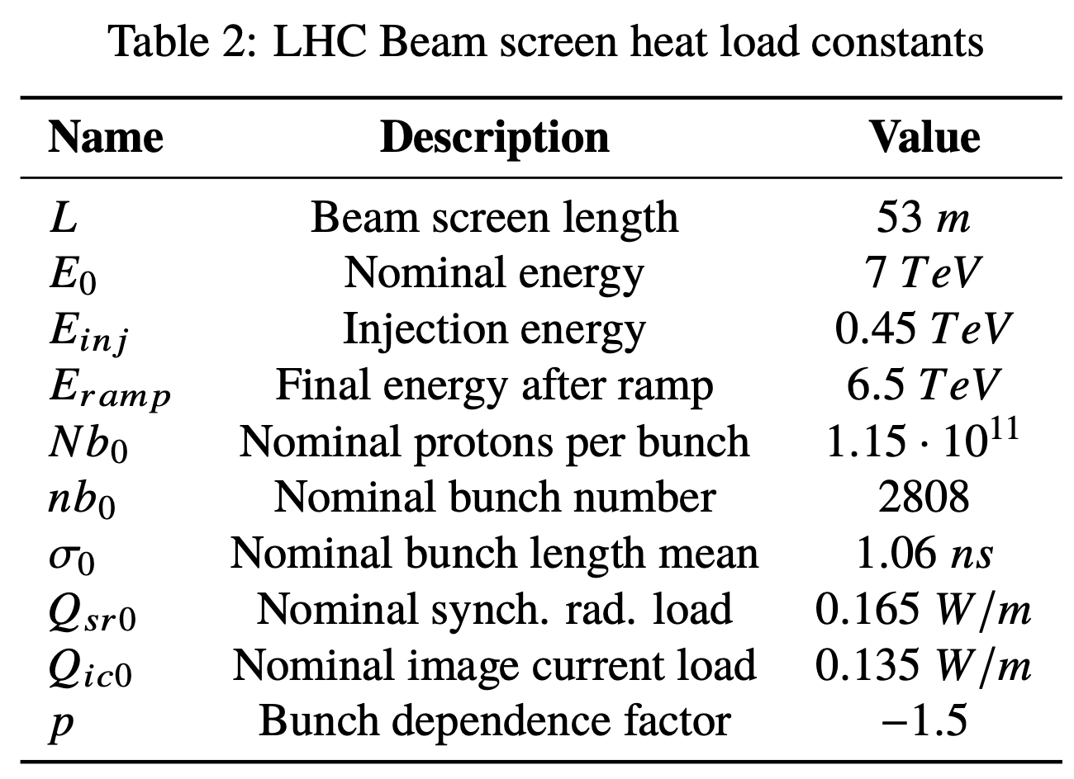
Typical Physics fills: 2022 vs 2023
Fill #8471 (23rd November 2022)
25ns_2462b_2450_1737_1735_180bpi_17inj_2INDIV
BCMS scheme : 5x36b trains
Fill #9072 (16th July 2023) – before ITL8 event
25ns_2464b_2452_1842_1821_236bpi_12inj_hybrid
Hybrid scheme : 56b (8b4e) + 5x36b trains
σ = 1.25 ns
N = 2462 bunches
N = 1.5e11 ppb
I_{tot} = 3.6e14
σ = 1.27 ns
n = 2464 bunches
N = 1.6e11 ppb
I_{tot} = 3.9e14
Notes:
From 2022 to 2023, intensity per bunch has increased! This could be done through the implementation of the hybrid injection scheme.
Number of bunches in the machine remained the same (only +2)
We could have gone up to 1.9e11 ppb, but we were limited by the PIMS issue (RF fingers)
BCMS (Batch Compression Merging and Splitting)
Improvements in the injector chain, most notably the introduction of the Batch Compression Merging and Splitting (BCMS) beam production scheme, allowed increasing the beam brightness by decreasing the injected beam emittance from ∼3 μm to ∼1.7 μm.

Slide 5
Heat load comparison 2022 vs 2023
2022
Fill #8471: 25ns_2462b_2450_1737_1735_180bpi_17inj_2INDIV (5x36b)
Fill #9072: 25ns_2464b_2452_1842_1821_236bpi_12inj_hybrid (56b (8b4e) + 5x36b trains)
2023
DR
85 W/hc
2022
2023
Notes:
LHC Design Report = 85 W/half-cell.
We see that we still have some available margin on the cryo cooling capacities.
For the normalized heat loads, the decrease is more important because I_tot is higher in 2023 (3.9e14) than in 2022 (3.6e14)

Slide 6
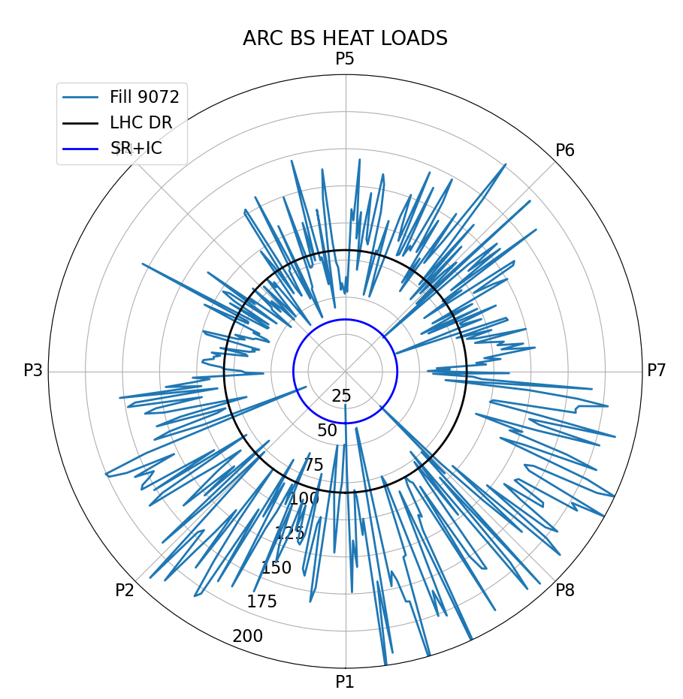
Heat load repartition in 2023
Fill #9072 (16th July 2023): 25ns_2464b_2452_1842_1821_236bpi_12inj_hybrid
13L5
33L5
17L6
13R4
The 416 ARC half-cells are represented on the ring (53m each)
xxR/Ly
Instrumented half-cell
33R2
15R2
27L8
31L2
Notes:
52 half-cells per ARC. The instrumented half cells are well shared around the ring, and representative of the loads – see next slide.

Slide 7
Heat load distribution over LHC

Slide 8
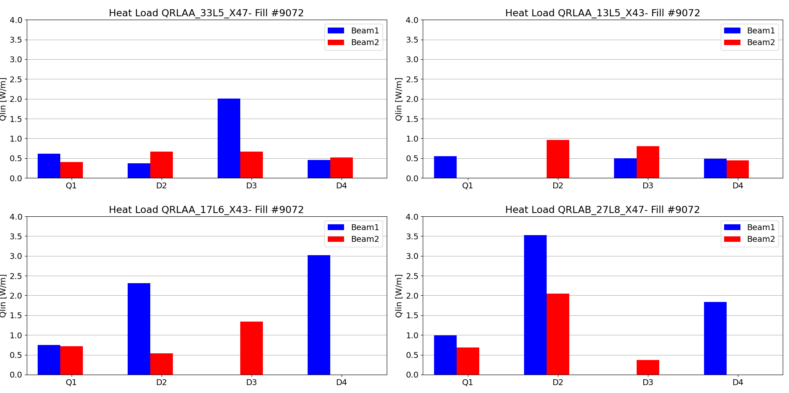
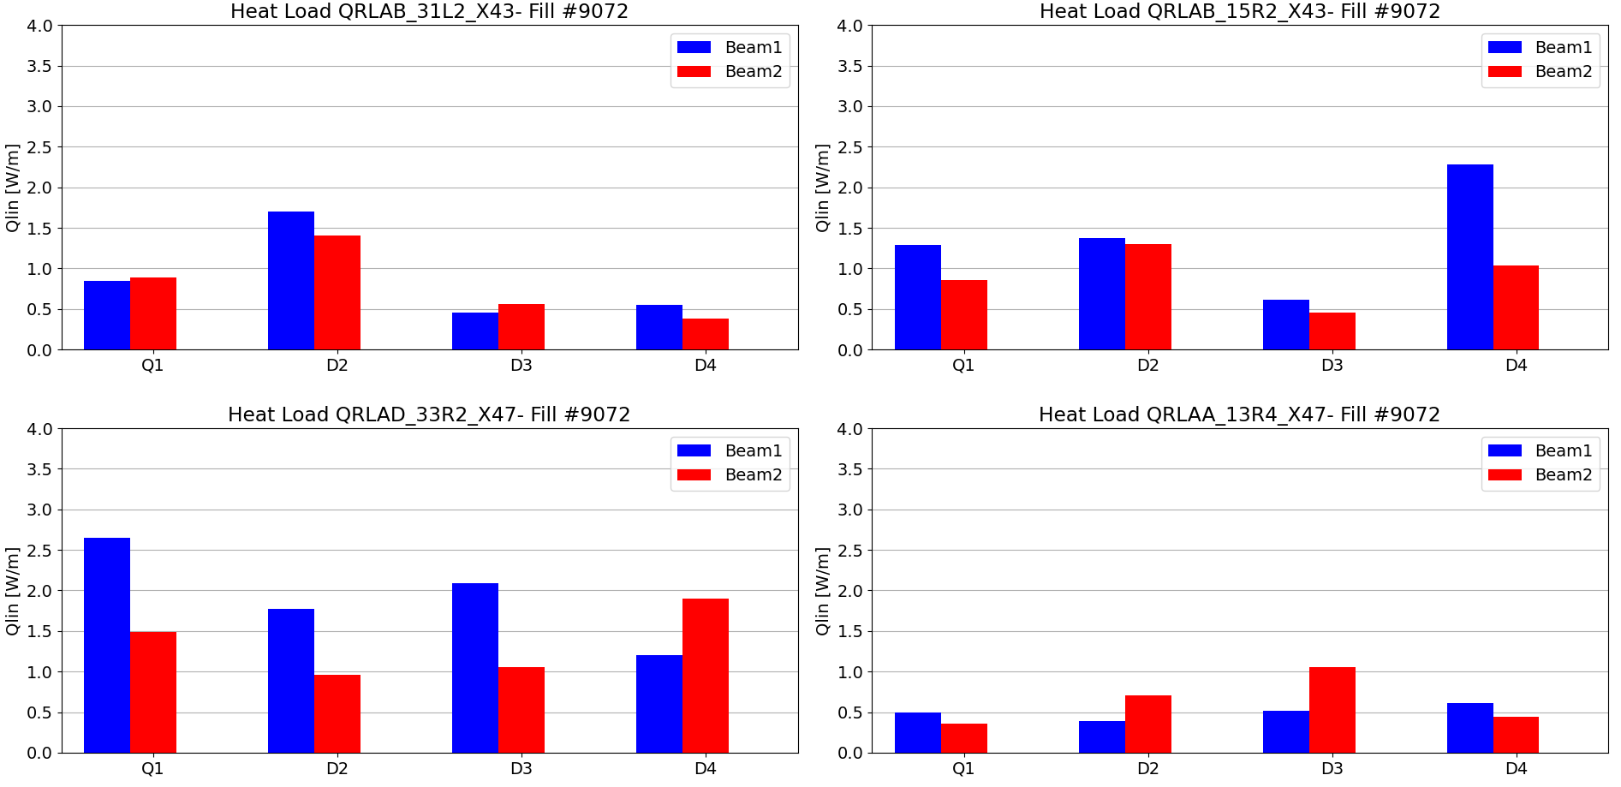
Results of the new cryo instrumentation
Full instrumentation of 8 half-cells validated in 2022, please refer to Chamonix Workshop 2023
64 individual apertures instrumented (48 in dipoles + 16 in quadrupoles)
6 apertures missing due to instrumentation issues
  1 sensor lost in 13L5 (need to open the IC)
  2 sensors badly calibrated in 17L6 and 27L8, to be corrected during EYETS’23
Over the instrumented half-cells:
  1 magnet exchanged in 2017
  2 magnets exchanged in LS2
LS2
2017
LS2
Notes:
- The 6 missing apertures (10% of the installed instrum) do not impact the general statistics and analysis performed on the instrumented half-cells
- The 2 badly calibrated sensors in 17L6 and 27L8 are about to be exchanged duriong this YETS
1 missing sensor « kills » 2 apertures.
Most important contributor is quadrupole Q1 in 33R2.

Slide 9
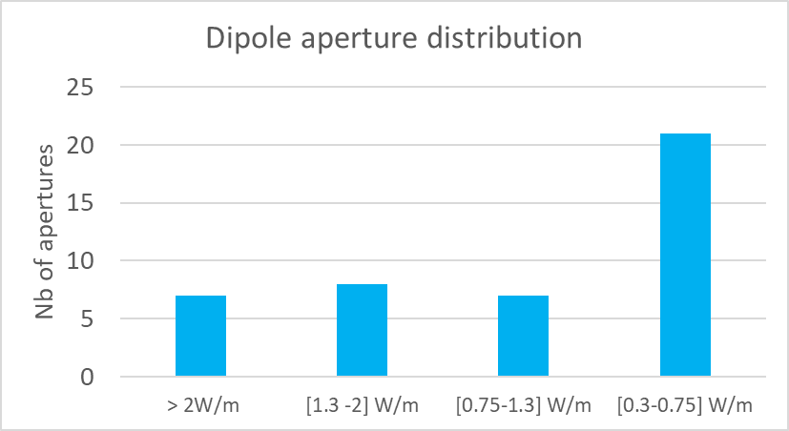
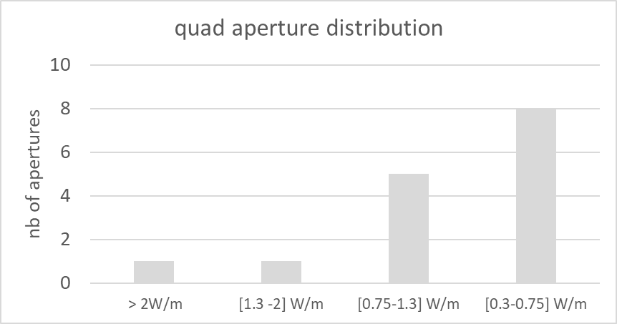
Statistics on instrumented apertures
Expected heat loads for such a fill (#9072, 2023 reference for this talk):
  ≈ 0.3 W/m for [SR + IC]
Quite important dispersion of the heat loads within the apertures
Notes:
We cannot identify any particular pattern, but the additional heat laods observed are mainly due to a very few apertures.

Slide 10
Q5L8: carbon coating effect in the machine
Amorphous carbon coating performed by TE-VSC during LS2 on Q5L8 beam screens
  No e-cloud heat load observed anymore after the a-C coating
  Note that a-C coating is different from the forecast coating in the BST project (too long treatment)
2022 Q_{ec} not significative (error margin)
Non-measurable e-cloud heat load
Notes:
Carbon coating thickenss in Q5L8 is 100 nm (check Valentine’s presentation)
BST: beam screen treatment

Slide 11
PIMS and BS temperature sensors
7 PIMS are instrumented over the LHC:
  3 in 31L2
  1 in 13L5
  3 in 33L5
They allow to verify the deposition (or not) of unexpected heat load on the PIMS, and in general in the interconnections
Notes:
Drift: inter-quadrupoles spacing in which there is not mag field.

Slide 12
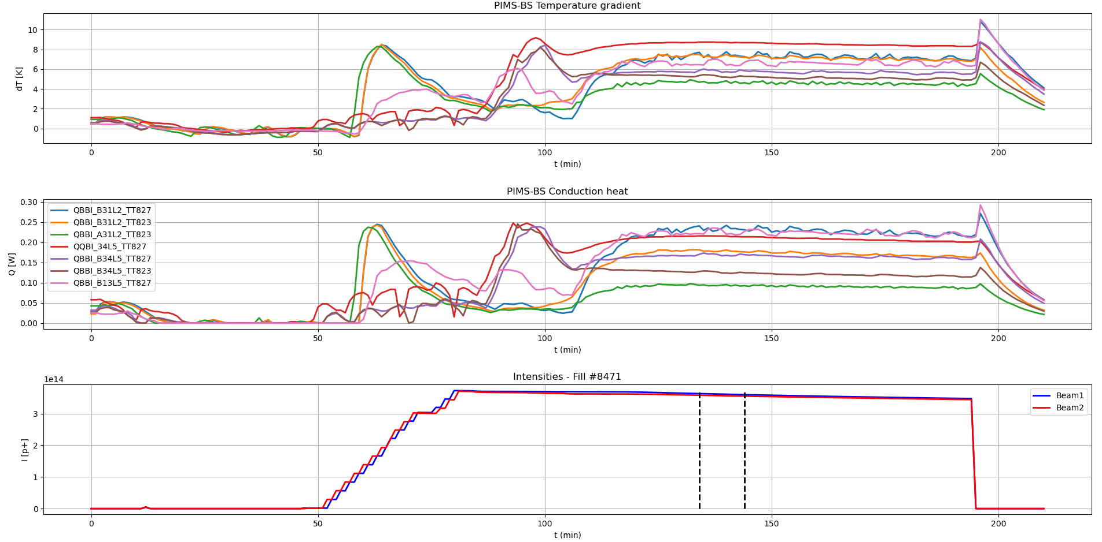
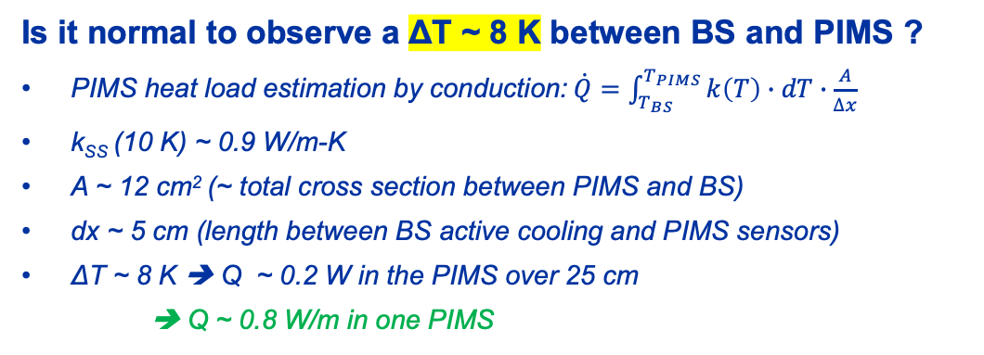
Heat conduction BS-PIMS
Is it normal to observe a ΔT ~ 8 K between BS and PIMS ?
  PIMS heat load estimation by conduction:$\dot{Q}=\int_{T_{BS}}^{T_{PIMS}}{k\left(T\right)∙dT∙\frac{A}{∆x}}$
  k_{SS} (10 K) ~ 0.9 W/m-K
  A ~ 12 cm² (~ total cross section between PIMS and BS)
  dx ~ 5 cm (length between BS active cooling and PIMS sensors)
  ΔT ~ 8 K ➔ Q ~ 0.2 W in the PIMS over 25 cm
    ➔ Q ~ 0.8 W/m in one PIMS
In Fill #8471 (23.11.2022), 1 hour after stable beams :
  Qsr + Qic = 0.3 W/m/aperture
  Qec in ARC34 =0.6 W/m/aperture in average (lowest sector)
  Observed ΔT is compatible with expectations
  All PIMS temperatures show similar behaviour
  No difference between high & low heat load magnets around
PIMS temps aligned with BS sensors when no beam
ΔT < 8 K with BS sensors in same interconnections
To explain the additional extra heat loads observed in some apertures around these PIMS (like 1,2 & 5), we should measure a PIMS heat load of ~40 W/m !
The extra heat loads measured in some apertures cannot come exclusively from the PIMS
Notes:
The PIMS have less heat load than their neighbouring magnets (the high load half cell has a key impact)

Slide 13
Cryogenic capacity limitations
New balancing of refrigerators cooling capacities between S78 and S81 allows to recover margin in S78 (all thermal shields are set on S81 refrigerator to alleviate S78 refrigerator)
  Configuration tested at the end of 2022, reconducted in 2023, but new estimated capacities to be tested
  Would require a test of ≈ 1 week to precisely assess the capacities in this cryoplants arrangement
ARC BS cooling capacities in physics mode & eco mode
225 W/hc
190 W/hc
2022 fill
2023 fill
More cooling margin in 2023…
…but not possible to operate in eco mode during proton physics
BS cooling capacity in physics mode
…in eco mode
Notes:
S78

Slide 14
CONCLUSIONS
From 2022 to 2023, it was possible to increase the intensity per bunch thanks to the implementation of the hybrid injection scheme, which allowed to significantly reduce the beam screen heat loads by reducing the e-cloud effect.
Additional instrumentation in 8 selected half-cells allowed to investigate the behaviour of the BS heat loads at the magnet/aperture level. They are well representative of the entire machine, and they reveal large differences across the half-cells and the apertures. Moreover, all recently replaced magnets demonstrate low heat loads.
a-C coating performed by TE-VSC on Q5L8 during LS2 allowed to reduce on this magnet the e-cloud heat load to a non-measurable level
Instrumentation of 7 PIMS allowed to verify that extra heat loads measured in some apertures were not induced by these equipment – however, remains marginal.
Cryoplants re-arrangement in S78&S81 allowed to recover cooling capacity in S78, detrimentally to S81
  To accurately re-assess the available cooling capacities in those 2 sectors, 1-week test is needed
Ready for next year run towards higher beam intensity and matching the cryogenic capacities!

Slide 15
THANK YOU
FOR YOUR ATTENTION
L. Delprat
https://indico.cern.ch/event/1337597/overview
B. Bradu

